Slide 1
IN THE NAME OF ALLAH
FRAGILITY ANALYSIS BASED ON ACCELERATION AND STRUCTURAL DUCTILITY DAMAGE INDEX WITH
RESPONSE SPECTRUM BASED ON DYNAMIC ANALYSIS OF A SINGLE-DEGREE-OF-FREEDOM (SDOF) SYSTEM
WRITTEN BY SALAR DELAVAR GHASHGHAEI (QASHQAI)

Slide 2
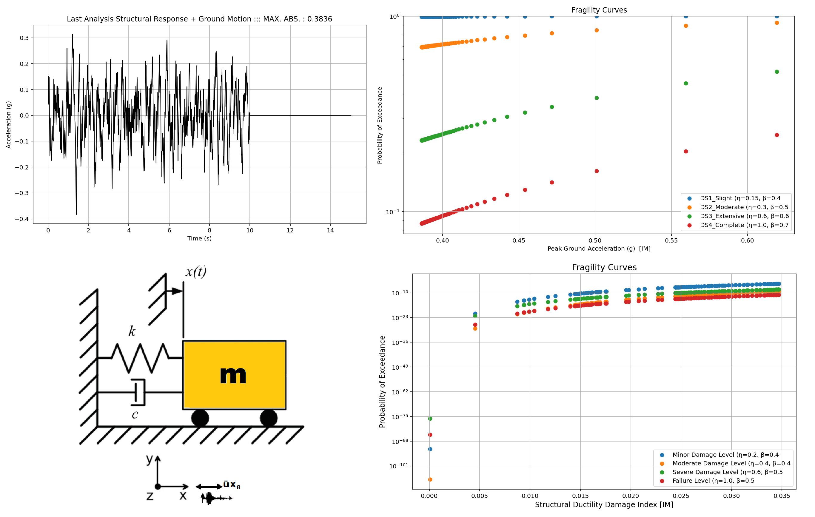

Slide 3
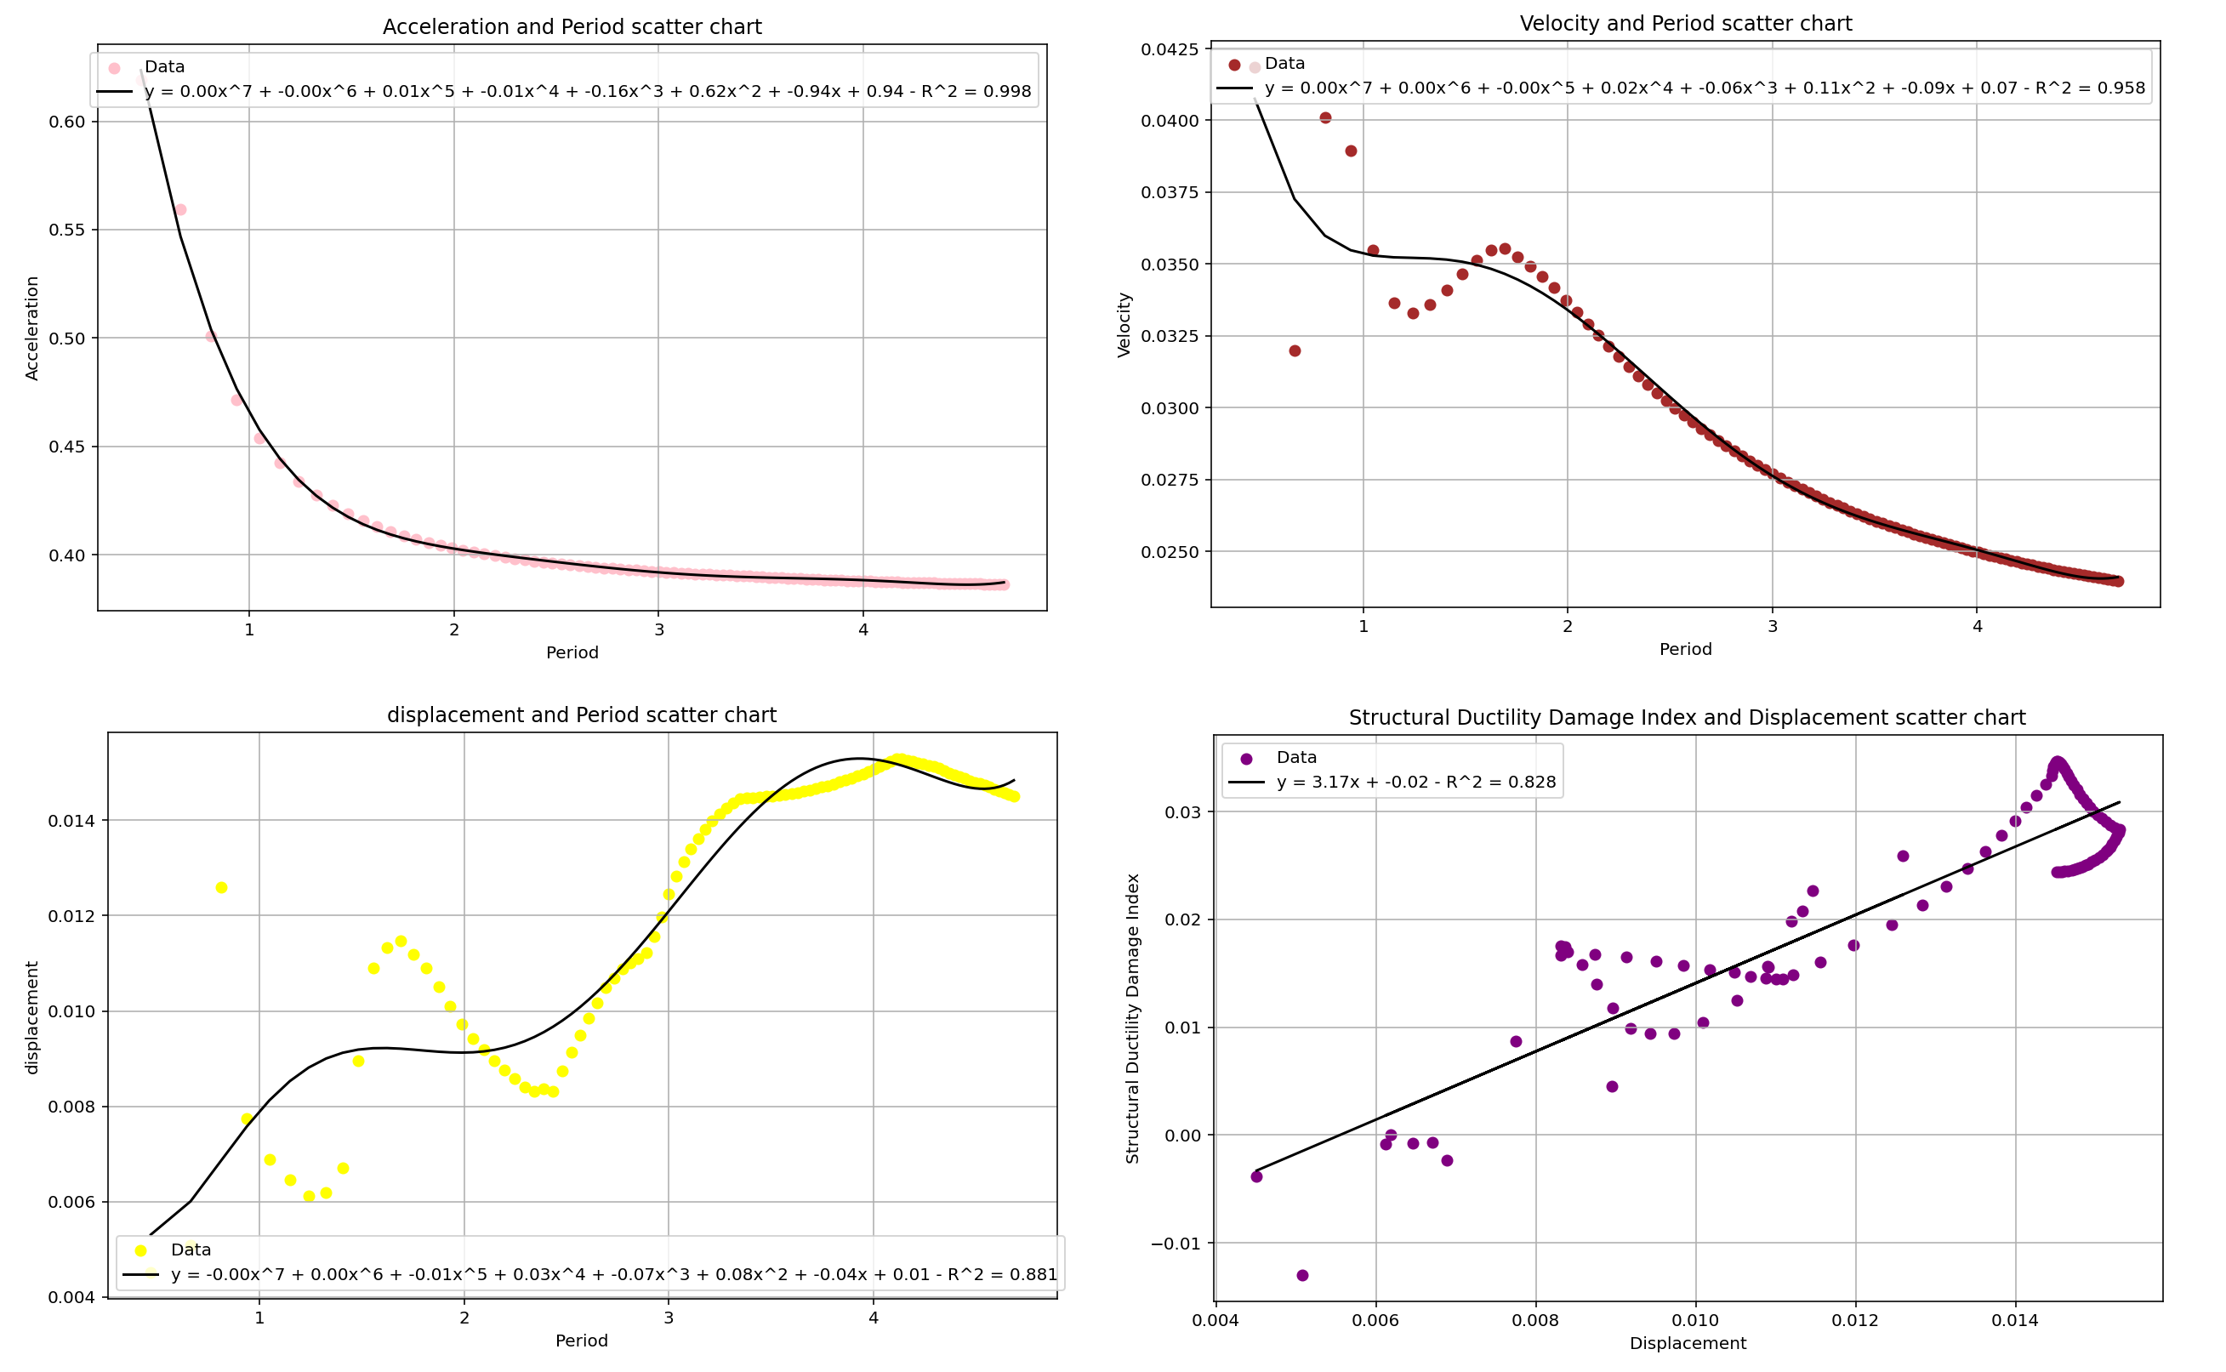

Slide 4
