Slide 1
IN THE NAME OF ALLAH, THE MOST GRACIOUS, THE MOST MERCIFUL
POST-BUCKLING ANALYSIS OF CONCRETE FRAME. EVALUATING STRAIN HARDENING AND ULTIMATE STRAIN CRITERIA USING OPENSEES
WRITTEN BY SALAR DELAVAR GHASHGHAEI (QASHQAI)

Slide 2
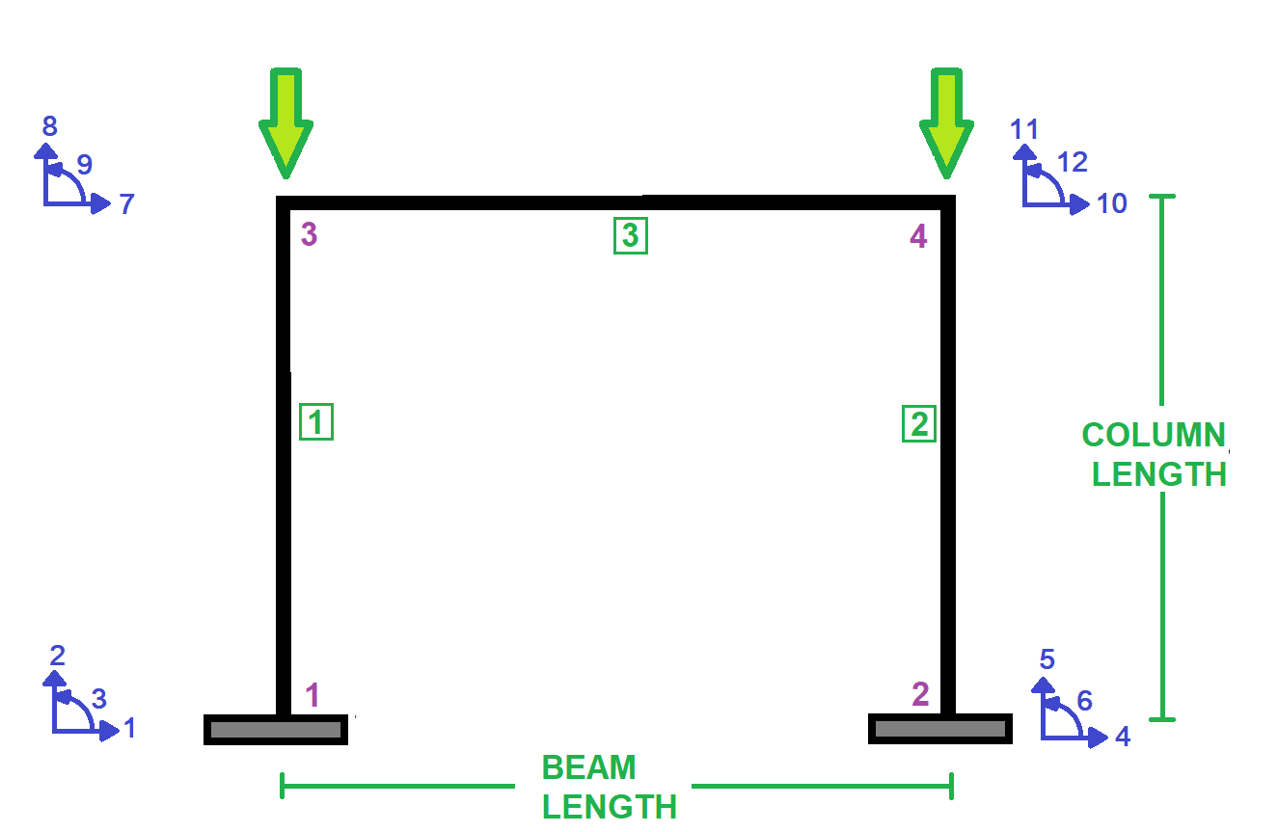

Slide 3
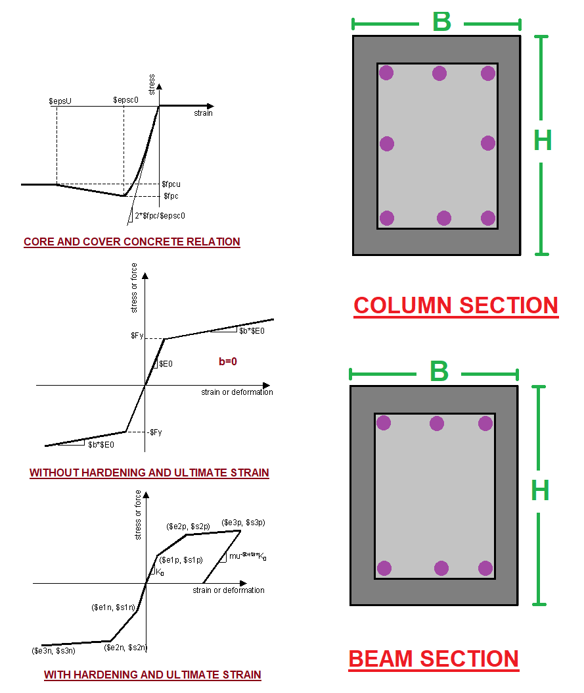

Slide 4
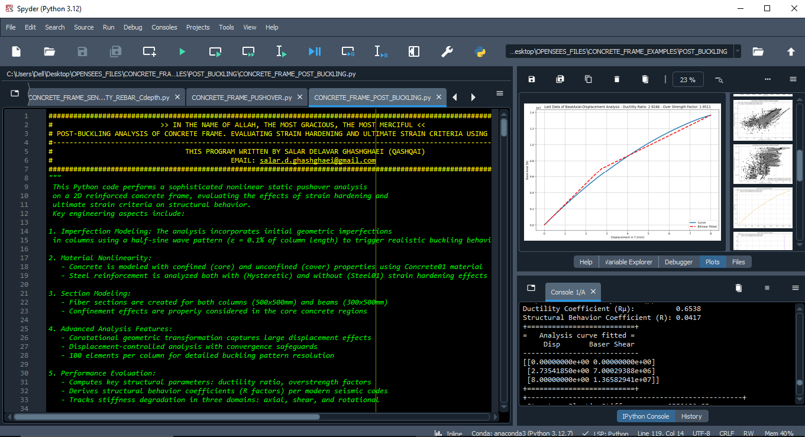

Slide 5
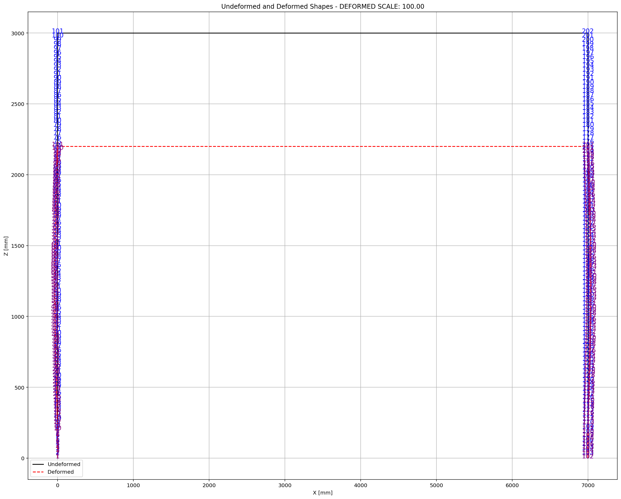

Slide 6
POST-BUCKLING ANALYSIS
(PUSHOVER)

Slide 7
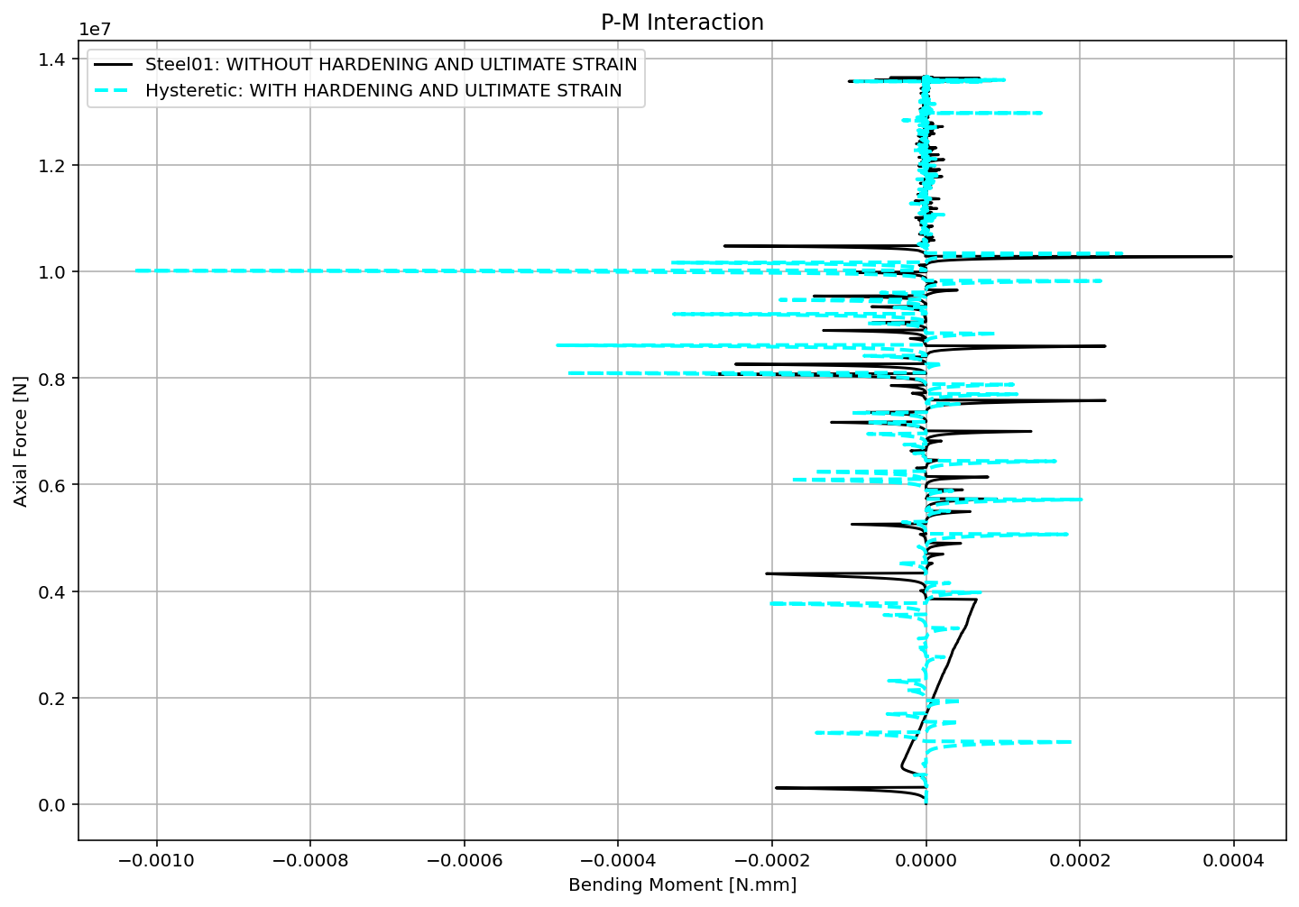

Slide 8
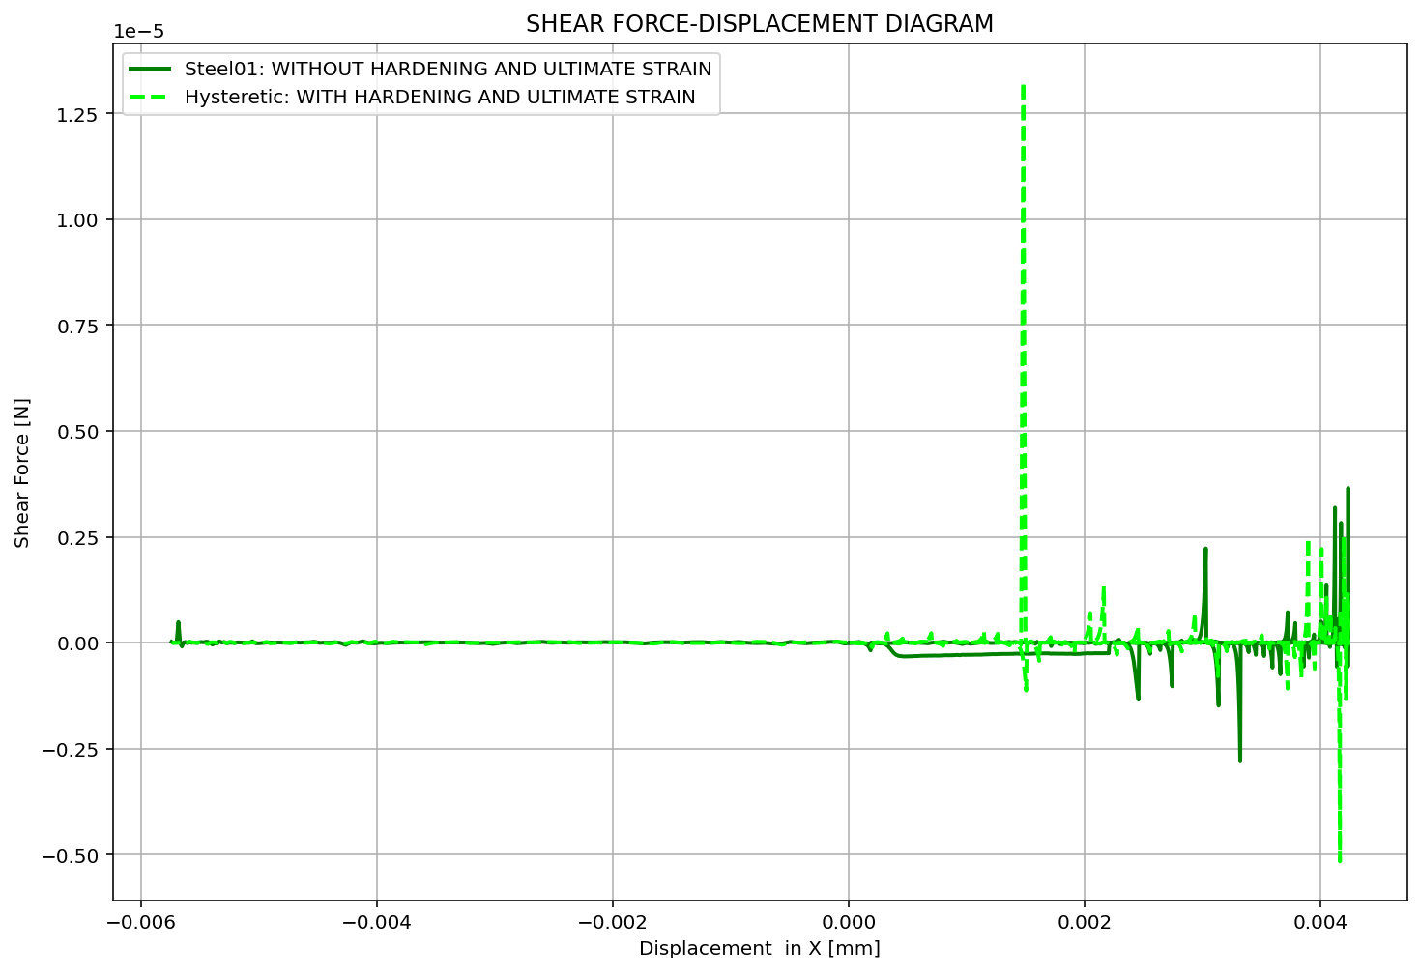

Slide 9
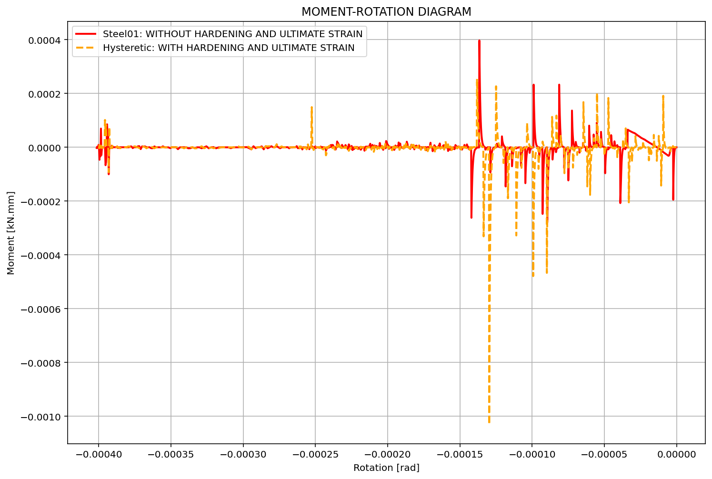

Slide 10
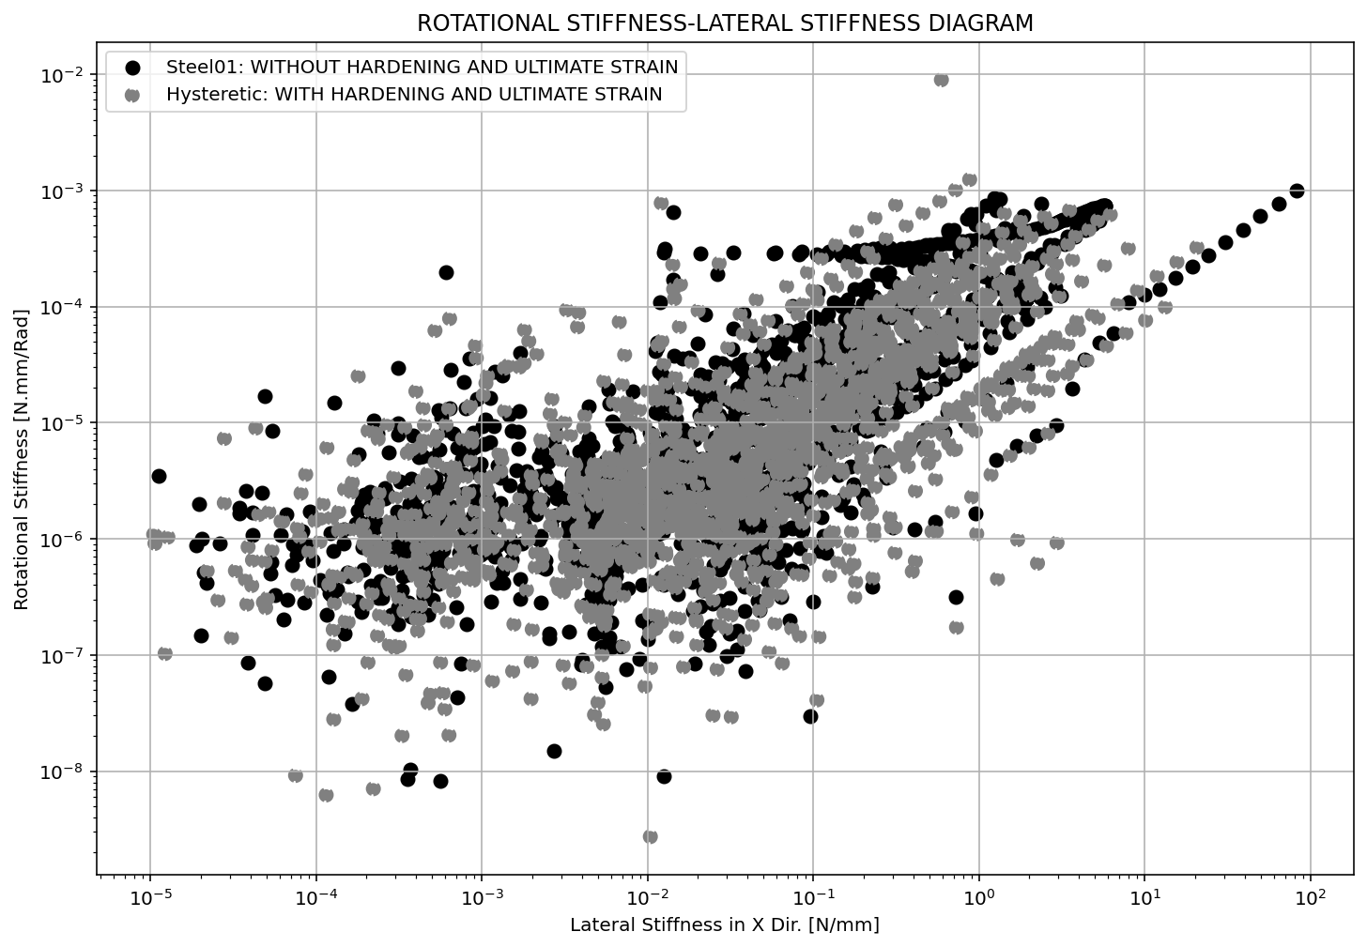

Slide 11
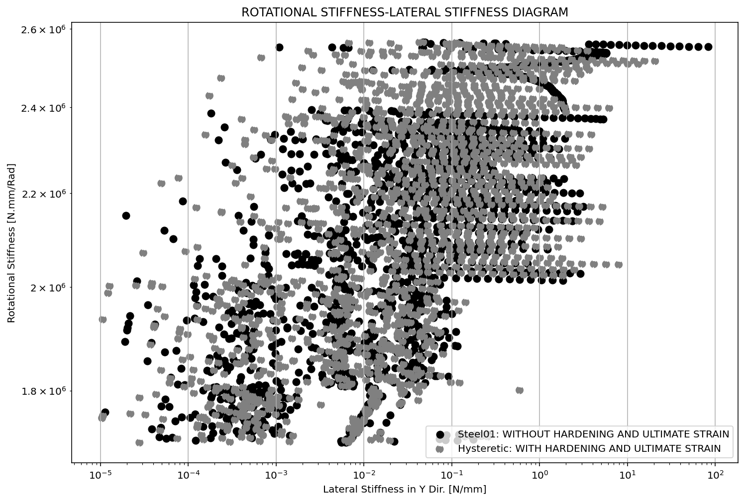

Slide 12
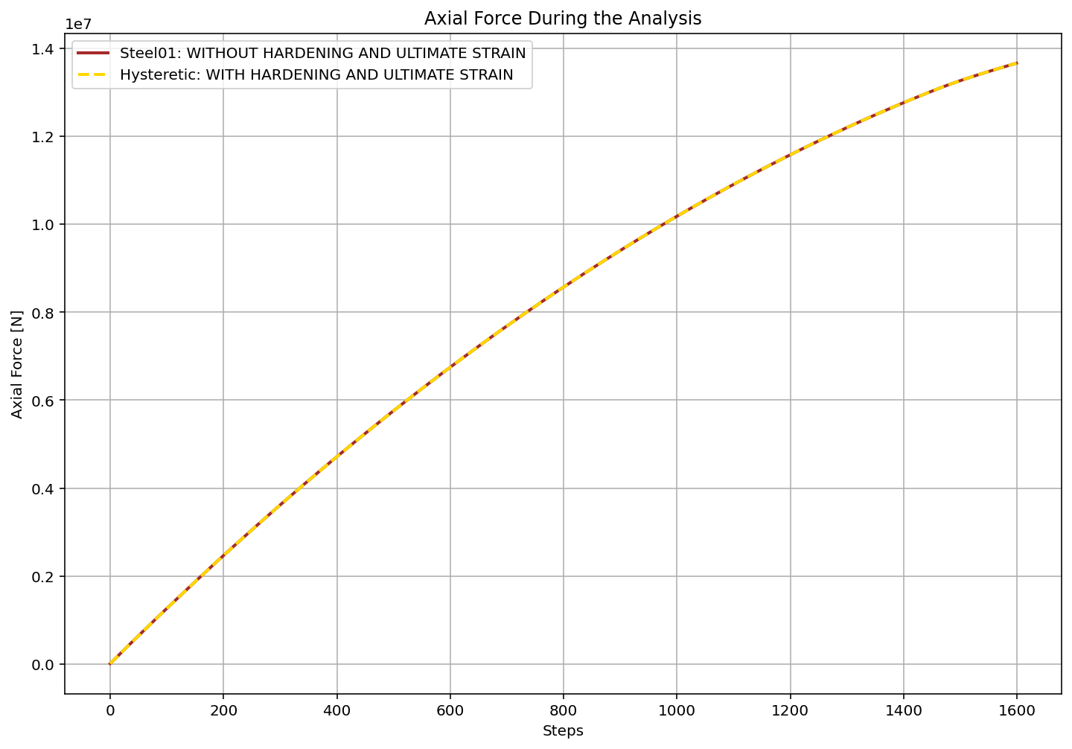

Slide 13
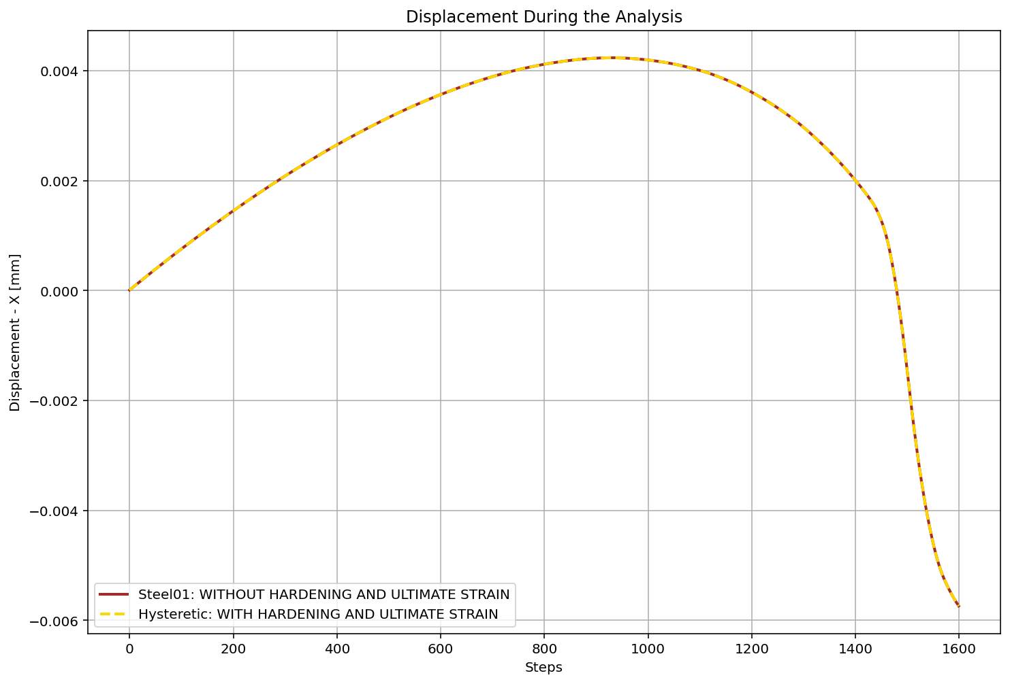

Slide 14
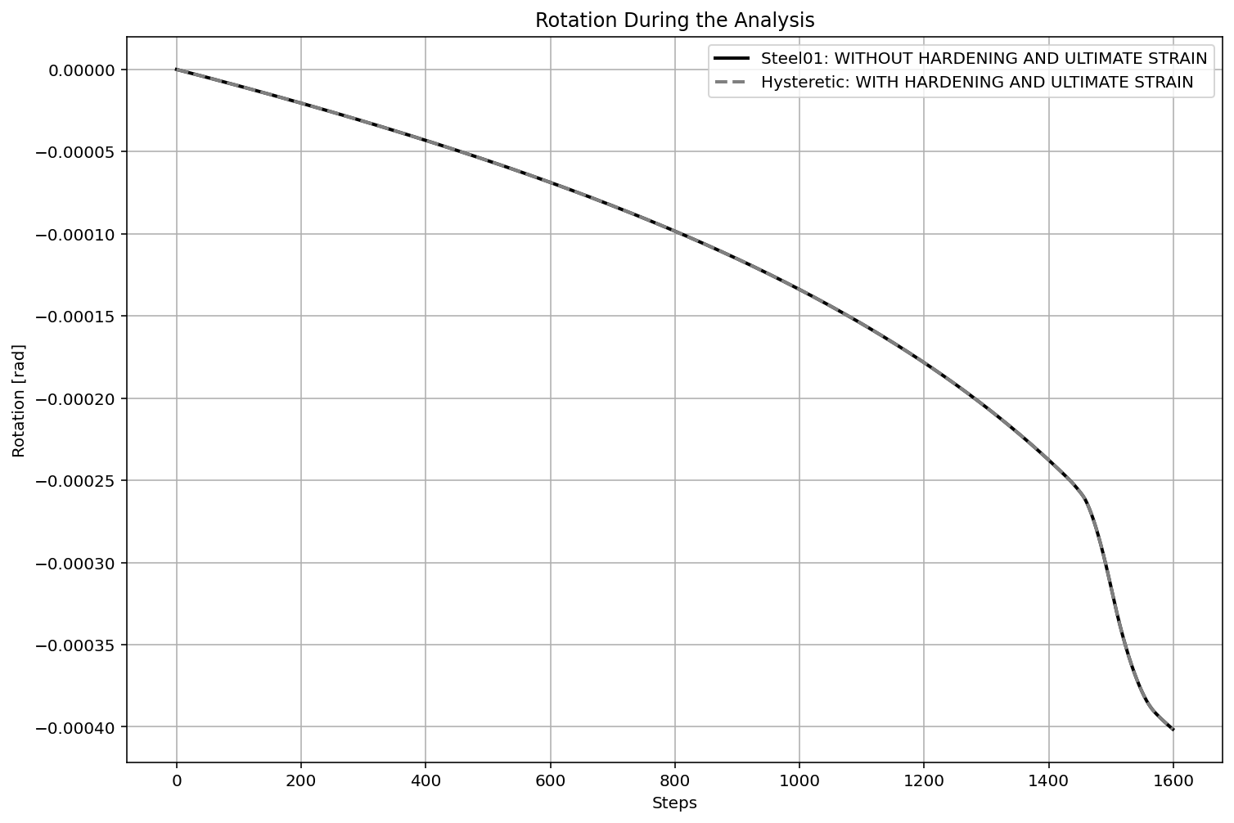

Slide 15
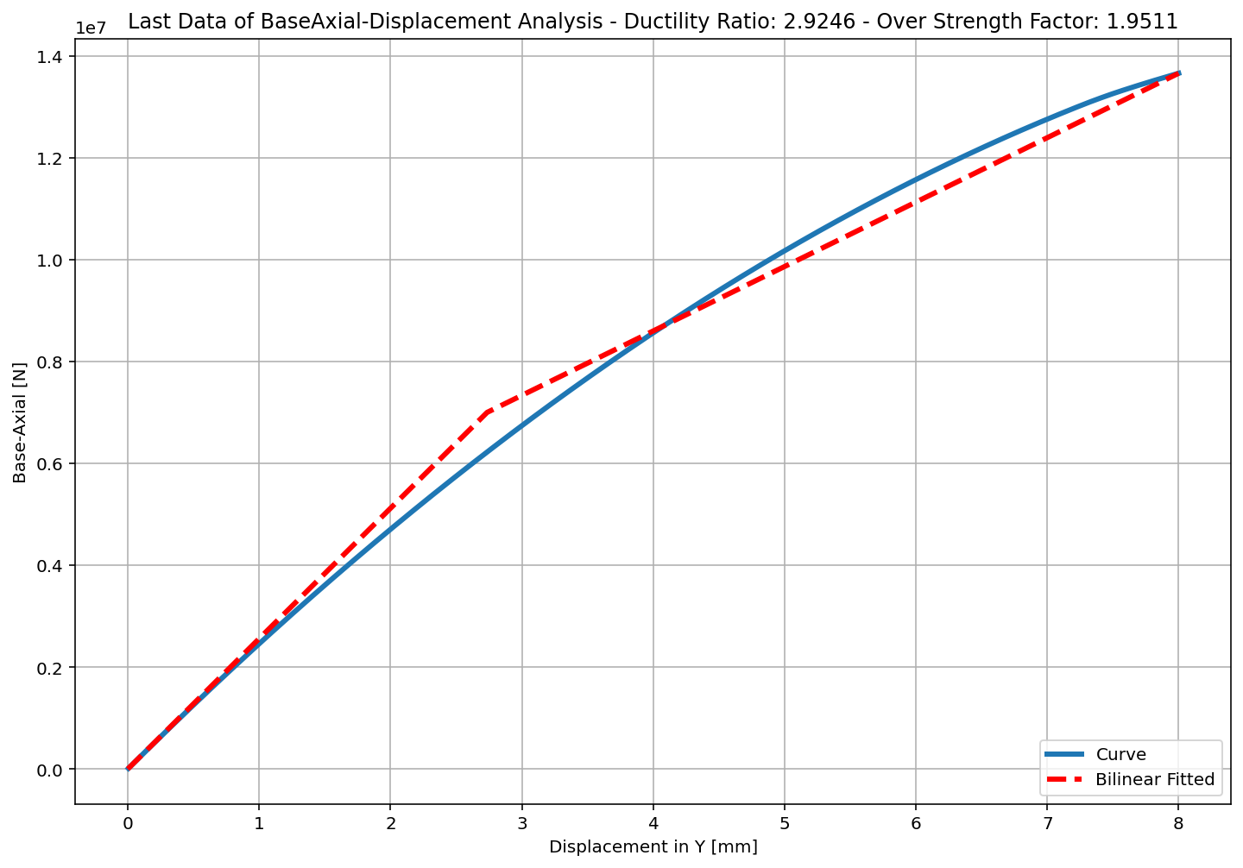
+==========================+
= Analysis curve fitted =
Disp Base Shear
----------------------------
[[0.00000000e+00 0.00000000e+00]
[2.73541850e+00 7.00029388e+06]
[8.00000000e+00 1.36582941e+07]]
+==========================+
+----------------------------------------------------+
Structure Elastic Stiffness : 2559130.85
Structure Plastic Stiffness : 1707286.77
Structure Tangent Stiffness : 1264677.97
Structure Ductility Ratio : 2.92
Structure Over Strength Factor: 1.95
+----------------------------------------------------+
Ductility Ratio: 1.4997
Over Strength Coefficient (Ω0): 1.9511
Displacement Ductility Ratio (μ): 2.9246
Ductility Coefficient (Rμ): 1.2877
Structural Behavior Coefficient (R): 2.5124

