Slide 1
>> IN THE NAME OF ALLAH, THE MOST GRACIOUS, THE MOST MERCIFUL <<
PERFORMANCE-CONSTRAINED OPTIMIZATION OF AN SDOF STRUCTURAL SYSTEM USING OPENSEESPY AND NONLINEAR DYNAMIC ANALYSIS
OPTIMIZATION ALGORITHM: SLSQP (Sequential Least Squares Programming)
WRITTEN BY SALAR DELAVAR GHASHGHAEI (QASHQAI)

Slide 2
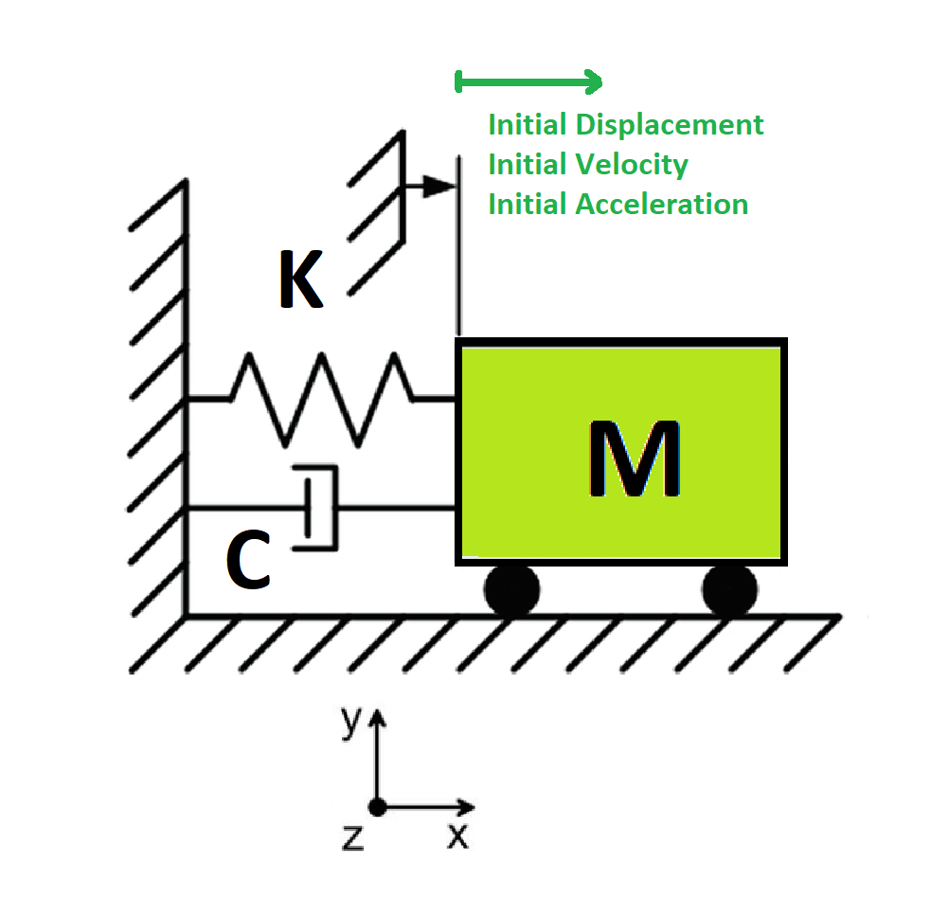

Slide 3
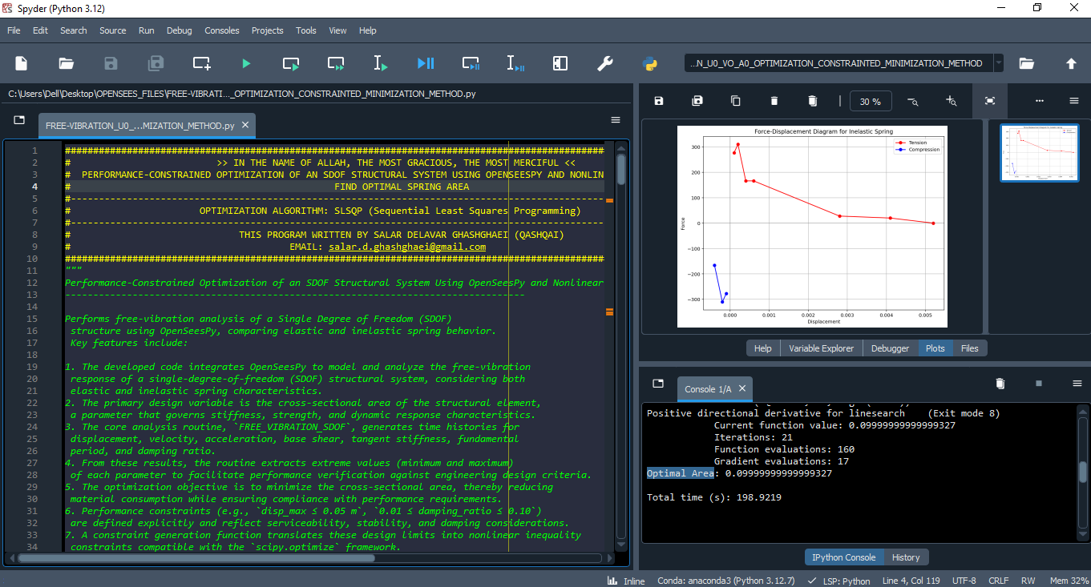

Slide 4
Positive directional derivative for linesearch (Exit mode 8)
Current function value: 0.09999999999999327
Iterations: 21
Function evaluations: 160
Gradient evaluations: 17
Optimal Area: 0.09999999999999327
Total time (s): 198.9219

Slide 5
