Slide 1
>> IN THE NAME OF ALLAH, THE MOST GRACIOUS, THE MOST MERCIFUL <<
COMPREHENSIVE EVALUATION OF THE EQUIVALENT VISCOUS DAMPING RATIO OF A NONLINEAR MDOF SYSTEM UNDER MULTIPLE LOADING PROTOCOLS
THIS PROGRAM WRITTEN BY SALAR DELAVAR GHASHGHAEI (QASHQAI)

Slide 2
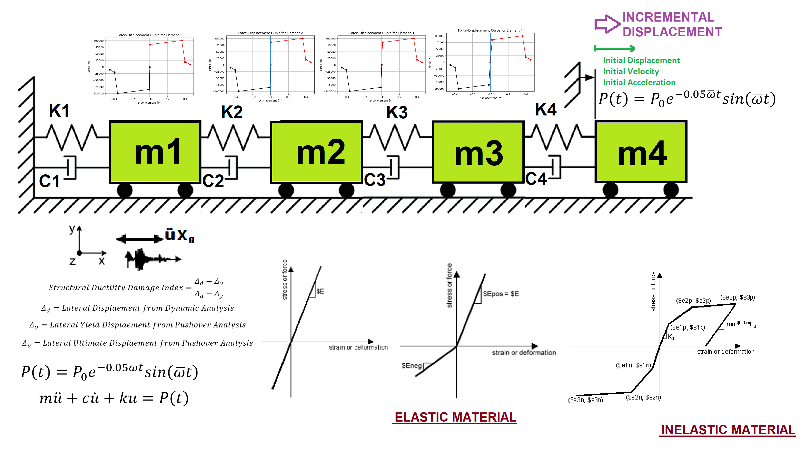

Slide 3
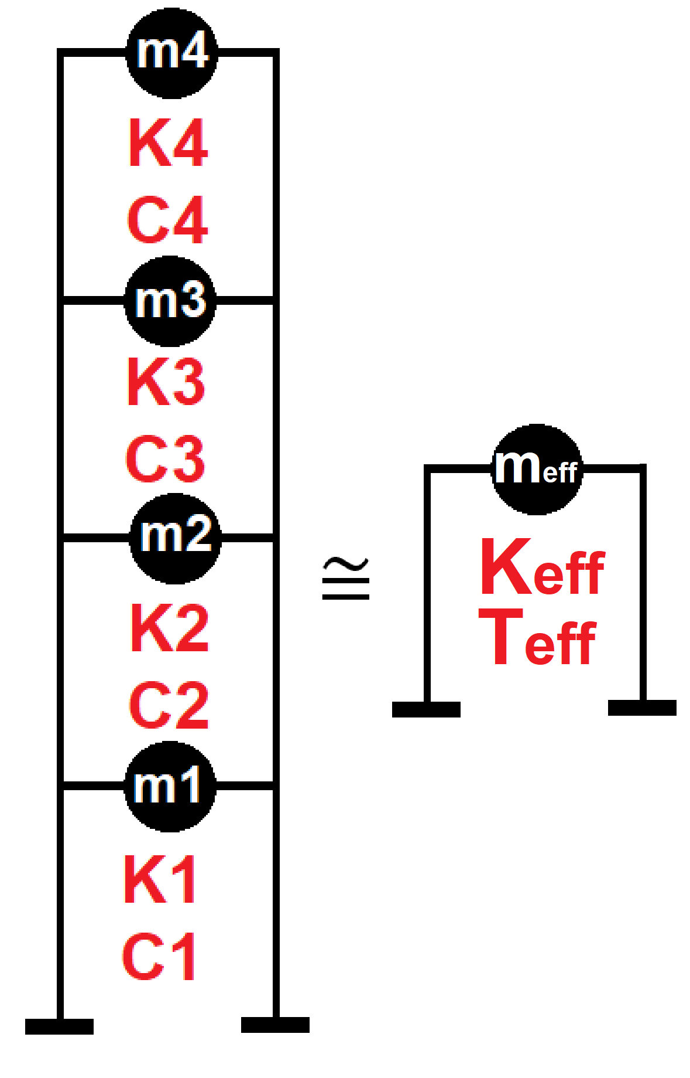

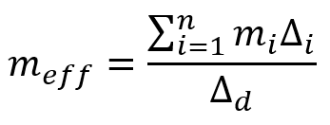
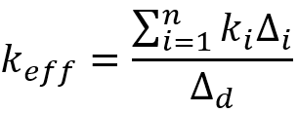
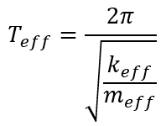
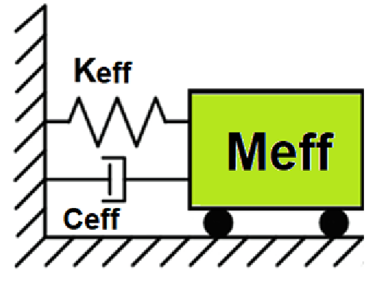
Displacement-based seismic analysis transformation,
converting a multi-degree-of-freedom (MDOF) system
into an equivalent single-degree-of-freedom (SDOF)
system for seismic assessment

Slide 4
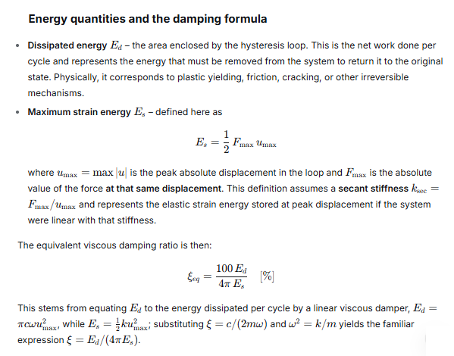

Slide 5
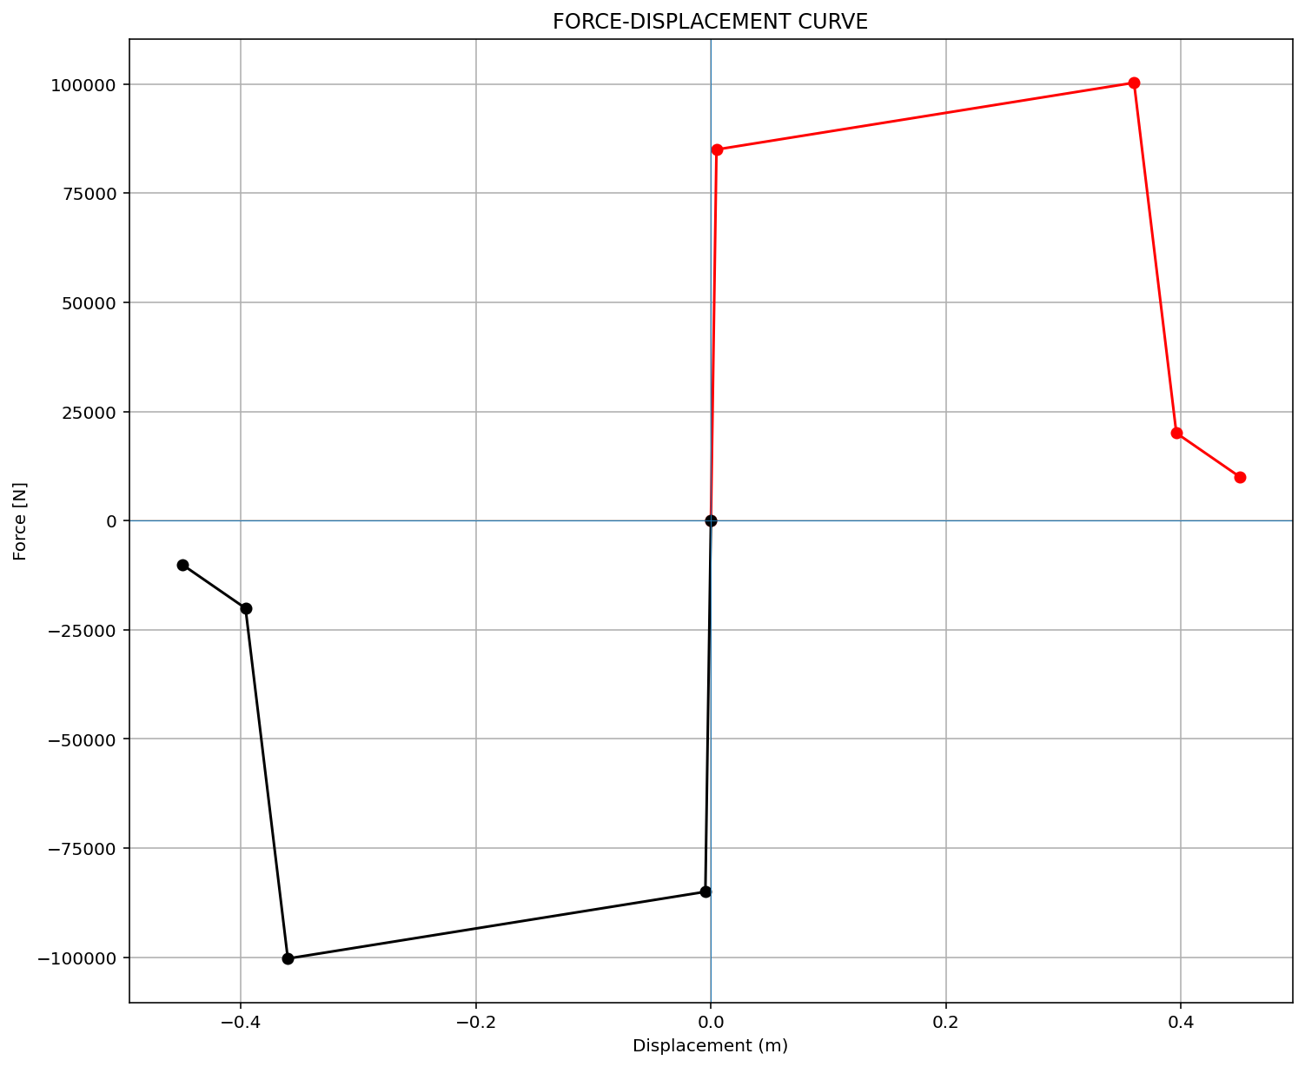
ELEMENT 01

Slide 6

ELEMENT 02

Slide 7
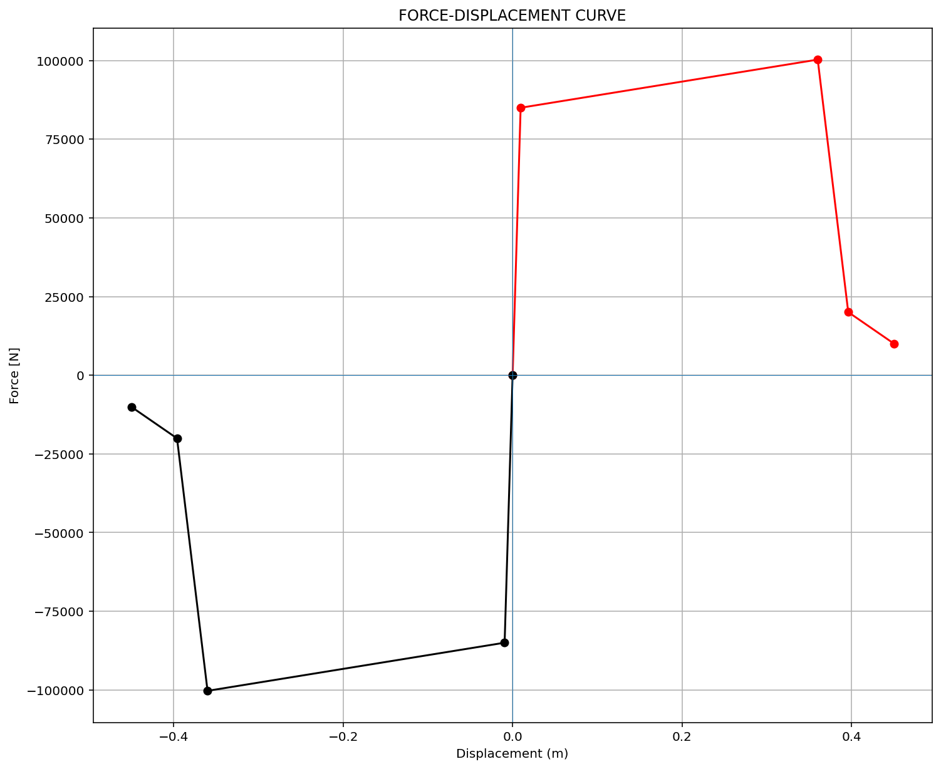
ELEMENT 03

Slide 8
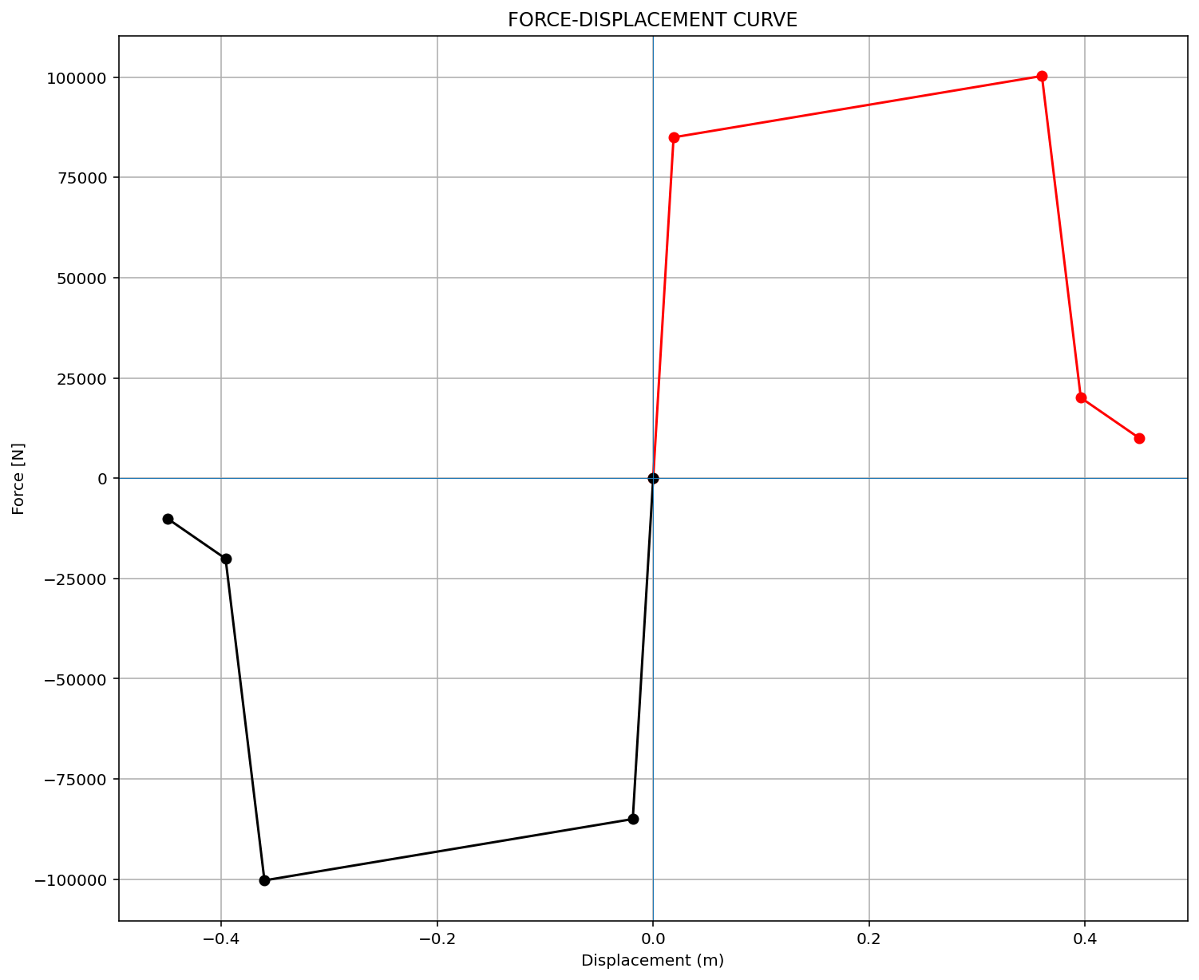
ELEMENT 04

Slide 9
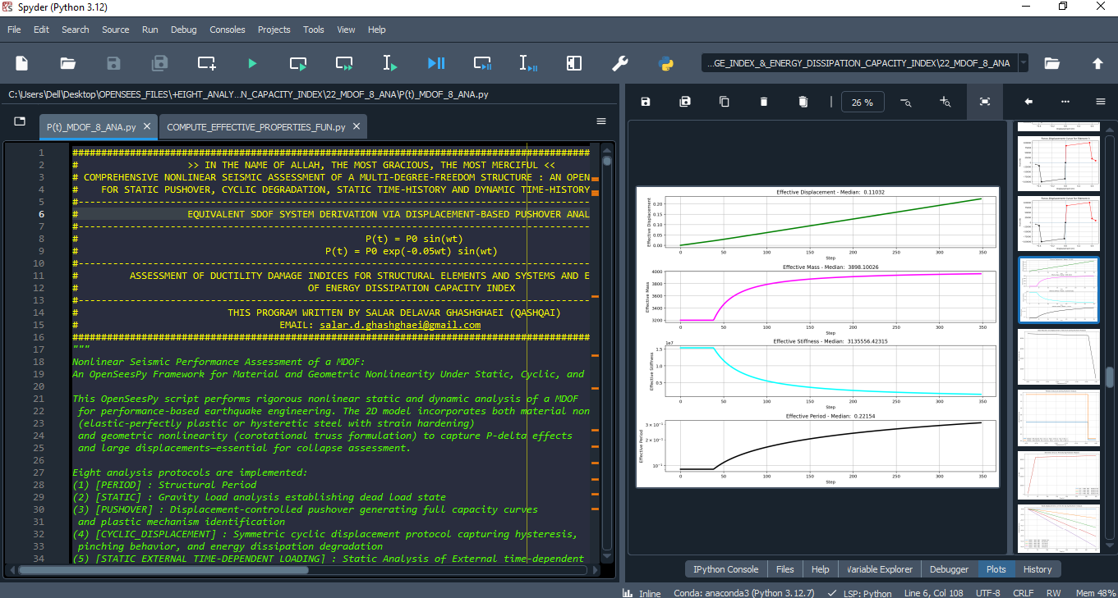

Slide 10
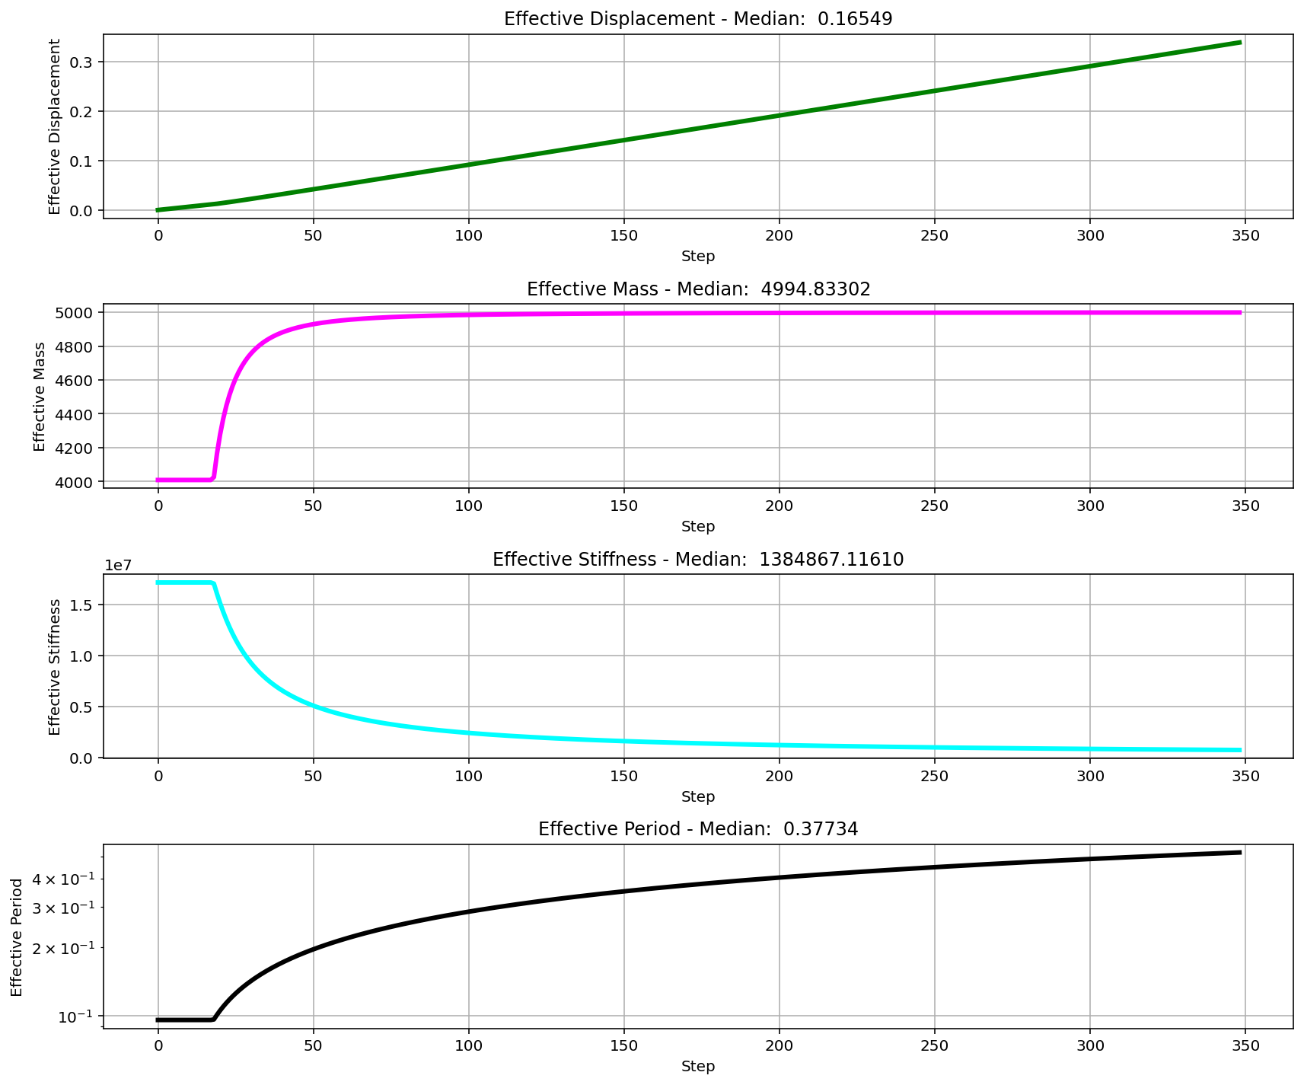

Slide 11
CYCLIC DISPLACEMENT ANALYSIS

Slide 12
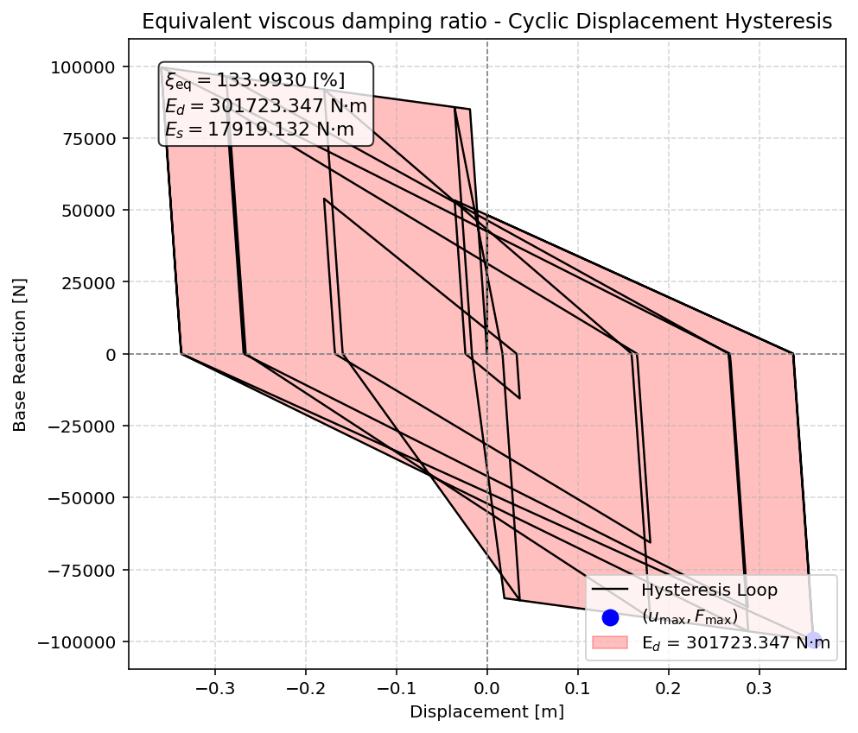

Slide 13
STATIC TIME-HISTORY WITH EXTERNAL TIME-DEPENDENT LOADING ANALYSIS

Slide 14
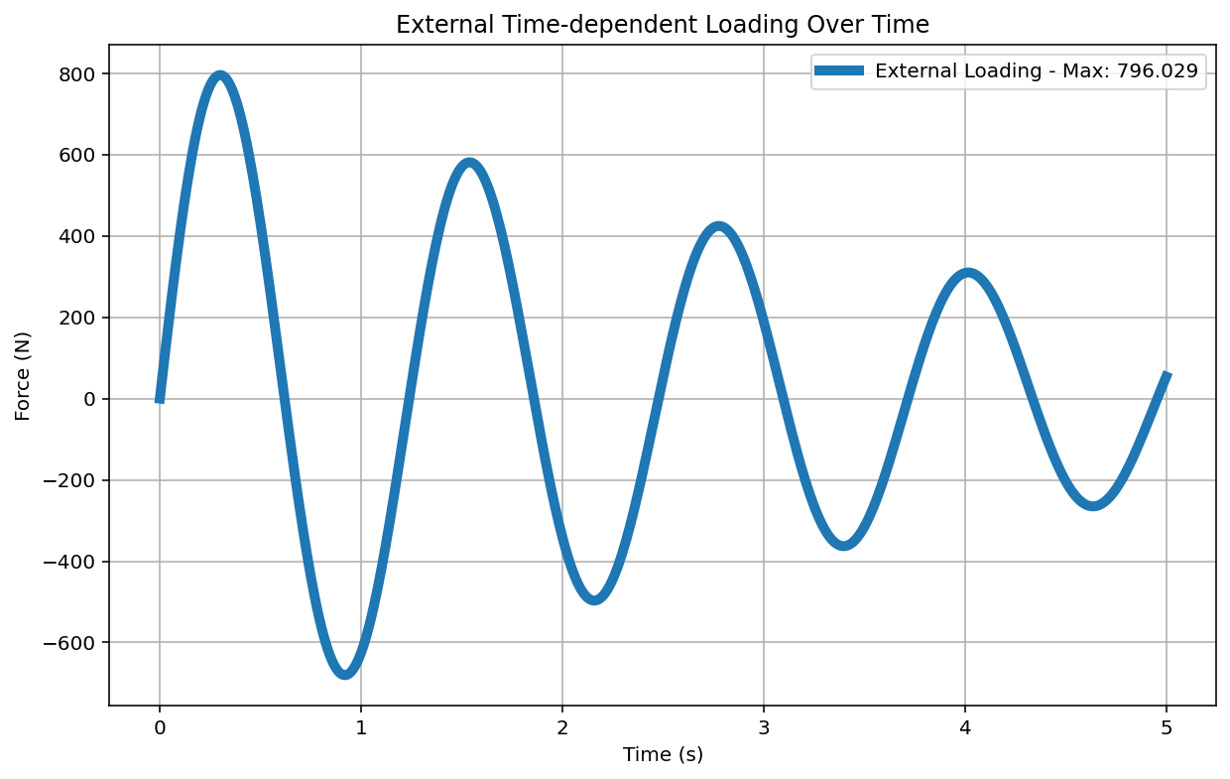

Slide 15
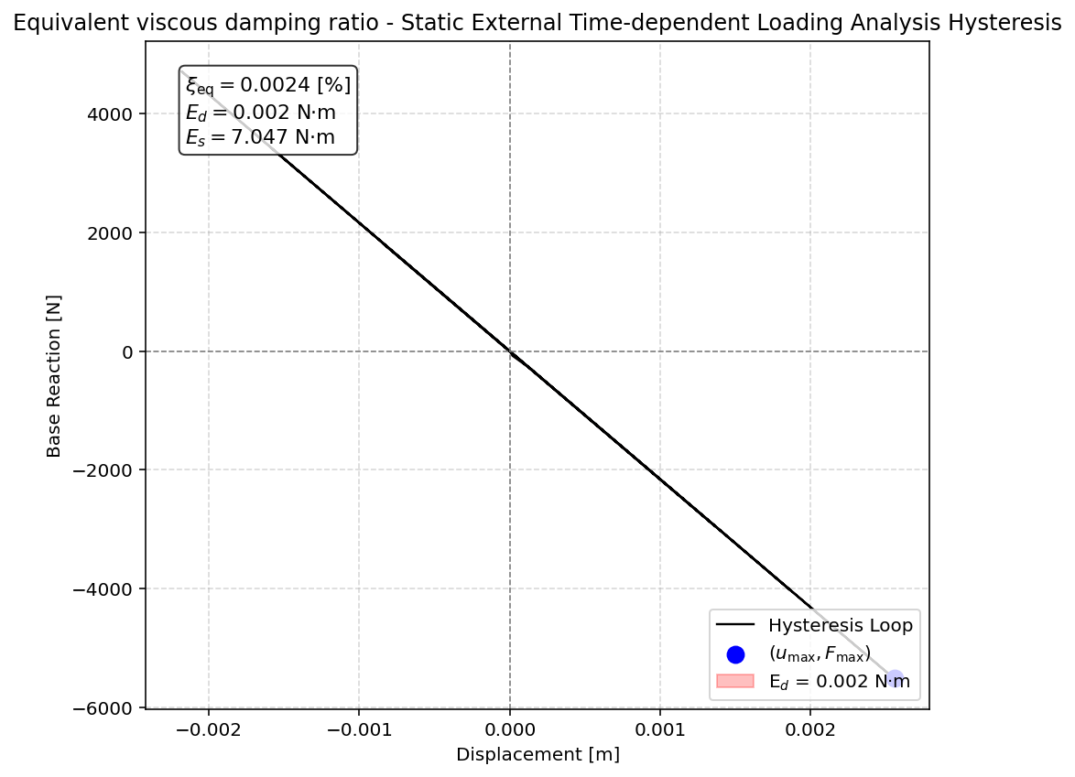

Slide 16
DYNAMIC TIME-HISTORY WITH EXTERNAL TIME-DEPENDENT LOADING ANALYSIS

Slide 17
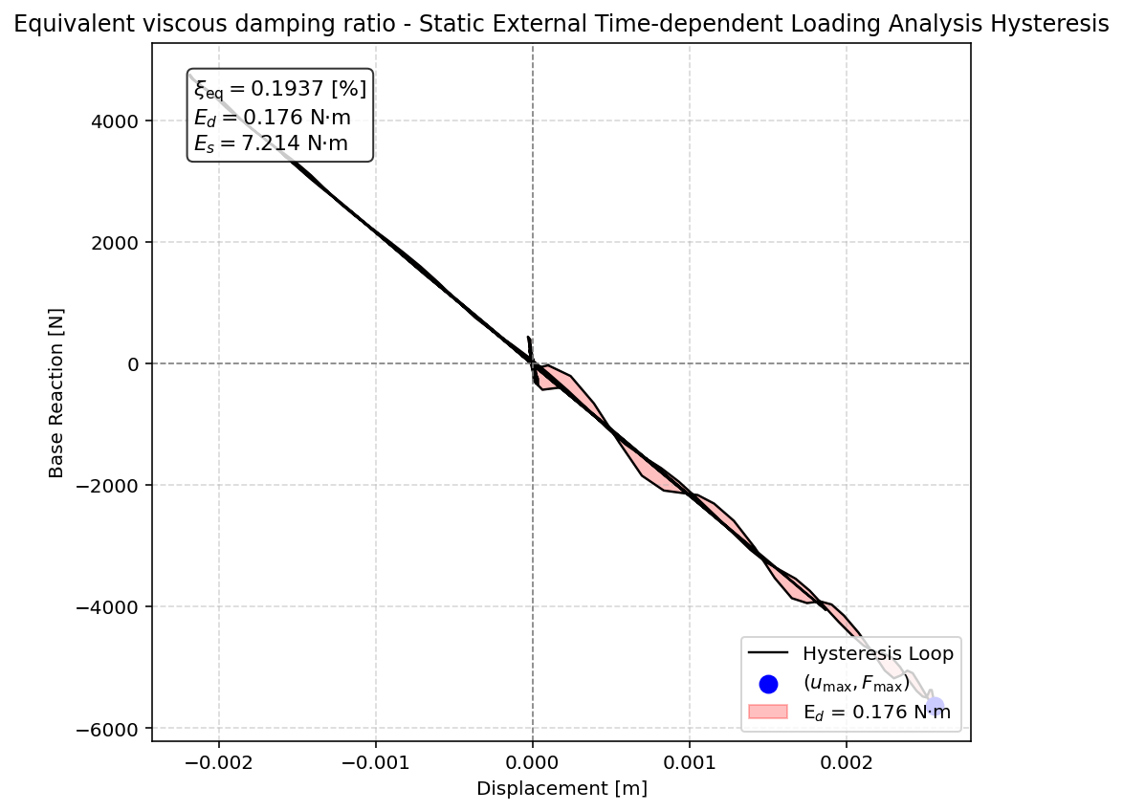

Slide 19
FREE-VIBRATION ANALYSIS

Slide 20
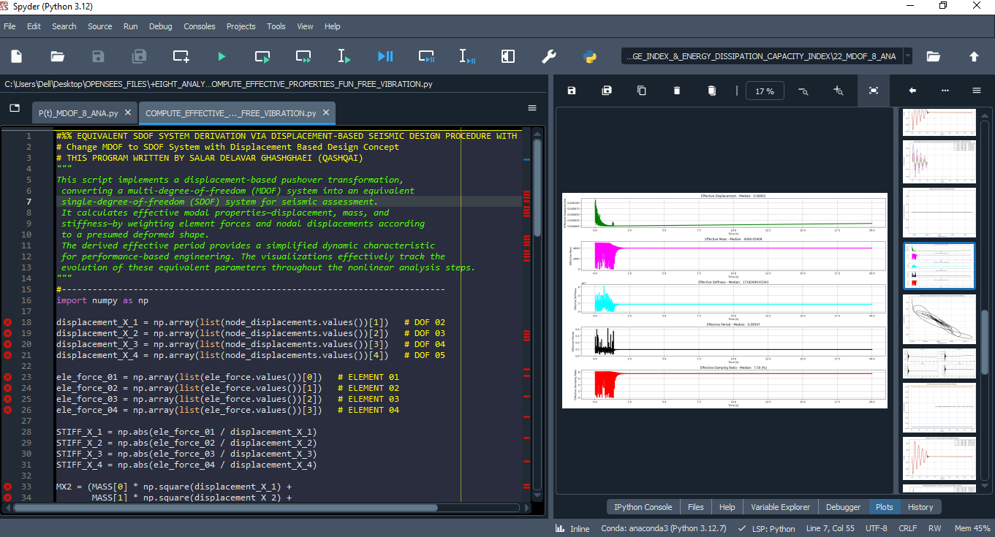

Slide 21
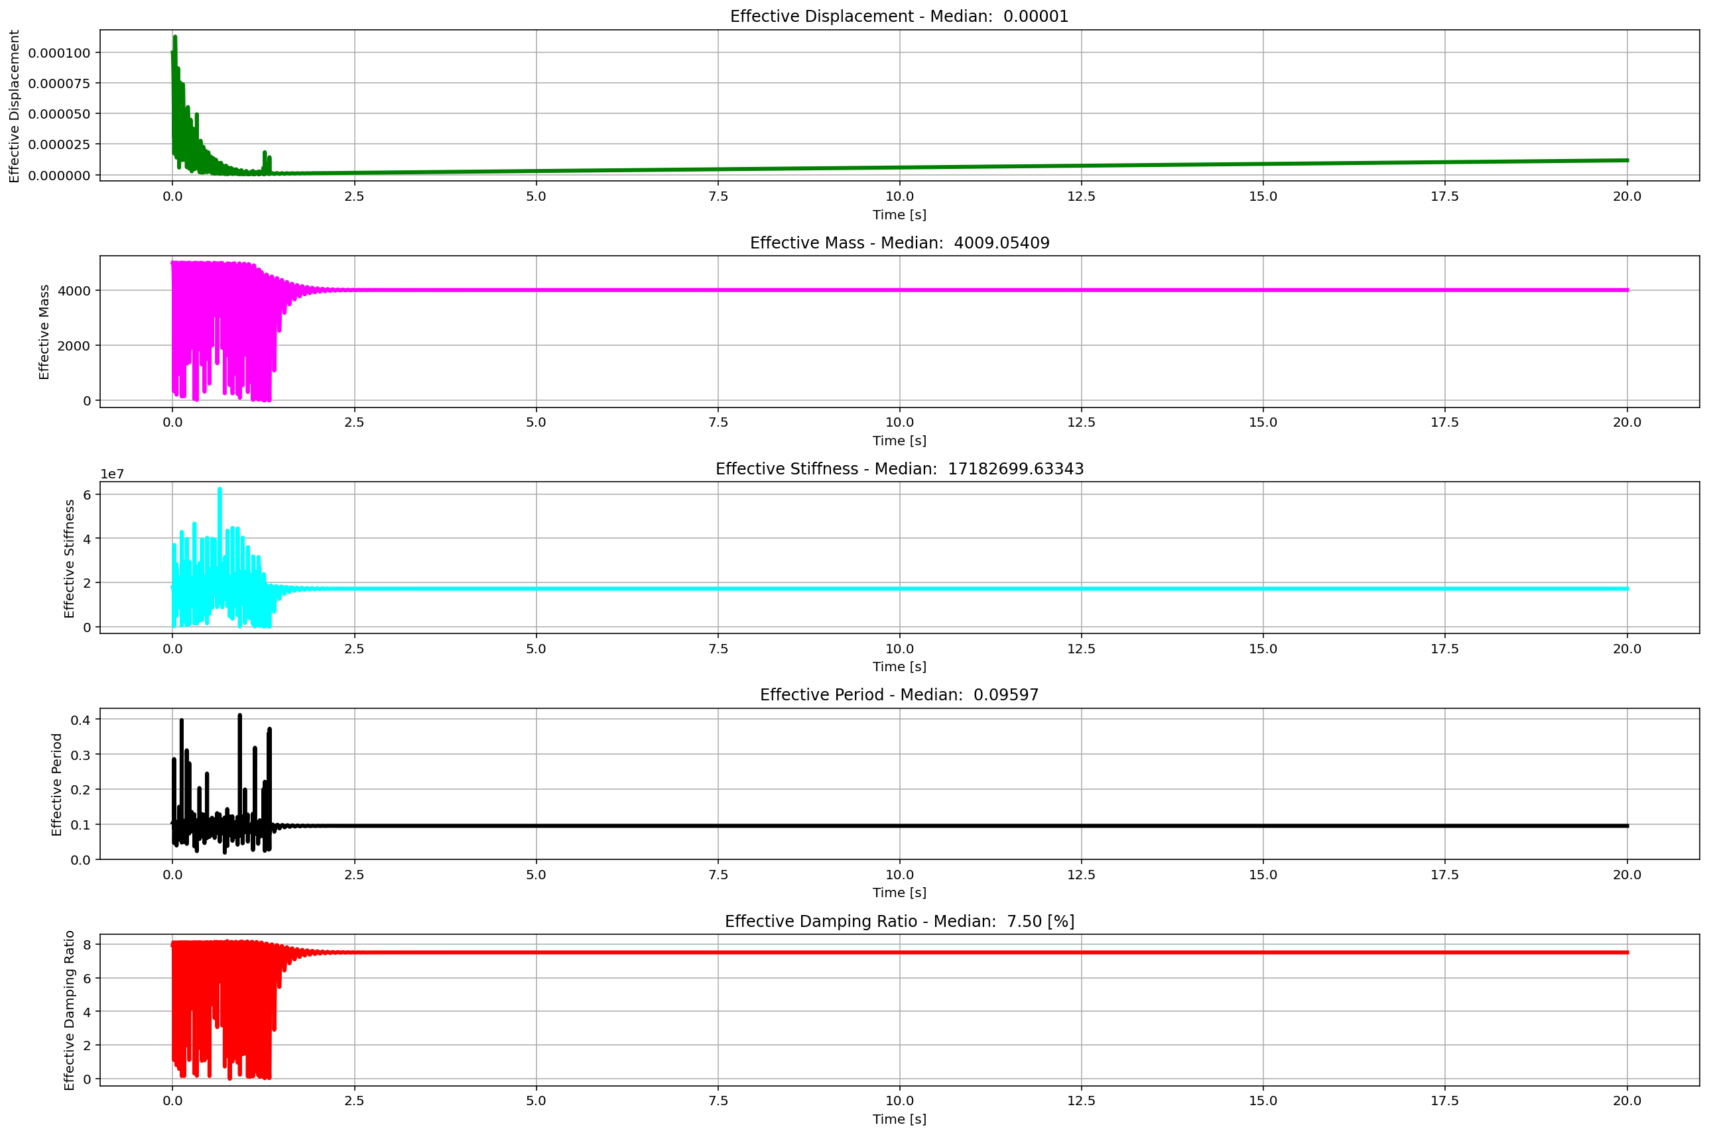
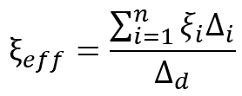

Slide 22
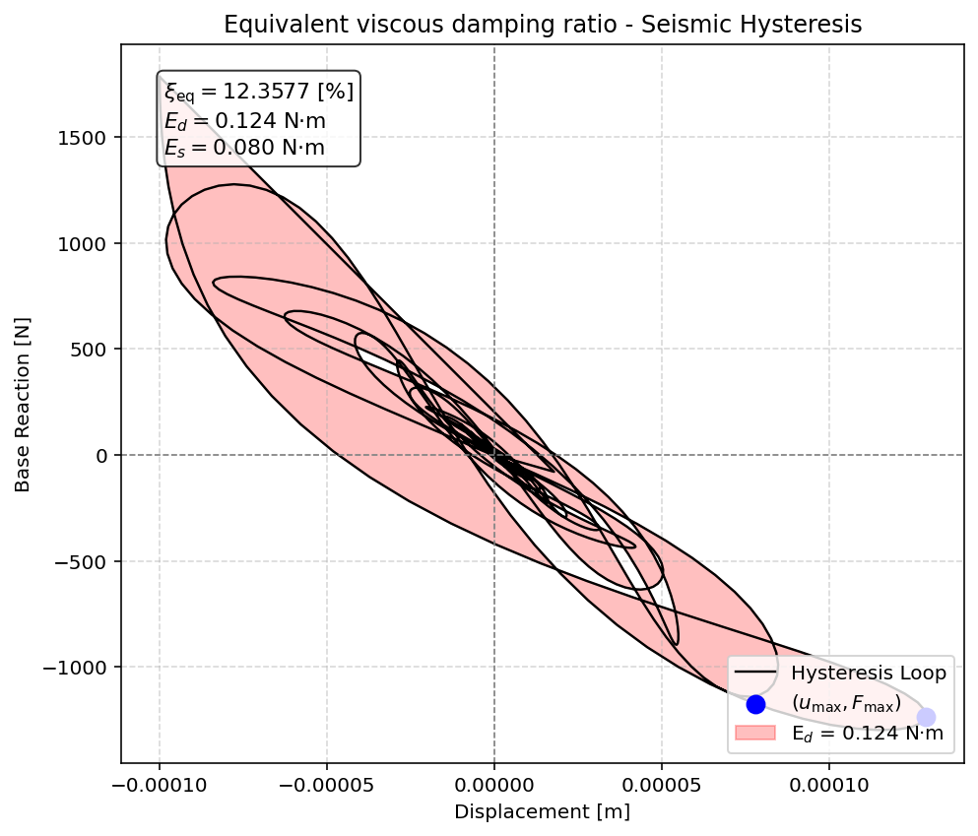

Slide 23
SEISMIC ANALYSIS

Slide 24
