Slide 1
>> IN THE NAME OF ALLAH, THE MOST GRACIOUS, THE MOST MERCIFUL <<
DETERMINATION OF THE OPTIMUM ELASTIC STIFFNESS OF EACH COLUMN BASED ON THE CONSTANT STRUCTURAL PERIOD THROUGH MASS VARIATION USING FINITE-DIFFERENCE NEWTON ITERATION AND OPENSEES
THIS PYTHON SCRIPT IS WRITTEN BY SALAR DELAVAR GHASHGHAEI (QASHQAI)

Slide 2


Slide 3
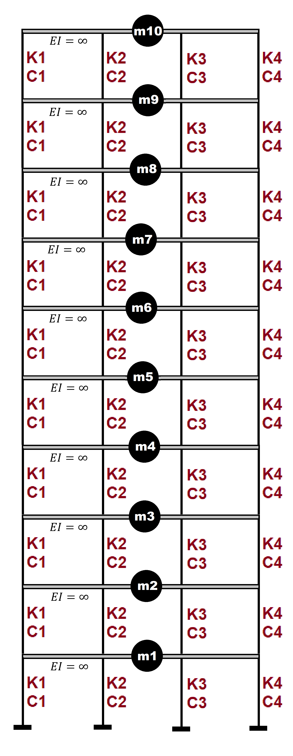

Slide 4
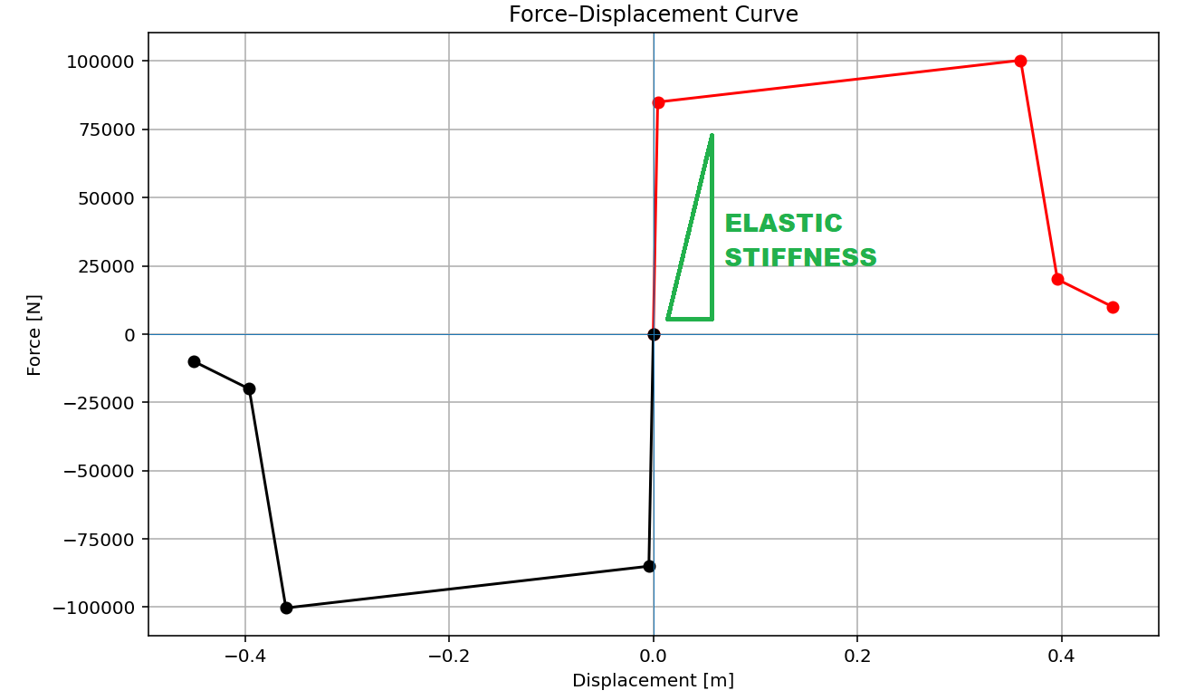
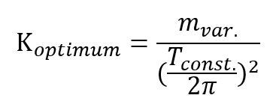

Slide 5
OPTIMIZATION PROBLEM FOR STRUCTURAL PERIOD BY CHANGING INTIAL ELASTIC STIFFNESS

Slide 6
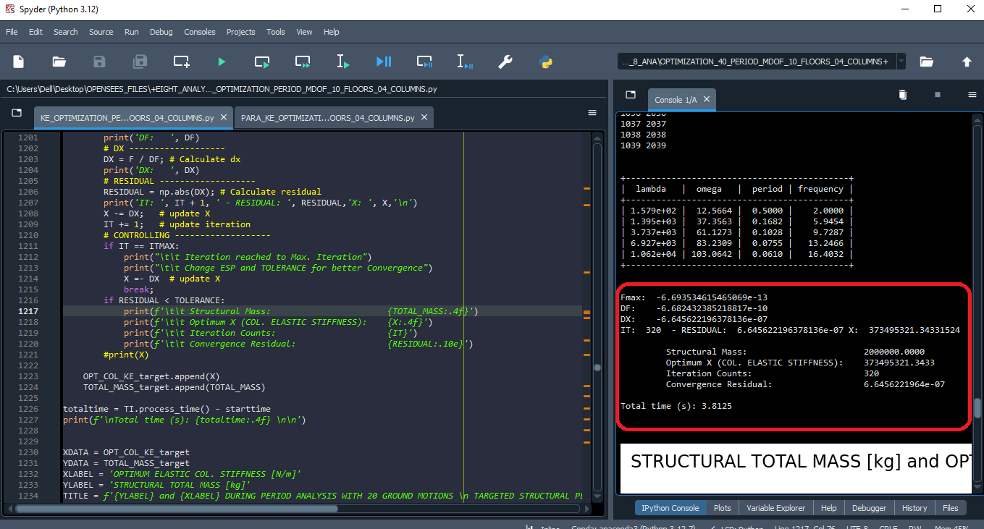

Slide 7
Fmax: -6.693534615465069e-13
DF: -6.682432385218817e-10
DX: -6.645622196378136e-07
IT: 320 - RESIDUAL: 6.645622196378136e-07 X: 373495321.34331524
Structural Mass: 2000000.0000
Optimum X (COL. ELASTIC STIFFNESS): 373495321.3433
Iteration Counts: 320
Convergence Residual: 6.6456221964e-07
Total time (s): 3.8125

Slide 8
