Slide 1
>> IN THE NAME OF ALLAH, THE MOST GRACIOUS, THE MOST MERCIFUL <<
COMPREHENSIVE NONLINEAR SEISMIC ASSESSMENT OF TWO ELEMENTS TRUSS: AN OPENSEES FRAMEWORK FOR STATIC PUSHOVER, CYCLIC DEGRADATION, STATIC TIME-HISTORY AND DYNAMIC TIME-HISTORY ANALYSIS THIS PROGRAM IS WRITTEN BY SALAR DELAVAR GHASHGHAEI (QASHQAI)

Slide 2
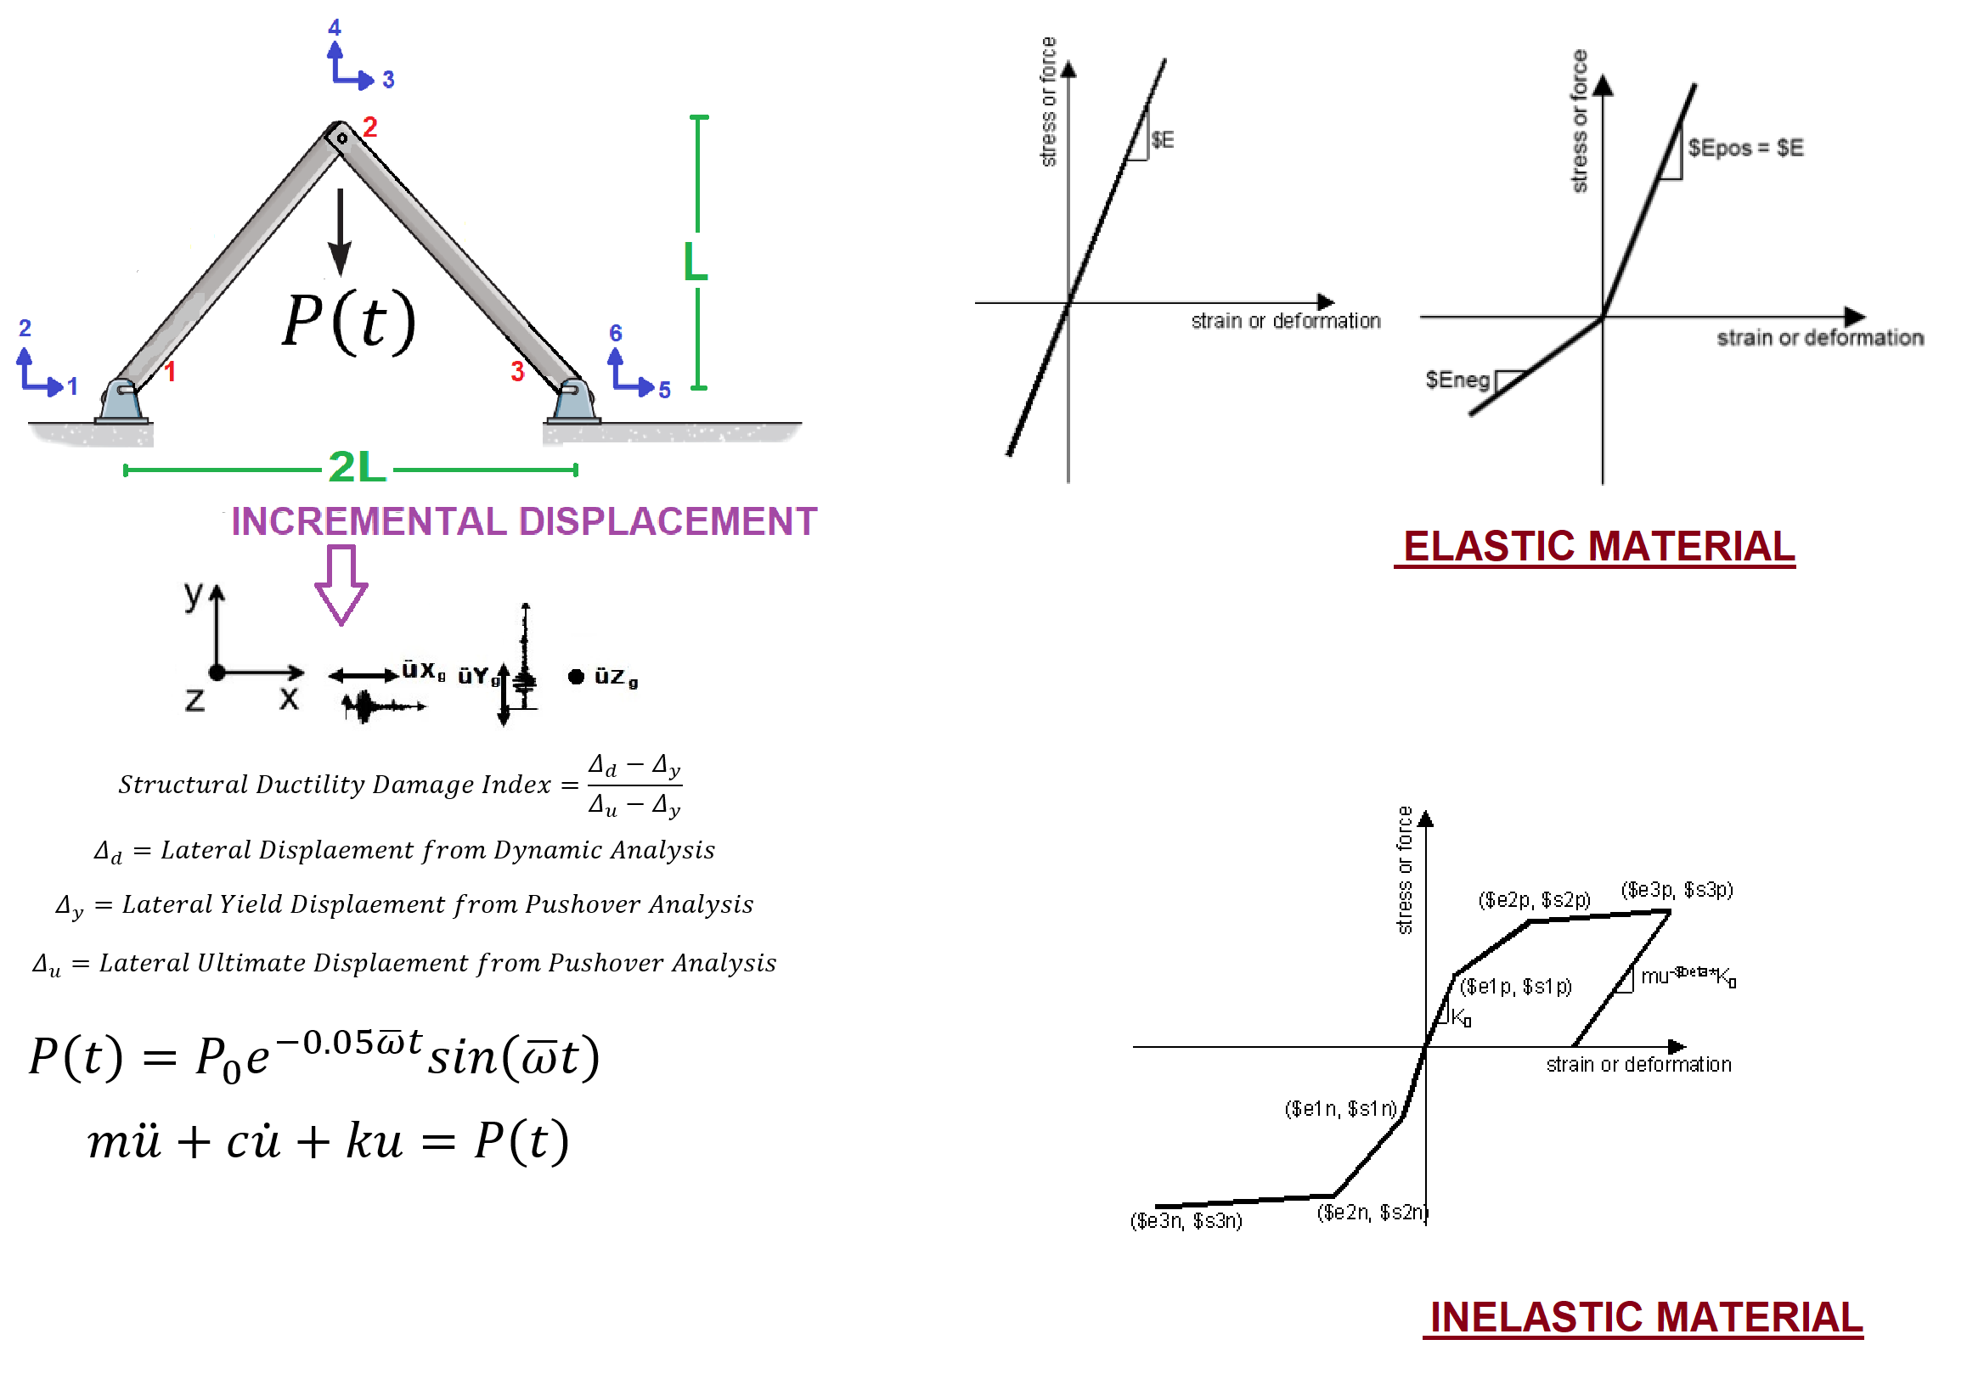

Slide 3
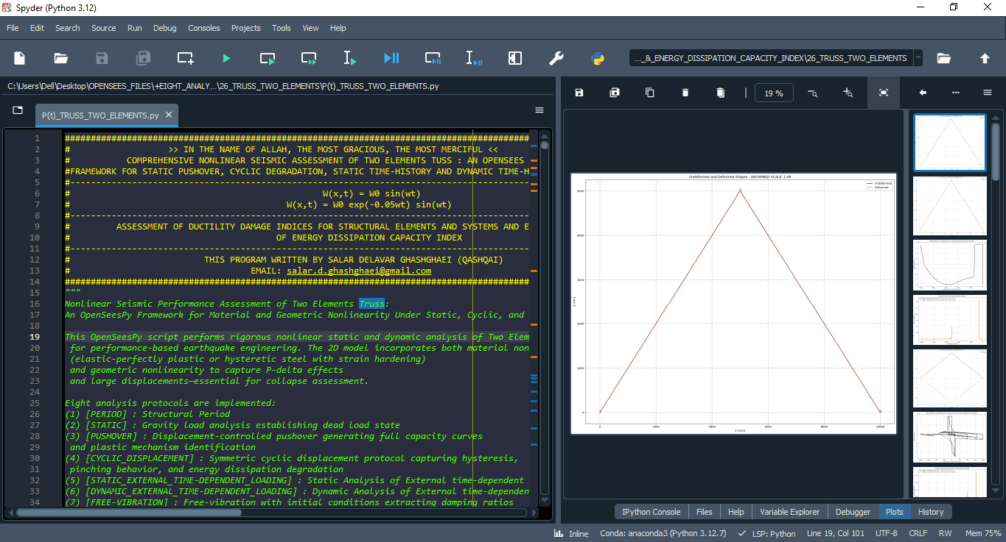

Slide 4
STATIC ANALYSIS

Slide 6
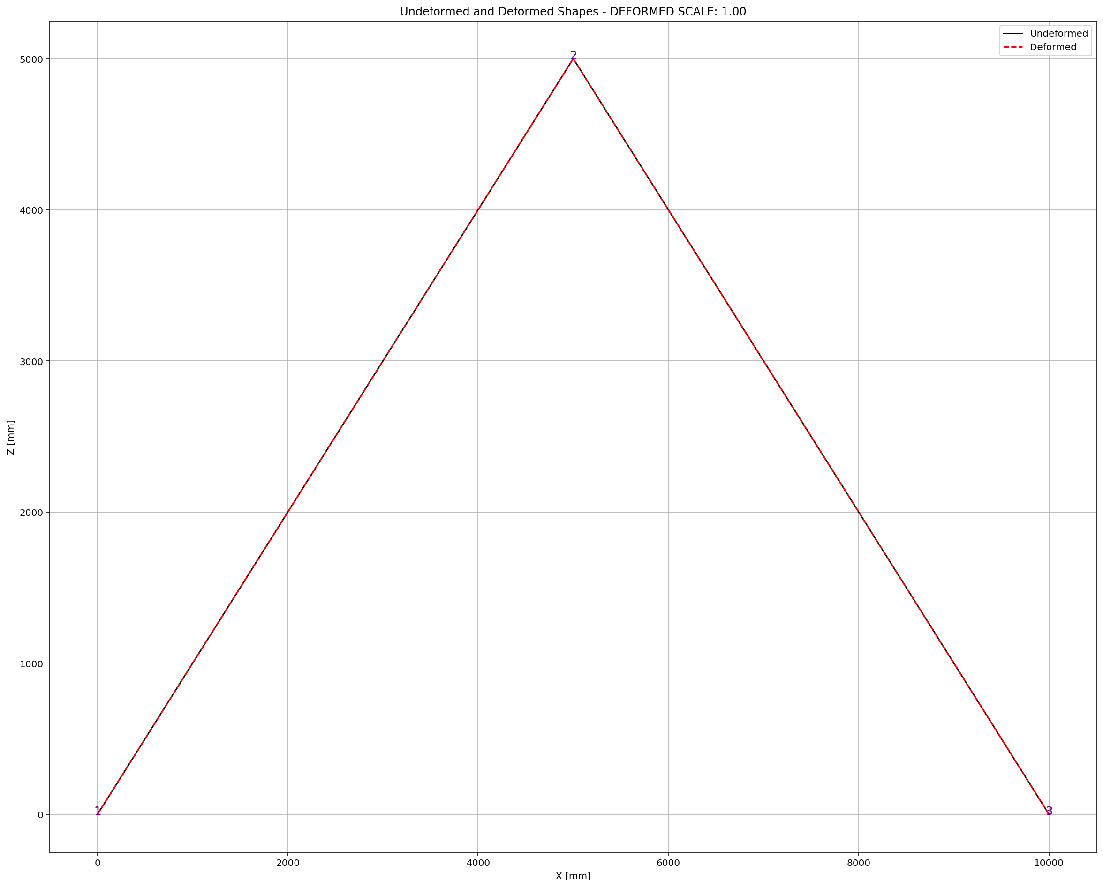

Slide 7
PUSHOVER ANALYSIS

Slide 8
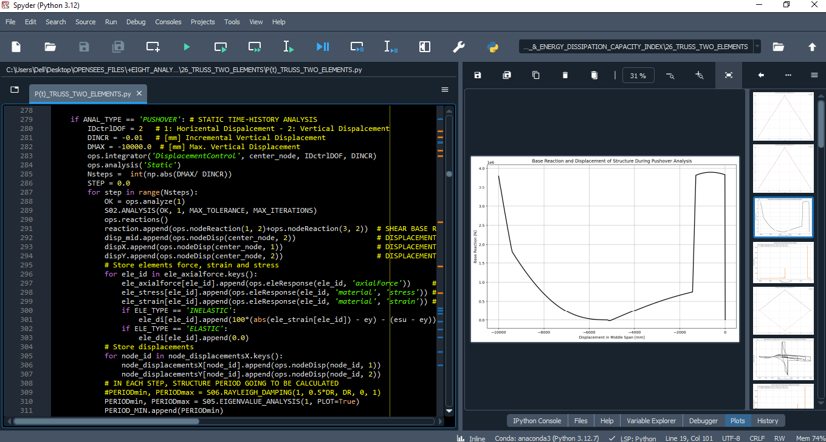

Slide 9
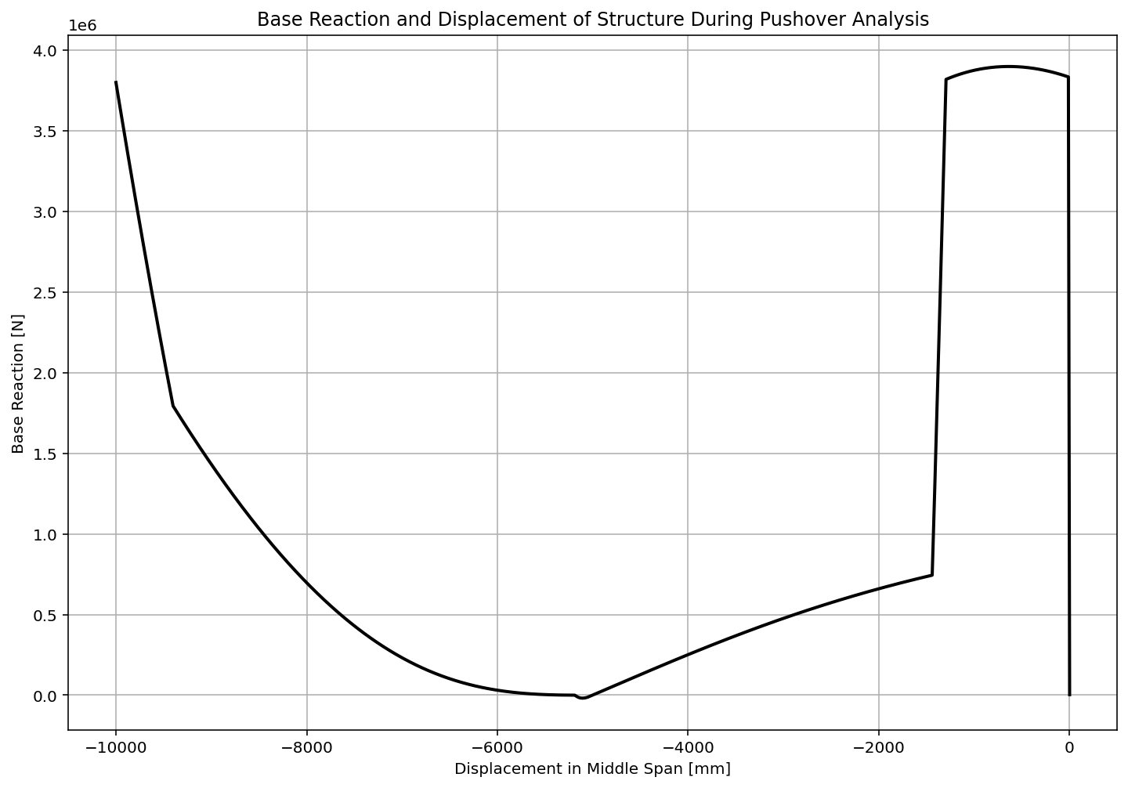
For 1000.0 mm Vertical Displacement

Slide 10
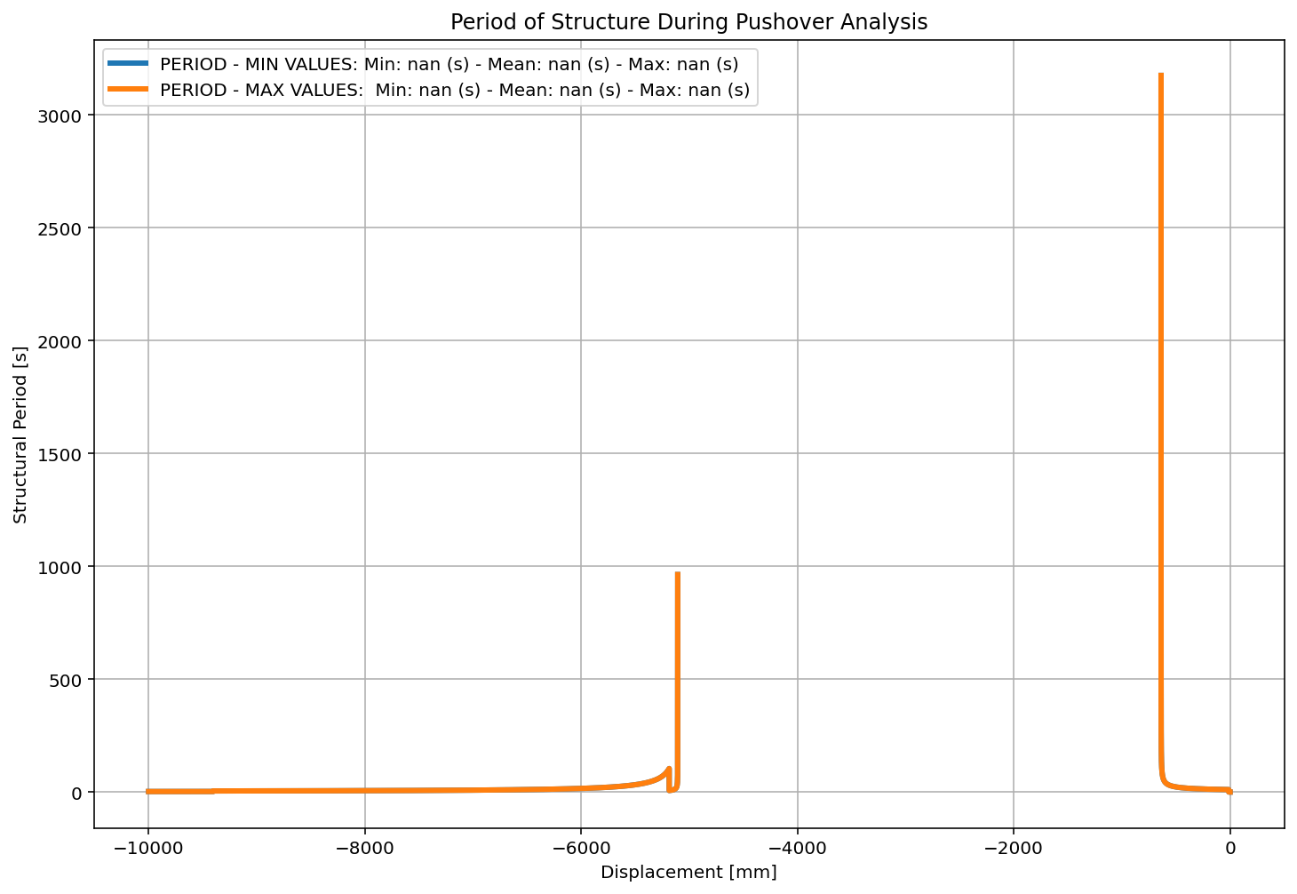
For 1000.0 mm Vertical Displacement

Slide 11
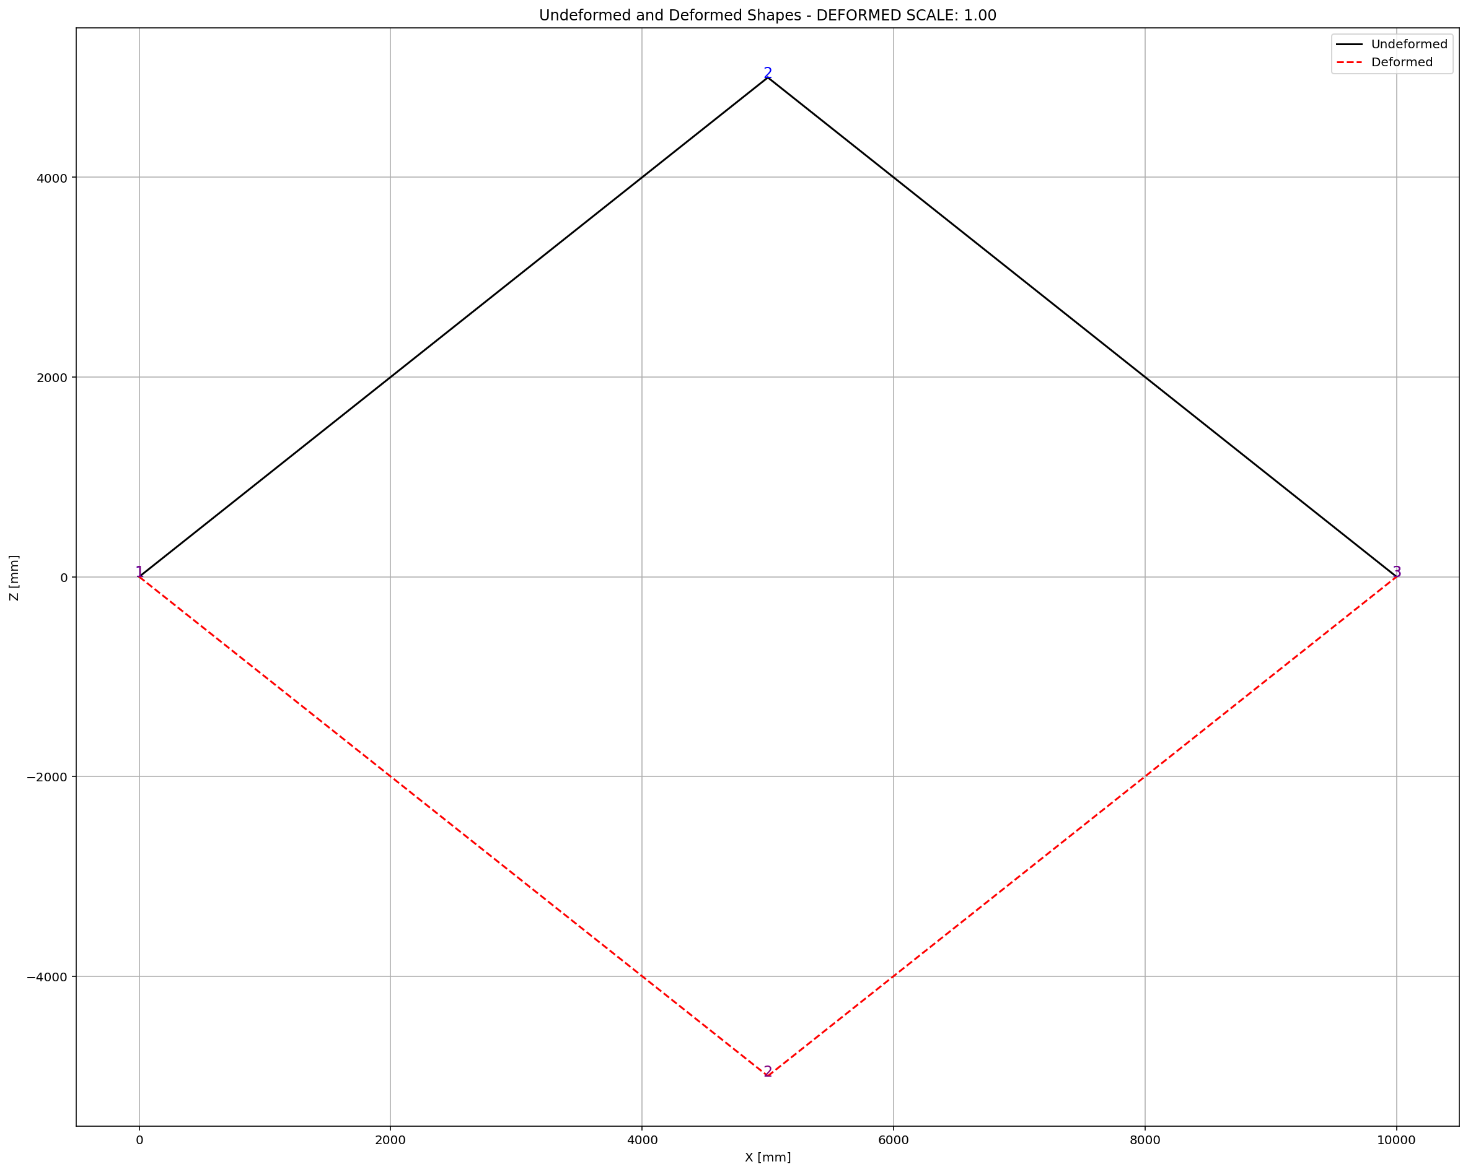
For 1000.0 mm Vertical Displacement

Slide 12
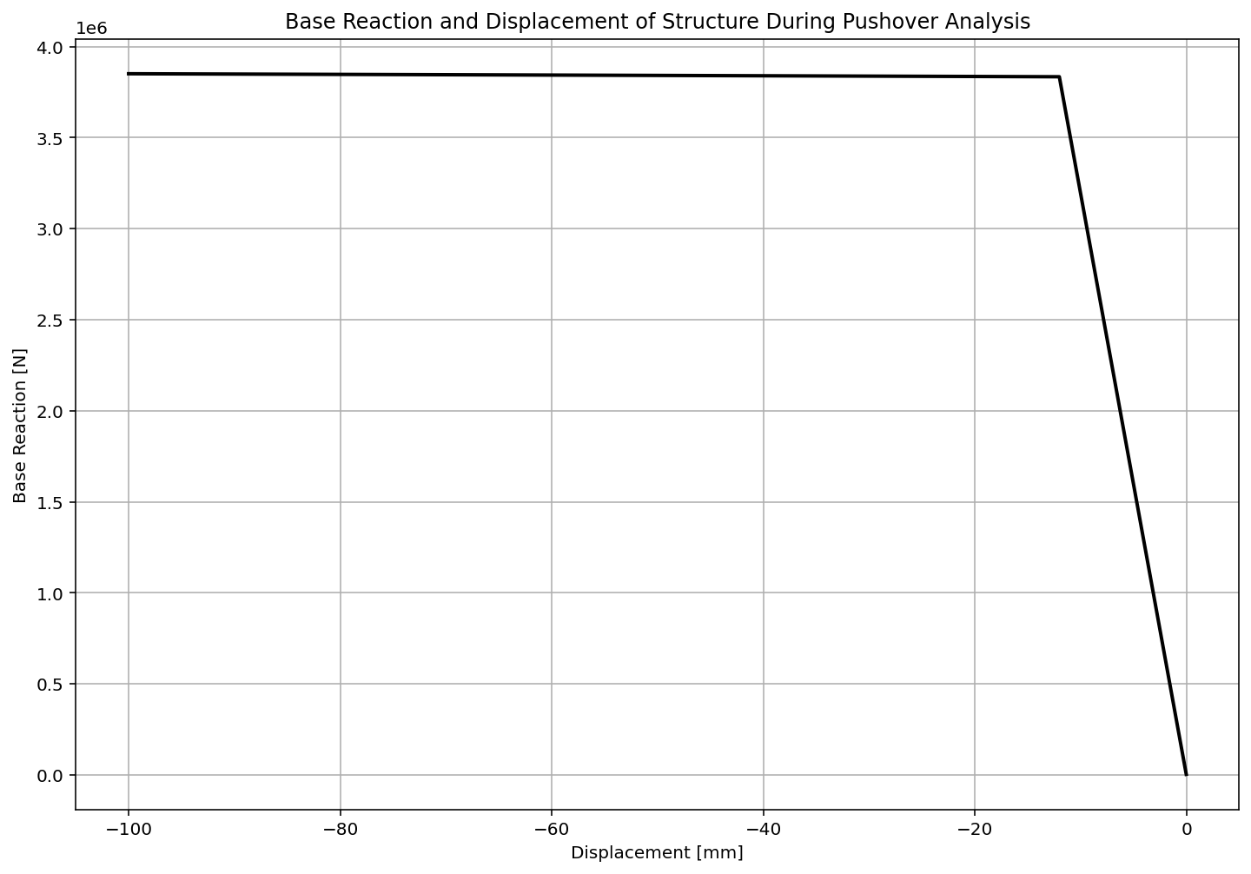
For 100.0 mm Vertical Displacement

Slide 13
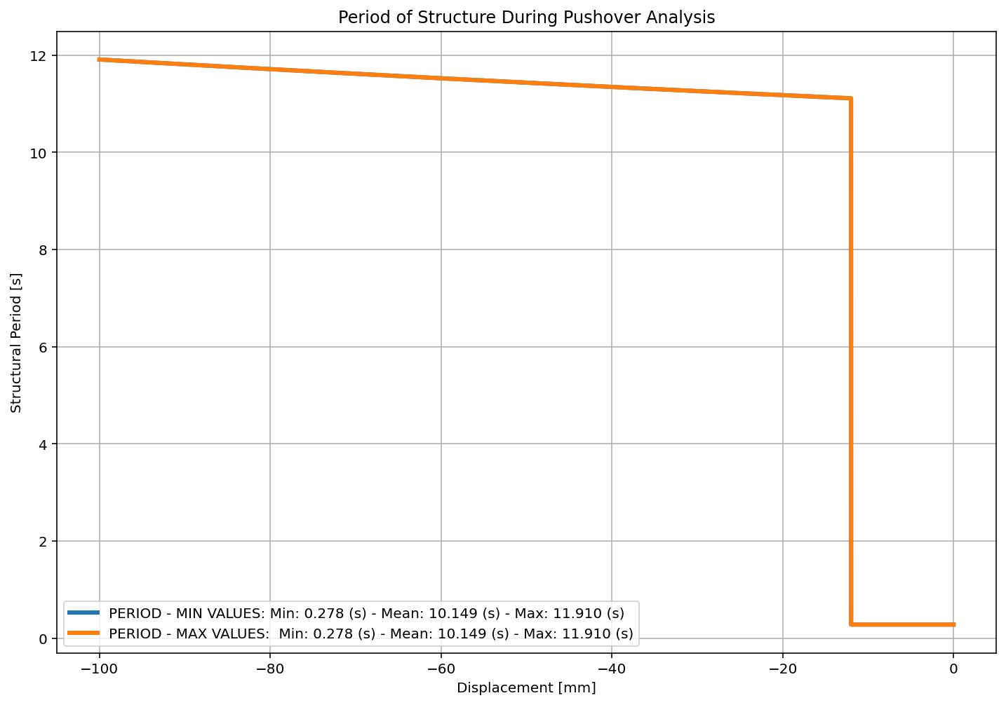
For 100.0 mm Vertical Displacement

Slide 14
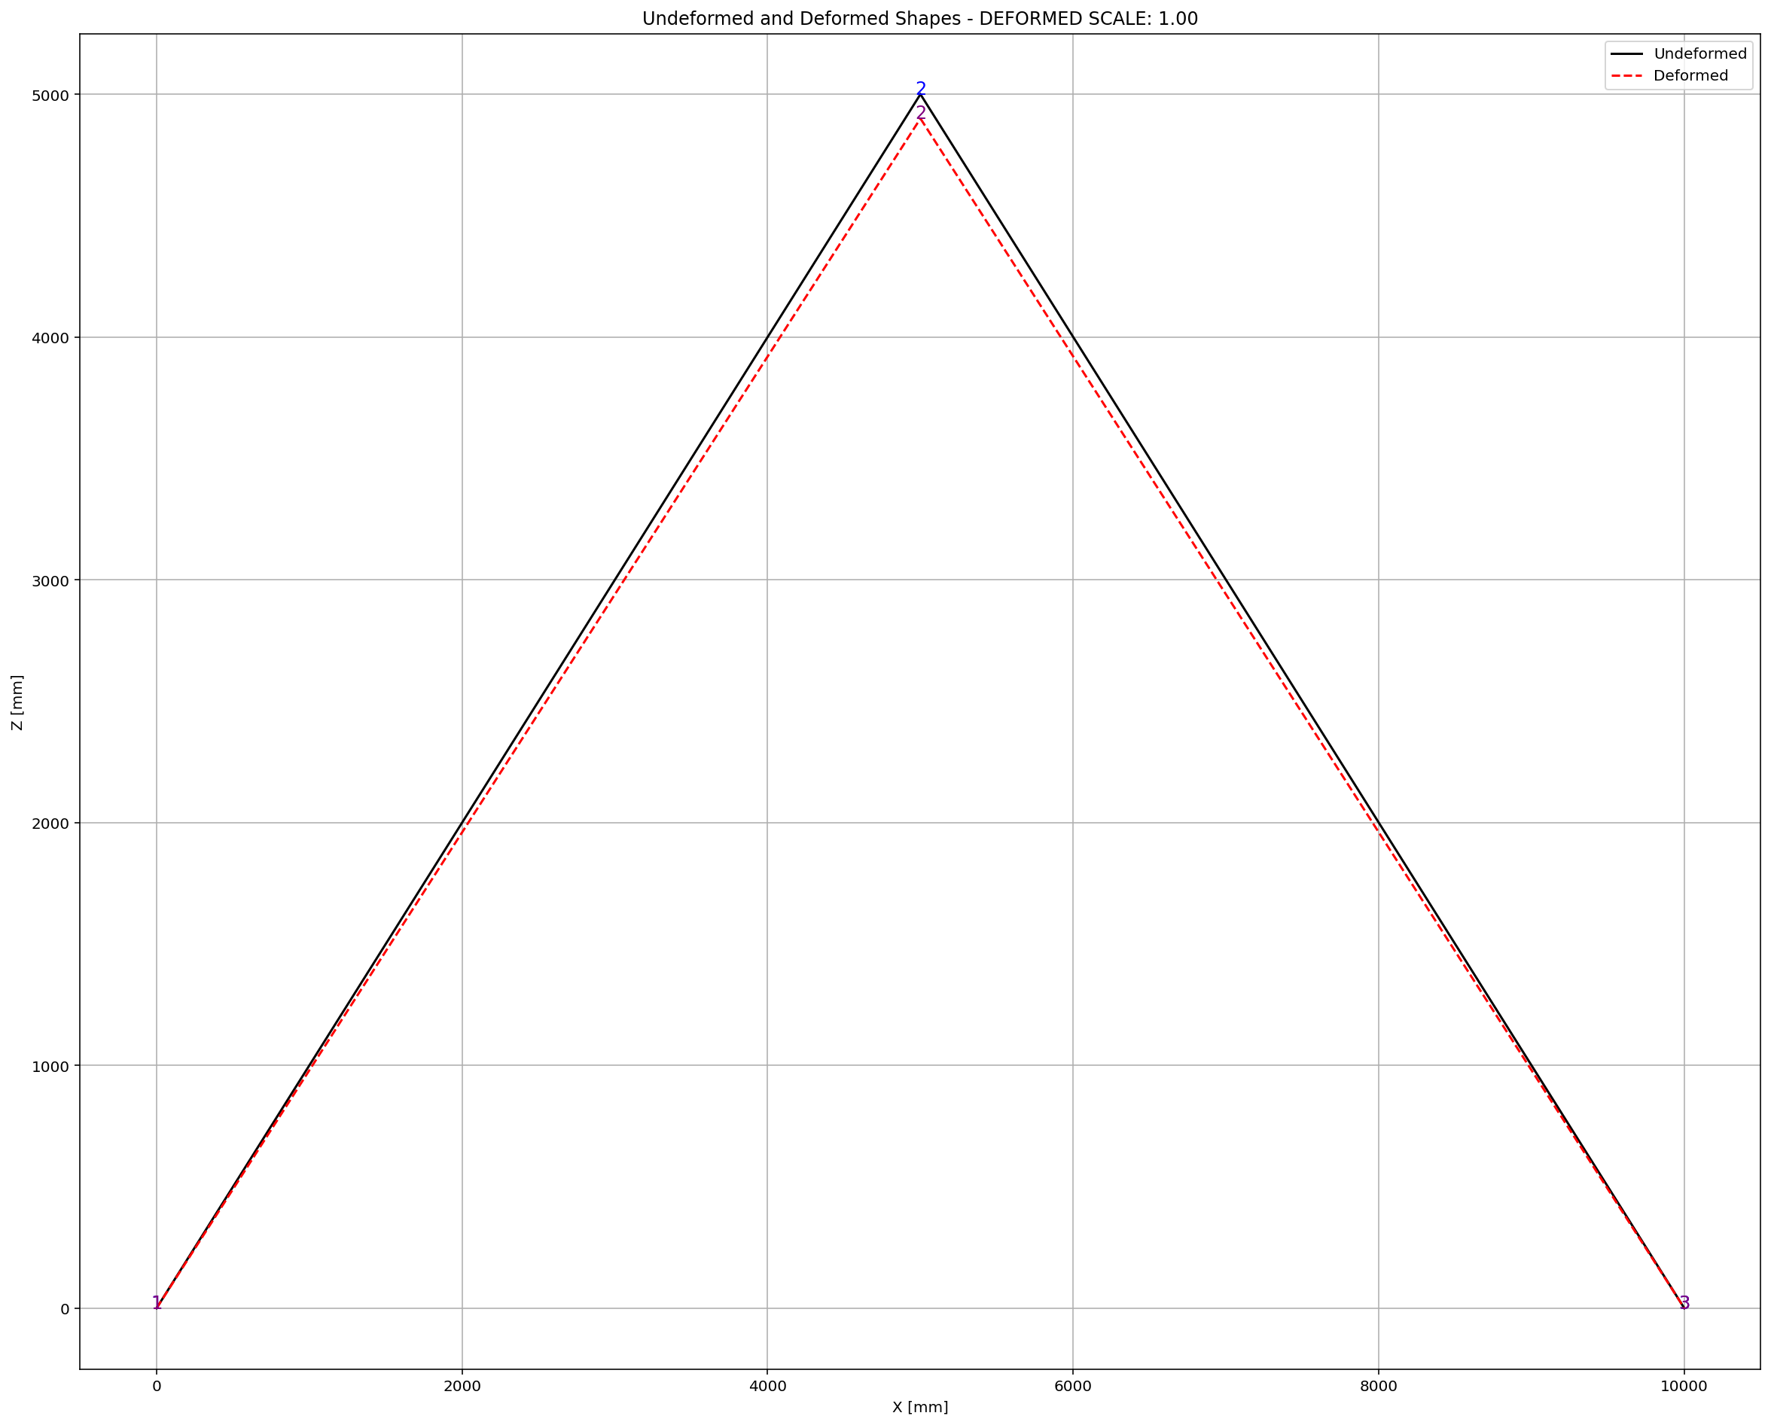
For 100.0 mm Vertical Displacement

Slide 15
CYCLIC DISPLACEMENT ANALYSIS

Slide 16
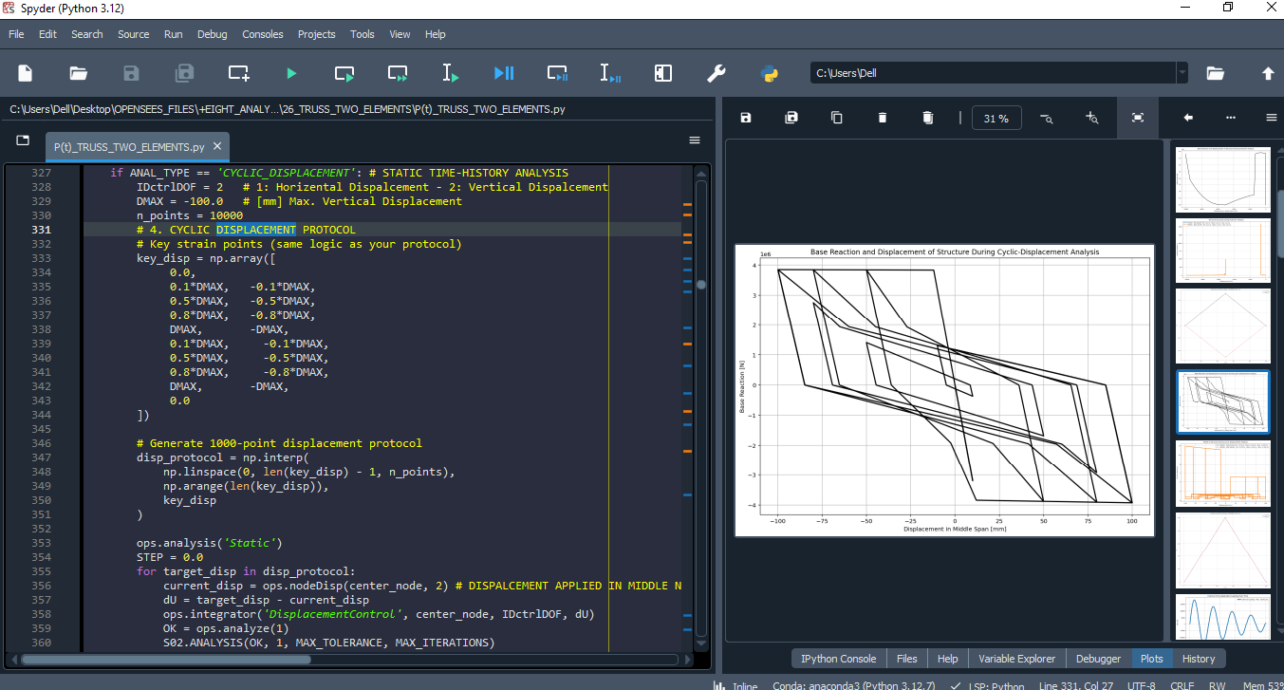

Slide 17
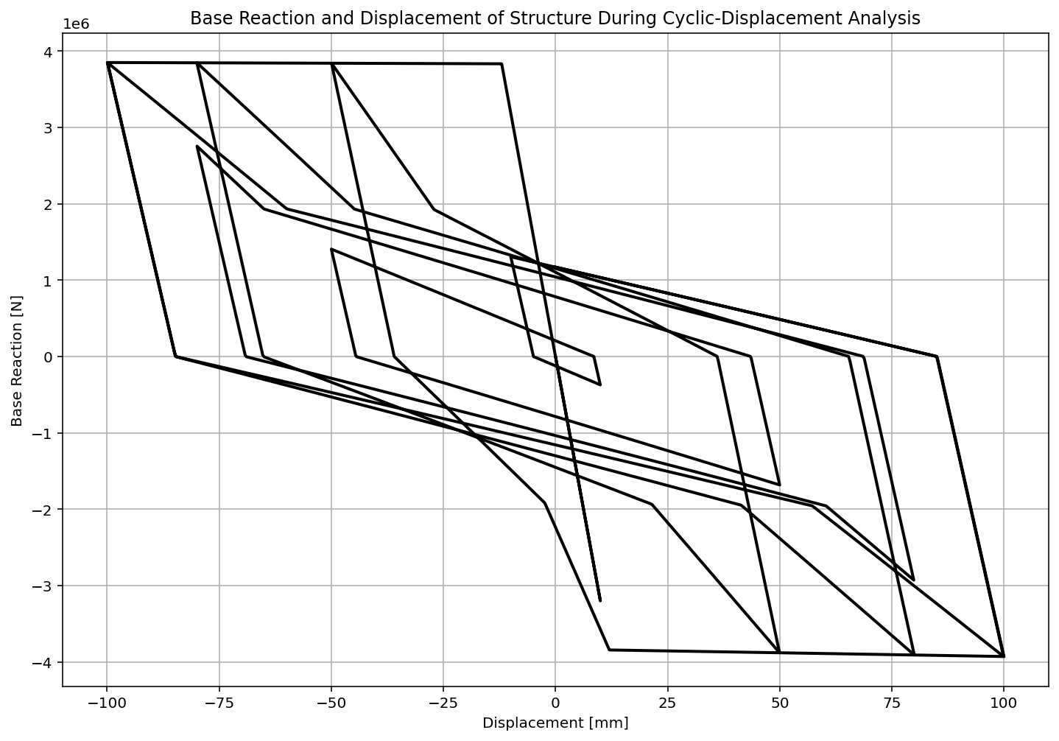

Slide 18
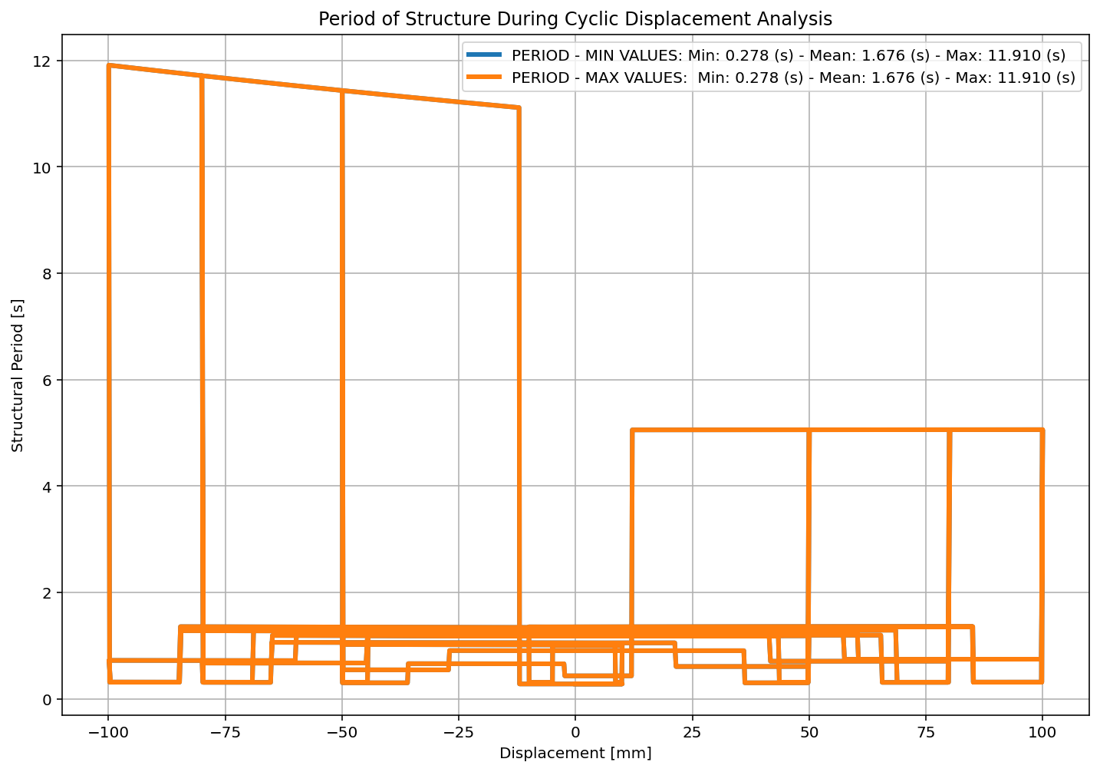

Slide 19
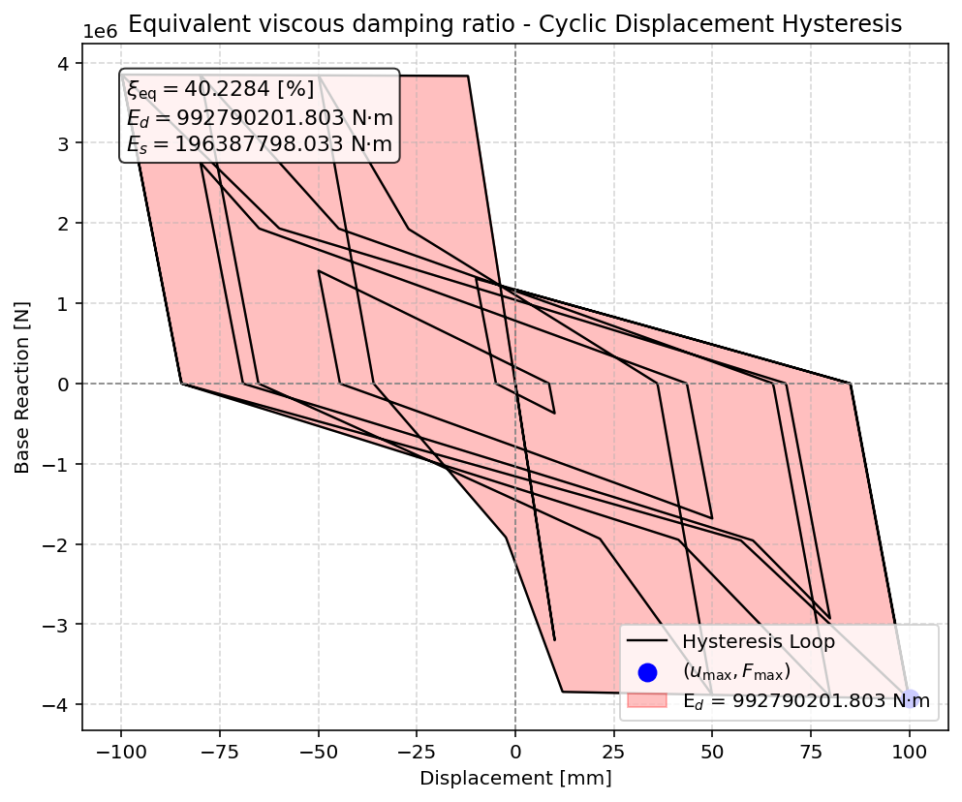

Slide 21
STATIC TIME-HISTORY WITH EXTERNAL TIME-DEPENDENT LOADING ANALYSIS

Slide 22
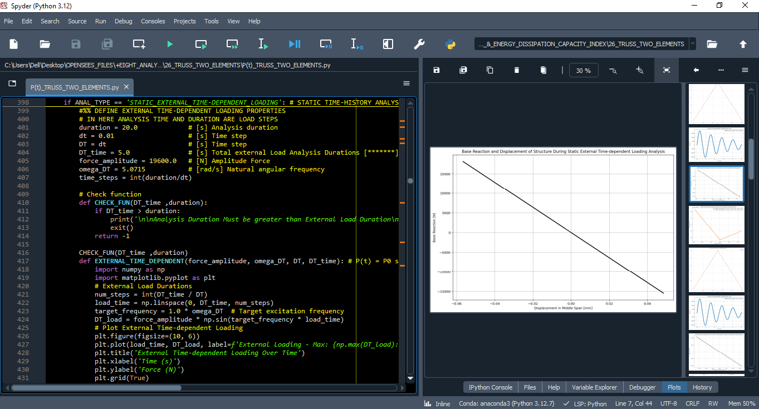

Slide 23
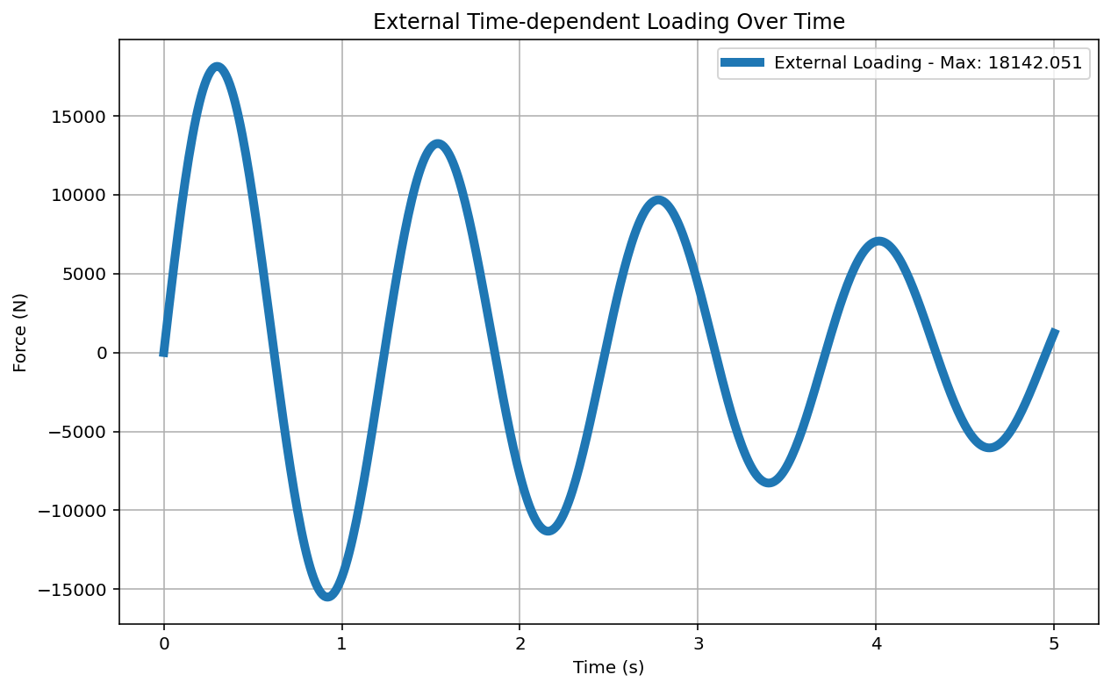

Slide 24
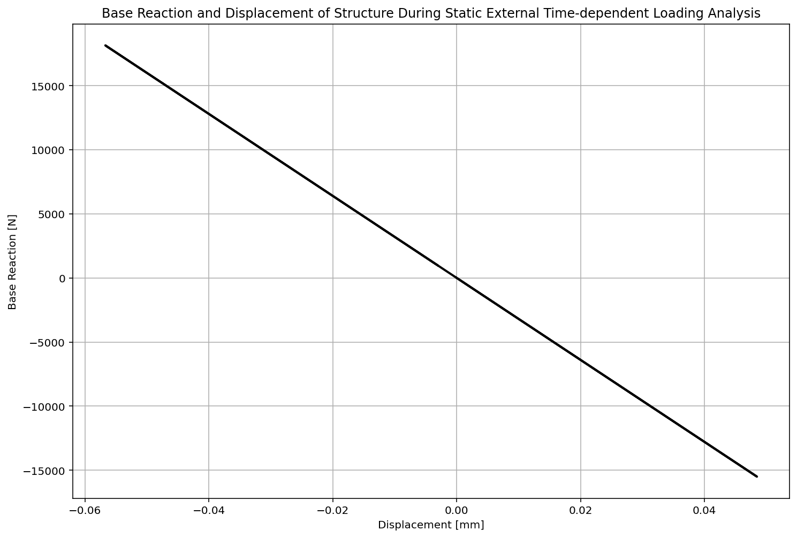

Slide 25
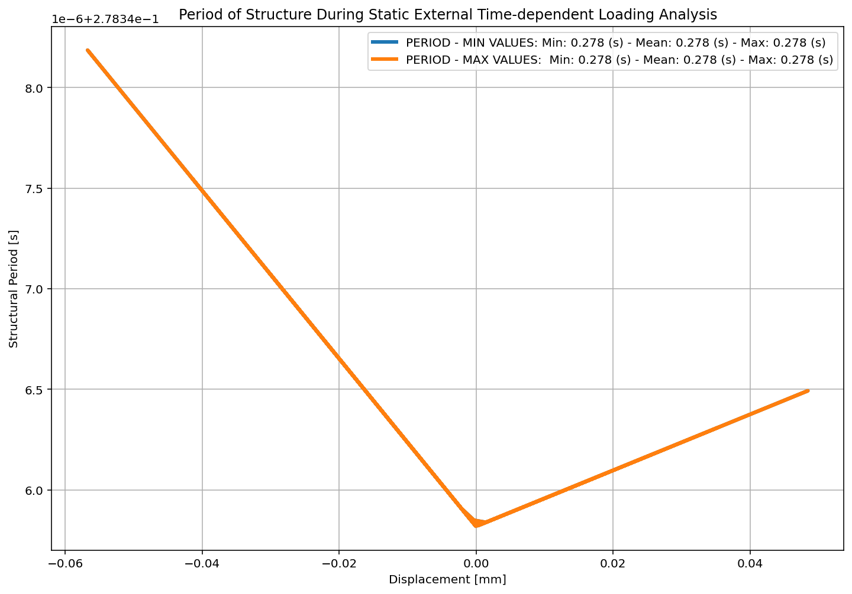

Slide 26


Slide 27
DYNAMIC TIME-HISTORY WITH EXTERNAL TIME-DEPENDENT LOADING ANALYSIS

Slide 28
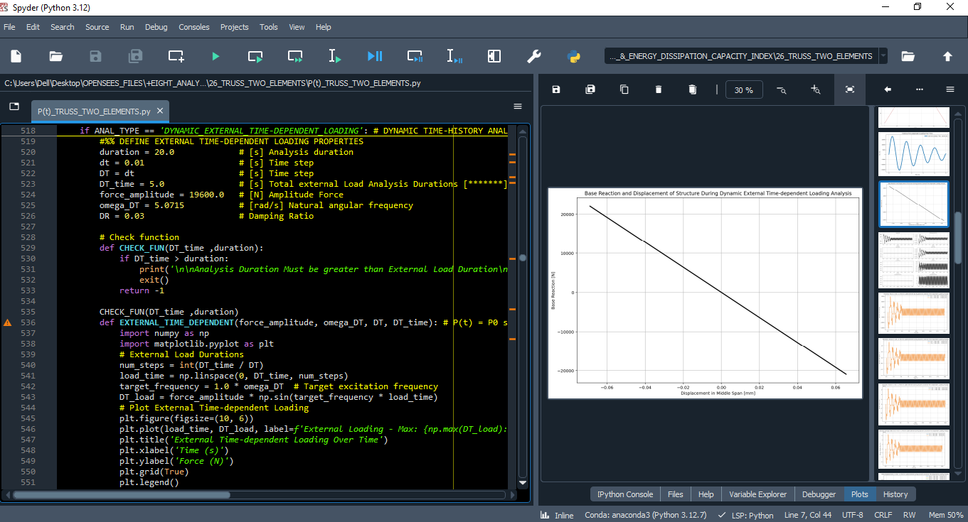

Slide 30
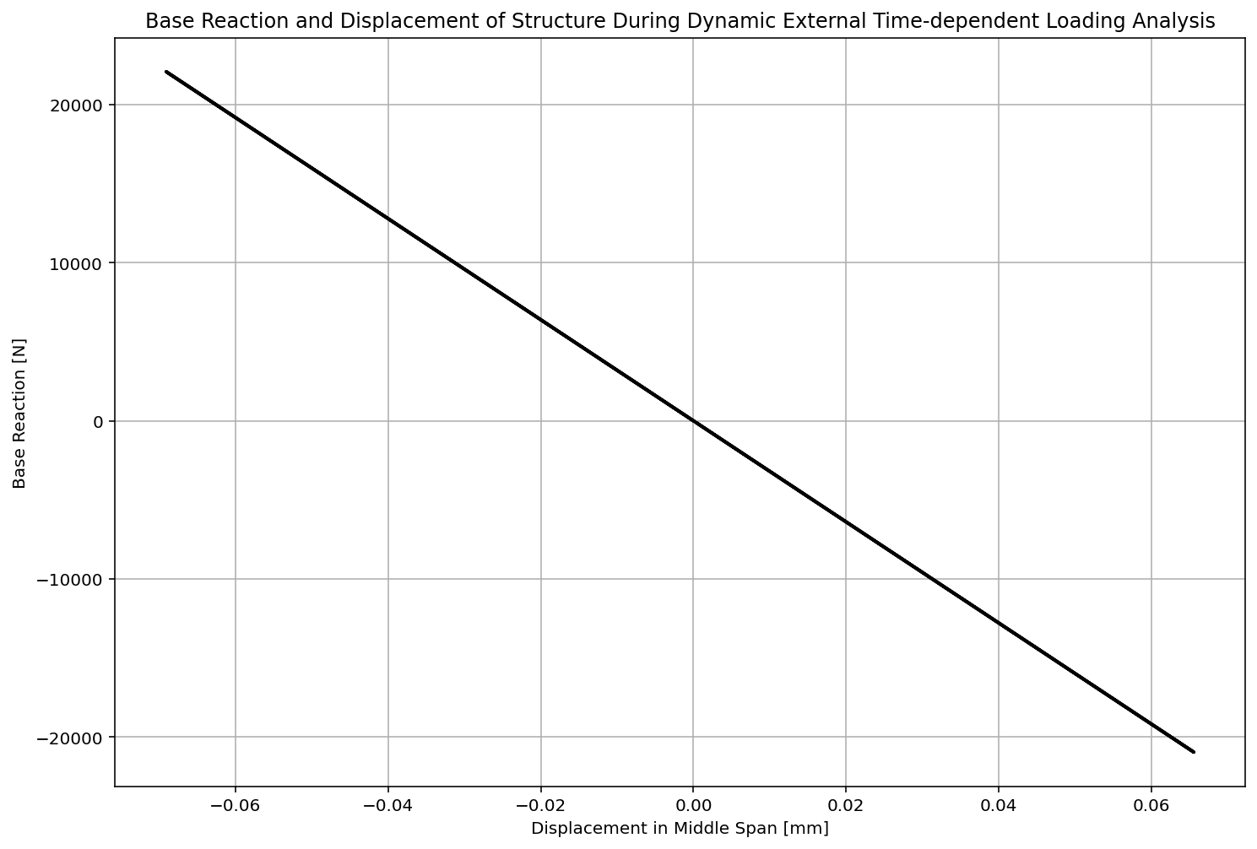

Slide 31
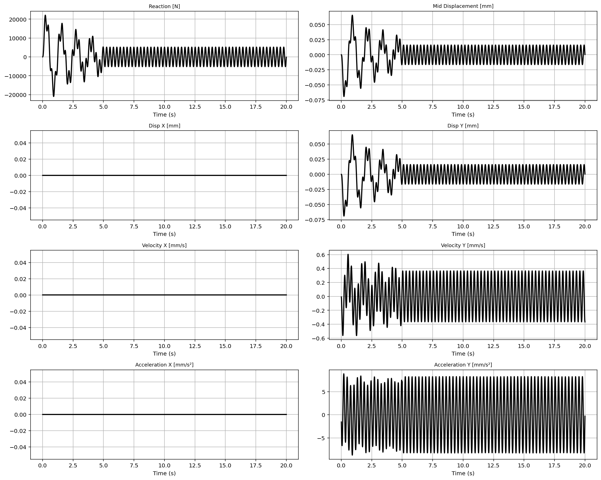

Slide 32
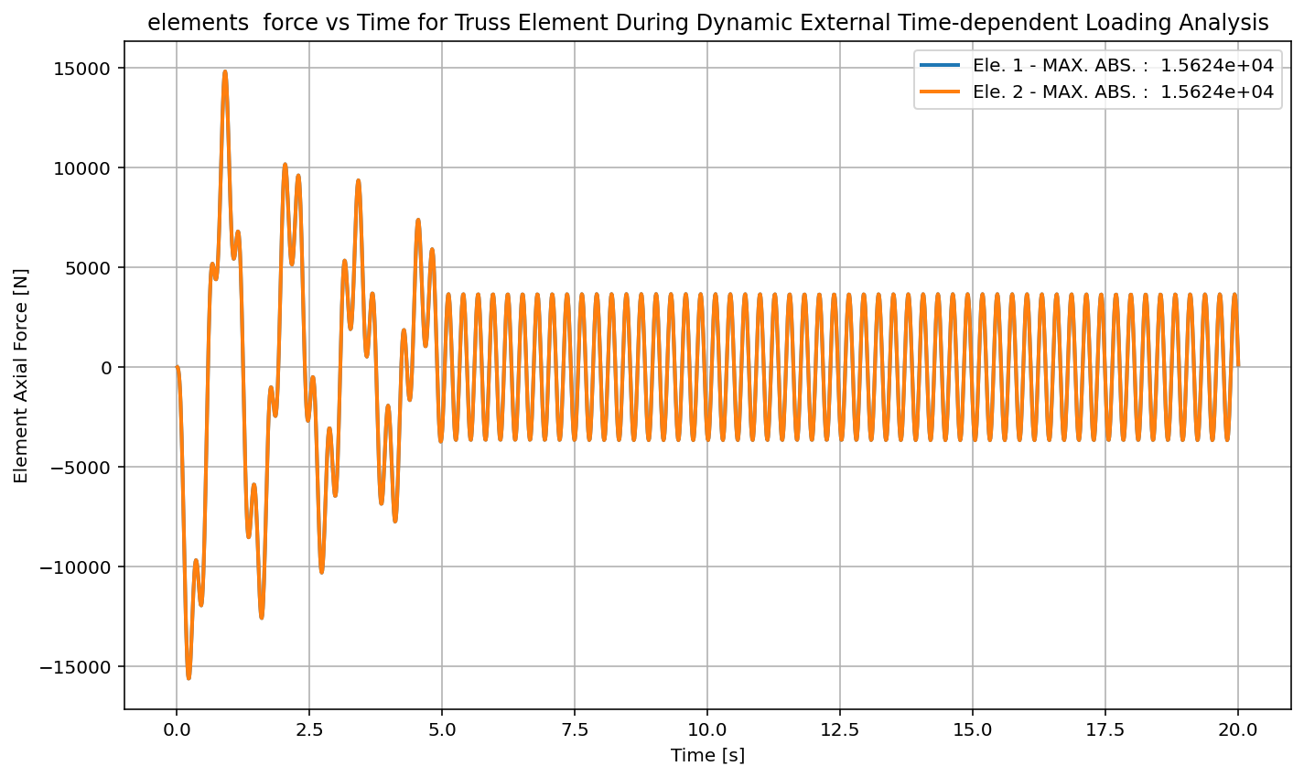

Slide 33
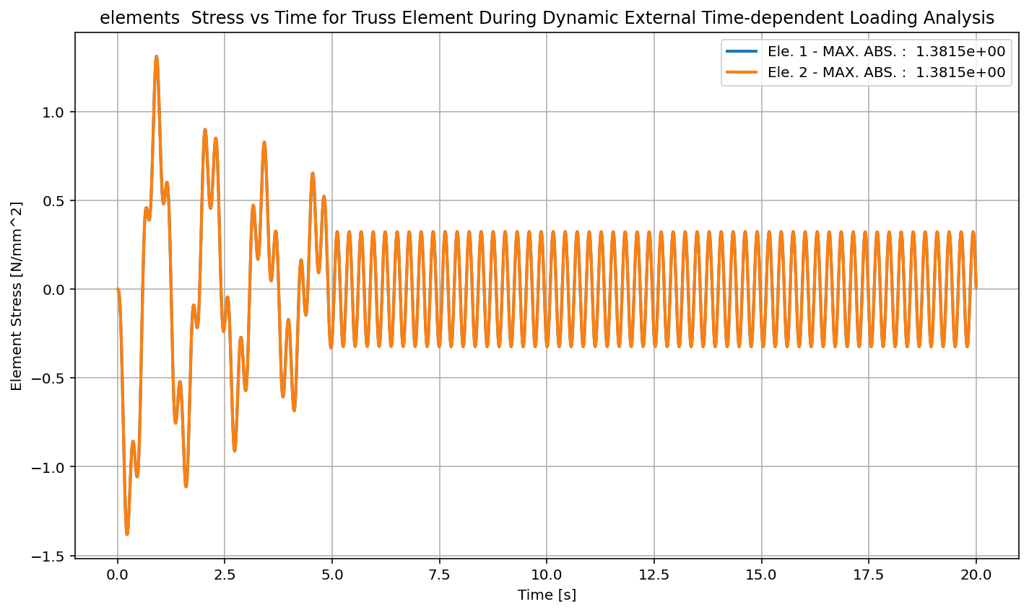

Slide 34
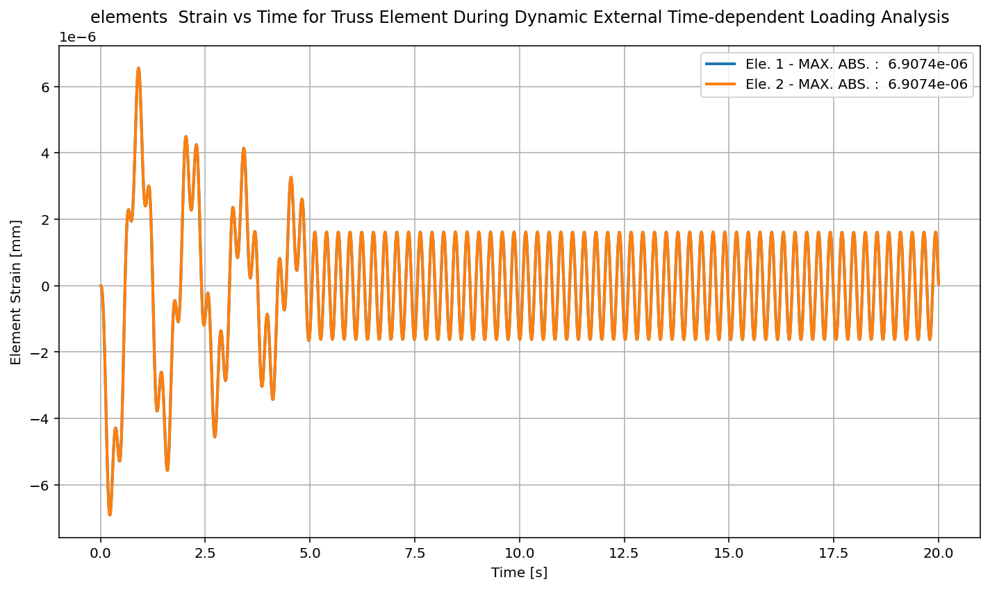

Slide 35
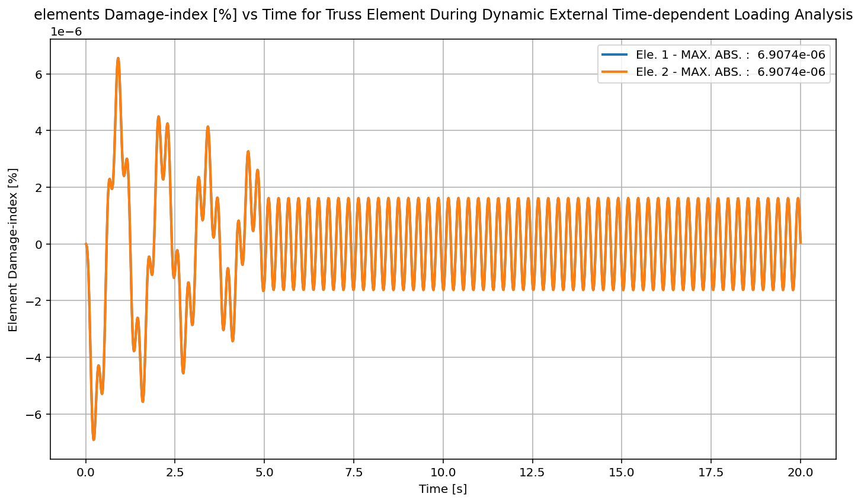

Slide 36
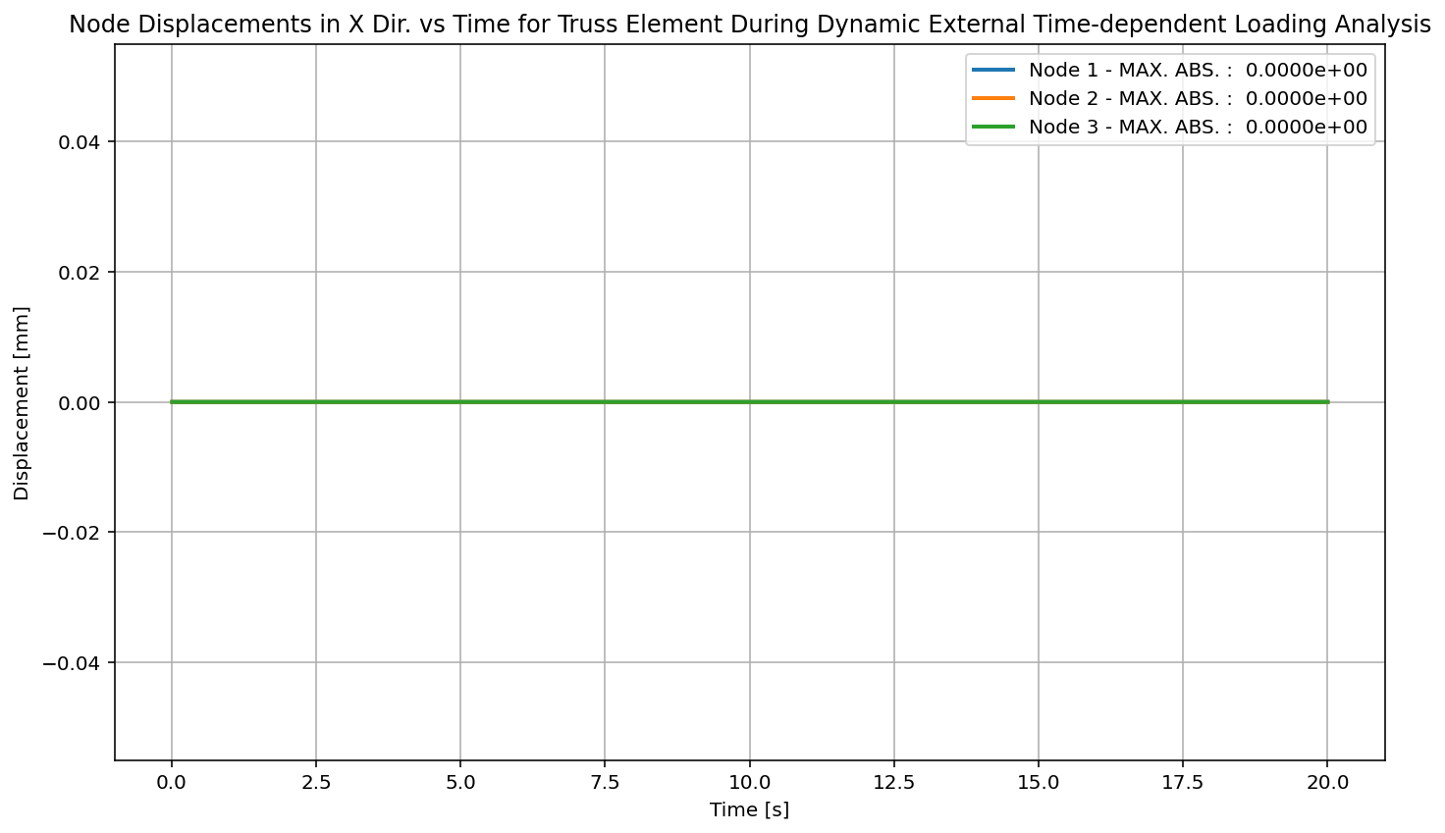

Slide 37
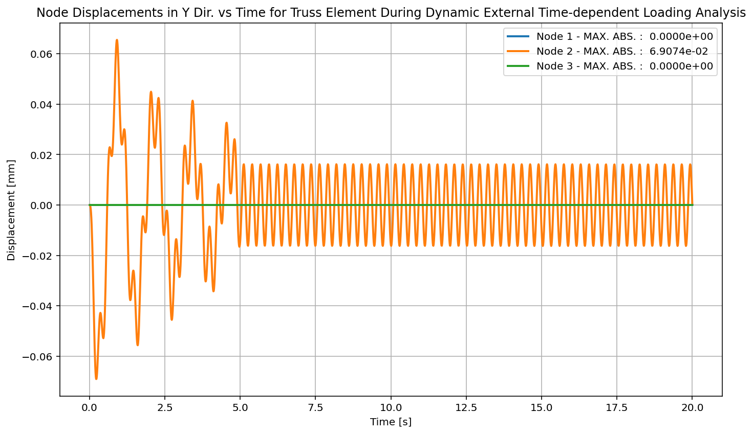

Slide 38
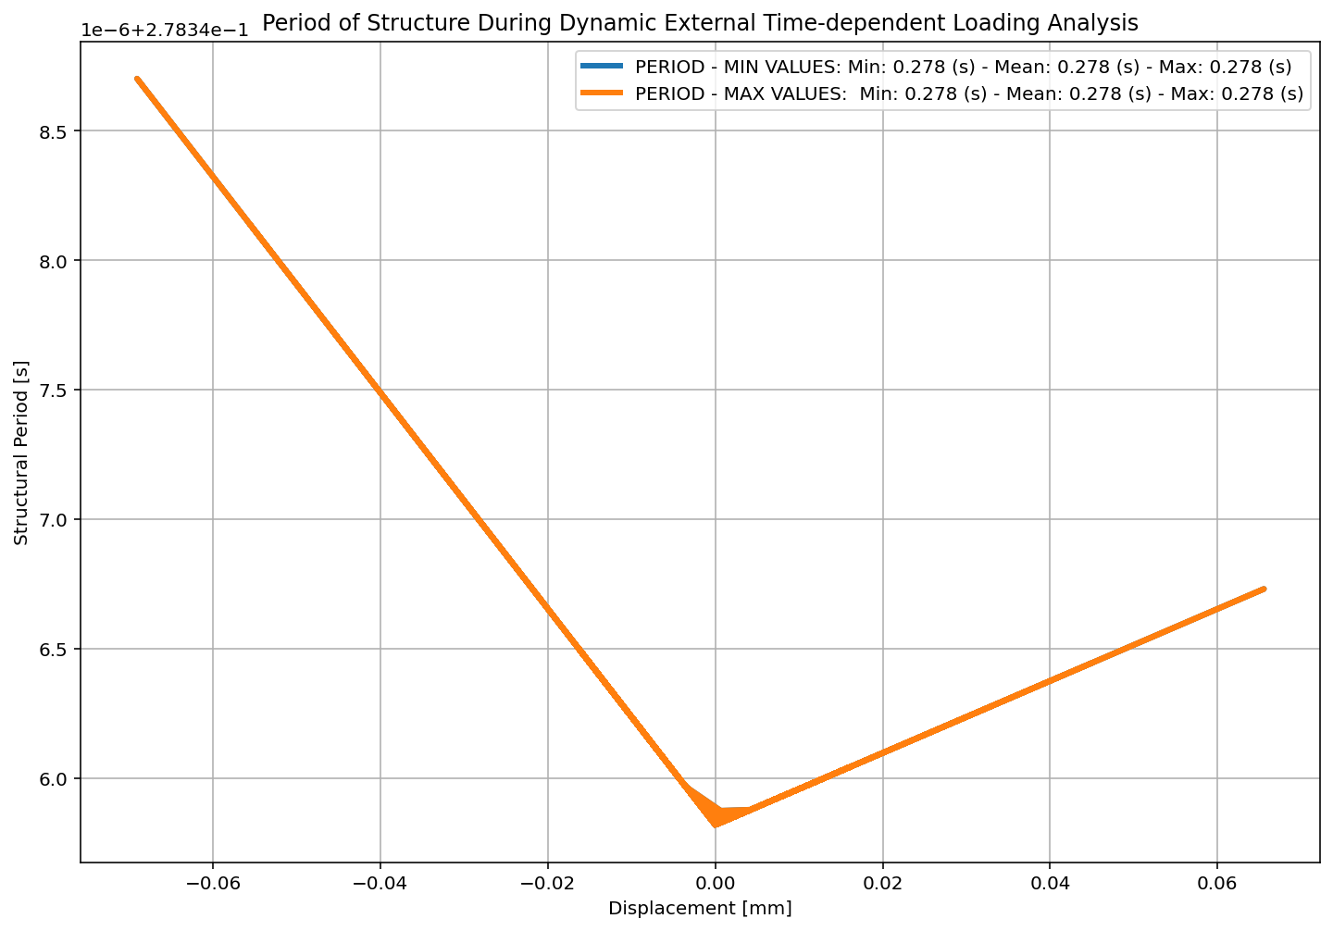

Slide 40
FREE-VIBRATION ANALYSIS

Slide 41
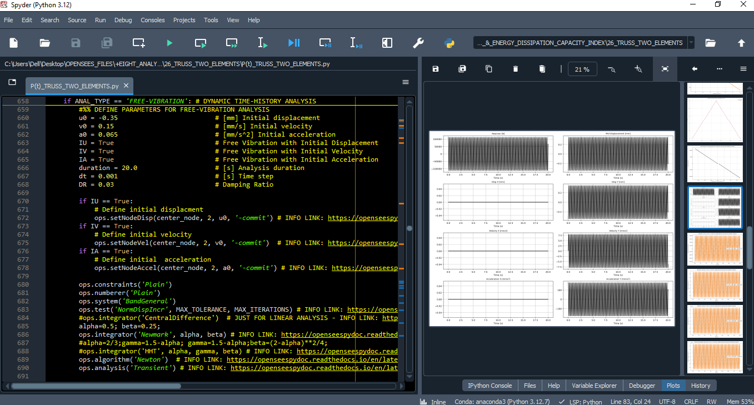

Slide 42
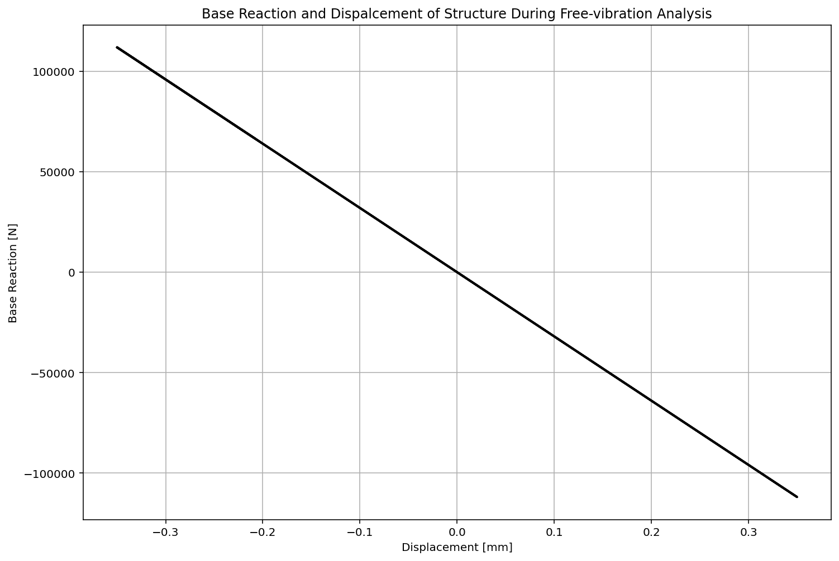

Slide 43
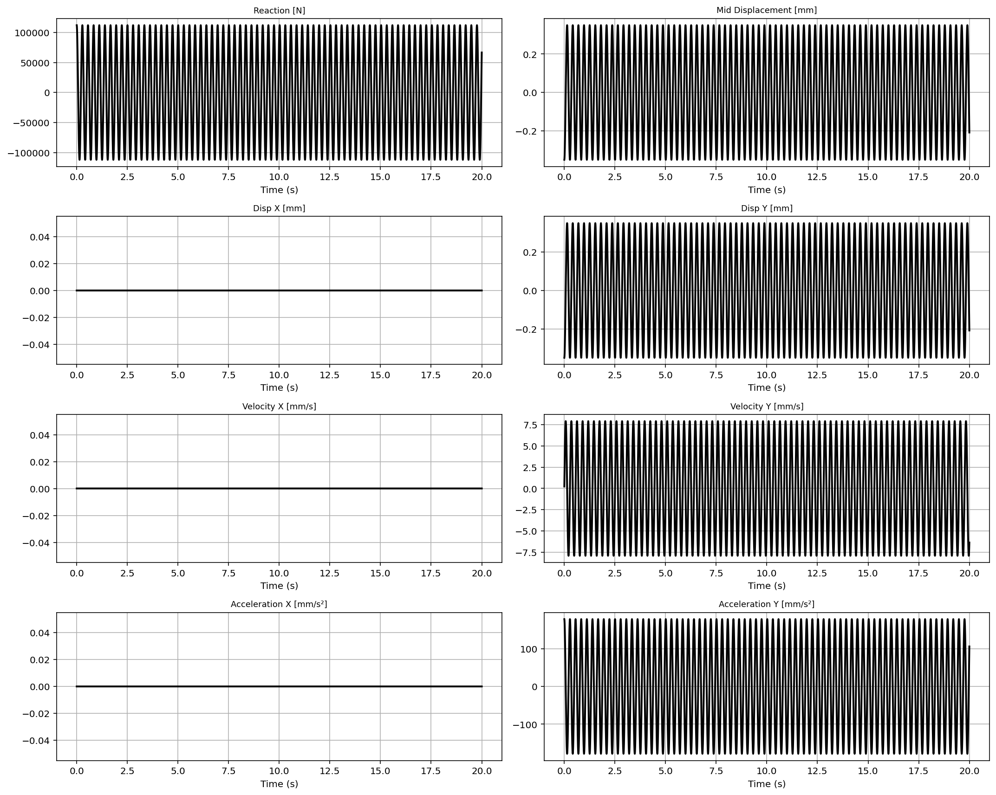

Slide 44
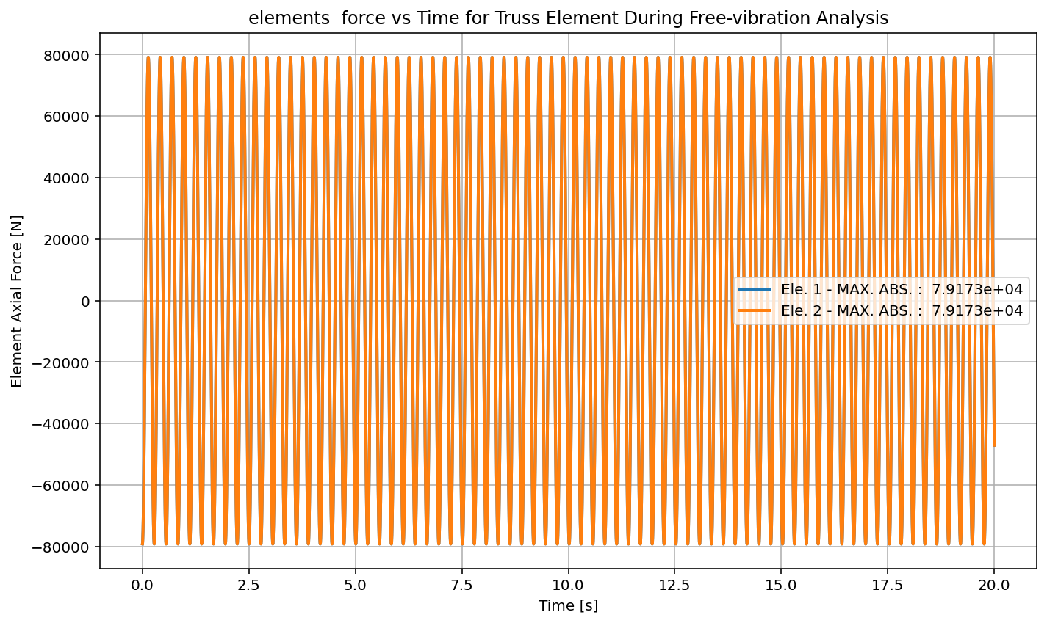

Slide 45
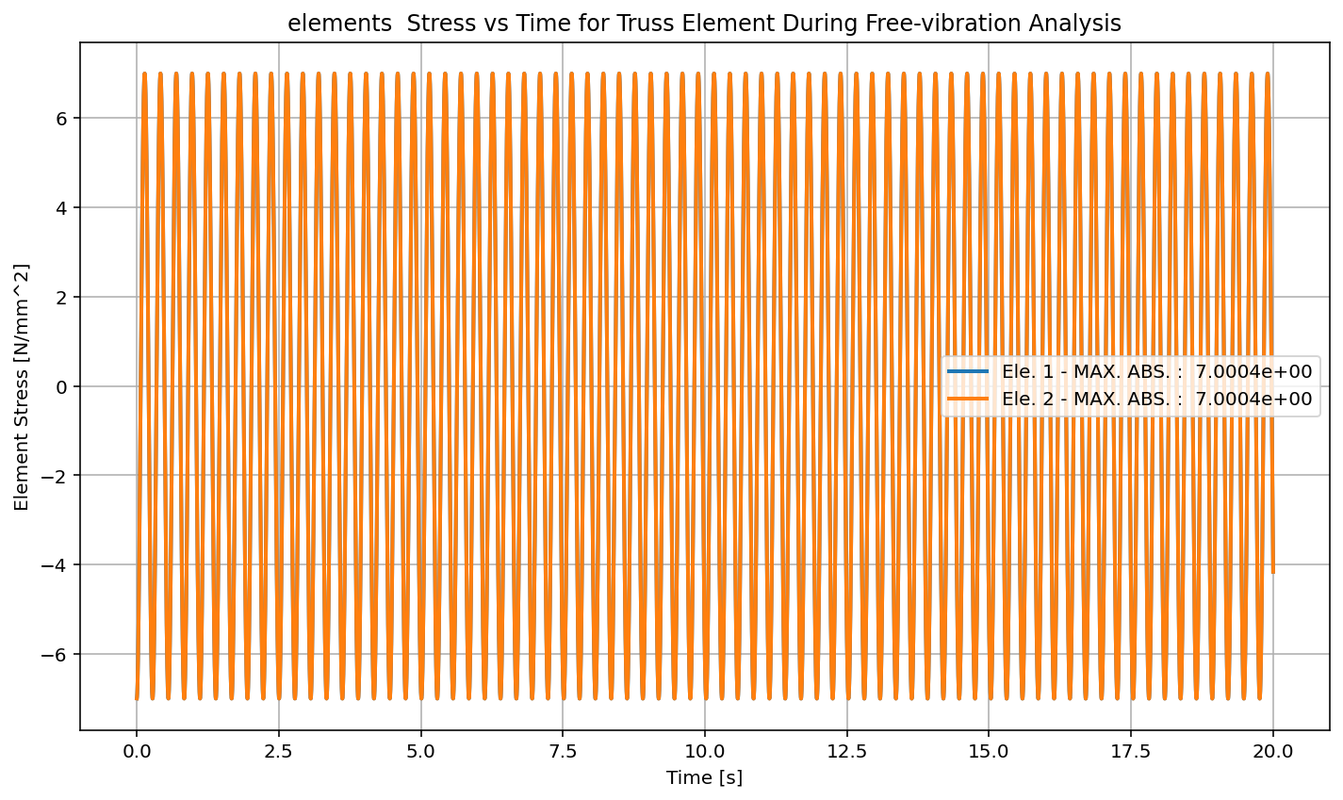

Slide 46
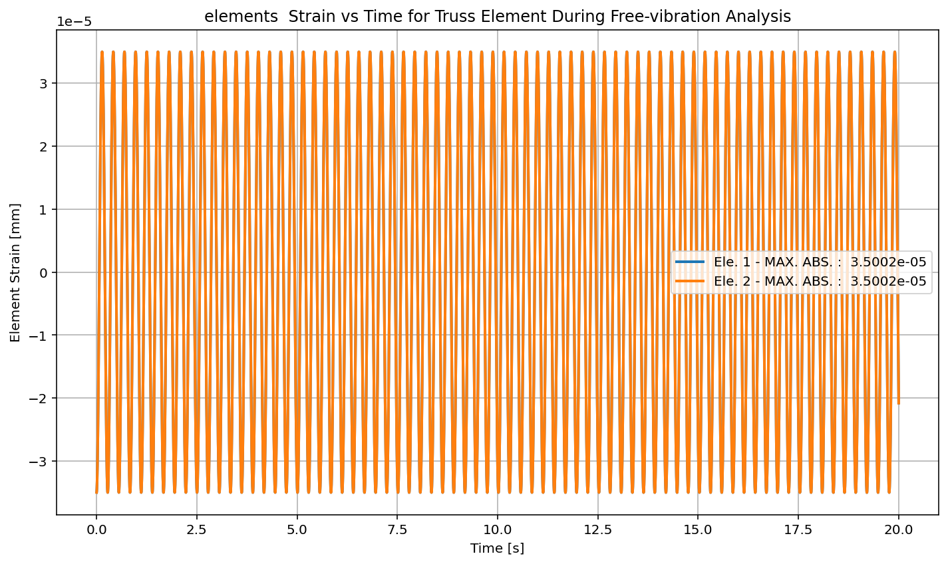

Slide 47
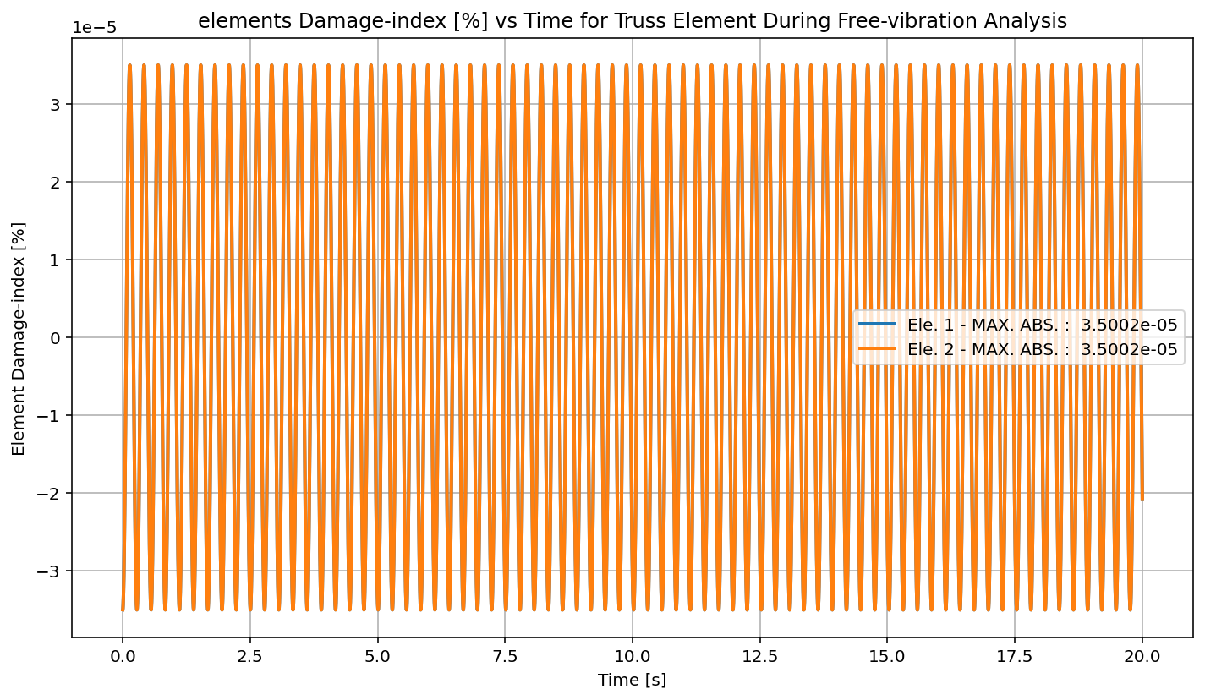

Slide 48
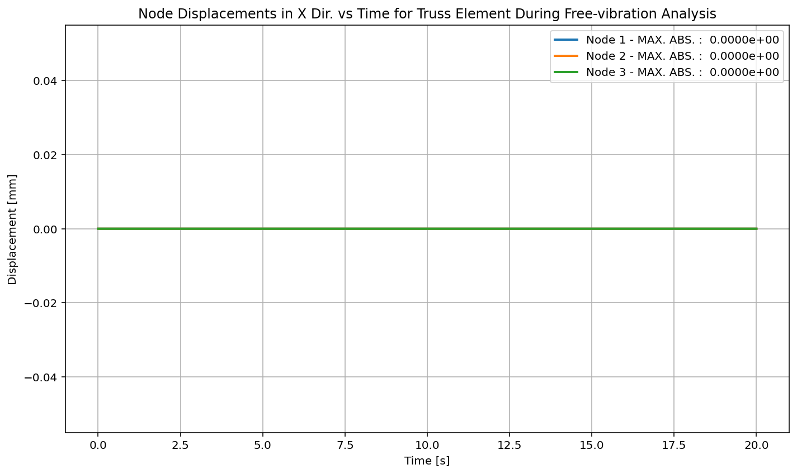

Slide 49
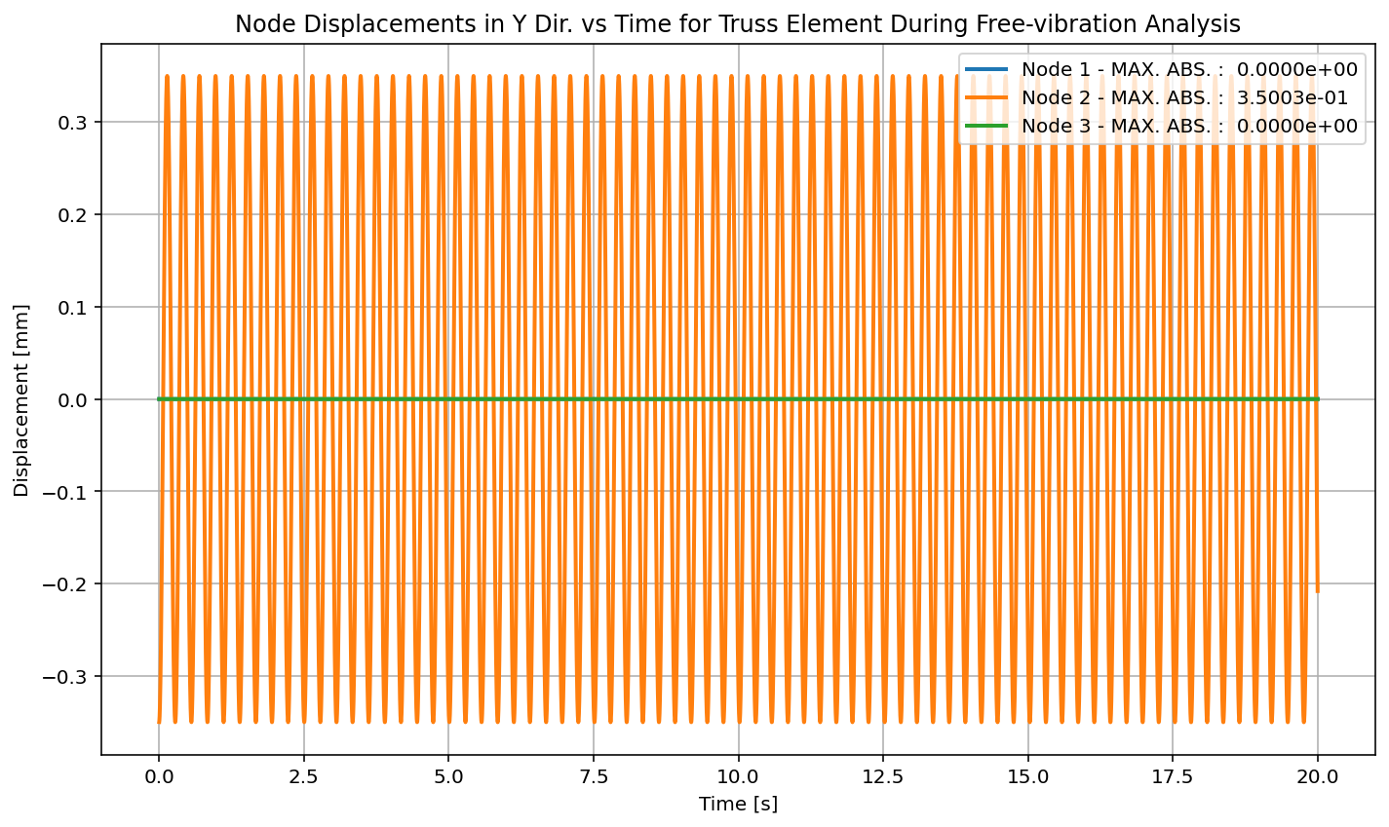

Slide 50
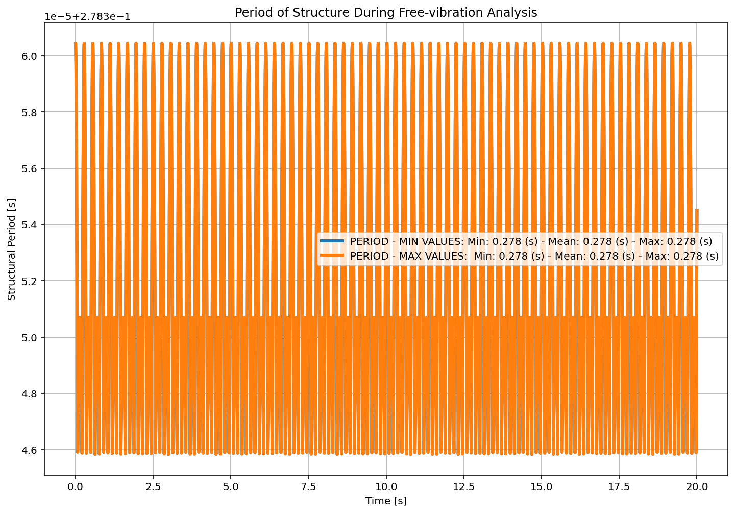

Slide 51
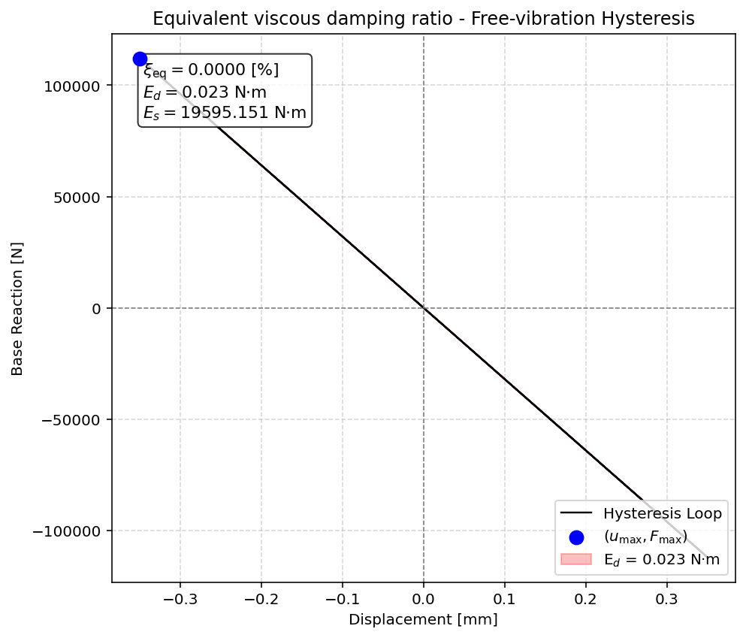

Slide 52


Slide 53
SEISMIC ANALYSIS

Slide 54
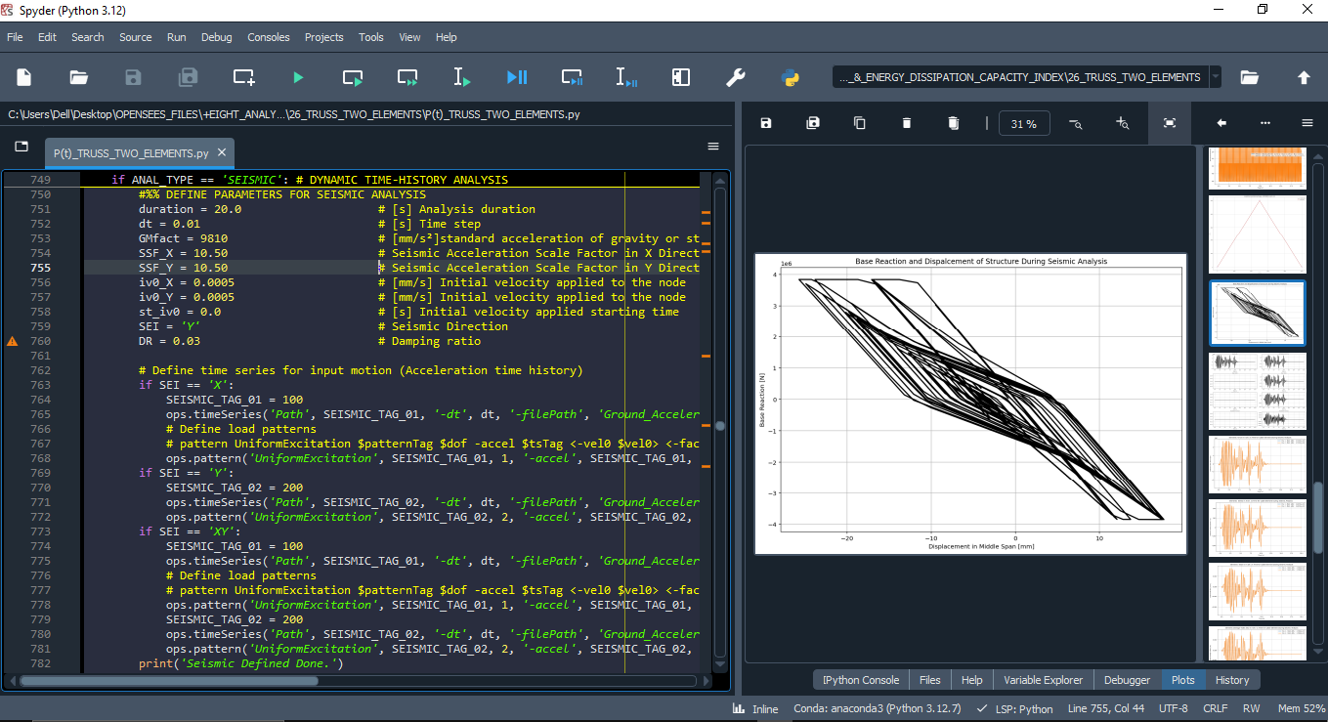

Slide 55
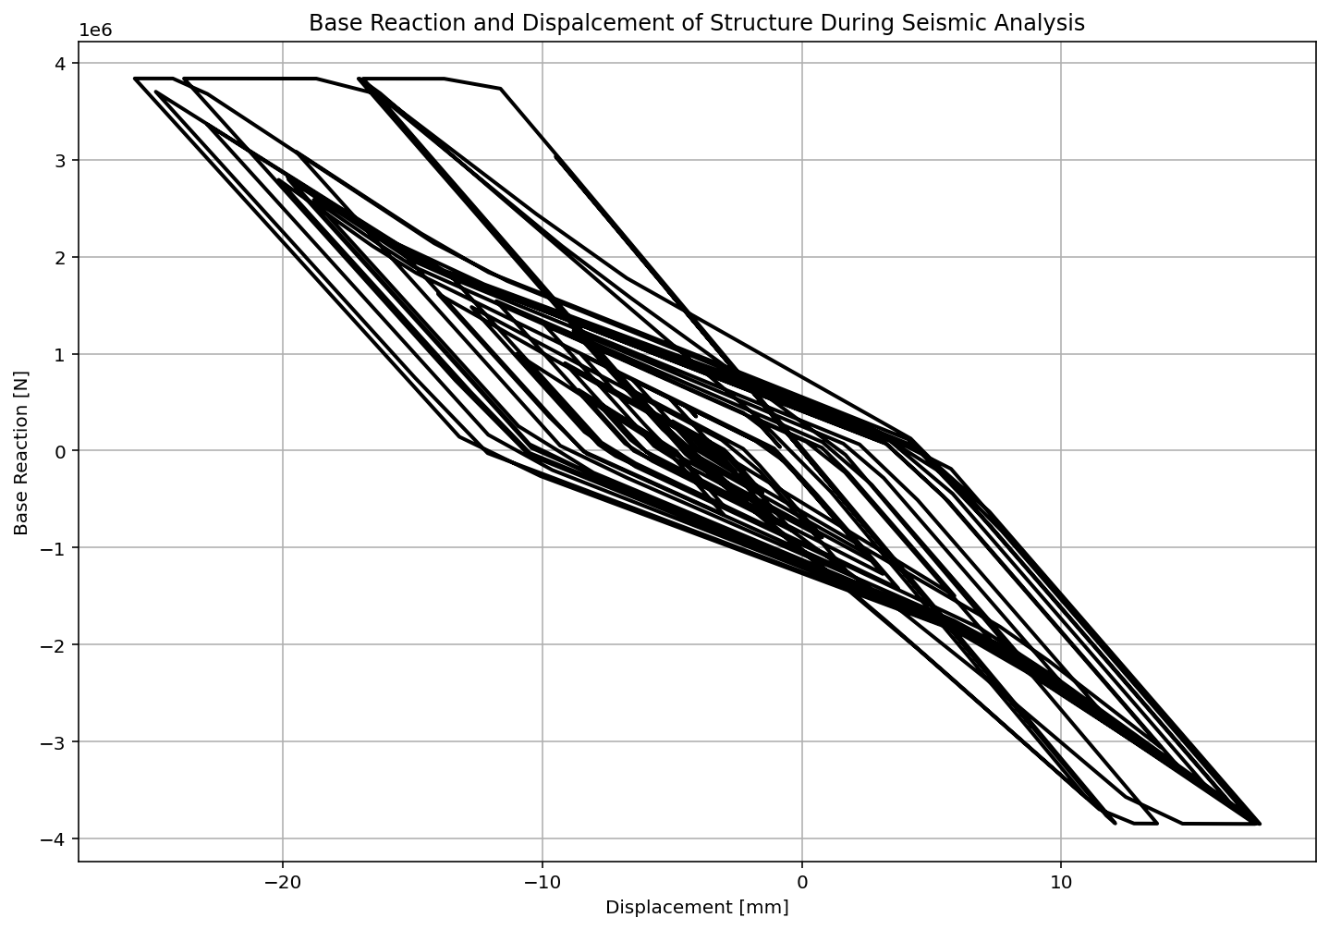

Slide 56
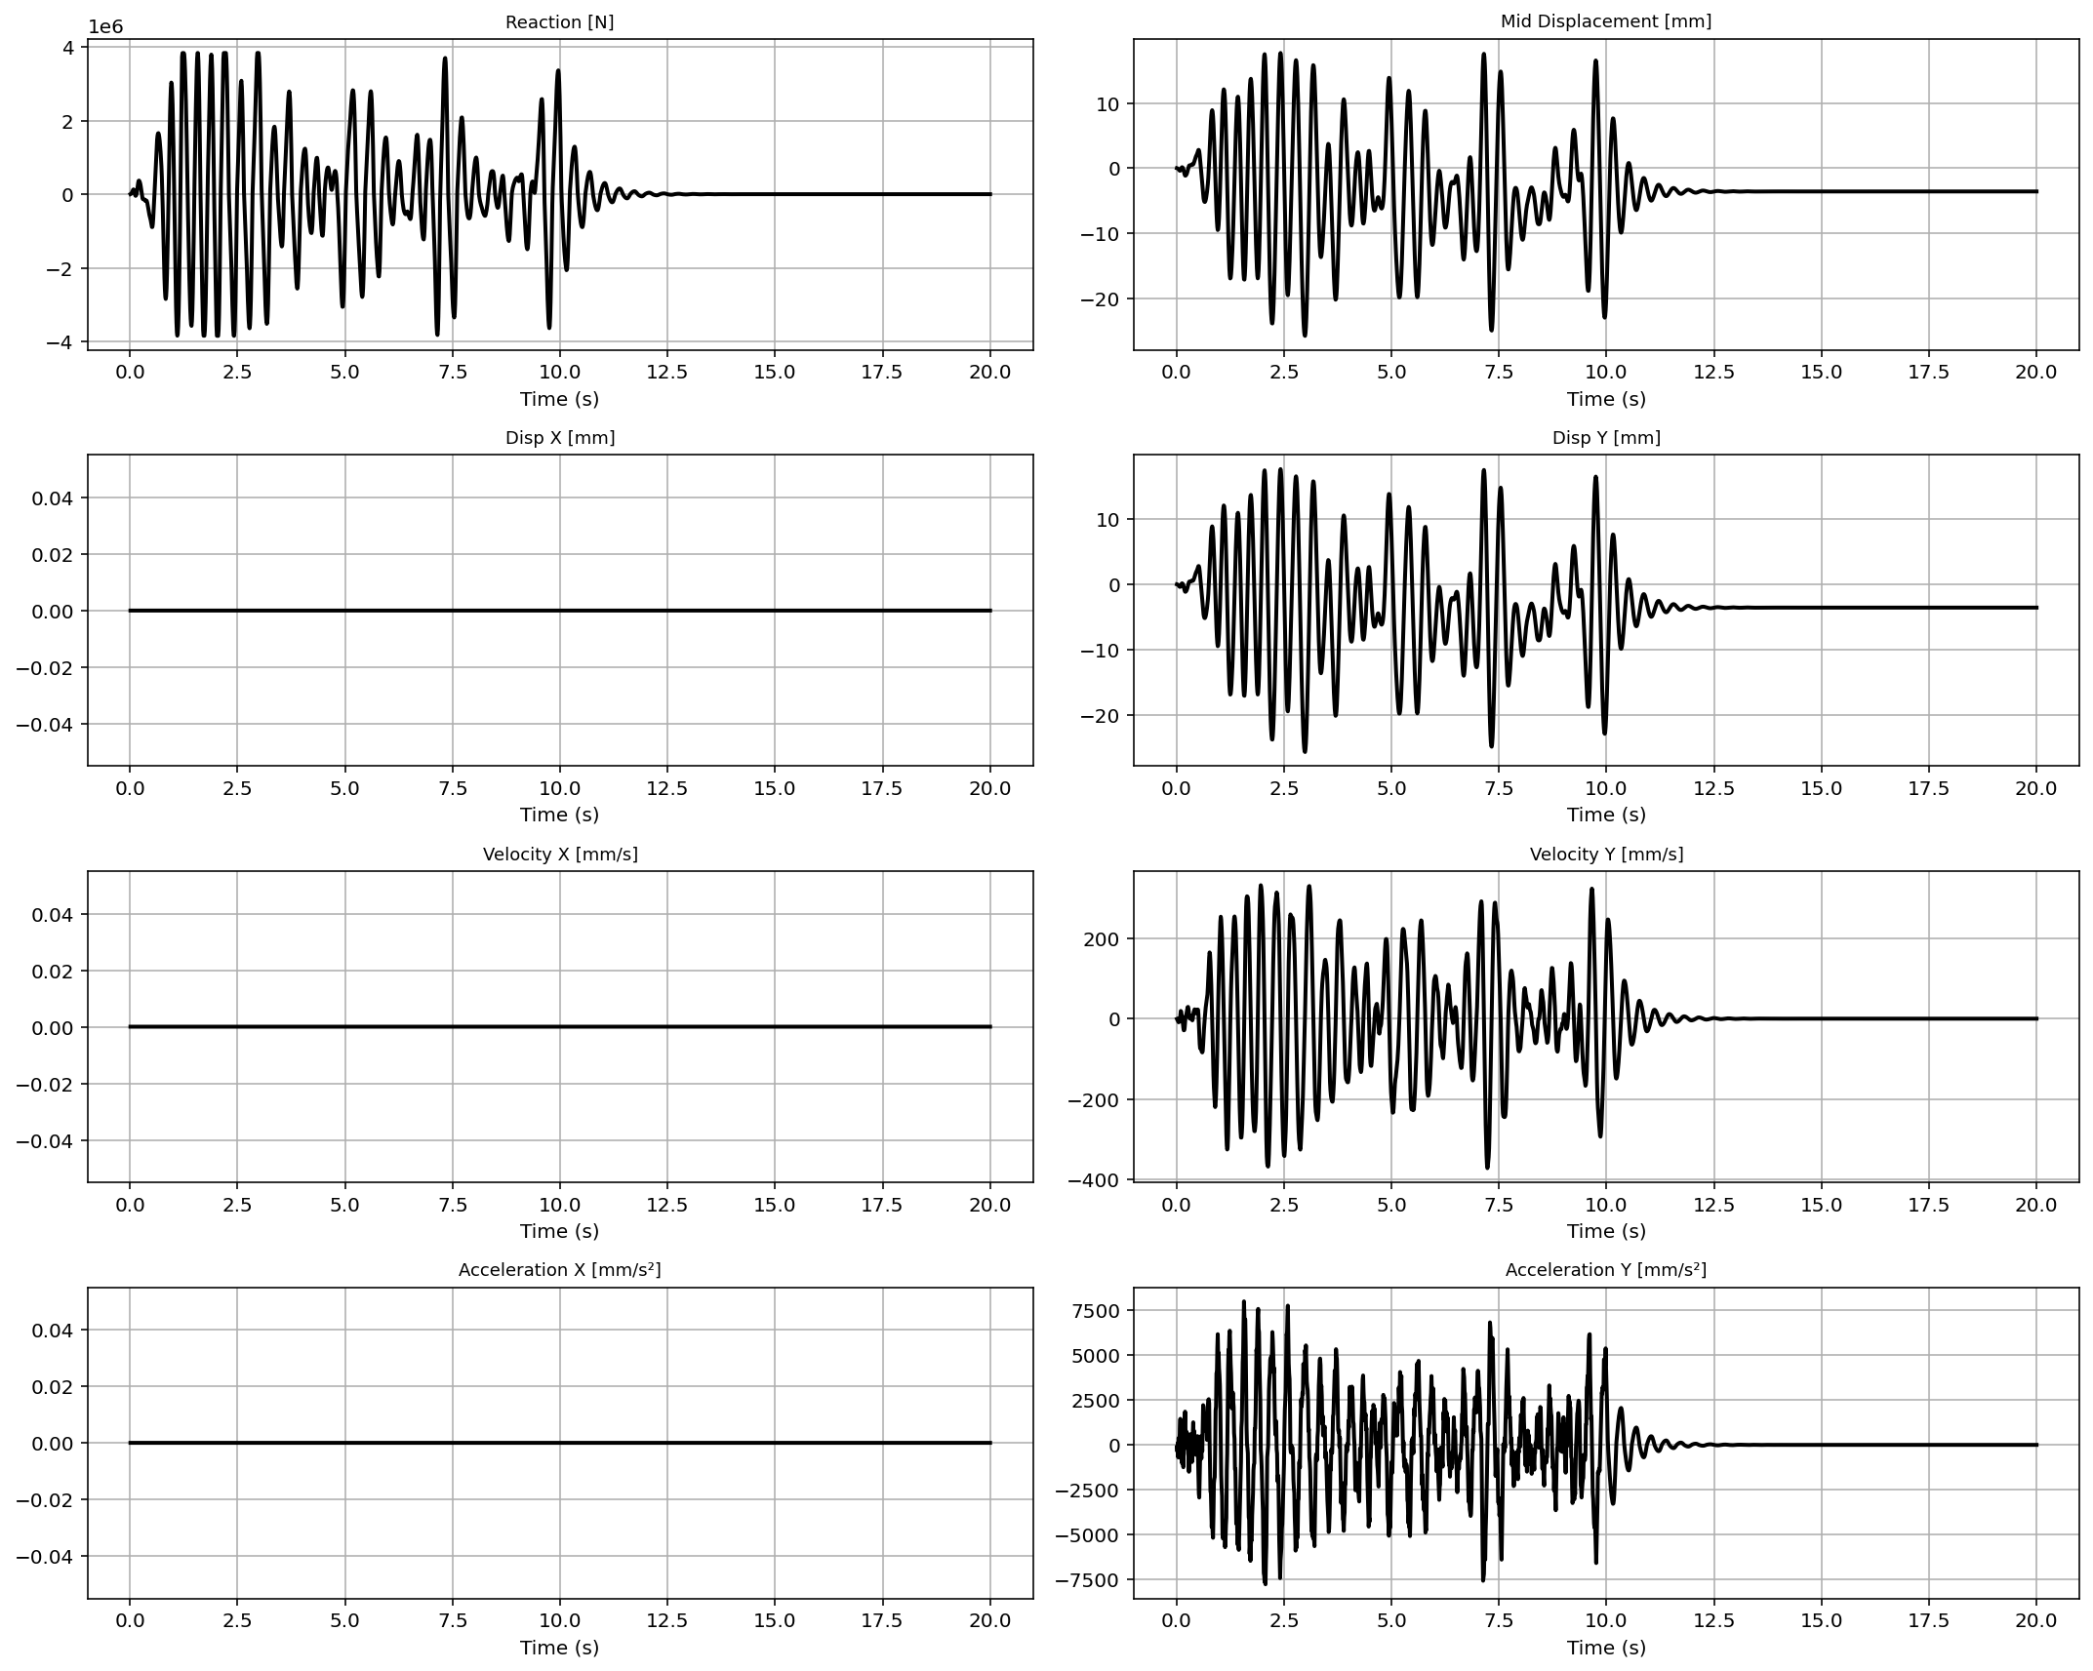

Slide 57
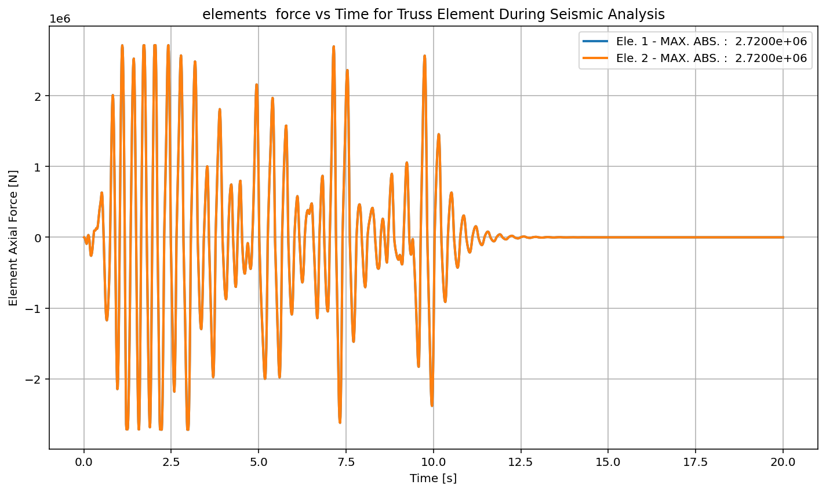

Slide 58
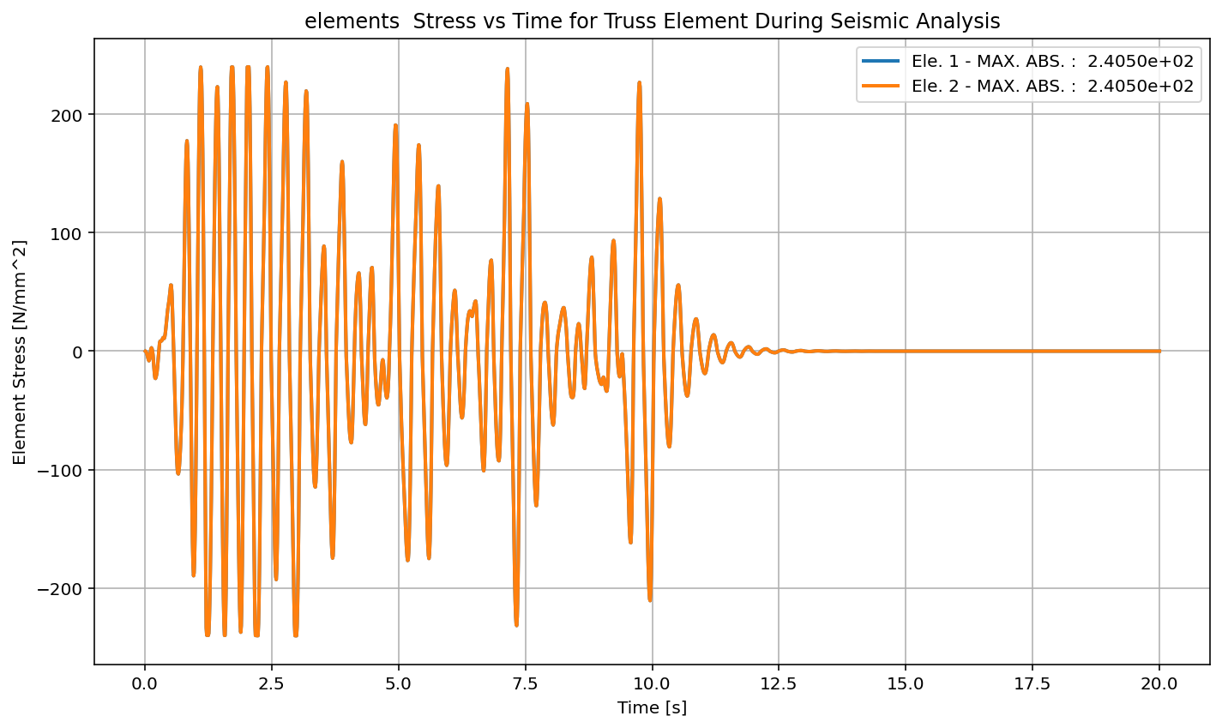

Slide 59
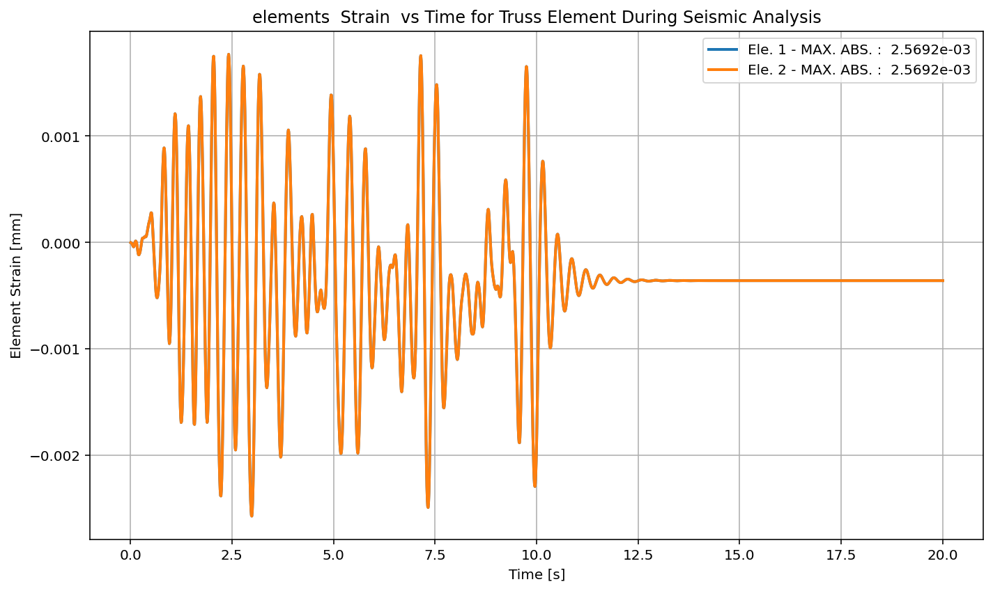

Slide 60
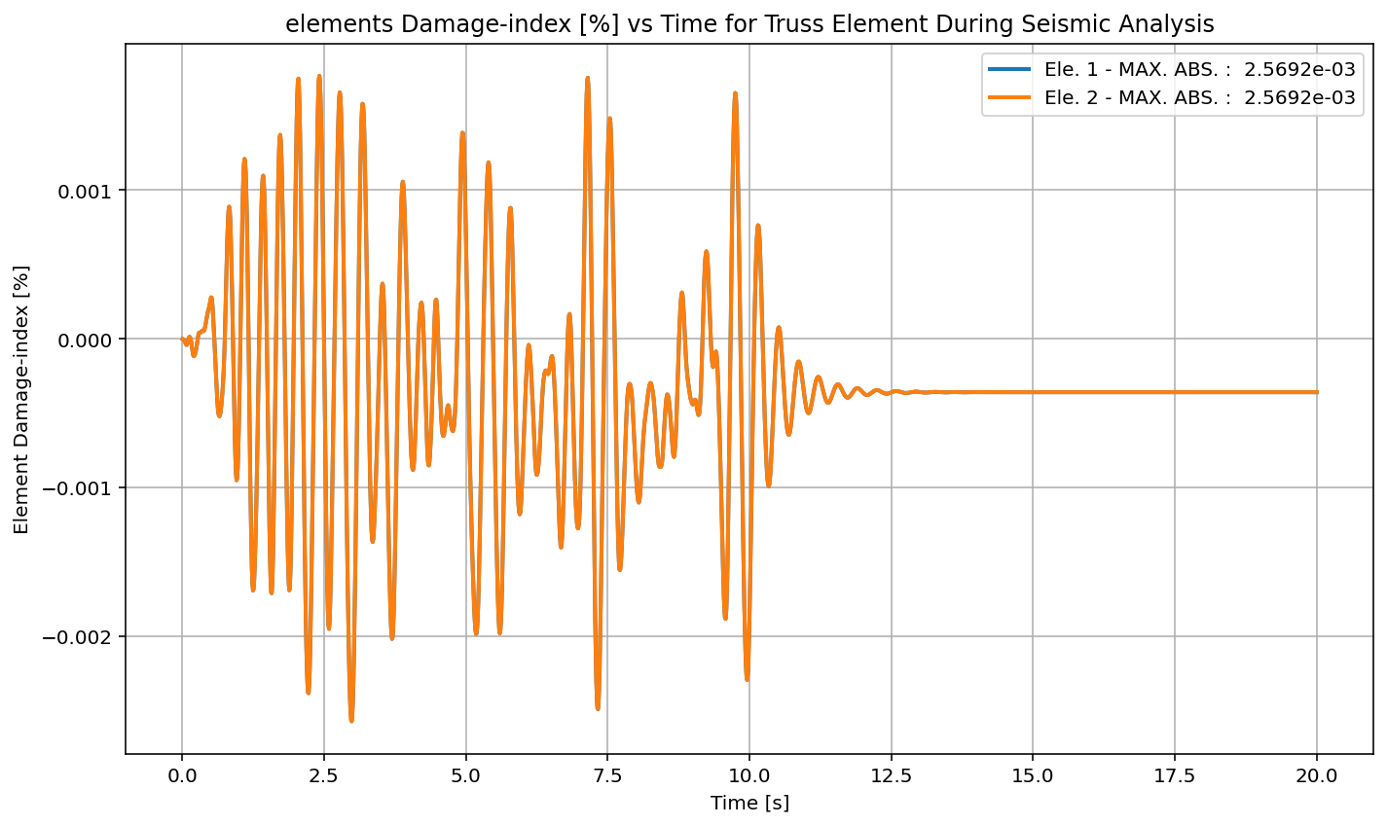

Slide 61
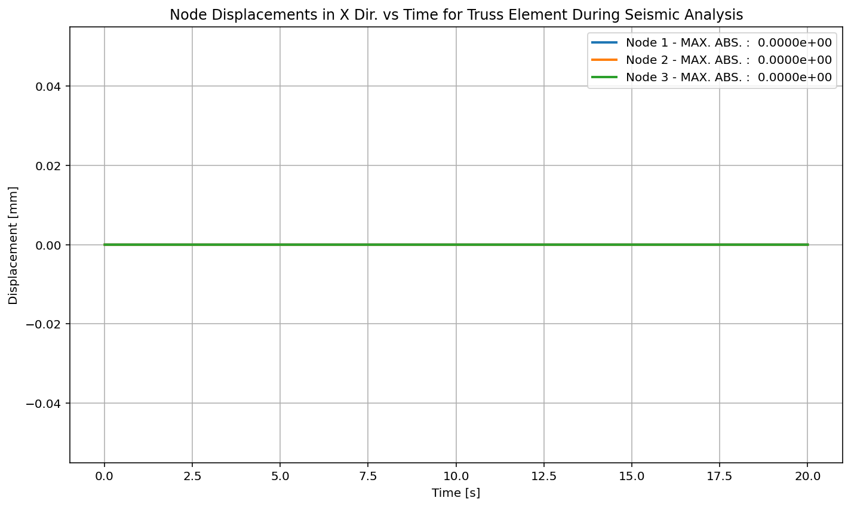

Slide 62
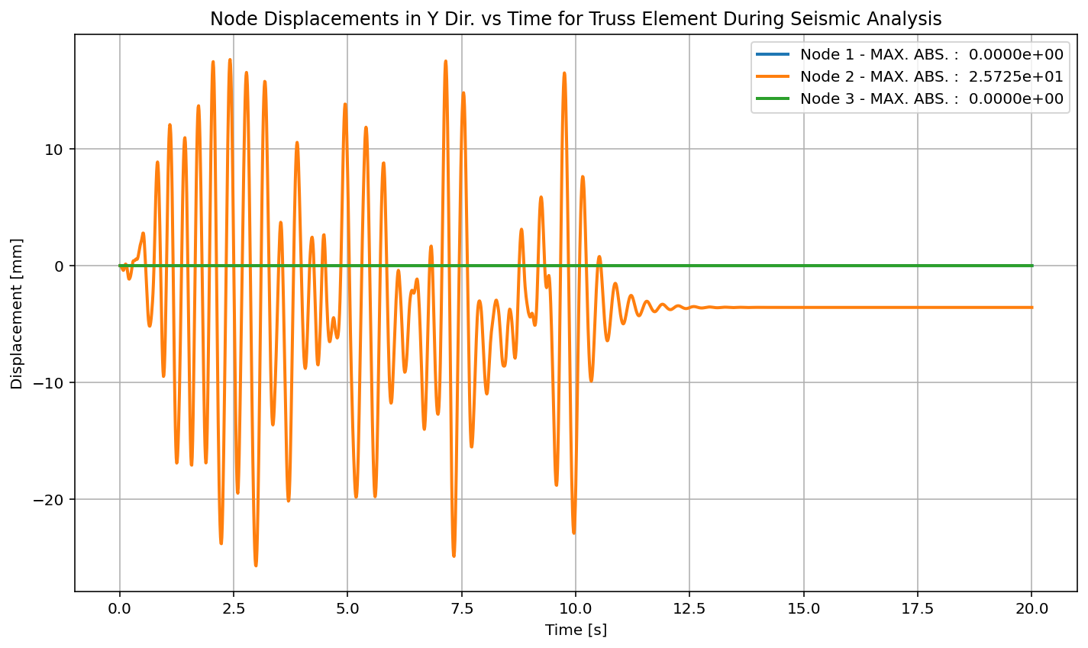

Slide 63
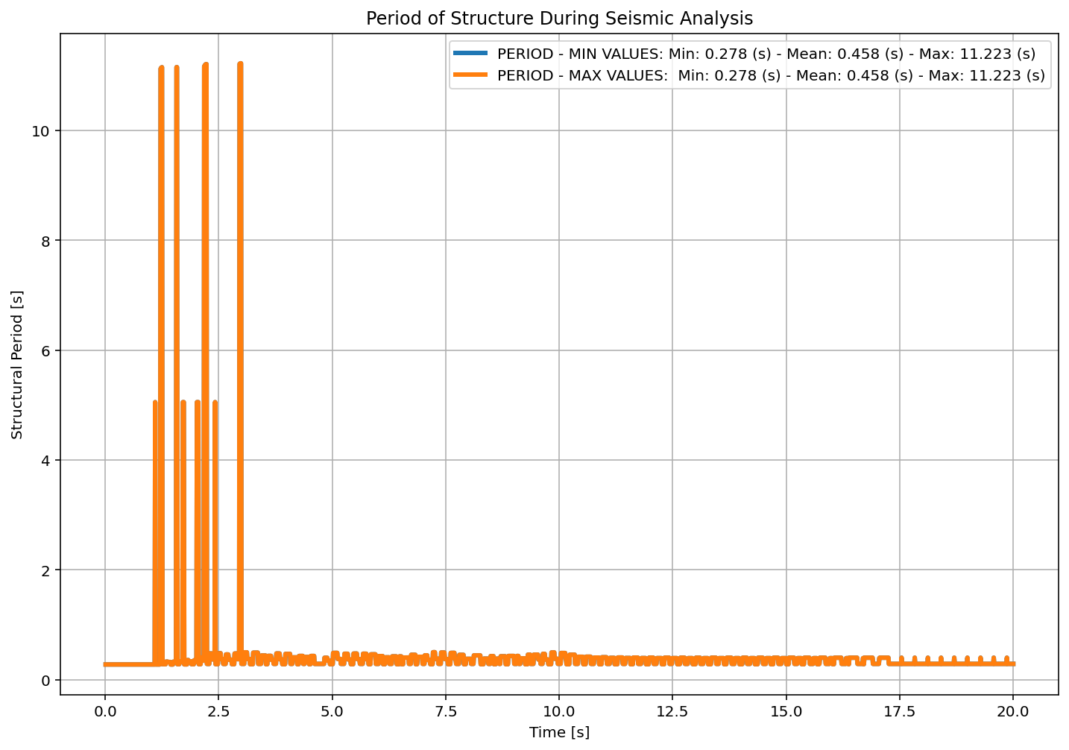

Slide 64
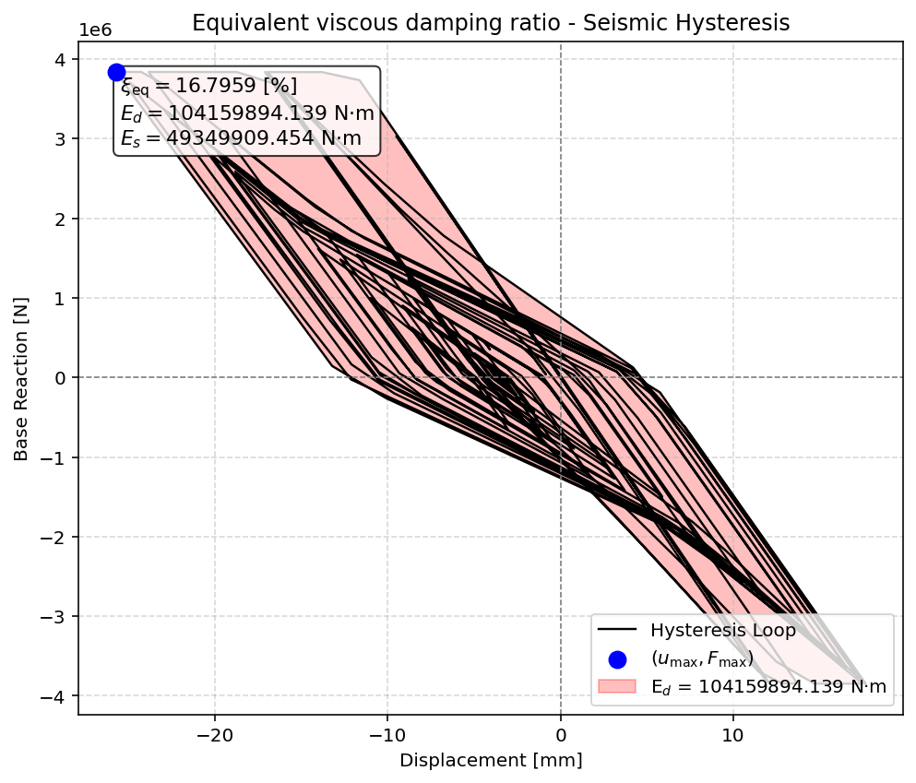

Slide 65


Slide 66


Slide 67
+==========================+
= Analysis curve fitted =
Disp Base Shear
----------------------------
[[0.00000000e+00 0.00000000e+00]
[1.19868464e+01 3.83386222e+06]
[1.00000000e+02 3.85055817e+06]]
+==========================+
+----------------------------------------------------+
Structure Elastic Stiffness : 319839.10
Structure Plastic Stiffness : 38505.58
Structure Tangent Stiffness : 189.70
Structure Ductility Ratio : 8.34
Structure Over Strength Factor: 1.00
+----------------------------------------------------+
Over Strength Coefficient (Ω0): 1.0044
Displacement Ductility Ratio (μ): 8.3425
Ductility Coefficient (Rμ): 8.3425
Structural Behavior Coefficient (R): 8.3788
Structural Ductility Damage Index in Y Direction: 15.6090 (%)

Slide 68


Slide 69


Slide 70
Dissipated Energy from Earthquake= 549146887.75 N·mm
Dissipated Energy from Cyclic Displacement= 2294934998.41 N·mm
DISSIPATED ENERGY CAPACITY INDEX: 23.929 [%]
ZONE 3: MODERATE–LOW DAMAGE

Slide 71


