Slide 1
>> IN THE NAME OF ALLAH, THE MOST GRACIOUS, THE MOST MERCIFUL <<
DETERMINATION OF OPTIMUM STRUCTURAL INITIAL ELASTIC STIFFNESS FROM STRUCTURAL PERIOD USING FINITE‑DIFFERENCE NEWTON ITERATION AND OPENSEES WITH AND WITHOUT PARALLEL COMPUTING
THIS PYTHON SCRIPT IS WRITTEN BY SALAR DELAVAR GHASHGHAEI (QASHQAI)

Slide 2
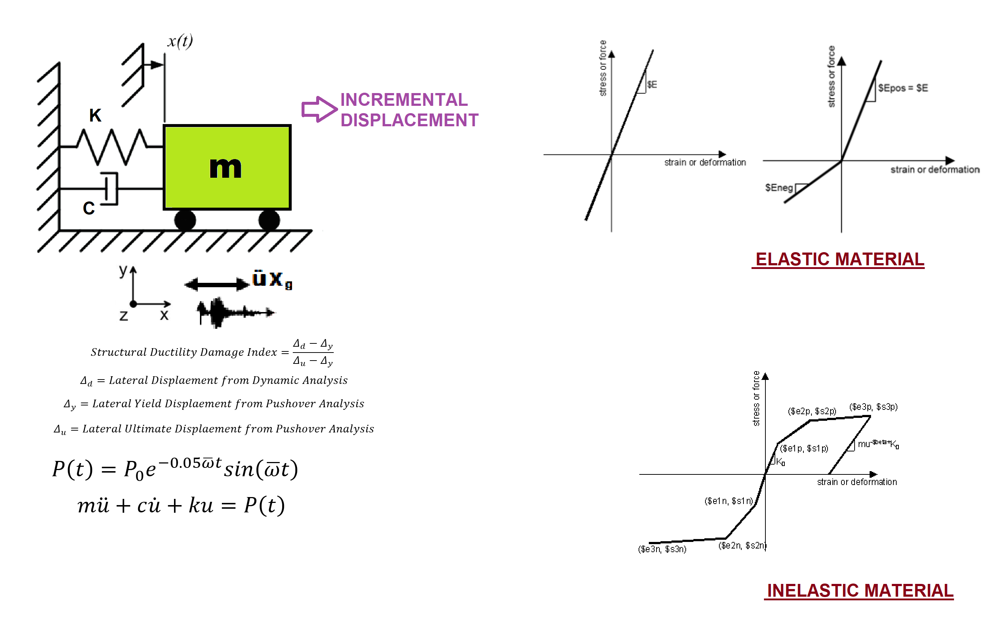

Slide 3
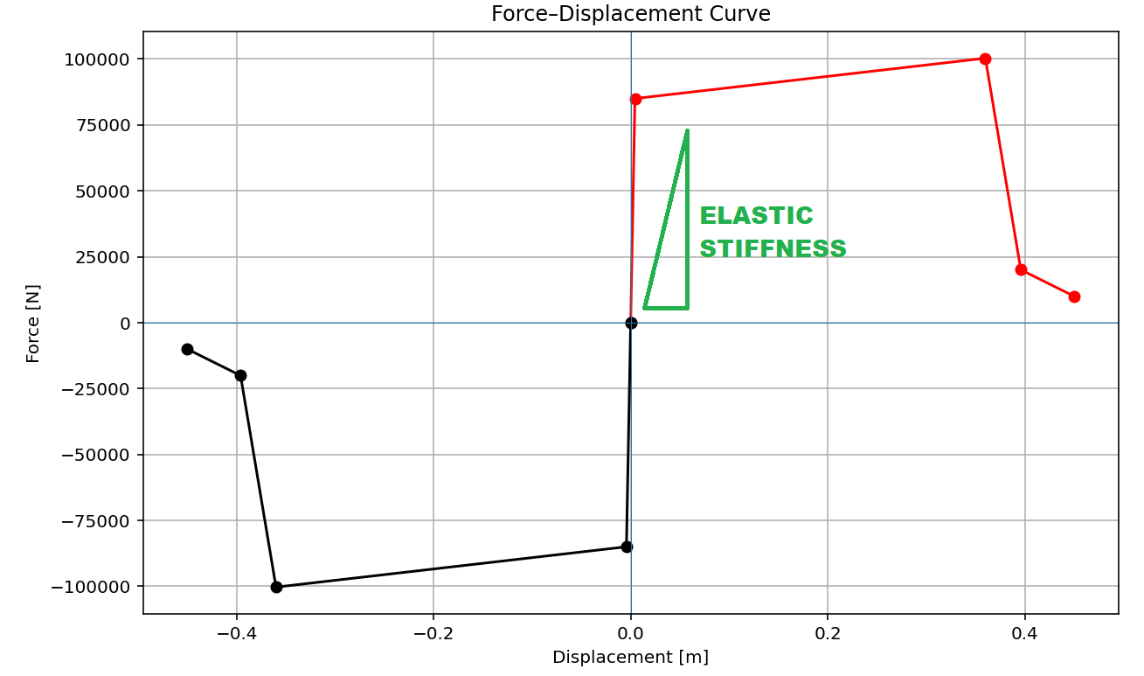

Slide 4
OPTIMIZATION PROBLEM FOR STRUCTURAL PERIOD BY CHANGING INTIAL ELASTIC STIFFNESS

Slide 5
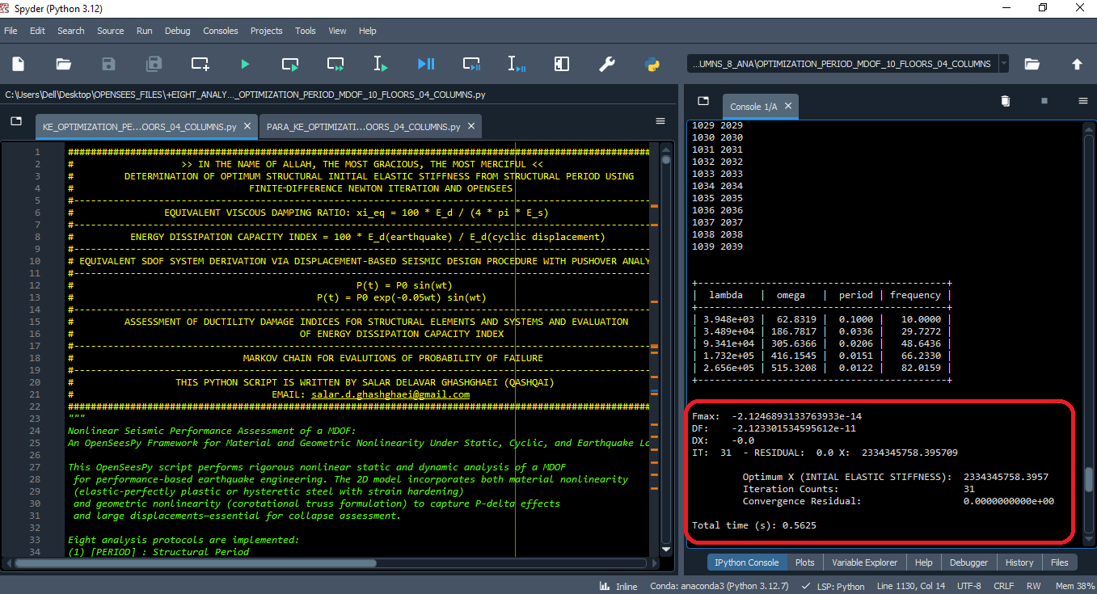

Slide 6
Fmax: -2.1246893133763933e-14
DF: -2.123301534595612e-11
DX: -0.0
IT: 31 - RESIDUAL: 0.0 X: 2334345758.395709
Optimum X (INTIAL ELASTIC STIFFNESS): 2334345758.3957
Iteration Counts: 31
Convergence Residual: 0.0000000000e+00
Total time (s): 0.5625

Slide 7
OPTIMIZATION PROBLEM FOR STRUCTURAL PERIOD BY CHANGING INTIAL ELASTIC STIFFNESS
(PARALLELCOMPUTING)

Slide 8
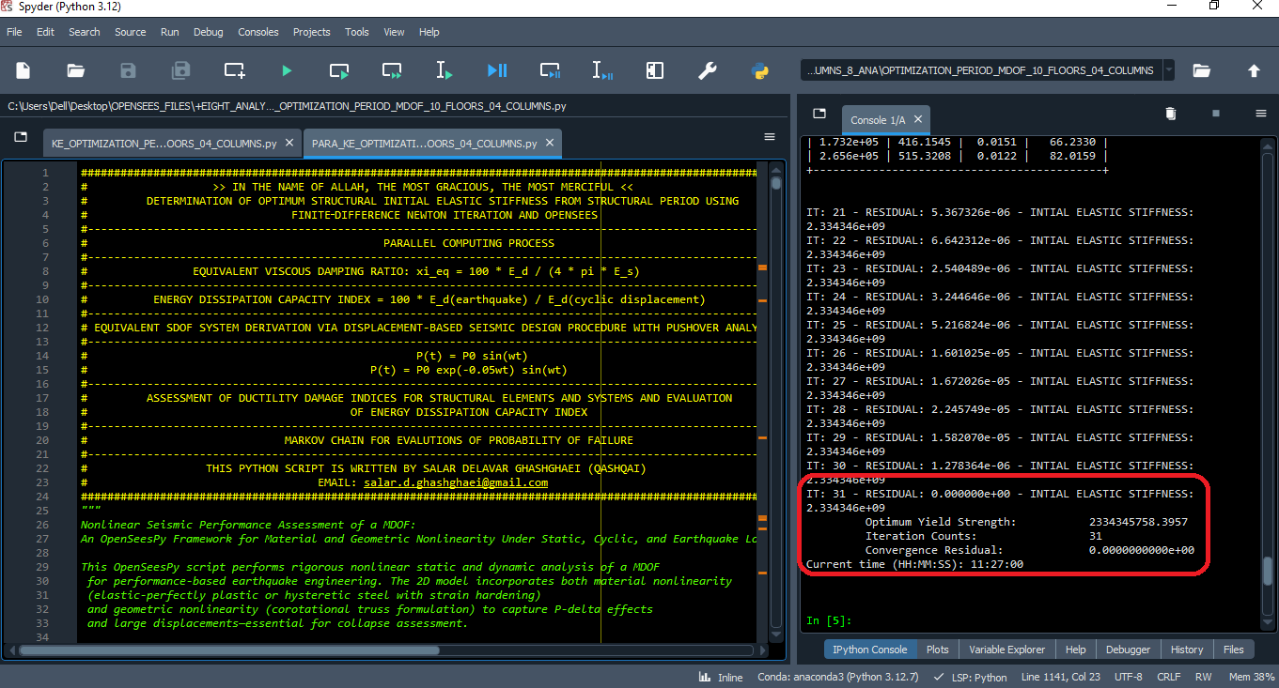

Slide 9
IT: 31 - RESIDUAL: 0.000000e+00 - INTIAL ELASTIC STIFFNESS: 2.334346e+09
Optimum Yield Strength: 2334345758.3957
Iteration Counts: 31
Convergence Residual: 0.0000000000e+00
Current time (HH:MM:SS): 12:03:41

