Slide 1
>> IN THE NAME OF ALLAH, THE MOST GRACIOUS, THE MOST MERCIFUL <<
COMPARATIVE FREE-VIBRATION AND PUSHOVER ANALYSIS OF A MDOF STRUCTURE: ELASTIC VS INELASTIC RESPONSE USING OPENSEES
WRITTEN BY SALAR DELAVAR GHASHGHAEI (QASHQAI)

Slide 2
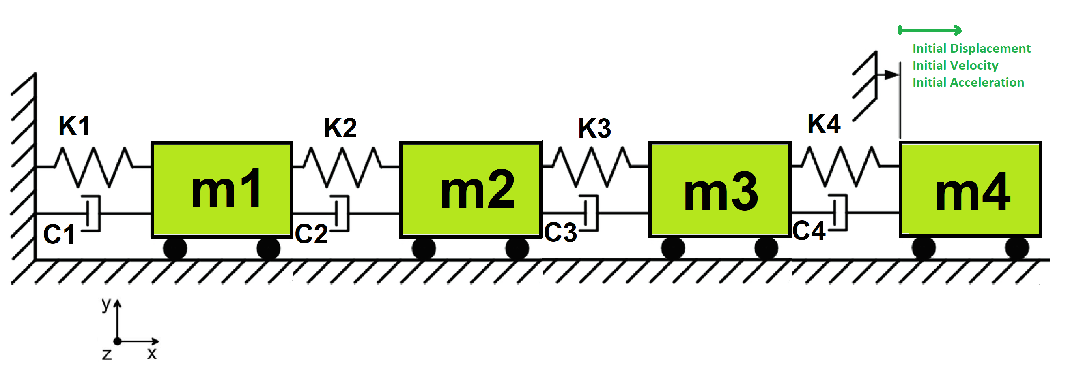

Slide 3
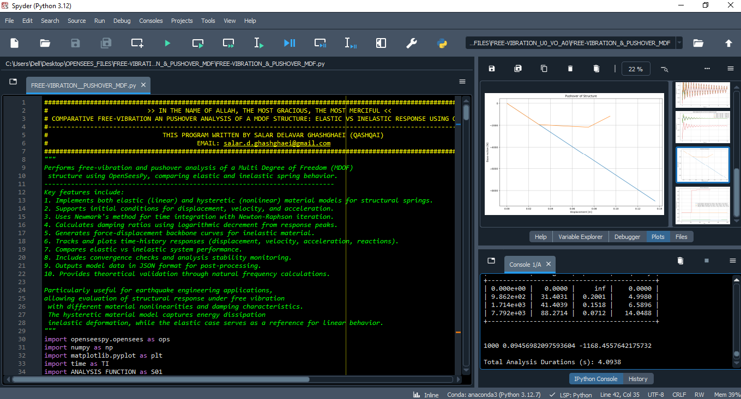

Slide 4
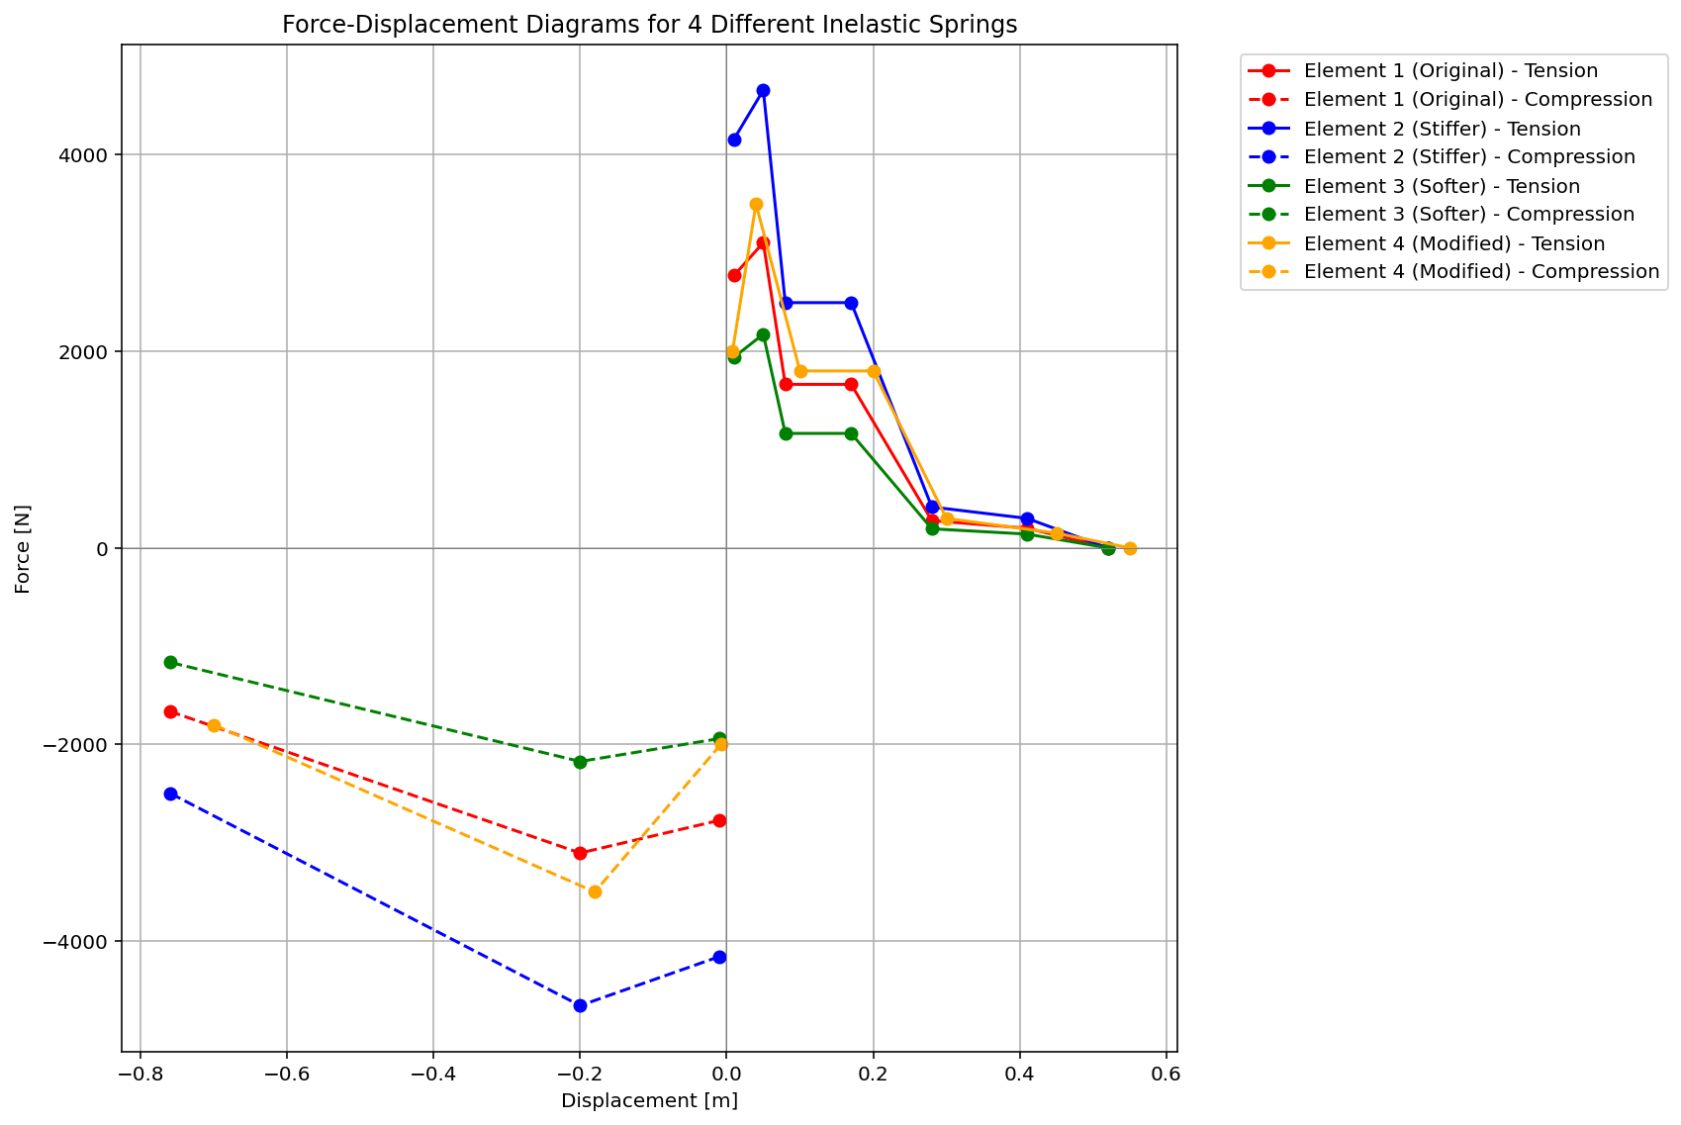

Slide 5
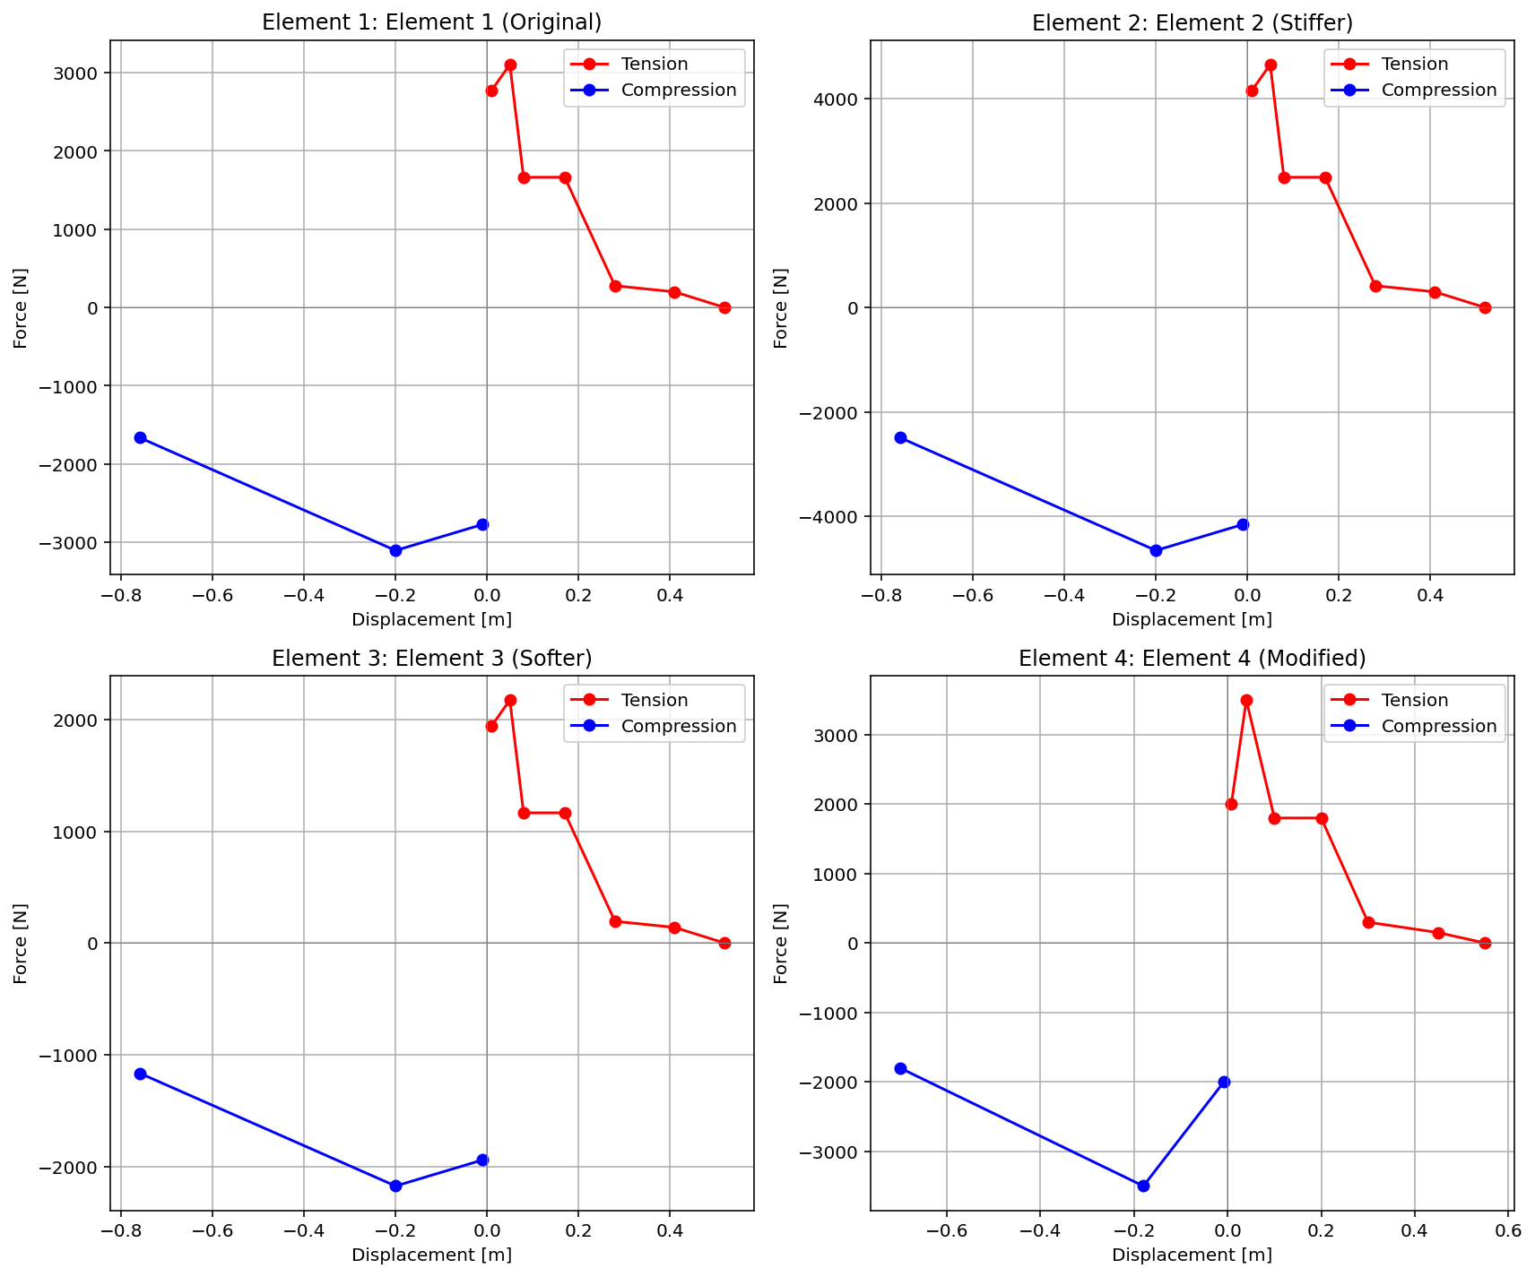

Slide 6
FREE-VIBRATION ANALYSIS

Slide 7
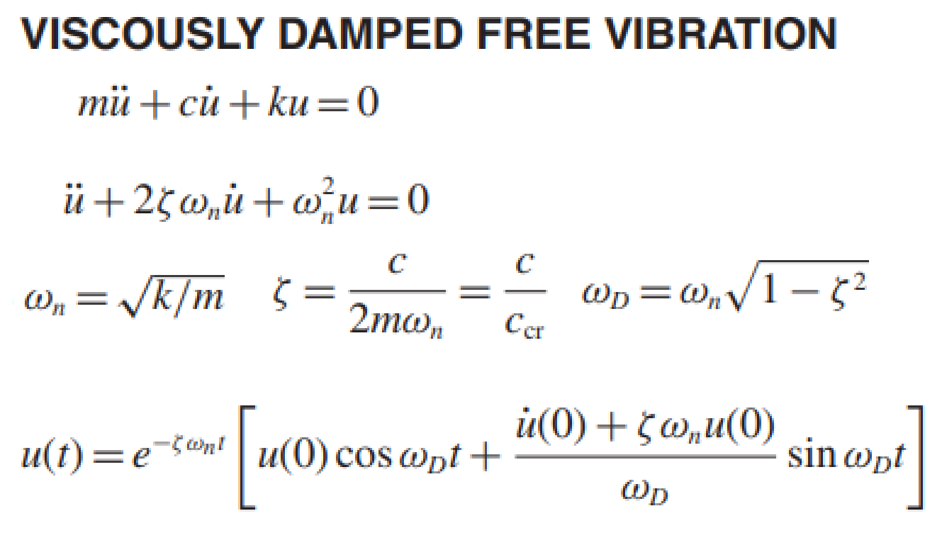
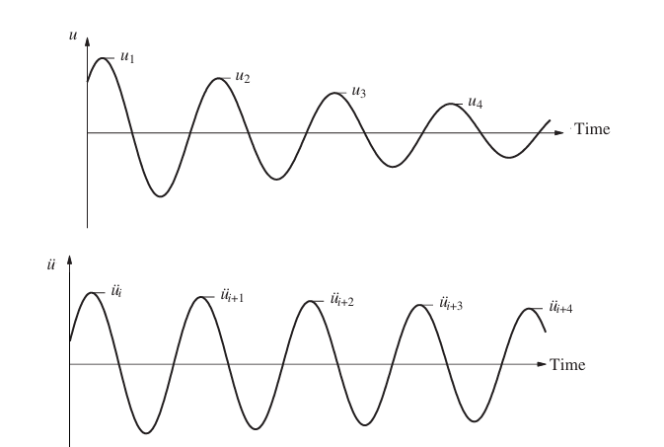
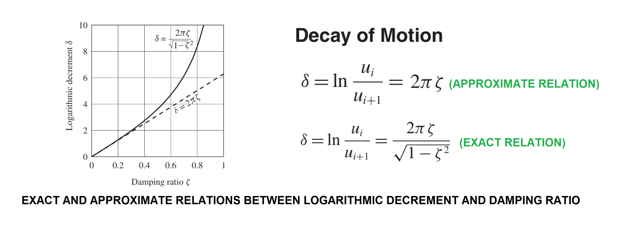

Slide 8
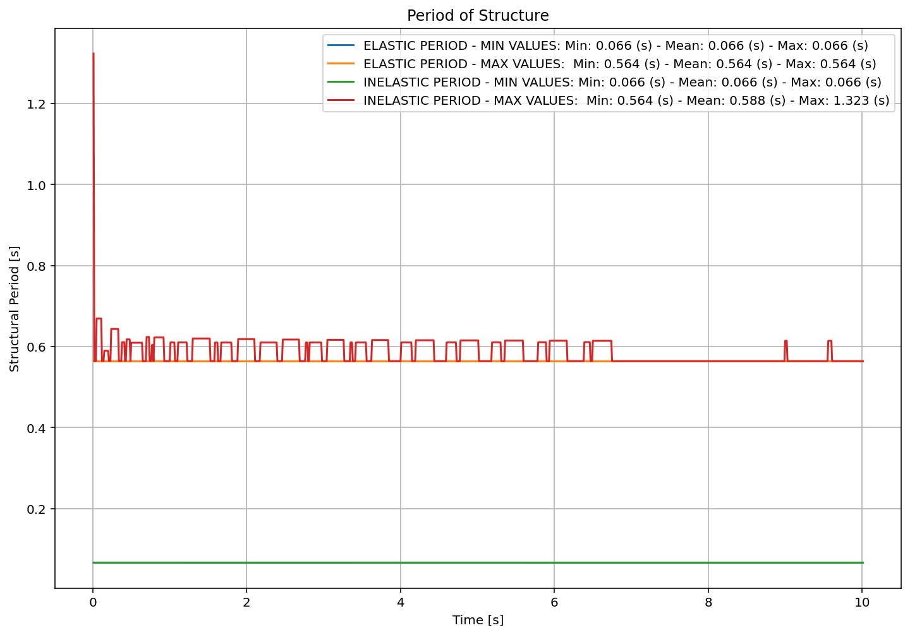

Slide 9
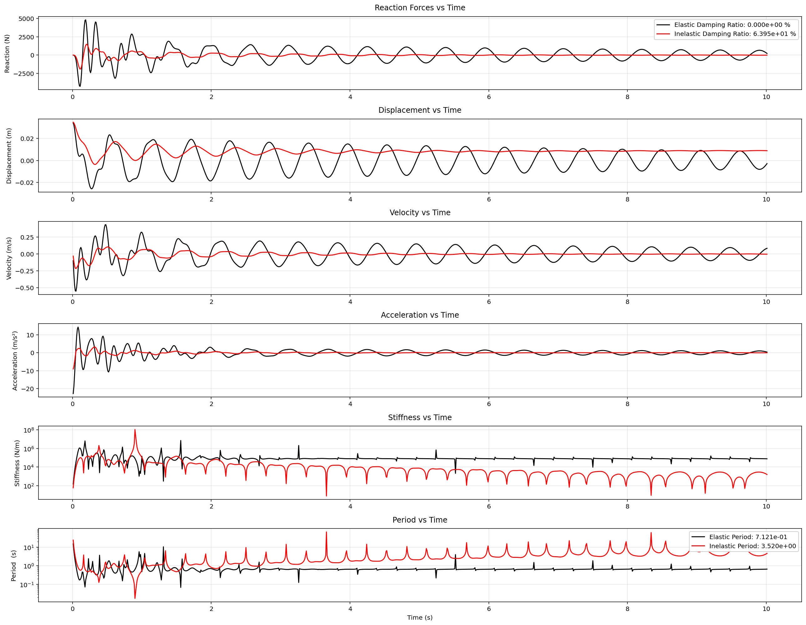

Slide 10
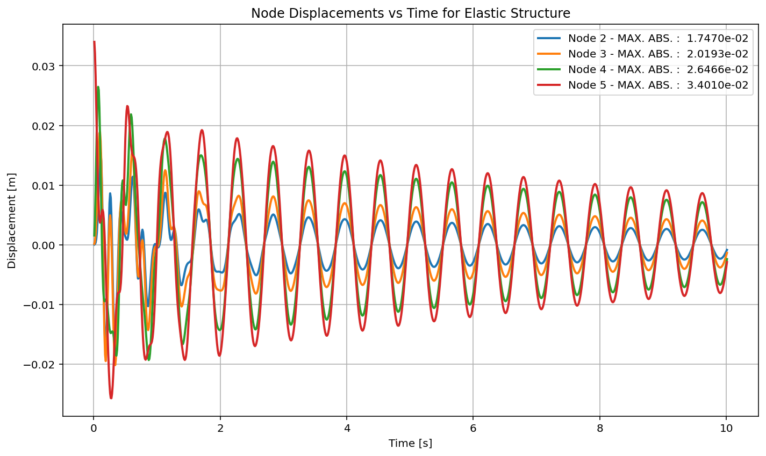

Slide 11
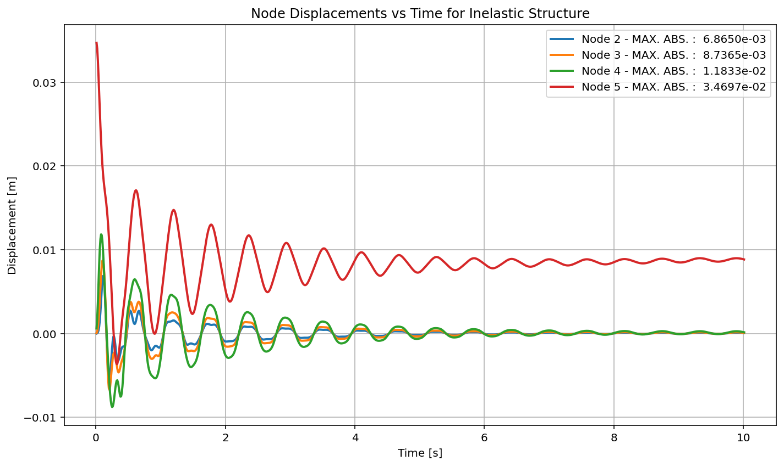

Slide 12
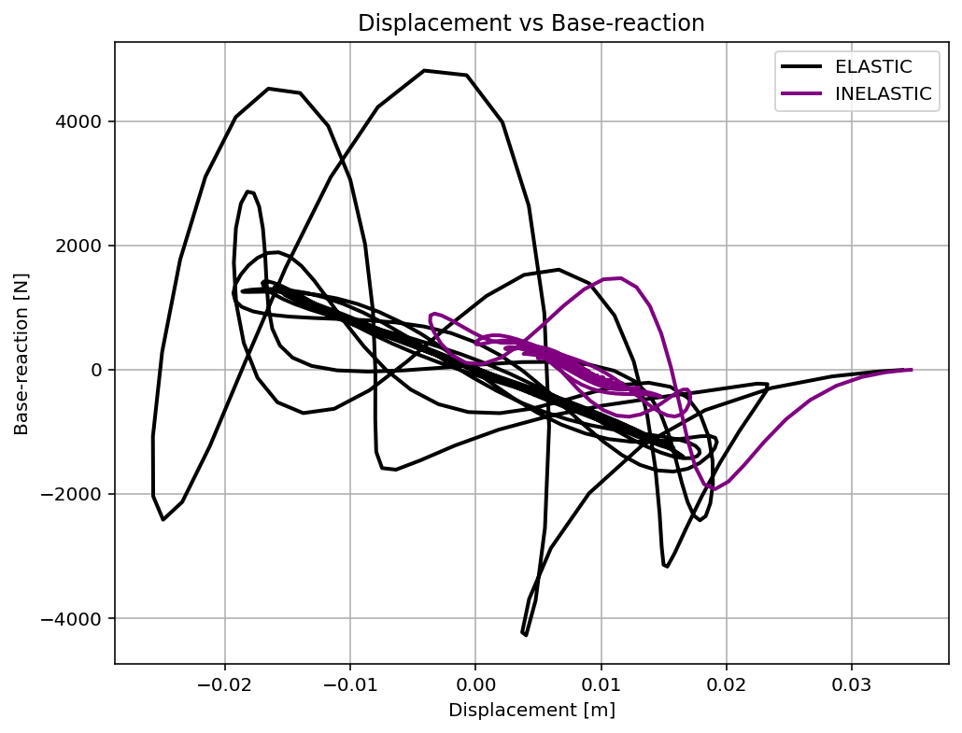

Slide 13
PUSHOVER ANALYSIS

Slide 14
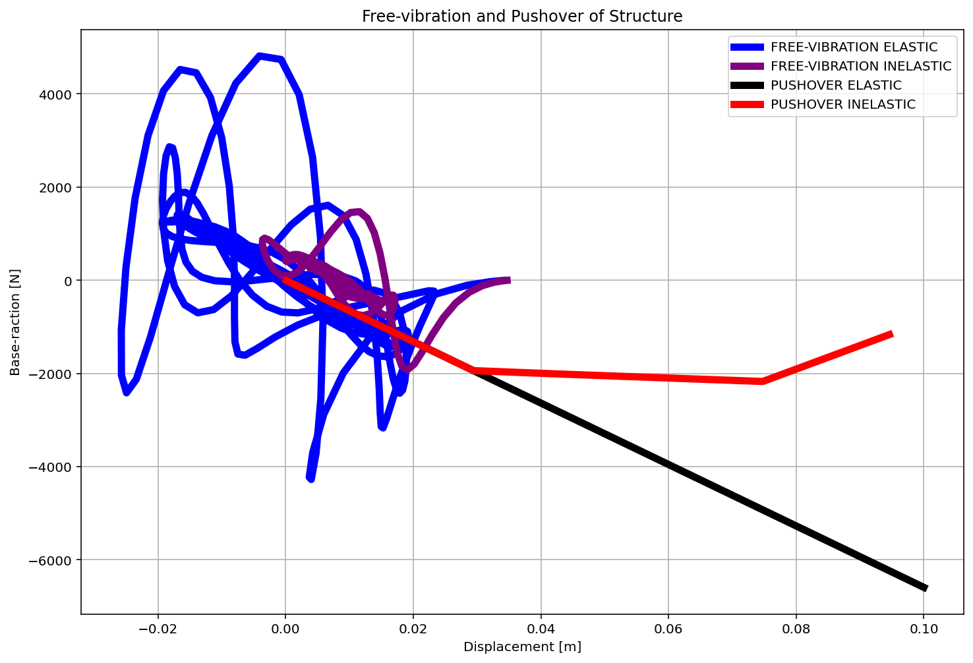

Slide 15
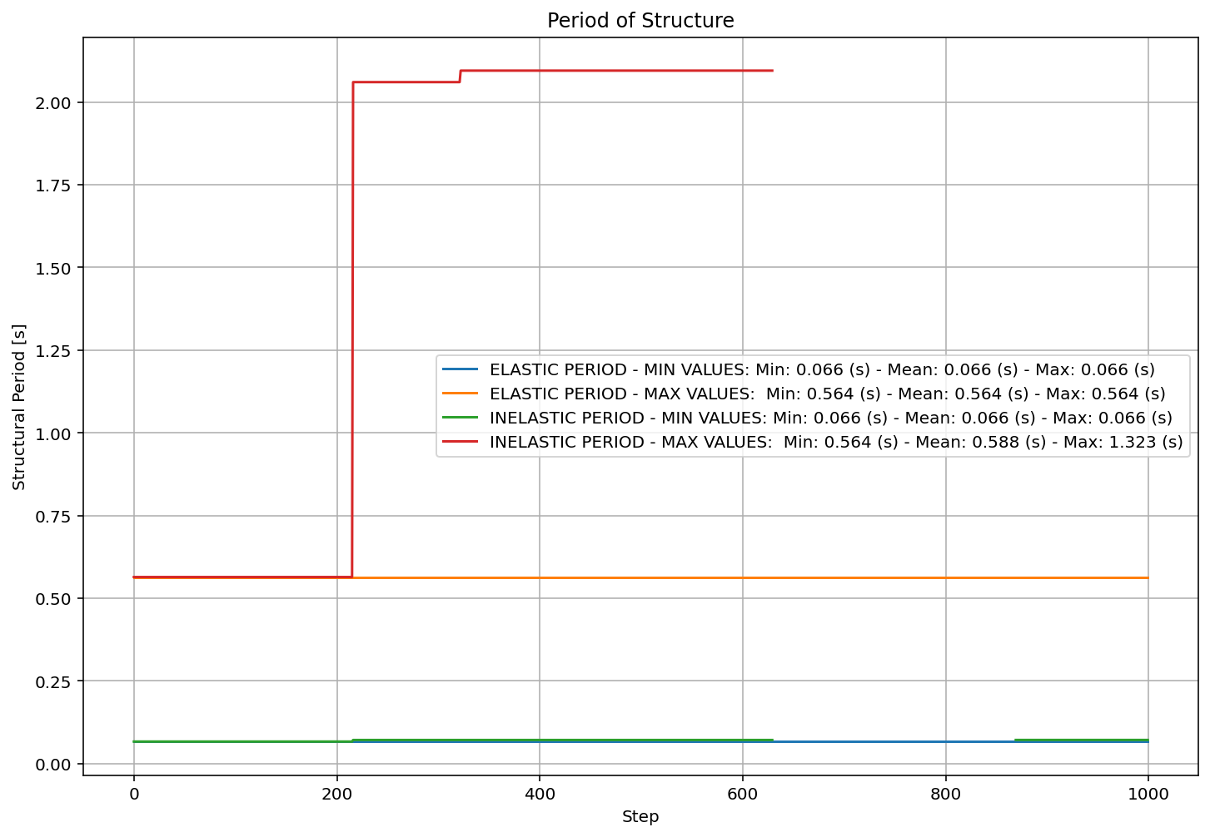

Slide 16
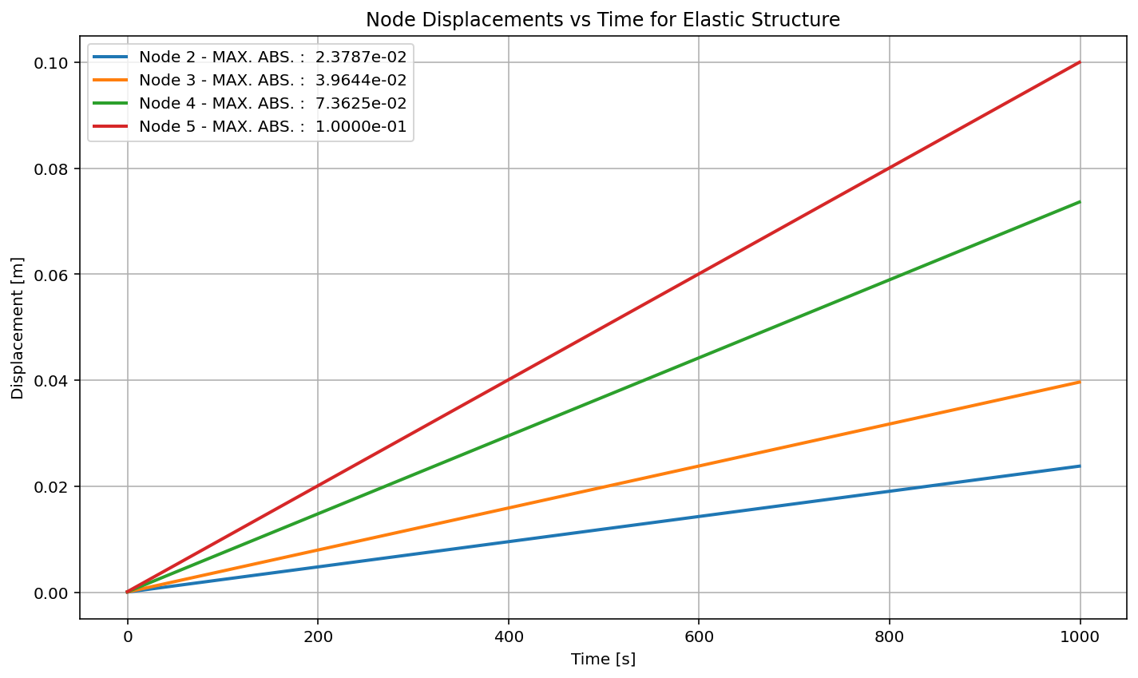

Slide 17
