Slide 1
IN THE NAME OF ALLAH, THE MOST GRACIOUS, THE MOST MERCIFUL
ASSESSMENTS OF THE STRUCTURAL DUCTILITY DAMAGE INDEX WITH DIFFERENT CONFINEMENT ENHANCEMENT RATIO OF CONCRETE FRAME WITH VISCOUS DAMPER USING OPENSEES
WRITTEN BY SALAR DELAVAR GHASHGHAEI (QASHQAI)

Slide 2
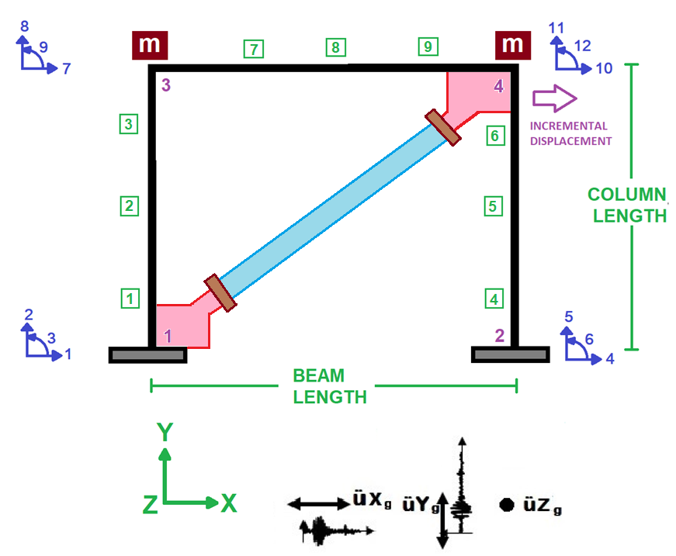

Slide 3
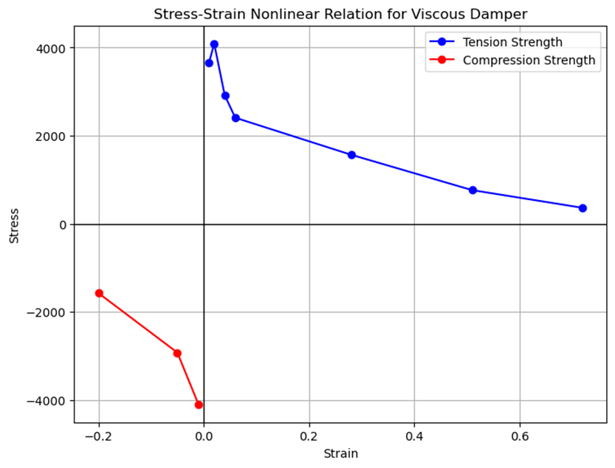

Slide 4
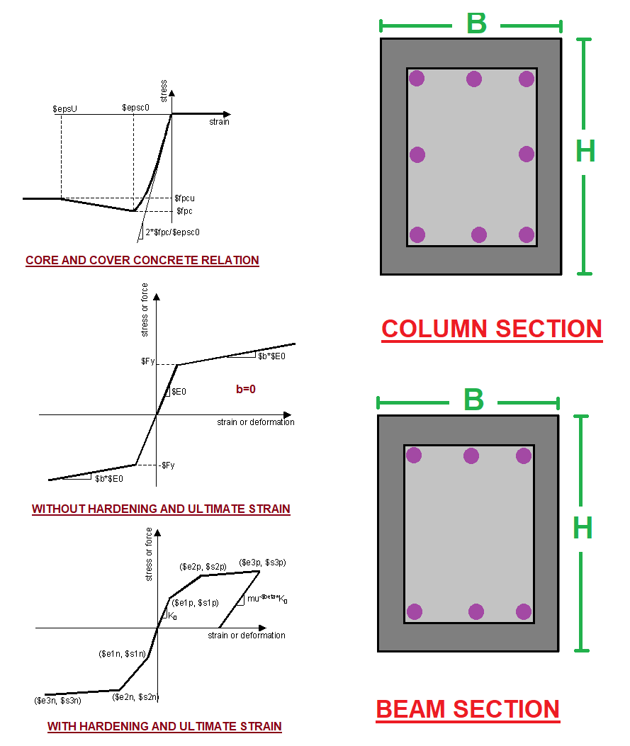

Slide 5
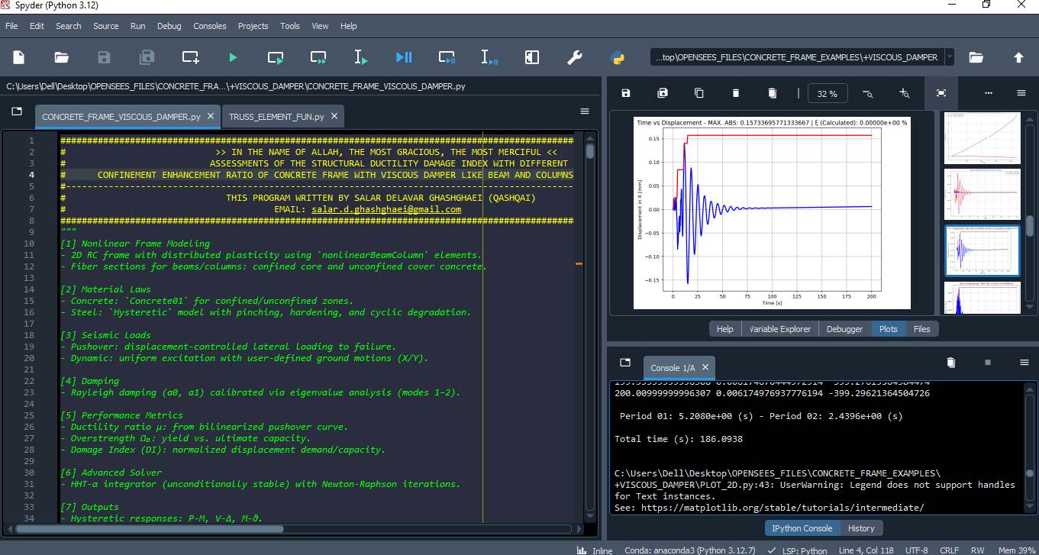

Slide 6
NONLINEAR STATIC ANALYSIS
(PUSHOVER)

Slide 7
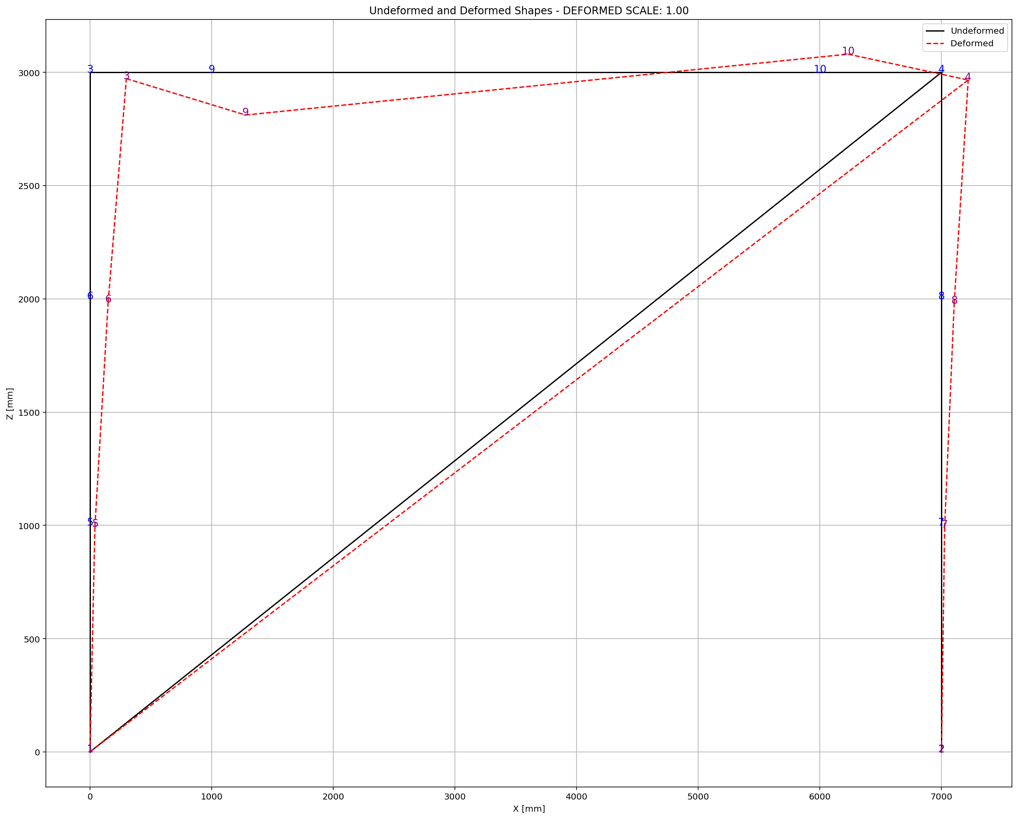

Slide 8
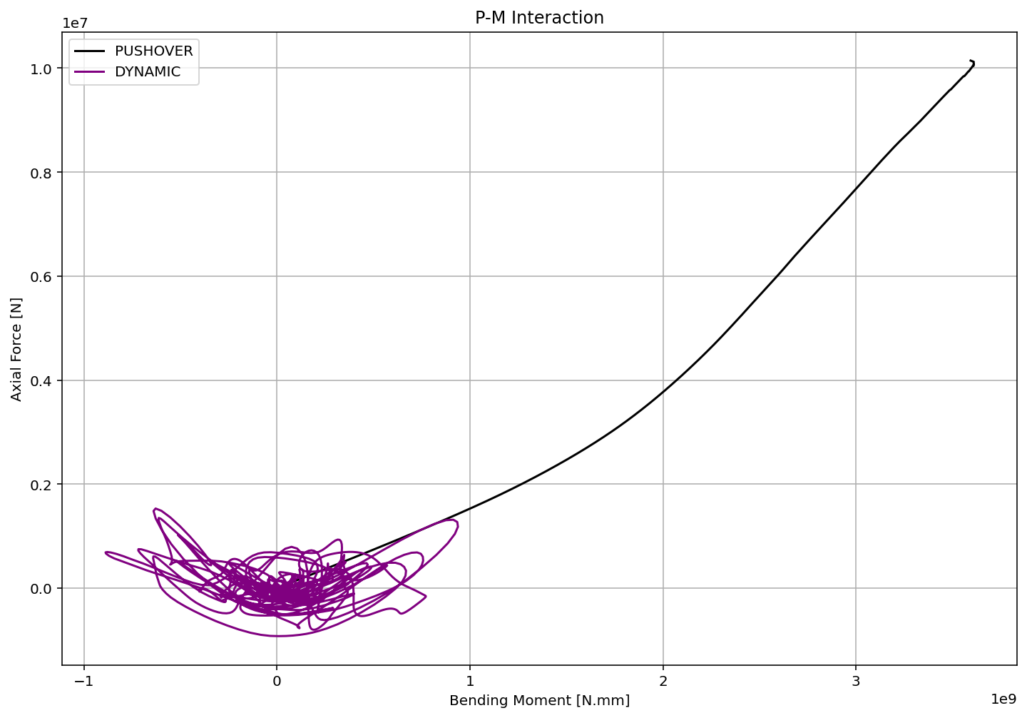

Slide 9
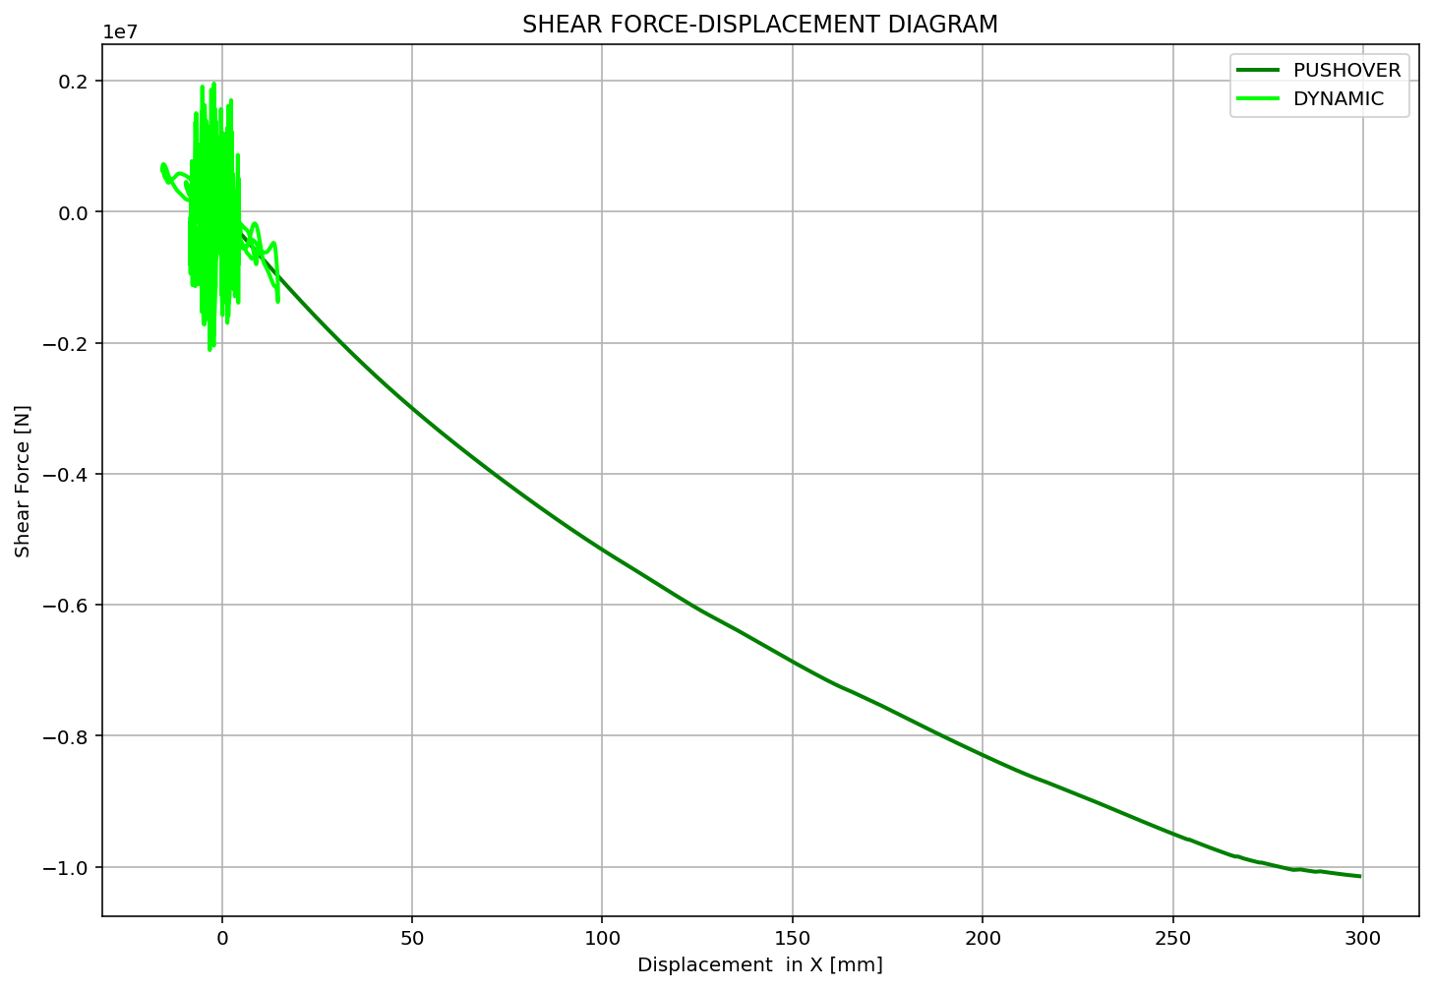

Slide 10
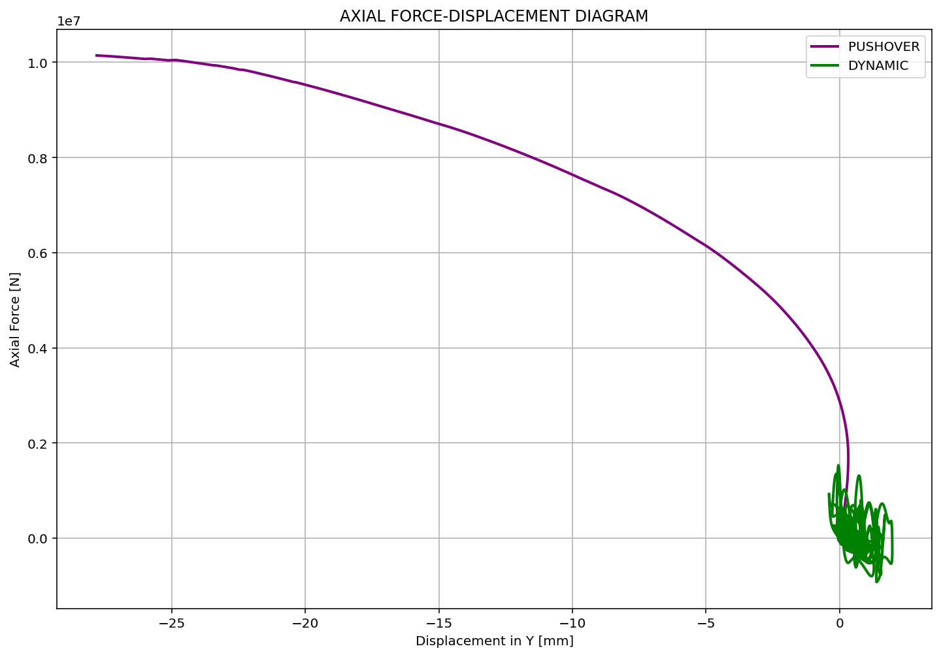

Slide 11
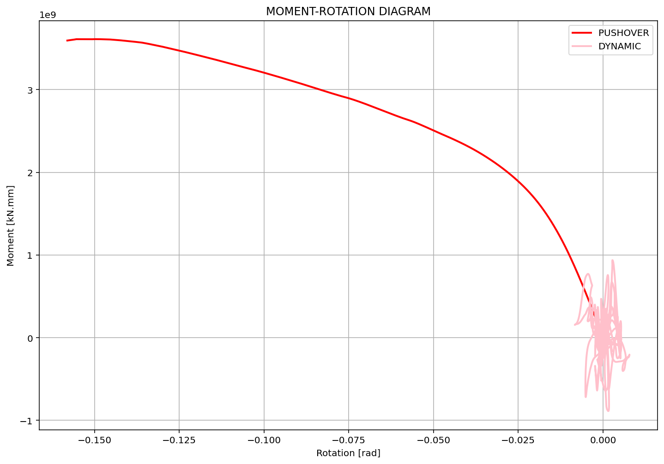

Slide 12
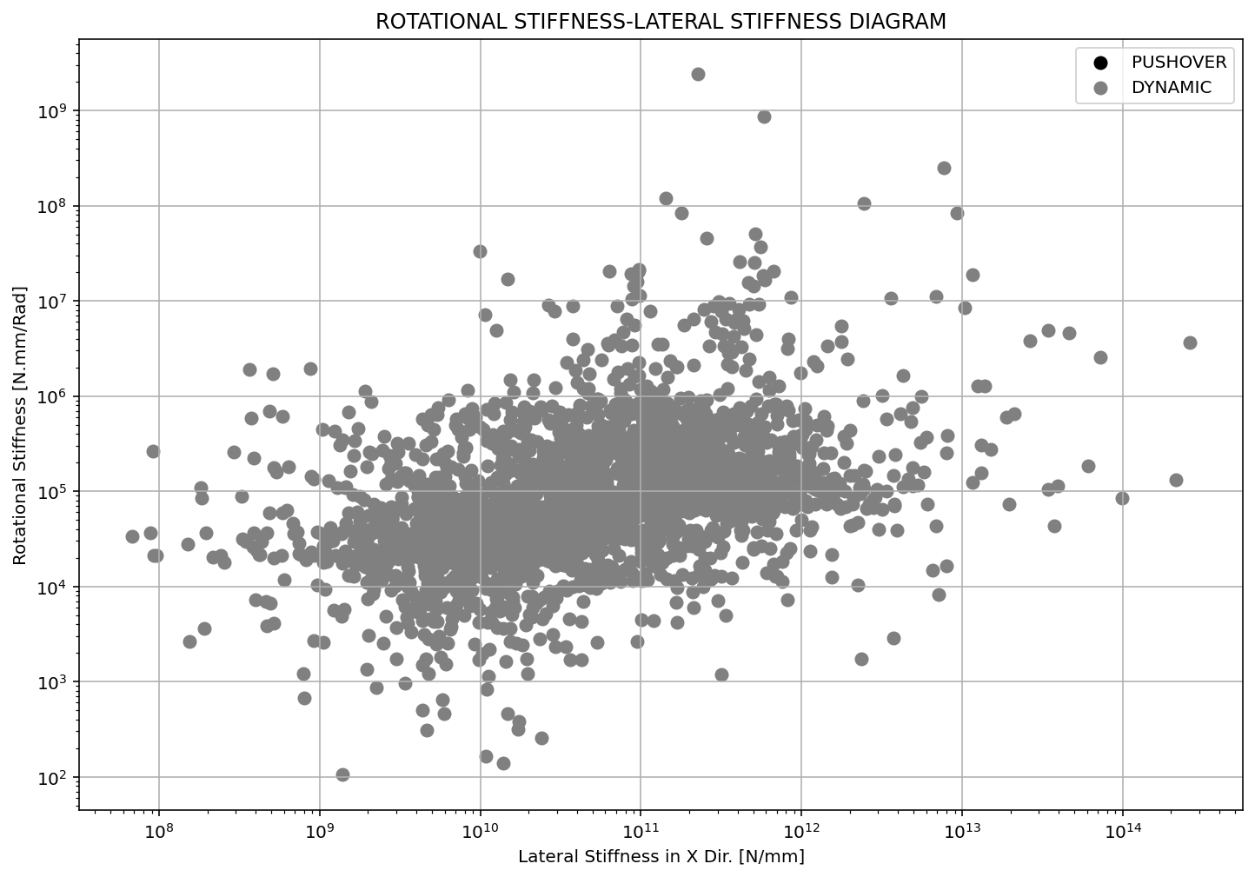

Slide 13
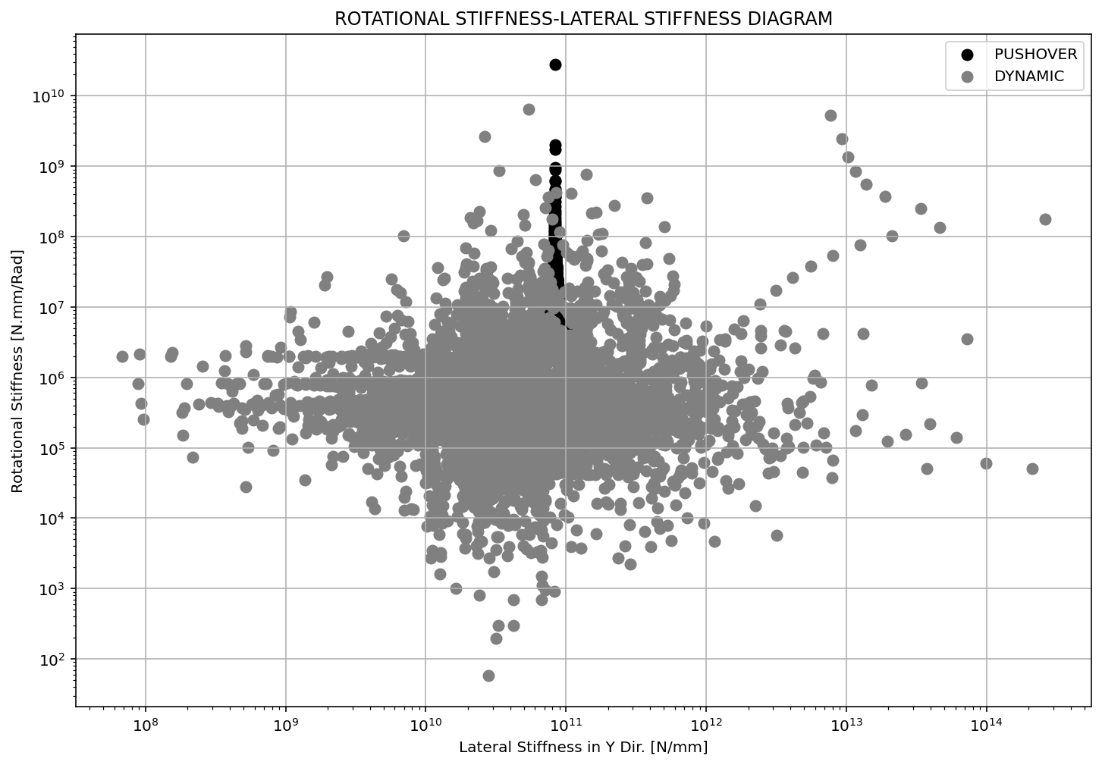

Slide 14
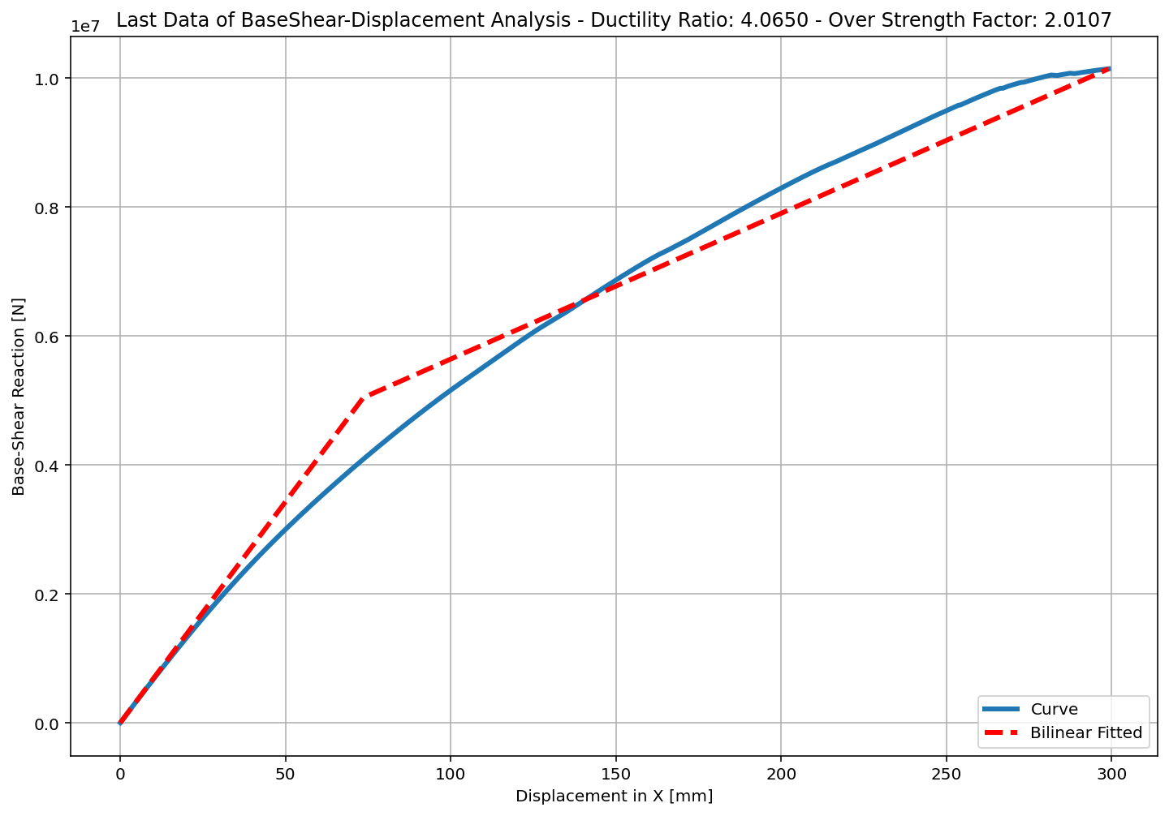
+==========================+
= Analysis curve fitted =
Disp Base Shear
----------------------------
[[0.00000000e+00 0.00000000e+00]
[7.35579646e+01 5.04563655e+06]
[2.99015026e+02 1.01452538e+07]]
+==========================+
+----------------------------------------------------+
Structure Elastic Stiffness : 68594.02
Structure Plastic Stiffness : 33928.91
Structure Tangent Stiffness : 22619.02
Structure Ductility Ratio : 4.07
Structure Over Strength Factor: 2.01
+----------------------------------------------------+
Over Strength Coefficient (Ω0): 2.0107
Displacement Ductility Ratio (μ): 4.0650
Ductility Coefficient (Rμ): 4.0650
Structural Behavior Coefficient (R): 8.1735
Structural Ductility Damage Index in X Direction: -0.3256

Slide 15
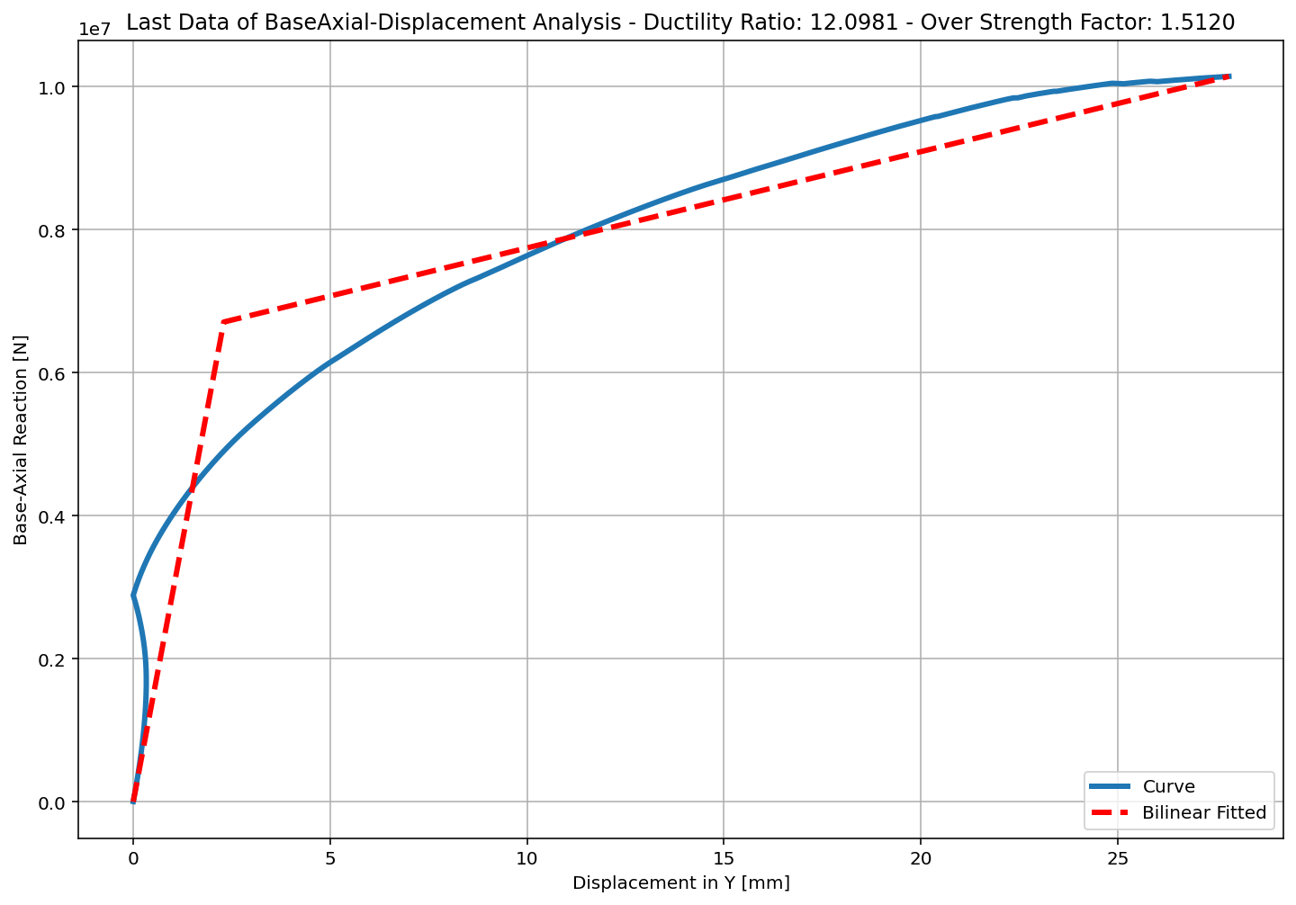
+==========================+
= Analysis curve fitted =
Disp Base Shear
----------------------------
[[0.00000000e+00 0.00000000e+00]
[2.29937403e+00 6.70990300e+06]
[2.78181299e+01 1.01452538e+07]]
+==========================+
+----------------------------------------------------+
Structure Elastic Stiffness : 2918143.34
Structure Plastic Stiffness : 364699.35
Structure Tangent Stiffness : 134620.62
Structure Ductility Ratio : 12.10
Structure Over Strength Factor: 1.51
+----------------------------------------------------+
Over Strength Coefficient (Ω0): 1.5120
Displacement Ductility Ratio (μ): 12.0981
Ductility Coefficient (Rμ): 12.0981
Structural Behavior Coefficient (R): 18.2922
Structural Ductility Damage Index in Y Direction: -0.0892

Slide 16
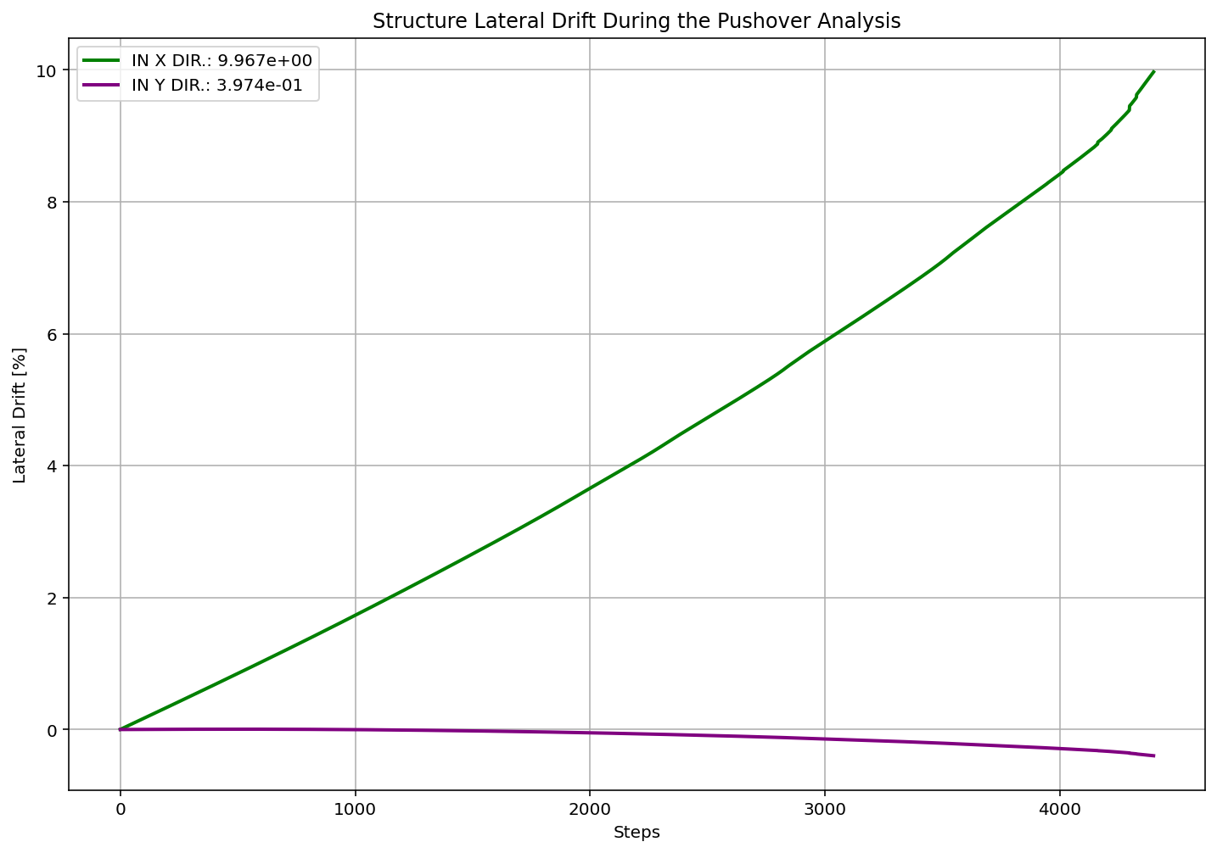

Slide 17
NONLINEAR DYNAMIC ANALYSIS

Slide 18
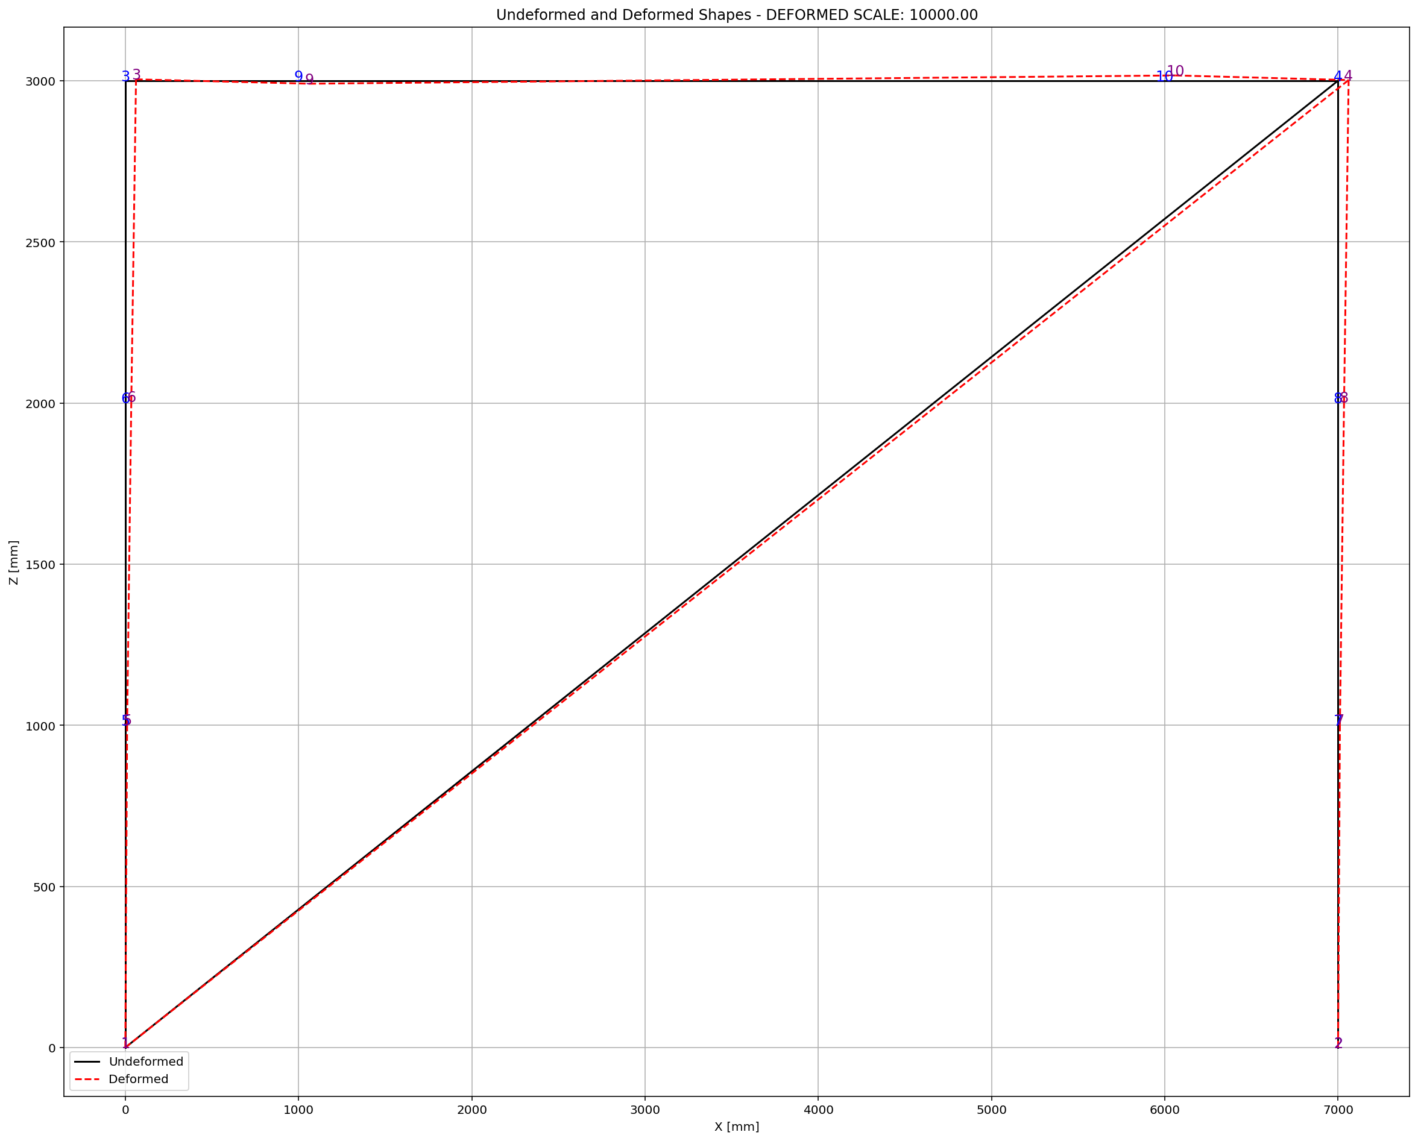

Slide 19
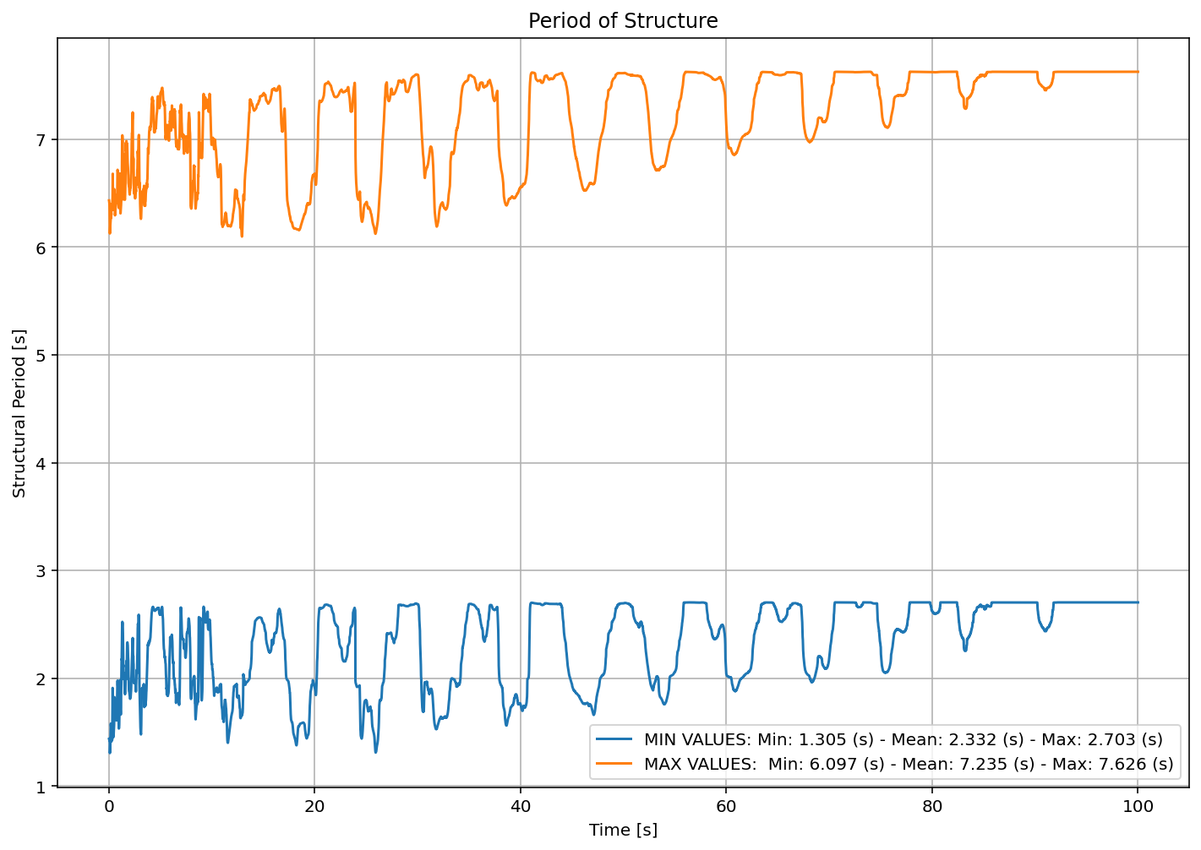

Slide 20
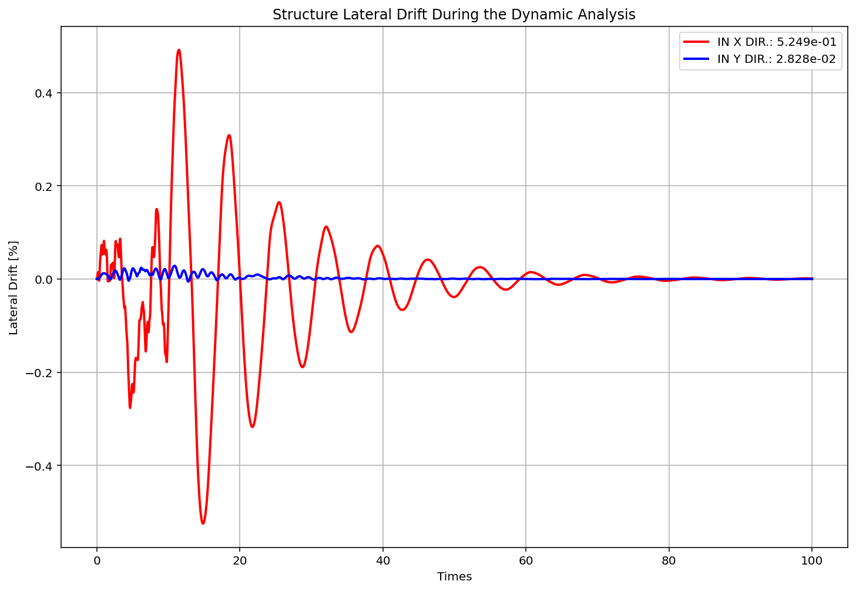

Slide 21
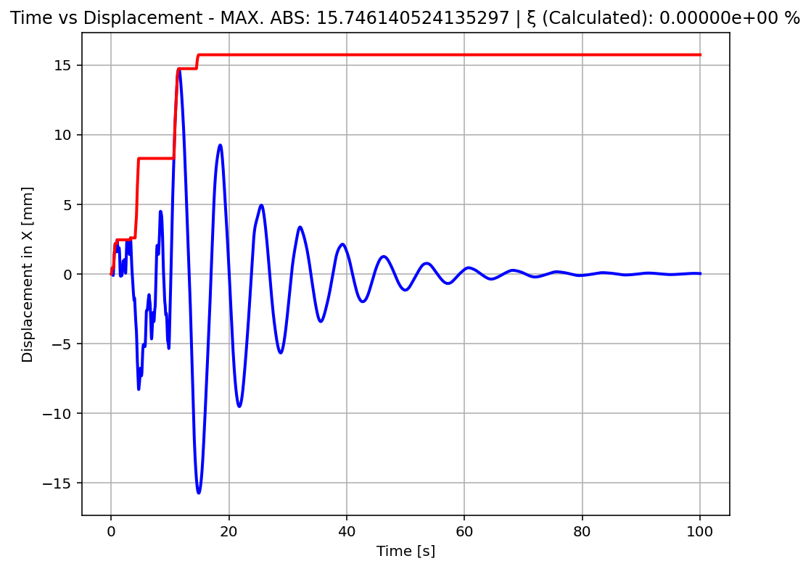

Slide 22
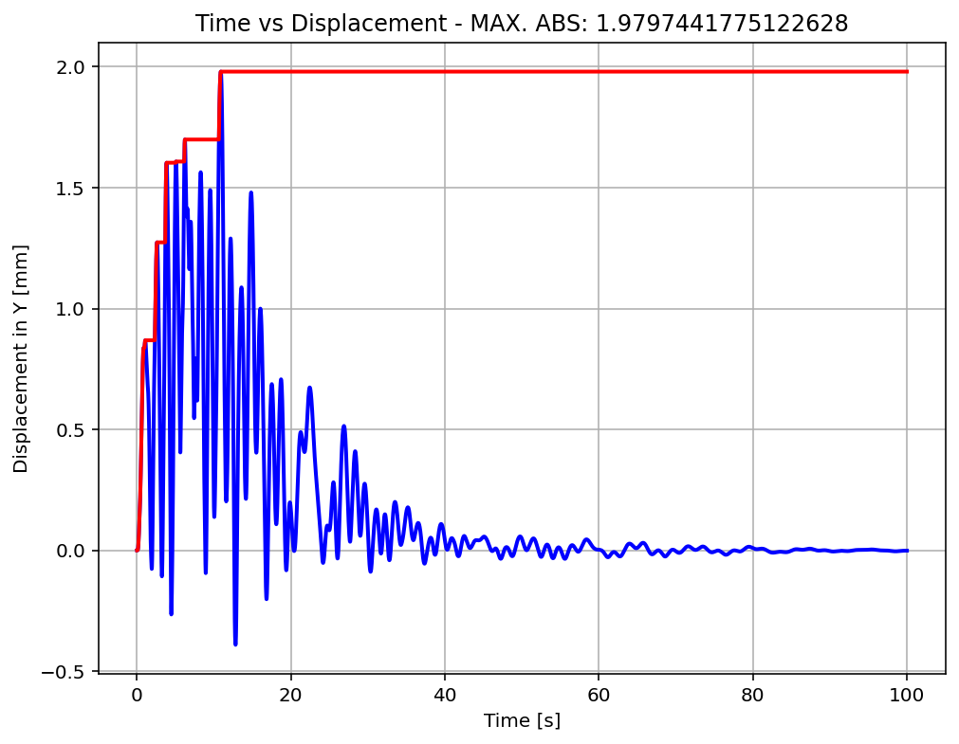

Slide 23
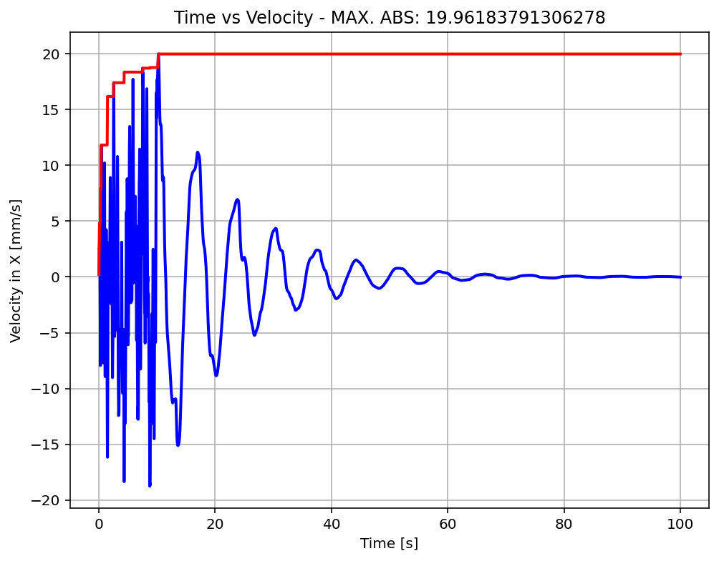

Slide 24
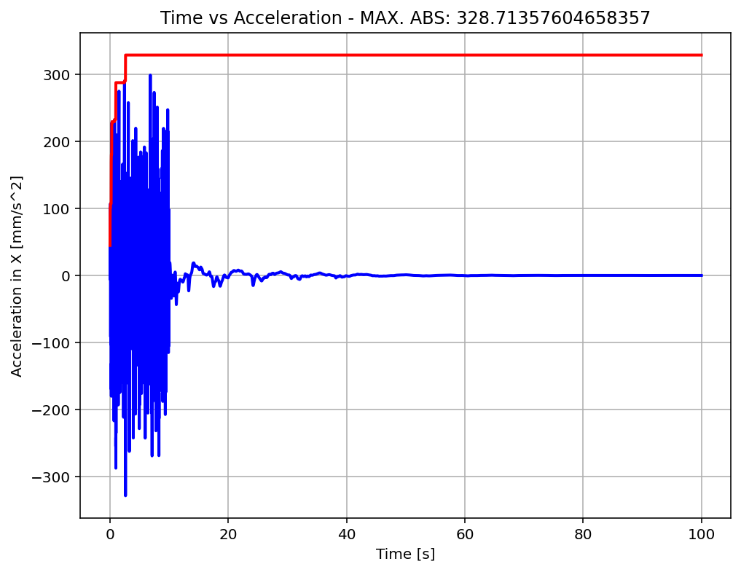

Slide 25
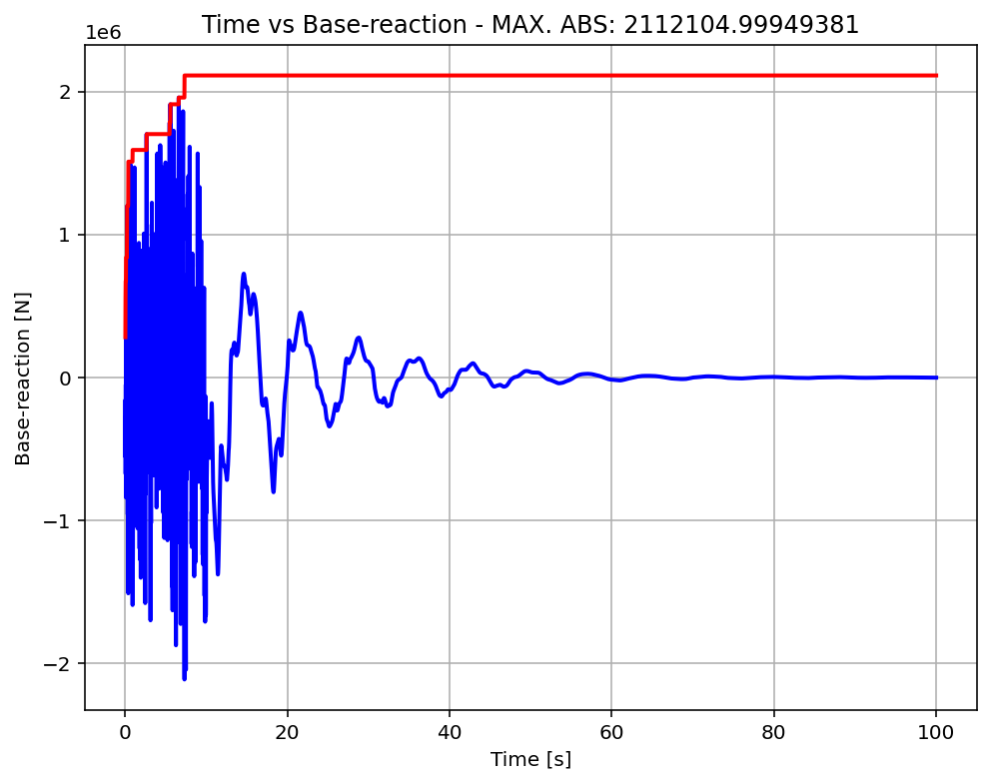

Slide 26
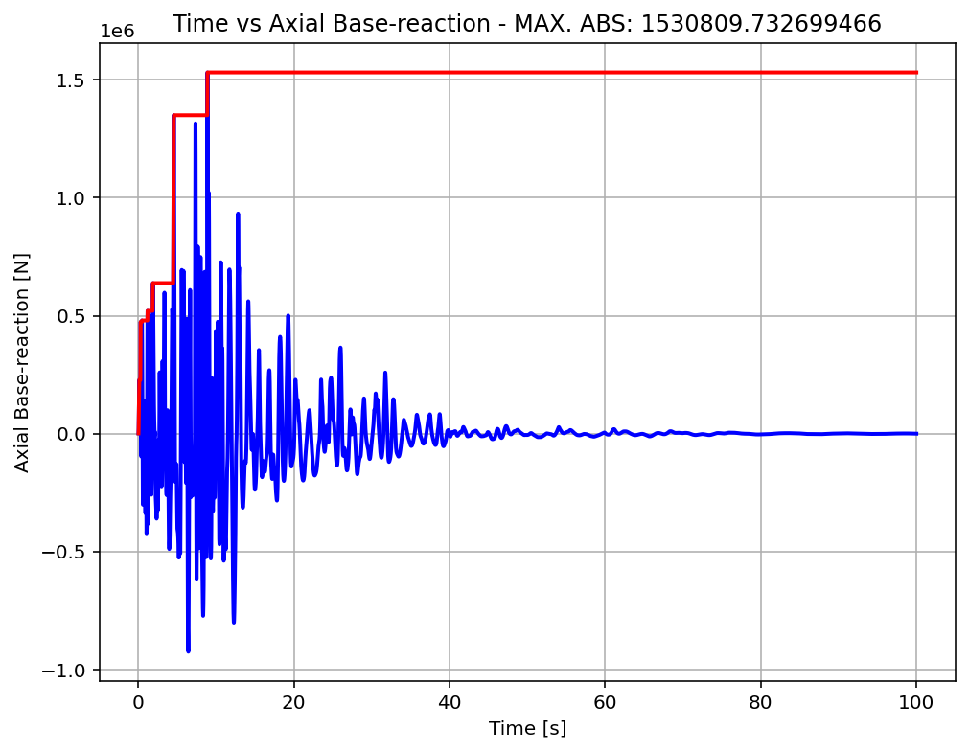

Slide 27
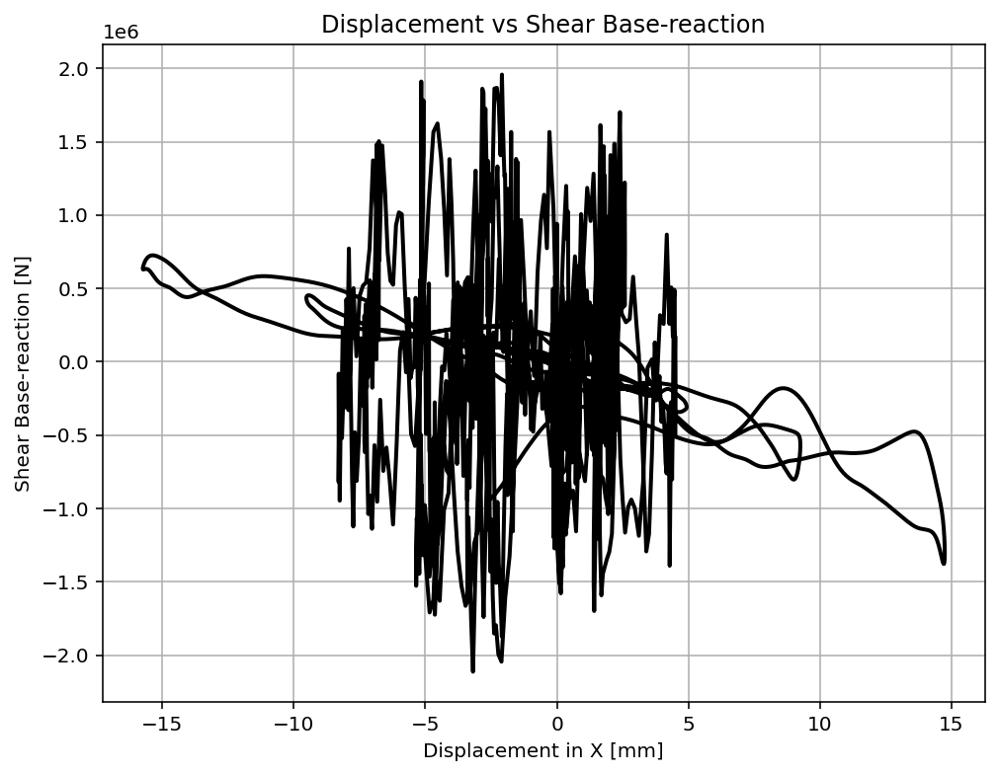

Slide 28
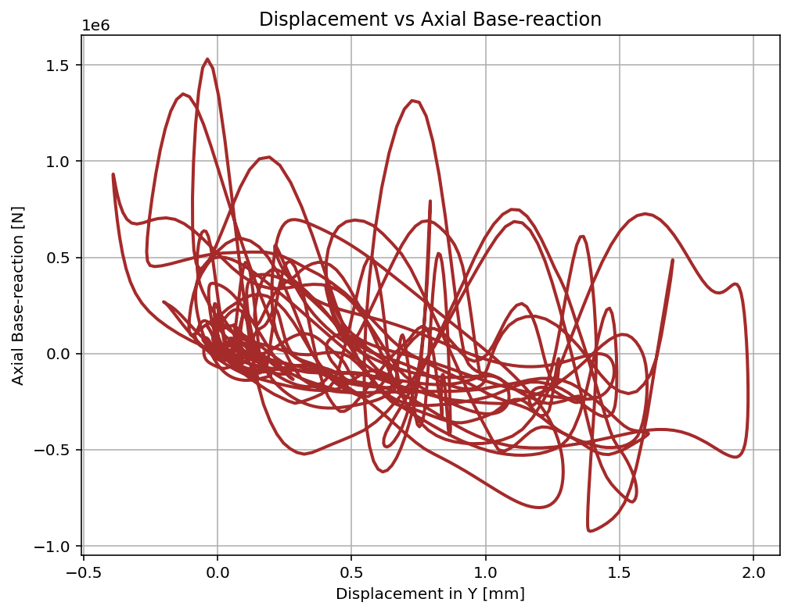

Slide 29
