Slide 1
IN THE NAME OF ALLAH, THE MOST GRACIOUS, THE MOST MERCIFUL
OPTIMIZATION OF STRUCTURAL BEHAVIOR COEFFICIENT USING PUSHOVER ANALYSIS OF CONCRETE FRAME SECTIONS:
EVALUATING STRAIN HARDENING AND ULTIMATE STRAIN EFFECTS IN OPENSEES. DETERMINING OPTIMAL COLUMN SECTION REBAR DIAMETER FOR A TARGET STRUCTURAL BEHAVIOR COEFFICIENT VIA THE NEWTON-RAPHSON METHOD.
WRITTEN BY SALAR DELAVAR GHASHGHAEI (QASHQAI)

Slide 2
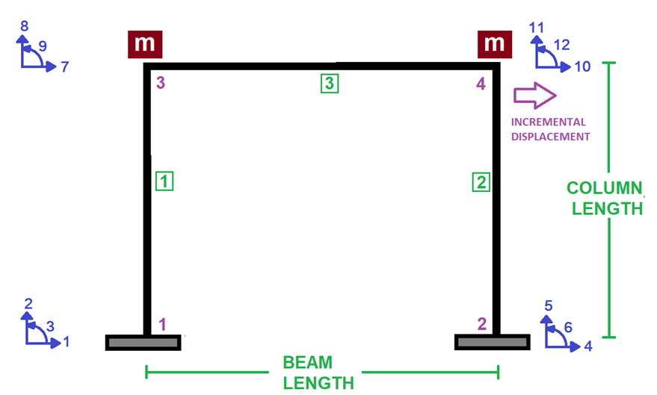

Slide 3
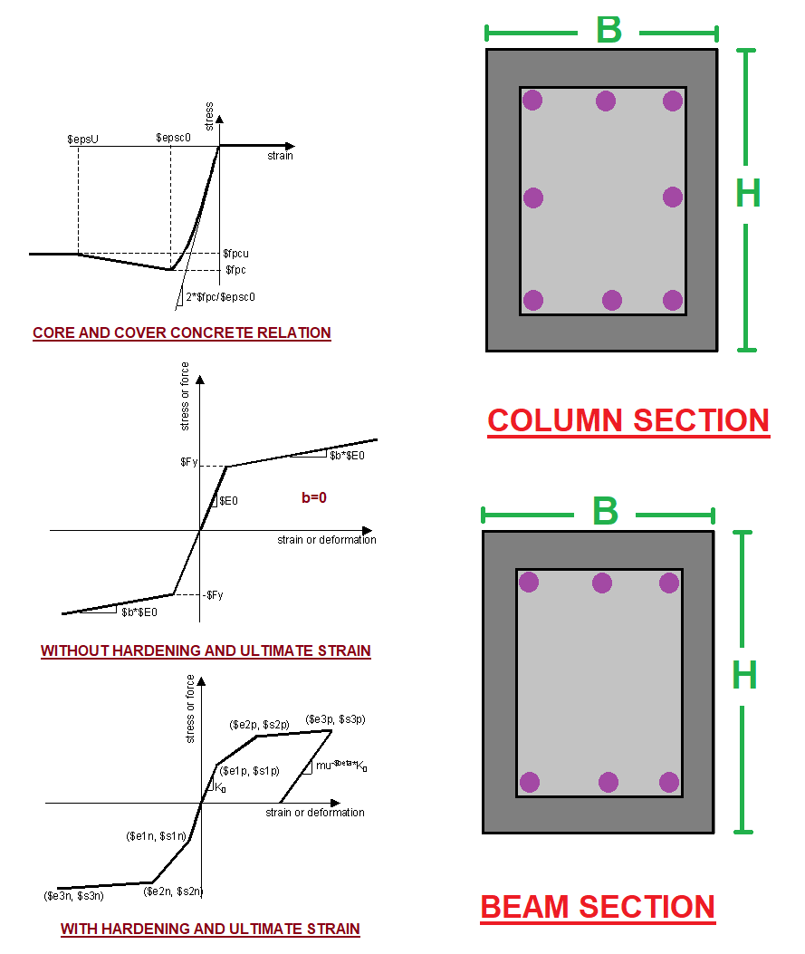

Slide 4
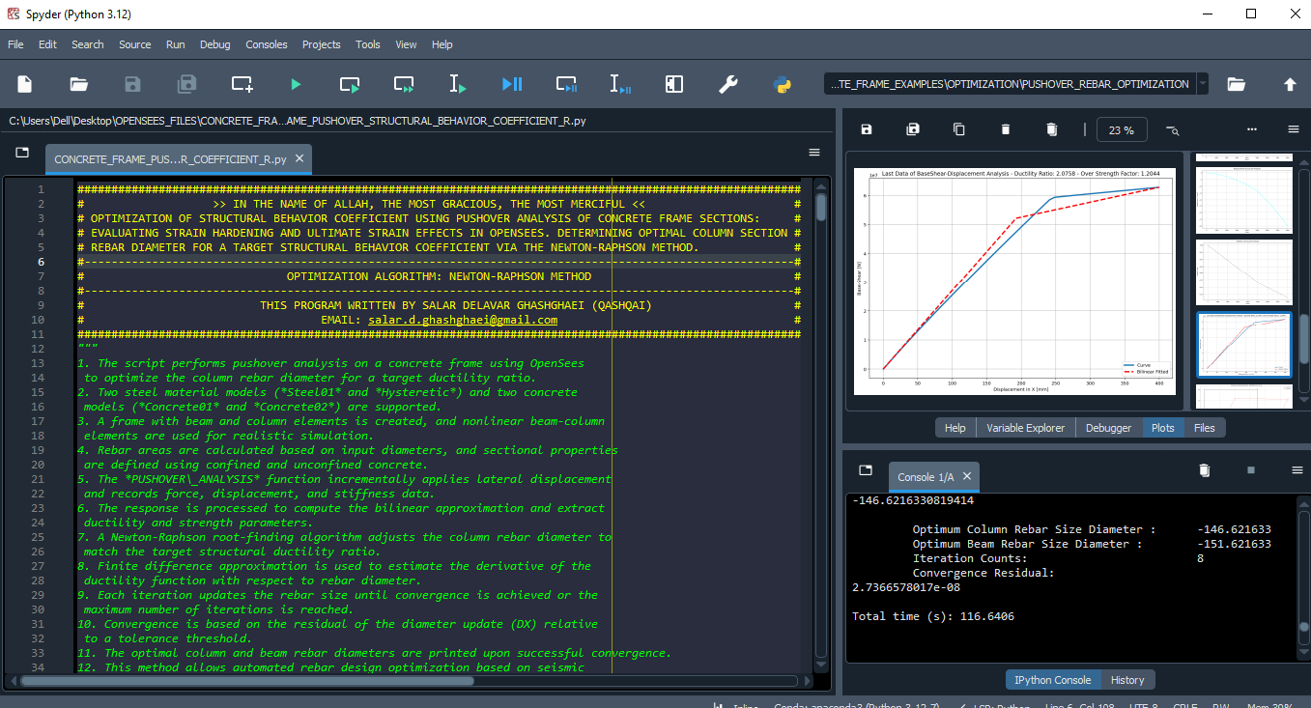

Slide 5
NONLINEAR STATIC ANALYSIS
(PUSHOVER)

Slide 6
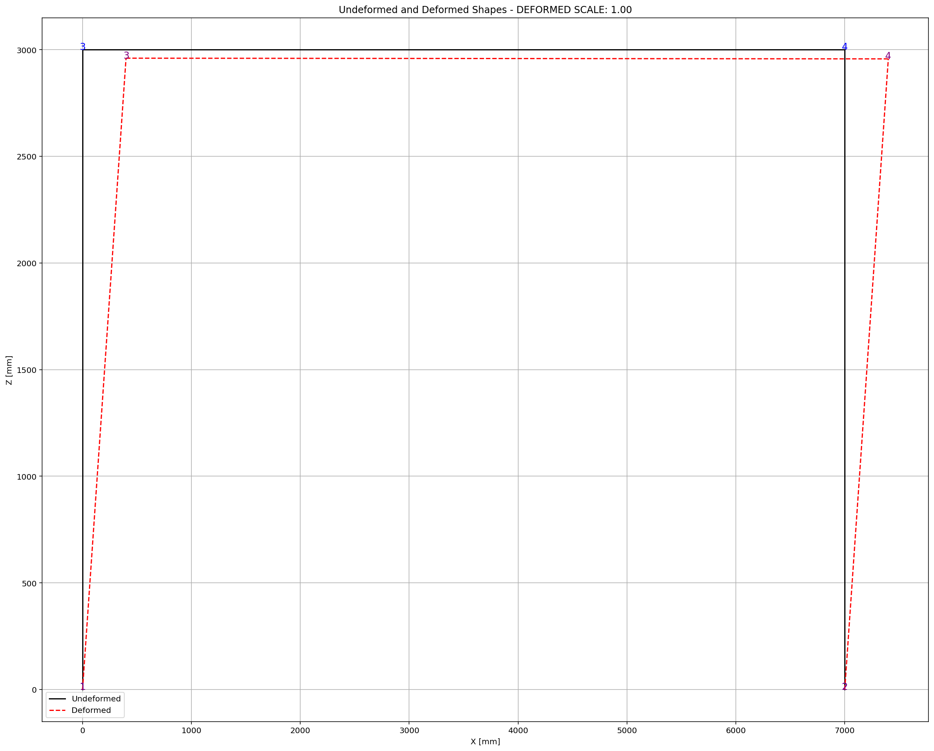
Optimum Column Rebar Size Diameter : -146.621633
Optimum Beam Rebar Size Diameter : -151.621633
Iteration Counts: 8
Convergence Residual: 2.7366578017e-08
Total time (s): 116.6406

Slide 7
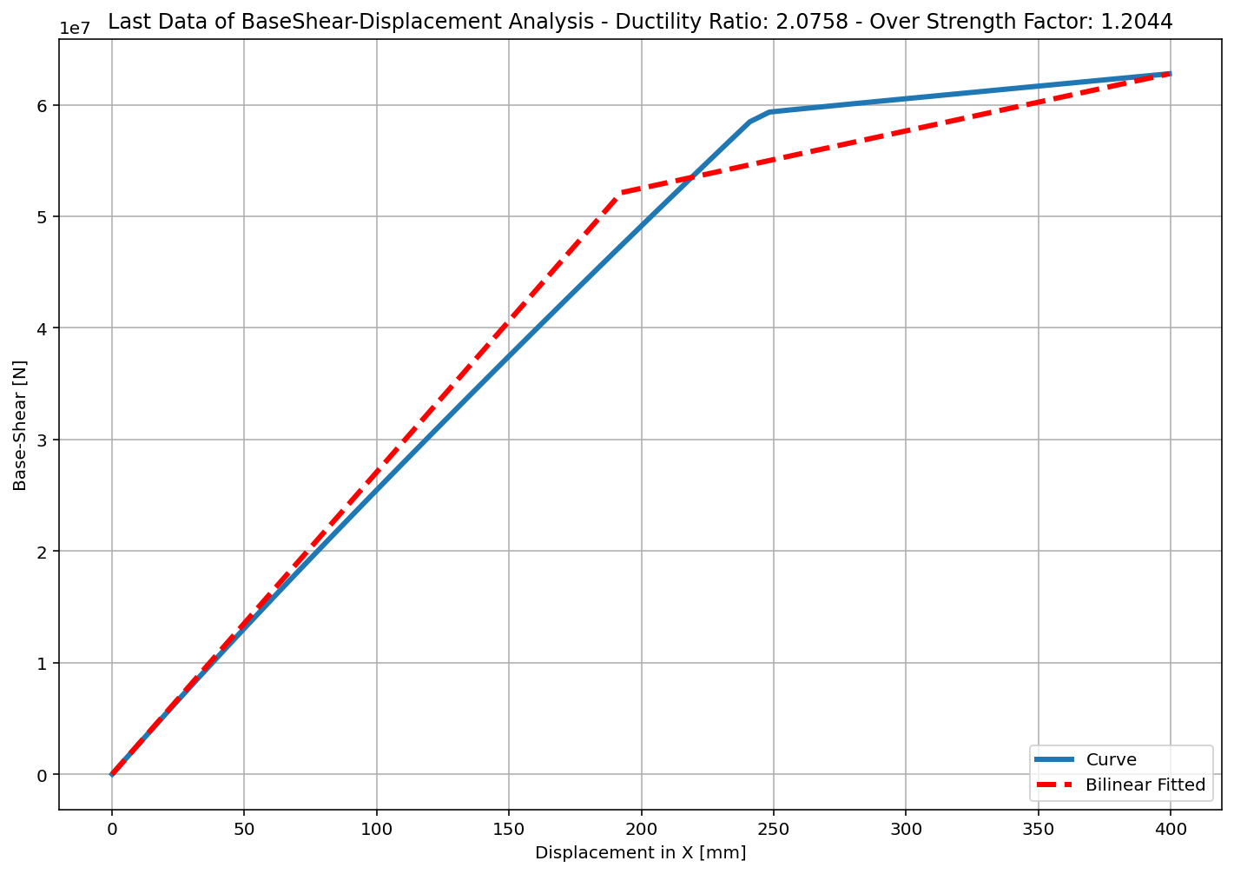
+==========================+
= Analysis curve fitted =
Disp Base Shear
----------------------------
[[0.00000000e+00 0.00000000e+00]
[1.92439746e+02 5.21205098e+07]
[3.99459091e+02 6.27728507e+07]]
+==========================+
+----------------------------------------------------+
Structure Elastic Stiffness : 270840.67
Structure Plastic Stiffness : 157144.63
Structure Tangent Stiffness : 51455.77
Structure Ductility Ratio : 2.08
Structure Over Strength Factor: 1.20
+----------------------------------------------------+
Over Strength Coefficient (Ω0): 1.2044
Displacement Ductility Ratio (μ):2.0758
Ductility Coefficient (Rμ): 2.0758
Structural Behavior Coefficient (R): 2.5000

Slide 8
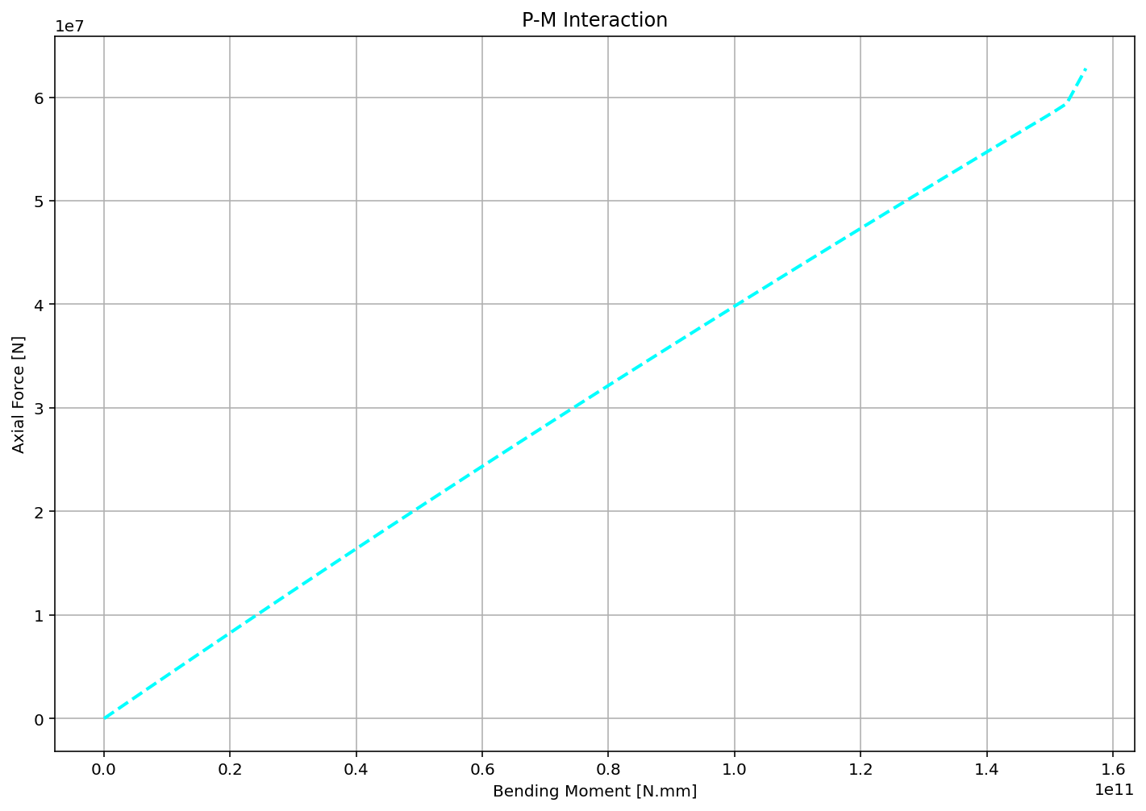

Slide 9
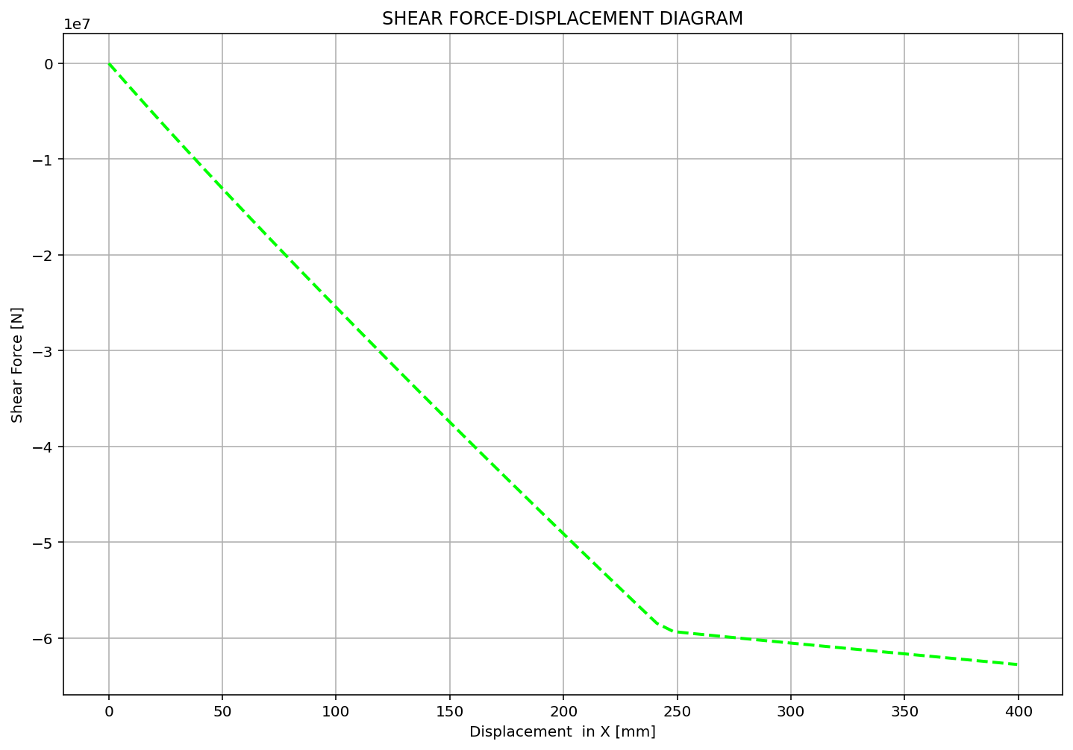

Slide 10
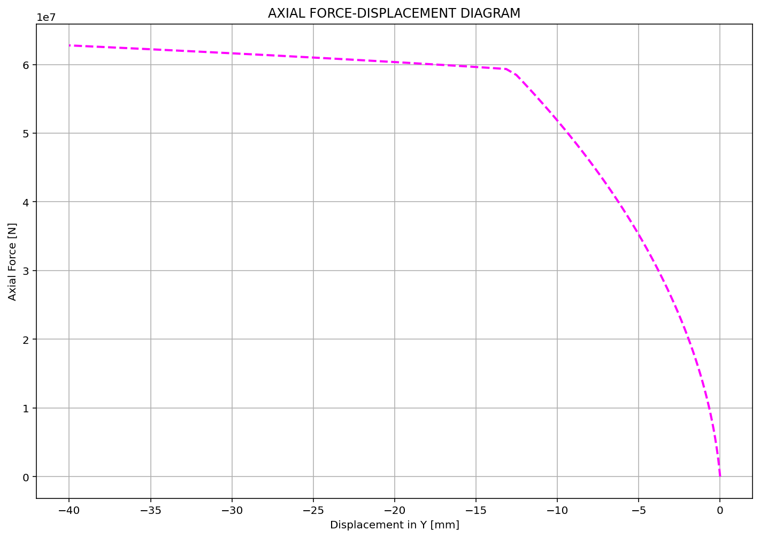

Slide 11
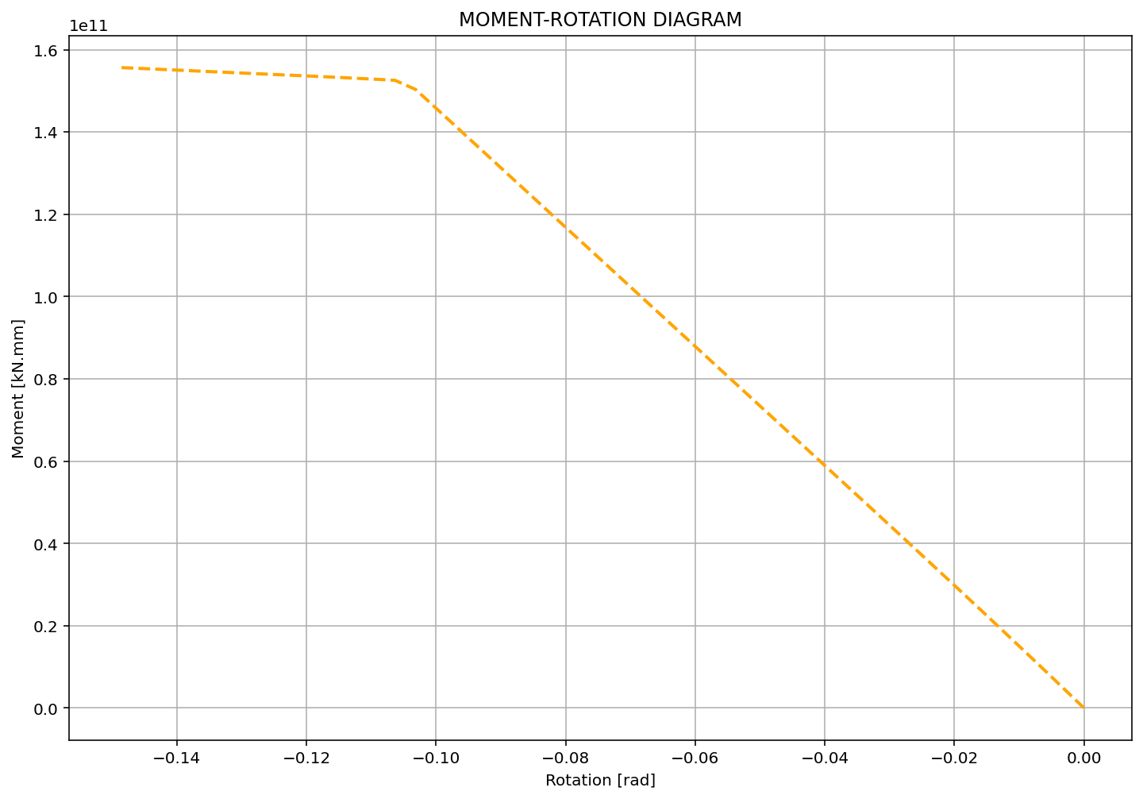

Slide 12
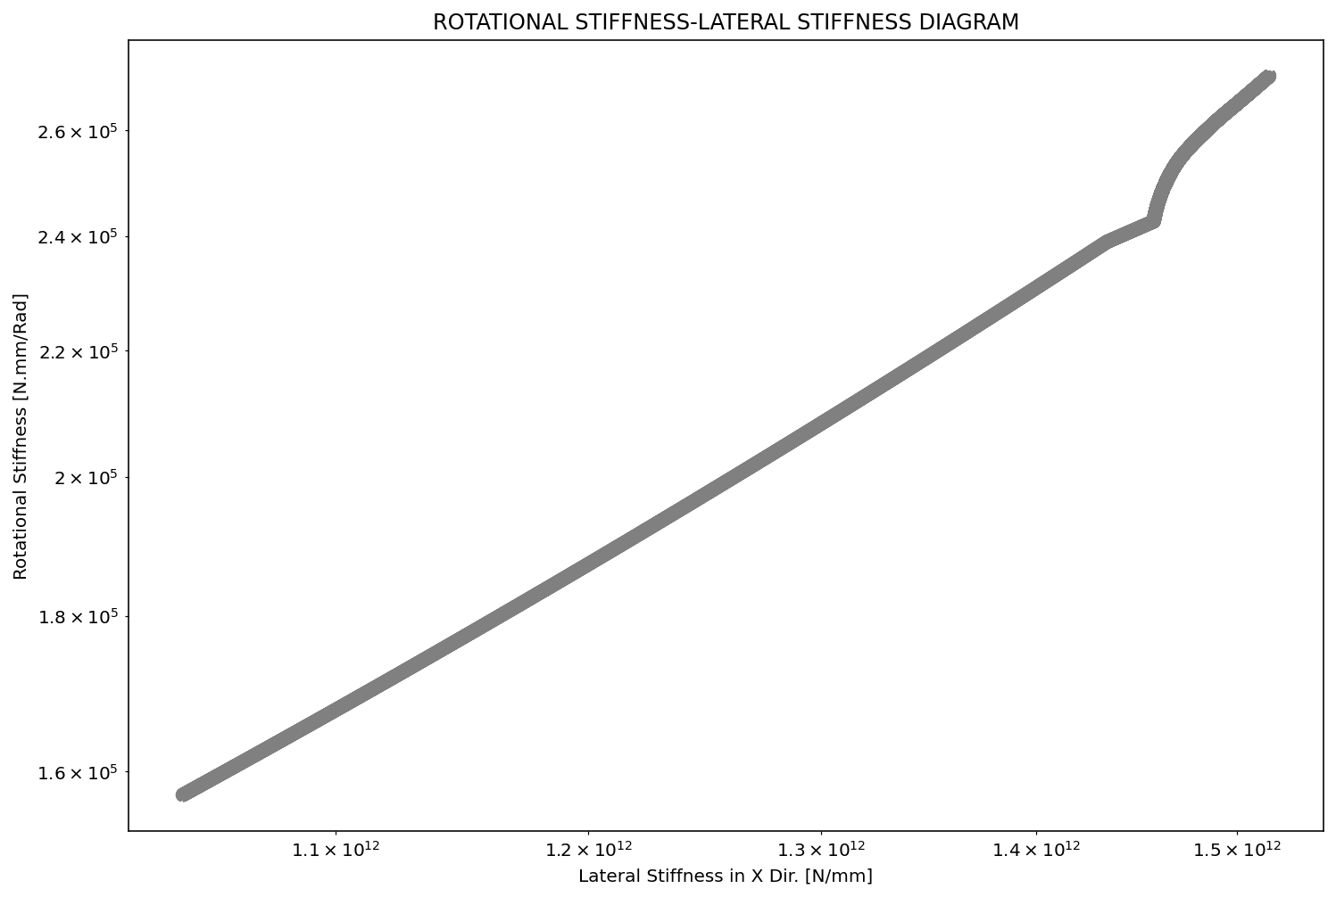

Slide 13
