Slide 1
IN THE NAME OF ALLAH, THE MOST GRACIOUS, THE MOST MERCIFUL
OPTIMIZATION OF PLATE THICKNESS WITH COMPARATIVE ANALYSIS OF AXIAL FORCE–MOMENT (P–M) INTERACTION IN CONFINED REINFORCED CONCRETE WITH PLATE COMPOSITE SECTIONS: EVALUATING STRAIN HARDENING AND ULTIMATE STRAIN CRITERIA USING OPENSEES
WRITTEN BY SALAR DELAVAR GHASHGHAEI (QASHQAI)

Slide 2
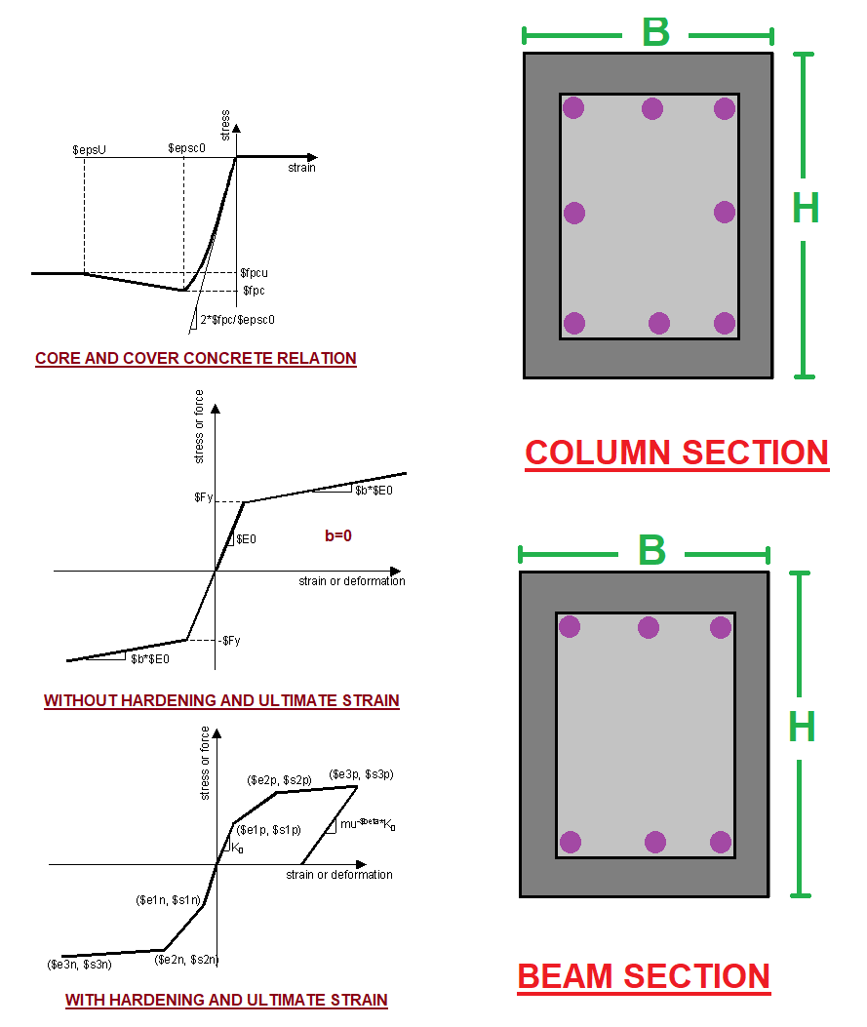
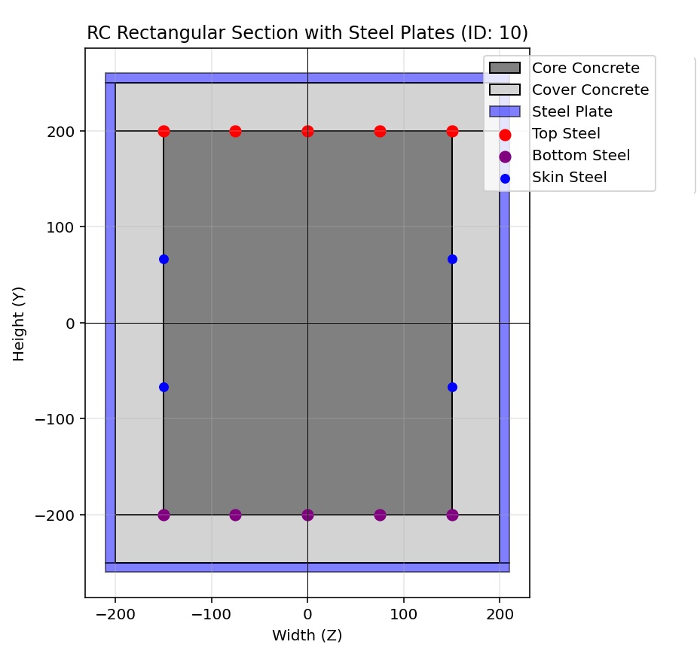

Slide 3
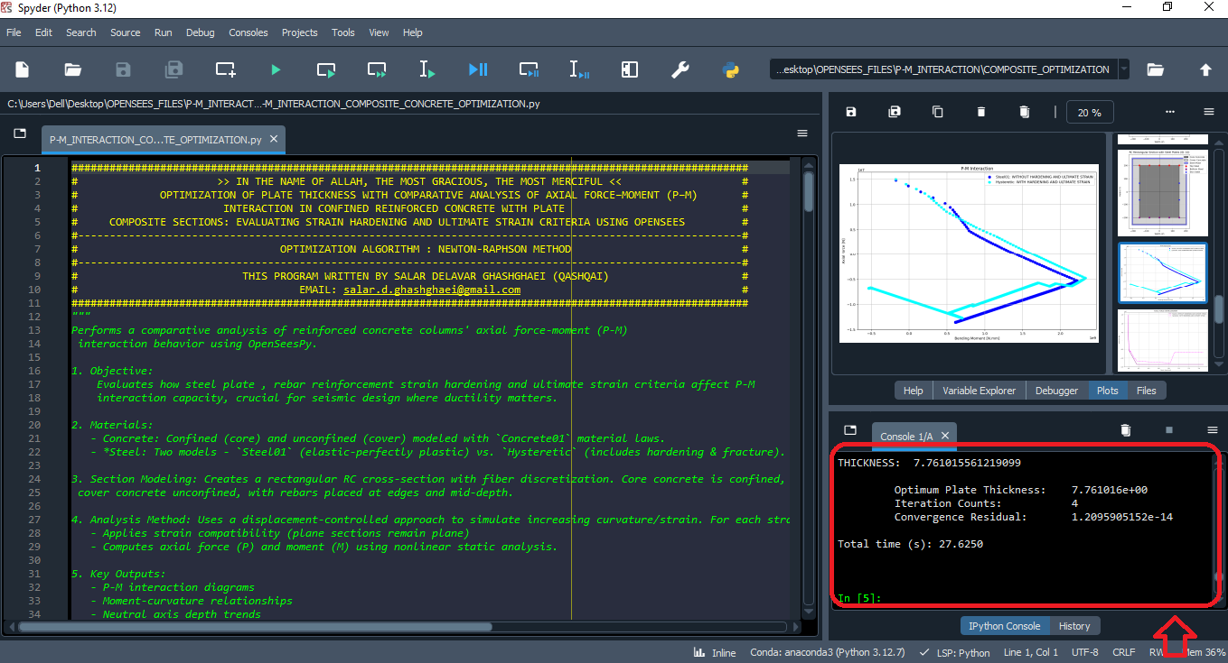

Slide 4
PLATE THICKNESS: 1.00000000e+01
F: 1036871.385868473
Fmin: 1036866.7435809877
Fmax: 1036876.0281560402
DF: 464228.75262796873
DX: 2.2335354714649007
IT: 1 - RESIDUAL: 2.2335354714649007 - PLATE THICKNESS: 10
PLATE THICKNESS: 7.76646453e+00
F: 2517.2699756994843
Fmin: 2512.650228900835
Fmax: 2521.8897225987166
DF: 461974.6848940849
DX: 0.005448934883253633
IT: 2 - RESIDUAL: 0.005448934883253633 - PLATE THICKNESS: 7.766464528535099
PLATE THICKNESS: 7.76101559e+00
F: 0.014982929453253746
Fmin: -4.6047088745981455
Fmax: 4.63467482291162
DF: 461969.1848754882
DX: 3.2432746477001504e-08
IT: 3 - RESIDUAL: 3.2432746477001504e-08 - PLATE THICKNESS: 7.7610155936518455
PLATE THICKNESS: 7.76101556e+00
F: 5.587935447692871e-09
Fmin: -4.619691805914044
Fmax: 4.619691899046302
DF: 461969.18524801725
DX: 1.2095905151537061e-14
IT: 4 - RESIDUAL: 1.2095905151537061e-14 - PLATE THICKNESS: 7.761015561219099
Optimum Plate Thickness: 7.761016e+00
Iteration Counts: 4
Convergence Residual: 1.2095905152e-14
Total time (s): 27.6250

Slide 5
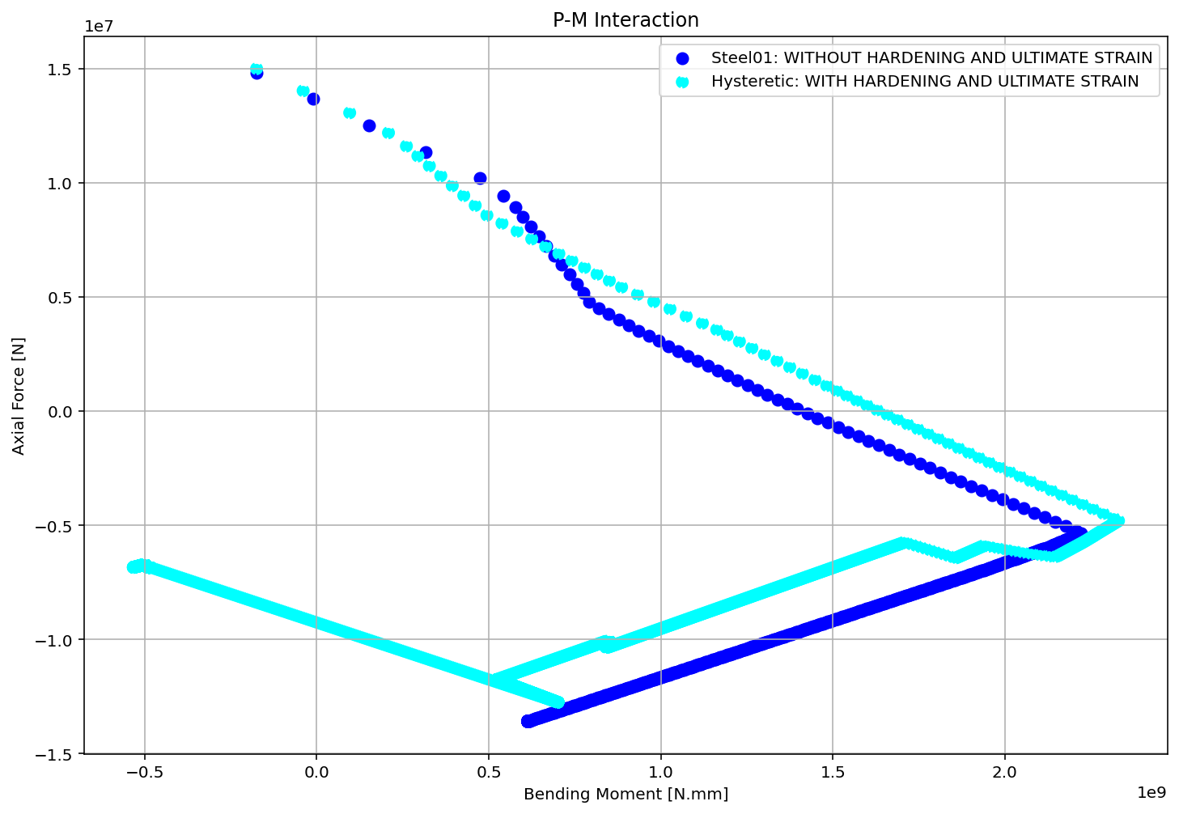

Slide 6
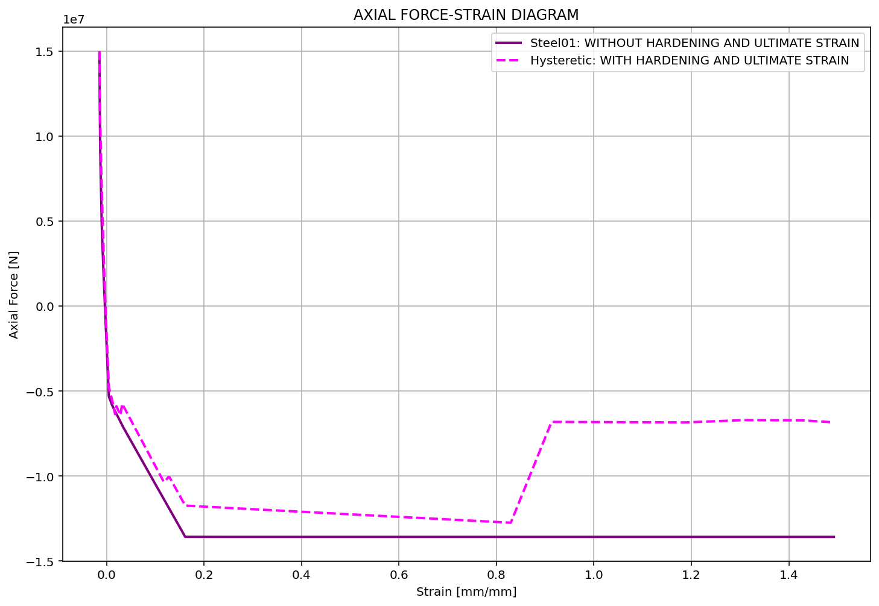

Slide 7
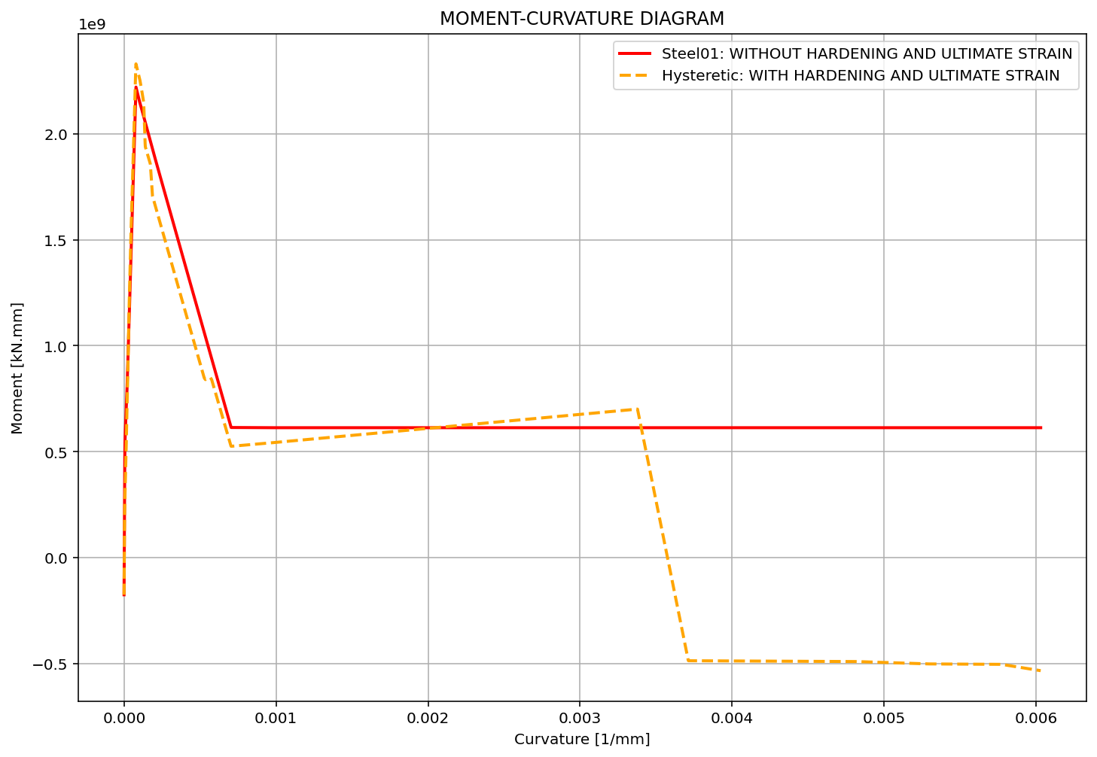

Slide 8
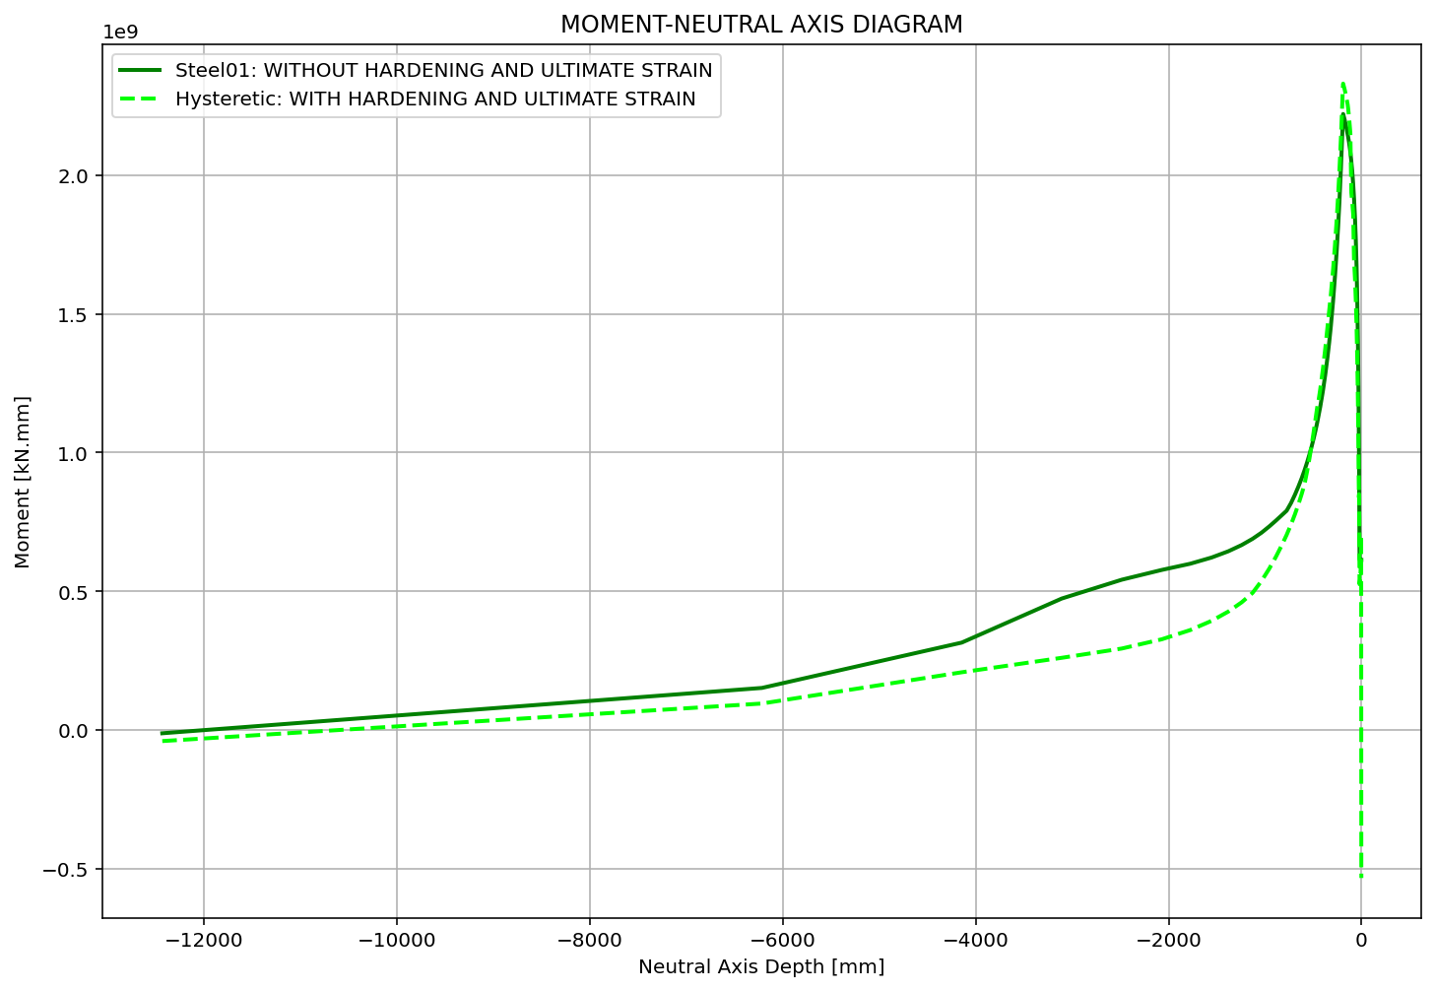

Slide 9
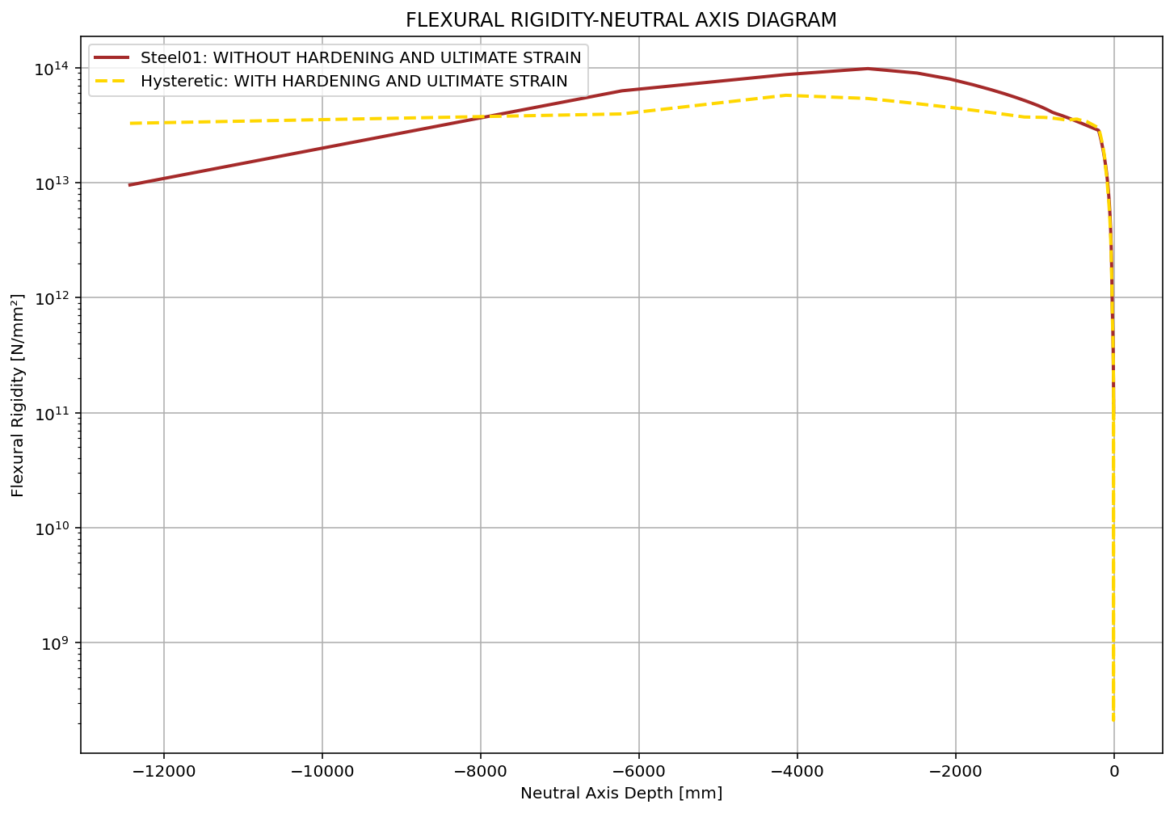

Slide 10
