Slide 1
>> IN THE NAME OF ALLAH, THE MOST GRACIOUS, THE MOST MERCIFUL <<
MODELING OF 2D DOUBLE PENDULUM MDOF STRUCTURE USING OPENSEES
THIS PROGRAM WRITTEN BY MICHAEL H. SCOTT AND MODIFIED BY SALAR DELAVAR GHASHGHAEI (QASHQAI)

Slide 2
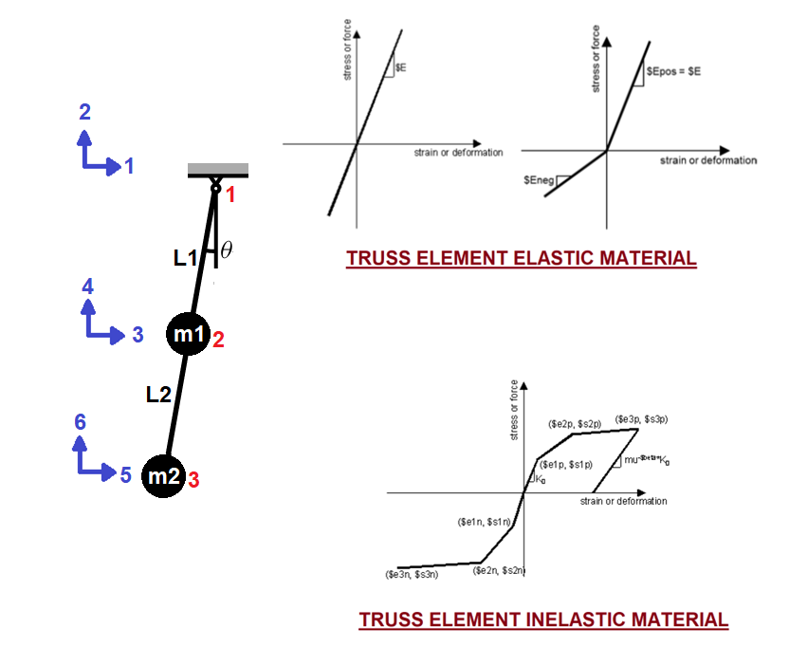

Slide 3
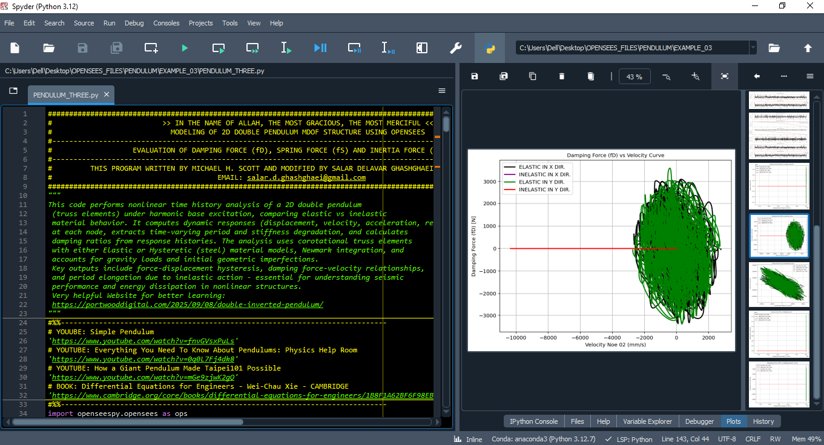

Slide 4
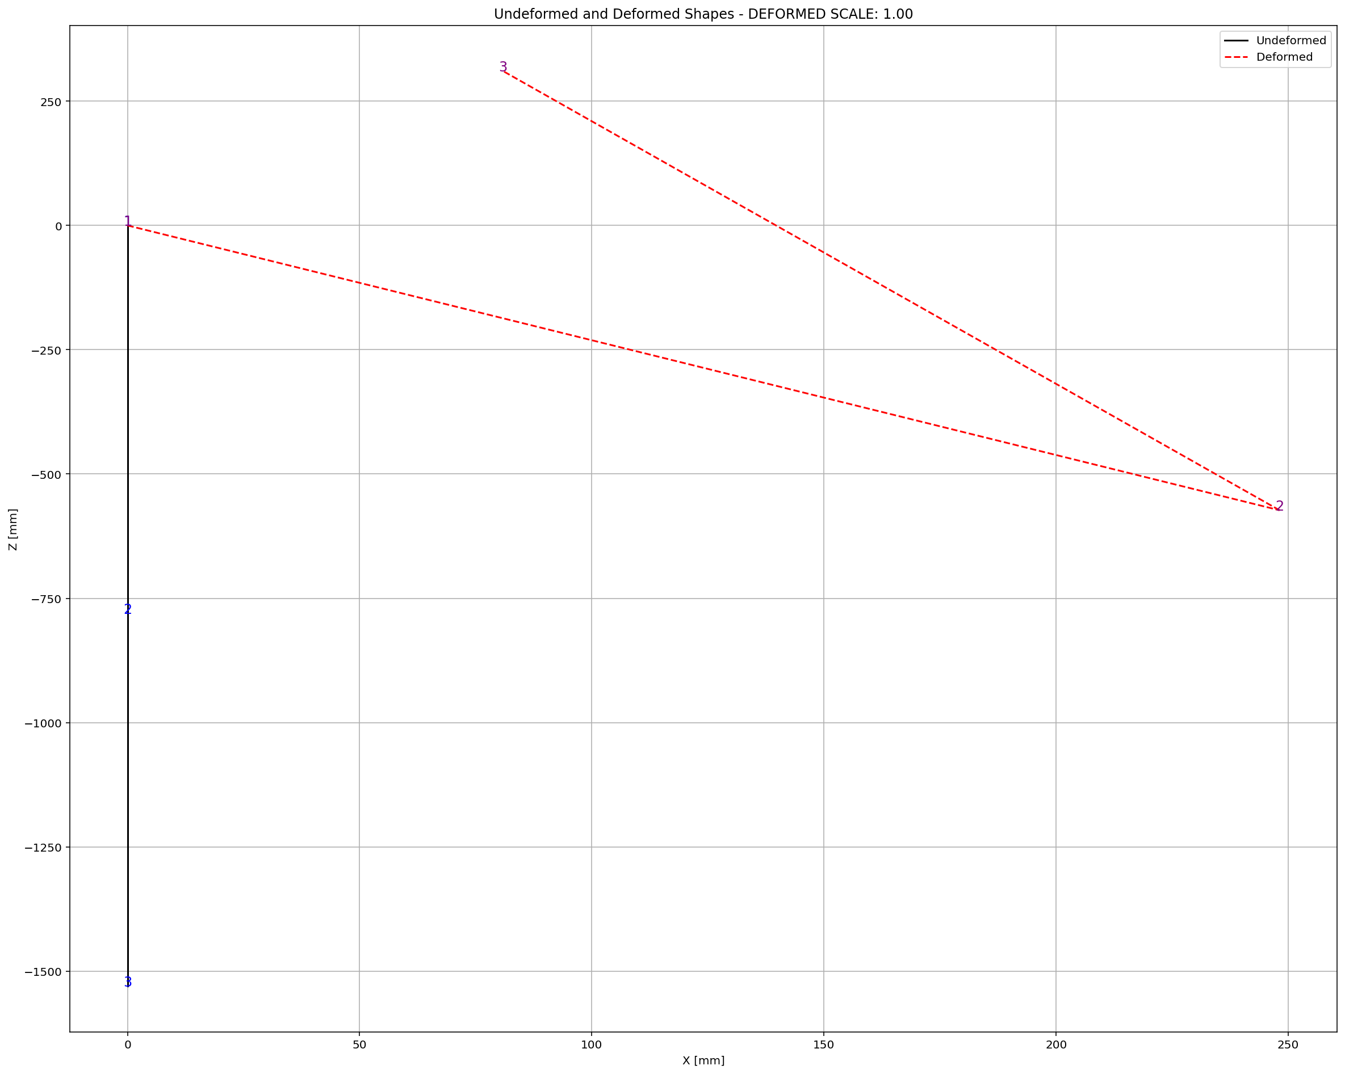

Slide 5
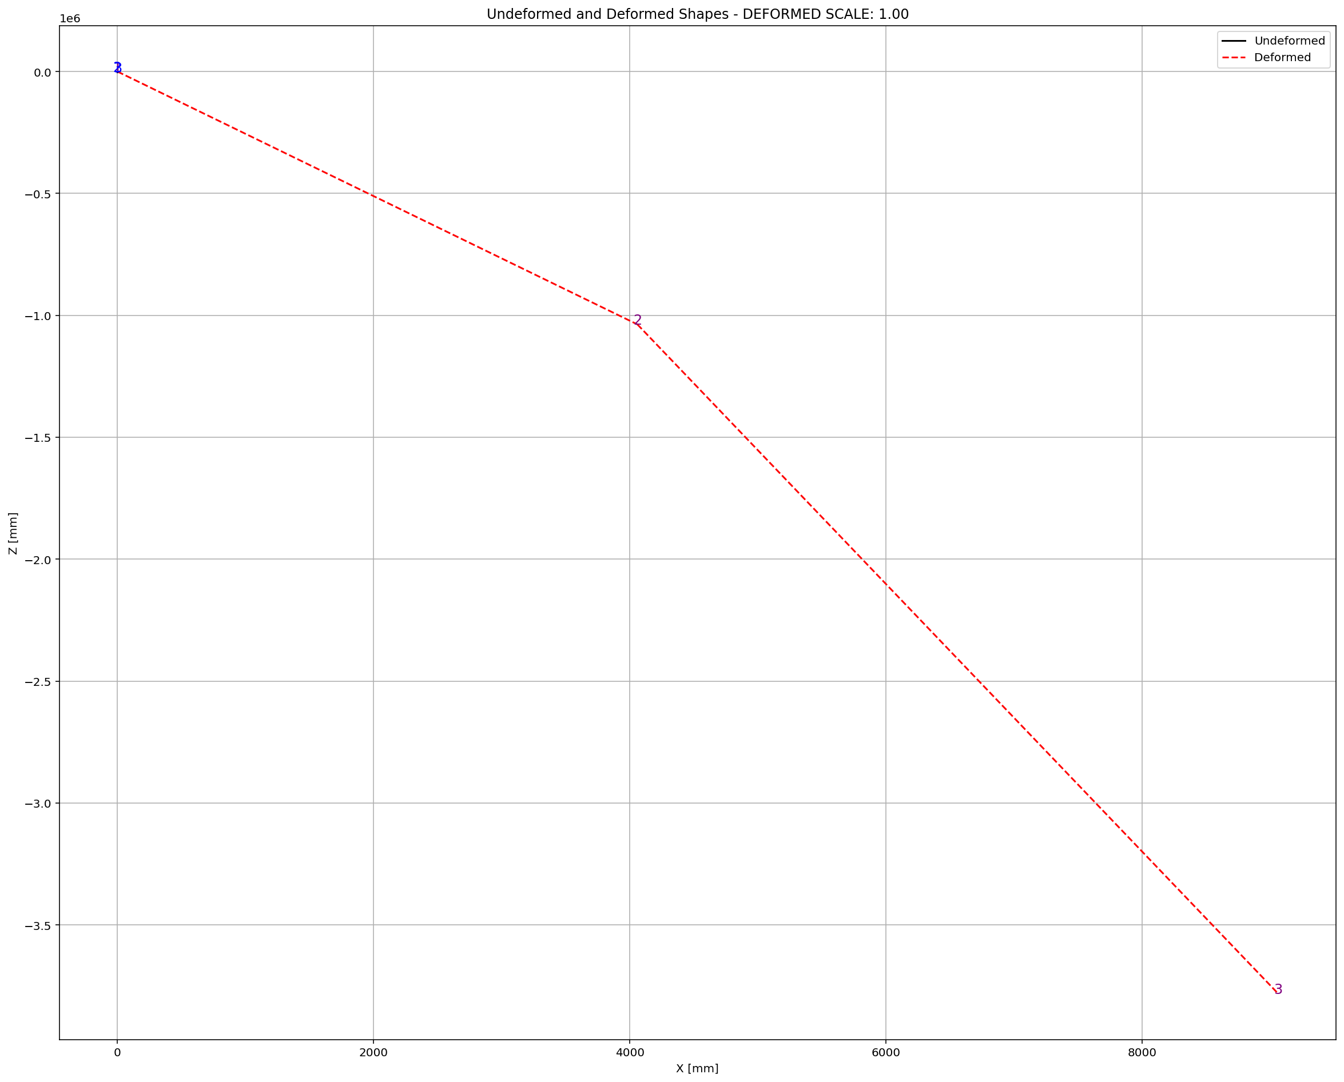

Slide 6
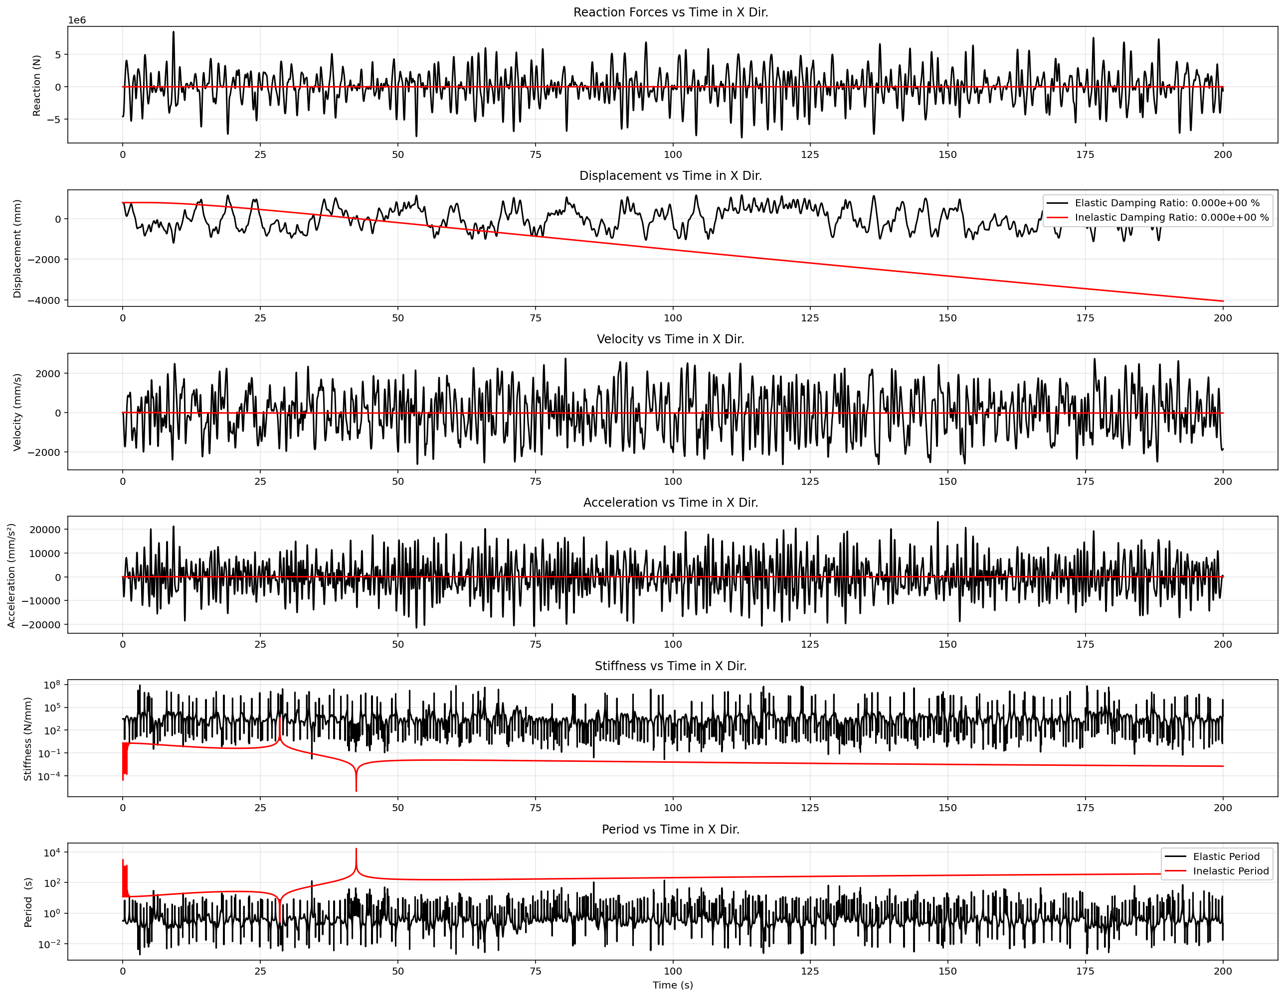

Slide 7
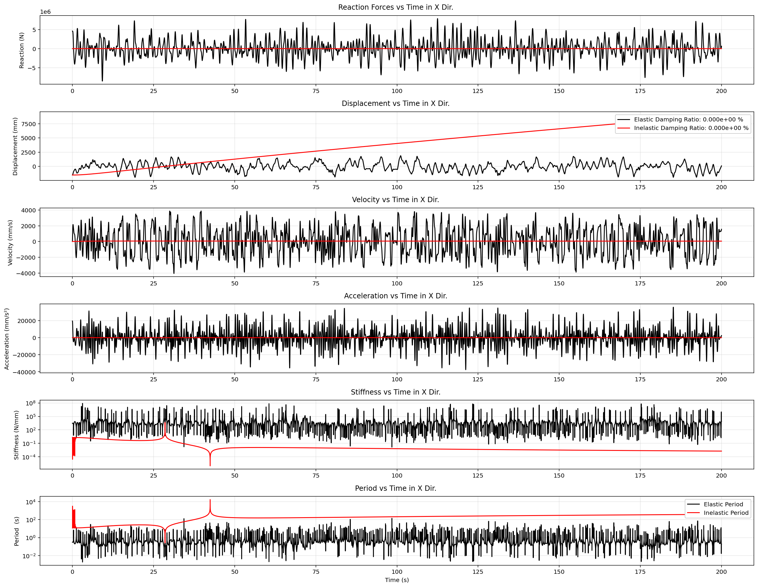

Slide 8
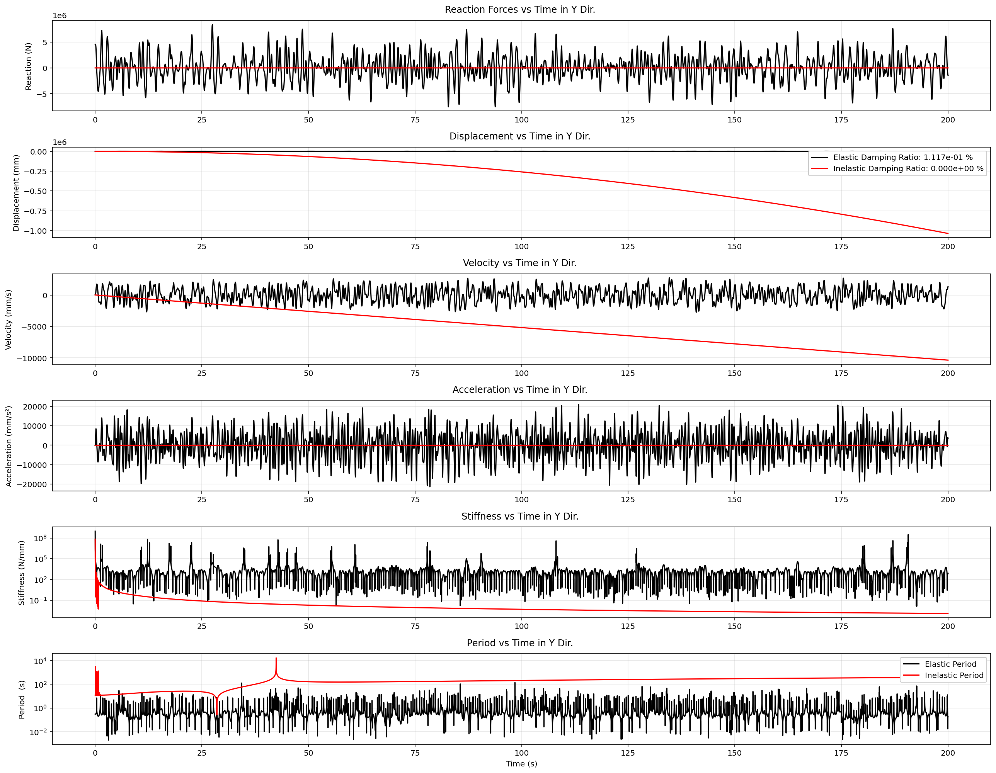

Slide 9
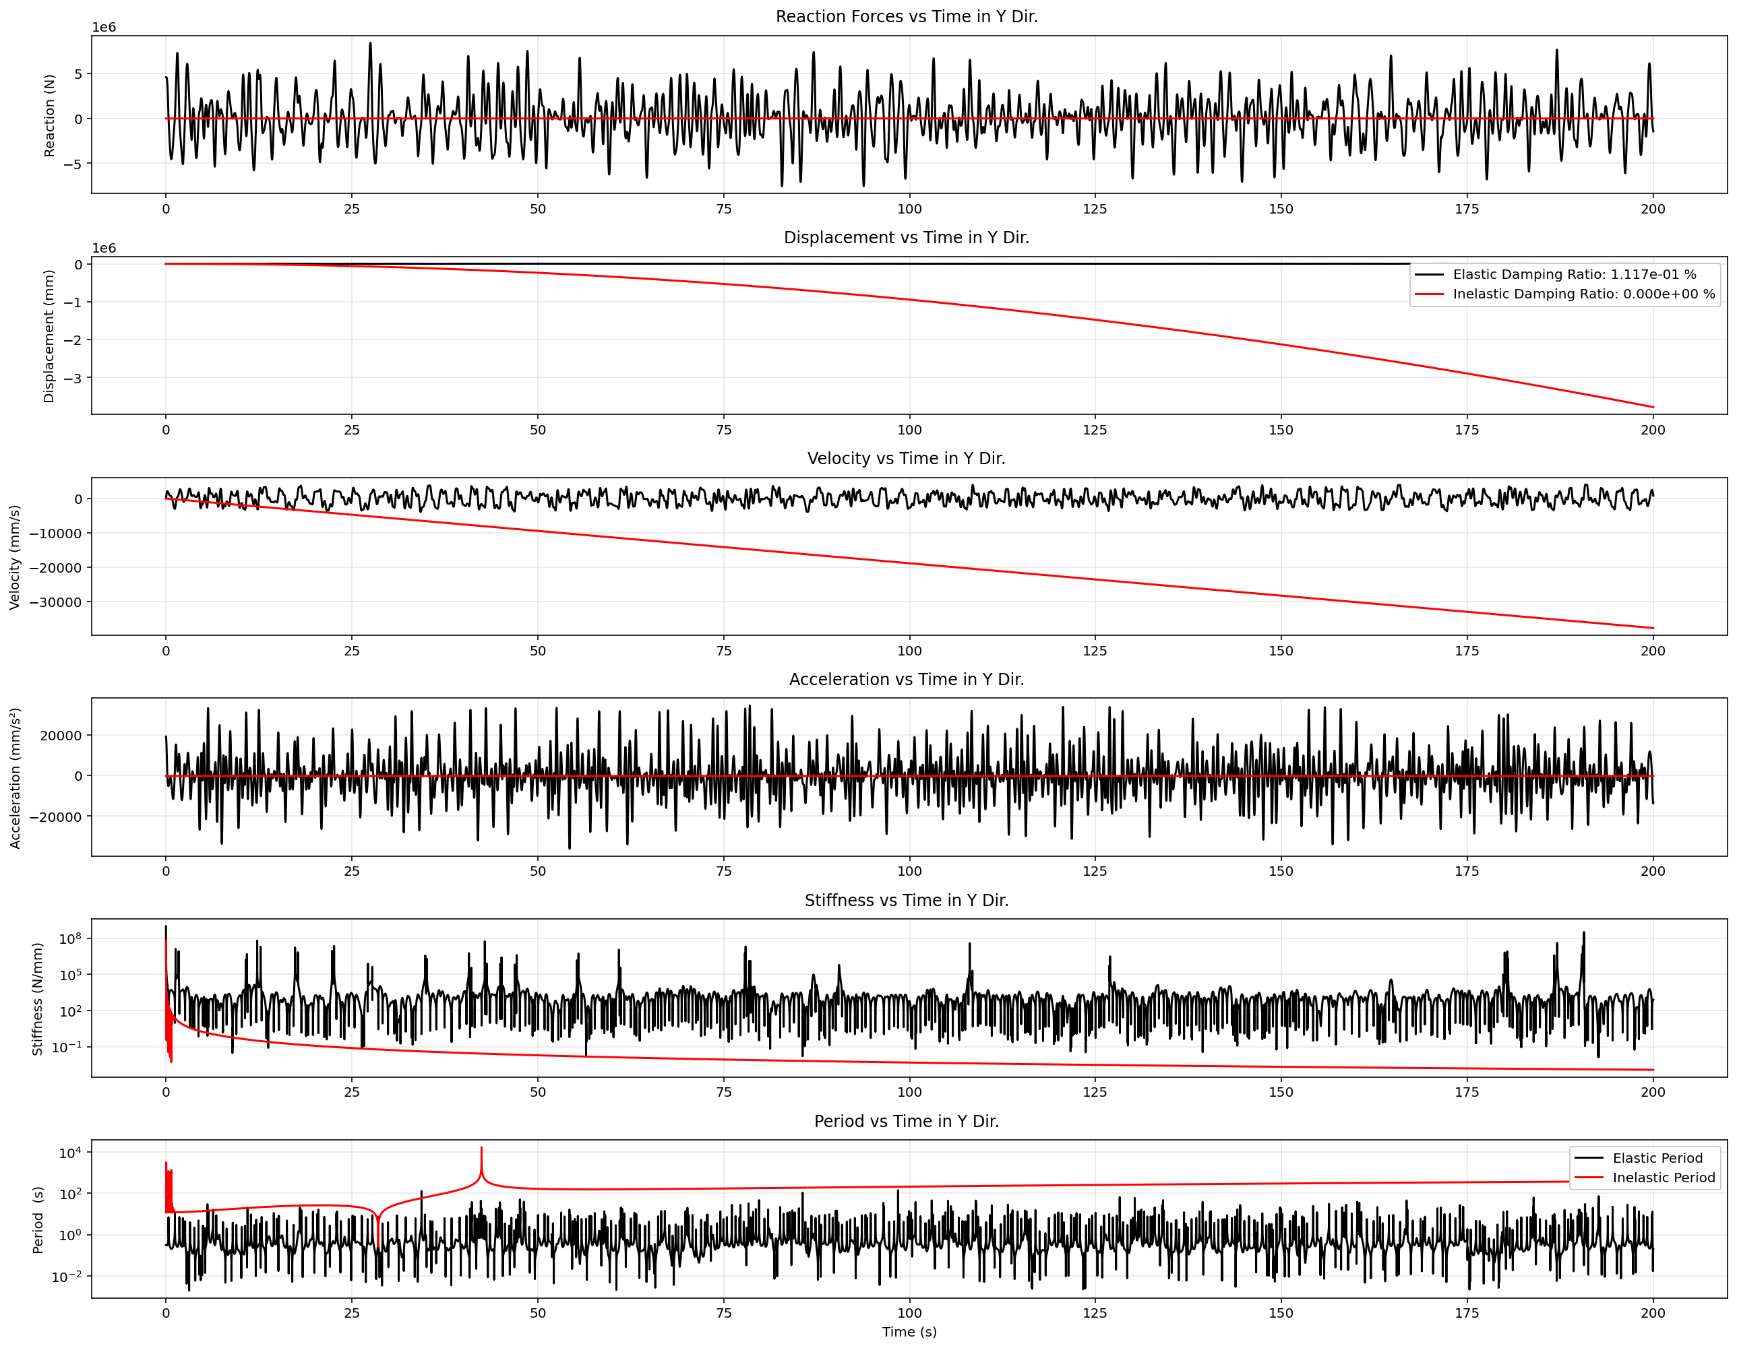

Slide 10
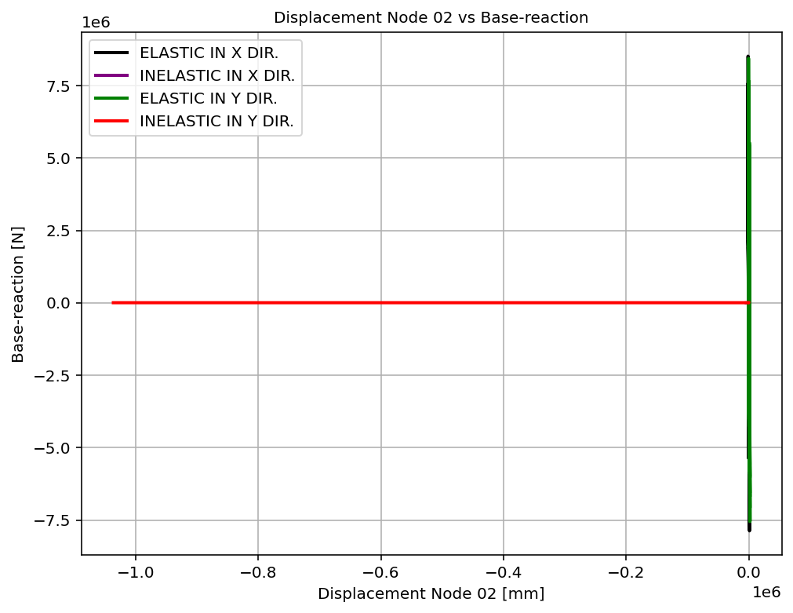

Slide 11
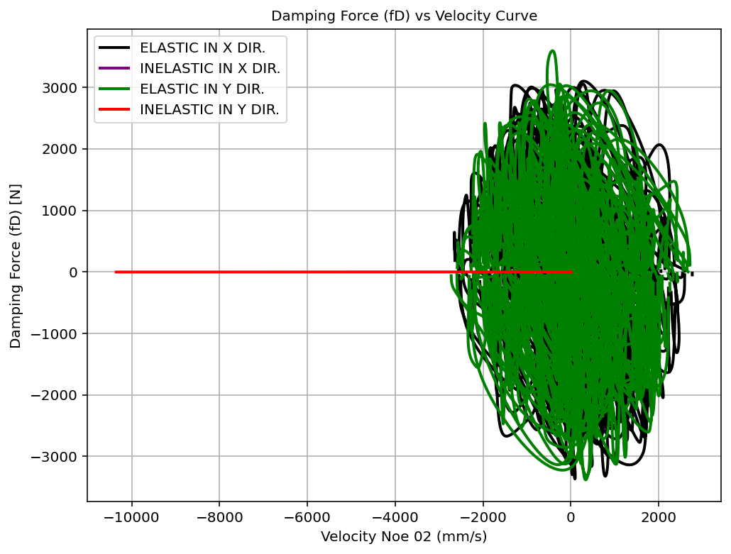

Slide 12
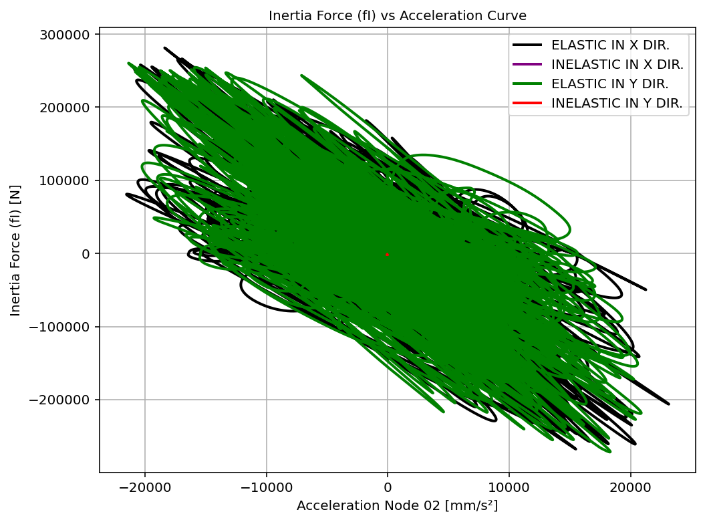

Slide 13
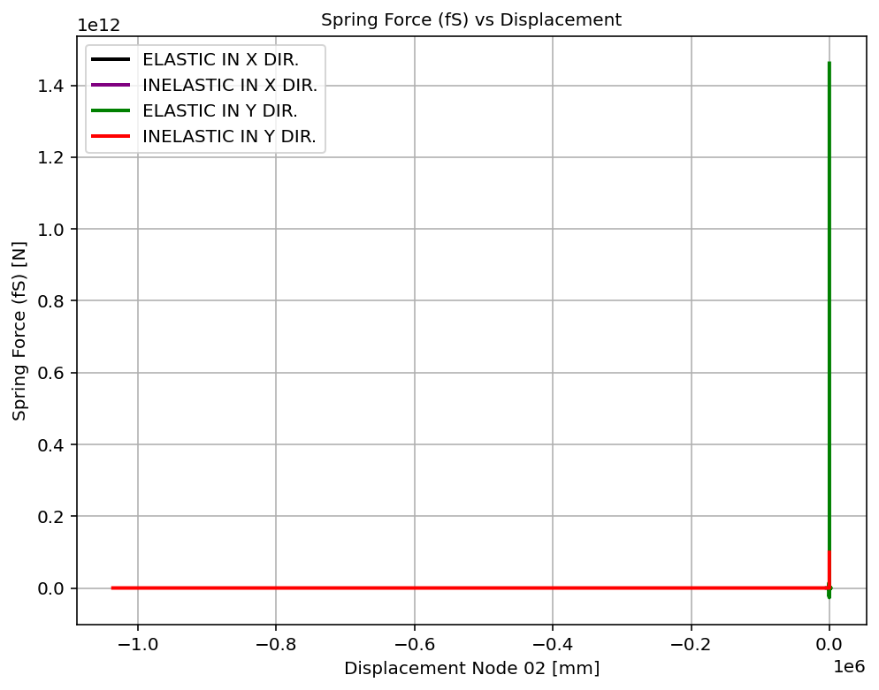

Slide 14
