Slide 1
>> IN THE NAME OF ALLAH, THE MOST GRACIOUS, THE MOST MERCIFUL <<
SENSITIVITY ANALYSIS OF COLUMN DUCTILITY RATIO AND OPENSEES VIA 20 SEISMIC GROUND MOTIONS
THIS PROGRAM WRITTEN BY SALAR DELAVAR GHASHGHAEI (QASHQAI)

Slide 2
Assume that a multi-degree-of-freedom structure is subjected to nonlinear dynamic analysis under
twenty different ground motion records. To investigate the influence of column ductility on
seismic performance, a sensitivity analysis is performed by systematically varying each column’s
ductility ratio from 20 to 50 in 21 steps. For each ductility level, a pushover analysis provides
the capacity curve and equivalent SDOF parameters, a cyclic displacement analysis establishes a
reference hysteretic energy, and twenty nonlinear time-history analyses are conducted using
different ground motions. From these analyses, the Energy Dissipation Capacity Index (EDCI)
and other response metrics such as maximum displacement, velocity, acceleration, damage index,
over-strength factor, ductility ratio, and equivalent viscous damping ratio are computed.
The median response over the twenty ground motions is then evaluated for each ductility level.
Finally, the results are assessed through trend plots, 3D contour surfaces, correlation heatmaps,
Random Forest regression, and ANOVA sensitivity analysis to identify the optimal column ductility
ratio that maximizes energy dissipation capacity while maintaining structural safety.

Slide 3
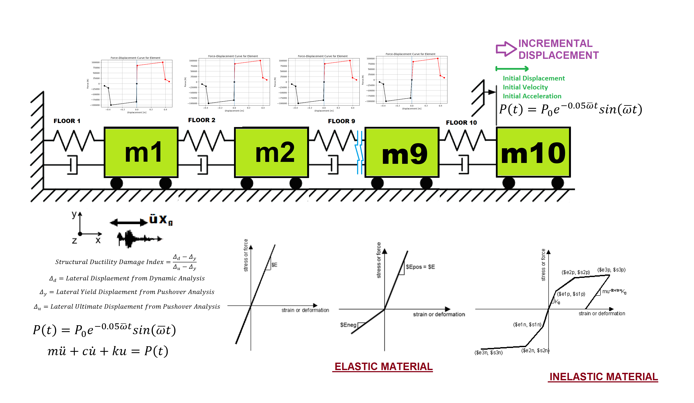

Slide 4
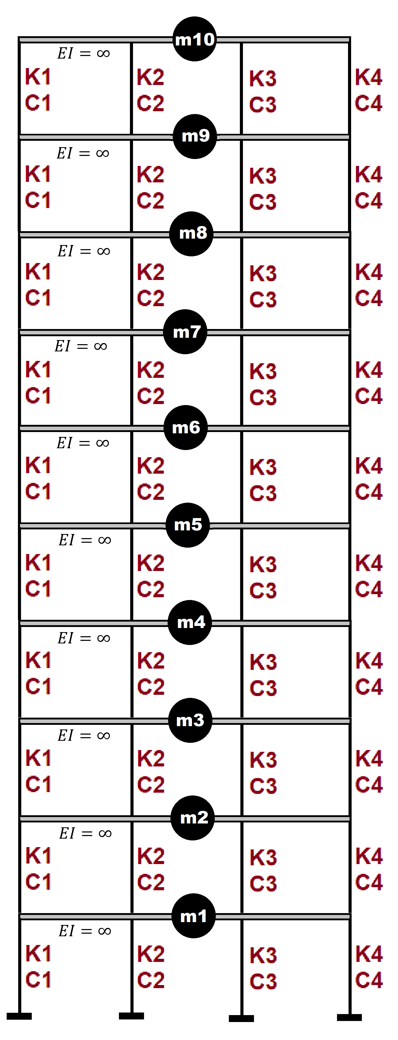

Slide 5
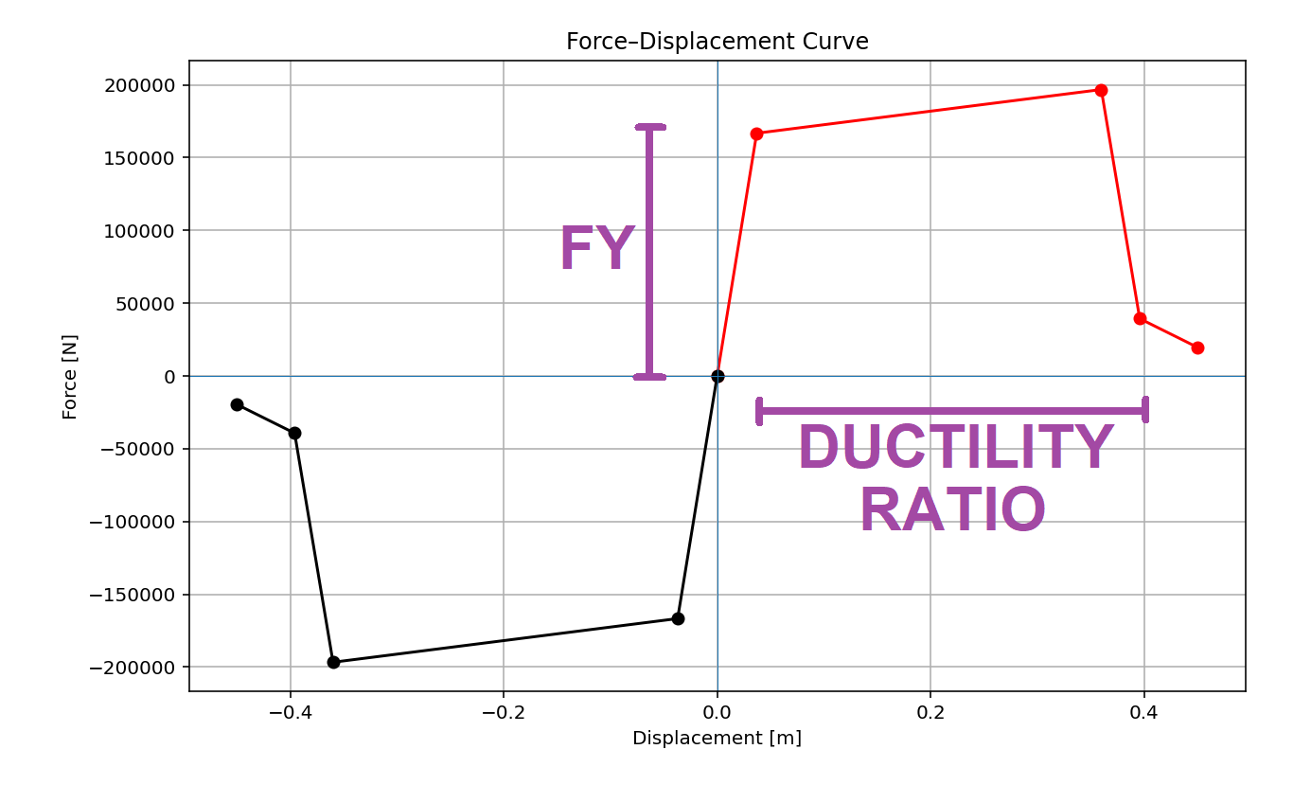

Slide 6
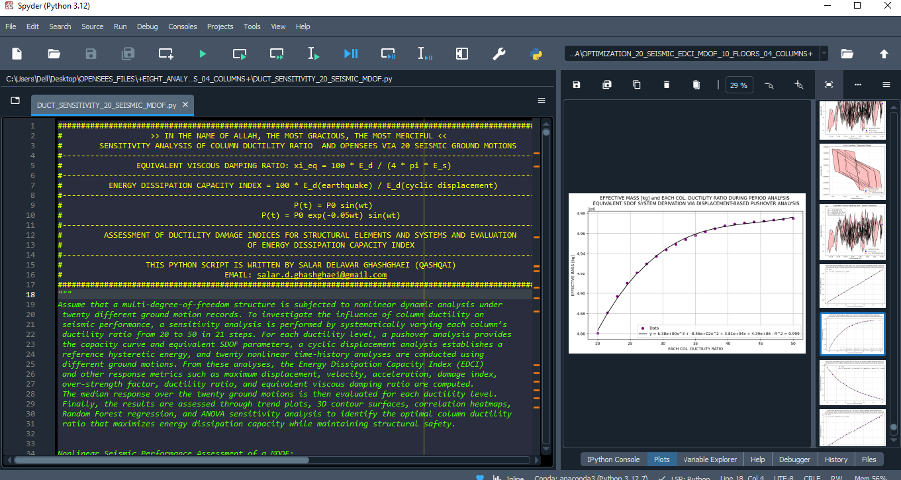

Slide 7
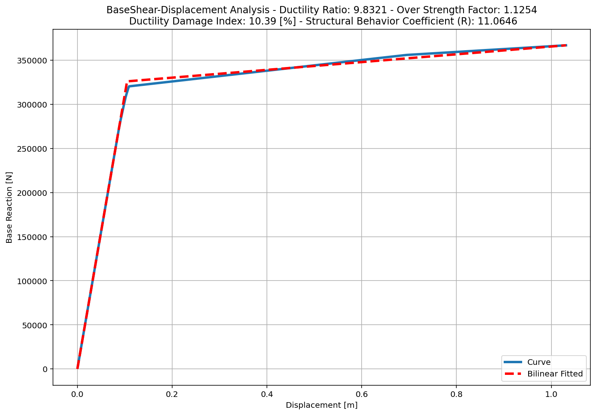

Slide 8
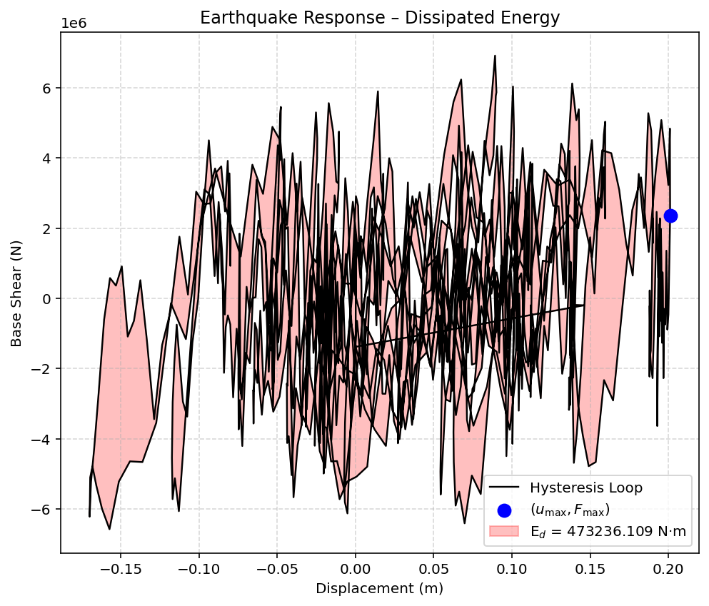

Slide 9
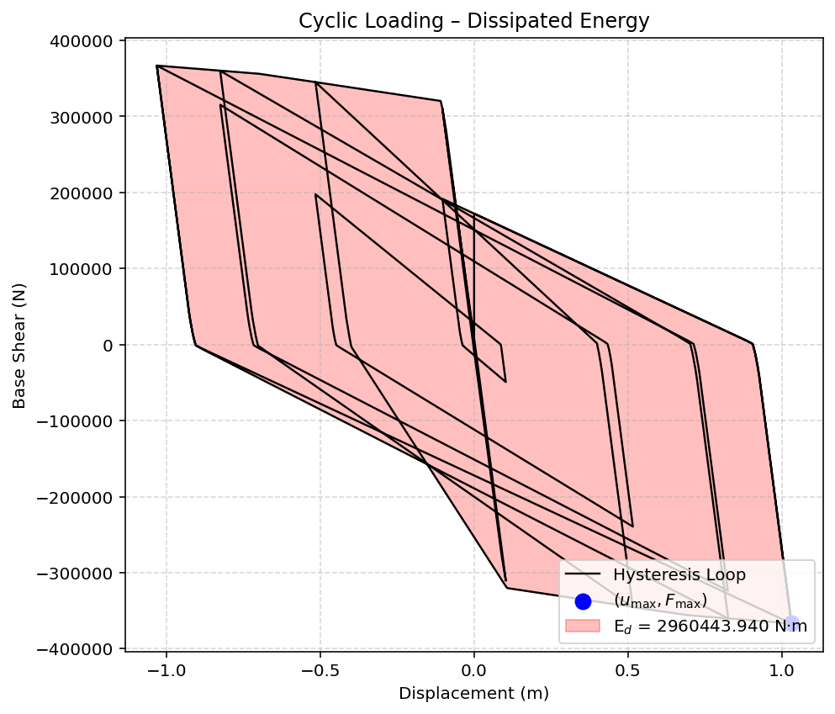

Slide 10
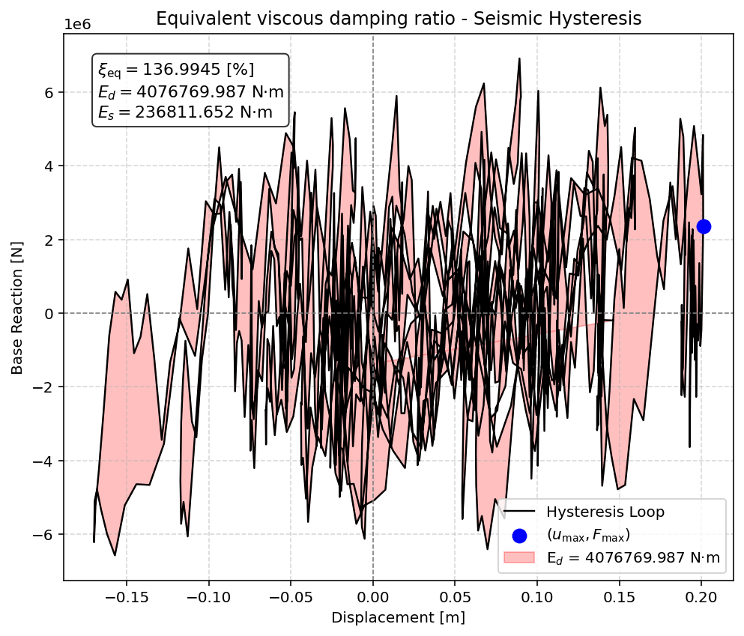

Slide 11
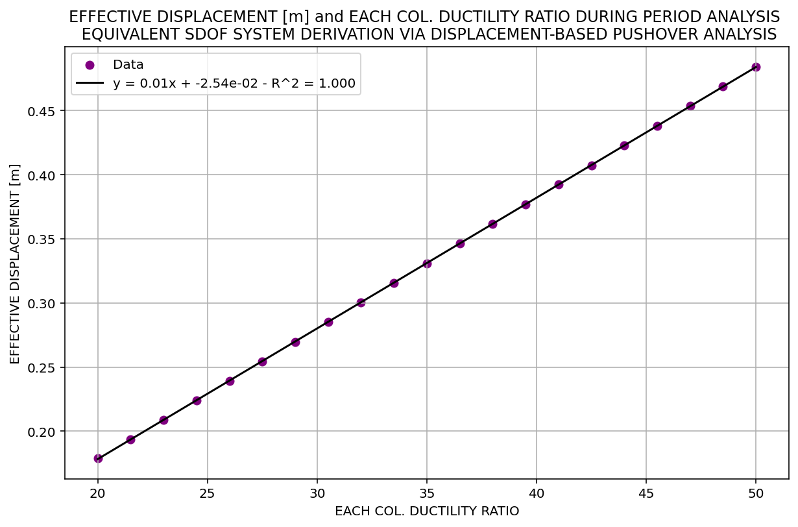

Slide 12
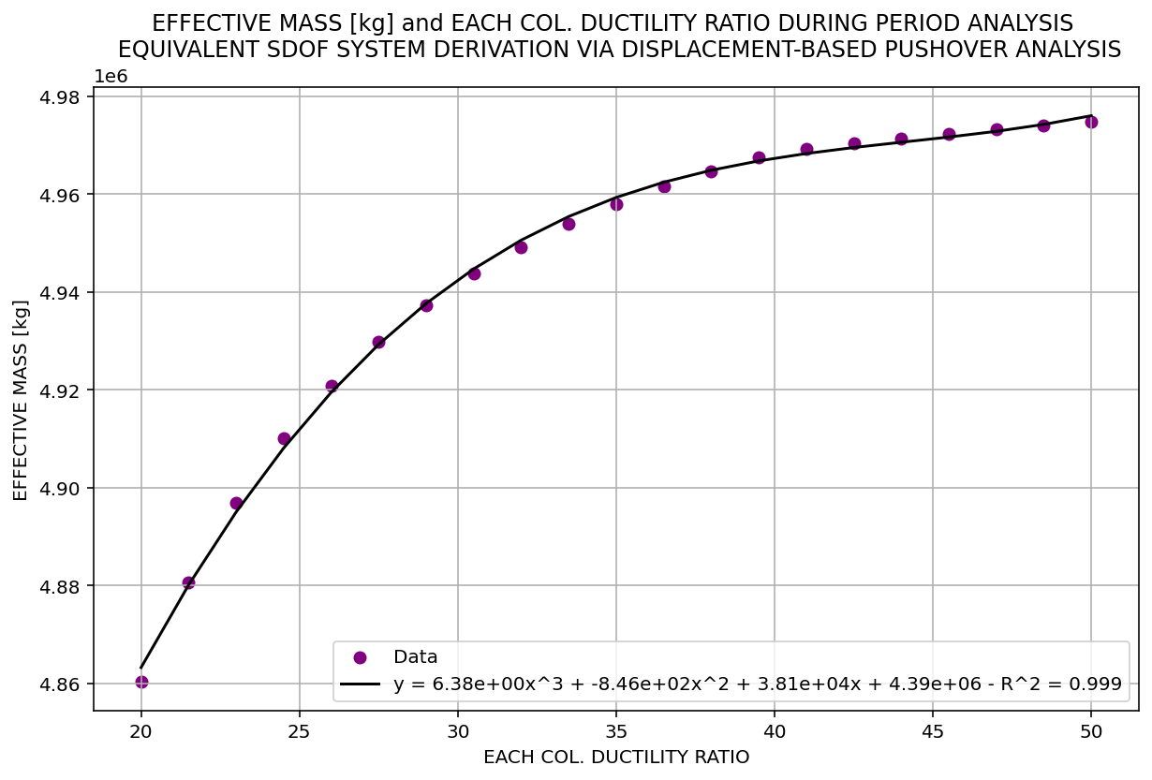

Slide 13
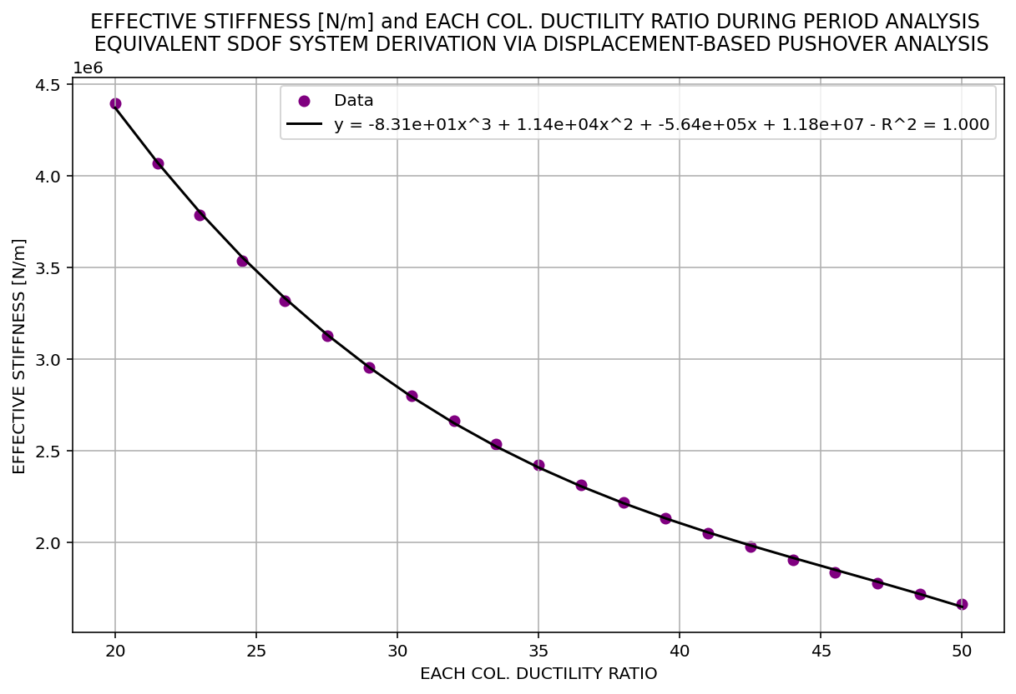

Slide 14
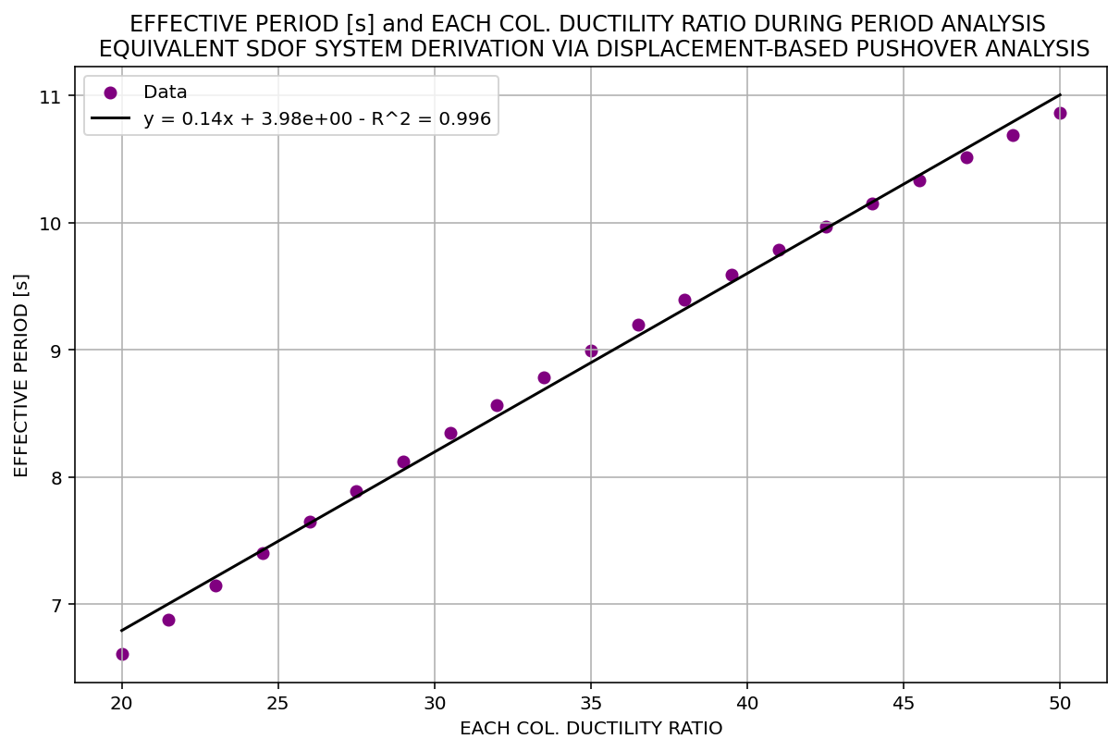

Slide 15
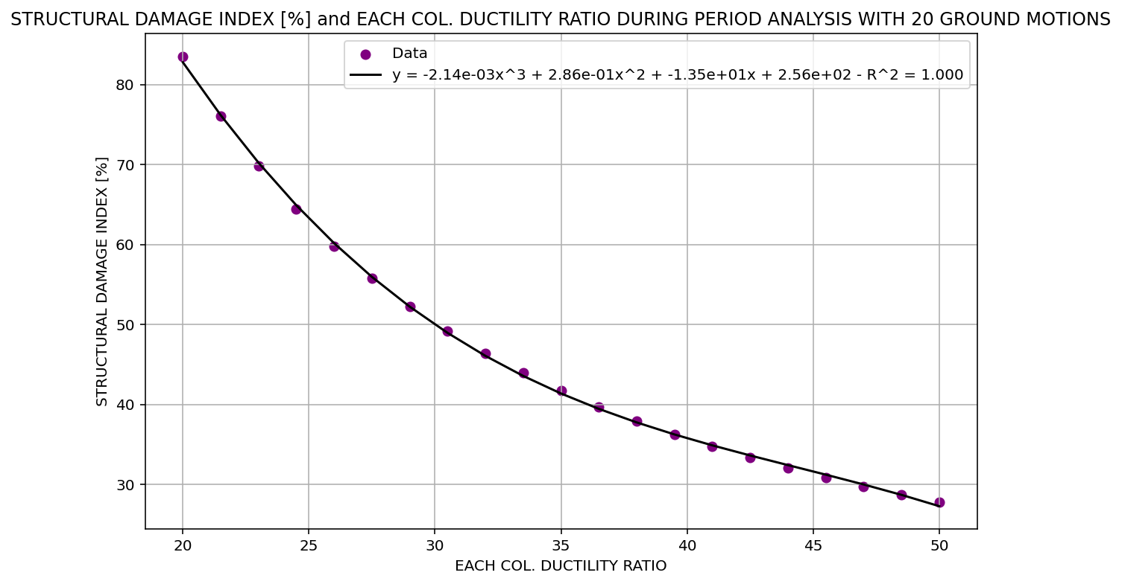

Slide 16
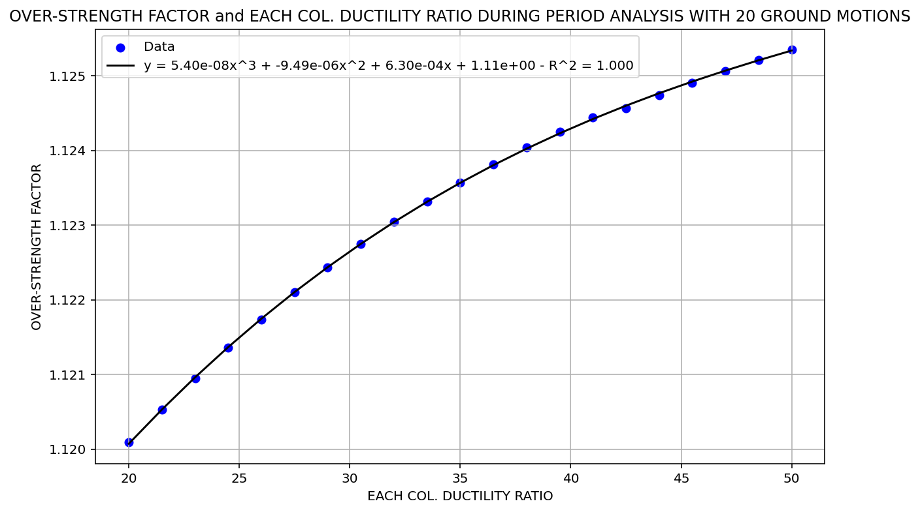

Slide 17
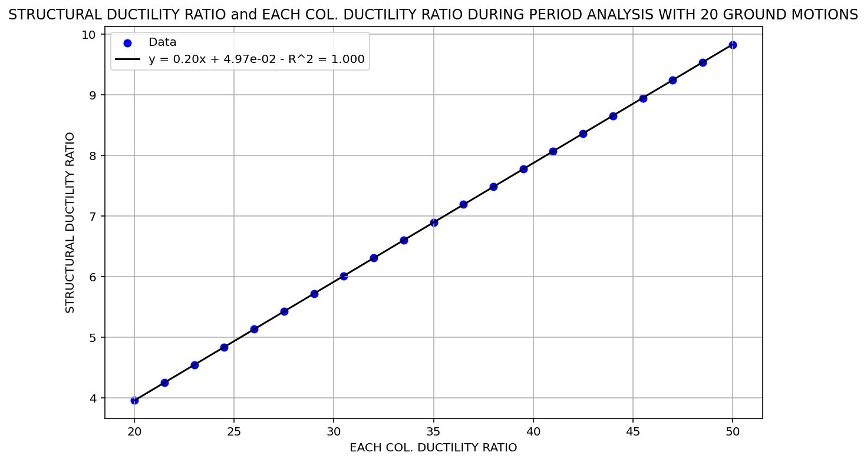

Slide 18
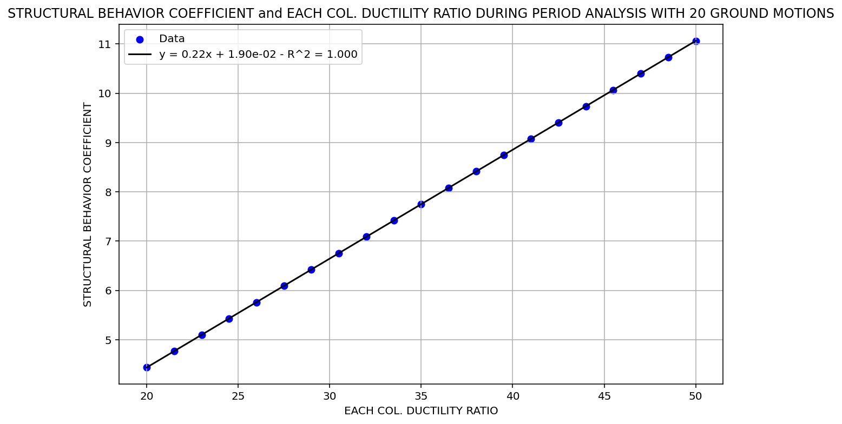

Slide 19
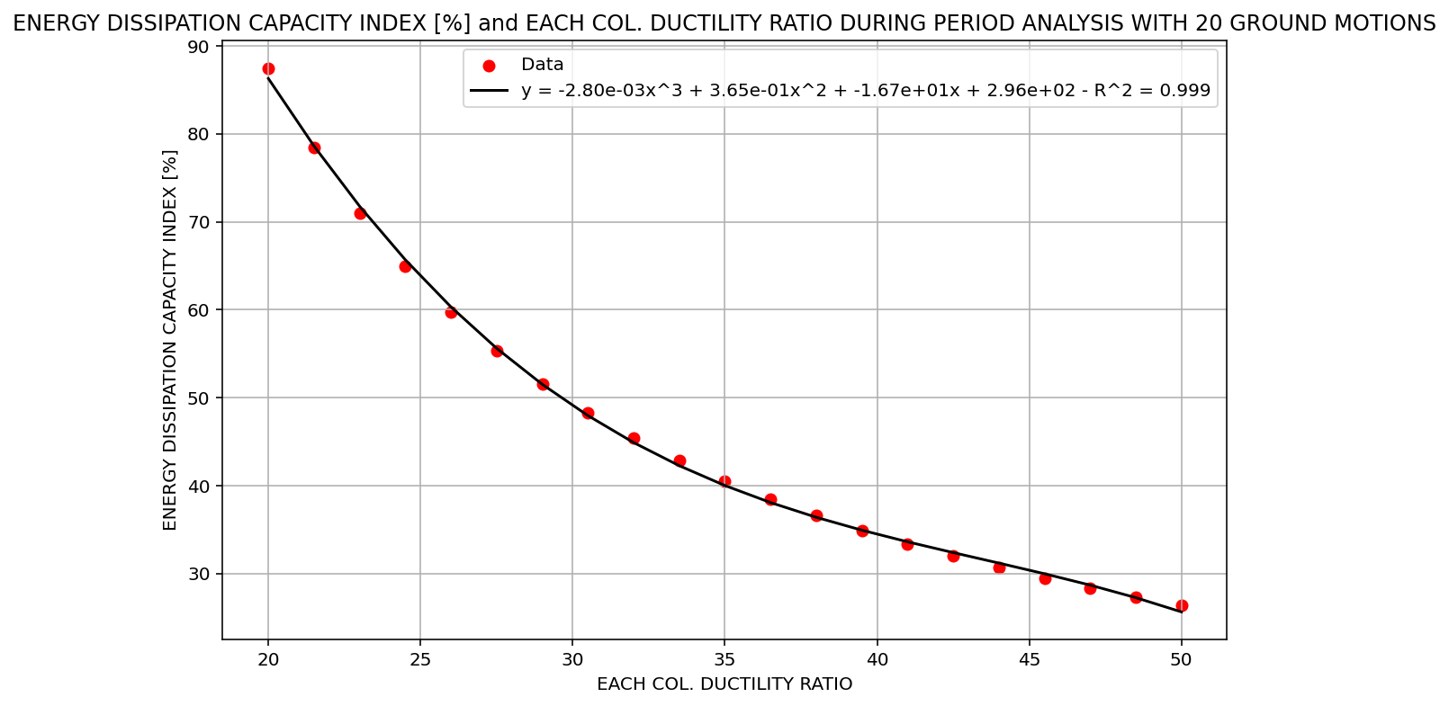

Slide 20
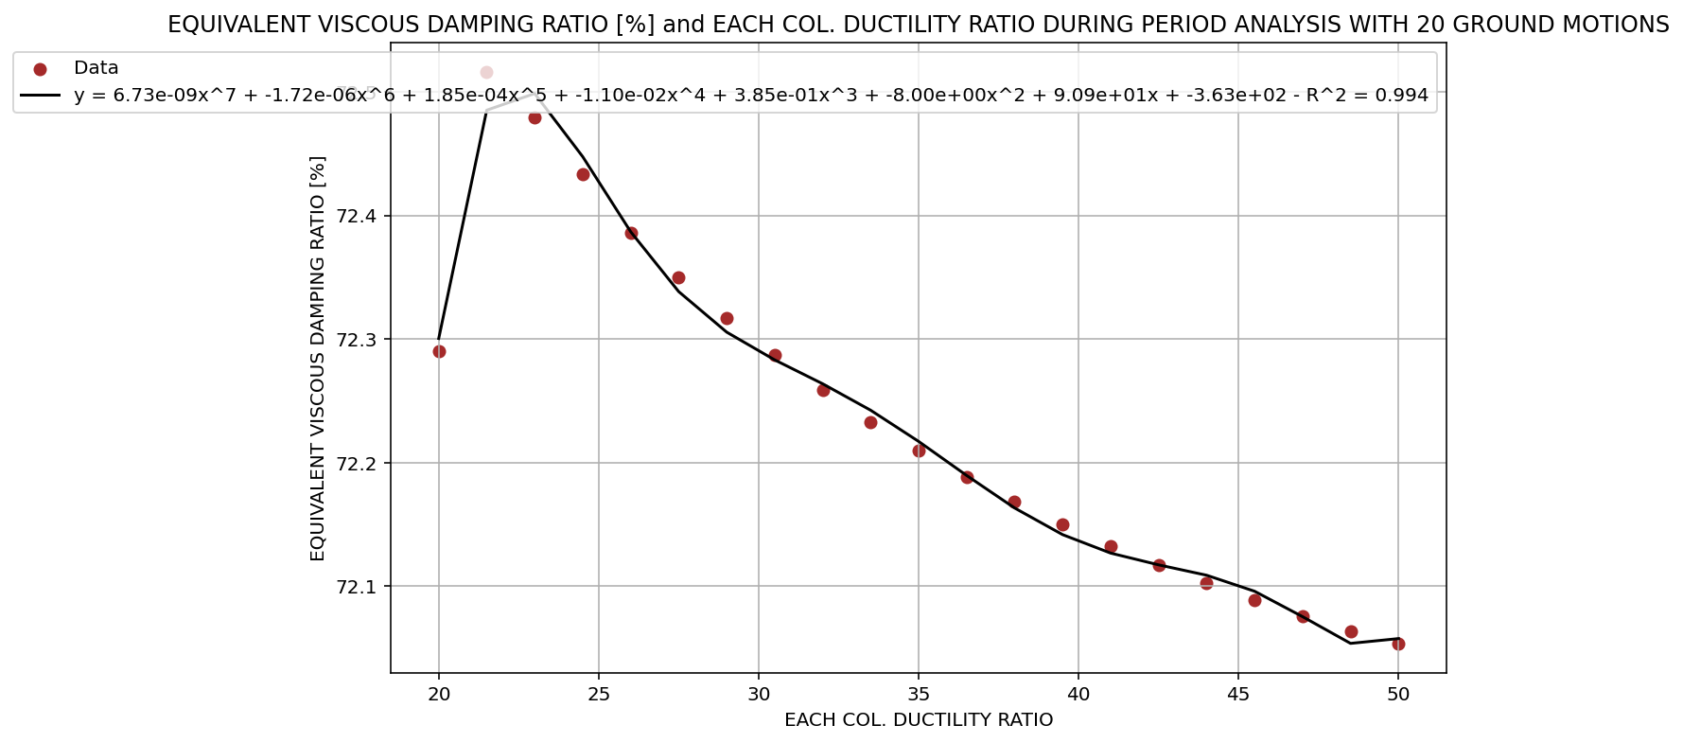

Slide 21
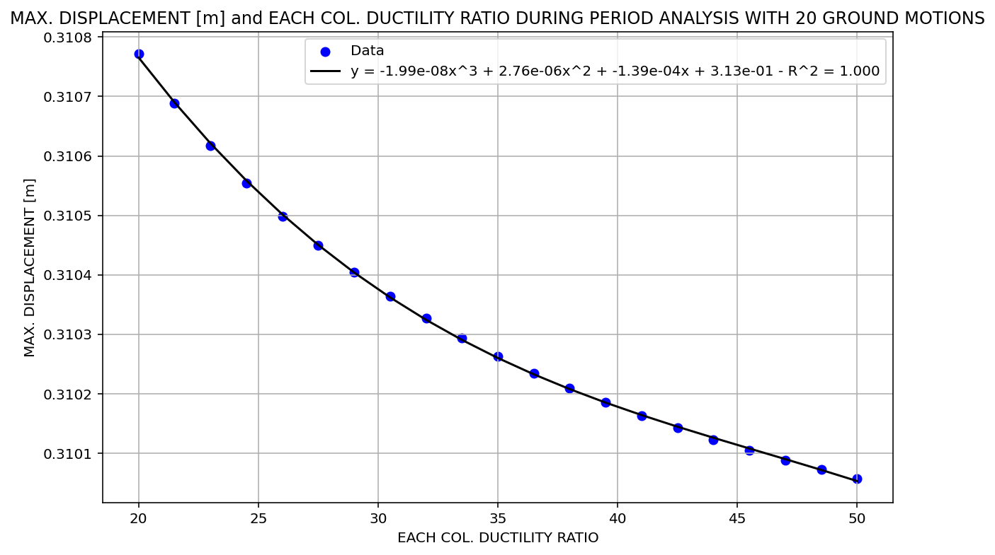

Slide 22
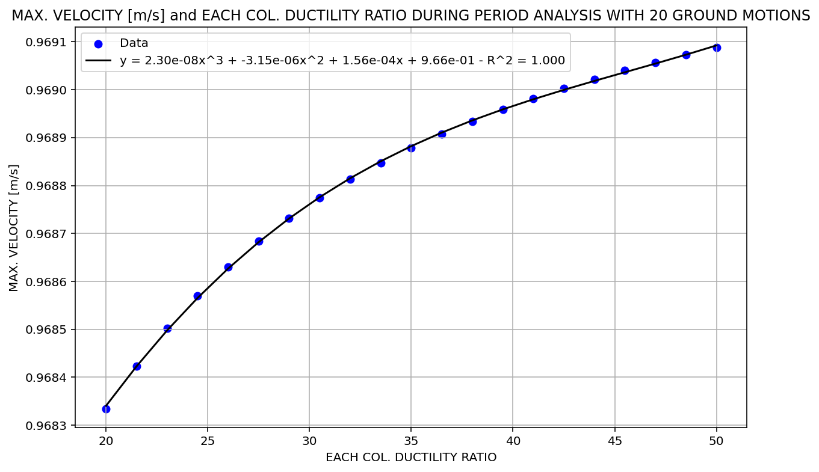

Slide 23
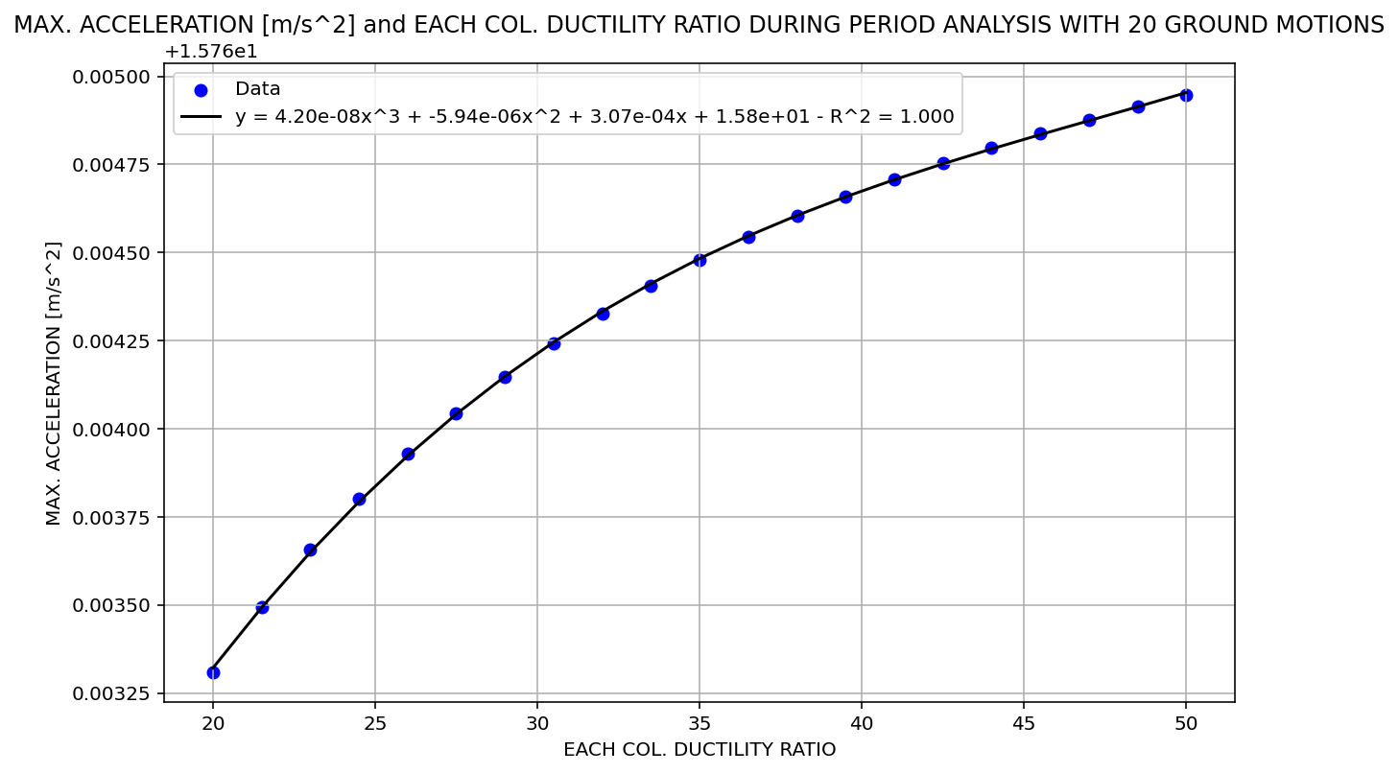

Slide 24
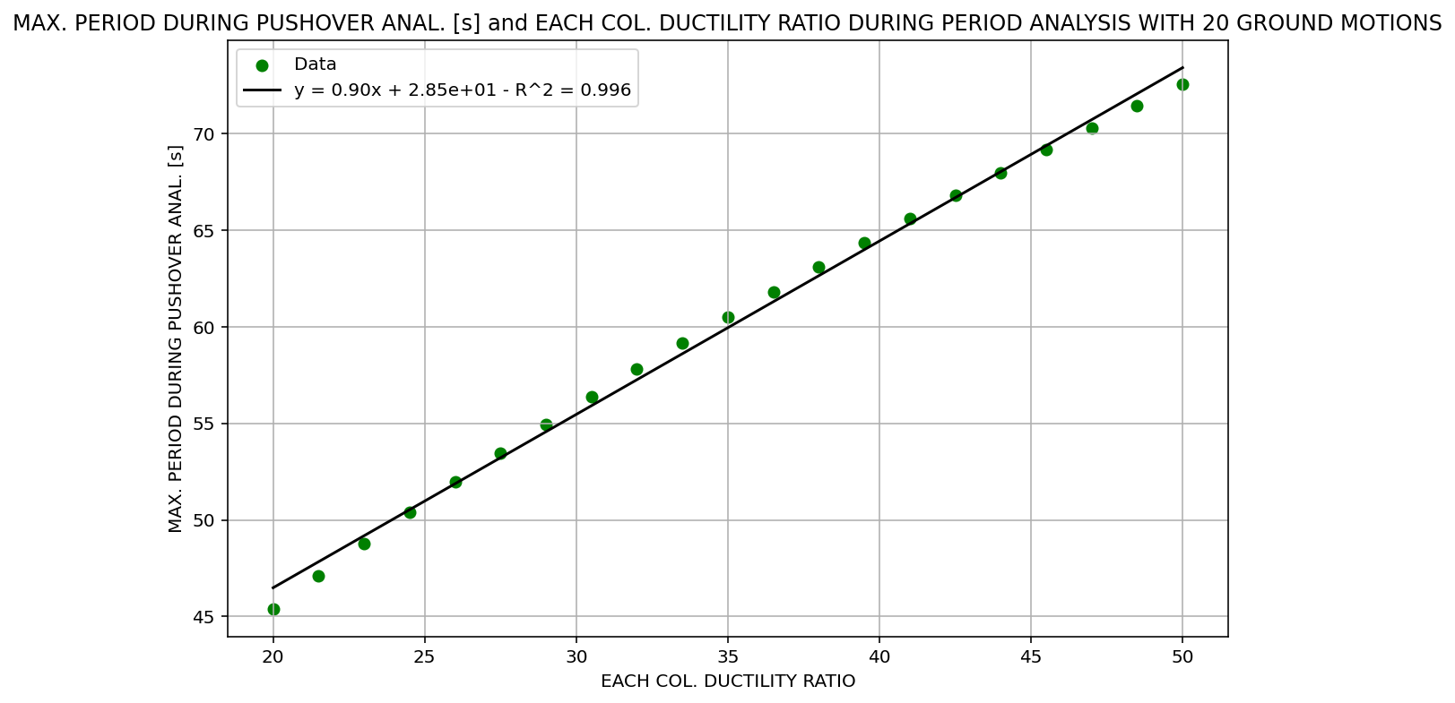

Slide 25
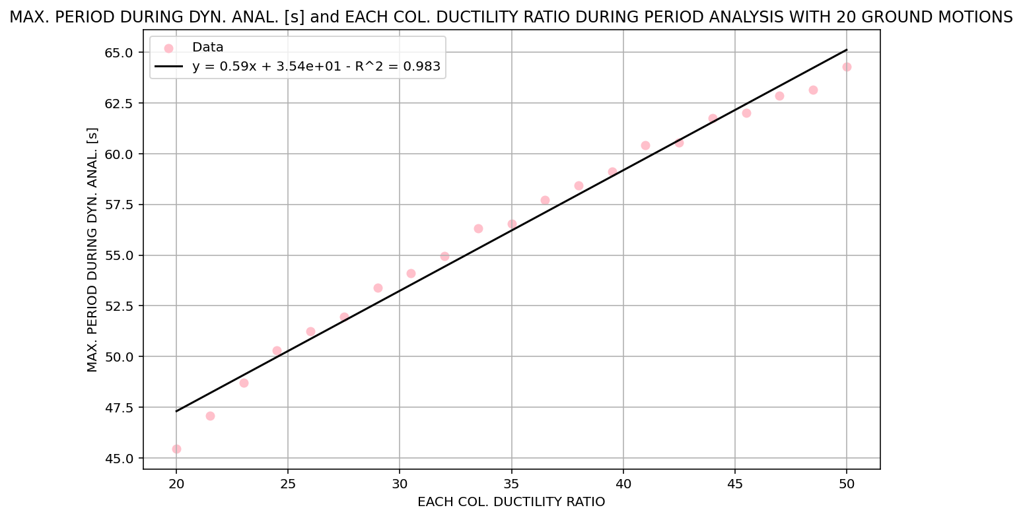

Slide 26
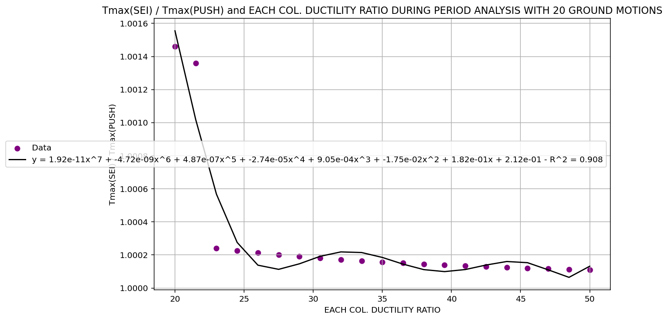

Slide 27
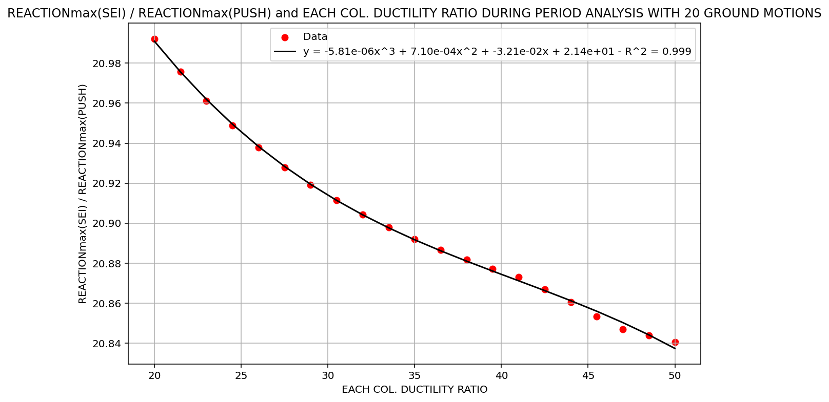

Slide 28
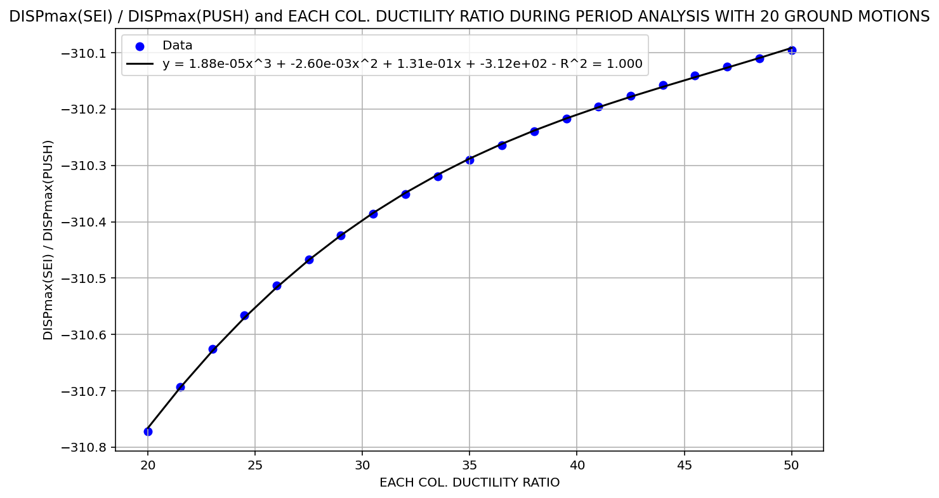

Slide 29
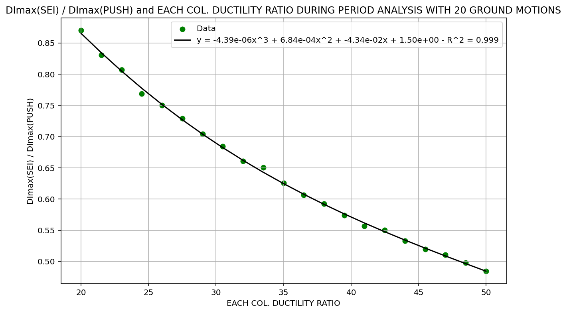

Slide 30
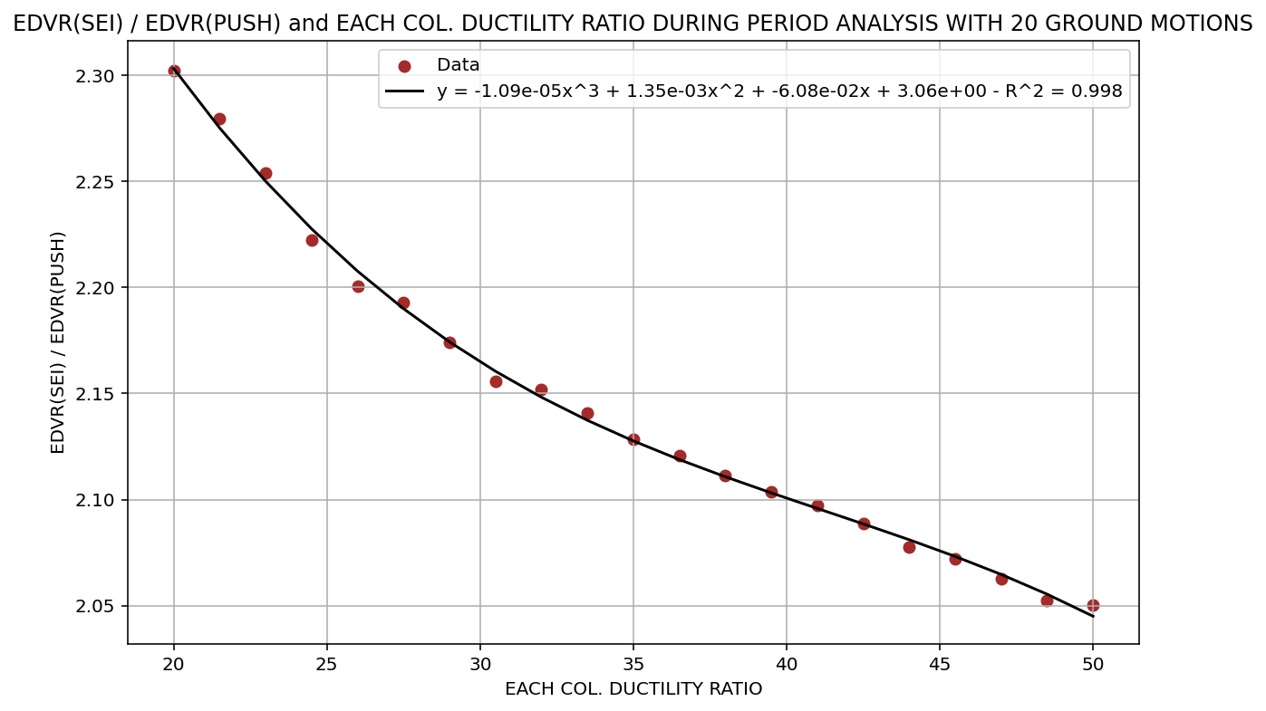

Slide 31
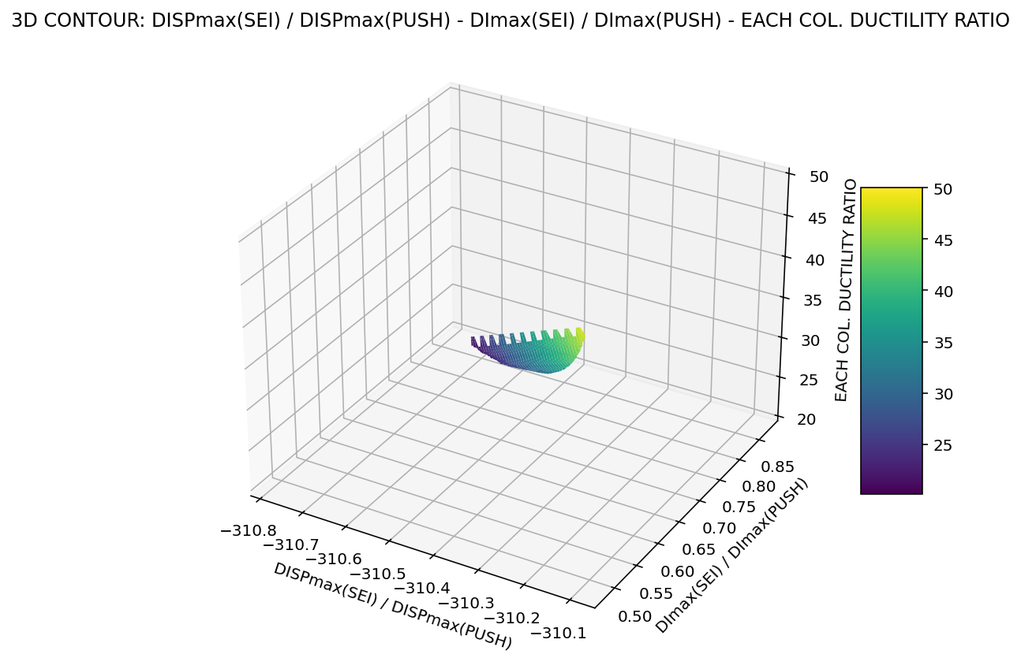

Slide 32
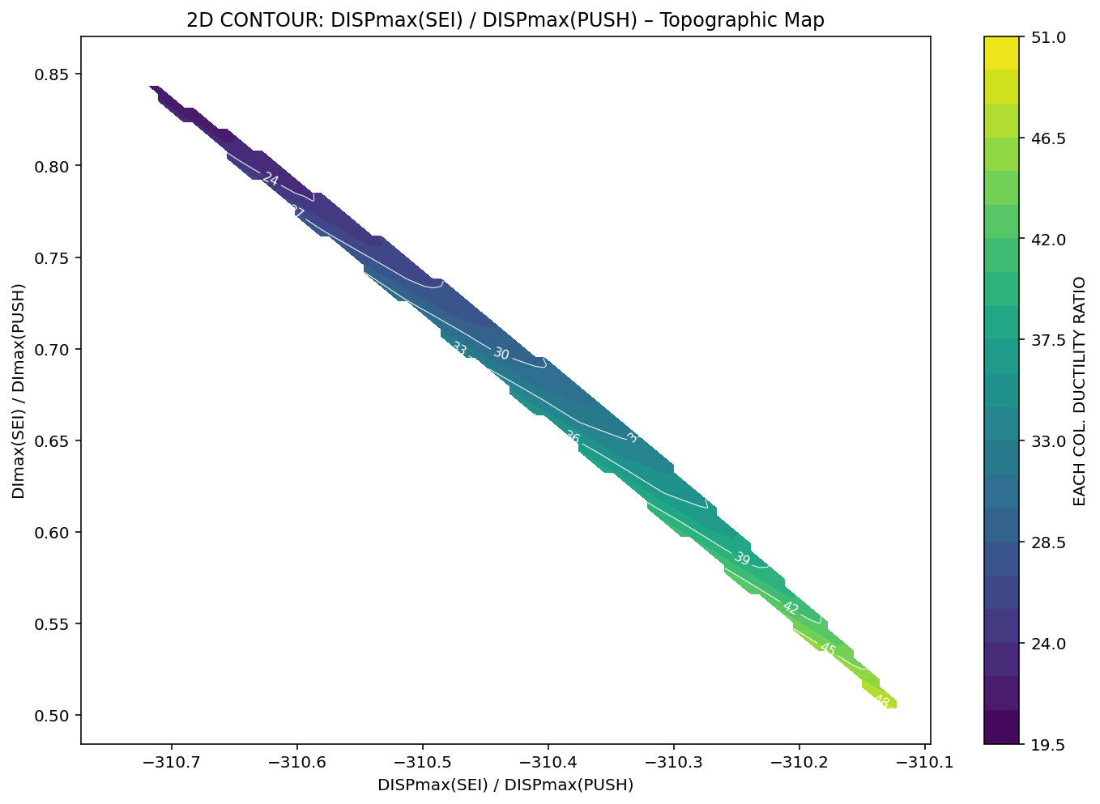

Slide 33
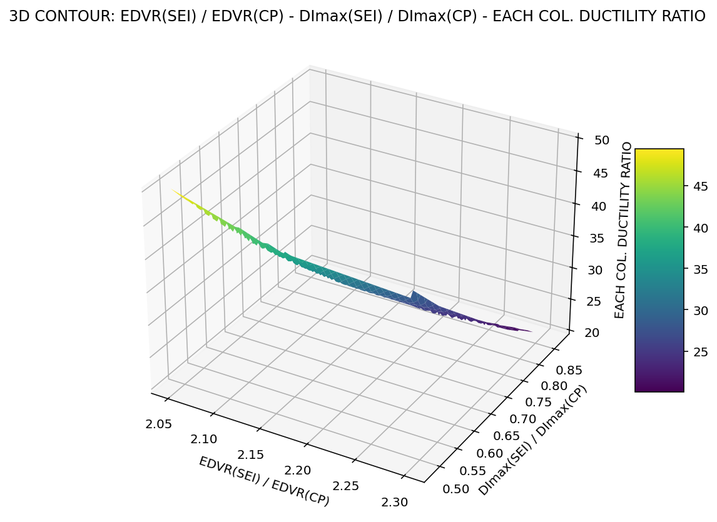

Slide 34
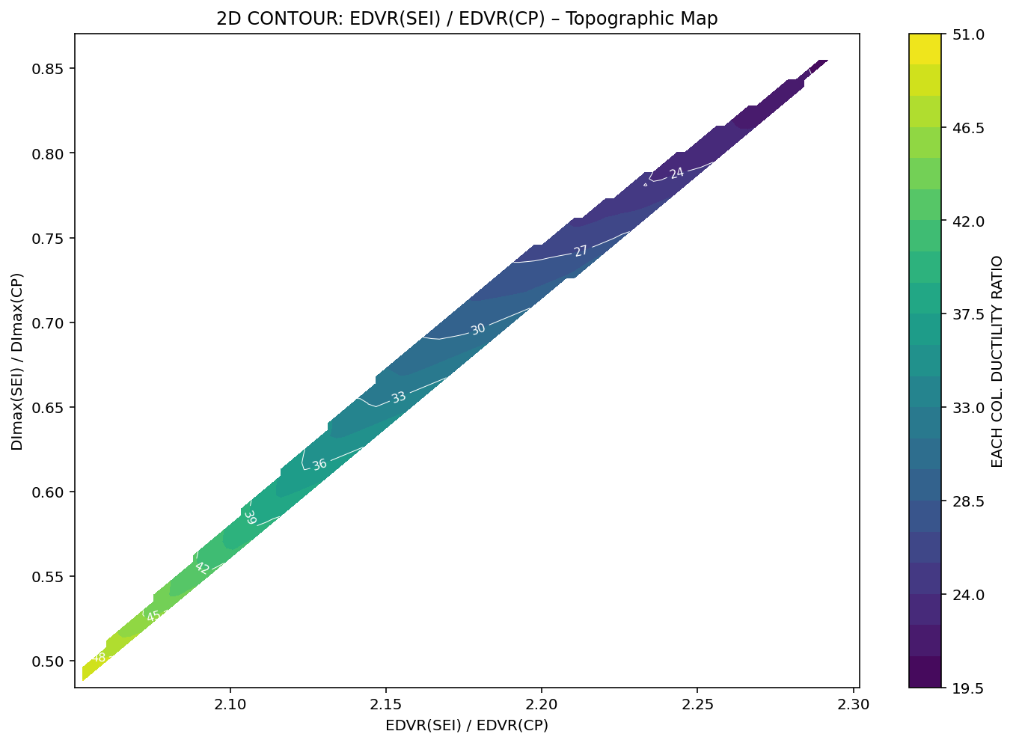

Slide 35
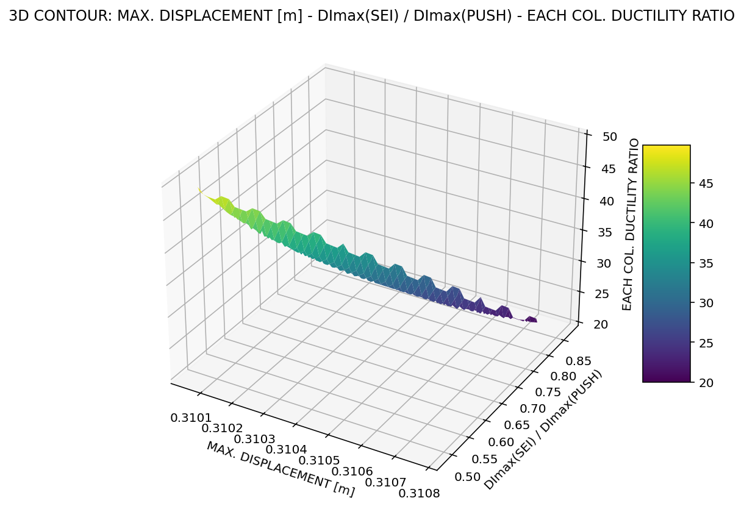

Slide 36
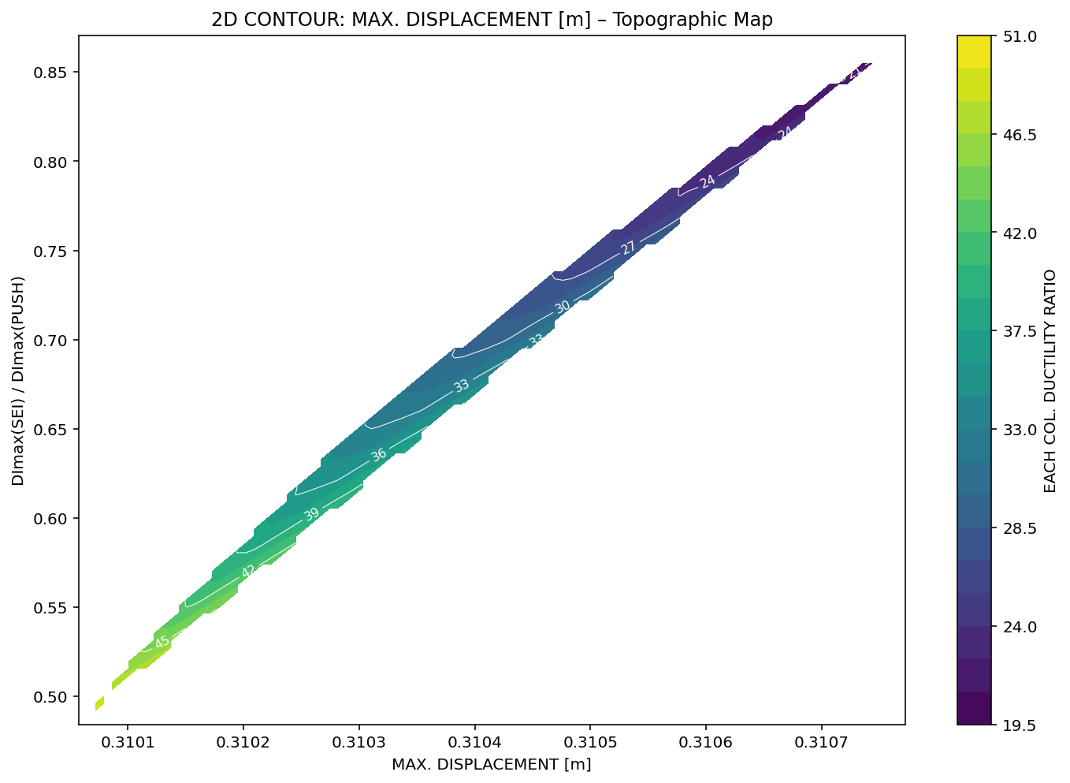

Slide 37
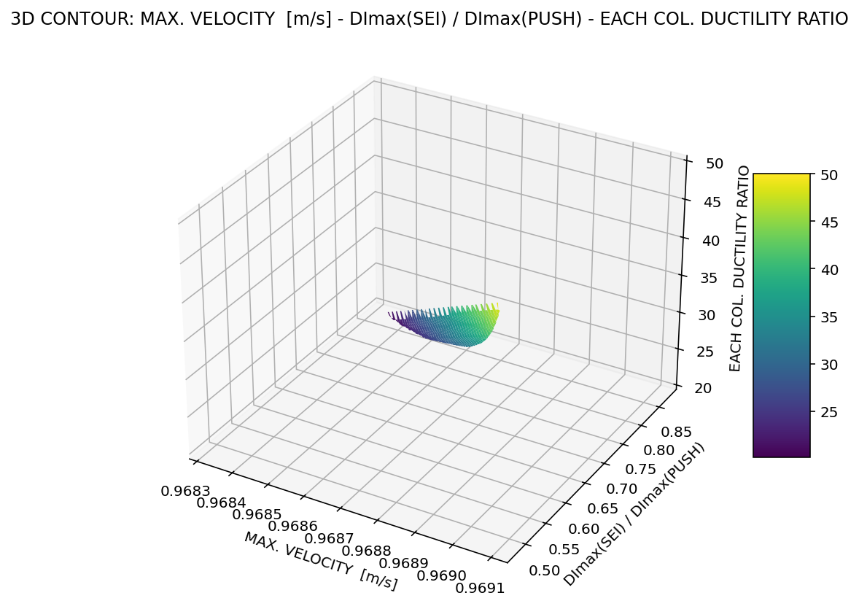

Slide 38
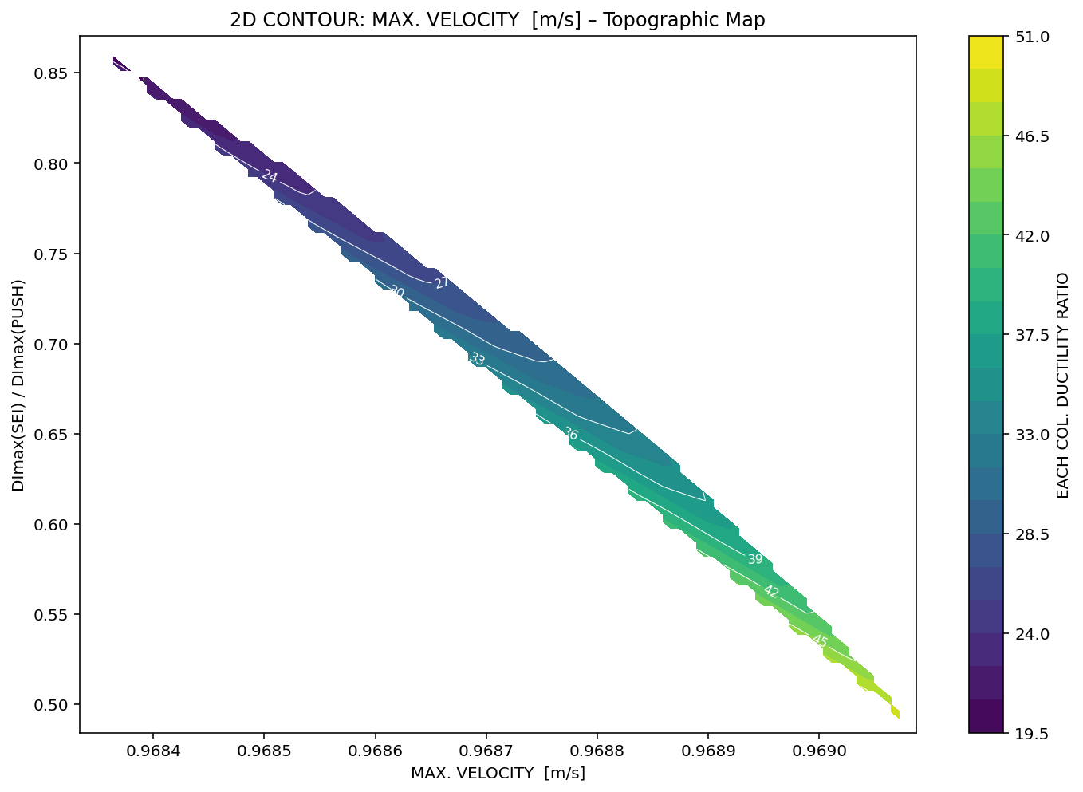

Slide 39
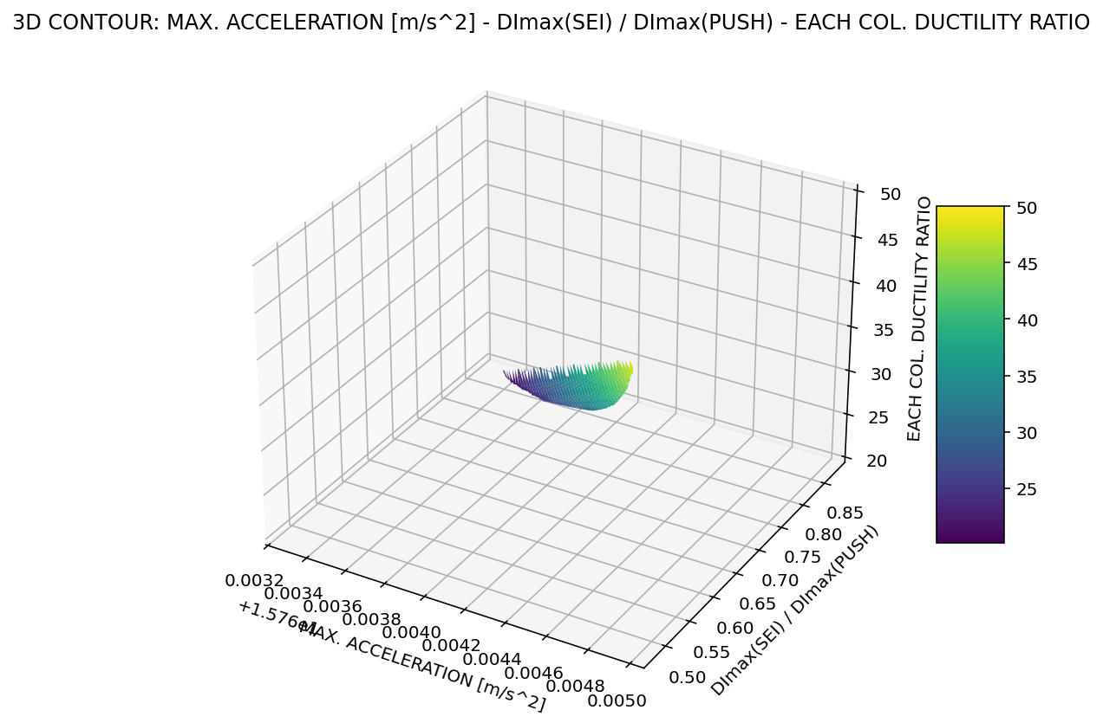

Slide 40
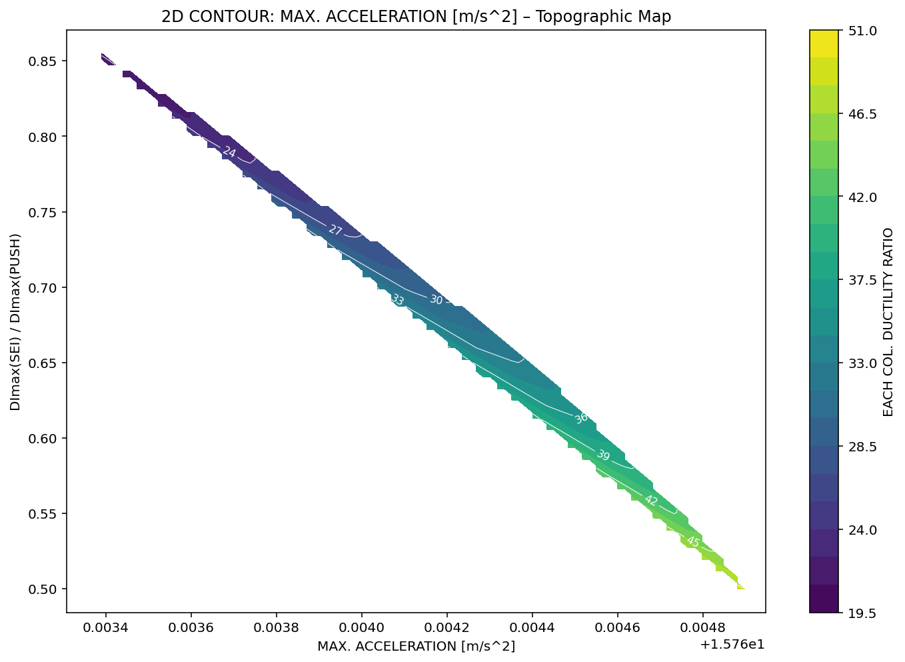

Slide 41
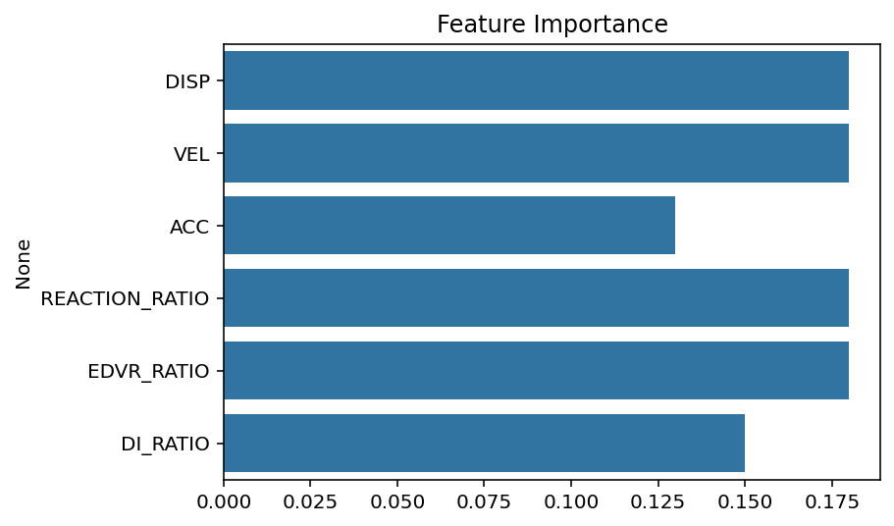

Slide 42
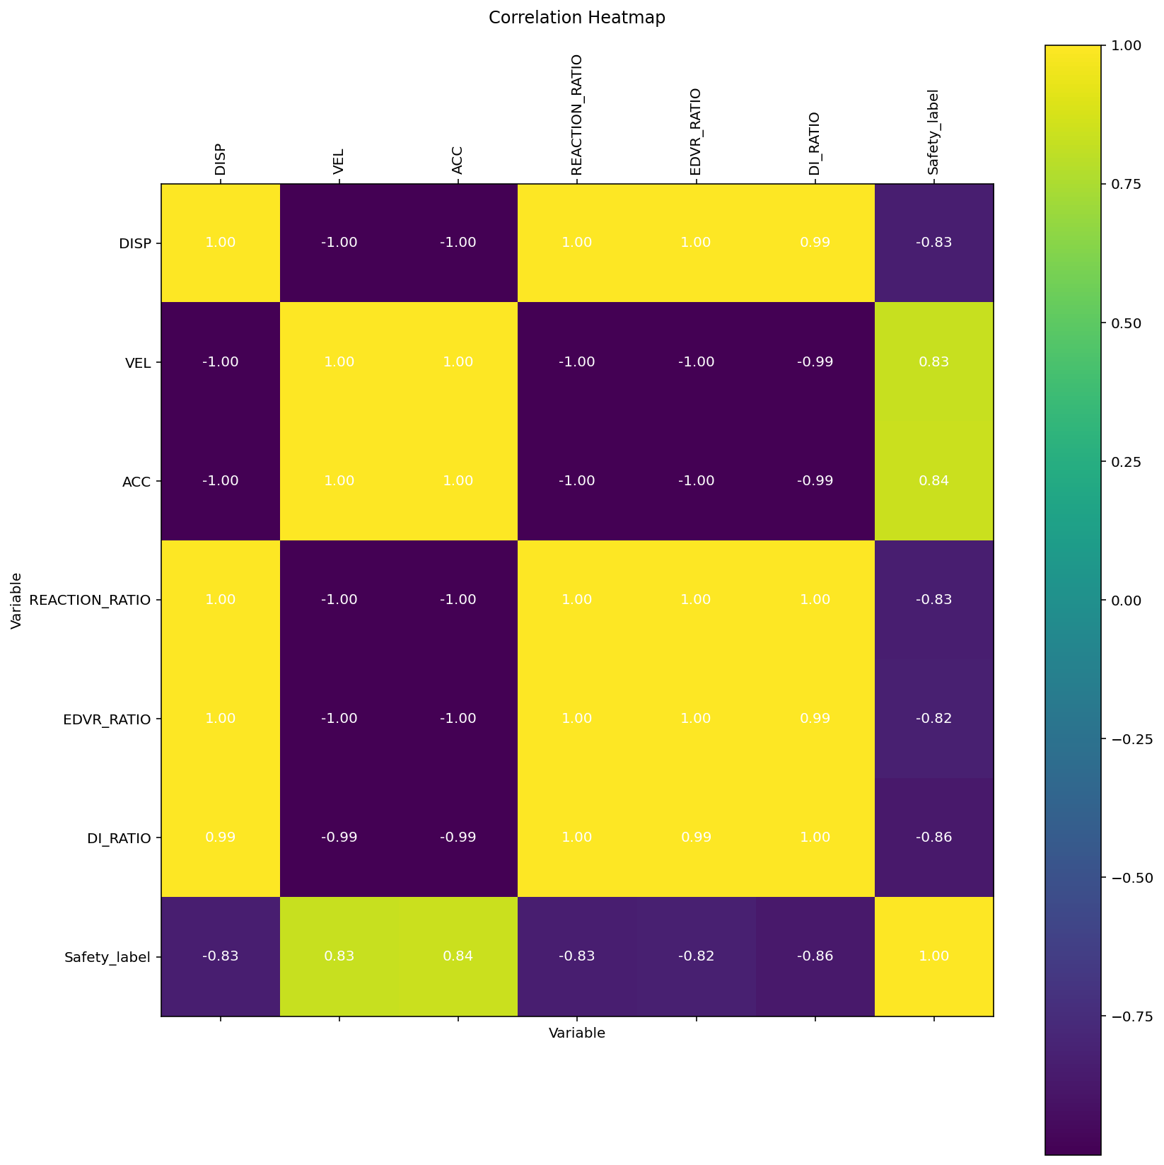

Slide 43
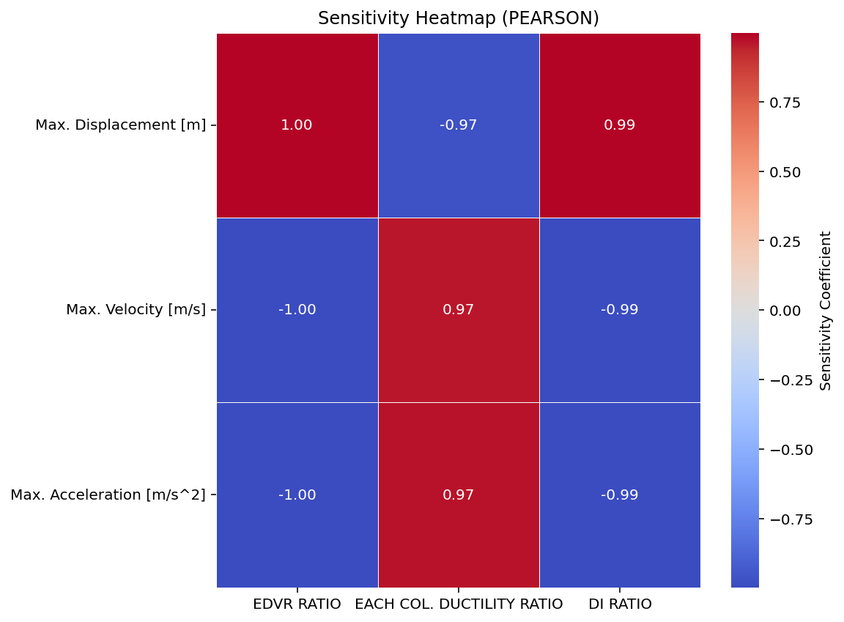

Slide 44
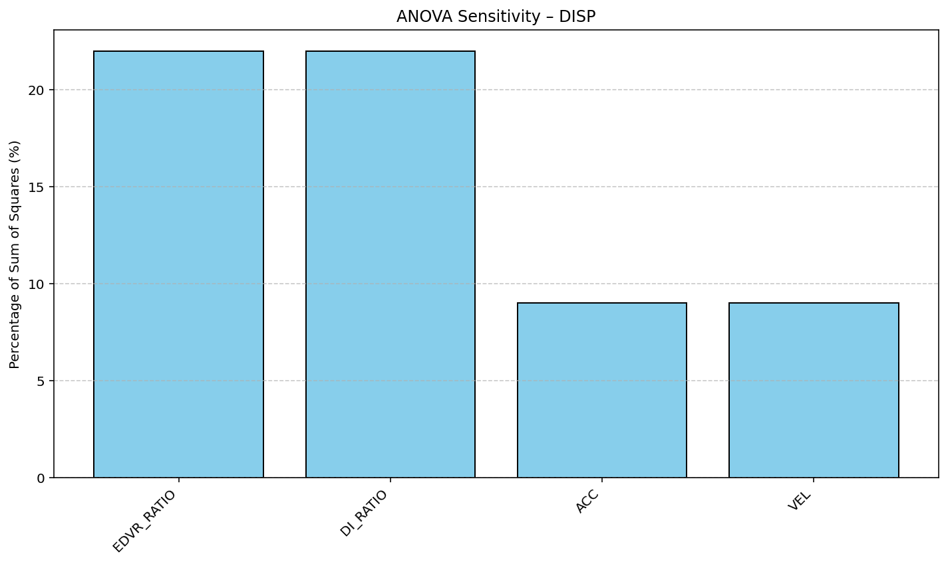

Slide 45
