Slide 1
IN THE NAME OF ALLAH, THE MOST GRACIOUS, THE MOST MERCIFUL
COMPARATIVE STUDY OF ELASTIC AND INELASTIC STRUCTURAL BEHAVIOR THROUGH PUSHOVER DYNAMIC ANALYSIS. HARMONIC IMPACT LOADING ANALYSIS OF CONCRETE FRAME USING OPENSEES
WRITTEN BY SALAR DELAVAR GHASHGHAEI (QASHQAI)

Slide 2
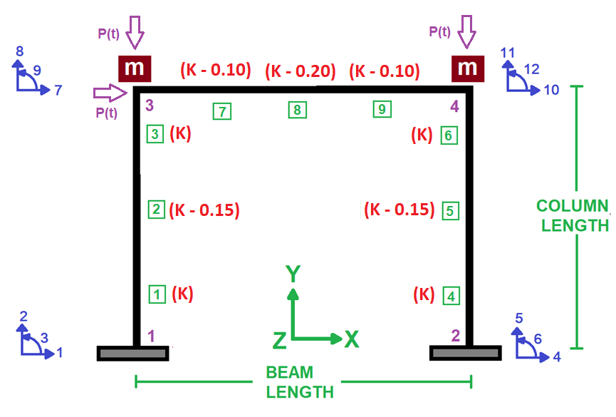

Slide 3
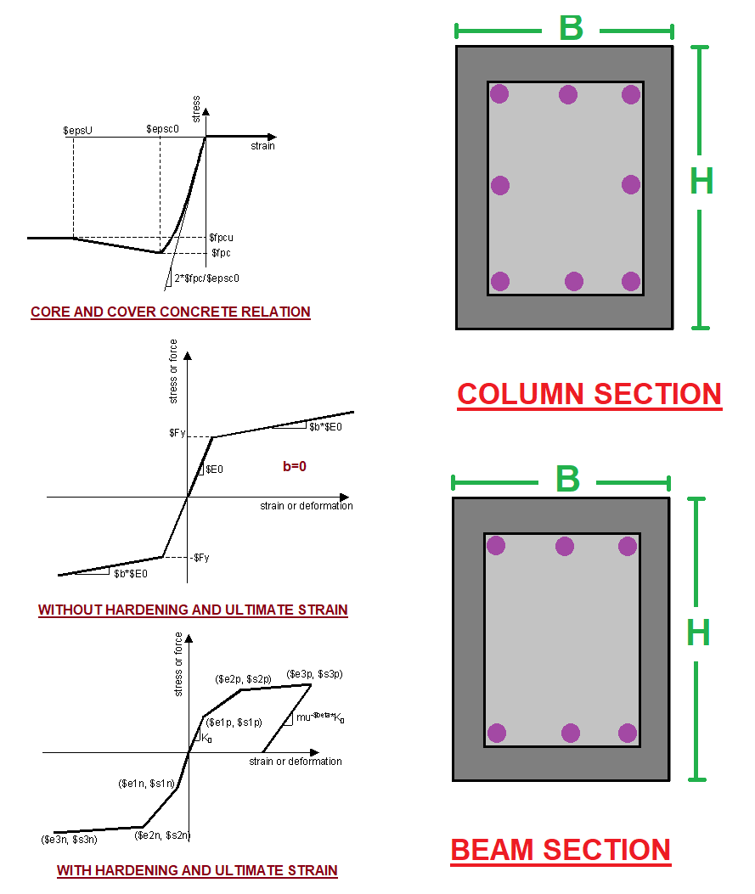

Slide 4
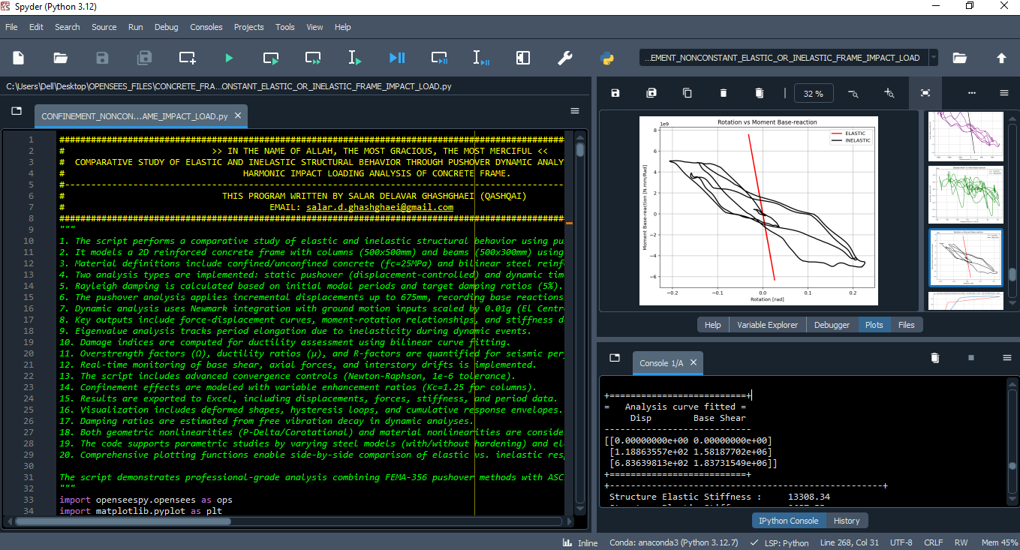

Slide 5
ELASTIC AND INELASTIC STATIC ANALYSIS
(PUSHOVER)

Slide 6
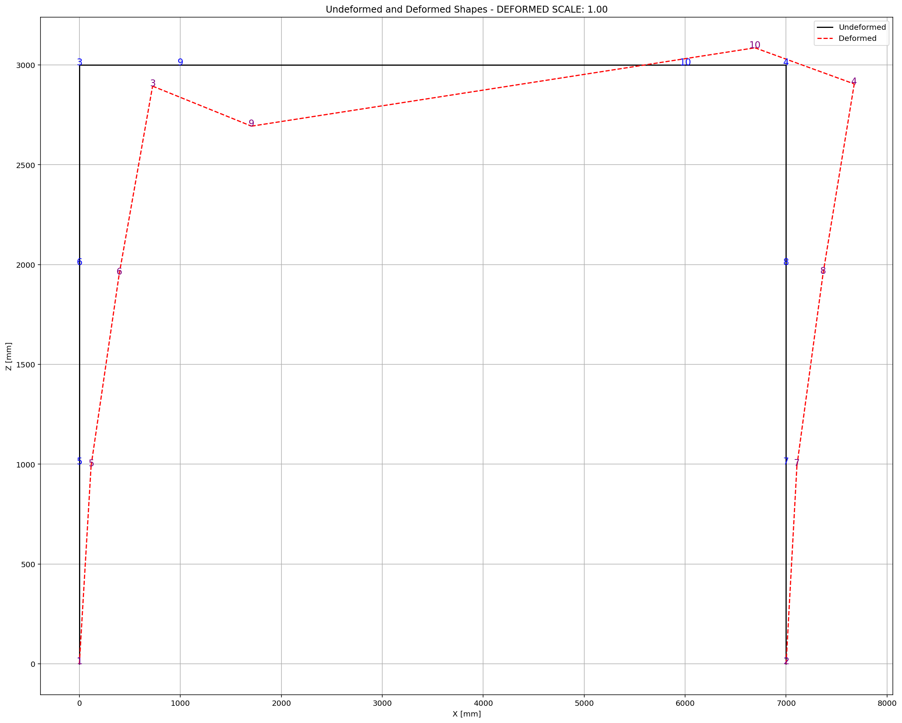

Slide 7
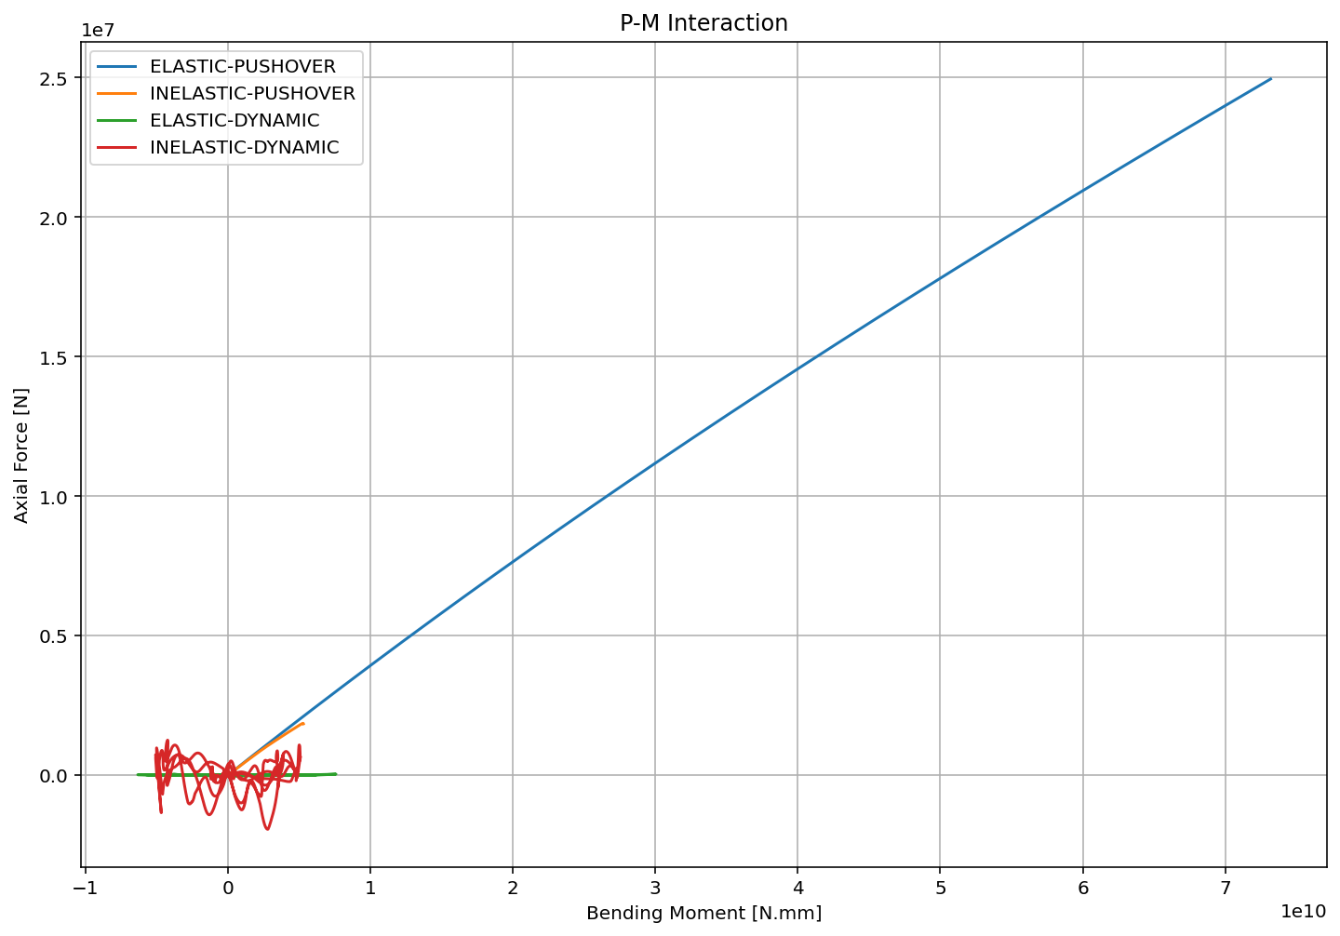

Slide 8
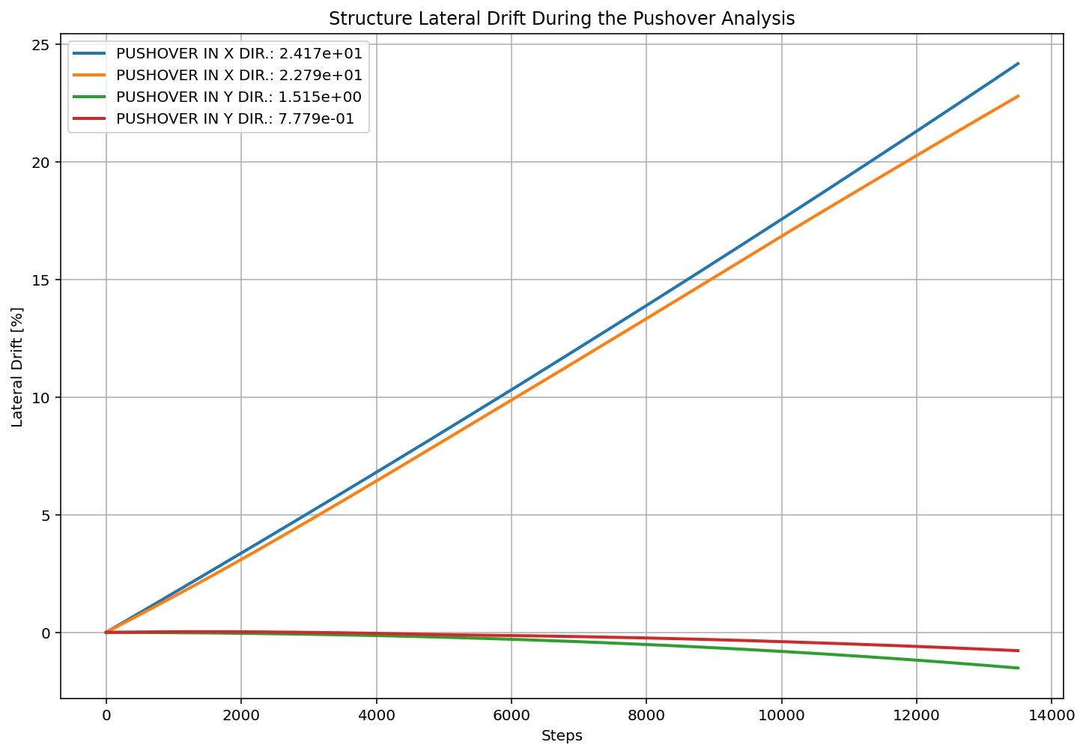

Slide 9
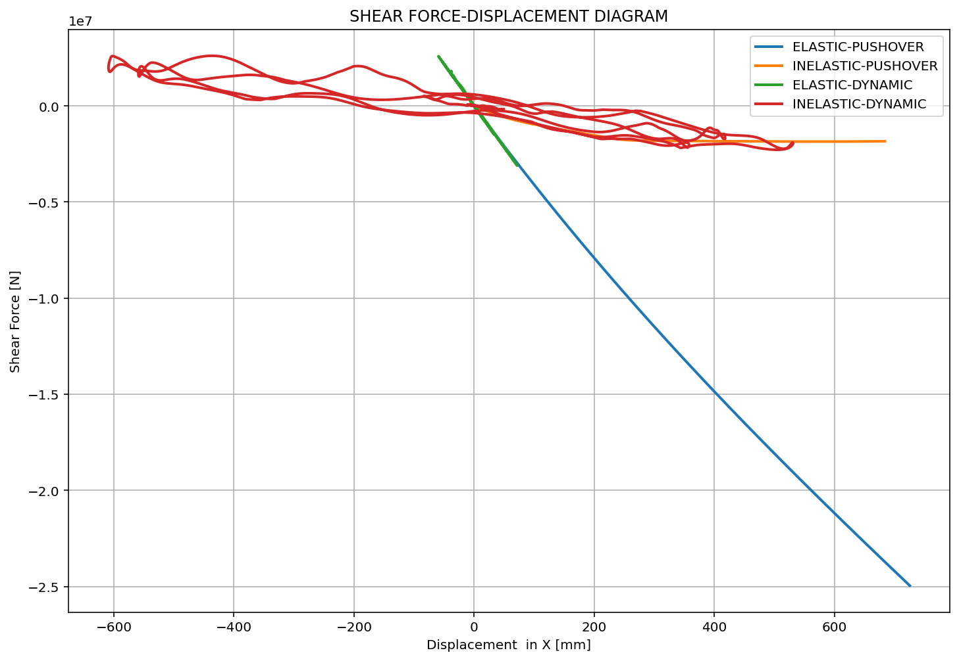

Slide 10
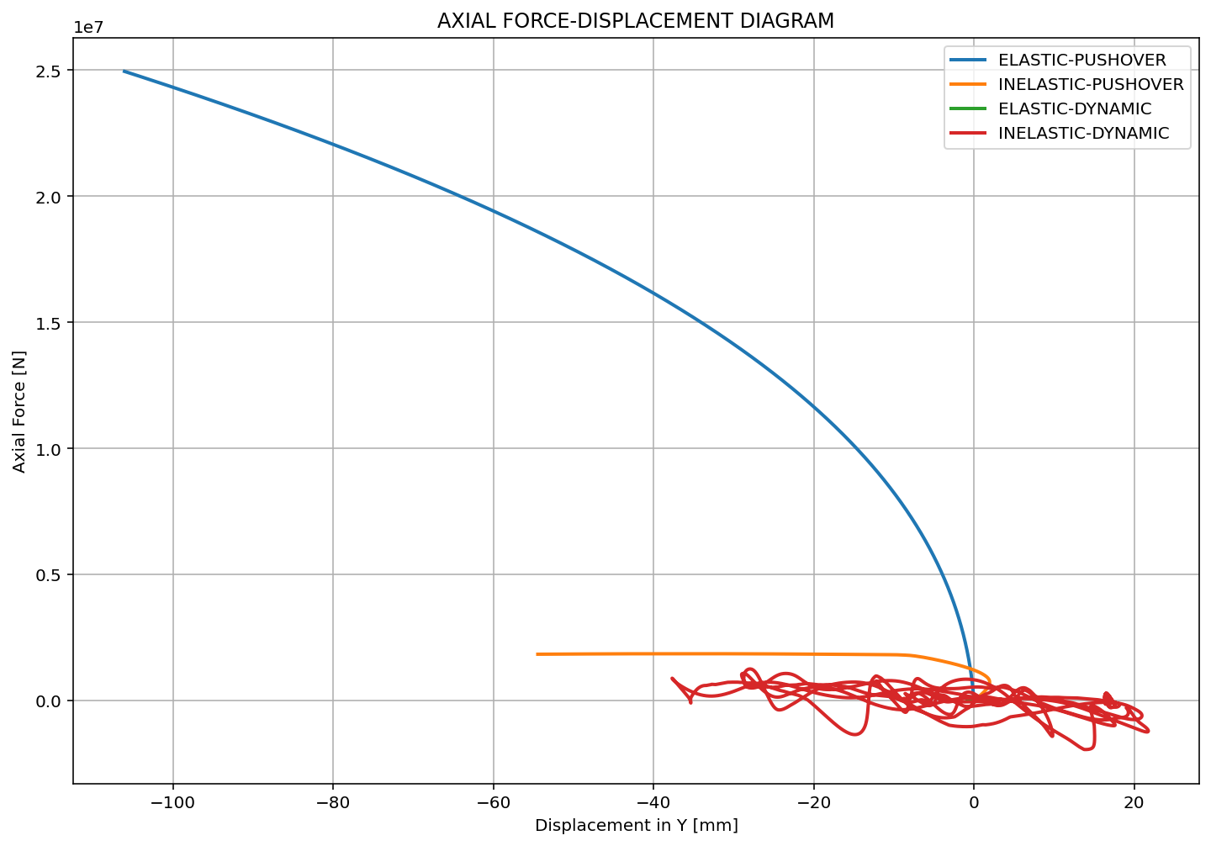

Slide 11
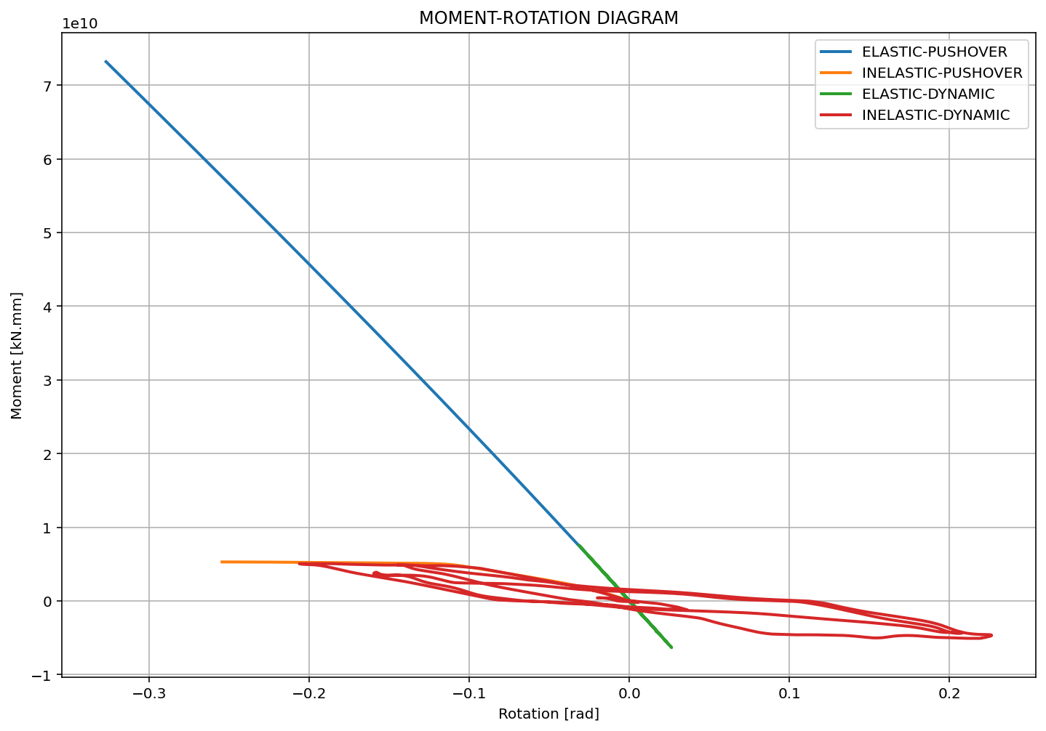

Slide 12
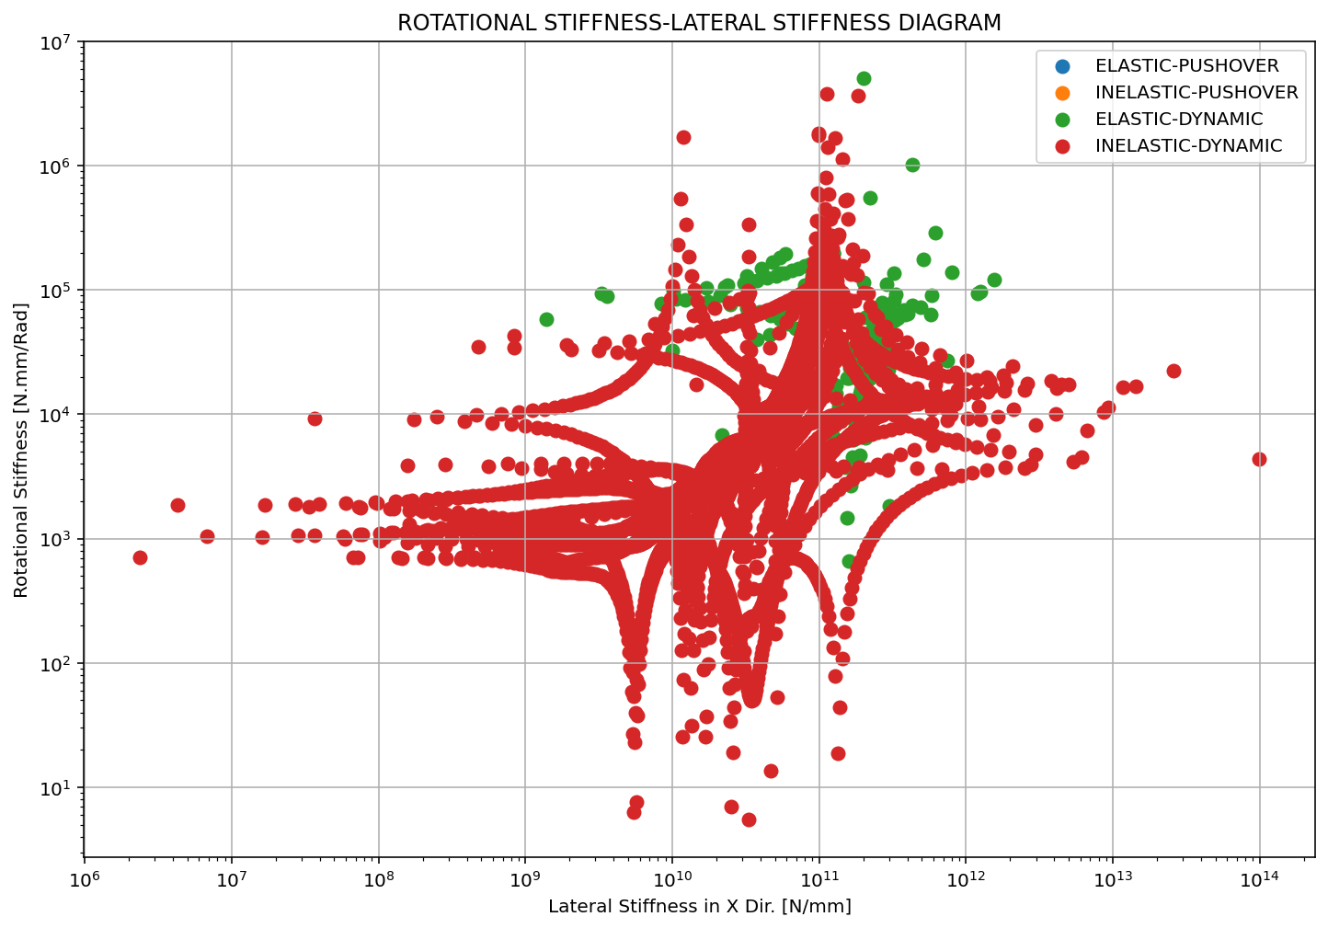

Slide 13
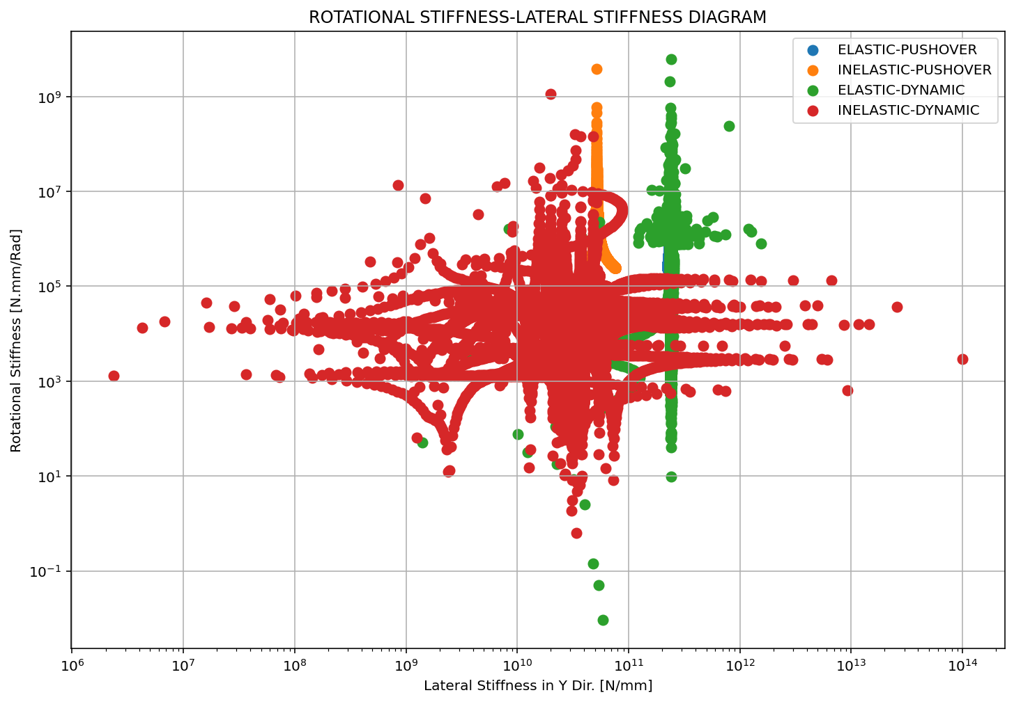

Slide 14
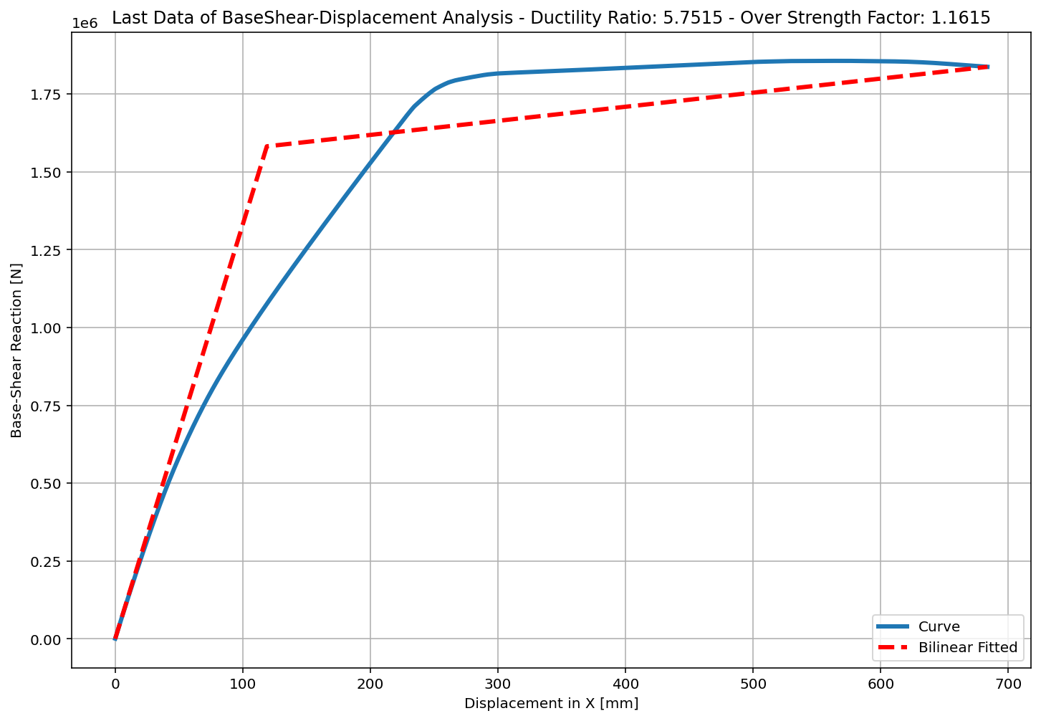
+==========================+
= Analysis curve fitted =
Disp Base Shear
----------------------------
[[0.00000000e+00 0.00000000e+00]
[1.18863557e+02 1.58187702e+06]
[6.83639813e+02 1.83731549e+06]]
+==========================+
+----------------------------------------------------+
Structure Elastic Stiffness : 13308.34
Structure Plastic Stiffness : 2687.55
Structure Tangent Stiffness : 452.28
Structure Ductility Ratio : 5.75
Structure Over Strength Factor: 1.16
+----------------------------------------------------+
Over Strength Coefficient (Ω0): 1.1615
Displacement Ductility Ratio (μ): 5.7515
Ductility Coefficient (Rμ): 5.7515
Structural Behavior Coefficient (R): 6.6802
Structural Ductility Damage Index in X Direction: 0.8677

Slide 15
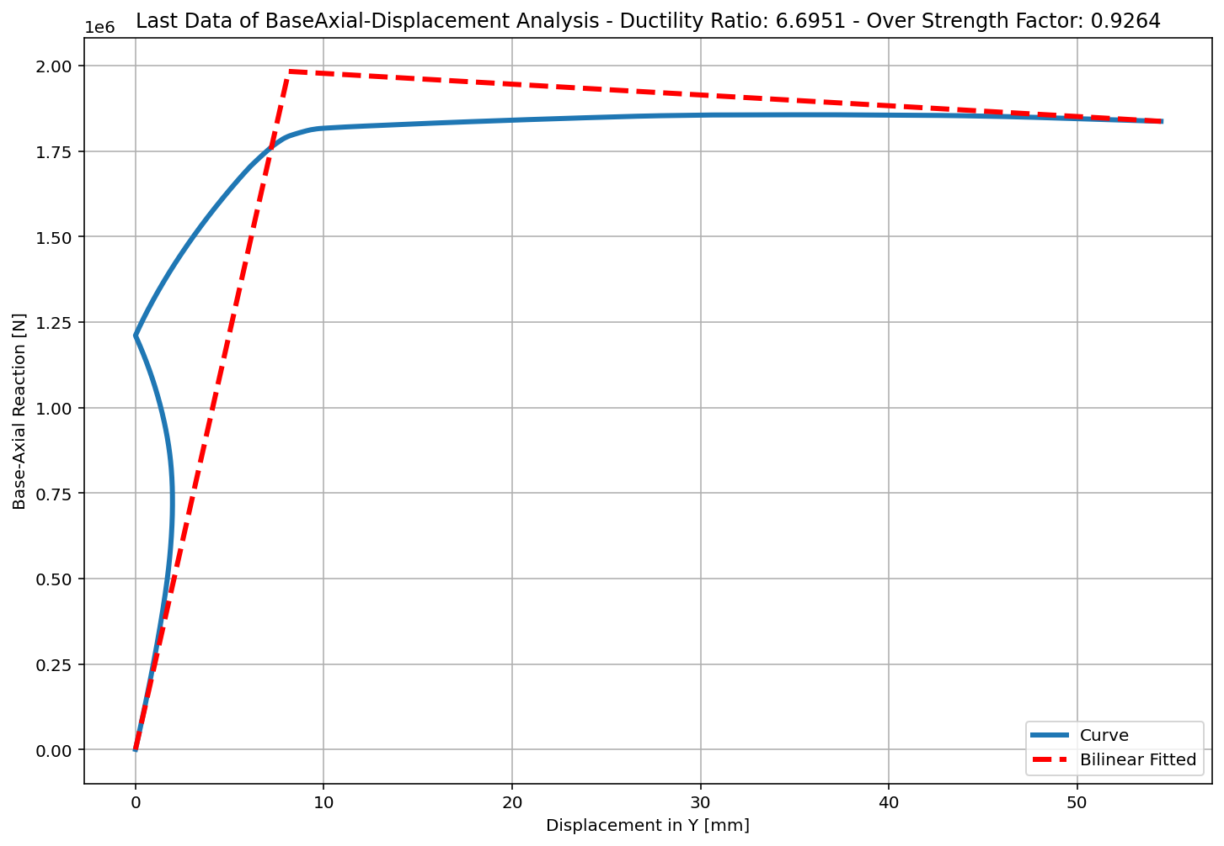
+==========================+
= Analysis curve fitted =
Disp Base Shear
----------------------------
[[0.00000000e+00 0.00000000e+00]
[8.13269403e+00 1.98335618e+06]
[5.44495459e+01 1.83731549e+06]]
+==========================+
+----------------------------------------------------+
Structure Elastic Stiffness : 243874.44
Structure Plastic Stiffness : 33743.45
Structure Tangent Stiffness : -3153.08
Structure Ductility Ratio : 6.70
Structure Over Strength Factor: 0.93
+----------------------------------------------------+
Over Strength Coefficient (Ω0): 0.9264
Displacement Ductility Ratio (μ): 6.6951
Ductility Coefficient (Rμ): 6.6951
Structural Behavior Coefficient (R): 6.2022
Structural Ductility Damage Index in Y Direction: 0.6380

Slide 16
ELASTIC AND INELASTIC DYNAMIC ANALYSIS

Slide 17
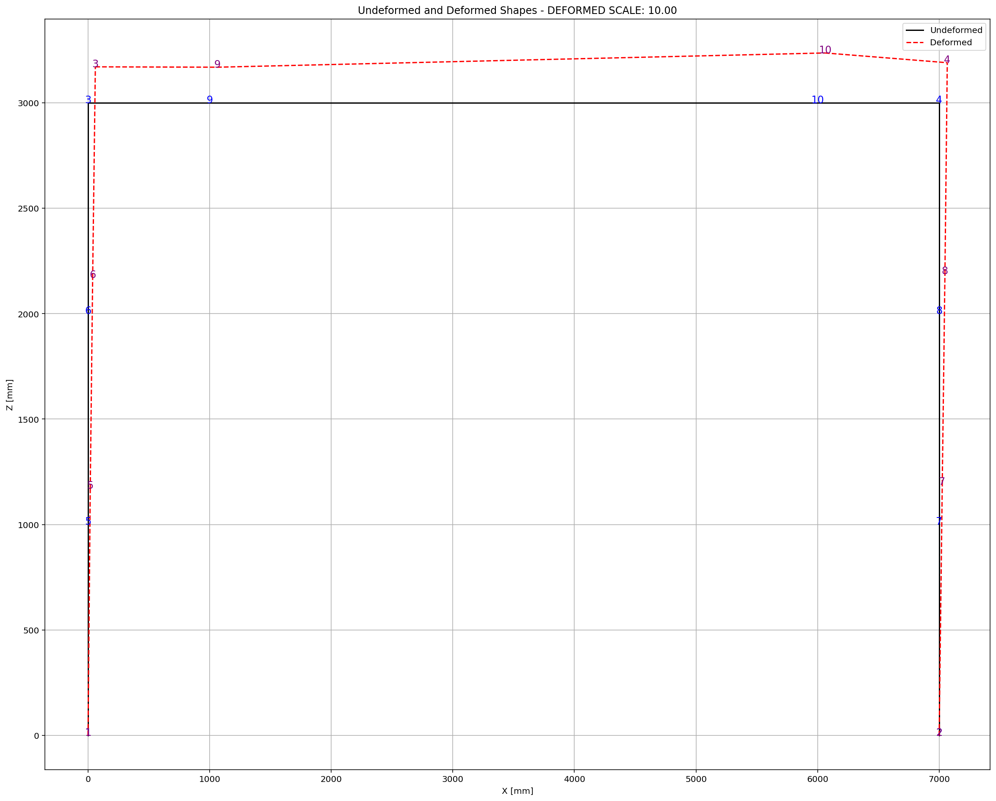

Slide 18
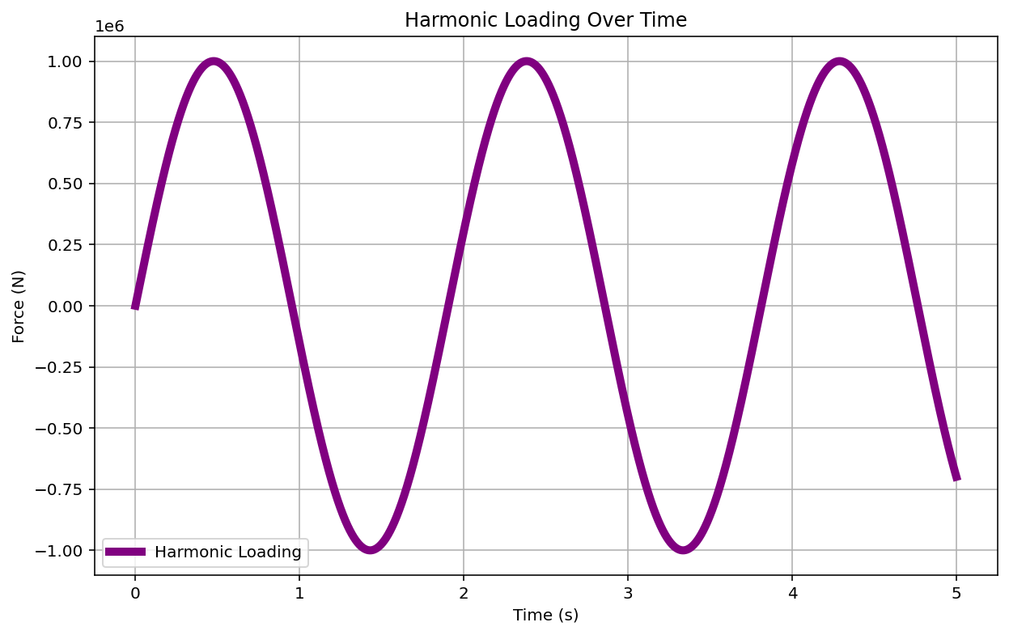

Slide 19
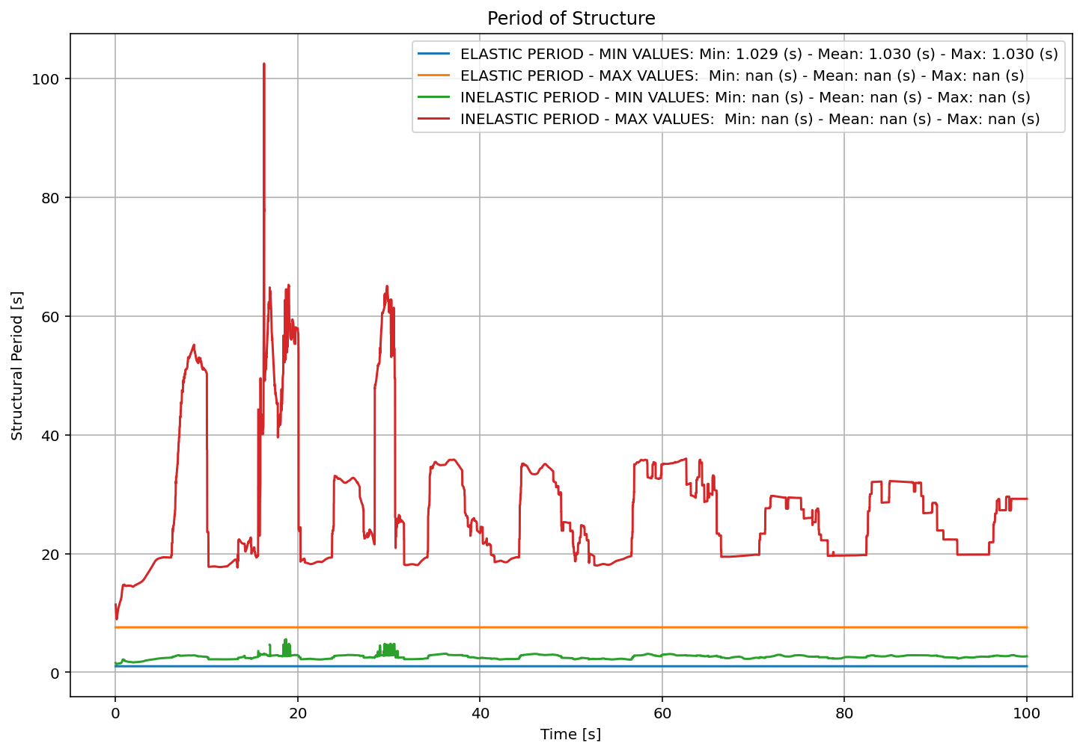

Slide 20
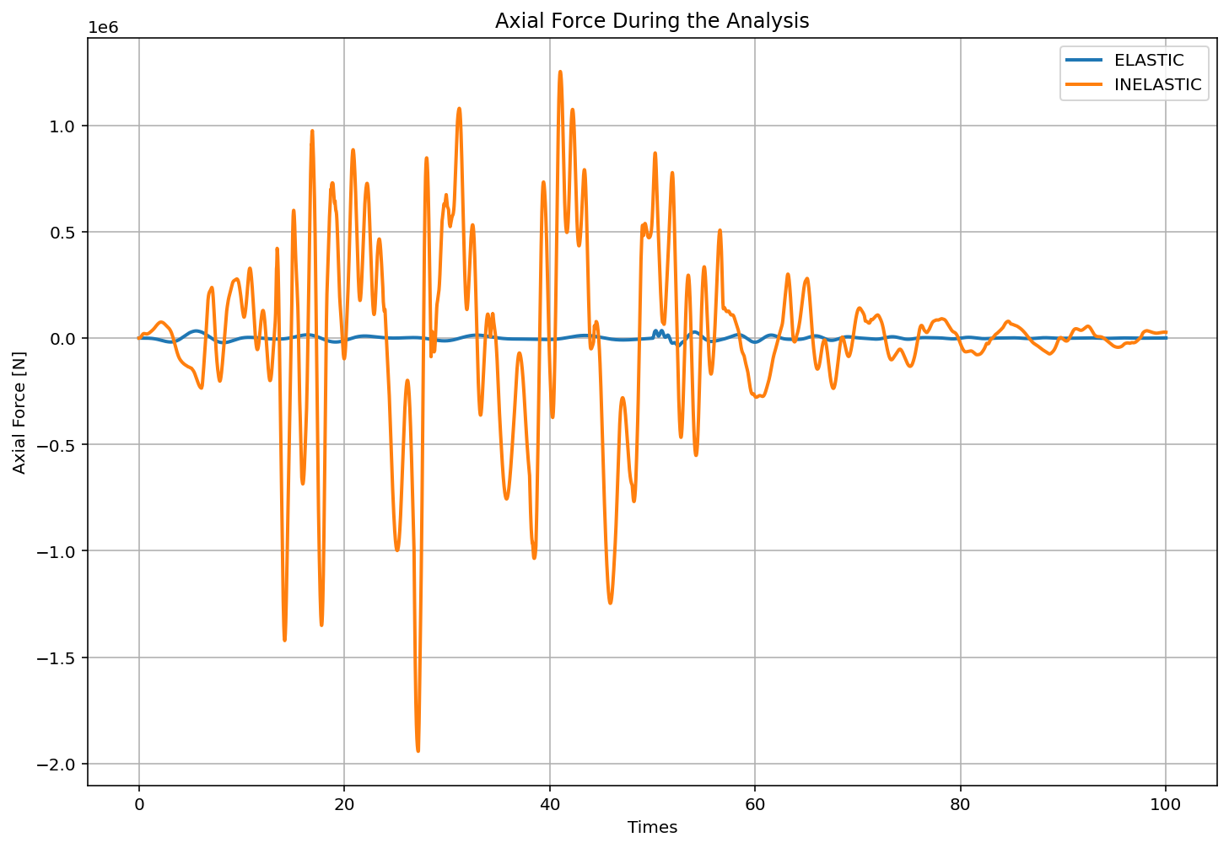

Slide 21
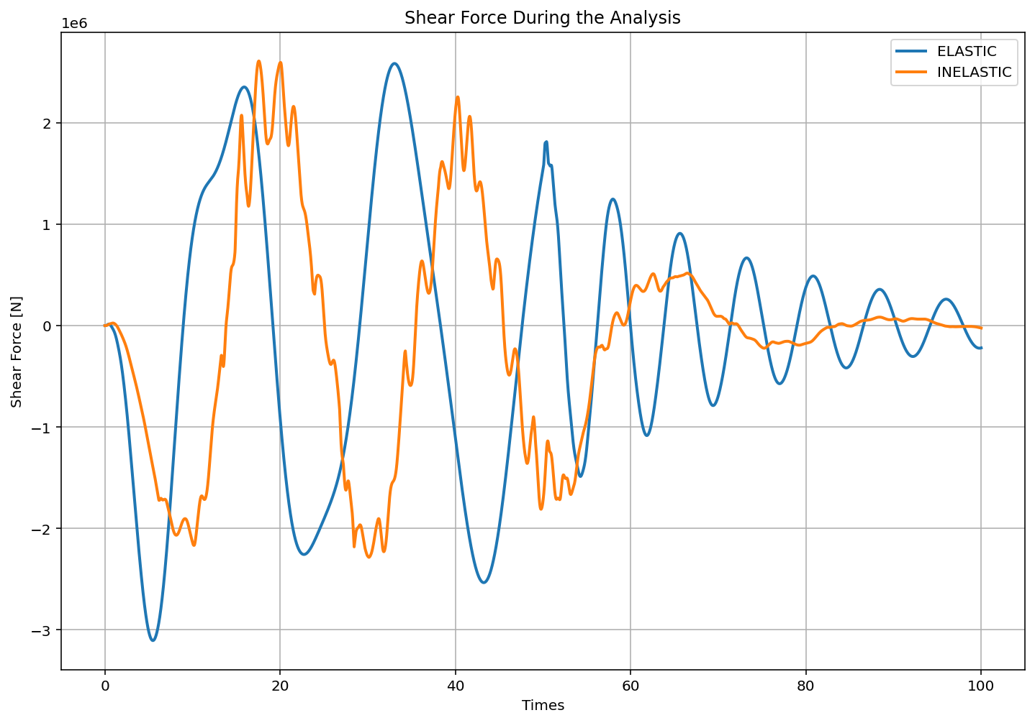

Slide 22
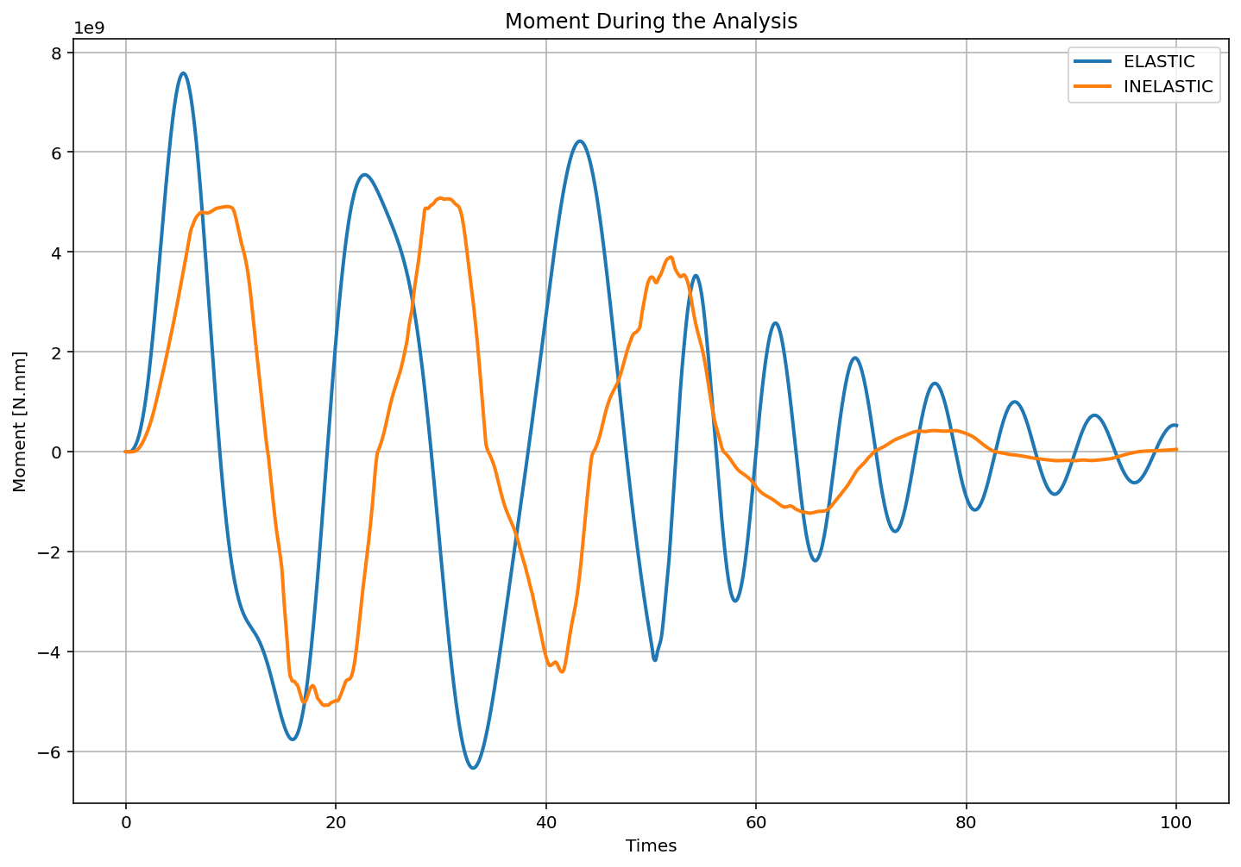

Slide 23
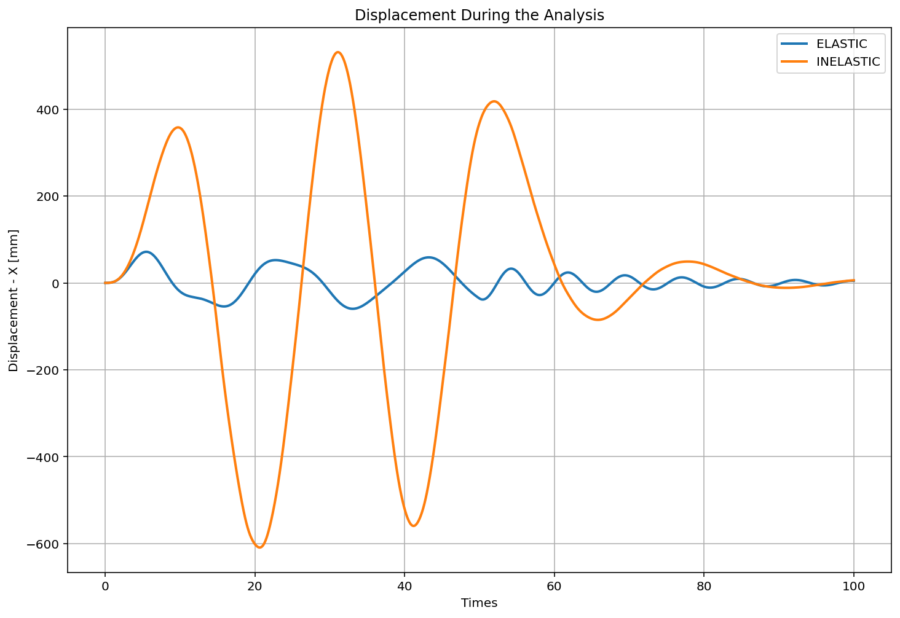

Slide 24
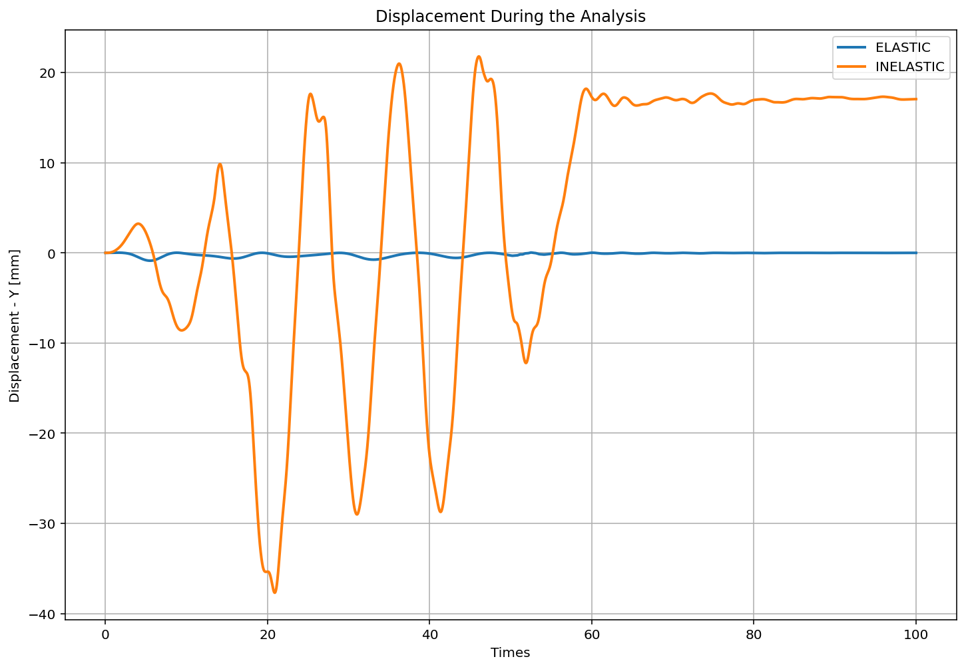

Slide 25
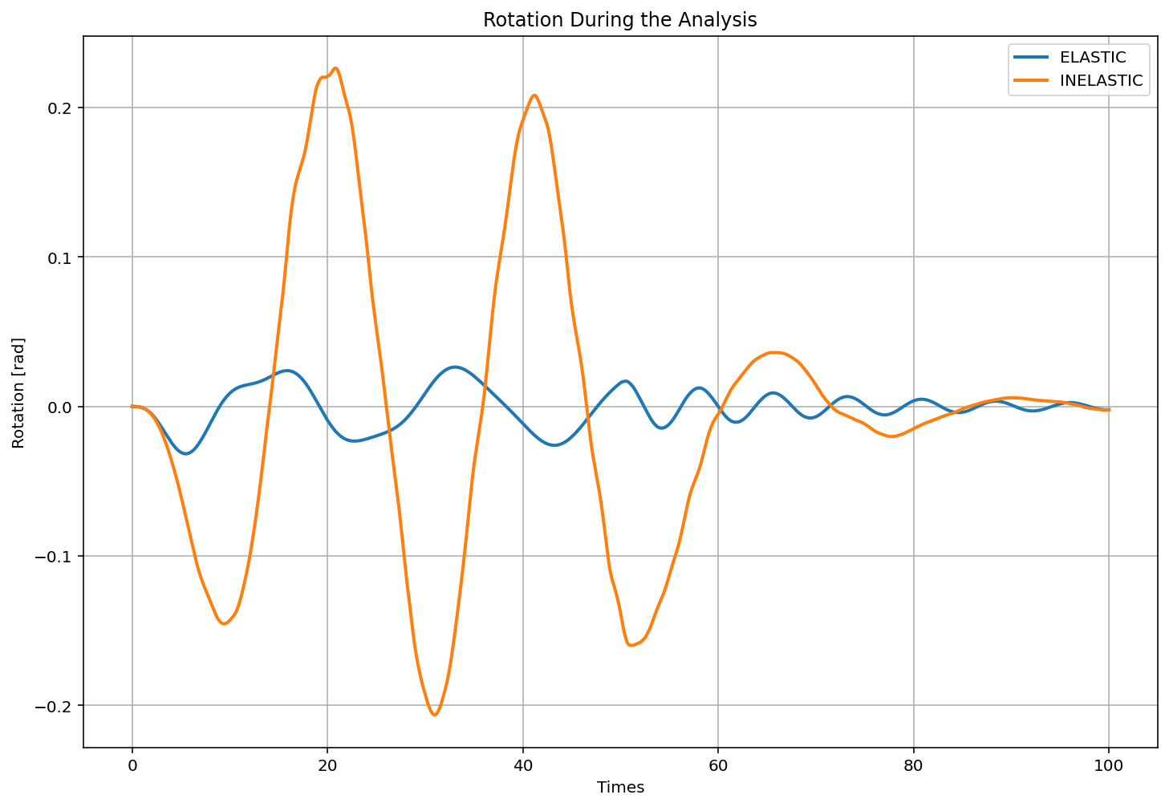

Slide 26
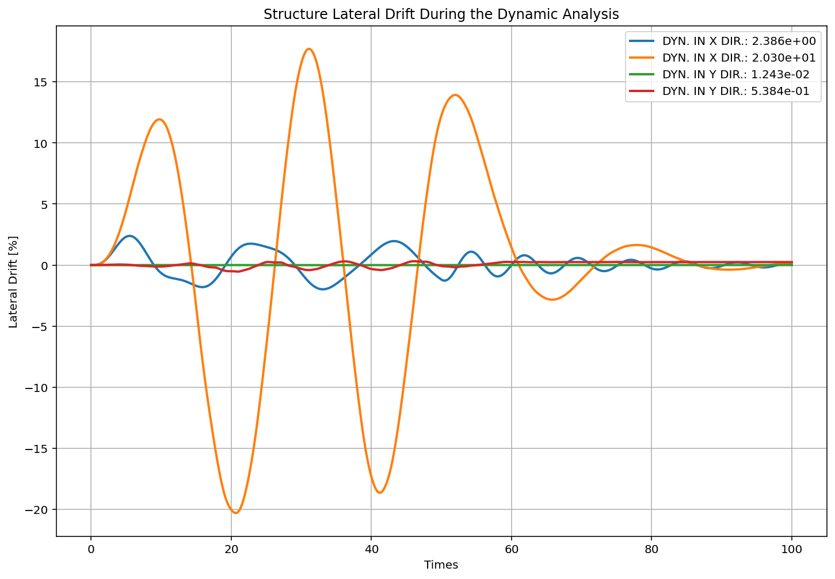

Slide 27
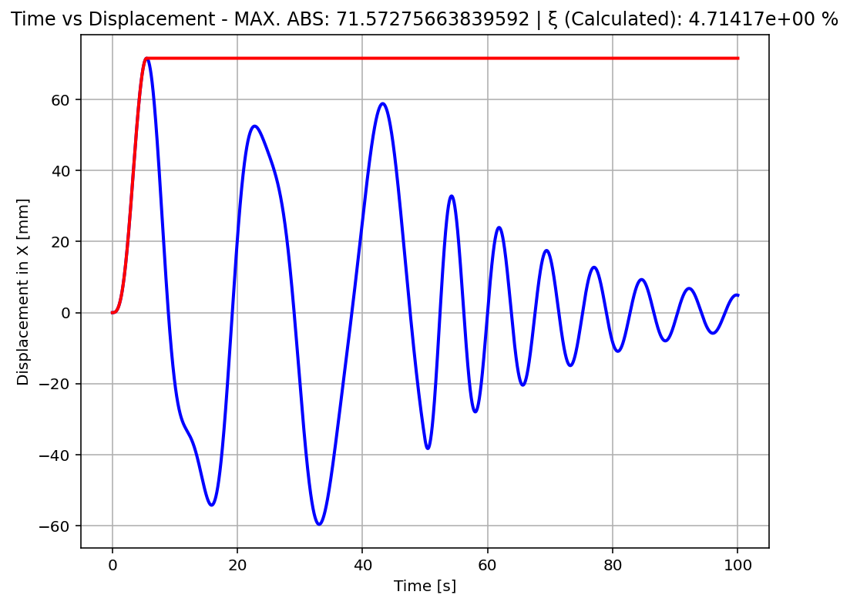

Slide 28
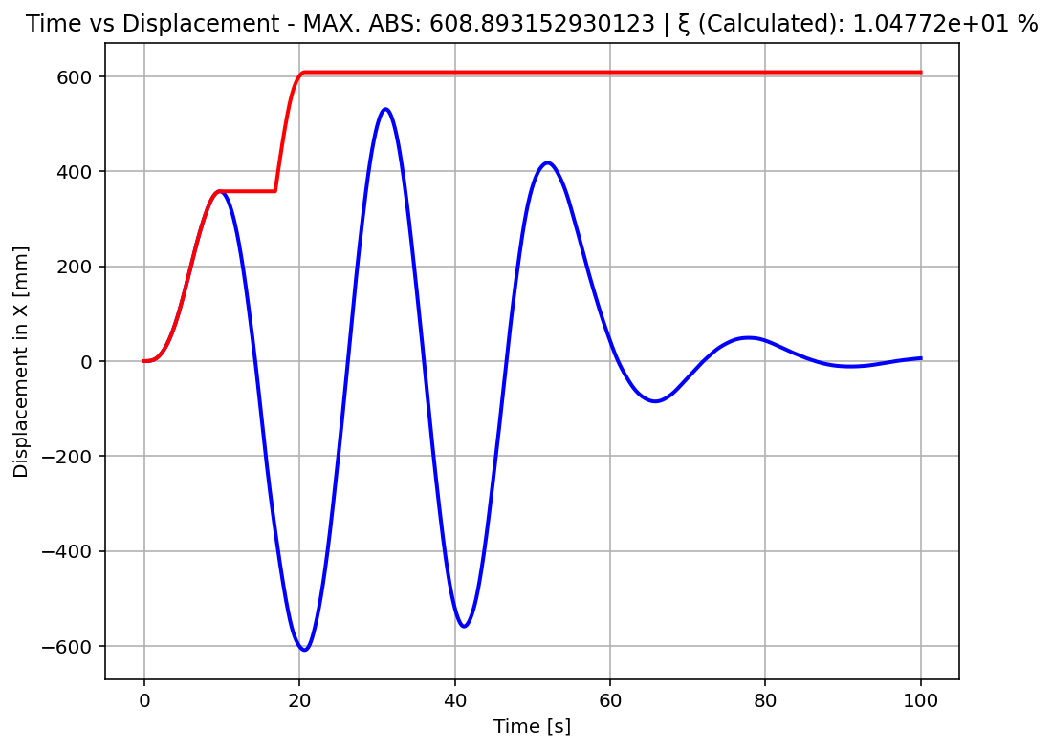

Slide 29
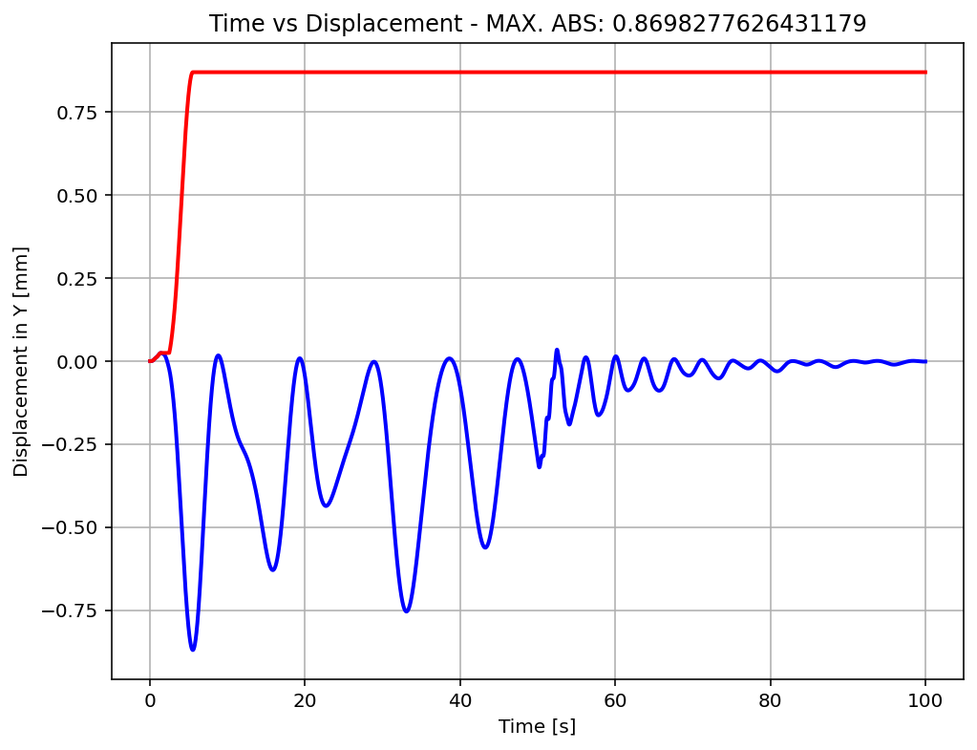

Slide 30
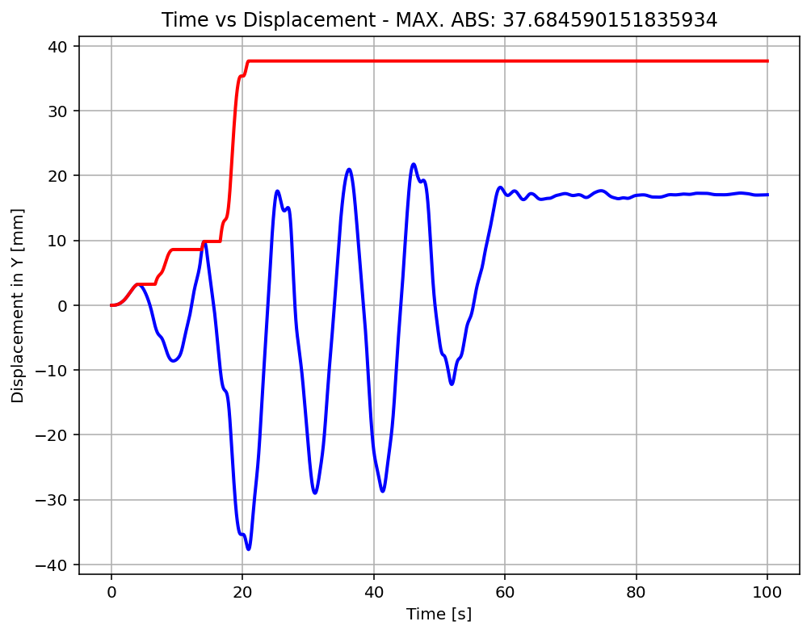

Slide 31
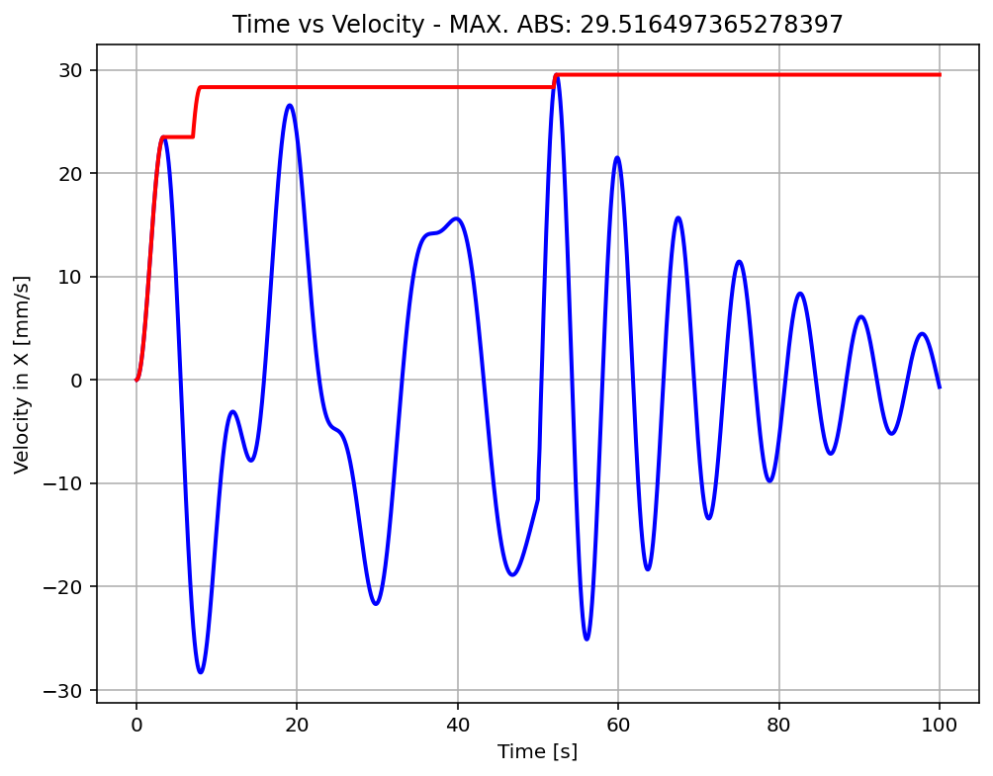

Slide 32
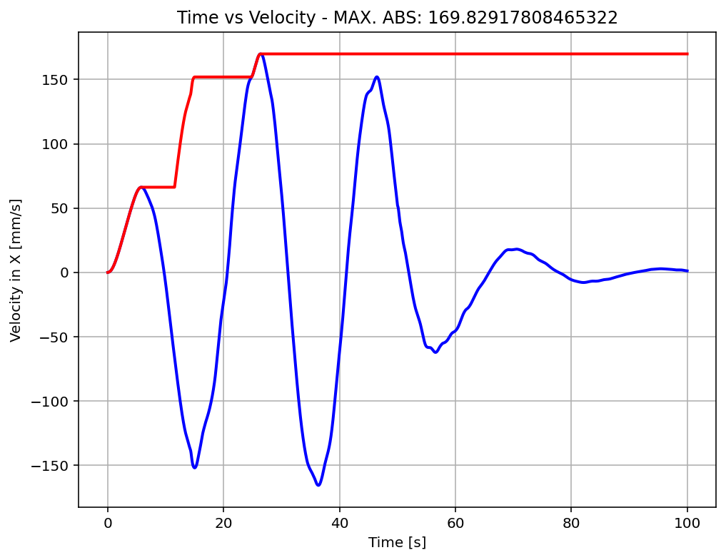

Slide 33
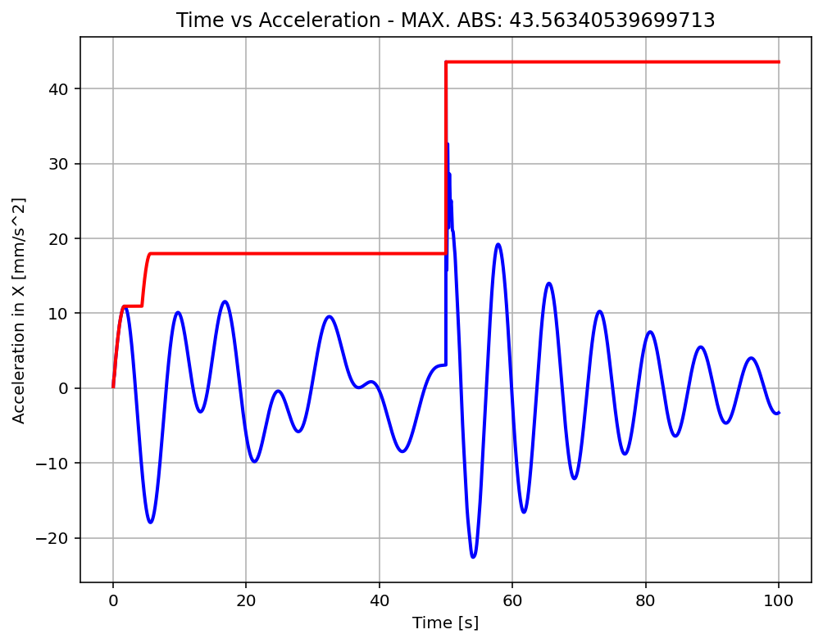

Slide 34
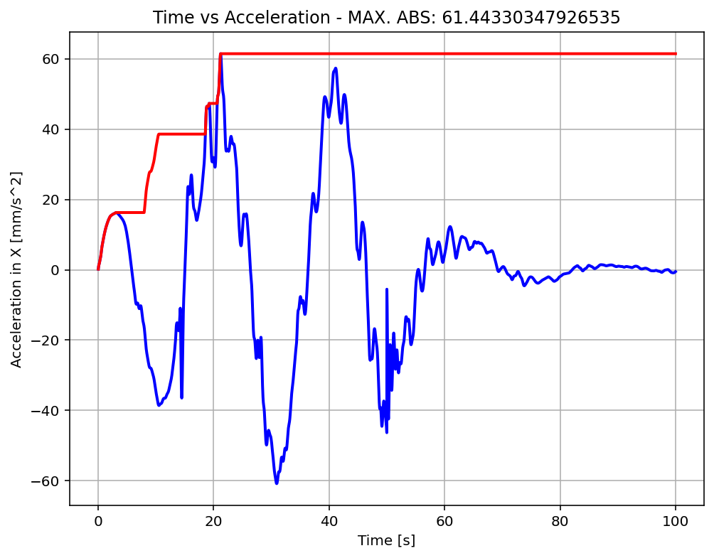

Slide 35
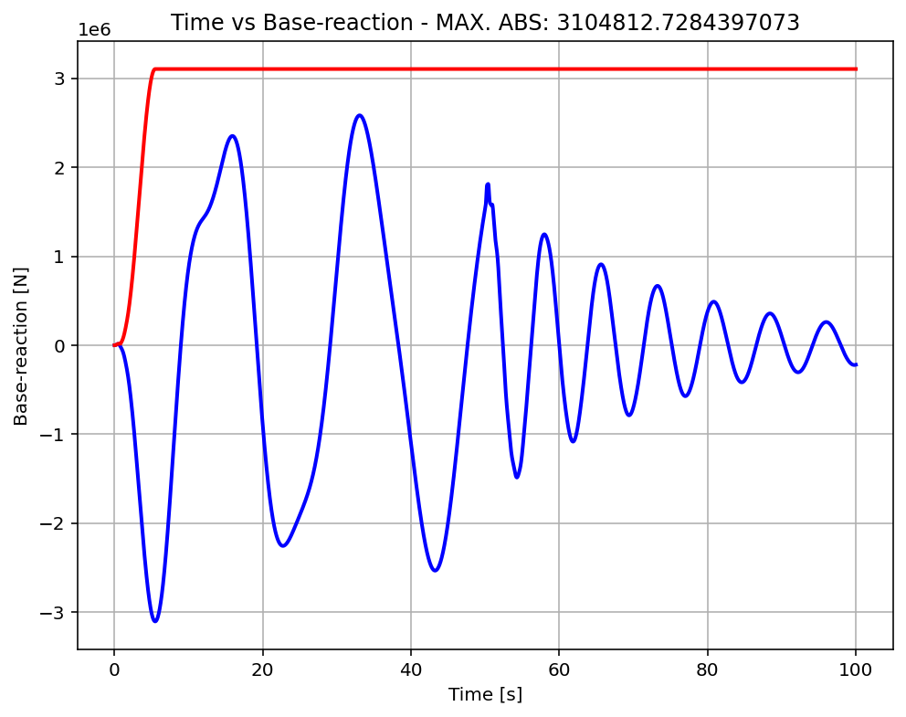

Slide 36
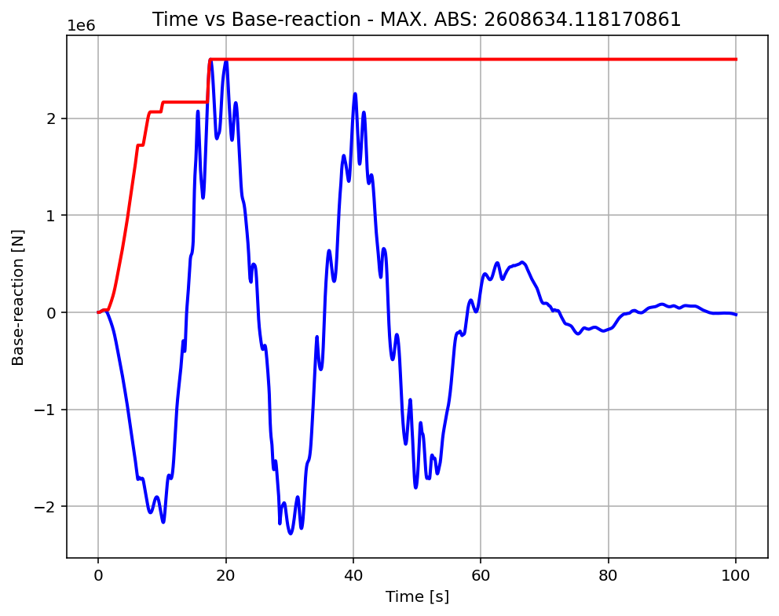

Slide 37
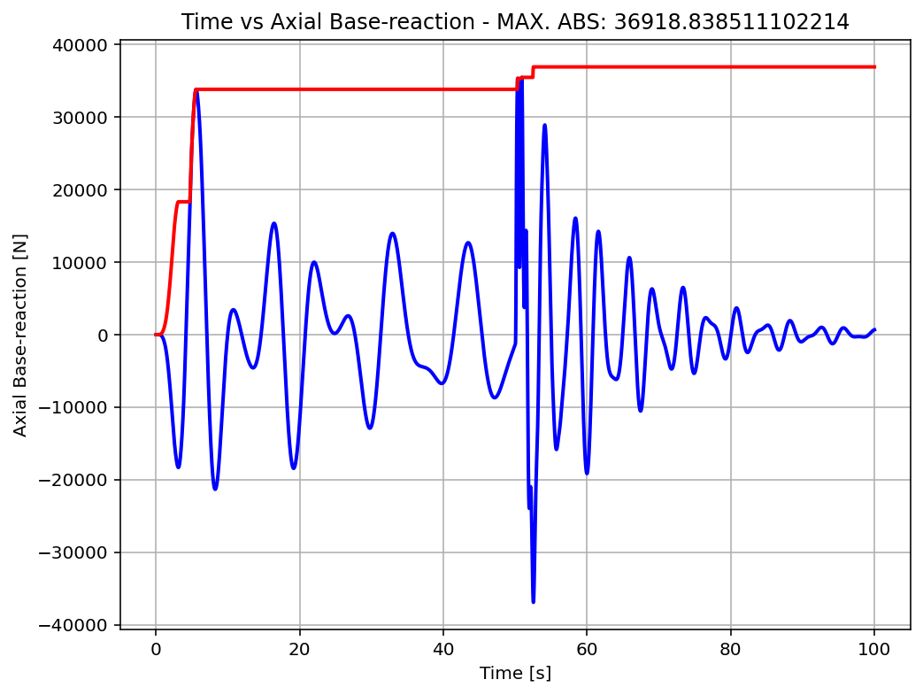

Slide 38
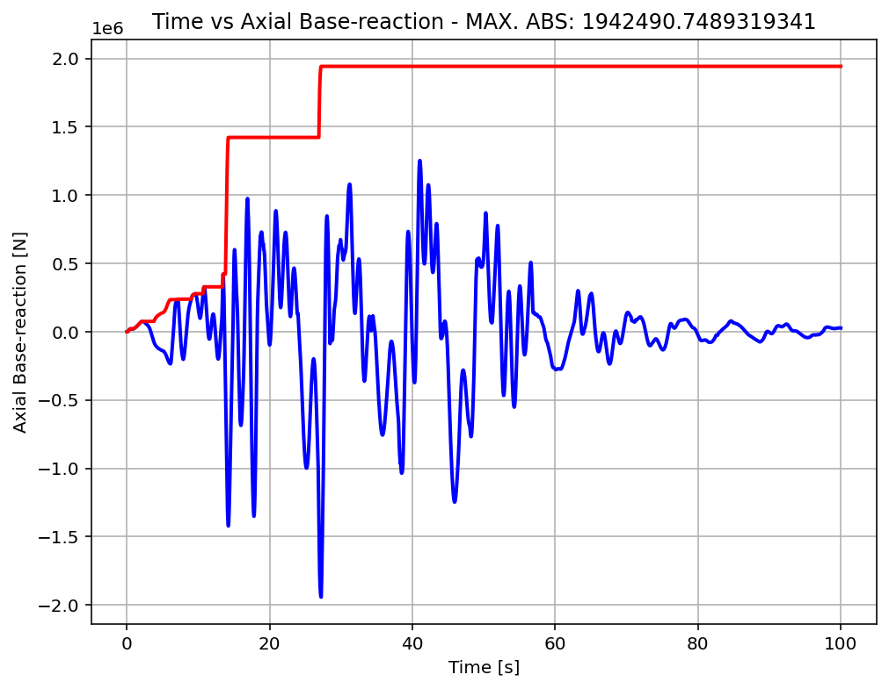

Slide 39
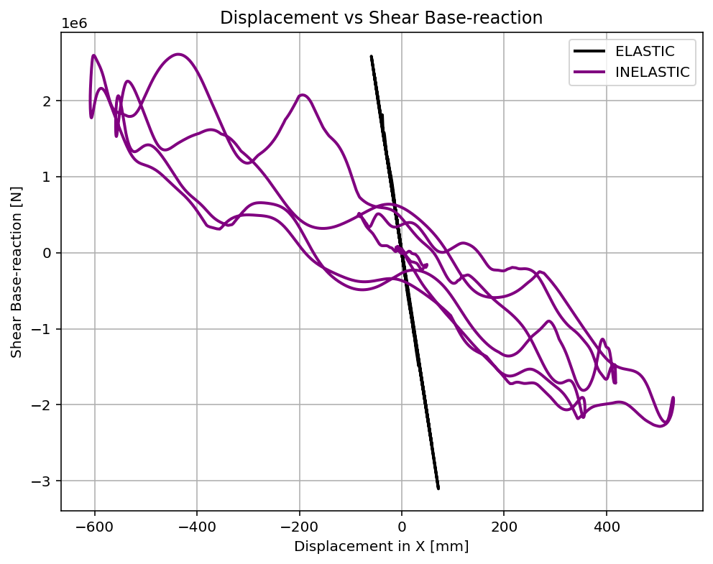

Slide 40
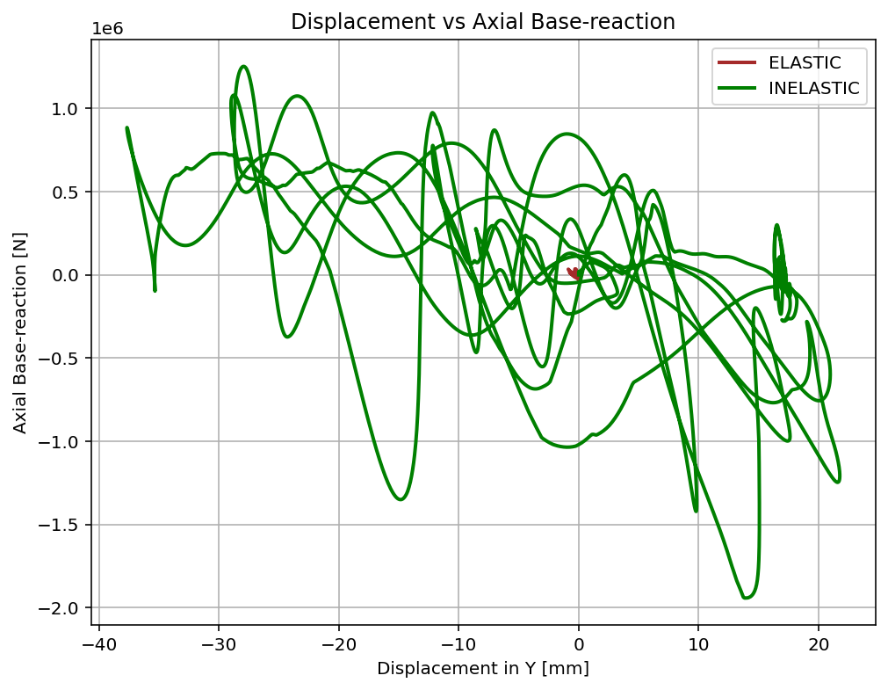

Slide 41
