Slide 1
IN THE NAME OF ALLAH, THE MOST GRACIOUS, THE MOST MERCIFUL
COMPARATIVE ANALYSIS OF AXIAL FORCE-MOMENT (P-M) INTERACTION BEHAVIOR IN FOUR DIFFERENT STEEL SECTIONS : EVALUATING STRAIN HARDENING EFFECTS AND ULTIMATE STRAIN CRITERIA
WRITTEN BY SALAR DELAVAR GHASHGHAEI (QASHQAI)

Slide 2
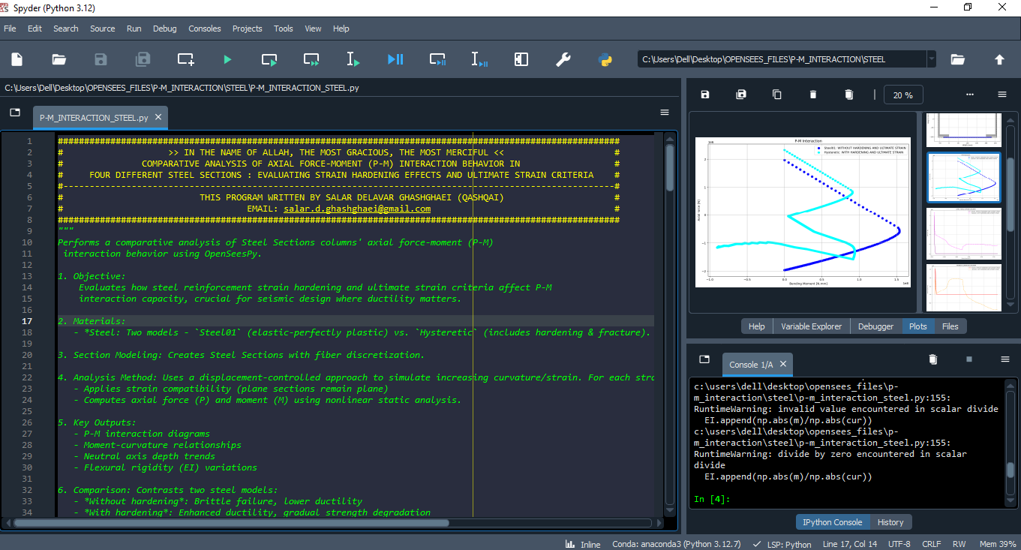

Slide 3
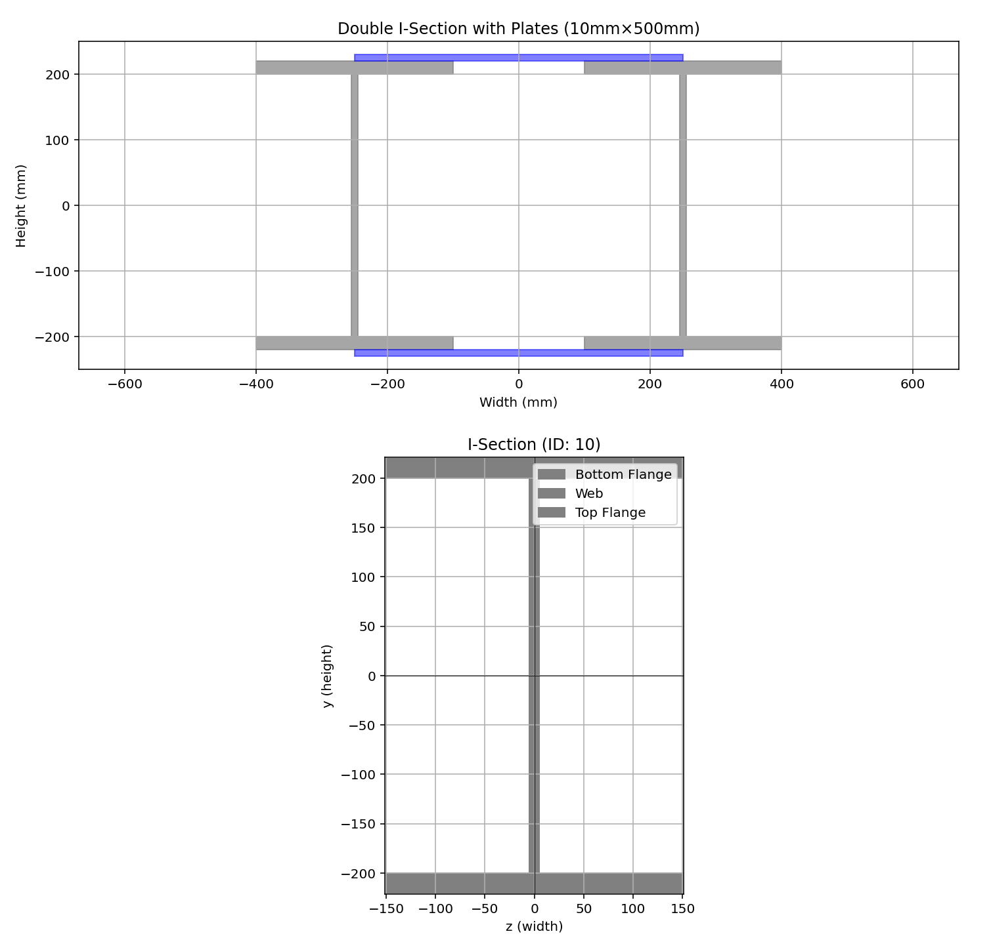

Slide 4
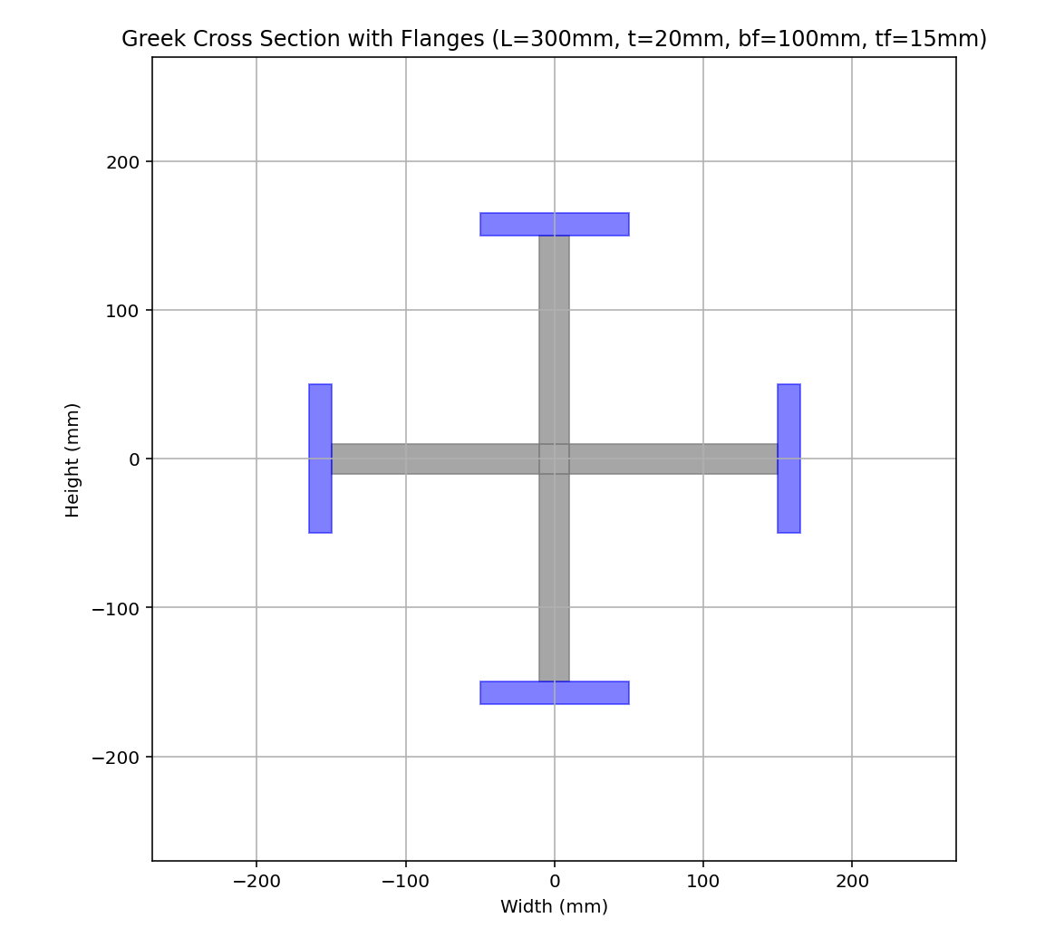

Slide 5
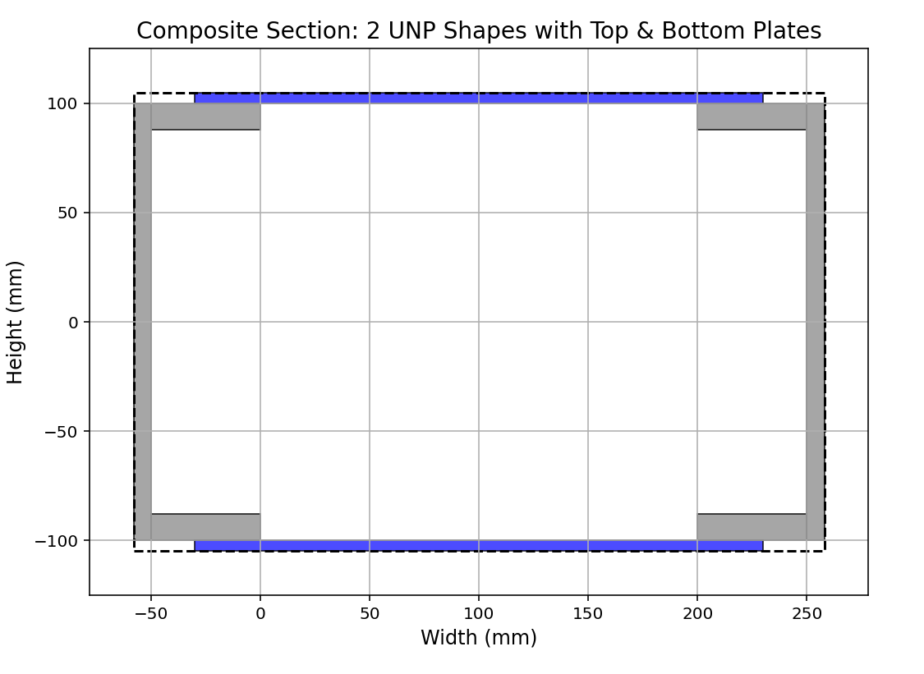

Slide 6
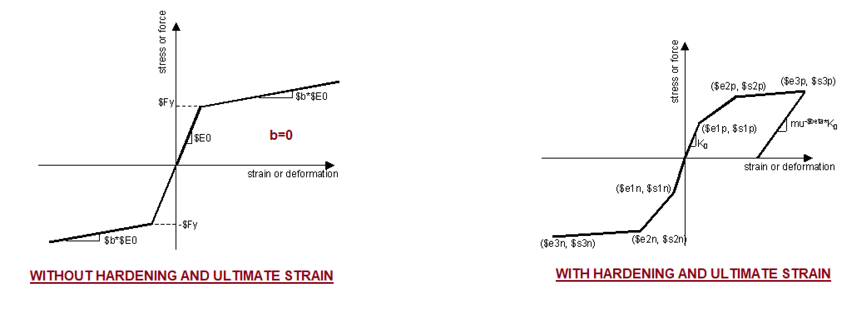

Slide 7
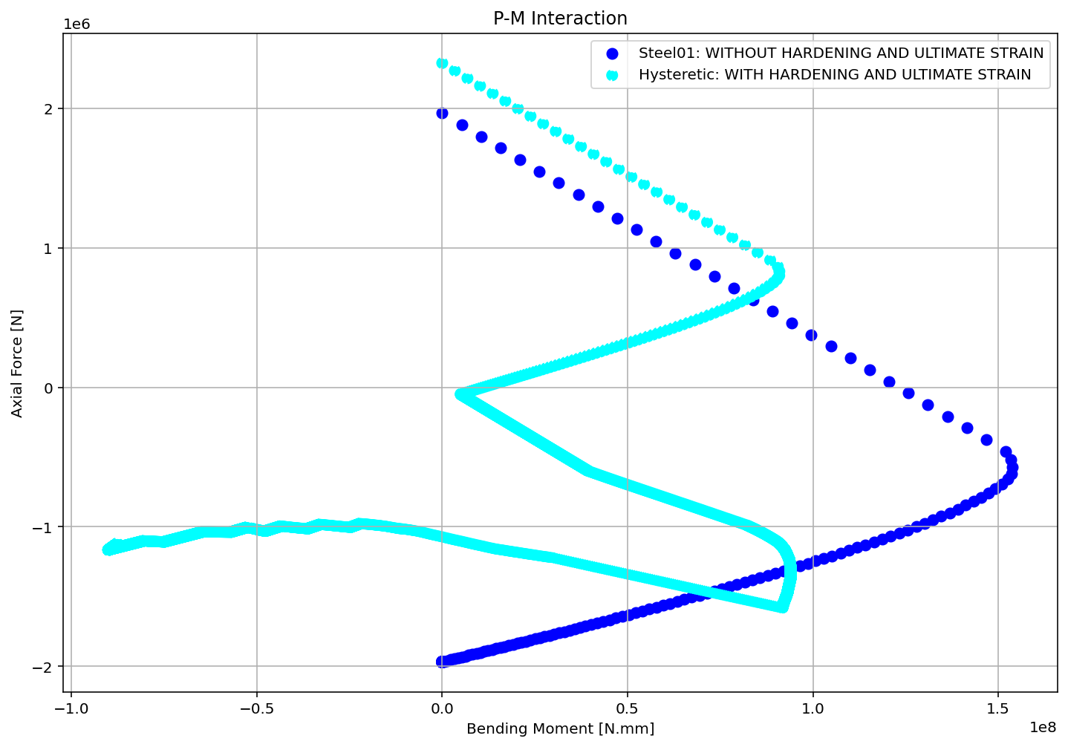

Slide 8
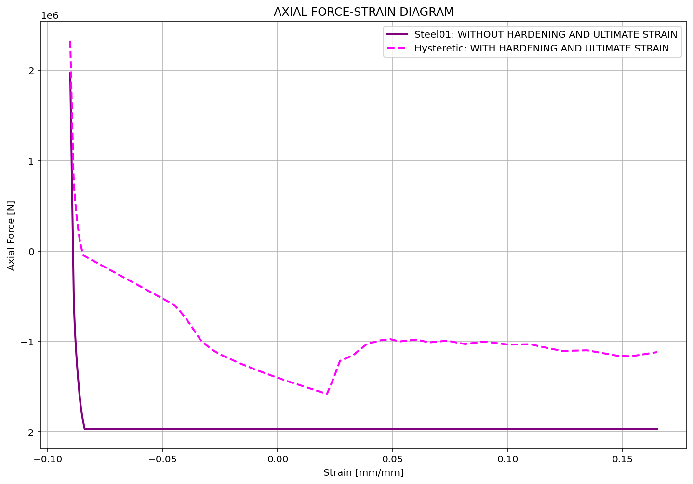

Slide 9
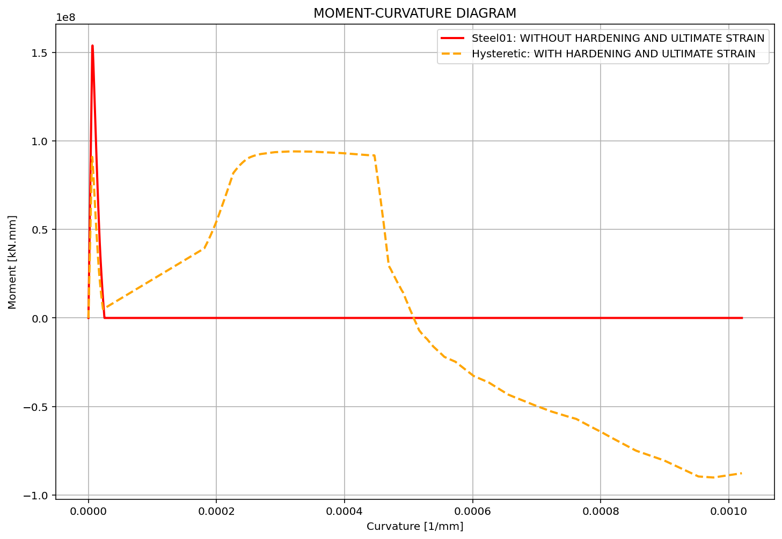

Slide 10
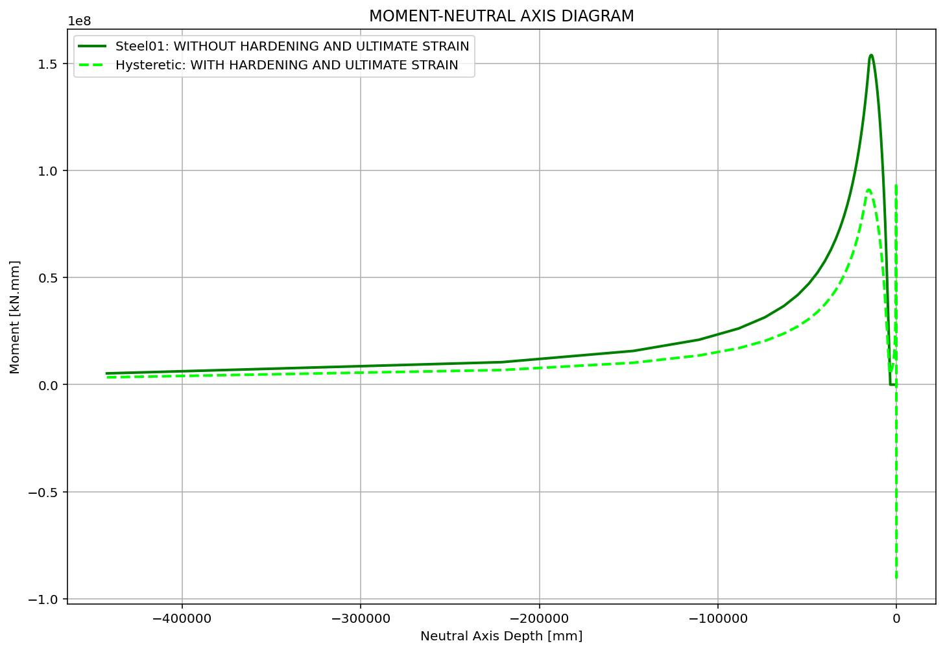

Slide 11
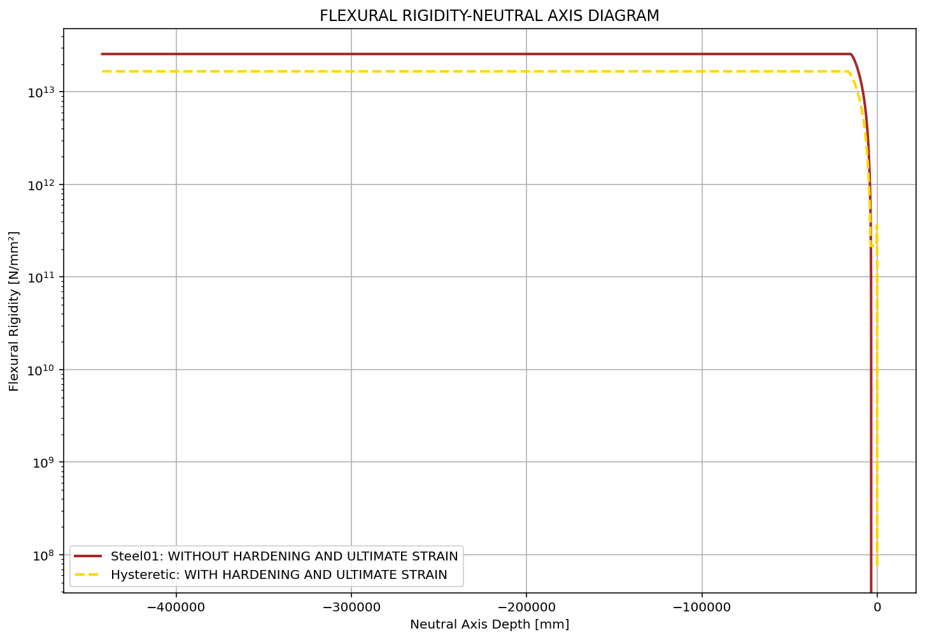

Slide 12
