Slide 1
>> IN THE NAME OF ALLAH, THE MOST GRACIOUS, THE MOST MERCIFUL <<
DETERMINATION OF OPTIMUM STRUCTURAL ULTIMATE DISPLACEMENT FROM ENERGY DISSIPATION CAPACITY INDEX USING FINITE‑DIFFERENCE NEWTON ITERATION AND OPENSEES
THIS PROGRAM WRITTEN BY SALAR DELAVAR GHASHGHAEI (QASHQAI)

Slide 2
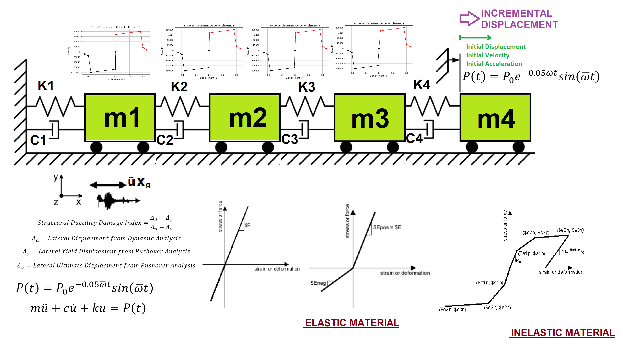

Slide 3
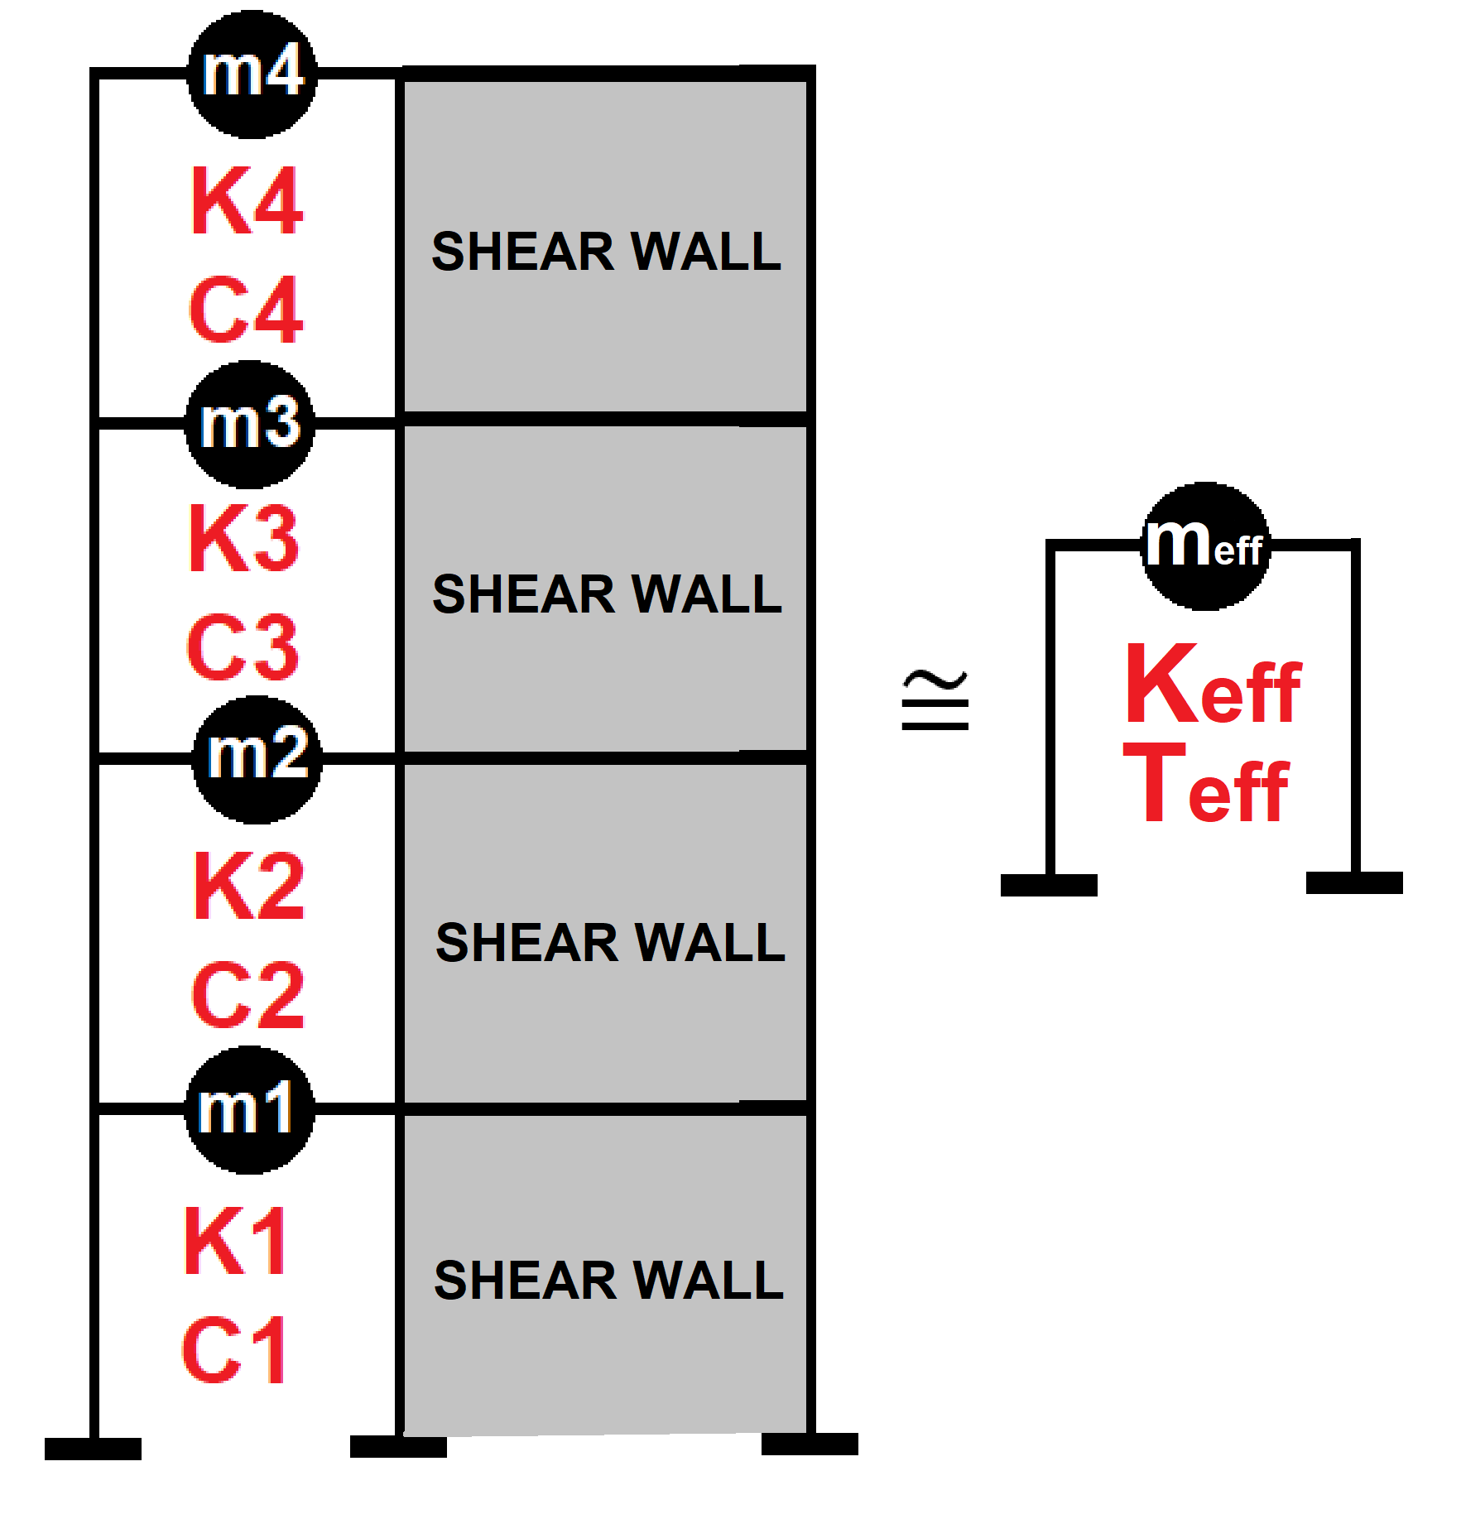

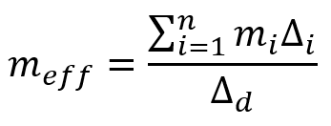
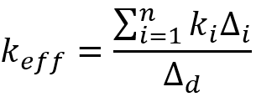
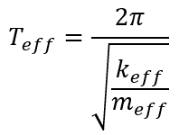
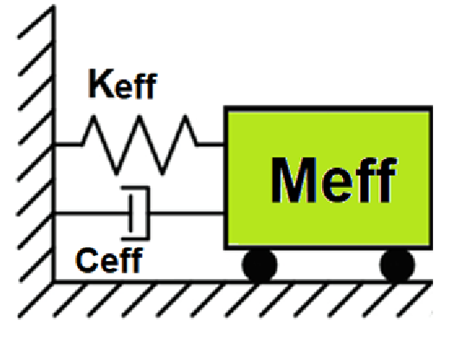
Displacement-based seismic analysis transformation,
converting a multi-degree-of-freedom (MDOF) system
into an equivalent single-degree-of-freedom (SDOF)
system for seismic assessment

Slide 4
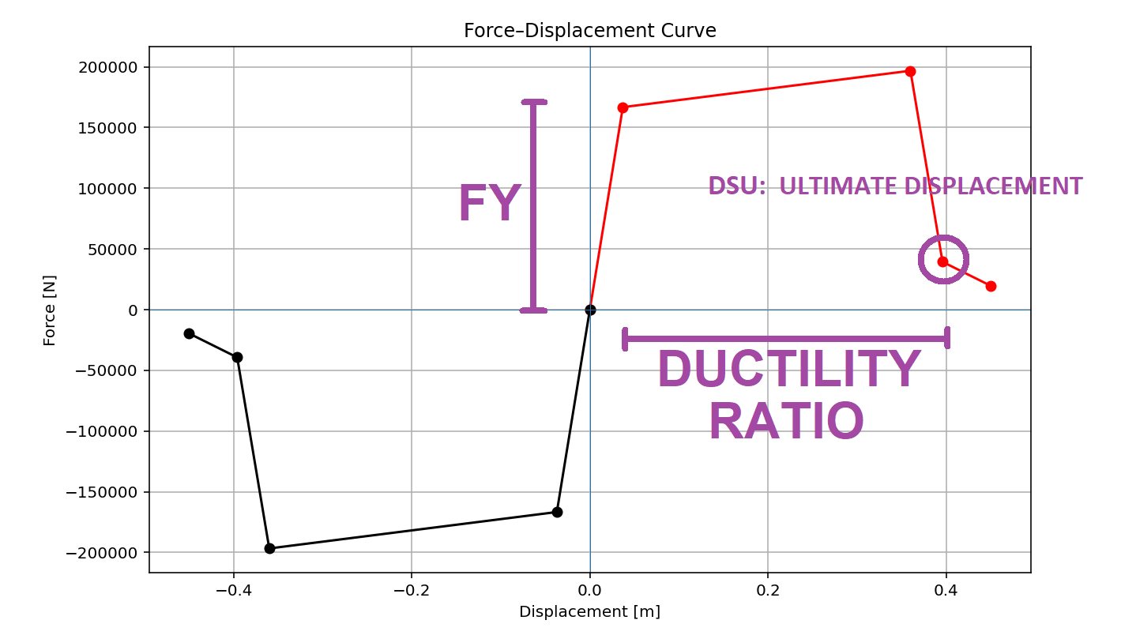

Slide 5
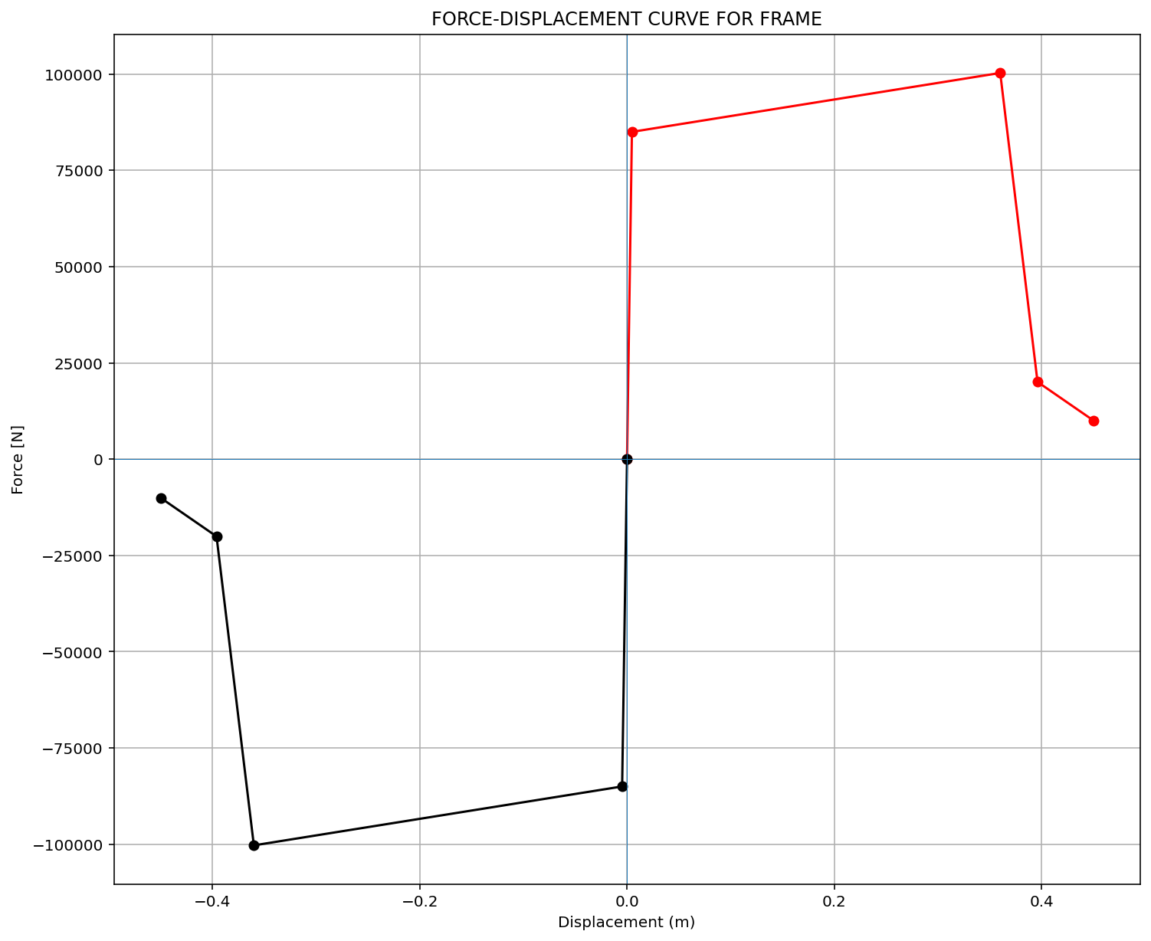

Slide 6
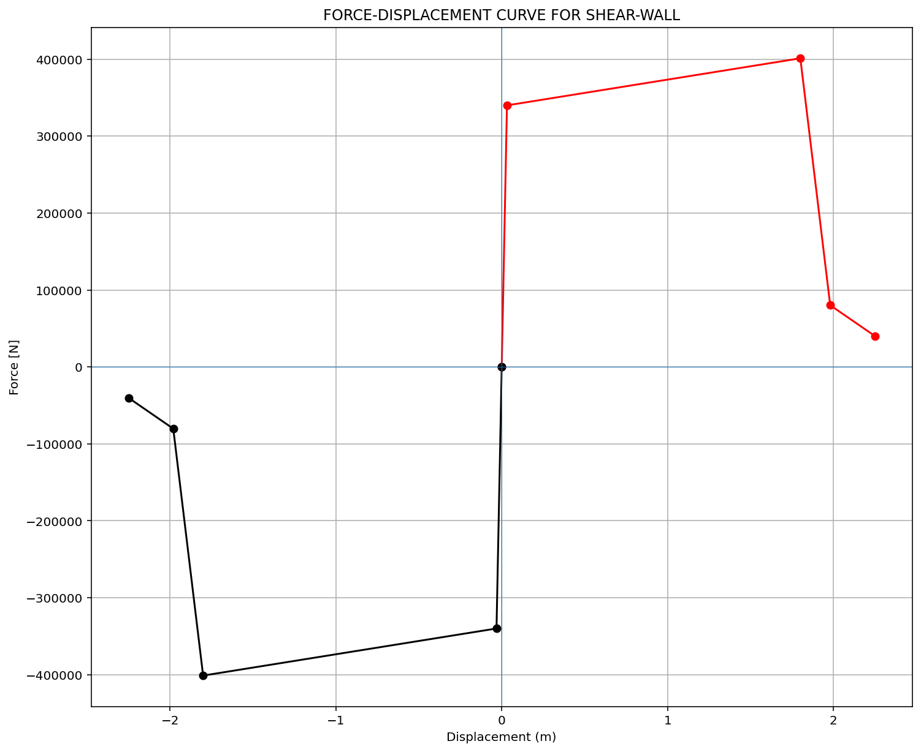

Slide 7
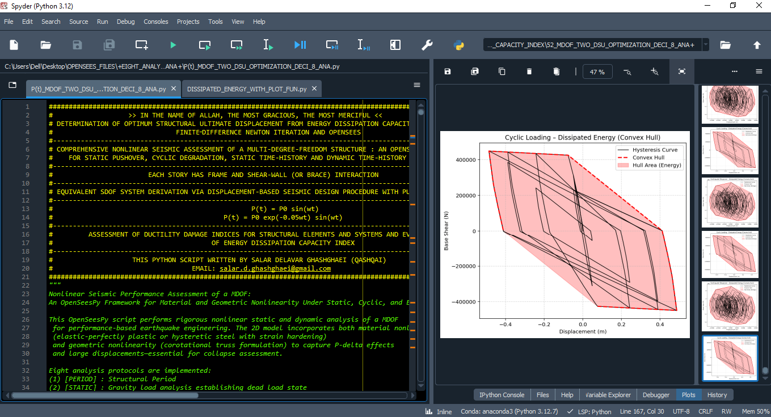

Slide 8
OPTIMIZATION PROBLEM FOR ENERGY DISSIPATION CAPACITY INDEX (EDCI)

Slide 9
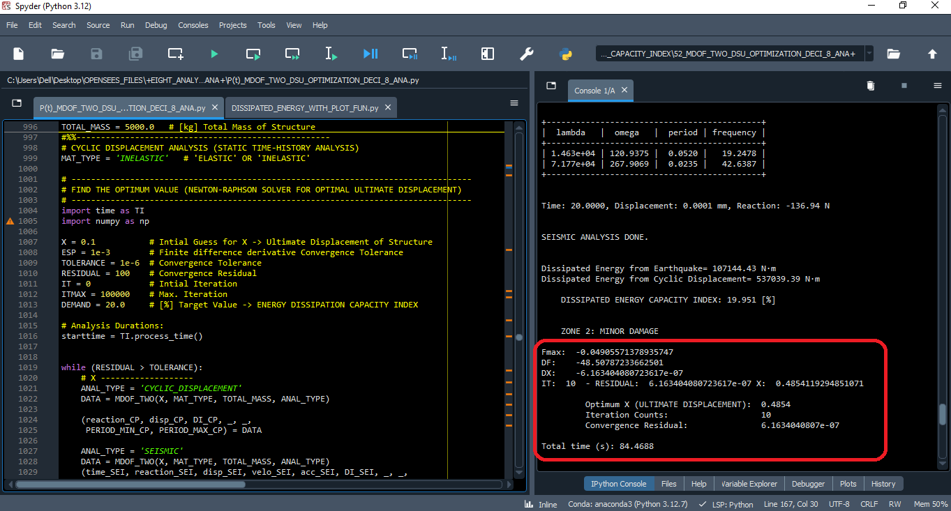

Slide 10
Dissipated Energy from Earthquake= 107144.43 N·m
Dissipated Energy from Cyclic Displacement= 537039.39 N·m
DISSIPATED ENERGY CAPACITY INDEX: 19.951 [%]
ZONE 2: MINOR DAMAGE
Fmax: -0.04905571378935747
DF: -48.50787233662501
DX: -6.163404080723617e-07
IT: 10 - RESIDUAL: 6.163404080723617e-07 X: 0.4854119294851071
Optimum X (ULTIMATE DISPLACEMENT): 0.4854
Iteration Counts: 10
Convergence Residual: 6.1634040807e-07
Total time (s): 84.4688

Slide 11
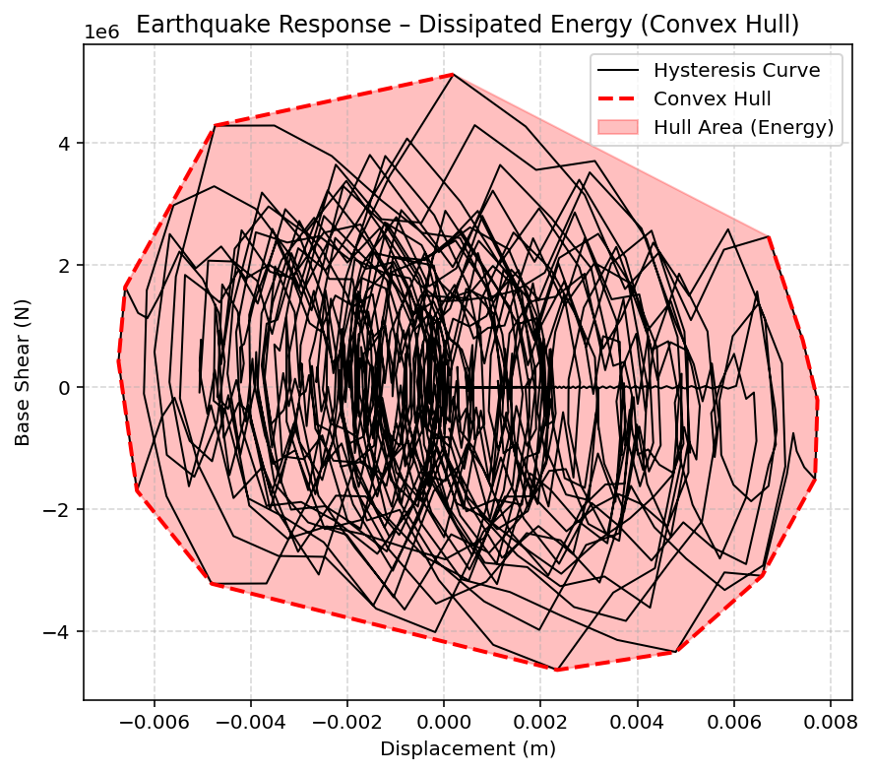

Slide 12
