Slide 1
IN THE NAME OF ALLAH, THE MOST GRACIOUS, THE MOST MERCIFUL
FREE-VIBRATION ANALYSIS OF CONCRETE FRAME. EVALUATING STRAIN HARDENING AND ULTIMATE STRAIN CRITERIA USING OPENSEES
WRITTEN BY SALAR DELAVAR GHASHGHAEI (QASHQAI)

Slide 2
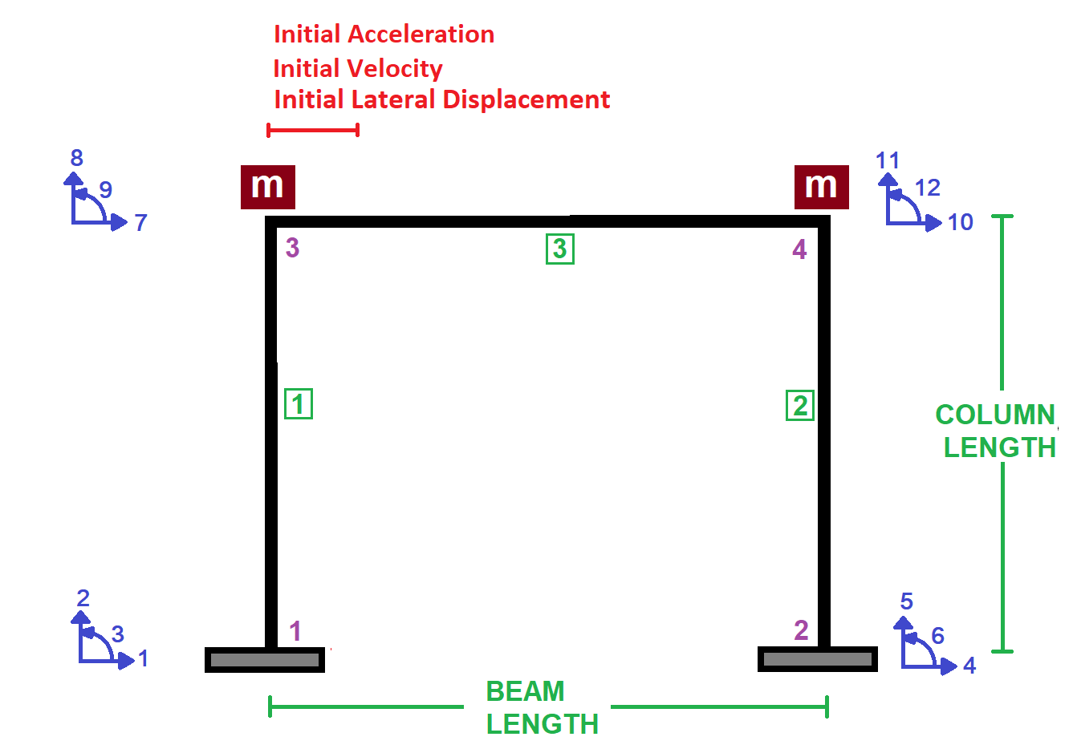

Slide 3
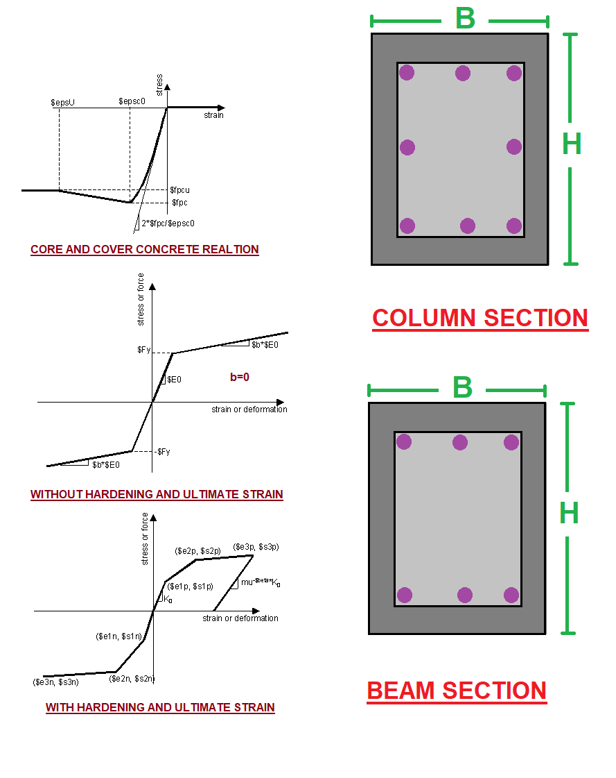

Slide 4
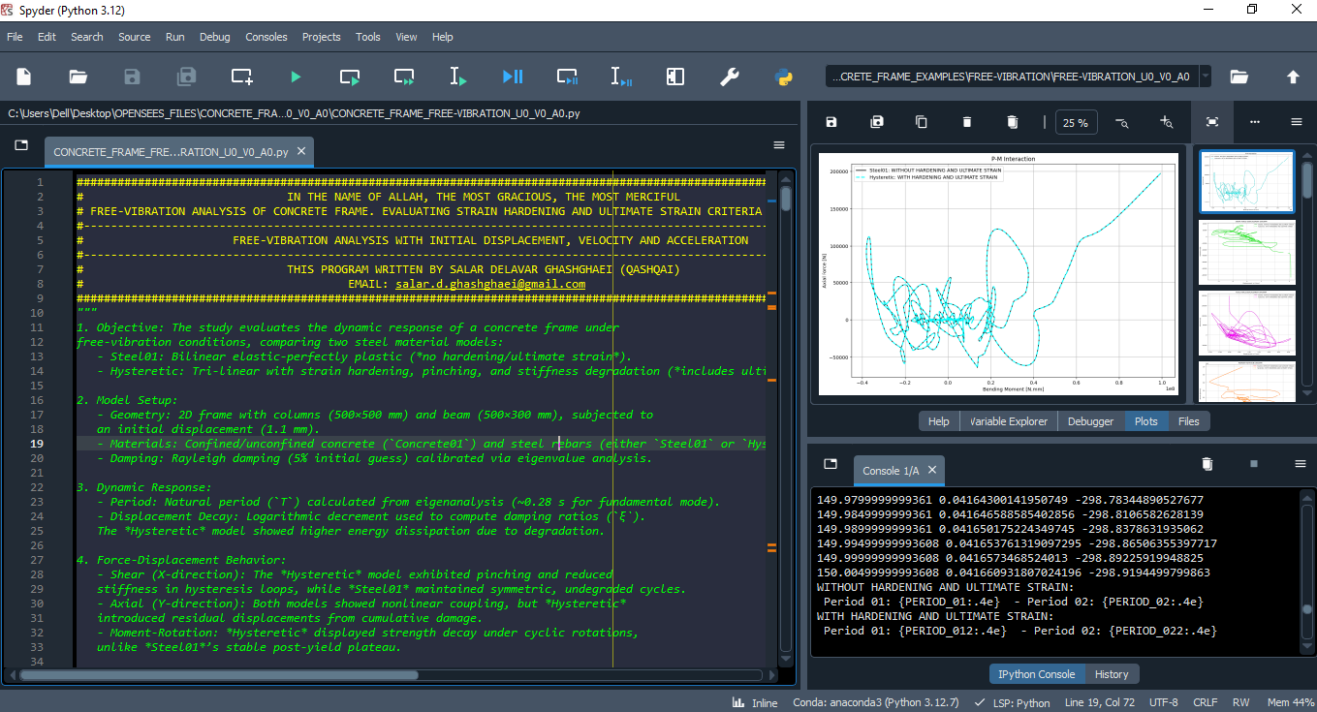

Slide 5
Free Vibration Analysis
With Initial Displacement ,Velocity and Acceleration

Slide 6
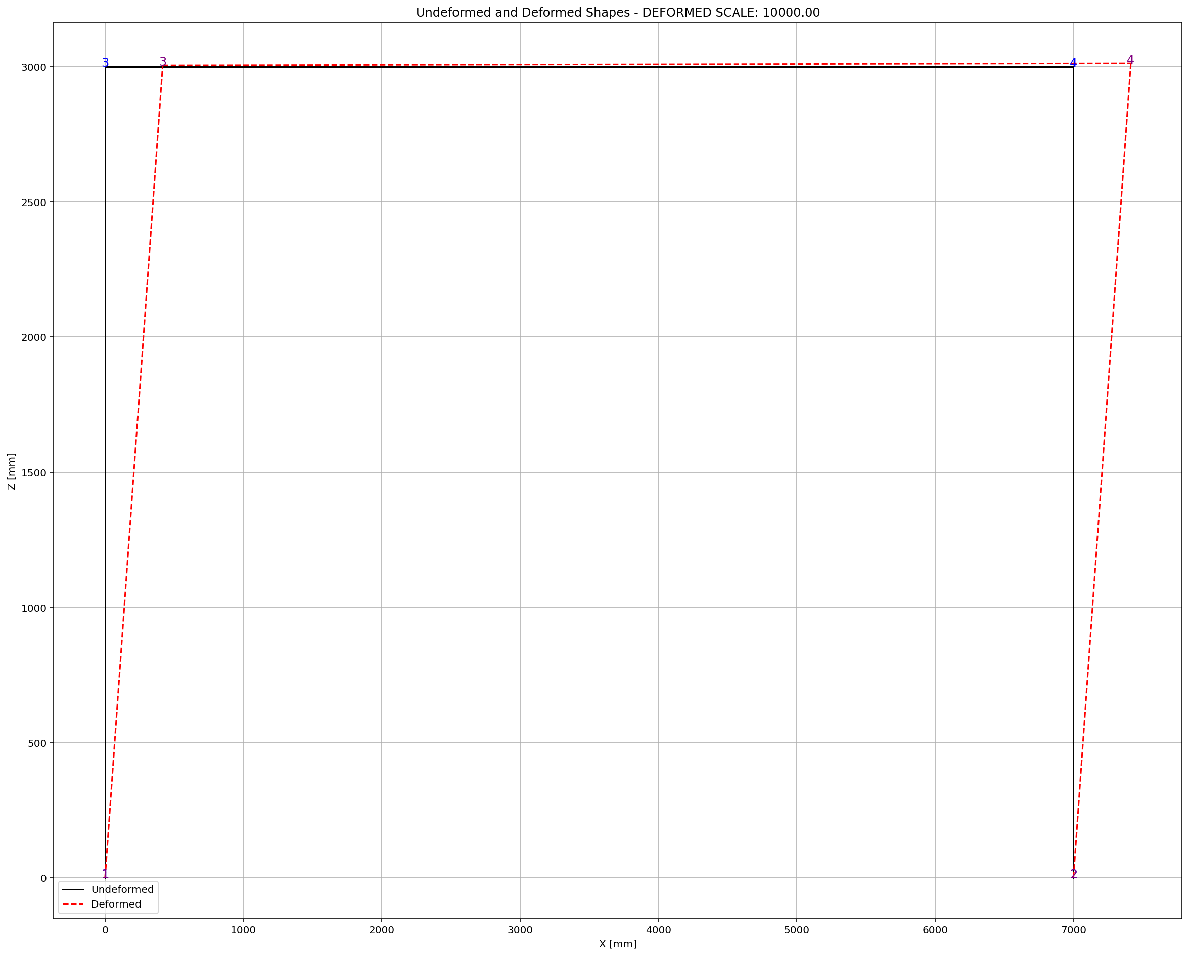

Slide 7
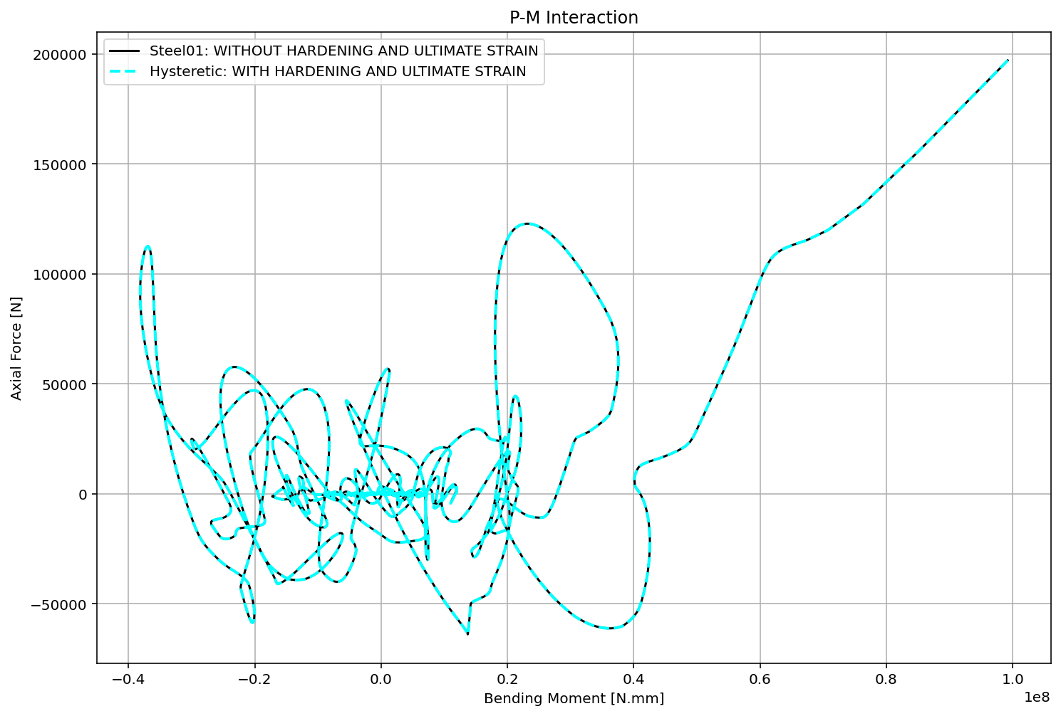

Slide 8
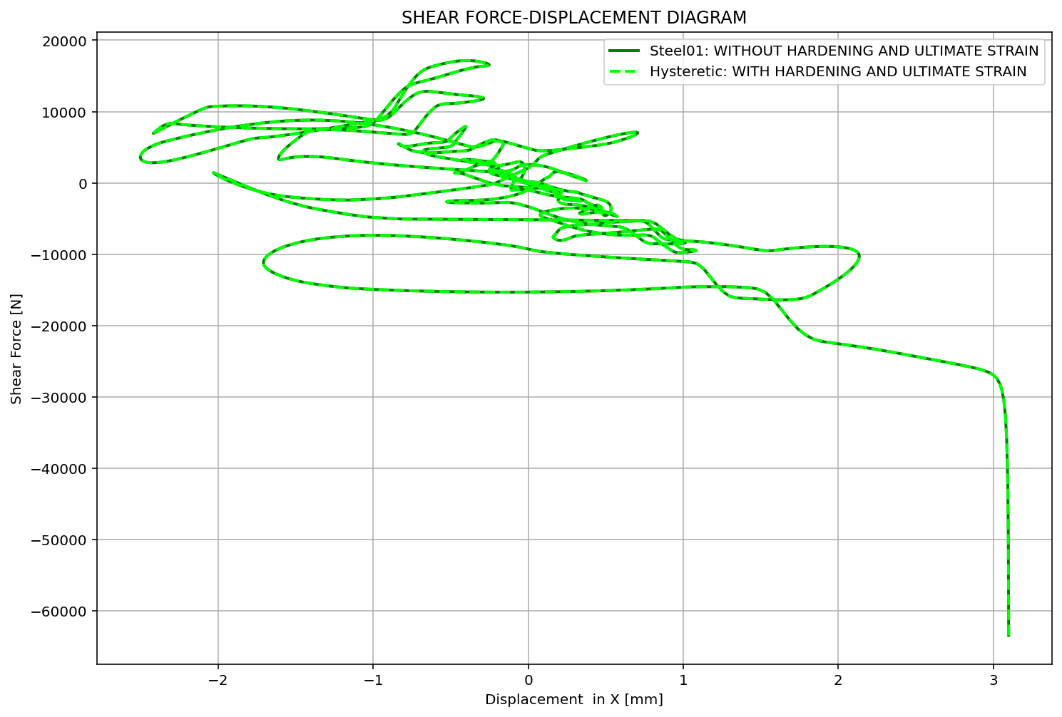

Slide 9
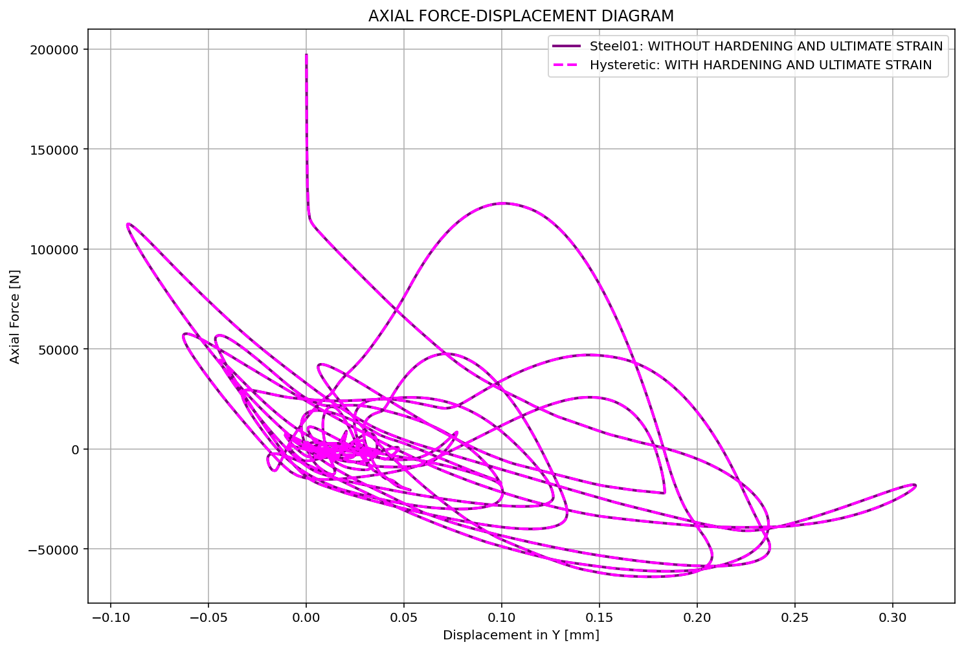

Slide 10
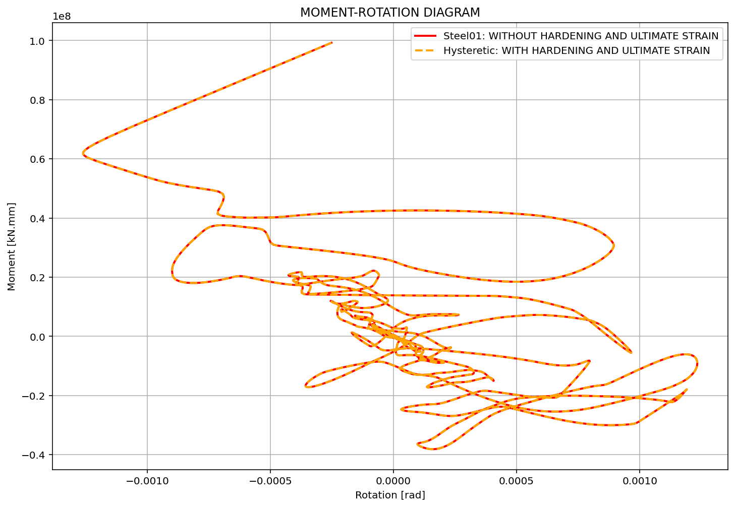

Slide 11
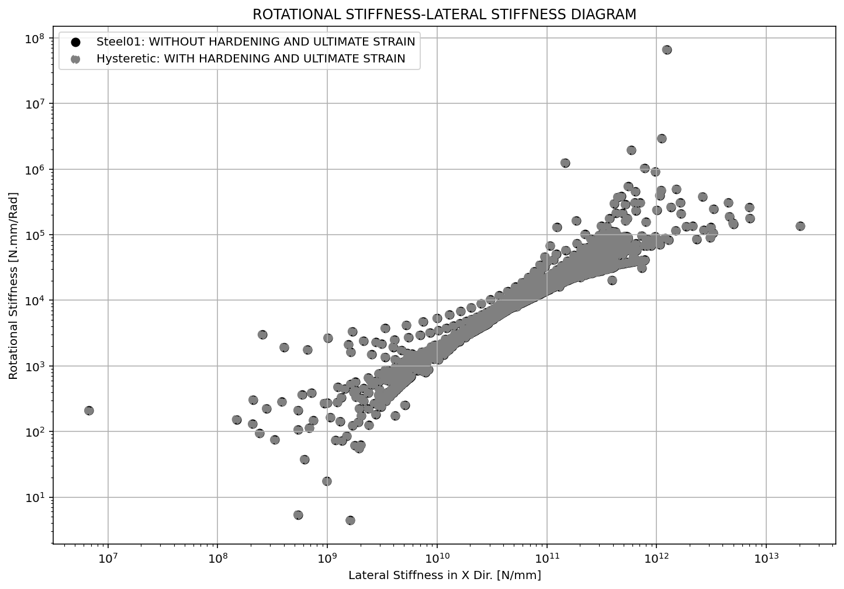

Slide 12
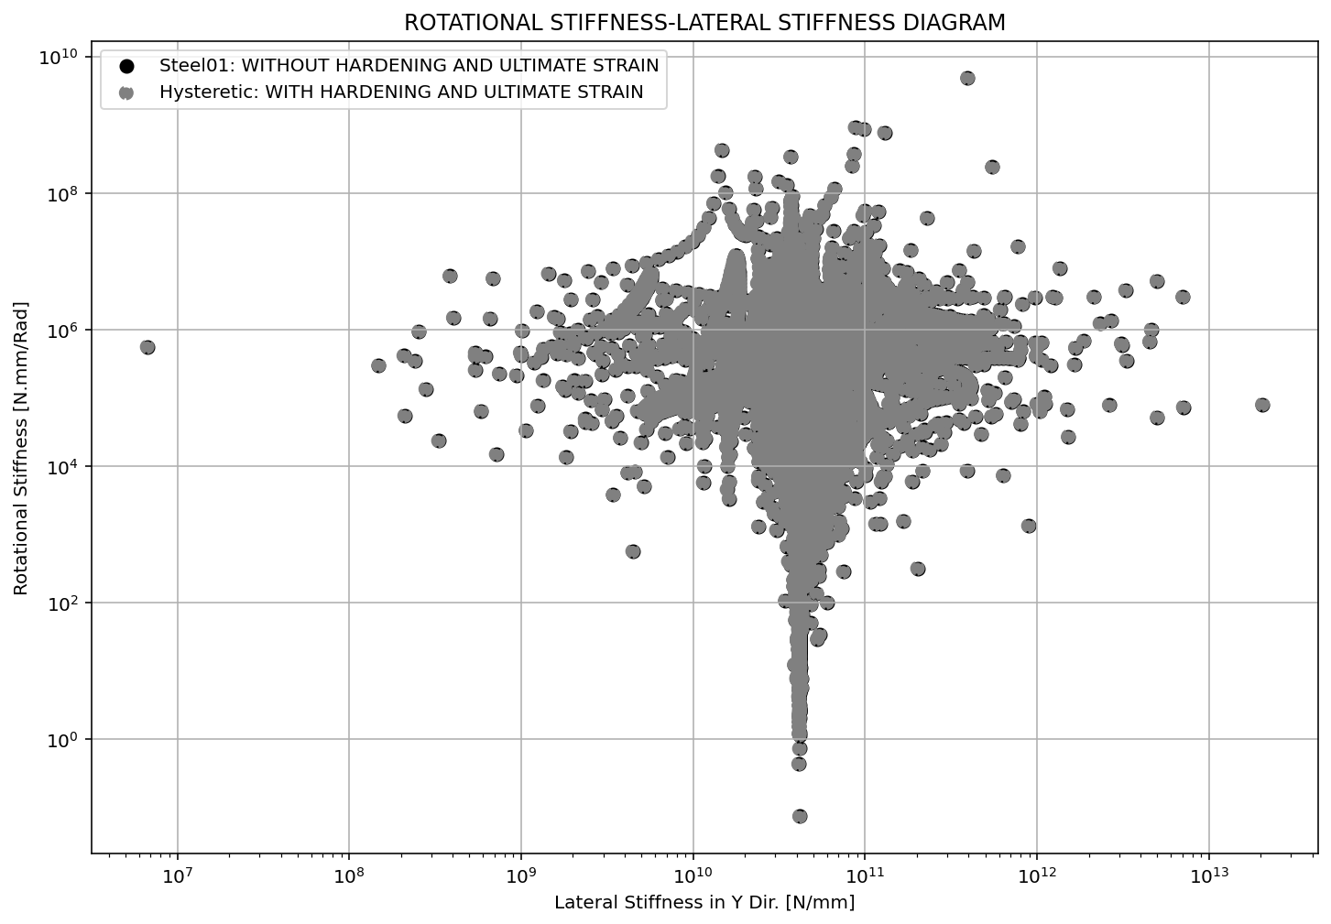

Slide 13
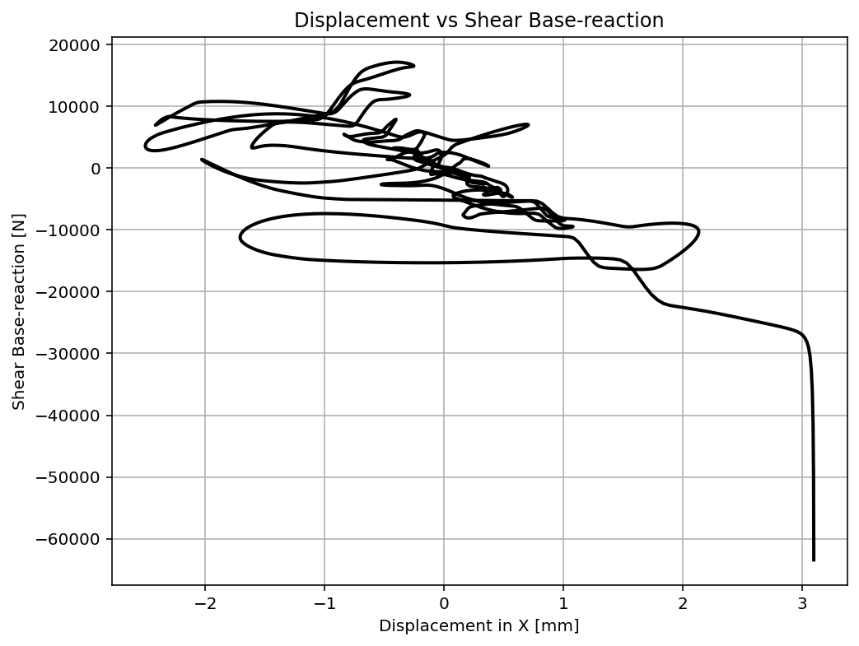

Slide 14
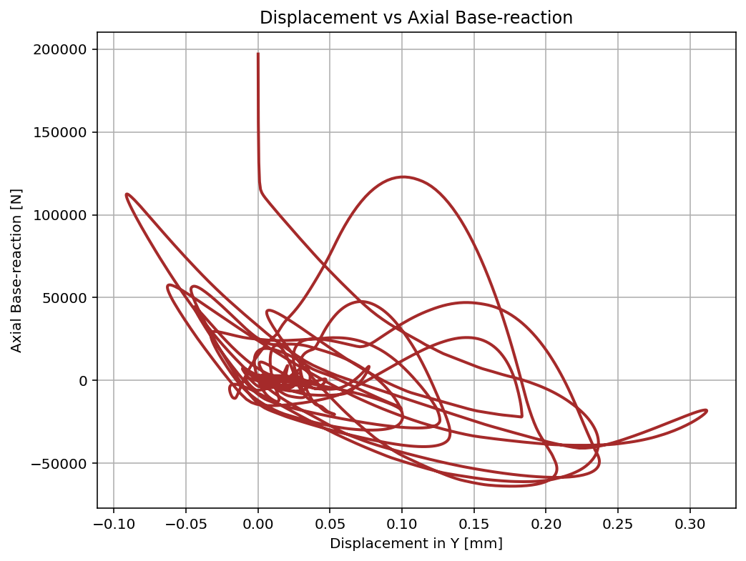

Slide 15
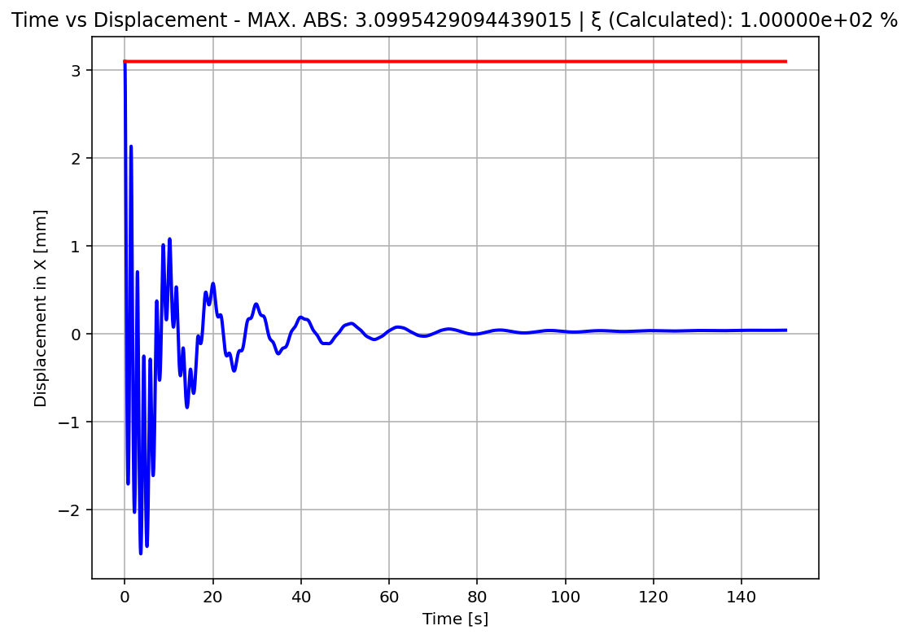

Slide 16
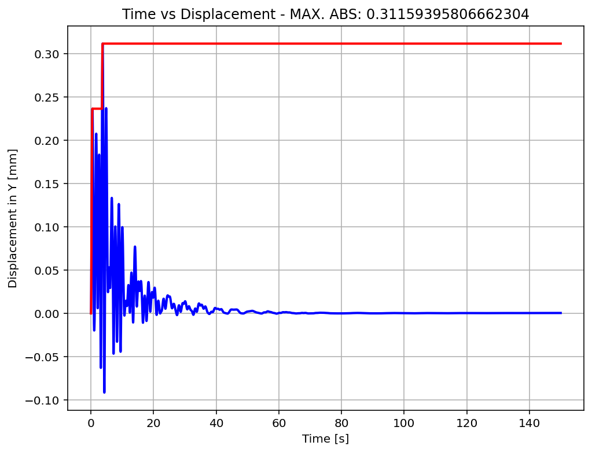

Slide 17
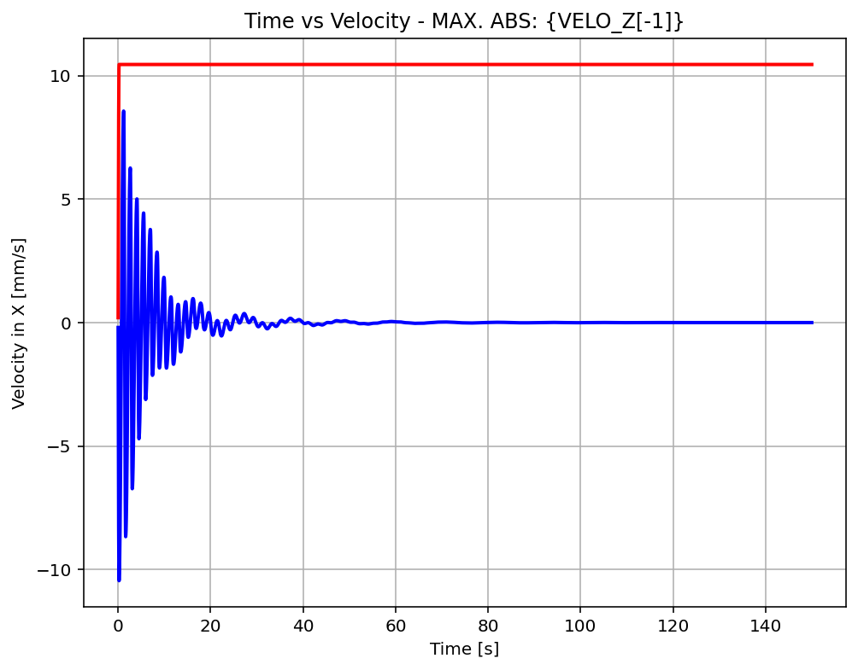

Slide 18
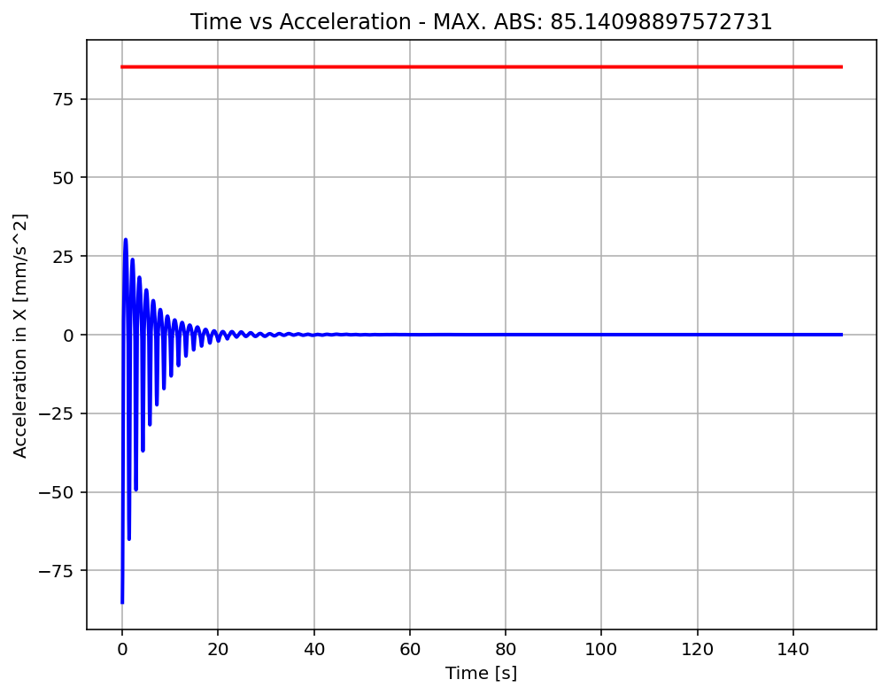

Slide 19
