Slide 1
>> IN THE NAME OF ALLAH, THE MOST GRACIOUS, THE MOST MERCIFUL <<
CONTACT-DRIVEN PUSHOVER ANALYSIS OF INELASTIC SDOF SYSTEMS: MONITORING PERIOD SHIFTS DURING SECONDARY SPRING ACTIVATION IN OPENSEES
WRITTEN BY SALAR DELAVAR GHASHGHAEI (QASHQAI)

Slide 2
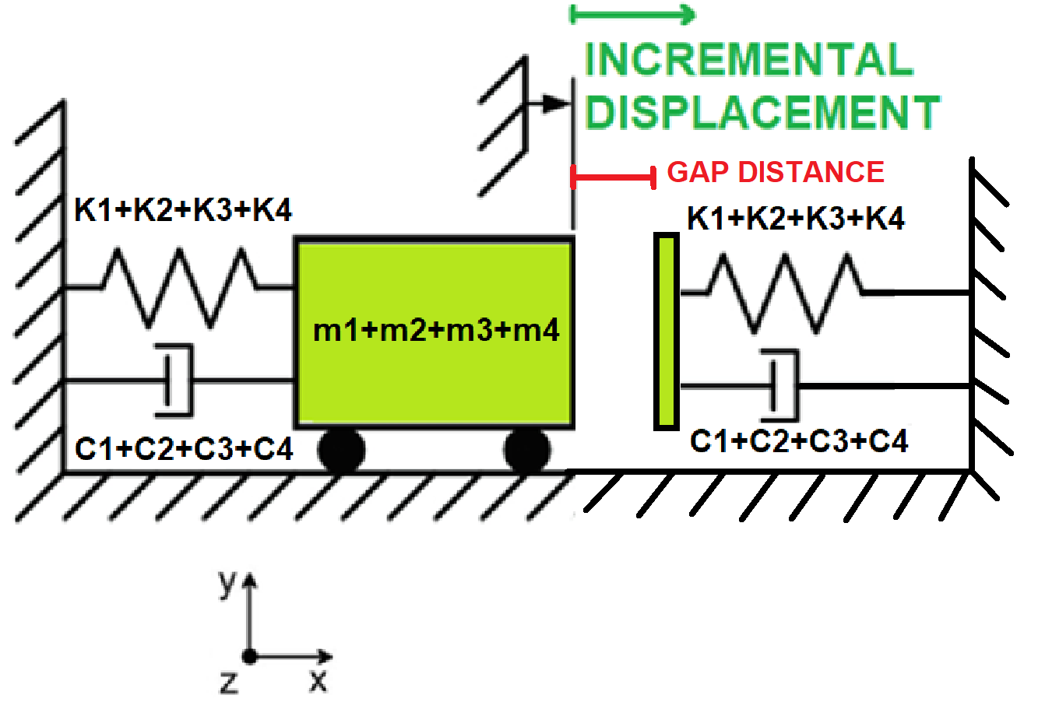

Slide 3
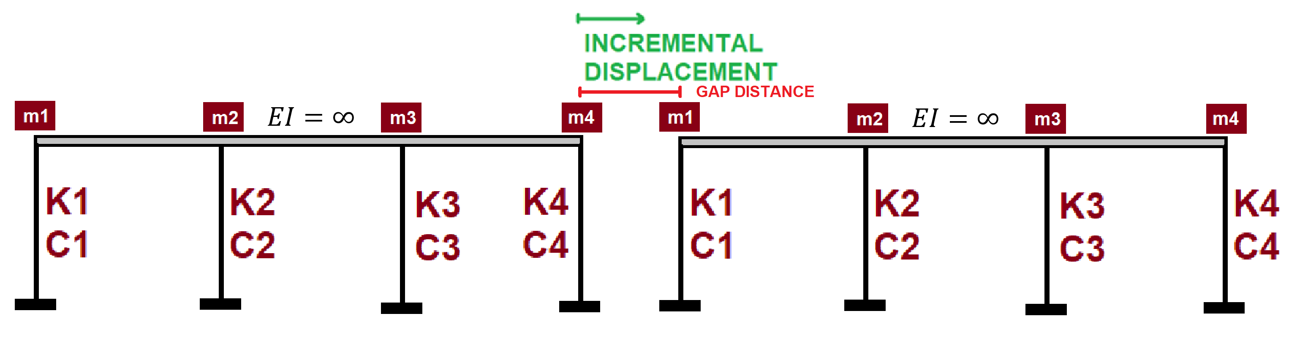

Slide 4
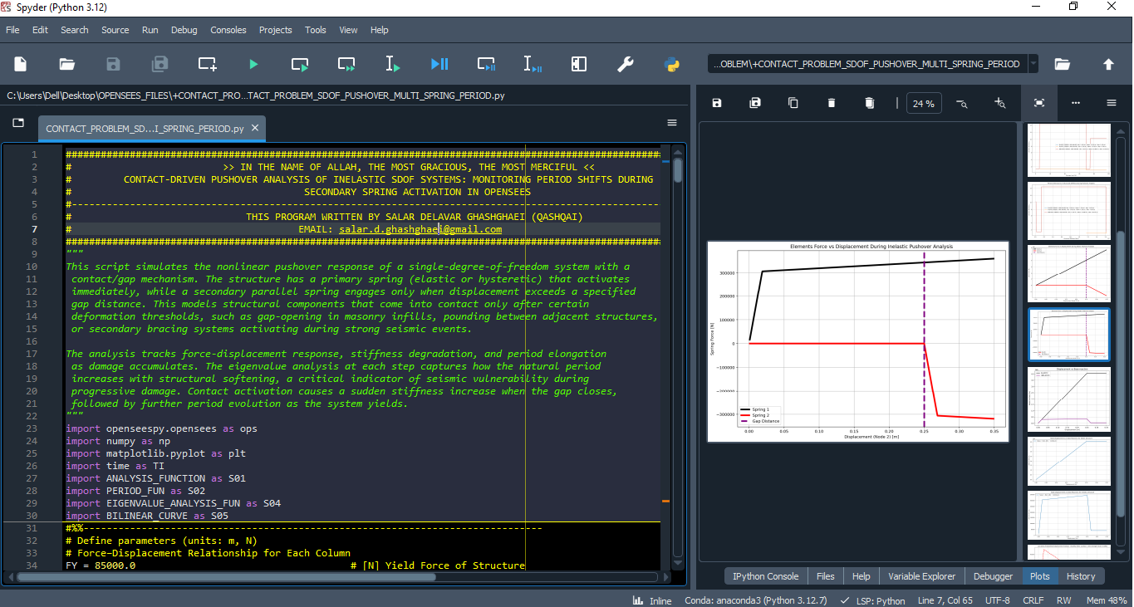

Slide 5
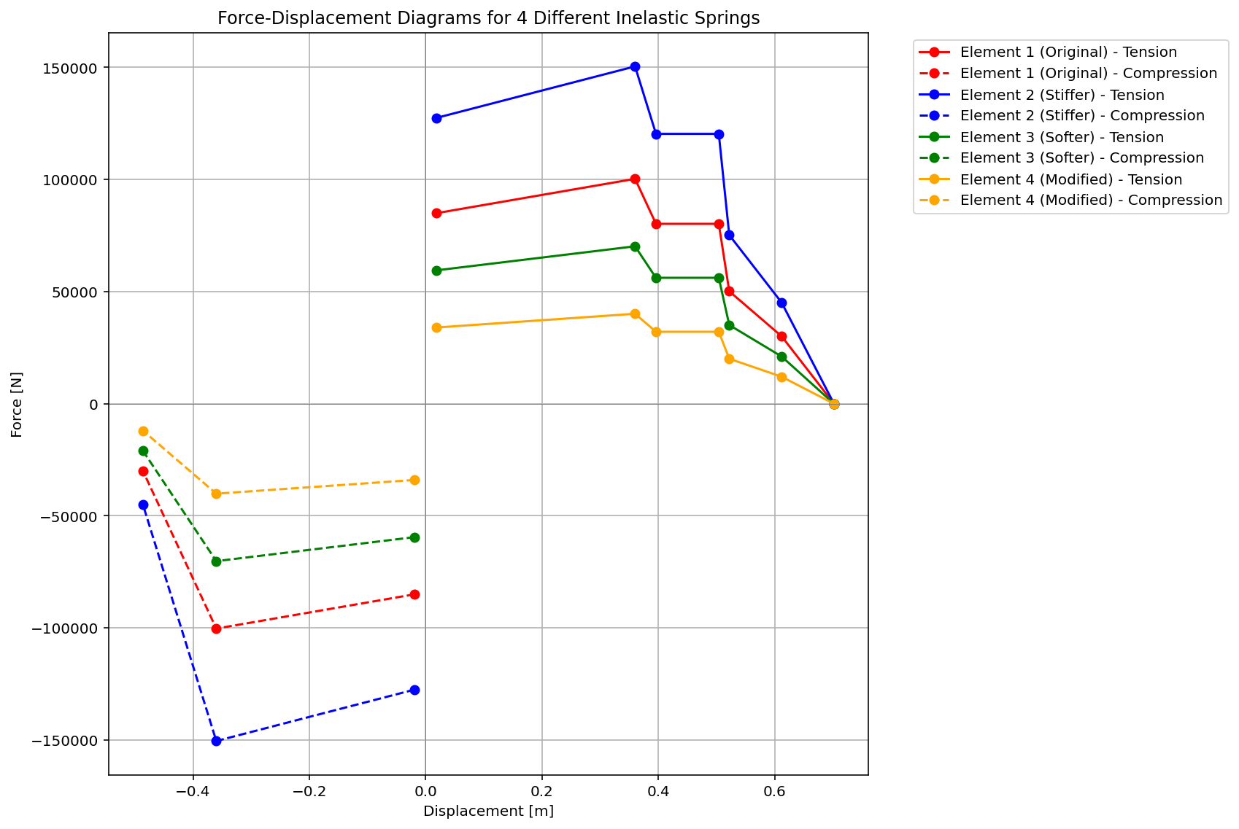

Slide 6
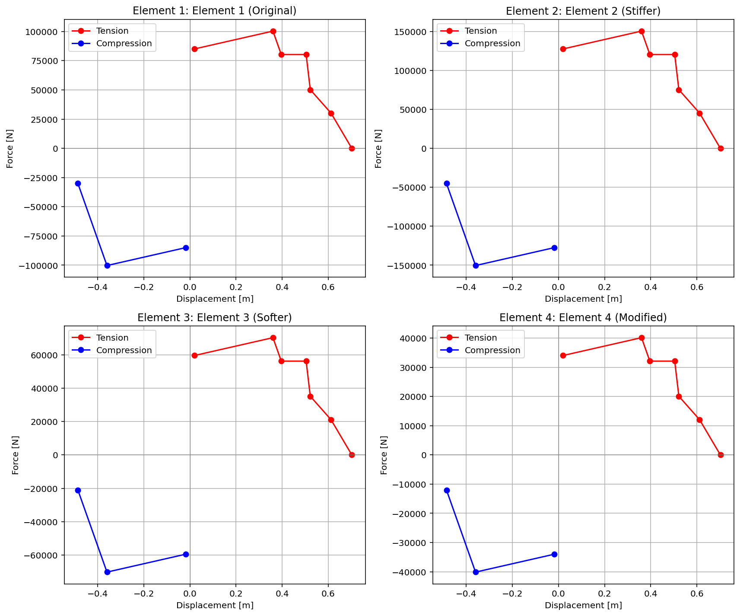

Slide 7
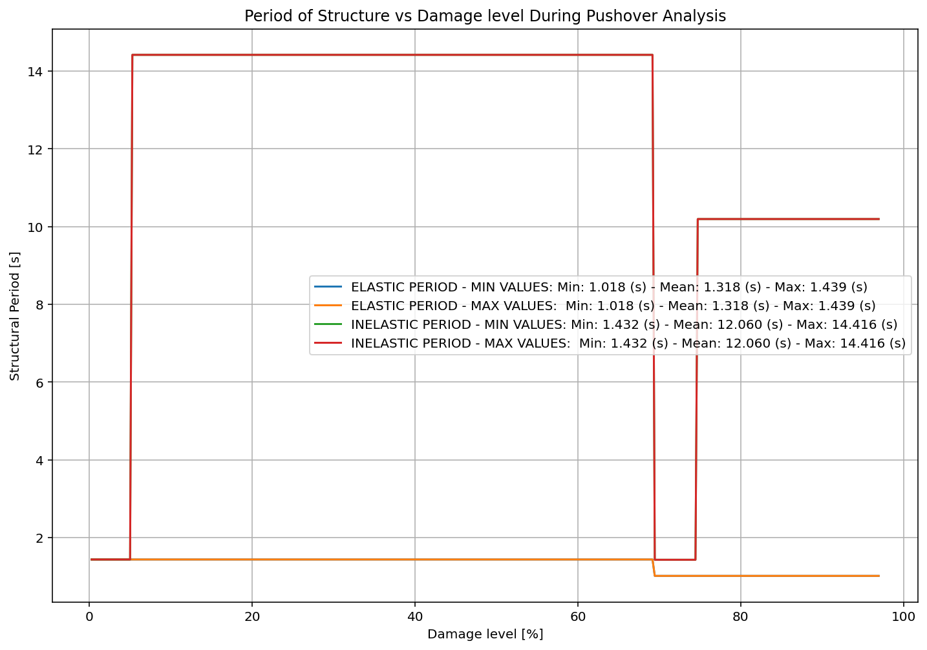

Slide 8
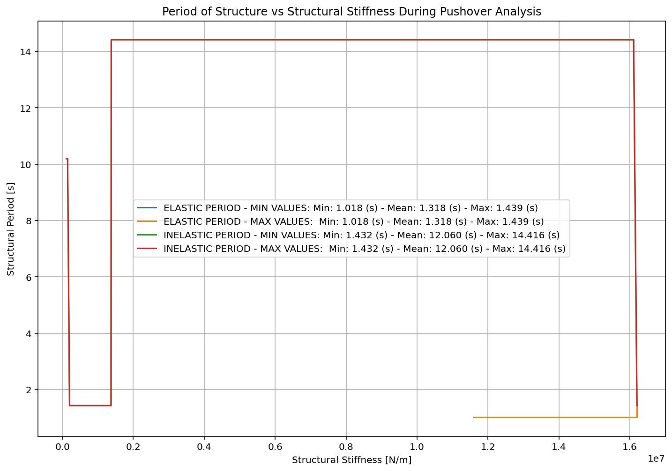

Slide 9
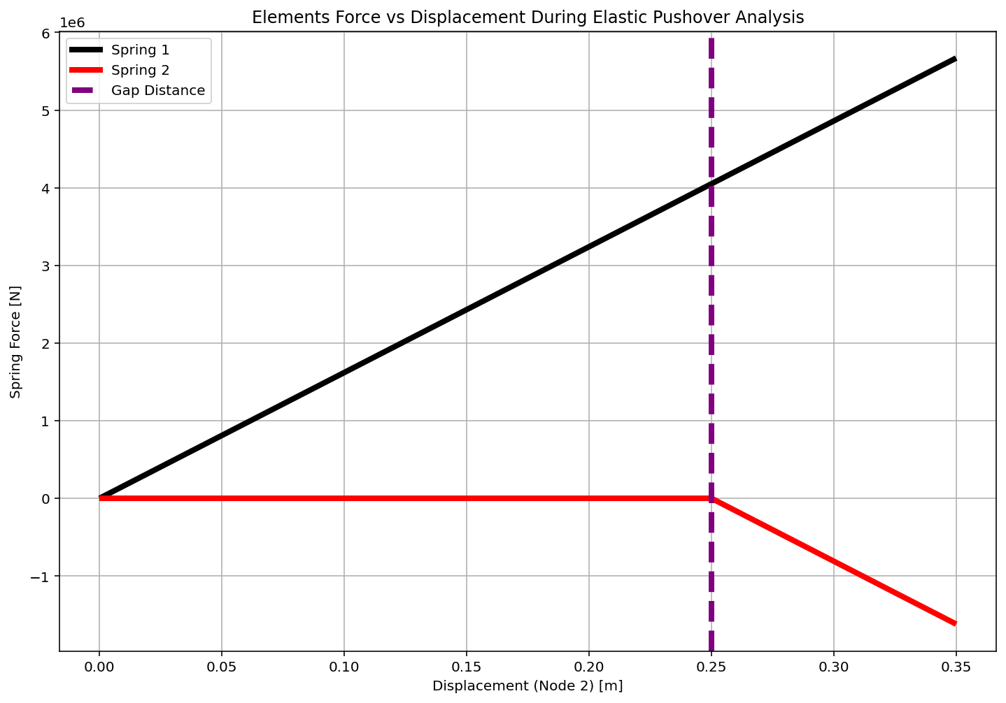

Slide 10
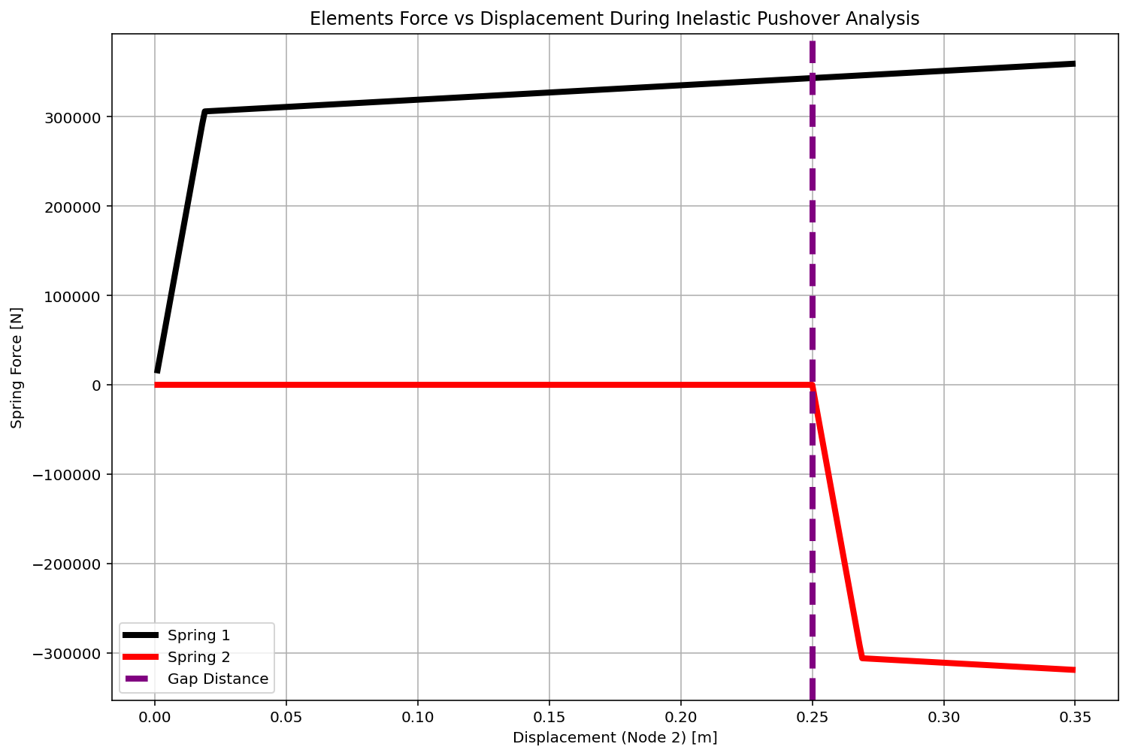

Slide 11
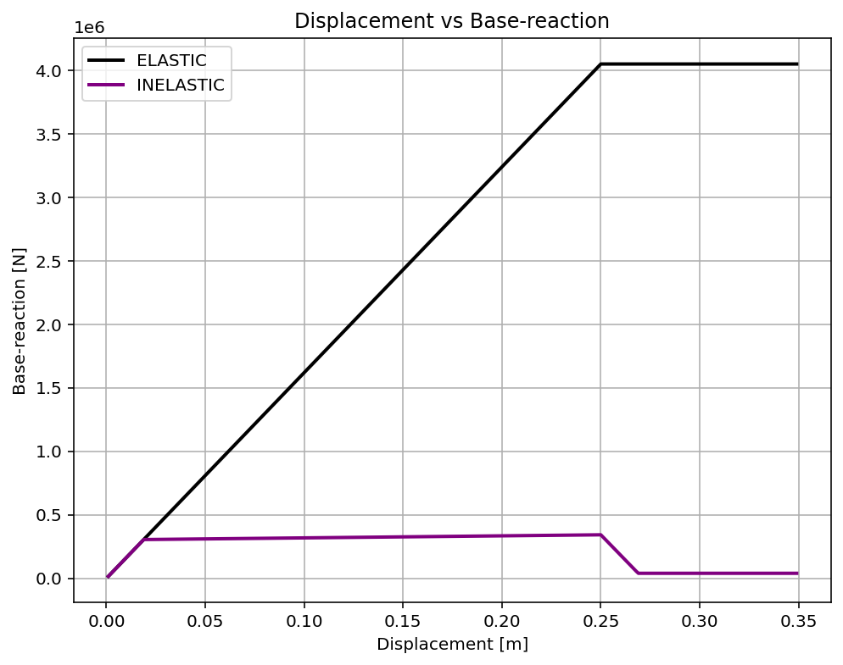

Slide 12
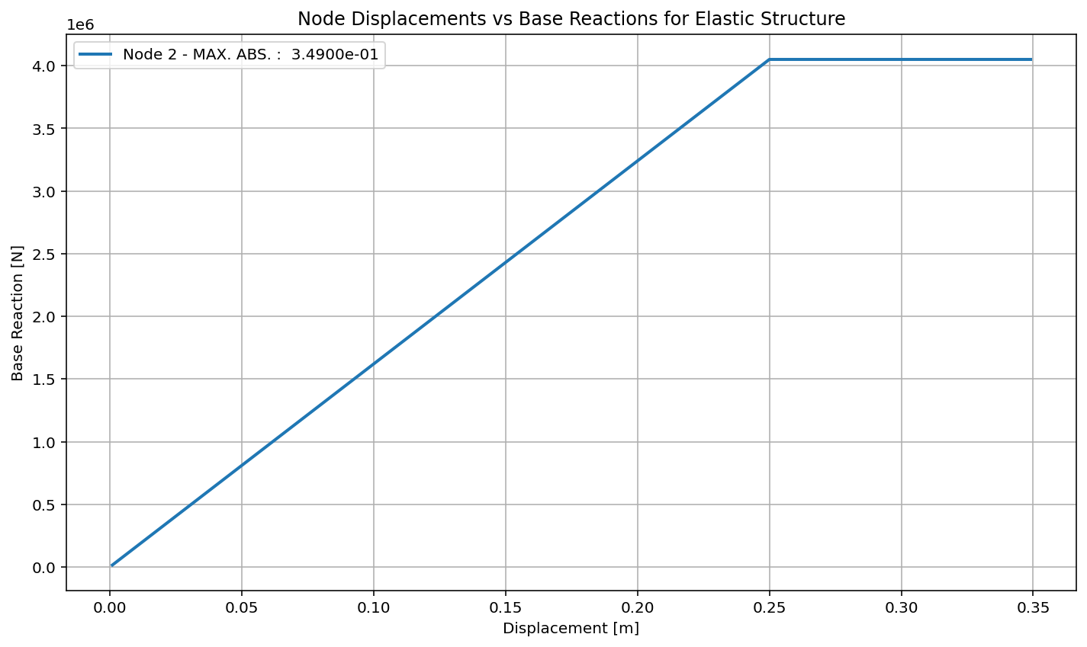

Slide 13
