Slide 1
IN THE NAME OF ALLAH, THE MOST GRACIOUS, THE MOST MERCIFUL
REVERSED CYCLIC PUSHOVER ANALYSIS OF CONCRETE FRAME. EVALUATING STRAIN HARDENING AND ULTIMATE STRAIN CRITERIA USING OPENSEES
WRITTEN BY SALAR DELAVAR GHASHGHAEI (QASHQAI)

Slide 2
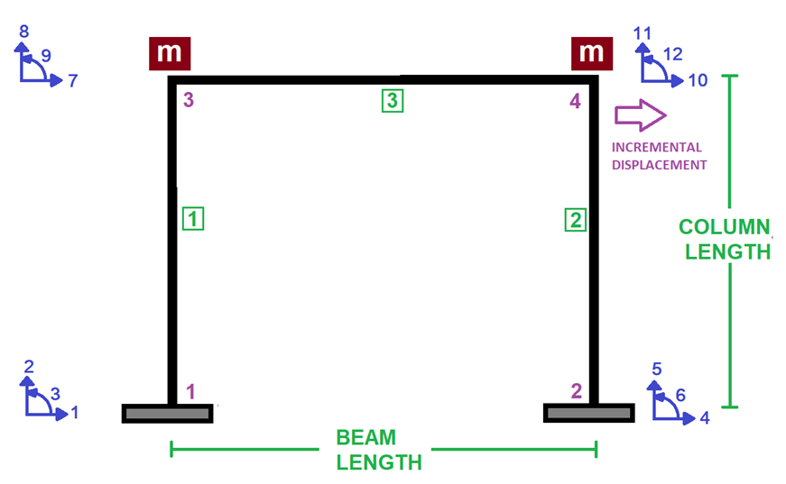

Slide 3
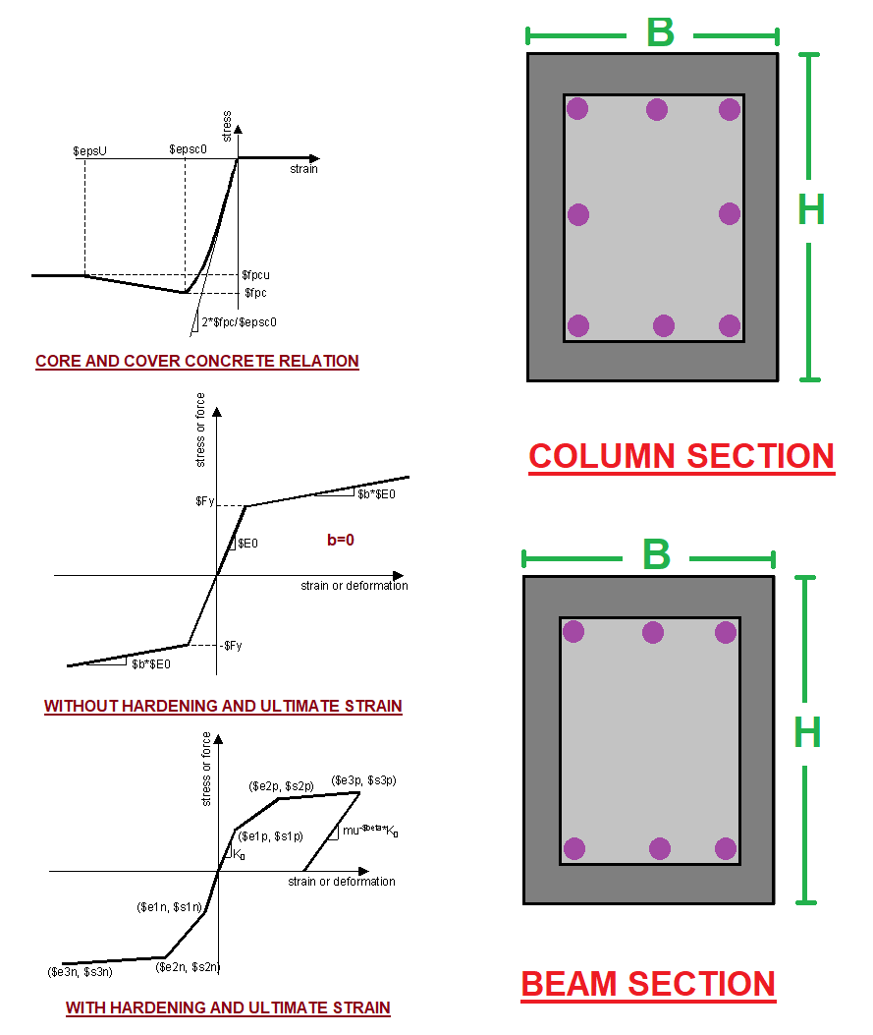

Slide 4
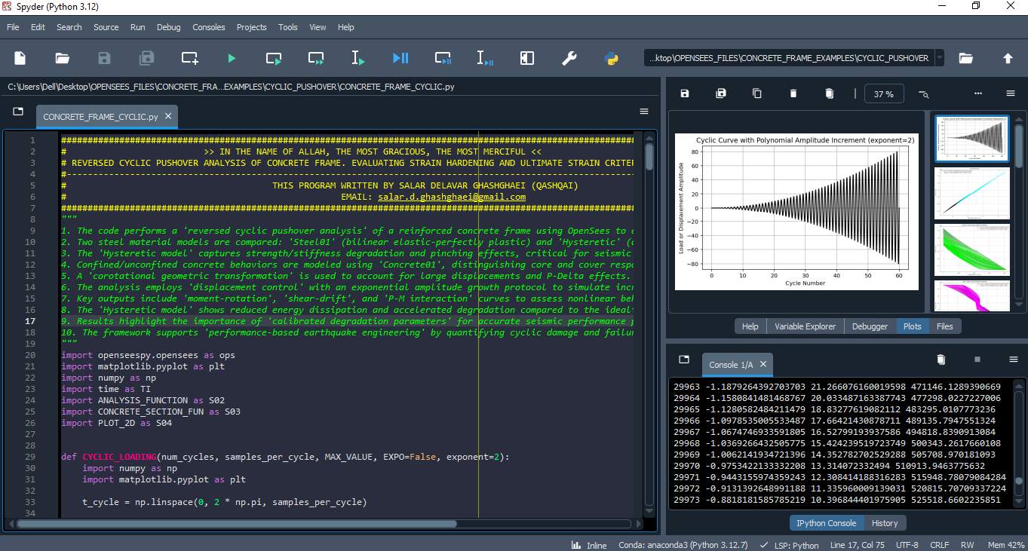

Slide 5
REVERSED CYCLIC PUSHOVER ANALYSIS

Slide 6
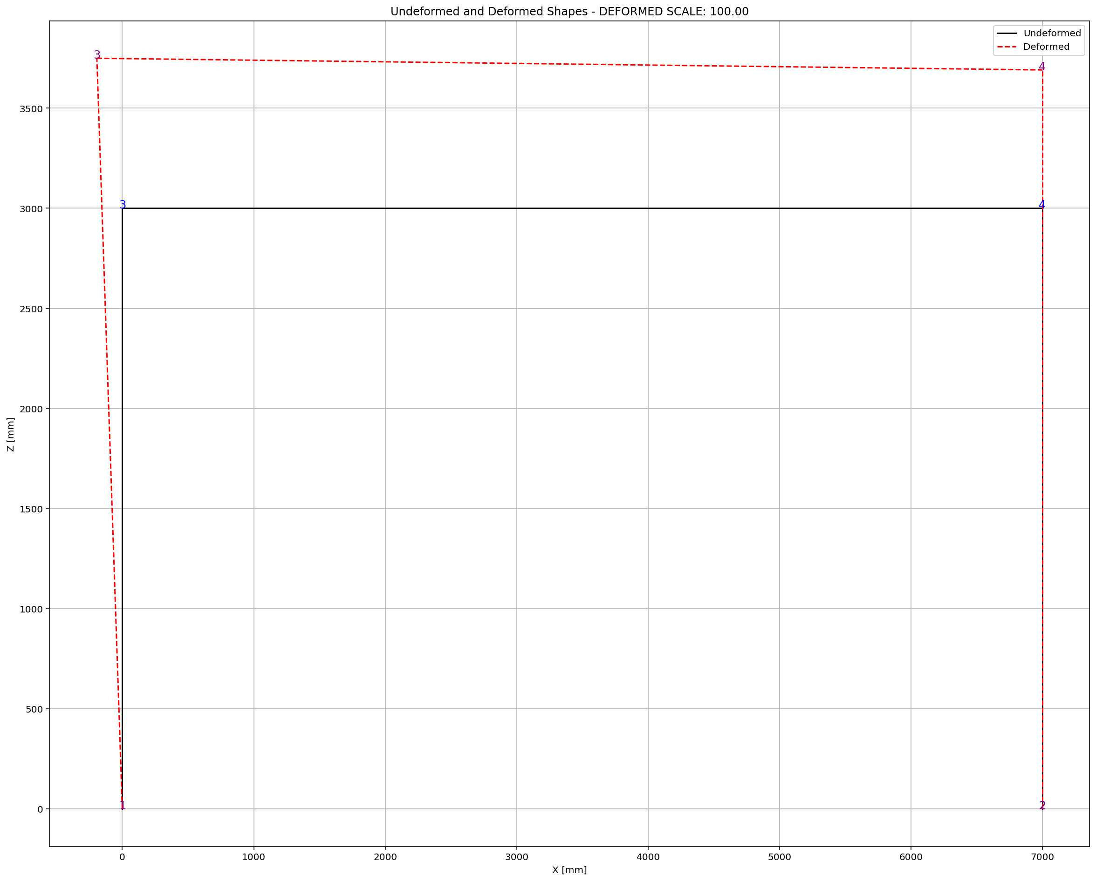

Slide 7
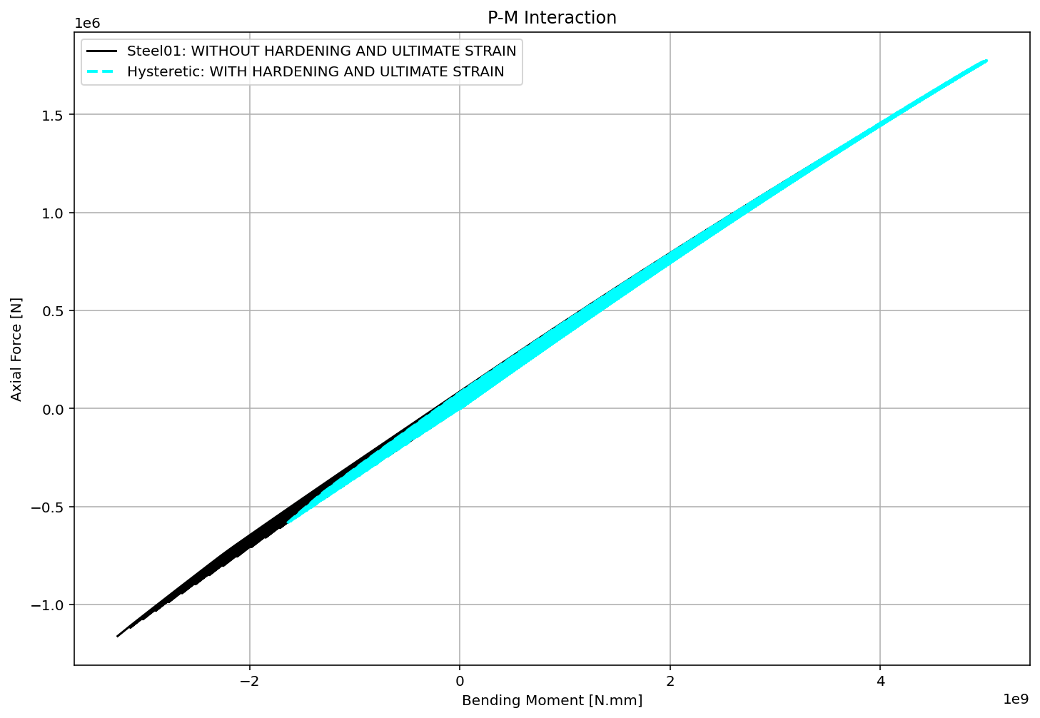

Slide 8
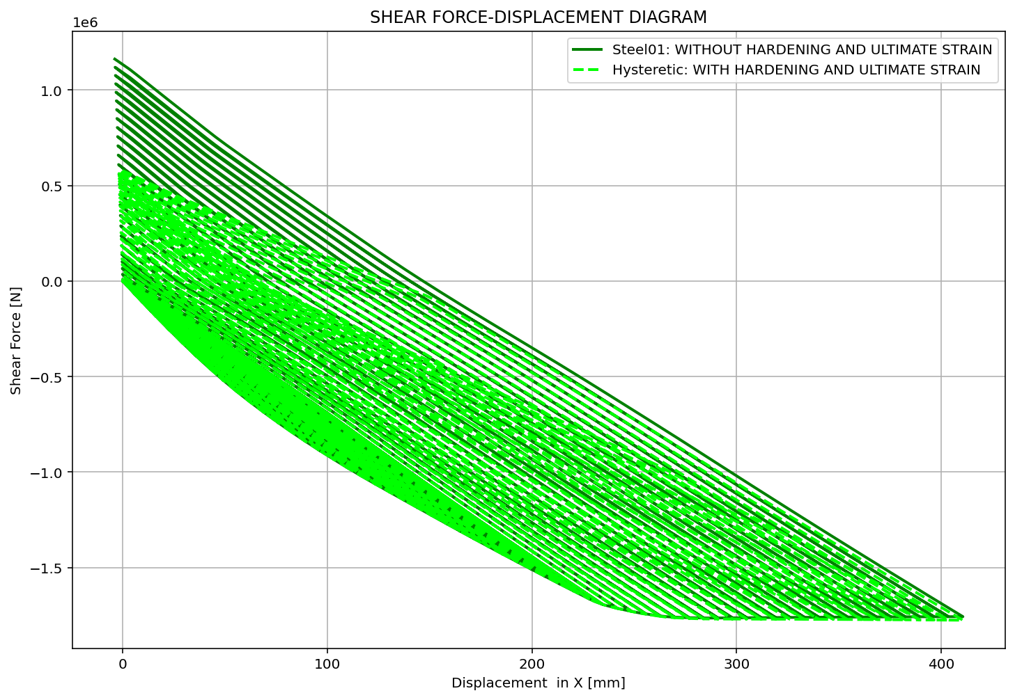

Slide 9
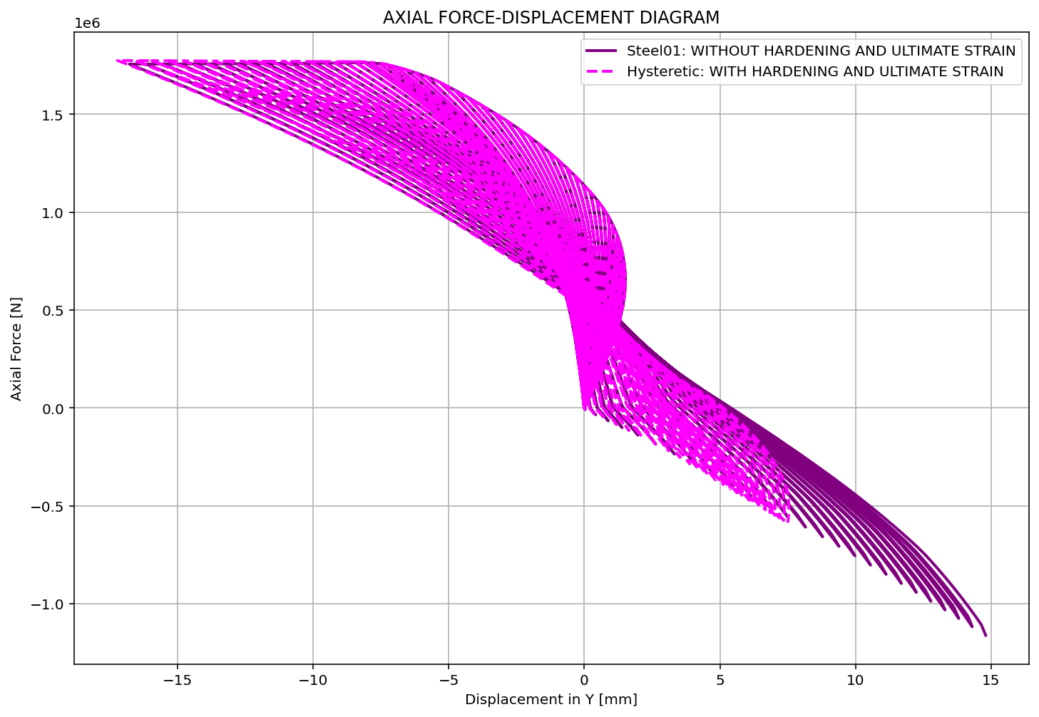

Slide 10
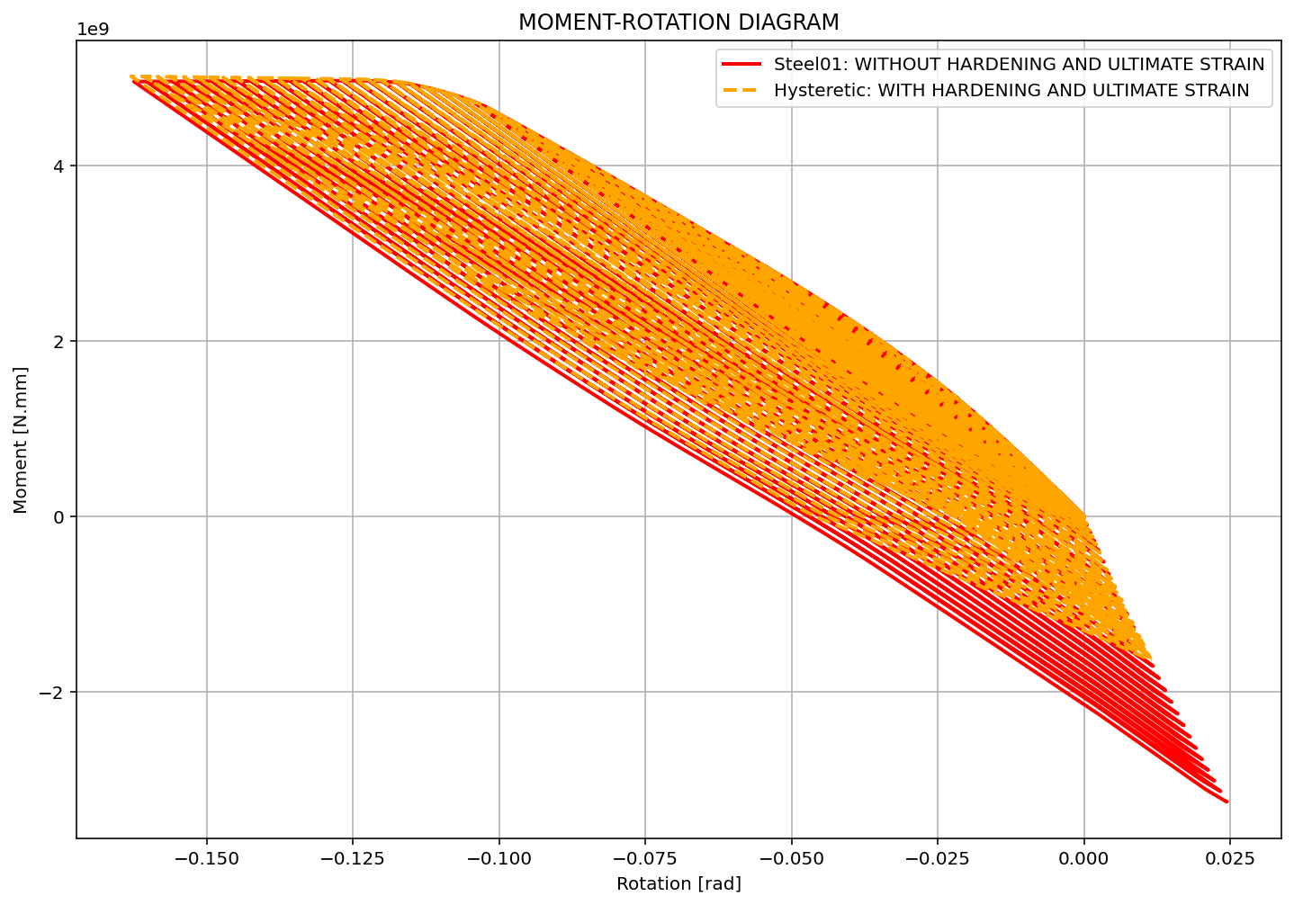

Slide 11
