Slide 1
>> IN THE NAME OF ALLAH, THE MOST GRACIOUS, THE MOST MERCIFUL <<
PUSHOVER ANALYSIS OF A MULTI-DEGREE-OF-FREEDOM STRUCTURE VIA EVALUATION OF A MULTILINEAR FITTING CURVE
THIS PYTHON SCRIPT IS WRITTEN BY SALAR DELAVAR GHASHGHAEI (QASHQAI)

Slide 2


Slide 3
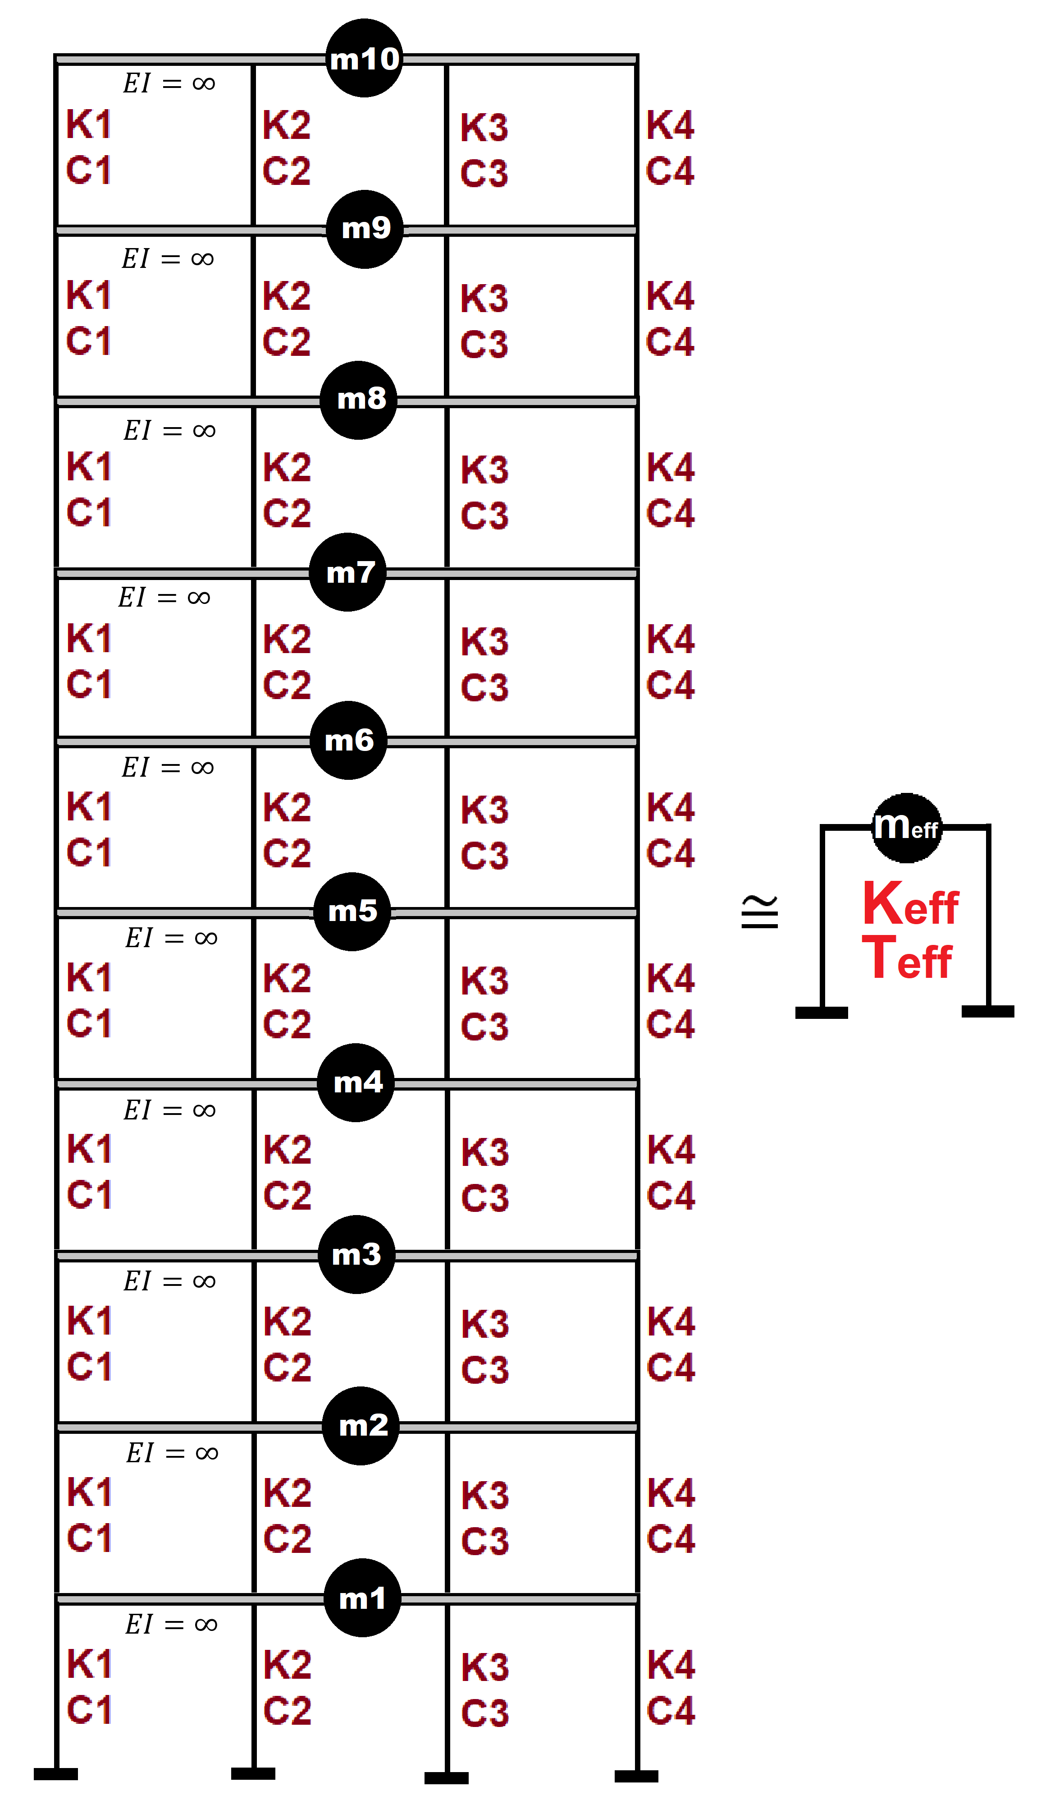

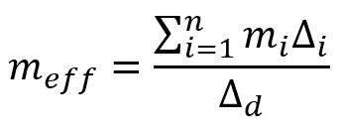
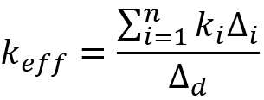
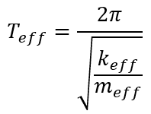
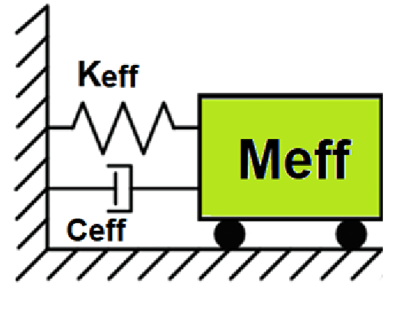
Displacement-based seismic analysis transformation,
converting a multi-degree-of-freedom (MDOF) system
into an equivalent single-degree-of-freedom (SDOF)
system for seismic assessment

Slide 4
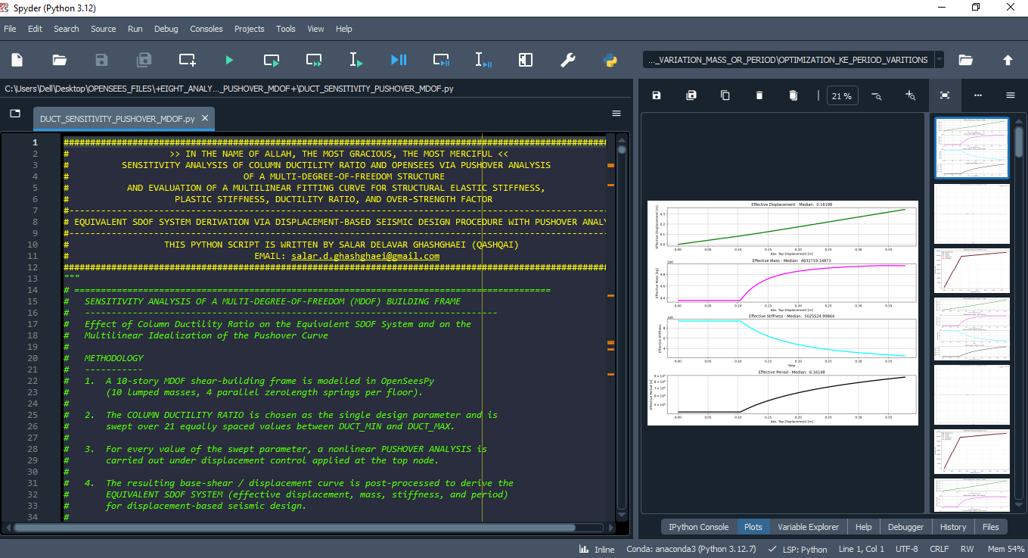

Slide 5
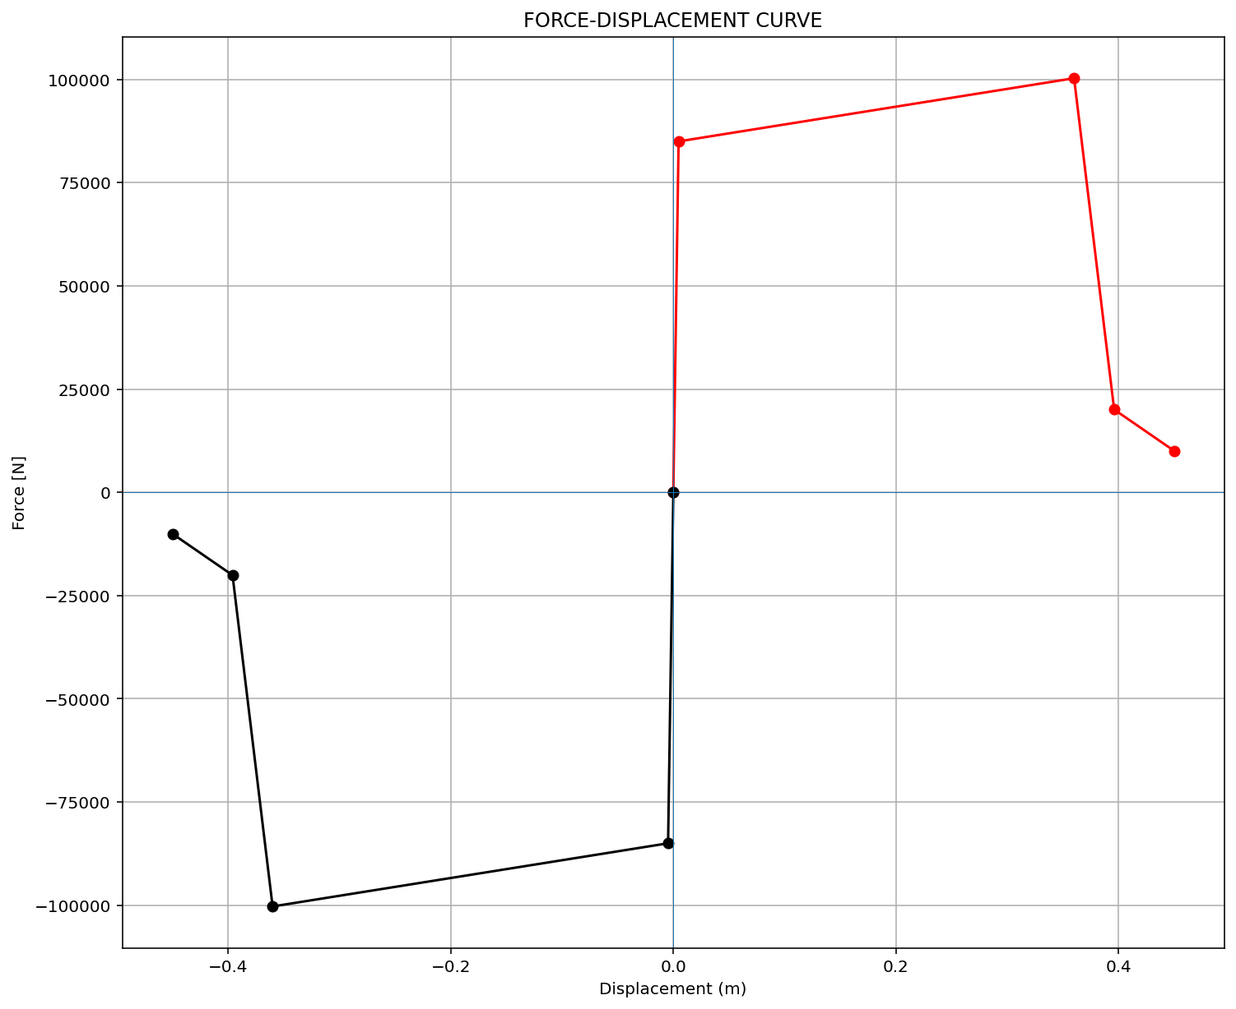
ELEMENT 01

Slide 6

ELEMENT 02

Slide 7
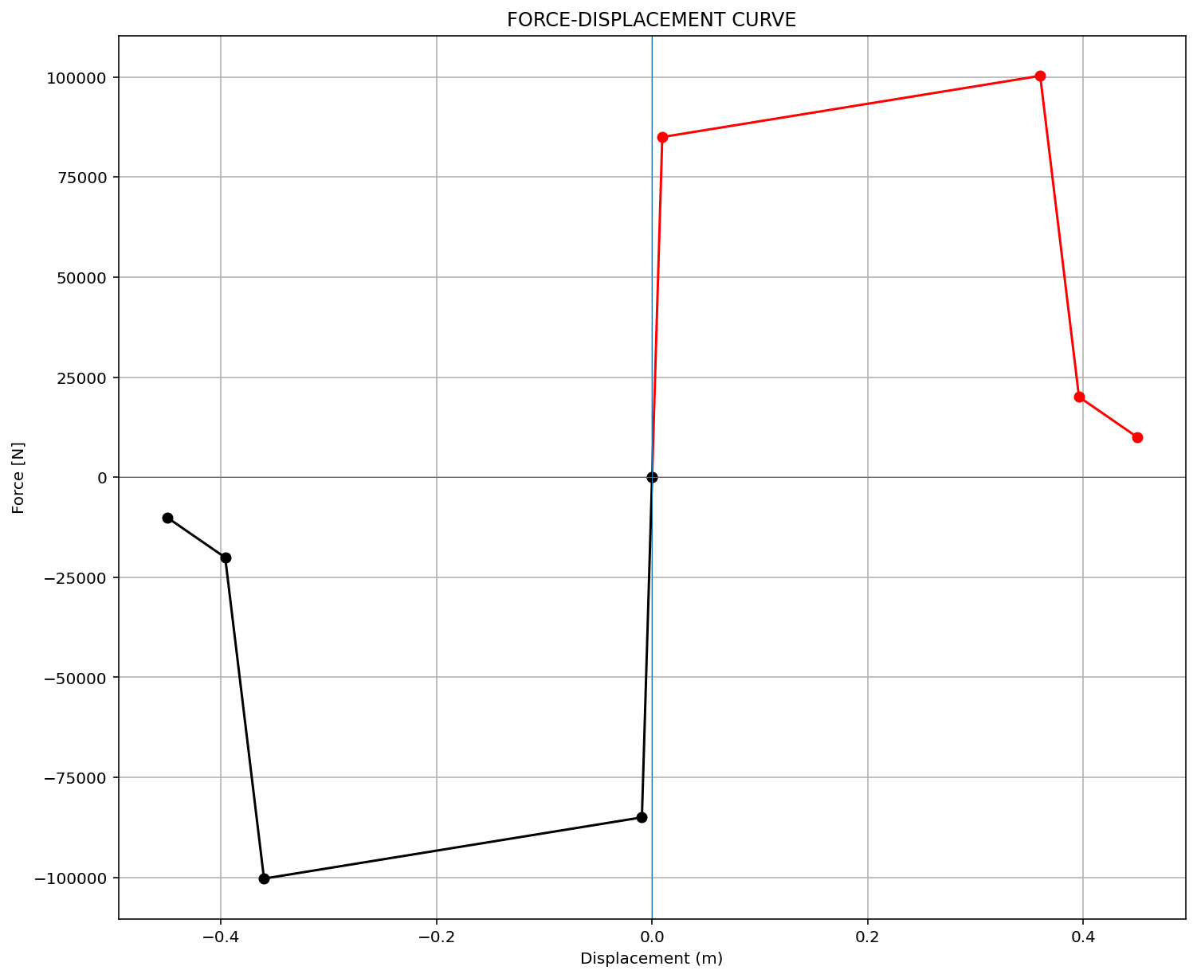
ELEMENT 03

Slide 8
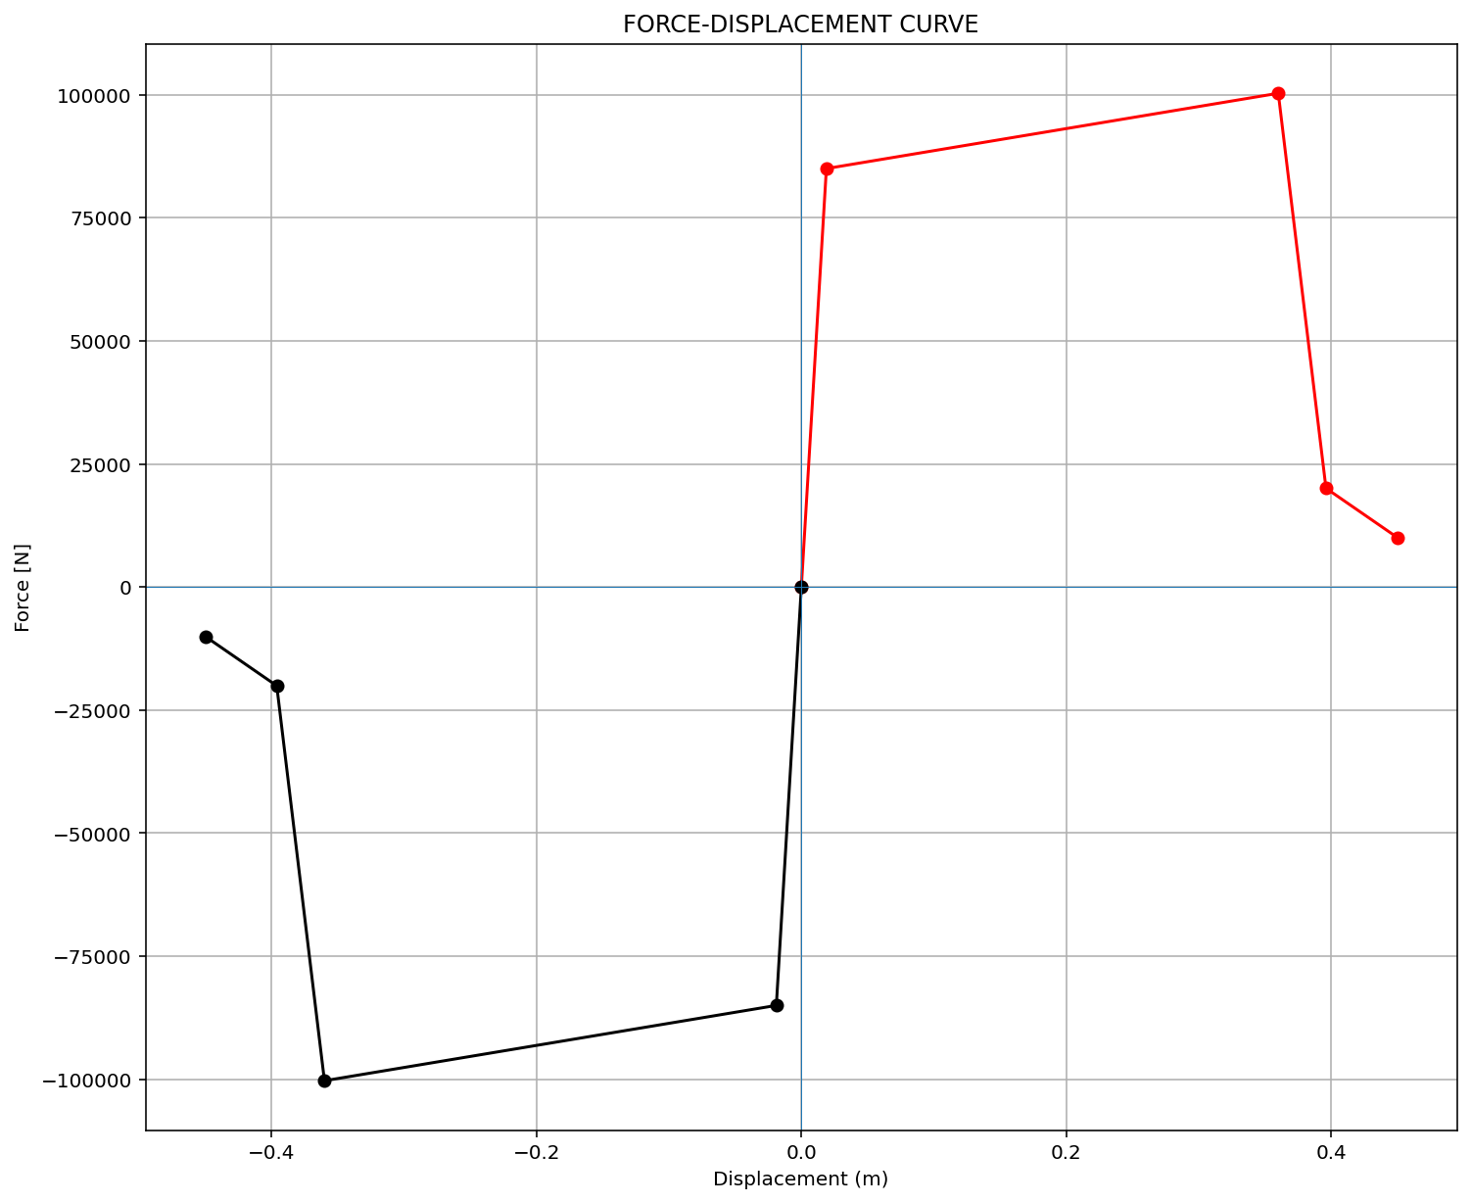
ELEMENT 04

Slide 9
PUSHOVER ANALYSIS

Slide 10
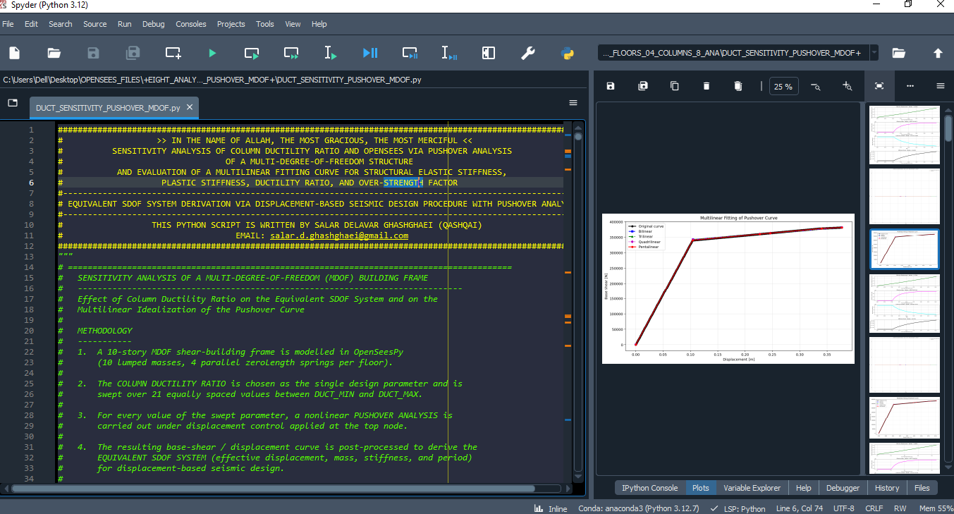

Slide 11
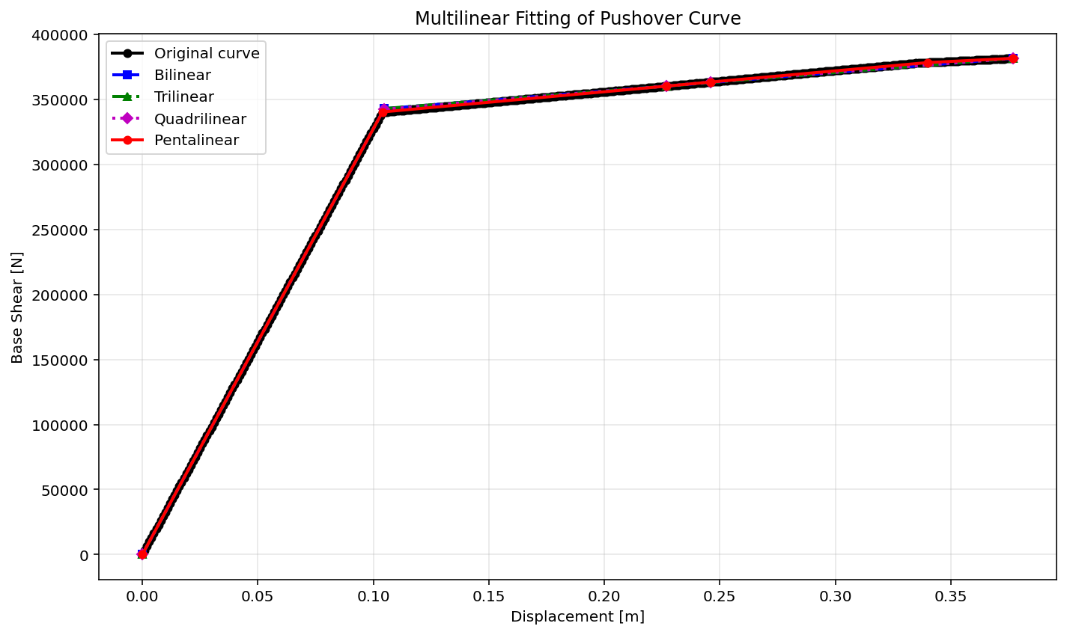

Slide 12
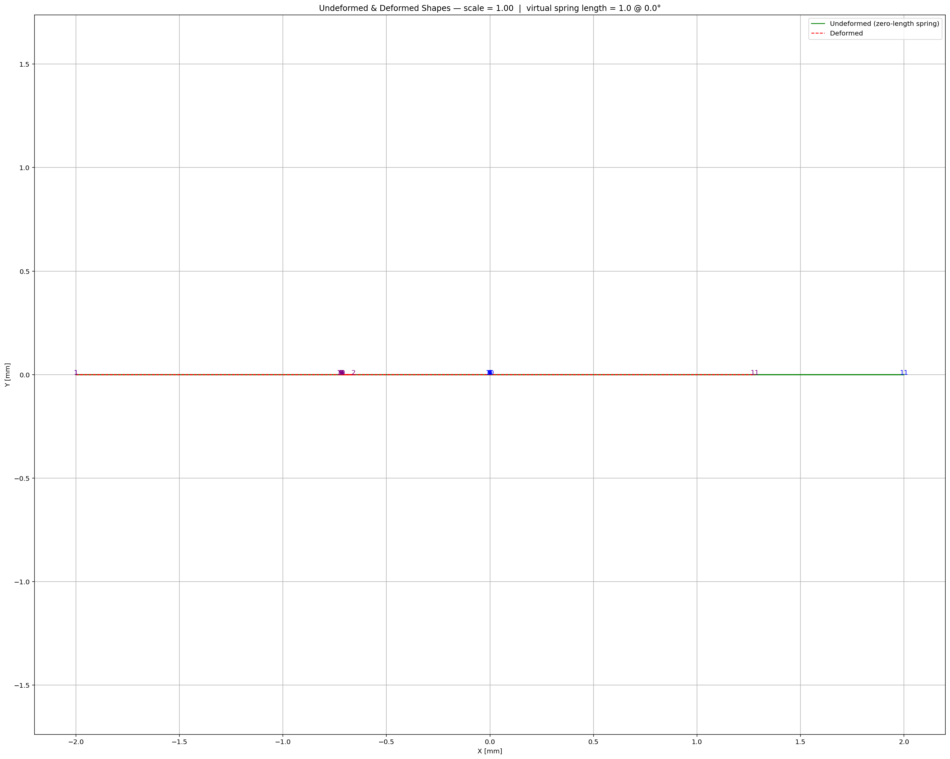

Slide 13
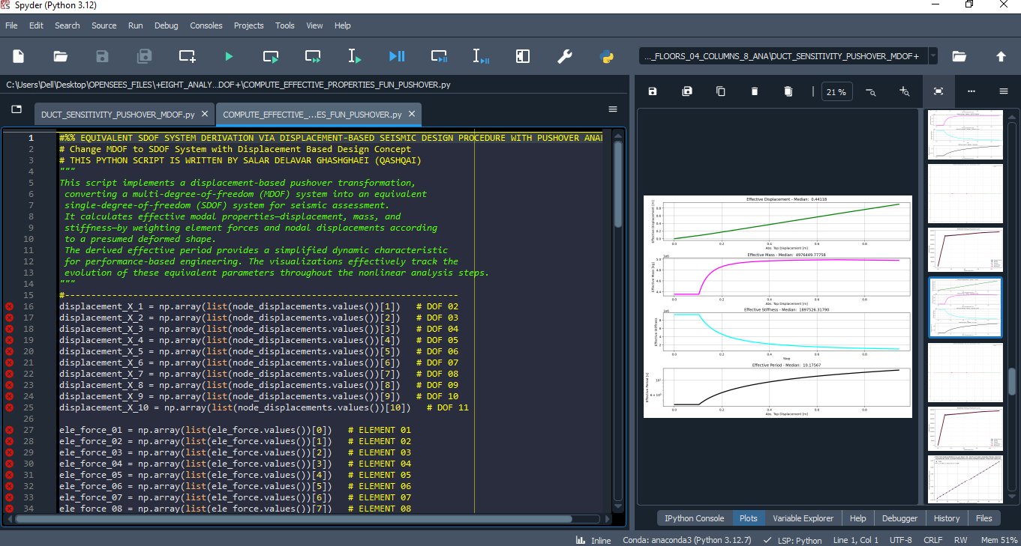

Slide 14
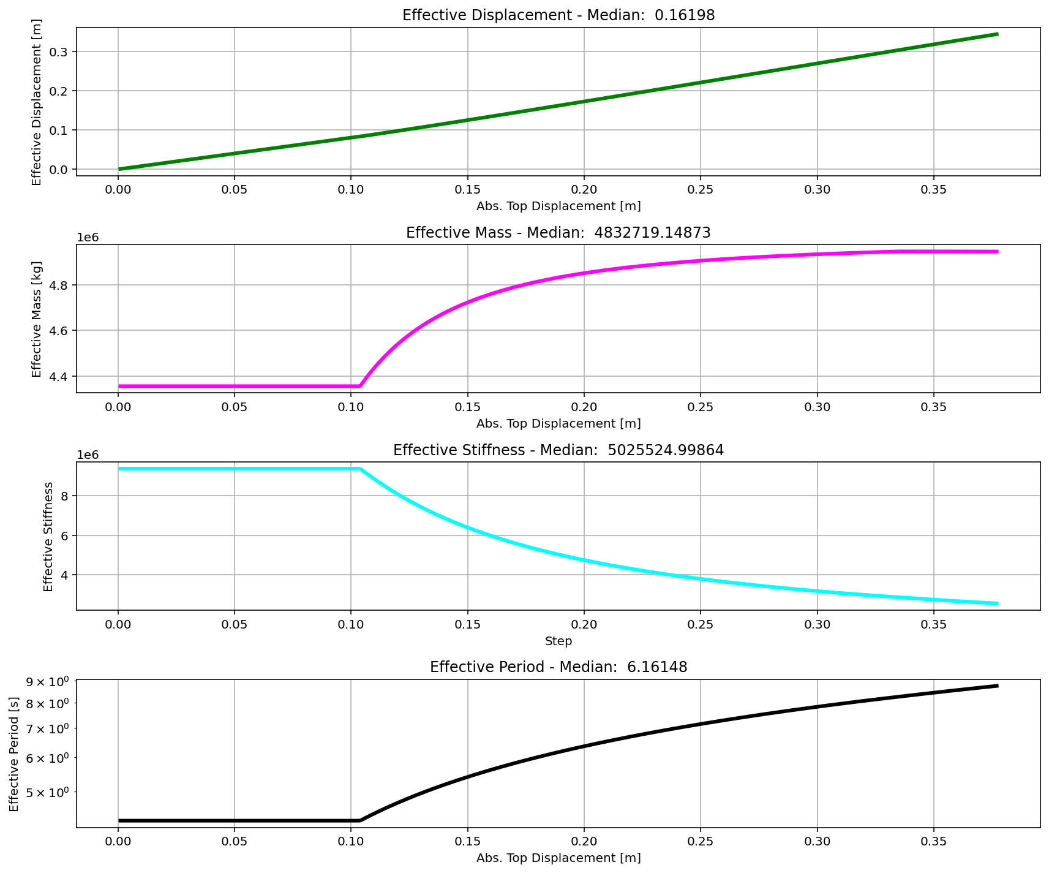

Slide 15
BILINEAR CURVE
+==========================+
= Analysis curve fitted =
Disp Base Shear
----------------------------
[[0.00000000e+00 0.00000000e+00]
[1.05586496e-01 3.45555806e+05]
[9.44000000e-01 3.86740624e+05]]
+==========================+
+----------------------------------------------------+
Structure Elastic Stiffness : 3272727.27
Structure Plastic Stiffness : 409682.86
Structure Tangent Stiffness : [3272727.27 49122.32]
Structure Ductility Ratio : 8.94
Structure Over Strength Factor: 1.12
+----------------------------------------------------+

Slide 16
TRILINEAR CURVE
+==========================+
= Analysis curve fitted =
Disp Base Shear
----------------------------
[[0.00000000e+00 0.00000000e+00]
[1.04512702e-01 3.42041571e+05]
[5.67000000e-01 3.70124071e+05]
[9.44000000e-01 3.86740624e+05]]
+==========================+
+----------------------------------------------------+
Structure Elastic Stiffness : 3272727.27
Structure Plastic Stiffness : 409682.86
Structure Tangent Stiffness : [3272727.27 60720.59 44075.74]
Structure Ductility Ratio : 9.03
Structure Over Strength Factor: 1.13
+----------------------------------------------------+

Slide 17
QUADRILINEAR CURVE
+==========================+
= Analysis curve fitted =
Disp Base Shear
----------------------------
[[0.00000000e+00 0.00000000e+00]
[1.04262557e-01 3.41222915e+05]
[5.67000000e-01 3.70124071e+05]
[6.14000000e-01 3.73181289e+05]
[9.44000000e-01 3.86740624e+05]]
+==========================+
+----------------------------------------------------+
Structure Elastic Stiffness : 3272727.27
Structure Plastic Stiffness : 409682.86
Structure Tangent Stiffness : [3272727.27 62456.92 65047.18 41088.89]
Structure Ductility Ratio : 9.05
Structure Over Strength Factor: 1.13
+----------------------------------------------------+

Slide 18
PENTALINEAR CURVE
+==========================+
= Analysis curve fitted =
Disp Base Shear
----------------------------
[[0.00000000e+00 0.00000000e+00]
[1.04126239e-01 3.40776781e+05]
[5.67000000e-01 3.70124071e+05]
[6.14000000e-01 3.73181289e+05]
[8.50000000e-01 3.83491914e+05]
[9.44000000e-01 3.86740624e+05]]
+==========================+
+----------------------------------------------------+
Structure Elastic Stiffness : 3272727.27
Structure Plastic Stiffness : 409682.86
Structure Tangent Stiffness : [3272727.27 63402.36 65047.18 43689.09 34560.74]
Structure Ductility Ratio : 9.07
Structure Over Strength Factor: 1.13
+----------------------------------------------------+

Slide 19
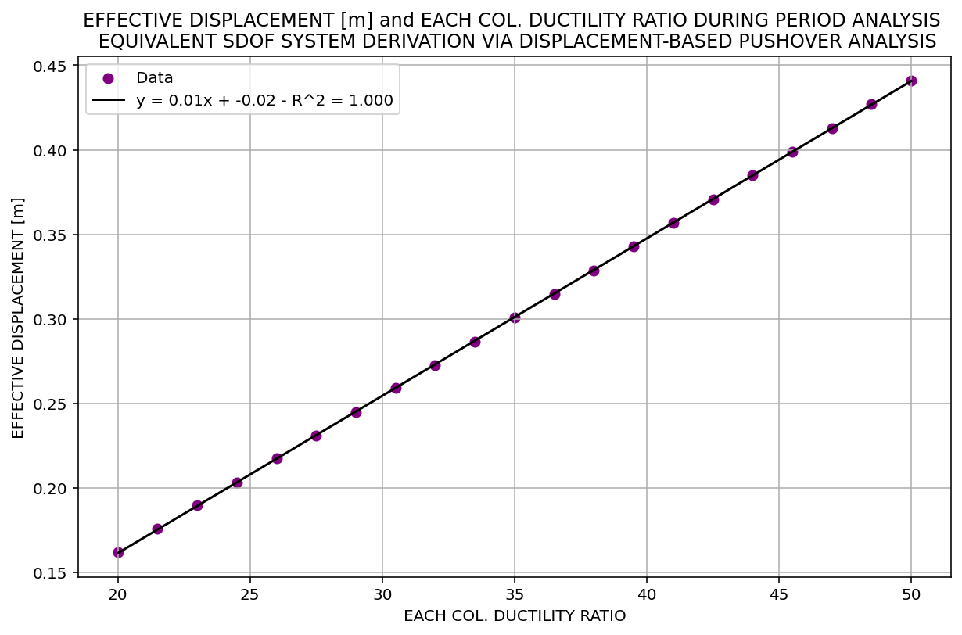

Slide 20
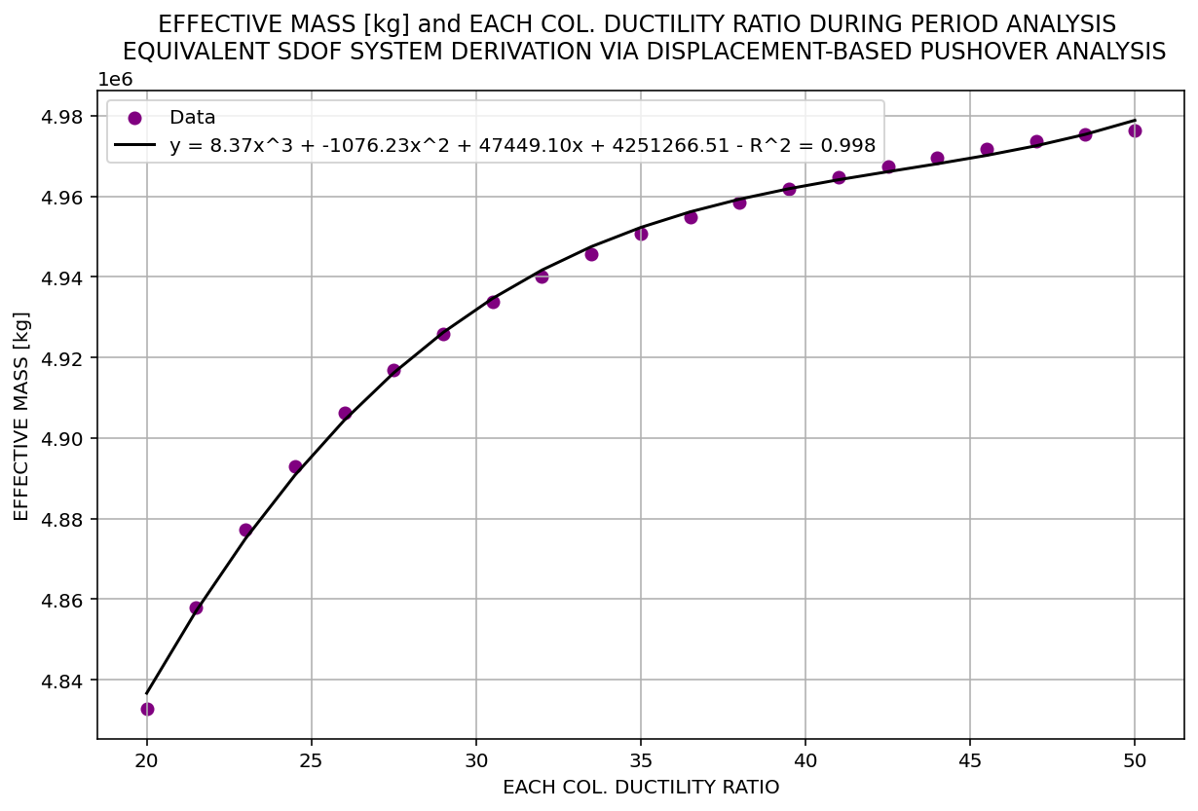

Slide 21
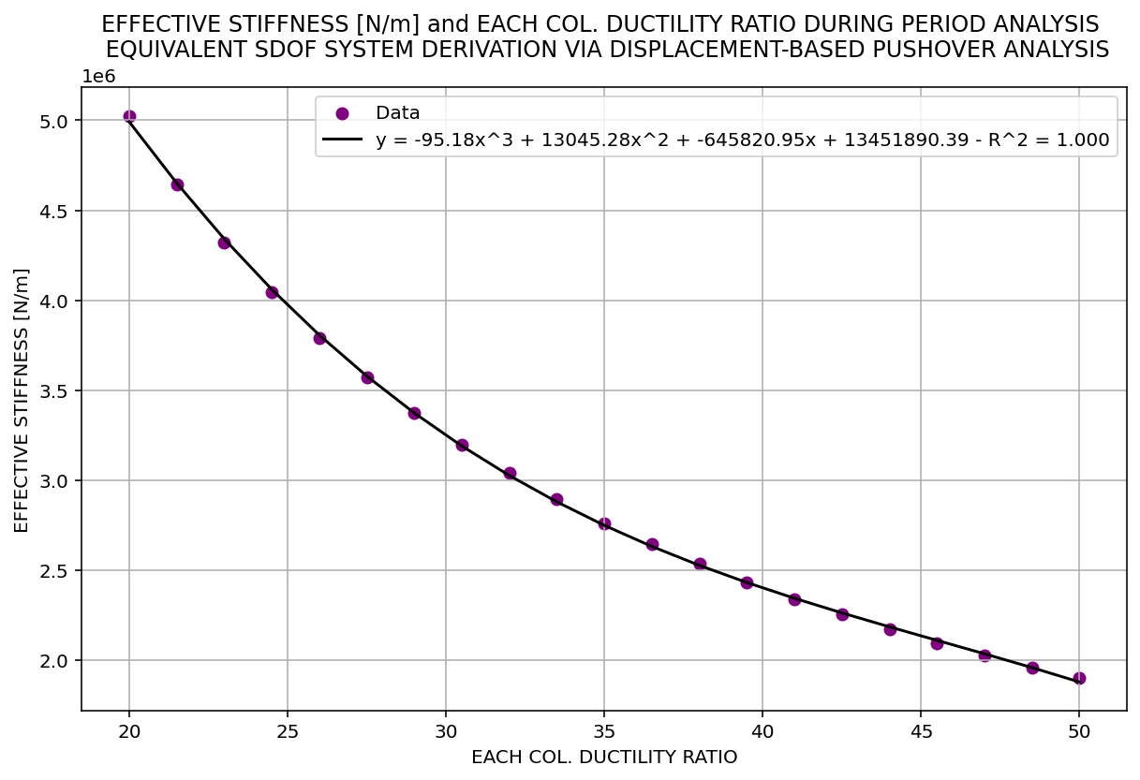

Slide 22
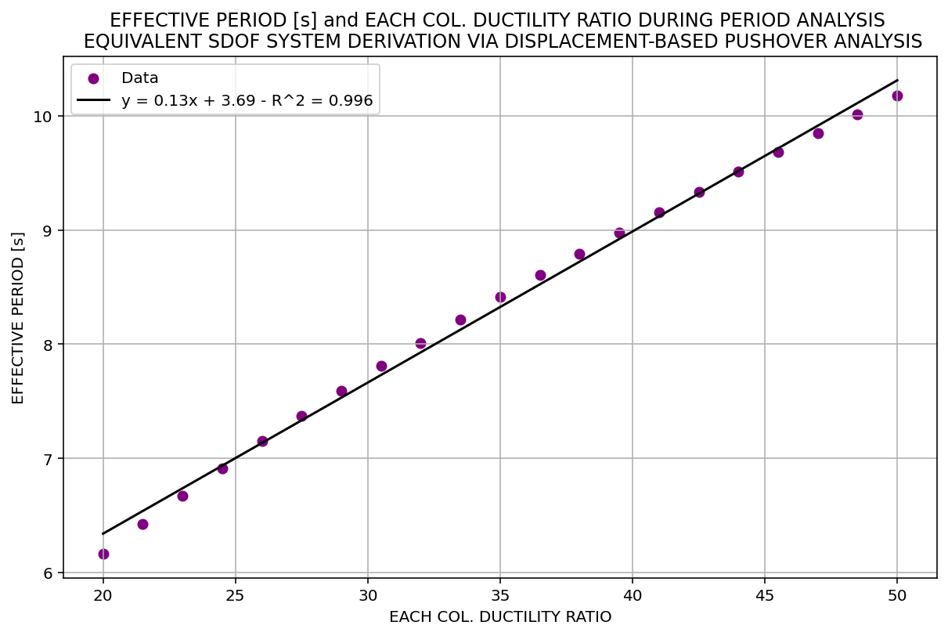

Slide 23
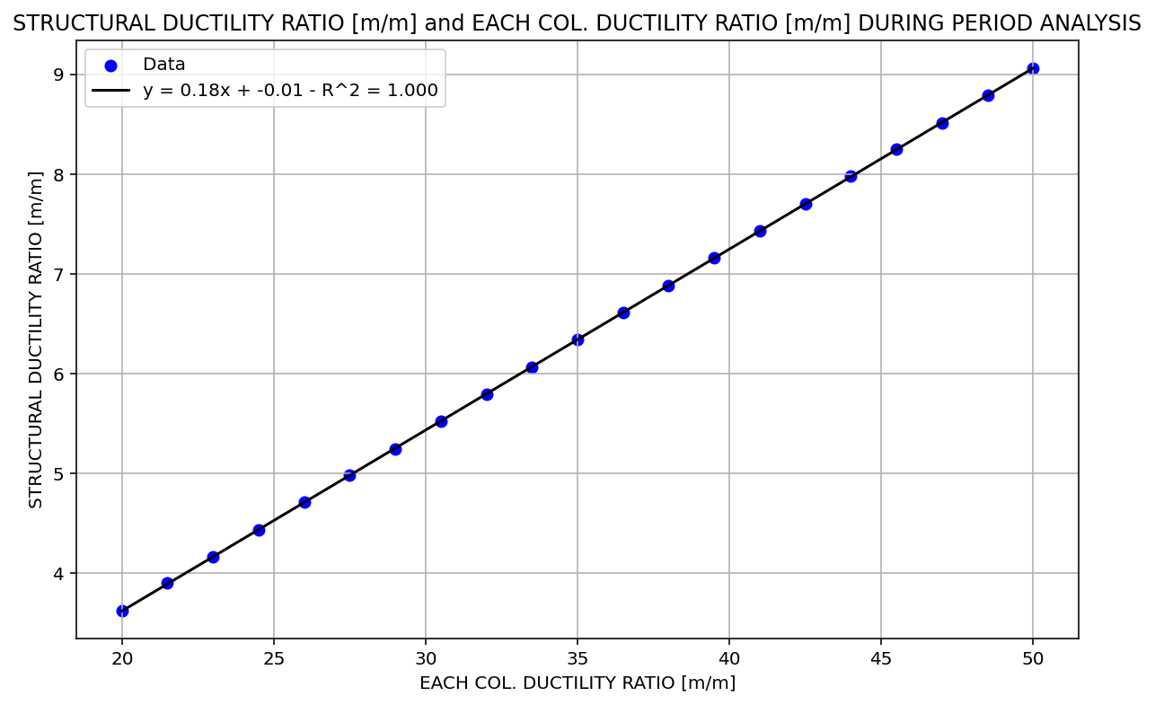

Slide 24
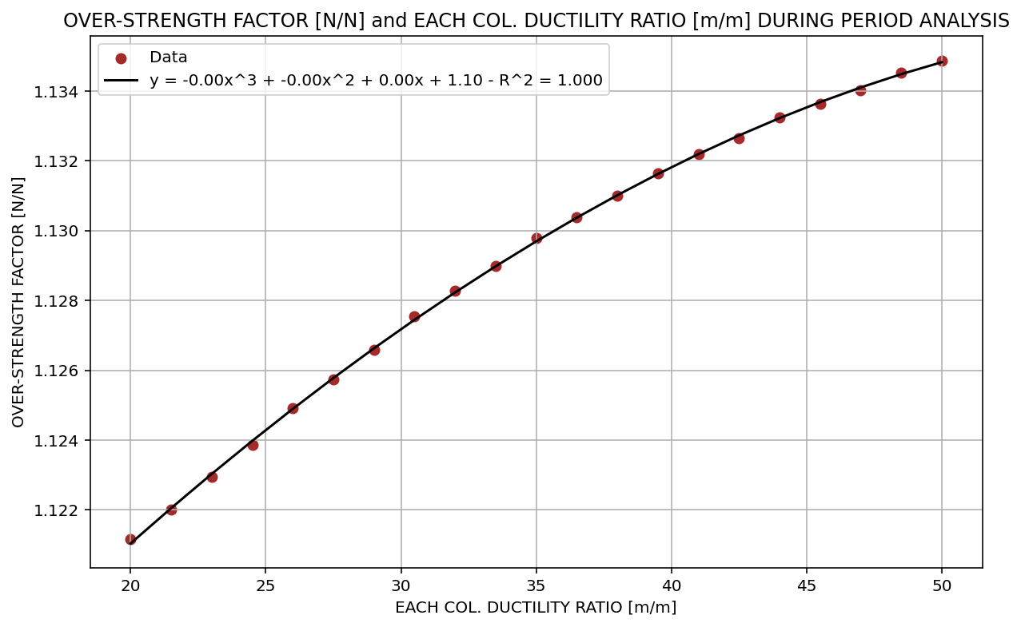

Slide 25
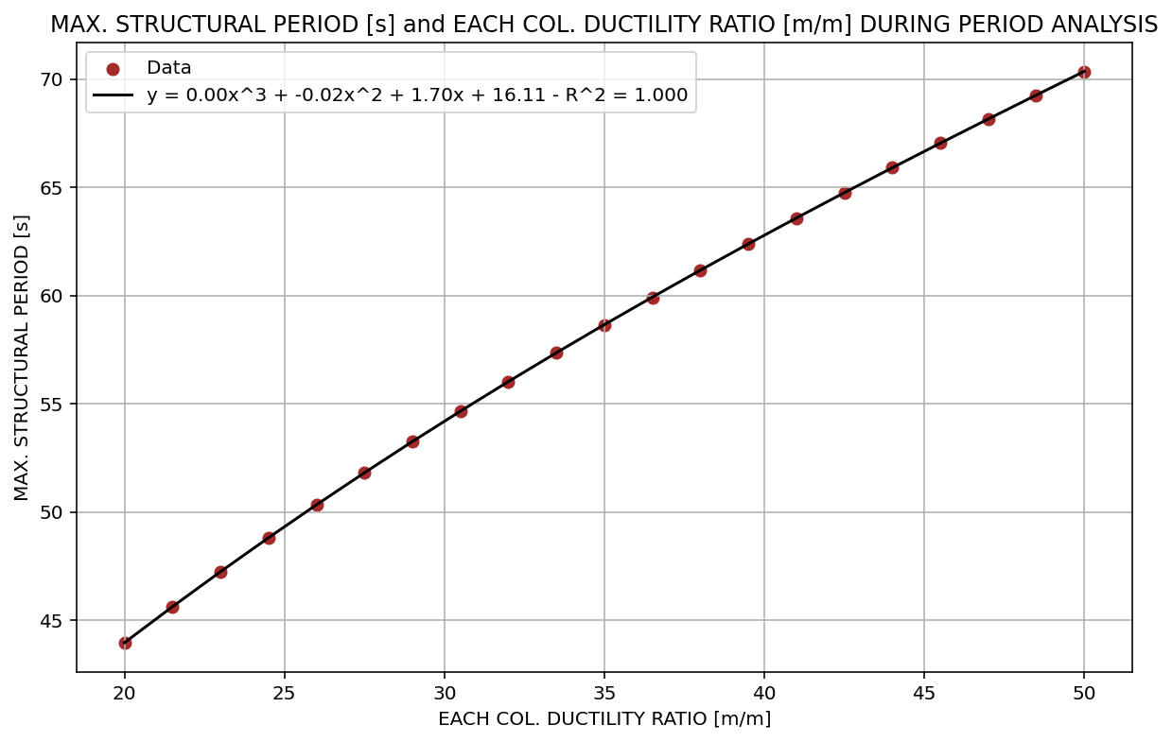

Slide 26
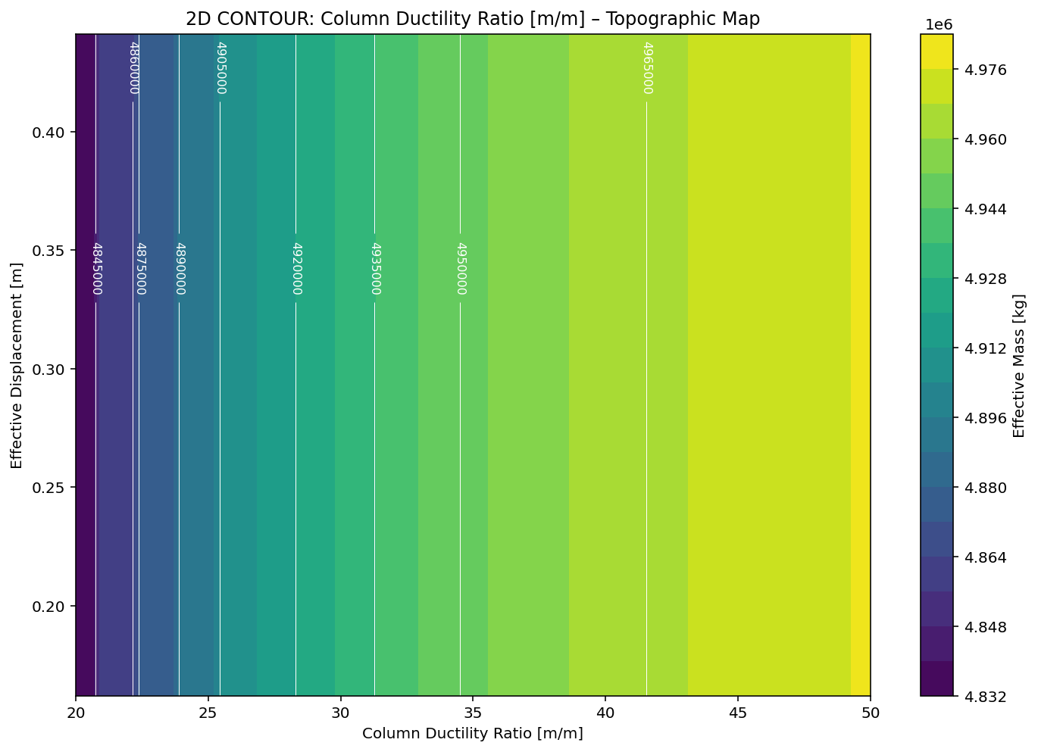

Slide 27
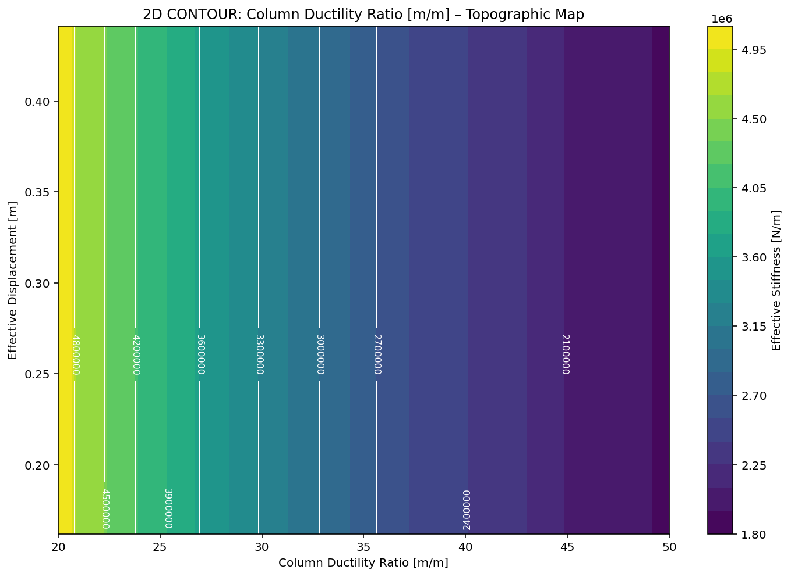

Slide 28
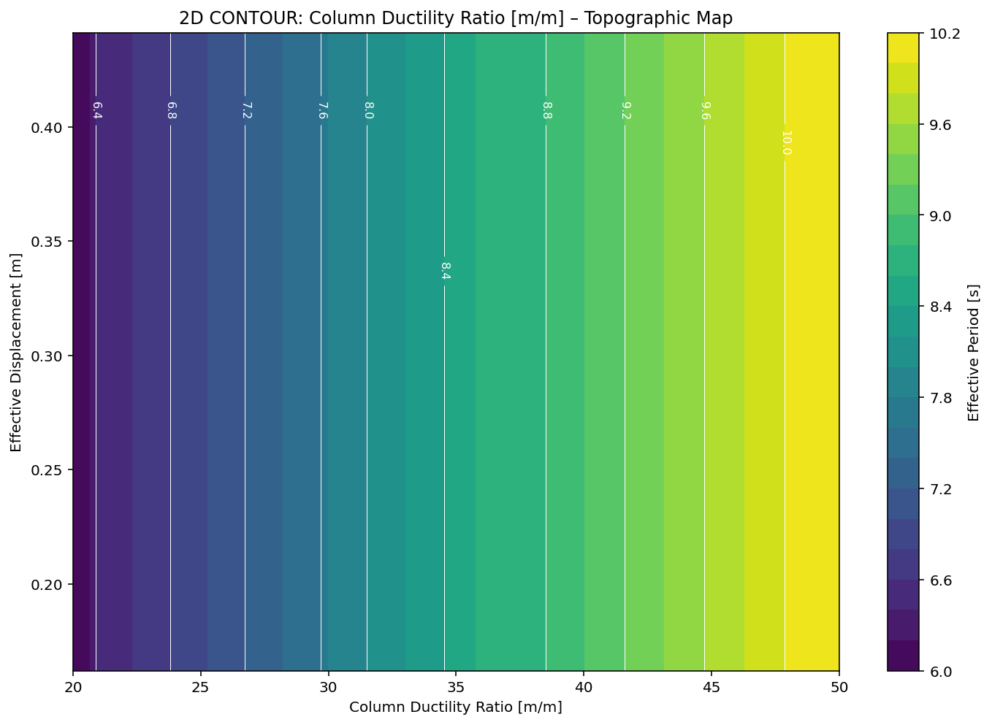

Slide 29
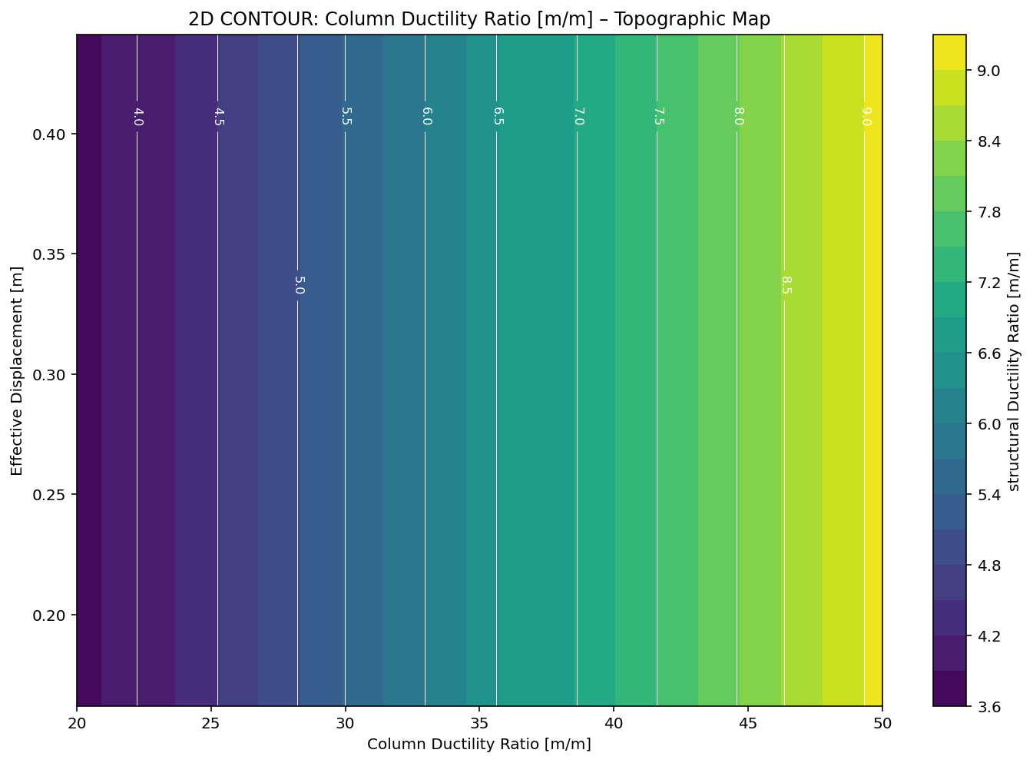

Slide 30
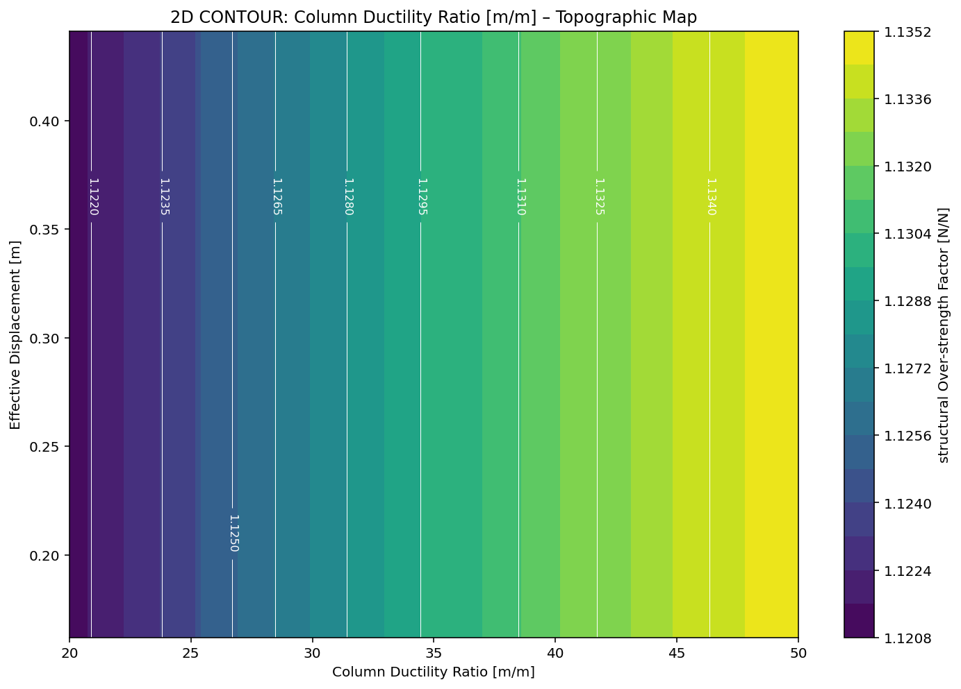

Slide 31


Slide 32
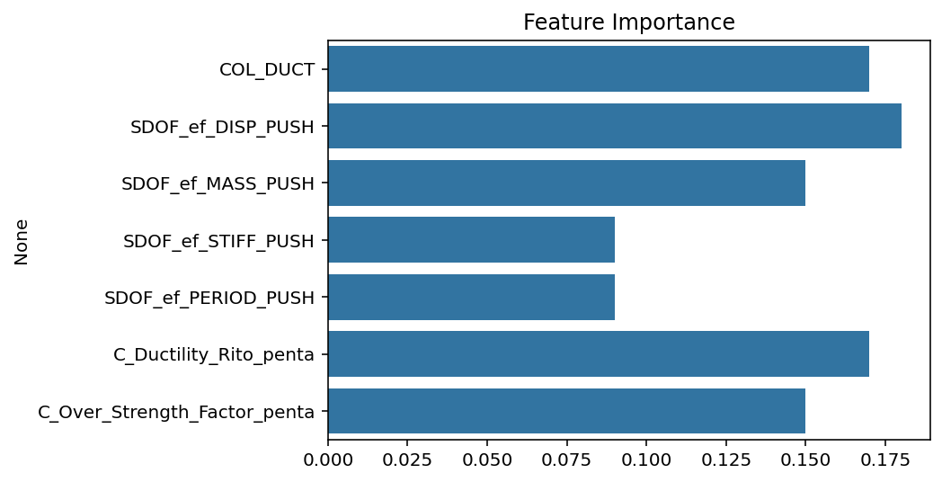

Slide 33
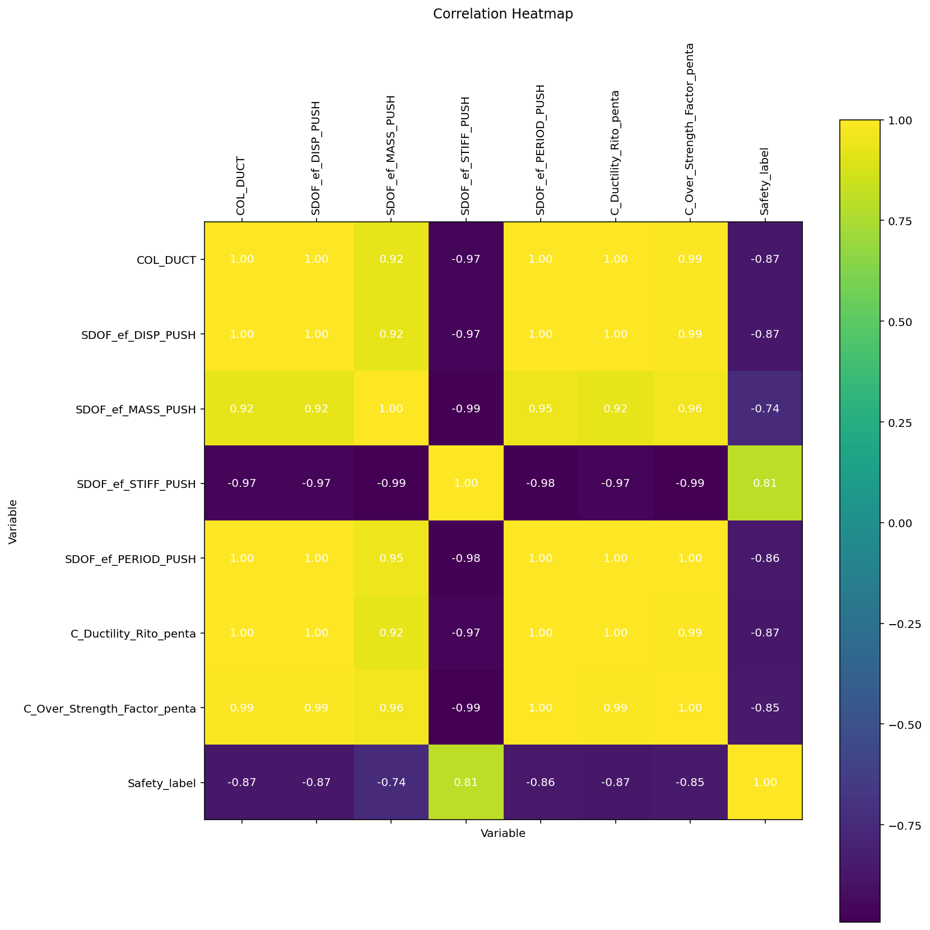

Slide 34
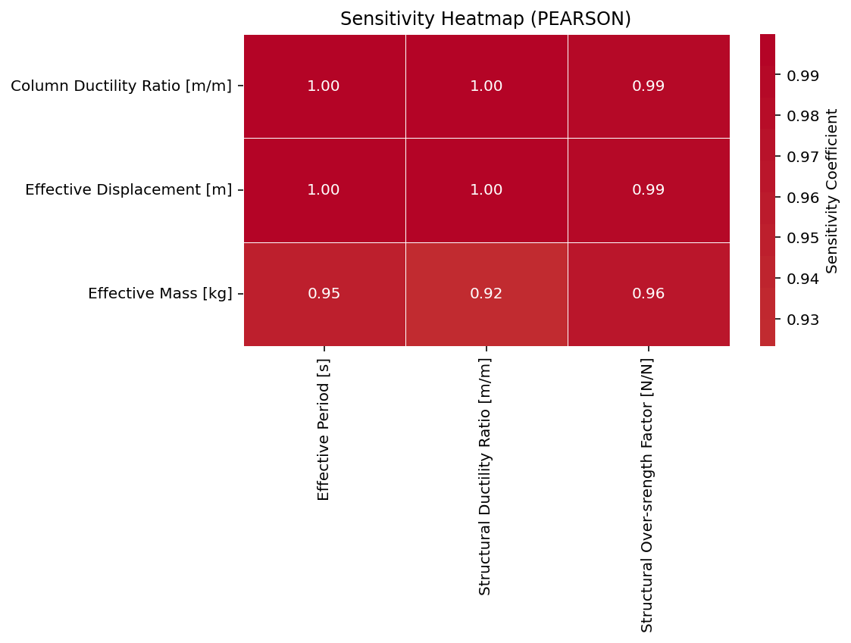

Slide 35
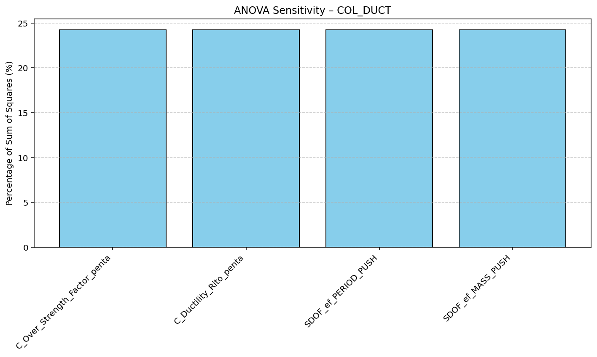

Slide 36
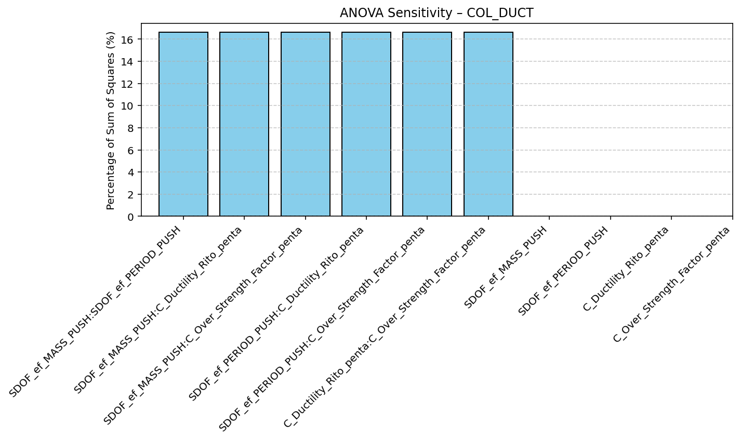

Slide 37
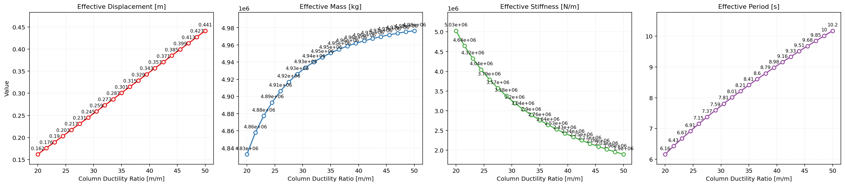

Slide 38
