Slide 1
>> IN THE NAME OF ALLAH, THE MOST GRACIOUS, THE MOST MERCIFUL <<
FORCE-PULSE IMPACT LOAD ANALYSIS OF A SINGLE-DEGREE-OF-FREEDOM (SDOF) SYSTEM USING OPENSEES
WRITTEN BY SALAR DELAVAR GHASHGHAEI (QASHQAI)

Slide 2
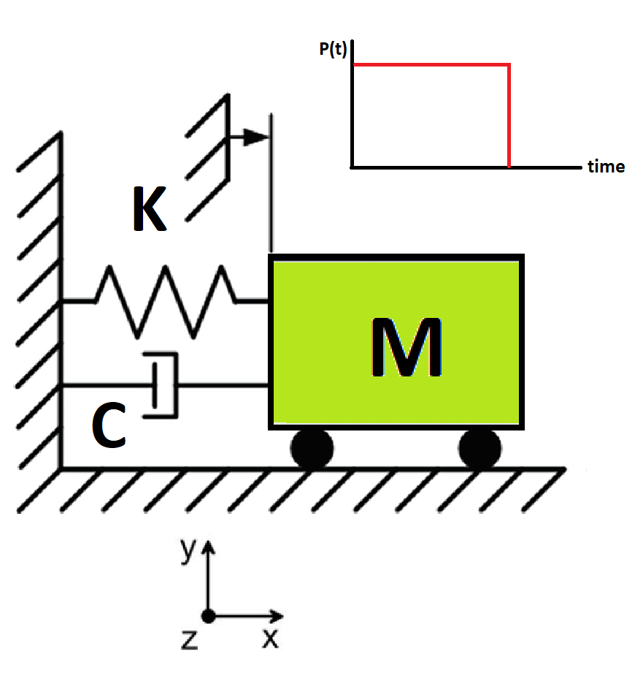

Slide 3
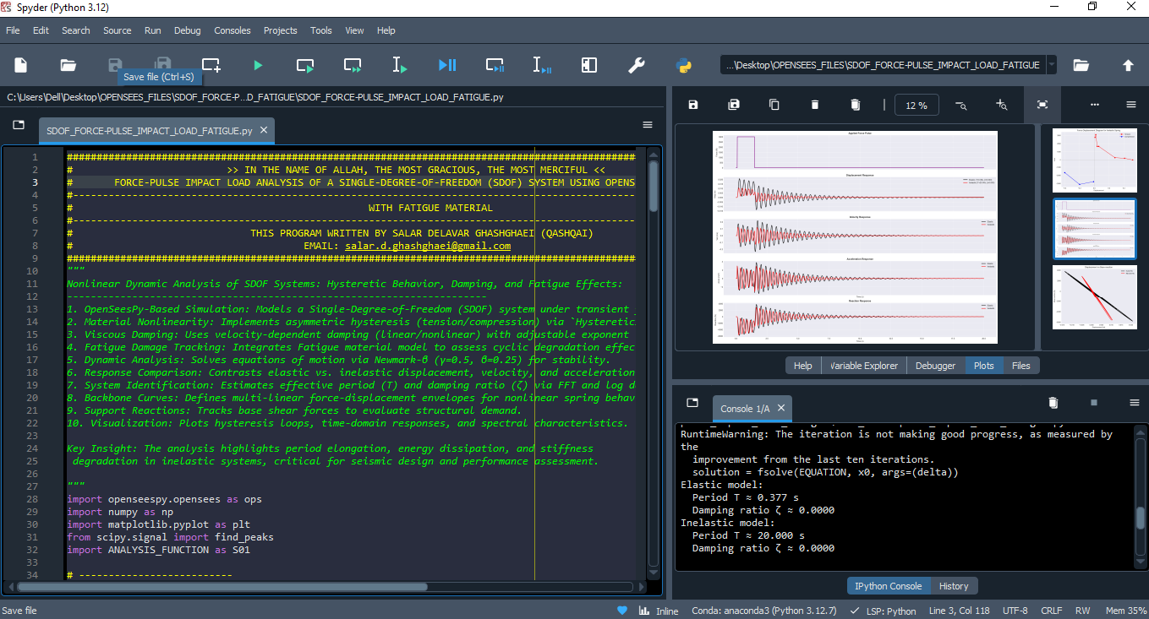

Slide 4
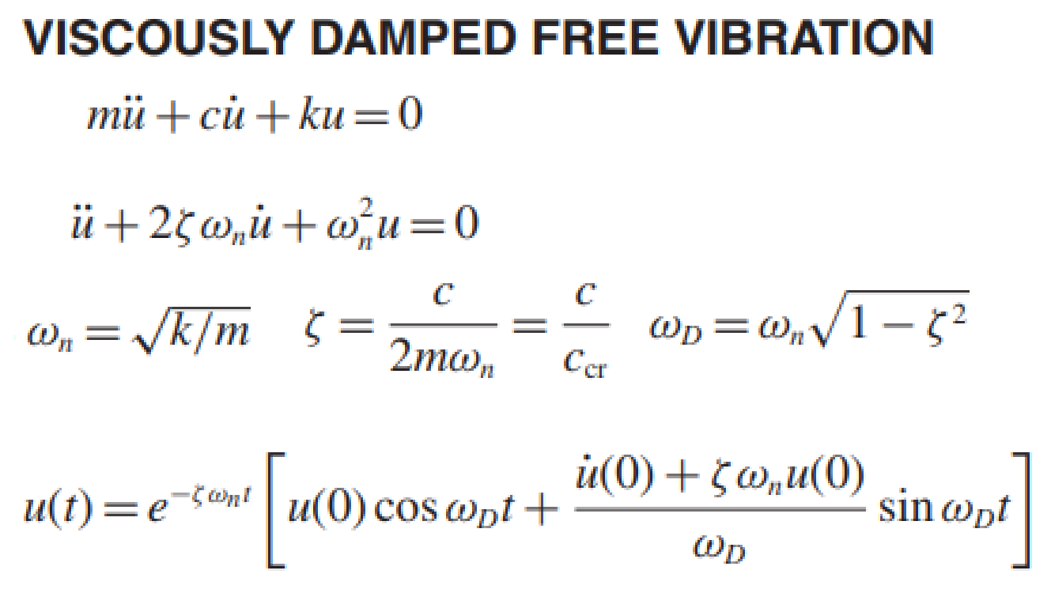
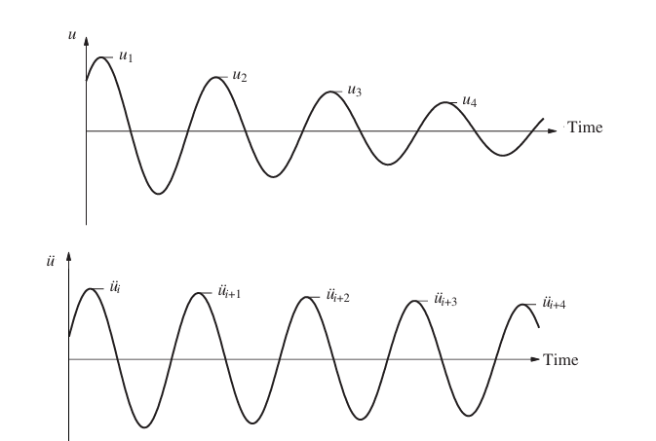
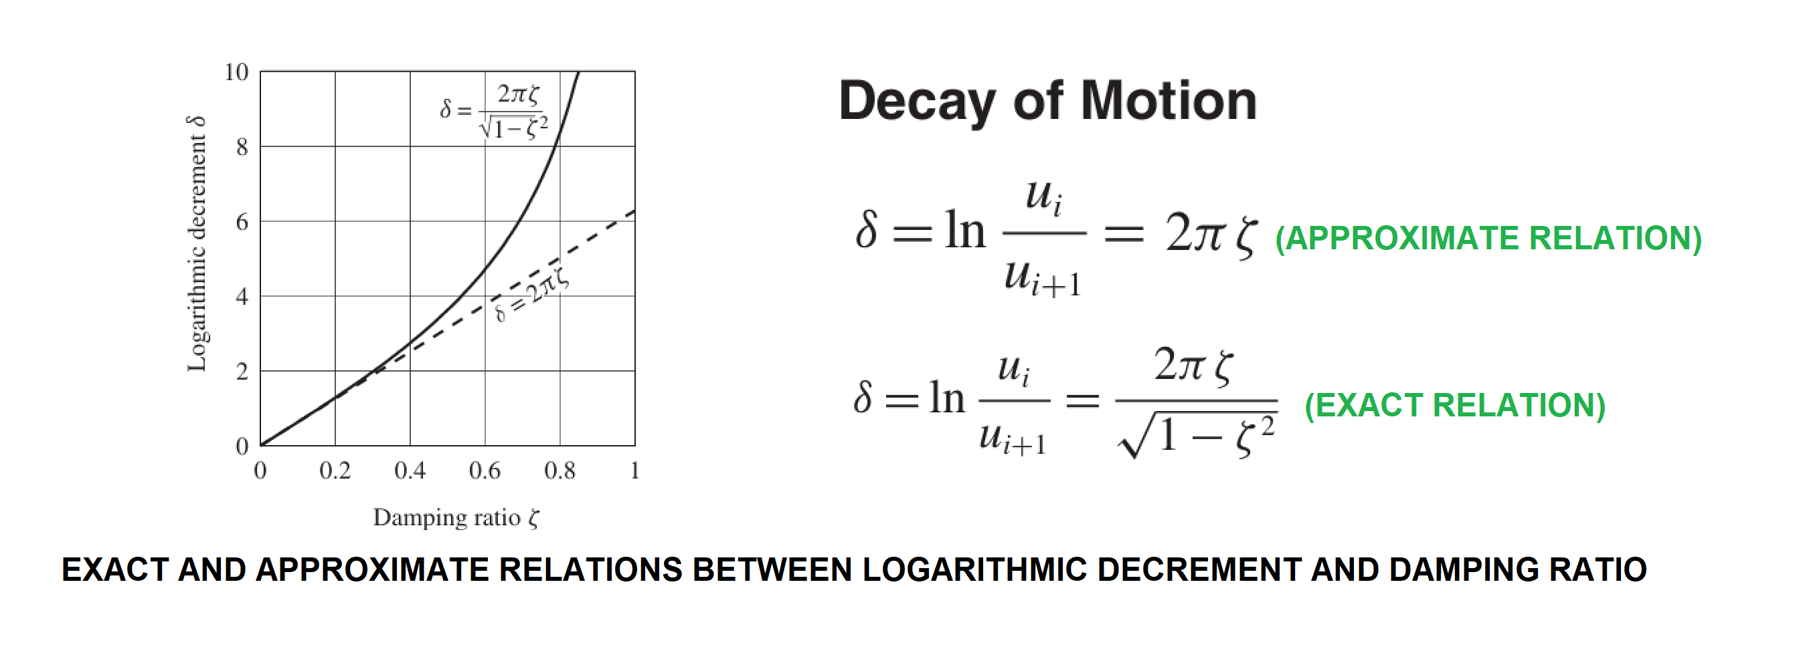

Slide 5
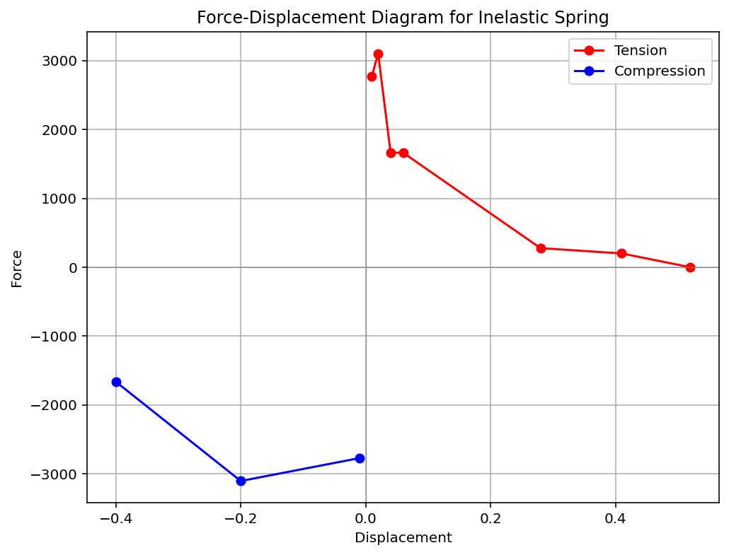

Slide 6
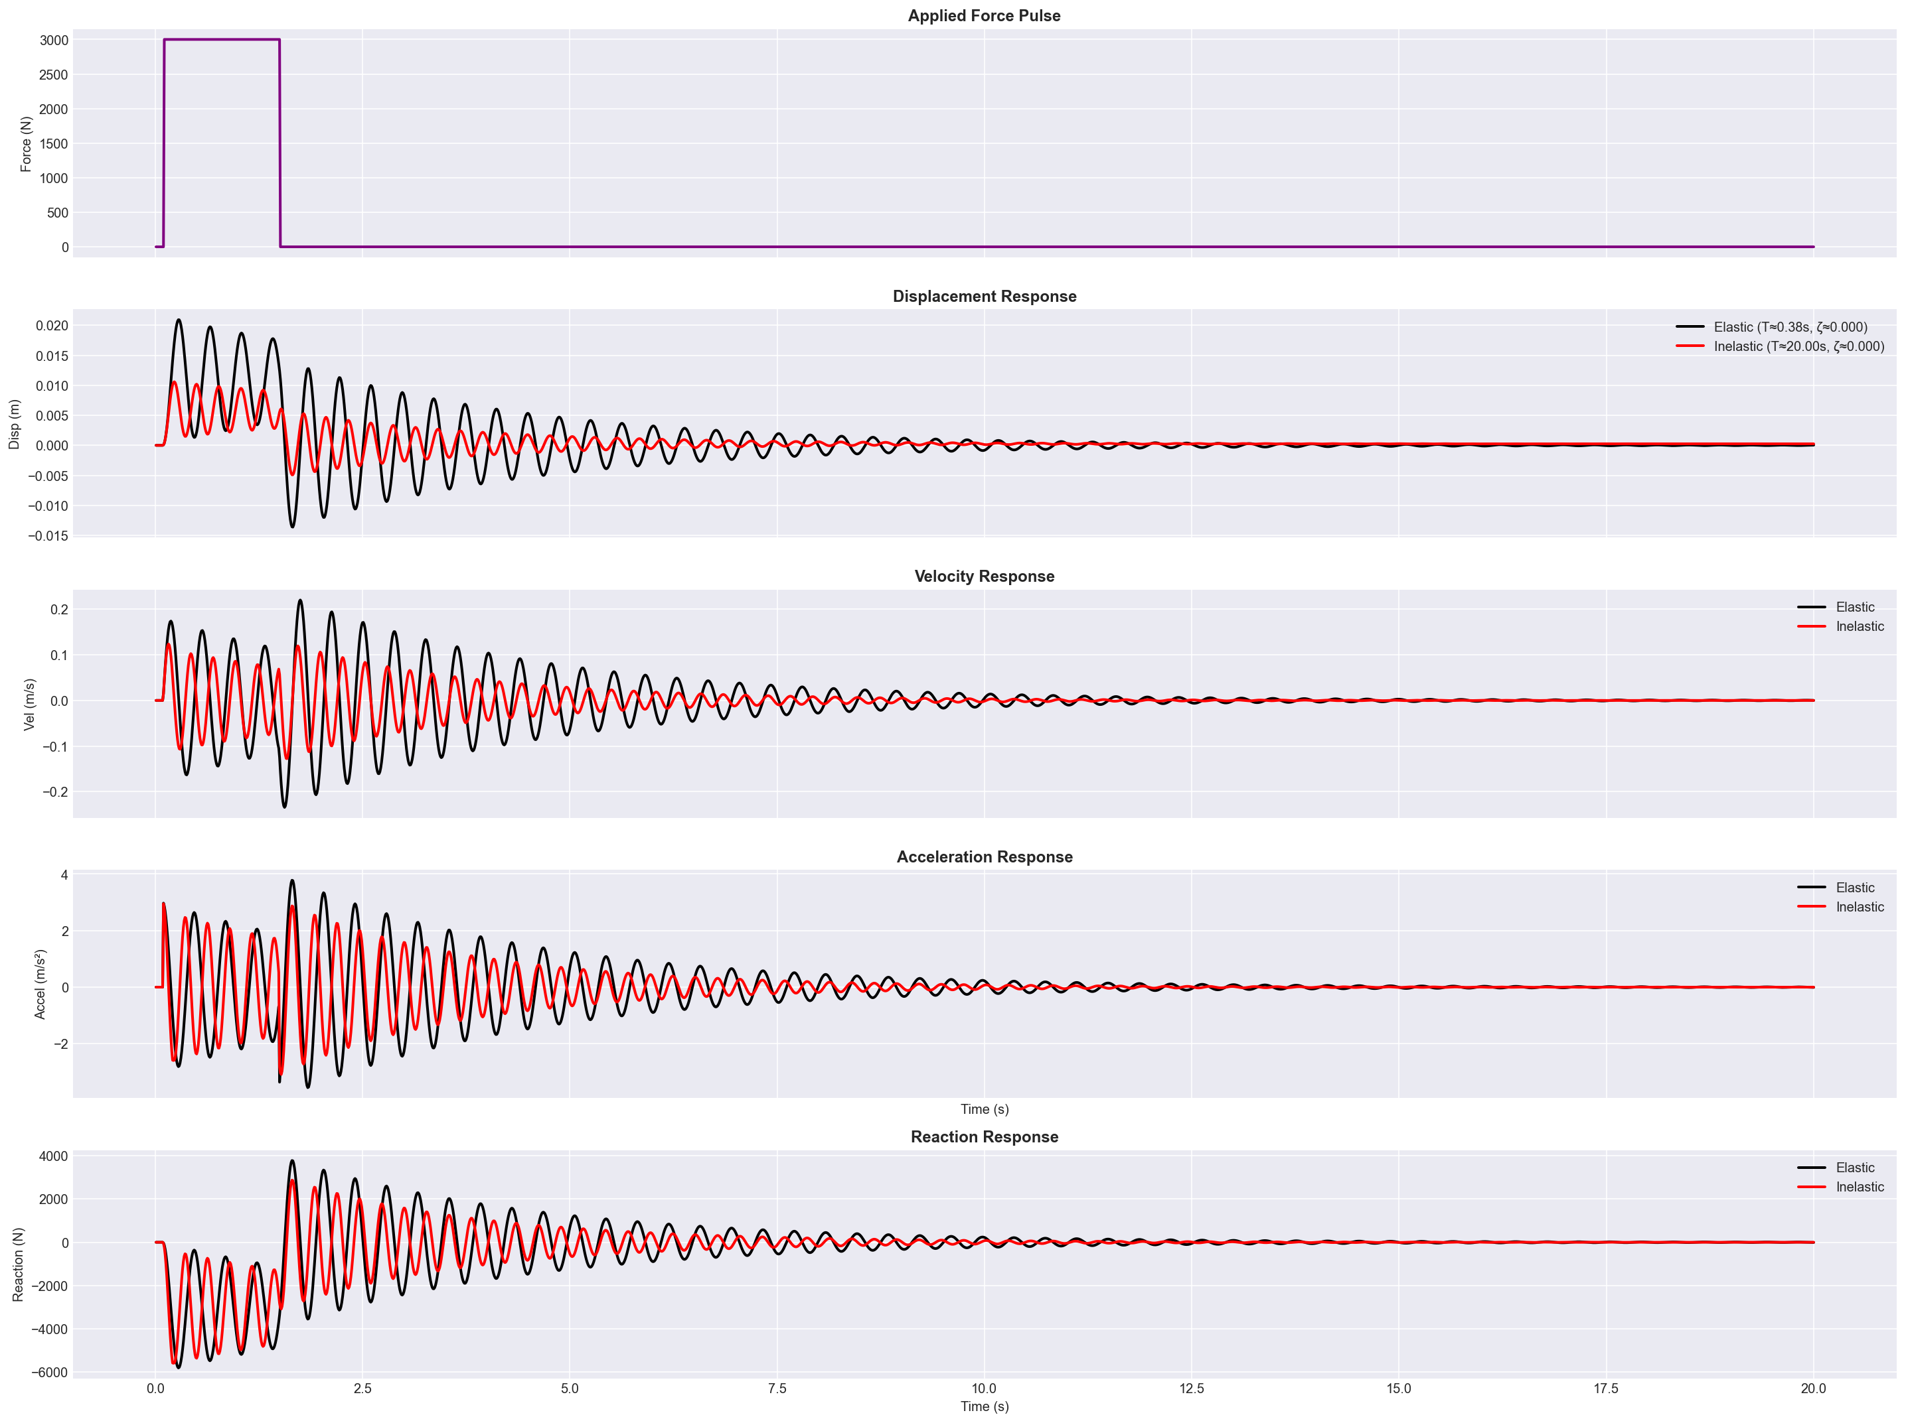

Slide 7
