Slide 1
IN THE NAME OF ALLAH, THE MOST GRACIOUS, THE MOST MERCIFUL
UTILIZING PARALLEL PROCESSING PROCEDURES FOR THE SIMULTANEOUS EXECUTION OF NONLINEAR STATIC AND DYNAMIC CONCRETE STRUCTURAL ANALYSIS, USING OPENSEES
WRITTEN BY SALAR DELAVAR GHASHGHAEI (QASHQAI)

Slide 2
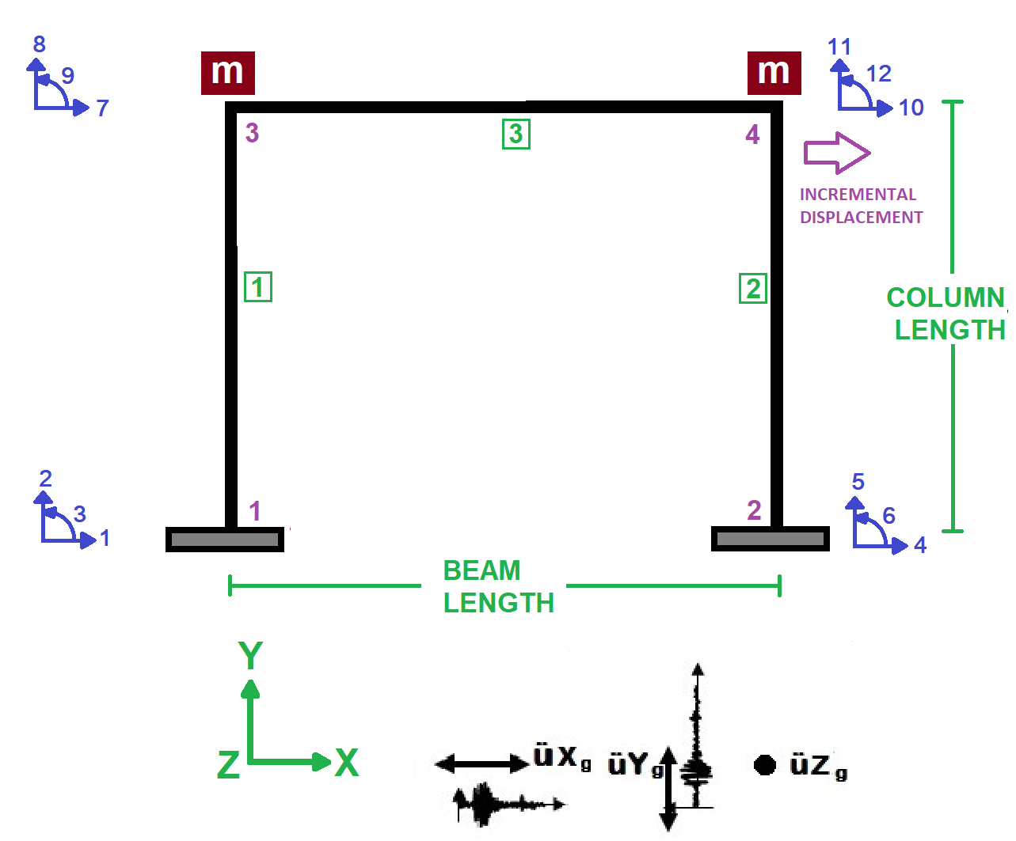

Slide 3
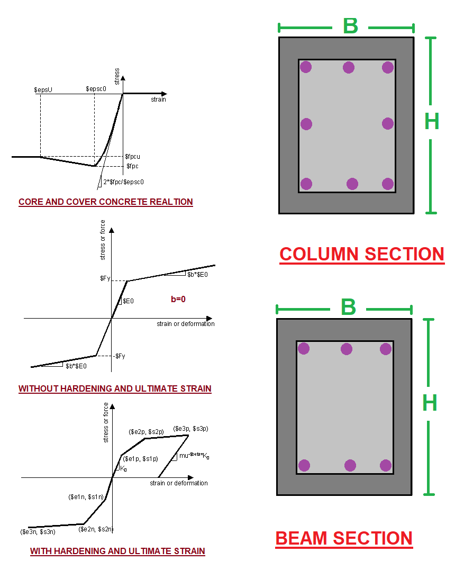

Slide 4
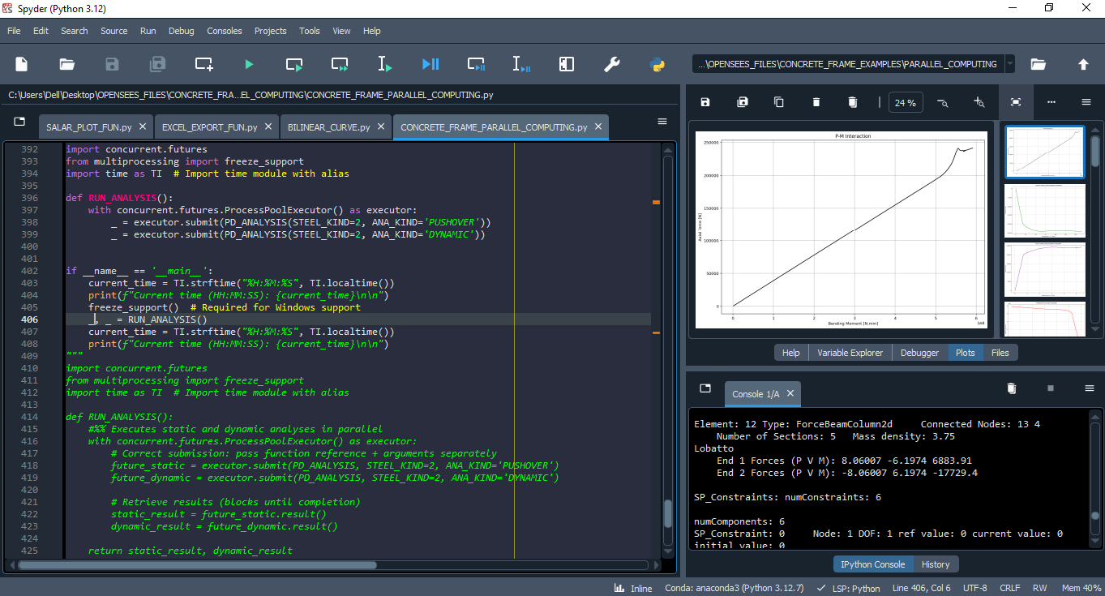

Slide 5
NONLINEAR STATIC ANALYSIS
(PUSHOVER)

Slide 6
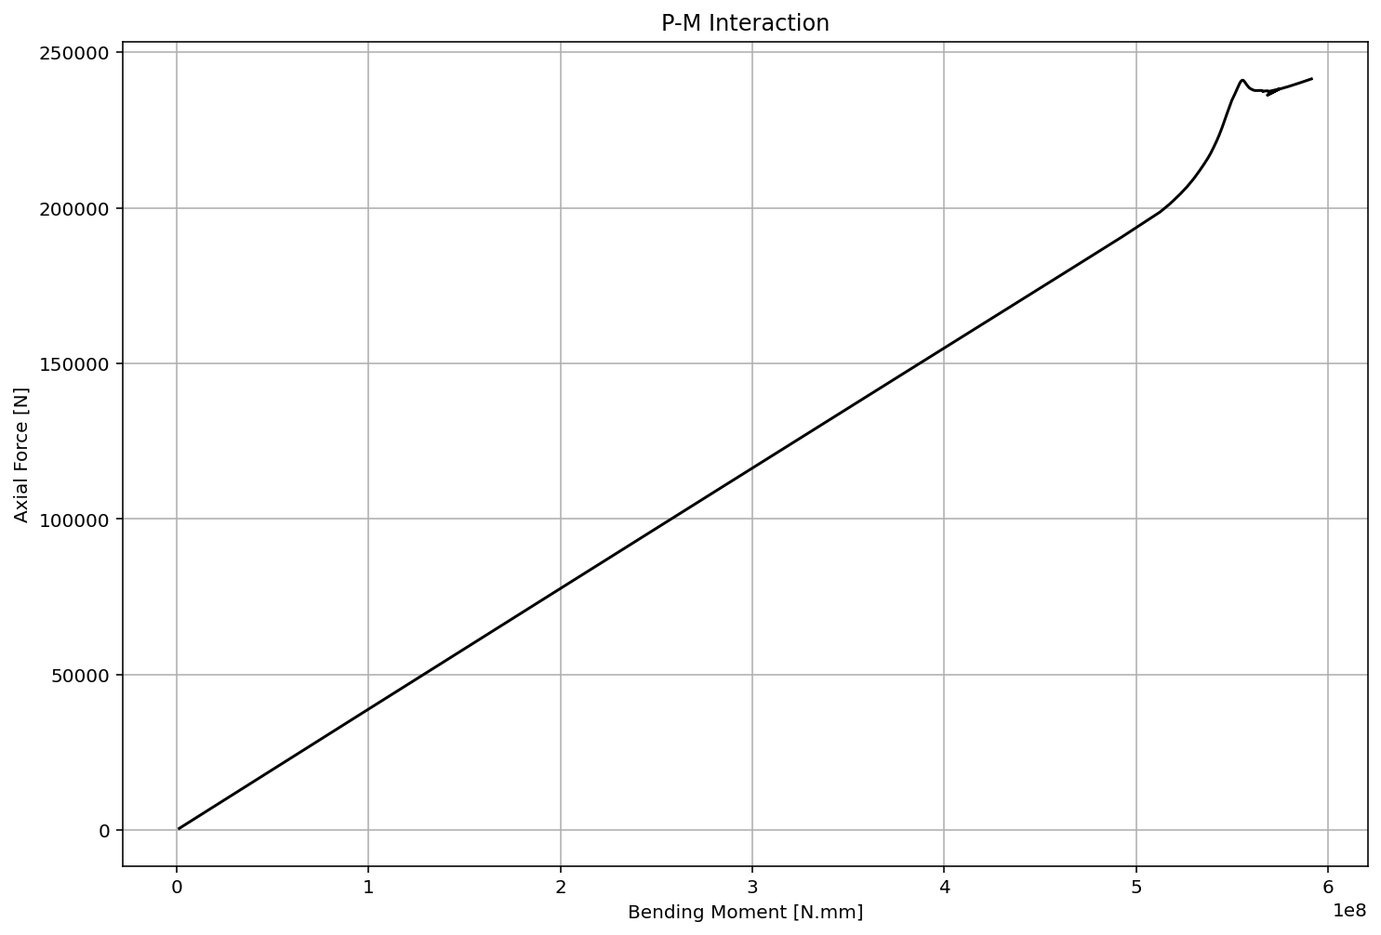

Slide 7
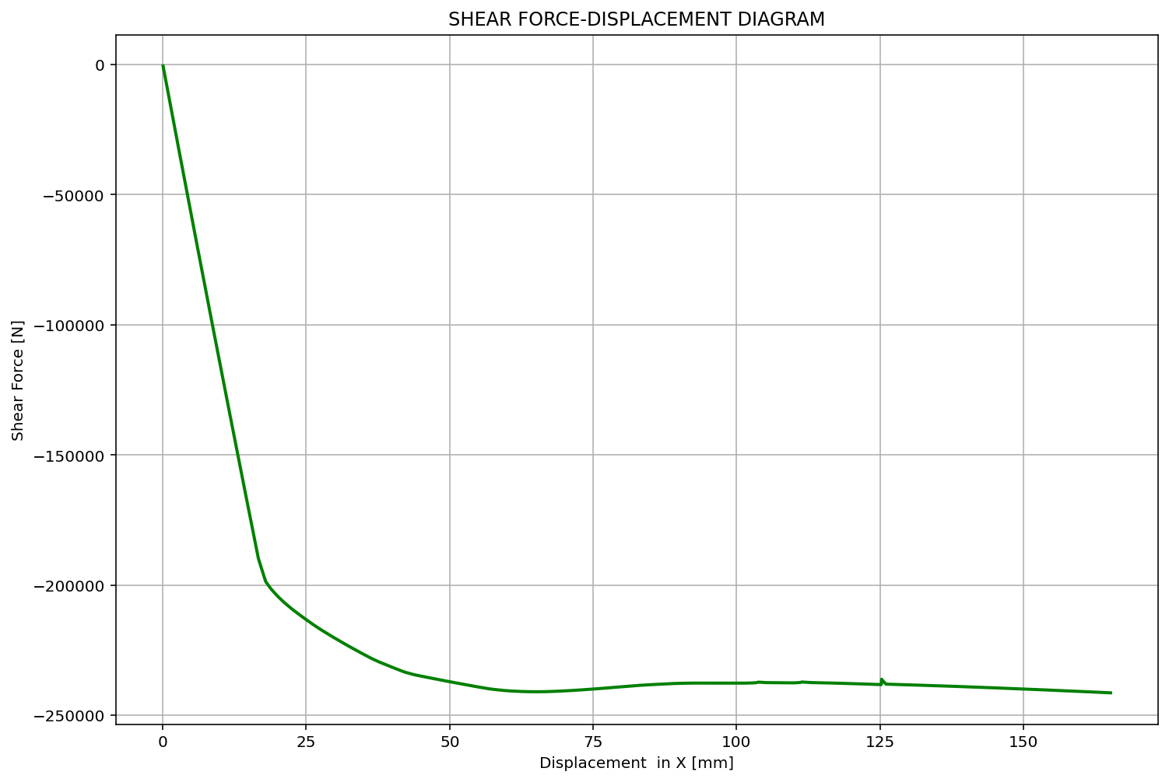

Slide 8
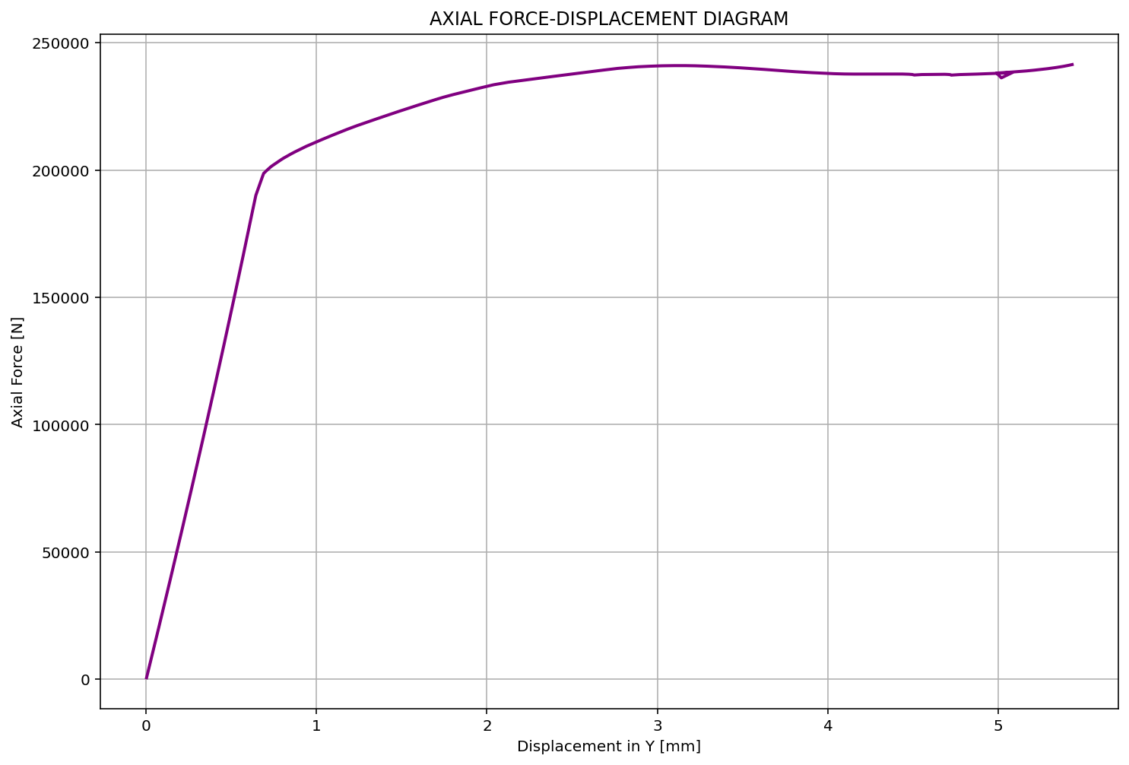

Slide 9
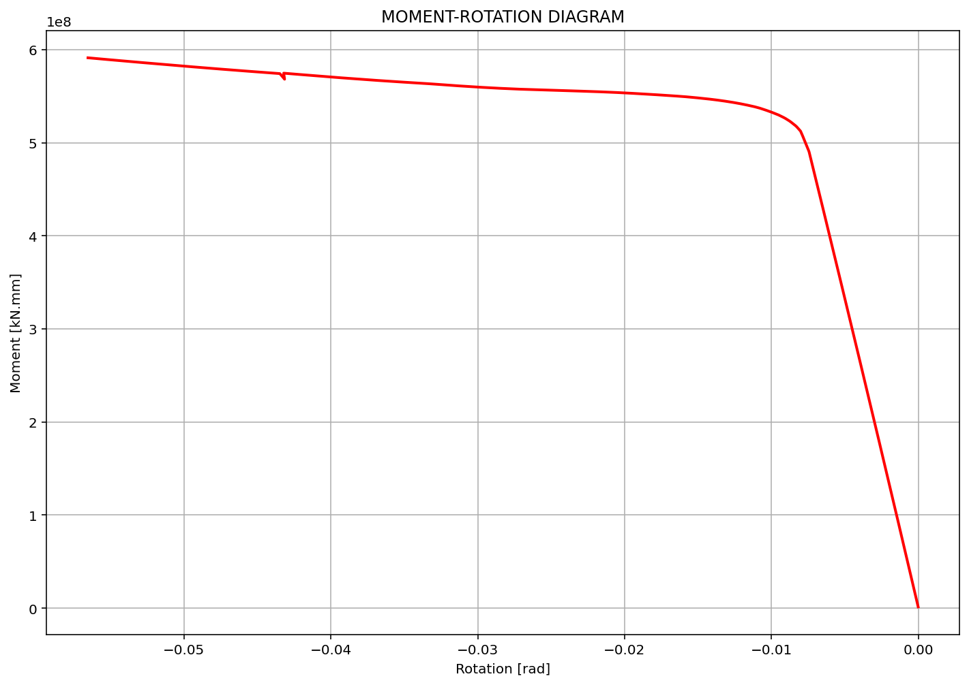

Slide 10
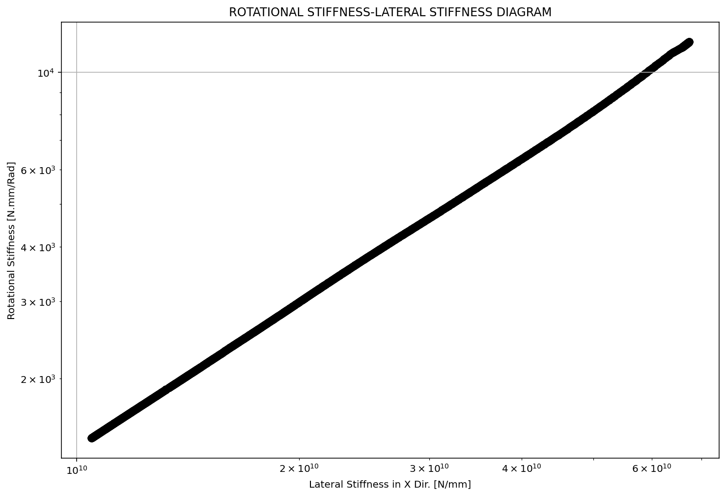

Slide 11
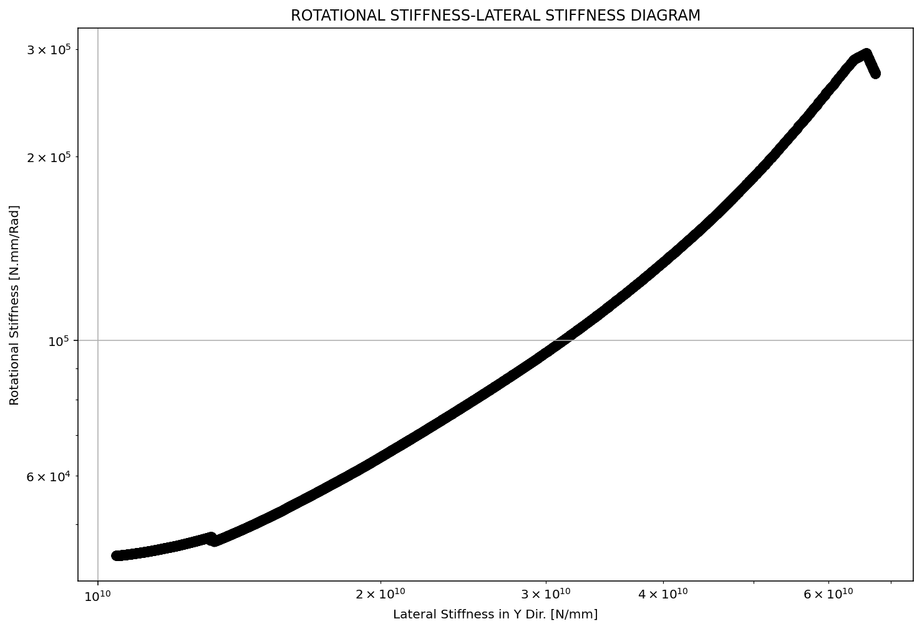

Slide 12
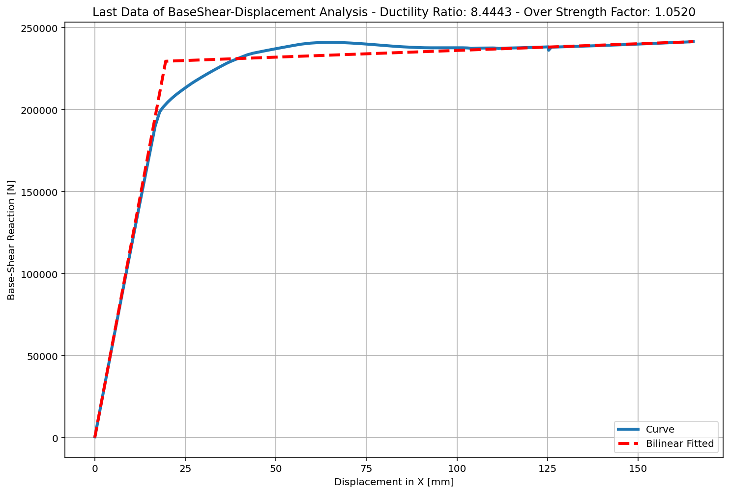

Slide 13
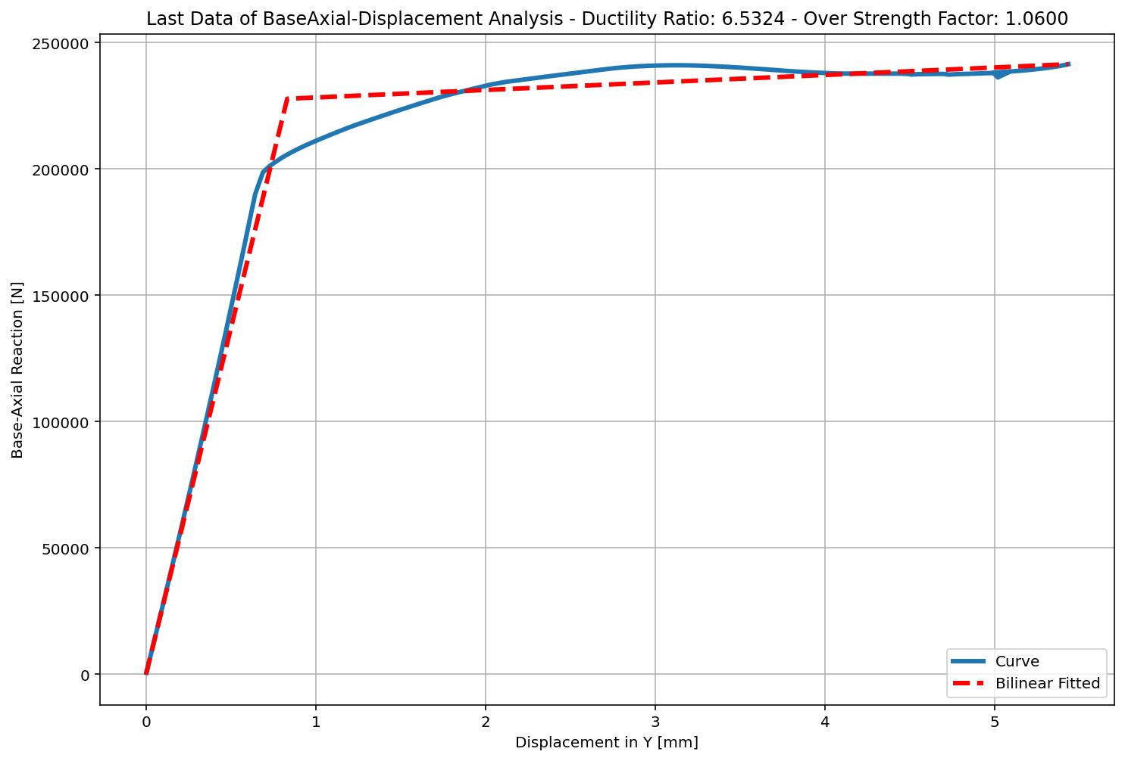

Slide 14
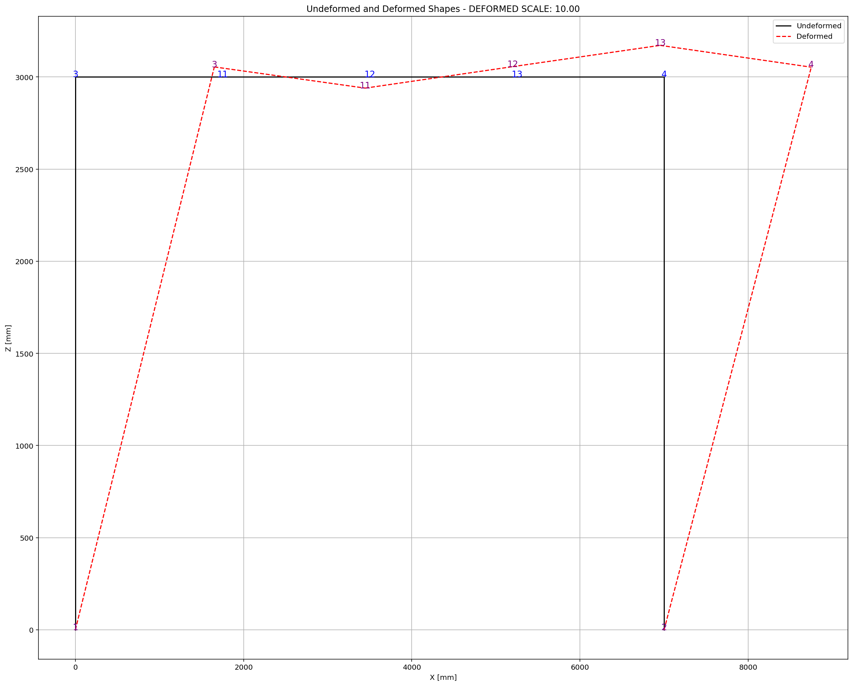

Slide 15
NONLINEAR DYNAMIC ANALYSIS

Slide 16
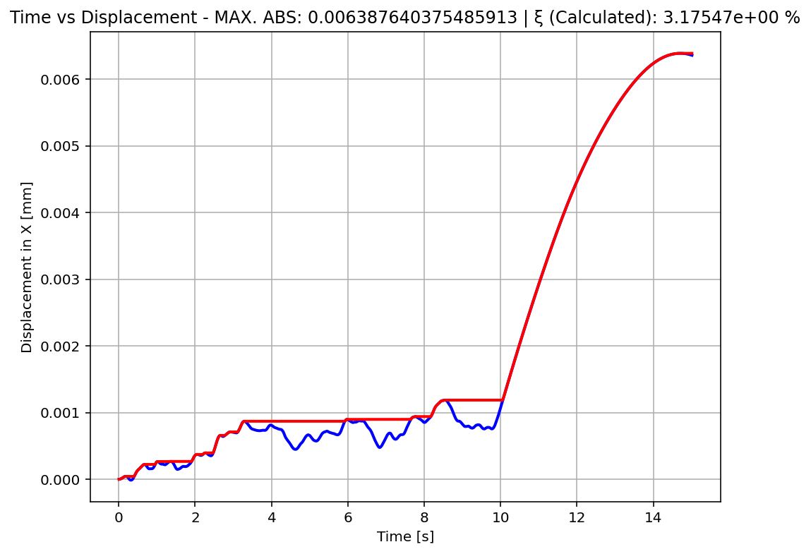

Slide 17
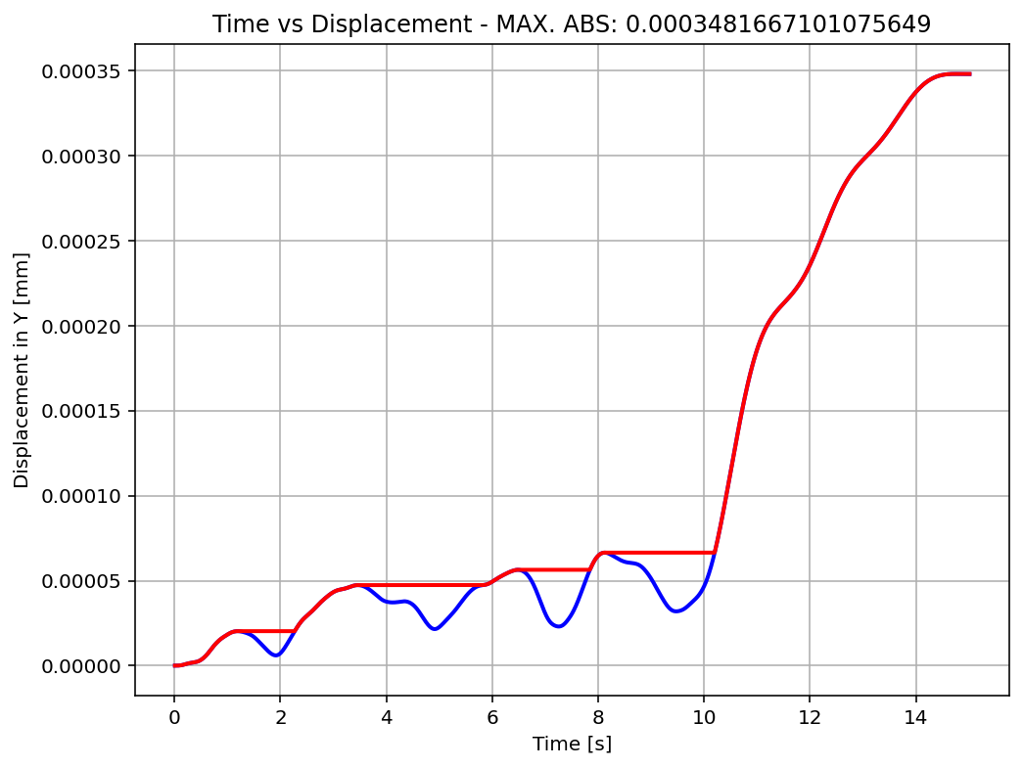

Slide 18
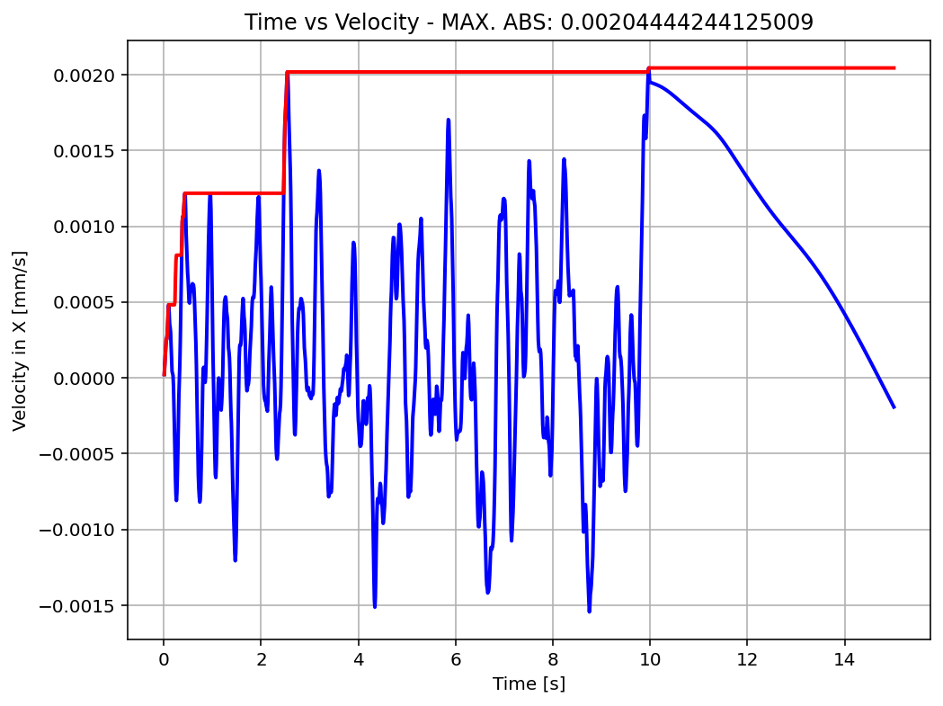

Slide 19
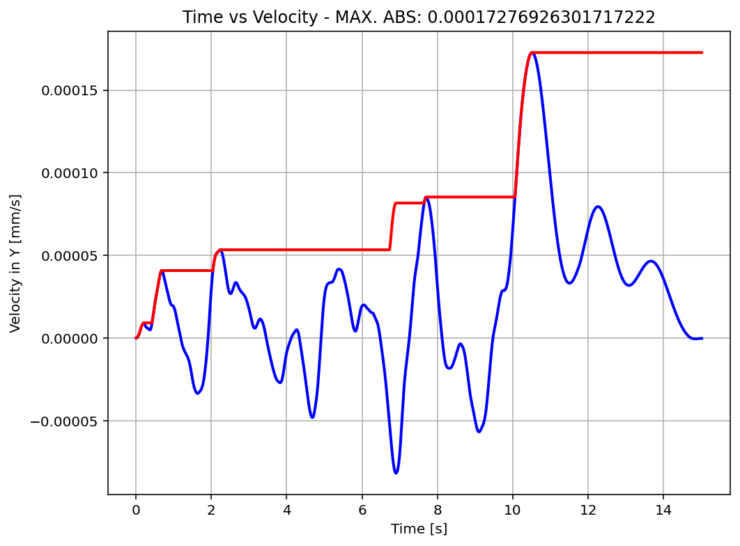

Slide 20
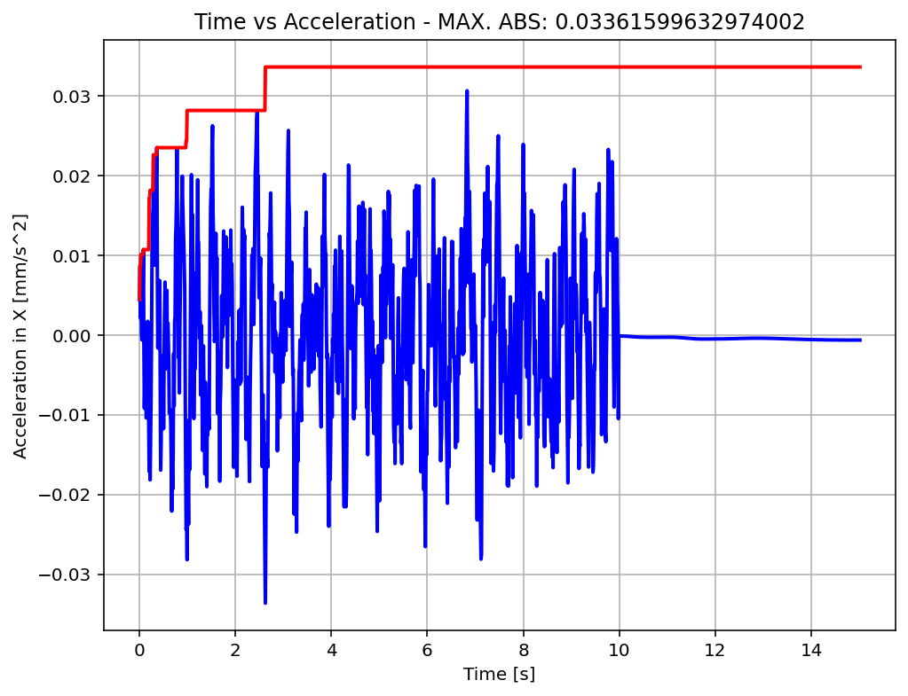

Slide 21
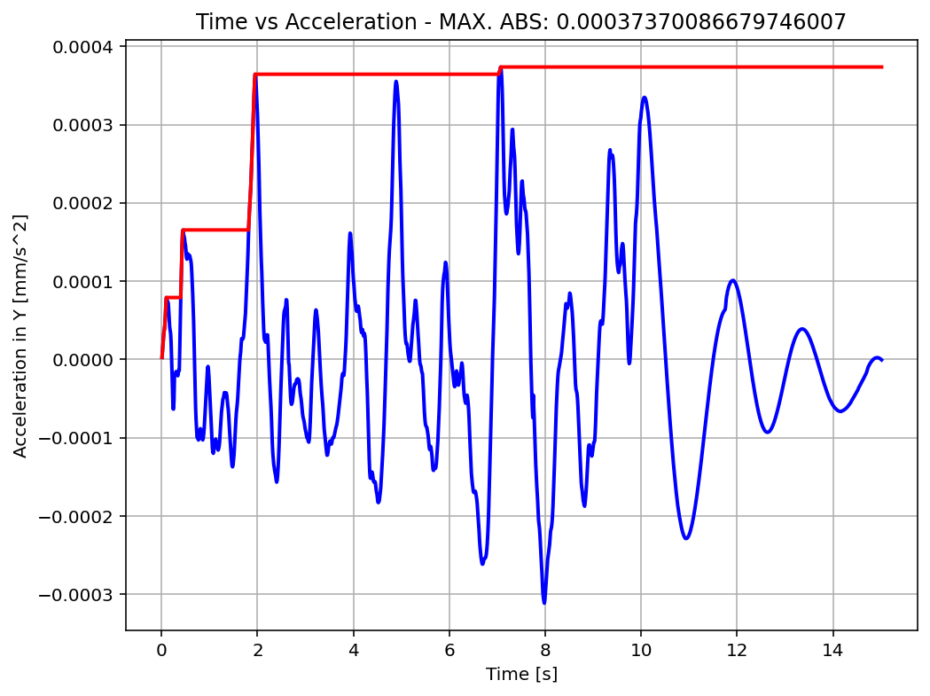

Slide 22
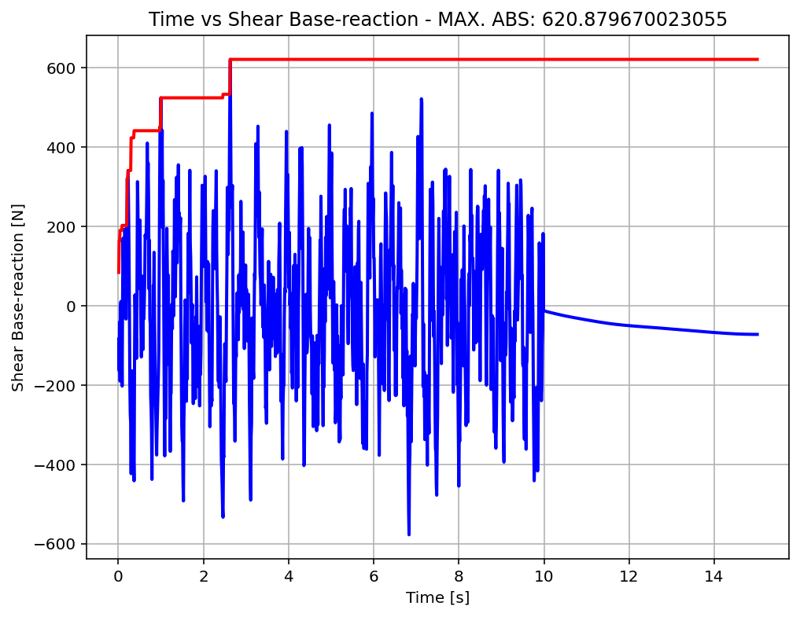

Slide 23
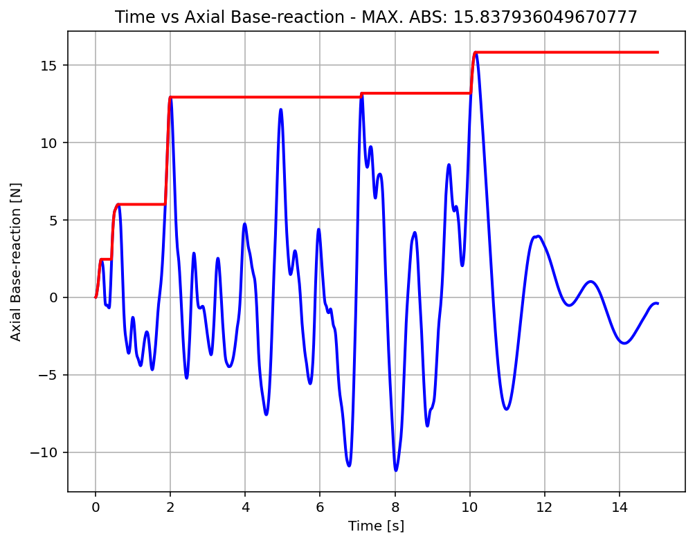

Slide 24
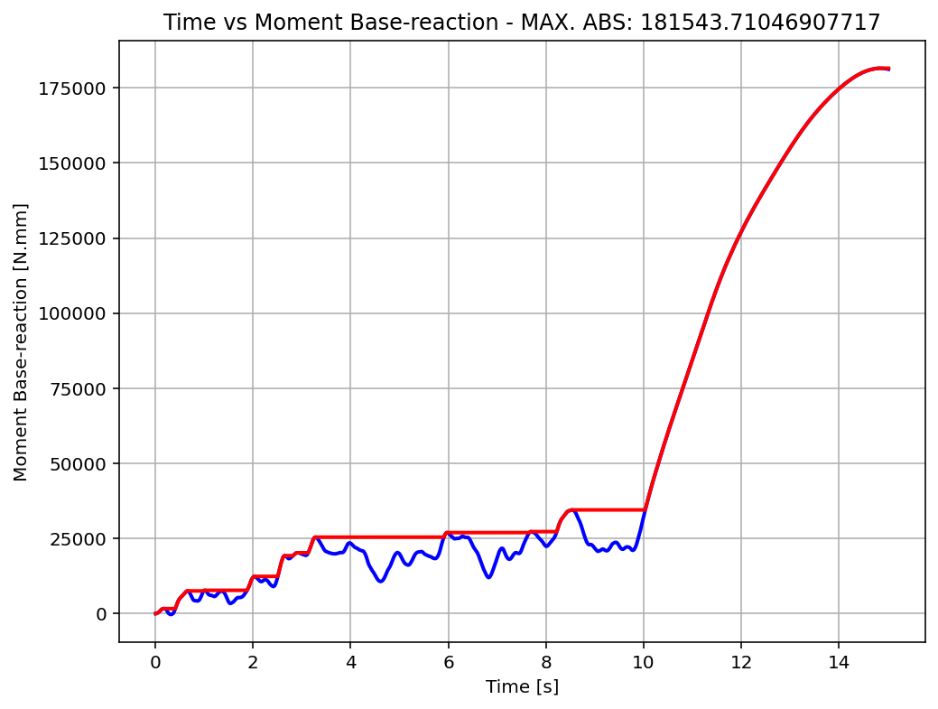

Slide 25
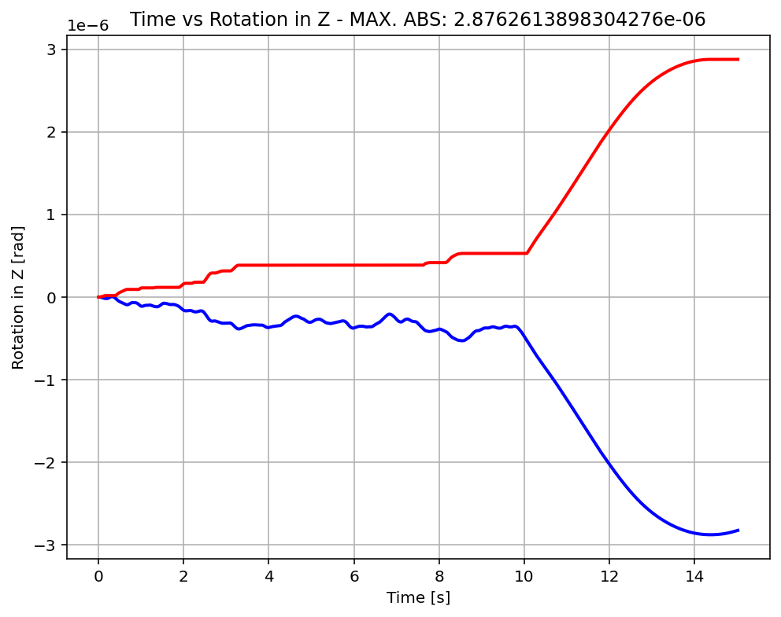

Slide 26
