Slide 1
>> IN THE NAME OF ALLAH, THE MOST GRACIOUS, THE MOST MERCIFUL <<
COMPREHENSIVE NONLINEAR SEISMIC ASSESSMENT OF MULTI-MODE POST-BUCKLING PHENOMENA A COLUMN WITH SEMI-RIGID CONNECTIONS: AN OPENSEES FRAMEWORK FOR STATIC PUSHOVER, CYCLIC DEGRADATION, STATIC TIME-HISTORY AND DYNAMIC TIME-HISTORY ANALYSIS
THIS PROGRAM IS WRITTEN BY SALAR DELAVAR GHASHGHAEI (QASHQAI)

Slide 2
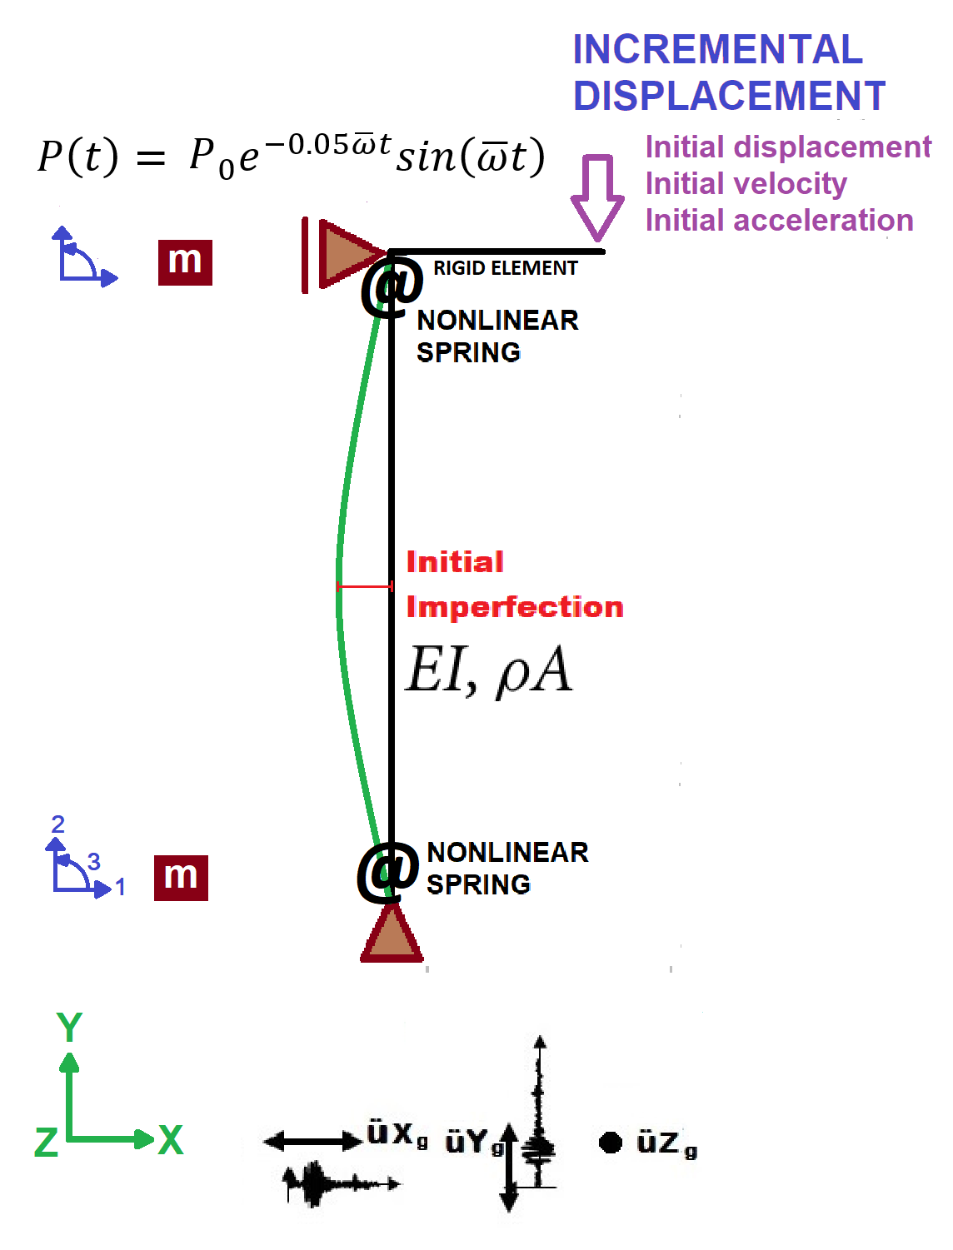

Slide 3
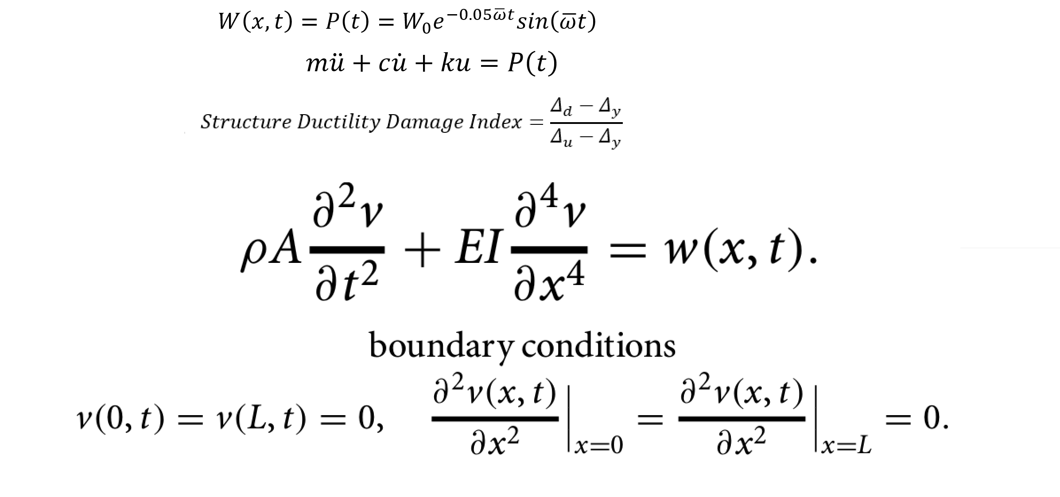

Slide 4
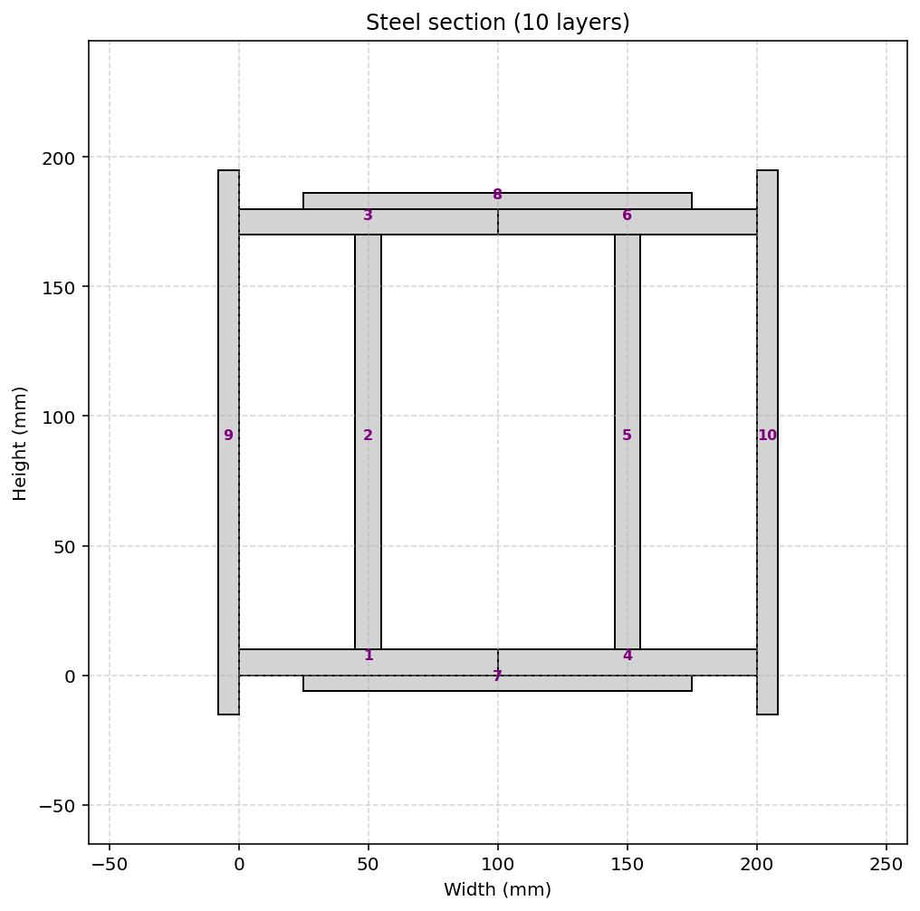

Slide 5
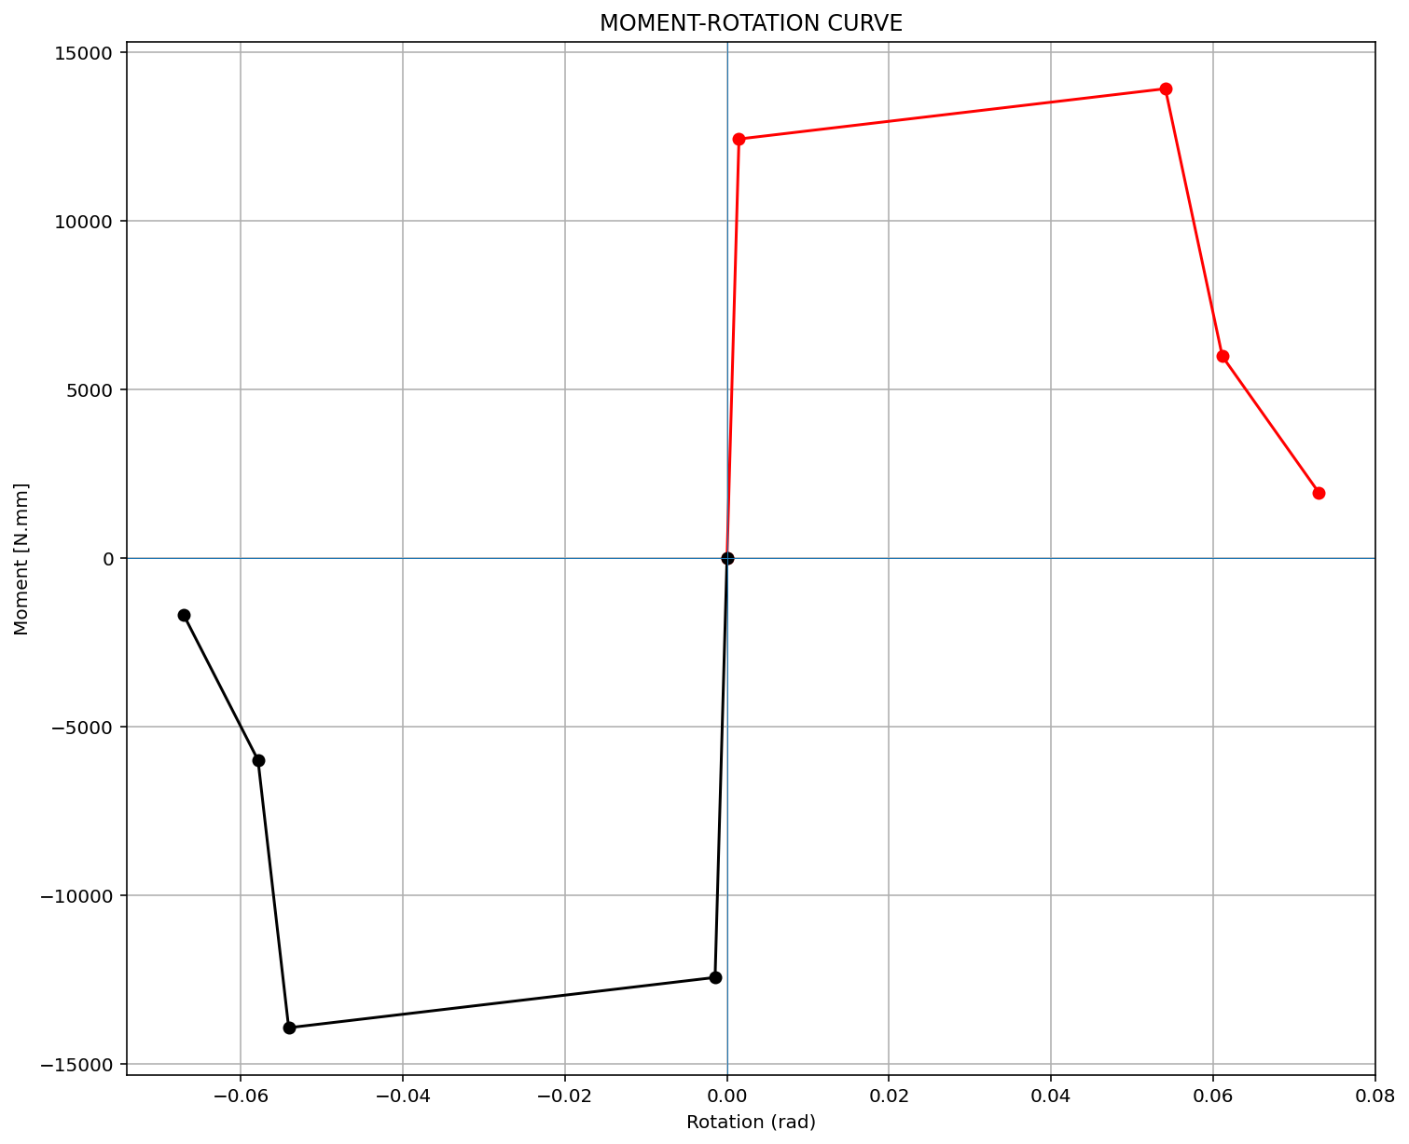

Slide 6
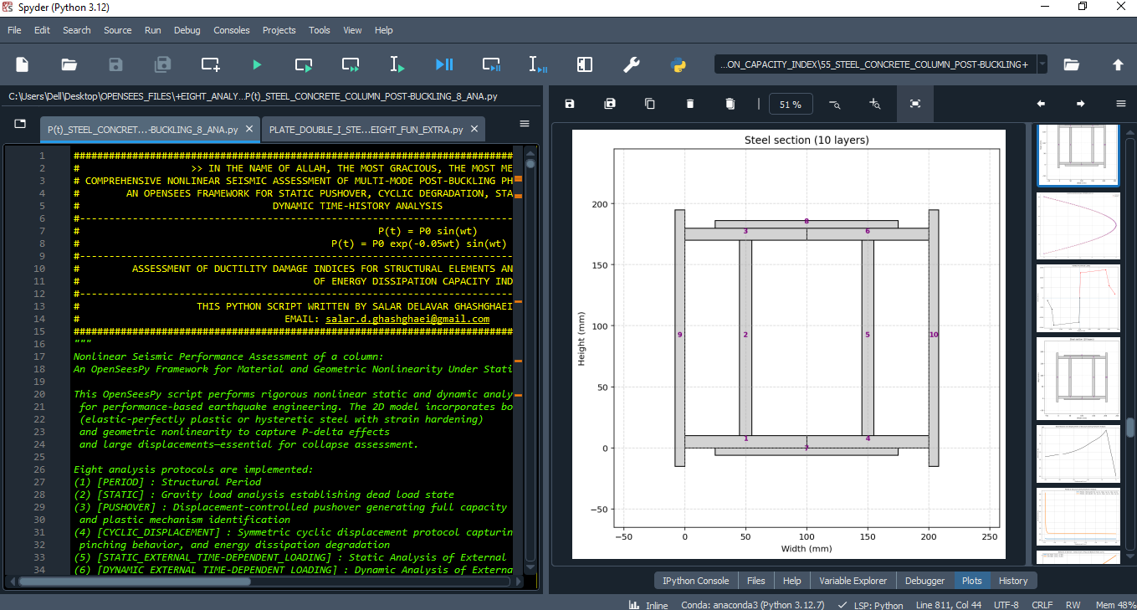

Slide 7
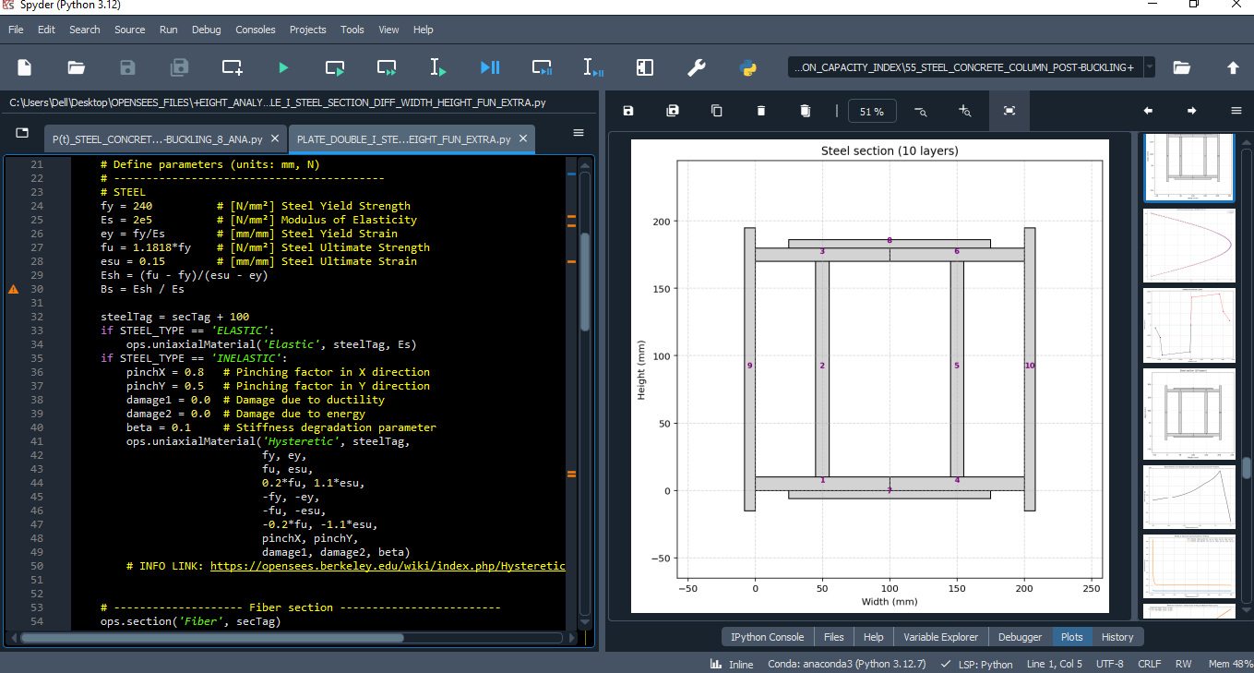

Slide 8
STATIC ANALYSIS

Slide 9
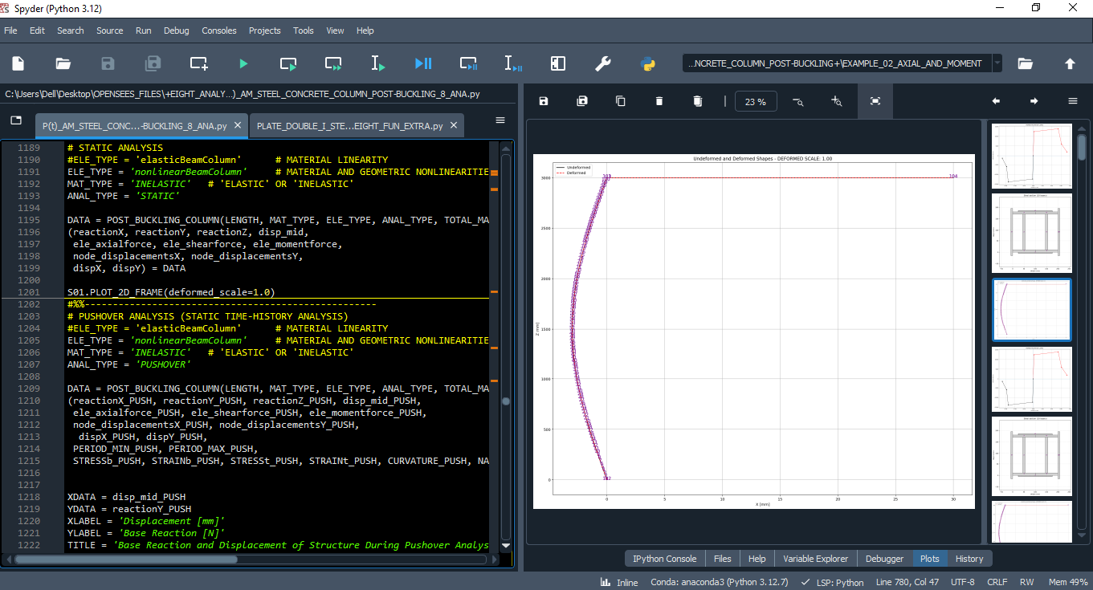

Slide 10
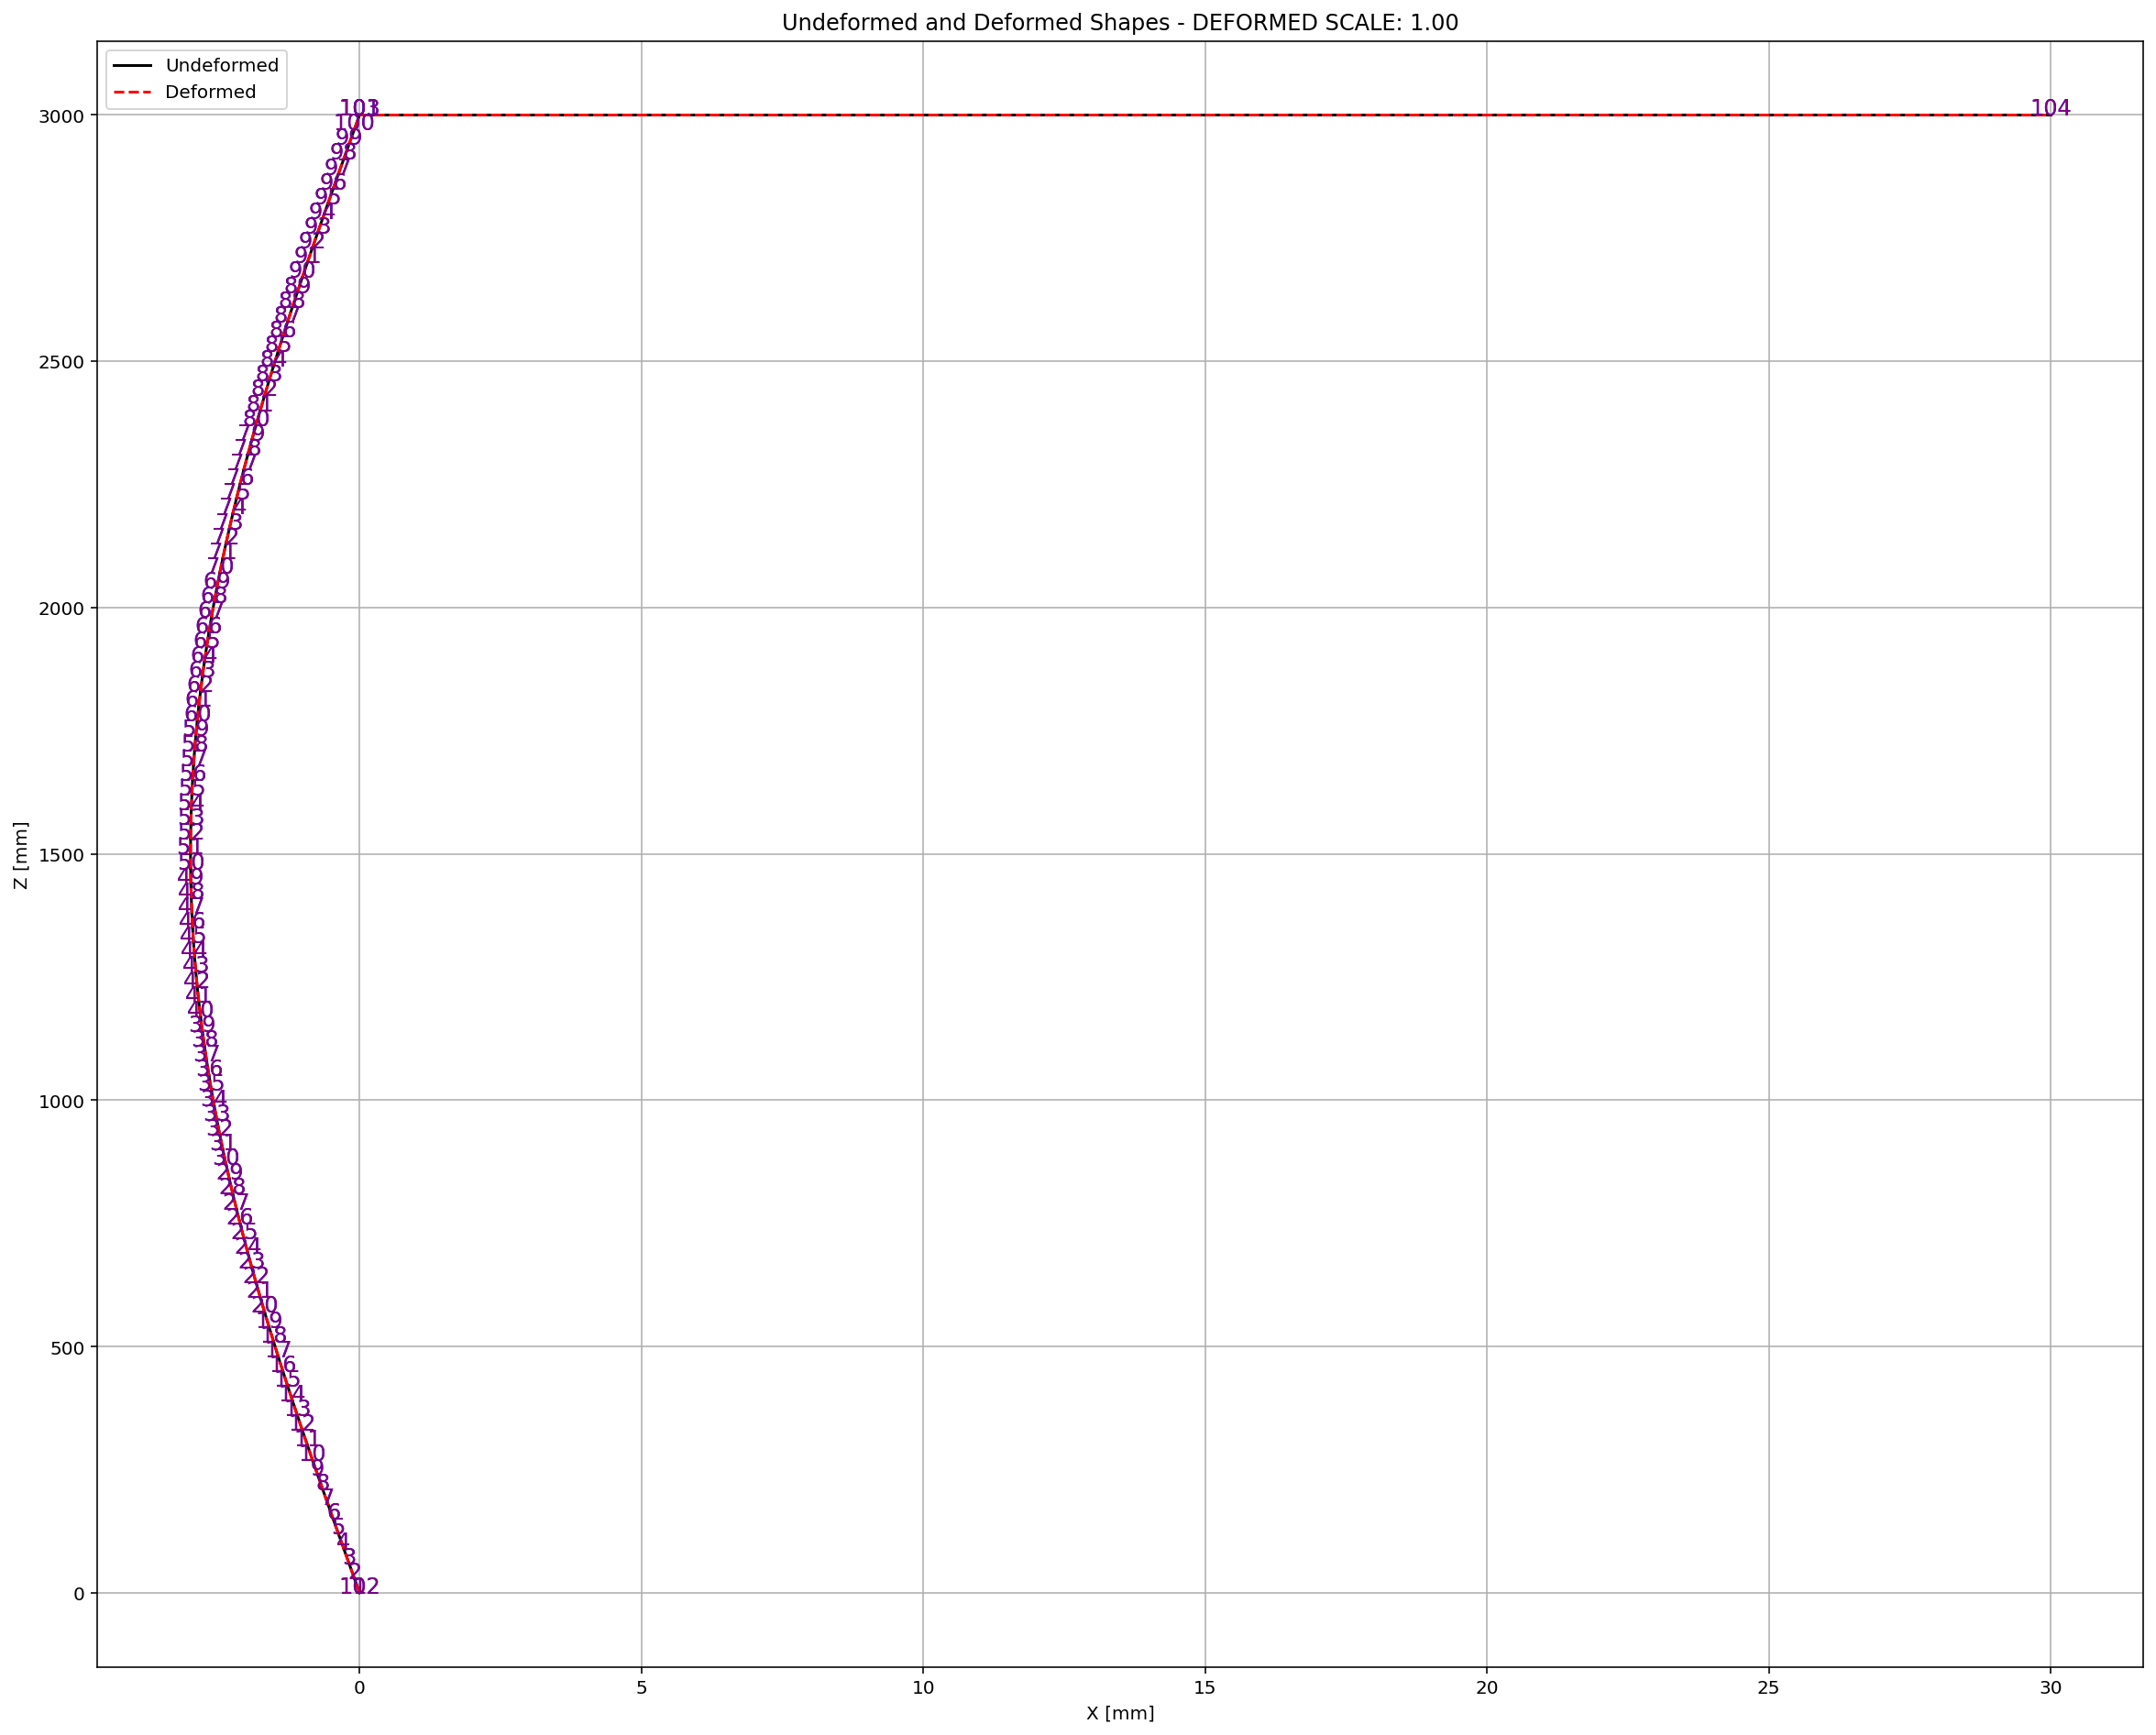

Slide 11
PUSHOVER ANALYSIS

Slide 12
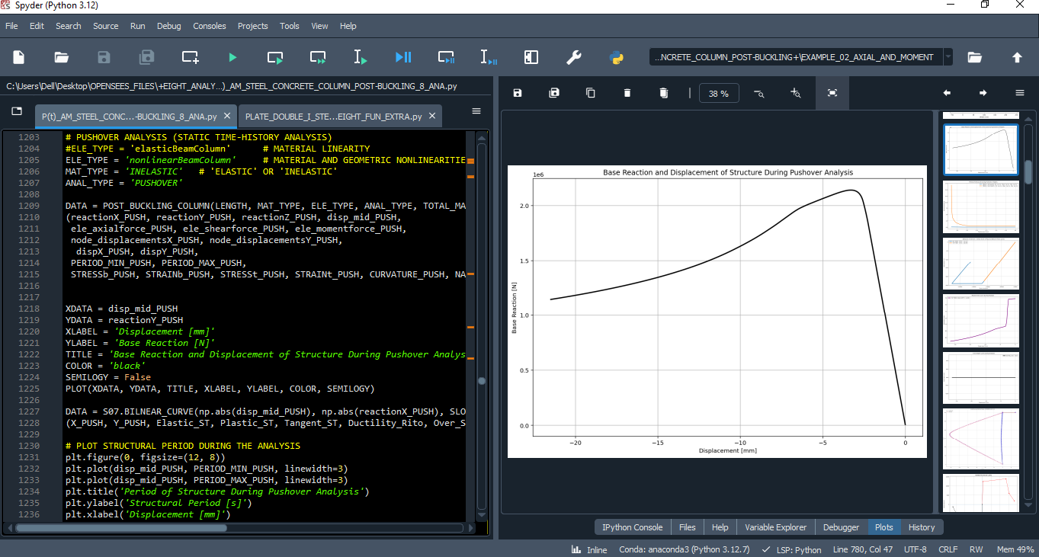

Slide 13
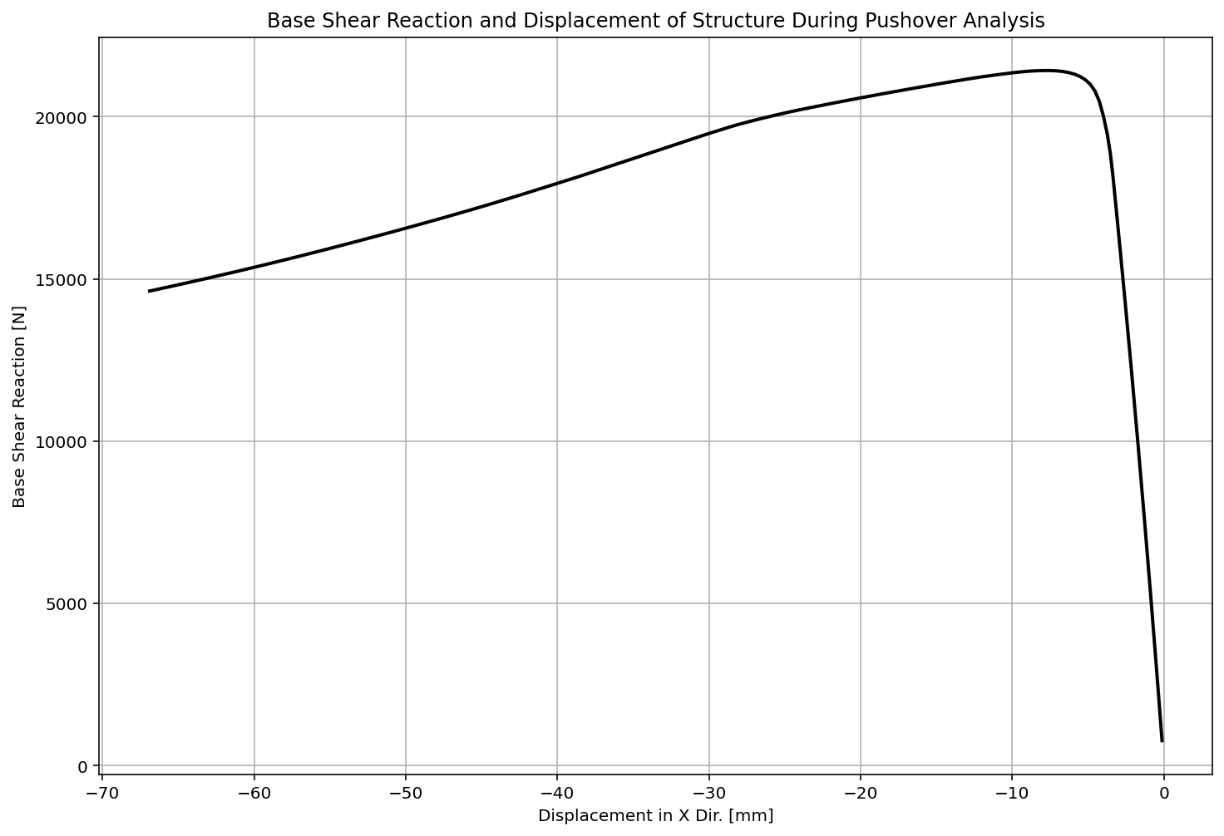

Slide 14
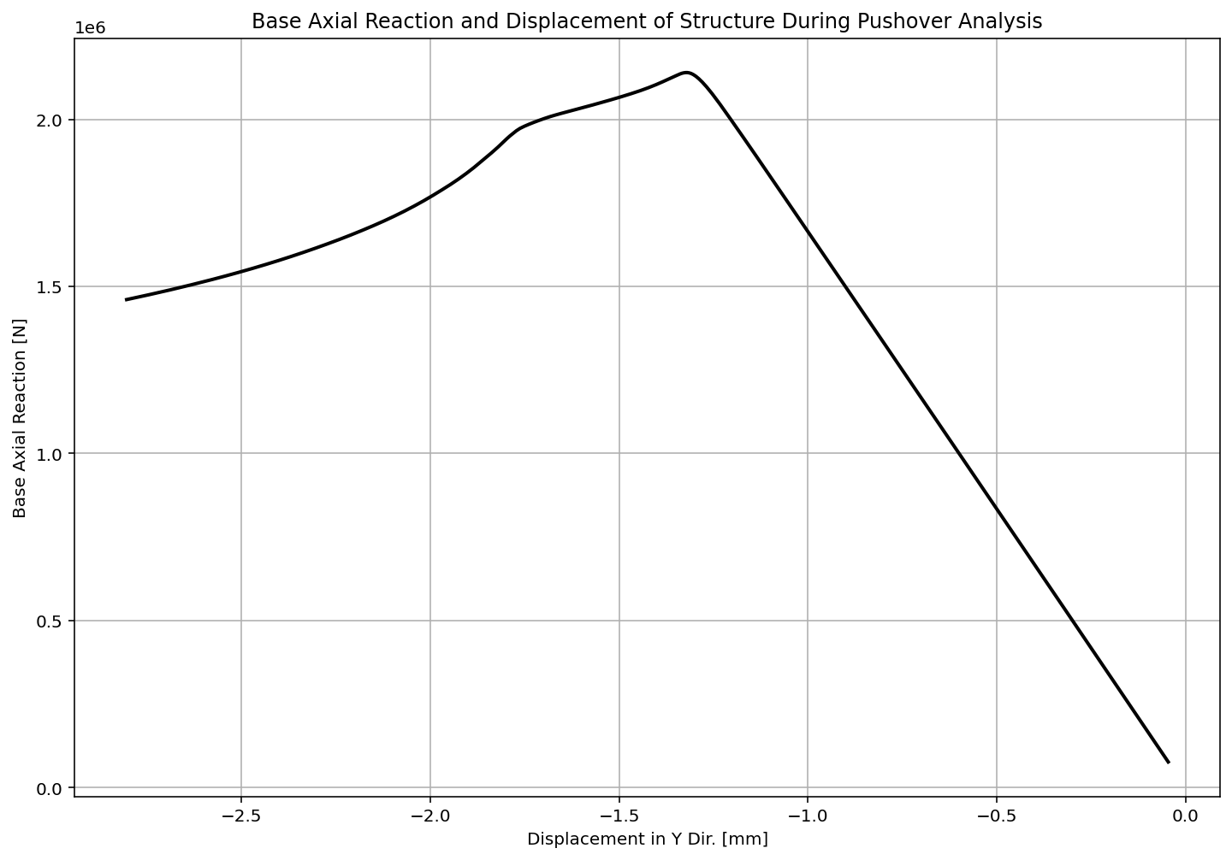

Slide 15
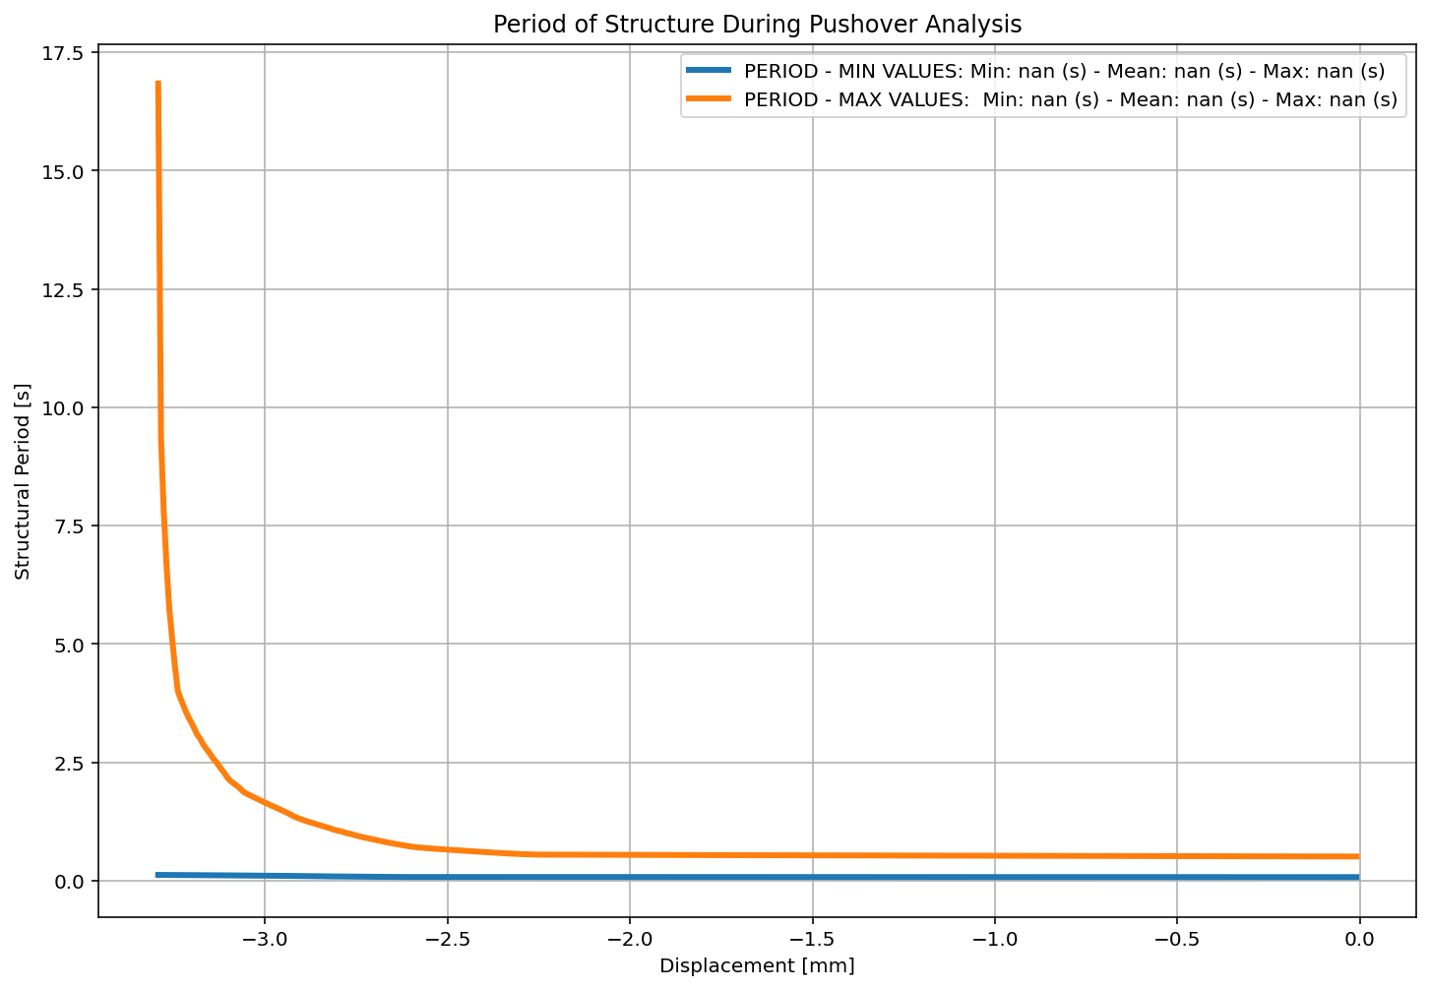

Slide 16
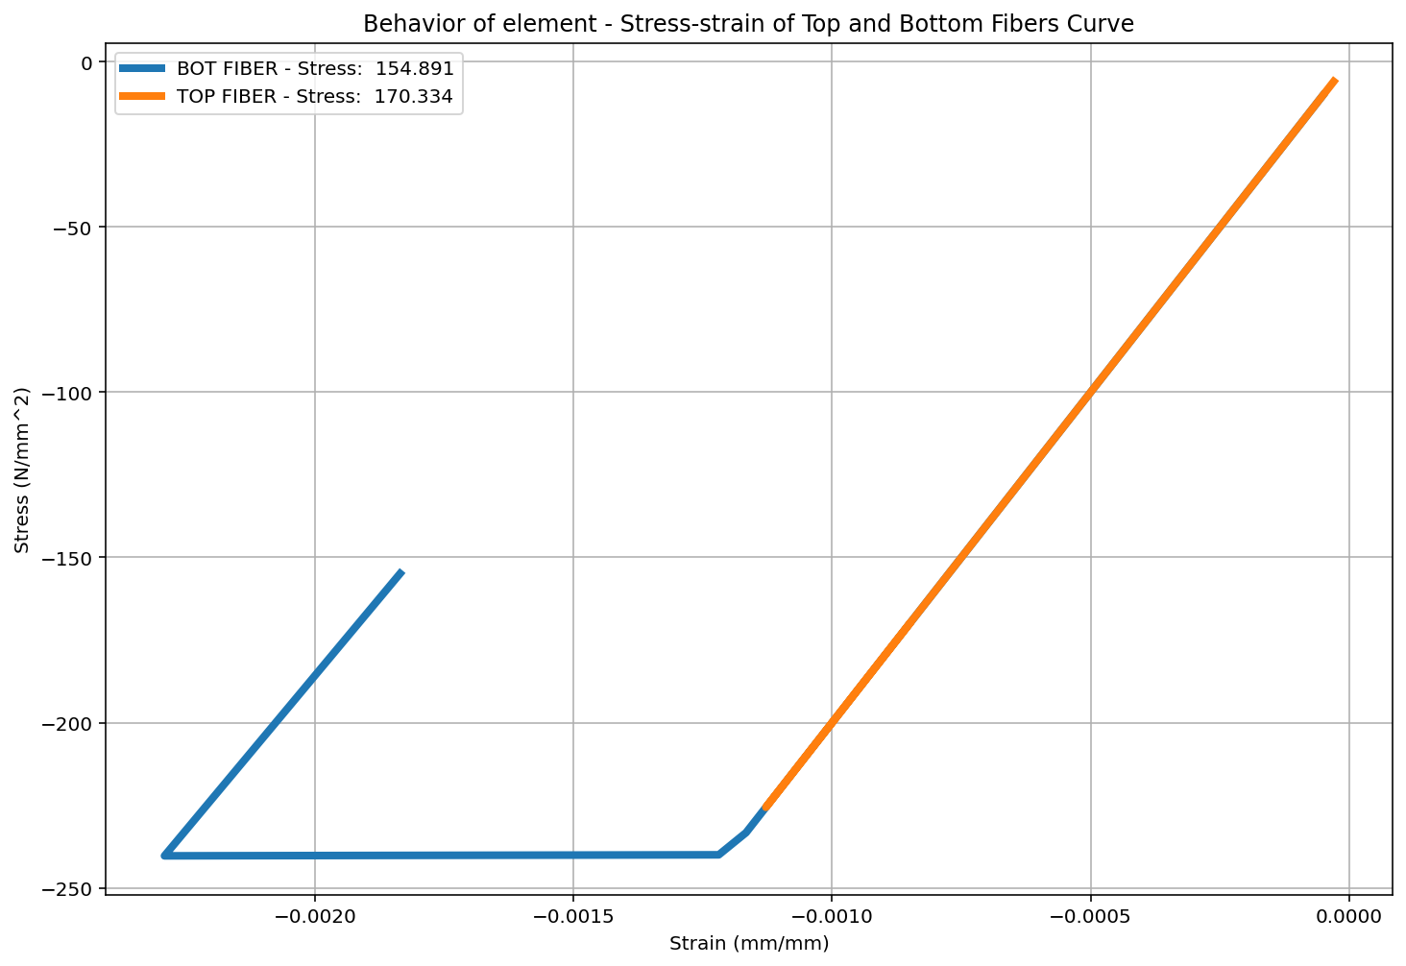

Slide 17
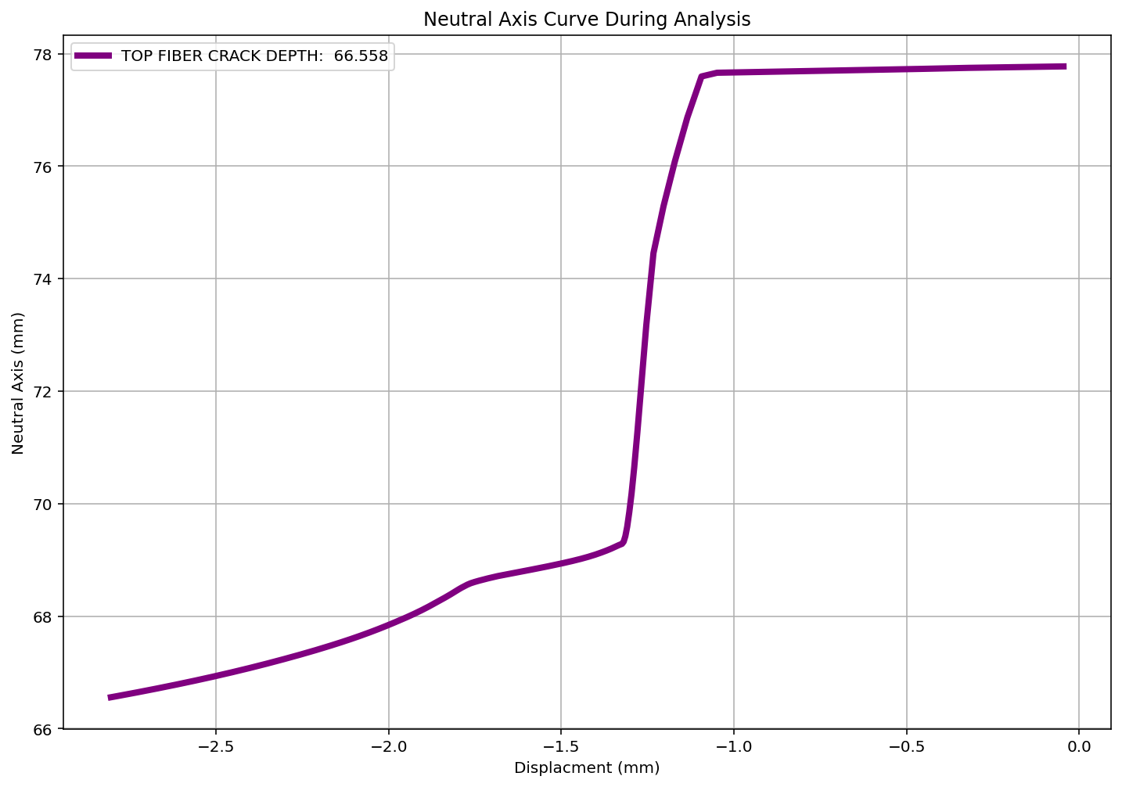

Slide 18
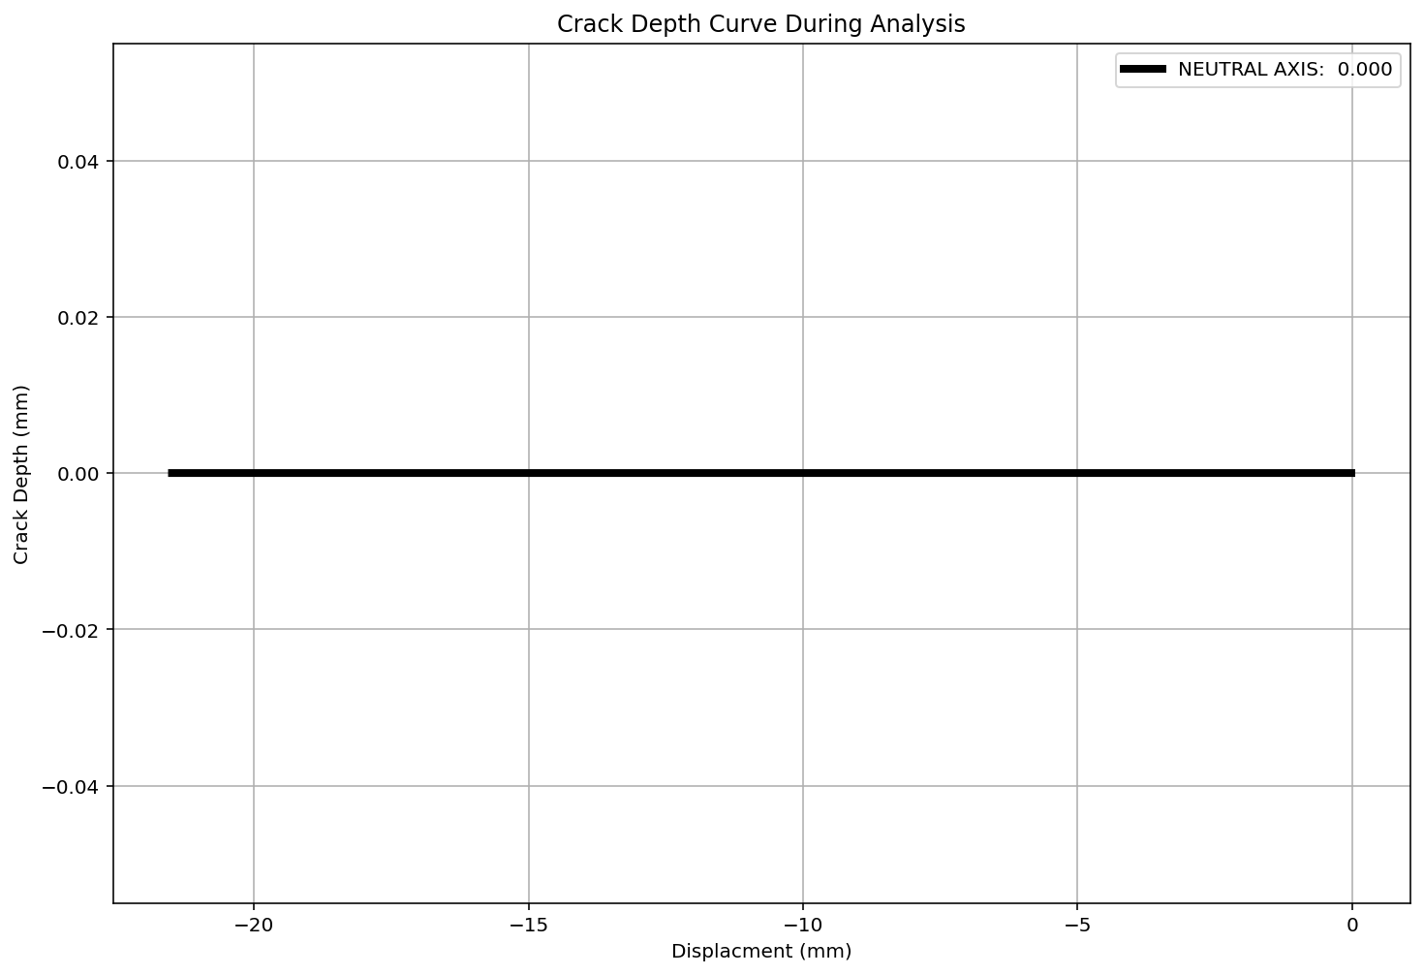

Slide 19
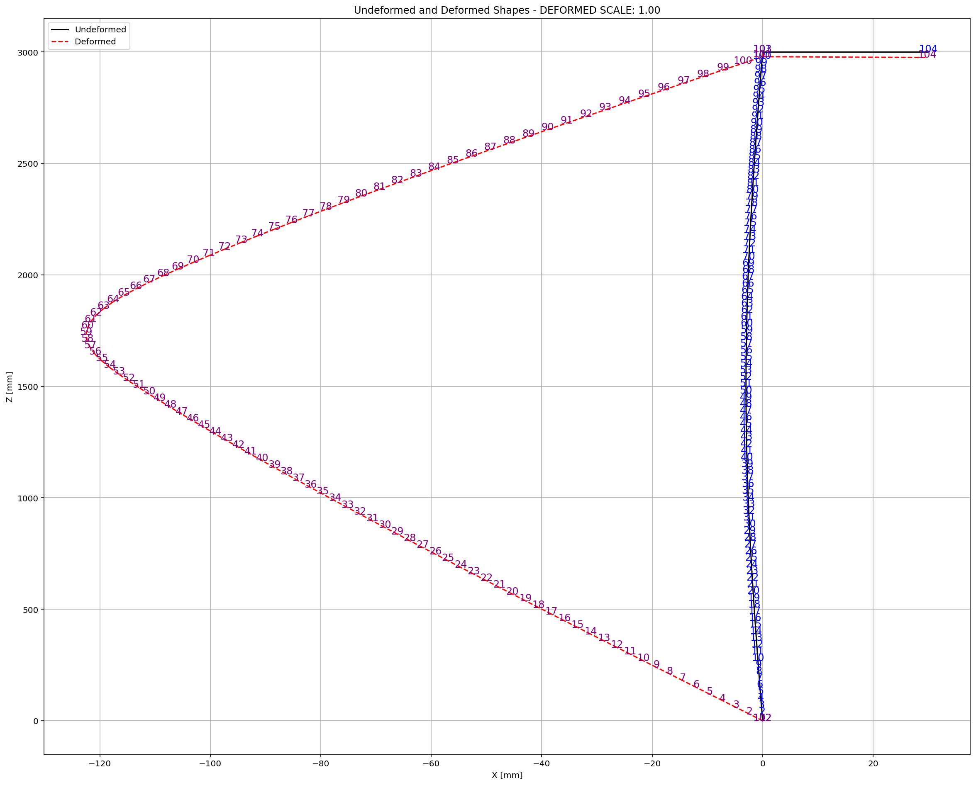

Slide 20
CYCLIC DISPLACEMENT ANALYSIS

Slide 21
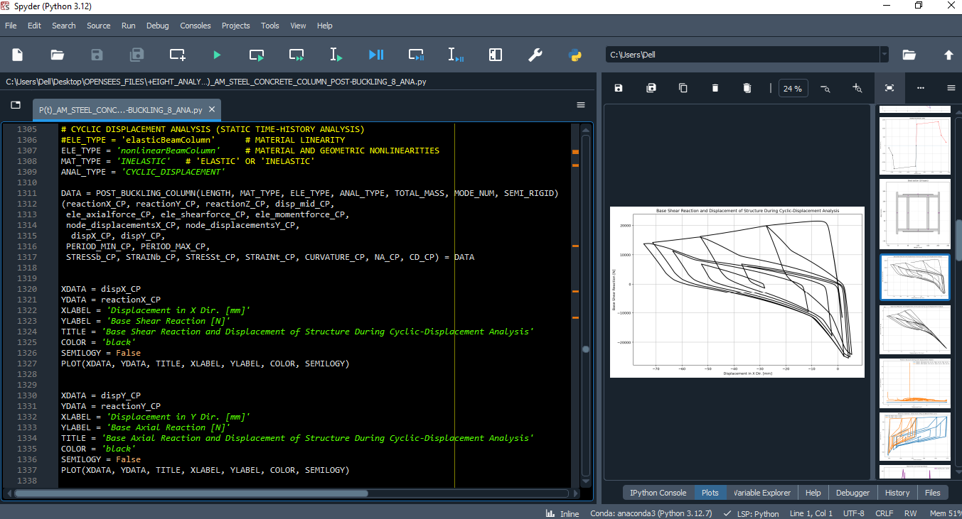

Slide 22
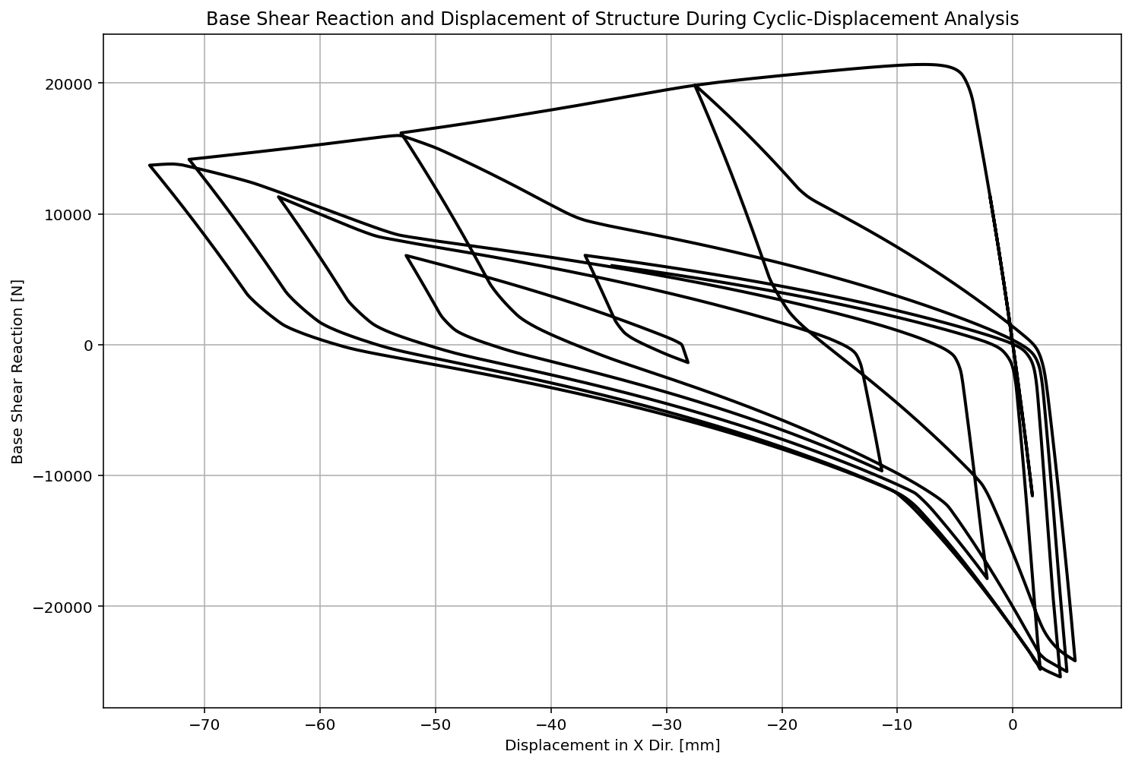

Slide 23
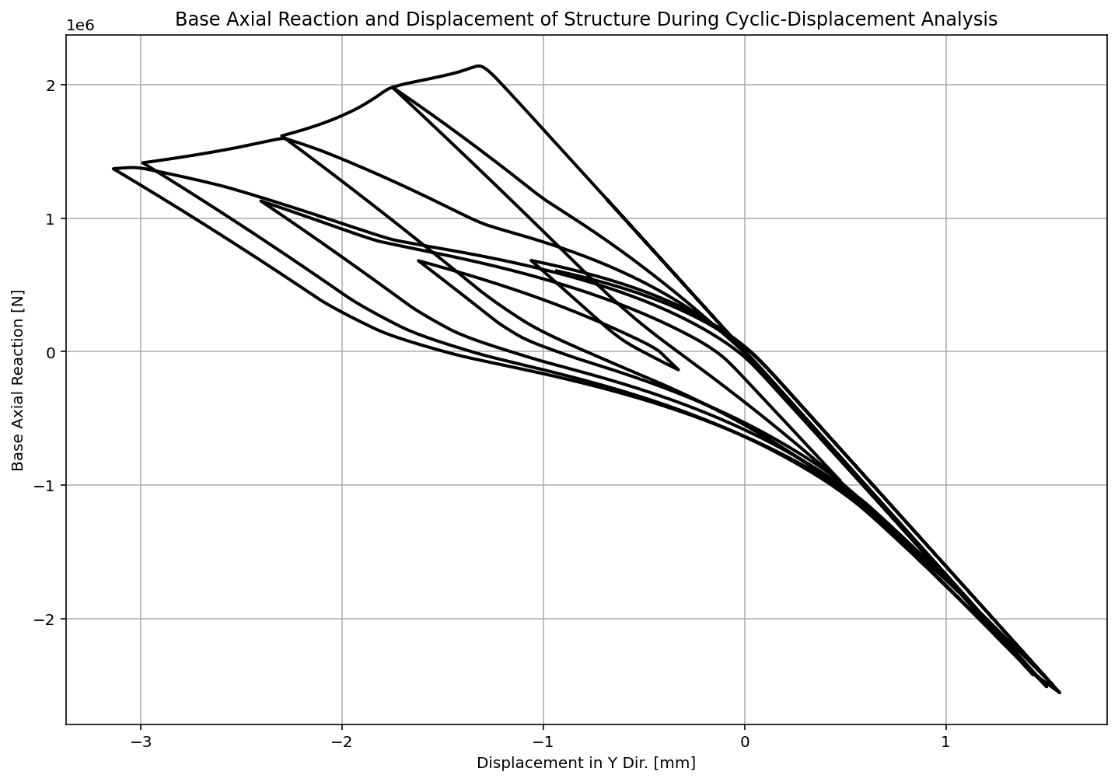

Slide 24
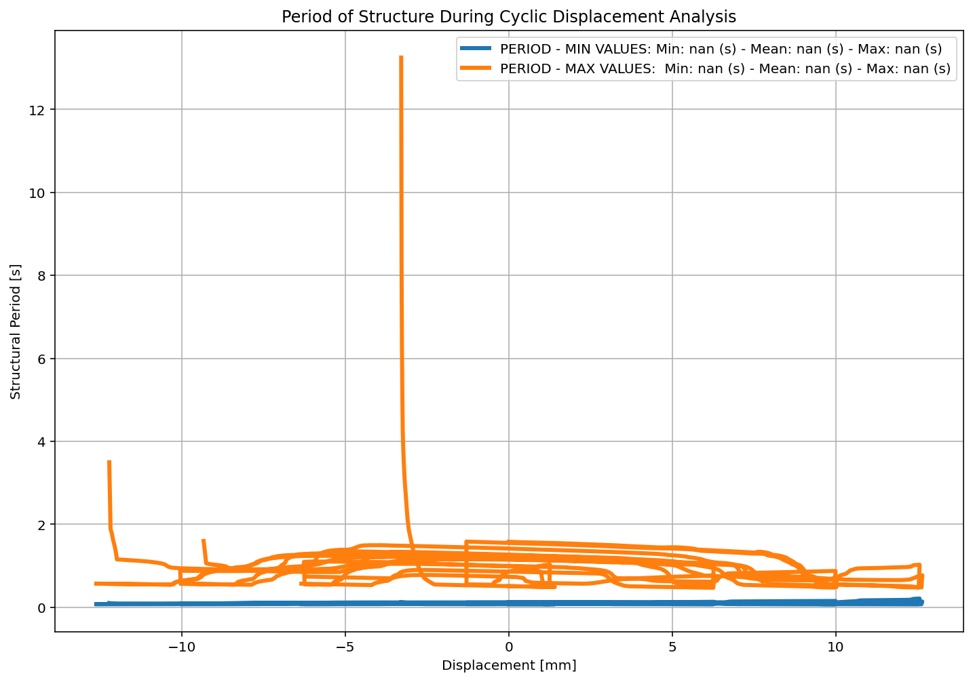

Slide 25
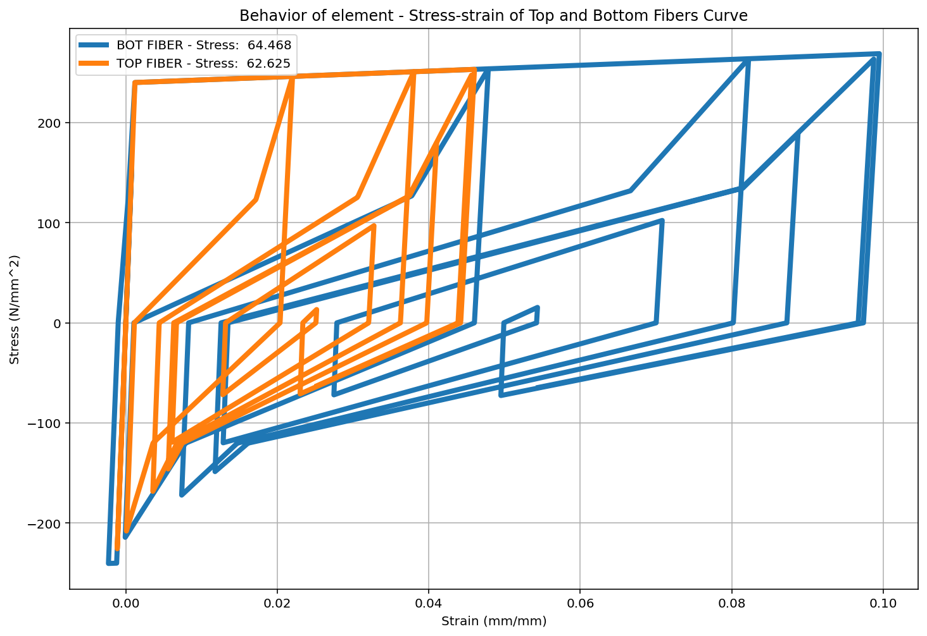

Slide 26
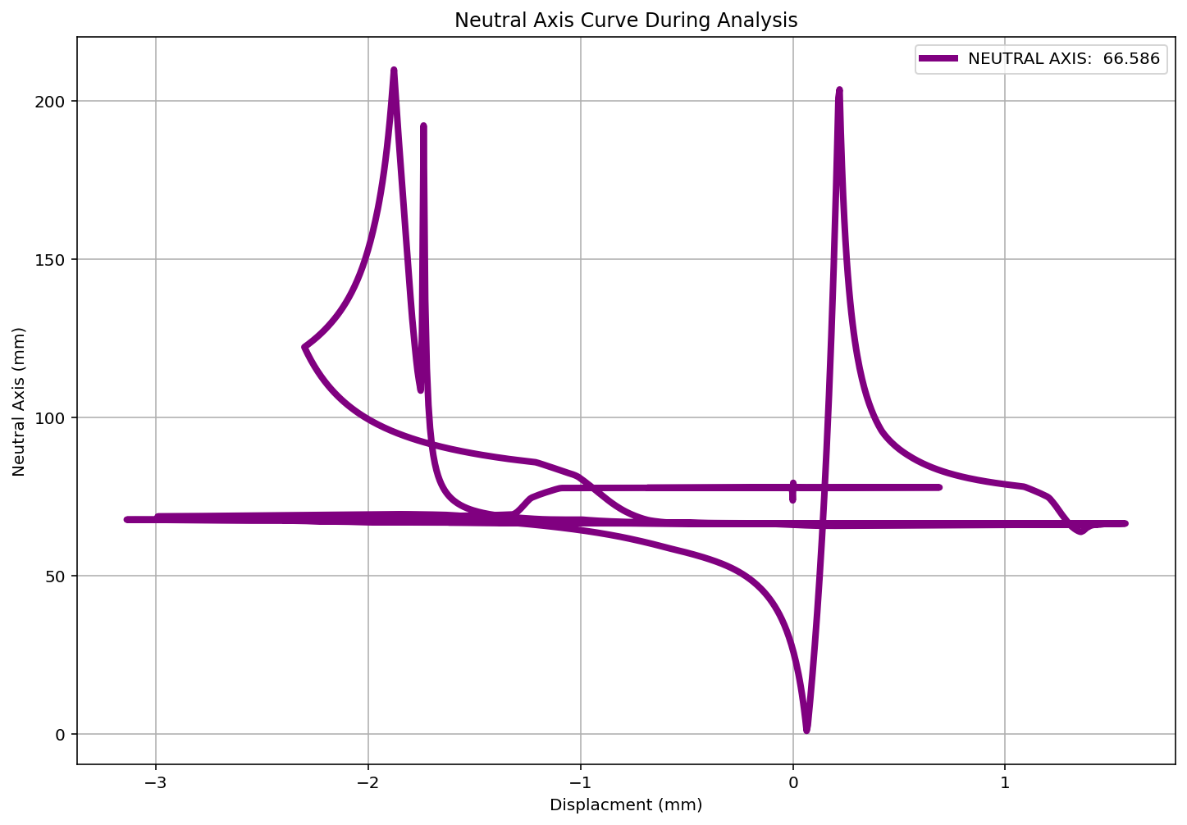

Slide 27
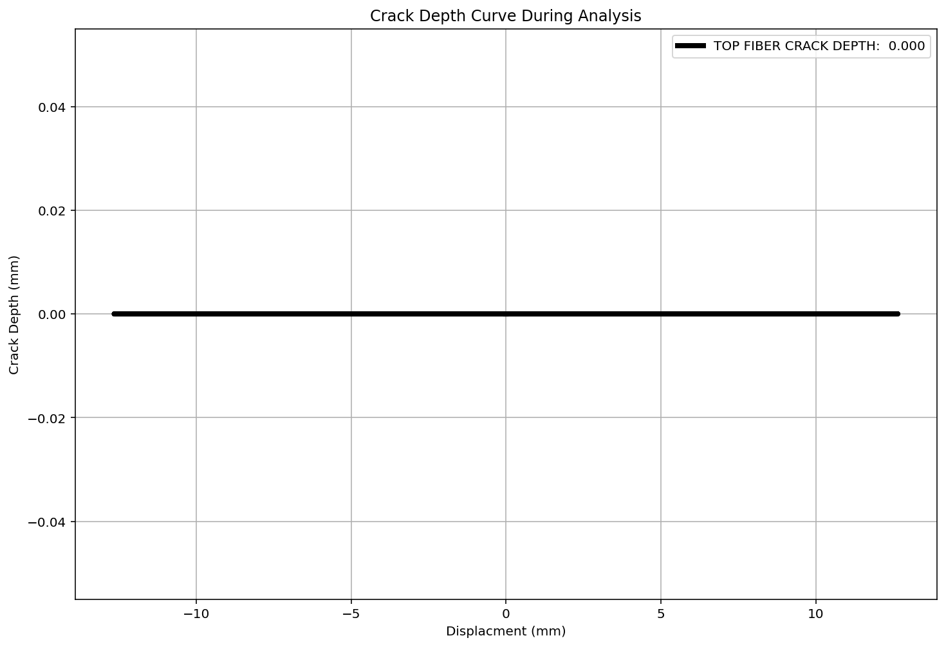

Slide 28
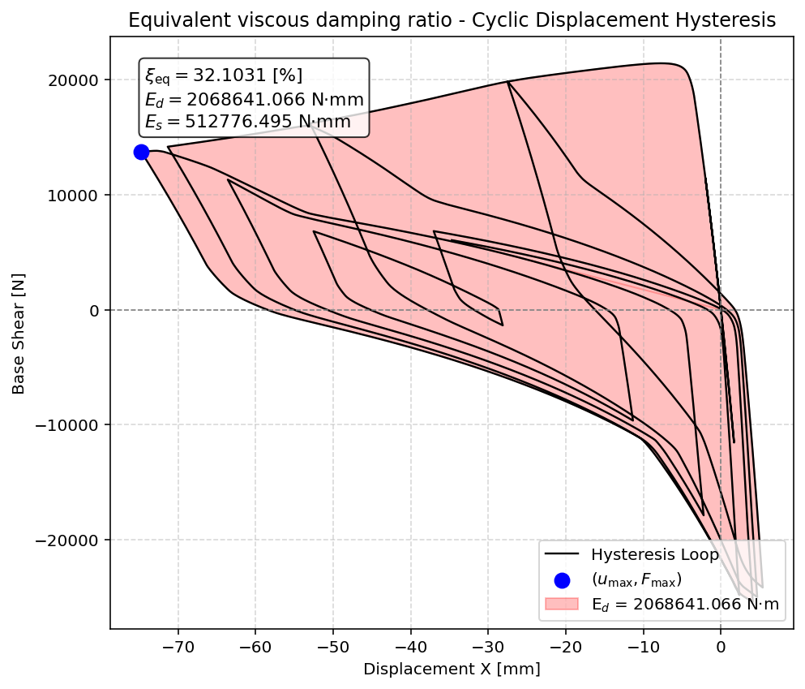

Slide 29
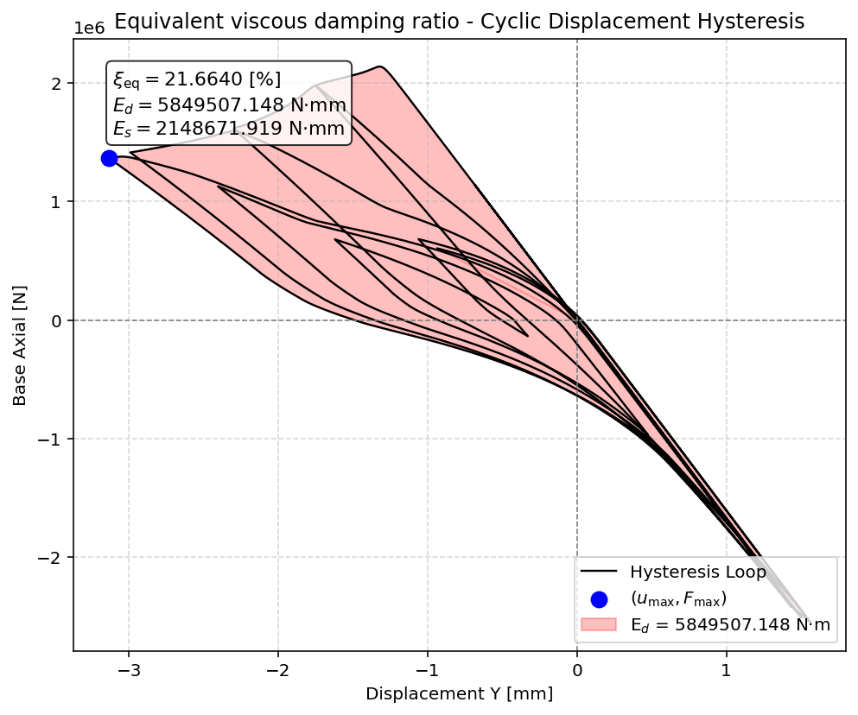

Slide 30
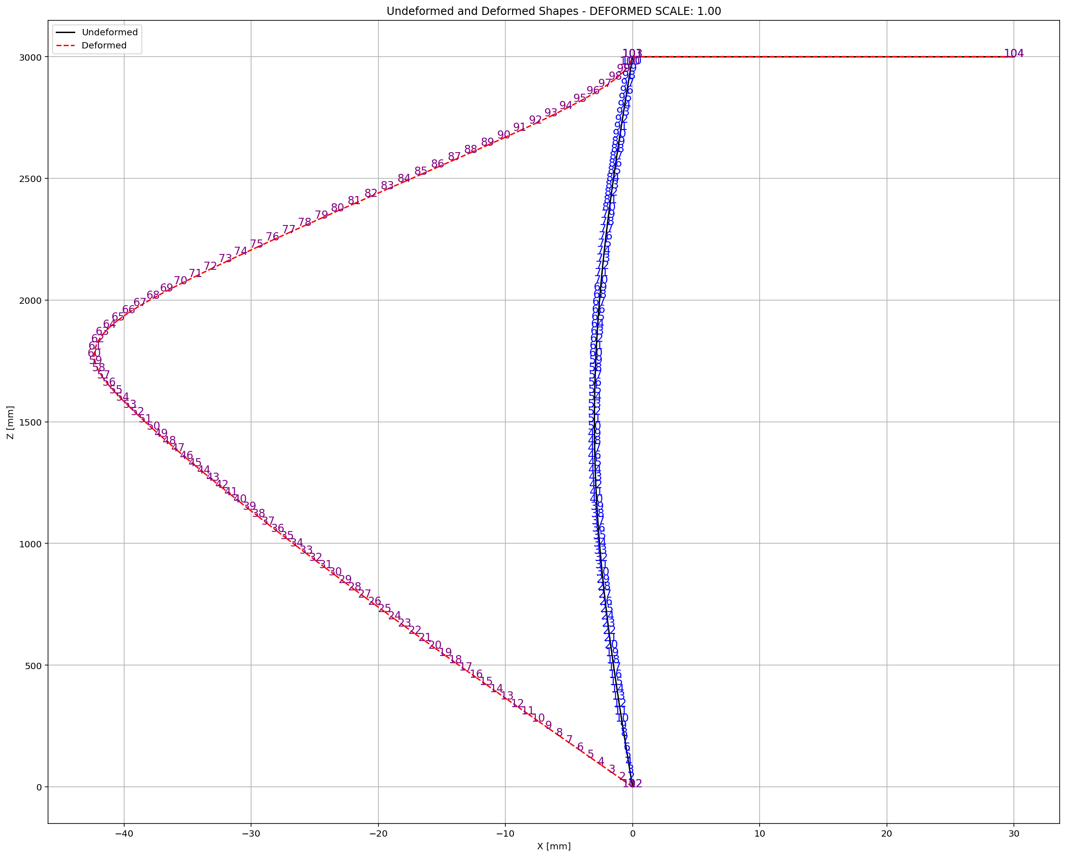

Slide 31
STATIC TIME-HISTORY WITH EXTERNAL TIME-DEPENDENT LOADING ANALYSIS

Slide 32
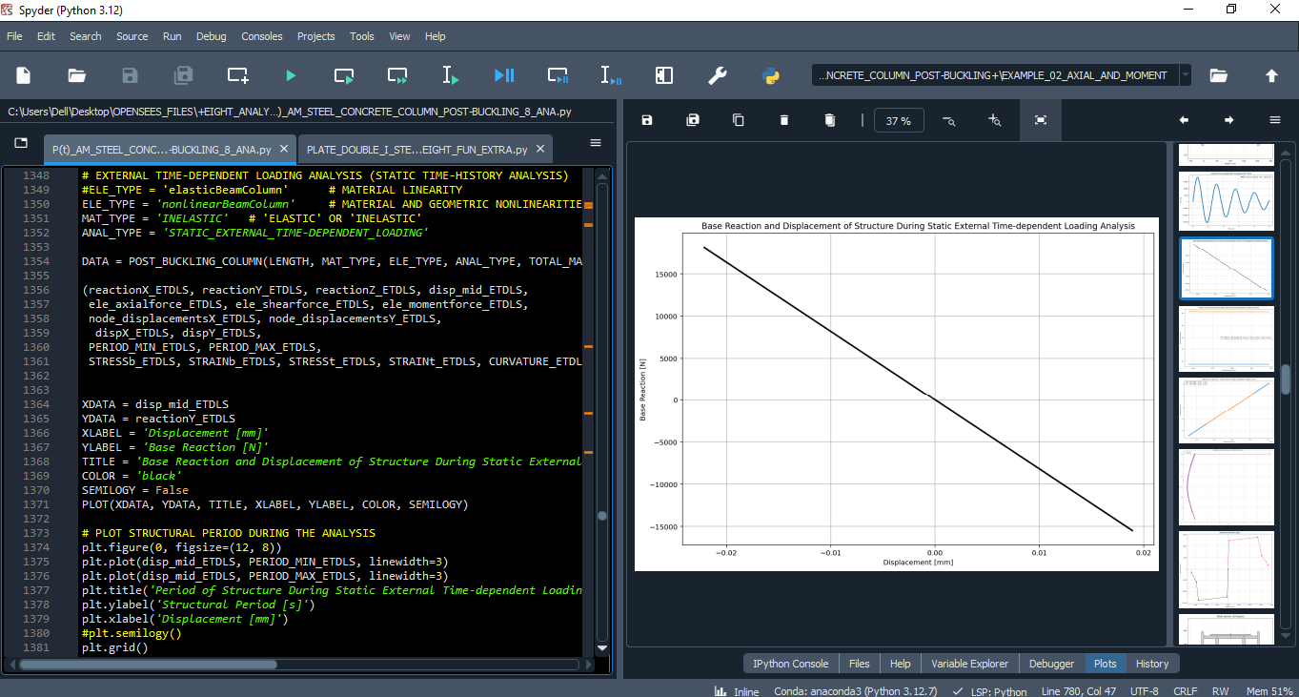

Slide 33
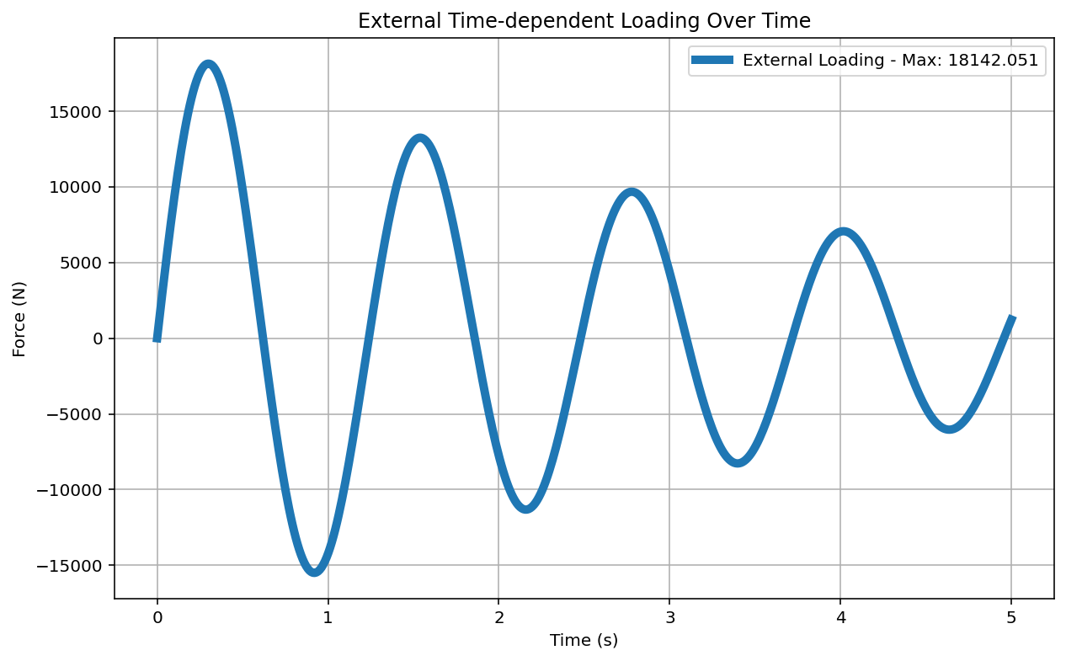

Slide 34
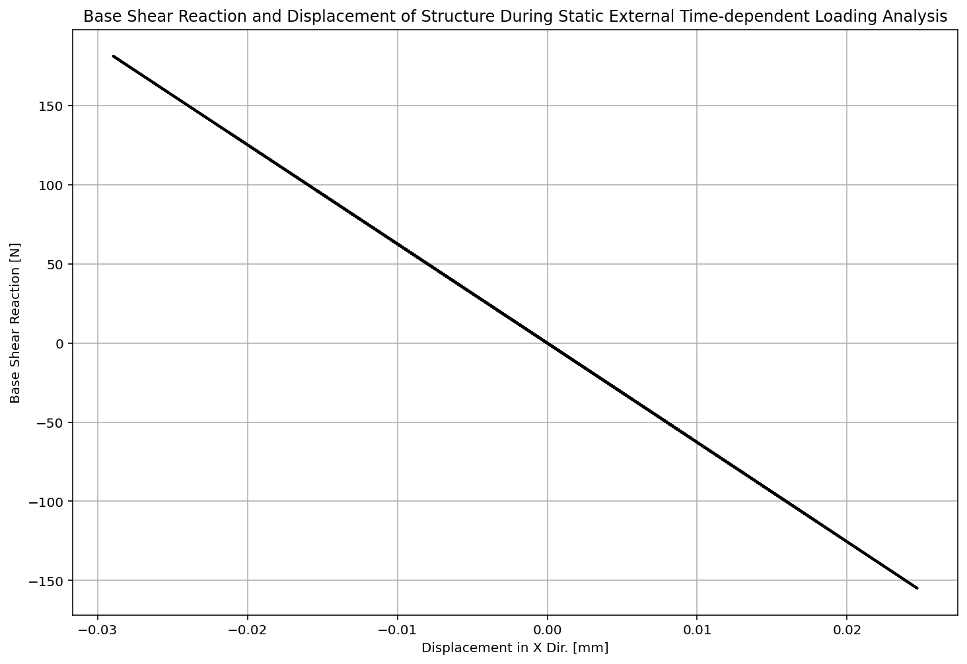

Slide 35
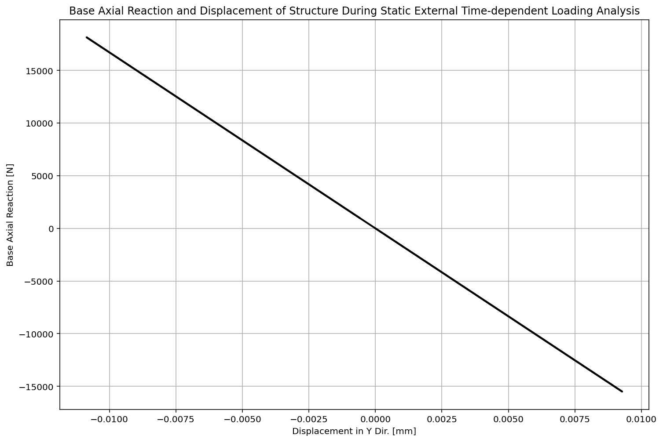

Slide 36
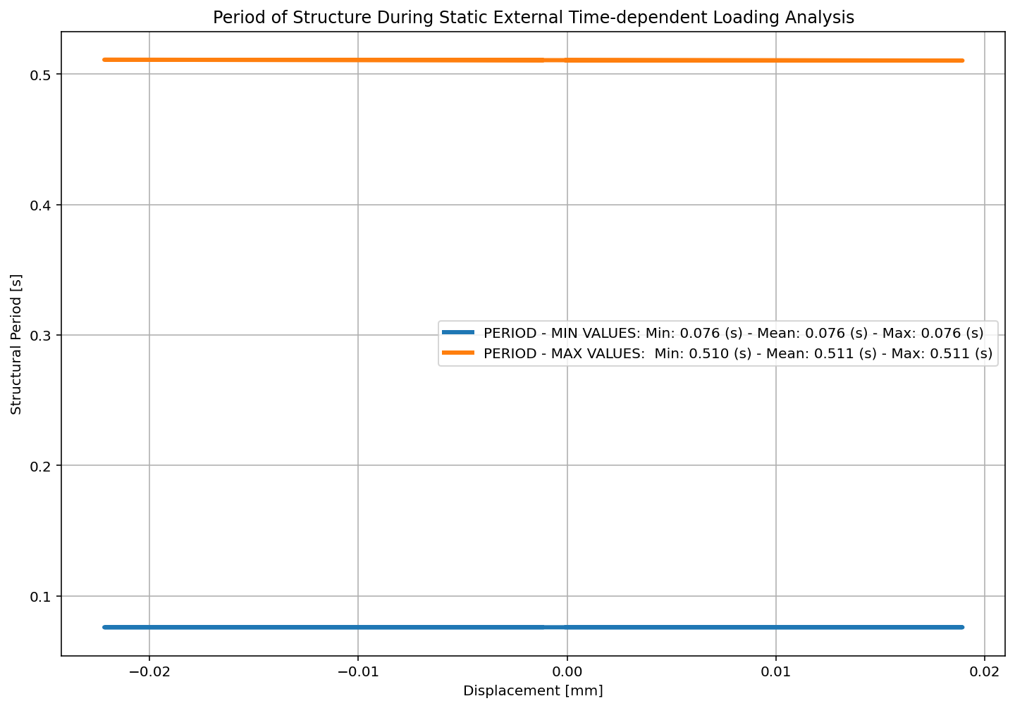

Slide 37
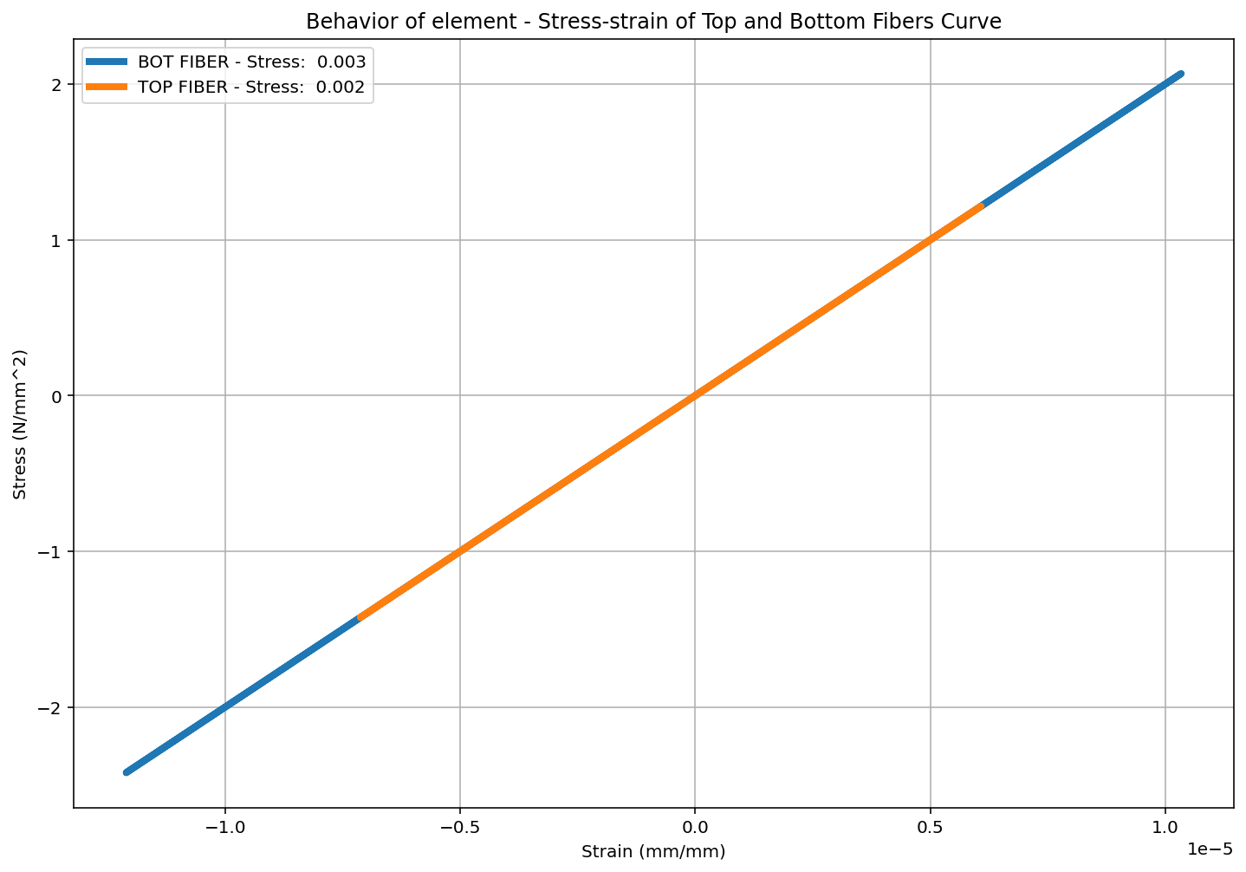

Slide 38


Slide 39
DYNAMIC TIME-HISTORY WITH EXTERNAL TIME-DEPENDENT LOADING ANALYSIS

Slide 40
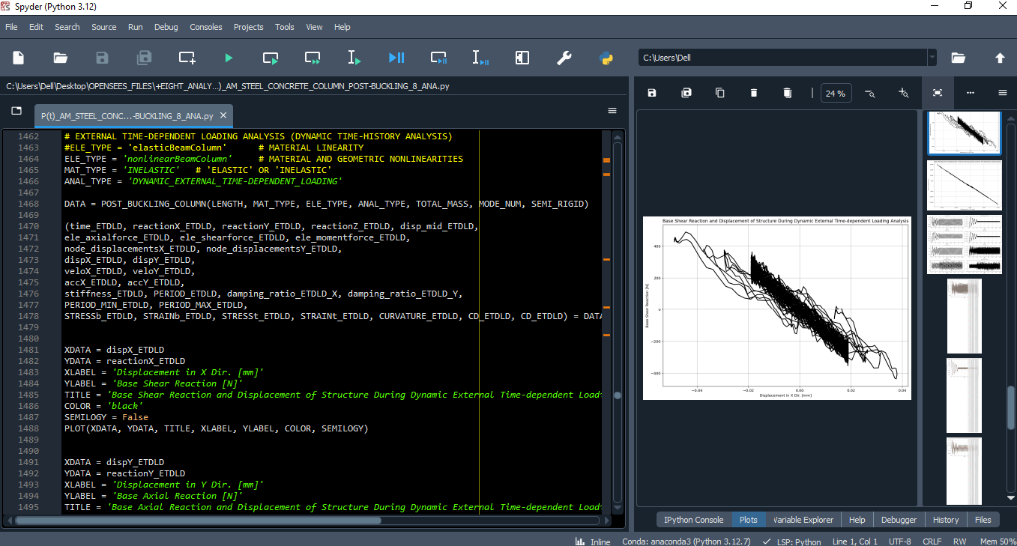

Slide 42
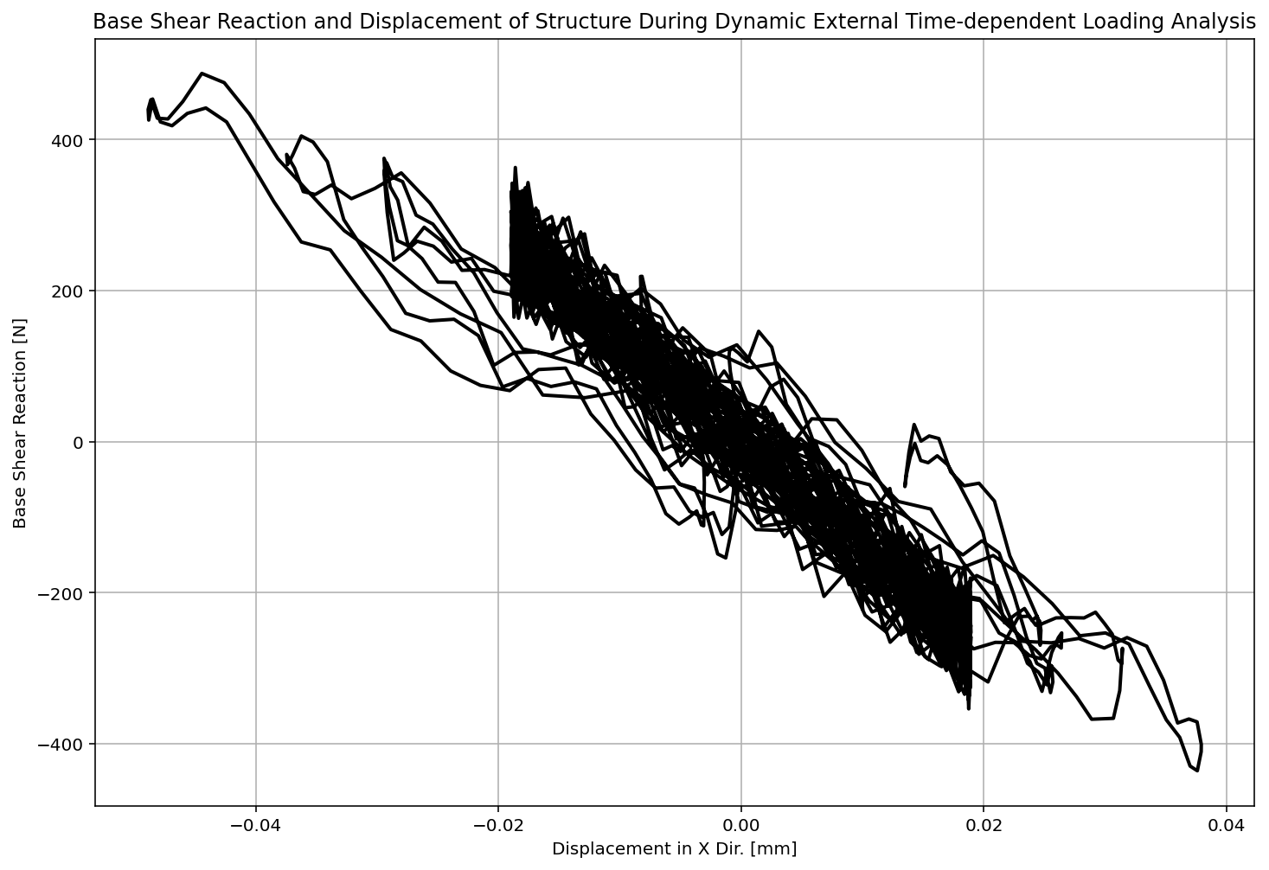

Slide 43
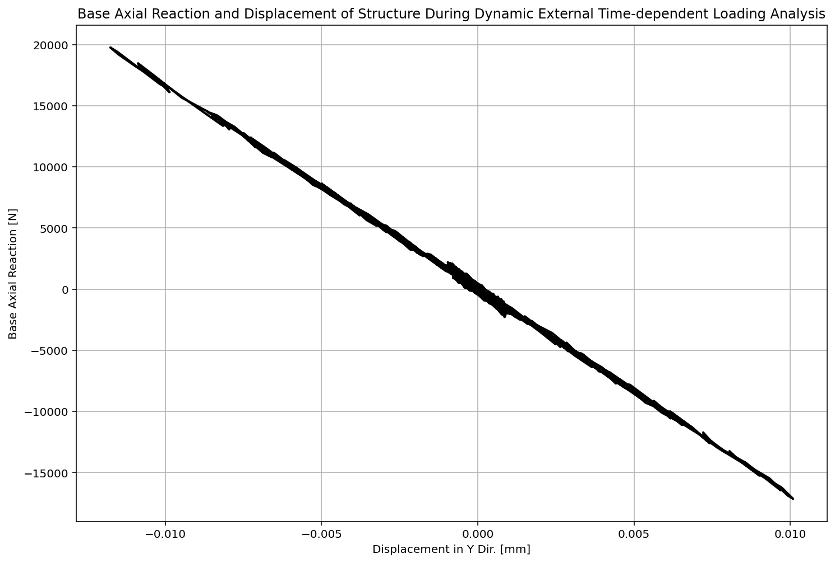

Slide 44
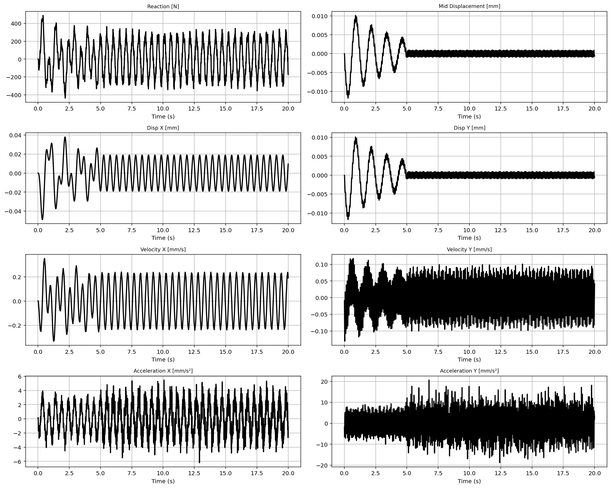

Slide 45
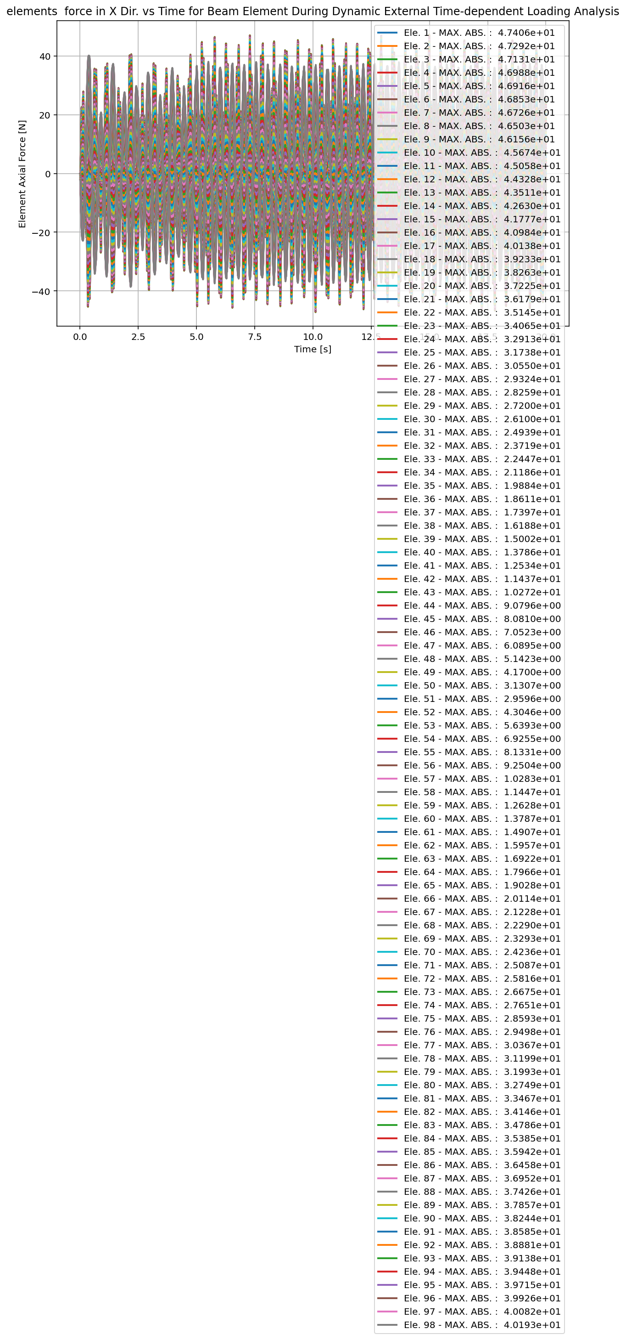

Slide 46
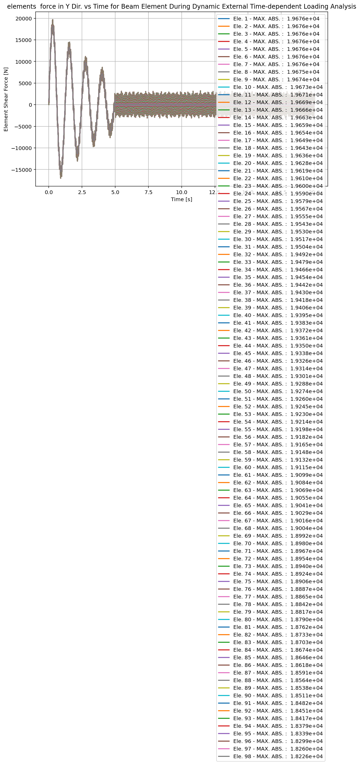

Slide 47
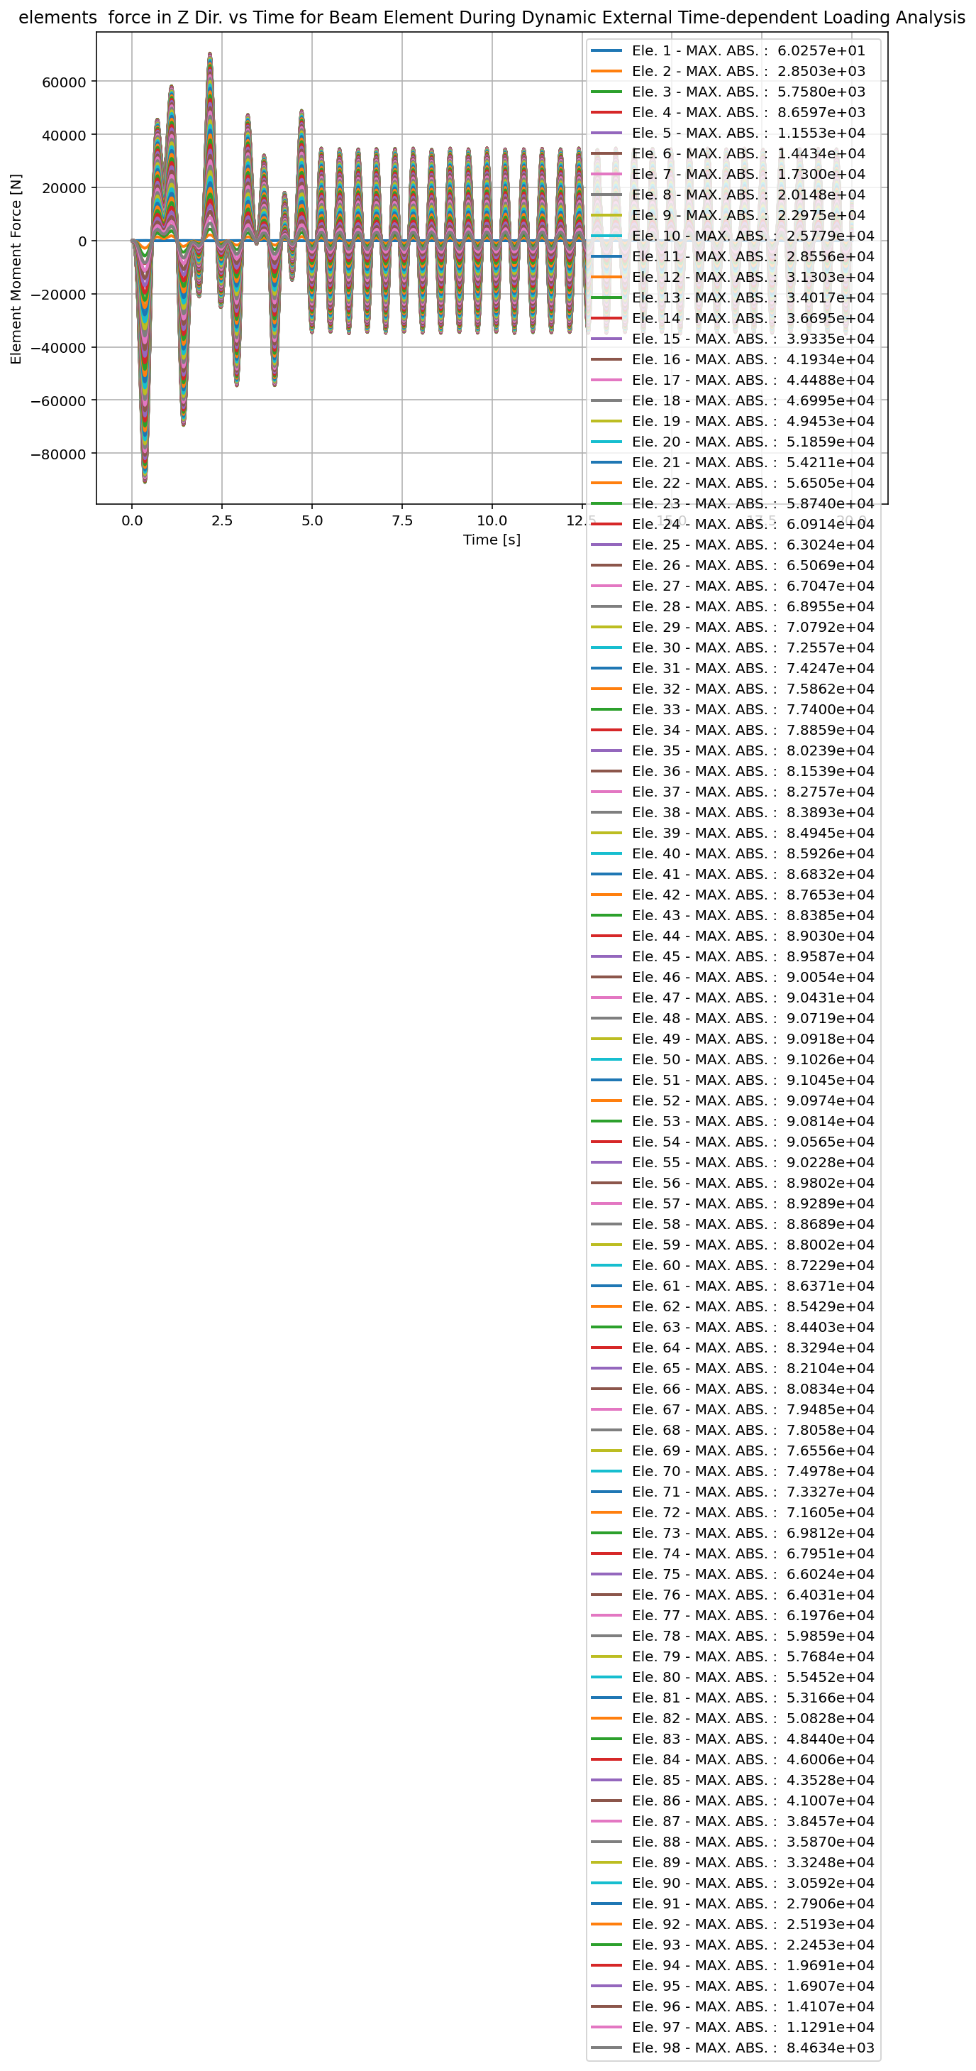

Slide 48
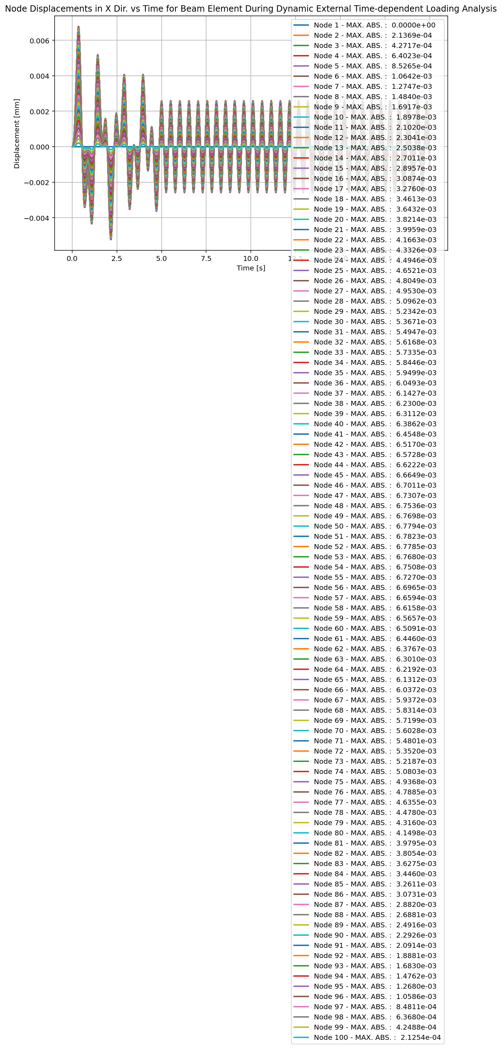

Slide 49
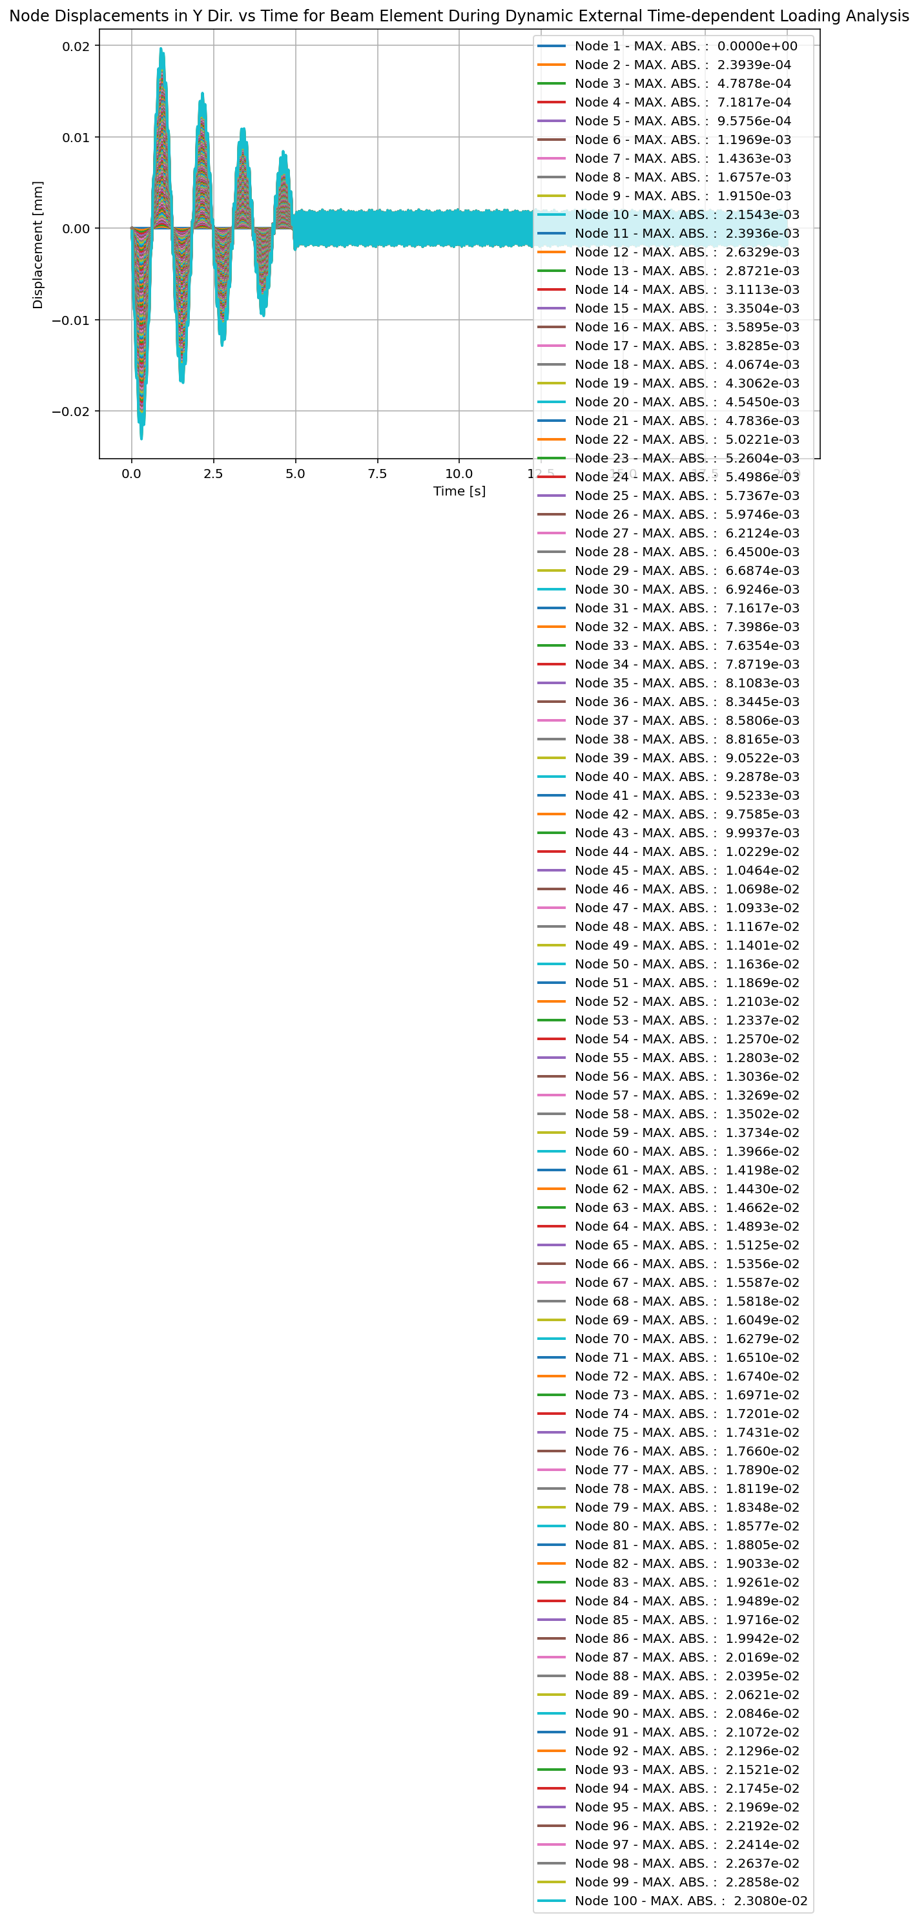

Slide 50
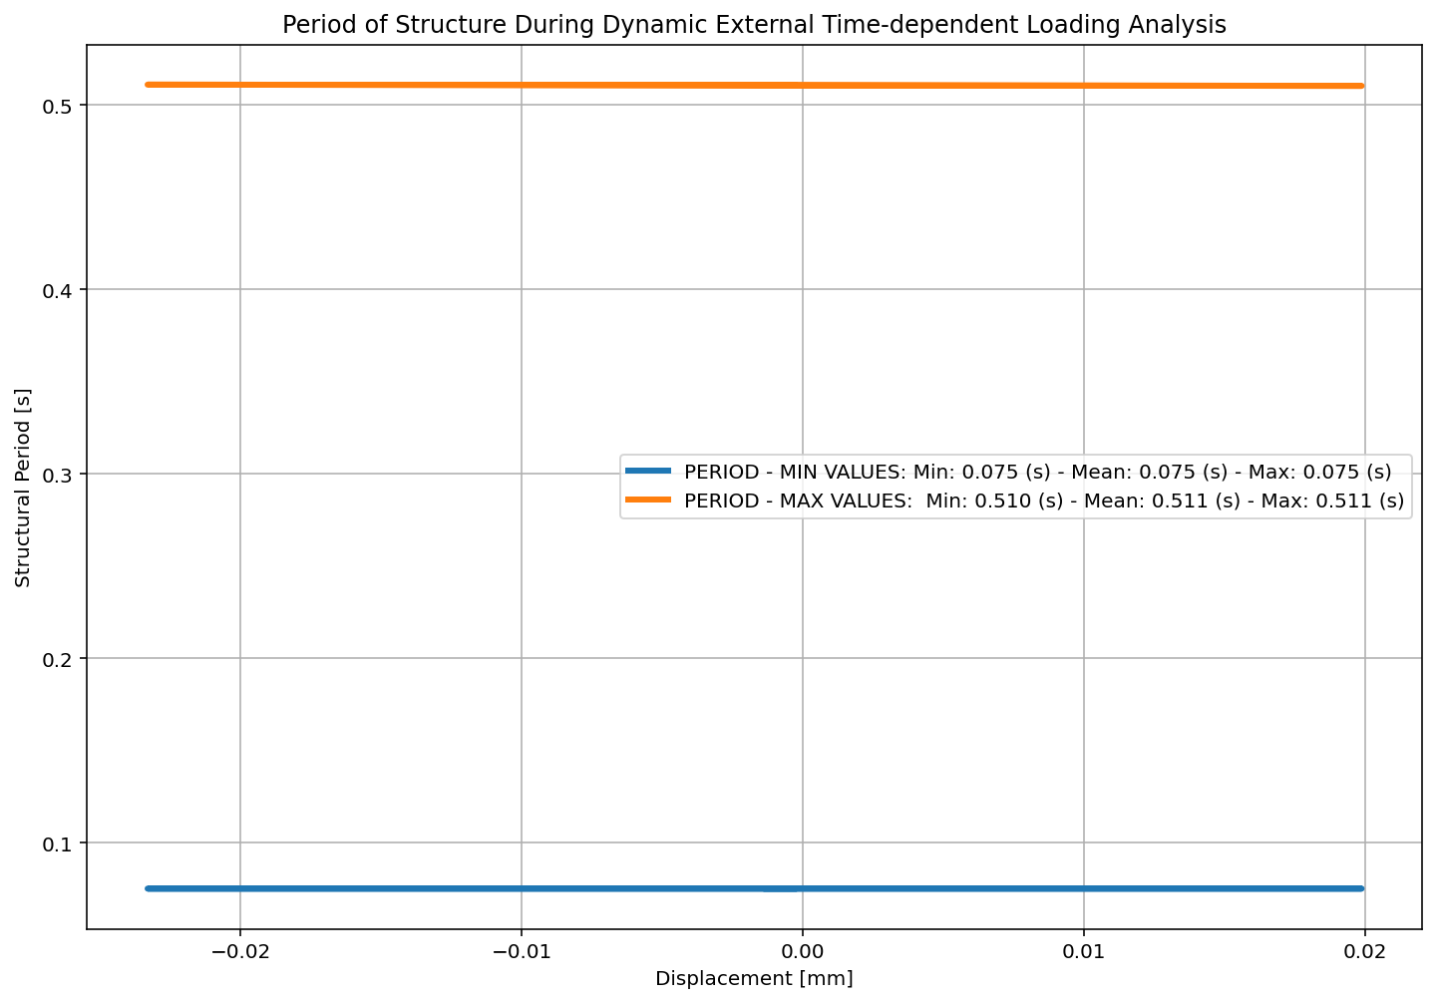

Slide 51


Slide 52
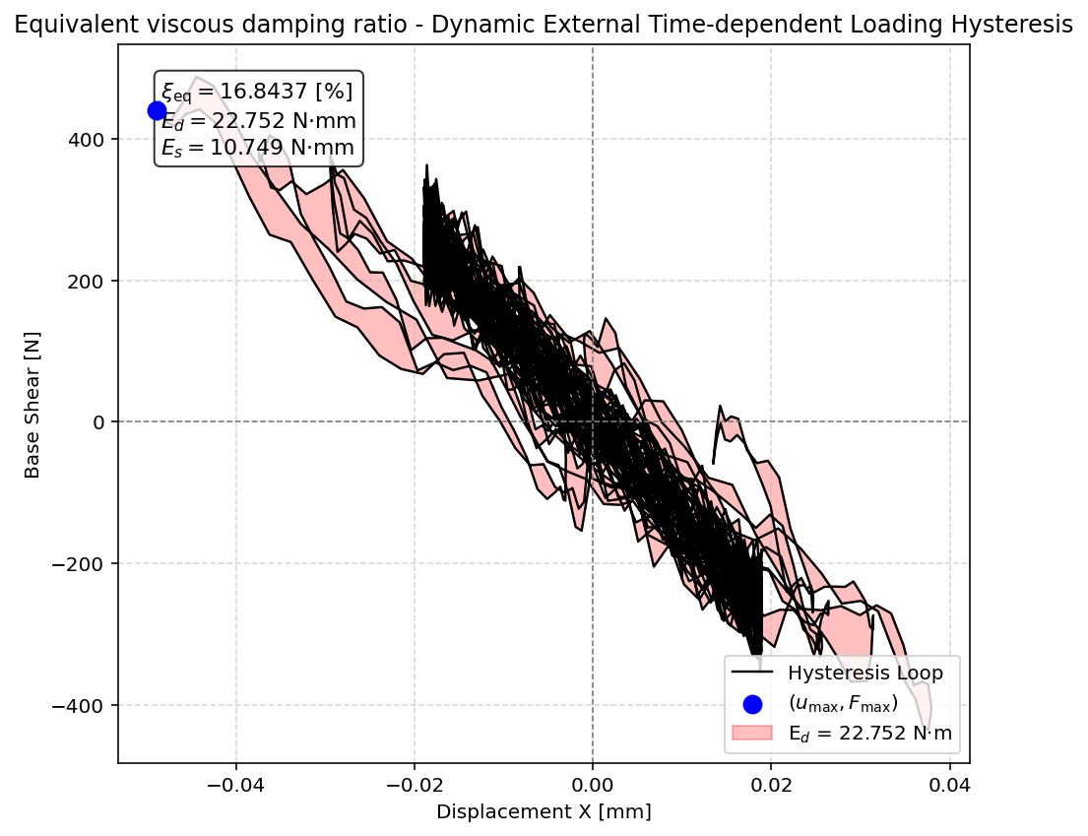

Slide 53
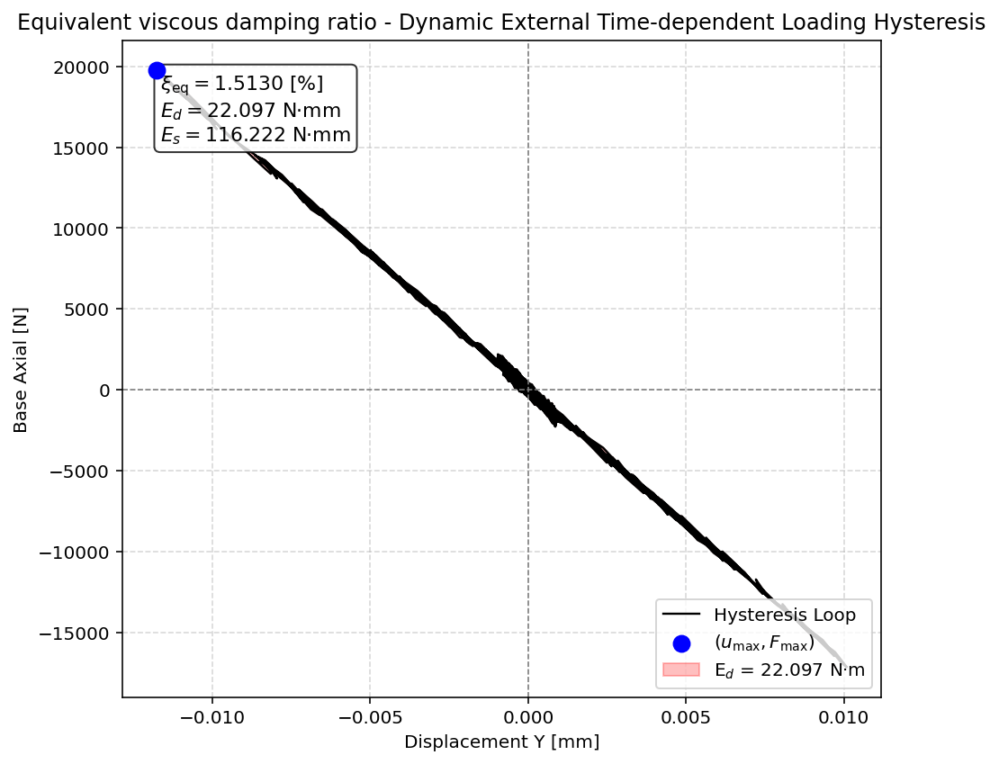

Slide 54


Slide 55
FREE-VIBRATION ANALYSIS

Slide 56
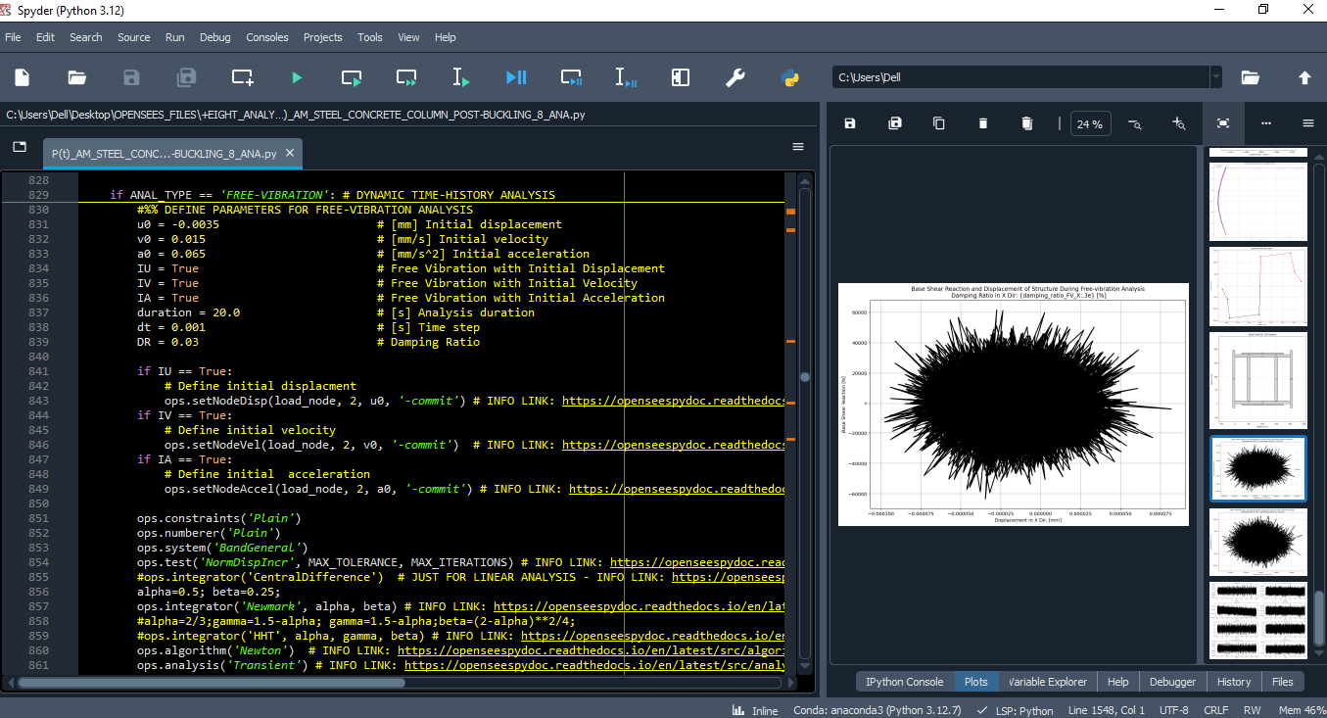

Slide 57
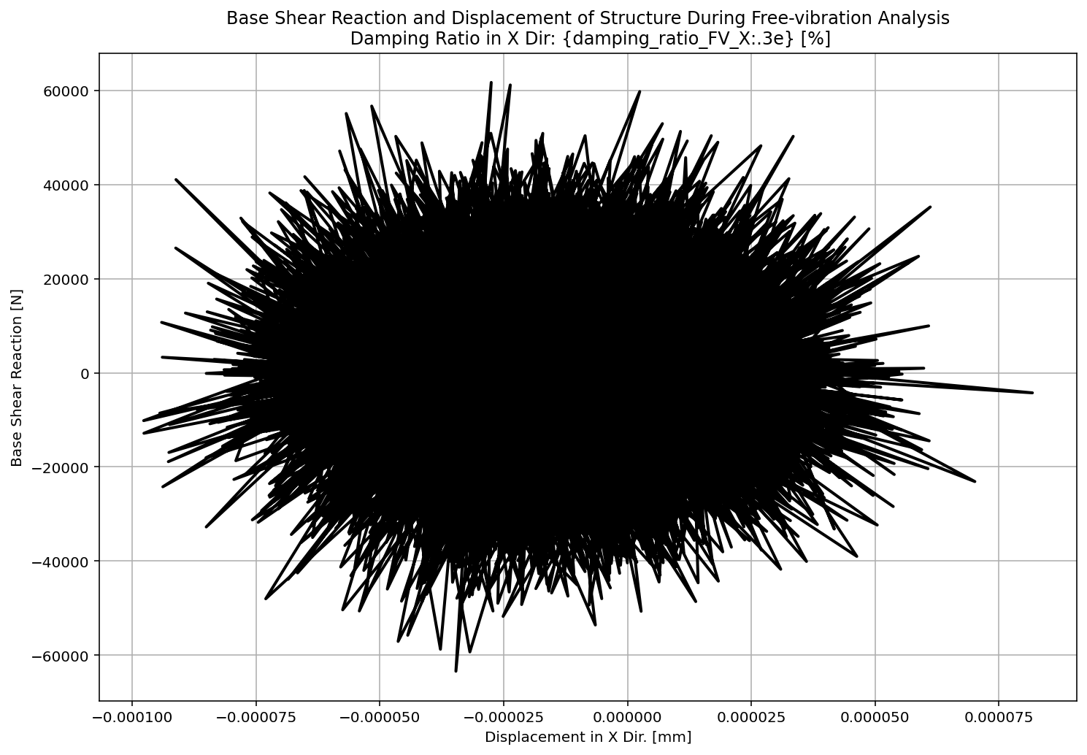

Slide 58
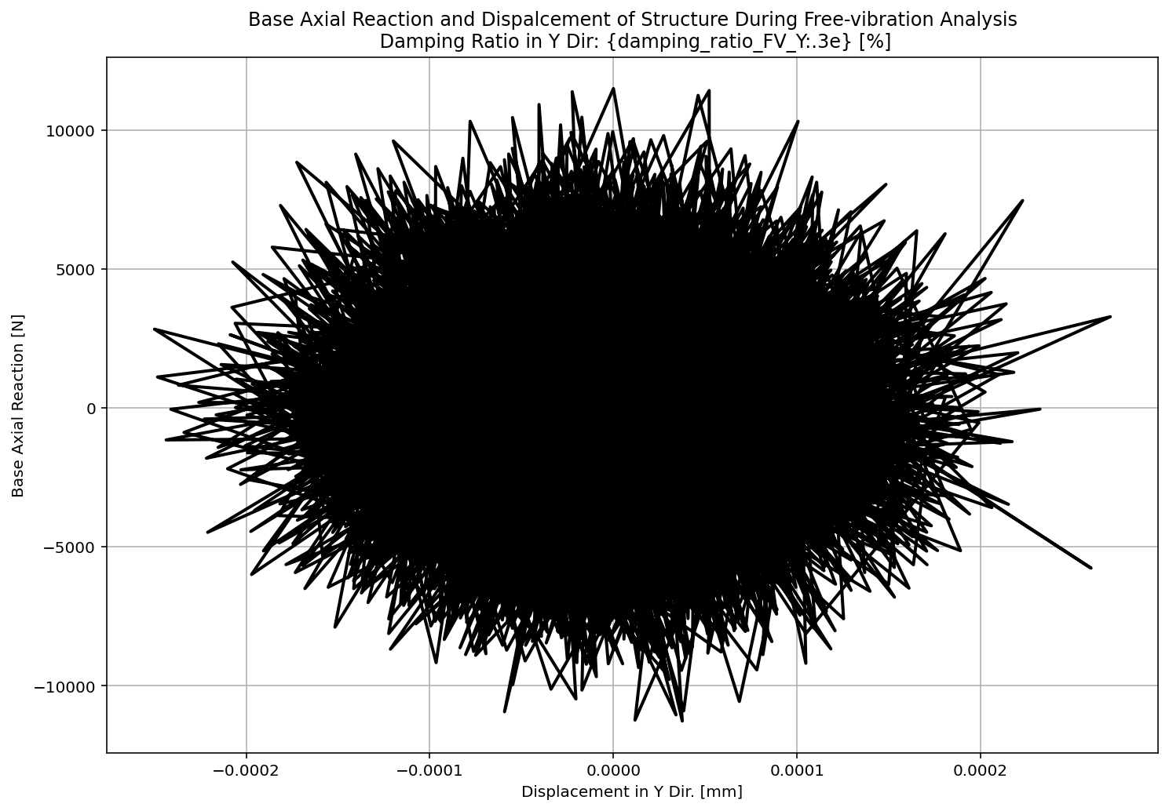

Slide 59
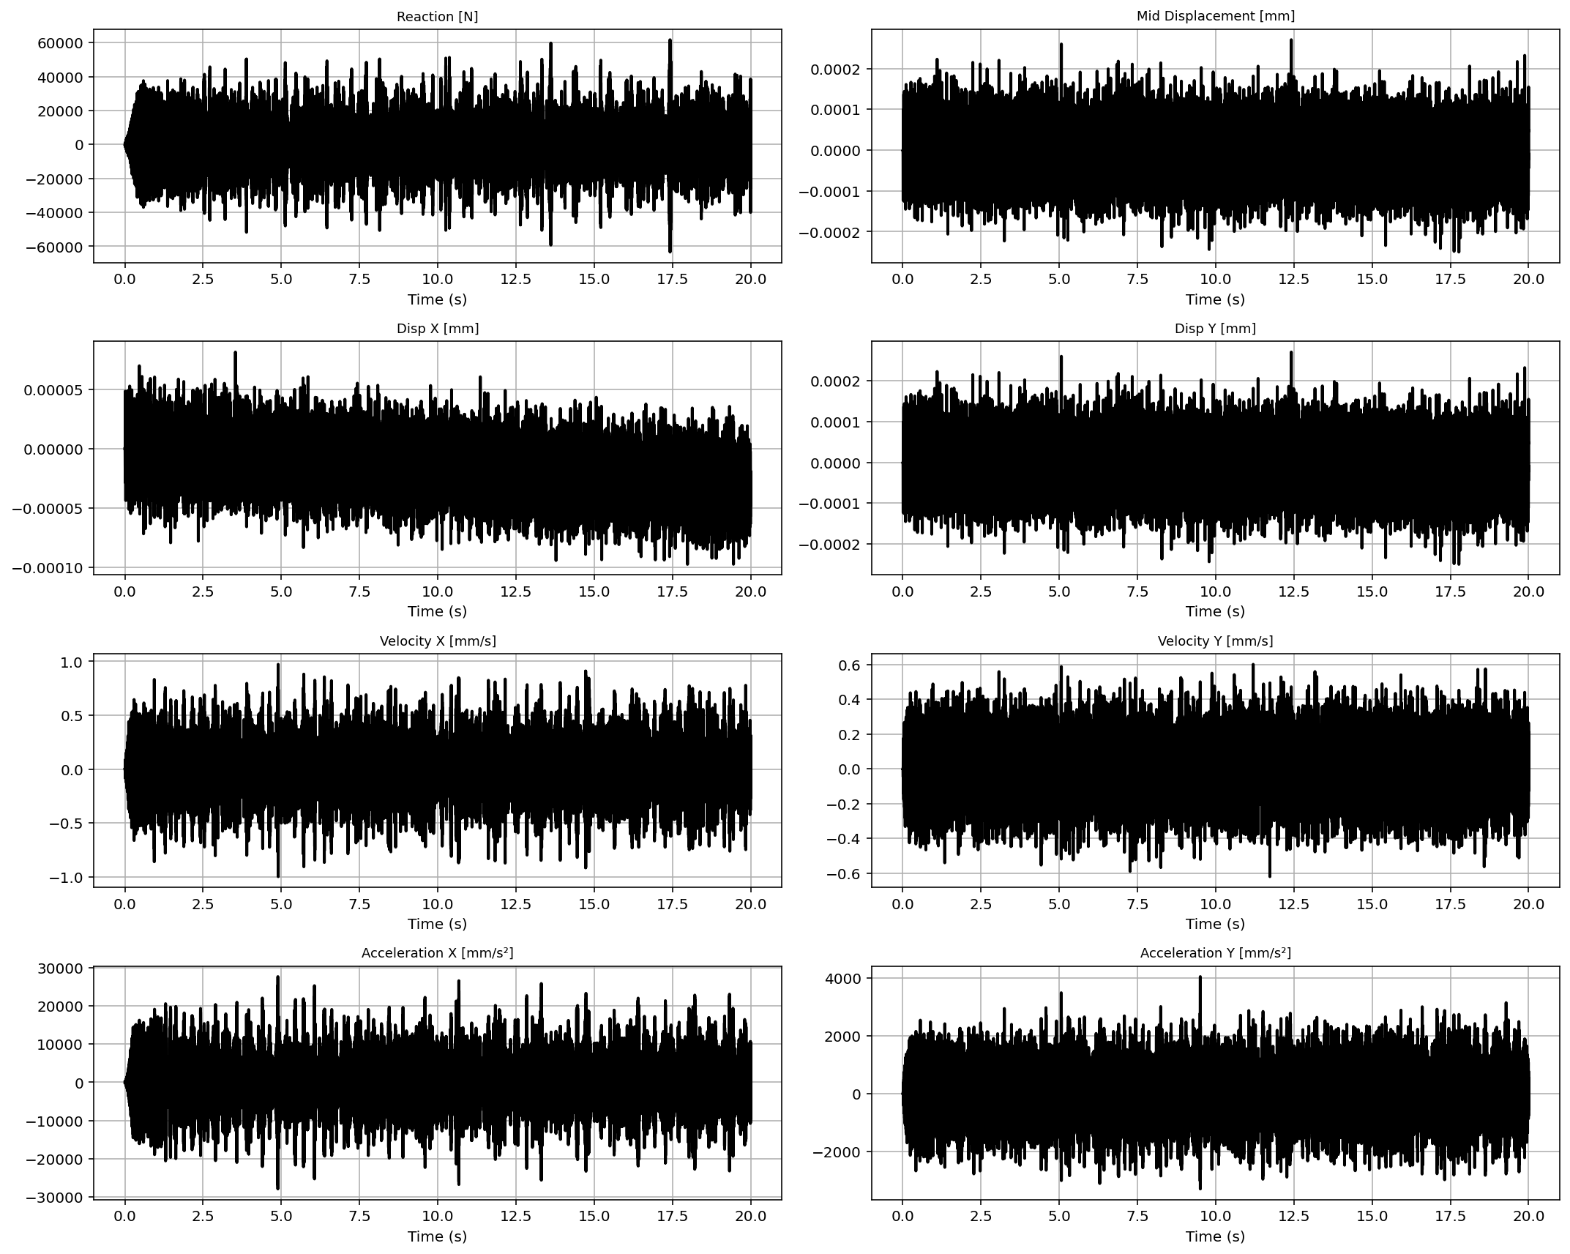

Slide 60
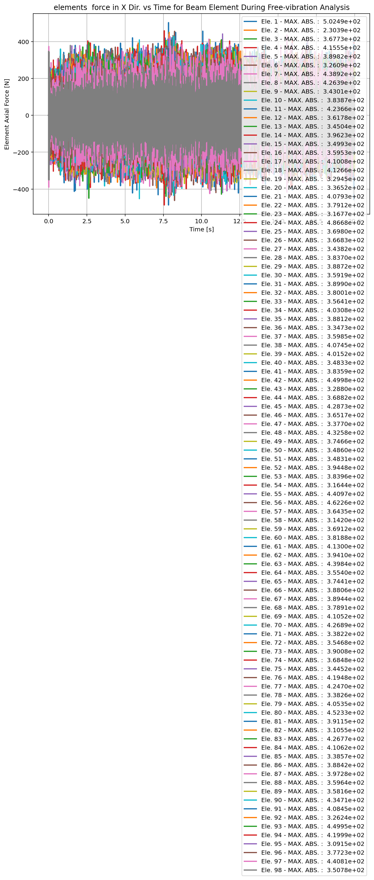

Slide 61
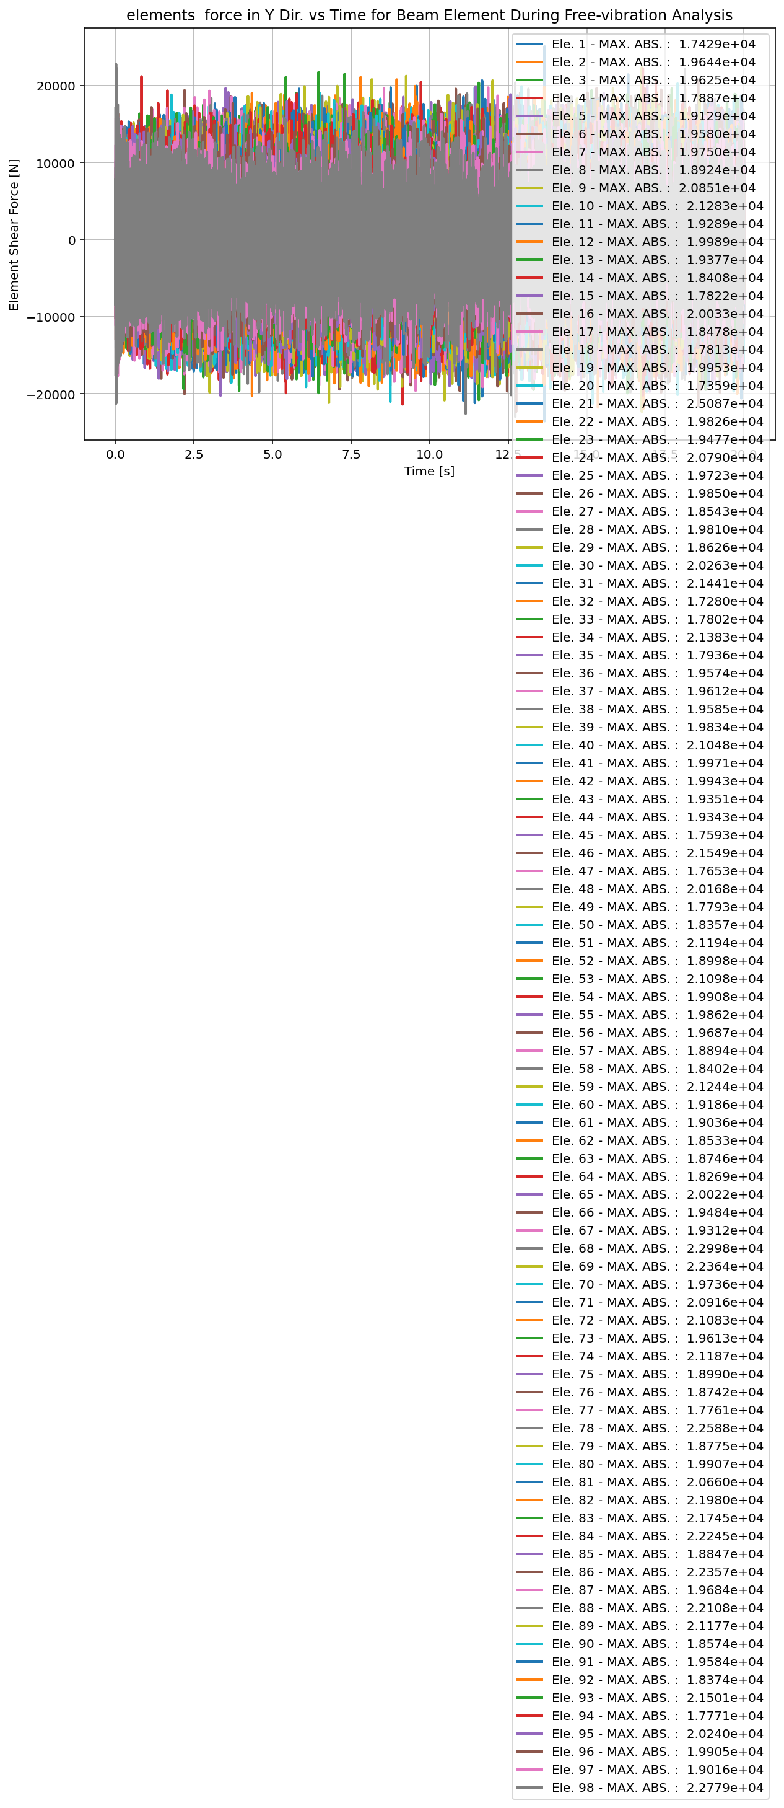

Slide 63


Slide 64


Slide 65


Slide 66


Slide 67


Slide 68


Slide 69


Slide 70


Slide 71


Slide 72
SEISMIC ANALYSIS

Slide 73


Slide 74


Slide 75


Slide 76


Slide 77


Slide 78


Slide 79


Slide 80


Slide 81


Slide 82


Slide 83


Slide 84


Slide 85


Slide 86


Slide 87


Slide 88


Slide 89


Slide 90


Slide 91


Slide 92
Dissipated Energy from Earthquake= 489440.55 N·mm
Dissipated Energy from Cyclic Displacement= 10612692.56 N·mm
DISSIPATED ENERGY CAPACITY INDEX: 0.292 [%]
ZONE 1: VERY MINOR DAMAGE

Slide 93


Slide 94
+==========================+
= Analysis curve fitted =
Disp Base Shear
----------------------------
[[0.00000000e+00 0.00000000e+00]
[2.80101456e+00 2.30592094e+06]
[2.50000000e+01 1.16951808e+06]]
+==========================+
+----------------------------------------------------+
Structure Elastic Stiffness : 823244.89
Structure Plastic Stiffness : 46780.72
Structure Tangent Stiffness : -51191.66
Structure Ductility Ratio : 8.93
Structure Over Strength Factor: 0.51
+----------------------------------------------------+
Over Strength Coefficient (Ω0): 0.6582
Displacement Ductility Ratio (μ): 17.6764
Ductility Coefficient (Rμ): 17.6764
Structural Behavior Coefficient (R): 11.6351
Structural Ductility Damage Index in X Direction: -5.7914 (%)

Slide 95


Slide 96


Slide 97
+==========================+
= Analysis curve fitted =
Disp Base Shear
----------------------------
[[0.00000000e+00 0.00000000e+00]
[2.80101456e+00 2.30592094e+06]
[2.50000000e+01 1.16951808e+06]]
+==========================+
+----------------------------------------------------+
Structure Elastic Stiffness : 823244.89
Structure Plastic Stiffness : 46780.72
Structure Tangent Stiffness : -51191.66
Structure Ductility Ratio : 8.93
Structure Over Strength Factor: 0.51
+----------------------------------------------------+
Over Strength Coefficient (Ω0): 0.6941
Displacement Ductility Ratio (μ): 2.2229
Ductility Coefficient (Rμ): 2.2229
Structural Behavior Coefficient (R): 1.5430
Structural Ductility Damage Index in Y Direction: -41.8758 (%)

