Slide 1
>> IN THE NAME OF ALLAH, THE MOST GRACIOUS, THE MOST MERCIFUL <<
COMPREHENSIVE NONLINEAR SEISMIC ASSESSMENT OF A CONCRETE T SECTION SLAB SUPERSTRUCTURE SIMPILY SUPPORTED SHORT SPAN BRIDGE: AN OPENSEES FRAMEWORK FOR MOMENT-ROTATION ANALYSIS
THIS PROGRAM WRITTEN BY SALAR DELAVAR GHASHGHAEI (QASHQAI)

Slide 2
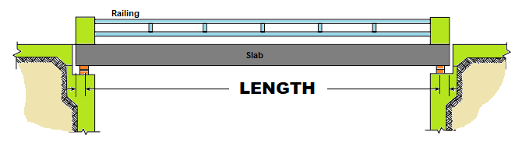
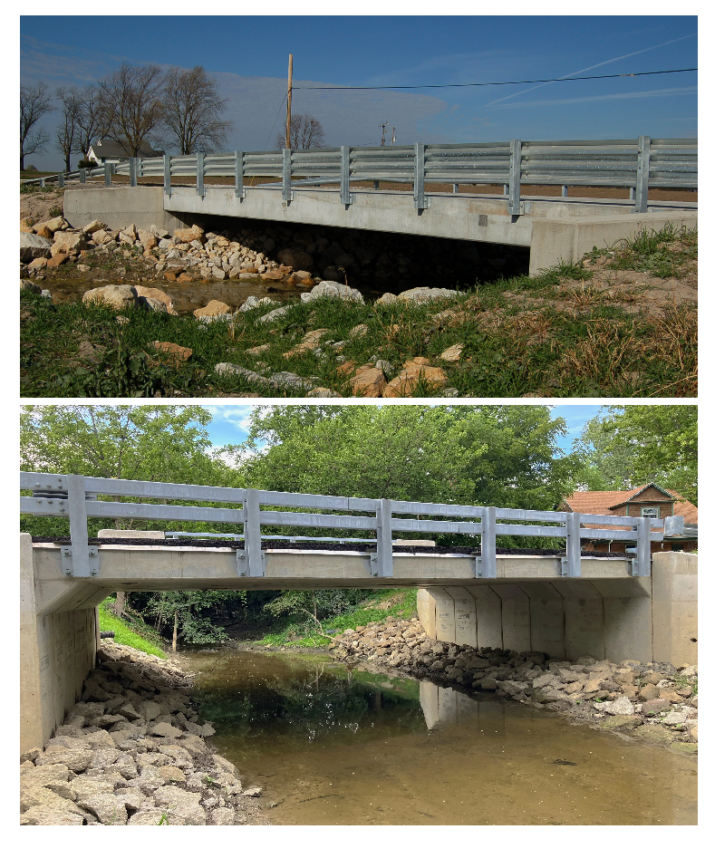
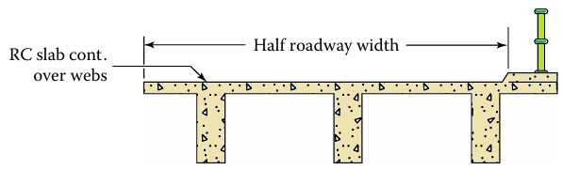
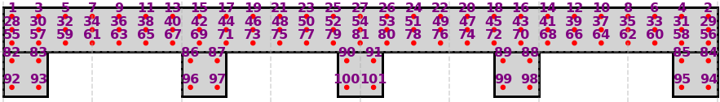
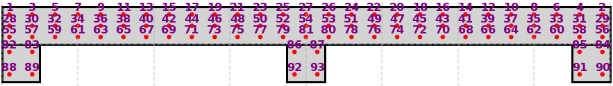
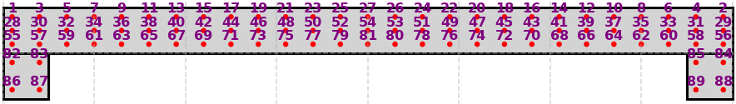

Slide 3
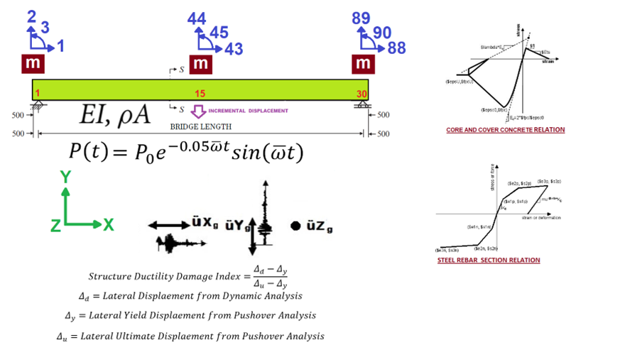

Slide 4
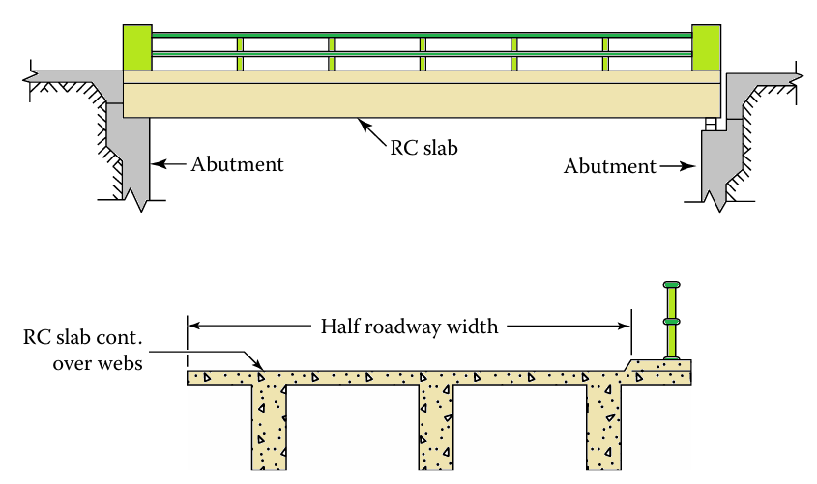

Slide 5
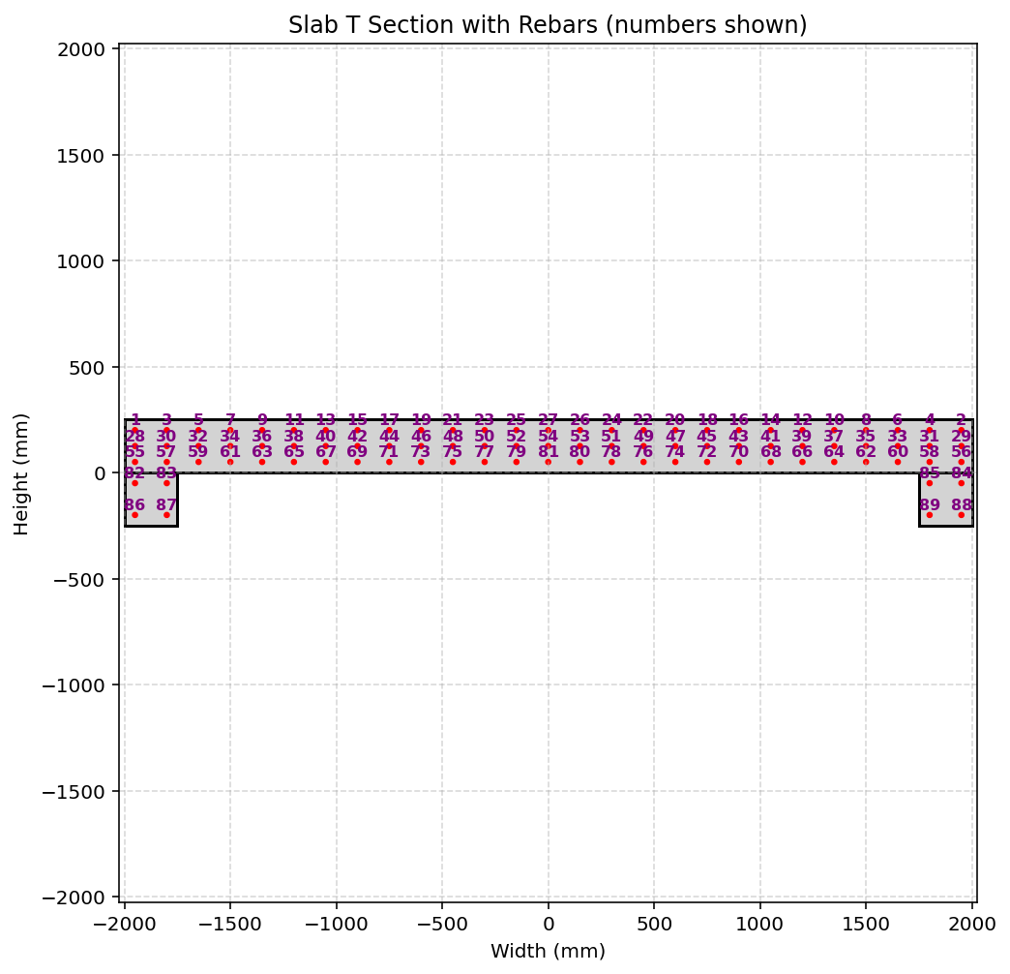

Slide 6
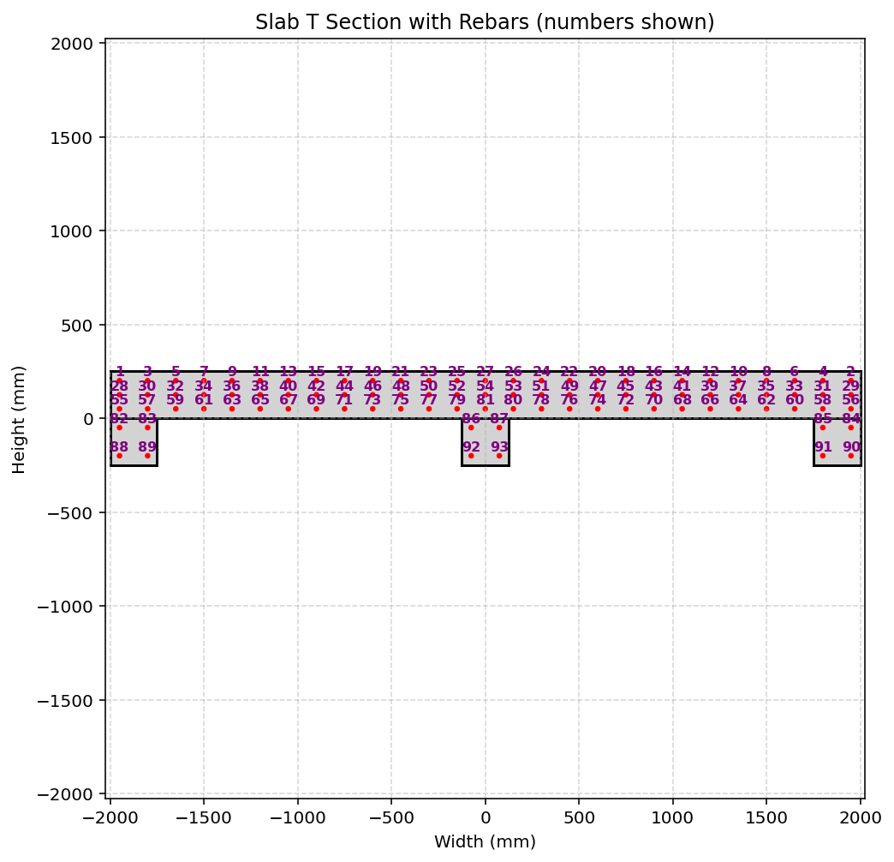

Slide 7
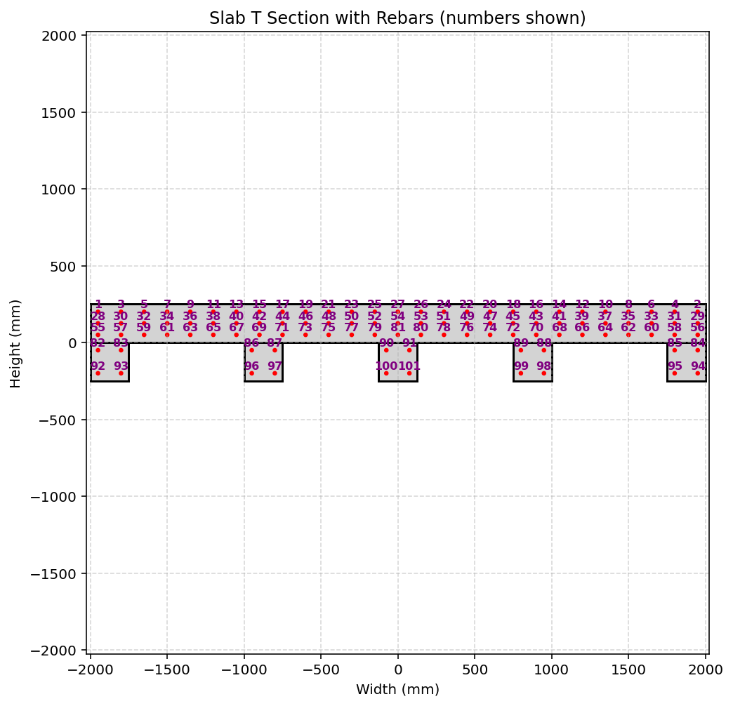

Slide 8
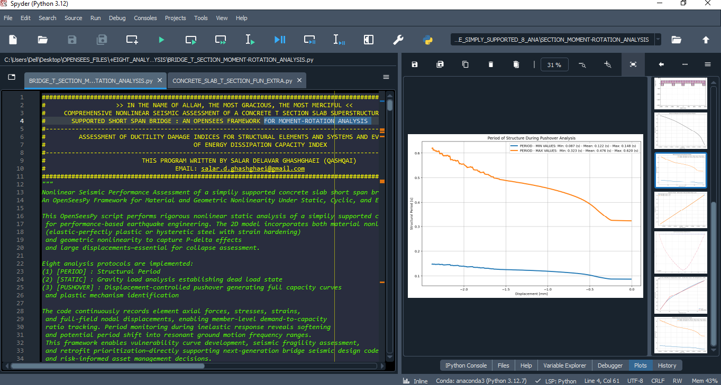

Slide 9
STATIC ANALYSIS

Slide 10
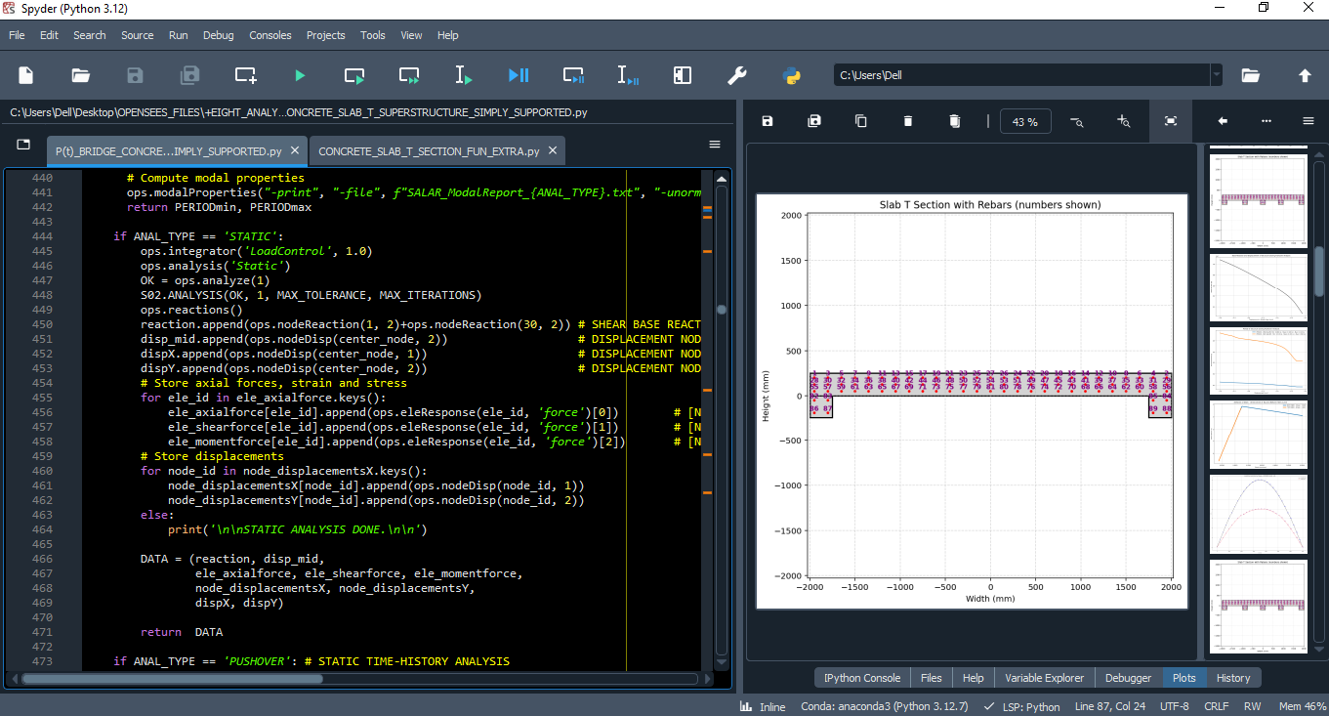

Slide 11
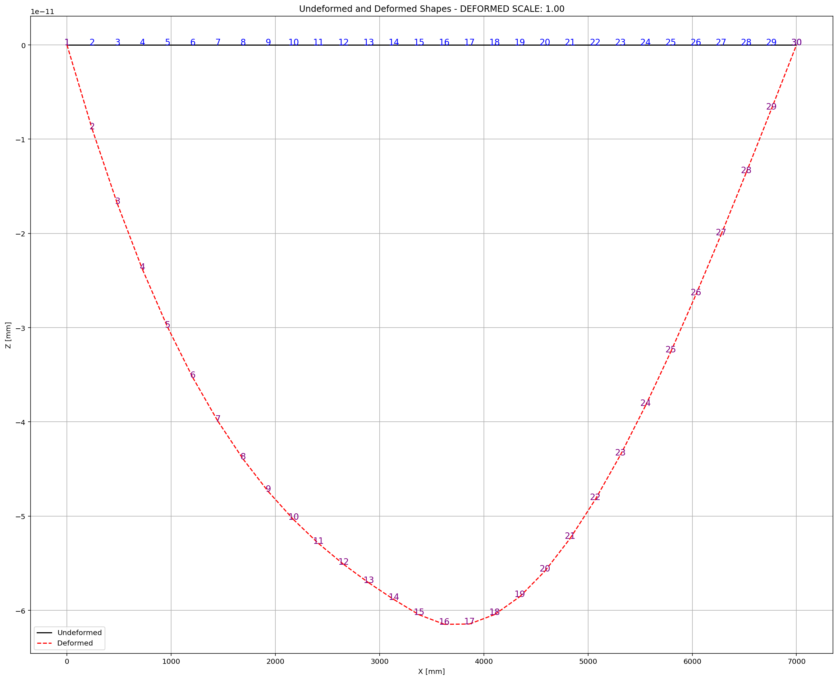

Slide 12
PUSHOVER ANALYSIS

Slide 13
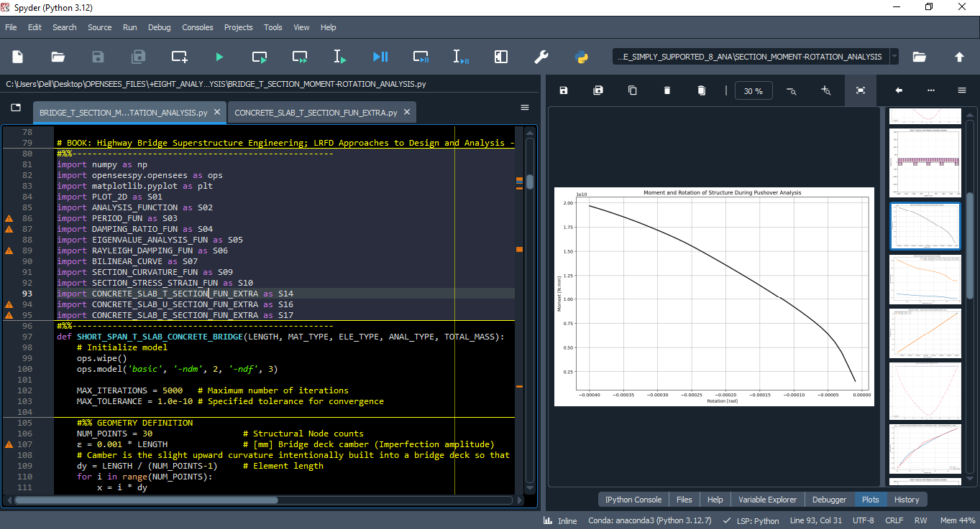

Slide 14
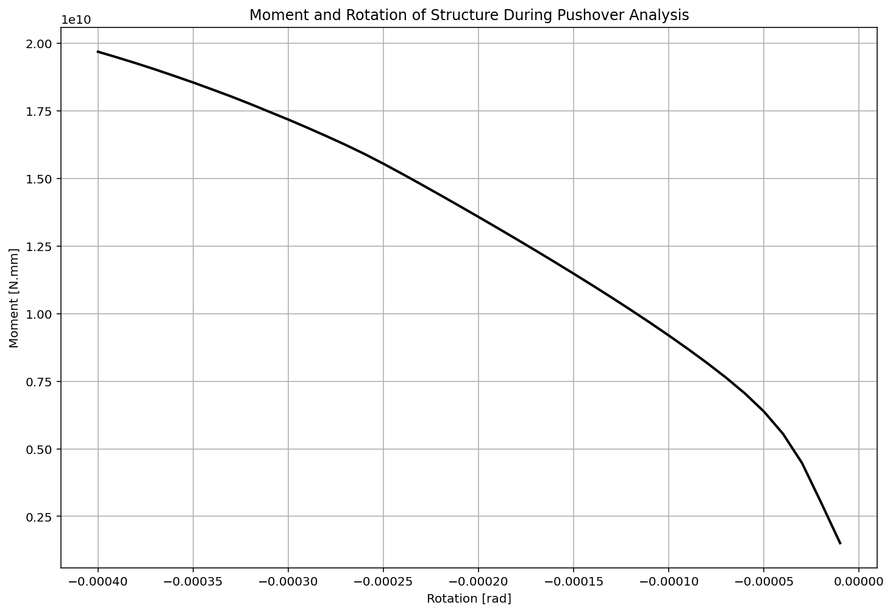

Slide 15
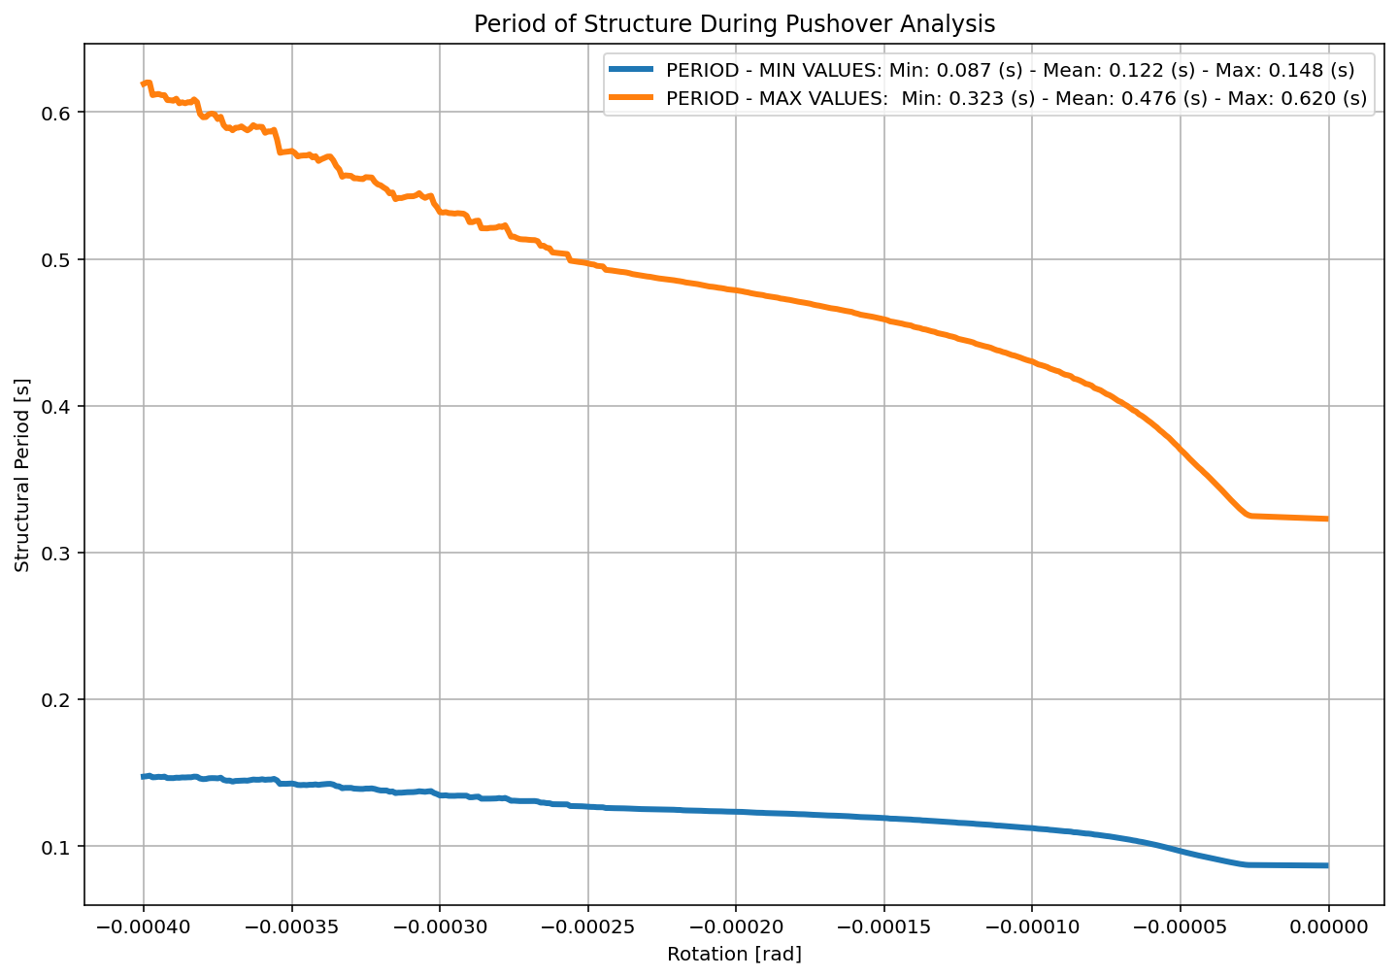

Slide 16
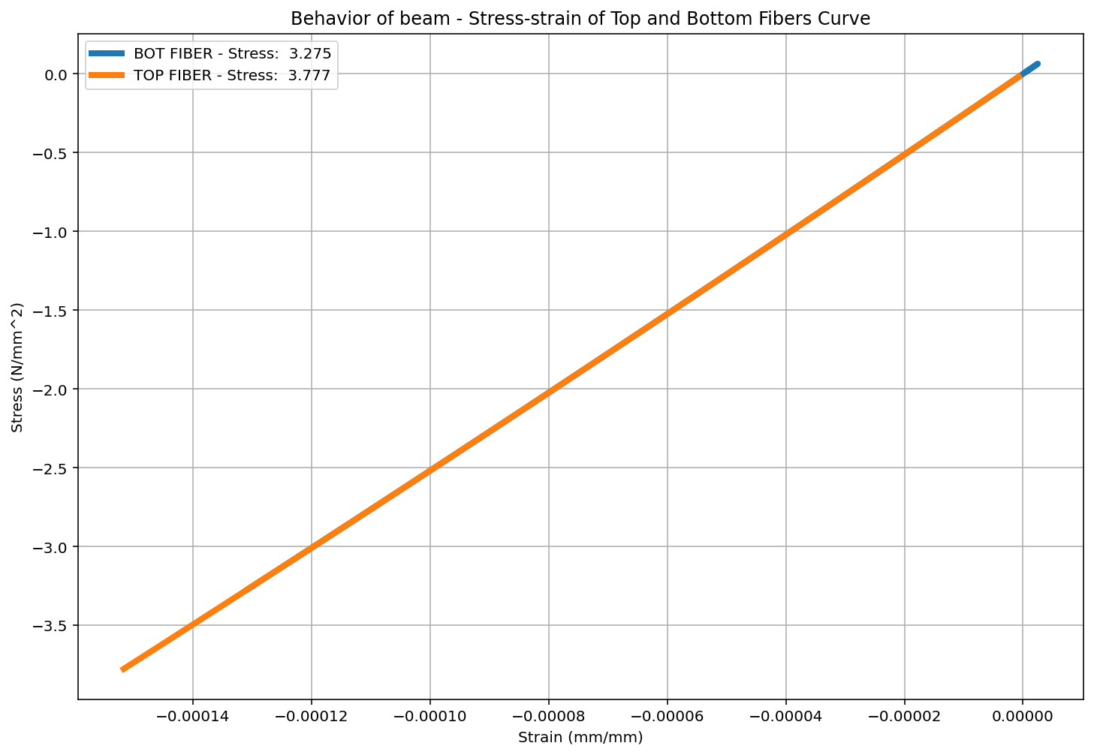

Slide 17
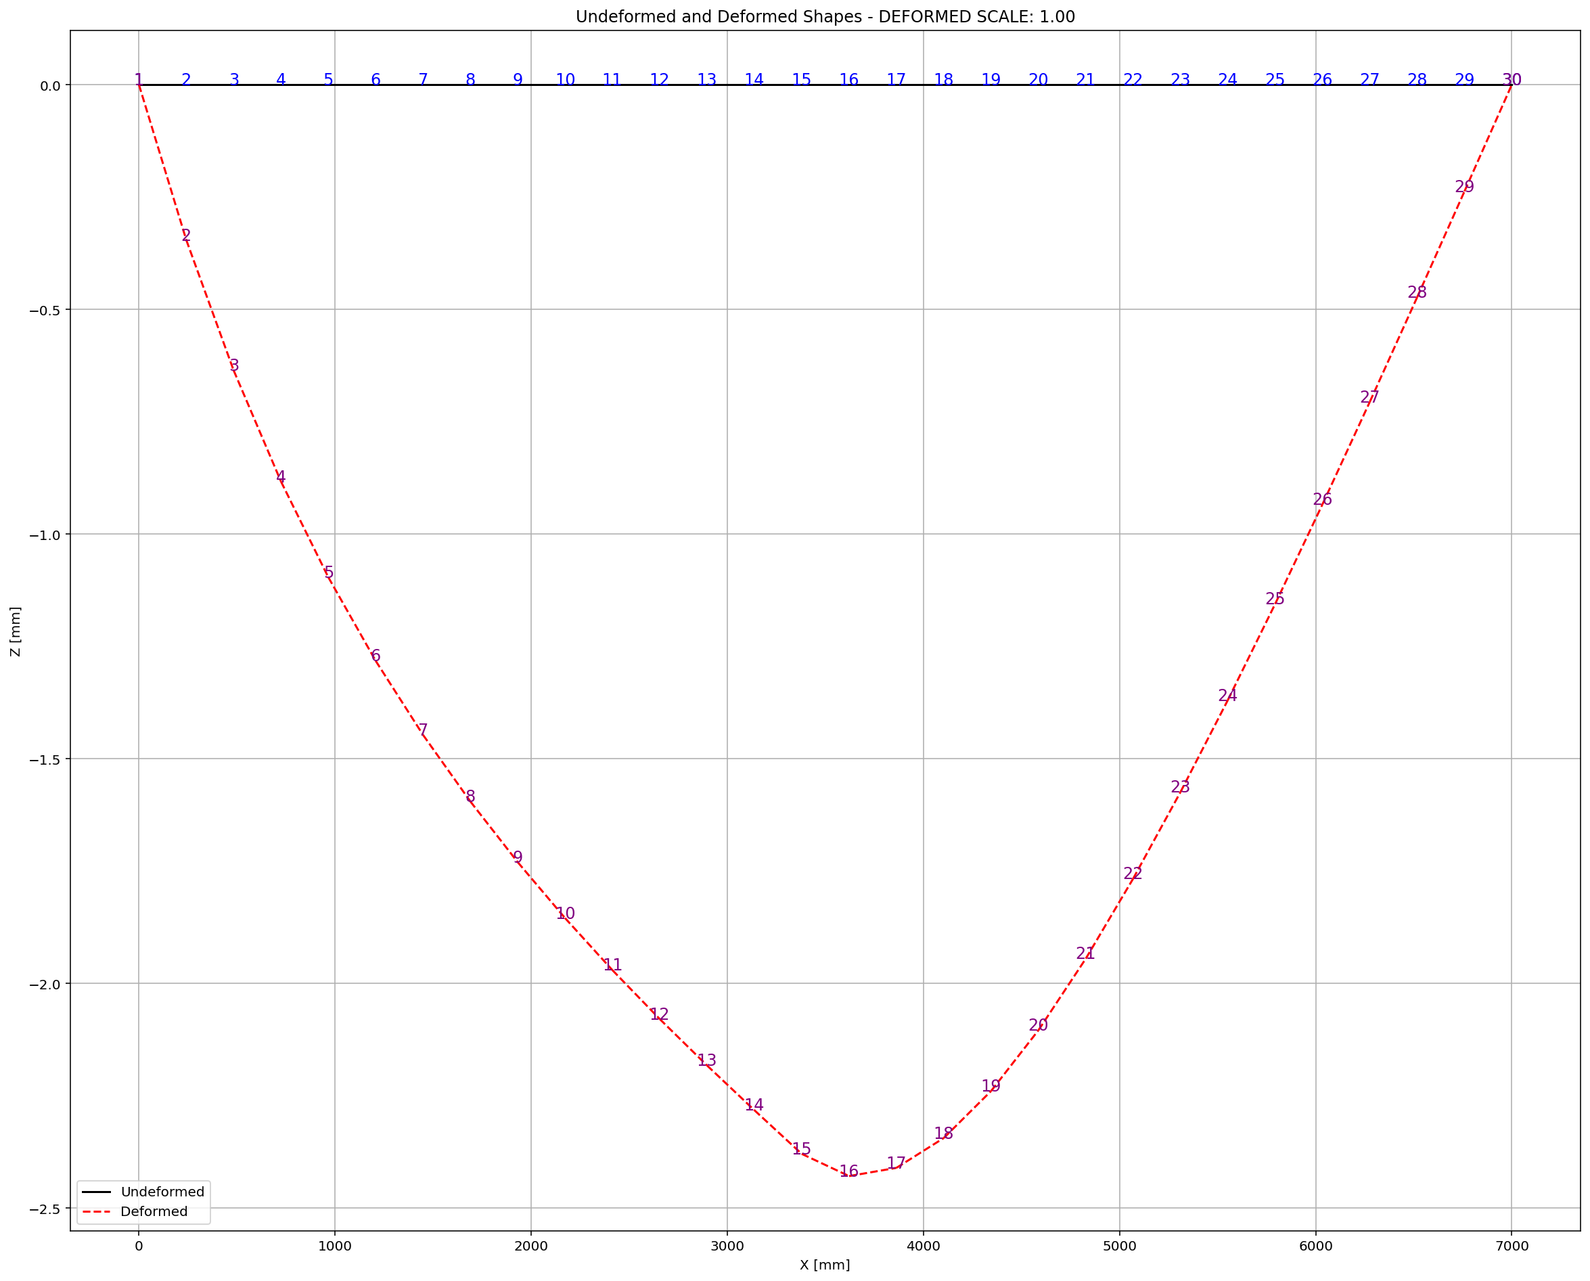

Slide 18
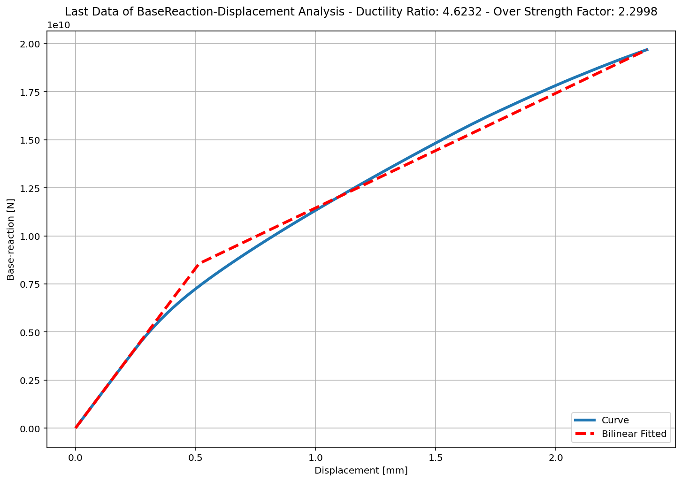

Slide 19
+==========================+
= Analysis curve fitted =
Disp Base Shear
----------------------------
[[0.00000000e+00 0.00000000e+00]
[5.14623391e-01 8.55871071e+09]
[2.37919579e+00 1.96836283e+10]]
+==========================+
+----------------------------------------------------+
Structure Elastic Stiffness : 16631017660.17
Structure Plastic Stiffness : 8273227590.39
Structure Tangent Stiffness : 5966471217.87
Structure Ductility Ratio : 4.62
Structure Over Strength Factor: 2.30
+----------------------------------------------------+
Over Strength Coefficient (Ω0): 2.2998
Displacement Ductility Ratio (μ): 4.6232
Ductility Coefficient (Rμ): 4.6232
Structural Behavior Coefficient (R): 10.6326

