Slide 1
IN THE NAME OF ALLAH
ASSESSMENTS OF THE STRUCTURAL DUCTILITY DAMAGE INDEX OF ULTRA-HIGH STRENGTH CONCRETE (UHSC) FRAME USING OPENSEES.
WRITTEN BY SALAR DELAVAR GHASHGHAEI (QASHQAI)

Slide 2
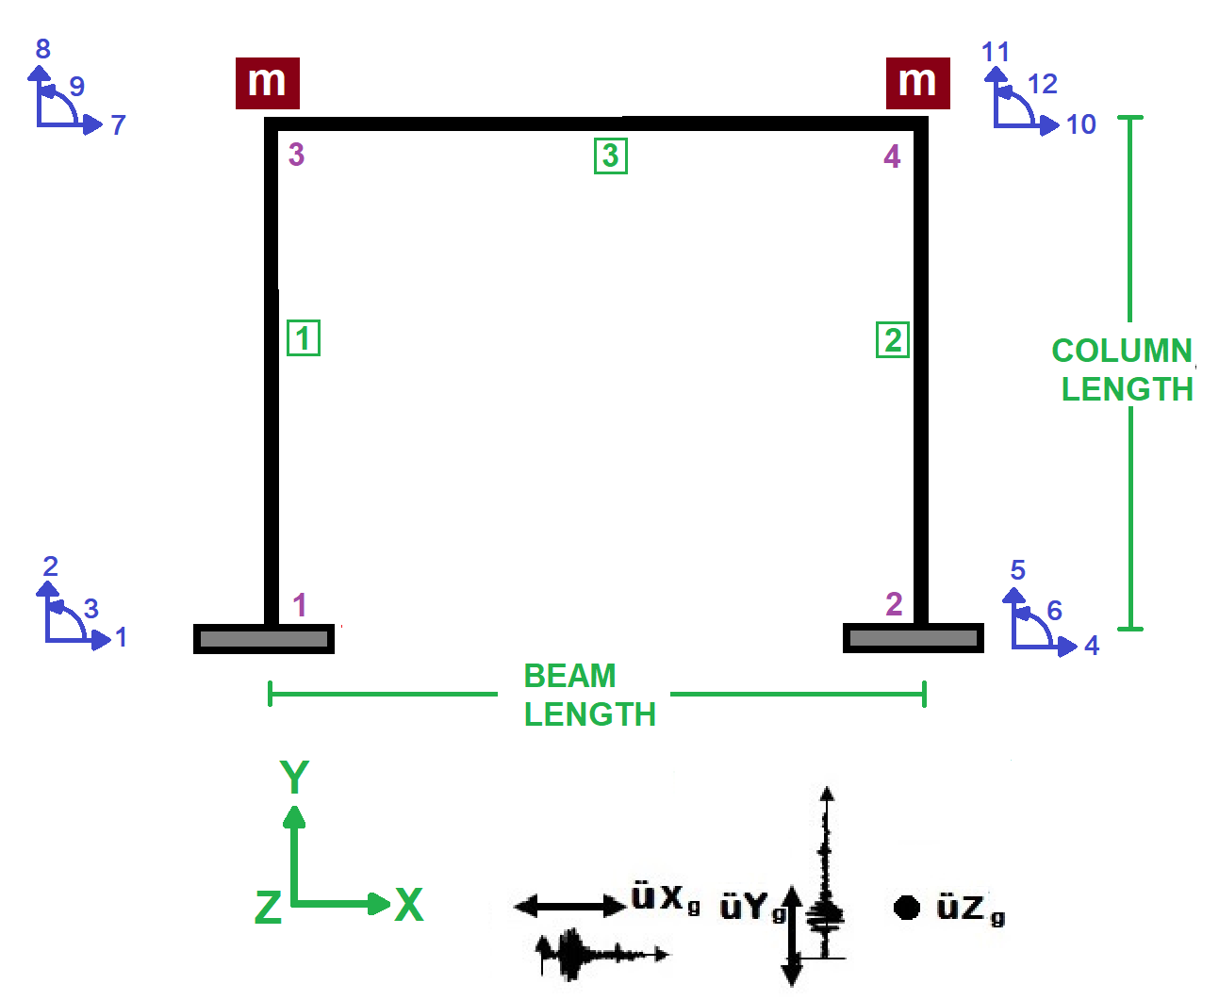

Slide 3
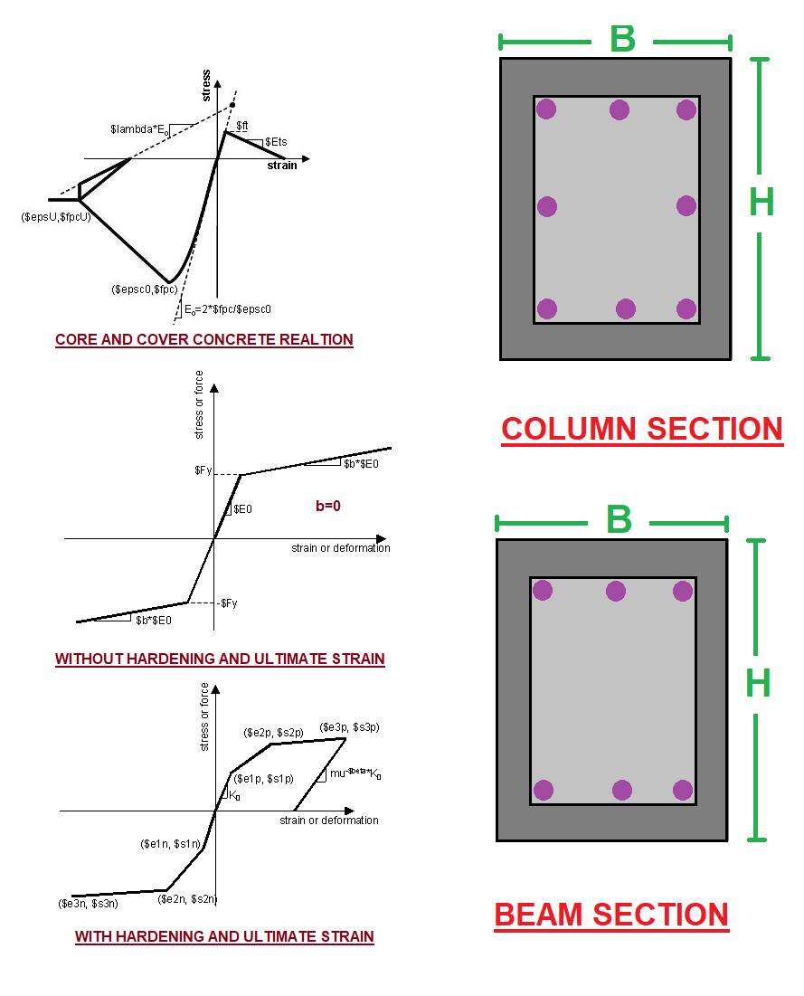

Slide 4
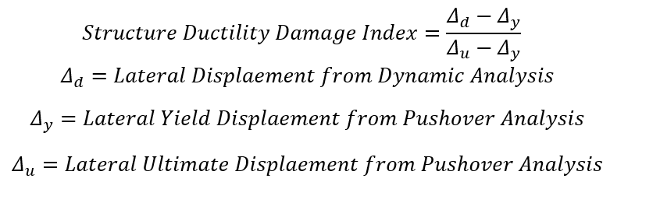

Slide 5
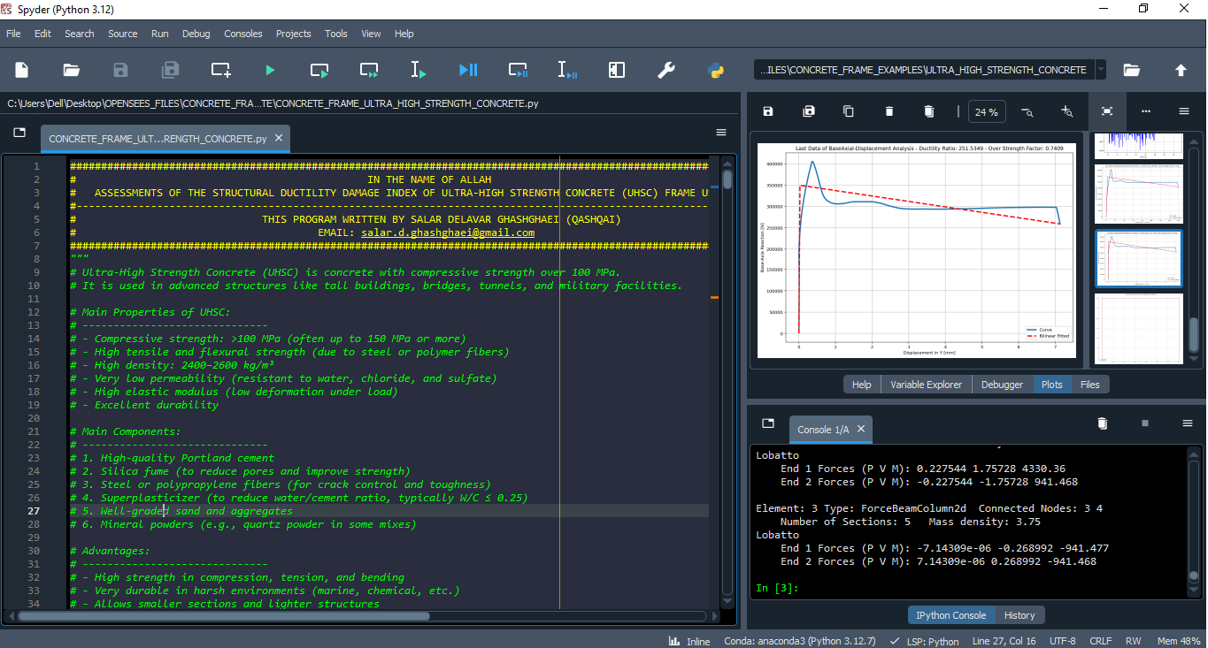

Slide 6
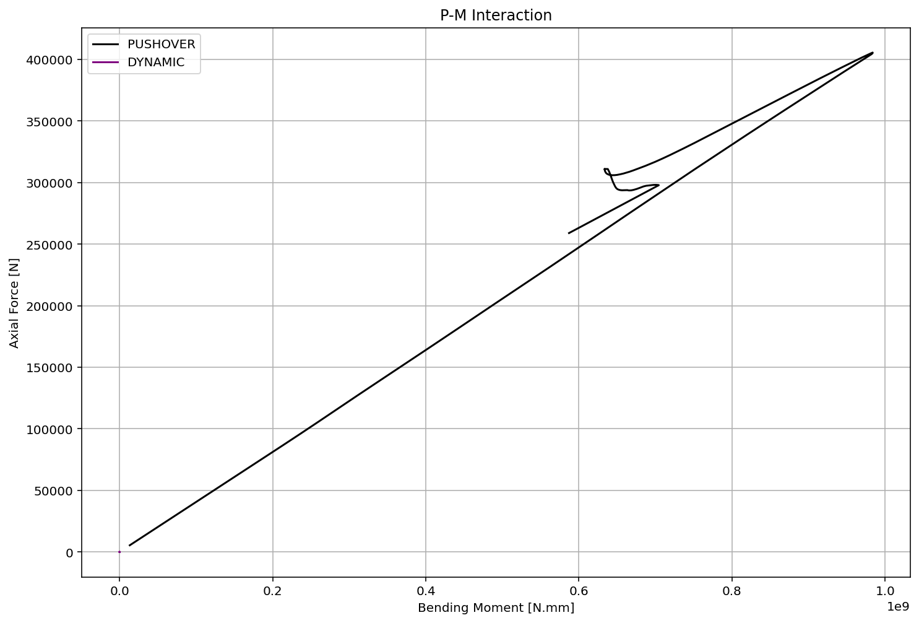

Slide 7
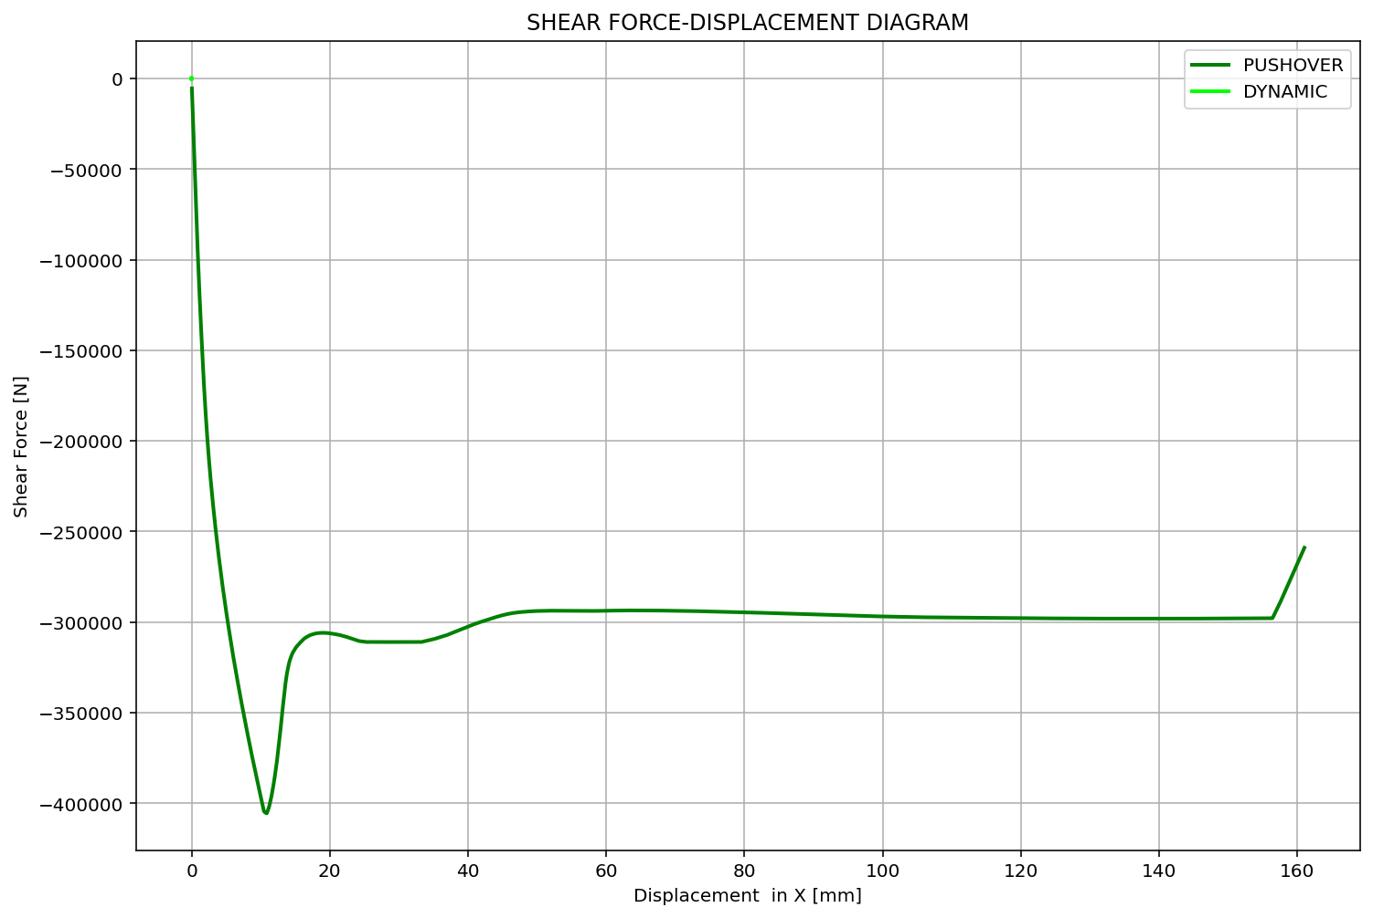

Slide 8
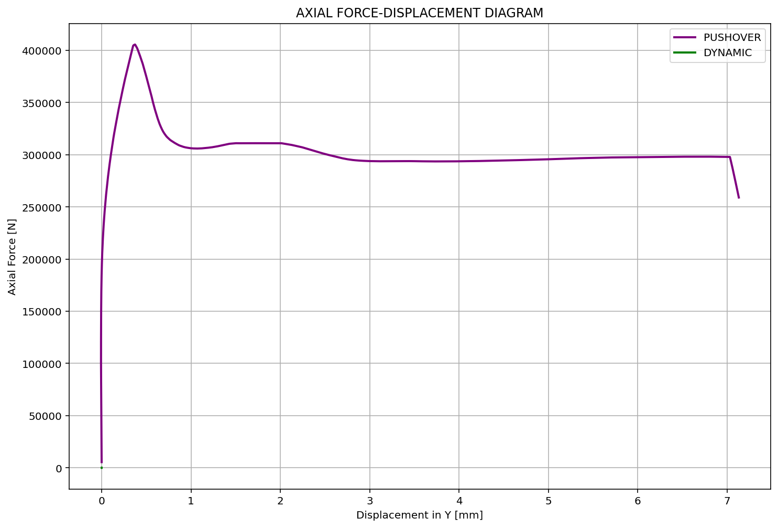

Slide 9
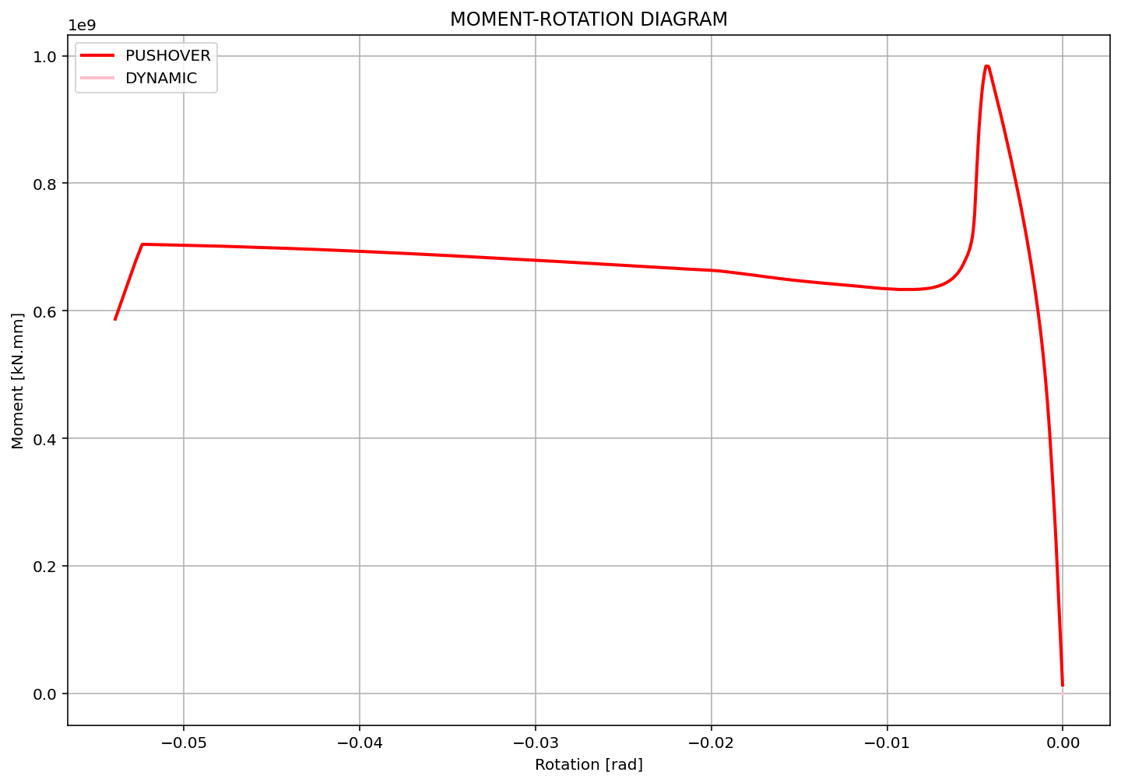

Slide 10
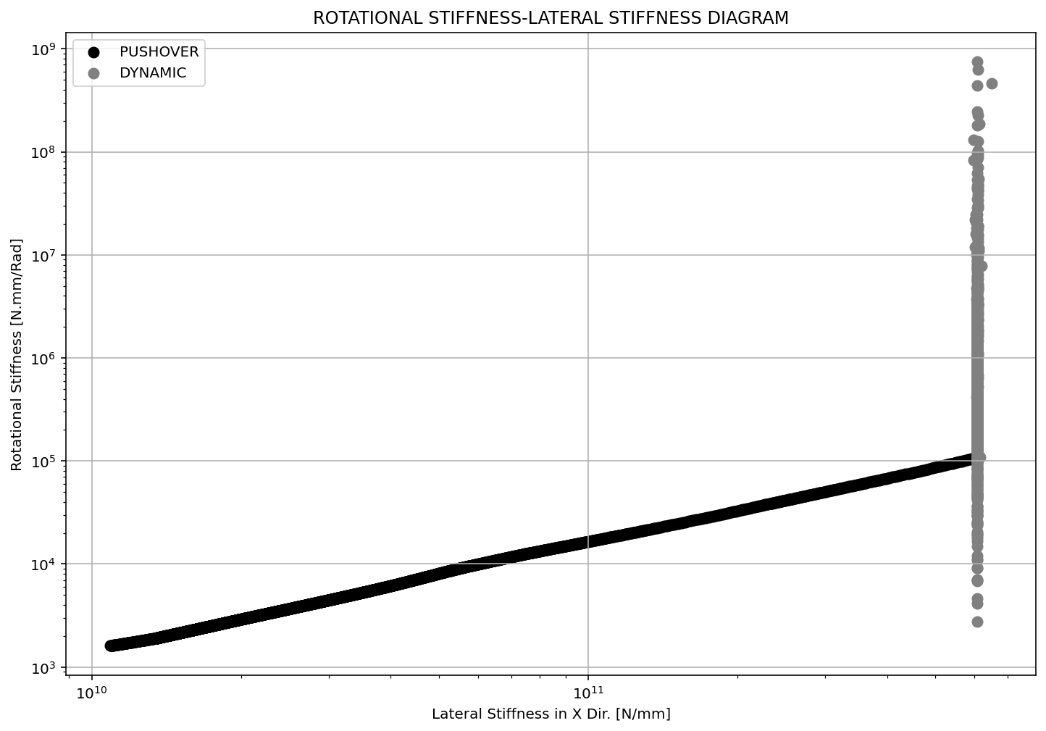

Slide 11
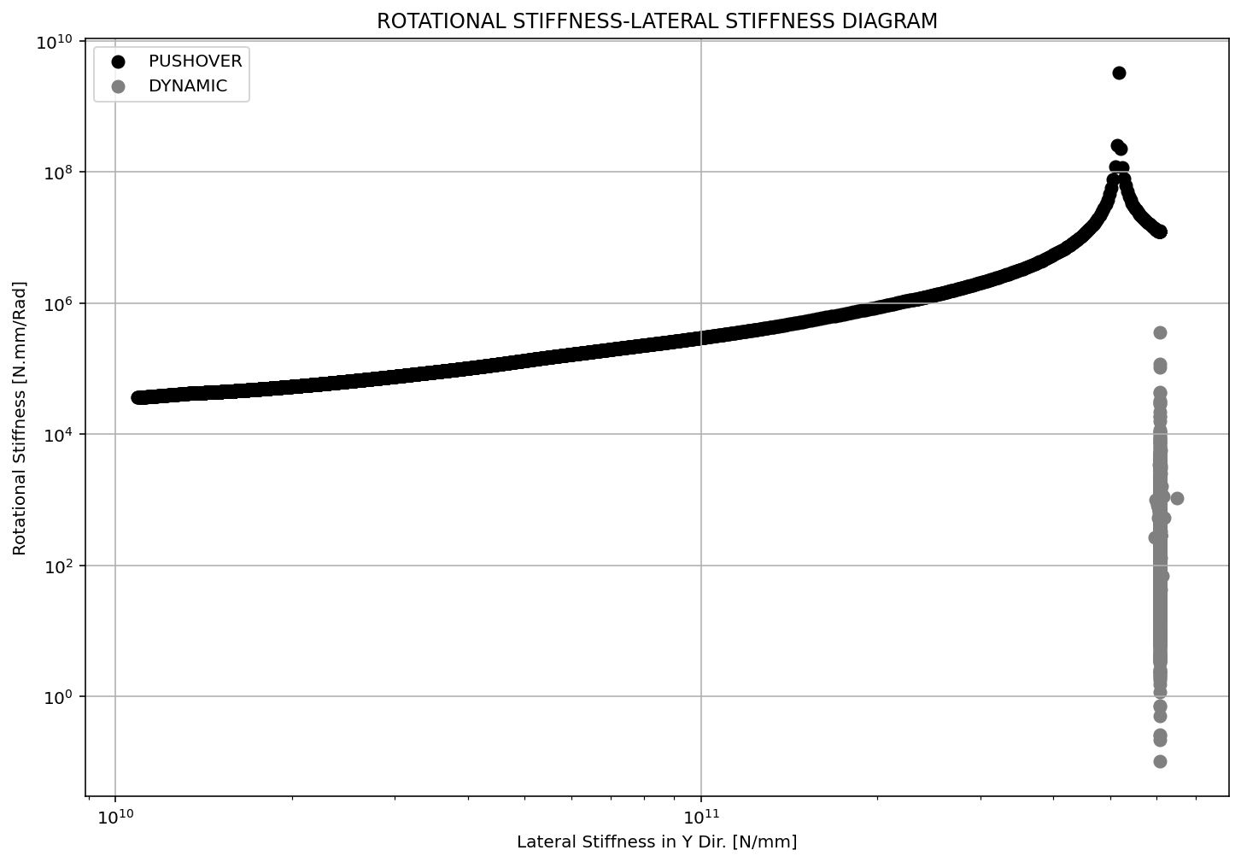

Slide 12
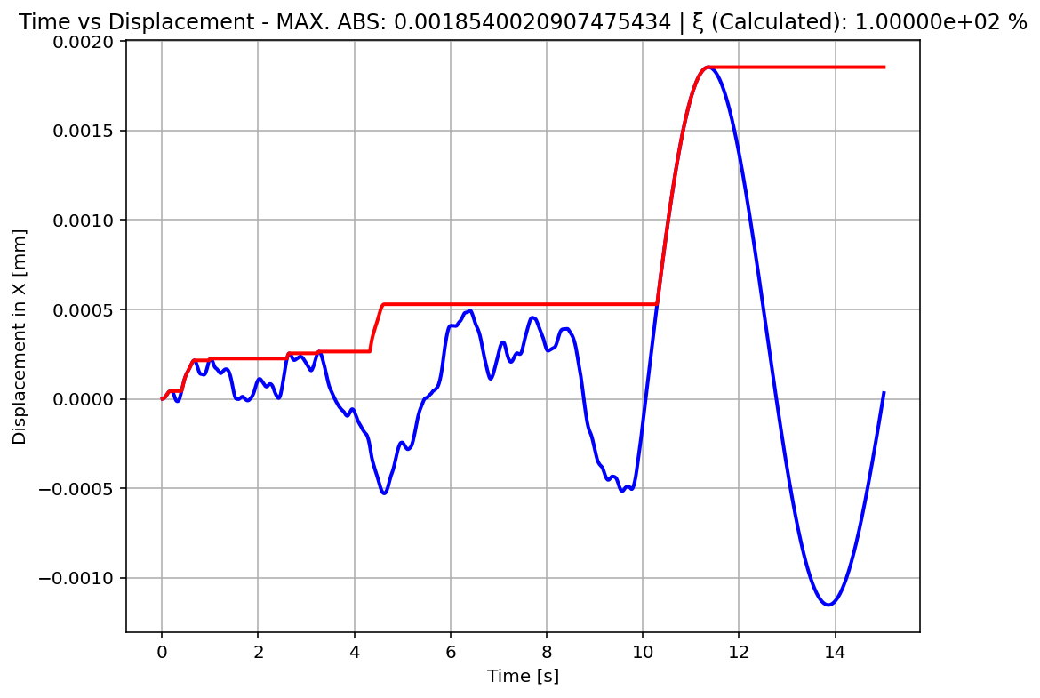

Slide 13
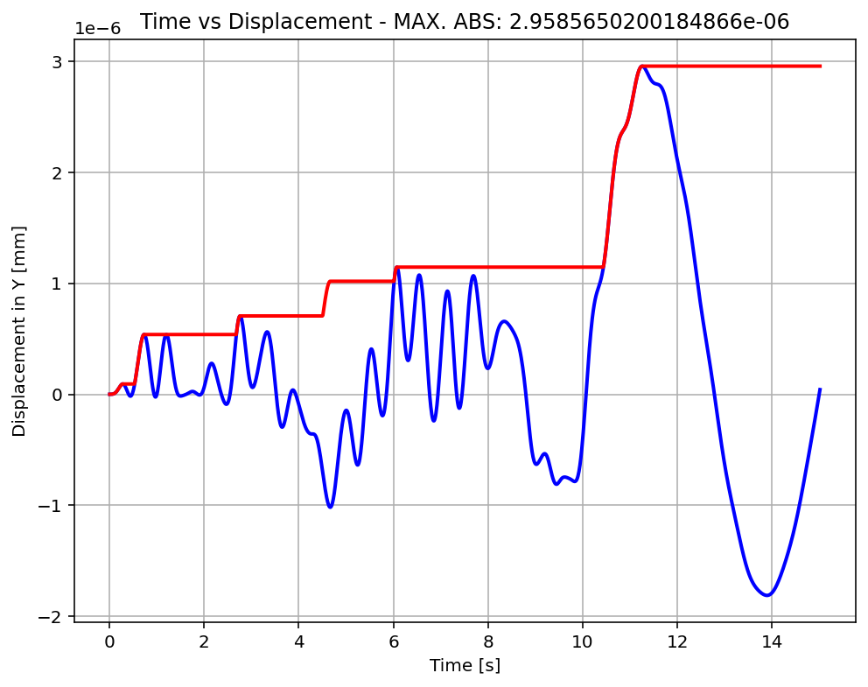

Slide 14
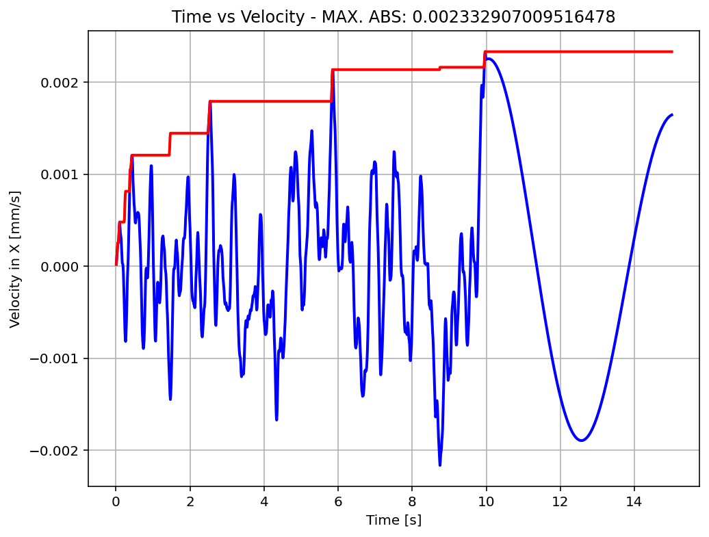

Slide 15
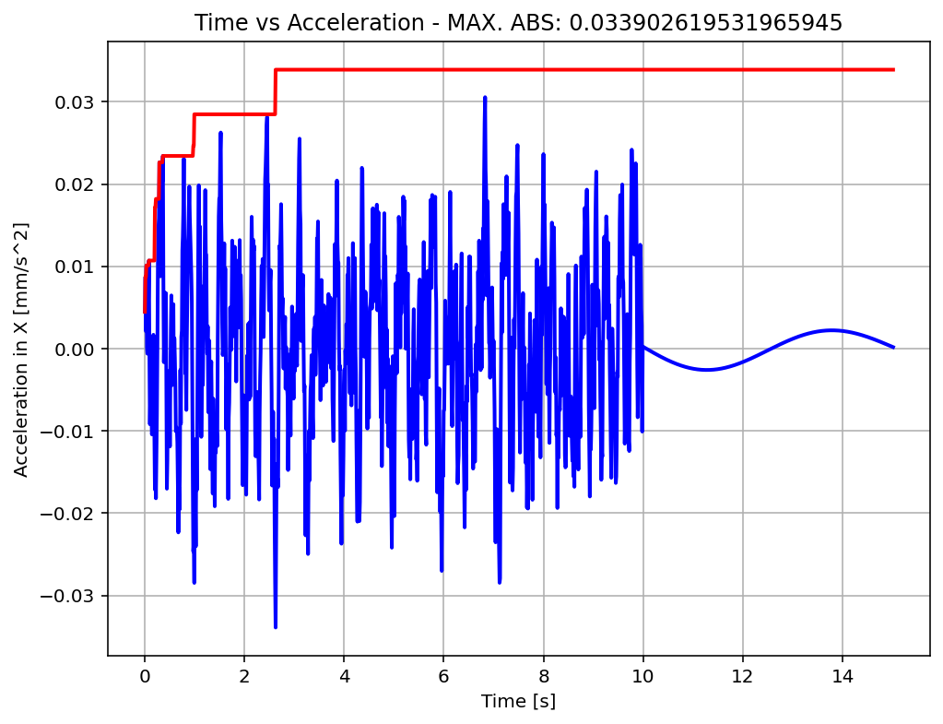

Slide 16
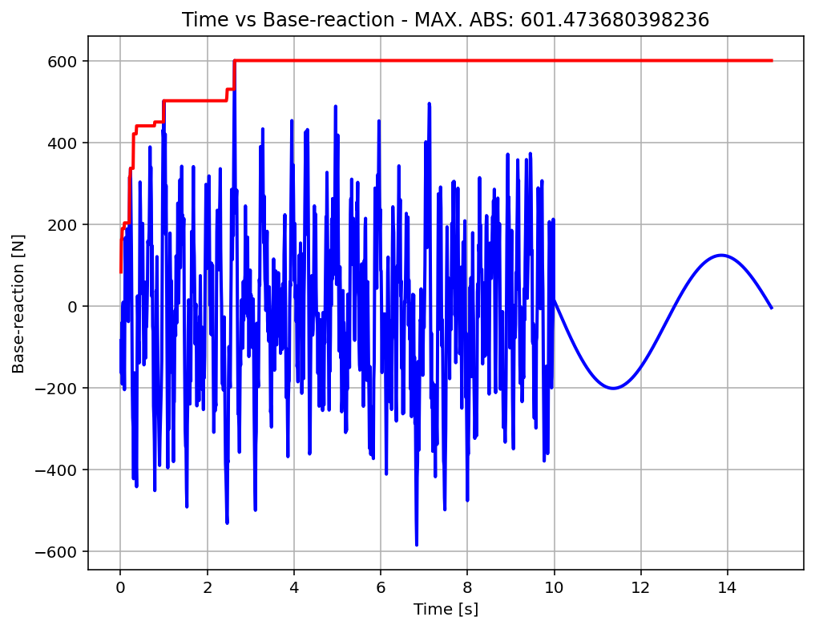

Slide 17
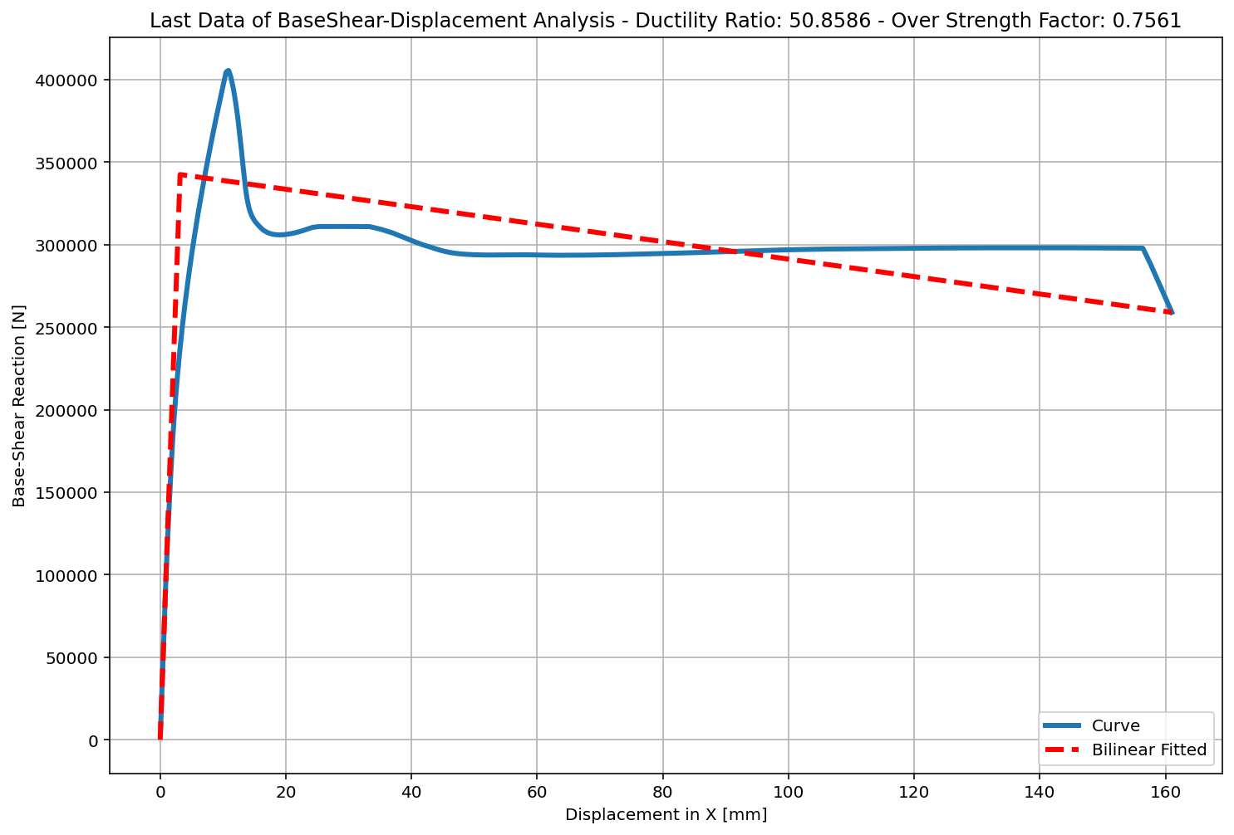

Slide 18
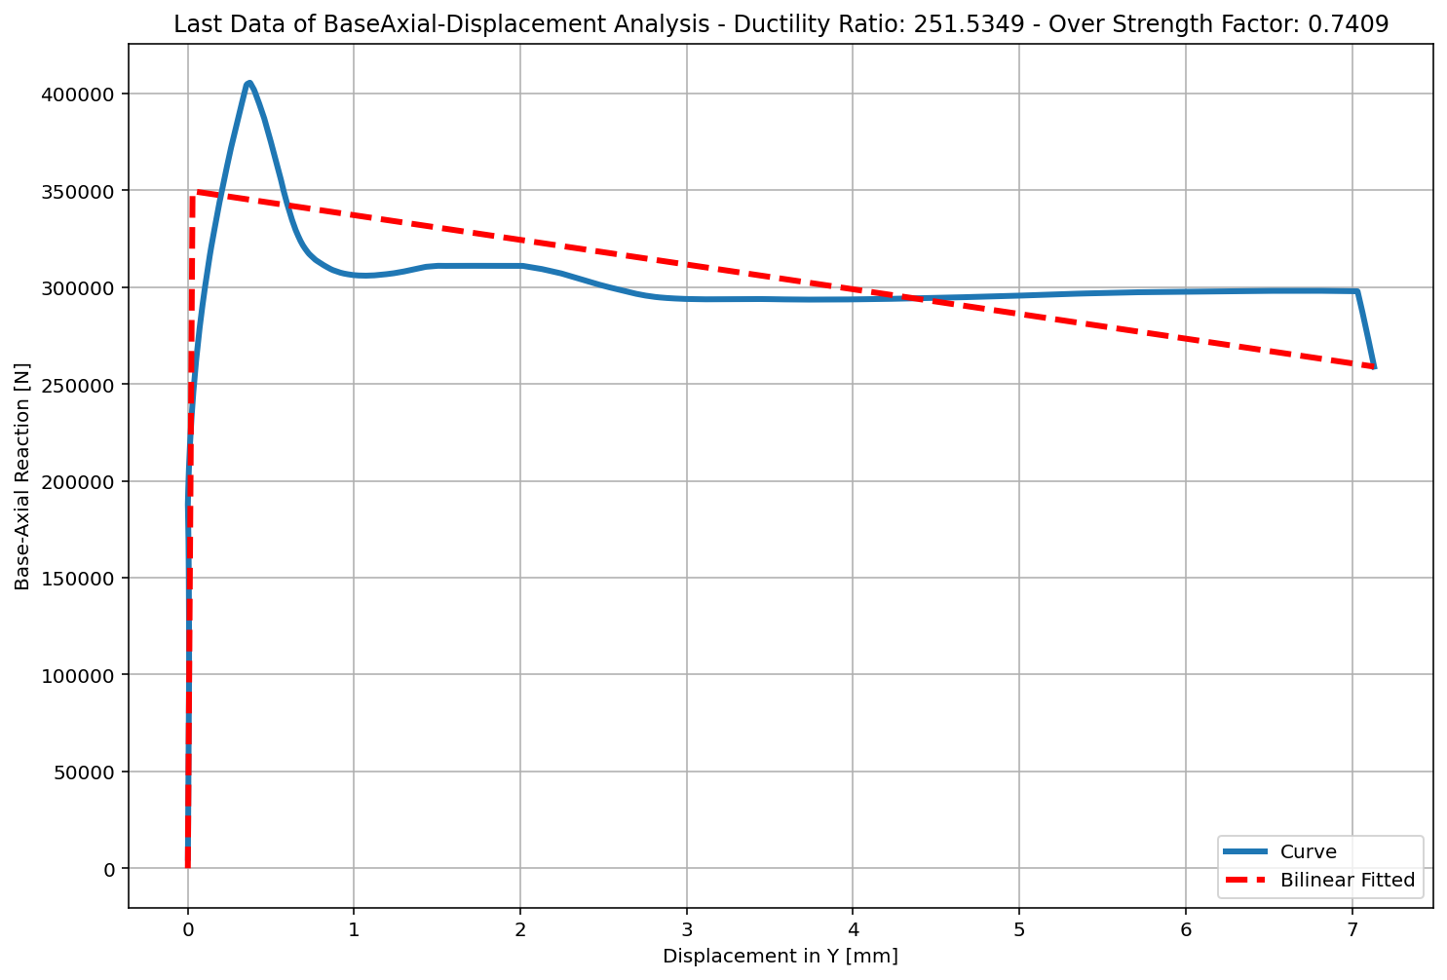

Slide 19
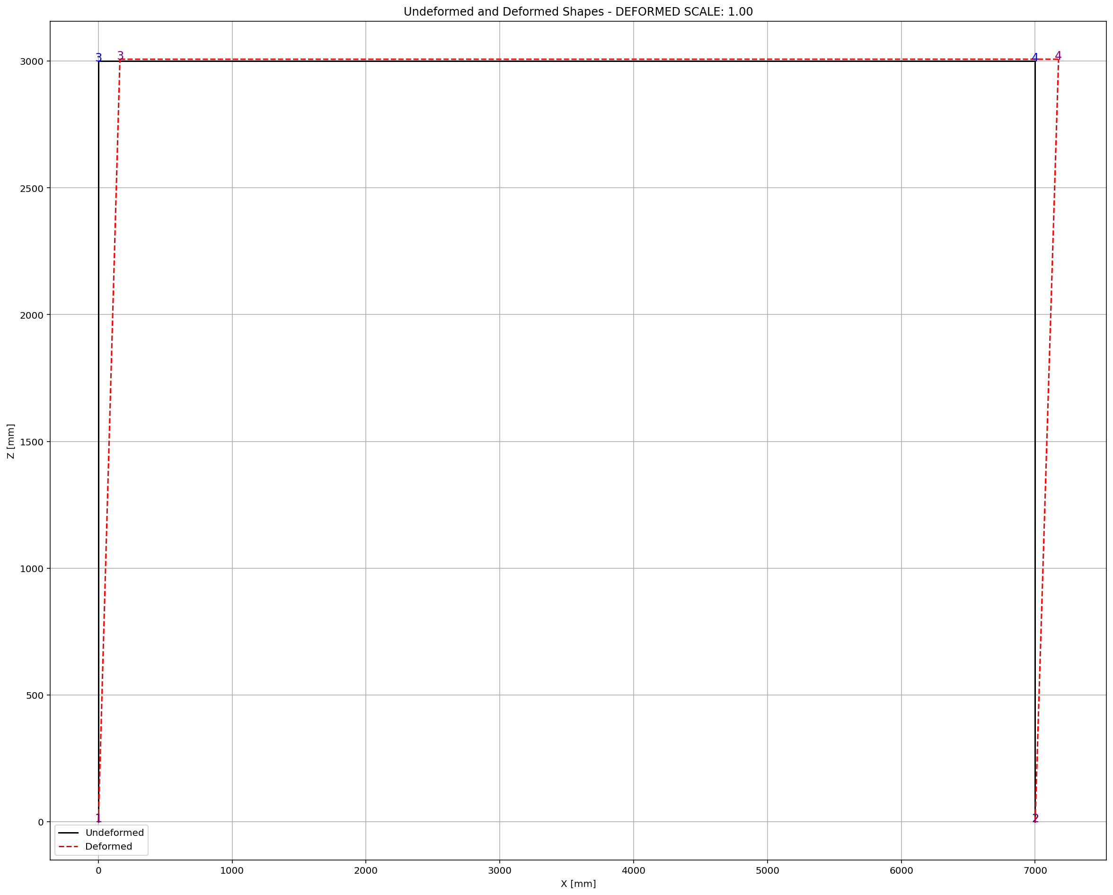
AFTER NONLINEAR STATIC ANALYSIS

Slide 20
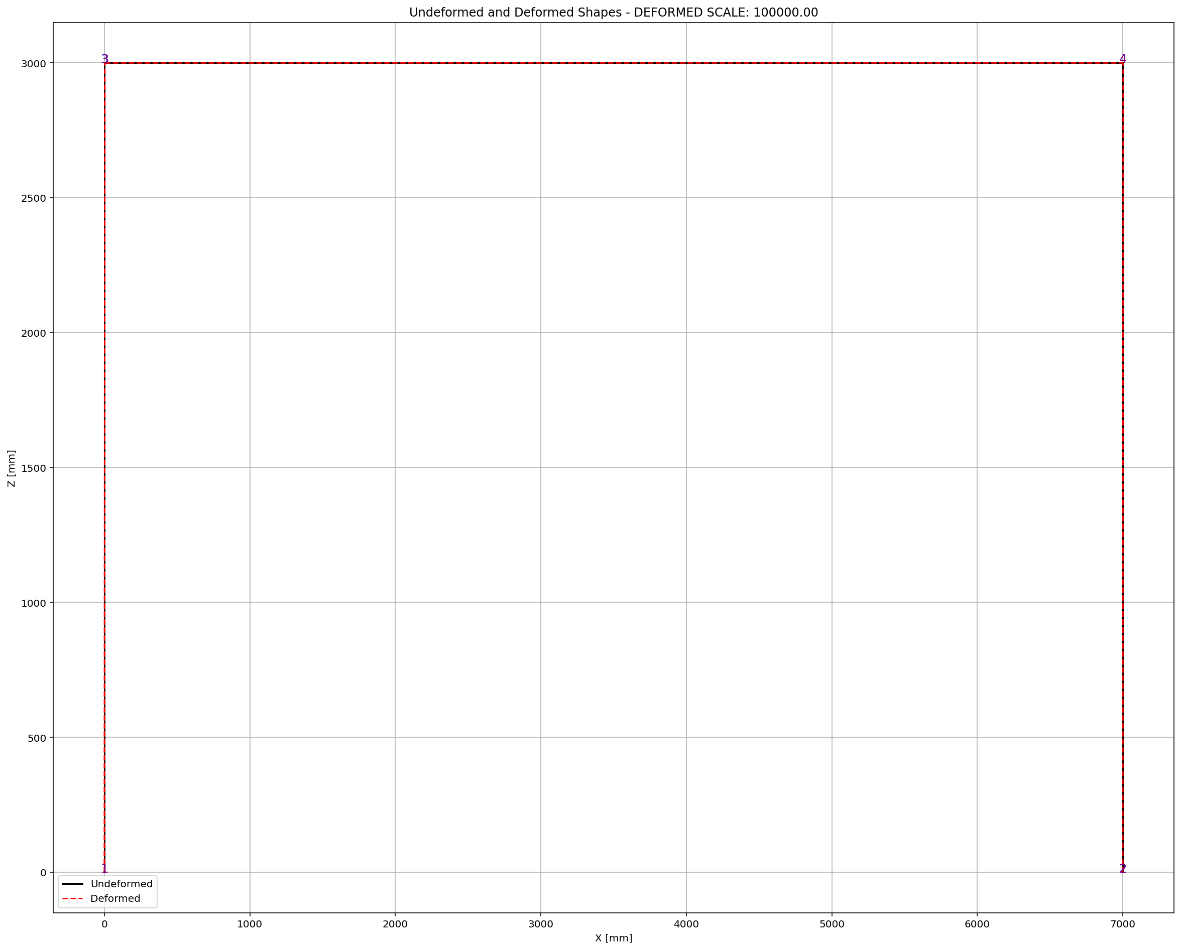
AFTER NONLINEAR DYNAMIC ANALYSIS

