Slide 1
>> IN THE NAME OF ALLAH, THE MOST GRACIOUS, THE MOST MERCIFUL <<
COMPARATIVE FREE-VIBRATION AND PUSHOVER ANALYSIS OF A SDOF STRUCTURE: ELASTIC VS INELASTIC RESPONSE USING OPENSEES
AND EVALUATION OF DISSIPATED ENERGY CAPACITY INDEX
WRITTEN BY SALAR DELAVAR GHASHGHAEI (QASHQAI)

Slide 2
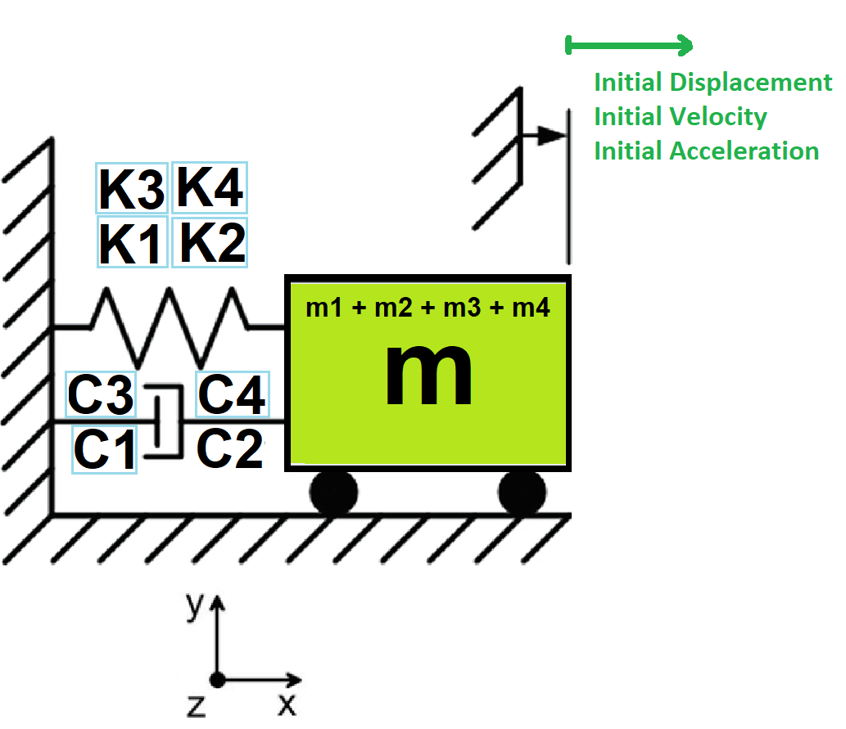

Slide 3
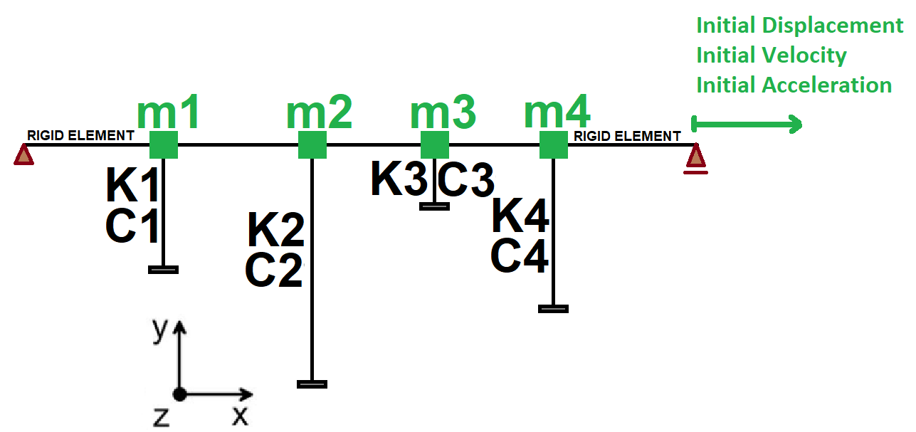

Slide 4
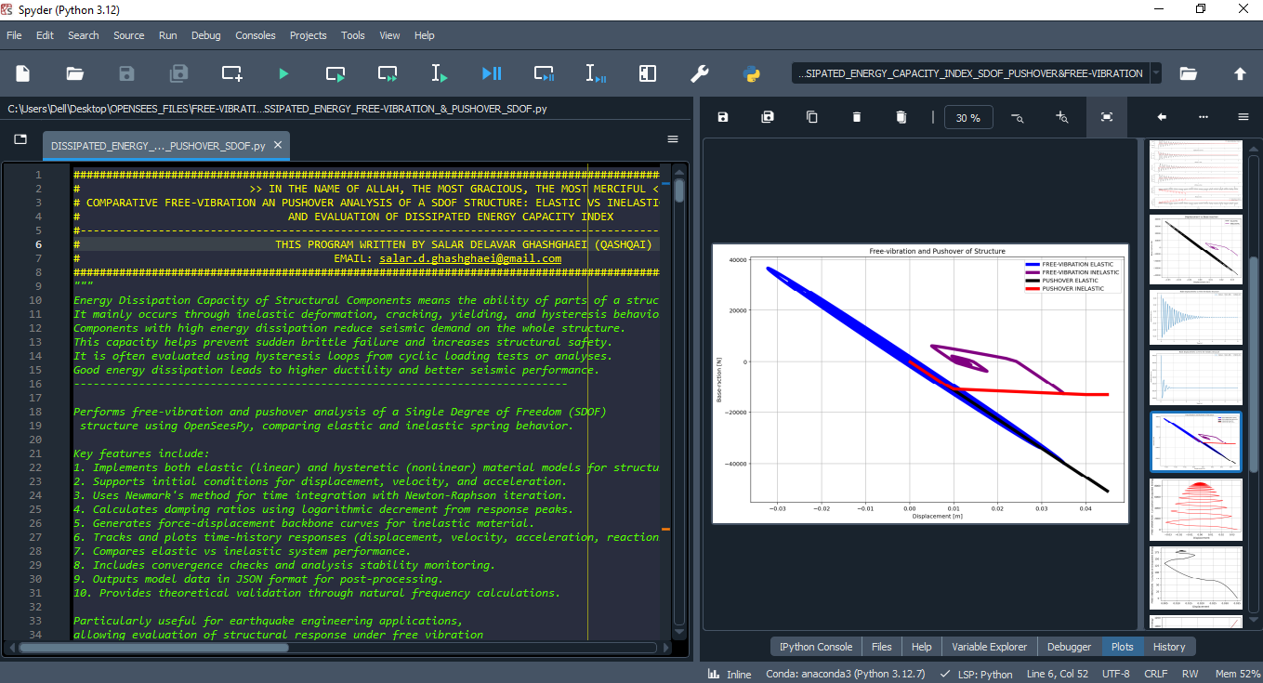

Slide 5
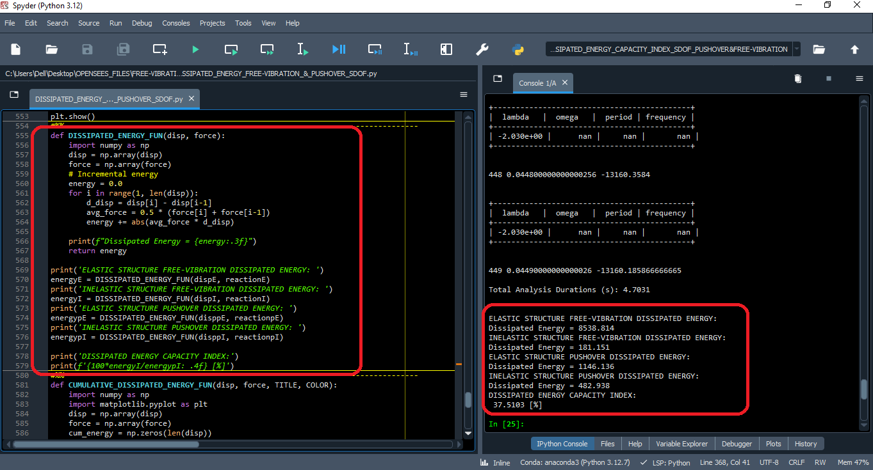

Slide 6
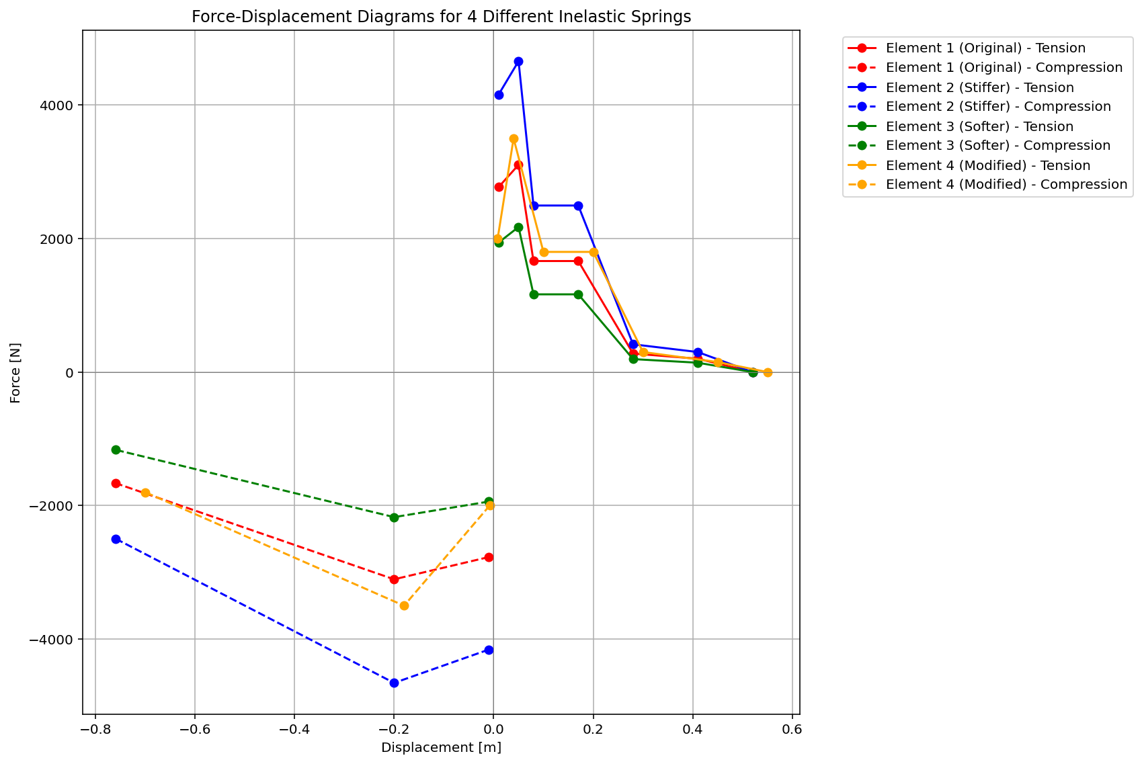

Slide 7
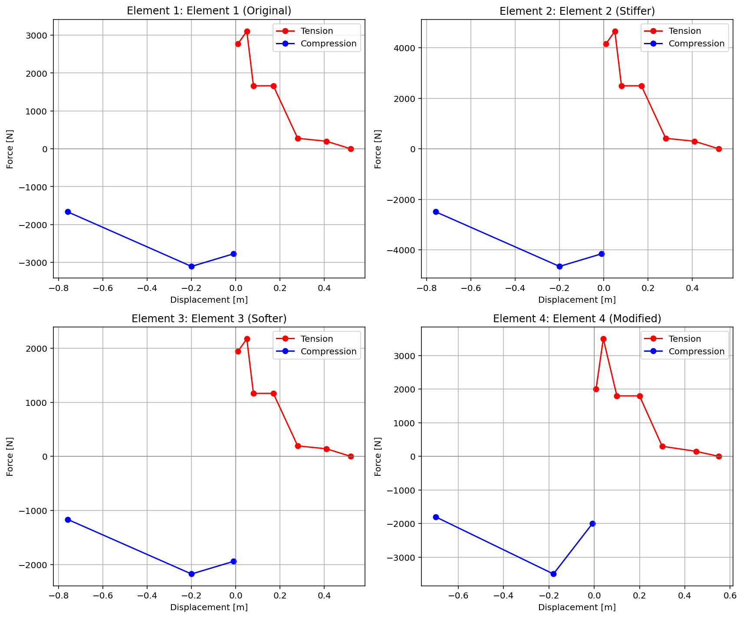

Slide 8
FREE-VIBRATION ANALYSIS

Slide 9
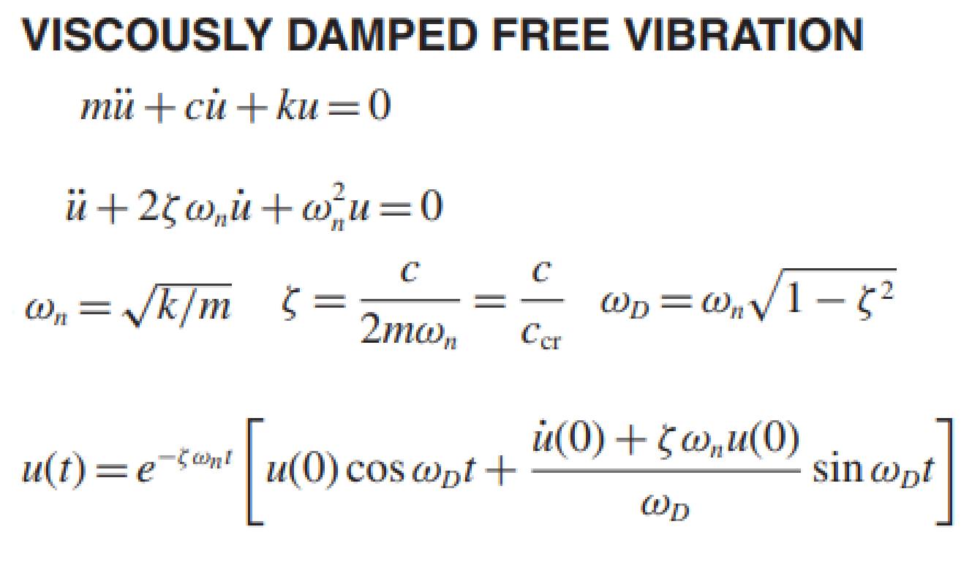
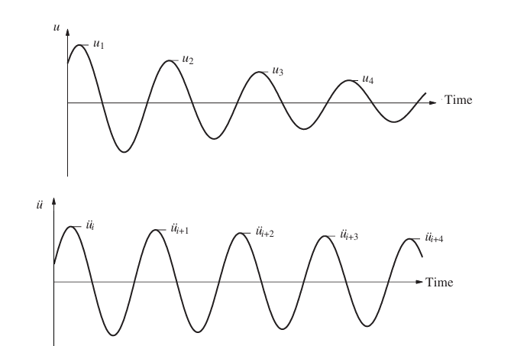
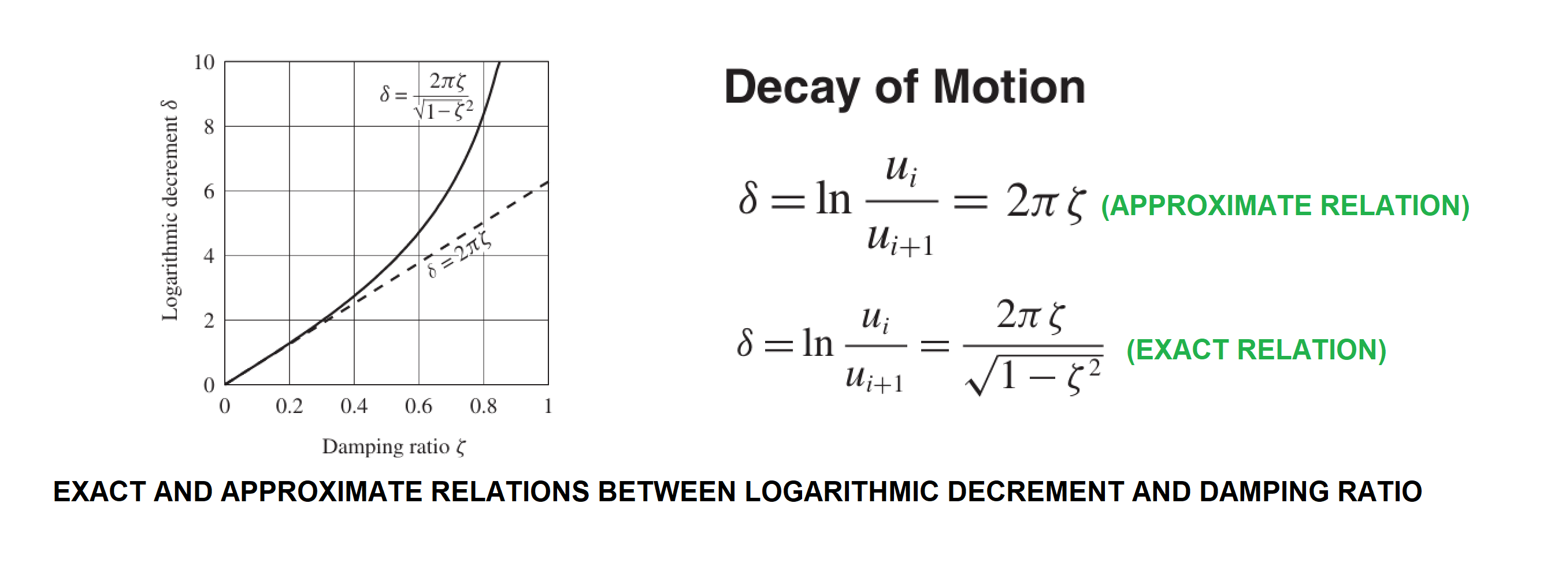

Slide 10
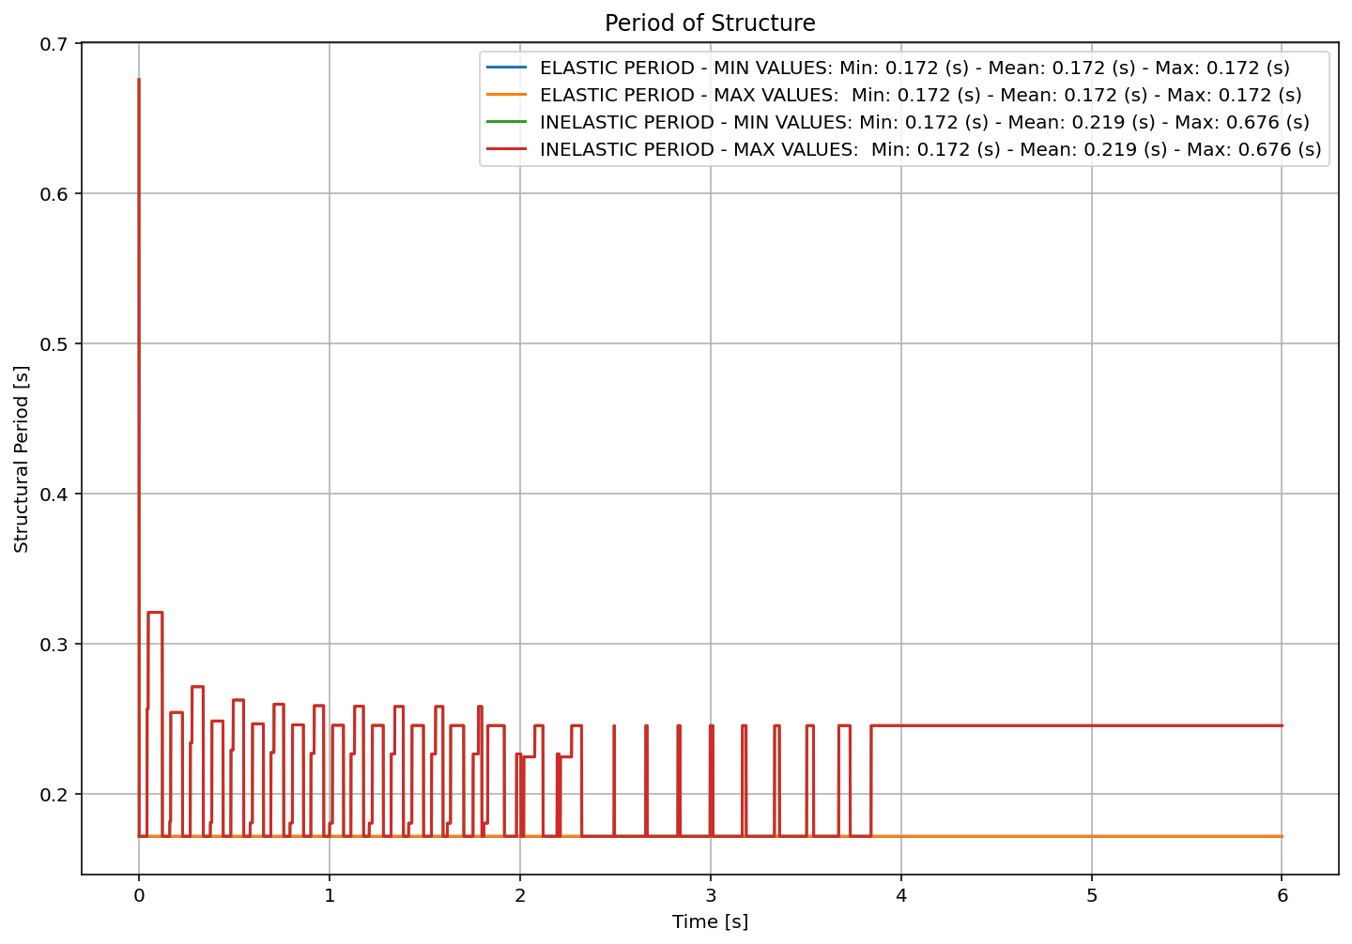

Slide 11
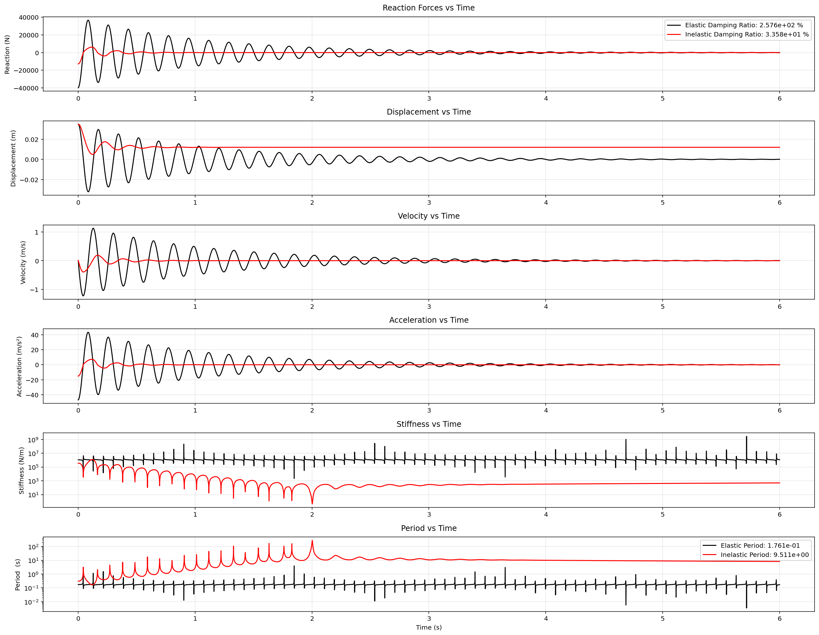

Slide 12
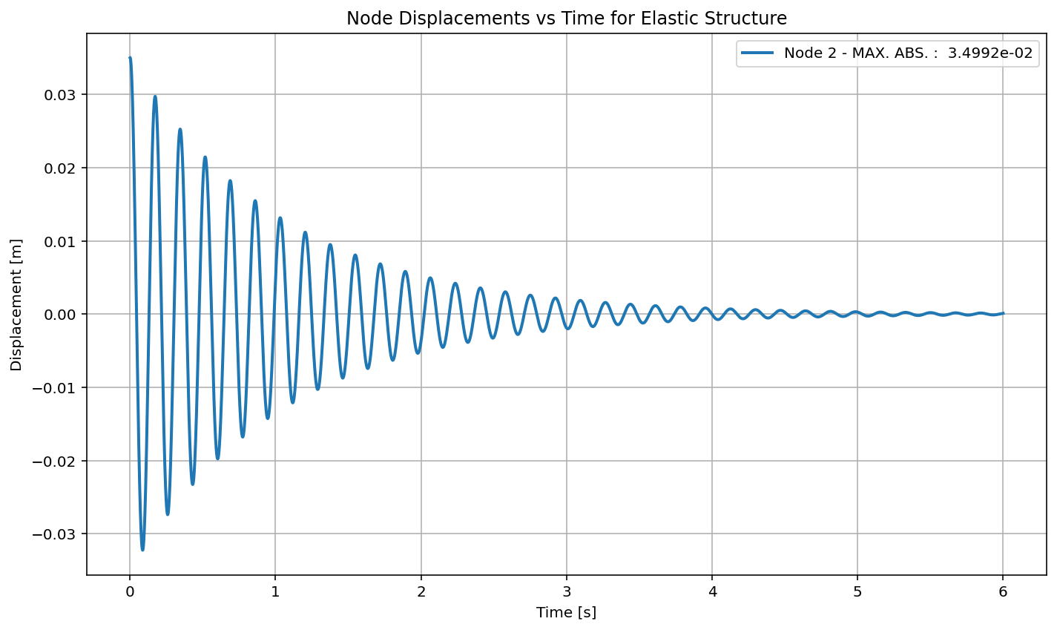

Slide 13
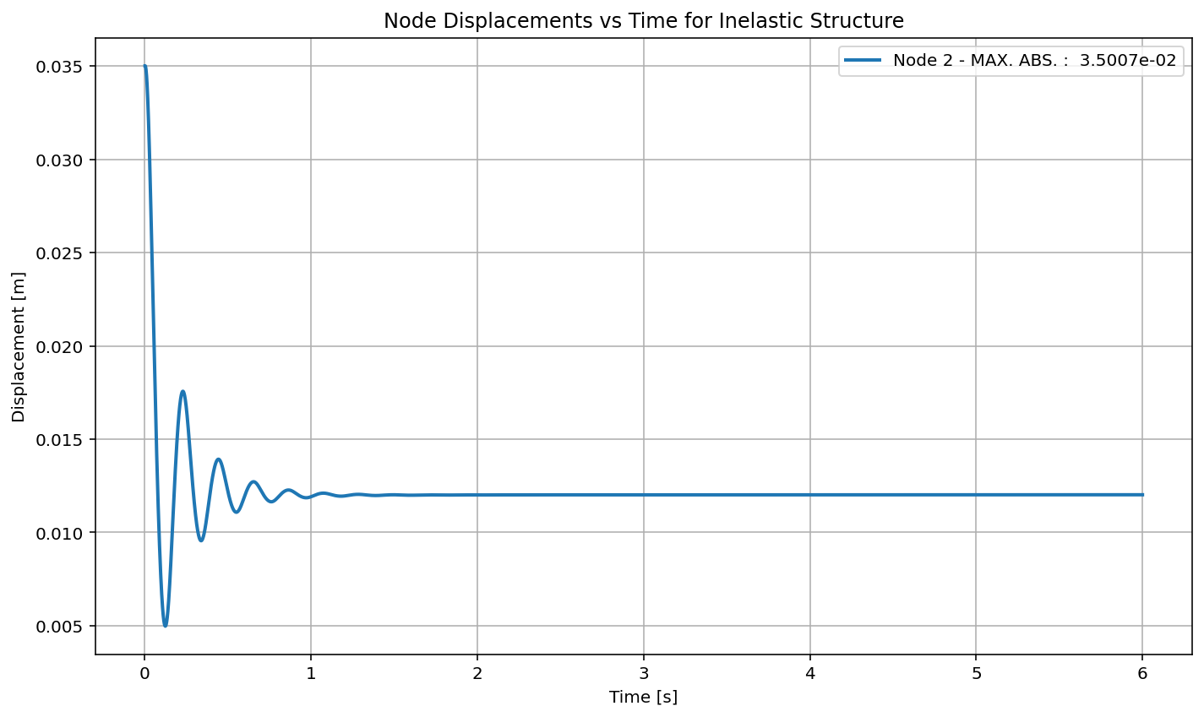

Slide 14
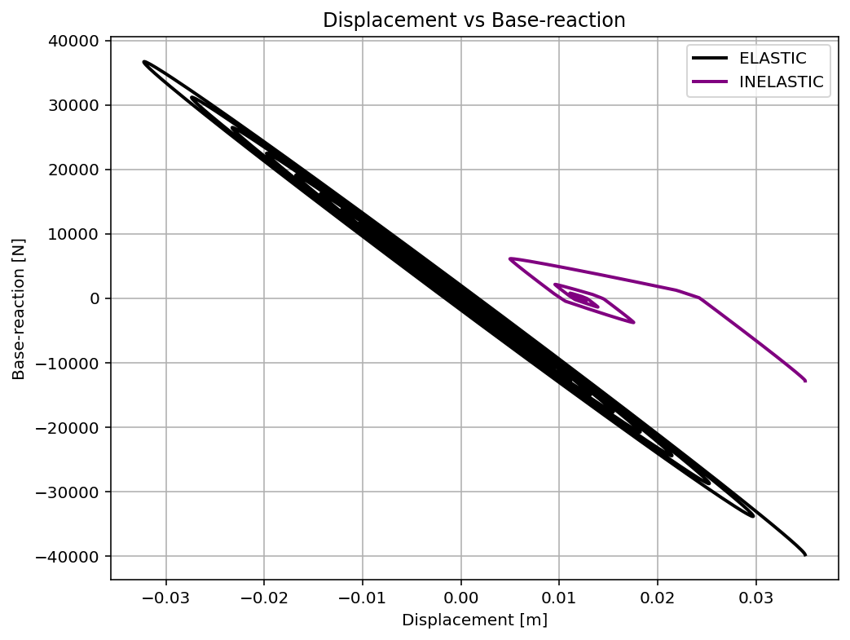

Slide 15
PUSHOVER ANALYSIS

Slide 16
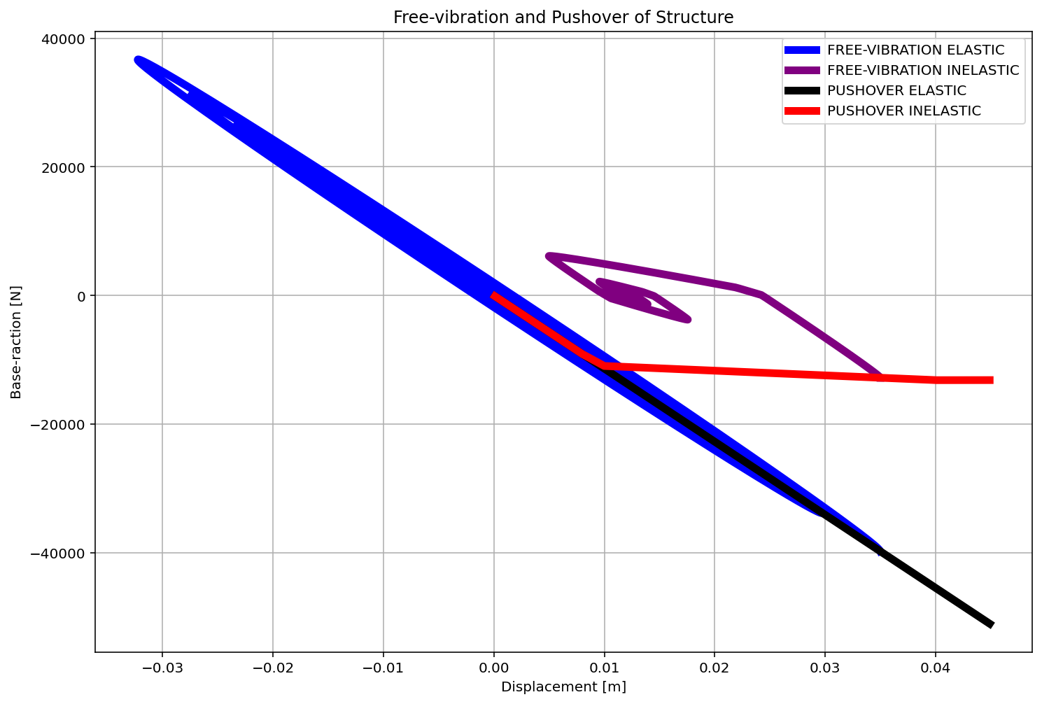

Slide 17
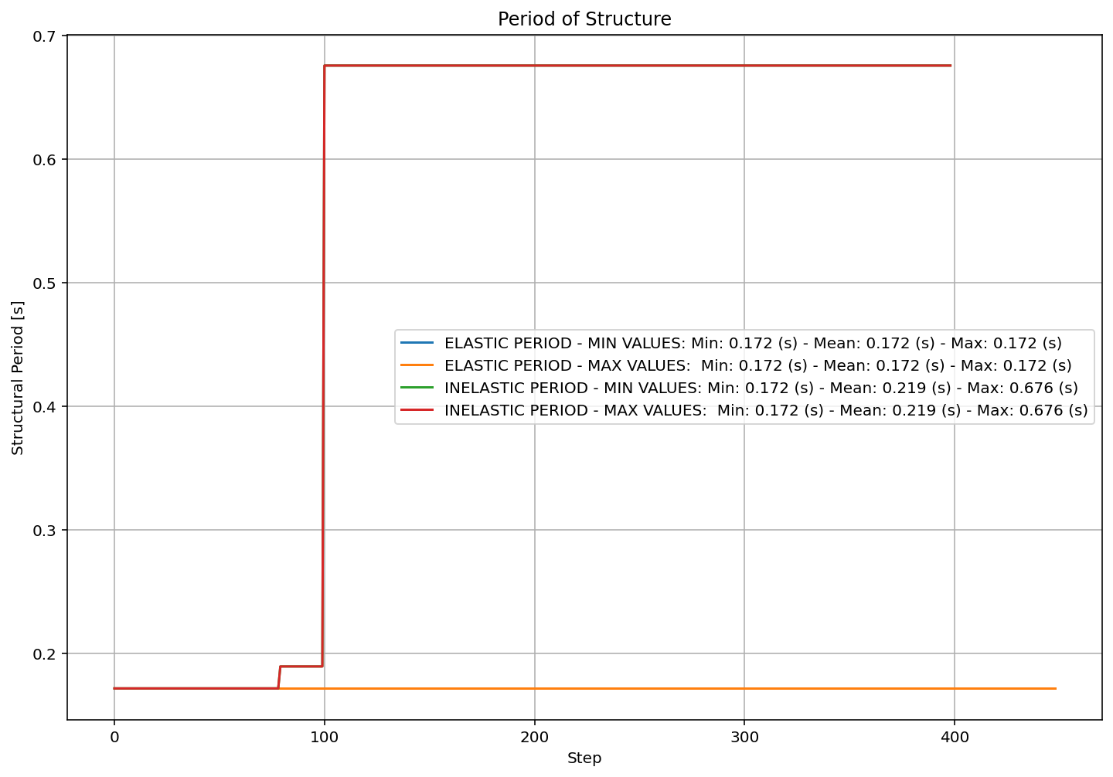

Slide 18
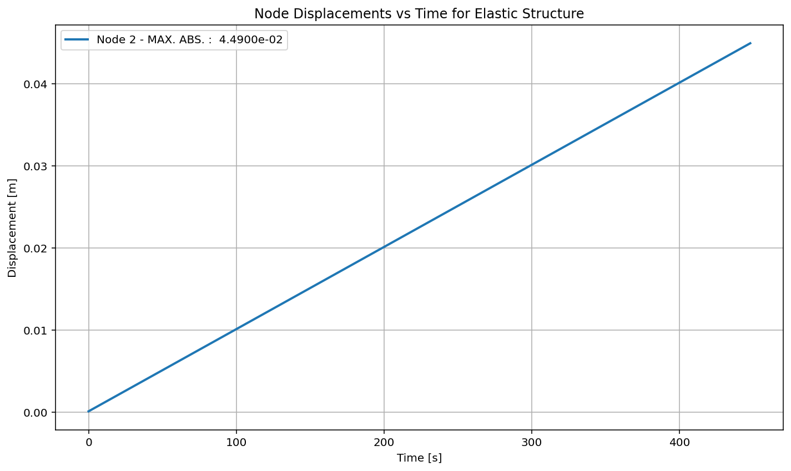

Slide 19


Slide 20
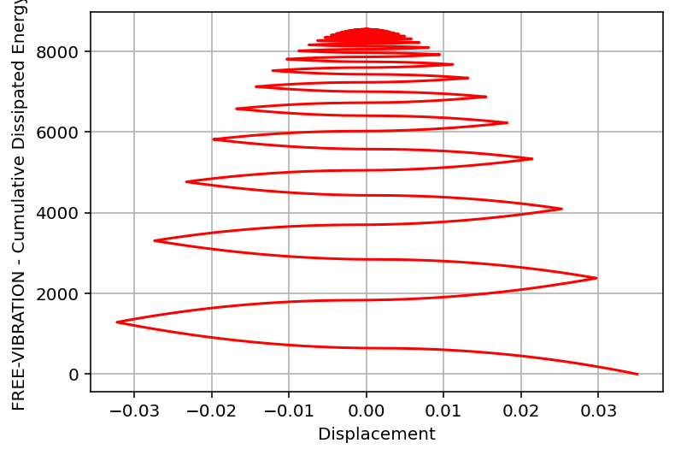

Slide 21
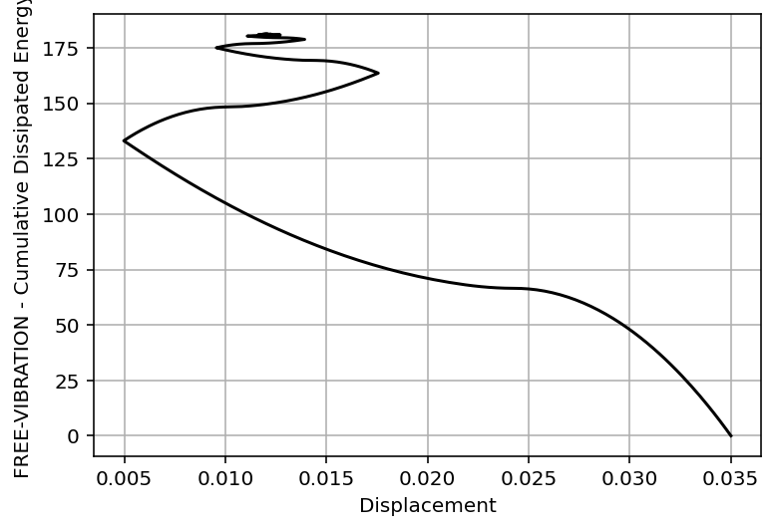

Slide 22
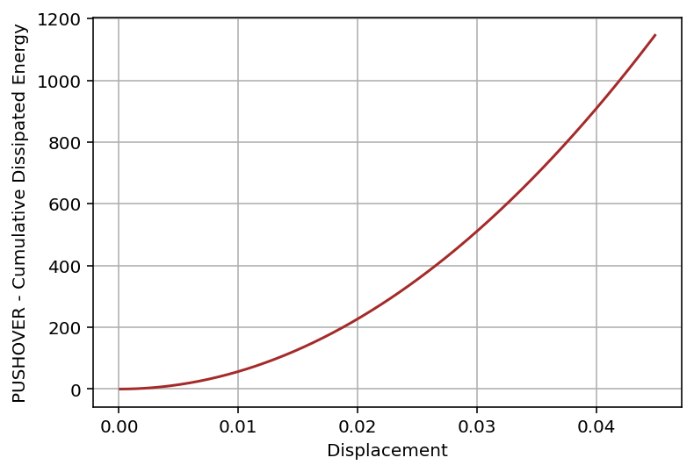

Slide 23
