Slide 1
>> IN THE NAME OF ALLAH, THE MOST GRACIOUS, THE MOST MERCIFUL <<
SIMULATE THE FREE-VIBRATION RESPONSE OF A SINGLE-DEGREE-OF-FREEDOM (SDOF) STRUCTURE INCORPORATING A PARALLEL CONTACT/GAP MECHANISM TO MODEL STAGED STIFFNESS ACTIVATION USING OPENSEES
WRITTEN BY SALAR DELAVAR GHASHGHAEI (QASHQAI)

Slide 2
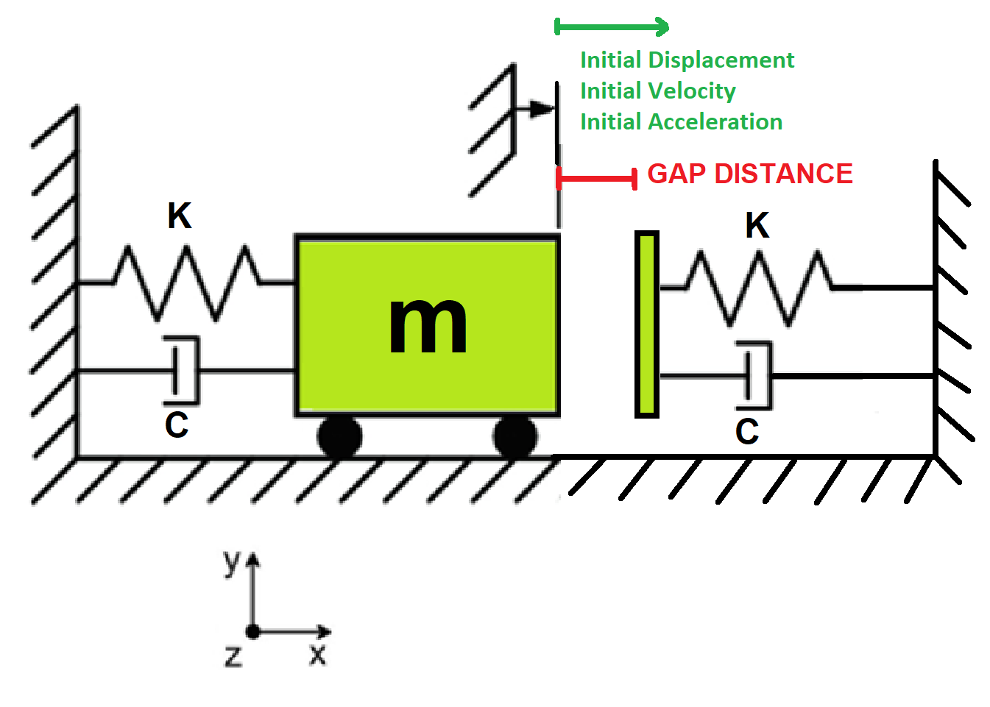

Slide 3
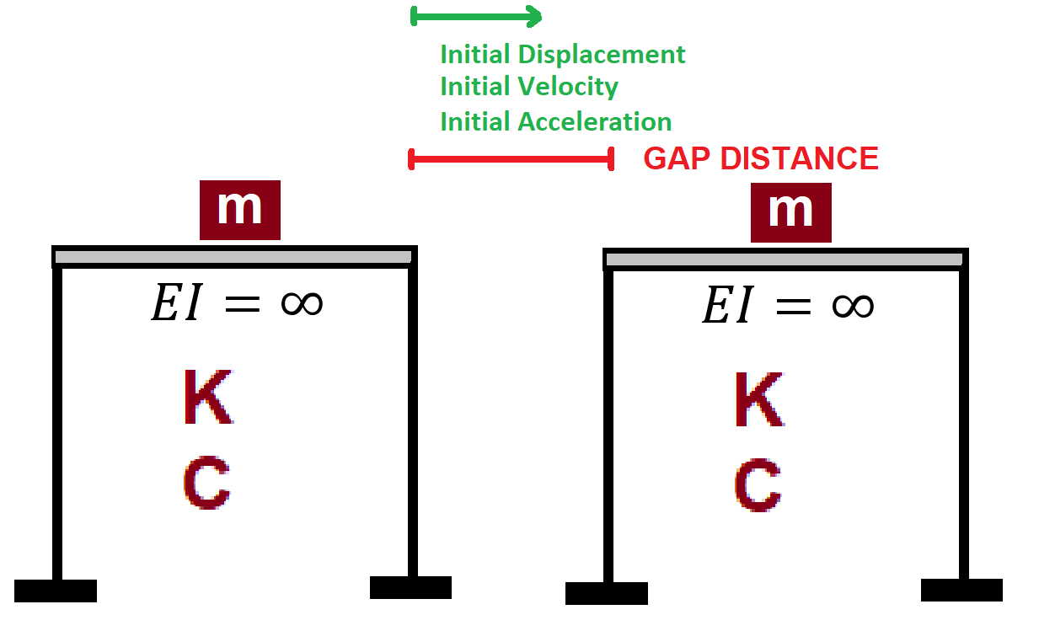

Slide 4
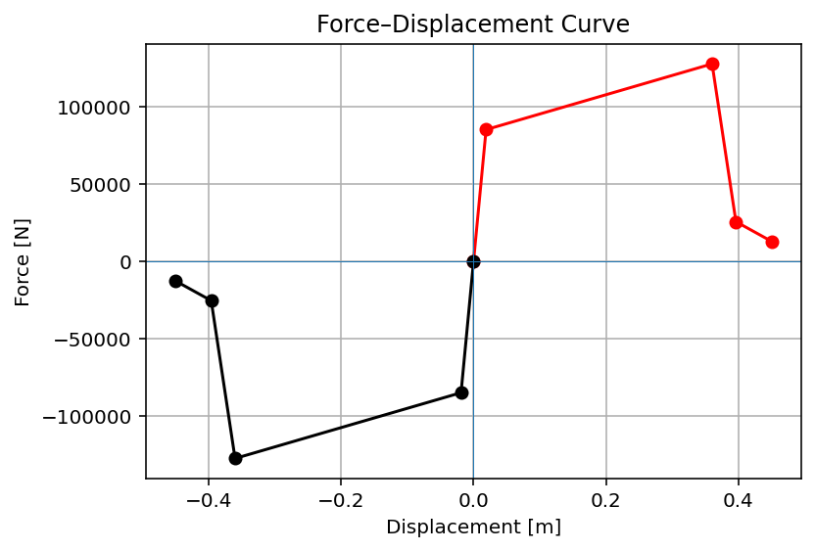

Slide 5
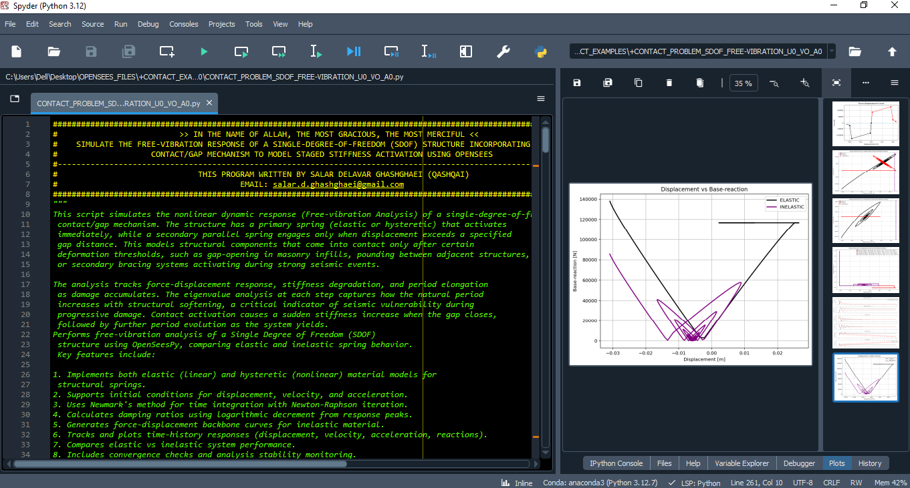

Slide 6
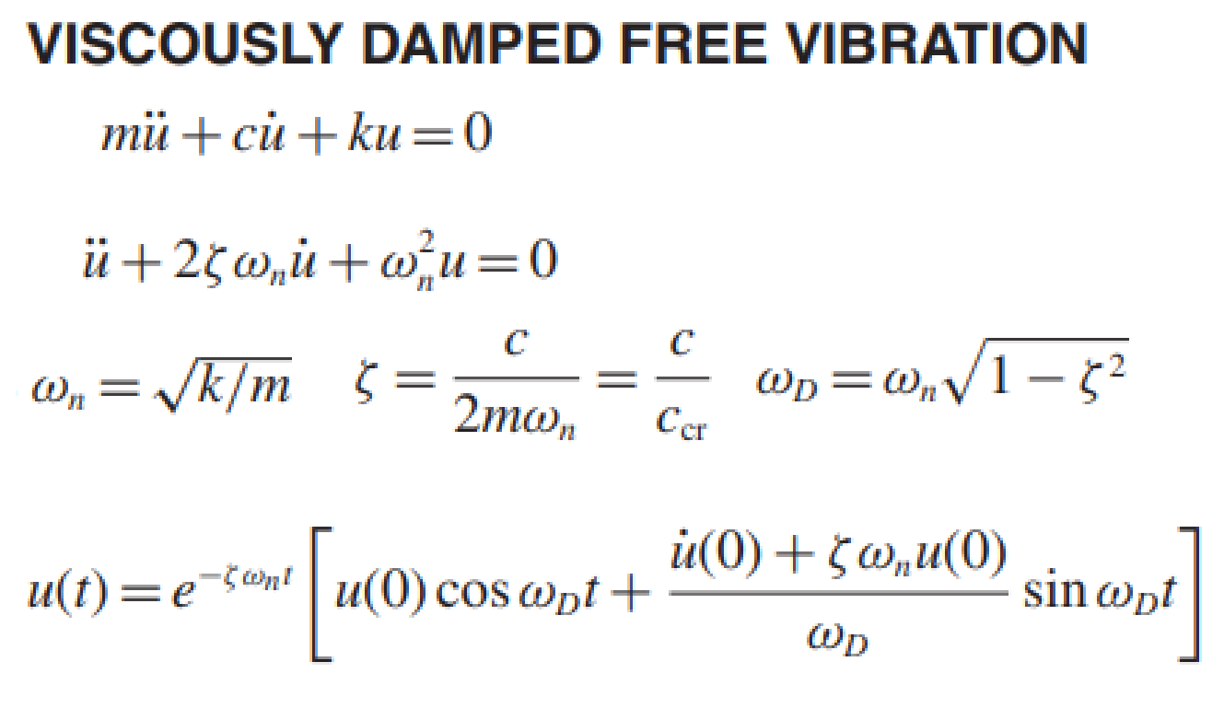
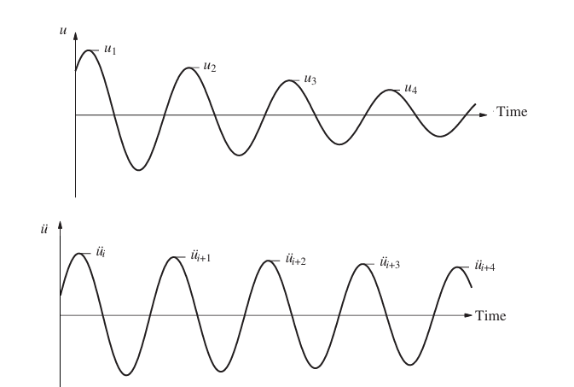
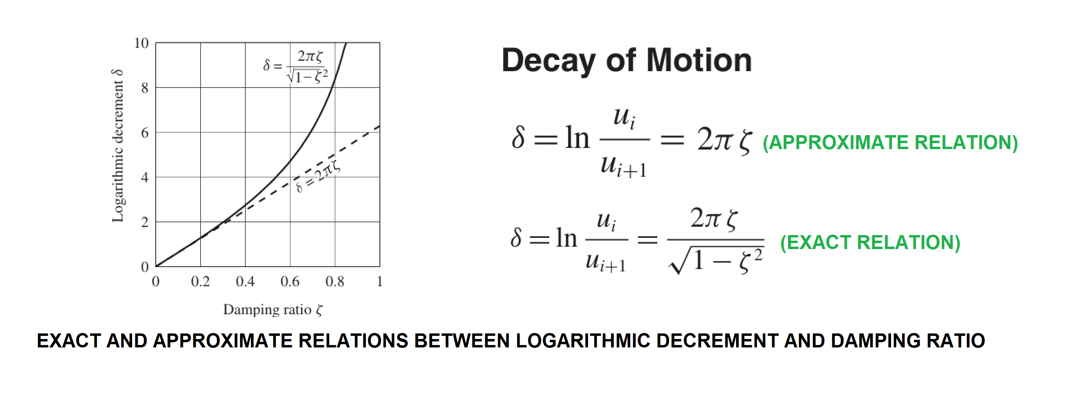

Slide 7
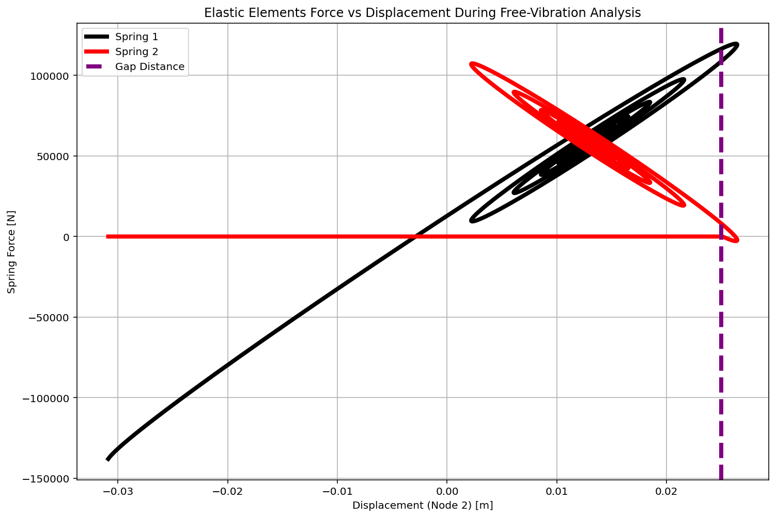

Slide 8
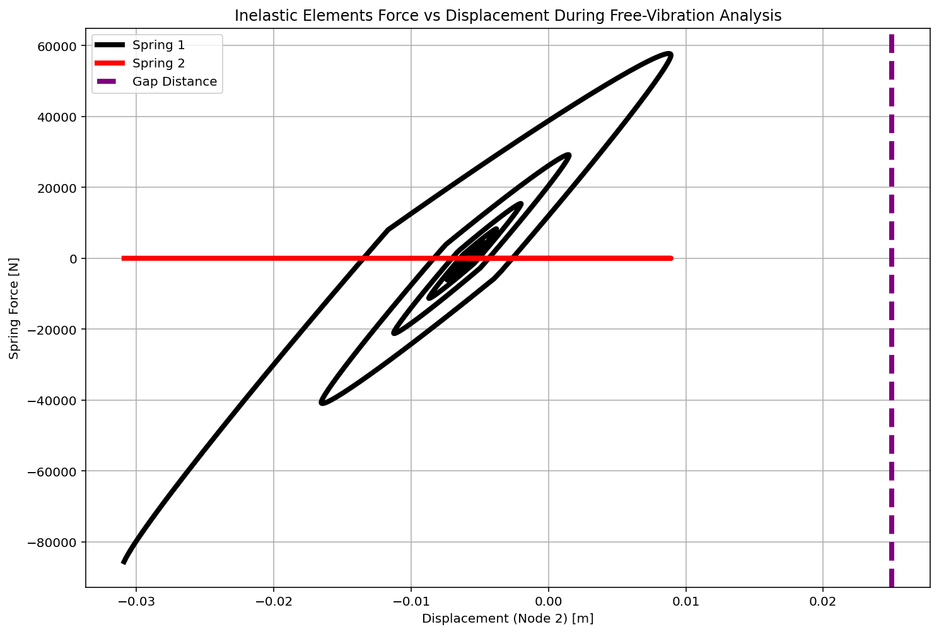

Slide 9
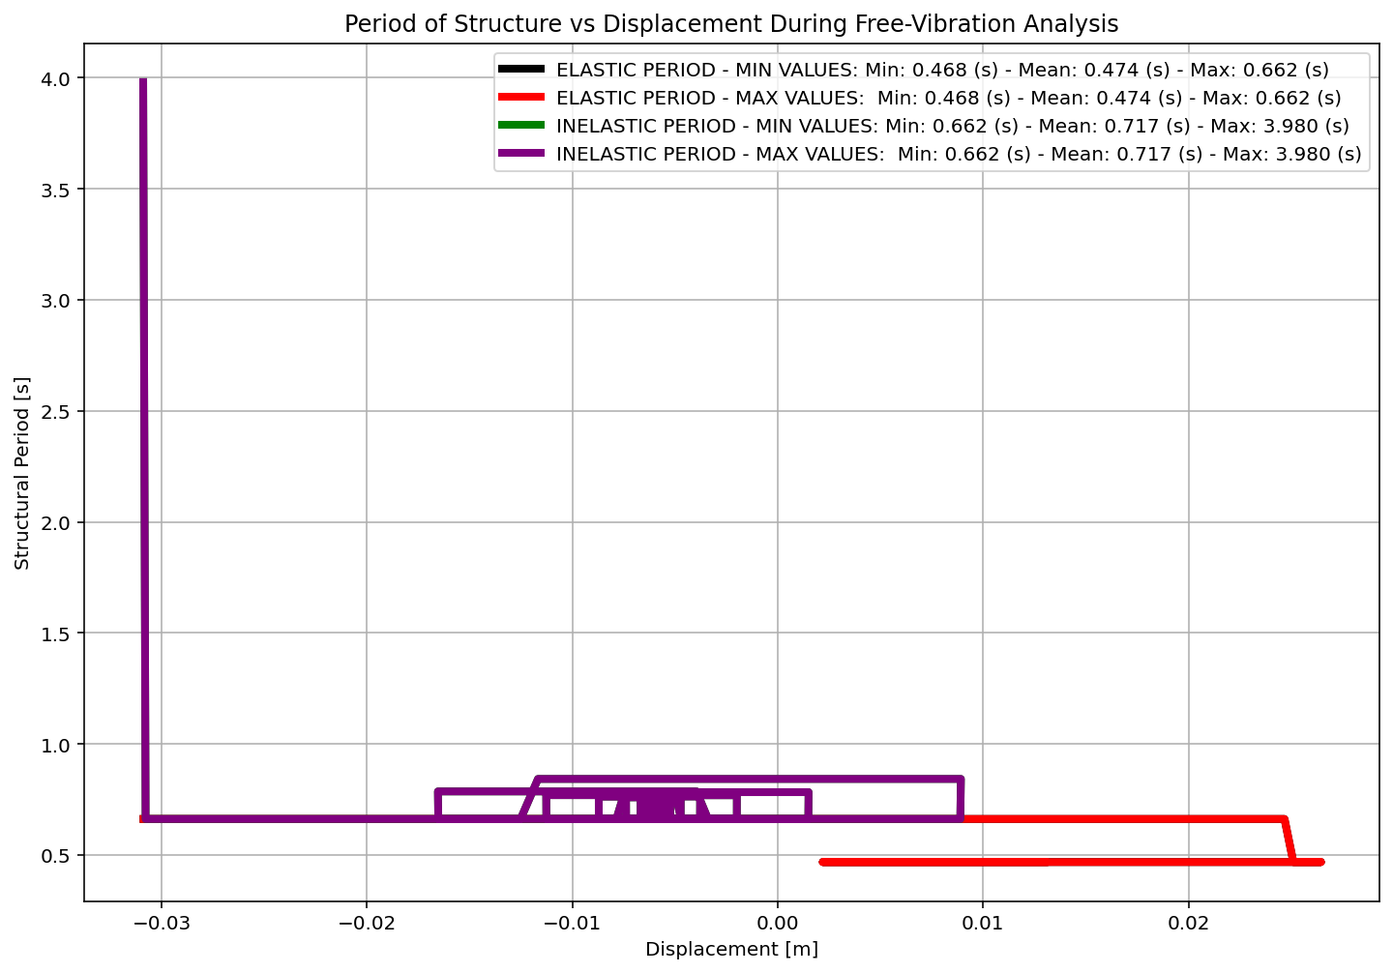

Slide 10
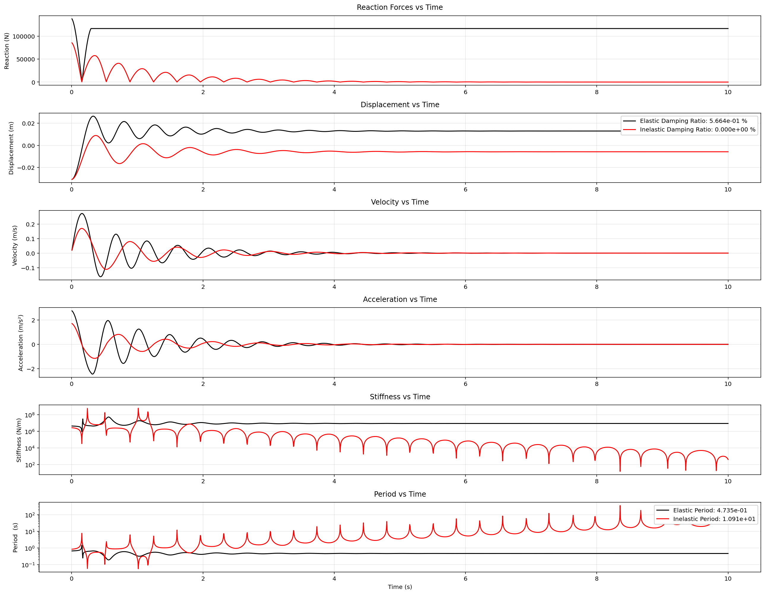

Slide 11
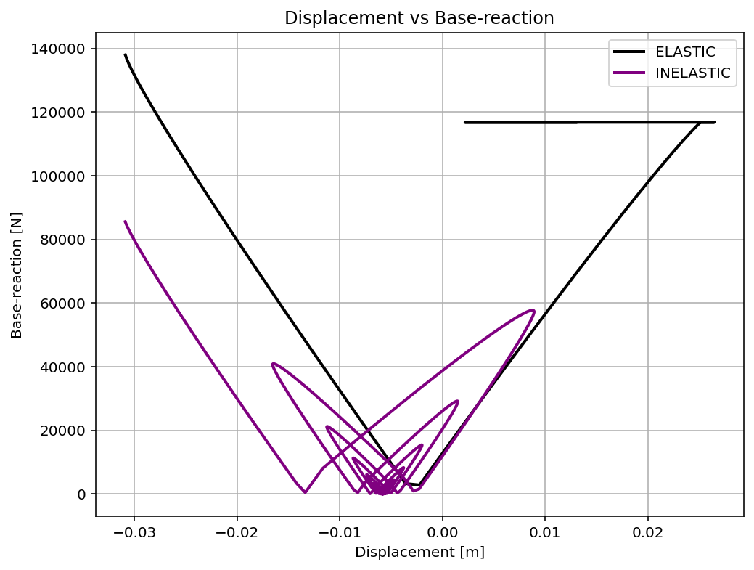

Slide 12
