Slide 1
>> IN THE NAME OF ALLAH, THE MOST GRACIOUS, THE MOST MERCIFUL <<
DETERMINATION OF OPTIMUM STRUCTURAL ULTIMATE DISPLACEMENT FROM ENERGY DISSIPATION CAPACITY INDEX USING FINITE‑DIFFERENCE NEWTON ITERATION AND OPENSEES
THIS PROGRAM WRITTEN BY SALAR DELAVAR GHASHGHAEI (QASHQAI)

Slide 2
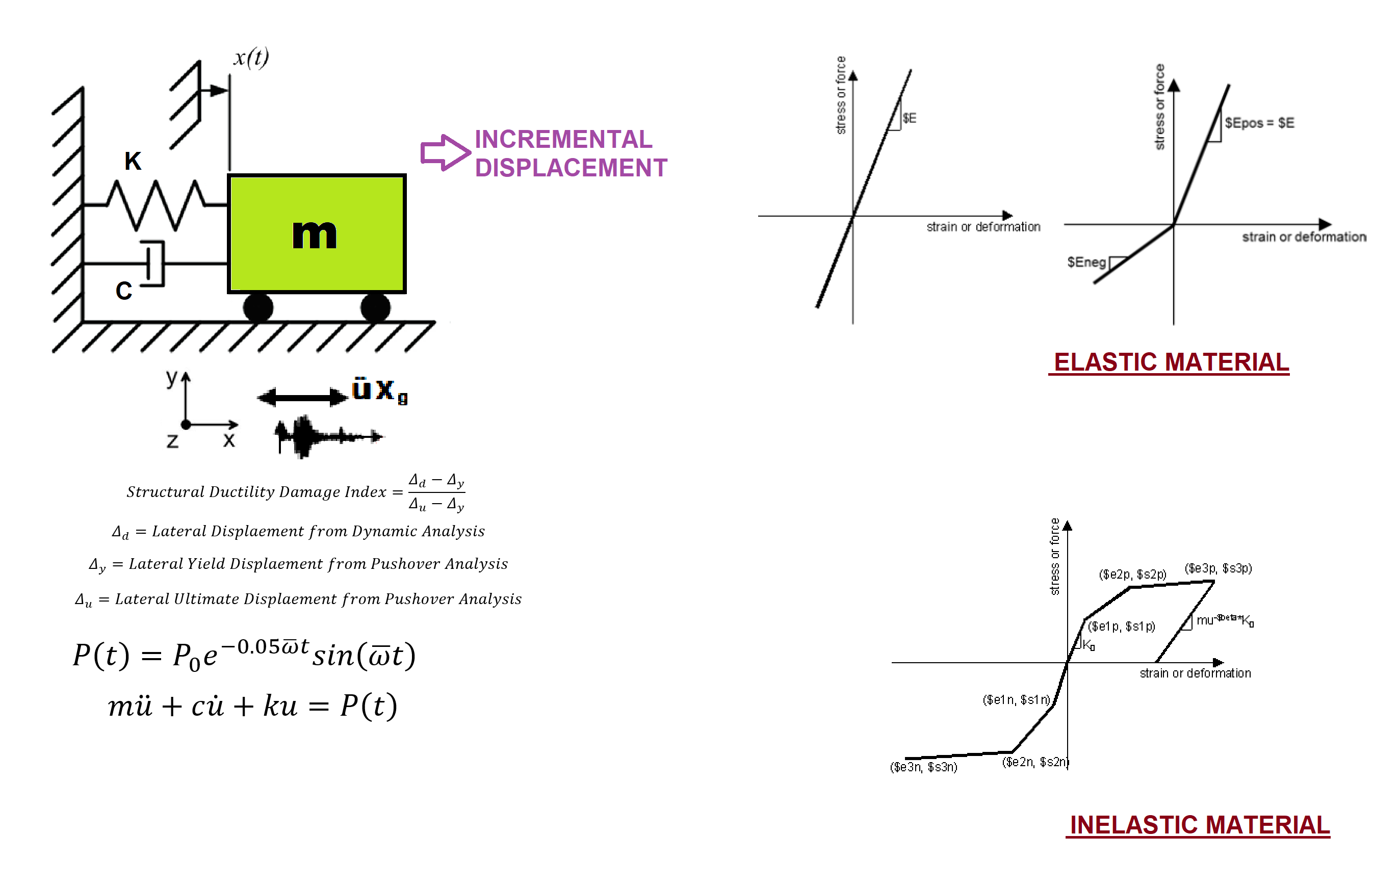

Slide 3
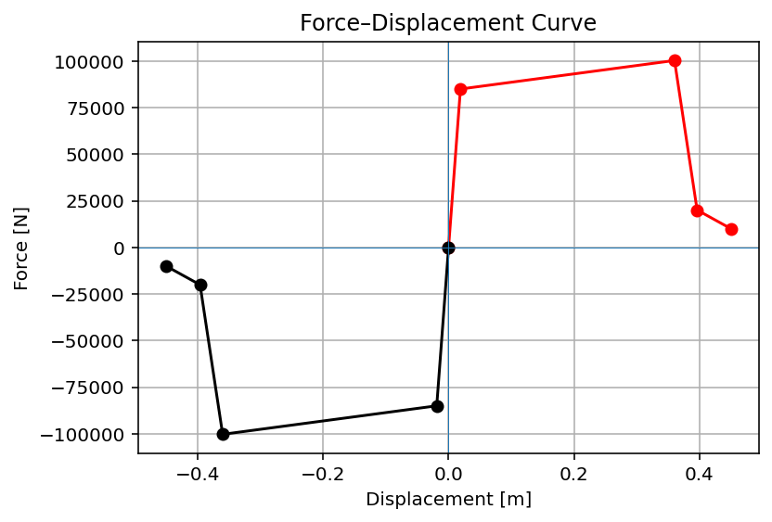

Slide 4
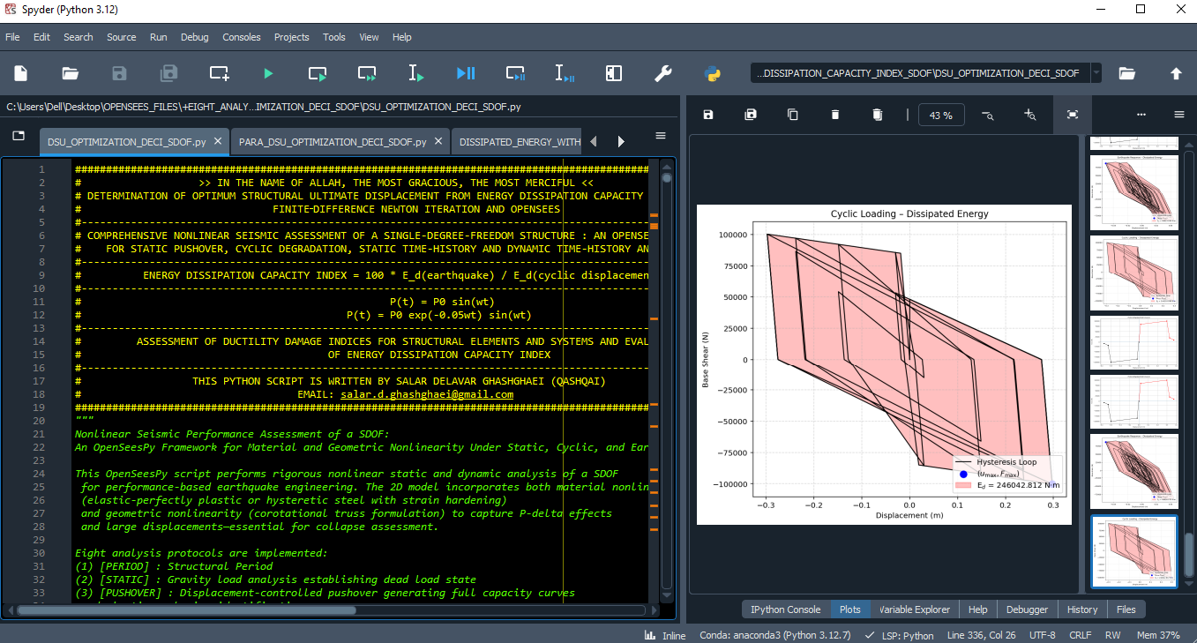

Slide 5
OPTIMIZATION PROBLEM FOR ENERGY DISSIPATION CAPACITY INDEX (EDCI)

Slide 6
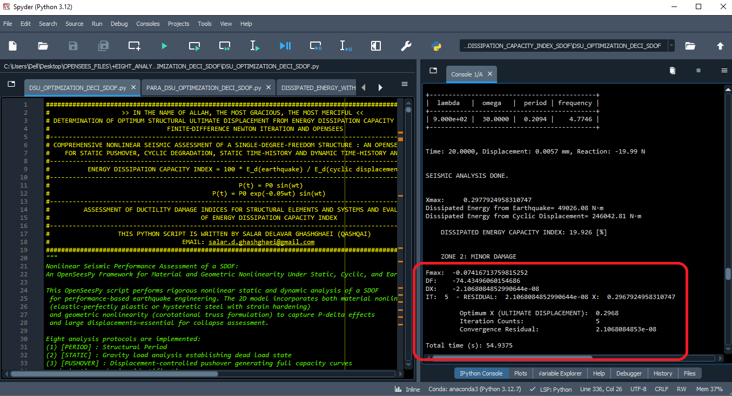

Slide 7
Dissipated Energy from Earthquake= 49026.08 N·m
Dissipated Energy from Cyclic Displacement= 246042.81 N·m
DISSIPATED ENERGY CAPACITY INDEX: 19.926 [%]
ZONE 2: MINOR DAMAGE
Fmax: -0.07416713759815252
DF: -74.43496060154686
DX: -2.1068084852990644e-08
IT: 5 - RESIDUAL: 2.1068084852990644e-08 X: 0.2967924958310747
Optimum X (ULTIMATE DISPLACEMENT): 0.2968
Iteration Counts: 5
Convergence Residual: 2.1068084853e-08
Total time (s): 54.9375

Slide 8
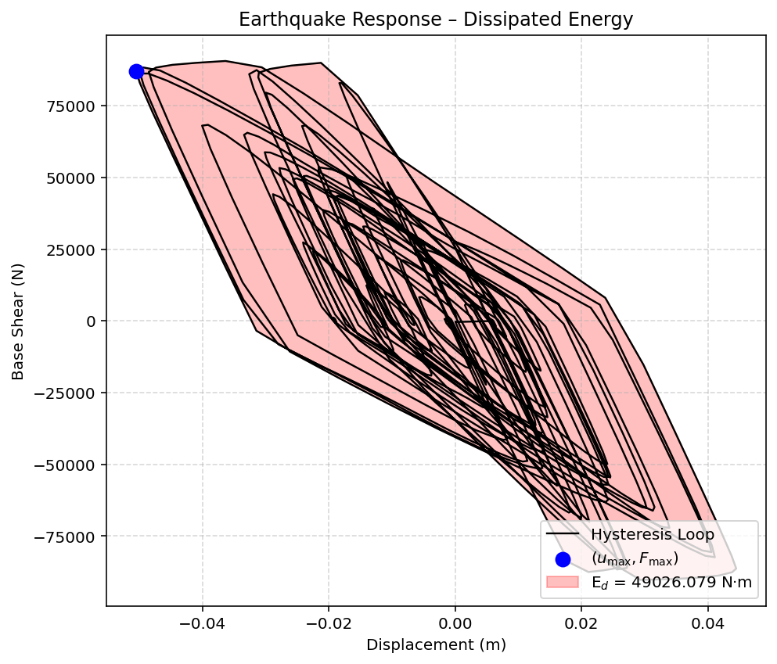

Slide 9
