Slide 1
>> IN THE NAME OF ALLAH, THE MOST GRACIOUS, THE MOST MERCIFUL <<
PUSHOVER ANALYSIS OF A MULTI-DEGREE-OF-FREEDOM STRUCTURE VIA EVALUATION OF A MULTILINEAR FITTING CURVE
THIS PYTHON SCRIPT IS WRITTEN BY SALAR DELAVAR GHASHGHAEI (QASHQAI)

Slide 2


Slide 3
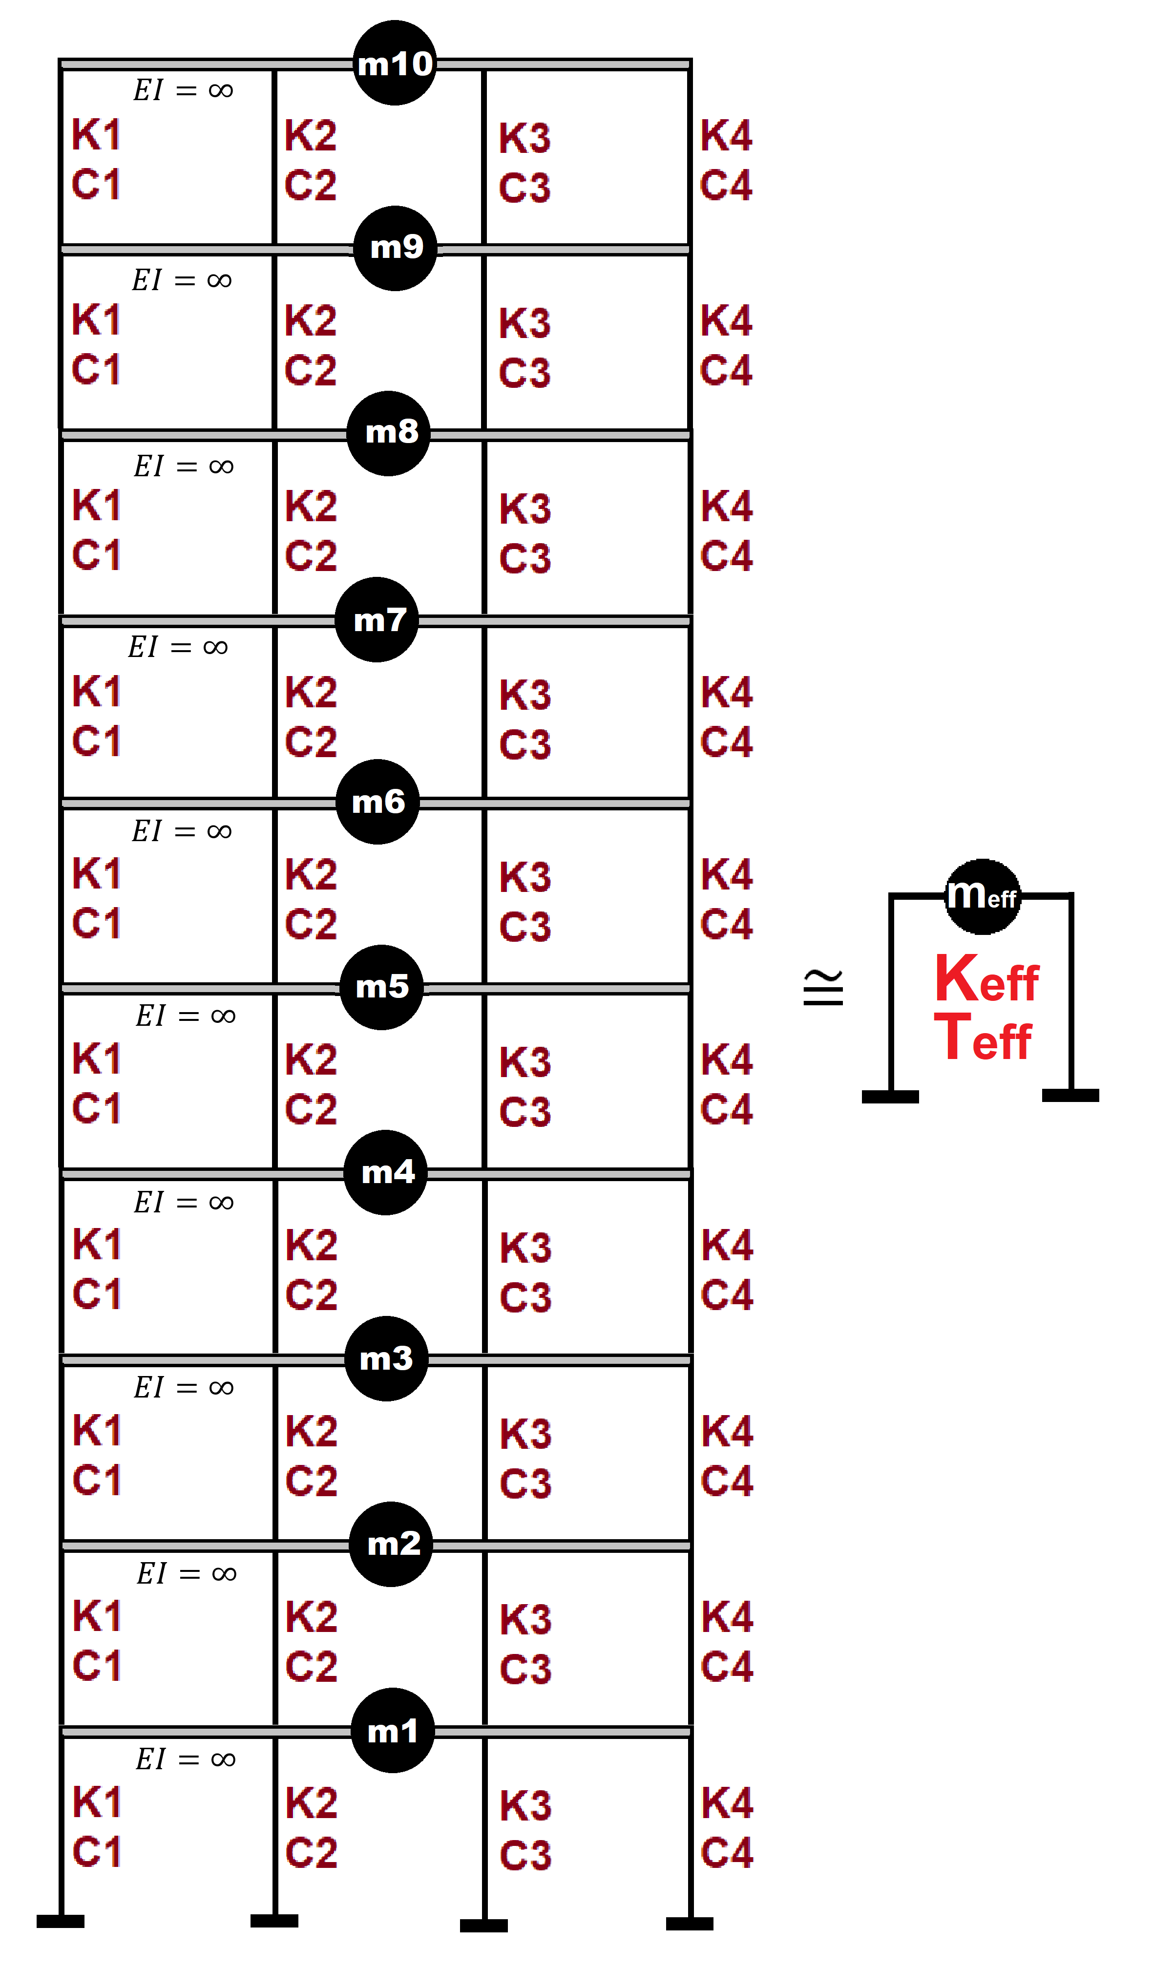

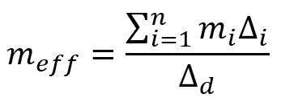
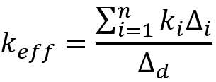
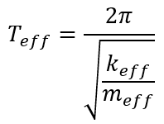
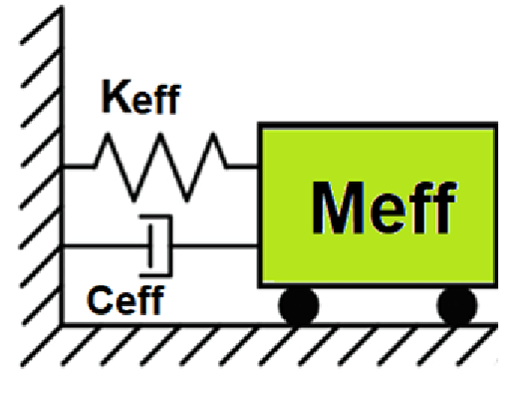
Displacement-based seismic analysis transformation,
converting a multi-degree-of-freedom (MDOF) system
into an equivalent single-degree-of-freedom (SDOF)
system for seismic assessment

Slide 4
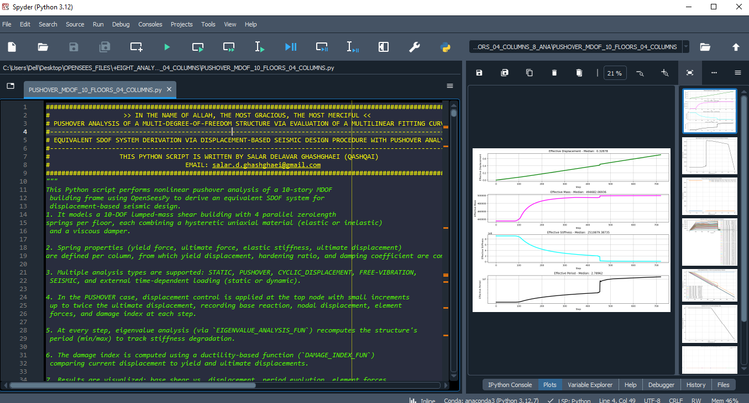

Slide 5
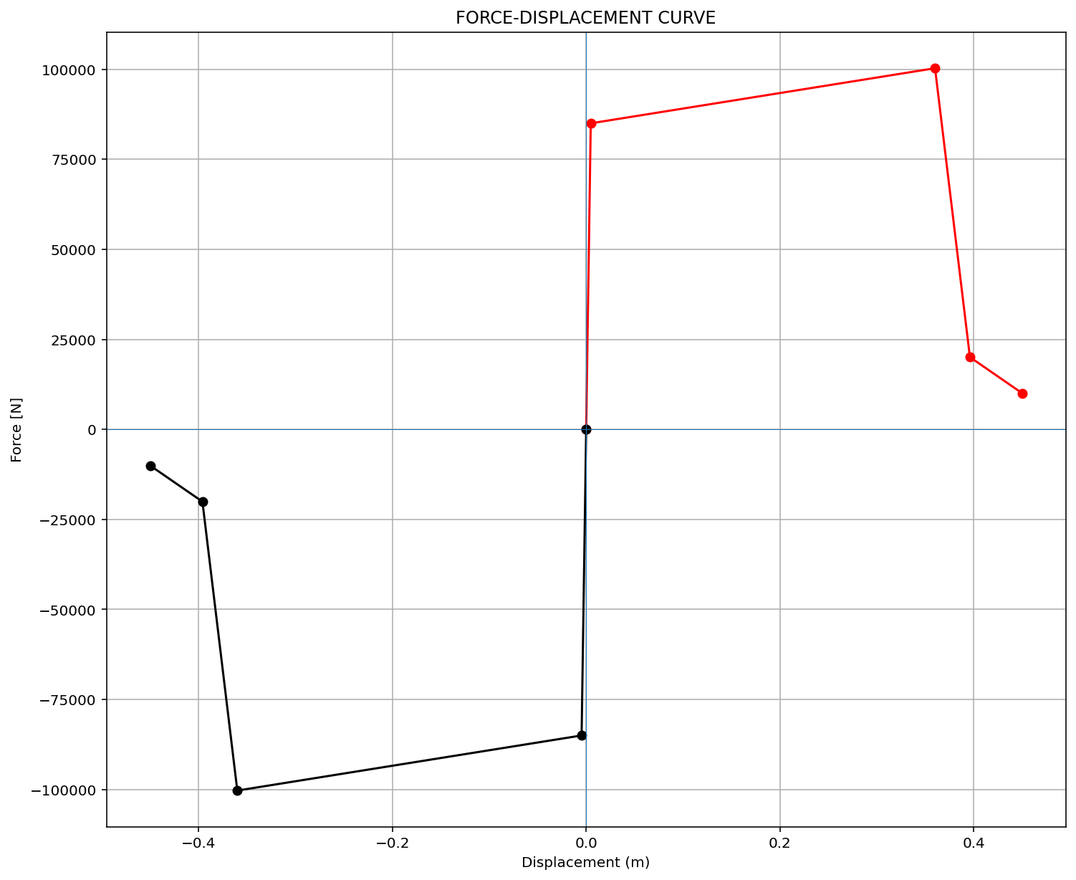
ELEMENT 01

Slide 6

ELEMENT 02

Slide 7
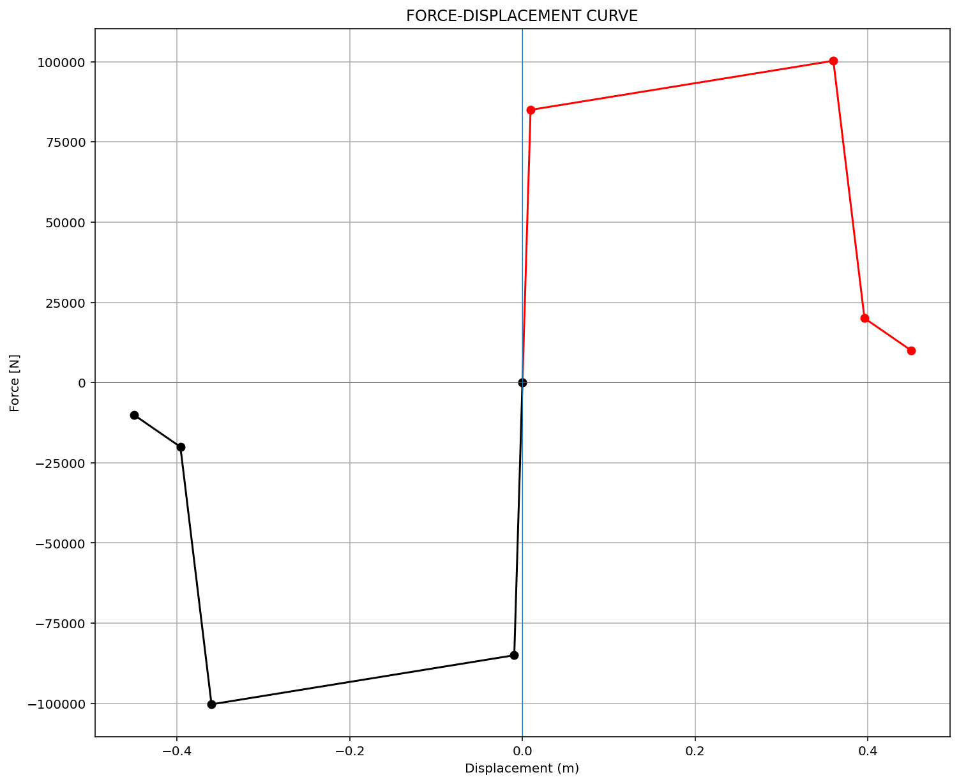
ELEMENT 03

Slide 8
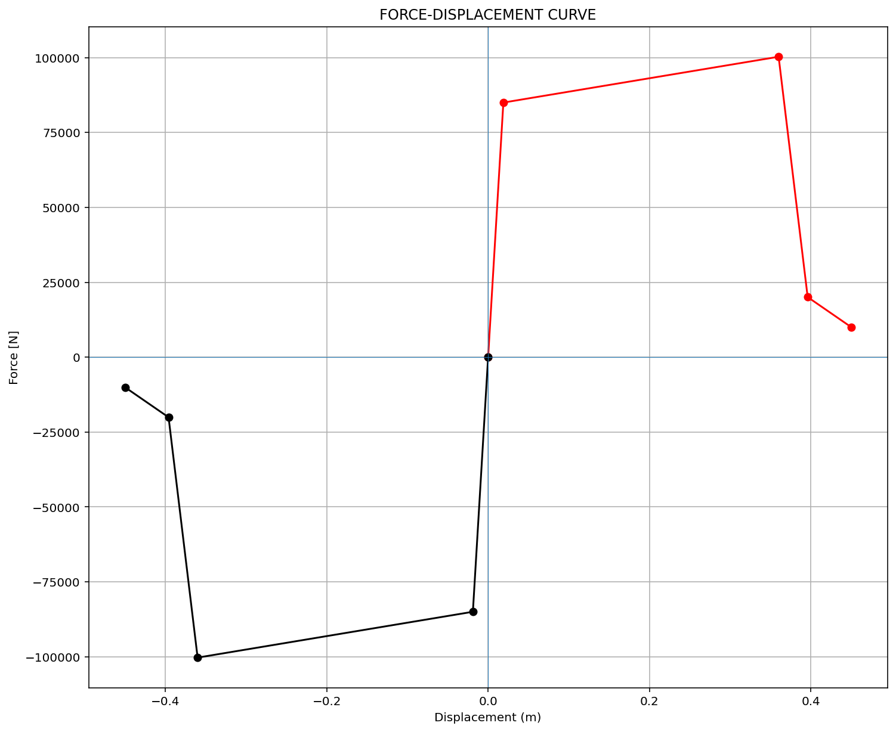
ELEMENT 04

Slide 9
PUSHOVER ANALYSIS

Slide 10
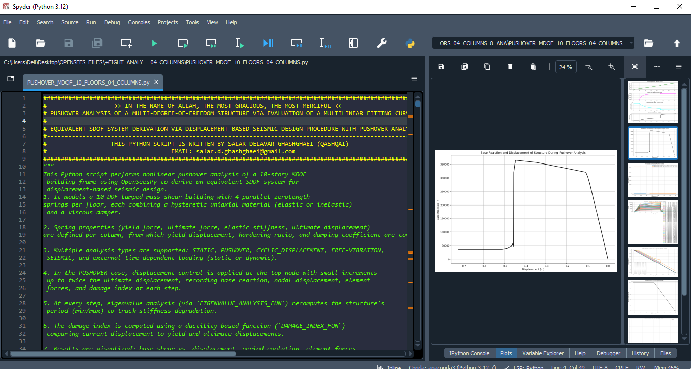

Slide 11
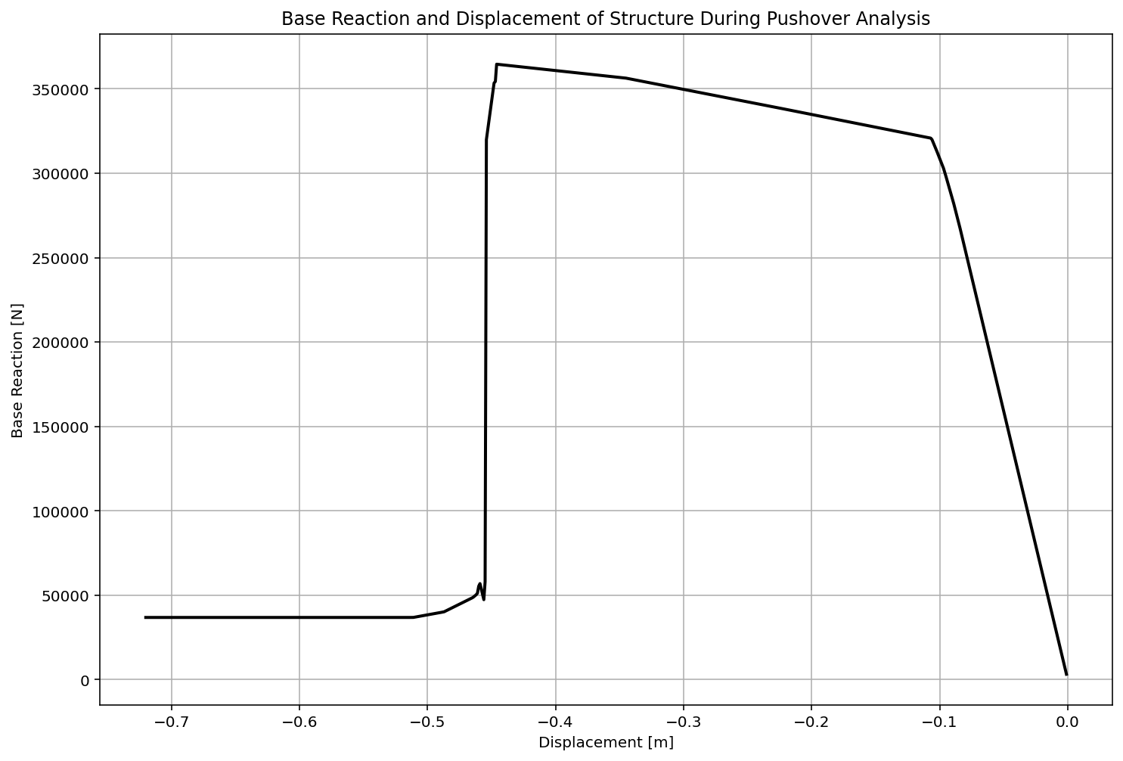

Slide 12
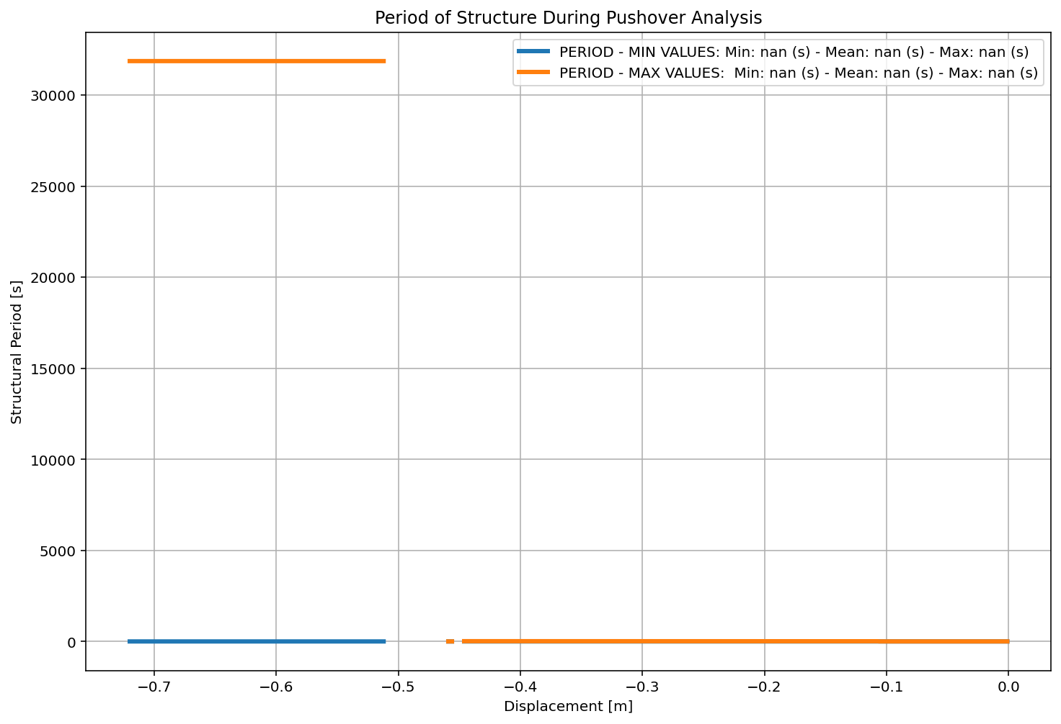

Slide 13
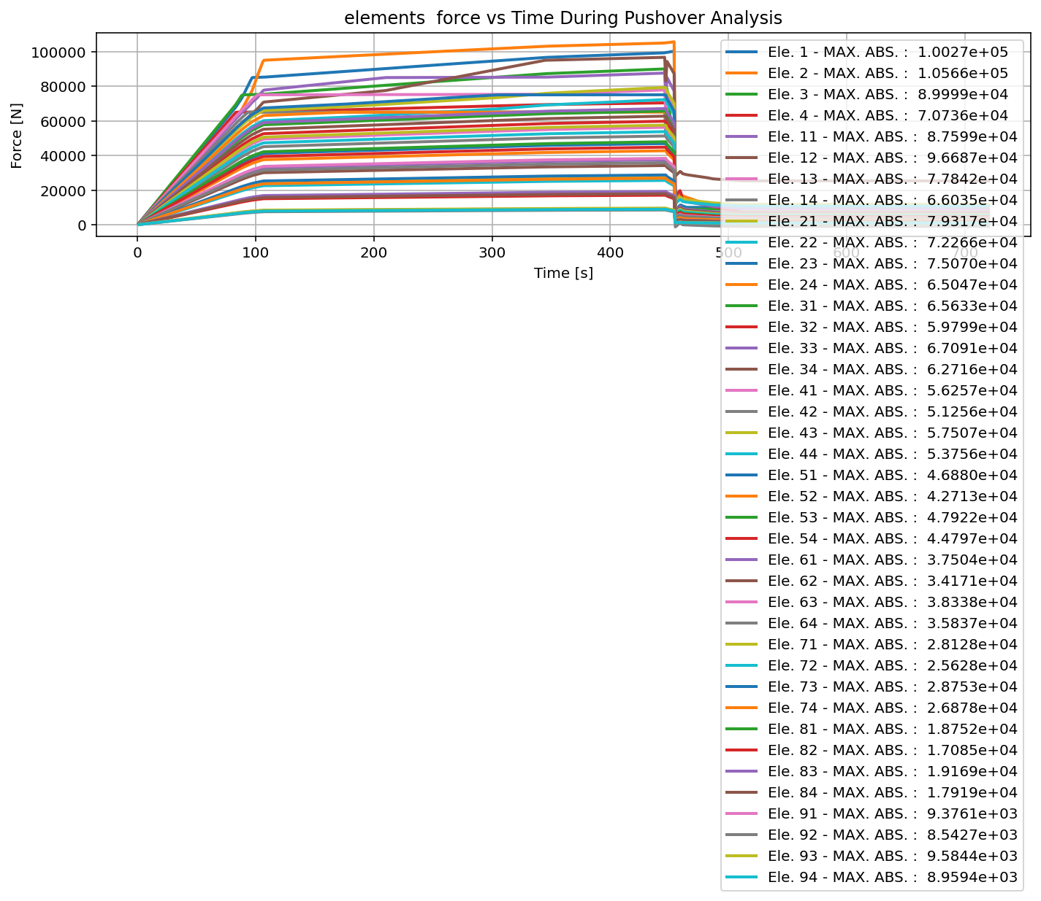

Slide 14
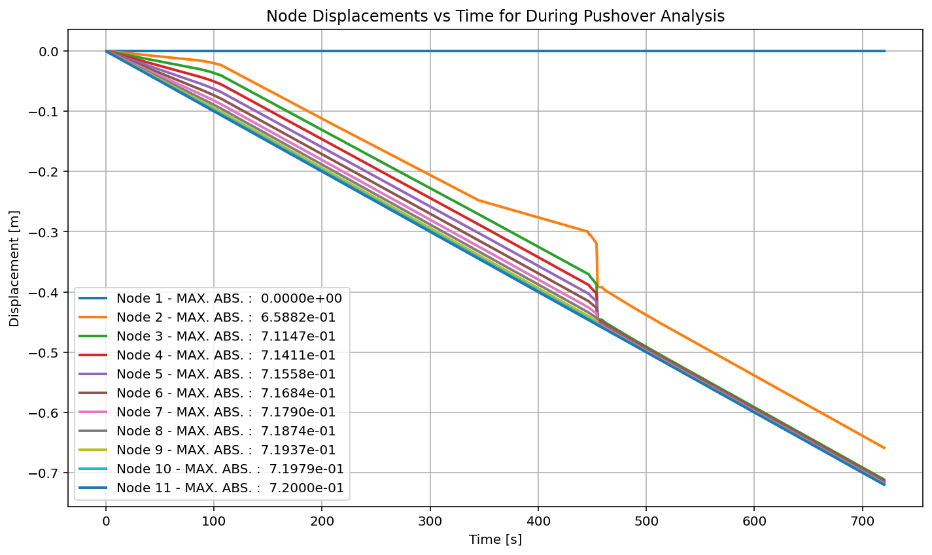

Slide 15
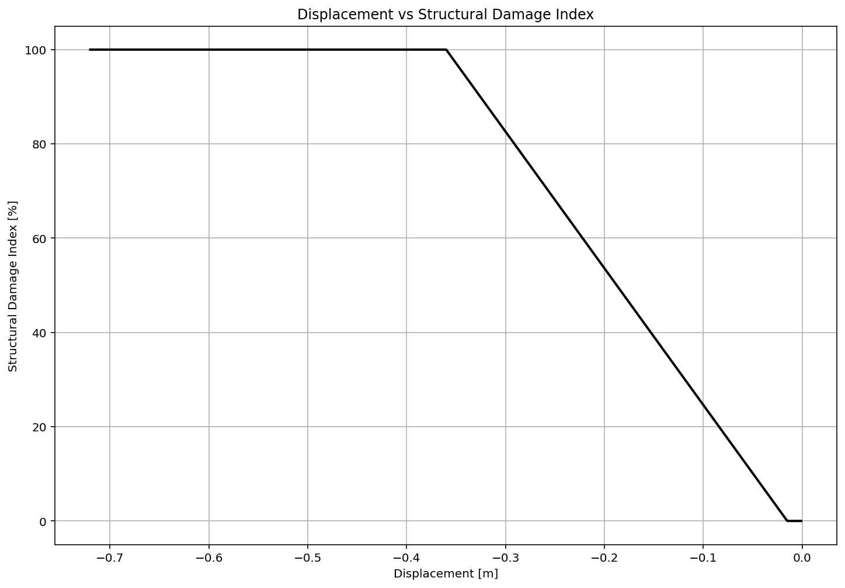

Slide 16
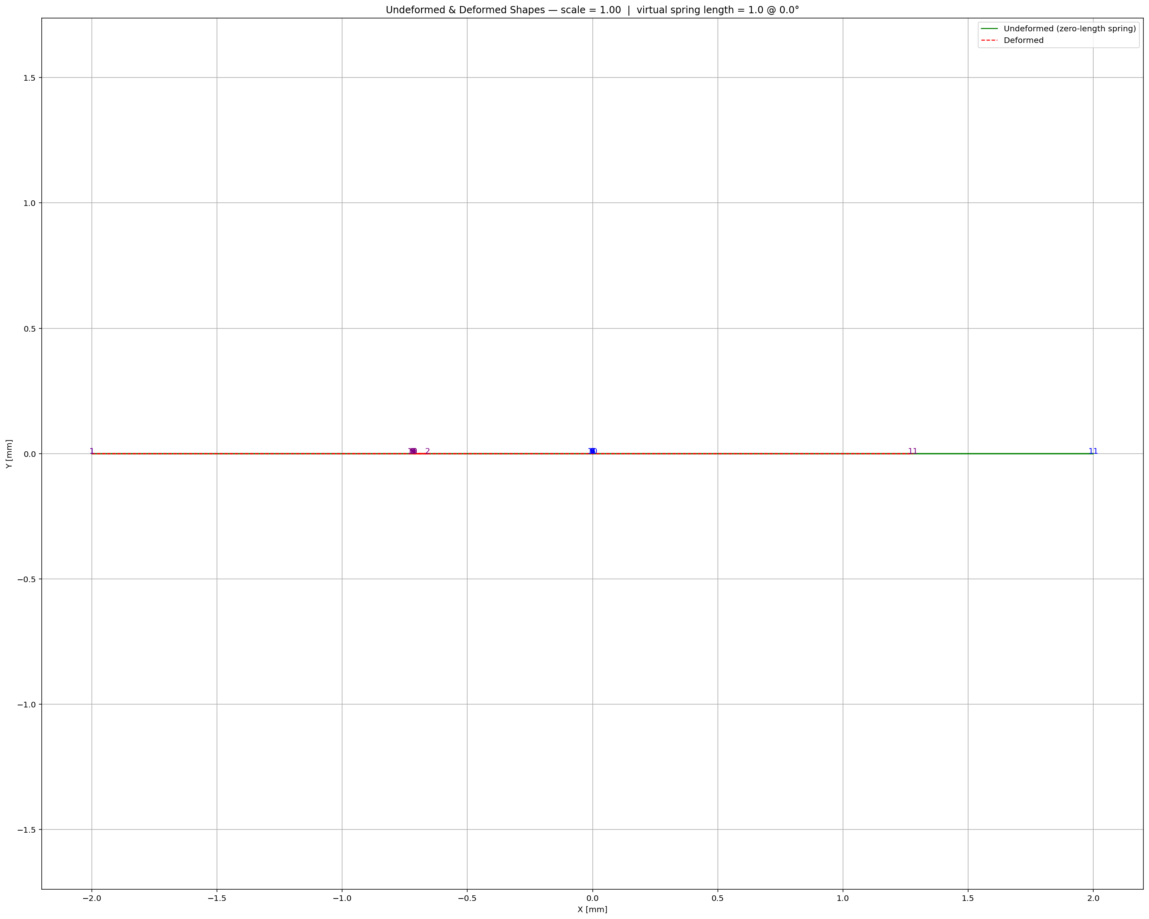

Slide 17
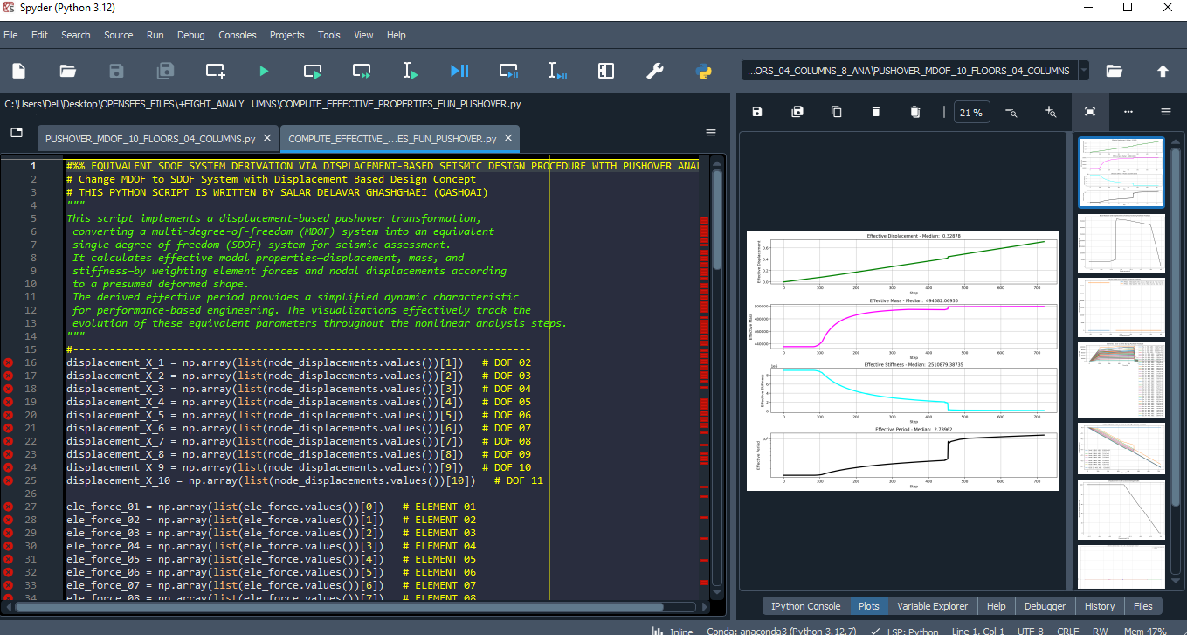

Slide 18
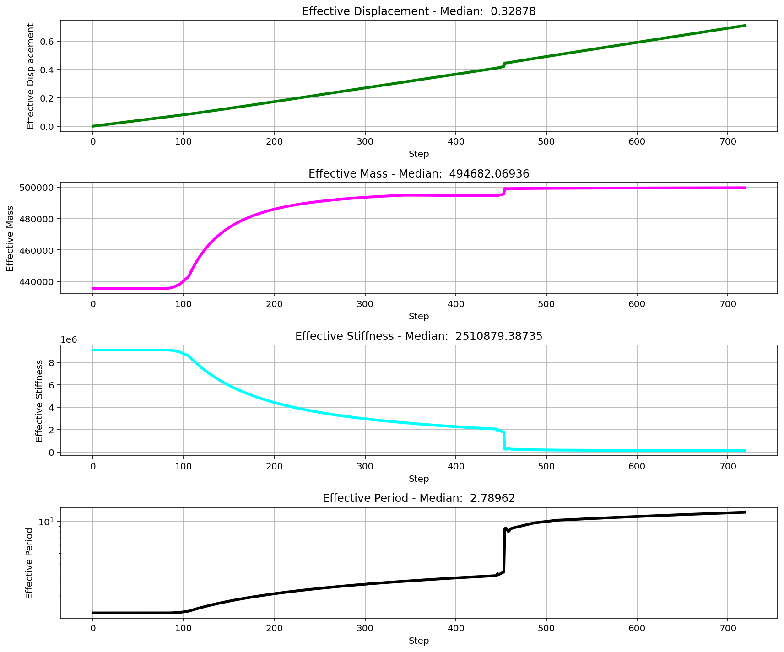

Slide 19
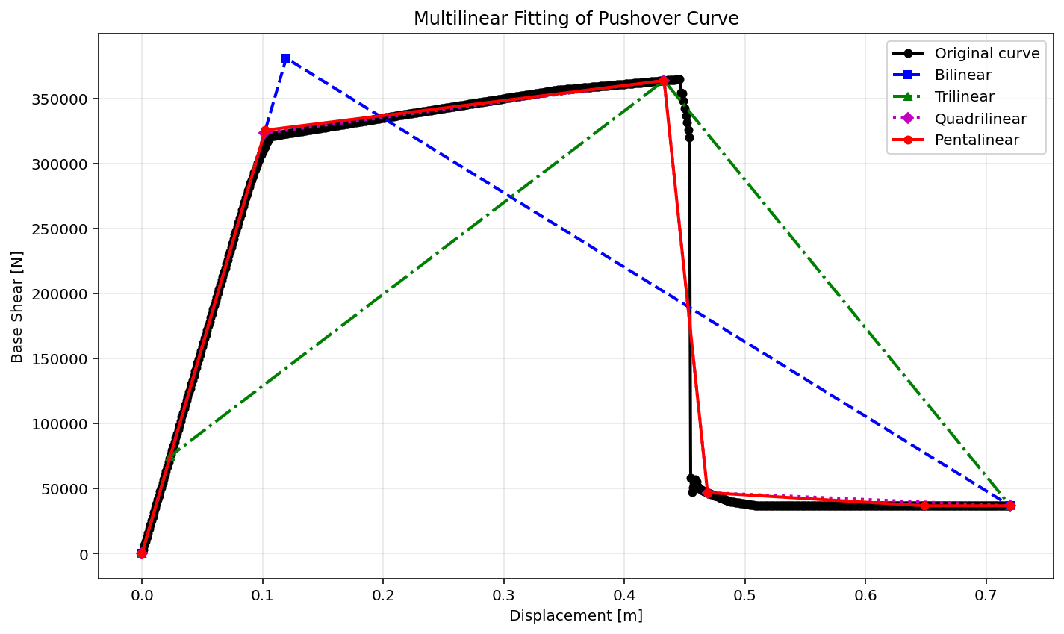

Slide 20
BILINEAR CURVE
+==========================+
= Analysis curve fitted =
Disp Base Shear
----------------------------
[[0.00000000e+00 0.00000000e+00]
[1.19655567e-01 3.80722259e+05]
[7.20000000e-01 3.68200000e+04]]
+==========================+
+----------------------------------------------------+
Structure Elastic Stiffness : 3181818.18
Structure Plastic Stiffness : 51138.89
Structure Tangent Stiffness : [3181818.18 -572841.59]
Structure Ductility Ratio : 6.02
Structure Over Strength Factor: 0.10
+----------------------------------------------------+

Slide 21
TRILINEAR CURVE
+==========================+
= Analysis curve fitted =
Disp Base Shear
----------------------------
[[0.00000000e+00 0.00000000e+00]
[2.35630358e-02 7.49732957e+04]
[4.33000000e-01 3.63556135e+05]
[7.20000000e-01 3.68200000e+04]]
+==========================+
+----------------------------------------------------+
Structure Elastic Stiffness : 3181818.18
Structure Plastic Stiffness : 51138.89
Structure Tangent Stiffness : [ 3181818.18 704828.5 -1138453.43]
Structure Ductility Ratio : 30.56
Structure Over Strength Factor: 0.49
+----------------------------------------------------+

Slide 22
QUADRILINEAR CURVE
+==========================+
= Analysis curve fitted =
Disp Base Shear
----------------------------
[[0.00000000e+00 0.00000000e+00]
[1.01558313e-01 3.23140086e+05]
[4.33000000e-01 3.63556135e+05]
[4.69000000e-01 4.69601085e+04]
[7.20000000e-01 3.68200000e+04]]
+==========================+
+----------------------------------------------------+
Structure Elastic Stiffness : 3181818.18
Structure Plastic Stiffness : 51138.89
Structure Tangent Stiffness : [ 3181818.18 121940.15 -8794334.08 -40398.84]
Structure Ductility Ratio : 7.09
Structure Over Strength Factor: 0.11
+----------------------------------------------------+

Slide 23
PENTALINEAR CURVE
+==========================+
= Analysis curve fitted =
Disp Base Shear
----------------------------
[[0.00000000e+00 0.00000000e+00]
[1.02268201e-01 3.25398820e+05]
[4.33000000e-01 3.63556135e+05]
[4.69000000e-01 4.69601085e+04]
[6.49000000e-01 3.68200000e+04]
[7.20000000e-01 3.68200000e+04]]
+==========================+
+----------------------------------------------------+
Structure Elastic Stiffness : 3181818.18
Structure Plastic Stiffness : 51138.89
Structure Tangent Stiffness : [ 3181818.18 115372.38 -8794334.08 -56333.94 0. ]
Structure Ductility Ratio : 7.04
Structure Over Strength Factor: 0.11
+----------------------------------------------------+

