Slide 1
IN THE NAME OF ALLAH, THE MOST GRACIOUS, THE MOST MERCIFUL
POST-BUCKLING ANALYSIS OF CONCRETE FRAME. EVALUATING STRAIN HARDENING AND ULTIMATE STRAIN CRITERIA USING OPENSEES
WRITTEN BY SALAR DELAVAR GHASHGHAEI (QASHQAI)

Slide 2
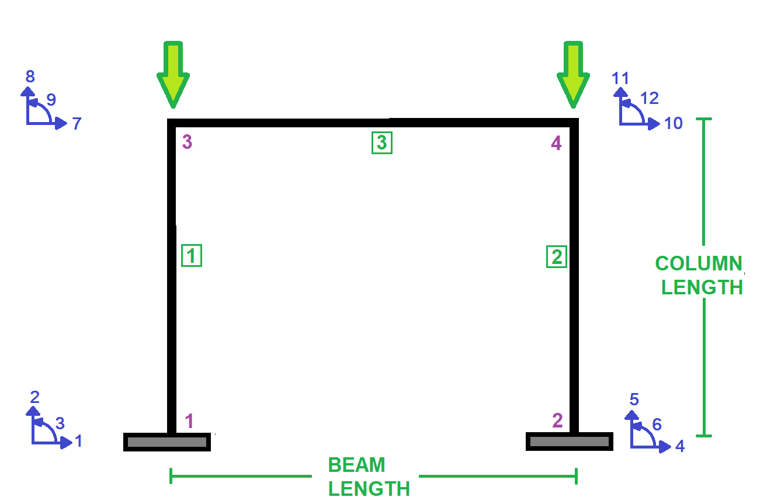

Slide 3
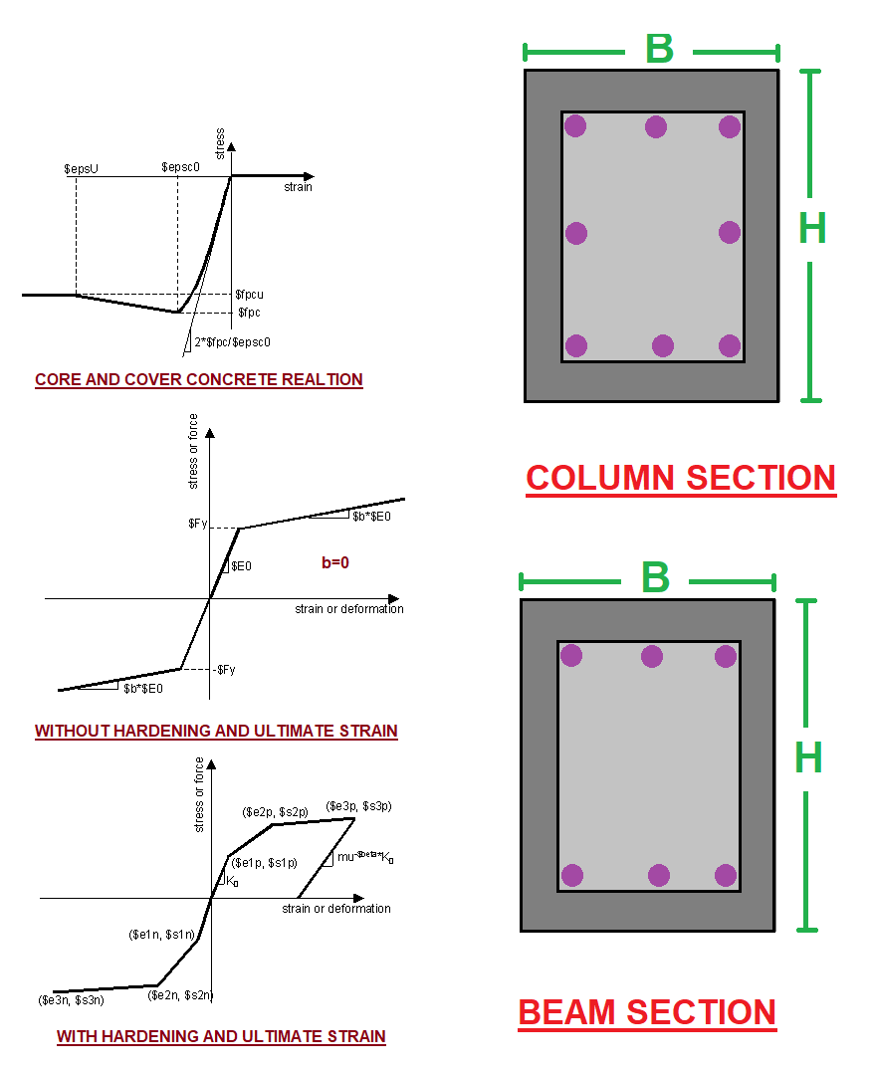

Slide 4
POST-BUCKLING ANALYSIS
(PUSHOVER)

Slide 5
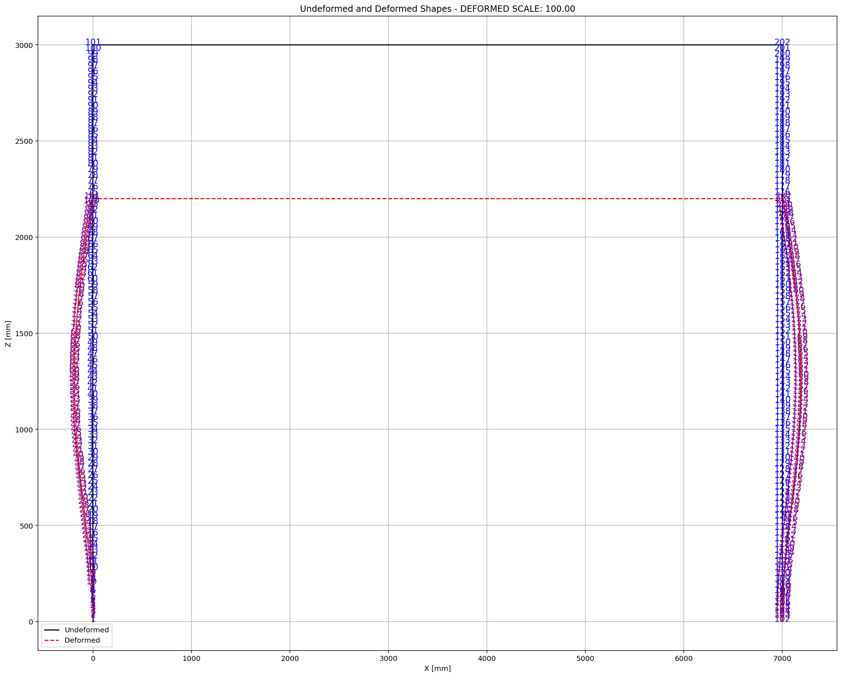

Slide 6
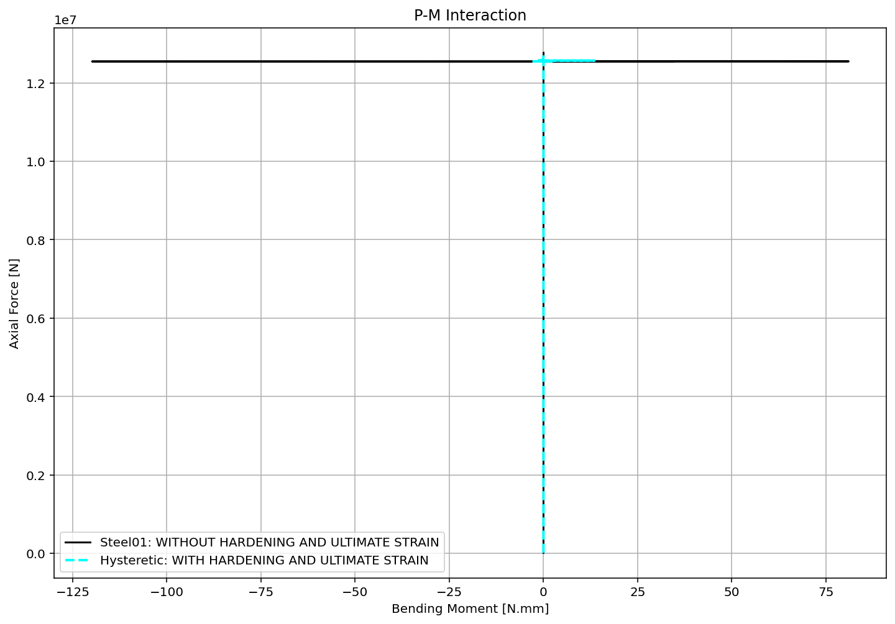

Slide 7
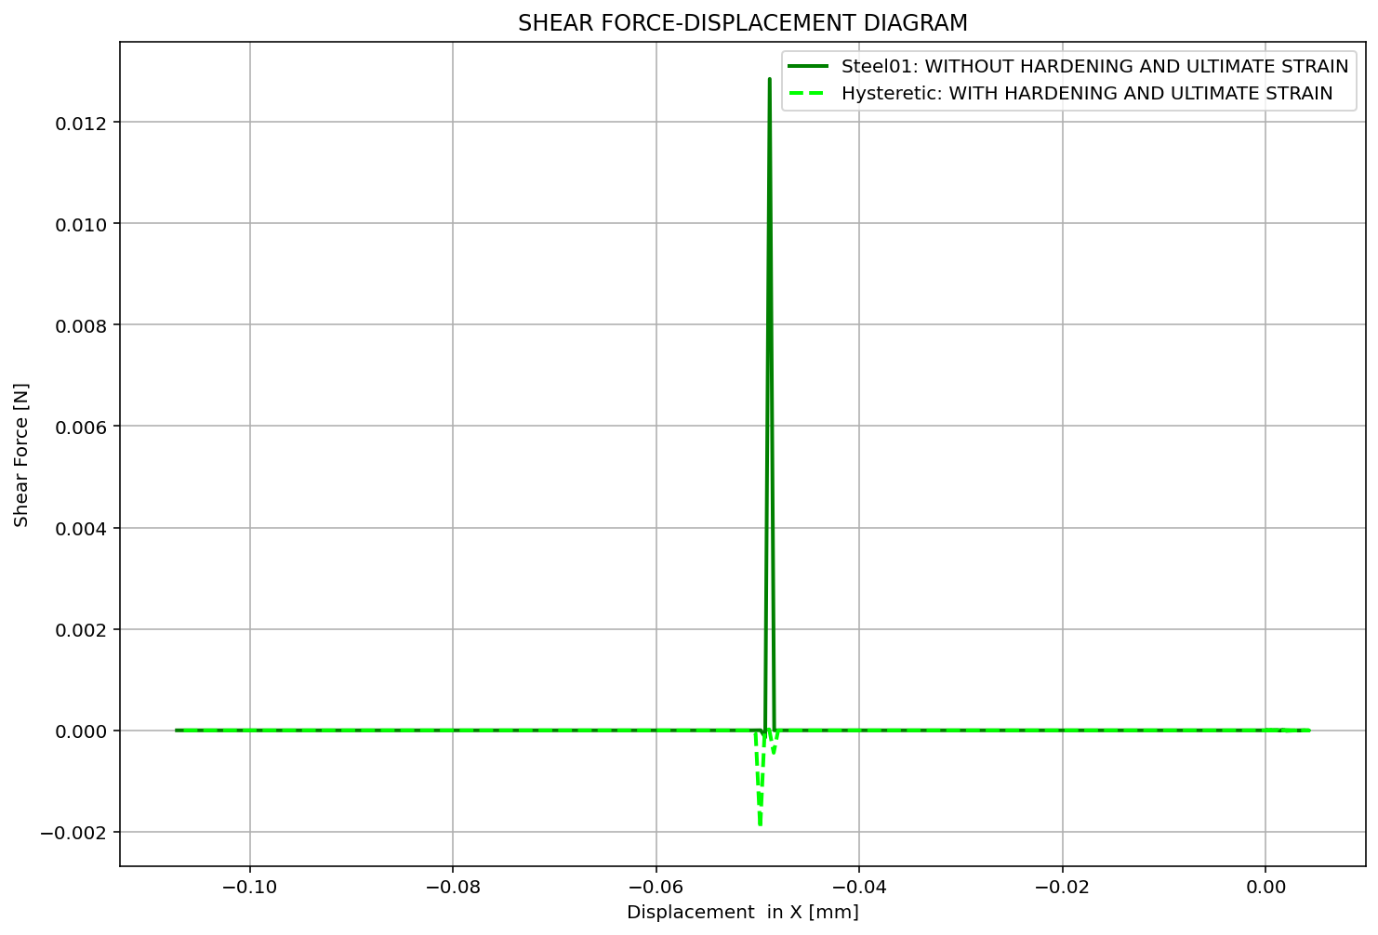

Slide 8
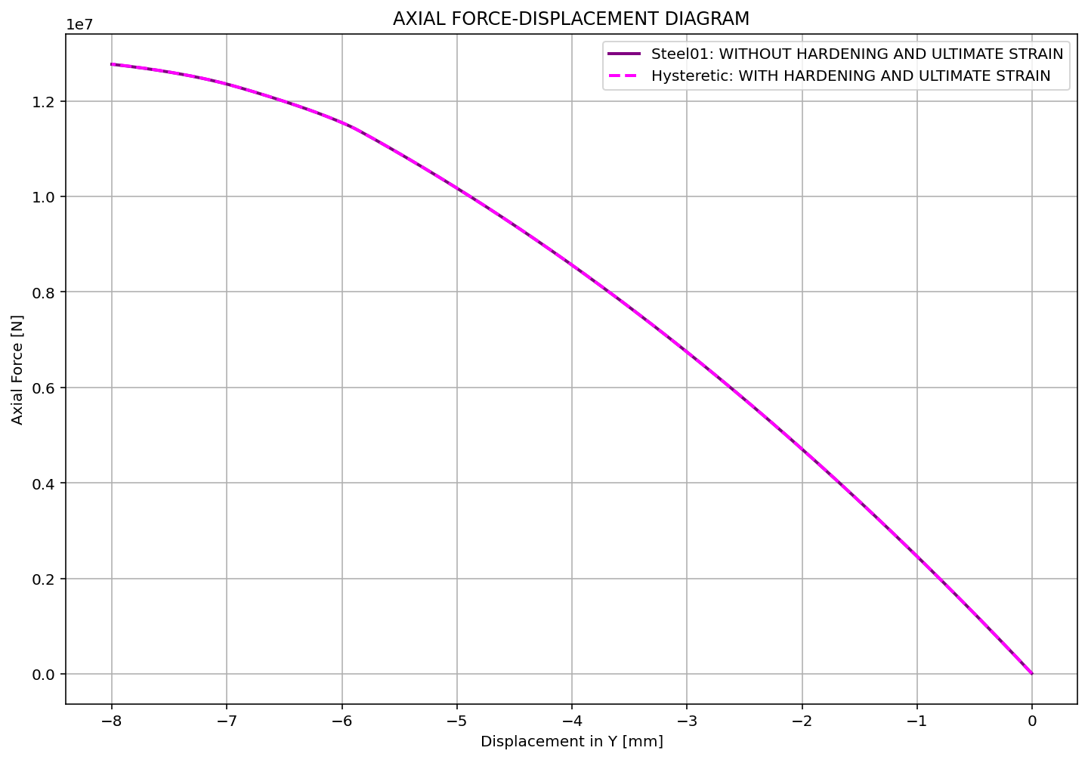

Slide 9
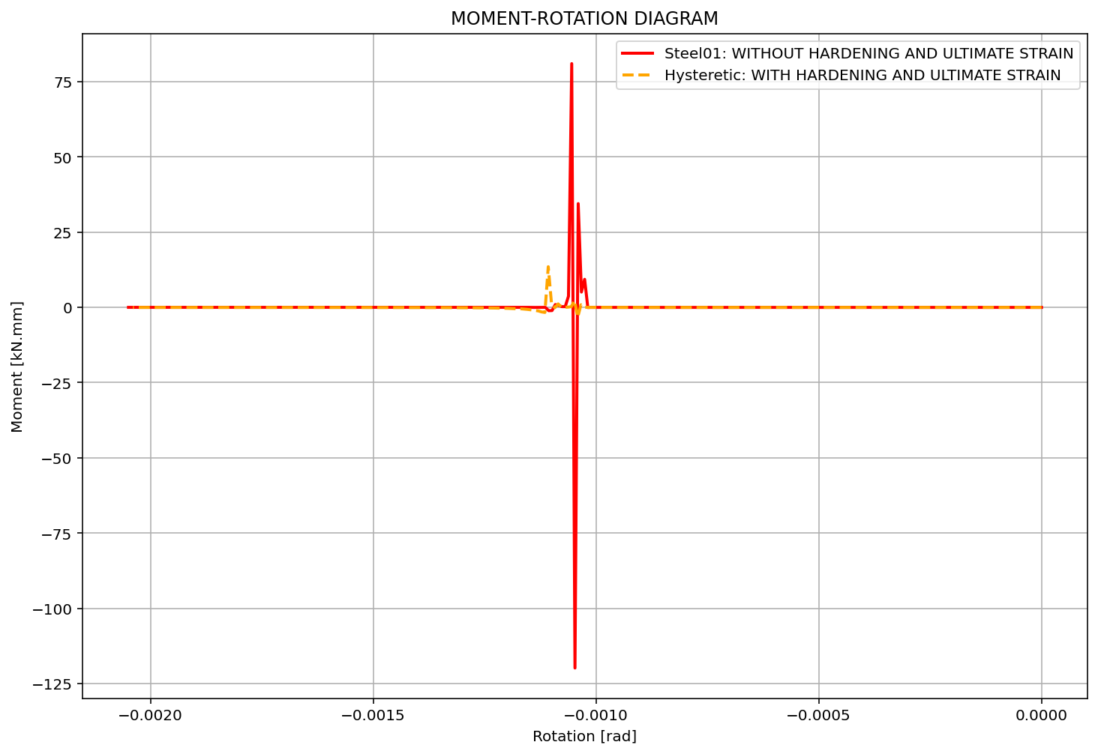

Slide 10
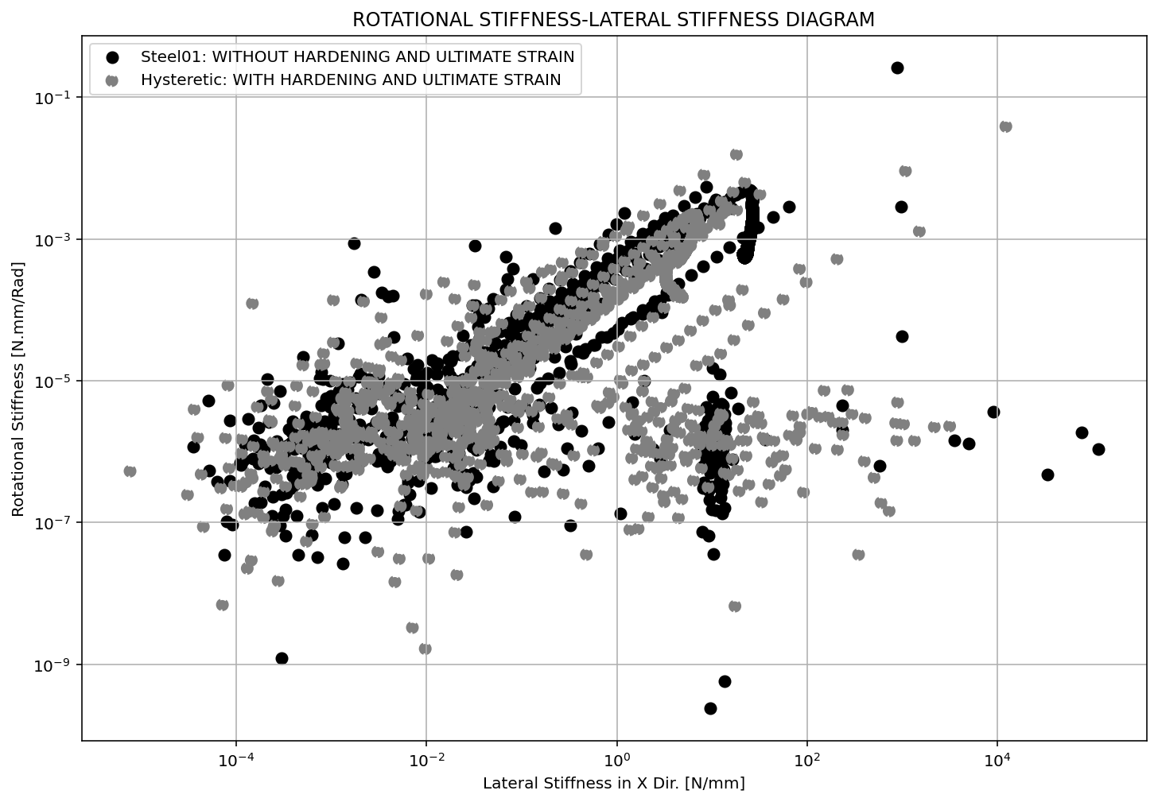

Slide 11
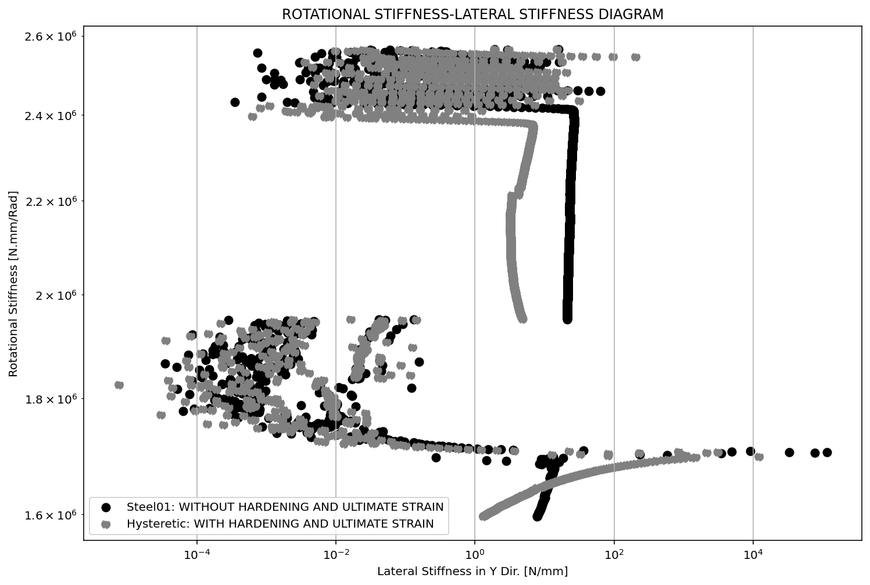

Slide 12
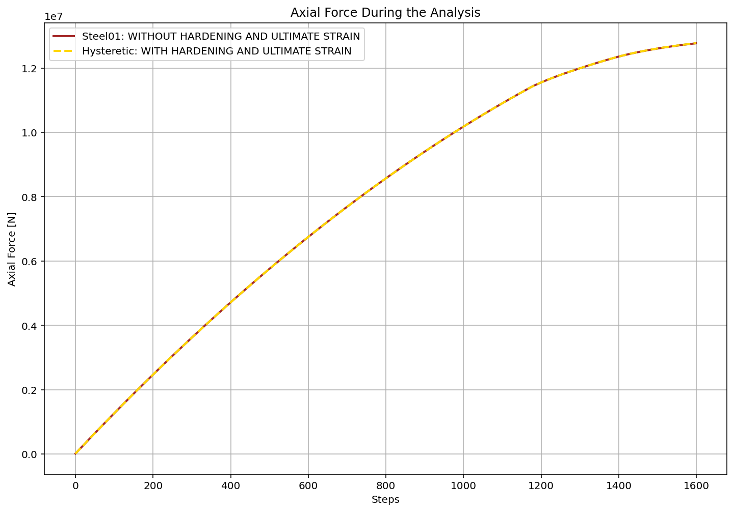

Slide 13
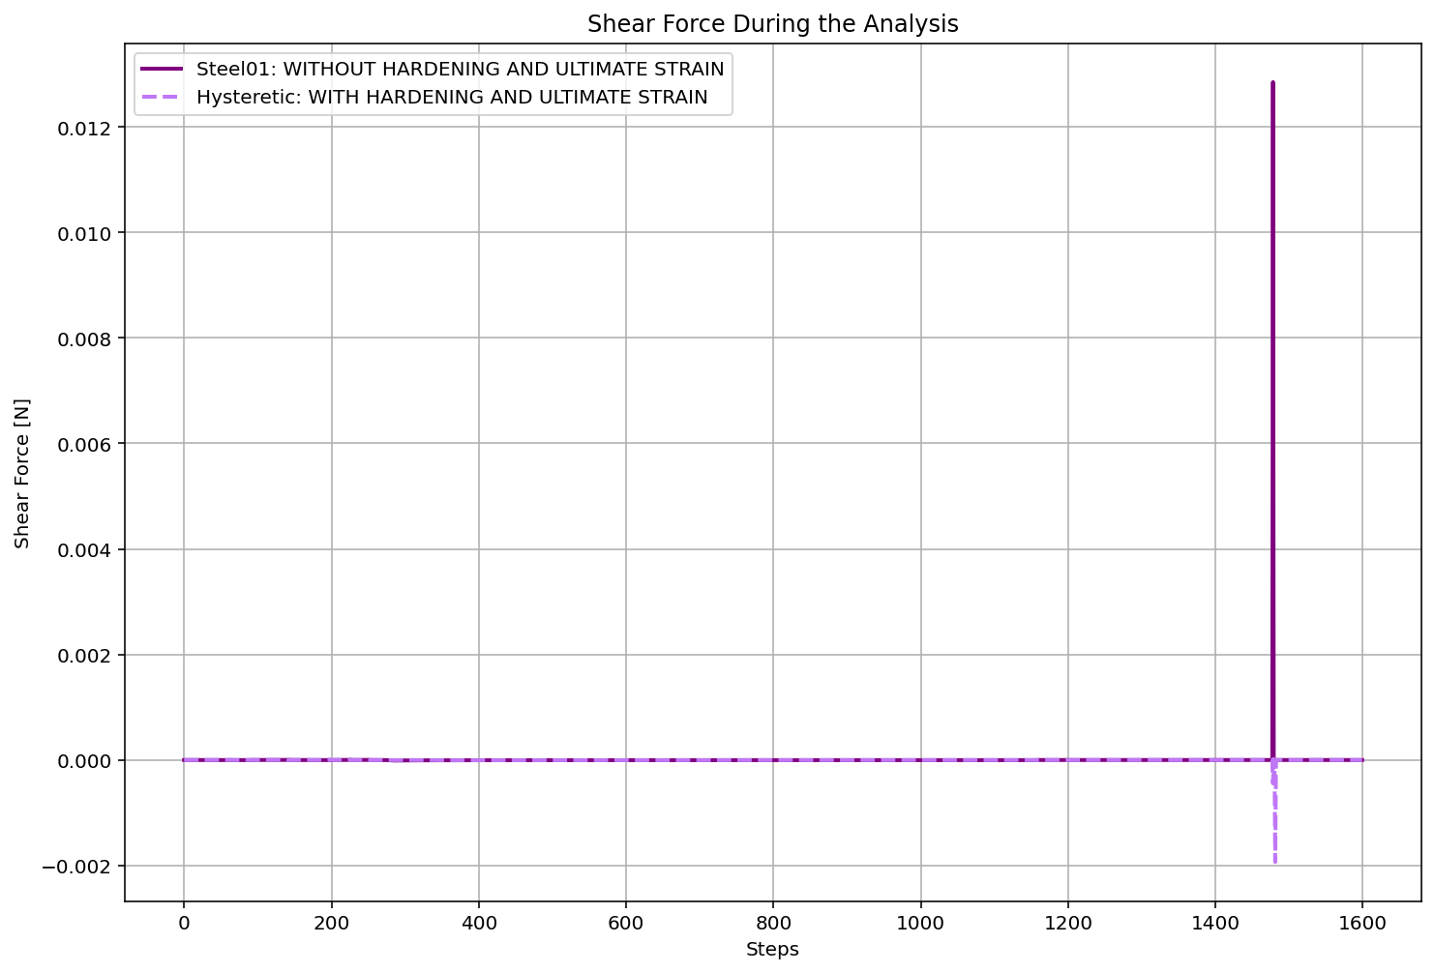

Slide 14
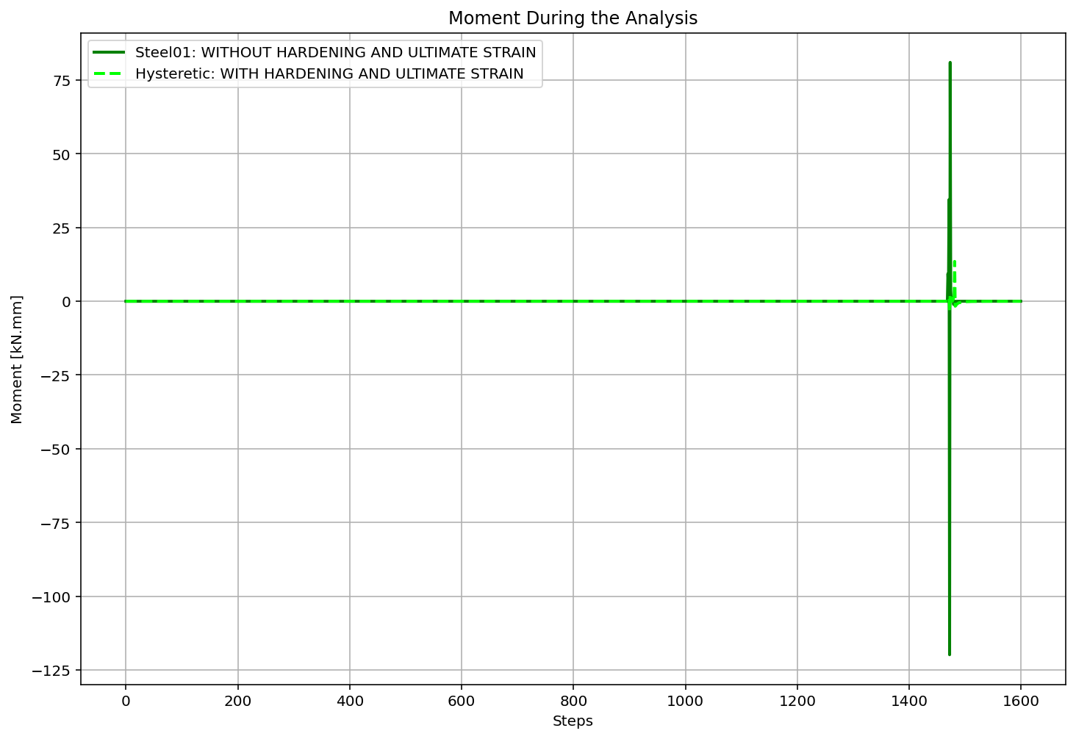

Slide 15
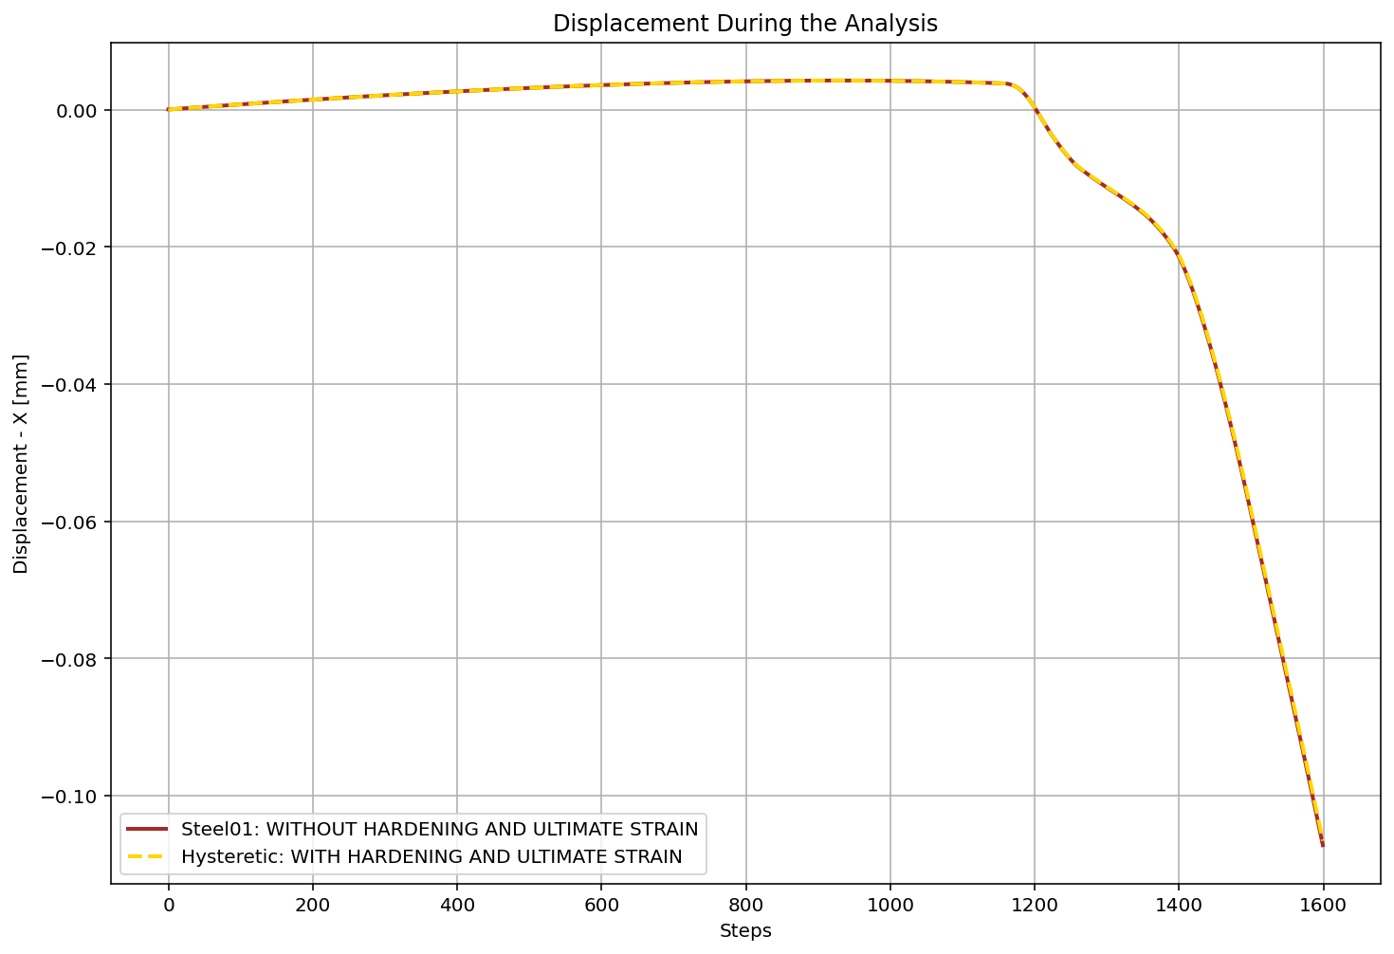

Slide 16
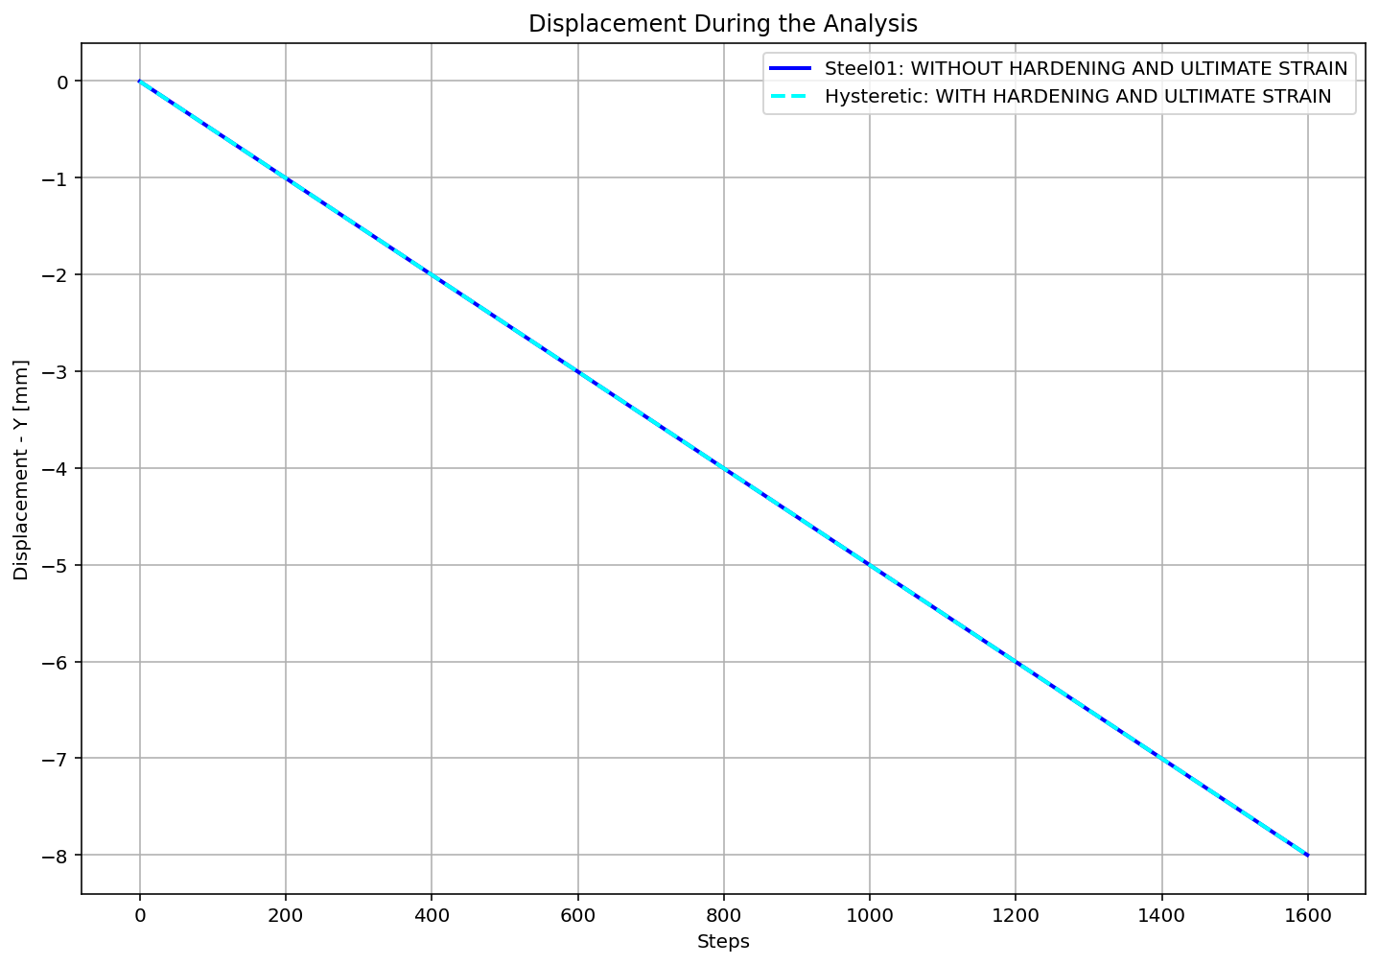

Slide 17
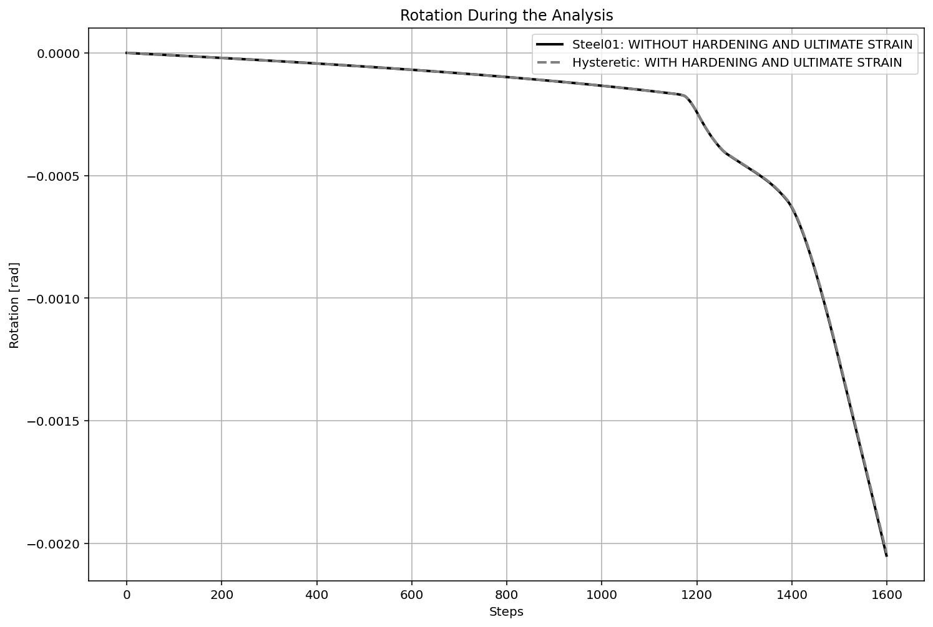

Slide 18
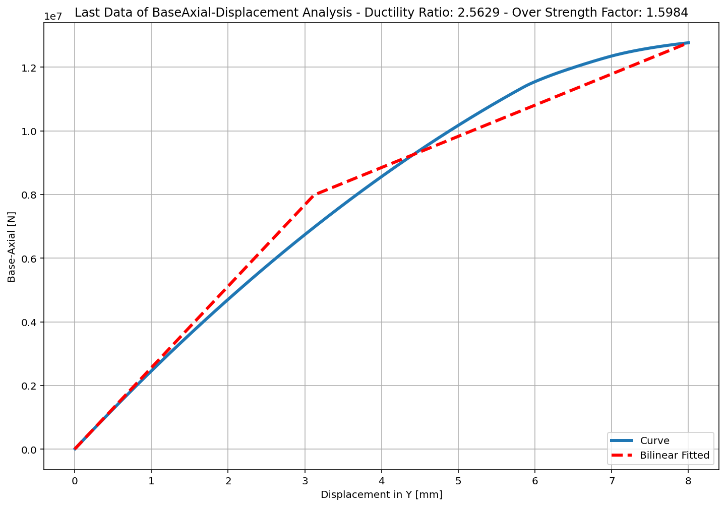
+==========================+
= Analysis curve fitted =
Disp Base Shear
----------------------------
[[0.00000000e+00 0.00000000e+00]
[3.12147311e+00 7.98825814e+06]
[8.00000000e+00 1.27685485e+07]]
+==========================+
+----------------------------------------------------+
Structure Elastic Stiffness : 2559130.85
Structure Plastic Stiffness : 1596068.57
Structure Tangent Stiffness : 979863.49
Structure Ductility Ratio : 2.56
Structure Over Strength Factor: 1.60
+----------------------------------------------------+
Ductility Ratio: 1.4997
Over Strength Coefficient (Ω0): 1.5984
Displacement Ductility Ratio (μ): 2.5629
Ductility Coefficient (Rμ): 1.2688
Structural Behavior Coefficient (R): 2.0280

