Slide 1
>> IN THE NAME OF ALLAH, THE MOST GRACIOUS, THE MOST MERCIFUL <<
COMPARATIVE FREE-VIBRATION ANALYSIS OF A MDOF STRUCTURE: ELASTIC VS INELASTIC RESPONSE USING OPENSEES
WRITTEN BY SALAR DELAVAR GHASHGHAEI (QASHQAI)

Slide 2
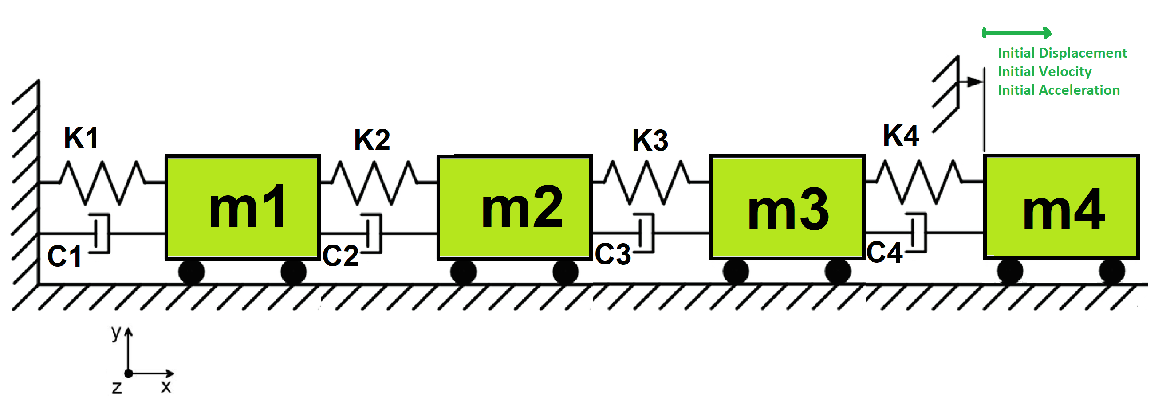

Slide 3
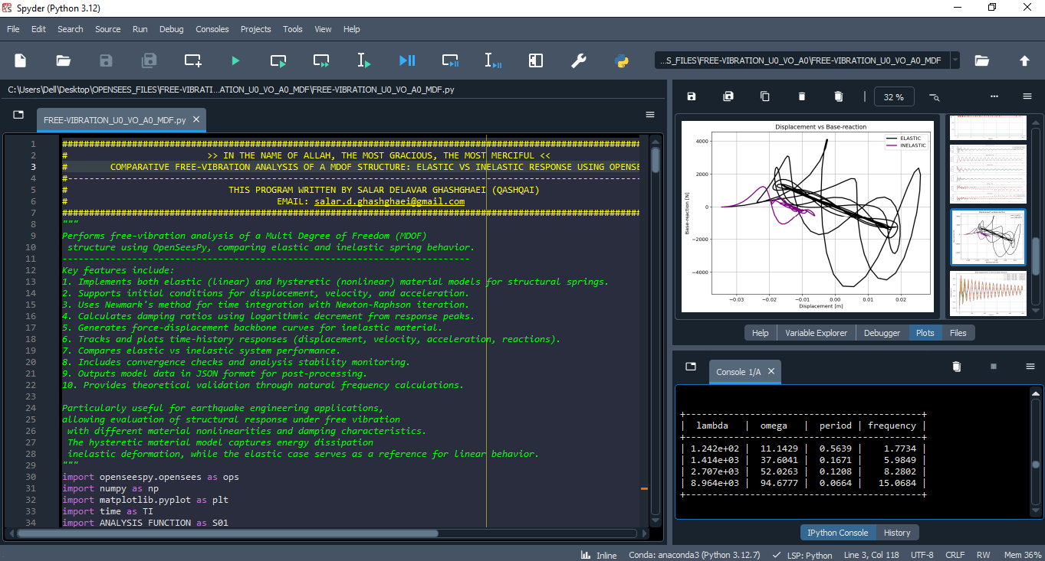

Slide 4
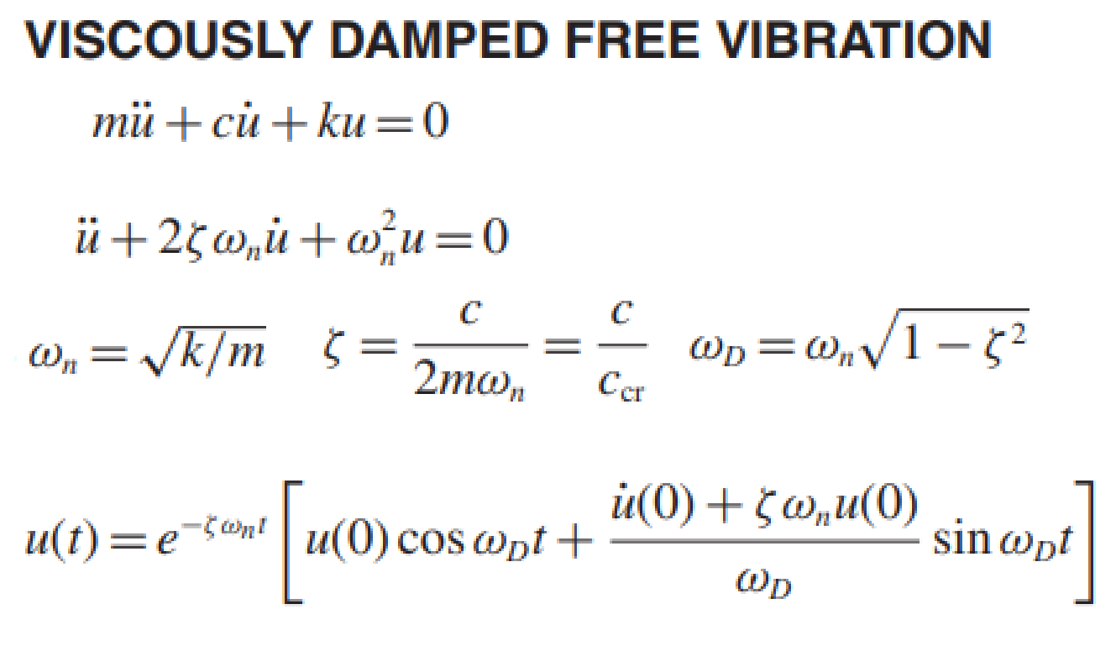
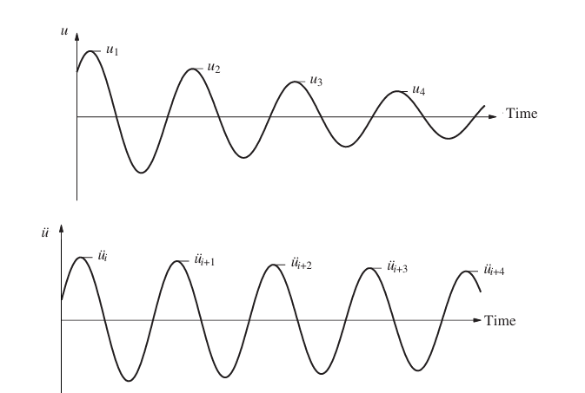
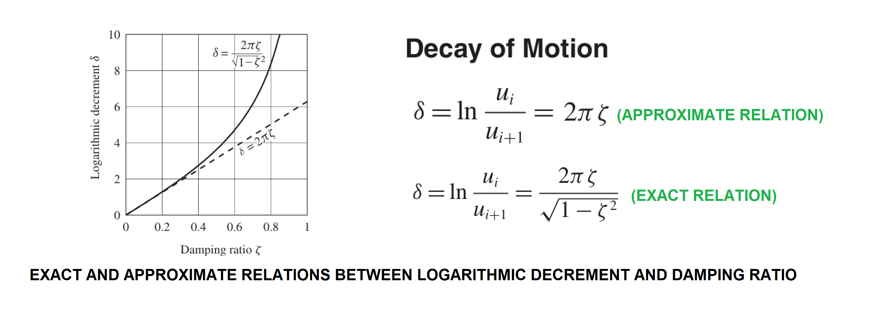

Slide 5
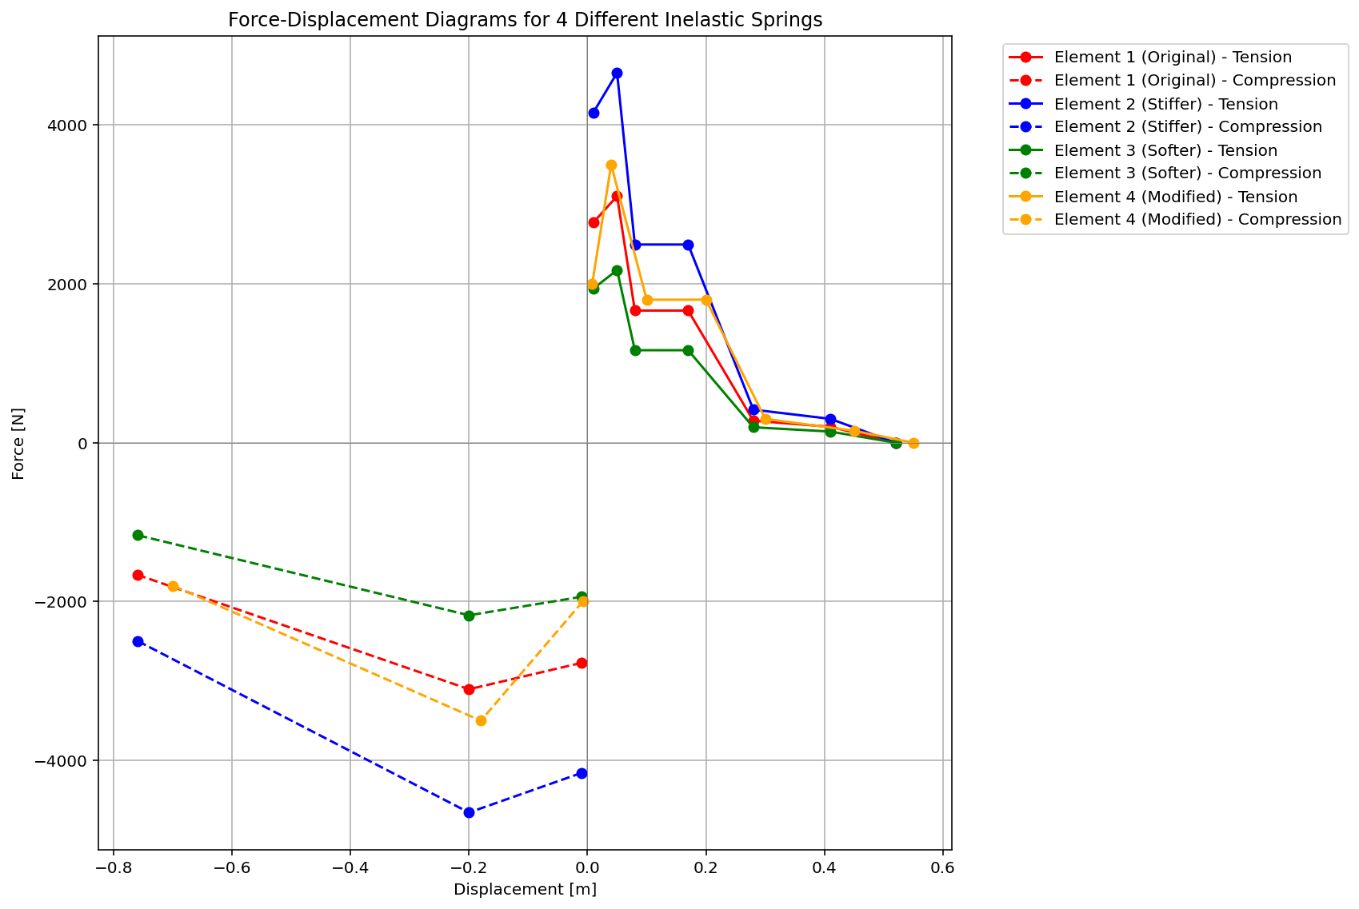

Slide 6
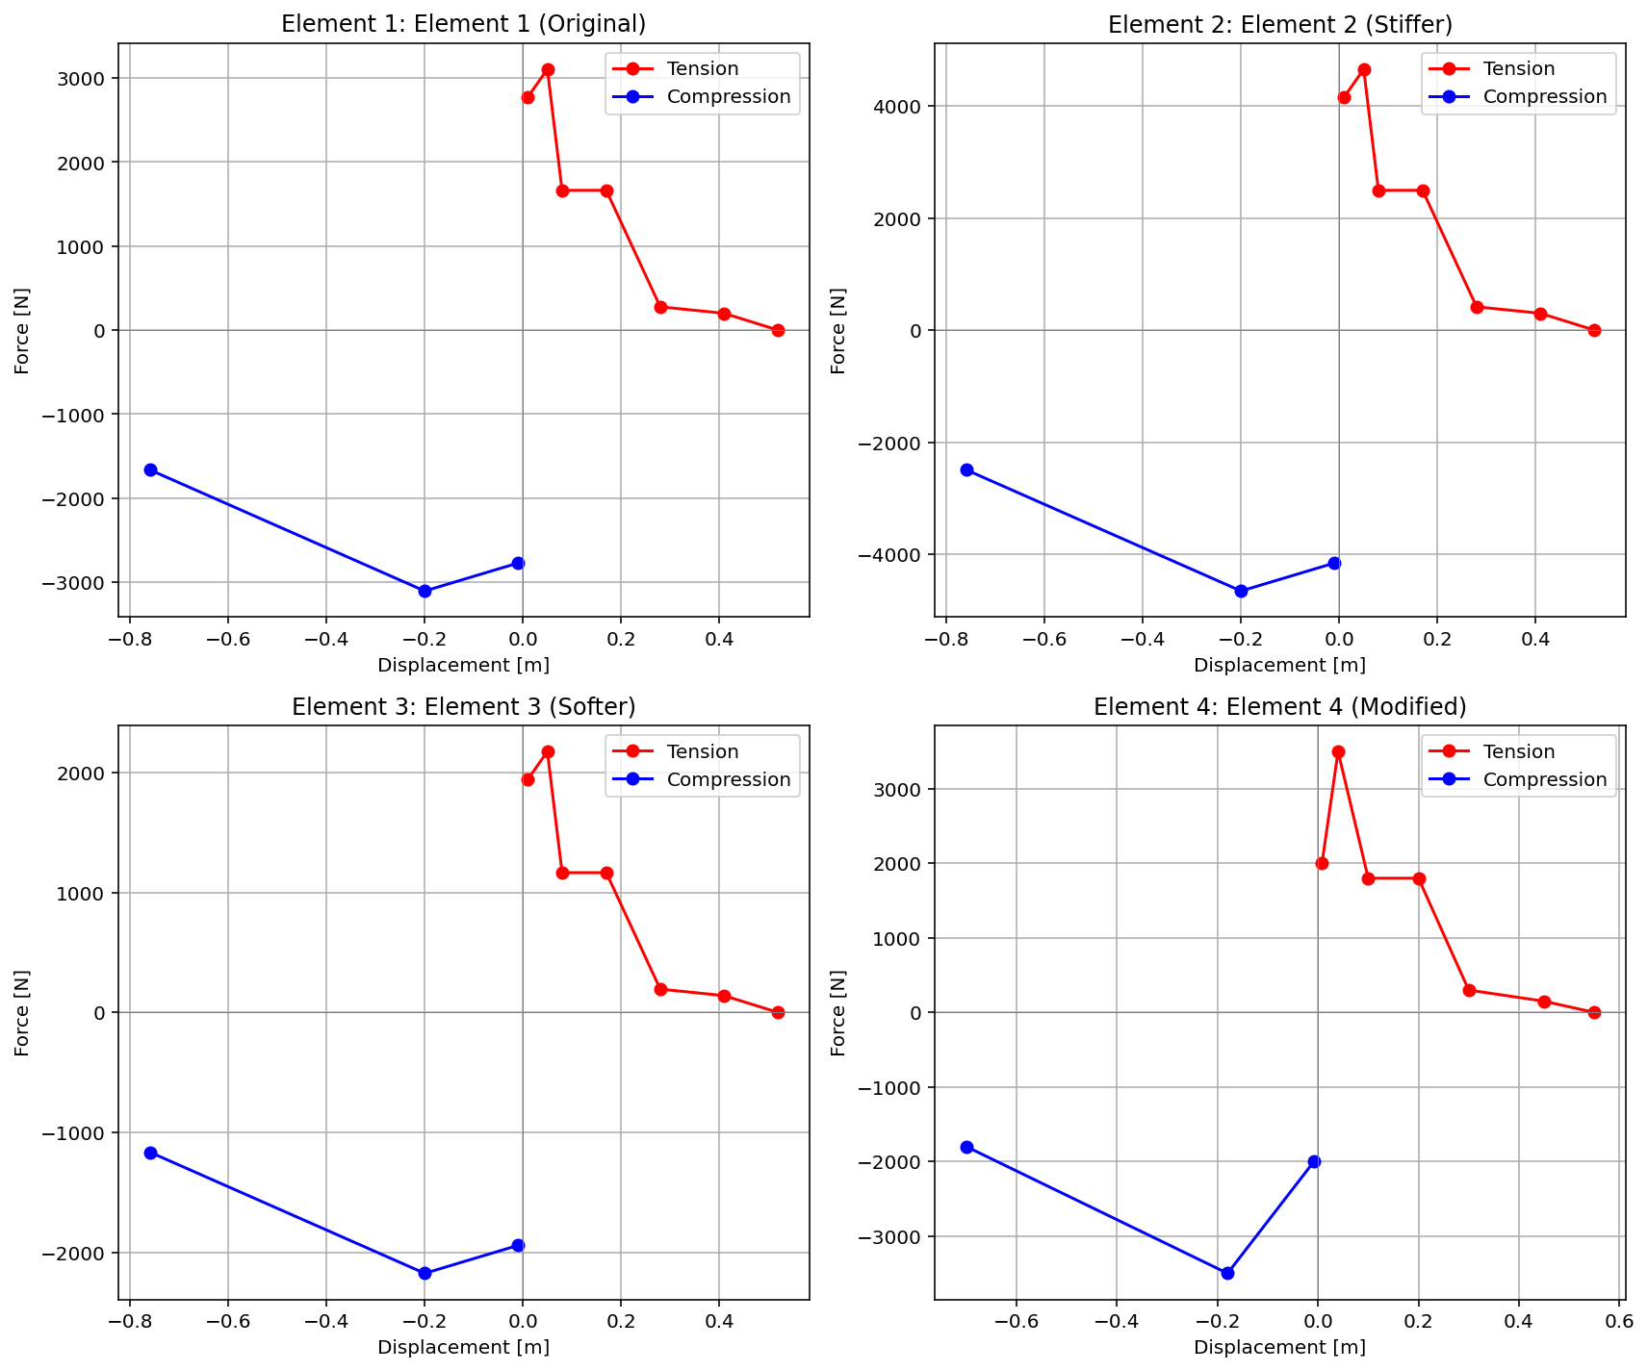

Slide 7
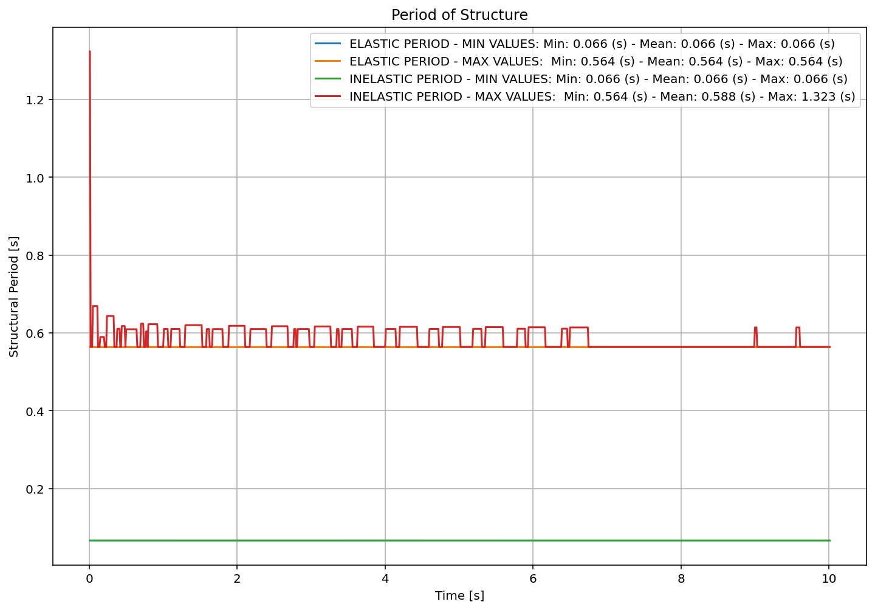

Slide 8
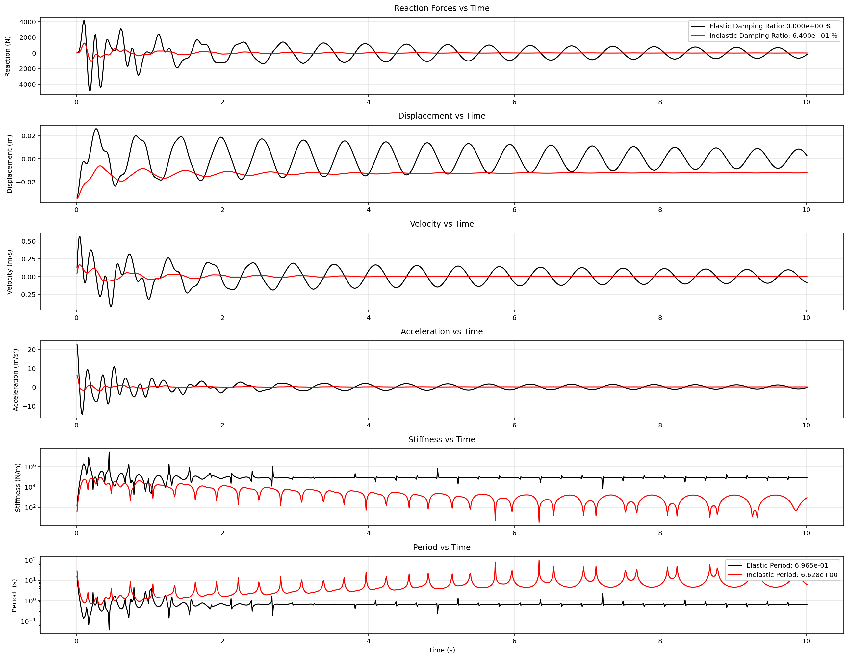

Slide 9
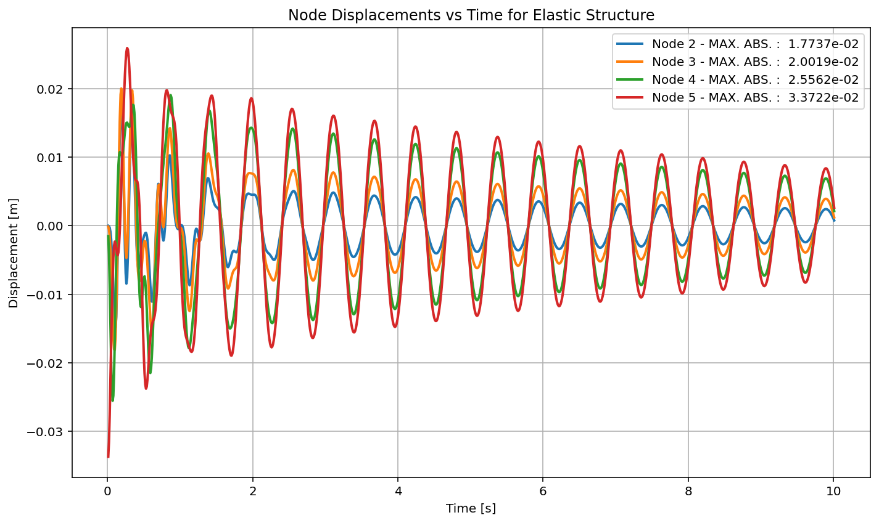

Slide 10
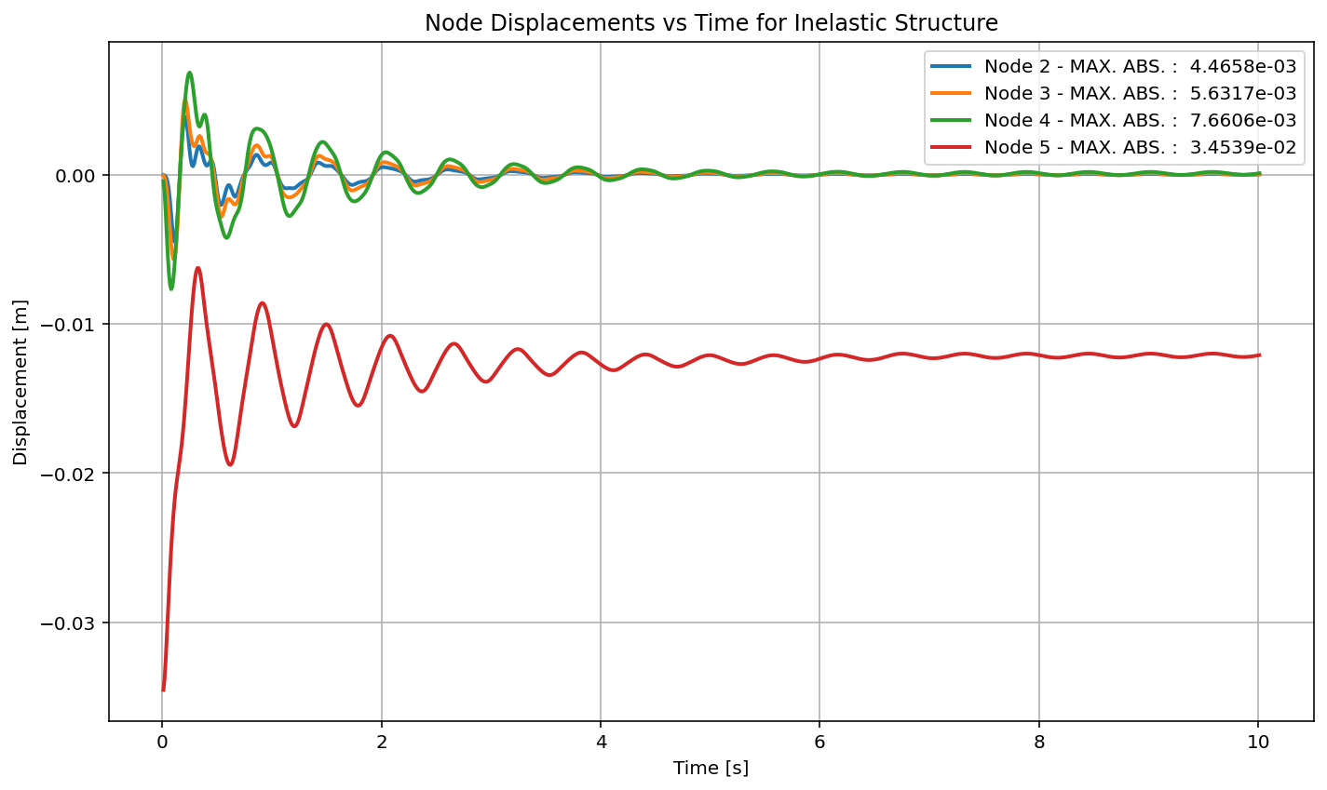

Slide 11
