Slide 1
IN THE NAME OF ALLAH
STEEL-CONCRETE COMPOSITE PLATE GIRDERS BRIDGE SUPERSTRUCTURE
RUNNING MOMENT-CURVATURE, PUSHOVER AND DYNAMIC ANALYSIS FOR CALCULATE STRUCTURAL DUCTILIY DAMAGE INEX
WRITTEN BY SALAR DELAVAR GHASHGHAEI (QASHQAI)

Slide 2
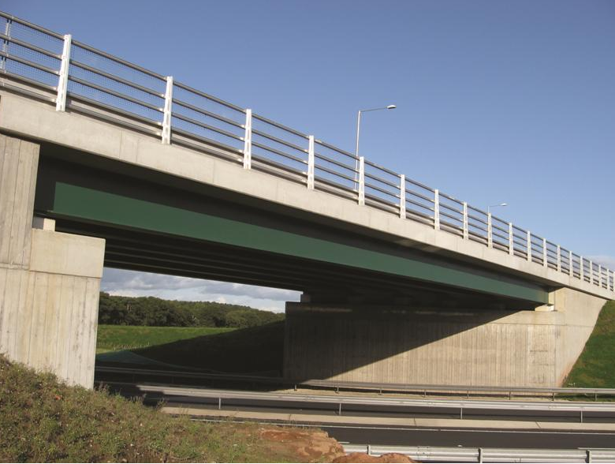

Slide 3
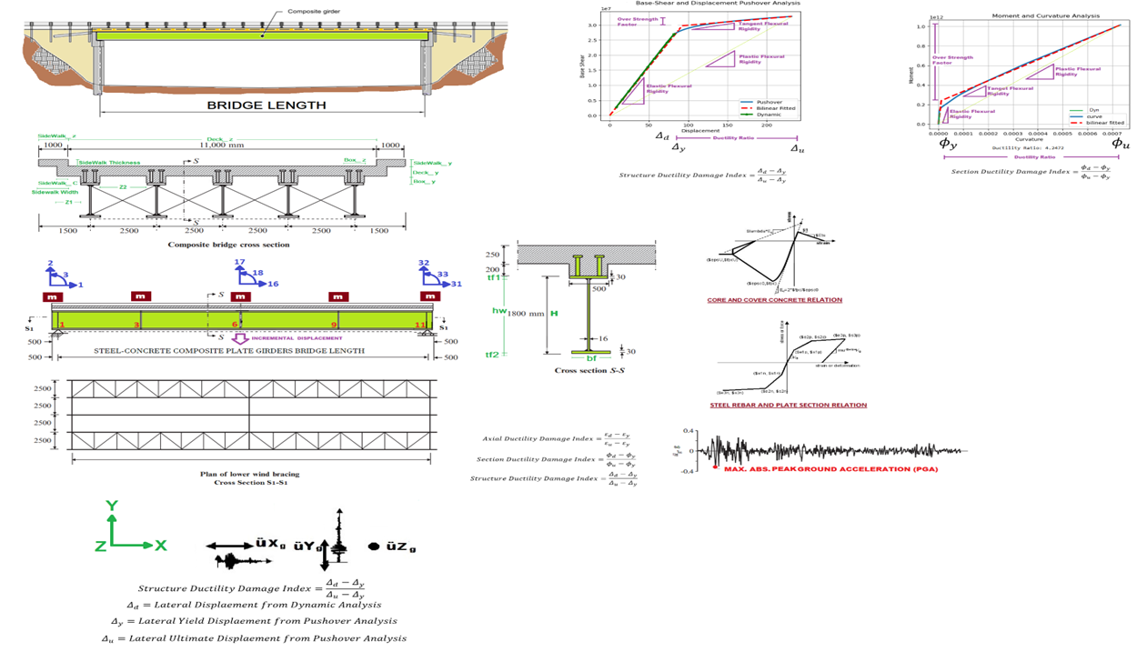

Slide 4
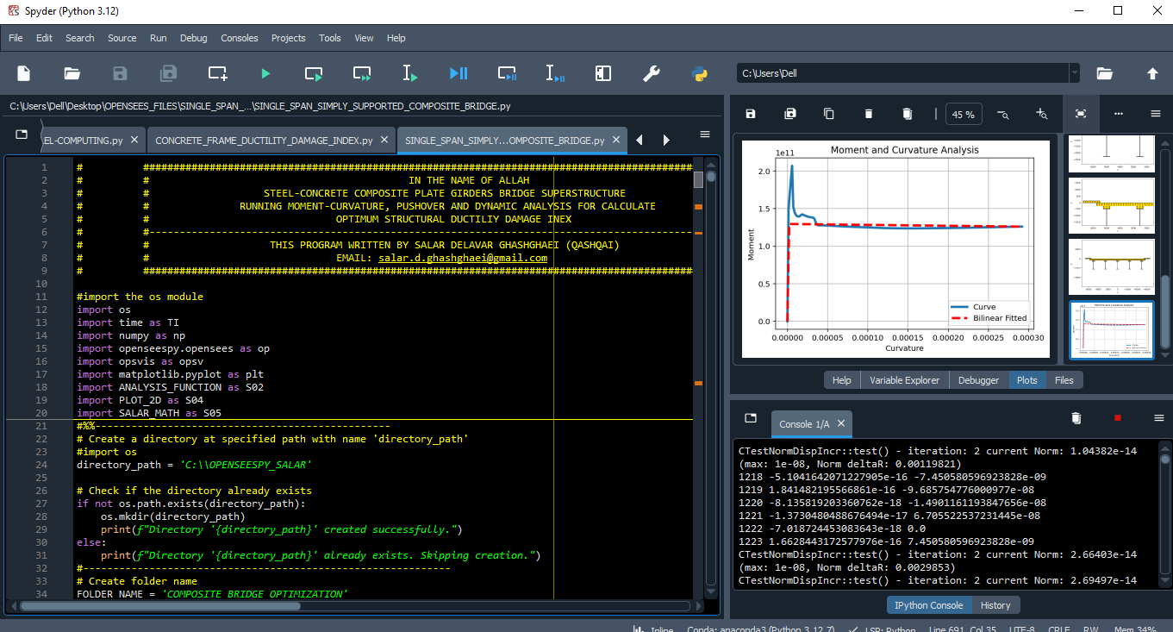

Slide 5
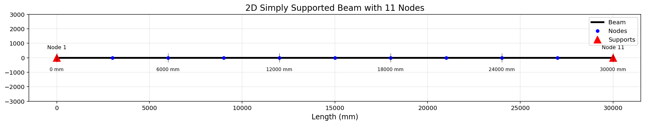

Slide 6
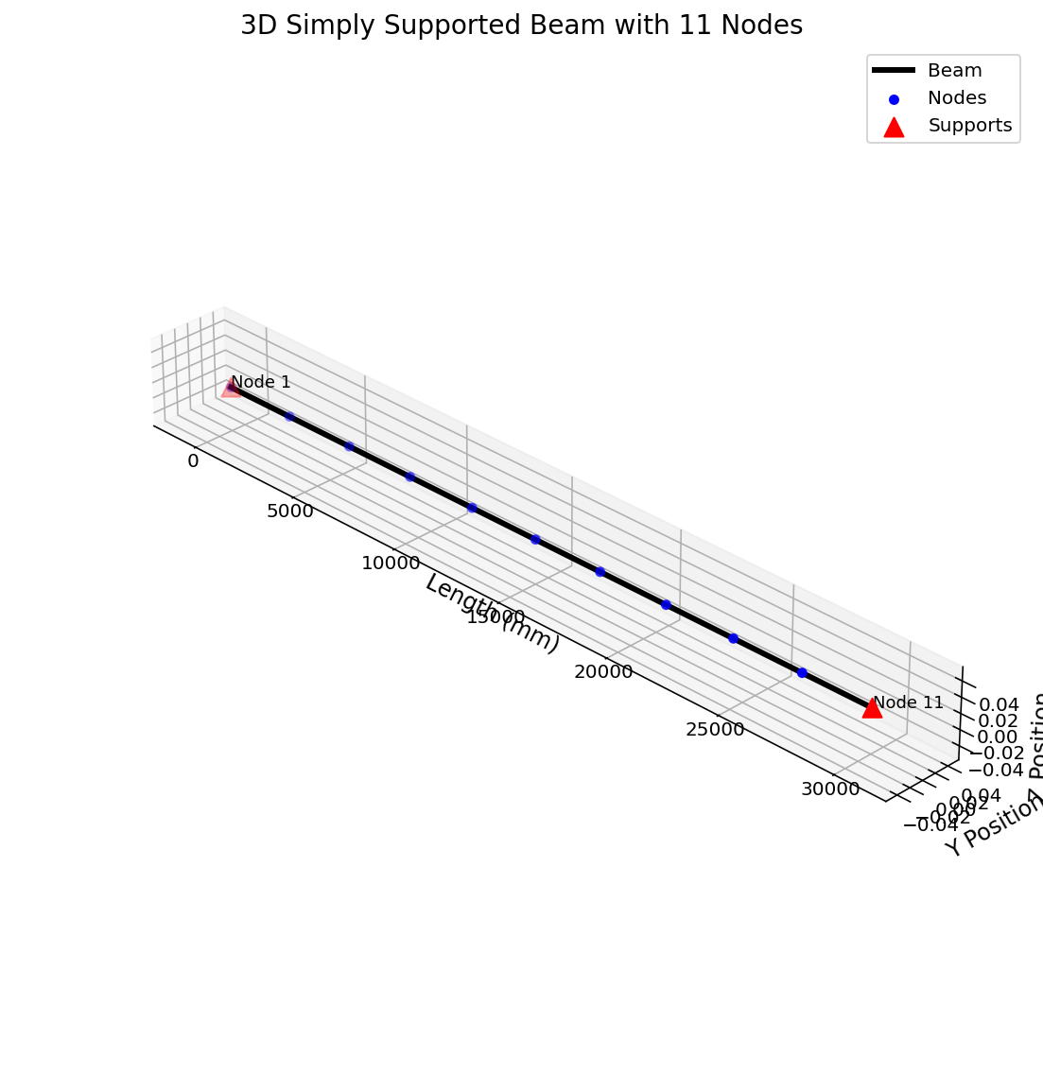

Slide 7
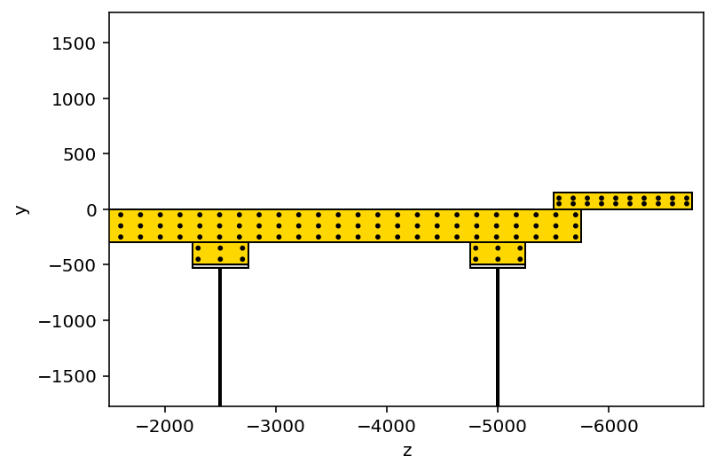
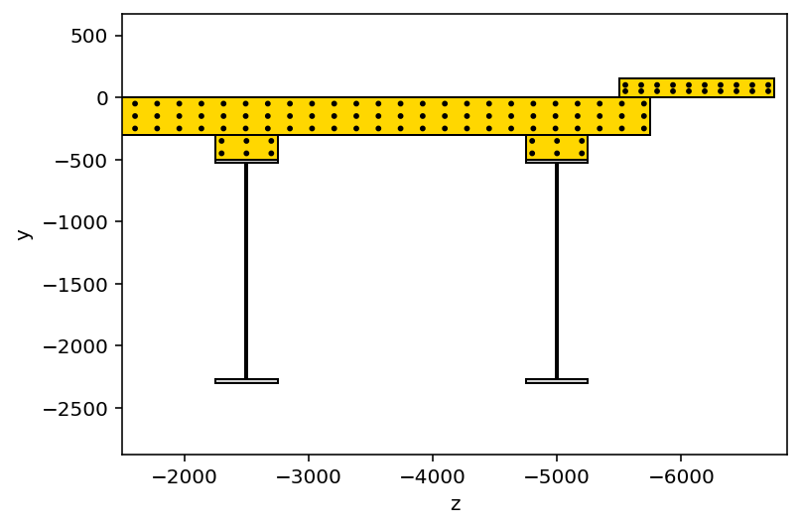
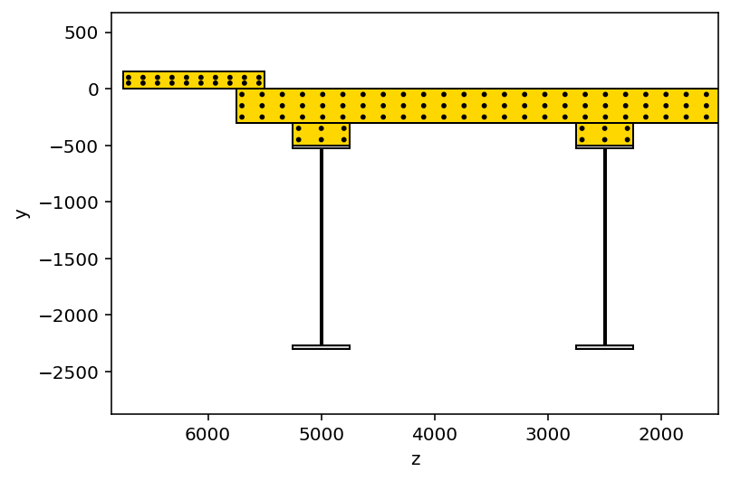

Slide 8
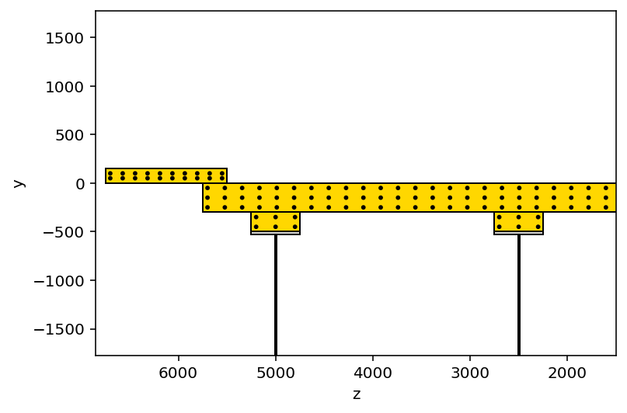
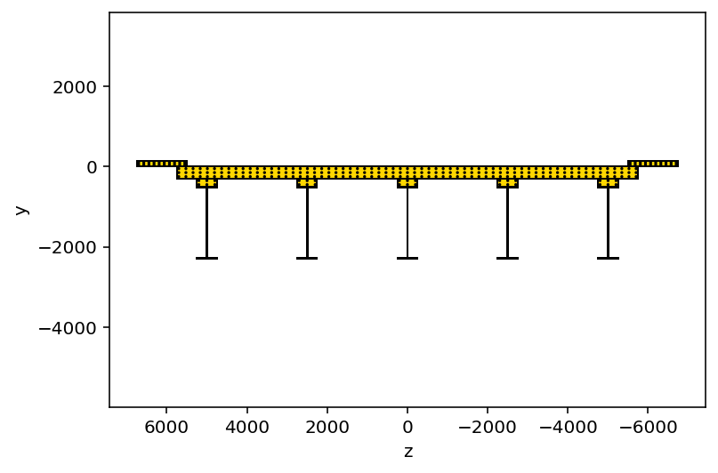

Slide 9
MOMENT-CURVATURE ANALYSIS

Slide 10
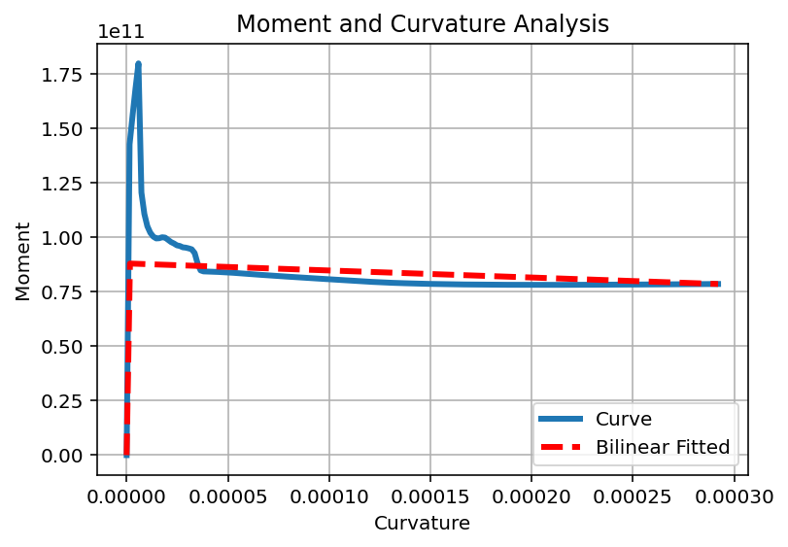
### SECTION PARAMETERS BASED ON ANALYSIS ###
=================================================
Section Elastic Stiffness : 53392851639150576.00
Section Plastic Stiffness : 269201845135970.91
Section Tangent Stiffness : -32337150063723.20
Section Ductility Ratio : 177.18
Section Over Strength Factor: 0.89
Section Yield Curvature: 0.000002
Section Ultimate Curvature: 0.000292

Slide 11
NONLINEAR STATIC ANALYSIS (PUSHOVER)

Slide 12
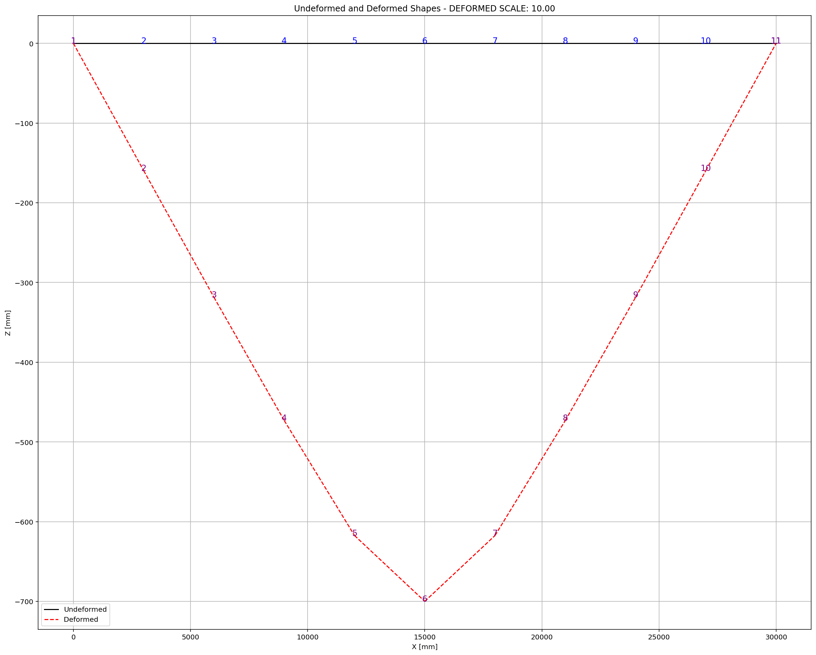

Slide 13
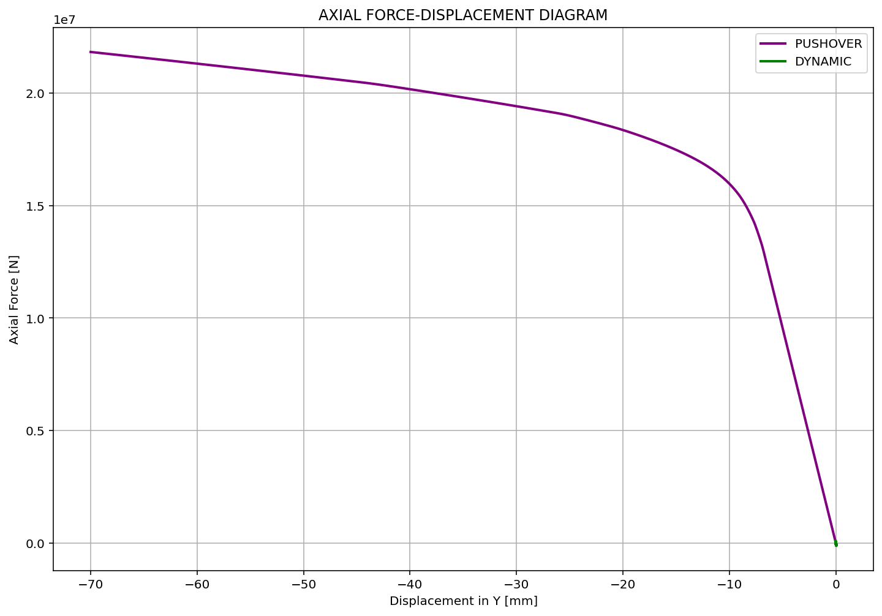

Slide 14
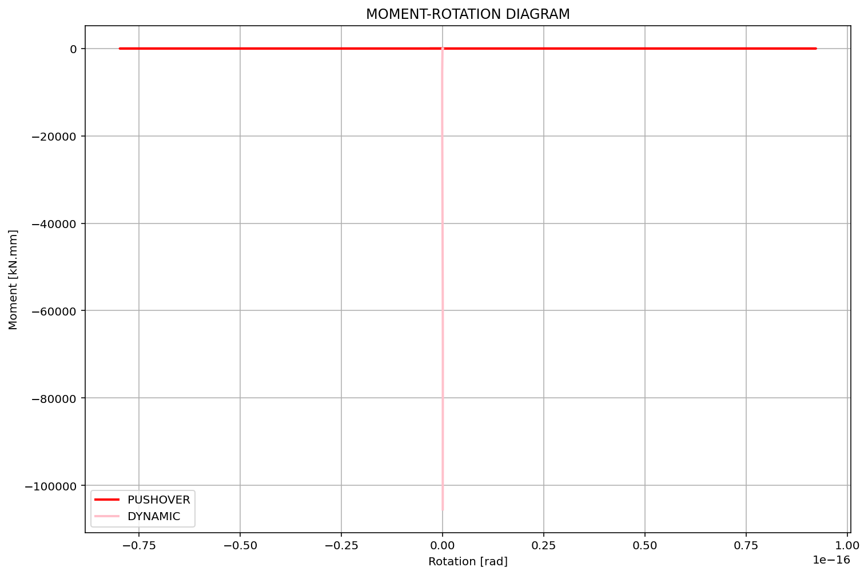

Slide 15
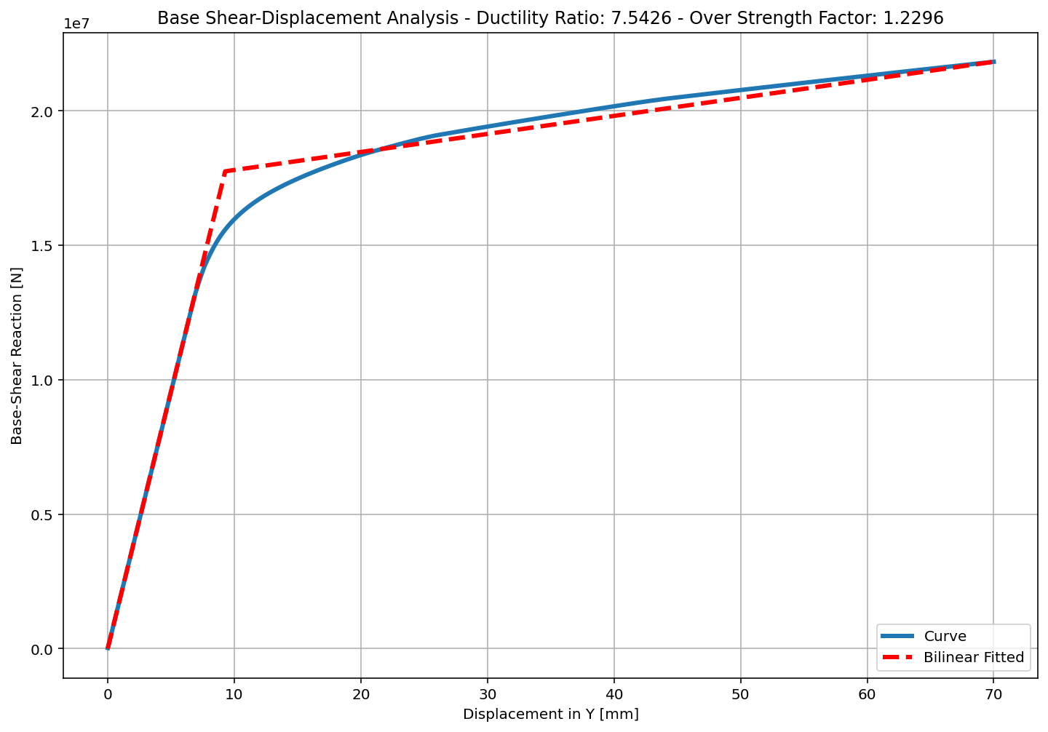
+==========================+
= Analysis curve fitted =
Disp Base Shear
----------------------------
[[0.00000000e+00 0.00000000e+00]
[9.28066373e+00 1.77487453e+07]
[7.00000000e+01 2.18236646e+07]]
+==========================+
+----------------------------------------------------+
Structure Elastic Stiffness : 1912443.53
Structure Plastic Stiffness : 311766.64
Structure Tangent Stiffness : 67110.74
Structure Ductility Ratio : 7.54
Structure Over Strength Factor: 1.23
+----------------------------------------------------+

Slide 16
NONLINEAR DYNAMIC ANALYSIS

Slide 17
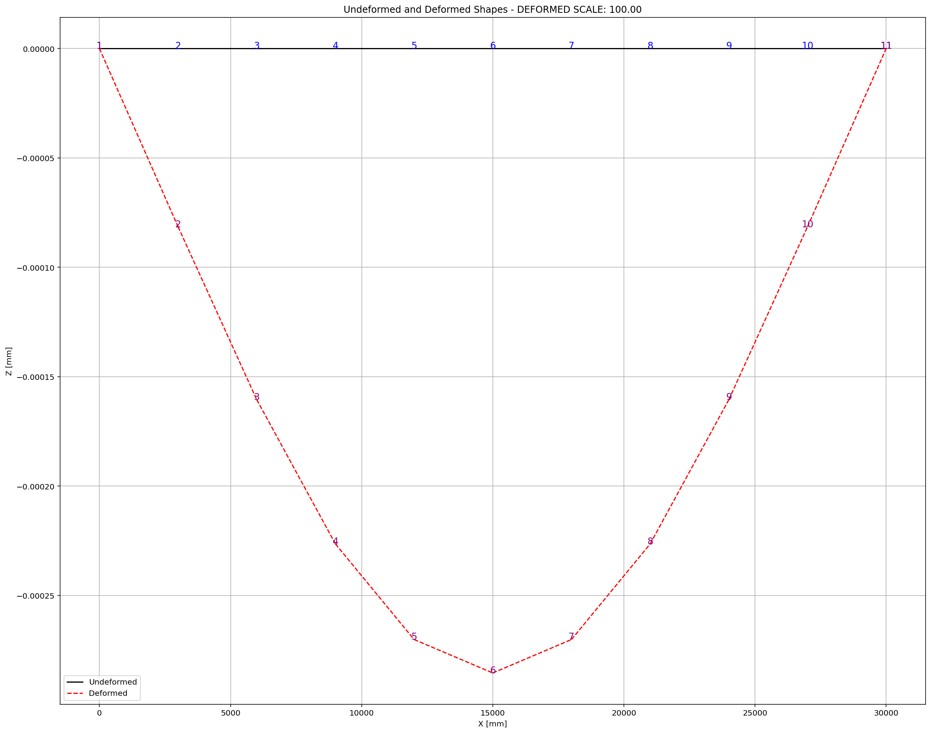

Slide 18
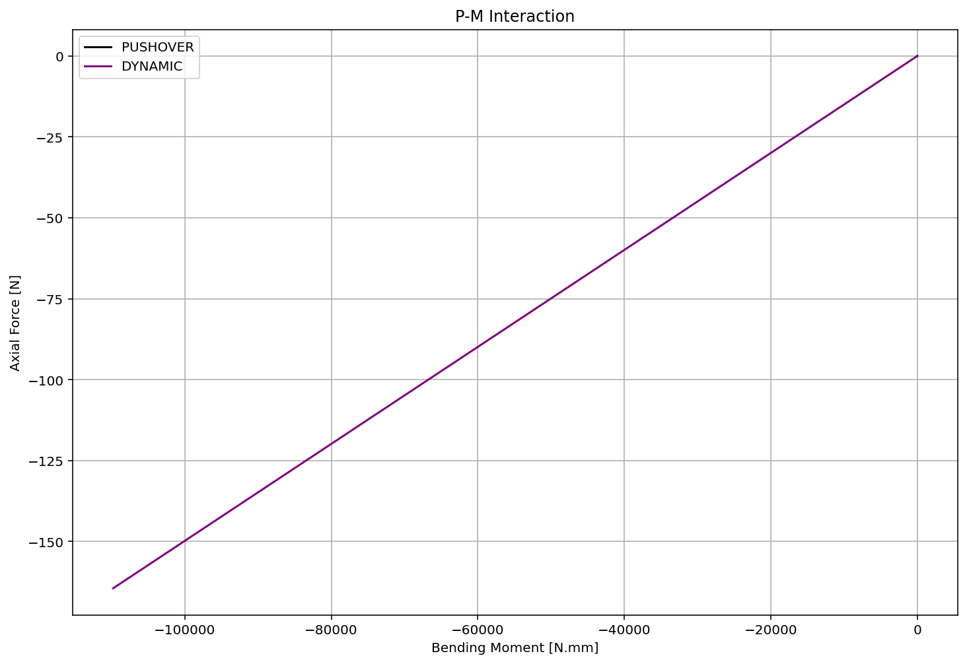

Slide 19
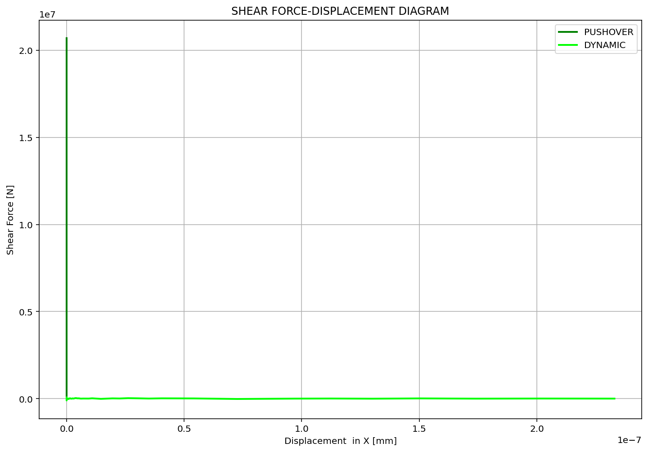

Slide 20
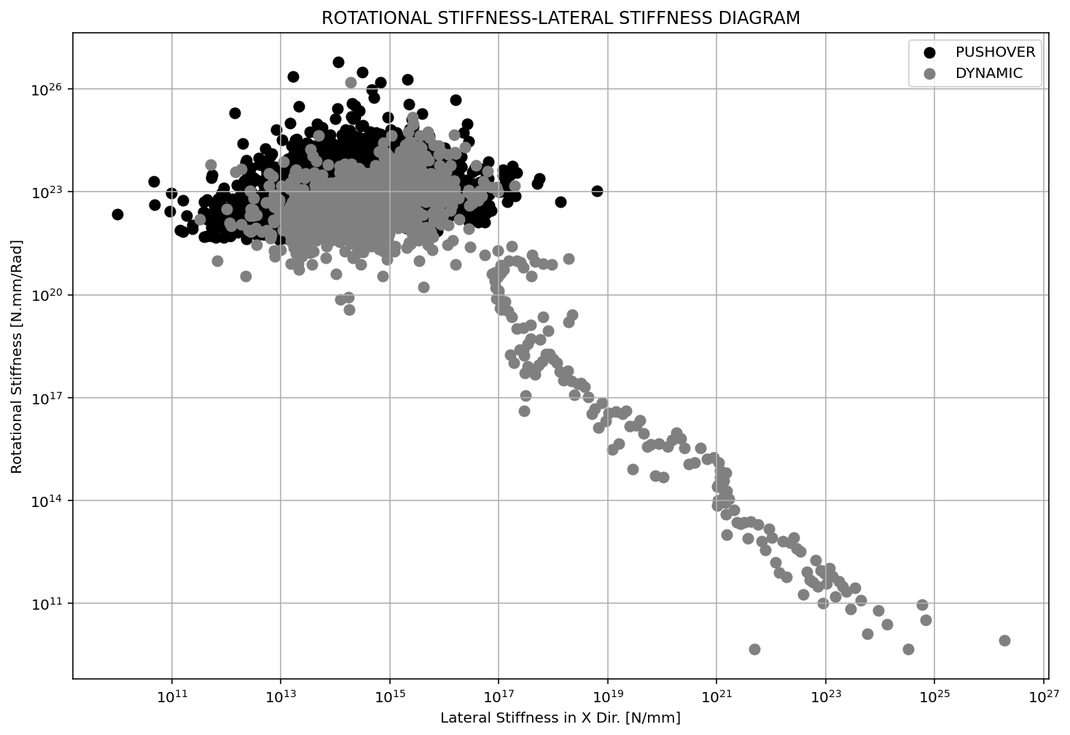

Slide 21
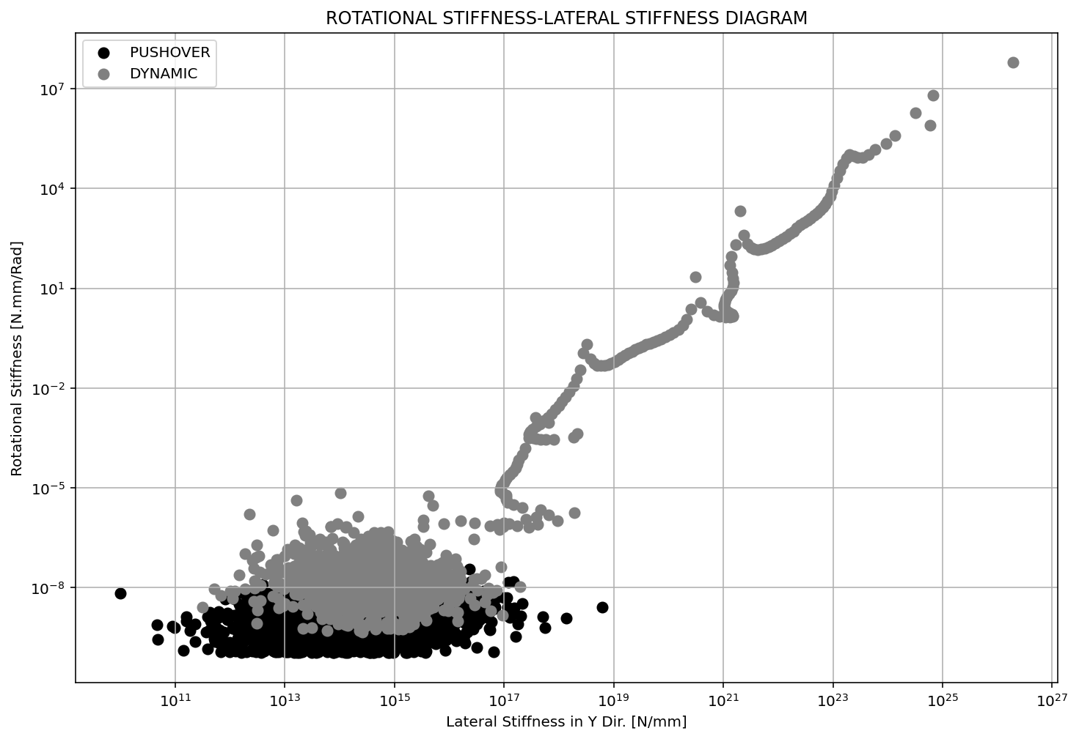

Slide 22
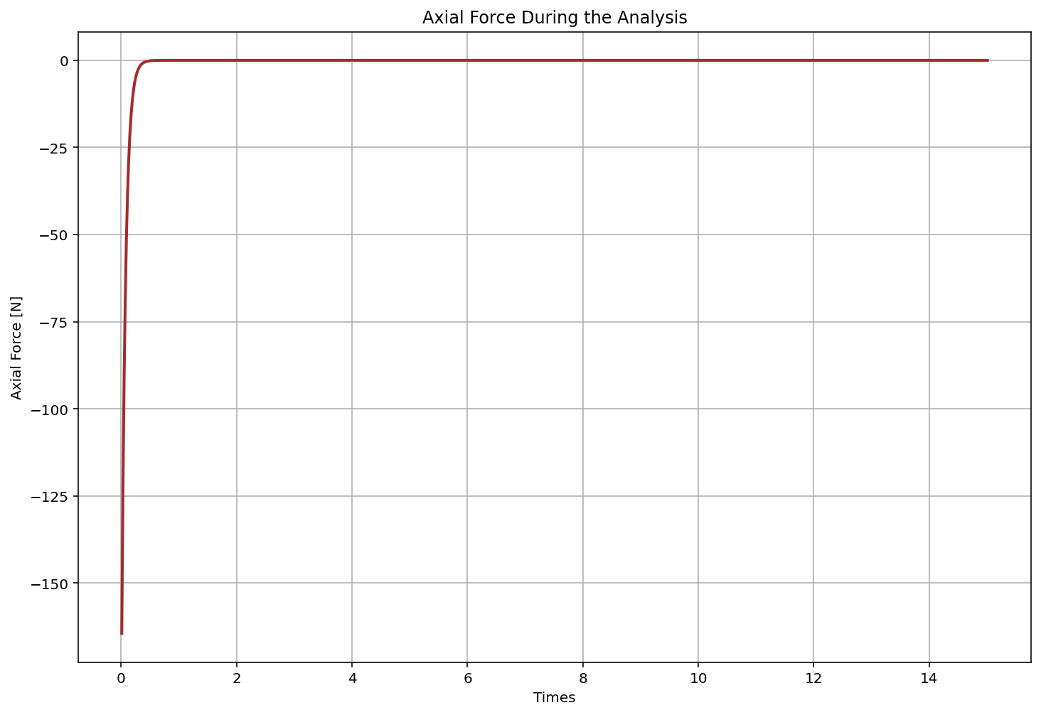

Slide 23
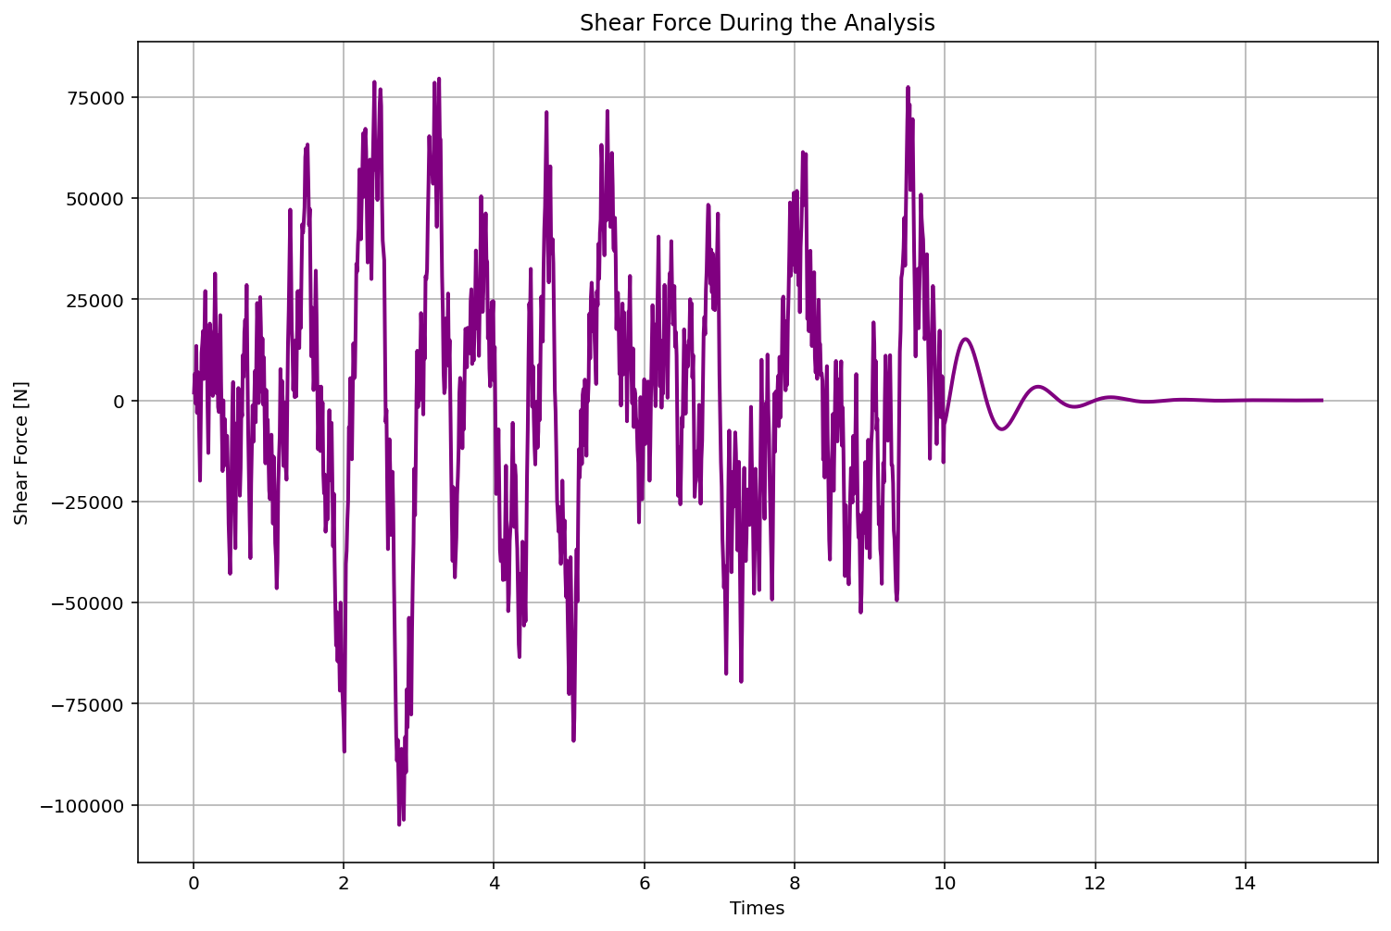

Slide 24
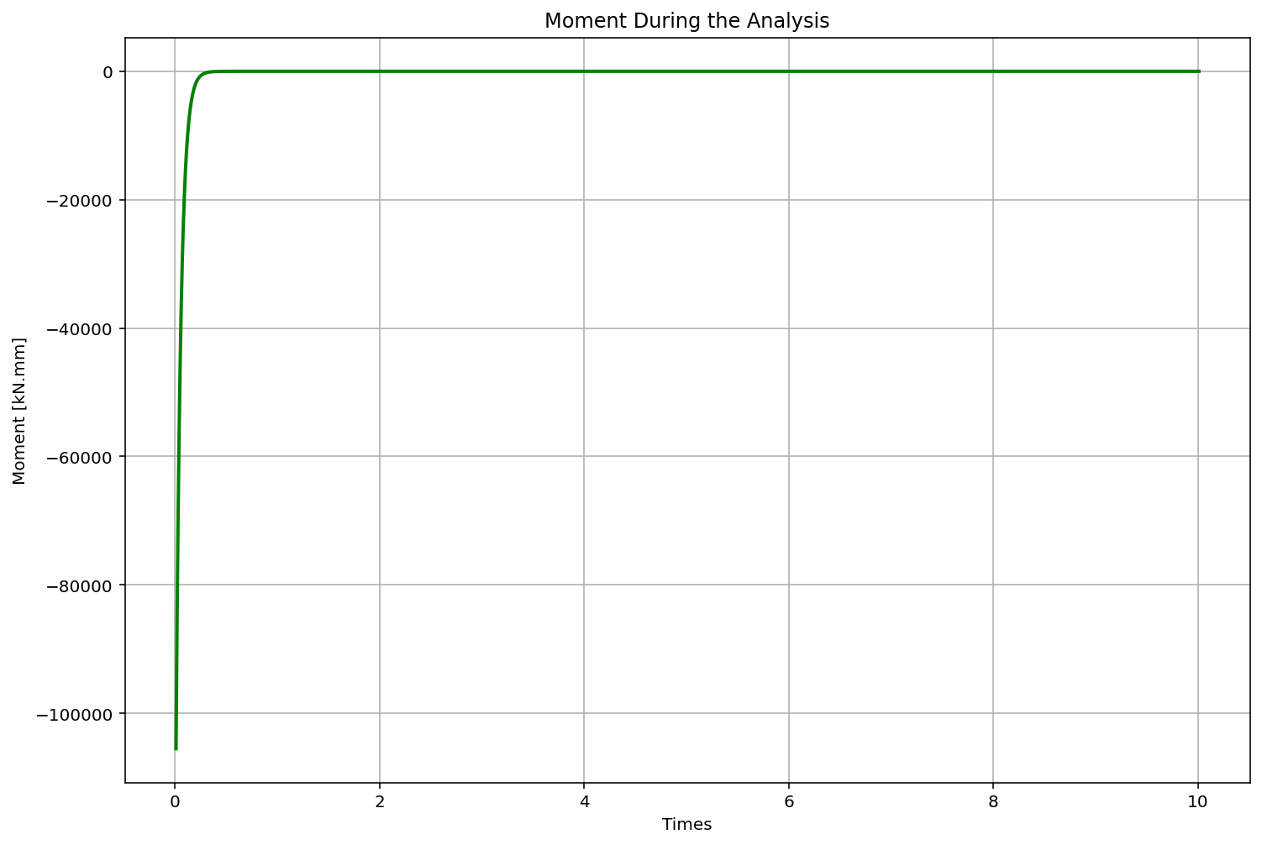

Slide 25
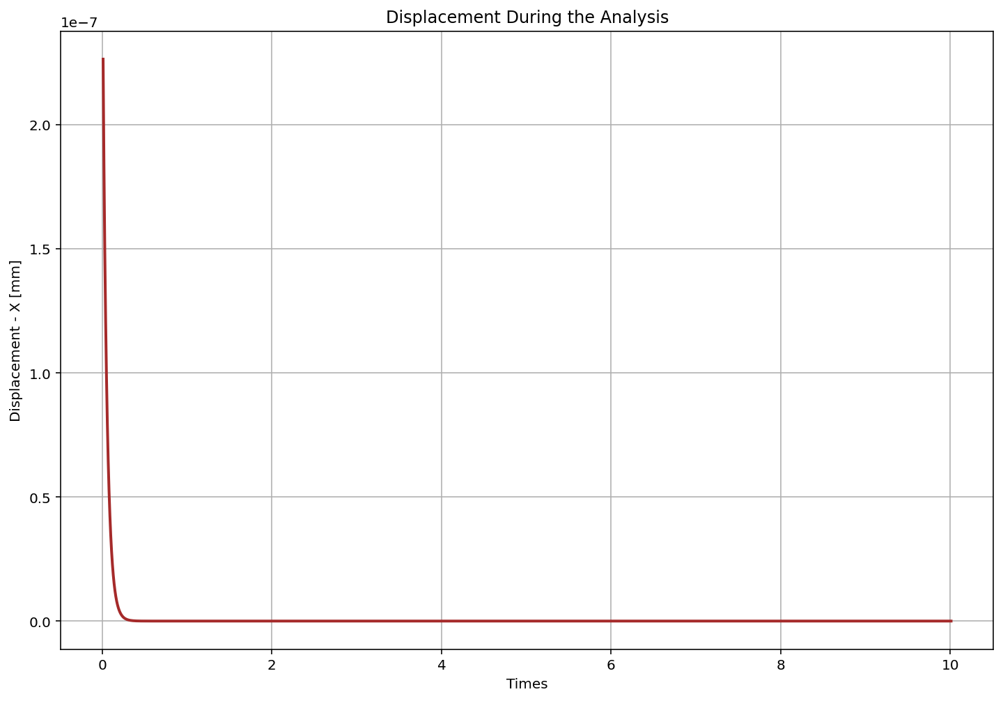

Slide 26
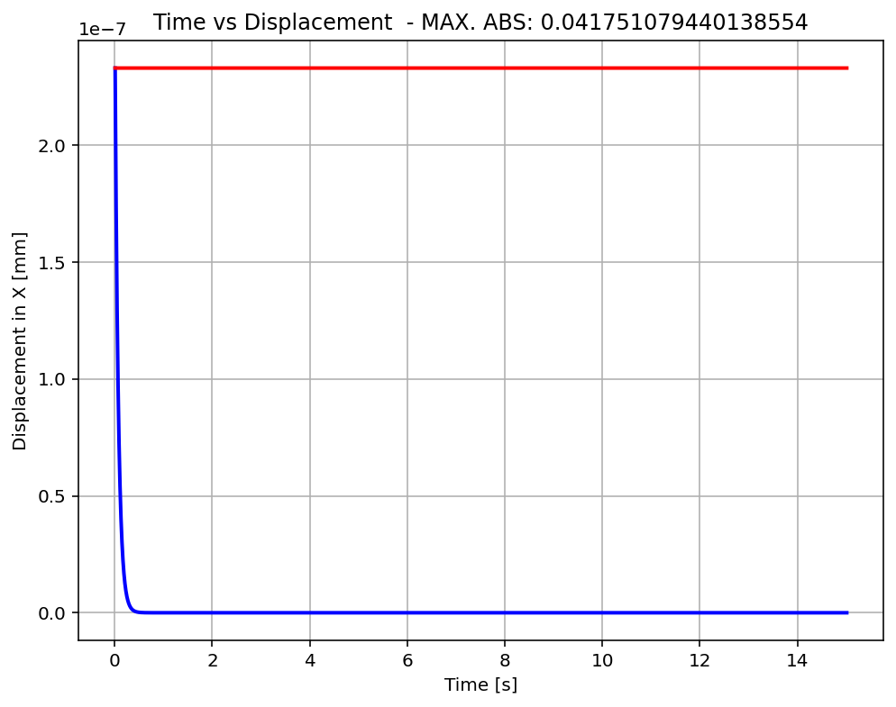

Slide 27
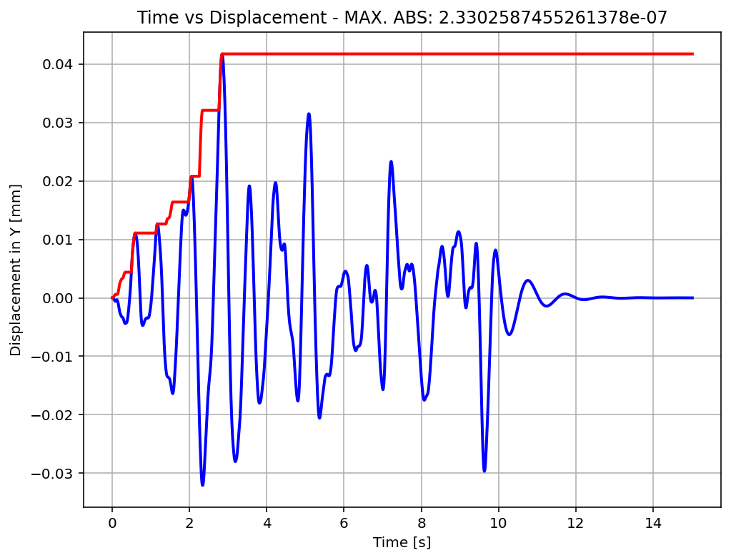

Slide 28
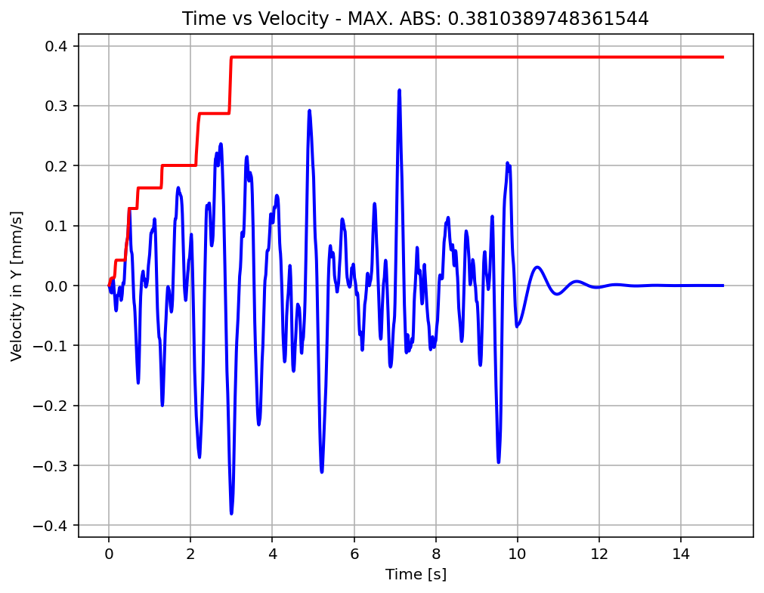

Slide 29
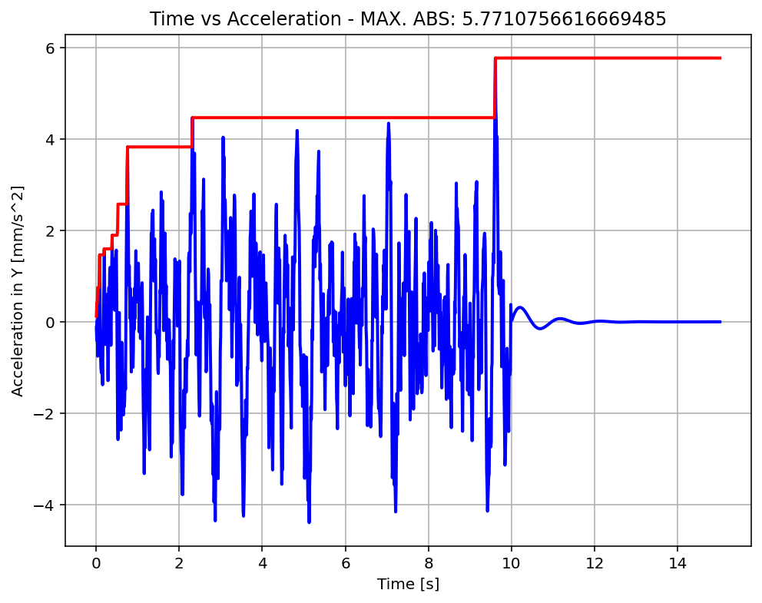

Slide 30
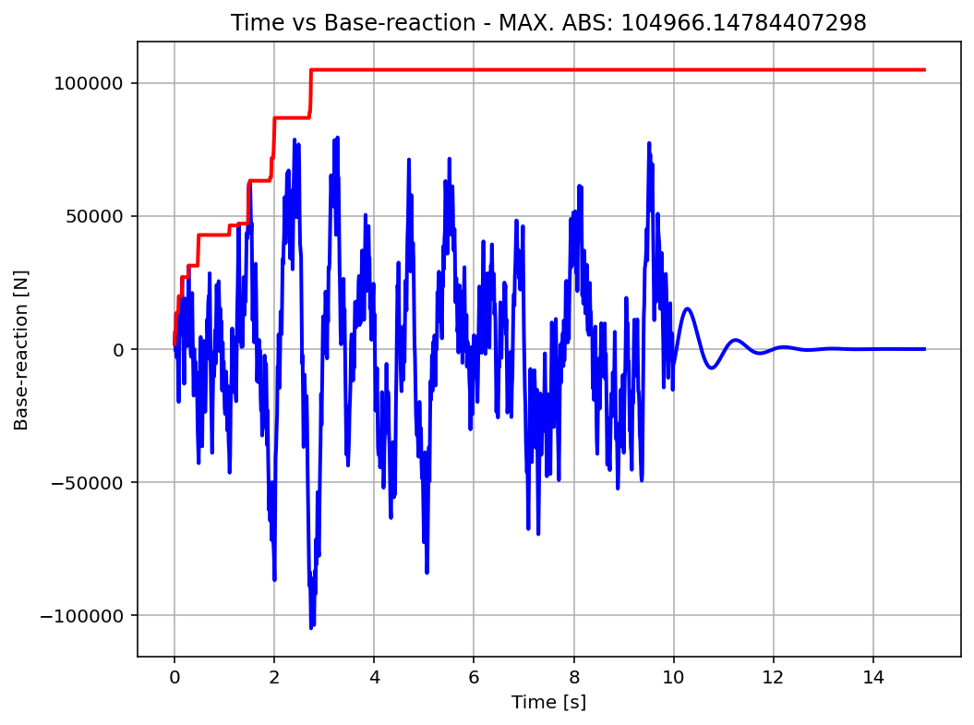

Slide 31
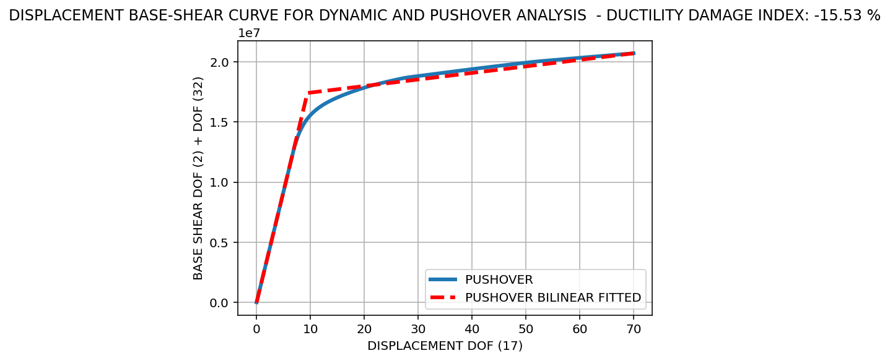
Over Strength Coefficient (Ω0): -12.1215
Displacement Ductility Ratio (μ): -14.3483
Ductility Coefficient (Rμ): -14.3483
Structural Behavior Coefficient (R): 173.9230
Structural Ductility Damage Index in Y Direction: 0.0657
### STRUCTURAL PARAMETERS BASED ON ANALYSIS ###
==================================================== Structure Elastic Stiffness : 0.00
Structure Plastic Stiffness : 0.00
Structure Tangent Stiffness : 0.00
Structure Ductility Ratio : -14.35
Structure Over Strength Factor: -12.12
Structure Yield Displacement: 9.45
Structure Ultimate Displacement: 70.00
Structure Demand Displacement: 0.04
Structure Ductility Damage index: -15.53 %

