Slide 1
IN THE NAME OF ALLAH
SENSITIVITY ANALYSIS OF CONCRETE FRAME BY CHANGING COLUMN REBAR DIAMETER AND COLUMN SECTION DEPTH. ANALYZING CREEP AND SHRINKAGE OF A CONCRETE FRAME. EVALUATING STRAIN HARDENING USING OPENSEES
AND CALCULATE STRUCTURAL BEHAVIOR COEFFICIENT
WRITTEN BY SALAR DELAVAR GHASHGHAEI (QASHQAI)

Slide 2
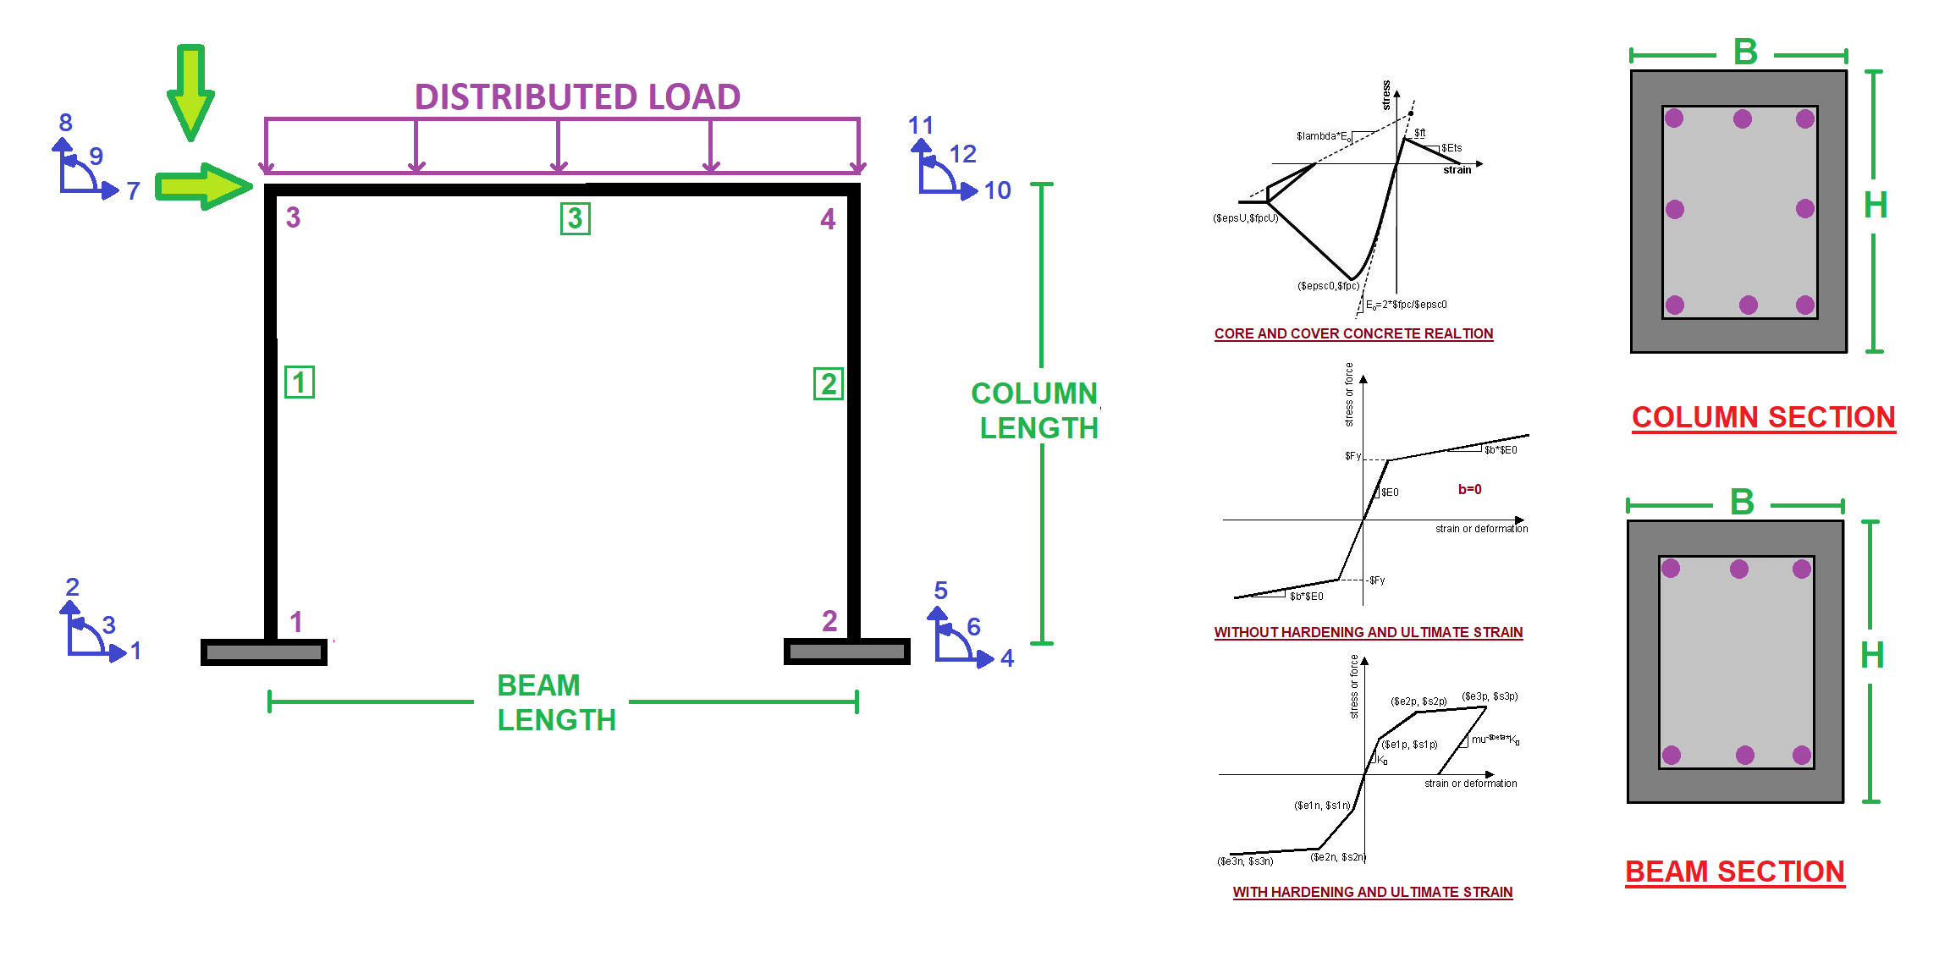

Slide 3
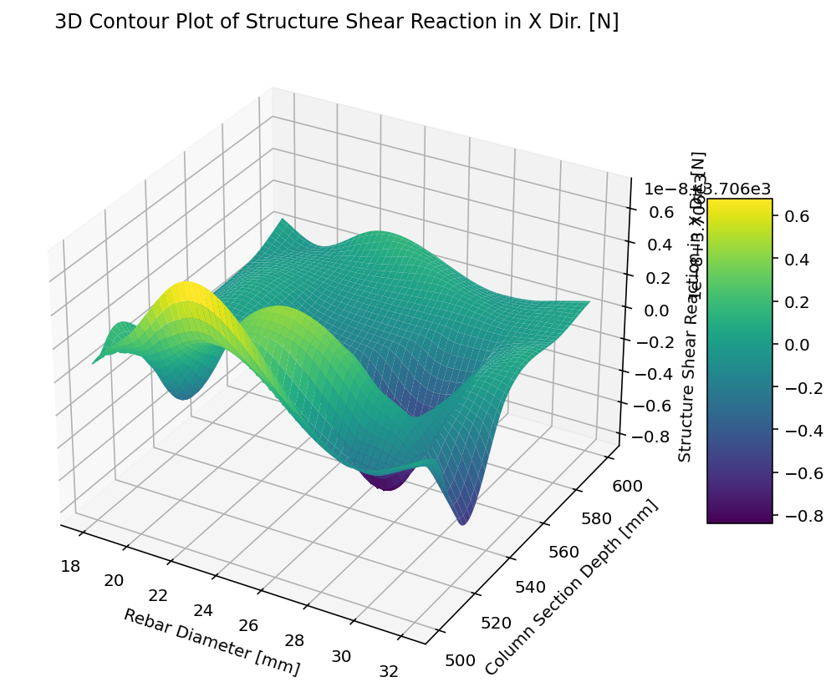

Slide 4
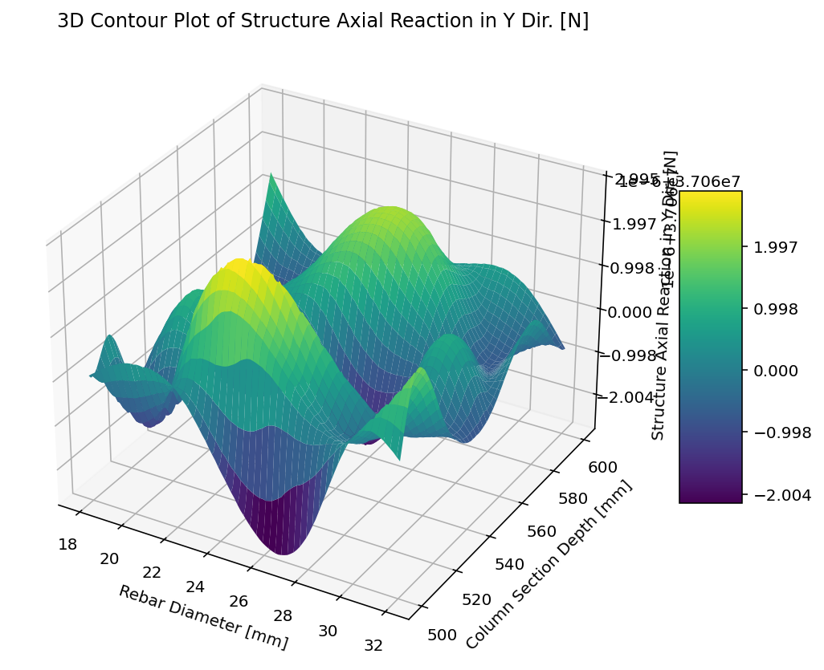

Slide 5
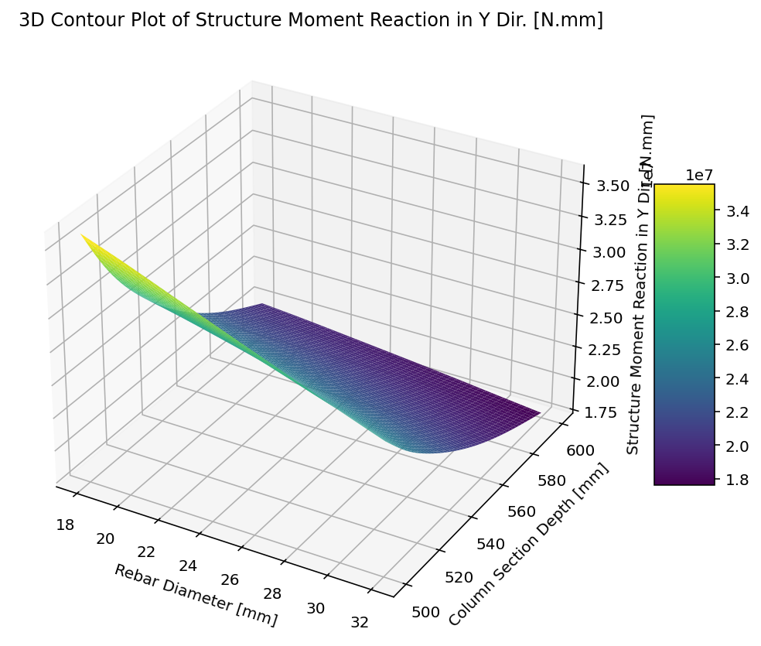

Slide 6
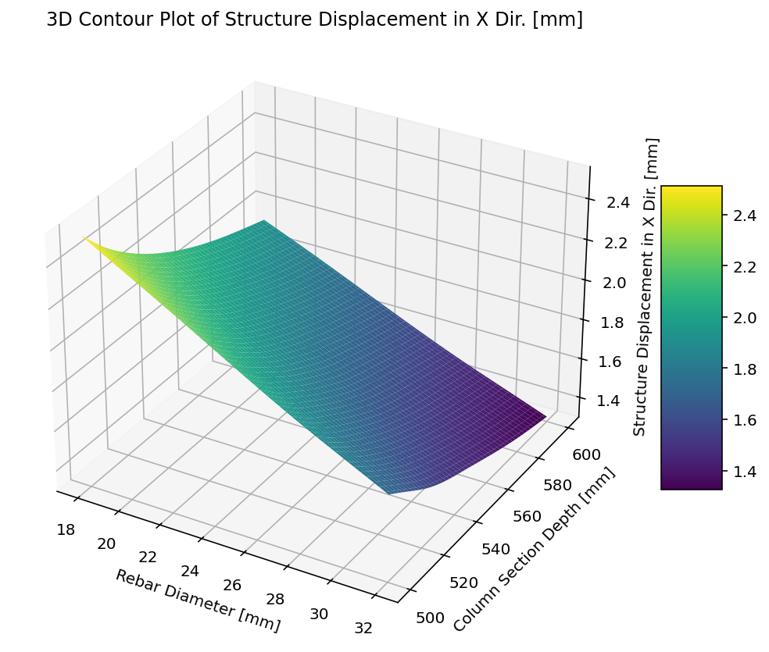

Slide 7
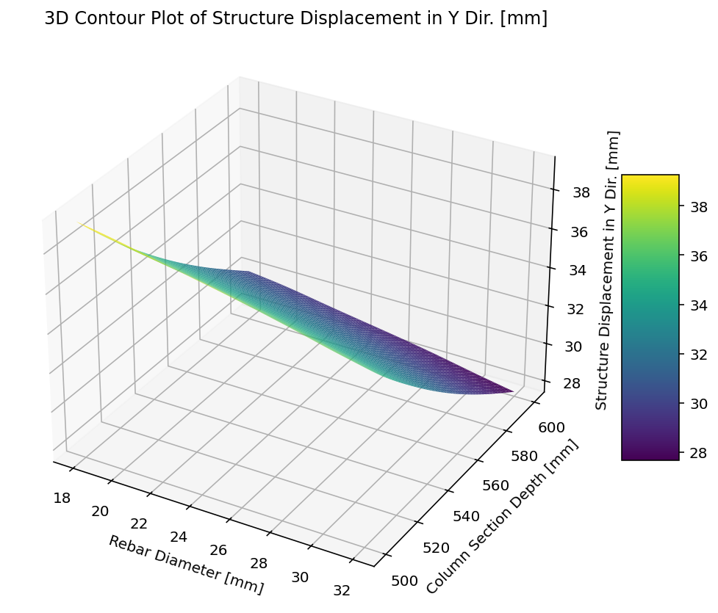

Slide 8
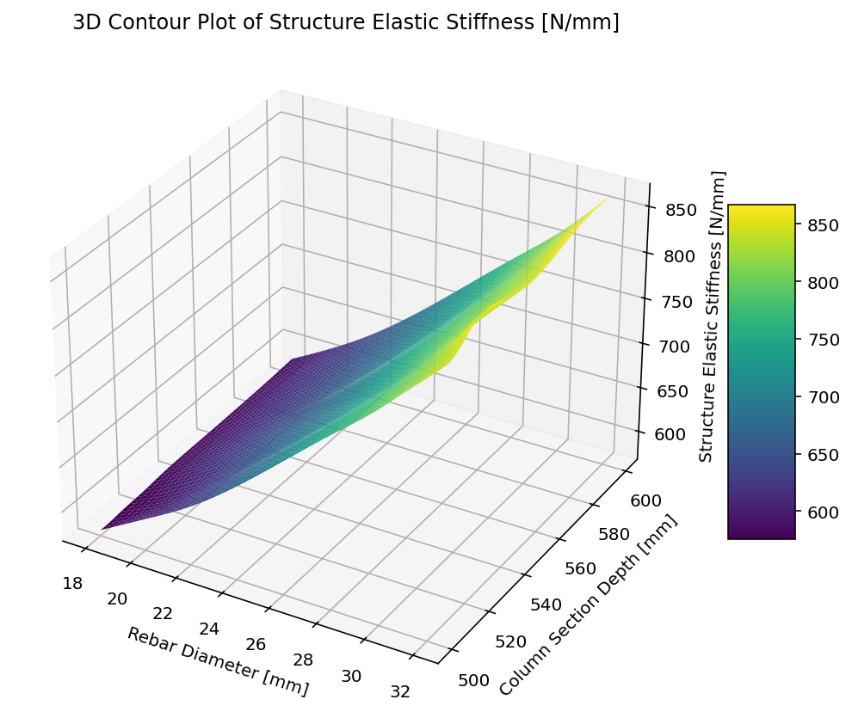

Slide 9
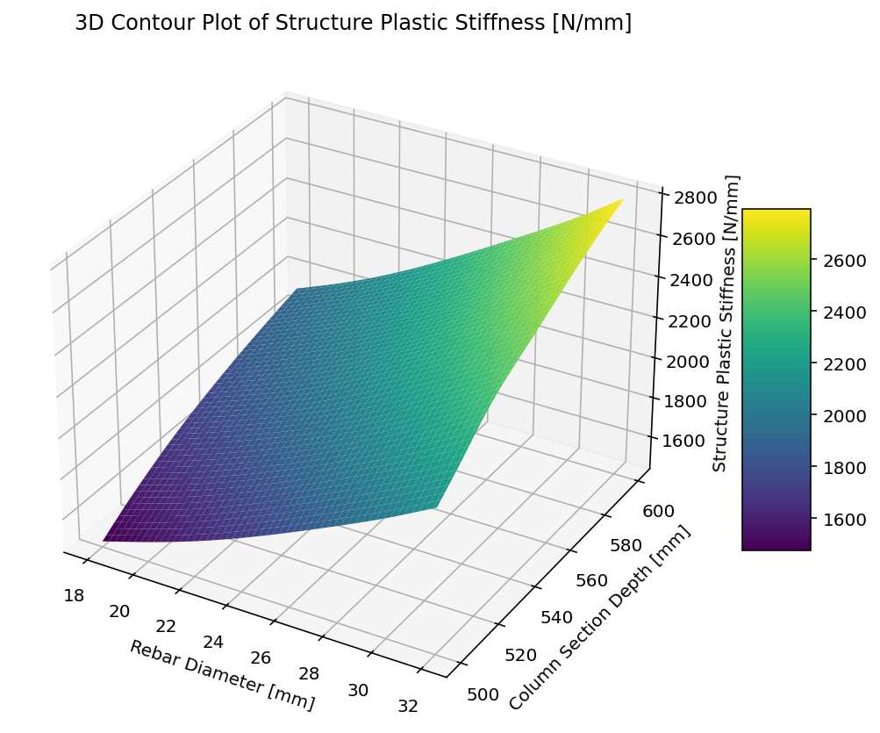

Slide 10
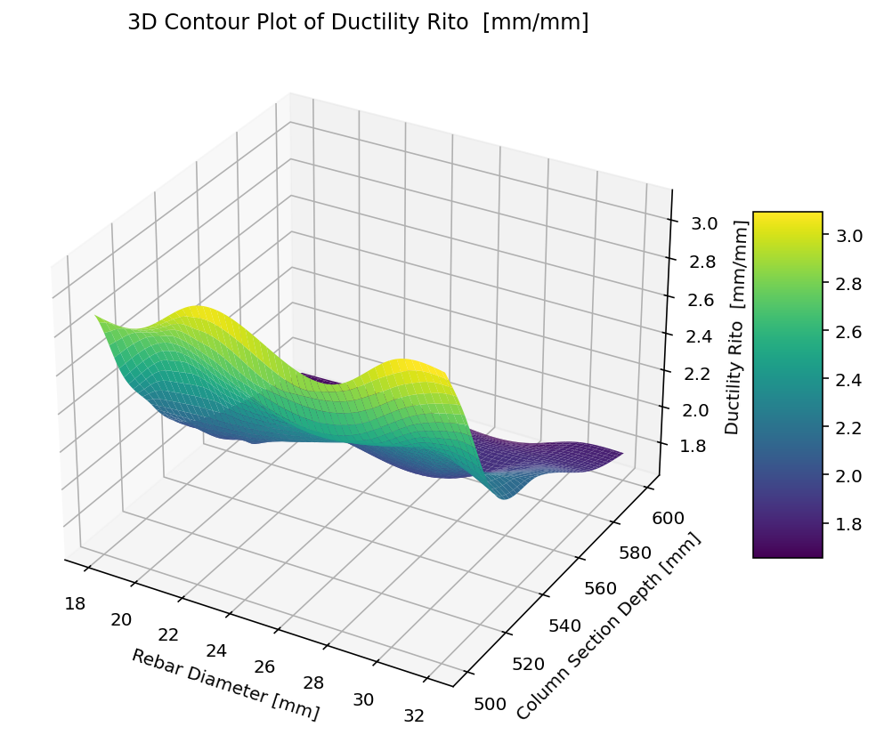

Slide 11
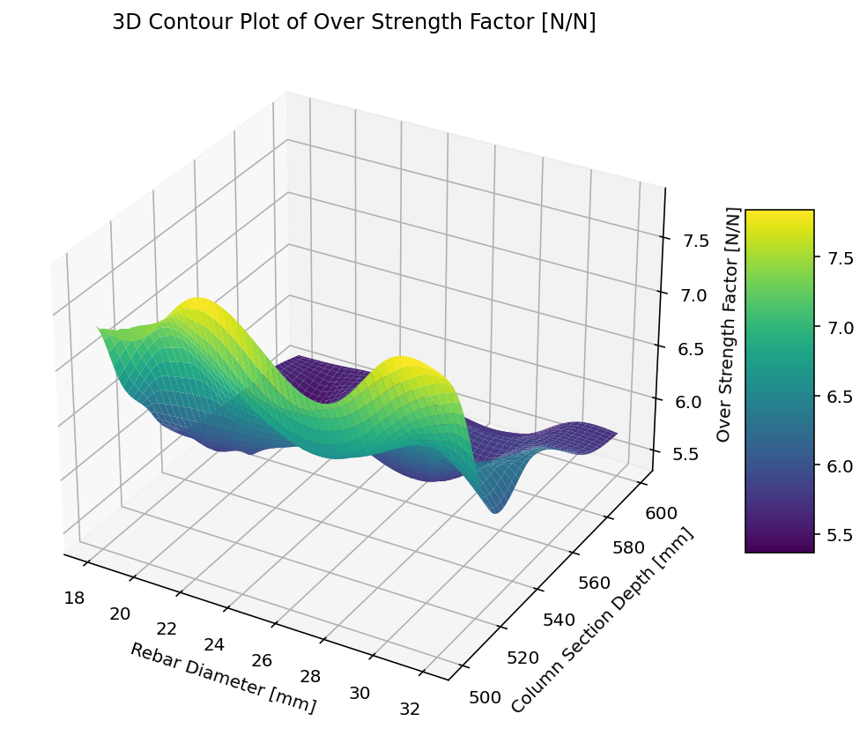

Slide 12
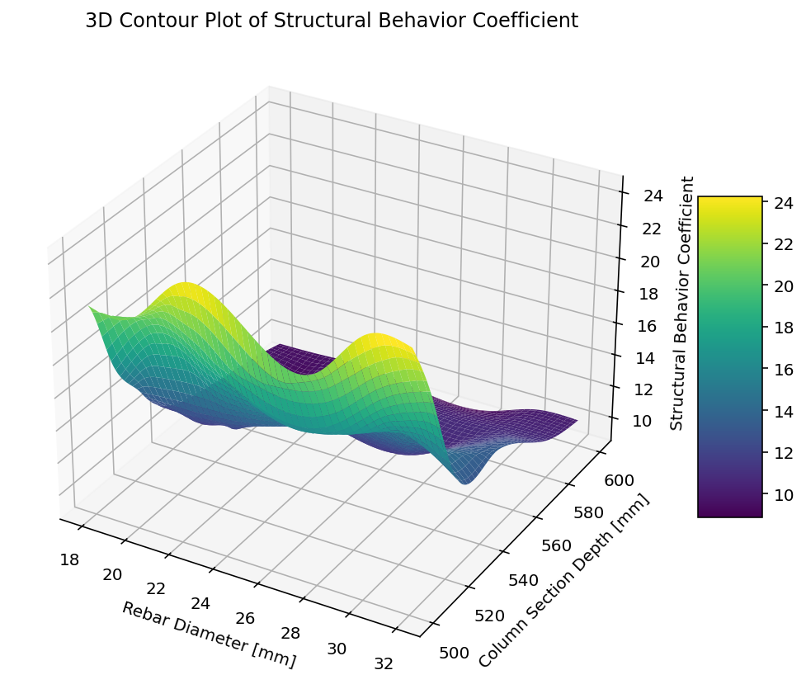

Slide 13
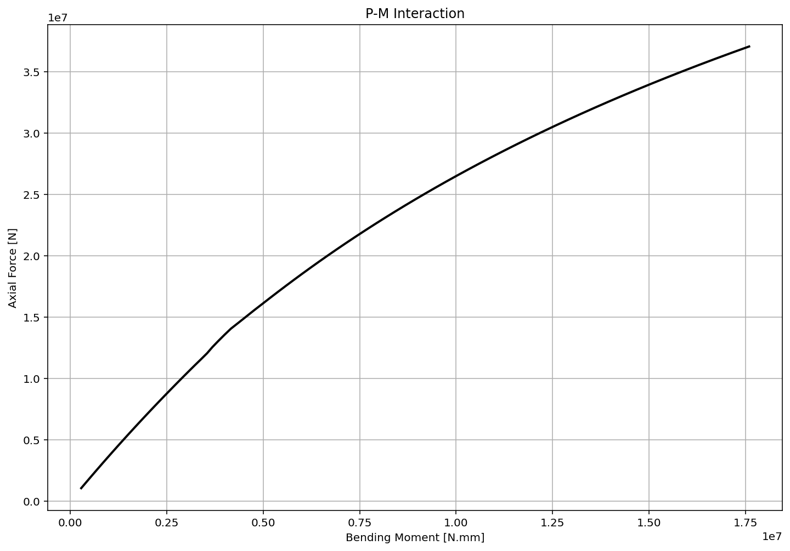

Slide 14
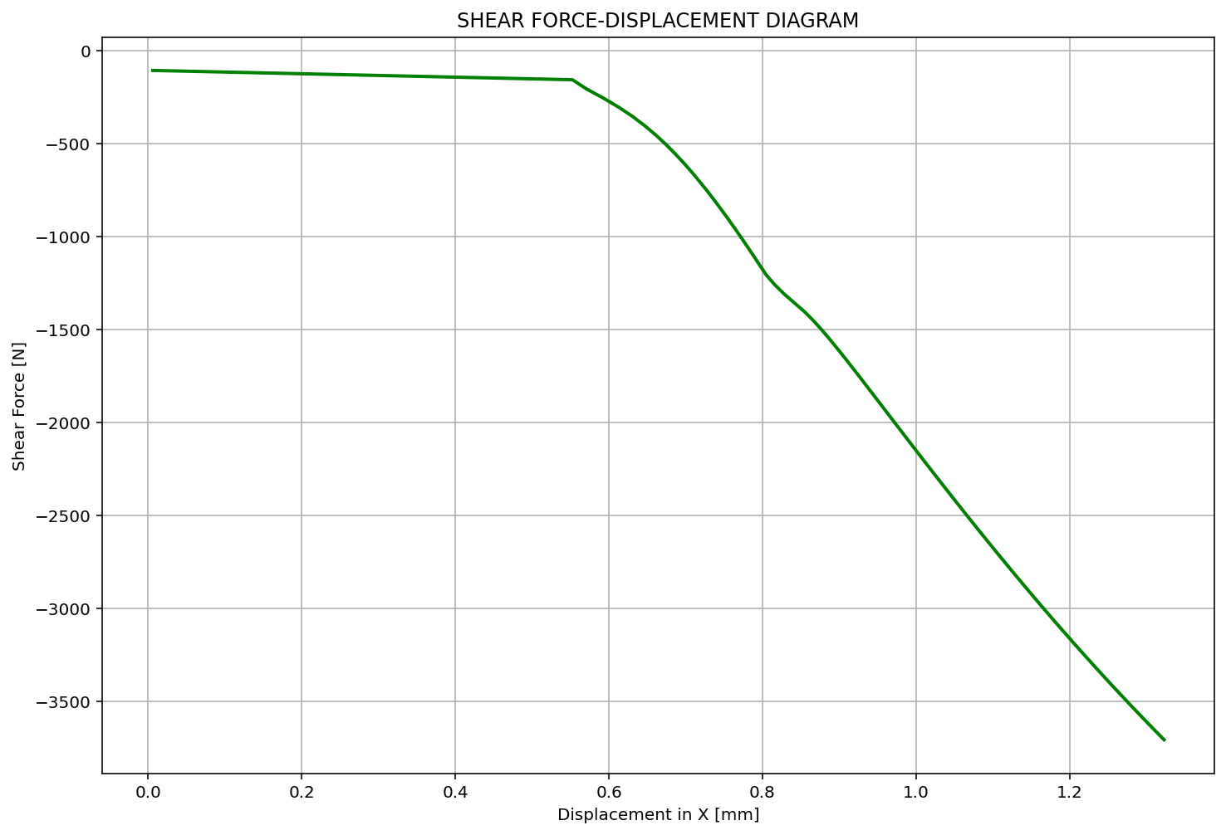

Slide 15
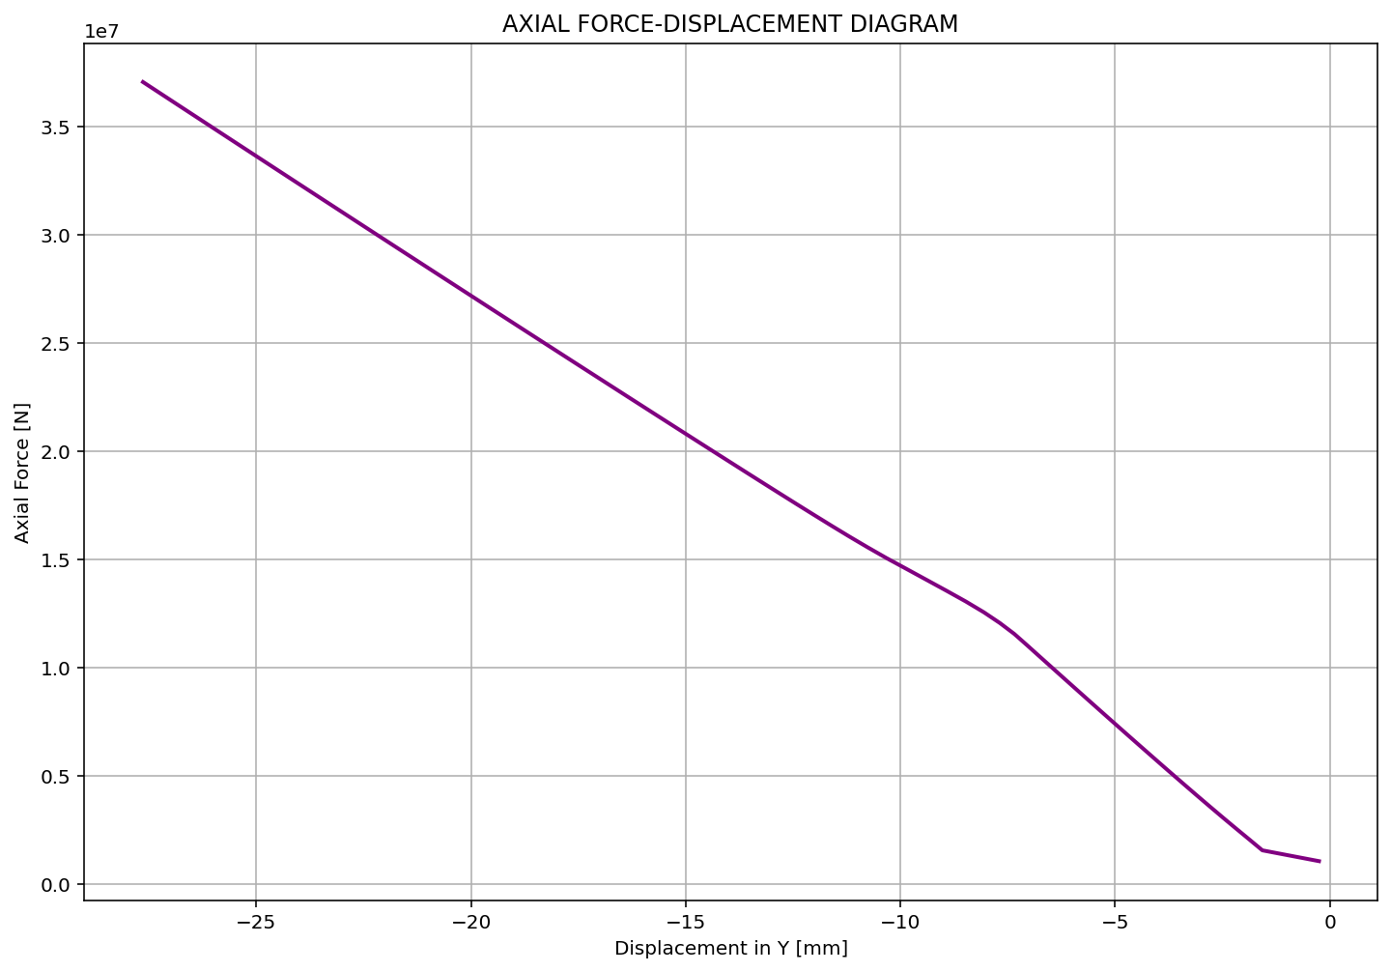

Slide 16
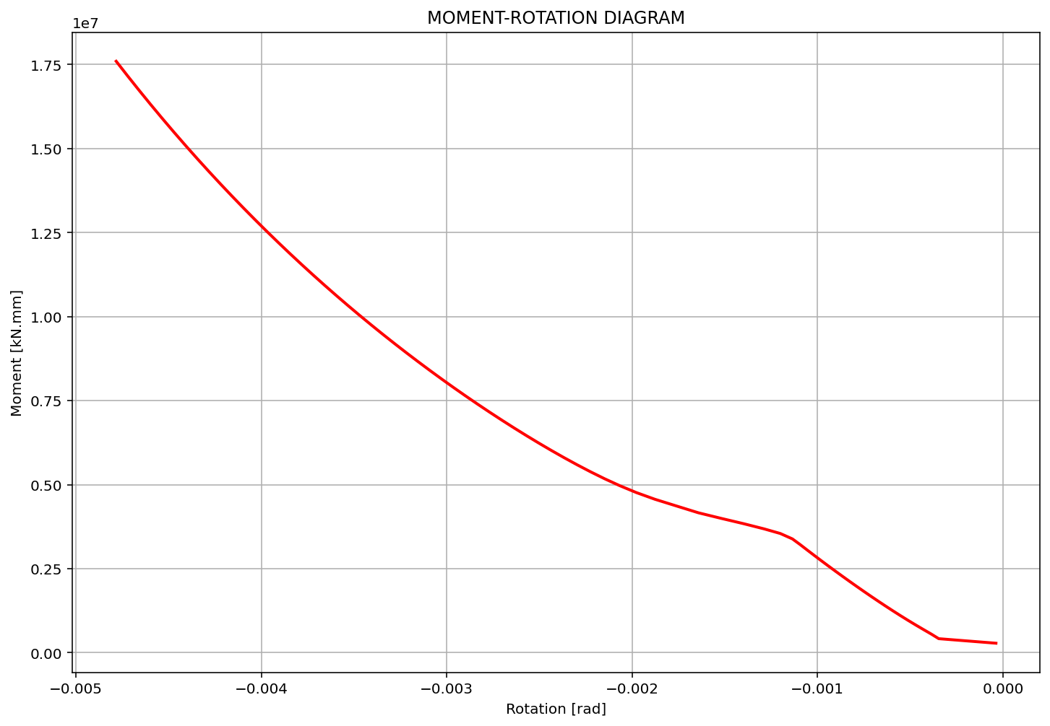

Slide 17
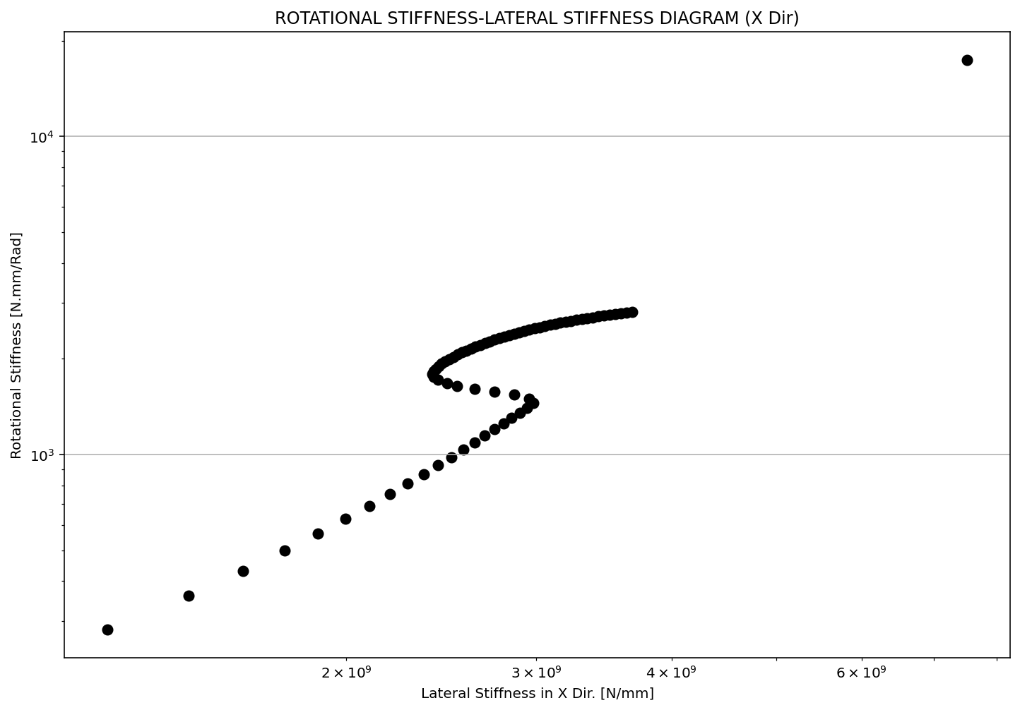

Slide 18
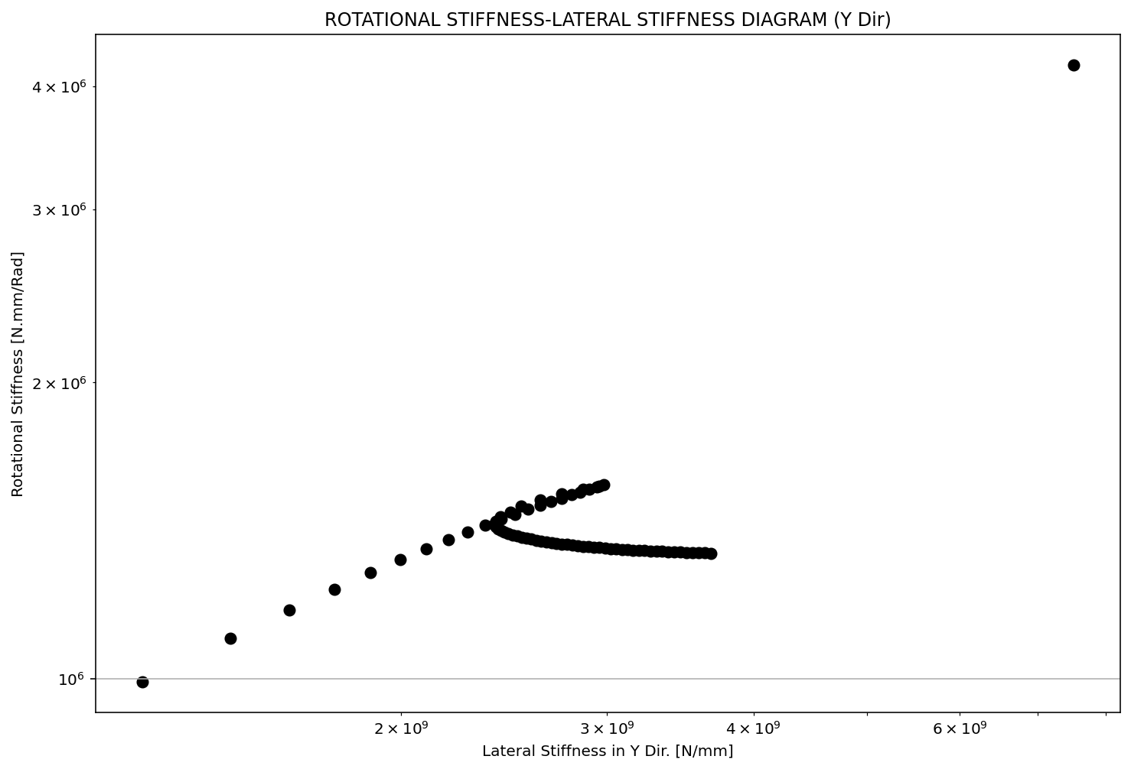

Slide 19
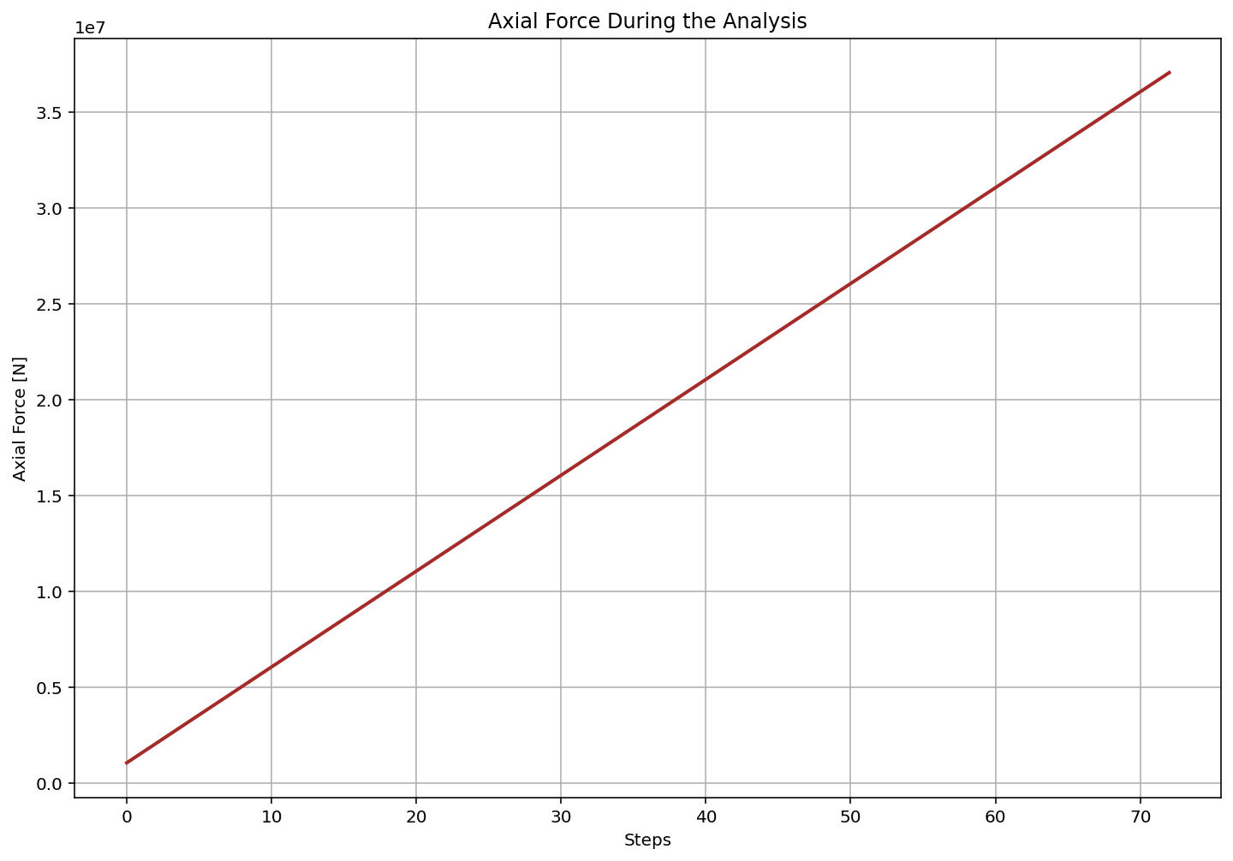

Slide 20
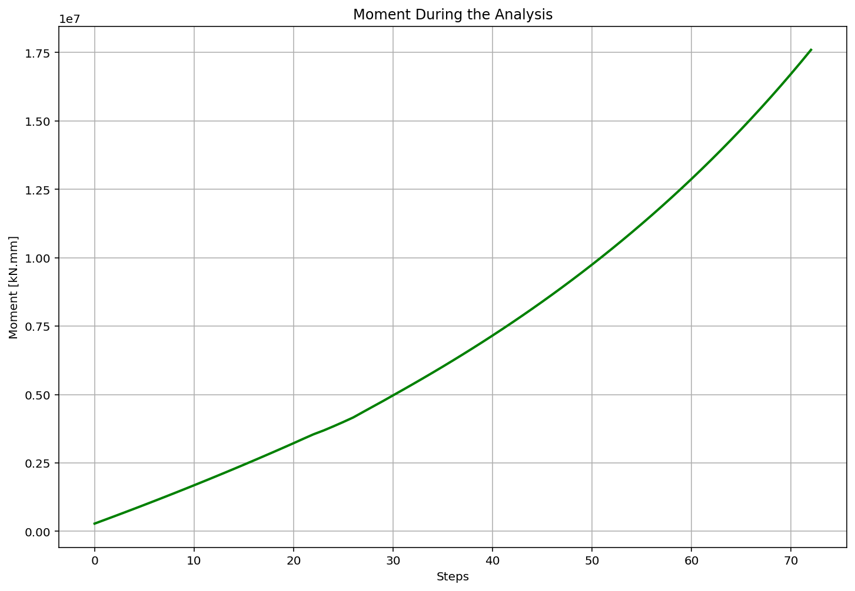

Slide 21
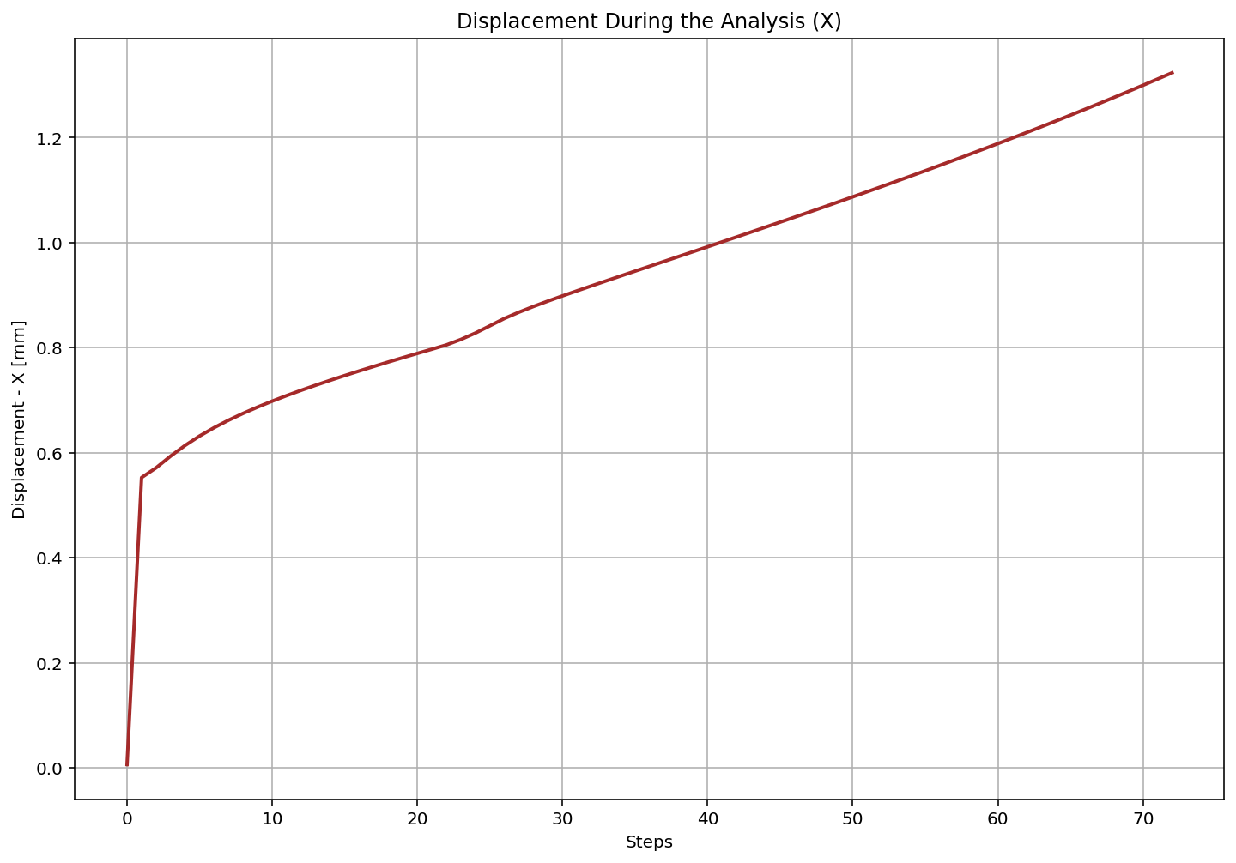

Slide 22
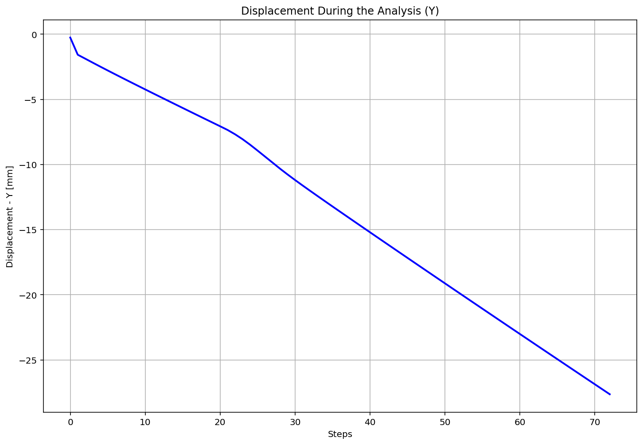

Slide 23
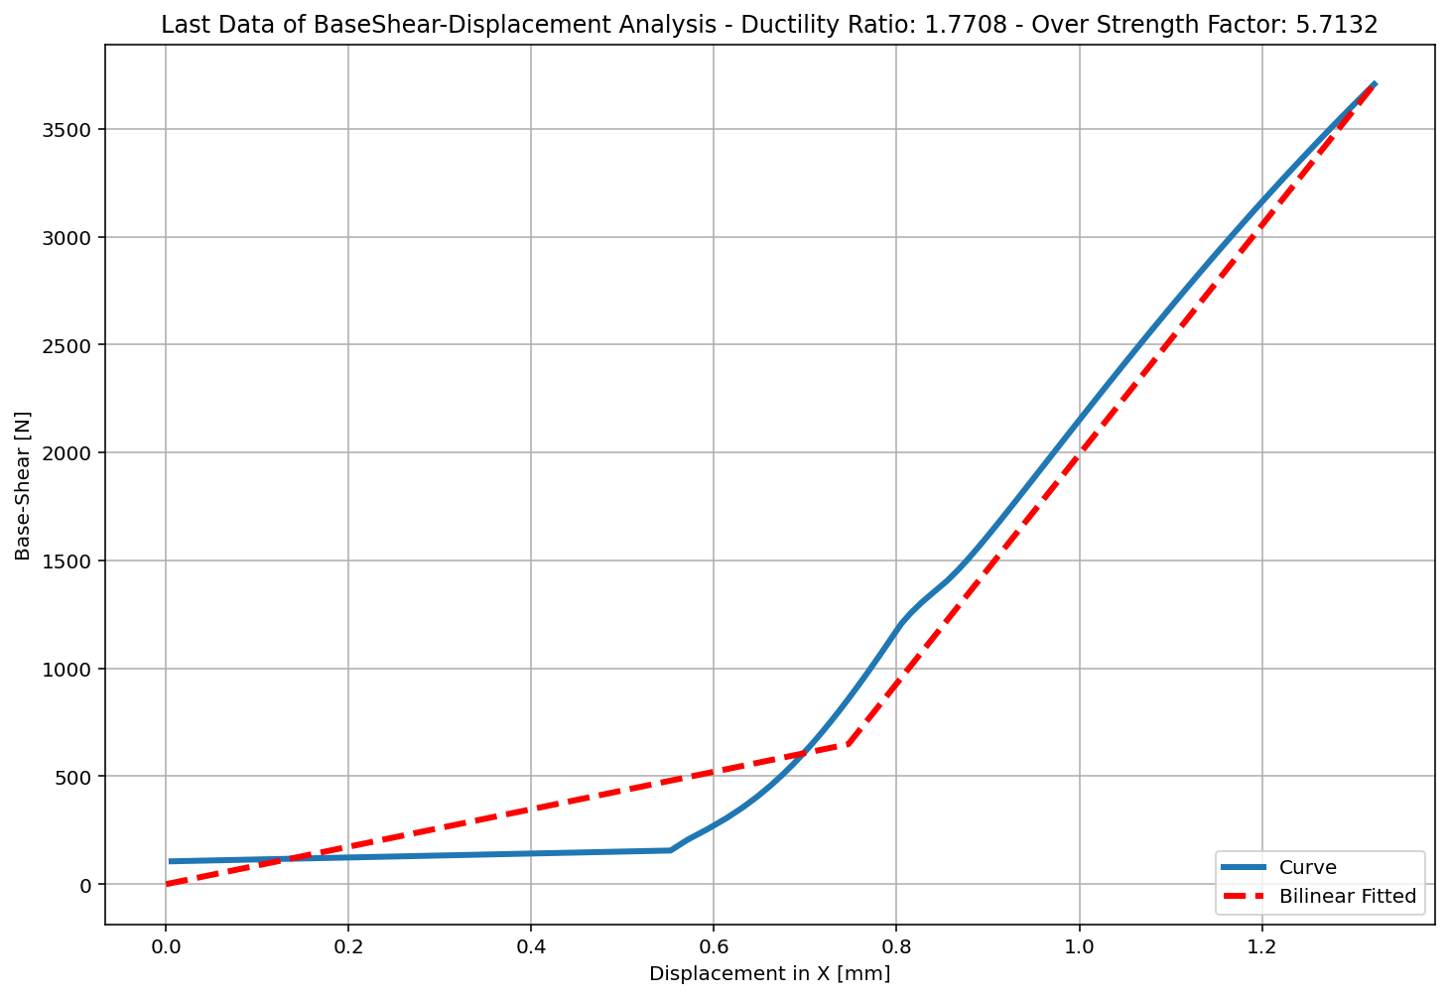

Slide 24
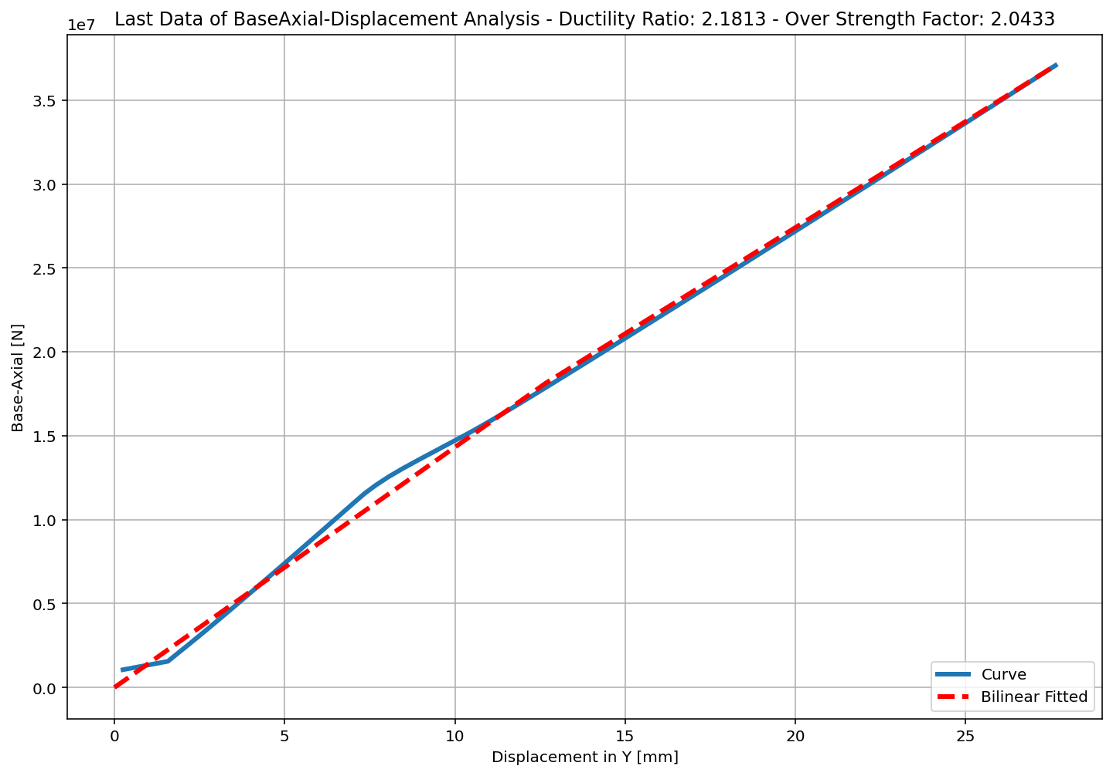

Slide 25
