Slide 1
>> IN THE NAME OF ALLAH, THE MOST GRACIOUS, THE MOST MERCIFUL <<
DETERMINATION OF THE OPTIMUM ELASTIC STIFFNESS OF EACH COLUMN BASED ON THE STRUCTURAL PERIOD VARATIONS THROUGH CONSTANT MASS USING FINITE-DIFFERENCE NEWTON ITERATION AND OPENSEES
THIS PYTHON SCRIPT IS WRITTEN BY SALAR DELAVAR GHASHGHAEI (QASHQAI)

Slide 2


Slide 3
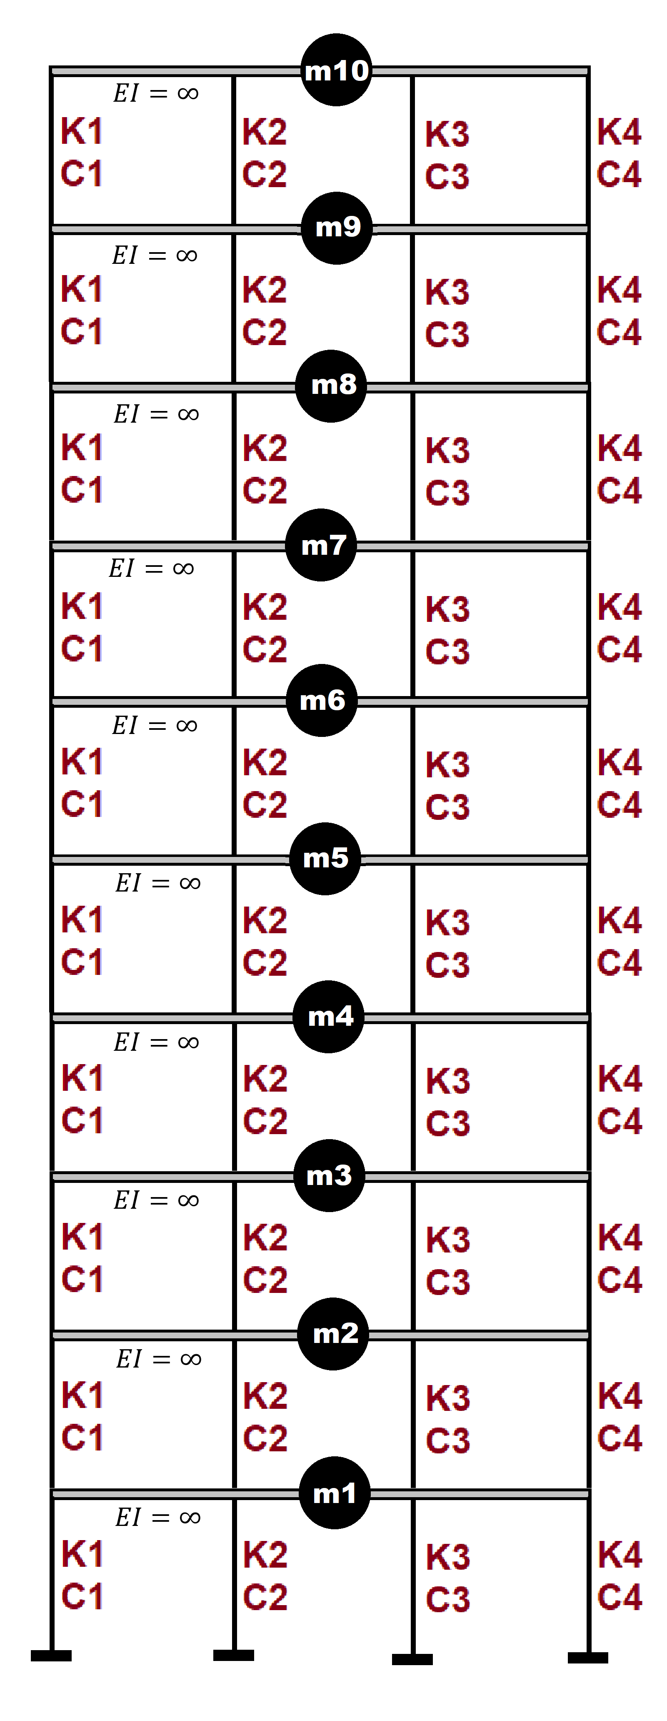

Slide 4
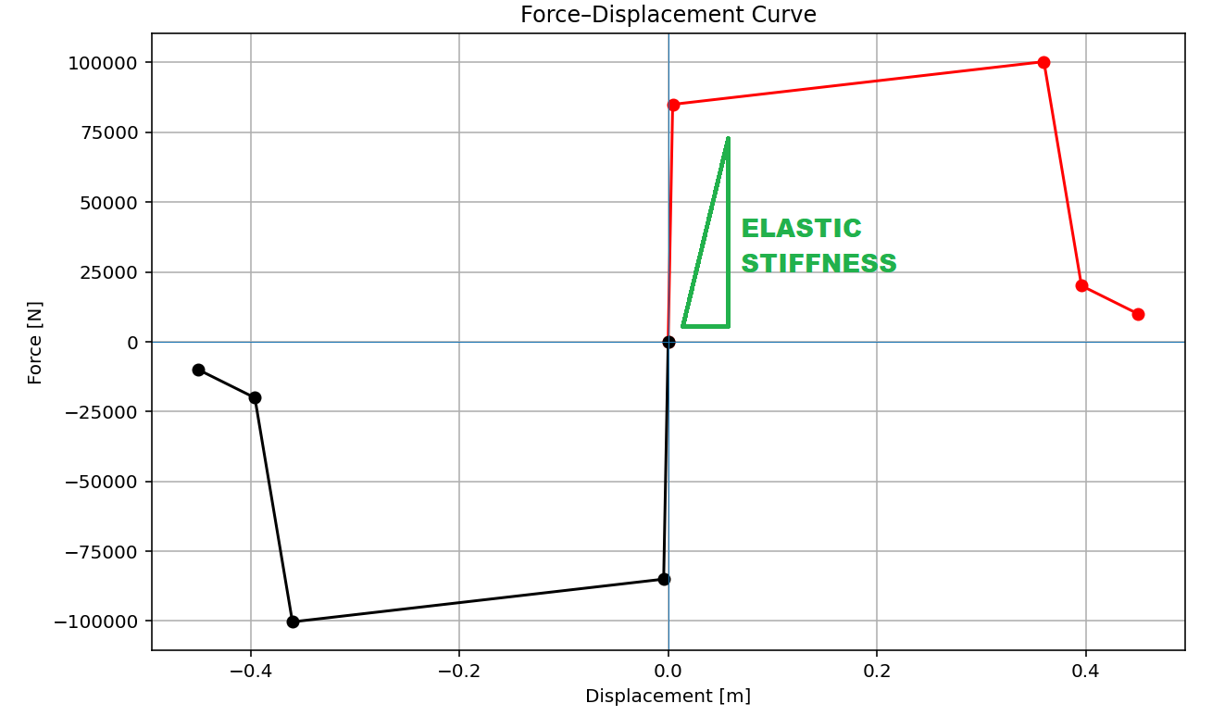

Slide 5
OPTIMIZATION PROBLEM FOR STRUCTURAL PERIOD BY CHANGING EACH COLUMN ELASTIC STIFFNESS

Slide 6
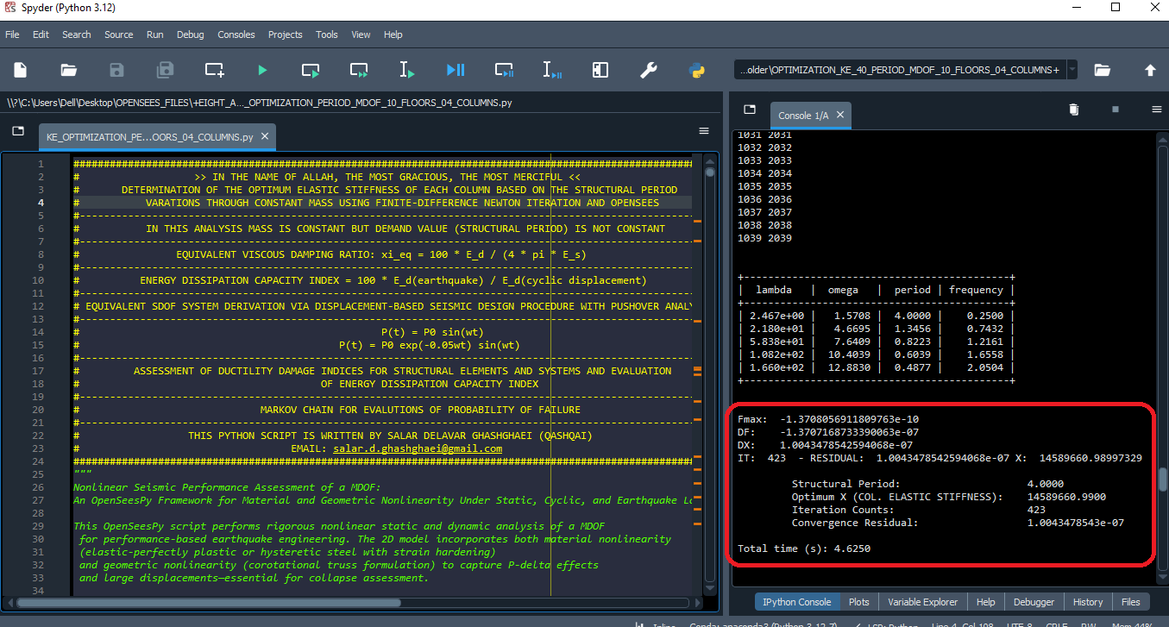

Slide 7
Fmax: -1.3708056911809763e-10
DF: -1.3707168733390063e-07
DX: 1.0043478542594068e-07
IT: 423 - RESIDUAL: 1.0043478542594068e-07 X: 14589660.98997329
Structural Period: 4.0000
Optimum X (COL. ELASTIC STIFFNESS): 14589660.9900
Iteration Counts: 423
Convergence Residual: 1.0043478543e-07
Total time (s): 4.6250

Slide 8
