Slide 1
>> IN THE NAME OF ALLAH, THE MOST GRACIOUS, THE MOST MERCIFUL <<
DETERMINATION OF OPTIMUM STRUCTURAL DUCTILITY RATIO FROM ENERGY DISSIPATION CAPACITY INDEX USING FINITE‑DIFFERENCE NEWTON ITERATION AND OPENSEES
THIS PROGRAM WRITTEN BY SALAR DELAVAR GHASHGHAEI (QASHQAI)

Slide 2
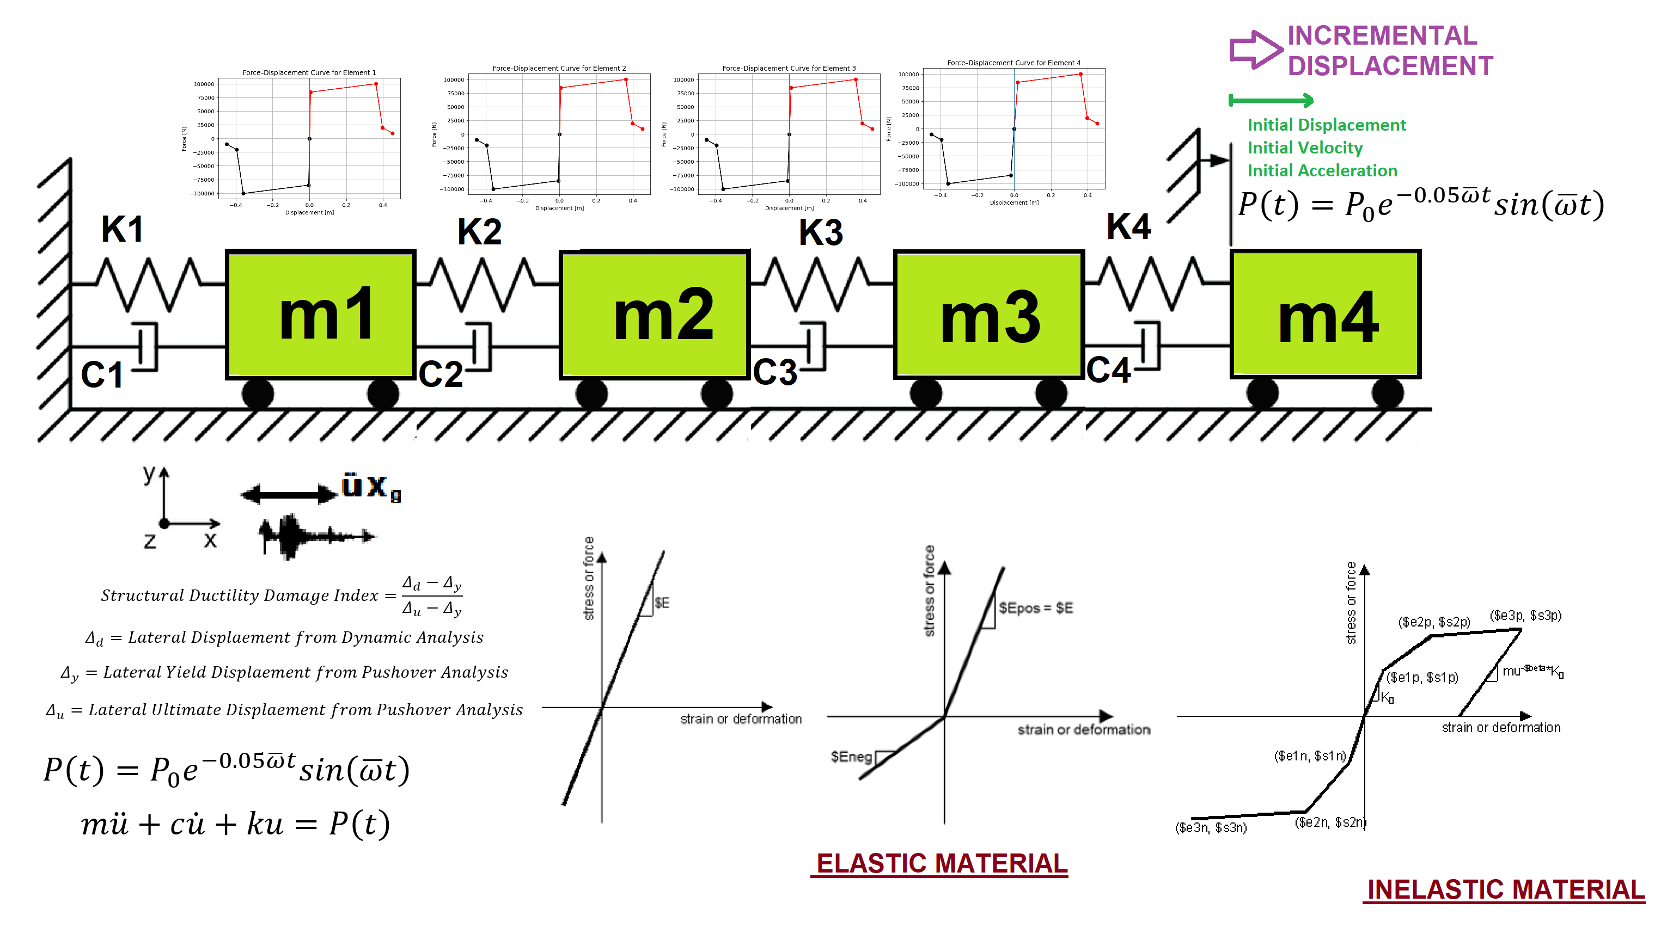

Slide 3
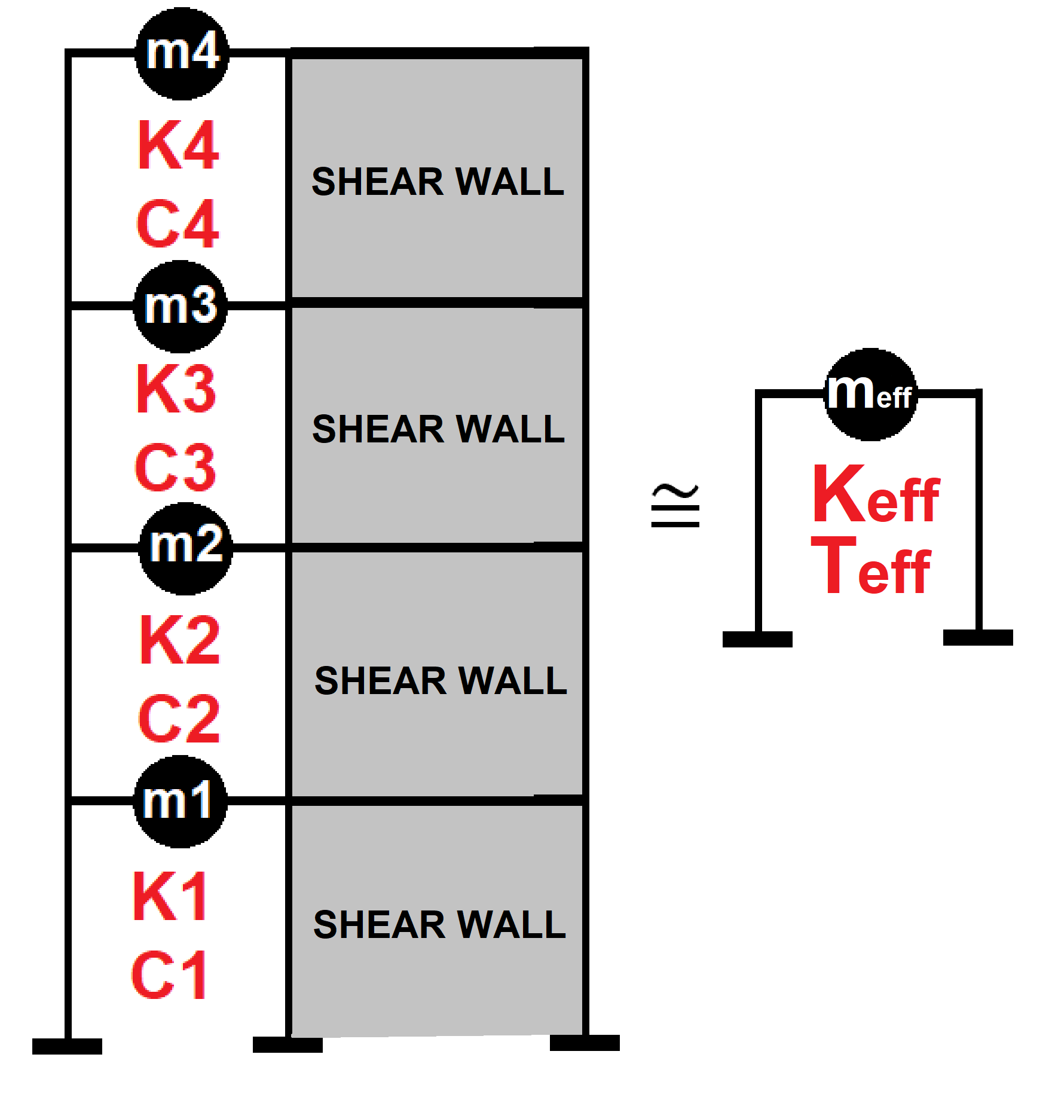

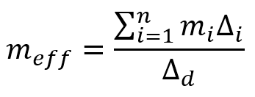
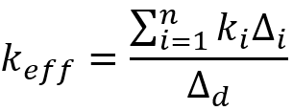
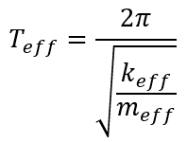
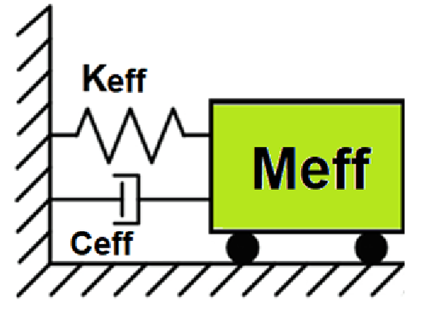
Displacement-based seismic analysis transformation,
converting a multi-degree-of-freedom (MDOF) system
into an equivalent single-degree-of-freedom (SDOF)
system for seismic assessment

Slide 4
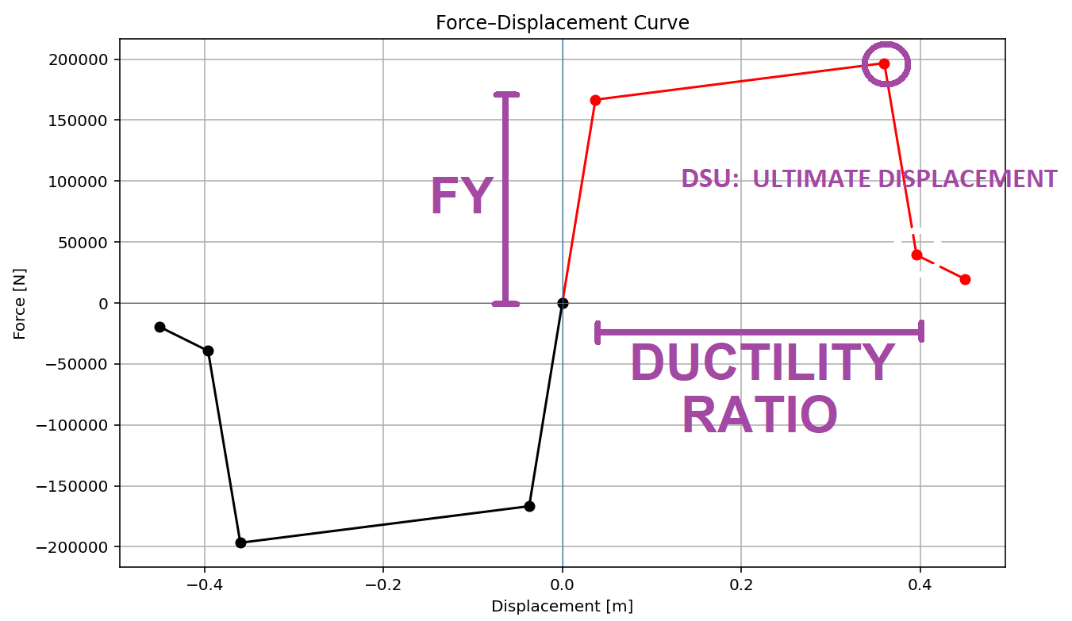

Slide 5
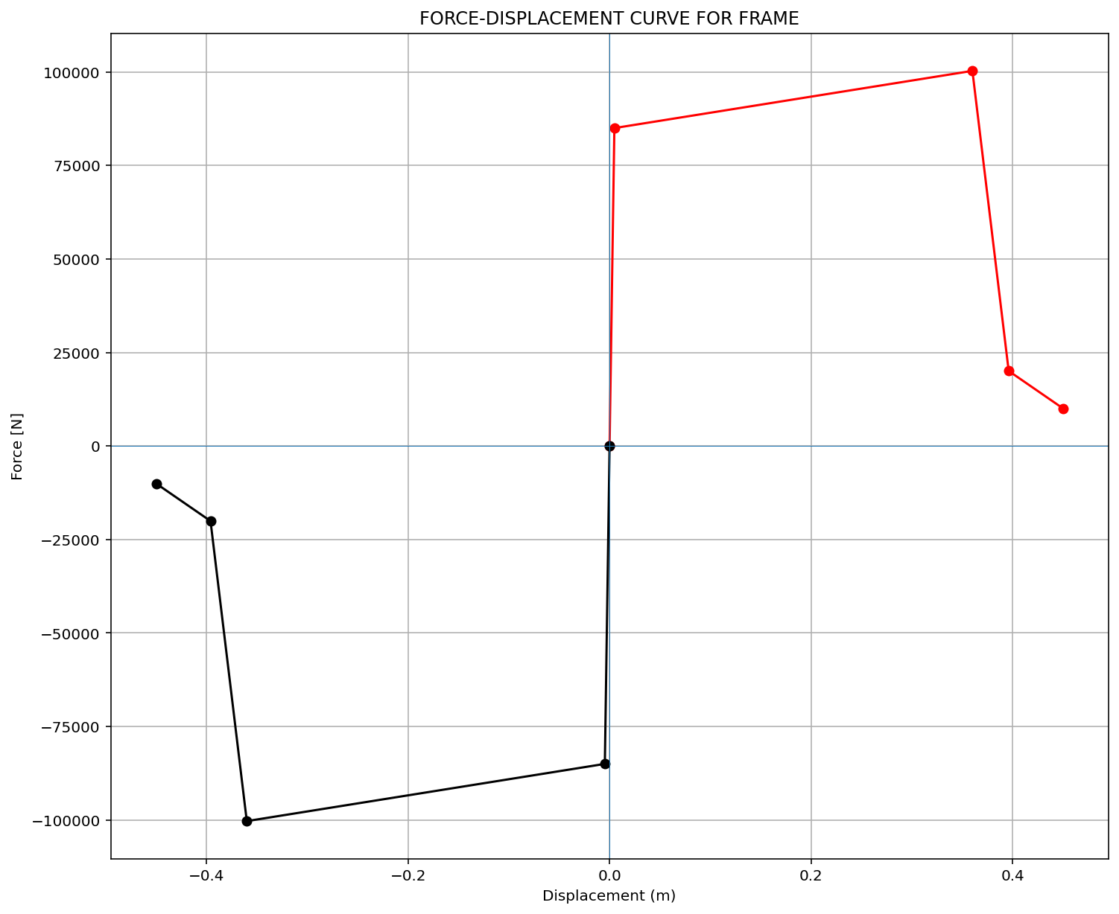

Slide 6
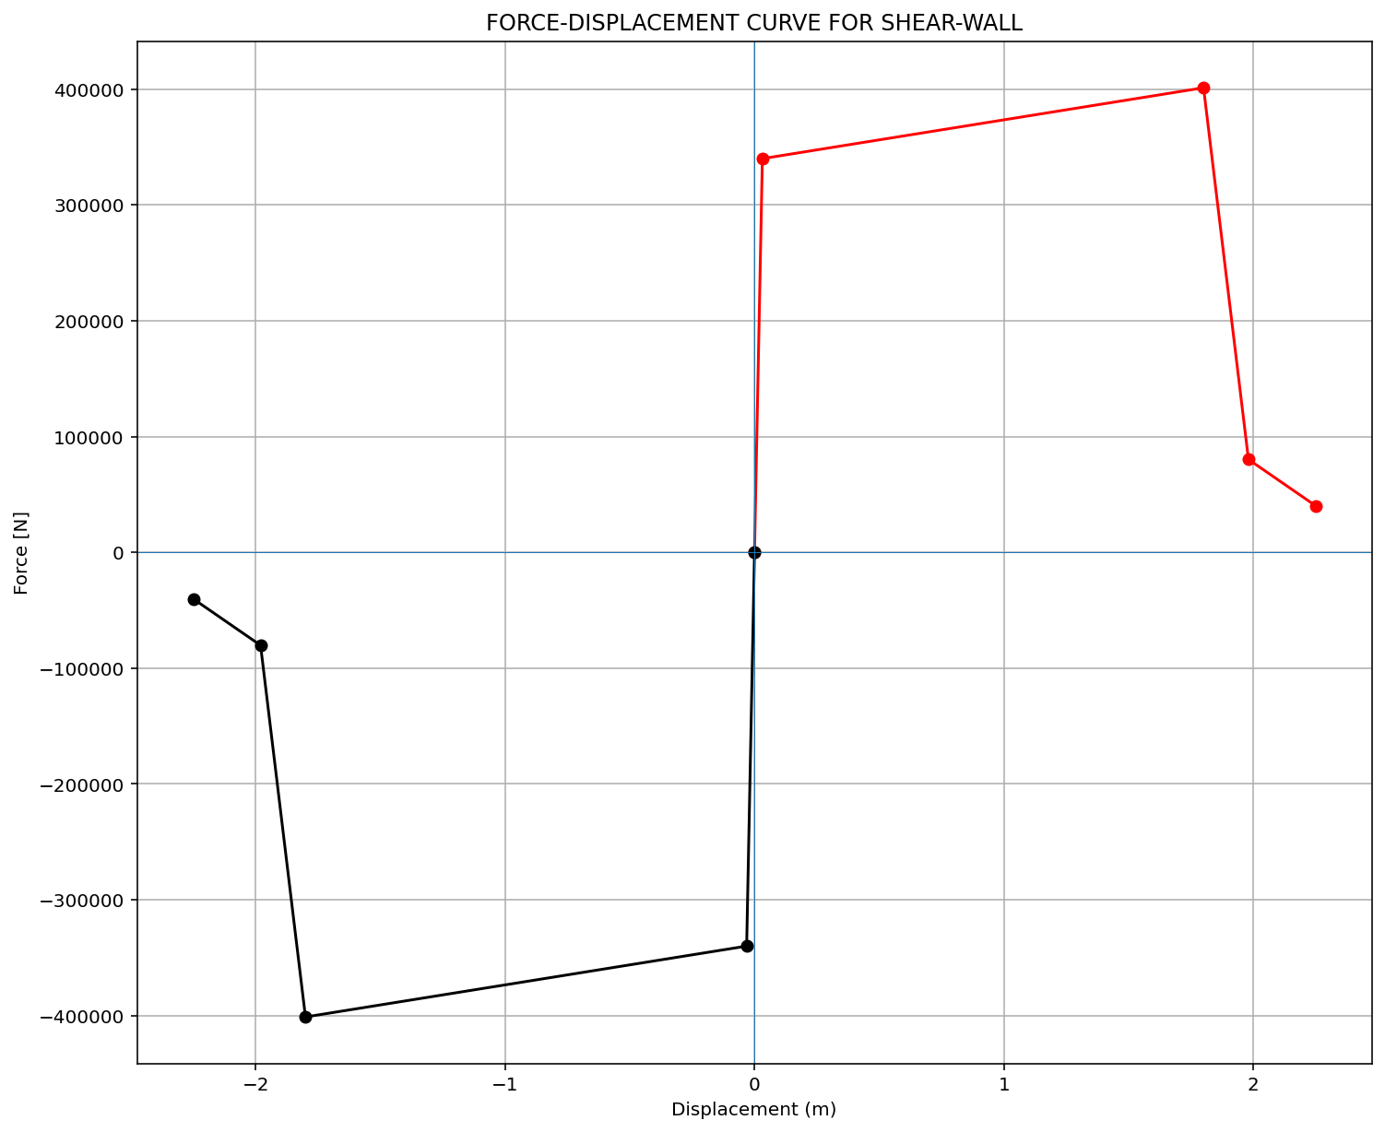

Slide 7
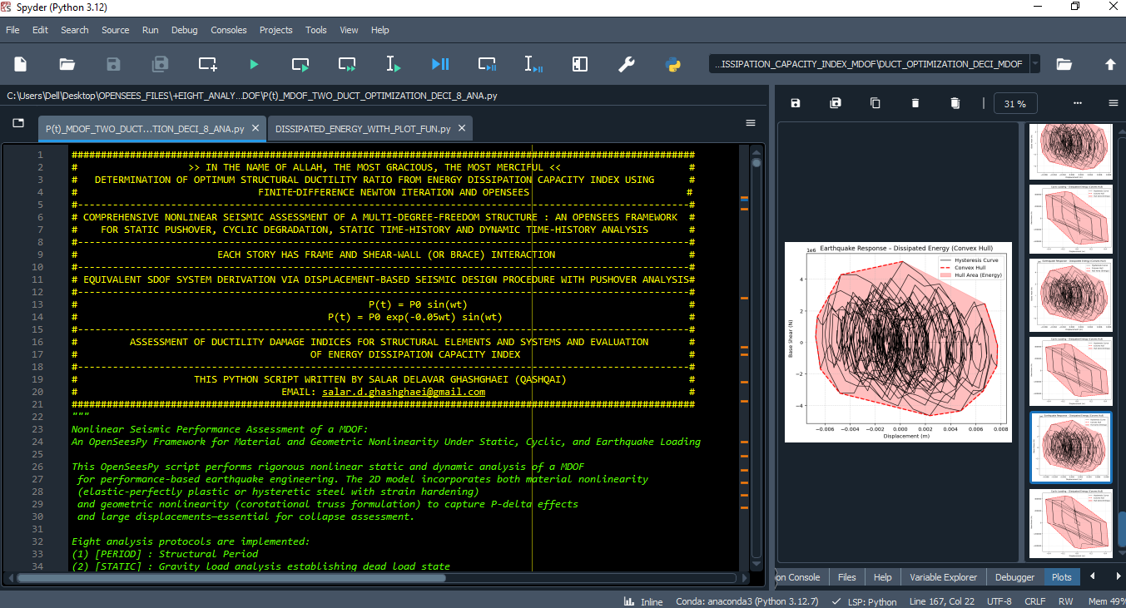

Slide 8
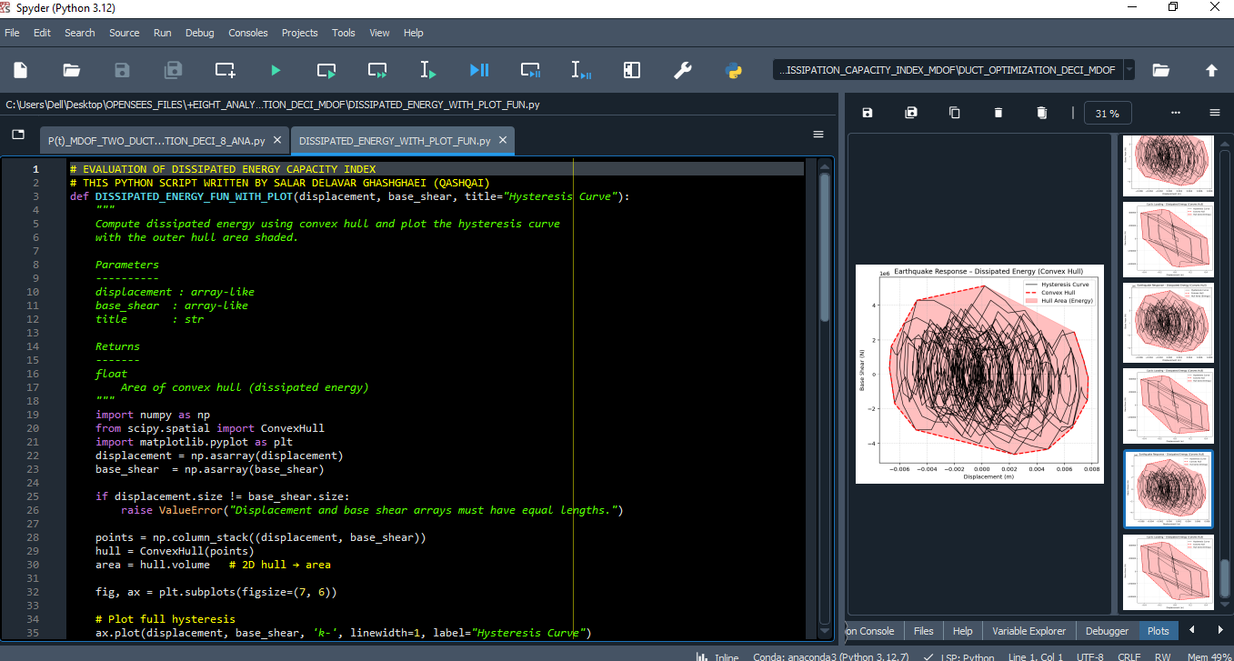

Slide 9
OPTIMIZATION PROBLEM FOR ENERGY DISSIPATION CAPACITY INDEX (EDCI)

Slide 10
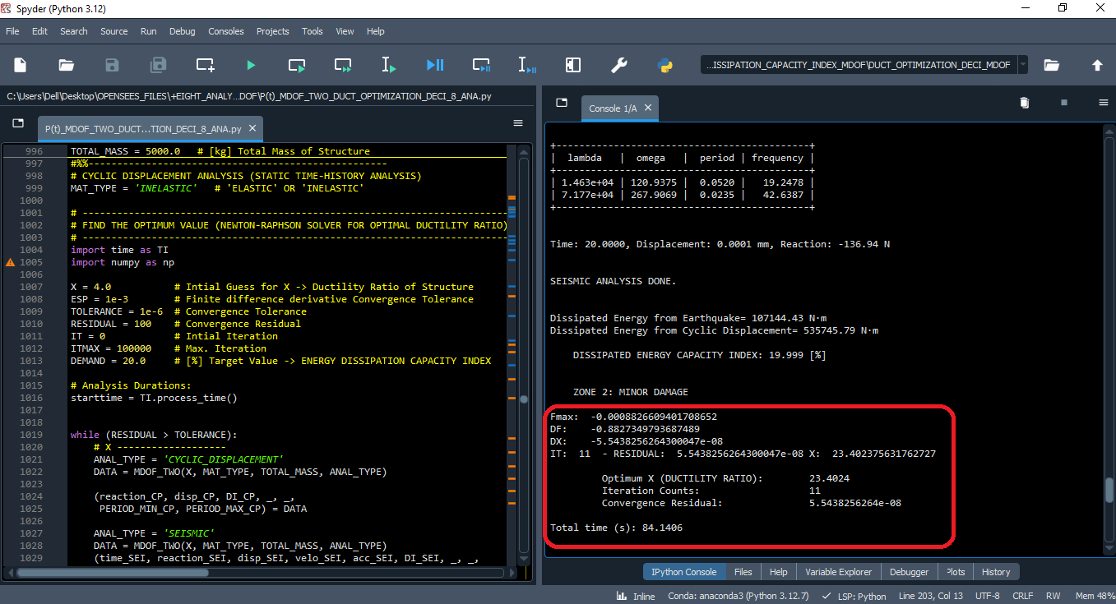

Slide 11
Dissipated Energy from Earthquake= 732813.284 N·m
Dissipated Energy from Cyclic Displacement= 3664139.377 N·m
DISSIPATED ENERGY CAPACITY INDEX: 19.999 [%]
ZONE 2: MINOR DAMAGE
Fmax: -0.0008826609401708652
DF: -0.8827349793687489
DX: -5.5438256264300047e-08
IT: 11 - RESIDUAL: 5.5438256264300047e-08 X: 23.402375631762727
Optimum X (DUCTILITY RATIO): 23.4024
Iteration Counts: 11
Convergence Residual: 5.5438256264e-08
Total time (s): 84.1406

Slide 12
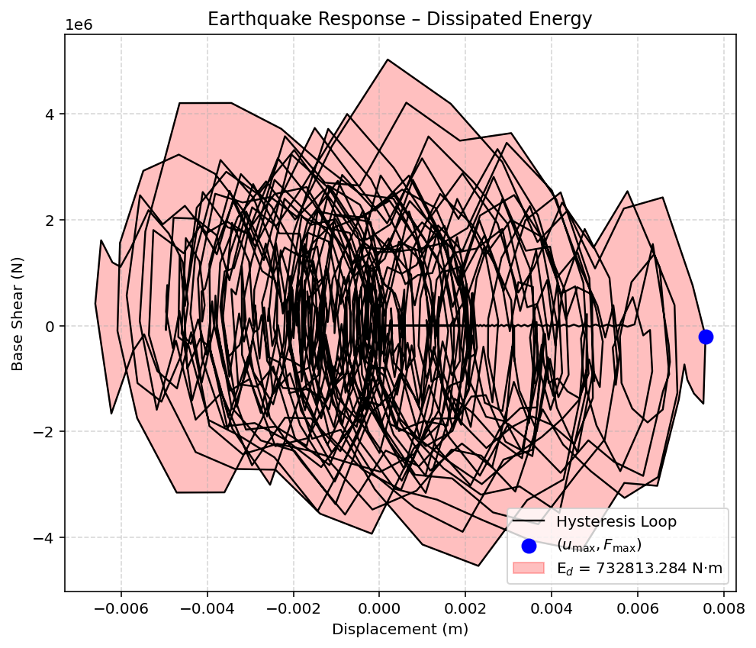

Slide 13
