Slide 1
>> IN THE NAME OF ALLAH, THE MOST GRACIOUS, THE MOST MERCIFUL <<
OPTIMIZATION OF A SINGLE-DEGREE-OF-FREEDOM STRUCTURE THROUGH FREE VIBRATION ANALYSIS USING OPENSEES
OPTIMIZATION ALGORITHM: NEWTON-RAPHSON METHOD
WRITTEN BY SALAR DELAVAR GHASHGHAEI (QASHQAI)

Slide 2
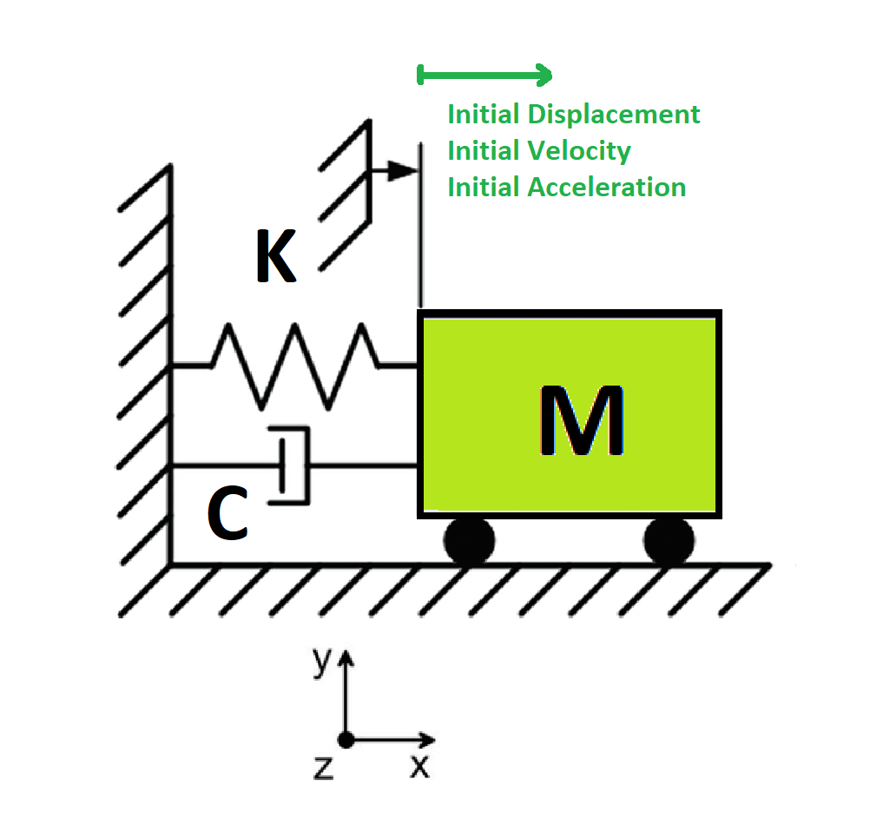

Slide 3
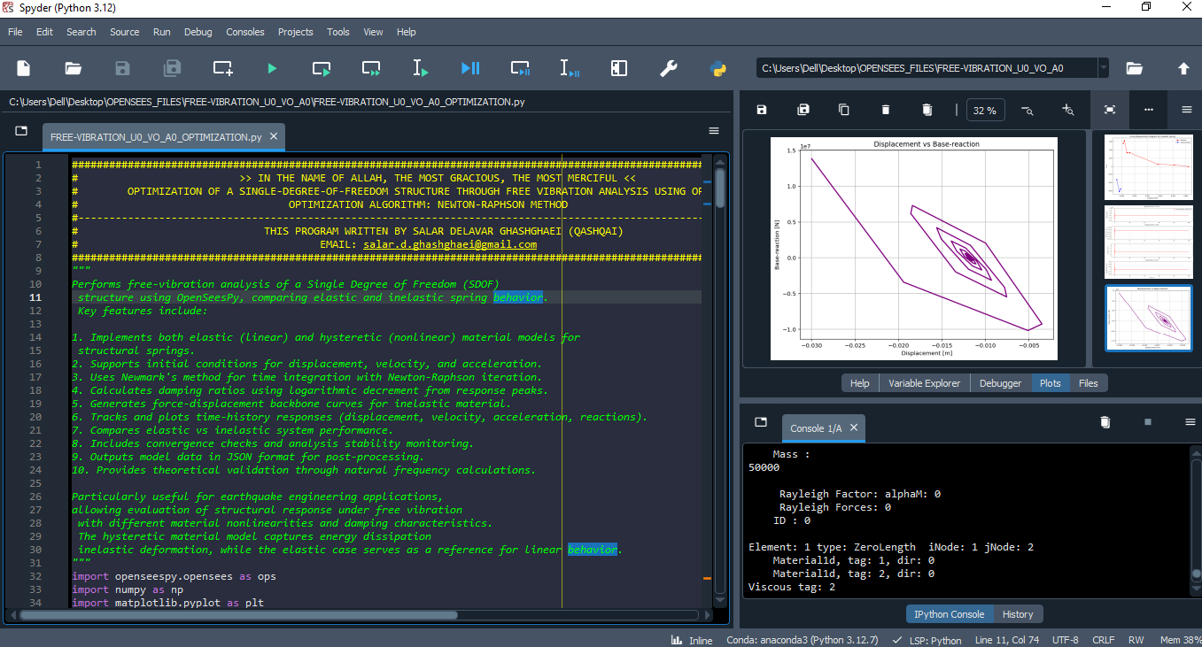

Slide 4
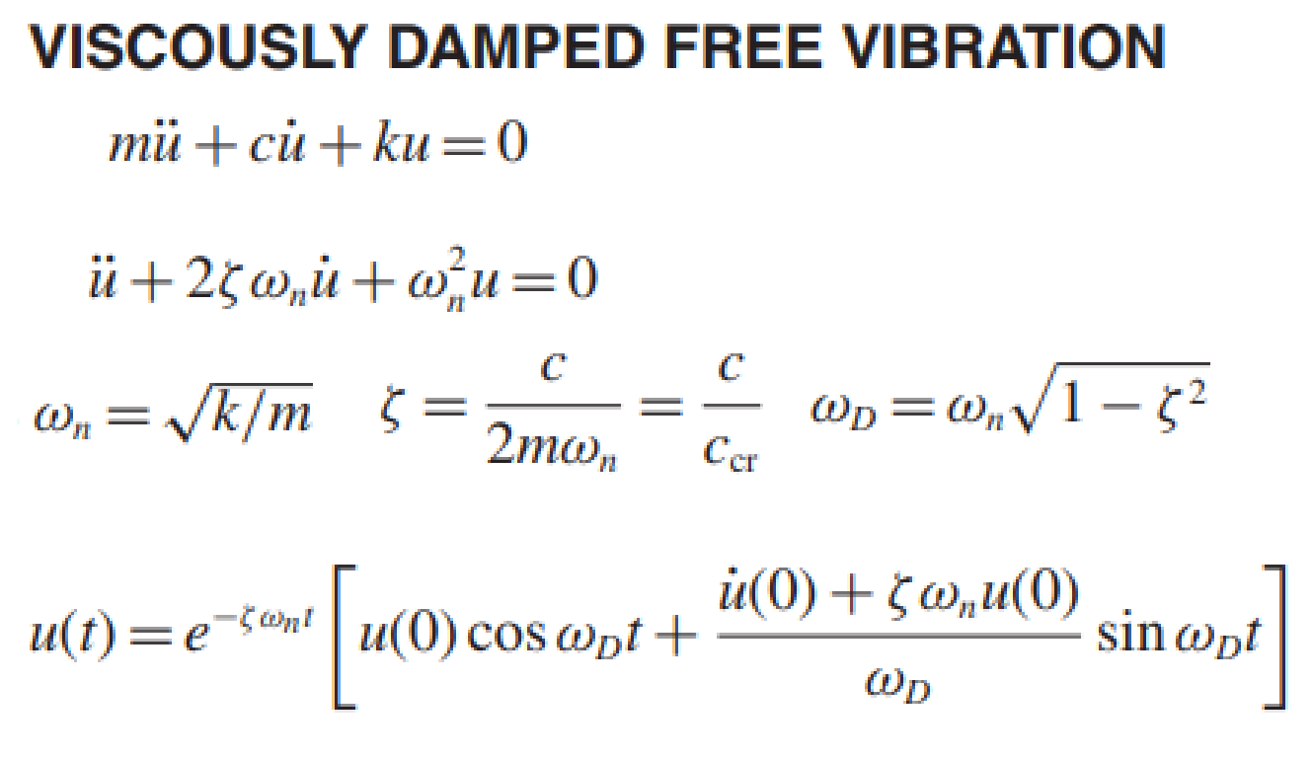
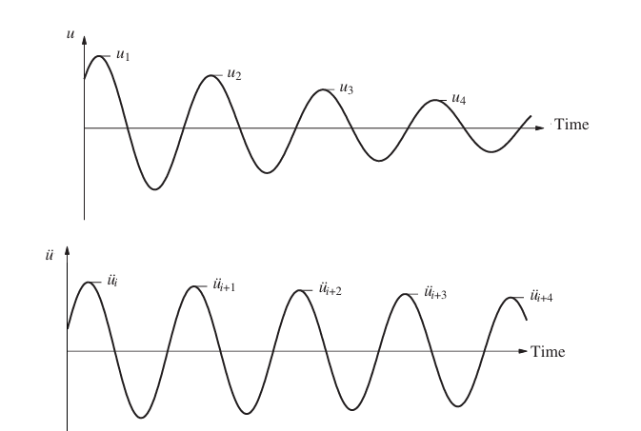
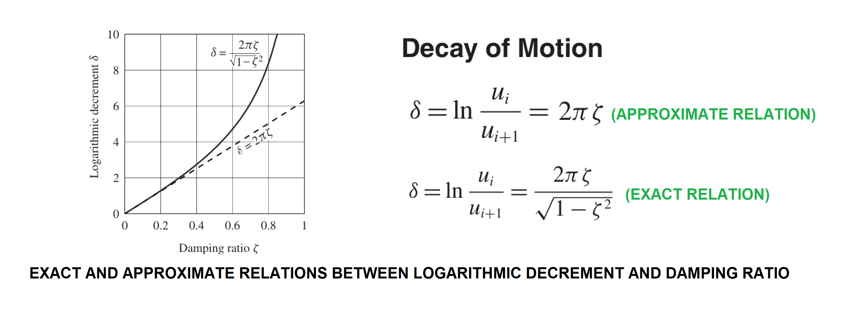

Slide 5
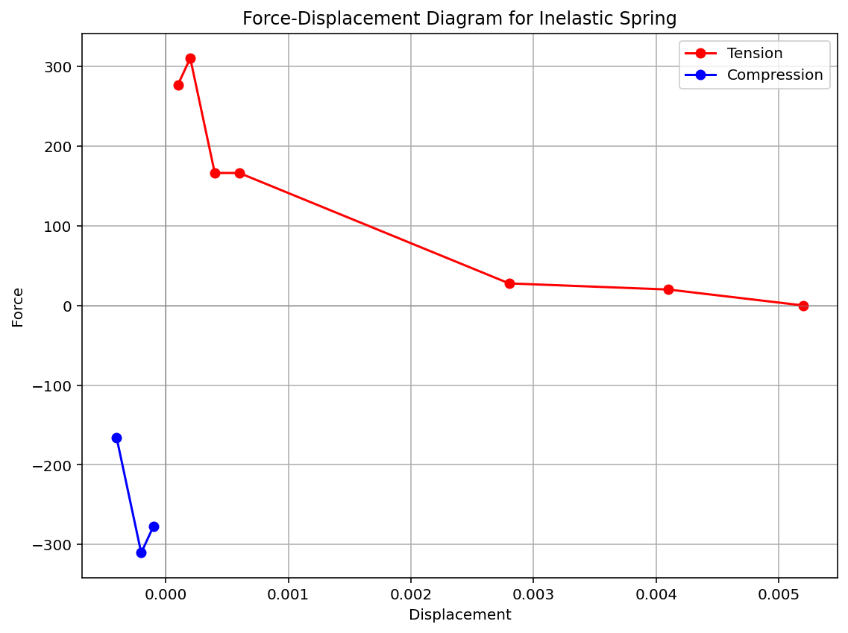

Slide 6
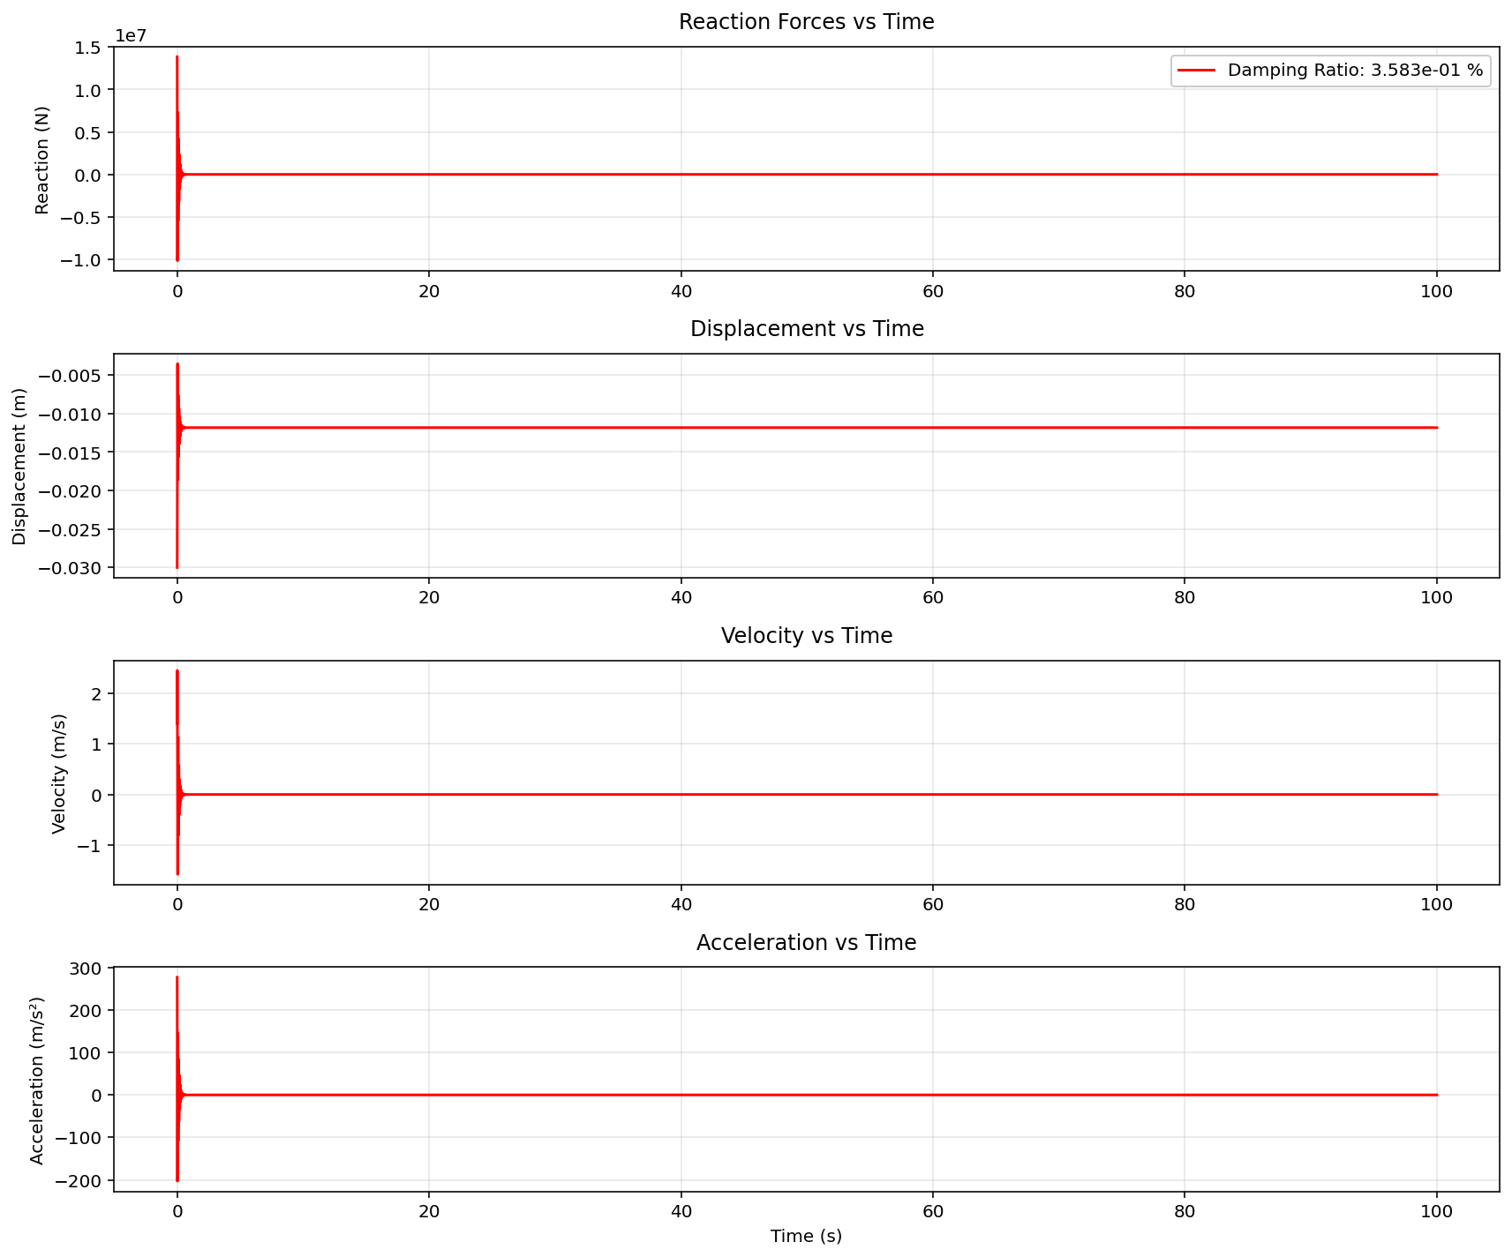

Slide 7
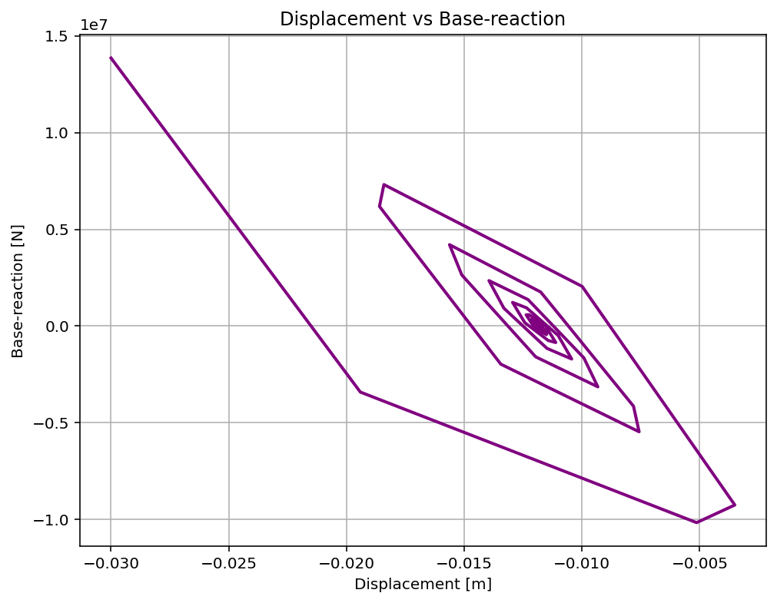

Slide 8
SUPPLY: 0.04384989
F: 0.013849889675598415
Fmin: 0.013849889675612244
Fmax: 0.013849889675584585
DF: -1.3829215550487104e-09
DX: -10014949.600746213
IT: 1 - RESIDUAL: 10014949.600746213 - X: 10015049.600746213
SUPPLY: 0.01695705
F: -0.013042953880630502
Fmin: -0.0130429538806109
Fmax: -0.013042953880650104
DF: -1.960237527853792e-09
DX: 6653761.952466474
IT: 2 - RESIDUAL: 6653761.952466474 - X: 3361287.6482797386
SUPPLY: 0.03822344
F: 0.008223439438450754
Fmin: 0.008223439438471737
Fmax: 0.008223439438429778
DF: -2.0979745718463505e-09
DX: -3919704.055904551
IT: 3 - RESIDUAL: 3919704.055904551 - X: 7280991.70418429
SUPPLY: 0.02635108
F: -0.0036489159704923835
Fmin: -0.0036489159704485227
Fmax: -0.0036489159705362477
DF: -4.386248309007357e-09
DX: 831899.088567141
IT: 4 - RESIDUAL: 831899.088567141 - X: 6449092.615617149
SUPPLY: 0.02968185
F: -0.00031814556011616063
Fmin: -0.00031814556007960654
Fmax: -0.0003181455601527078
DF: -3.655062363883132e-09
DX: 87042.44372404178
IT: 5 - RESIDUAL: 87042.44372404178 - X: 6362050.171893107
SUPPLY: 0.02999714
F: -2.8593443473050317e-06
Fmin: -2.859344311406664e-06
Fmax: -2.859344383206869e-06
DF: -3.590010233534002e-09
DX: 796.47247815511
IT: 6 - RESIDUAL: 796.47247815511 - X: 6361253.699414952
SUPPLY: 0.03000000
F: -6.043326949978223e-10
Fmin: -6.042968105079982e-10
Fmax: -6.043685829570933e-10
DF: -3.5886224547532204e-09
DX: 0.16840241697684538
IT: 7 - RESIDUAL: 0.16840241697684538 - X: 6361253.531012535
SUPPLY: 0.03000000
F: 5.604891550881064e-14
Fmin: 9.194034422677078e-14
Fmax: 2.0164425684754406e-14
DF: -3.588795927100818e-09
DX: -1.5617749419953598e-05
IT: 8 - RESIDUAL: 1.5617749419953598e-05 - X: 6361253.531028152
SUPPLY: 0.03000000
F: -6.938893903907228e-18
Fmin: 3.5887959271008185e-14
Fmax: -3.589489816491209e-14
DF: -3.5891428717960135e-09
DX: 1.9333011116481393e-09
IT: 9 - RESIDUAL: 1.9333011116481393e-09 - X: 6361253.531028151
Optimum Spring Area : 6361253.531028
Iteration Counts: 9
Convergence Residual: 1.9333011116e-09
Total time (s): 8.3125

