Slide 1
IN THE NAME OF ALLAH, THE MOST GRACIOUS, THE MOST MERCIFUL
CONCRETE SECTION CONFINEMENT ENHANCEMENT RATIO OPTIMIZATION WITH PUSHOVER ANALYSIS USING OPENSEES. FIND BEST CONCRETE COLUMN SECTION CONFINEMENT ENHANCEMENT RATIO WITH DEFINED STRUCTURAL DUCTILITY RATIO. OPTIMIZATION ALGORITHM: NEWTON-RAPHSON METHOD
WRITTEN BY SALAR DELAVAR GHASHGHAEI (QASHQAI)

Slide 2
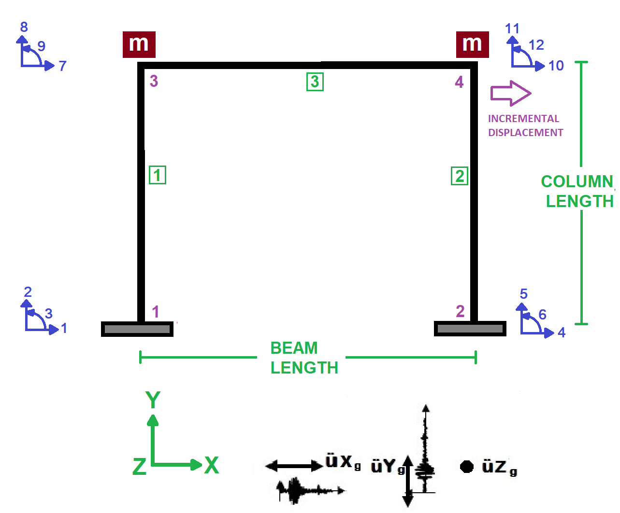

Slide 3
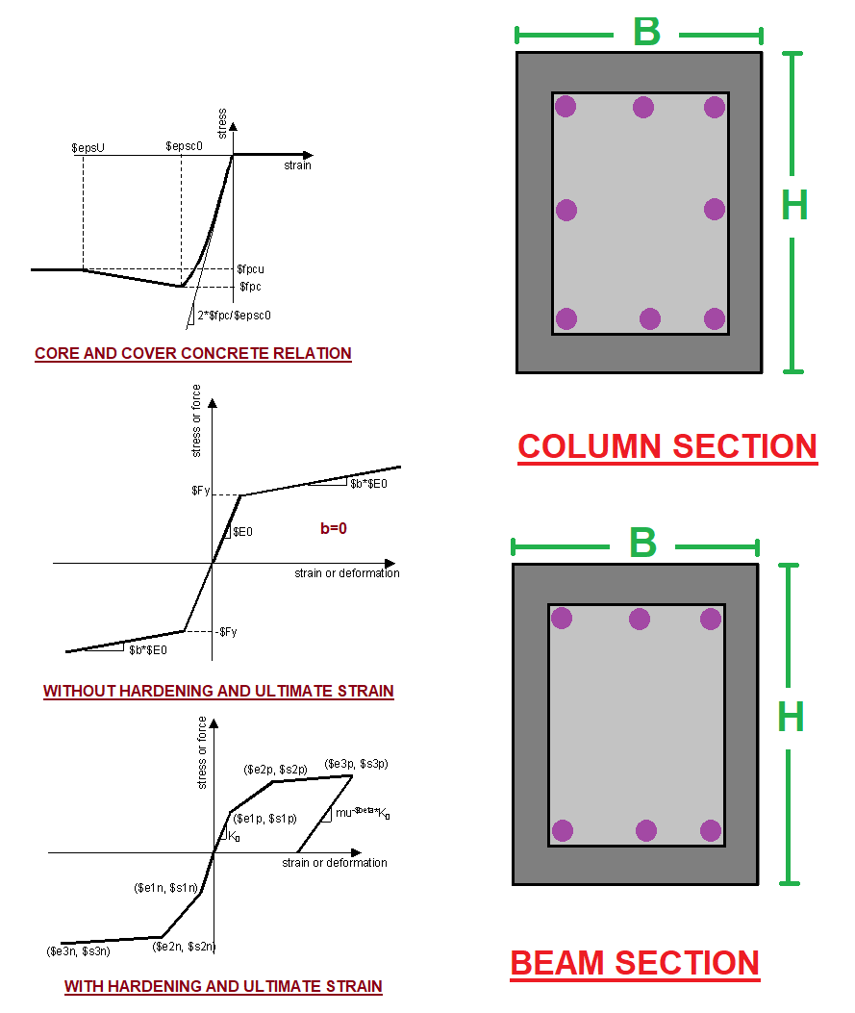

Slide 4
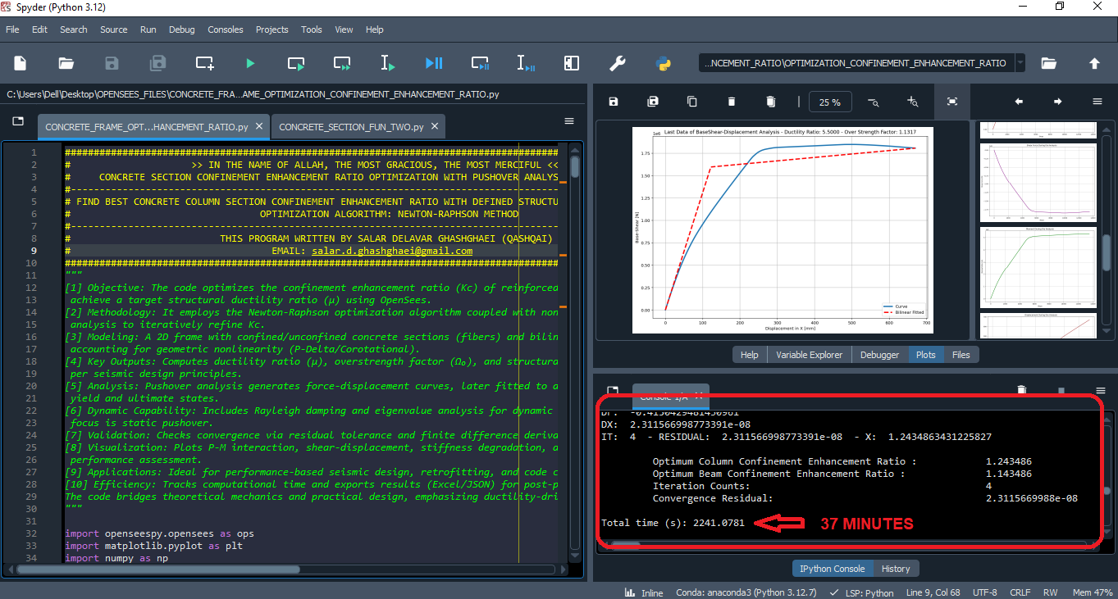

Slide 5
NONLINEAR STATIC ANALYSIS
(PUSHOVER)

Slide 6
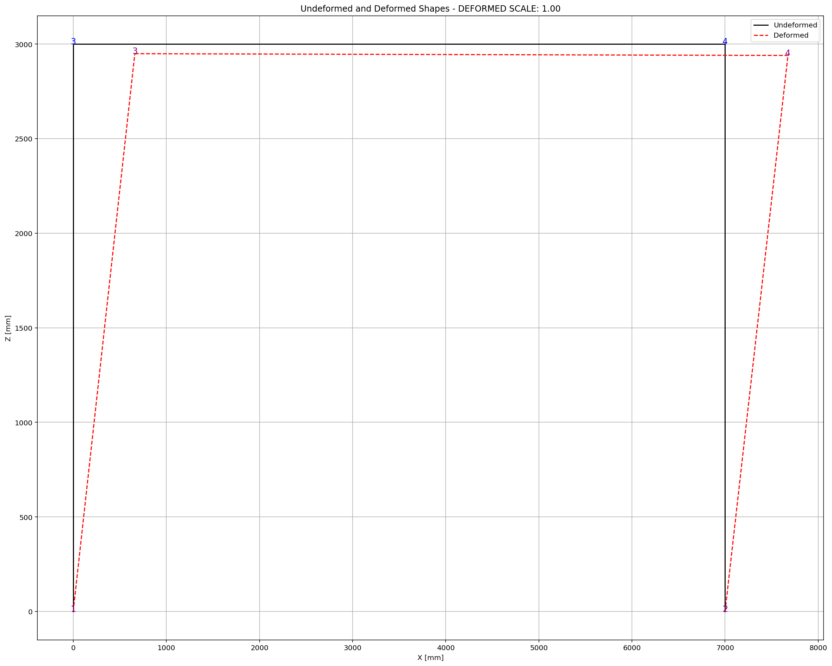
Fmax: -4.1625874294126675e-06
DF: -0.4150429481430961
DX: 2.311566998773391e-08
IT: 4 - RESIDUAL: 2.311566998773391e-08 - X: 1.2434863431225827
Optimum Column Confinement Enhancement Ratio : 1.243486
Optimum Middle Column Confinement Enhancement Ratio : 1.093486
Optimum Beam Confinement Enhancement Ratio : 1.143486
Optimum Middle Beam Confinement Enhancement Ratio : 1.043486
Iteration Counts: 4
Convergence Residual: 2.3115669988e-08
Total time (s): 2241.0781

Slide 7
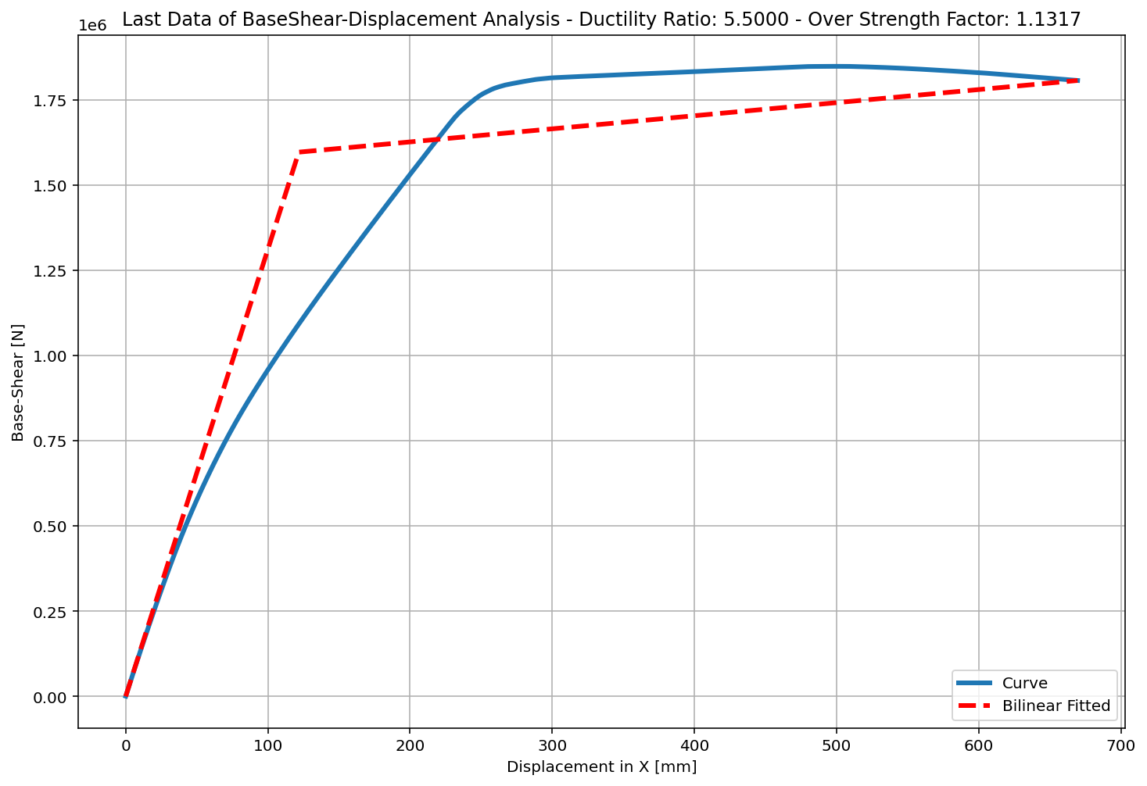
+==========================+
= Analysis curve fitted =
Disp Base Shear
----------------------------
[[0.00000000e+00 0.00000000e+00]
[1.21723804e+02 1.59603356e+06]
[6.69480416e+02 1.80624821e+06]]
+==========================+
+----------------------------------------------------+
Structure Elastic Stiffness : 13111.93
Structure Plastic Stiffness : 2697.99
Structure Tangent Stiffness : 383.77
Structure Ductility Ratio : 5.50
Structure Over Strength Factor: 1.13
+----------------------------------------------------+
Over Strength Coefficient (Ω0): 1.1317
Displacement Ductility Ratio (μ):5.5000
Ductility Coefficient (Rμ): 5.5000
Structural Behavior Coefficient (R): 6.2244

