Slide 1
>> IN THE NAME OF ALLAH, THE MOST GRACIOUS, THE MOST MERCIFUL <<
COMPREHENSIVE NONLINEAR SEISMIC ASSESSMENT OF A PEDESTRIAN BRIDGE STEEL VIERENDEEL GIRDERS : AN OPENSEES FRAMEWORK FOR STATIC PUSHOVER, CYCLIC DEGRADATION, STATIC TIME-HISTORY AND DYNAMIC TIME-HISTORY ANALYSIS
THIS PROGRAM IS WRITTEN BY SALAR DELAVAR GHASHGHAEI (QASHQAI)

Slide 2
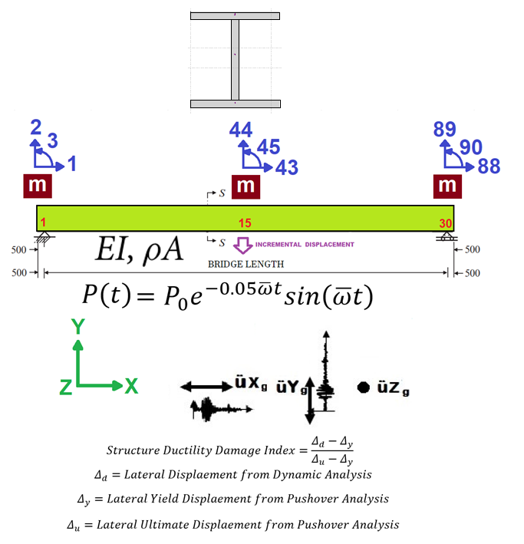
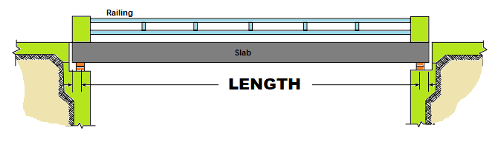

Slide 3
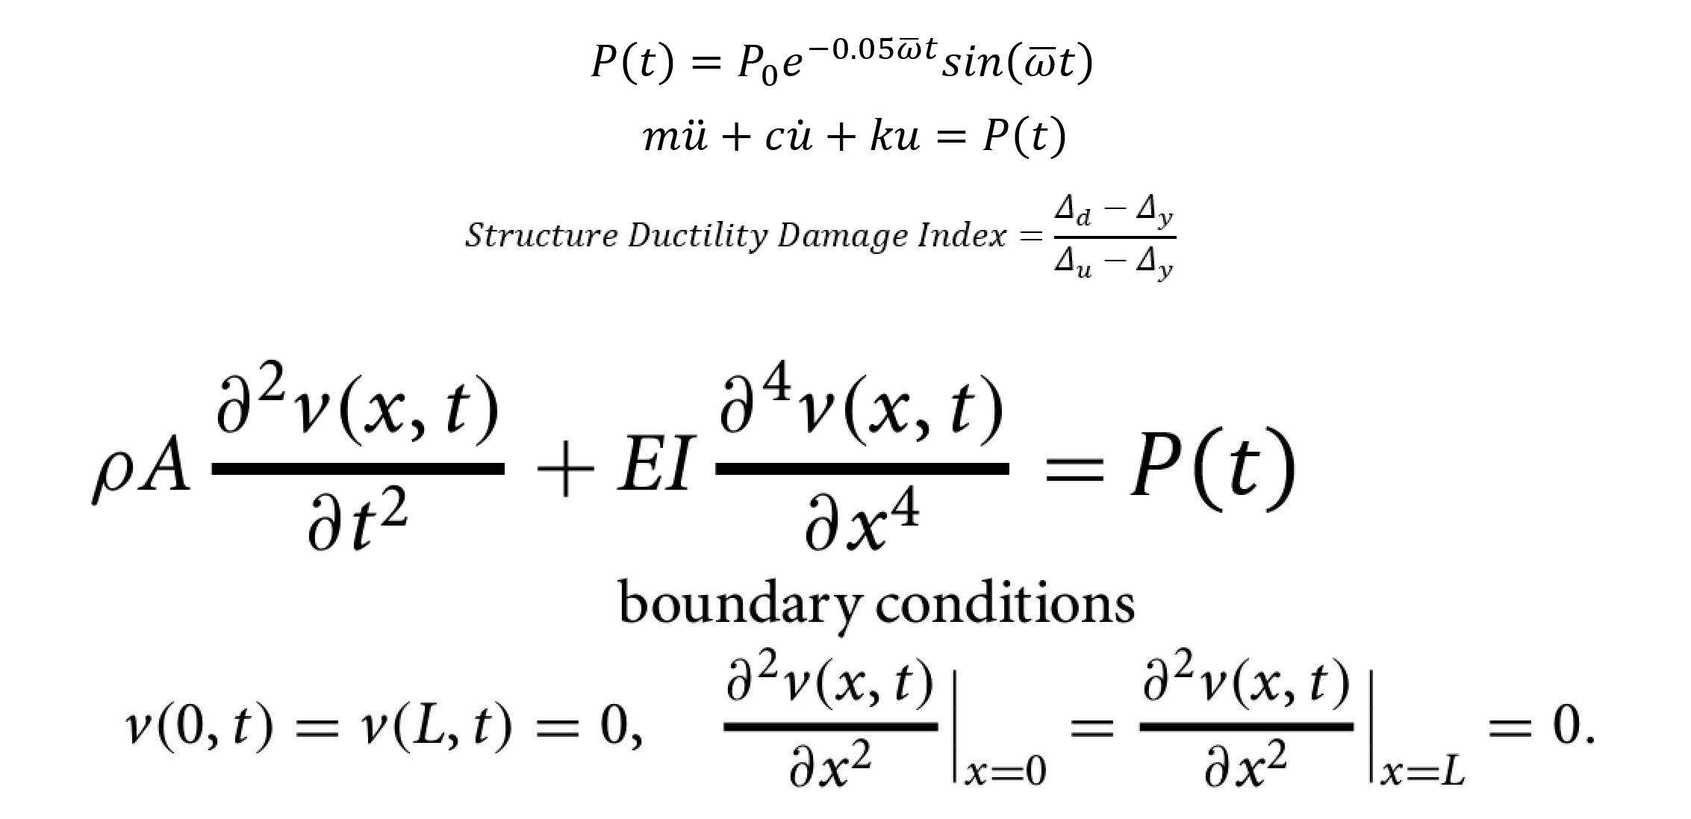

Slide 4


Slide 5
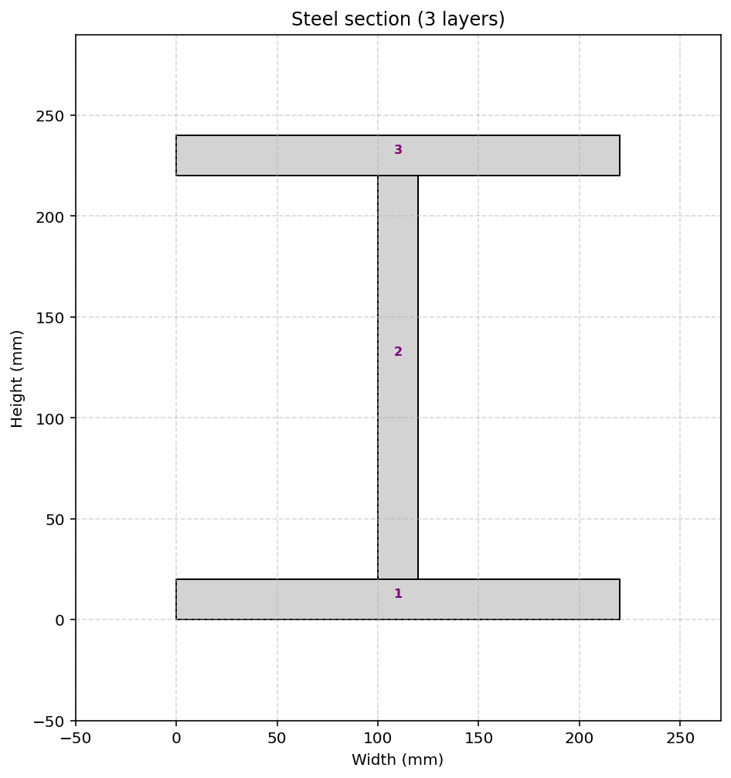

Slide 6
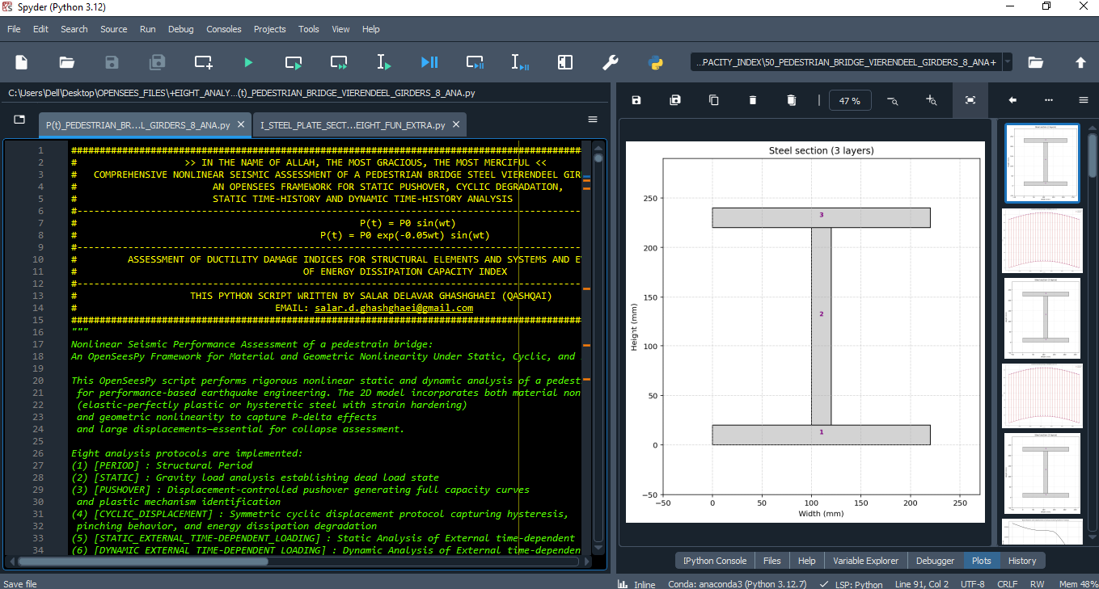

Slide 7
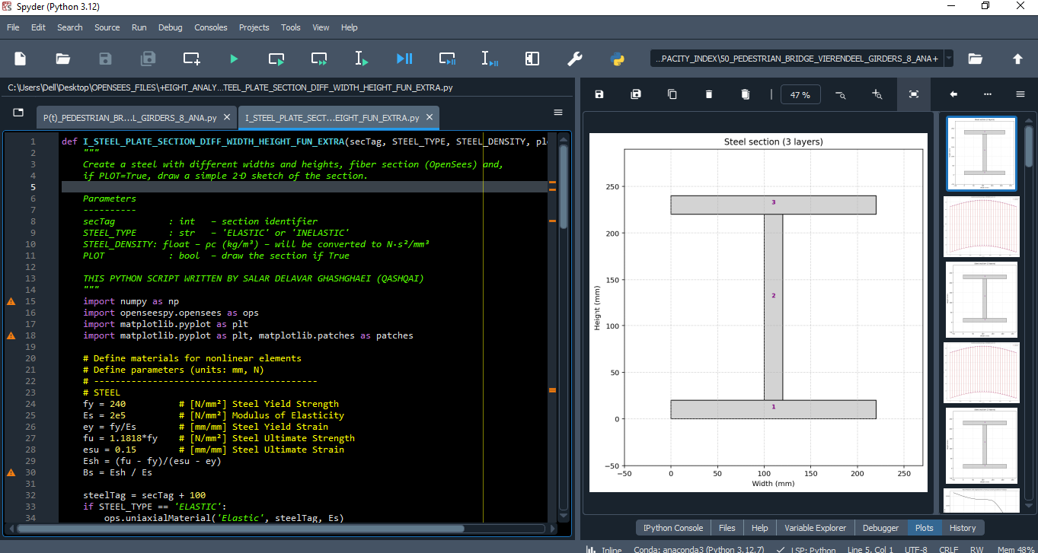

Slide 8
STATIC ANALYSIS

Slide 9
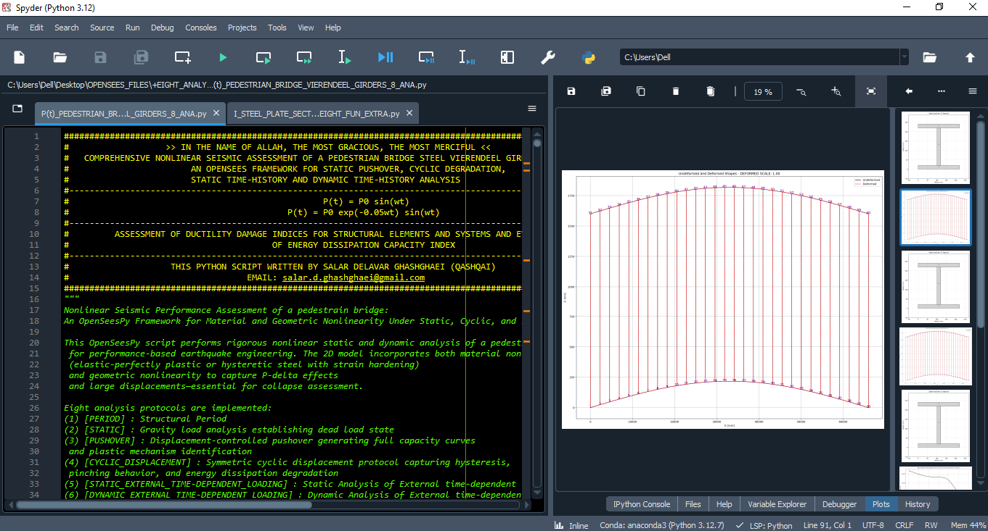

Slide 10
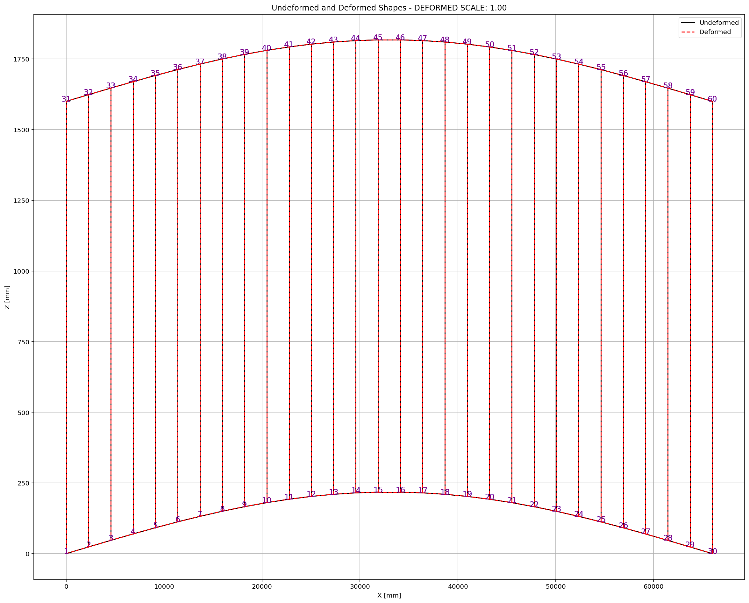

Slide 11
PUSHOVER ANALYSIS

Slide 12
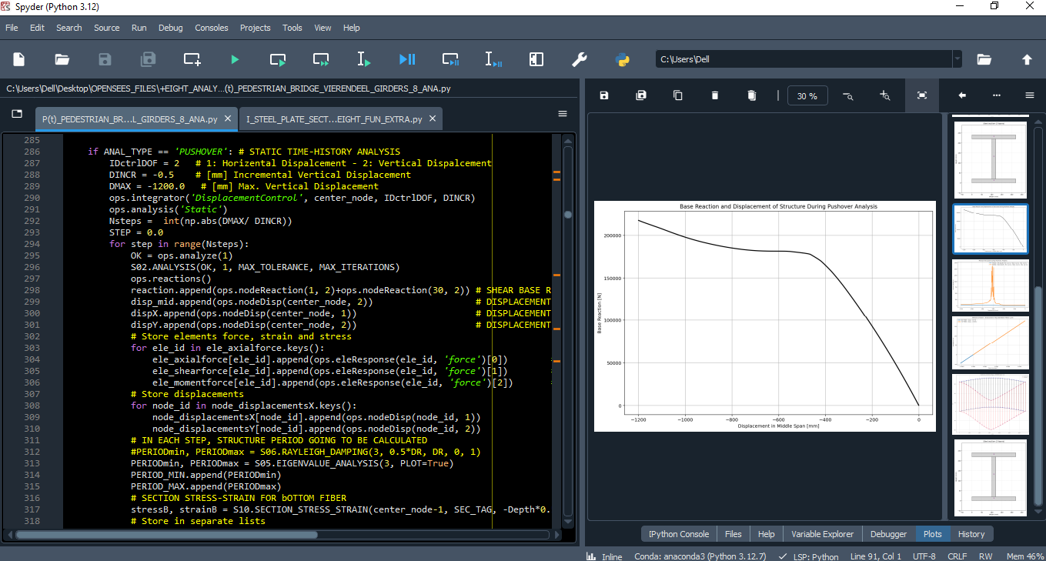

Slide 13
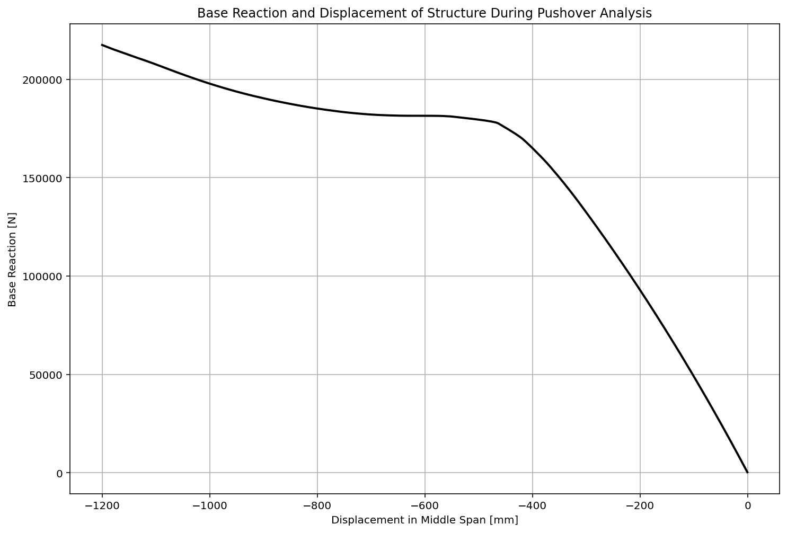

Slide 14
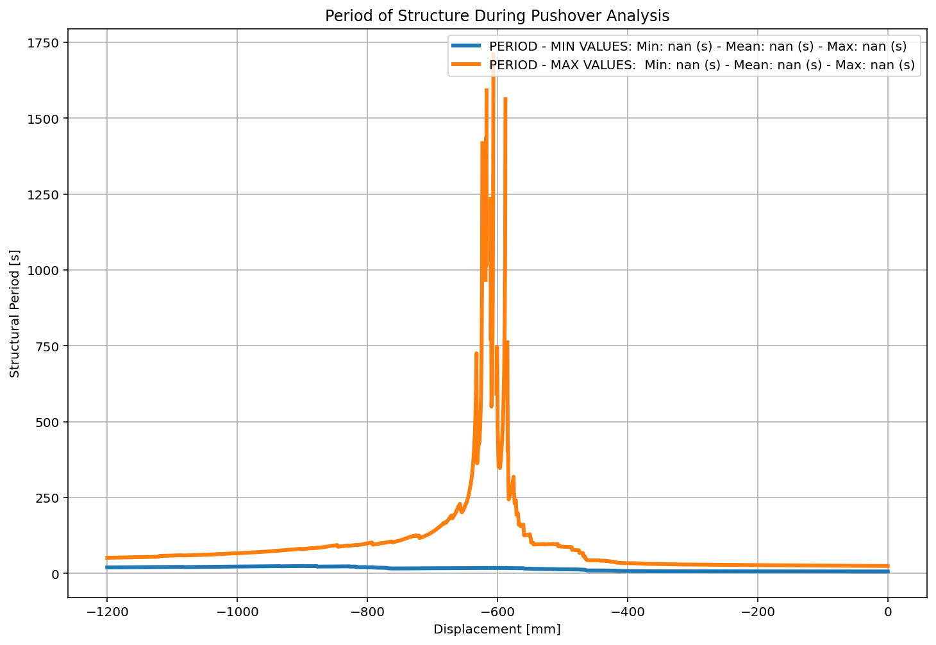

Slide 15
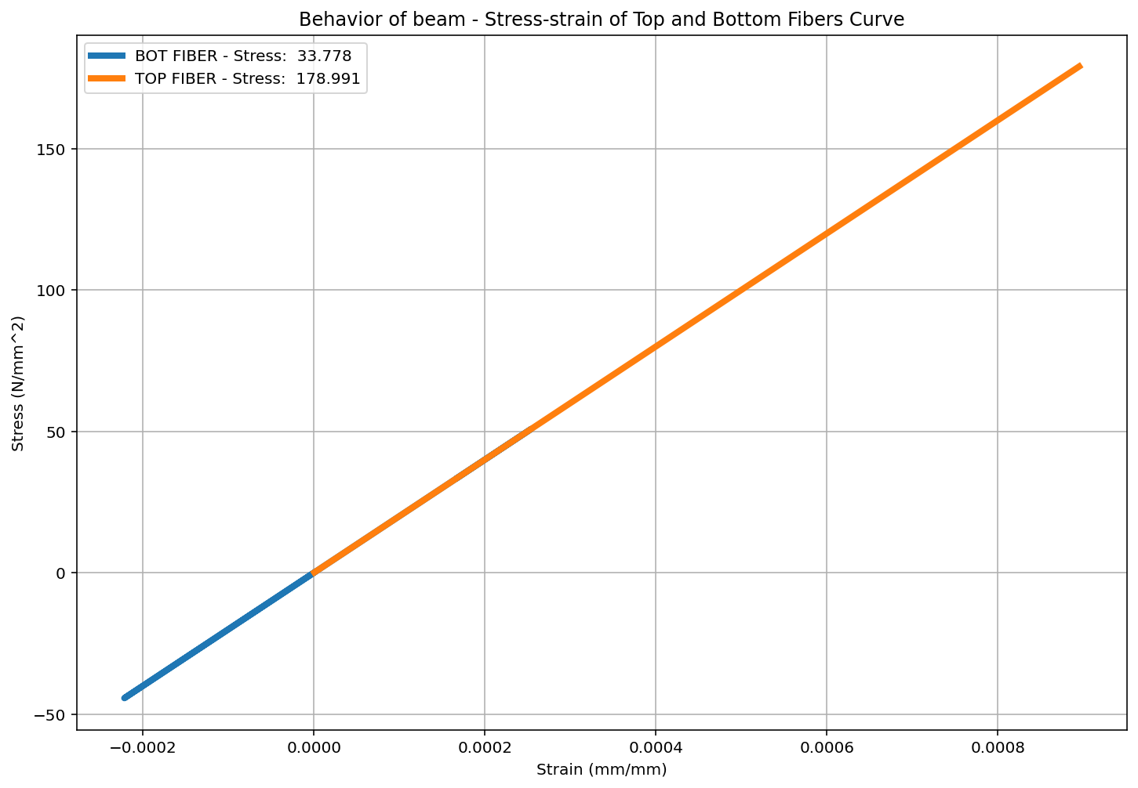

Slide 16
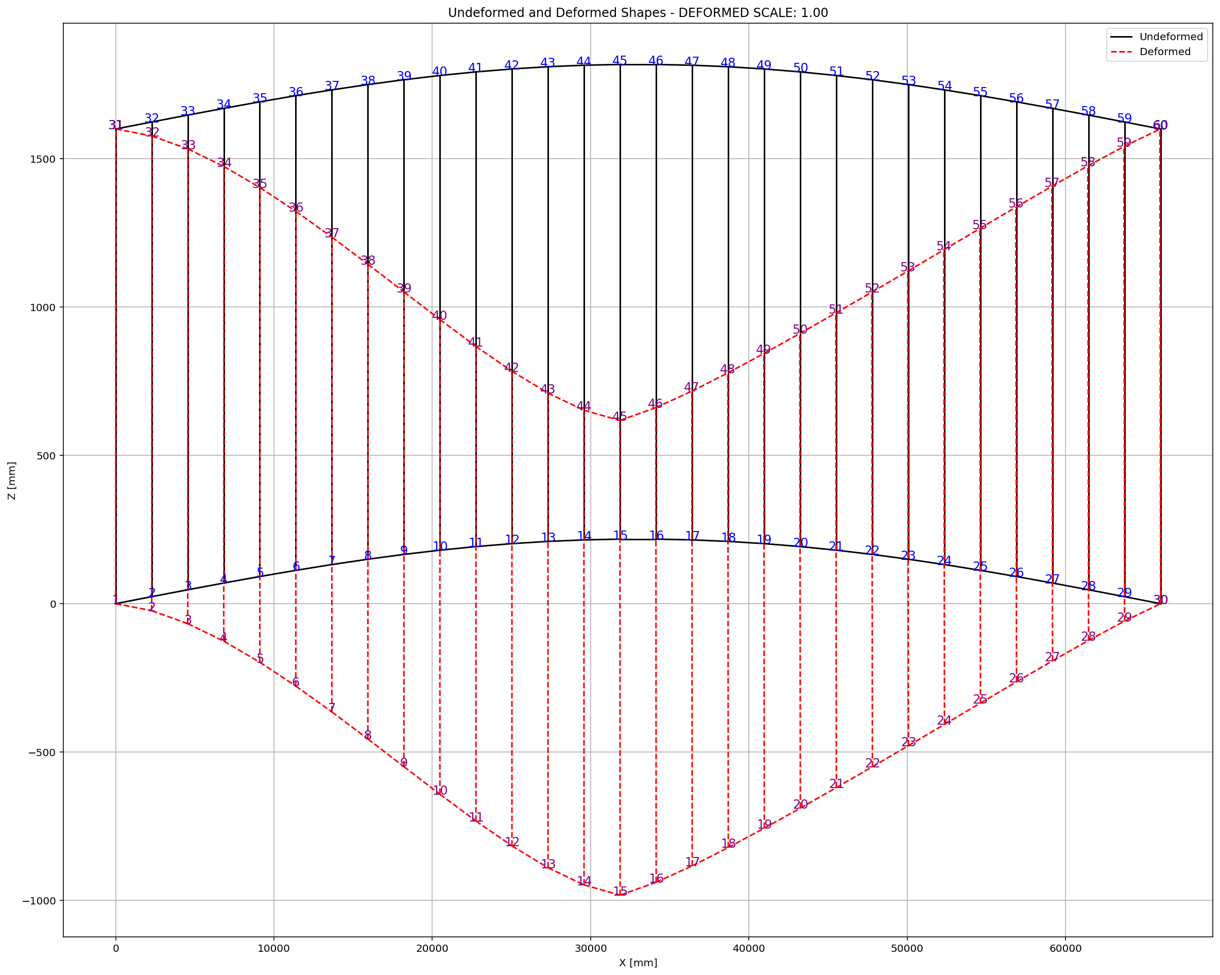

Slide 17
CYCLIC DISPLACEMENT ANALYSIS

Slide 18
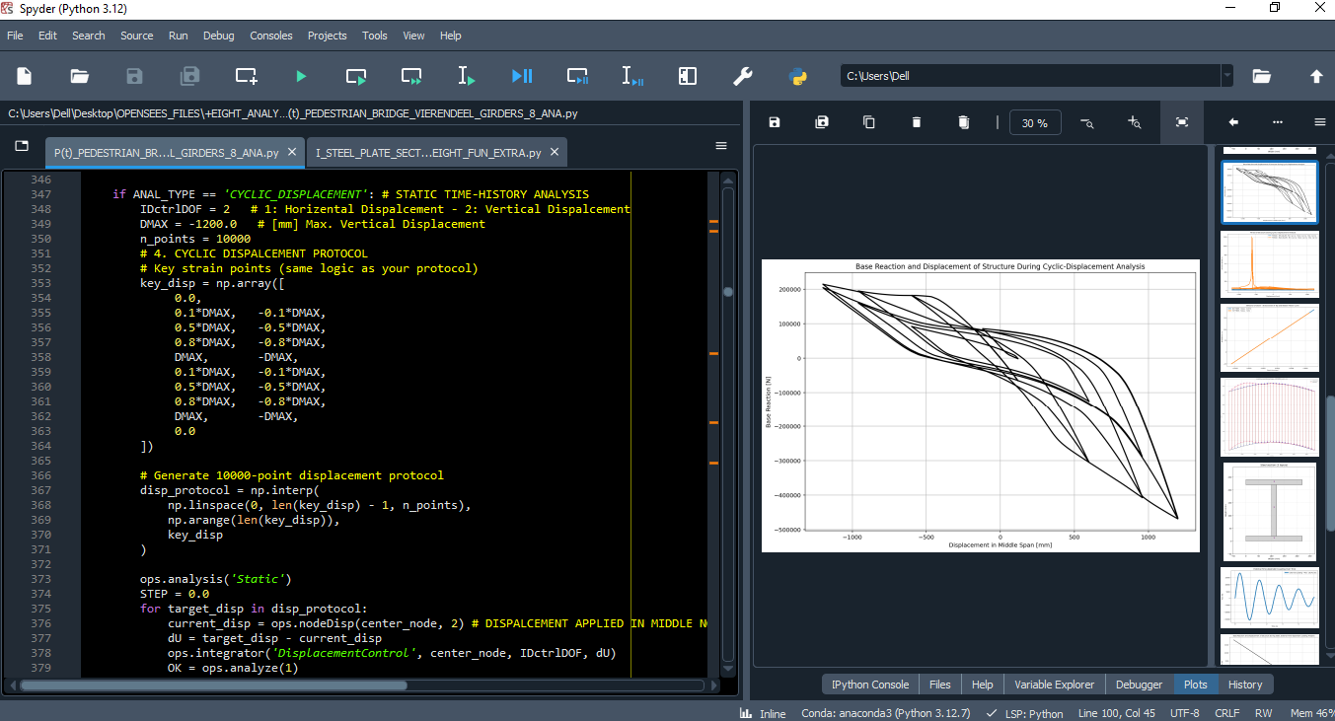

Slide 19
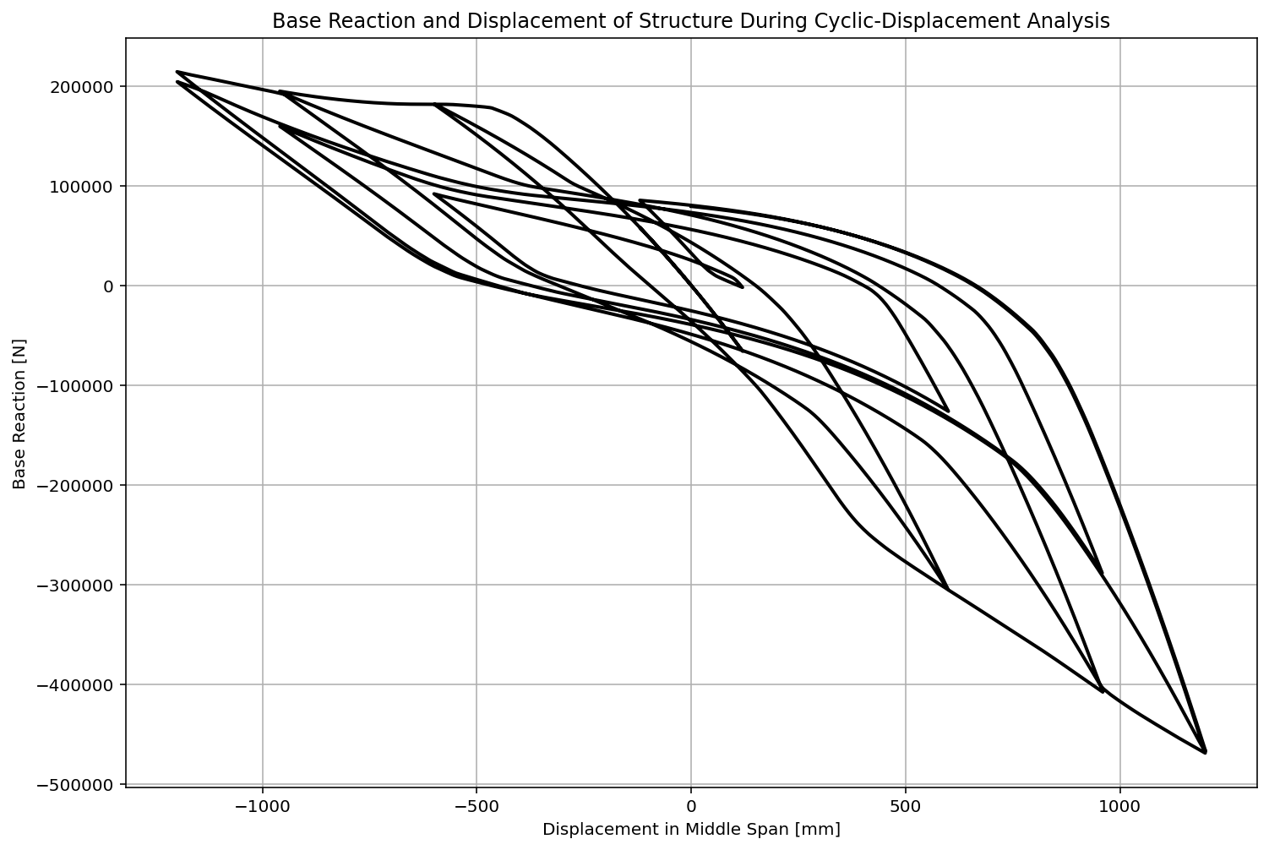

Slide 20
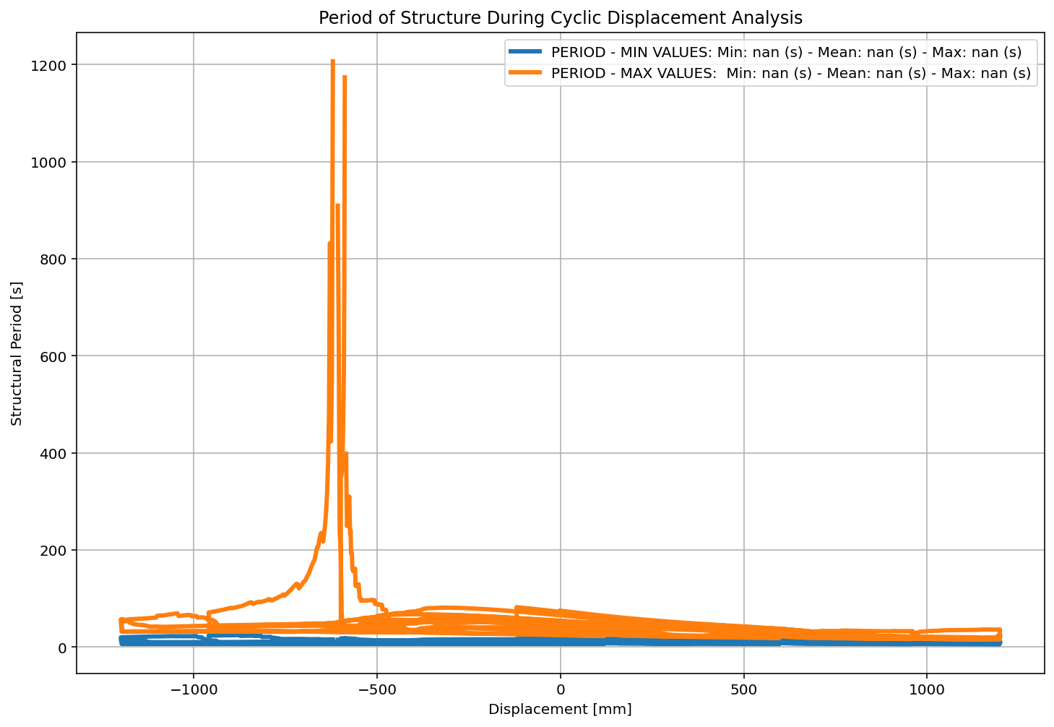

Slide 21
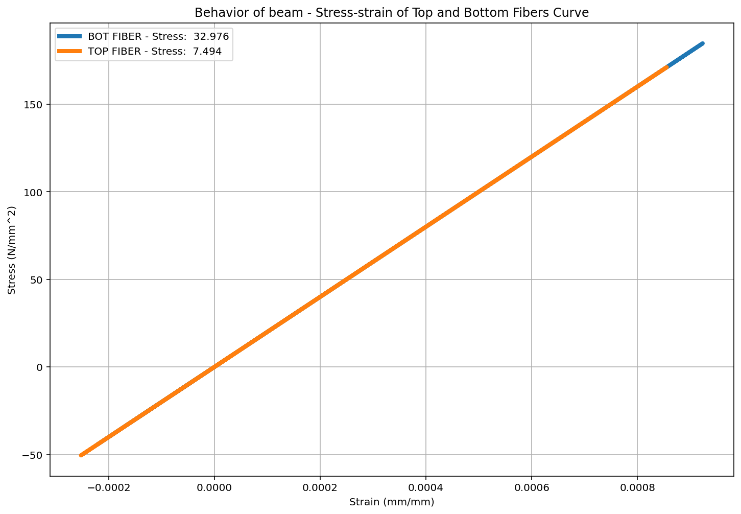

Slide 22
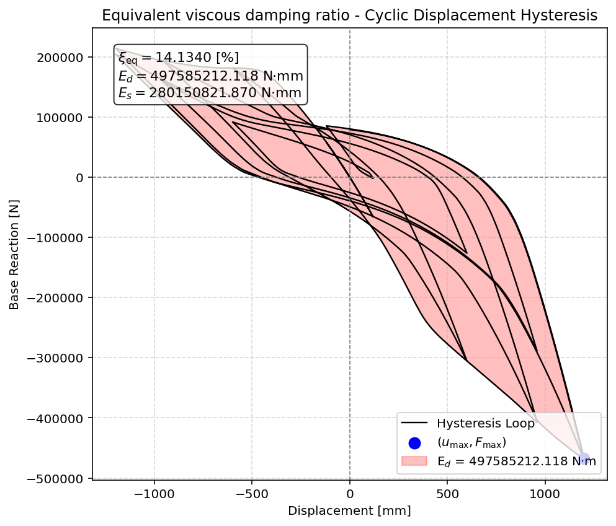

Slide 23
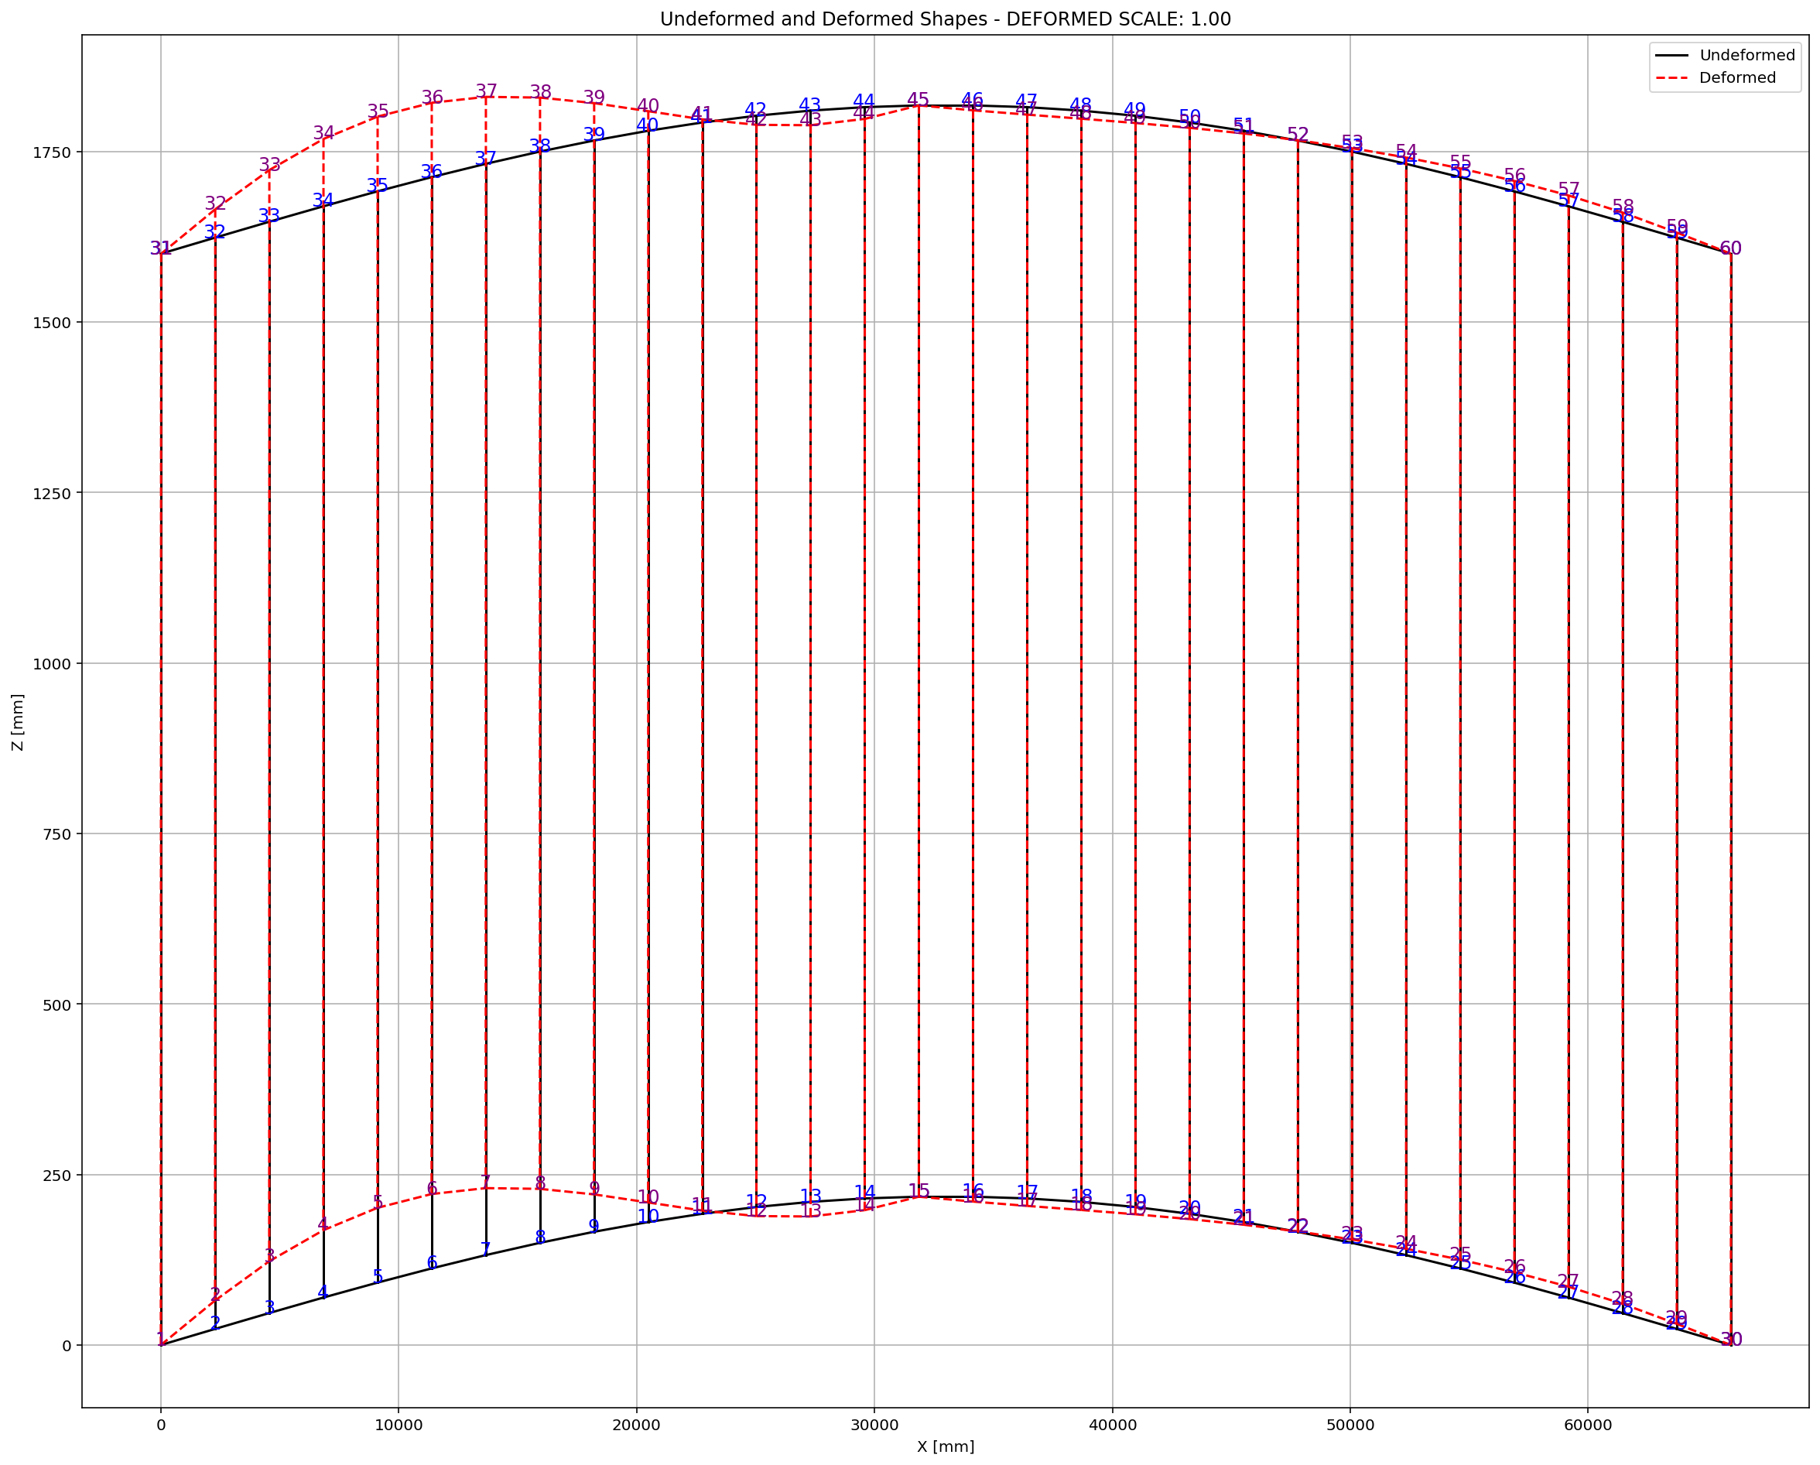

Slide 24
STATIC TIME-HISTORY WITH EXTERNAL TIME-DEPENDENT LOADING ANALYSIS

Slide 25
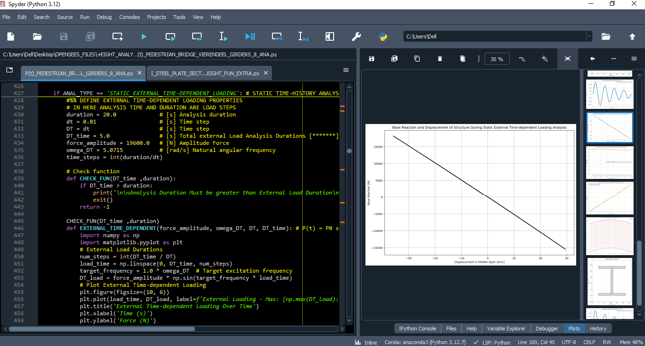

Slide 26
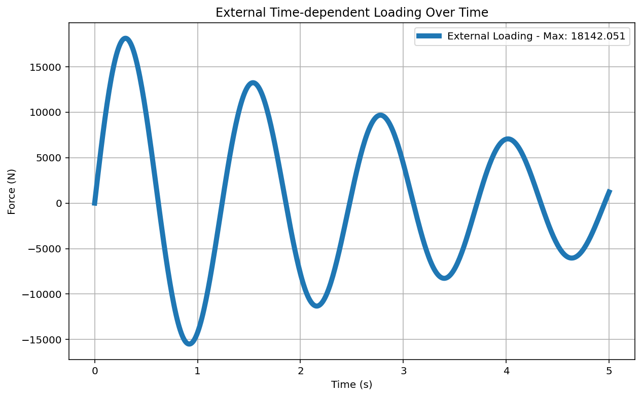

Slide 27
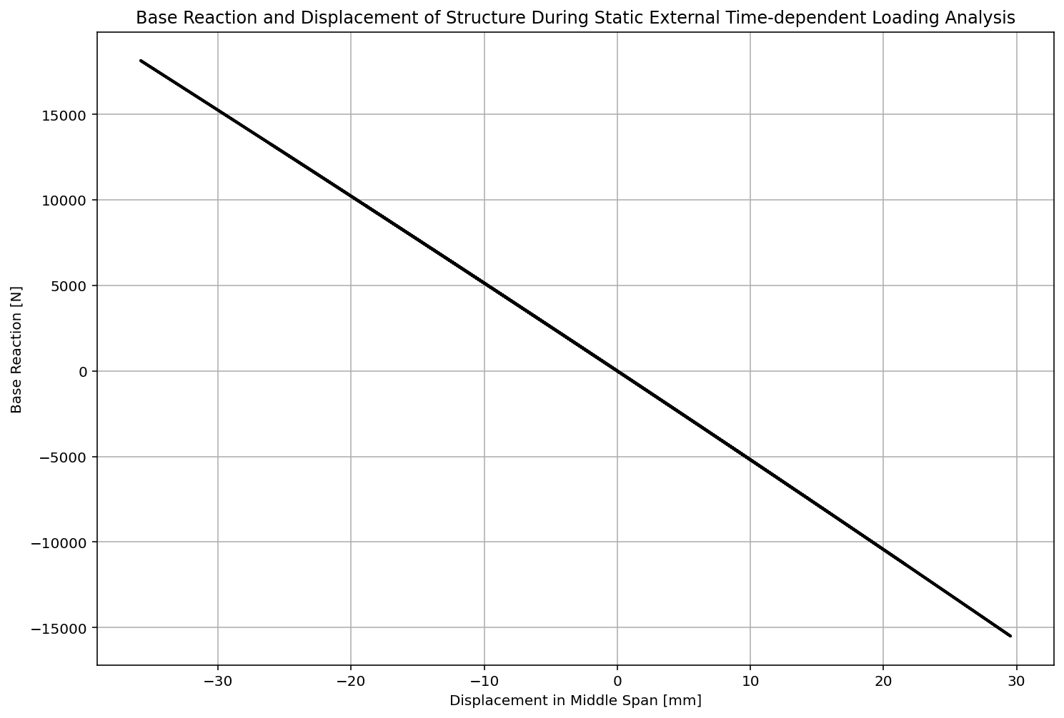

Slide 28
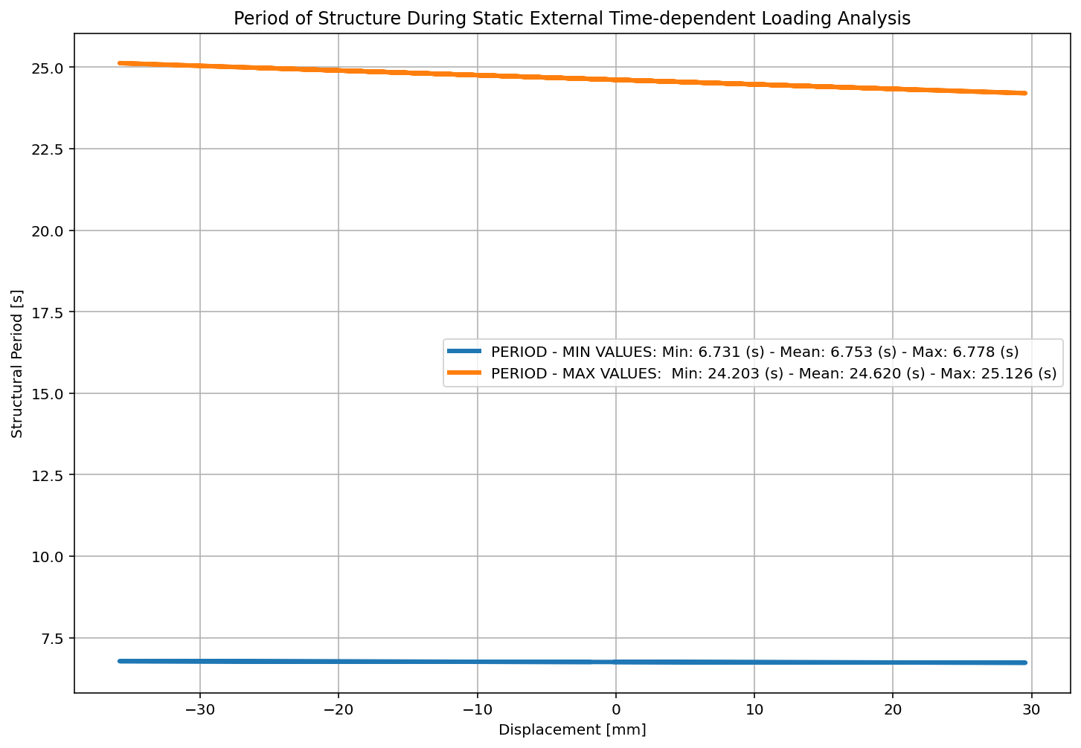

Slide 29
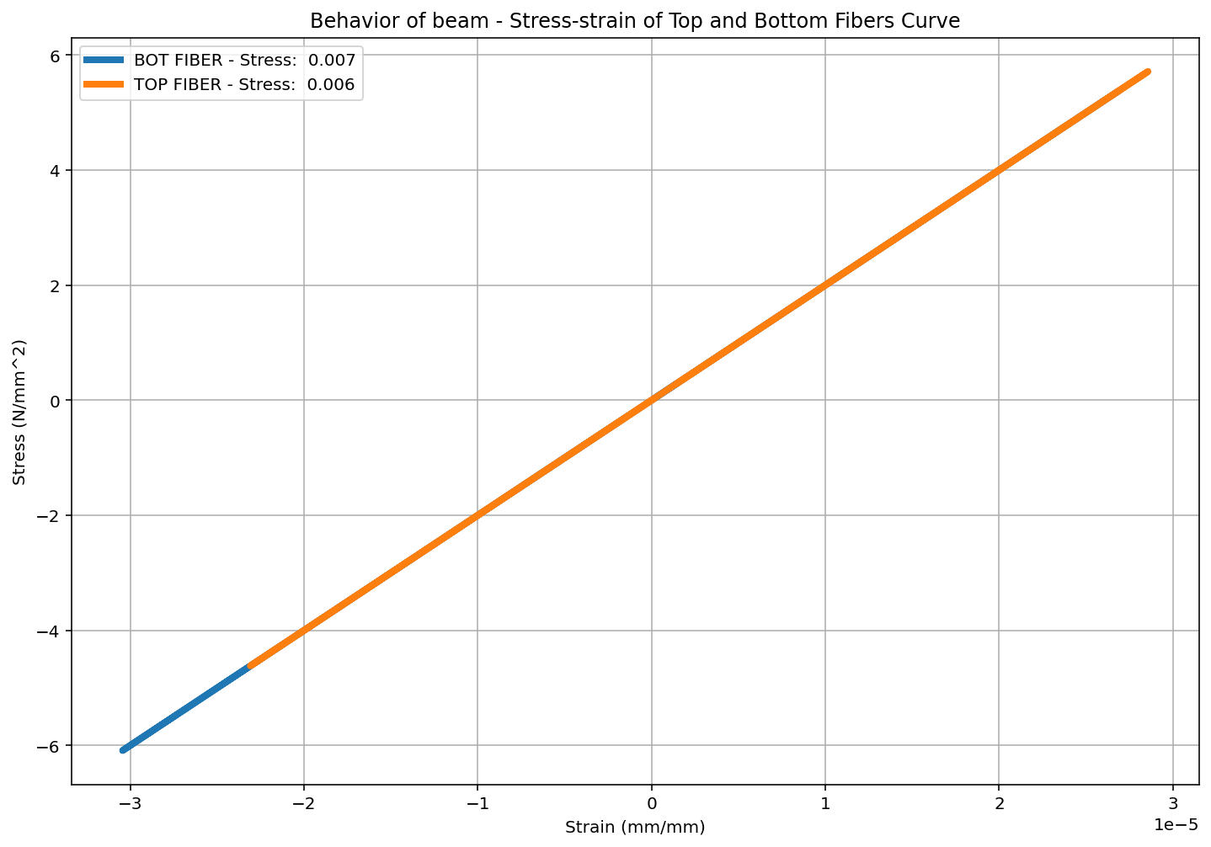

Slide 30


Slide 31
DYNAMIC TIME-HISTORY WITH EXTERNAL TIME-DEPENDENT LOADING ANALYSIS

Slide 32


Slide 34
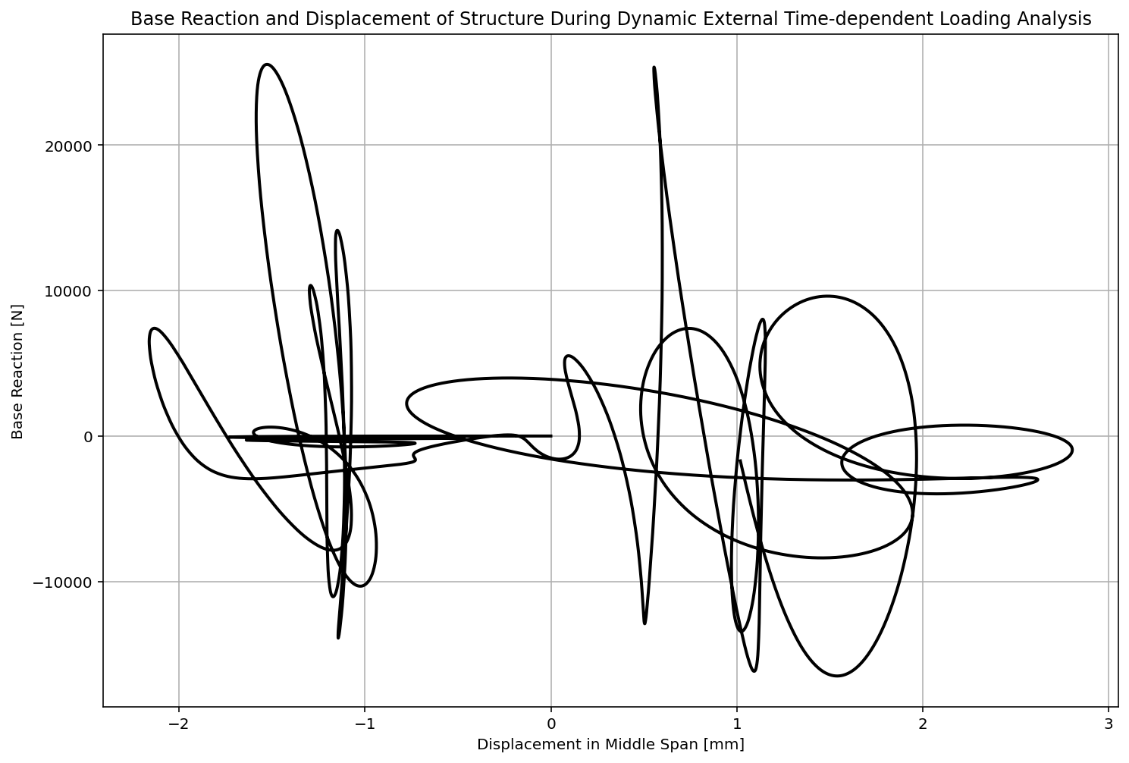

Slide 35
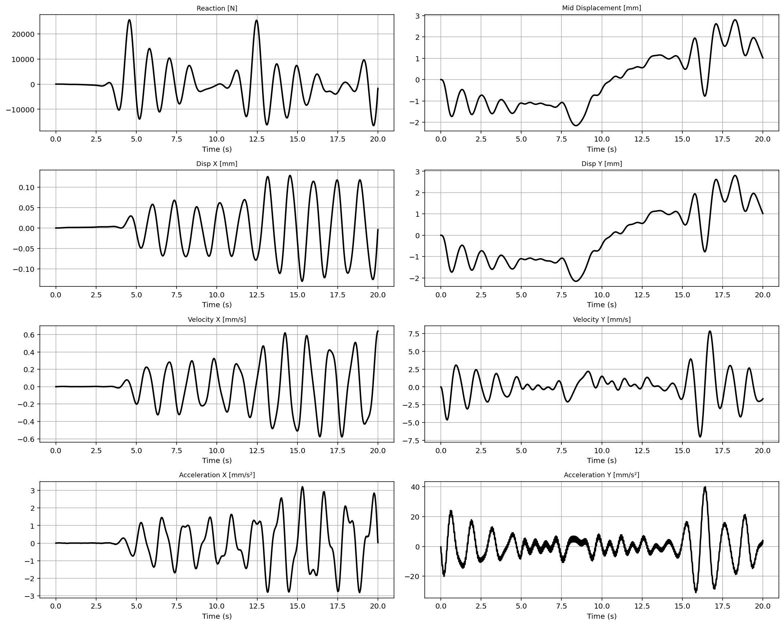

Slide 36
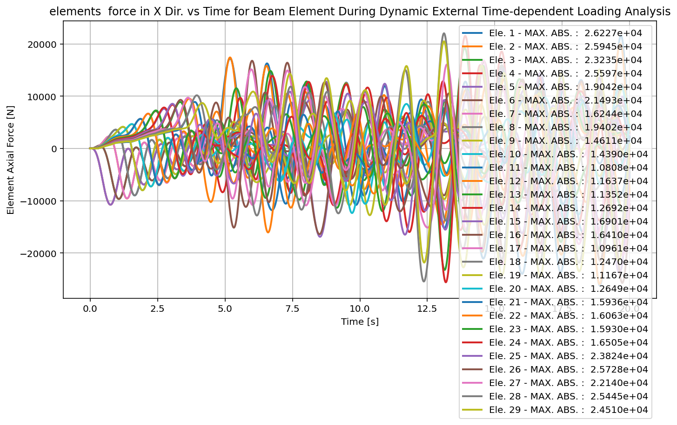

Slide 37
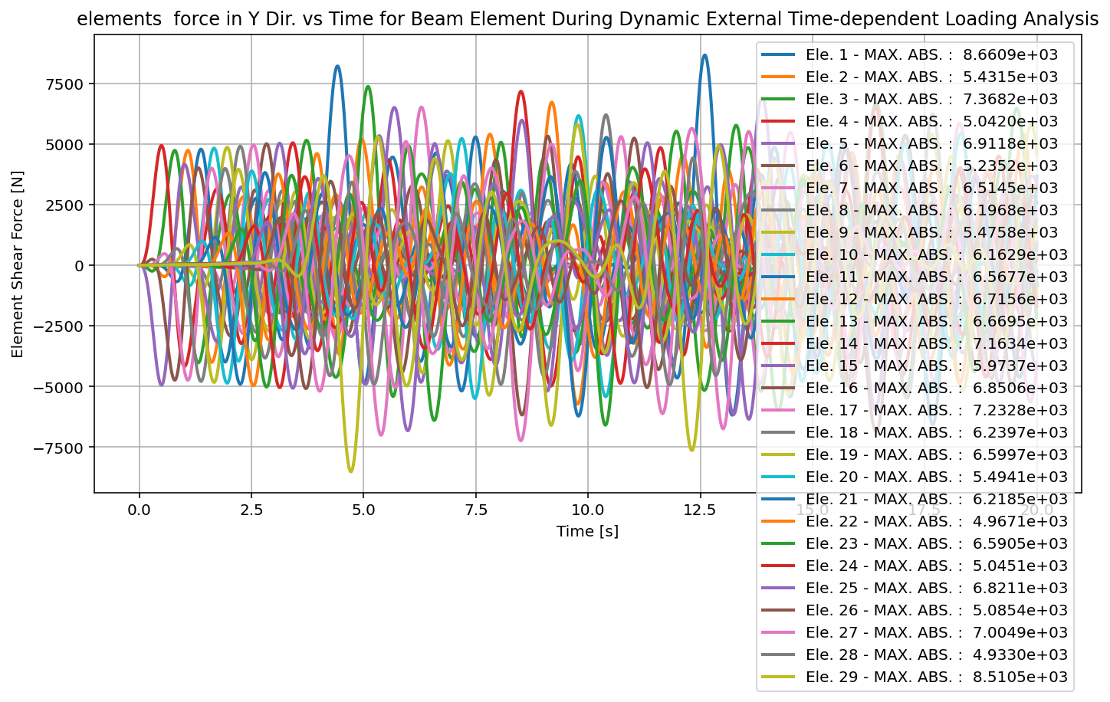

Slide 38
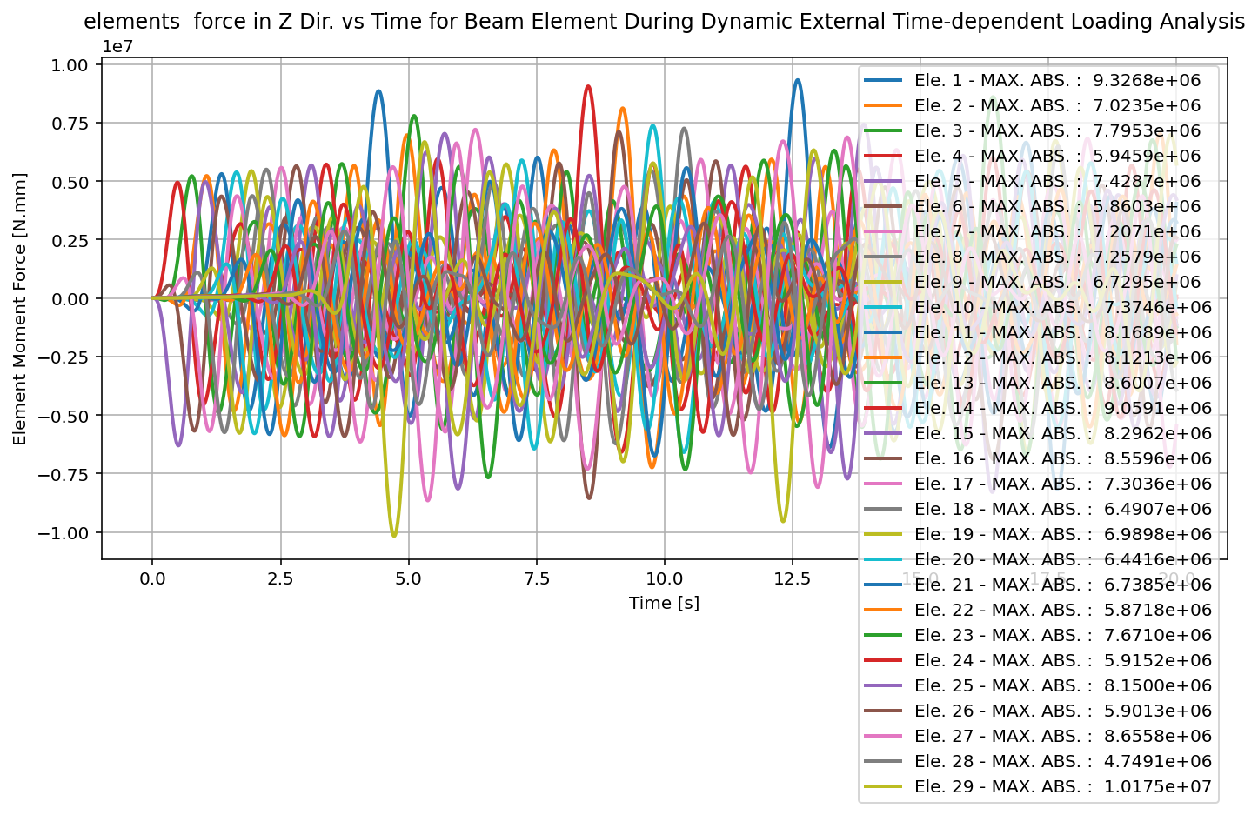

Slide 39
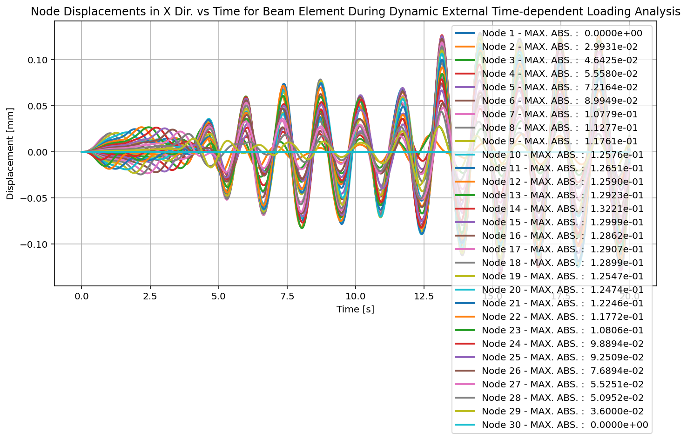

Slide 40
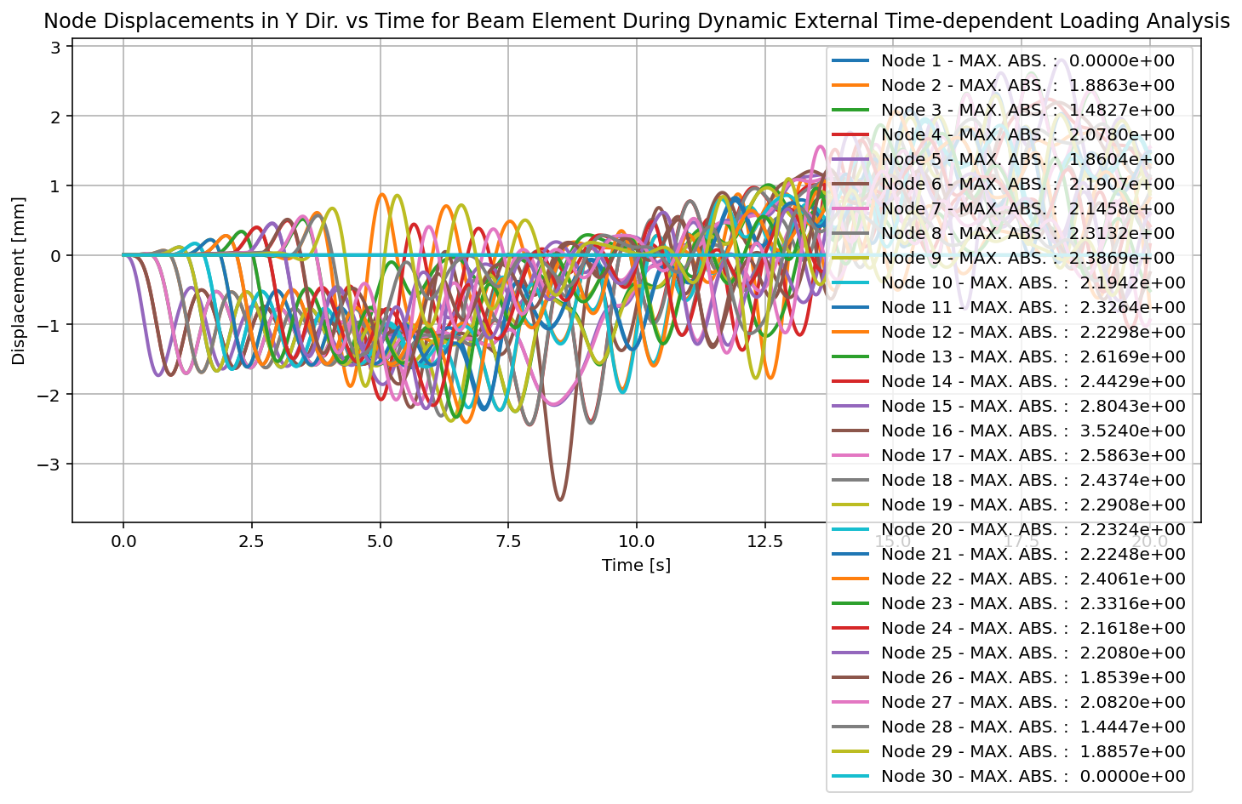

Slide 41
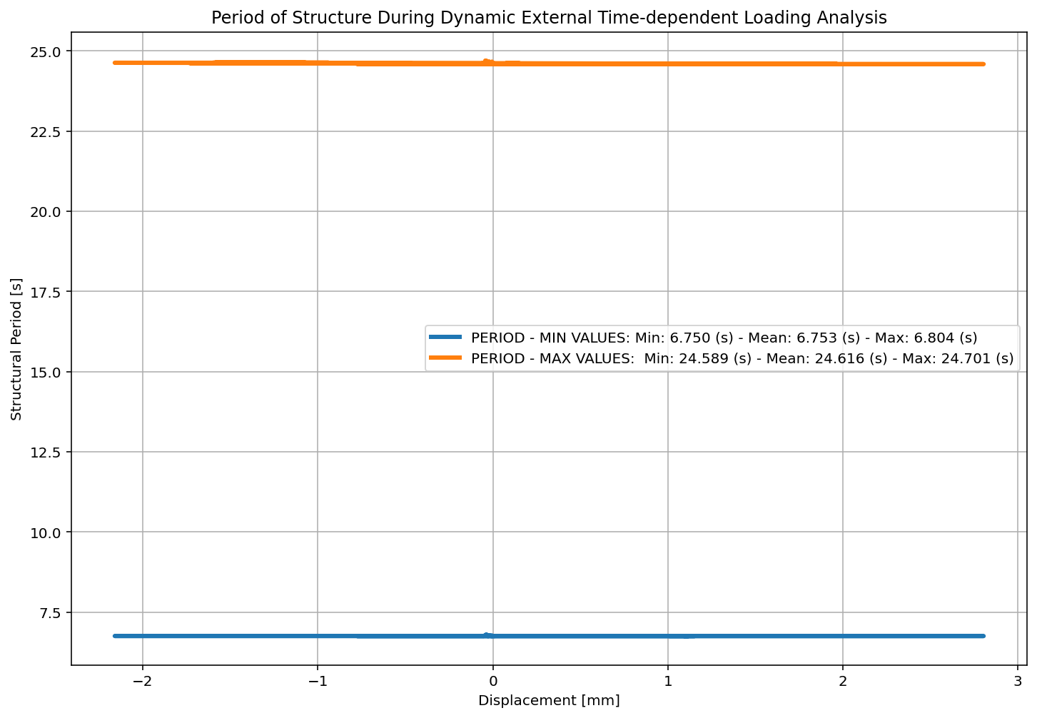

Slide 42
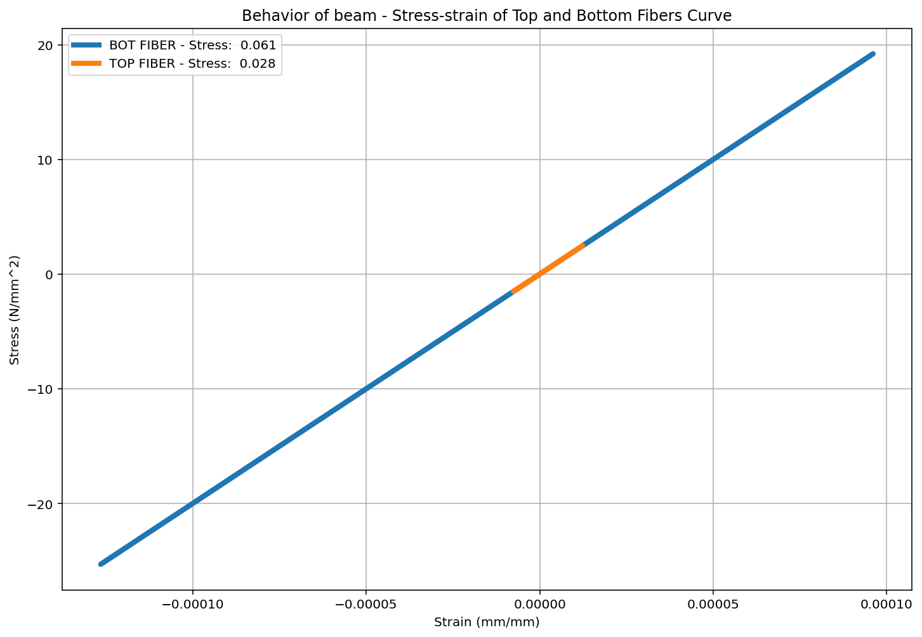

Slide 43
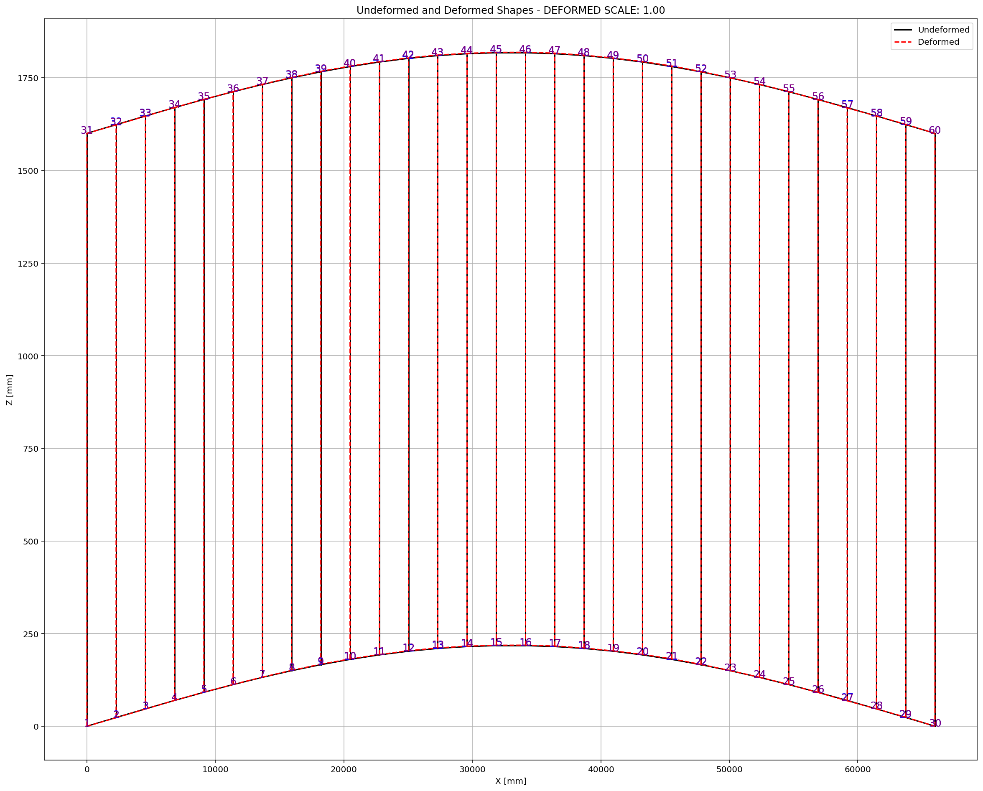

Slide 44
FREE-VIBRATION ANALYSIS

Slide 45
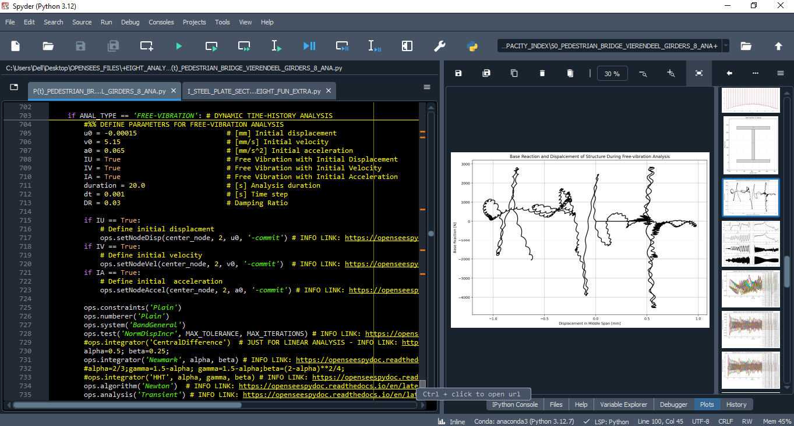

Slide 46
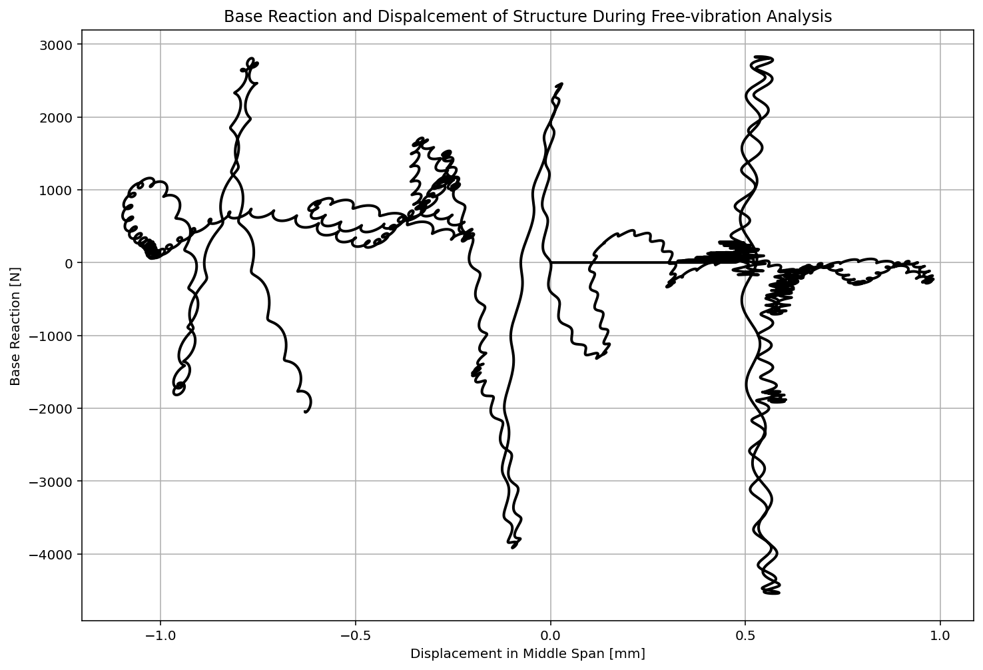

Slide 47
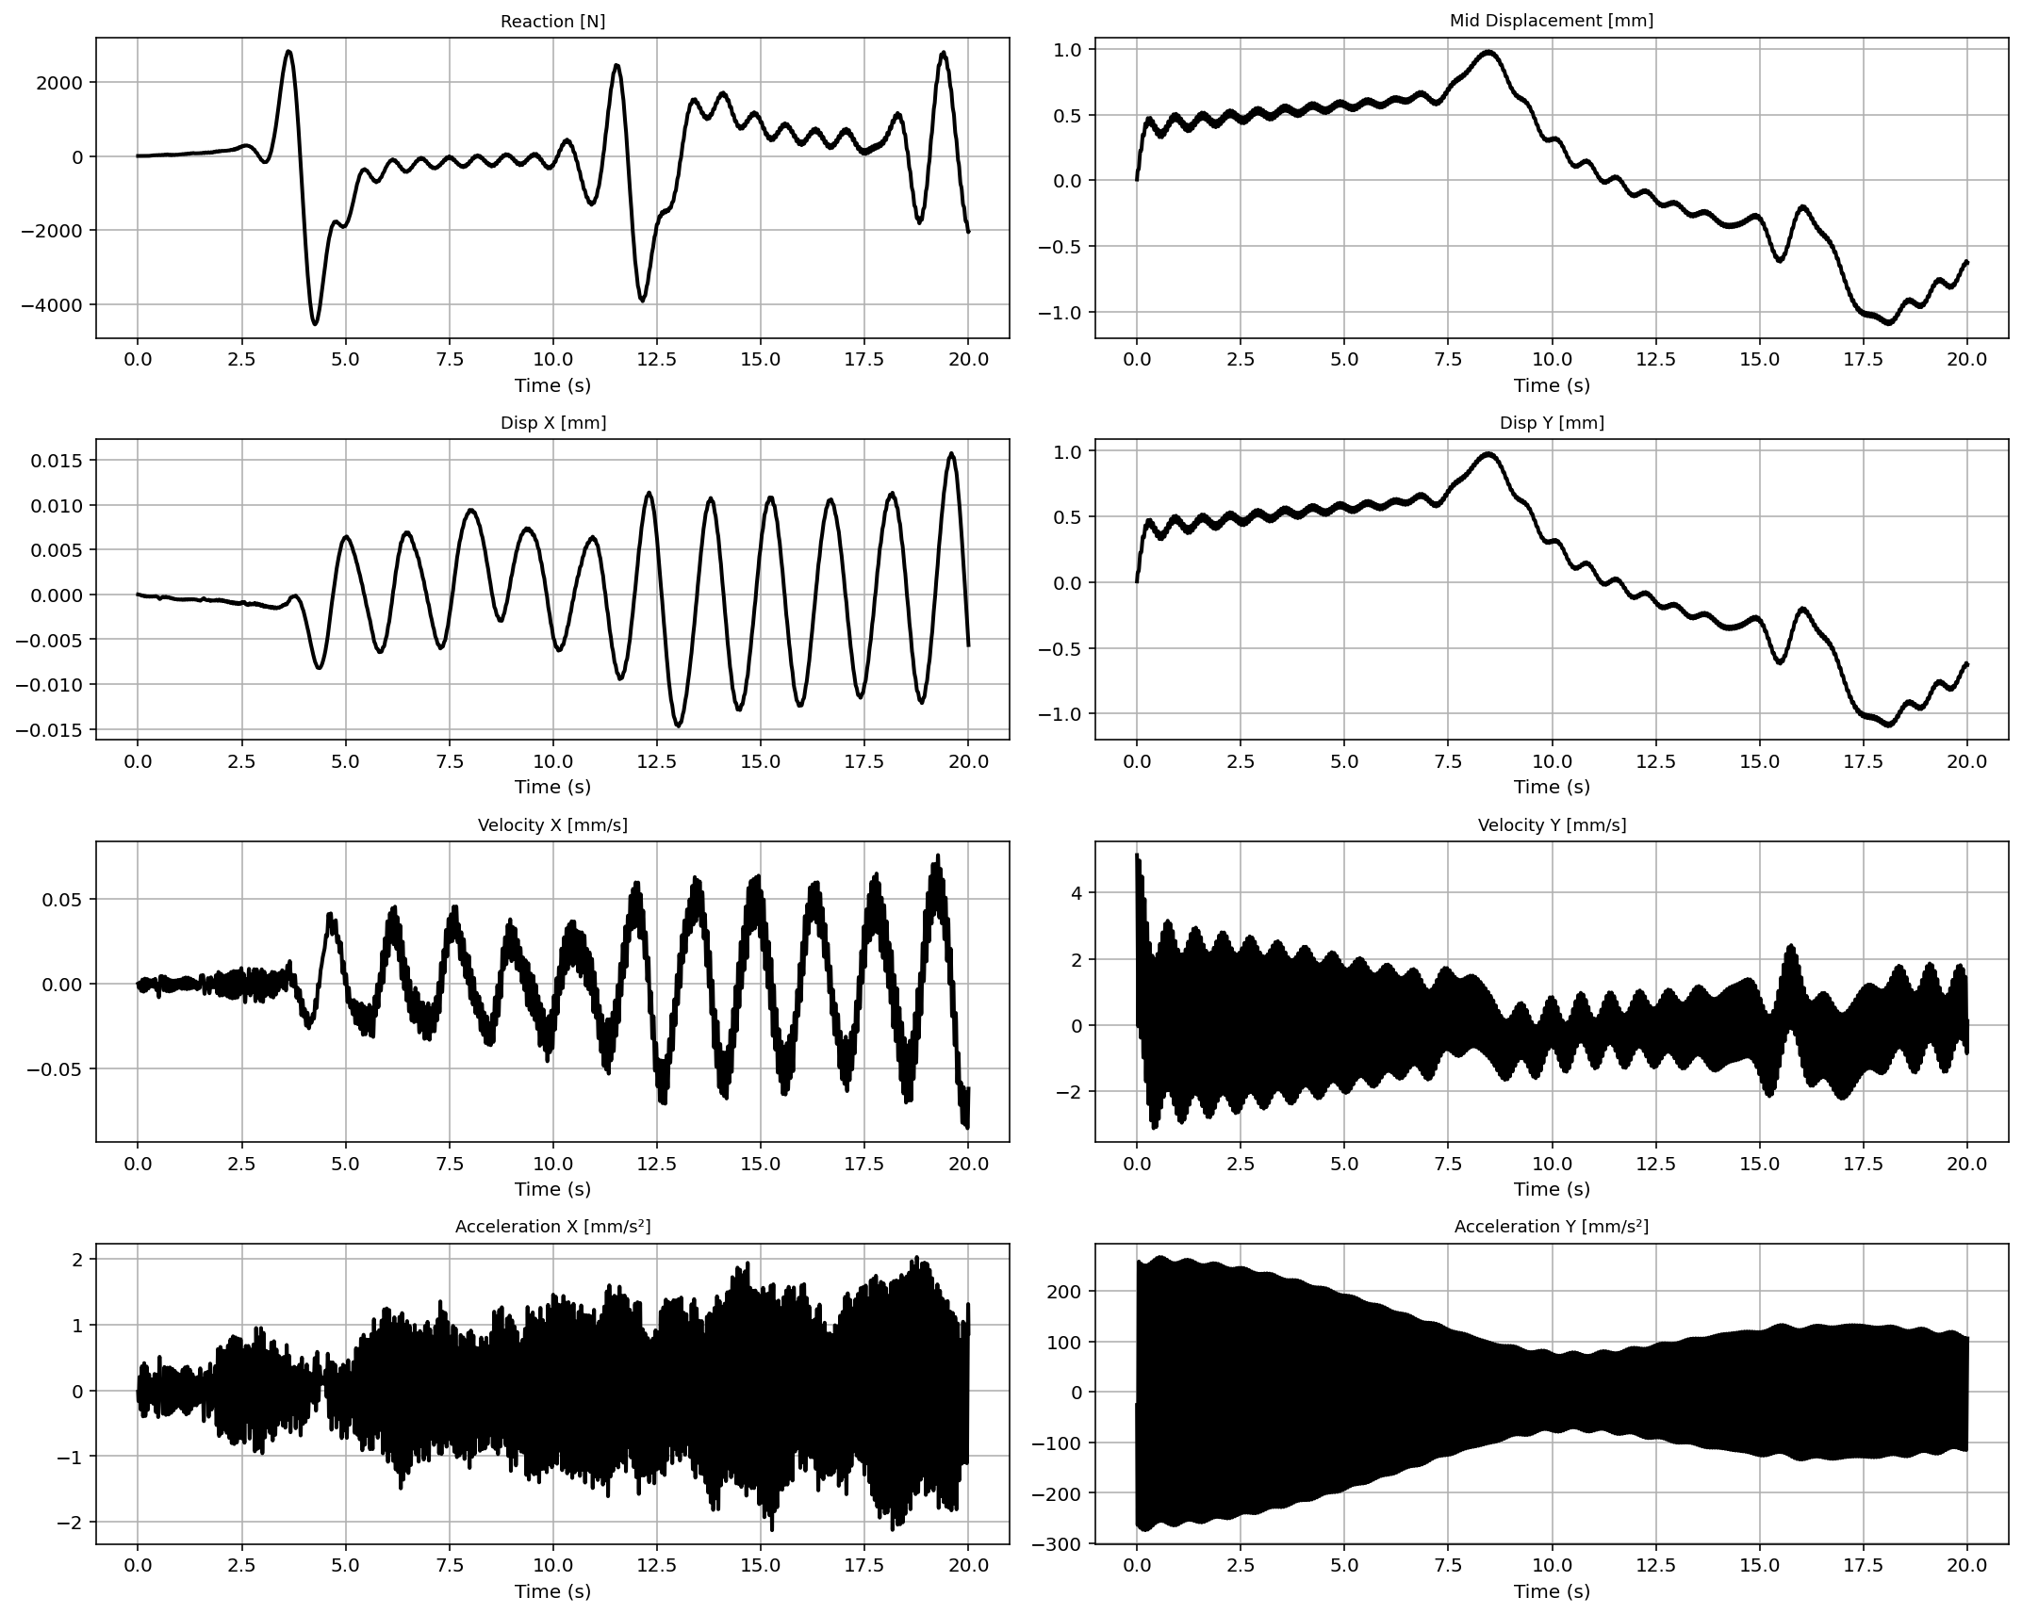

Slide 48
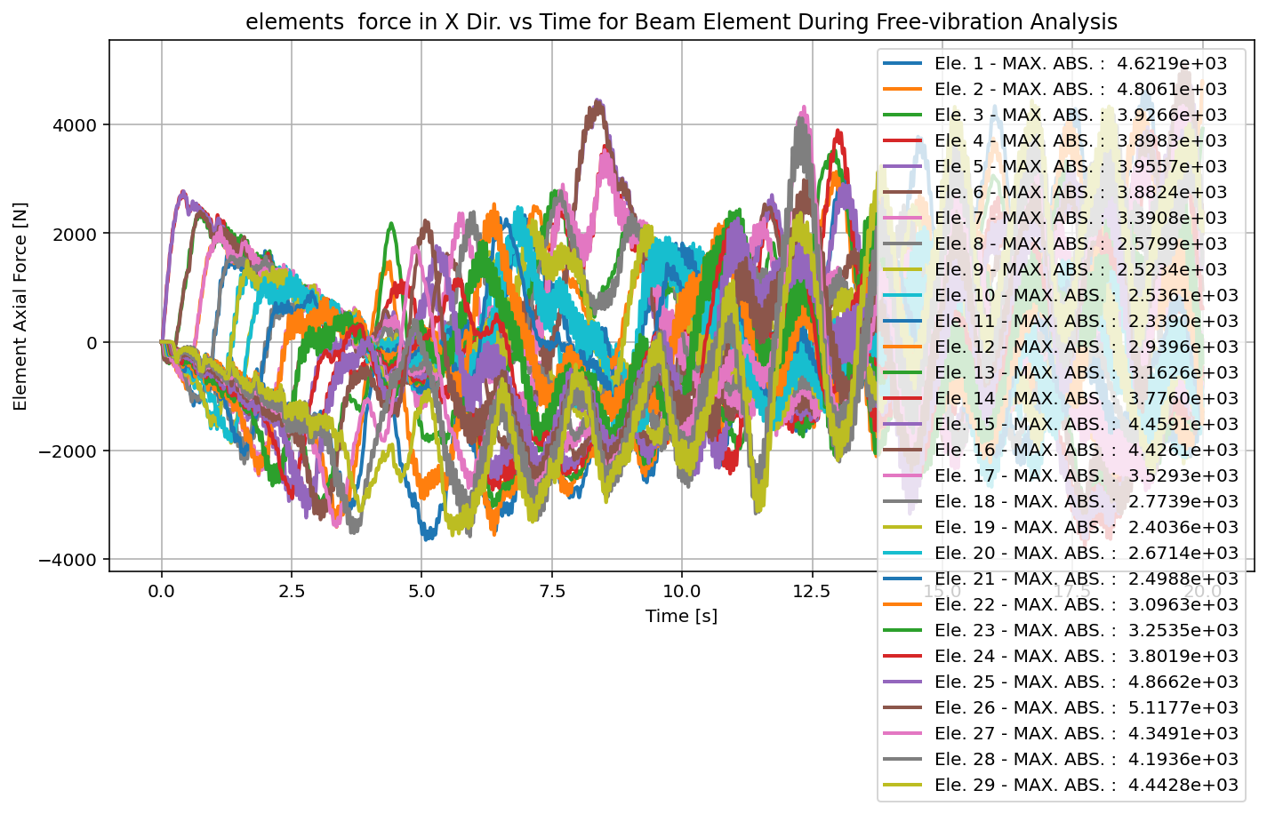

Slide 49
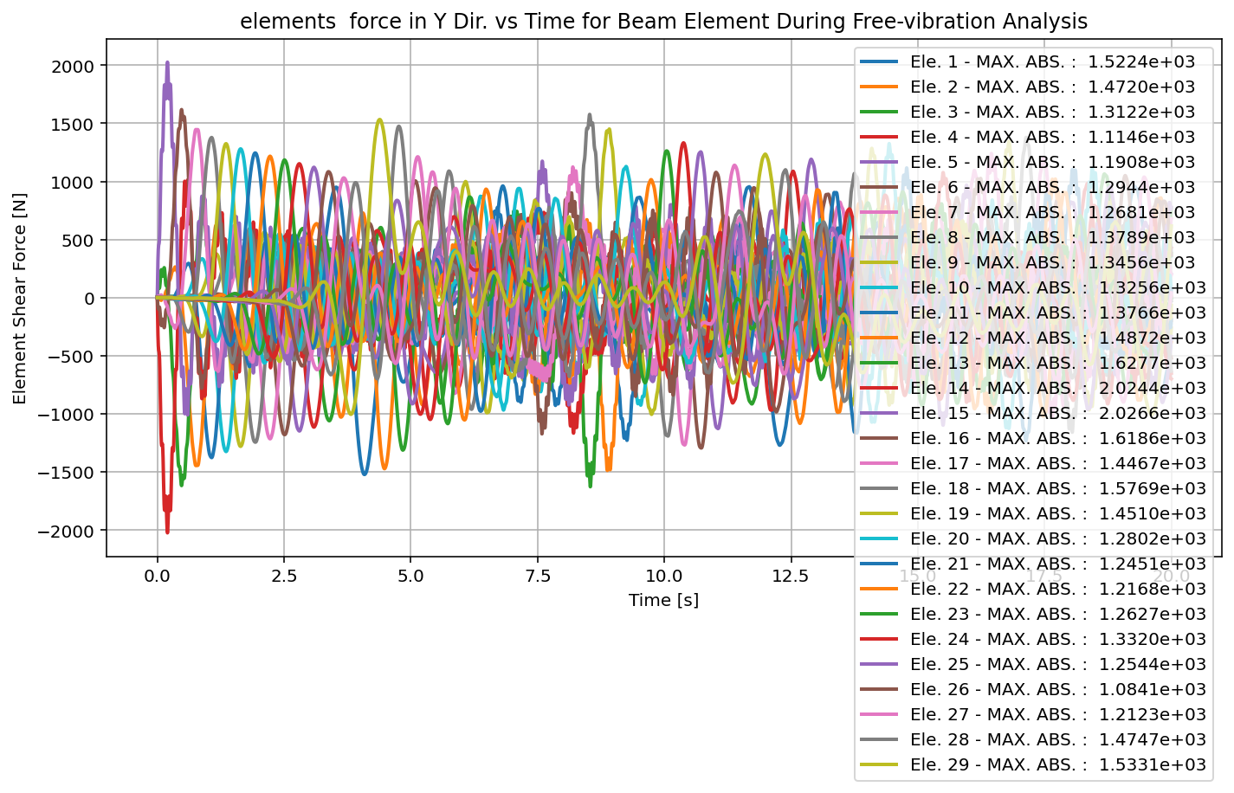

Slide 50
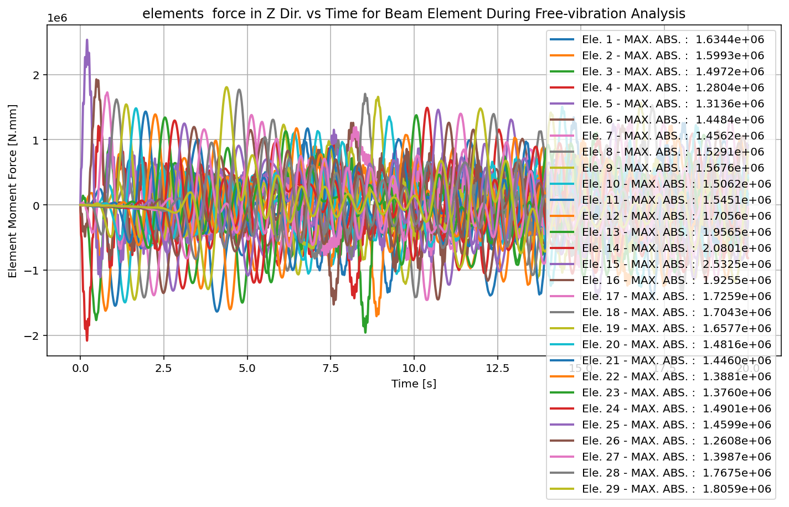

Slide 51
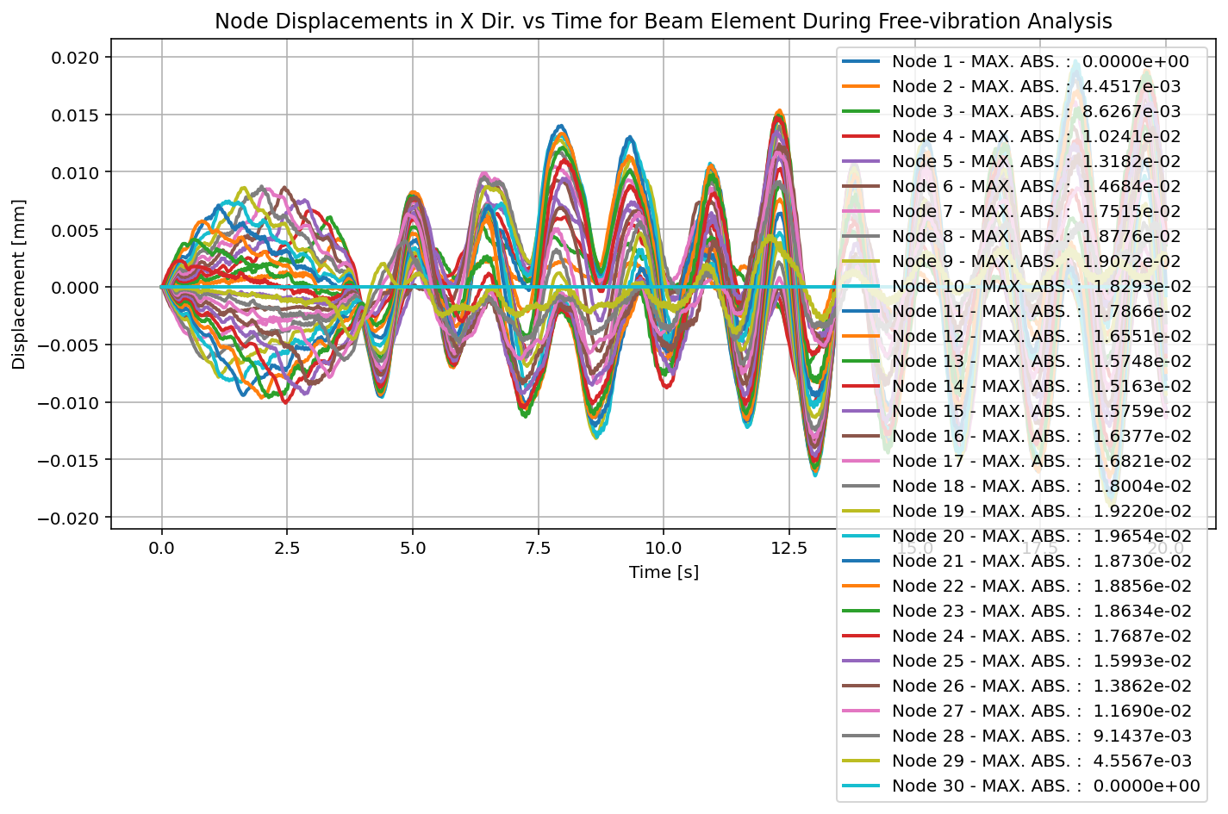

Slide 52
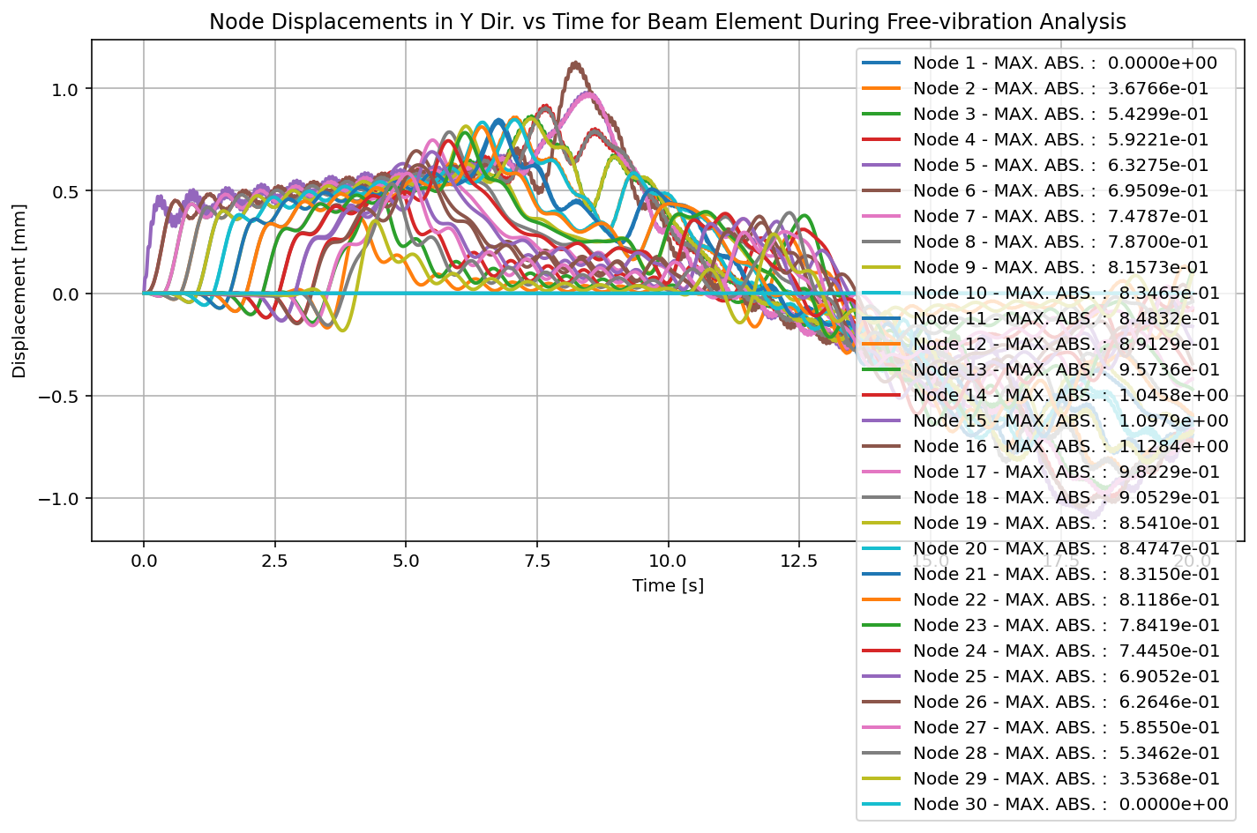

Slide 53
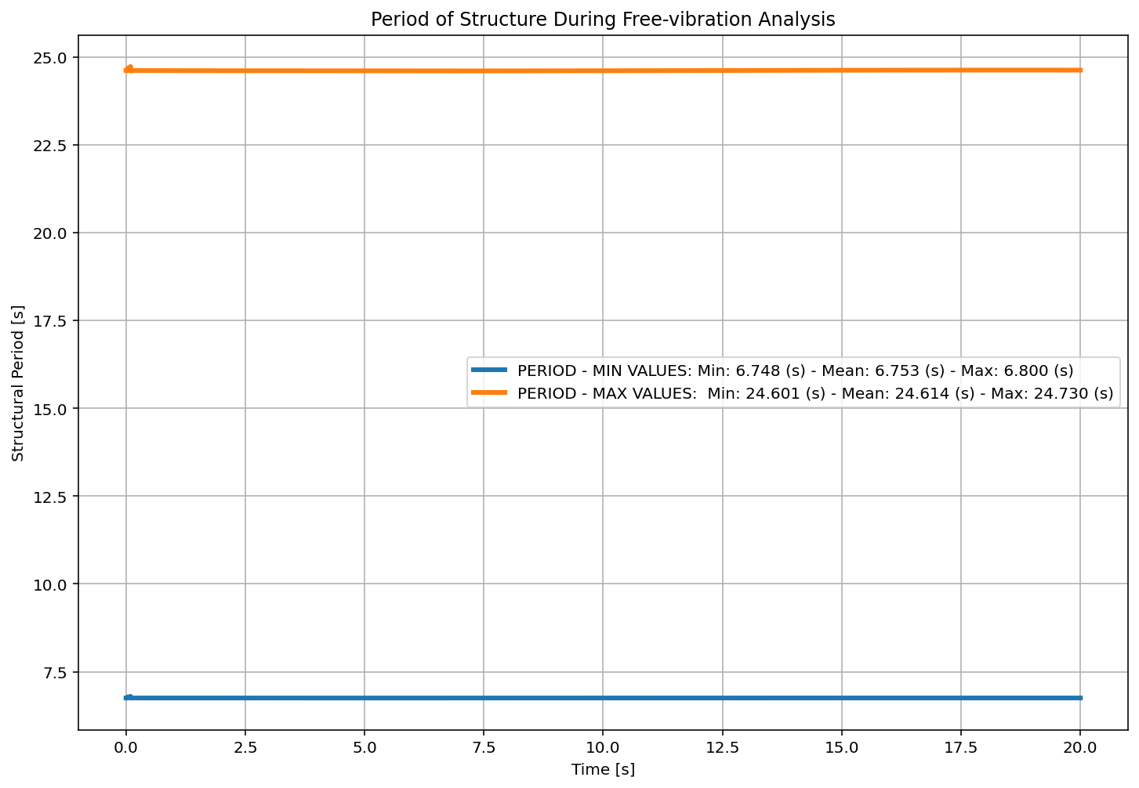

Slide 54
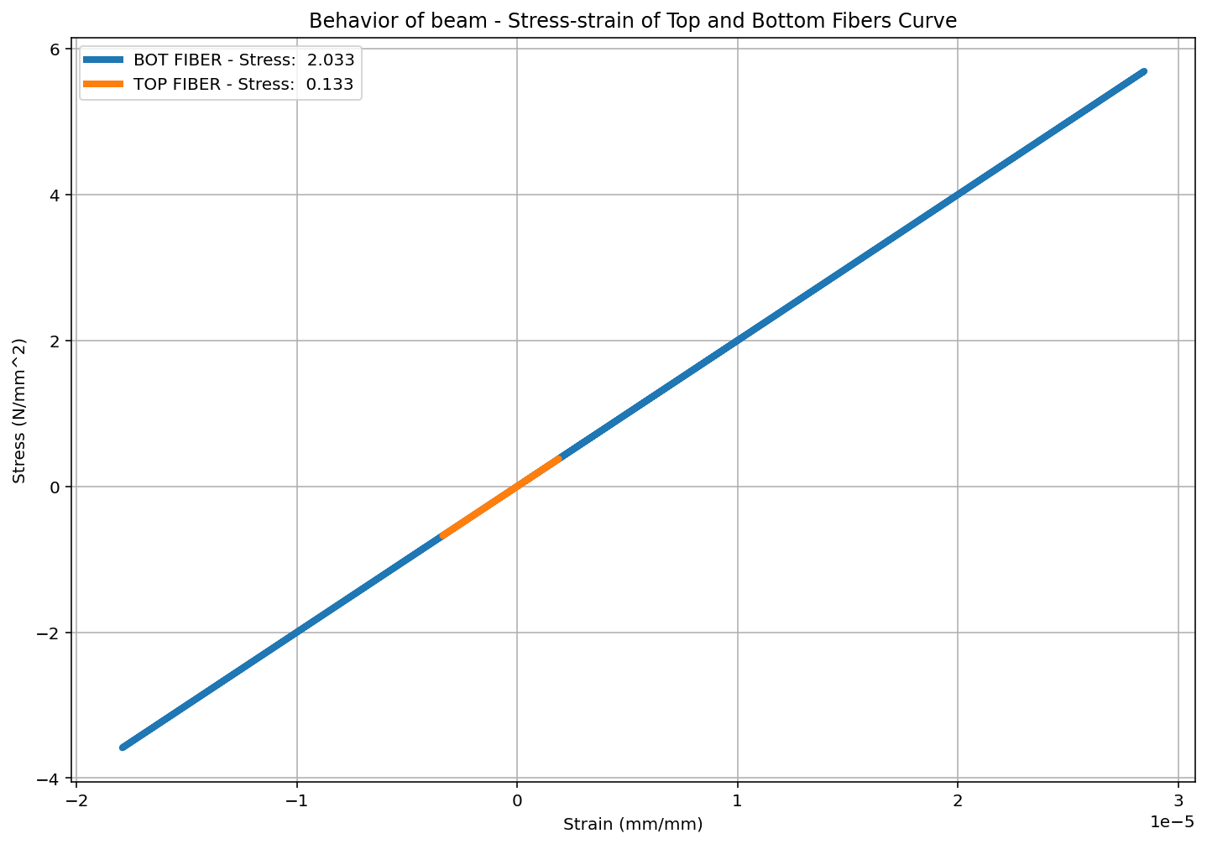

Slide 55
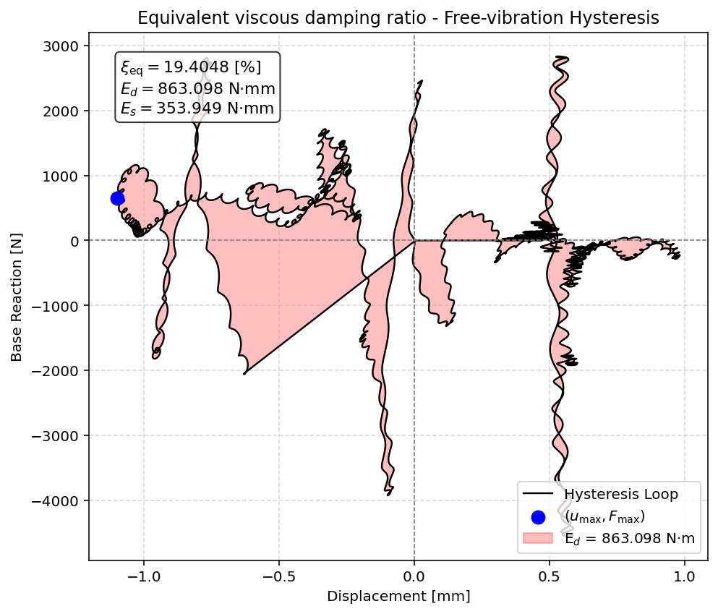

Slide 56
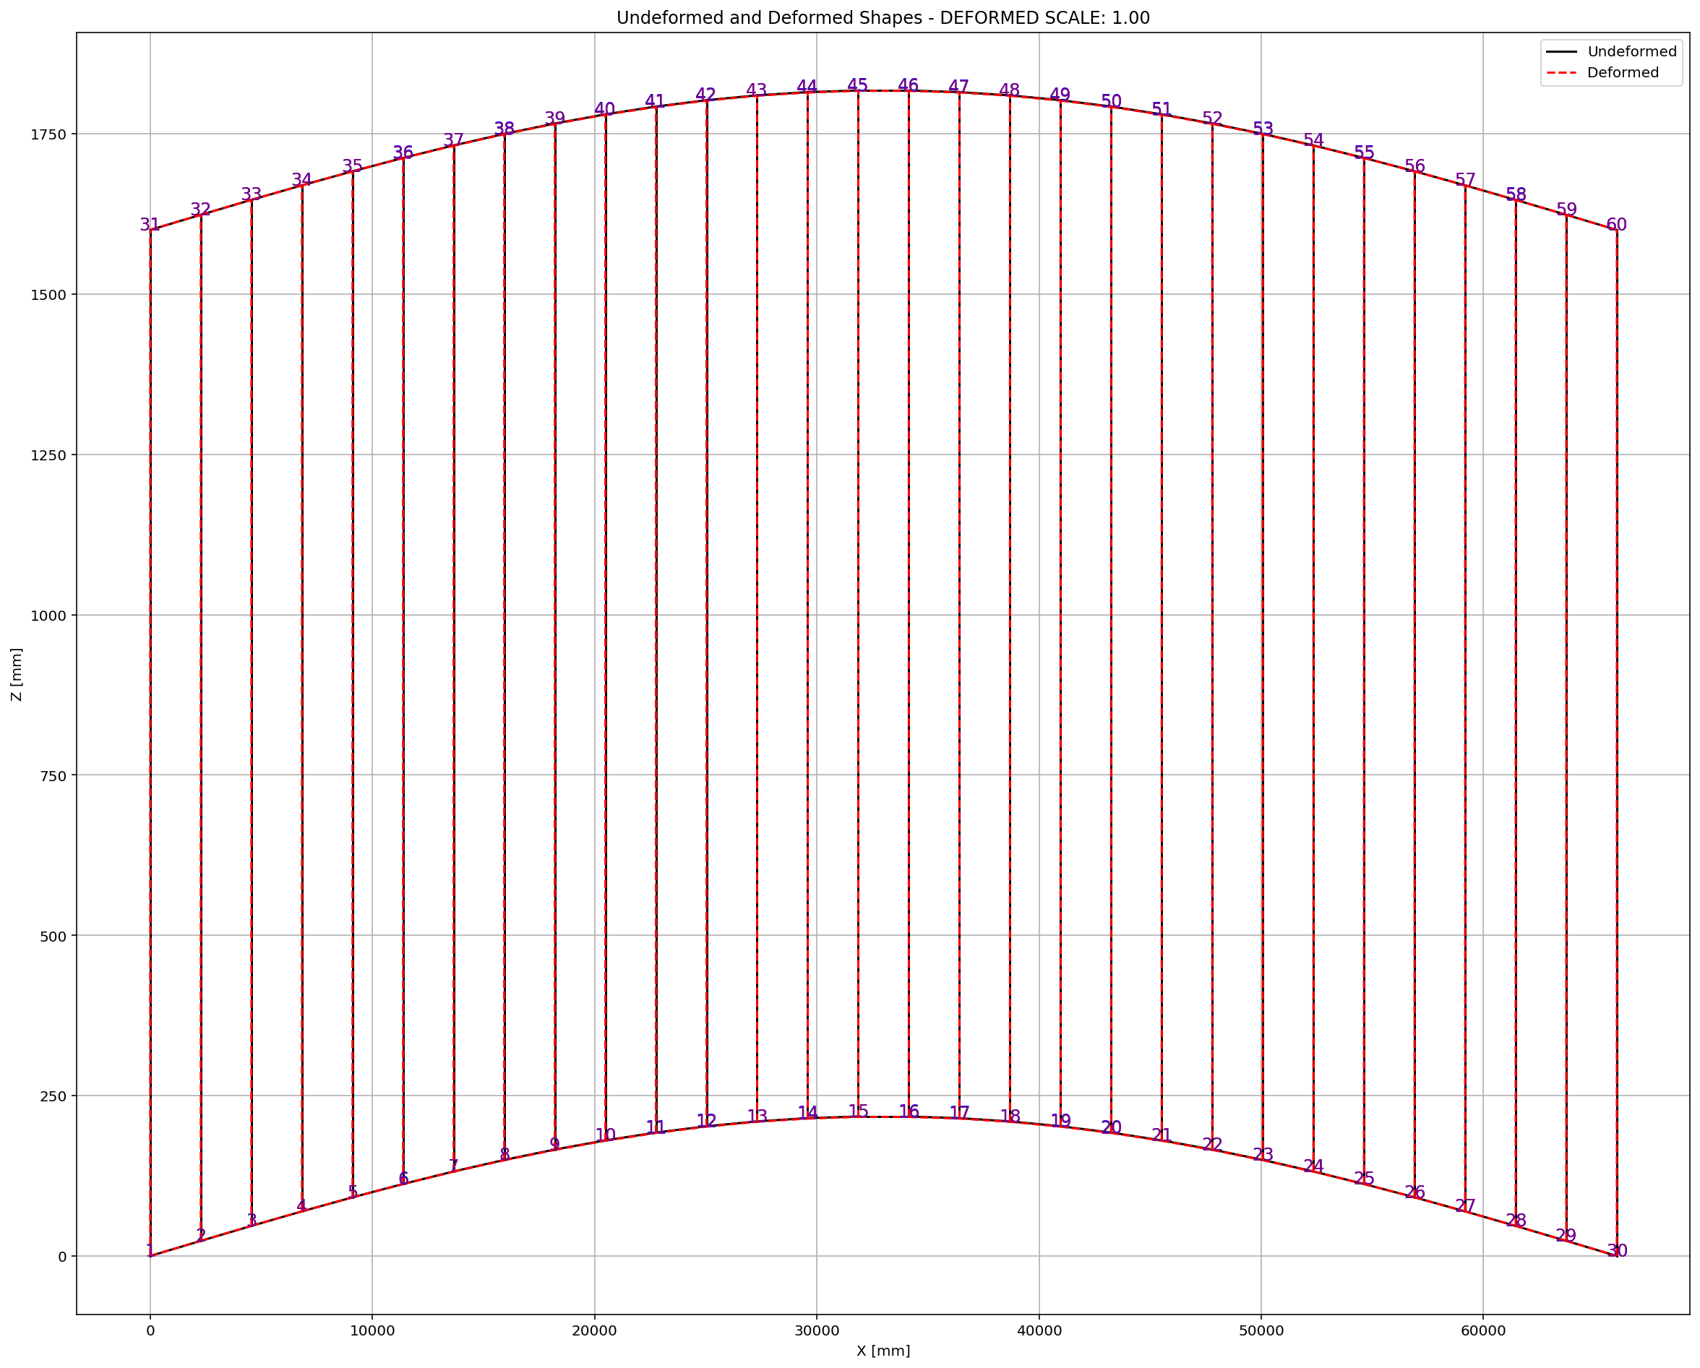

Slide 57
SEISMIC ANALYSIS

Slide 58
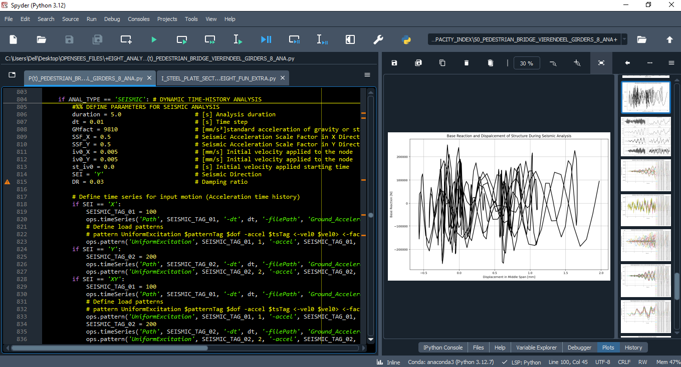

Slide 59
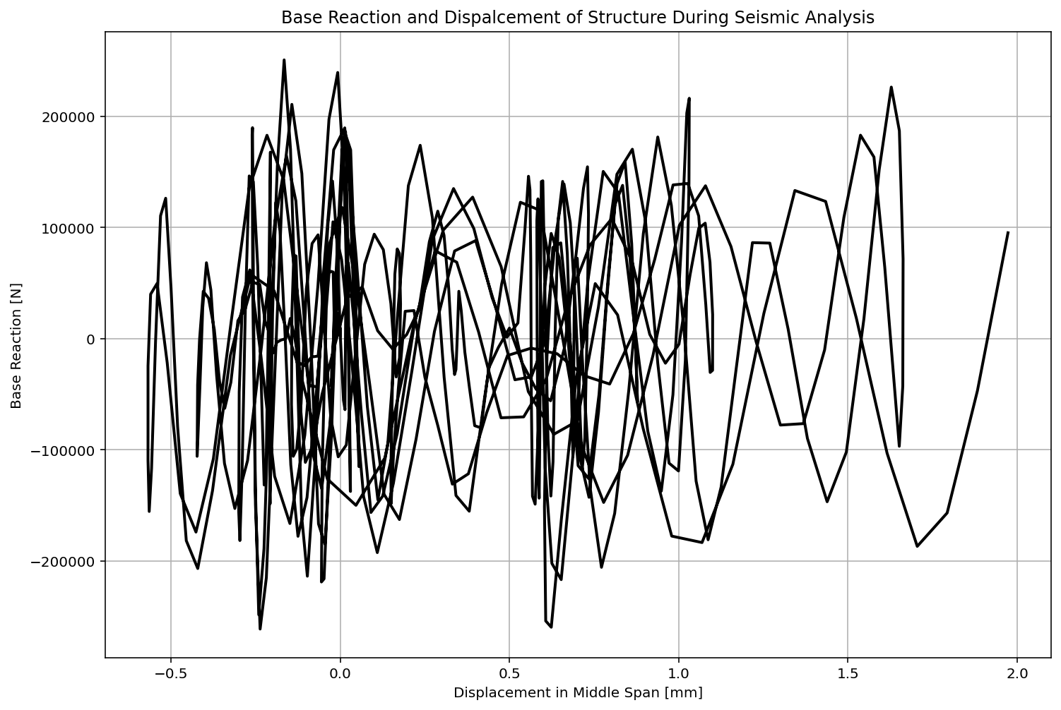

Slide 60
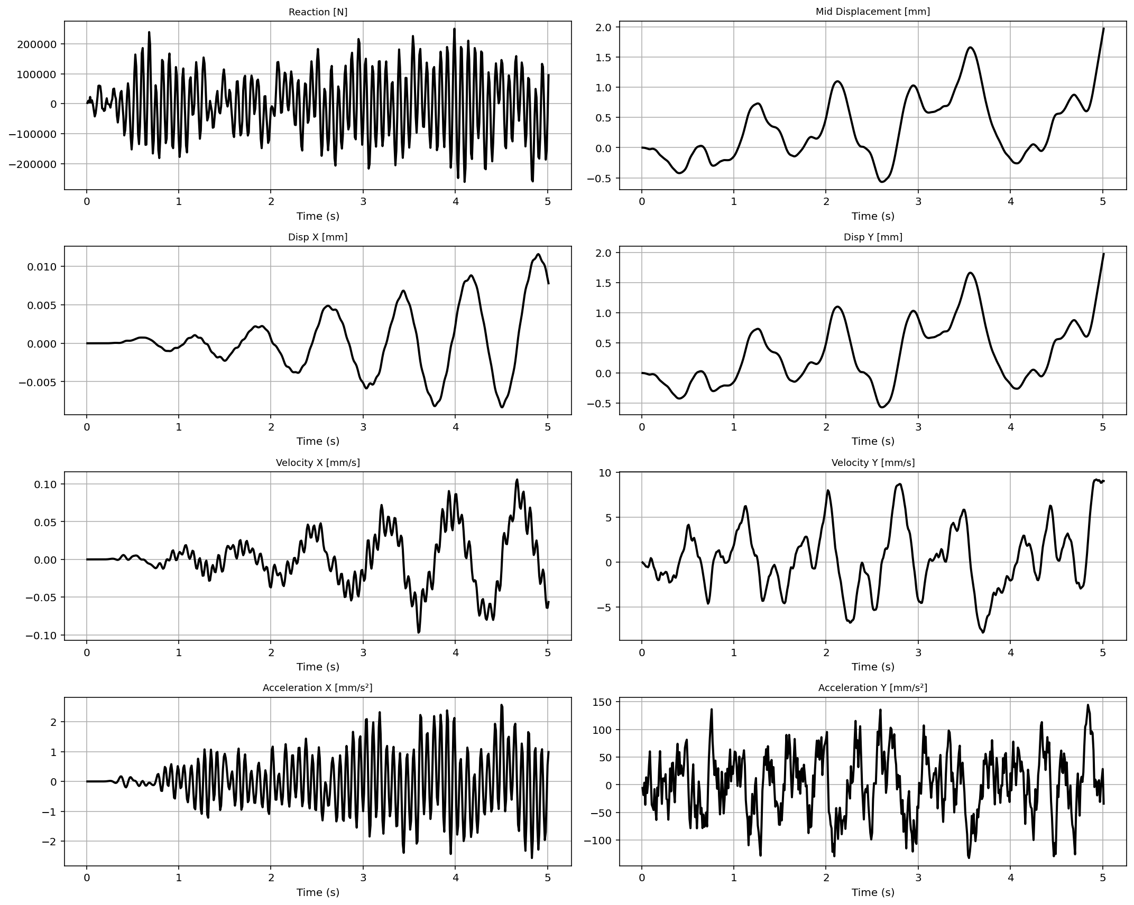

Slide 61
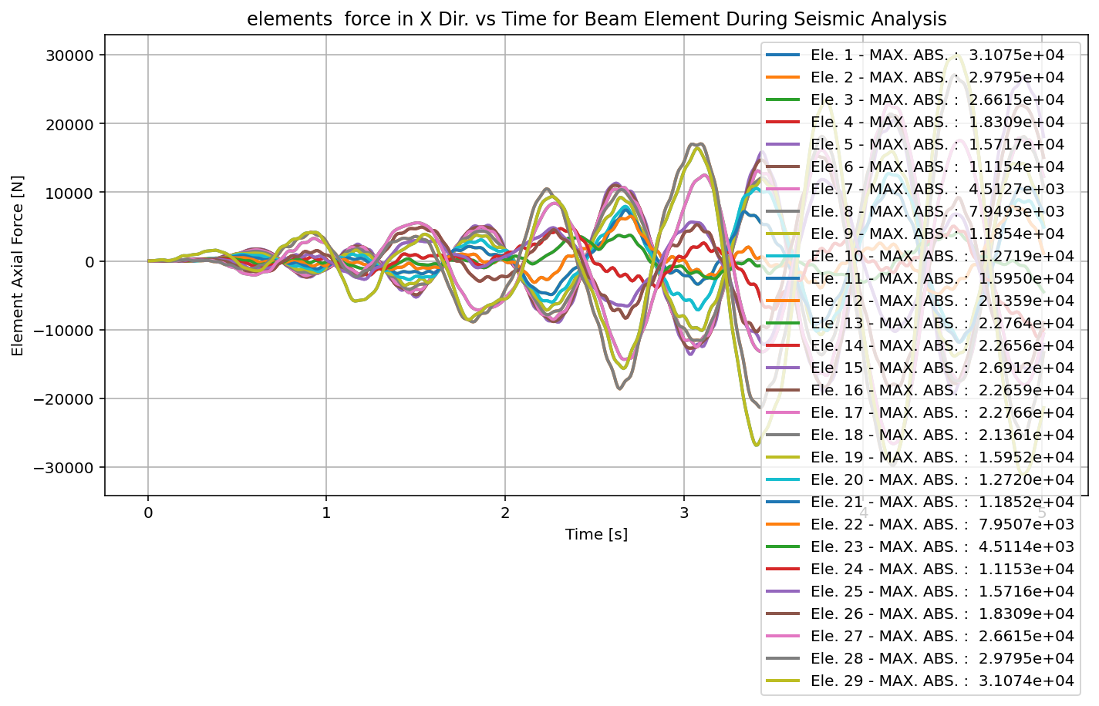

Slide 62


Slide 63


Slide 64


Slide 65


Slide 66


Slide 67


Slide 68


Slide 69


Slide 70


Slide 71
+==========================+
= Analysis curve fitted =
Disp Base Shear
----------------------------
[[ 0. 0. ]
[ 285.24327587 146849.7612848 ]
[ 1200. 217509.0131003 ]]
+==========================+
+----------------------------------------------------+
Structure Elastic Stiffness : 514.82
Structure Plastic Stiffness : 181.26
Structure Tangent Stiffness : 77.24
Structure Ductility Ratio : 4.21
Structure Over Strength Factor: 1.48
+----------------------------------------------------+
Over Strength Coefficient (Ω0): 1.4812
Displacement Ductility Ratio (μ): 4.2069
Ductility Coefficient (Rμ): 4.2069
Structural Behavior Coefficient (R): 6.2312
Structural Ductility Damage Index in Y Direction: -30.9668 (%)

Slide 72


Slide 73


Slide 74
Dissipated Energy from Earthquake= 257475.99 N·mm
Dissipated Energy from Cyclic Displacement= 1090129949.20 N·mm
DISSIPATED ENERGY CAPACITY INDEX: 0.024 [%]
ZONE 1: VERY MINOR DAMAGE

Slide 75


