Slide 1
IN THE NAME OF ALLAH, THE MOST GRACIOUS, THE MOST MERCIFUL
OPTIMIZATION OF STRUCTURAL BEHAVIOR COEFFICIENT USING PUSHOVER ANALYSIS OF CONCRETE FRAME SECTIONS: EVALUATING STRAIN HARDENING AND ULTIMATE STRAIN EFFECTS IN OPENSEES. DETERMINING OPTIMAL COLUMN SECTION REBAR DIAMETER FOR A TARGET STRUCTURAL BEHAVIOR COEFFICIENT VIA THE NEWTON-RAPHSON METHOD.
WRITTEN BY SALAR DELAVAR GHASHGHAEI (QASHQAI)

Slide 2
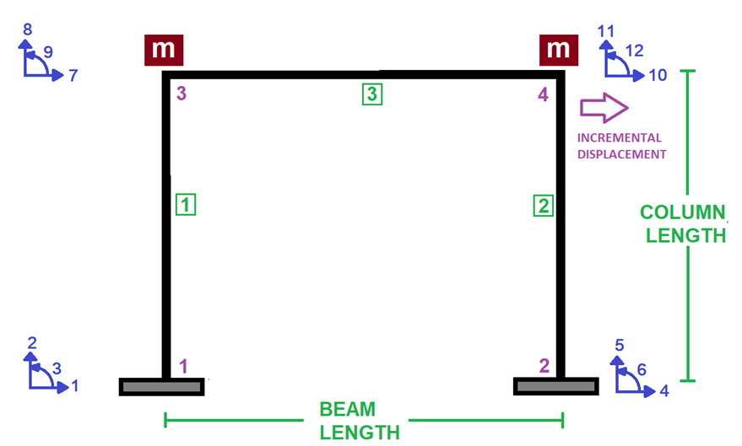

Slide 3
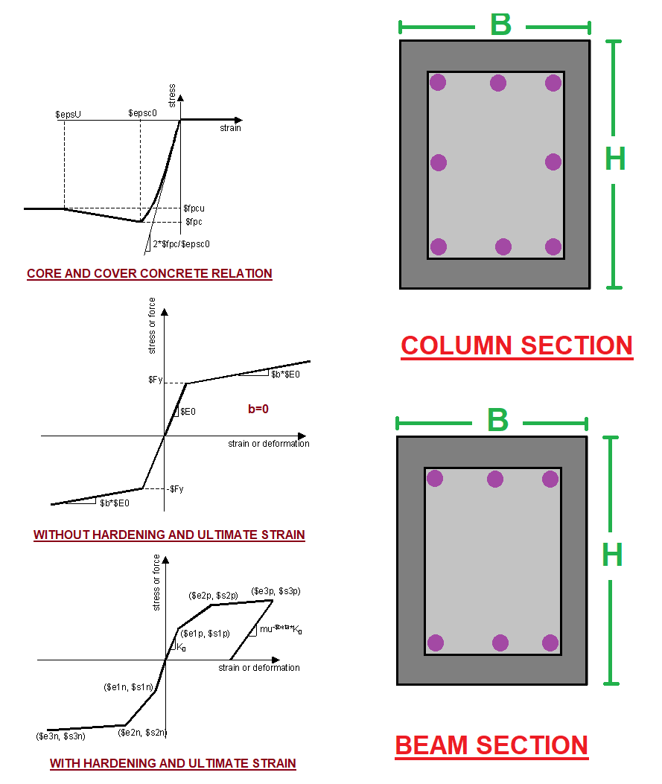

Slide 4
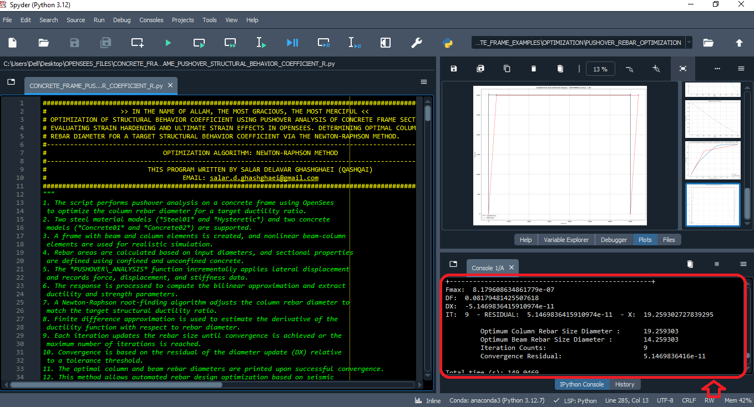

Slide 5
NONLINEAR STATIC ANALYSIS
(PUSHOVER)

Slide 6
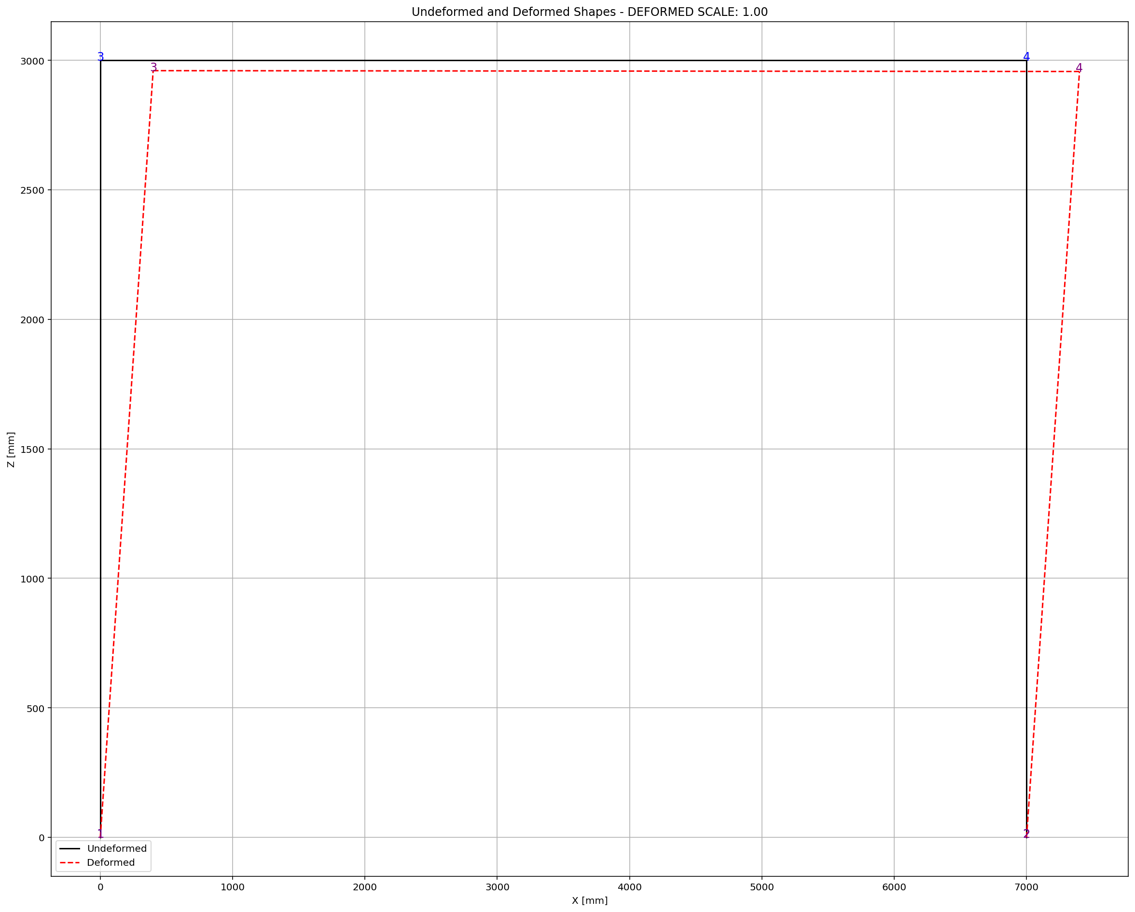
Fmax: 8.179608634861779e-07
DF: 0.08179481425507618
DX: -5.1469836415910974e-11
IT: 9 - RESIDUAL: 5.1469836415910974e-11 - X: 19.259302727839295
Optimum Column Rebar Size Diameter : 19.259303
Optimum Beam Rebar Size Diameter : 14.259303
Iteration Counts: 9
Convergence Residual: 5.1469836416e-11

Slide 7
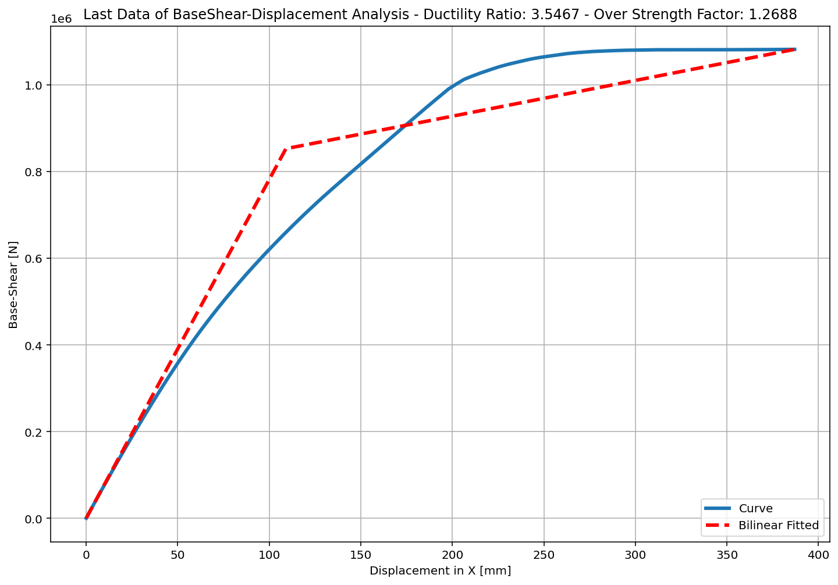
+==========================+
= Analysis curve fitted =
Disp Base Shear
----------------------------
[[0.00000000e+00 0.00000000e+00]
[1.09111502e+02 8.52824530e+05]
[3.86986496e+02 1.08204918e+06]]
+==========================+
+----------------------------------------------------+
Structure Elastic Stiffness : 7816.08
Structure Plastic Stiffness : 2796.09
Structure Tangent Stiffness : 824.92
Structure Ductility Ratio : 3.55
Structure Over Strength Factor: 1.27
+----------------------------------------------------+

Slide 8
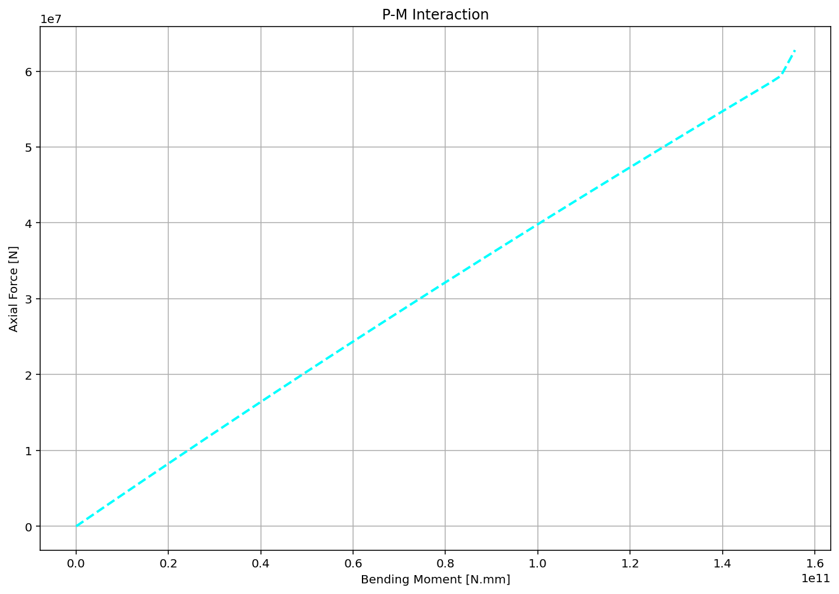

Slide 9
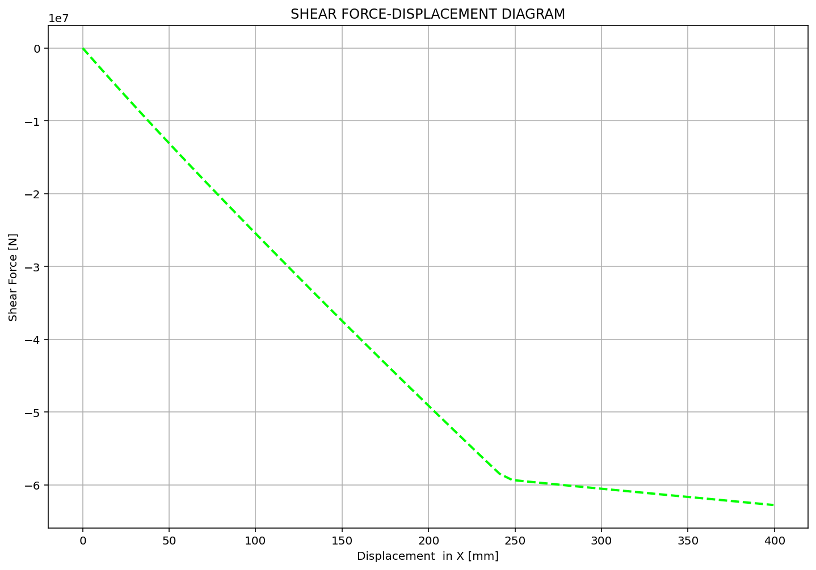

Slide 10
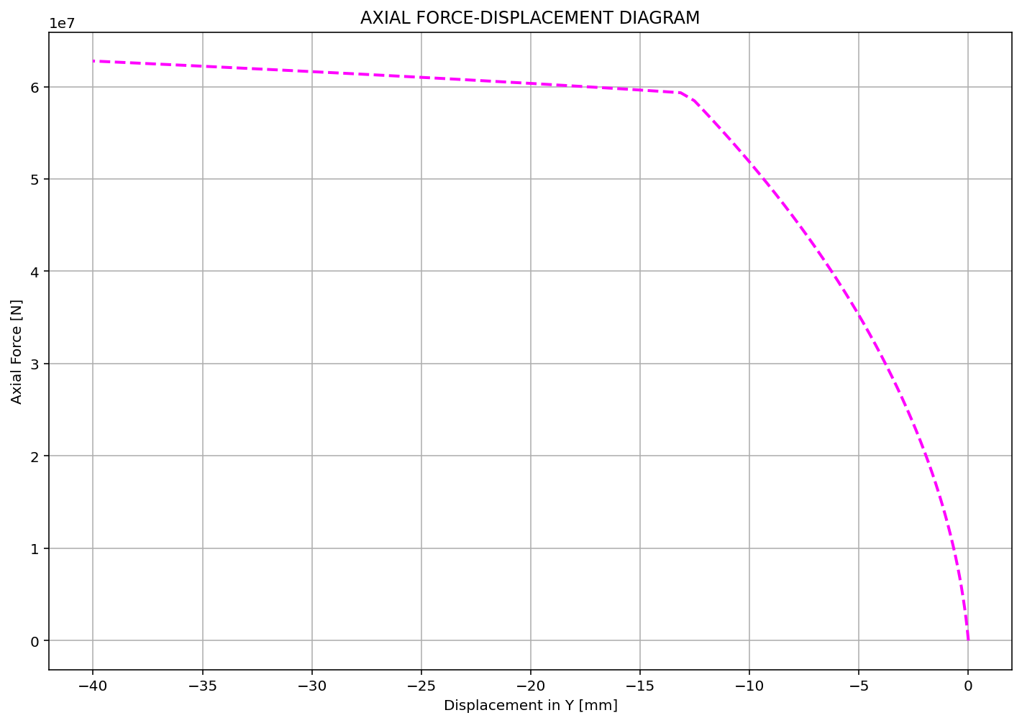

Slide 11
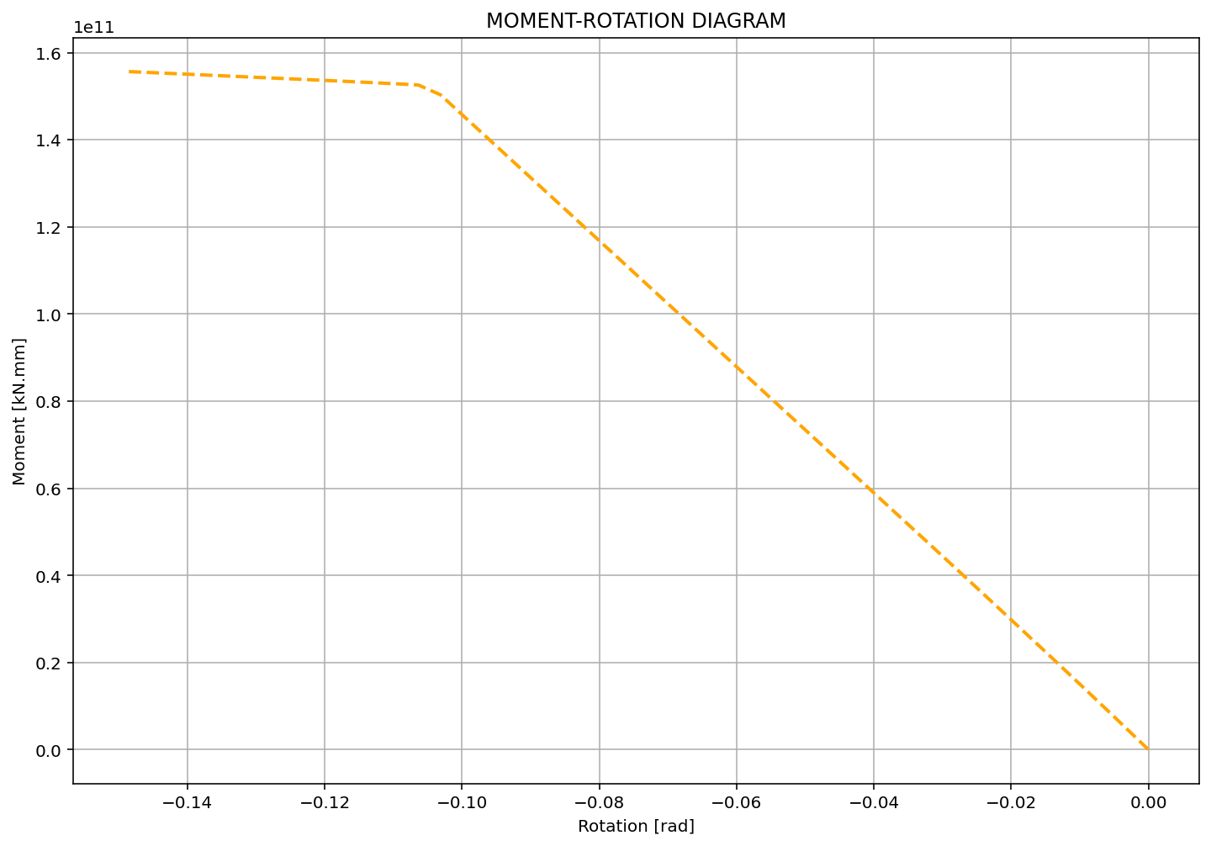

Slide 12
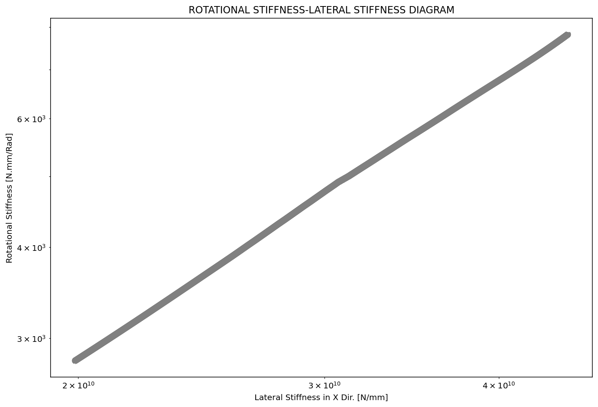

Slide 13
