Slide 1
>> IN THE NAME OF ALLAH, THE MOST GRACIOUS, THE MOST MERCIFUL <<
DETERMINATION OF OPTIMUM STRUCTURAL DAMPER STIFFNESS FROM ENERGY DISSIPATION CAPACITY INDEX USING FINITE‑DIFFERENCE NEWTON ITERATION AND OPENSEES
WRITTEN BY SALAR DELAVAR GHASHGHAEI (QASHQAI)

Slide 2
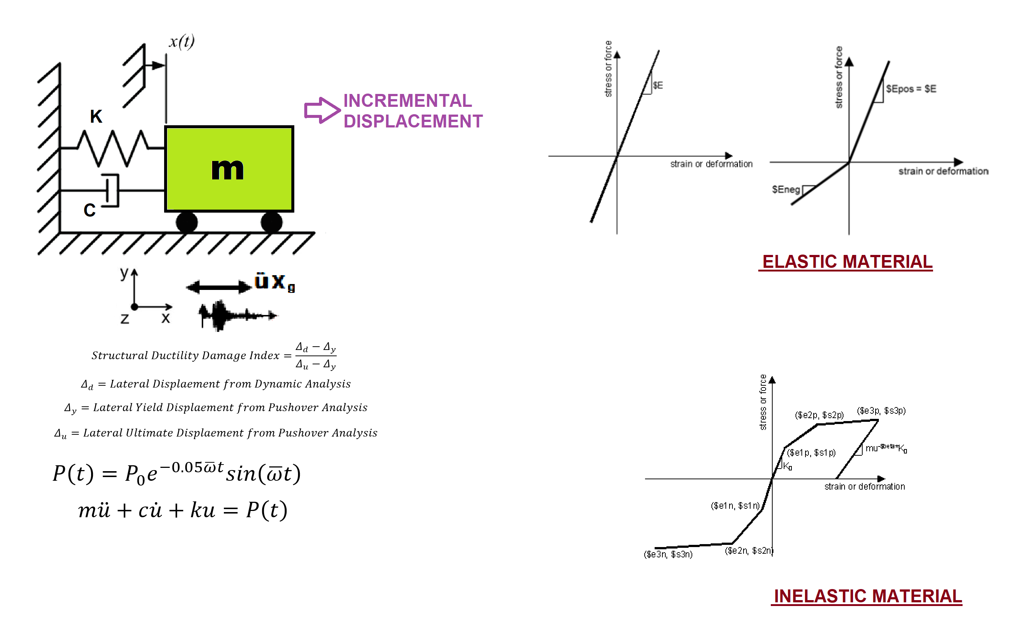

Slide 3
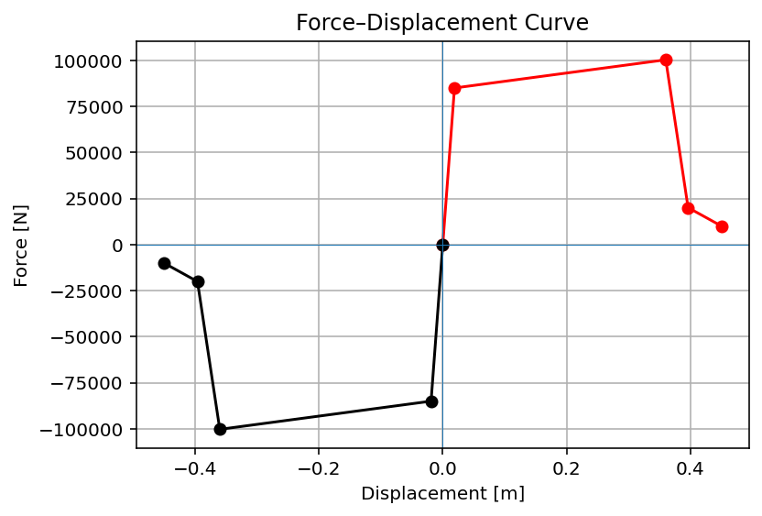

Slide 4
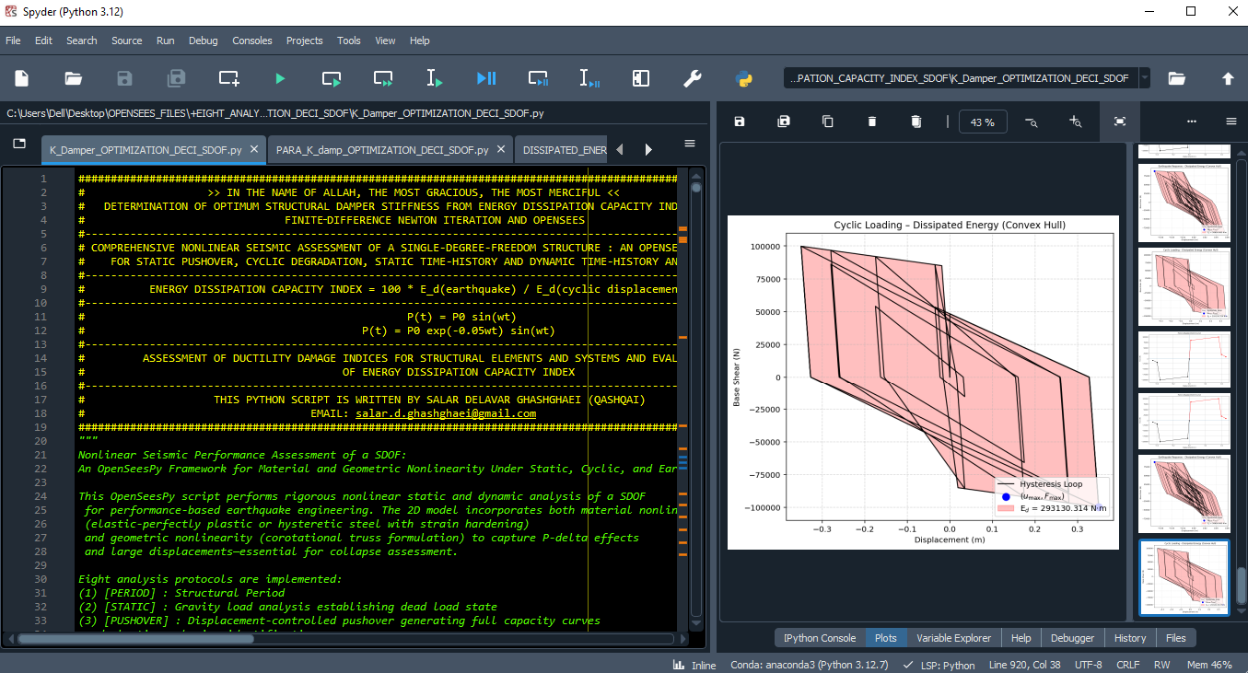

Slide 5
OPTIMIZATION PROBLEM FOR ENERGY DISSIPATION CAPACITY INDEX (EDCI)

Slide 6
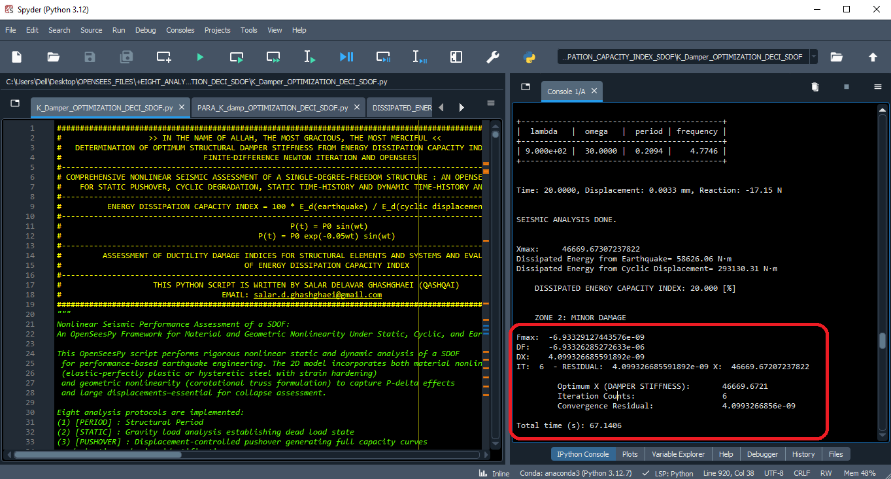

Slide 7
Dissipated Energy from Earthquake= 58626.06 N·m
Dissipated Energy from Cyclic Displacement= 293130.31 N·m
DISSIPATED ENERGY CAPACITY INDEX: 20.000 [%]
ZONE 2: MINOR DAMAGE
Fmax: -6.93329127443576e-09
DF: -6.93326285272633e-06
DX: 4.099326685591892e-09
IT: 6 - RESIDUAL: 4.099326685591892e-09 X: 46669.67207237822
Optimum X (DAMPER STIFFNESS): 46669.6721
Iteration Counts: 6
Convergence Residual: 4.0993266856e-09
Total time (s): 67.1406

Slide 8
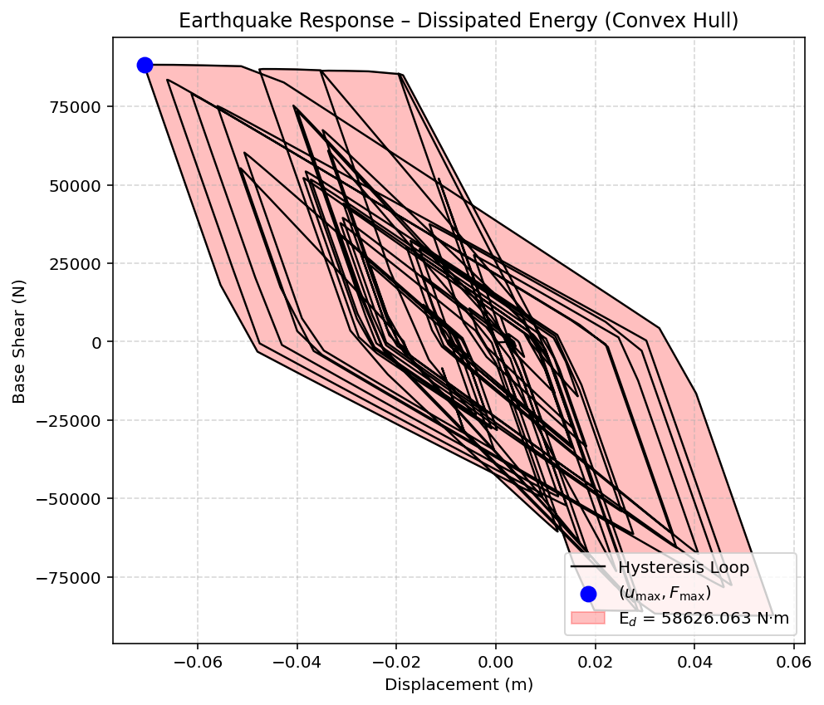

Slide 9
