Slide 1
IN THE NAME OF ALLAH, THE MOST GRACIOUS, THE MOST MERCIFUL
DYNAMIC RESPONSE ANALYSIS OF A SINGLE-DEGREE-OF-FREEDOM (SDOF)
INELASTIC STRUCTURE UNDER SEISMIC LOADING WITH UNCERTAINTY USING MONTE CARLO SIMULATION:
INCORPORATING BETA PROBABILITY DISTRIBUTION FOR STOCHASTIC PARAMETERS
WRITTEN BY SALAR DELAVAR GHASHGHAEI (QASHQAI)

Slide 2
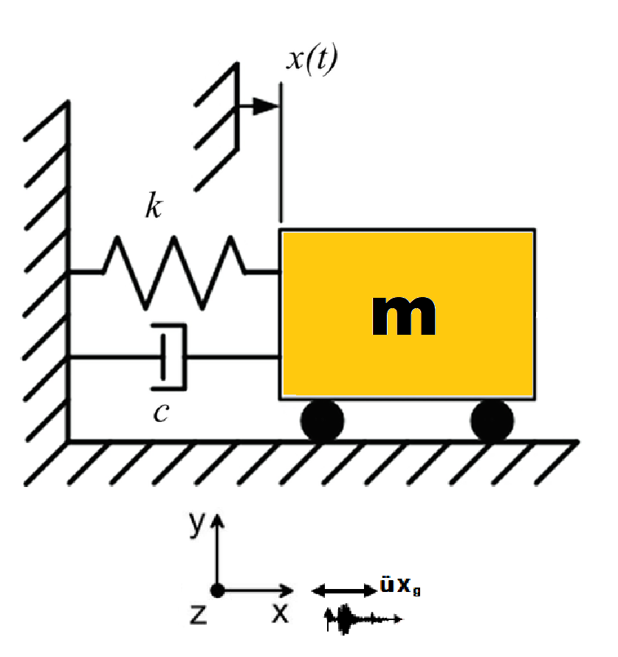

Slide 3
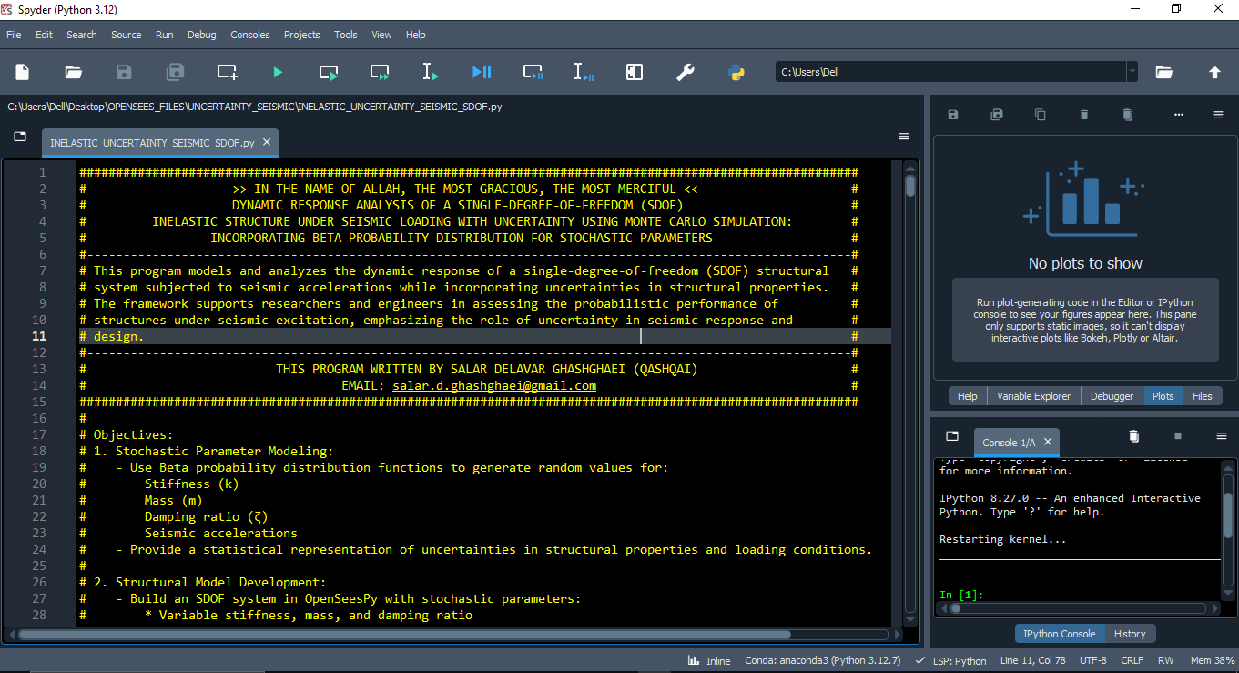

Slide 4
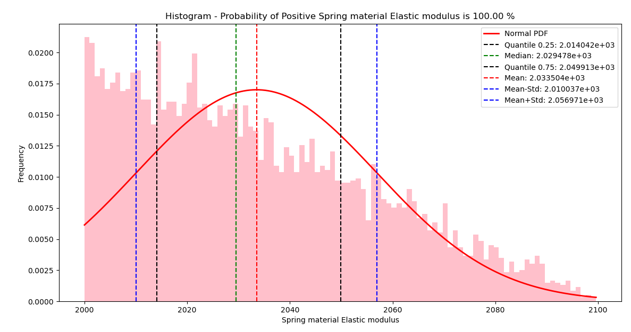

Slide 5
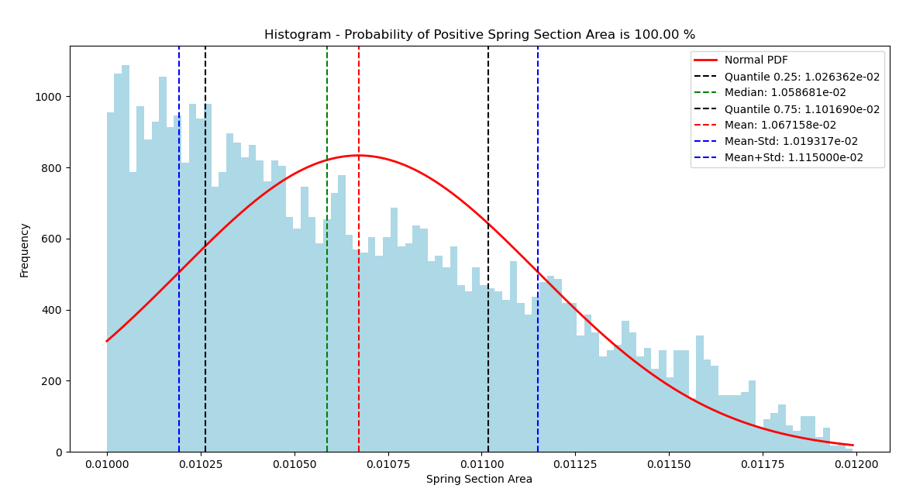

Slide 6
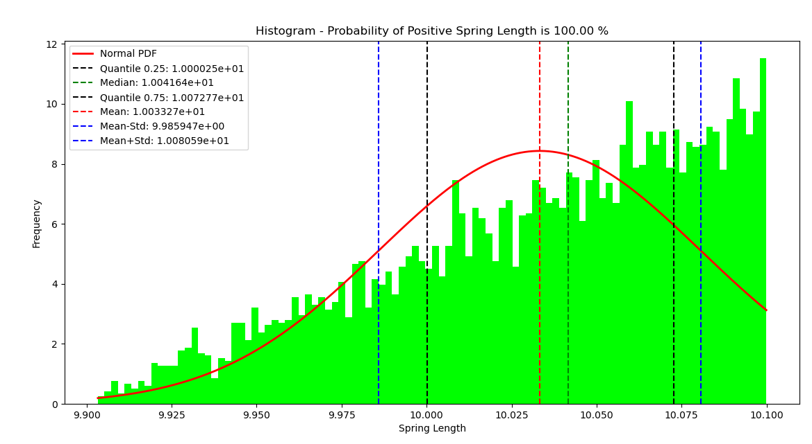

Slide 7
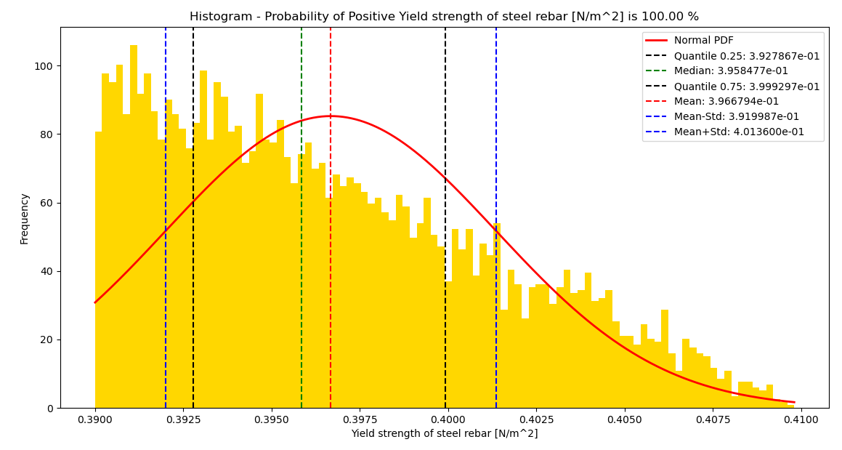

Slide 8
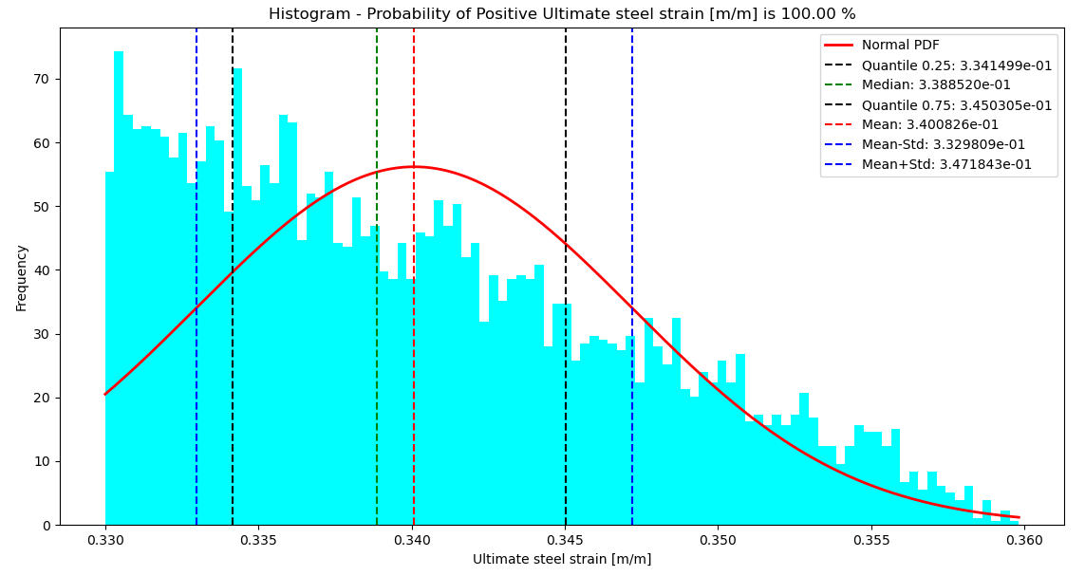

Slide 9
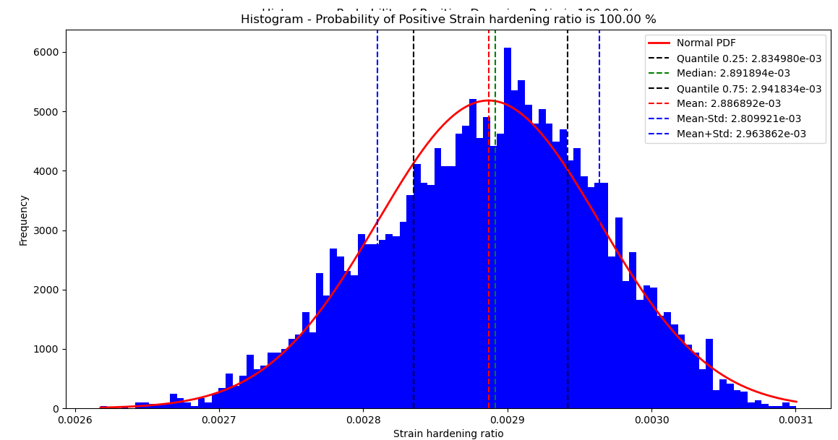

Slide 10
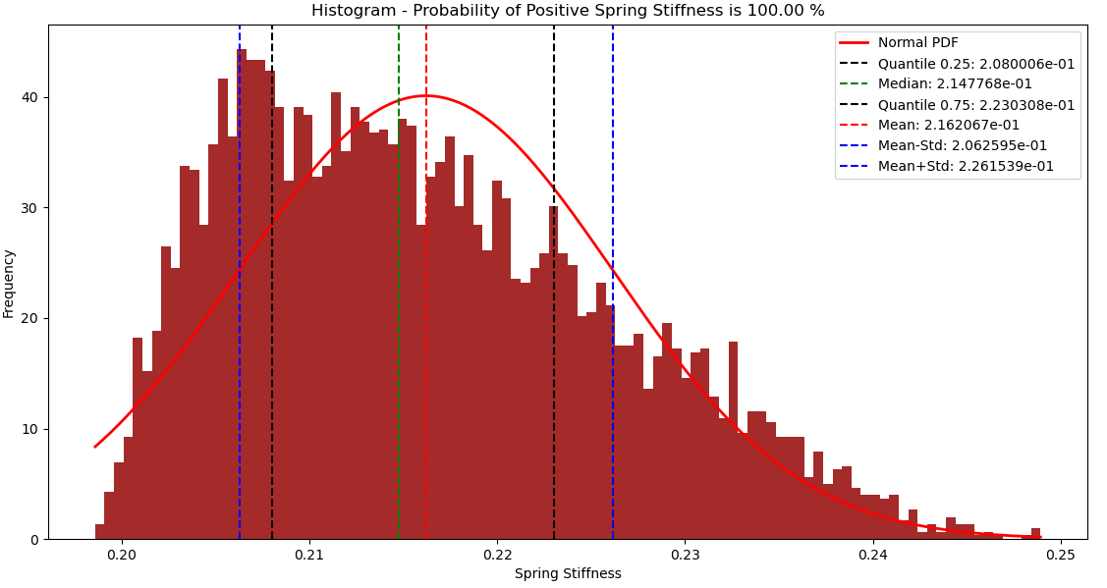

Slide 11
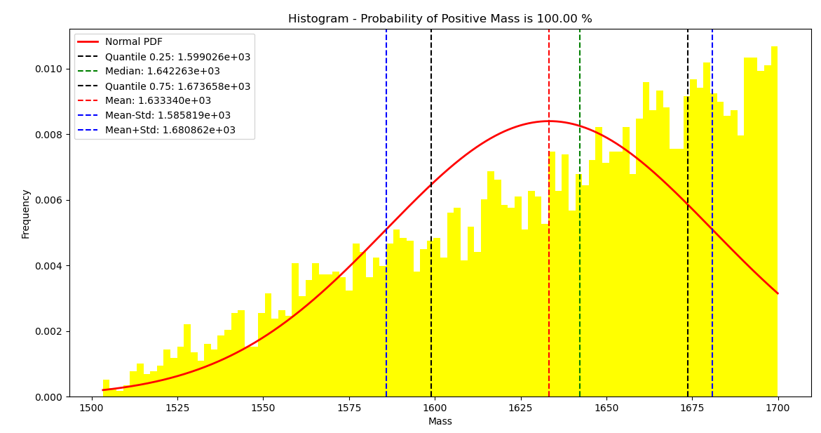

Slide 12
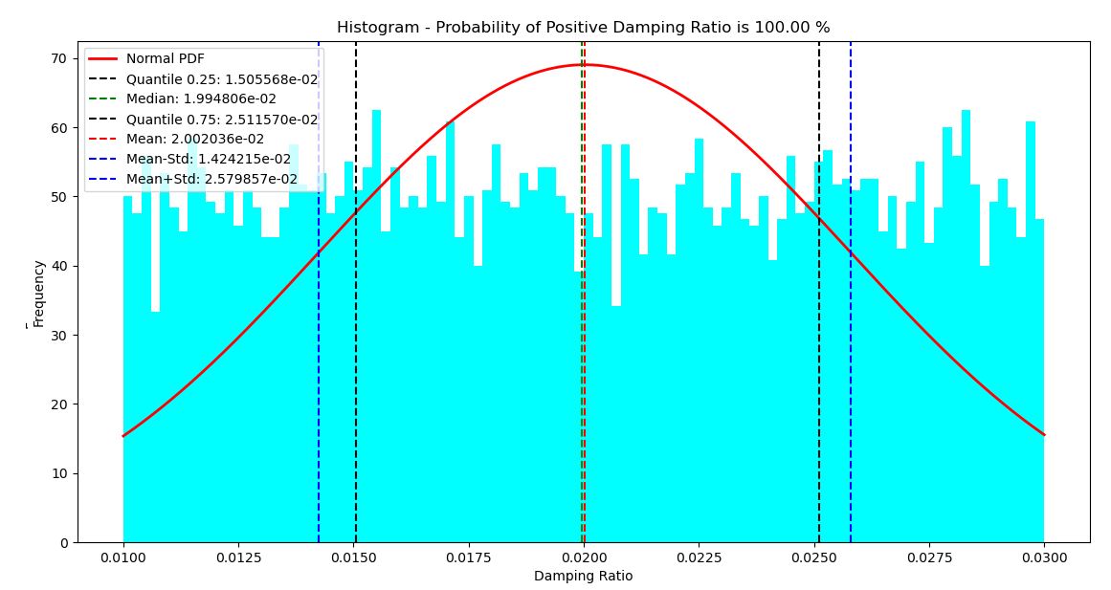

Slide 13
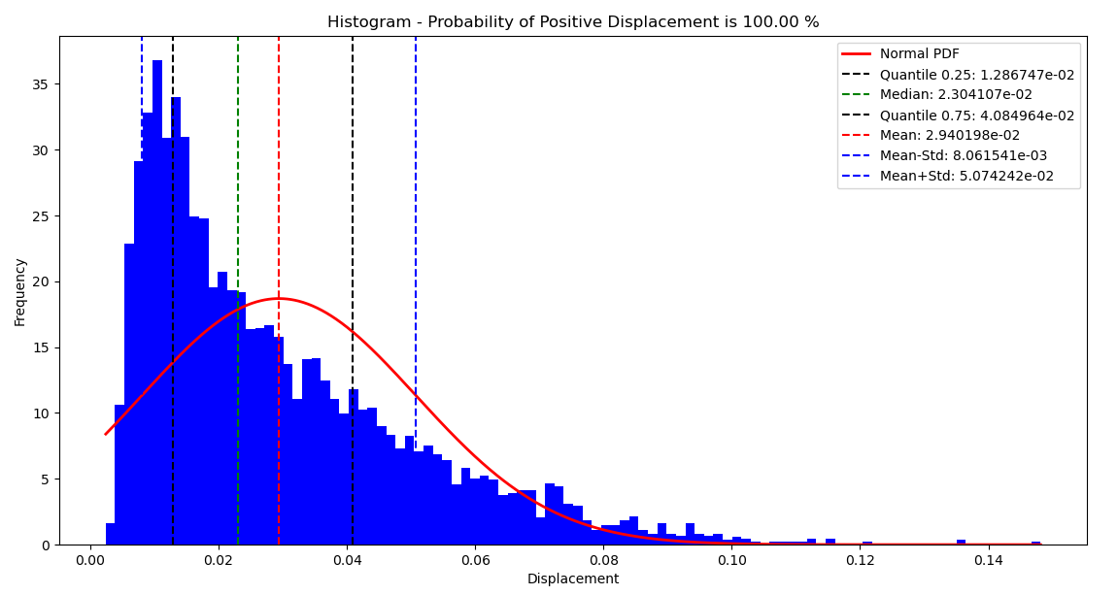

Slide 14
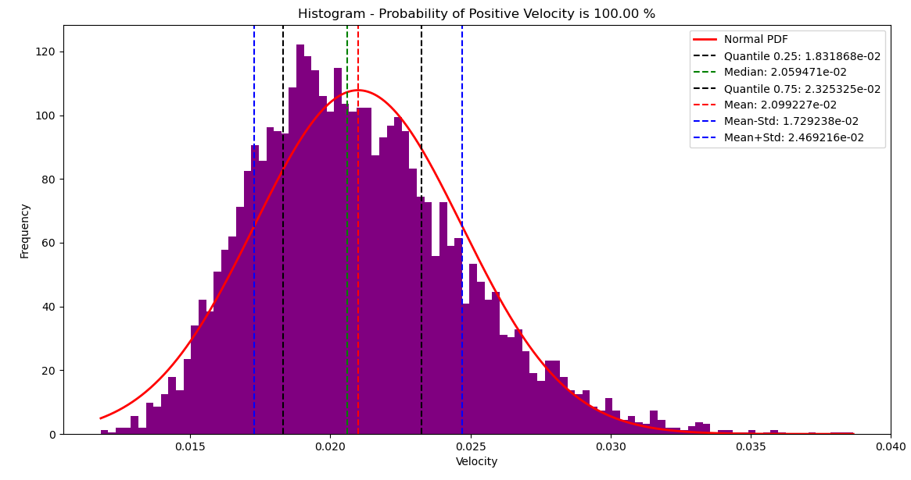

Slide 15
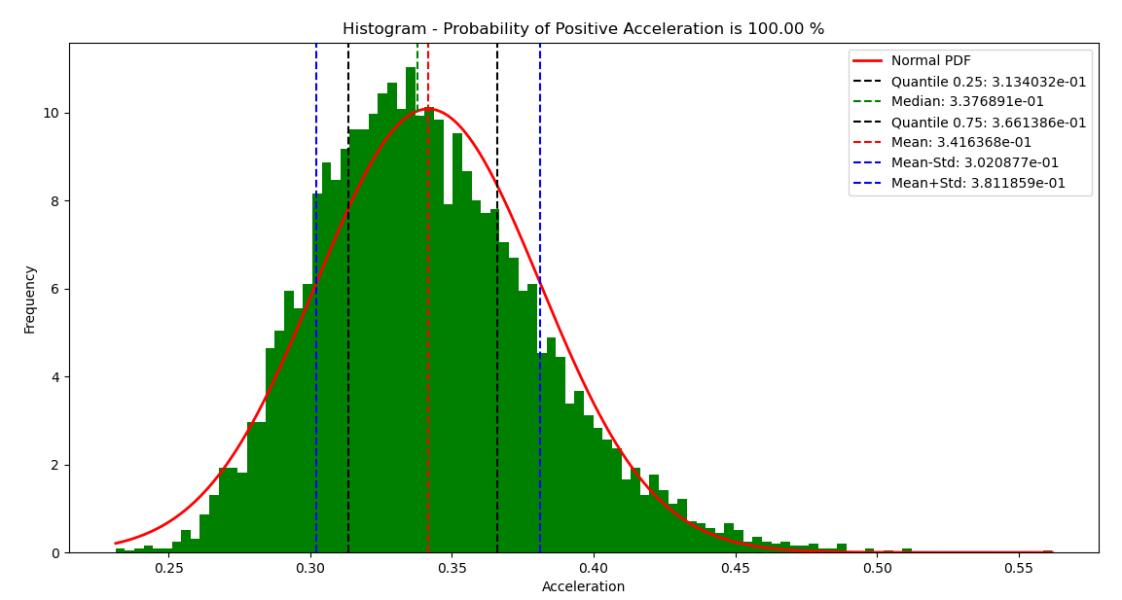

Slide 16
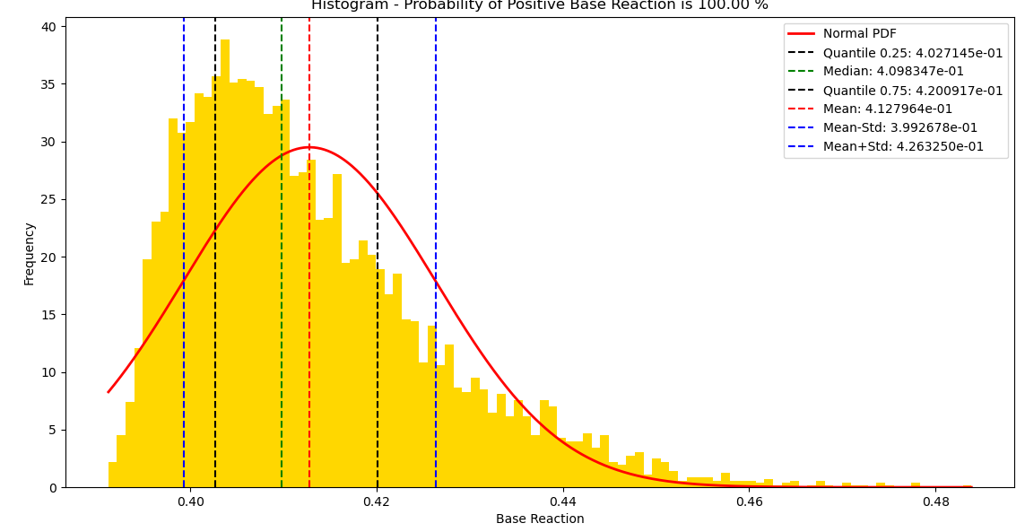

Slide 17
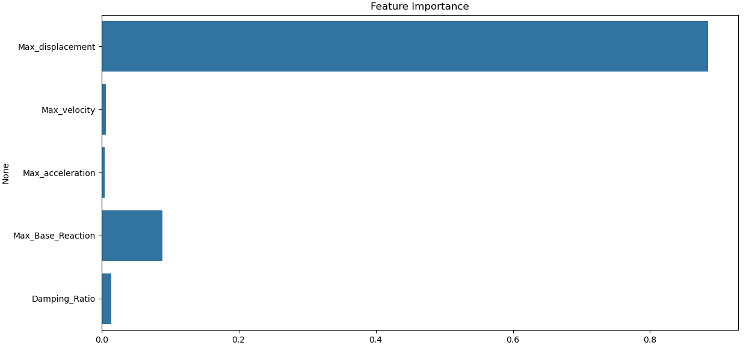

Slide 18
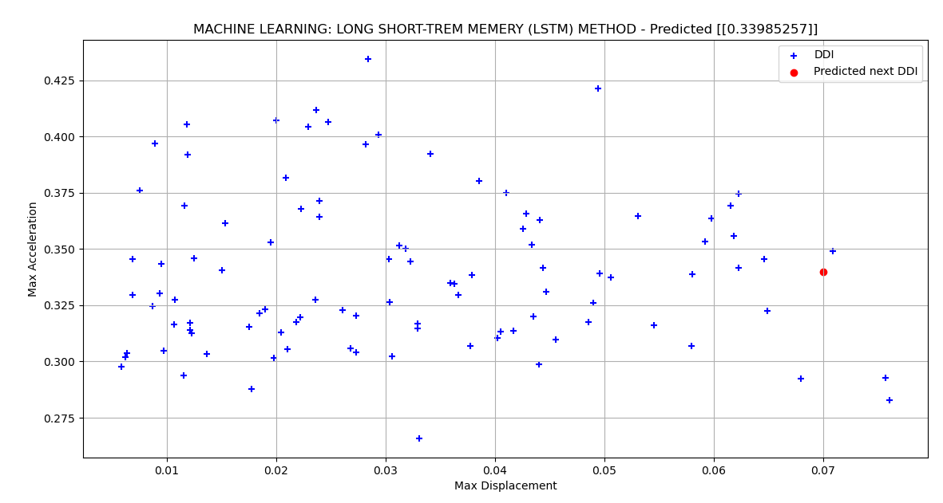

Slide 19
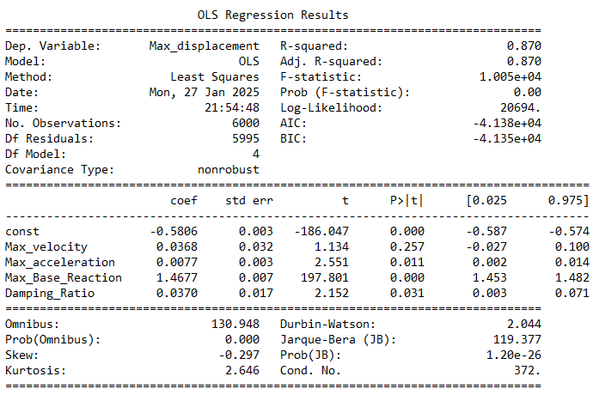

Slide 20
