Slide 1
>> IN THE NAME OF ALLAH, THE MOST GRACIOUS, THE MOST MERCIFUL <<
NONLINEAR DYNAMIC ANALYSIS OF A MULTI-DEGREE-OF-FREEDOM (MDOF) SOIL STRUCTURE SYSTEM UTILIZING 50 GROUND MOTIONS IN OPENSEES AND EVALUATION OF SEISMIC RESPONSE SPECTRUM
WRITTEN BY SALAR DELAVAR GHASHGHAEI (QASHQAI)

Slide 2
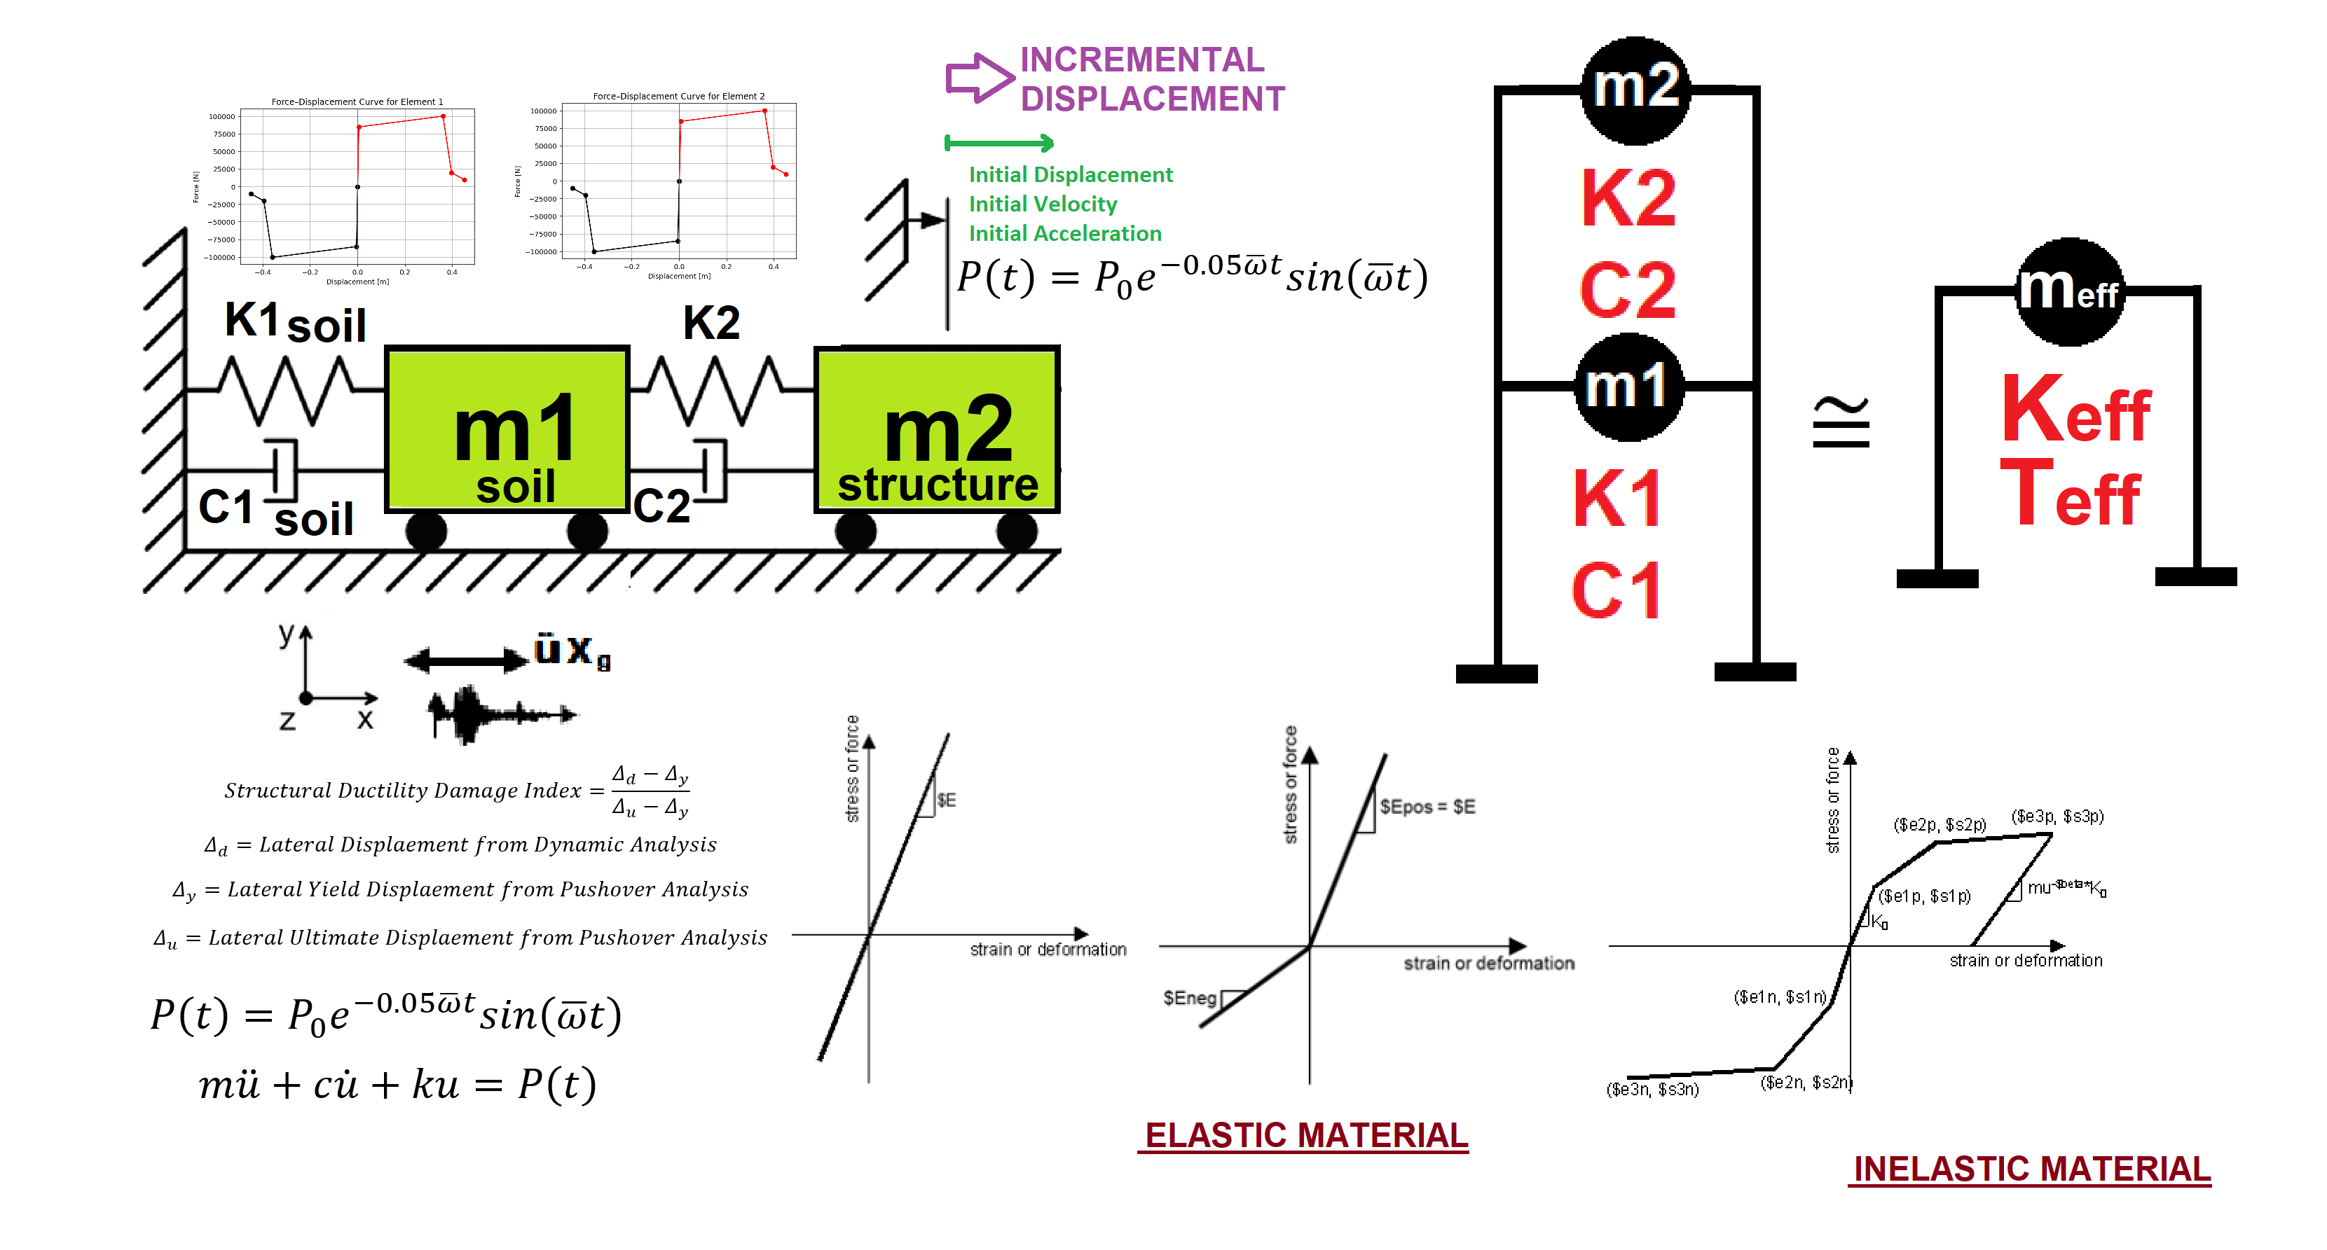

Slide 3


Slide 4
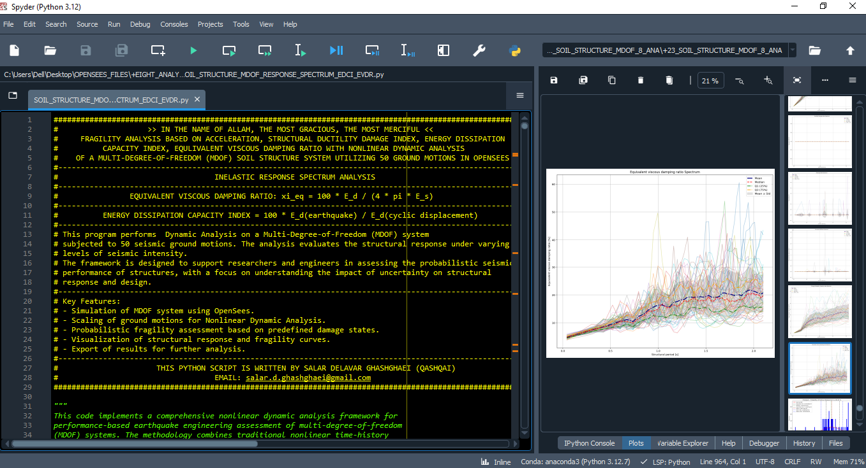

Slide 5
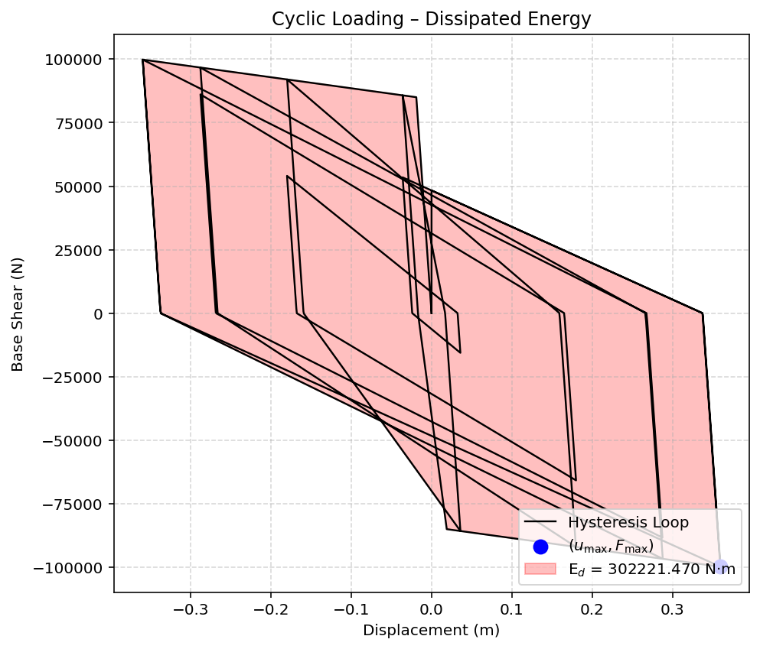

Slide 6
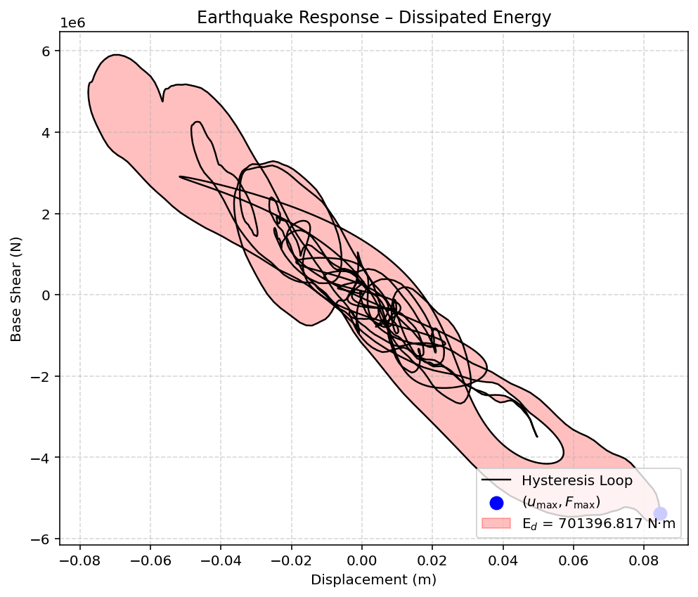

Slide 7
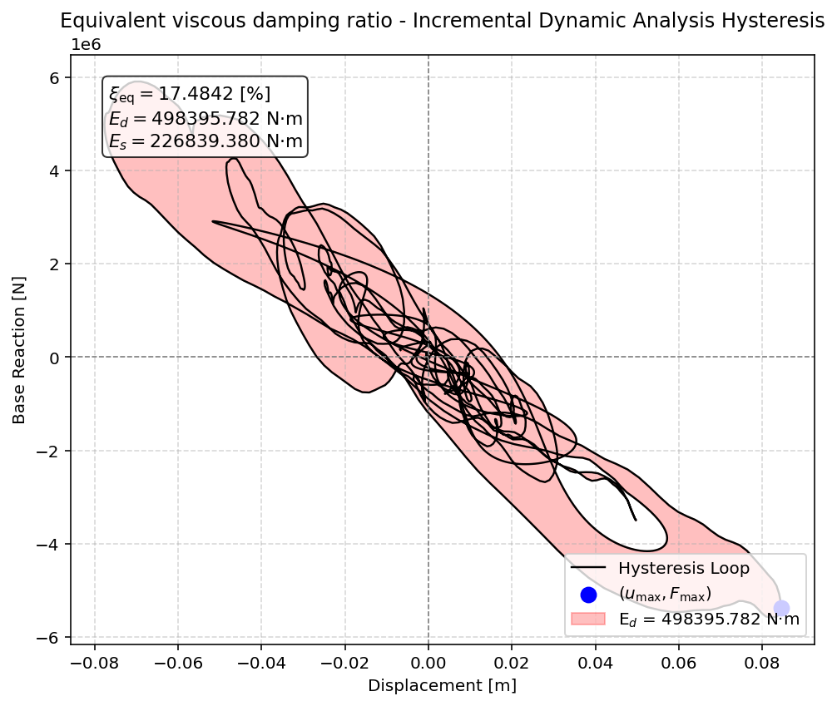

Slide 8
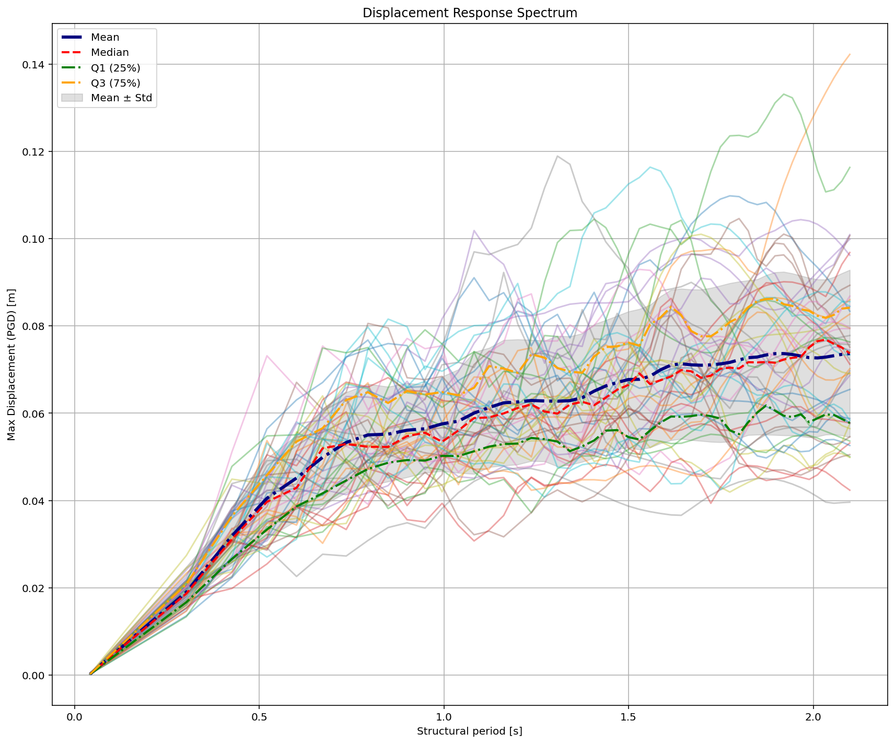

Slide 9
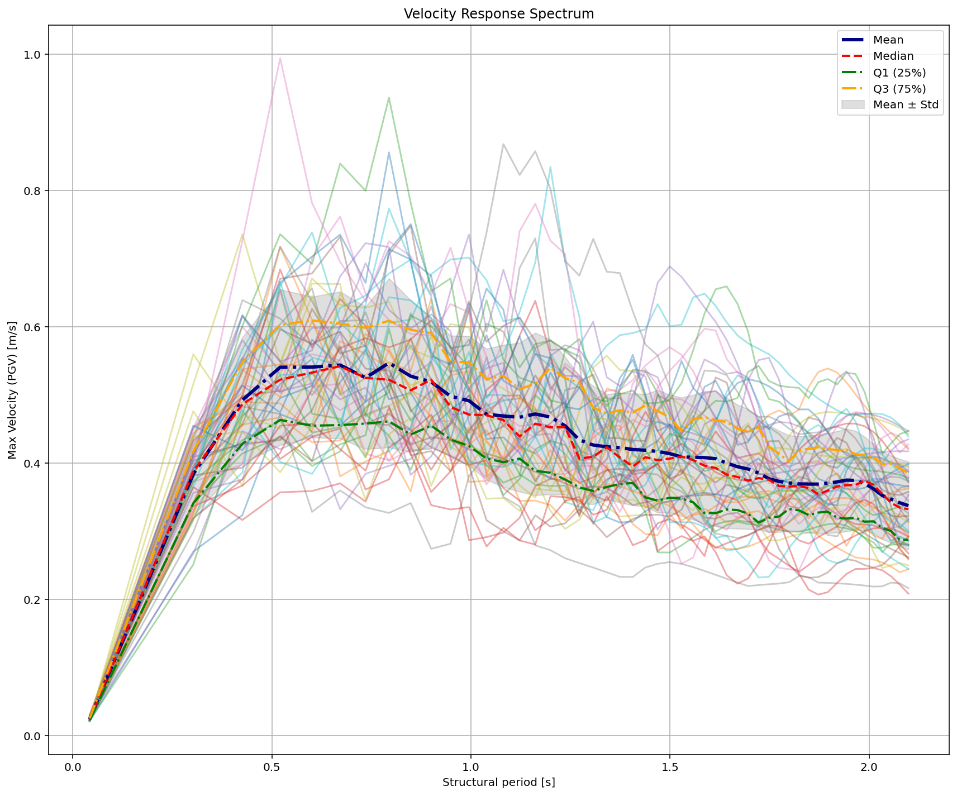

Slide 10
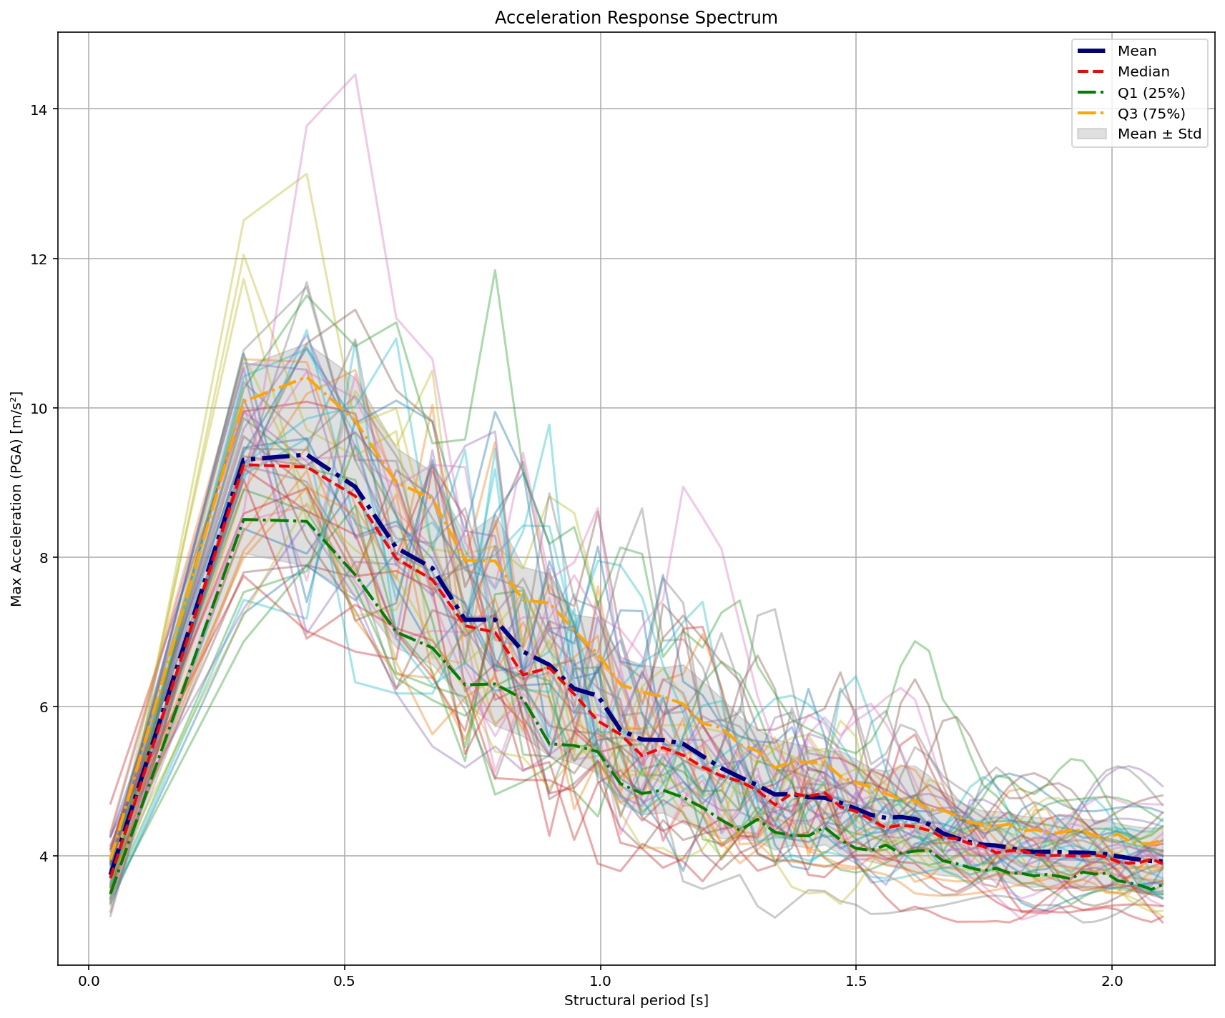

Slide 11
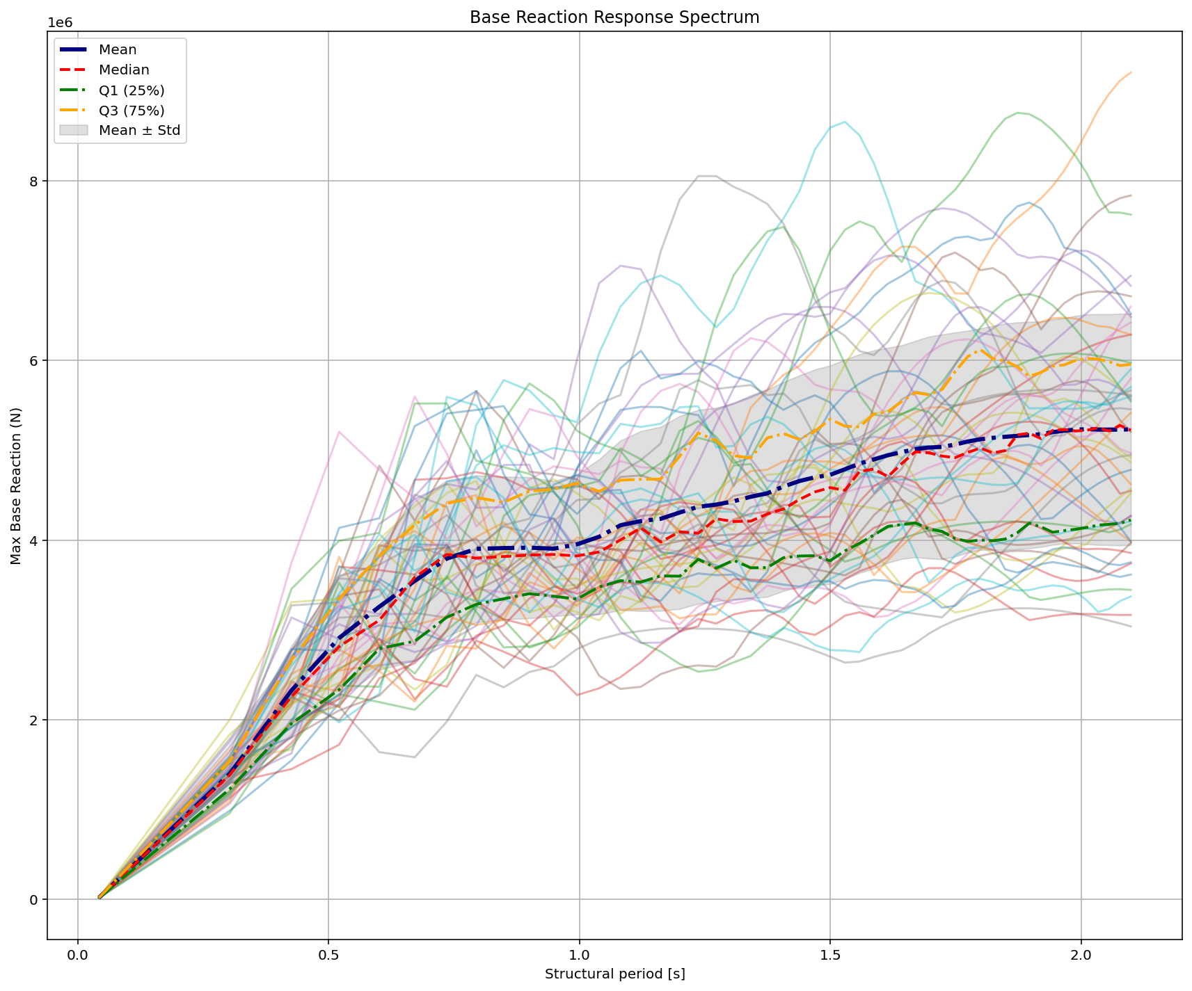

Slide 12
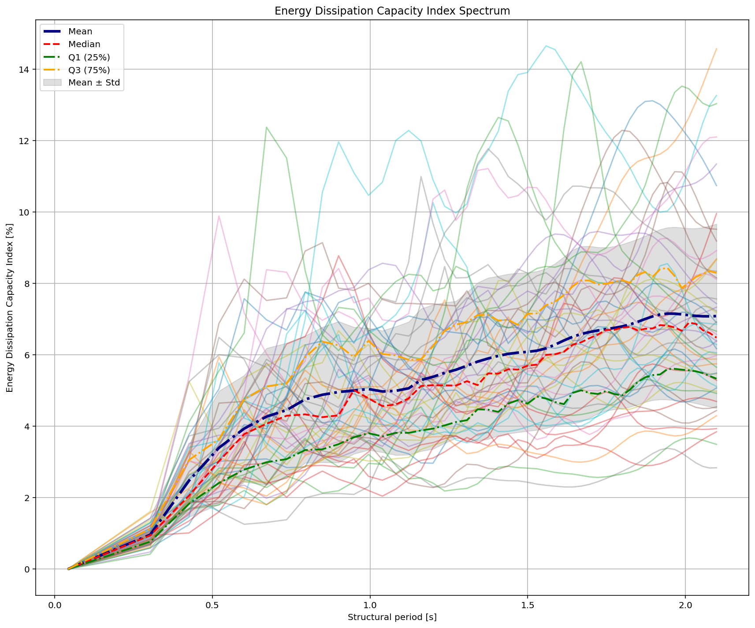


Slide 13
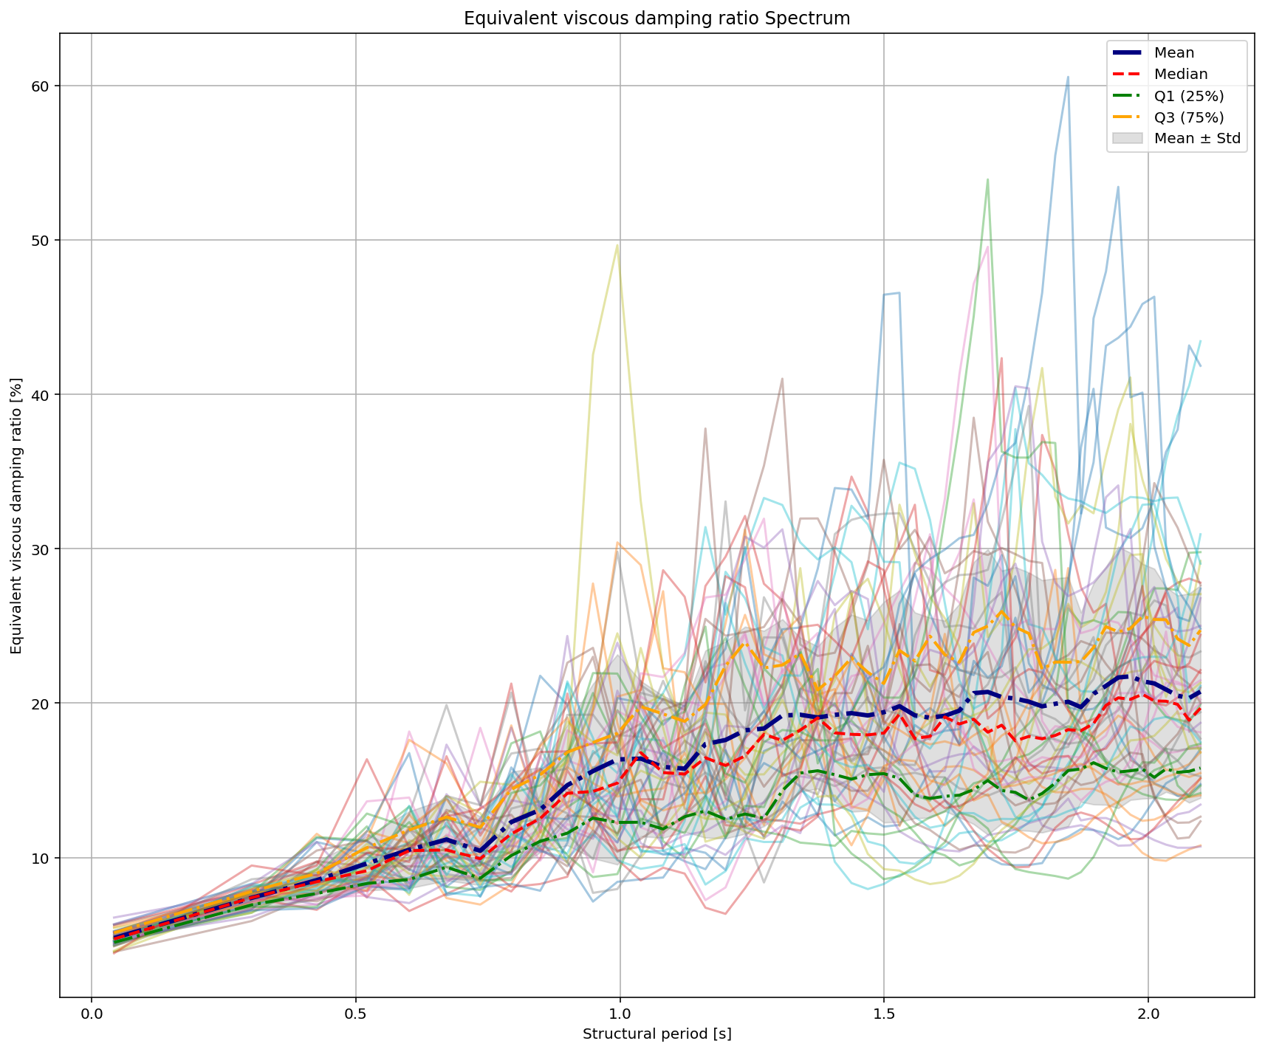

Slide 14
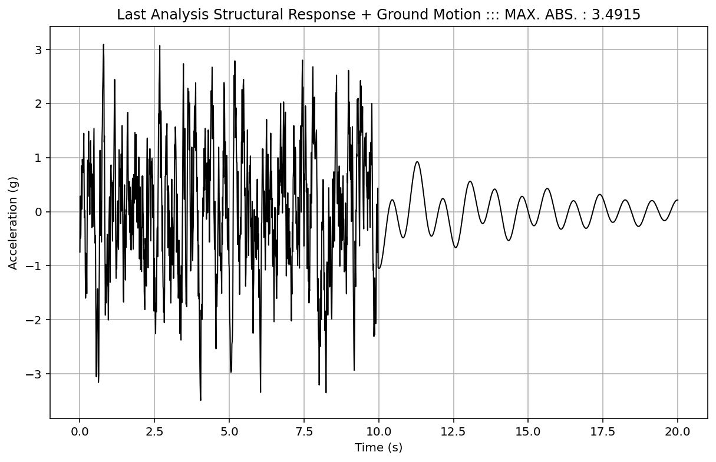

Slide 15
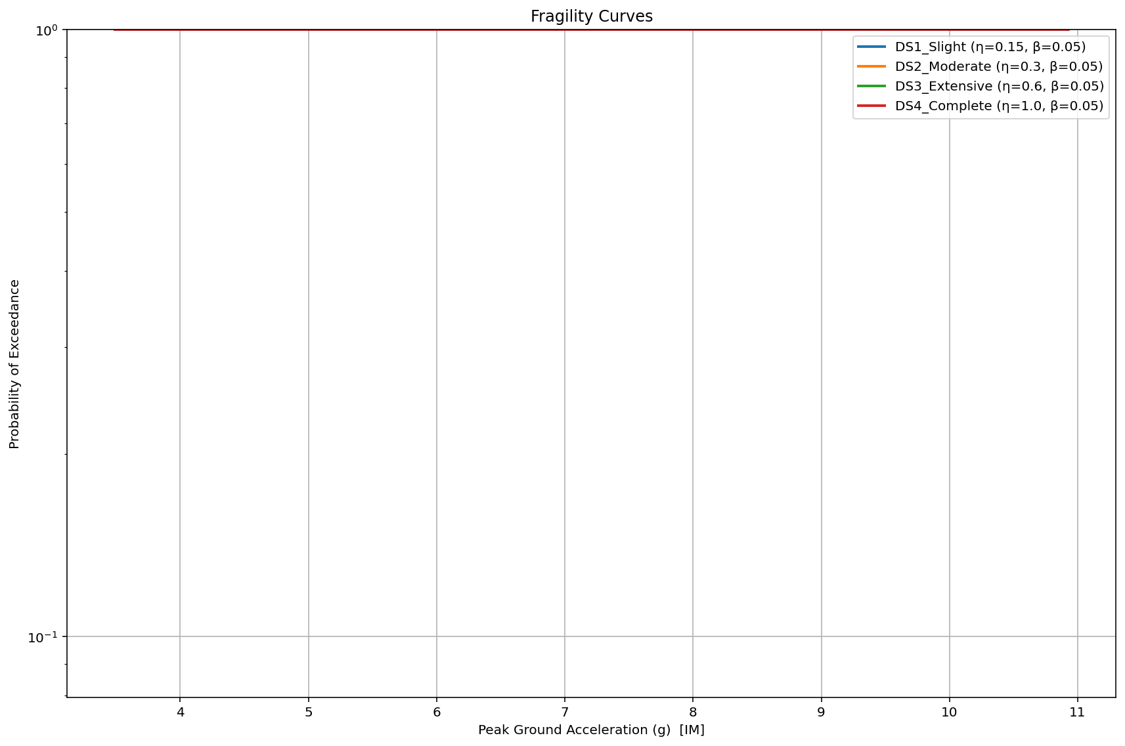

Slide 16
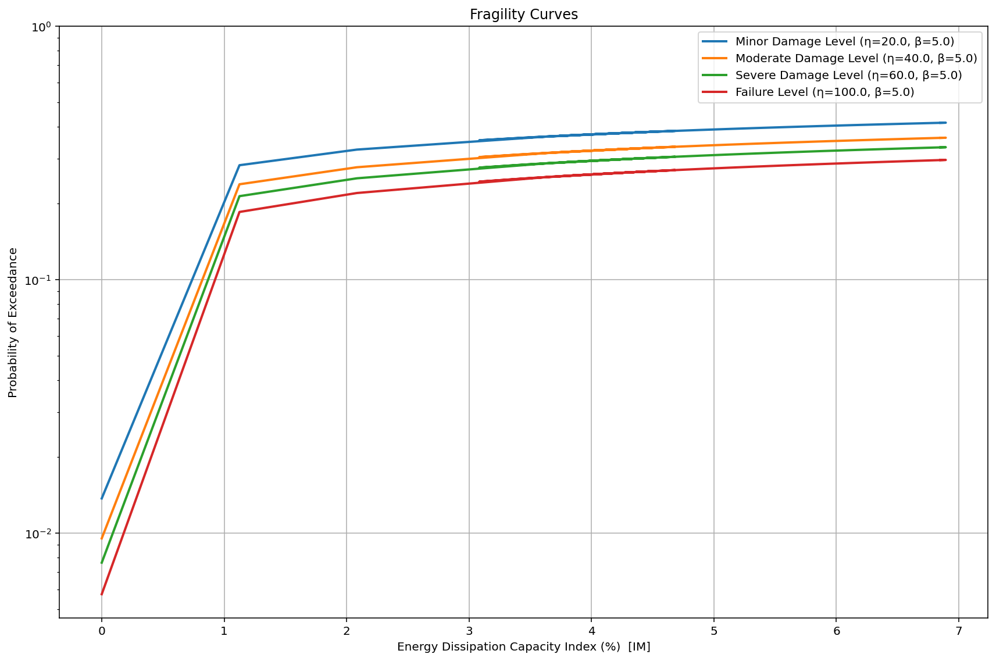

Slide 17
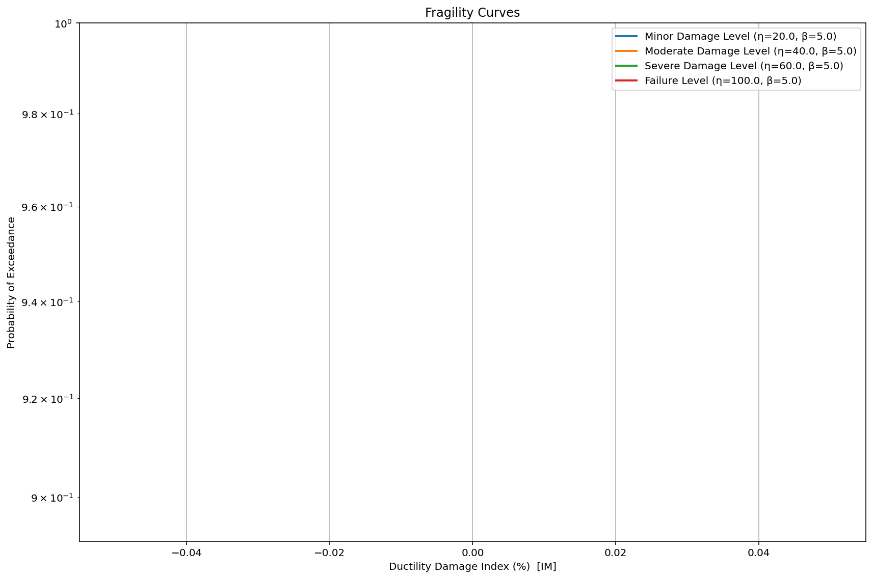

Slide 18
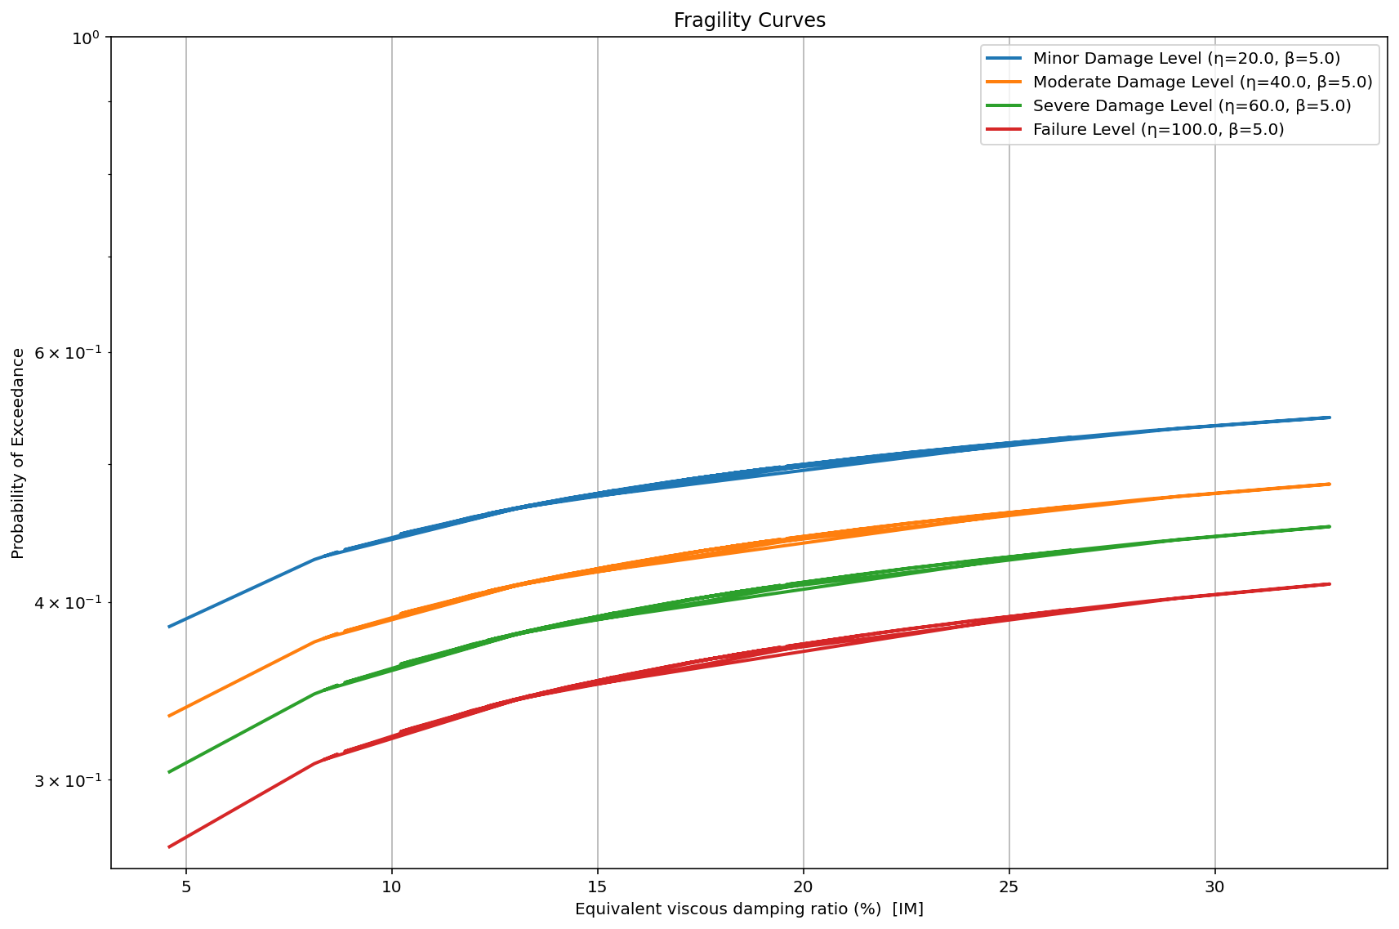


Slide 19
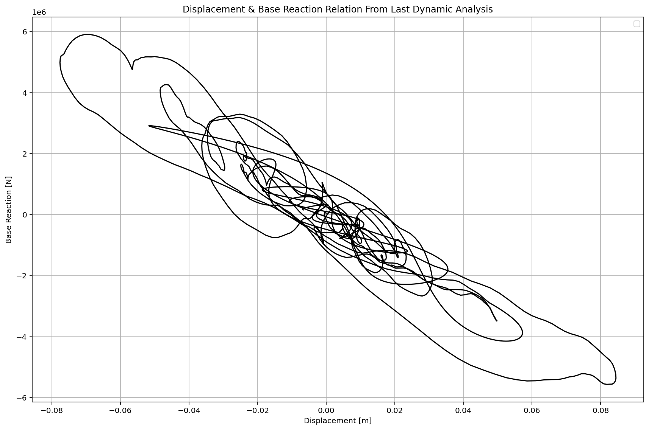

Slide 20
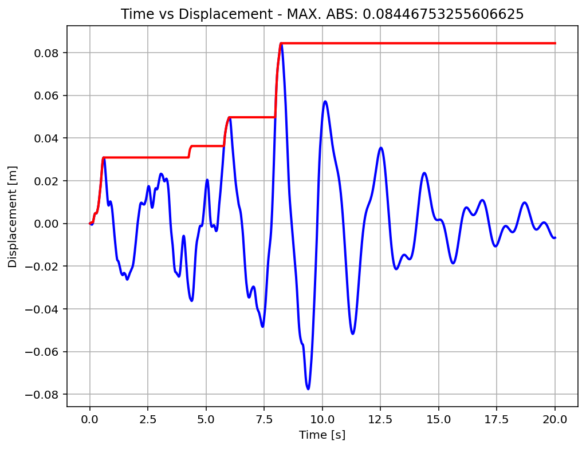

Slide 21
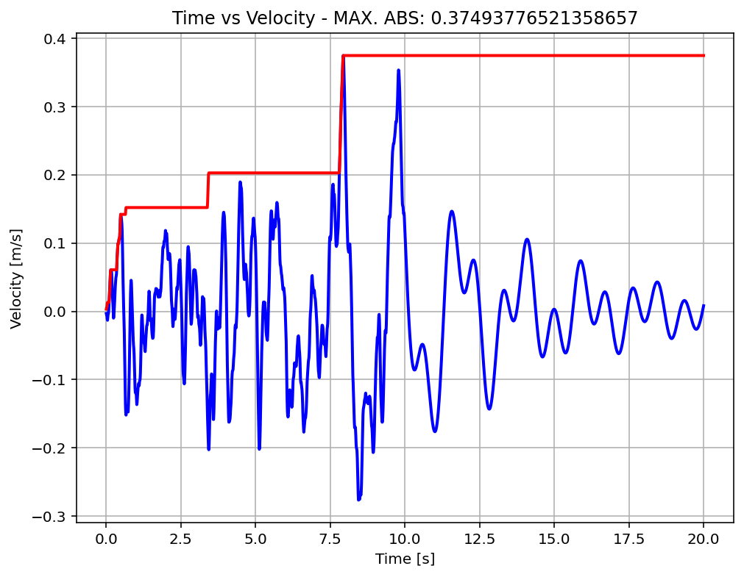

Slide 22
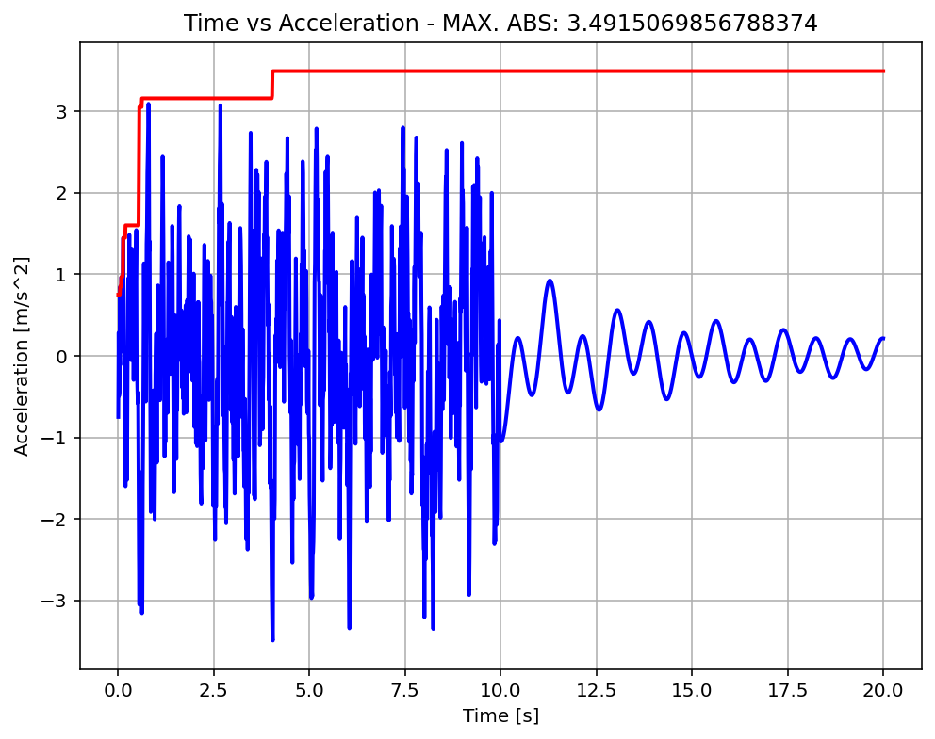

Slide 23
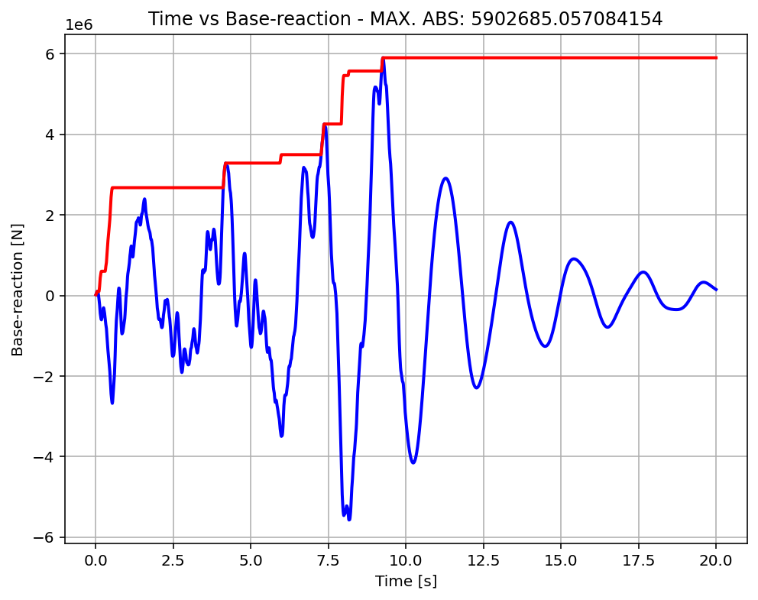

Slide 24
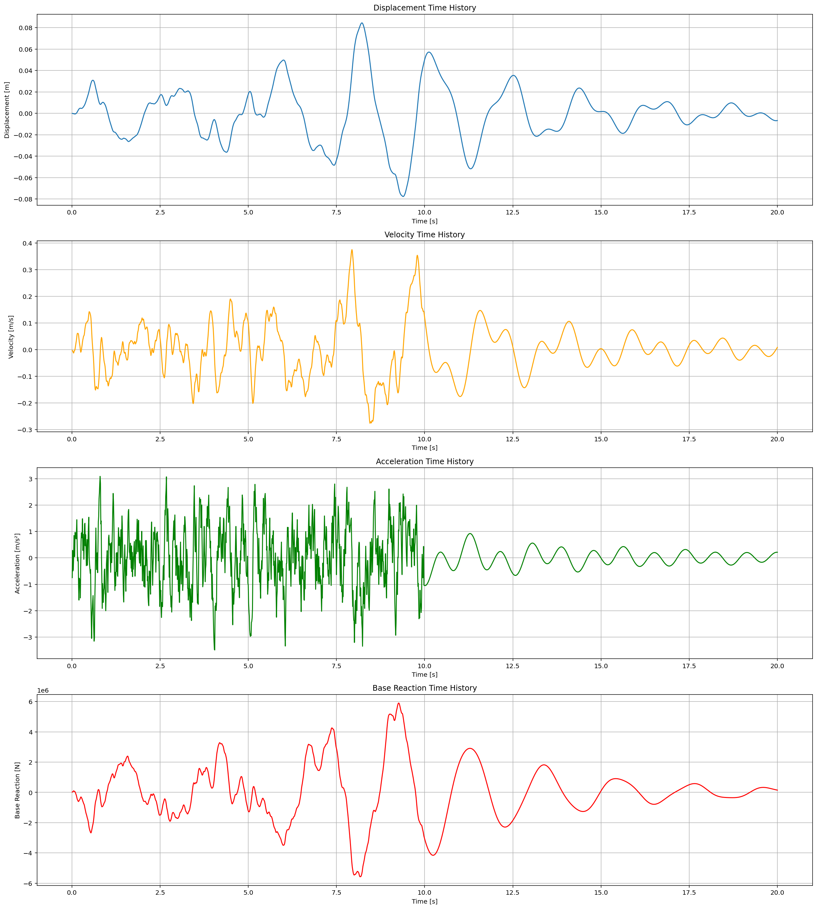

Slide 25
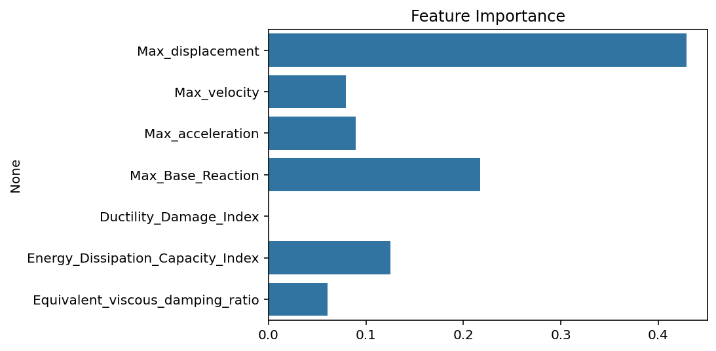

Slide 26
