Slide 1
IN THE NAME OF ALLAH
ASSESSMENT OF STRUCTURAL DUCTILITY DAMAGE INDEX IN CONCRETE FRAMES CONSIDERING SOIL-FOUNDATION-STRUCTURE INTERACTION USING OPENSEES.
SOIL-FOUNDATION INTERACTIONS SIMULATED WITH SIMPLE SPRINGS.
SOIL SPRINGS VALUES IS NOT EXACT.
WRITTEN BY SALAR DELAVAR GHASHGHAEI (QASHQAI)

Slide 2
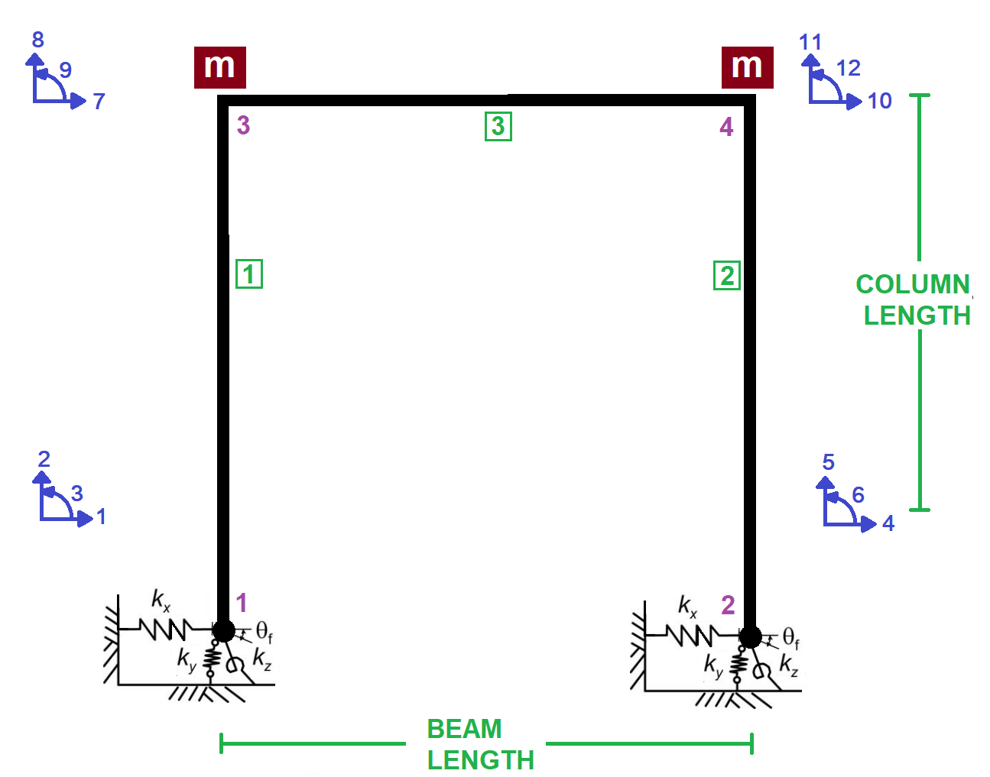

Slide 3
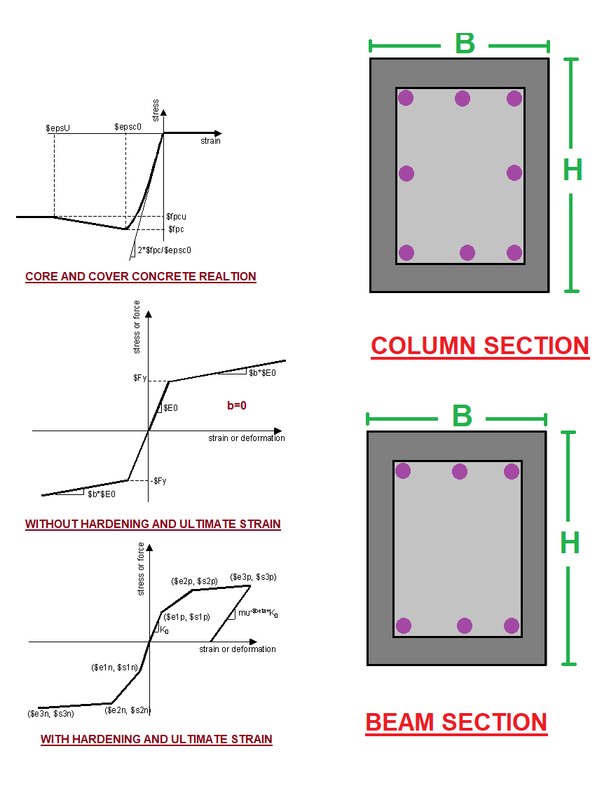

Slide 4
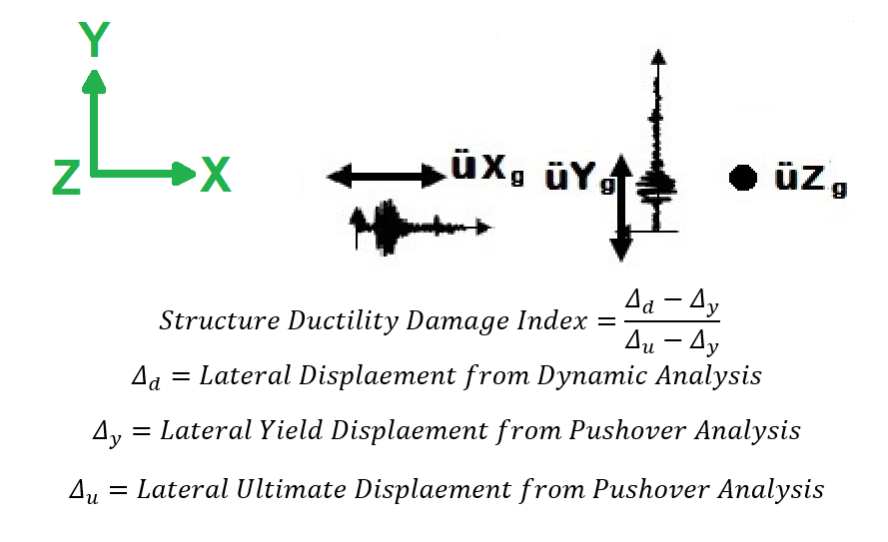

Slide 5
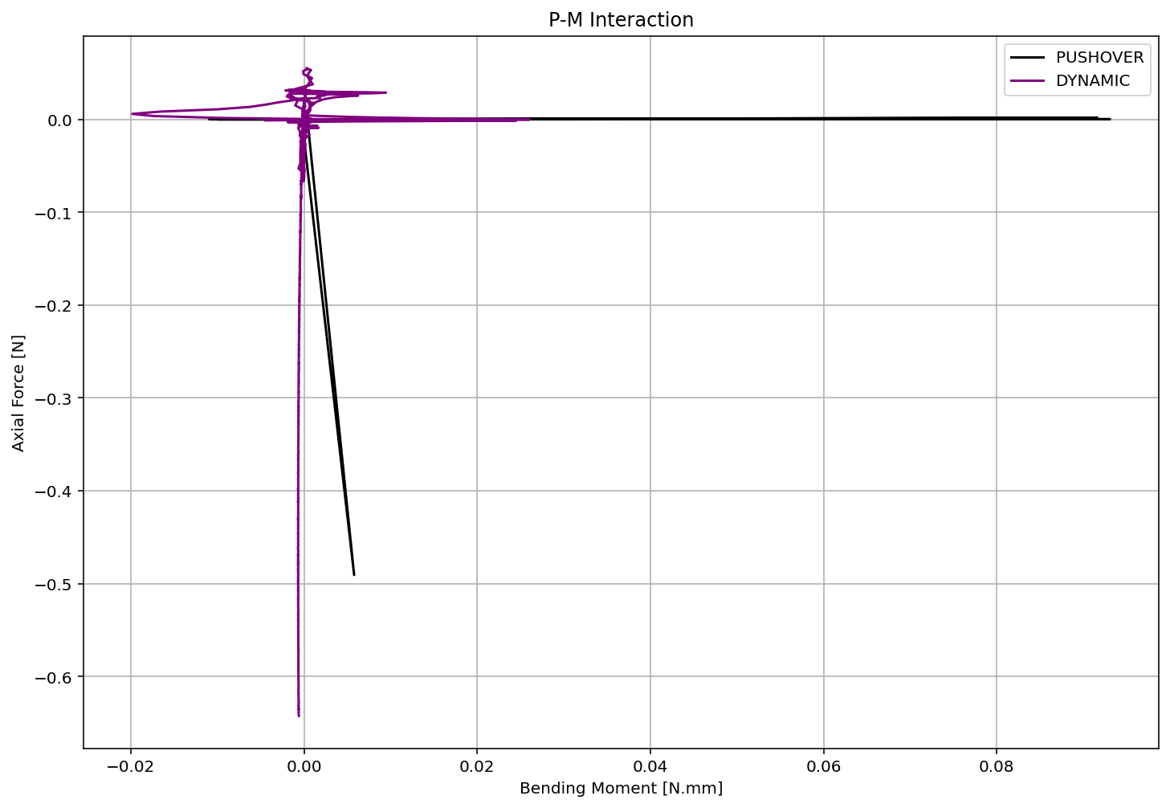

Slide 6
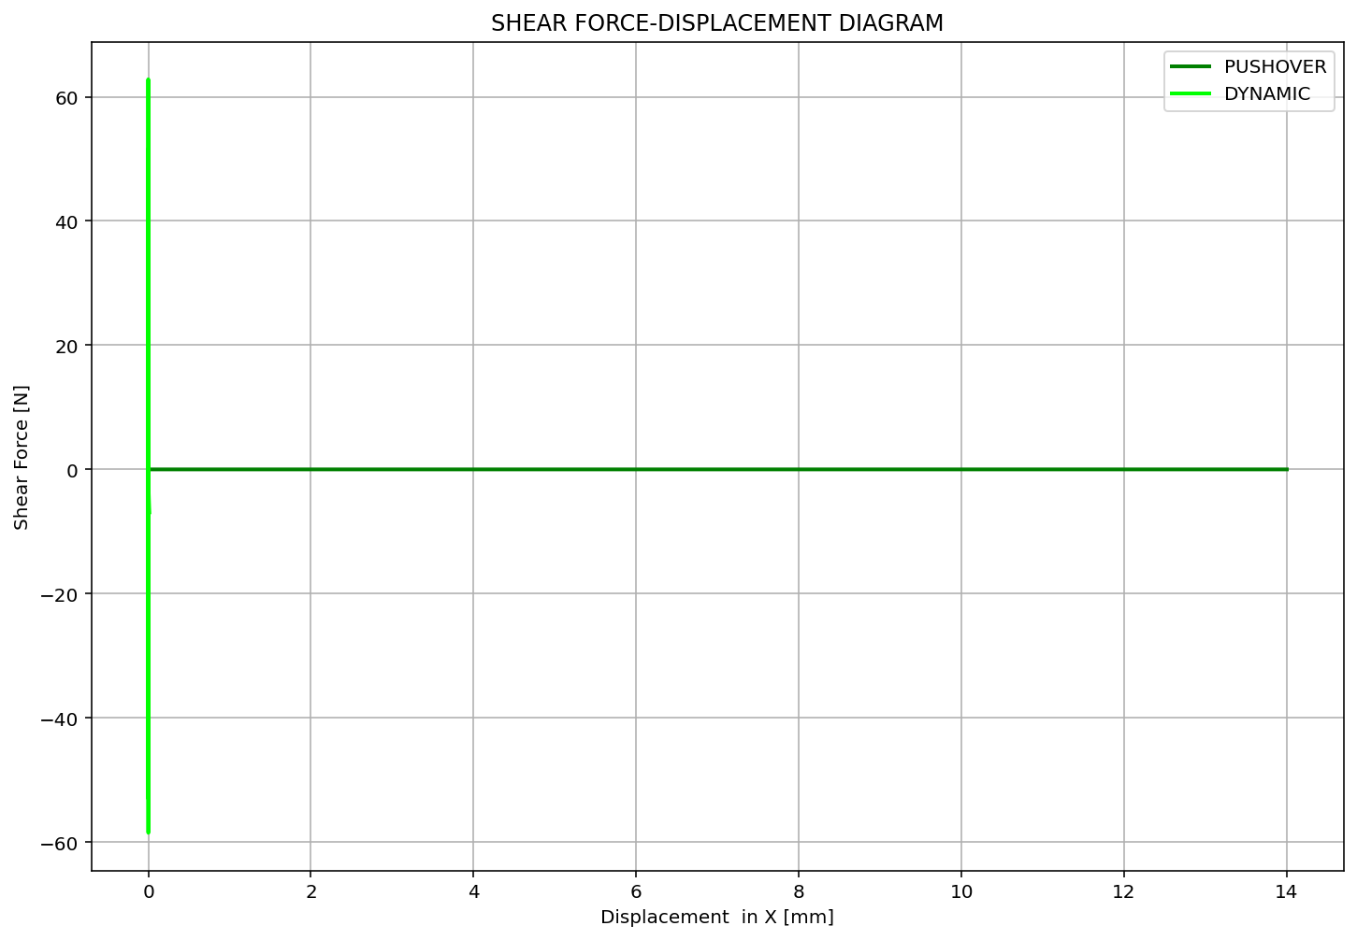

Slide 7
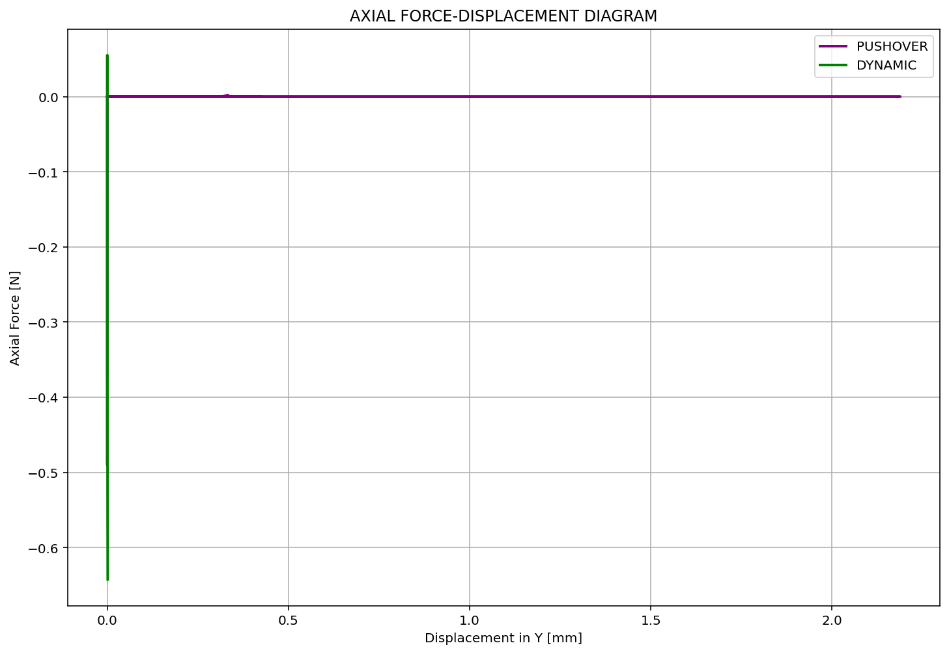

Slide 8
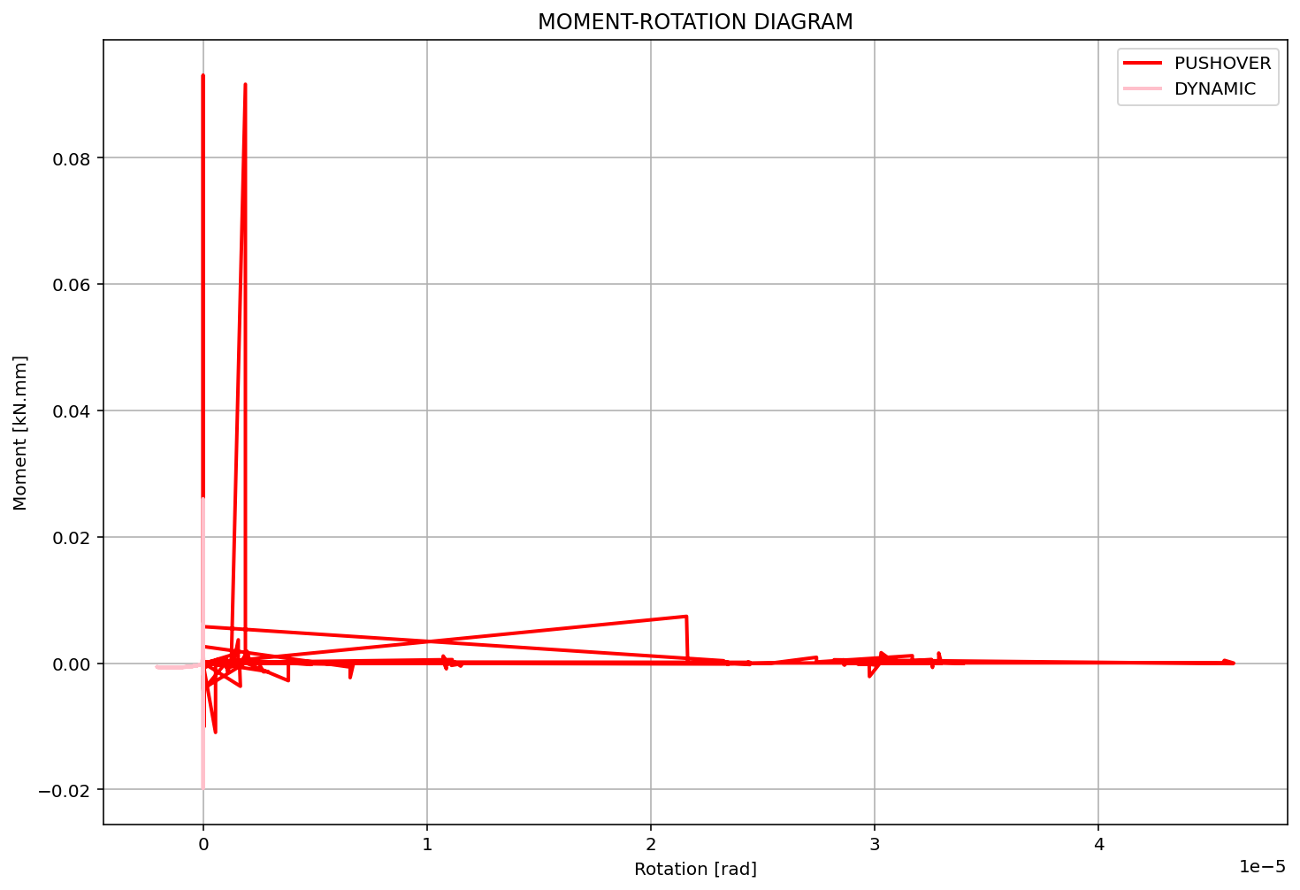

Slide 9
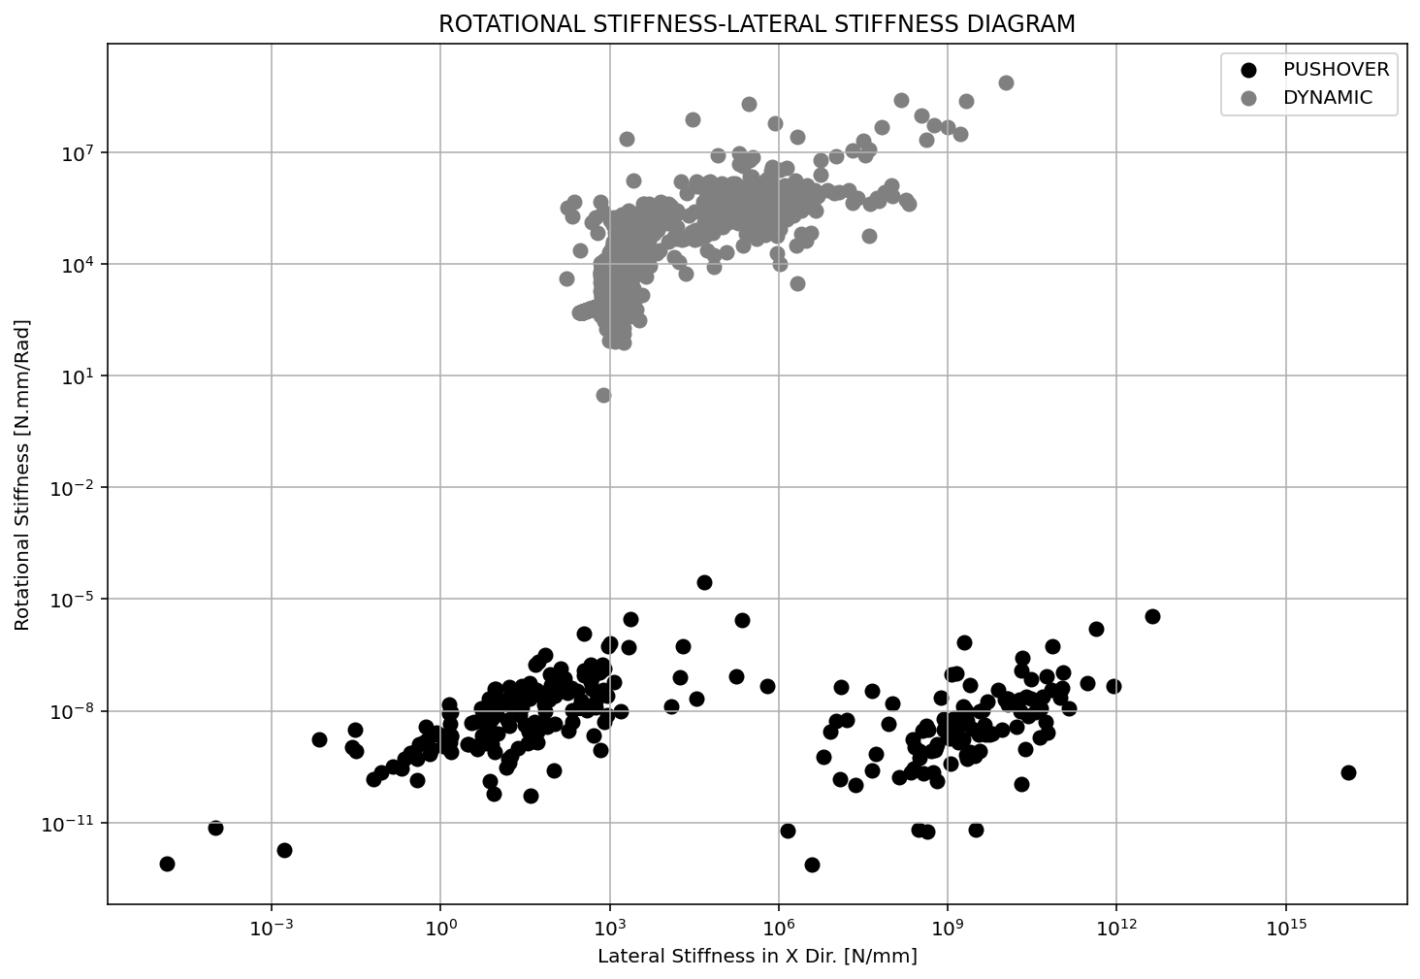

Slide 10
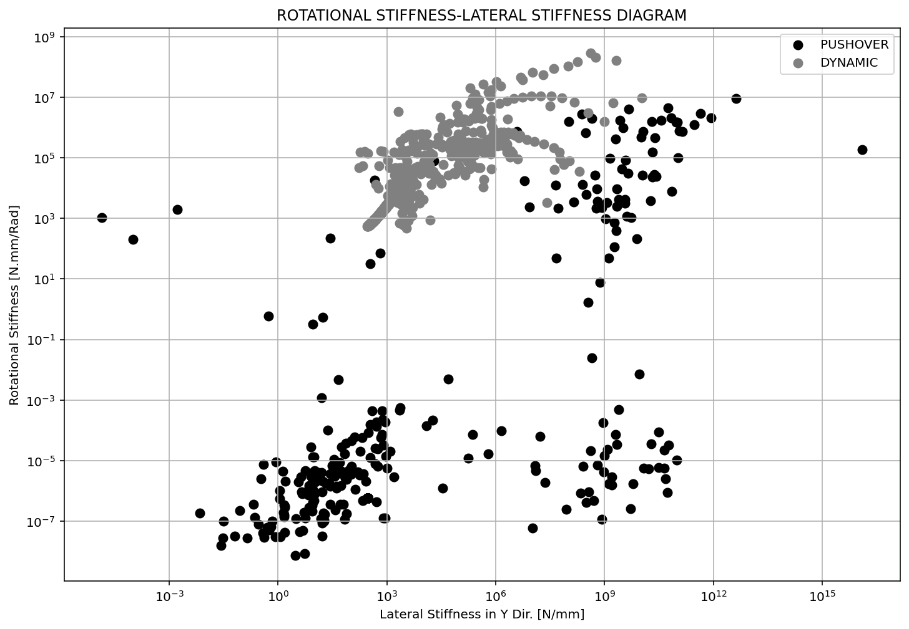

Slide 11
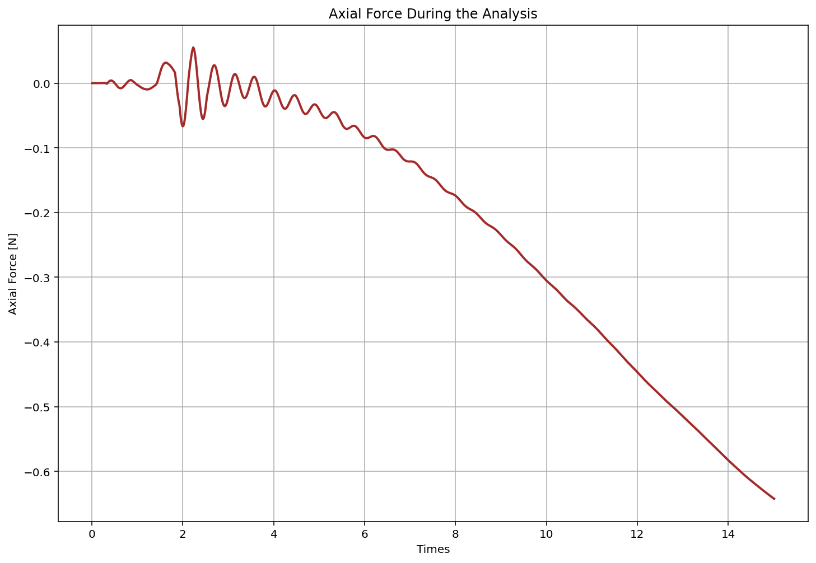

Slide 12
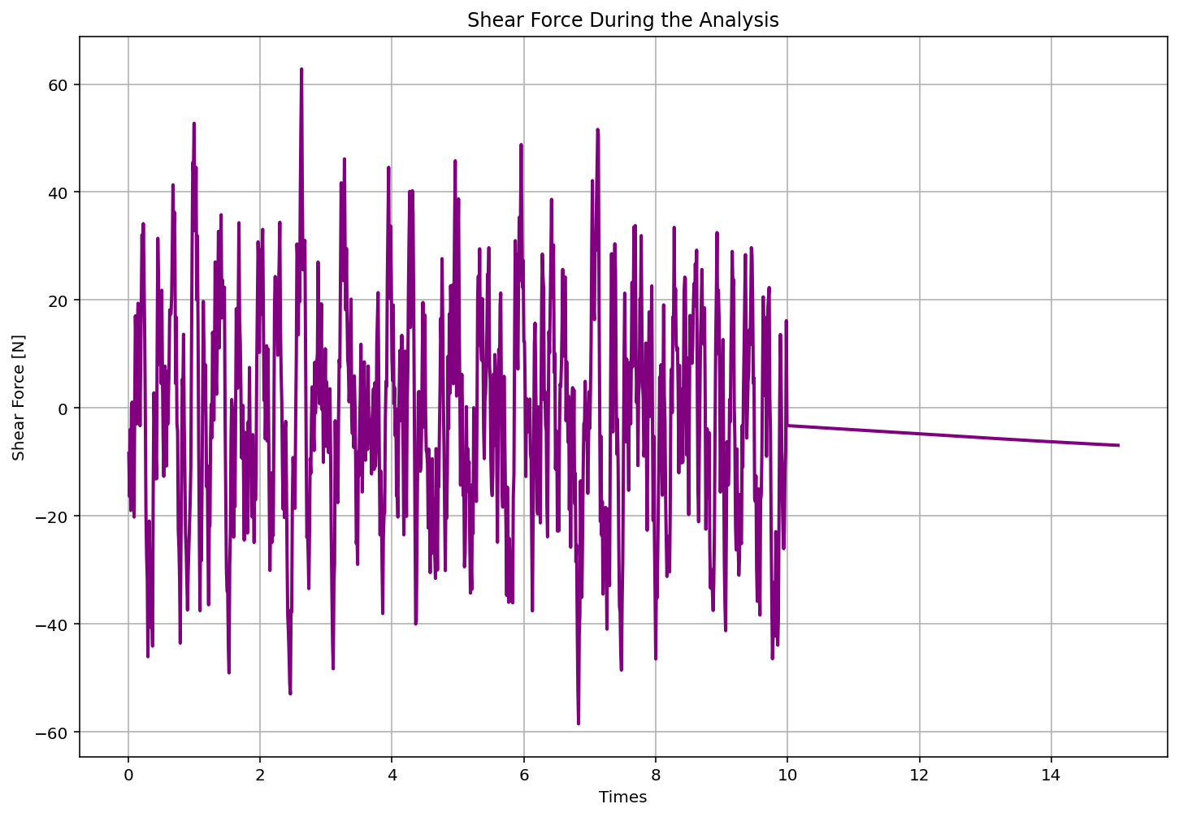

Slide 13
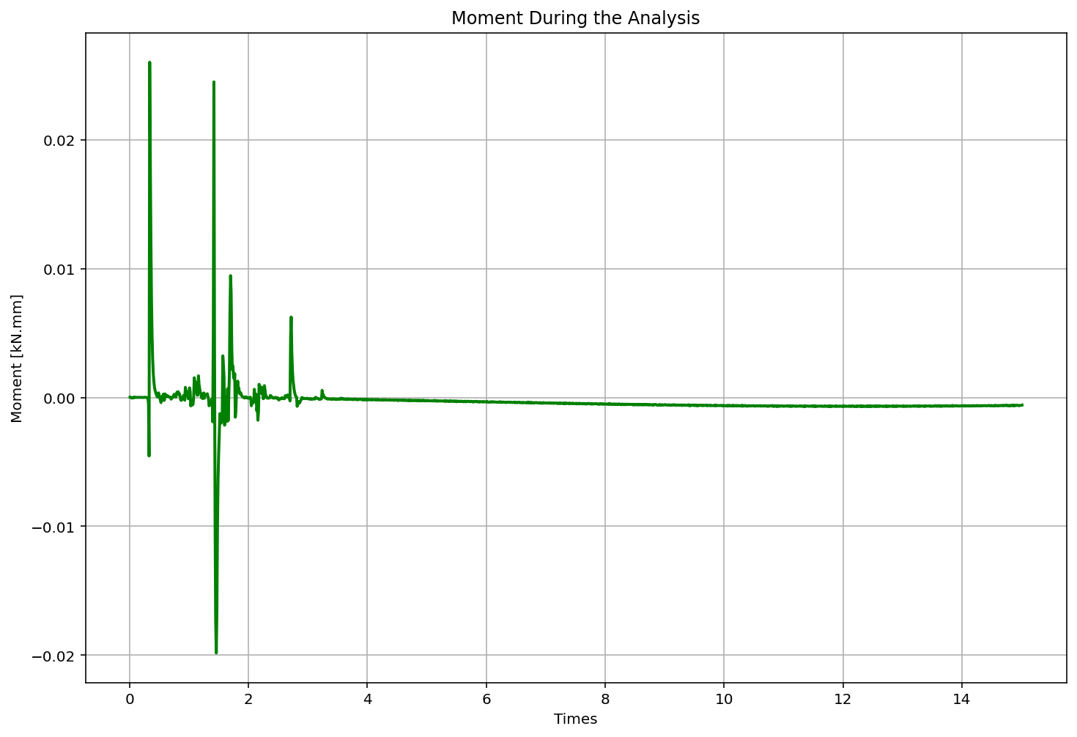

Slide 14
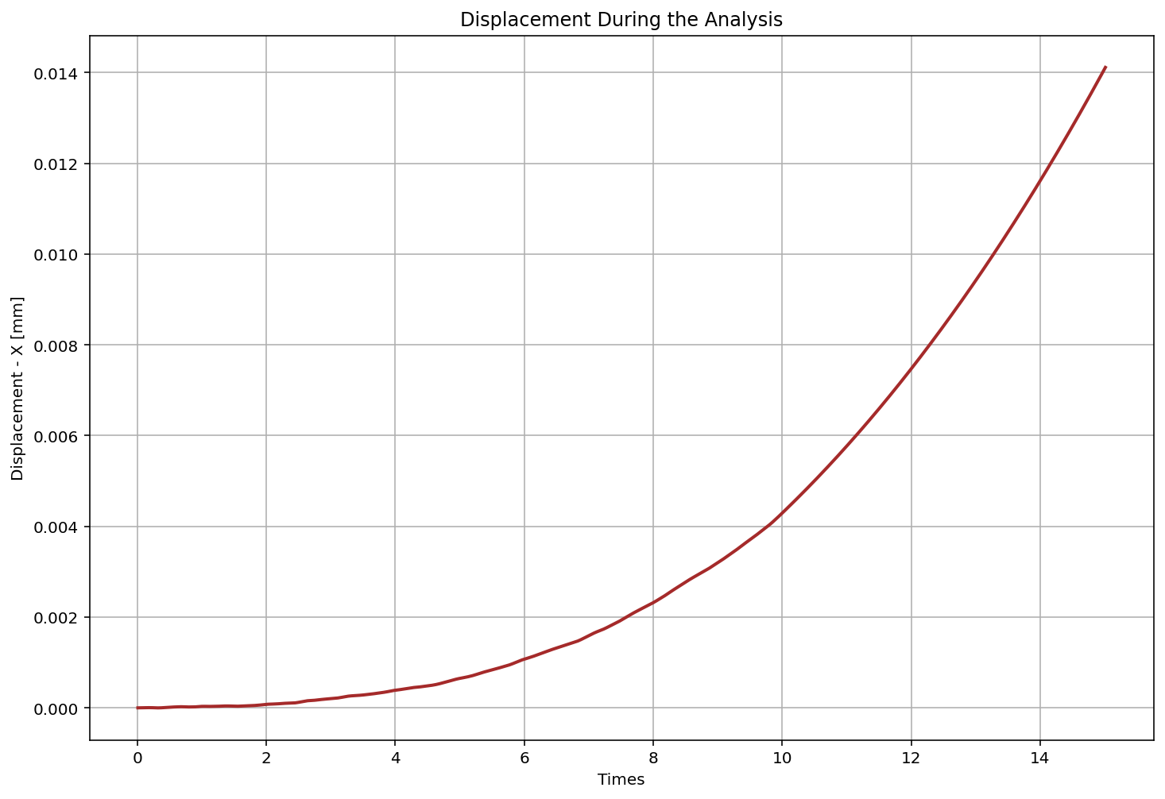

Slide 15
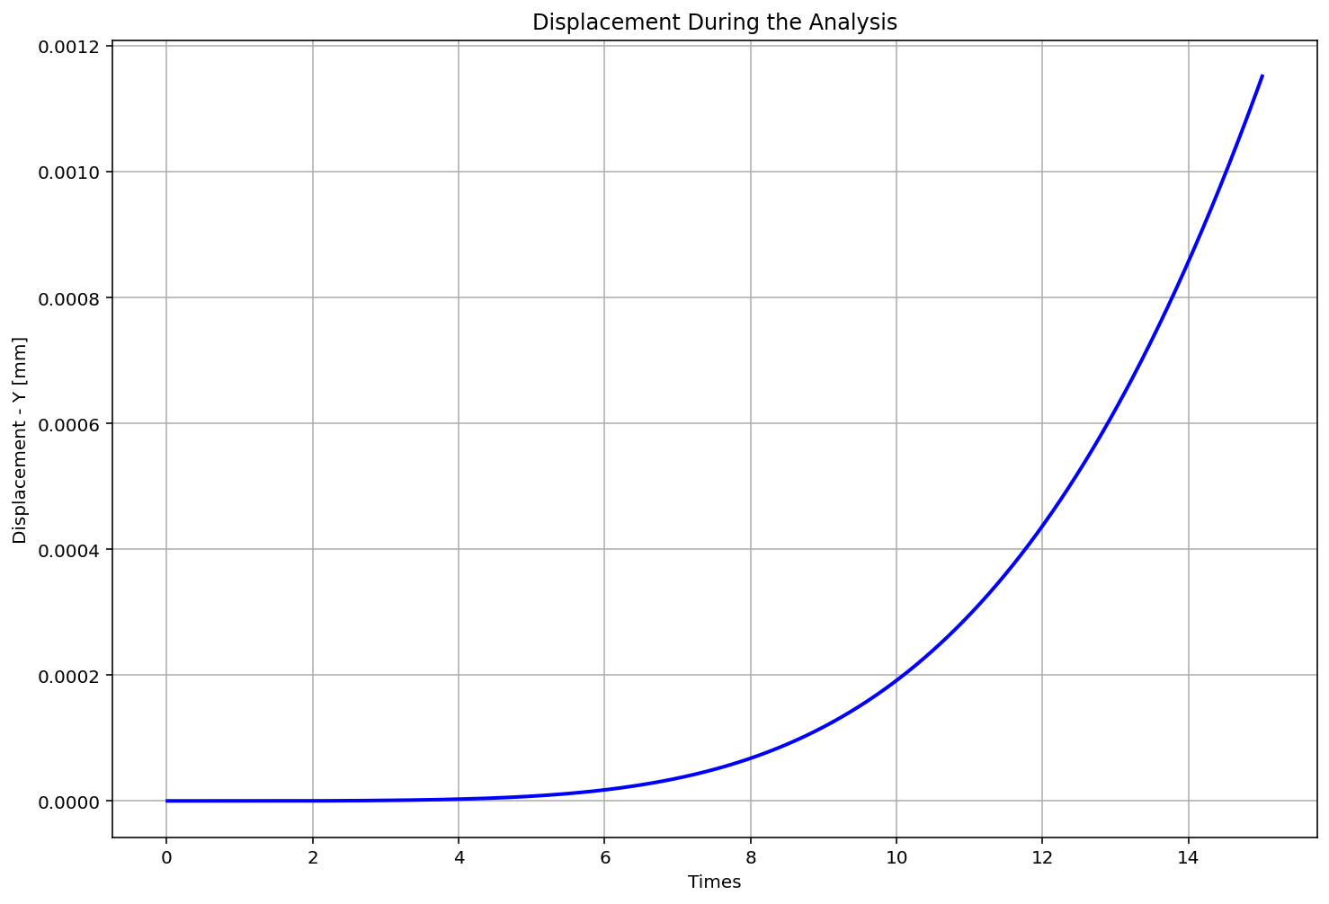

Slide 16
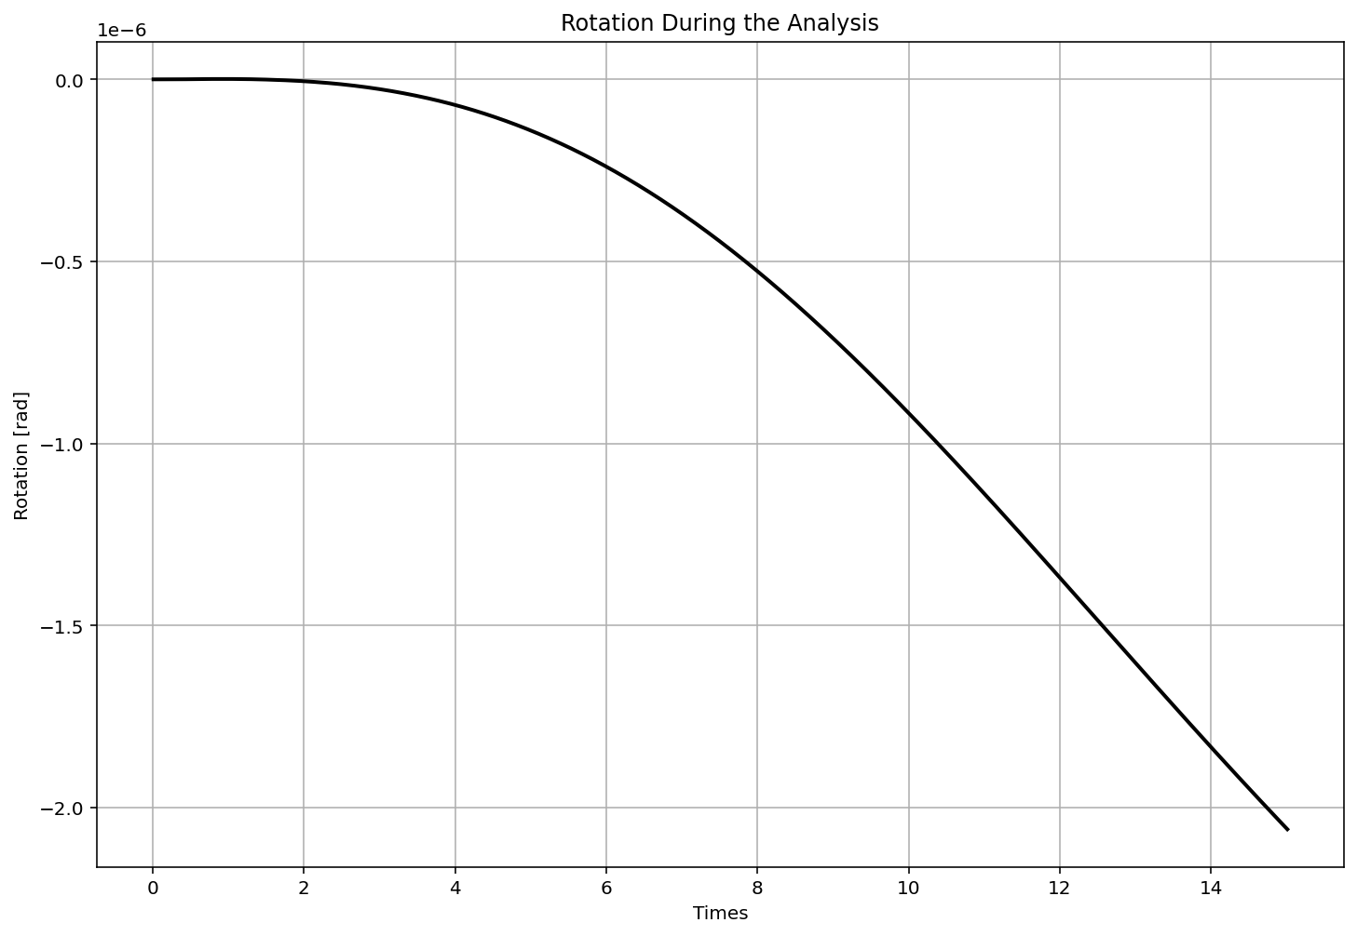

Slide 17
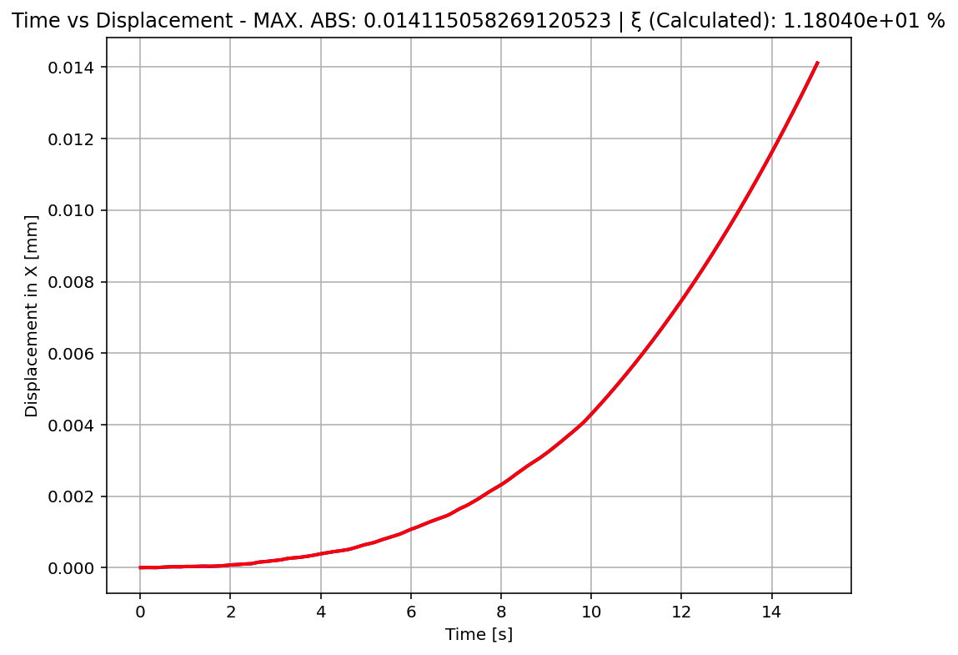

Slide 18
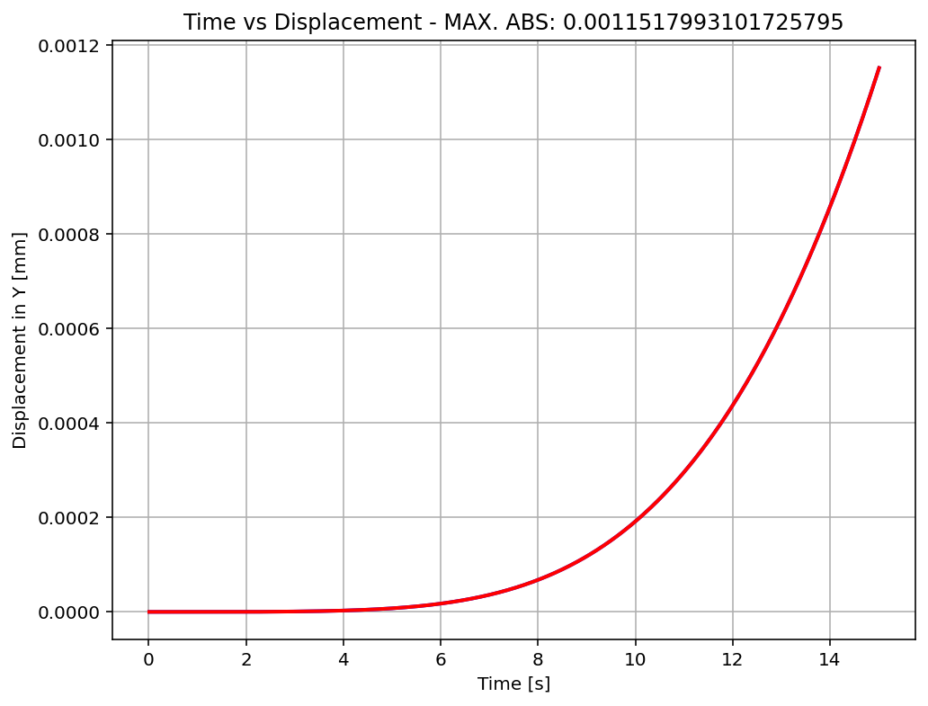

Slide 19
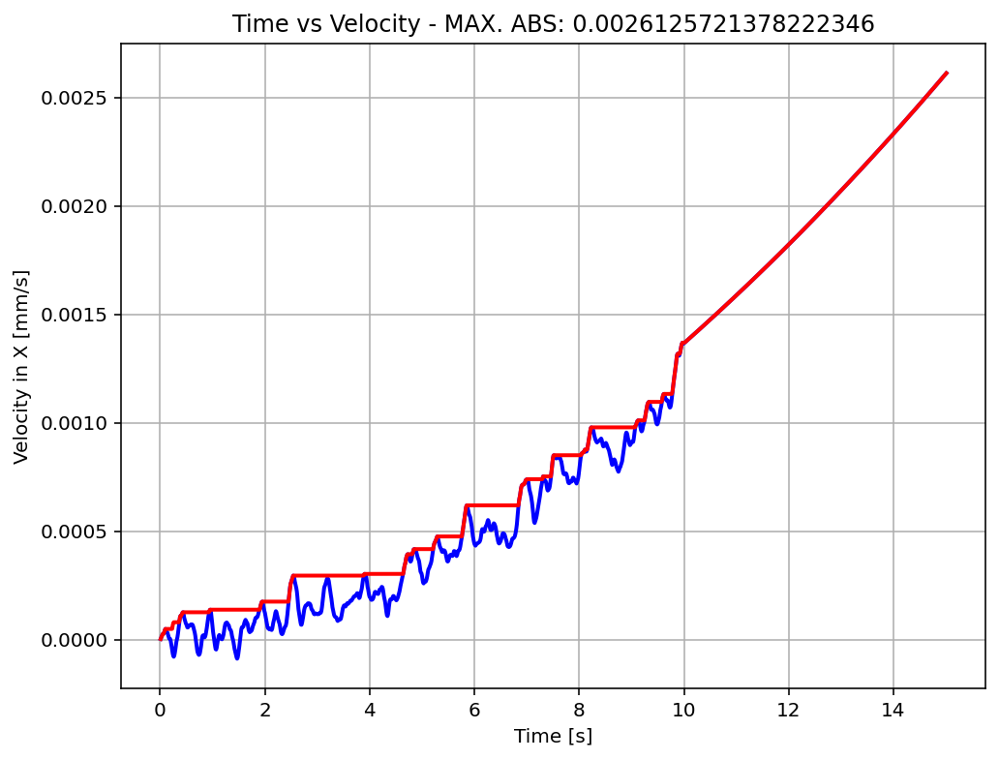

Slide 20
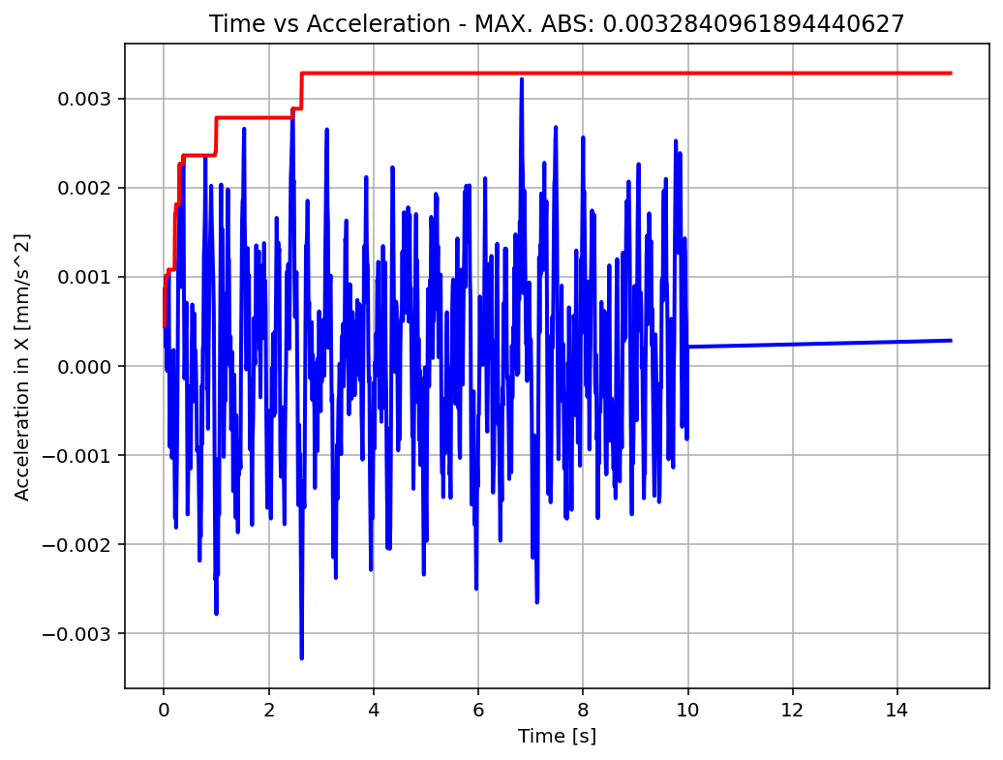

Slide 21
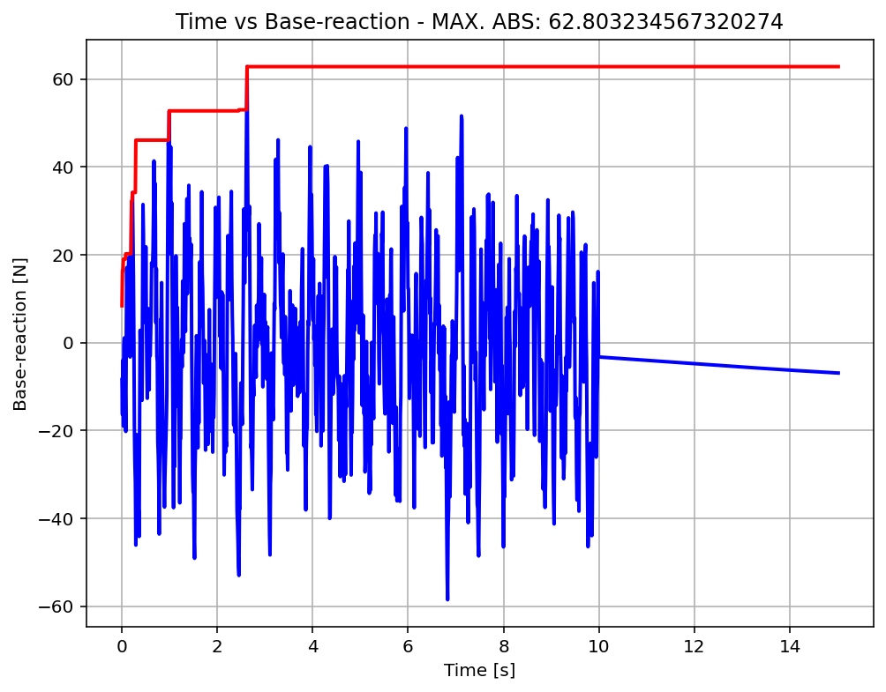

Slide 22
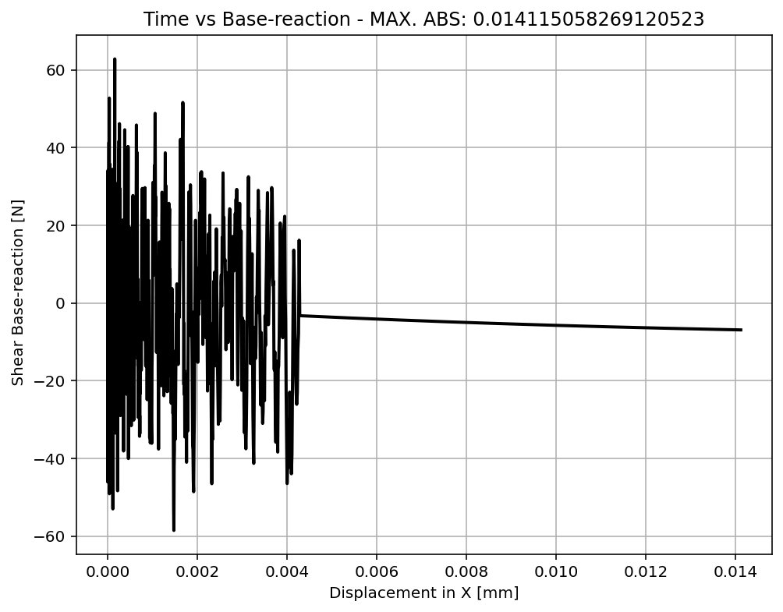

Slide 23
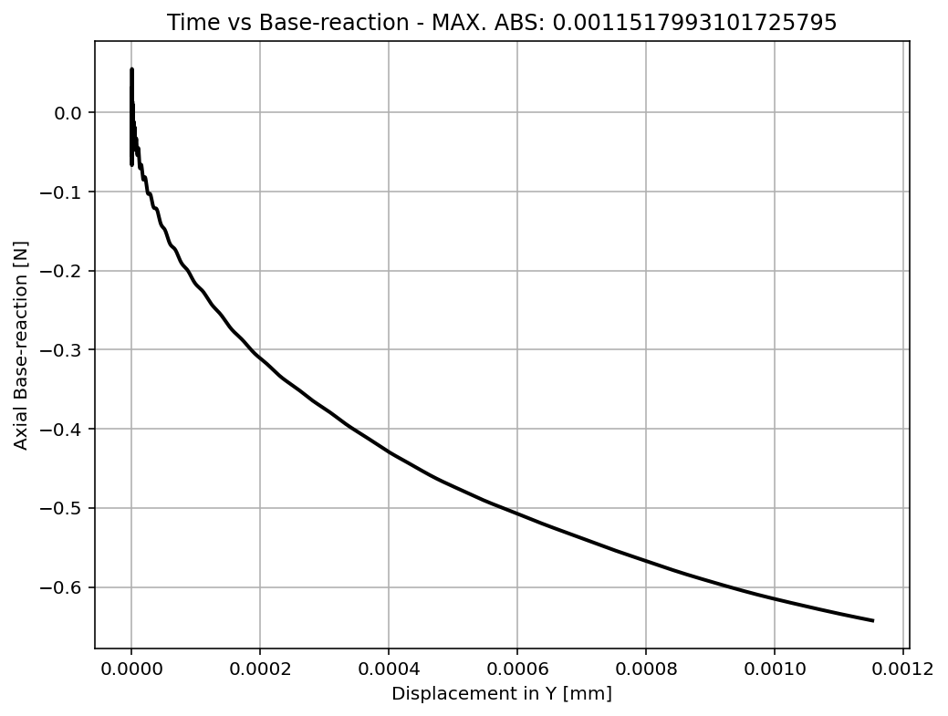

Slide 24
