Slide 1
>> IN THE NAME OF ALLAH, THE MOST GRACIOUS, THE MOST MERCIFUL <<
COMPREHENSIVE EVALUATION OF THE EQUIVALENT VISCOUS DAMPING RATIO OF A NONLINEAR MDOF (SOIL-STRUCTURE) SYSTEM UNDER MULTIPLE LOADING PROTOCOLS
THIS PROGRAM WRITTEN BY SALAR DELAVAR GHASHGHAEI (QASHQAI)

Slide 2
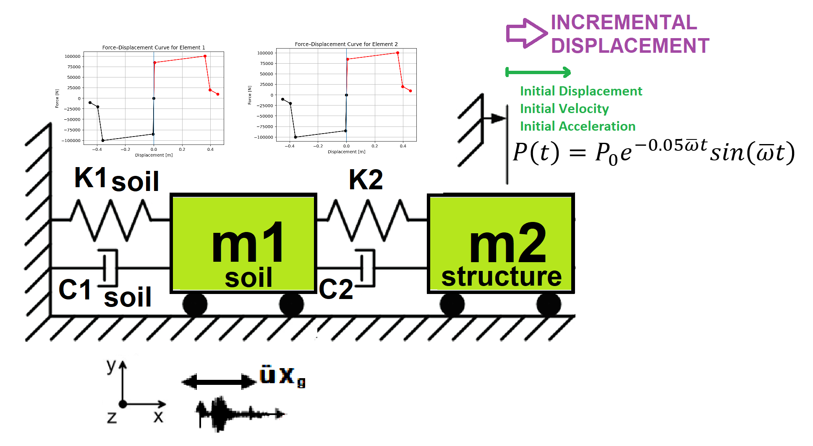

Slide 3
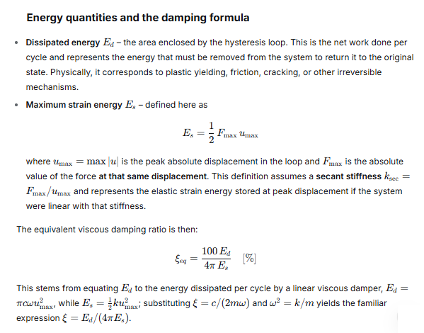

Slide 4
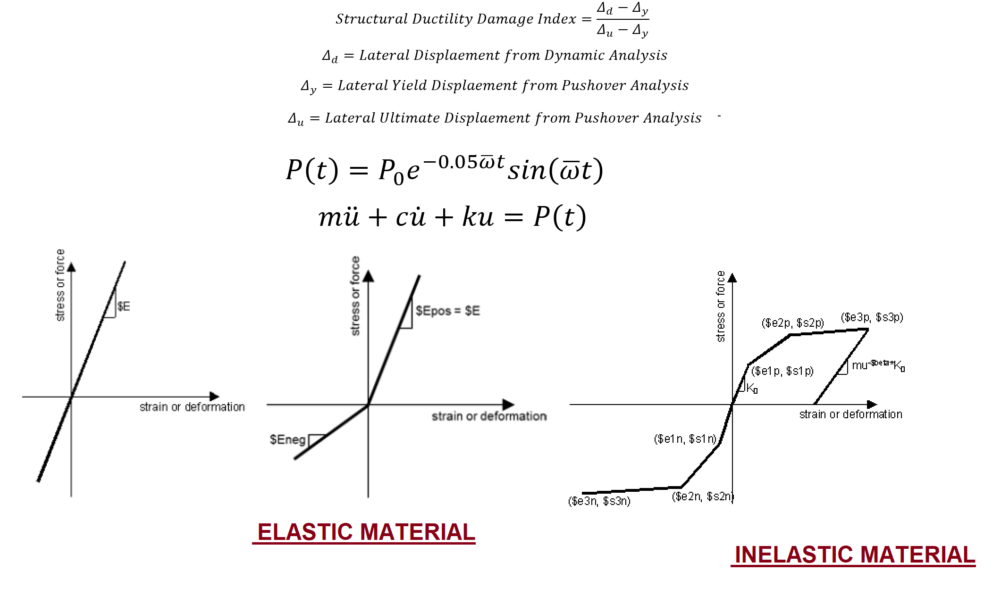

Slide 5
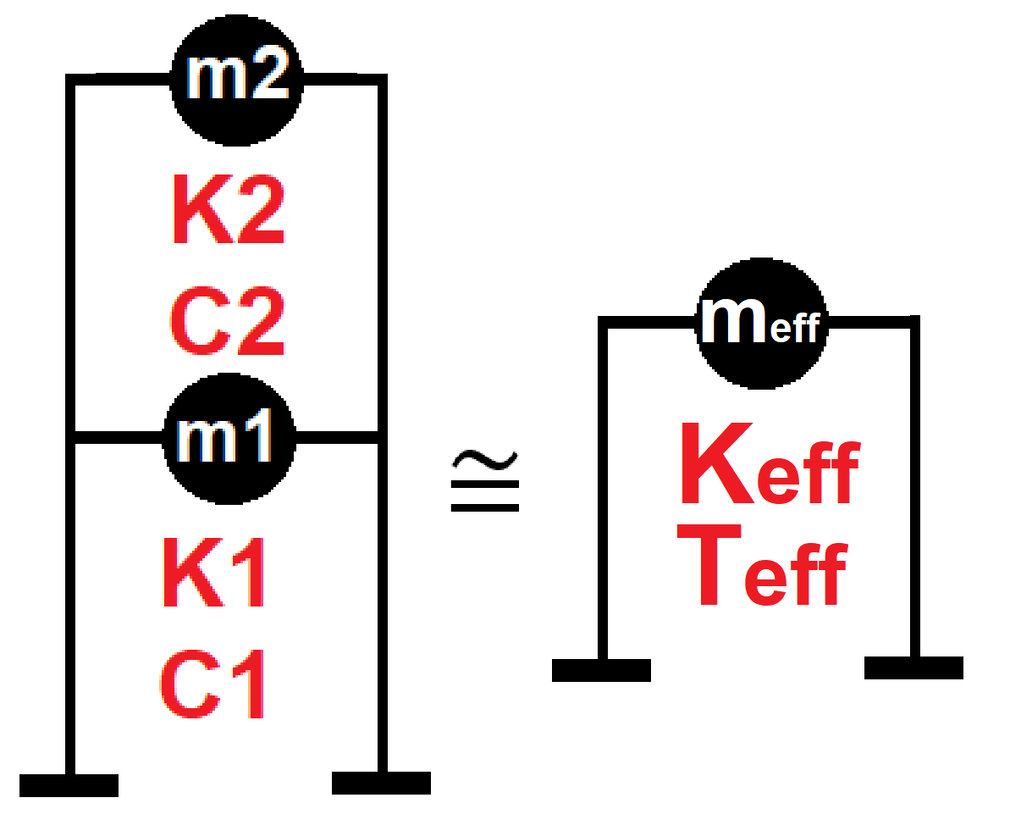

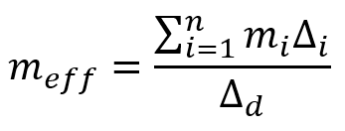
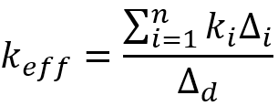
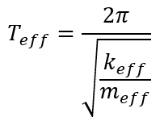
Displacement-based seismic analysis transformation,
converting a multi-degree-of-freedom (MDOF) system
into an equivalent single-degree-of-freedom (SDOF)
system for seismic assessment

Slide 6
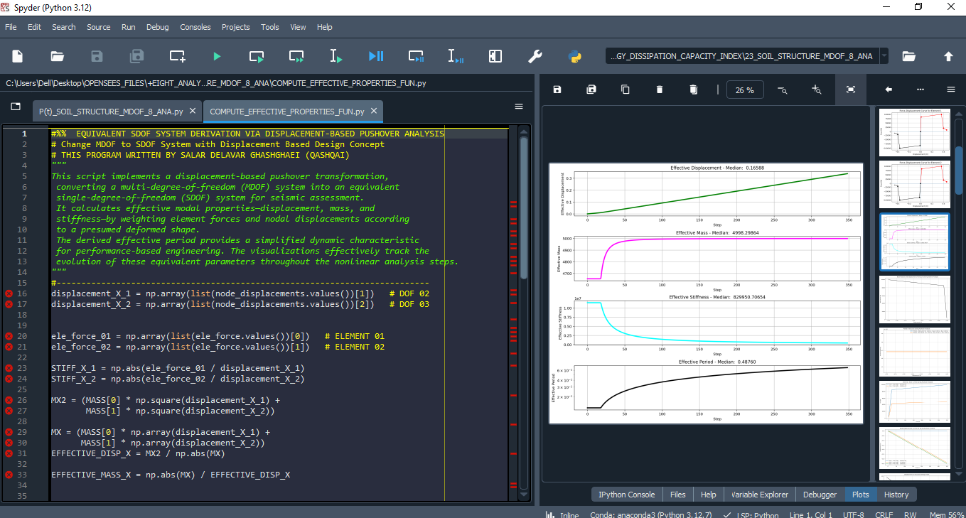

Slide 7
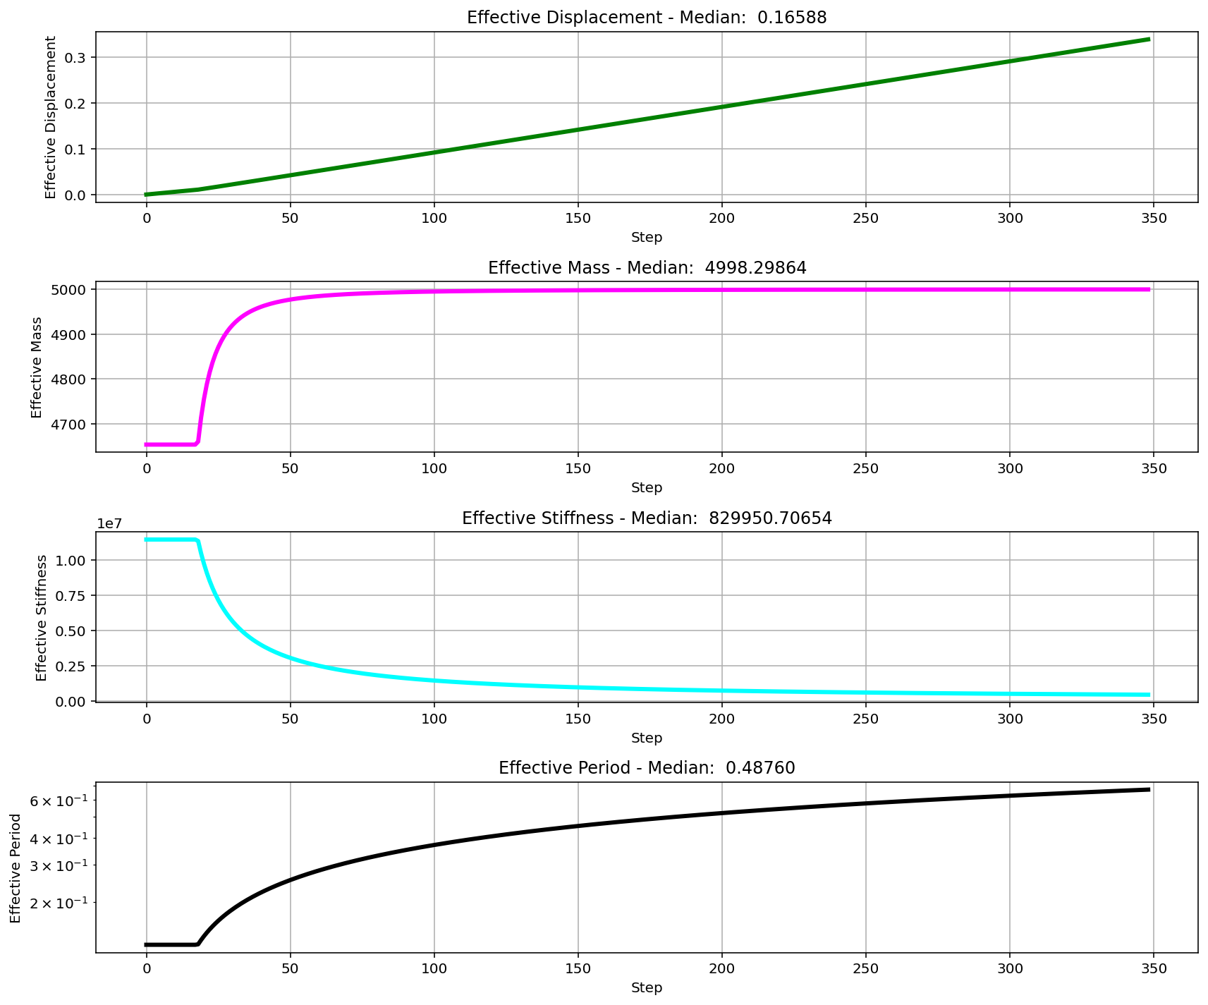

Slide 8
CYCLIC DISPLACEMENT ANALYSIS

Slide 9
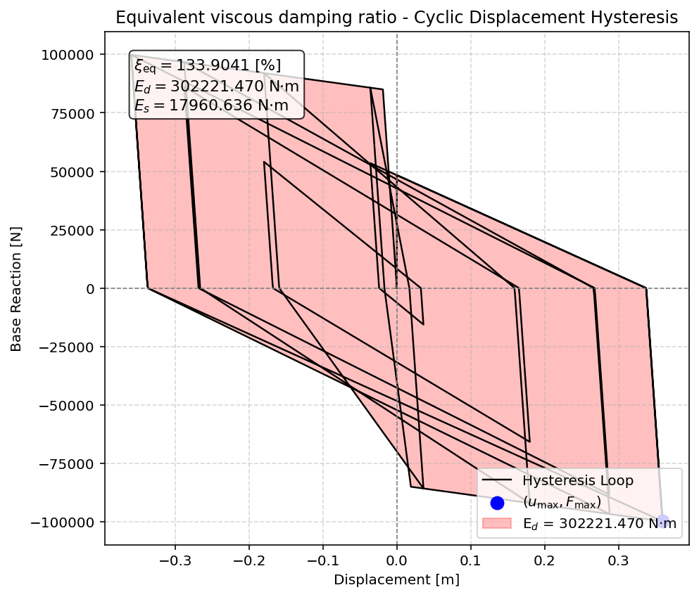

Slide 10
STATIC TIME-HISTORY WITH EXTERNAL TIME-DEPENDENT LOADING ANALYSIS

Slide 11
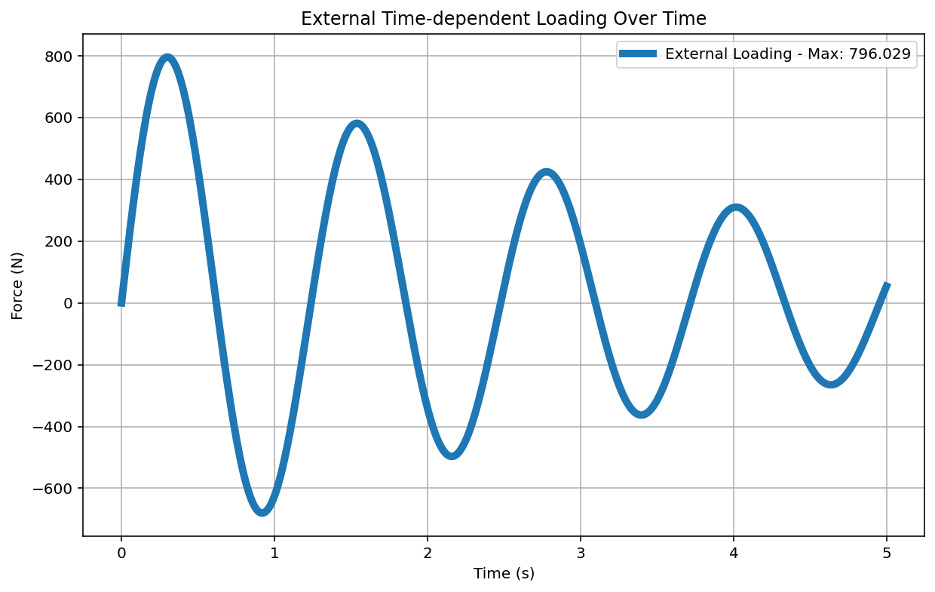

Slide 12
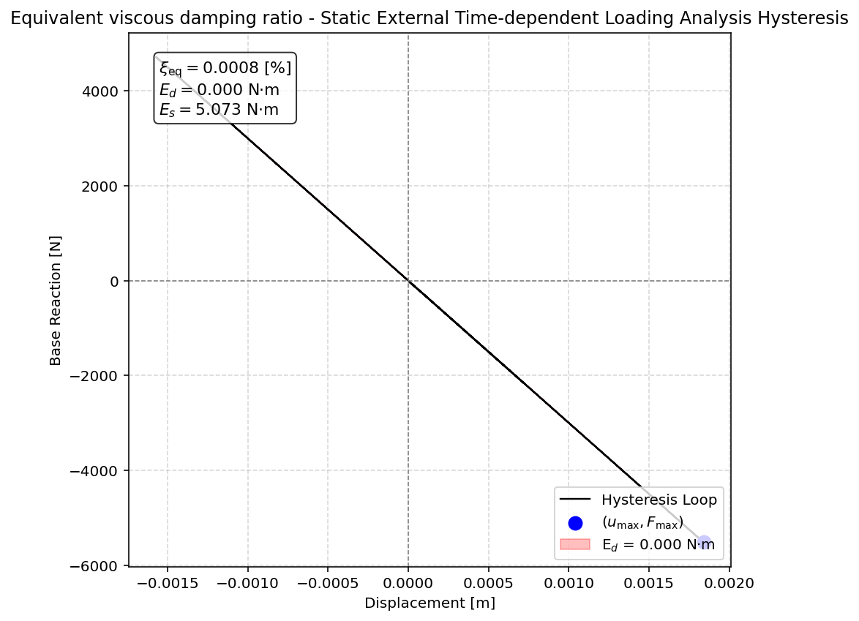

Slide 13
DYNAMIC TIME-HISTORY WITH EXTERNAL TIME-DEPENDENT LOADING ANALYSIS

Slide 15
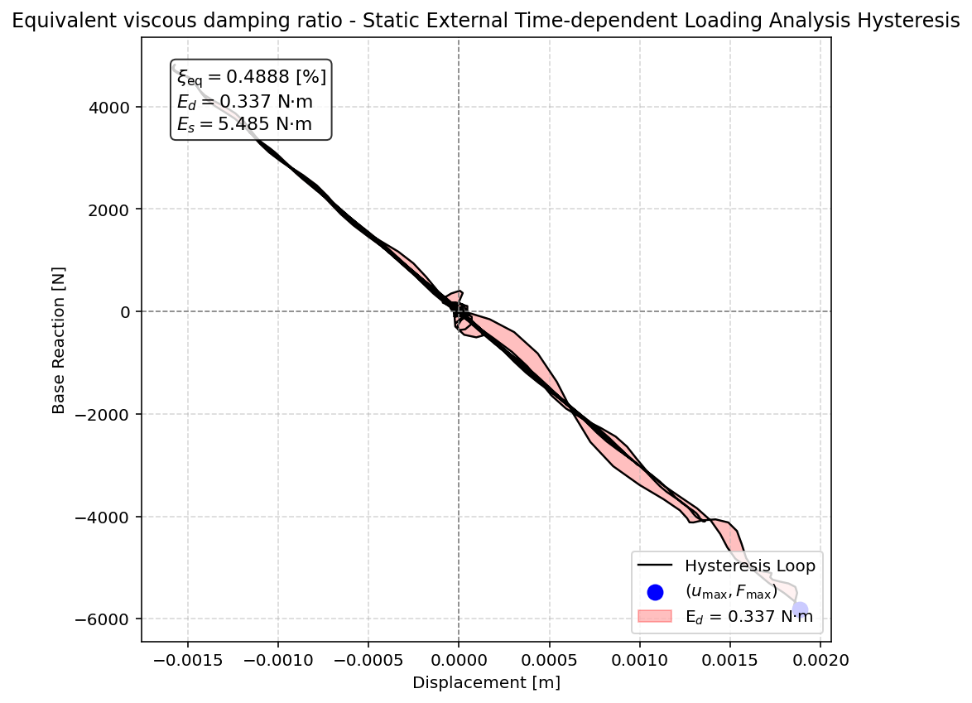

Slide 16
FREE-VIBRATION ANALYSIS

Slide 17
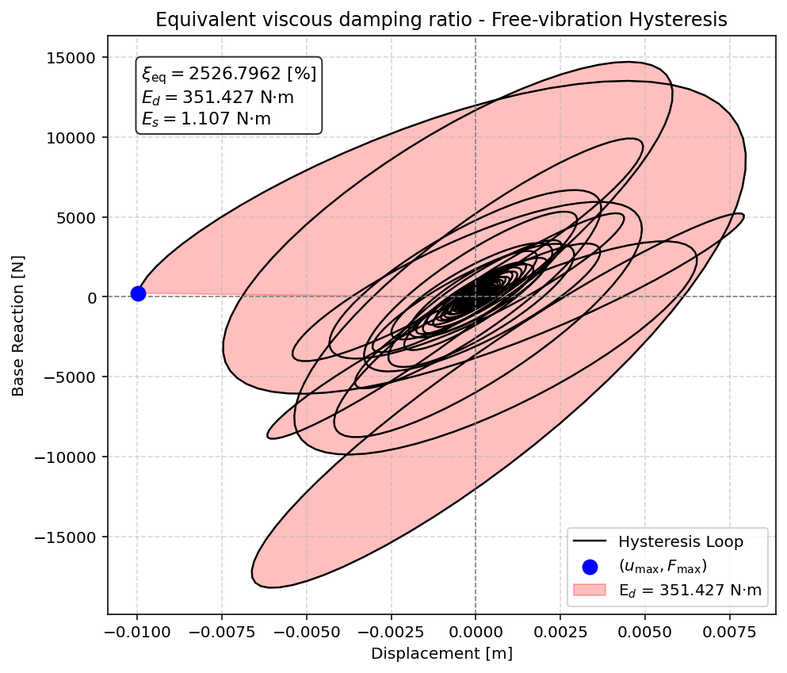

Slide 18
SEISMIC ANALYSIS

Slide 19
