Slide 1
IN THE NAME OF ALLAH, THE MOST GRACIOUS, THE MOST MERCIFUL
OPTIMIZATION OF COLUMN SECTION DEPTH BASED ON TARGET STRUCTURAL PERIOD FOR CONCRETE FRAME USING OPENSEES
WRITTEN BY SALAR DELAVAR GHASHGHAEI (QASHQAI)

Slide 2
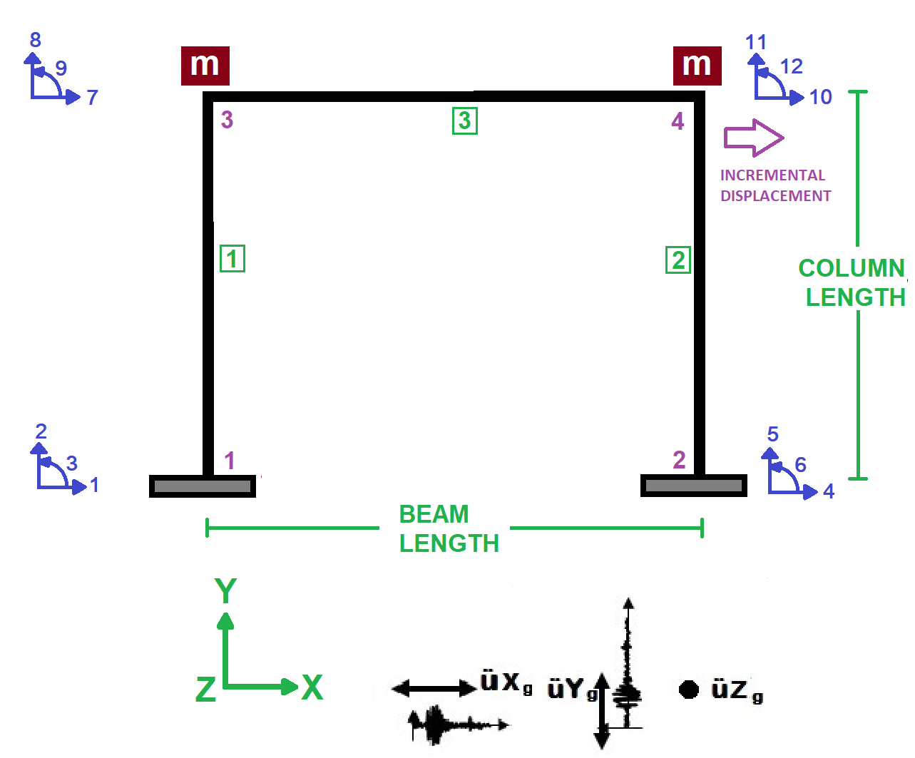

Slide 3
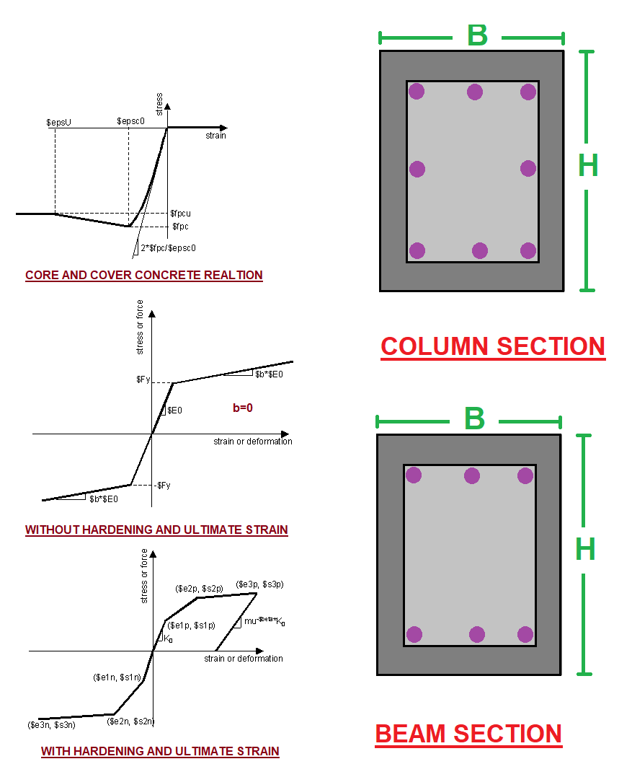

Slide 4
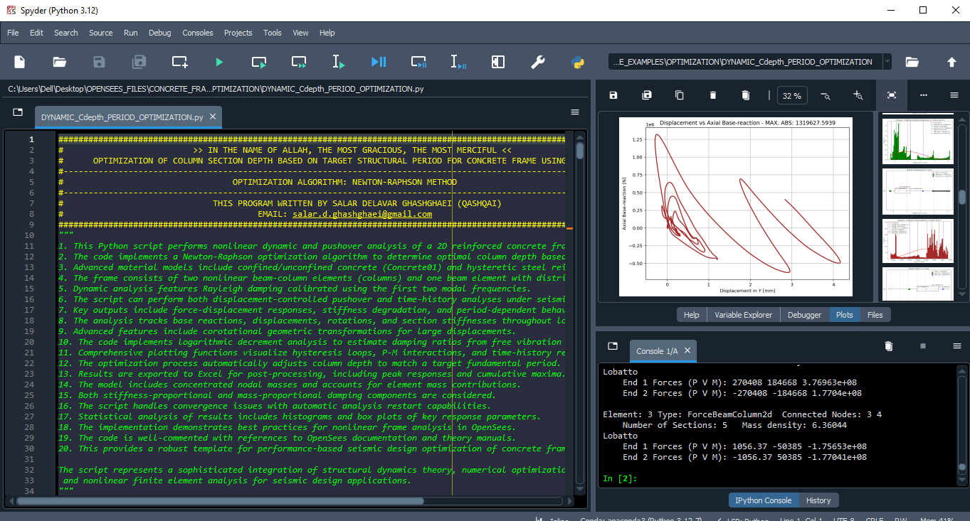

Slide 5
NONLINEAR DYNAMIC ANALYSIS
RESULTS

Slide 6
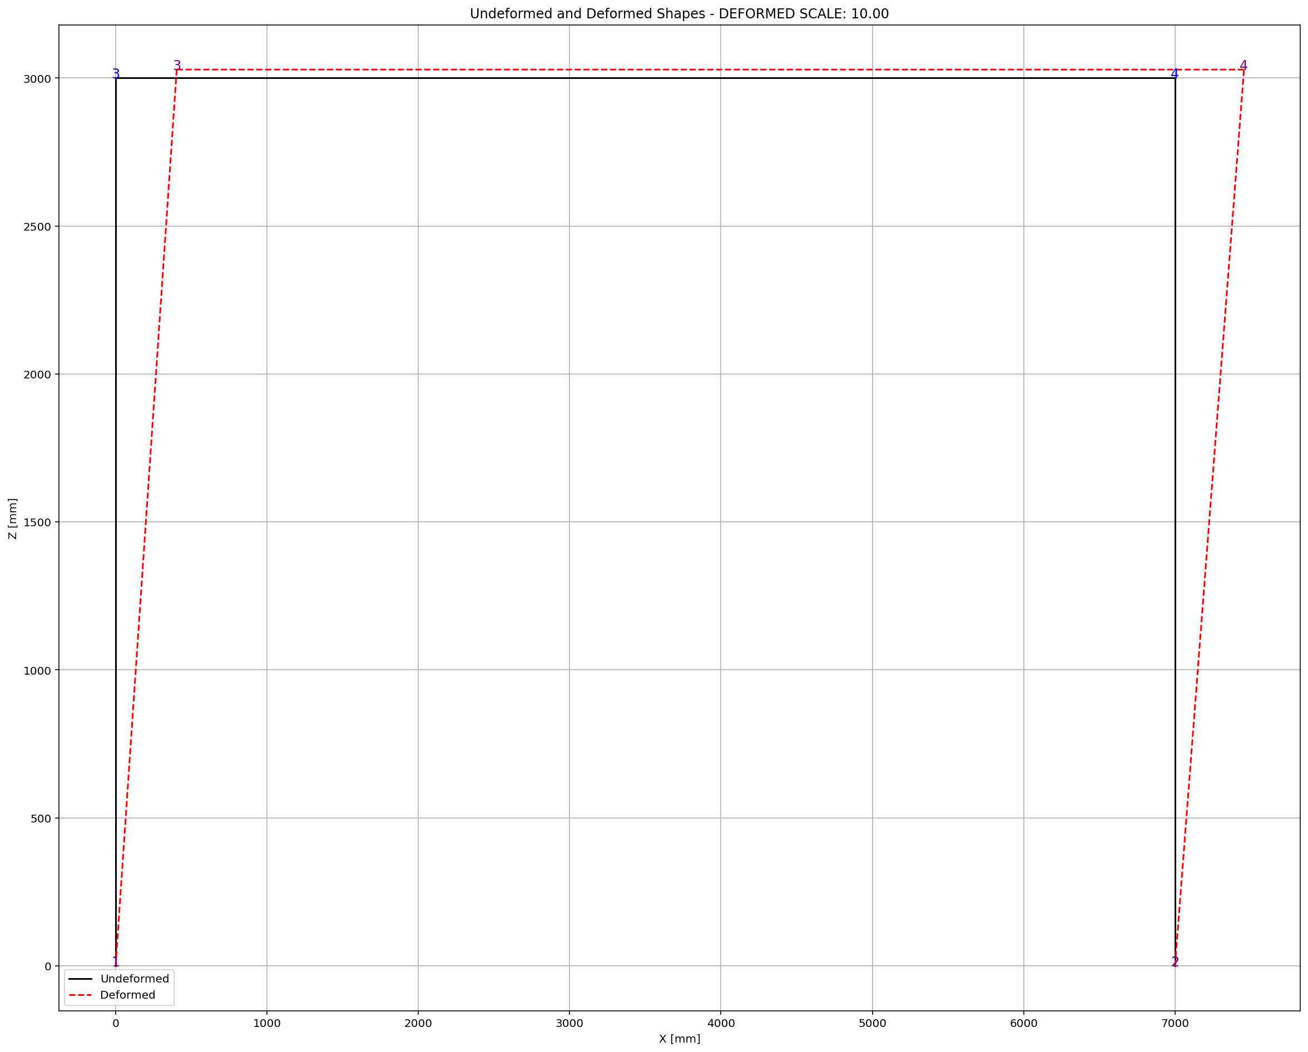
PERIOD_01 : 1.32113890 - PERIOD_02 : 9.34380605
F: 1.843806048673832
Structure First Period: 1.3211389075865452
Structure Second Period: 9.343806261665975
Fmin: 1.843806261665975
Structure First Period: 1.3211389003907277
Structure Second Period: 9.34380583568142
Fmax: 1.8438058356814206
DF: -0.02129922771487713
DX: -86.56680295436094
IT: 1 - RESIDUAL: 86.56680295436094 - X: 586.5668029543609
Structure First Period: 1.2938764559626208
Structure Second Period: 7.81336791685246
PERIOD_01 : 1.29387646 - PERIOD_02 : 7.81336792
F: 0.3133679168524601
Structure First Period: 1.2938764587320013
Structure Second Period: 7.813368063685243
Fmin: 0.3133680636852434
Structure First Period: 1.2938764531932436
Structure Second Period: 7.8133677700197985
Fmax: 0.31336777001979854
DF: -0.014683272242521637
DX: -21.34183114476149
IT: 2 - RESIDUAL: 21.34183114476149 - X: 607.9086340991224
Structure First Period: 1.2881289006602148
Structure Second Period: 7.51251922775103
PERIOD_01 : 1.28812890 - PERIOD_02 : 7.51251923
F: 0.01251922775102976
Structure First Period: 1.2881289032798524
Structure Second Period: 7.512519363090006
Fmin: 0.01251936309000623
Structure First Period: 1.2881288980405776
Structure Second Period: 7.51251909241217
Fmax: 0.012519092412169641
DF: -0.013533891829453635
DX: -0.9250279157532739
IT: 3 - RESIDUAL: 0.9250279157532739 - X: 608.8336620148757
Structure First Period: 1.287886860074277
Structure Second Period: 7.500021607458597
PERIOD_01 : 1.28788686 - PERIOD_02 : 7.50002161
F: 2.1607458596584195e-05
Structure First Period: 1.287886862687799
Structure Second Period: 7.5000217423308575
Fmin: 2.1742330857499326e-05
Structure First Period: 1.287886857460755
Structure Second Period: 7.500021472586389
Fmax: 2.147258638895977e-05
DF: -0.013487223426977833
DX: -0.001602068706993009
IT: 4 - RESIDUAL: 0.001602068706993009 - X: 608.8352640835827
Structure First Period: 1.2878864413712046
Structure Second Period: 7.500000000080559
PERIOD_01 : 1.28788644 - PERIOD_02 : 7.50000000
F: 8.055867084522106e-11
Structure First Period: 1.2878864439847162
Structure Second Period: 7.500000134951995
Fmin: 1.3495199535640268e-07
Structure First Period: 1.2878864387576943
Structure Second Period: 7.499999865209172
Fmax: -1.3479082827672073e-07
DF: -0.013487141181656169
DX: -5.972998262581305e-09
IT: 5 - RESIDUAL: 5.972998262581305e-09 - X: 608.8352640895557
Optimum Column Section Depth : 608.835264
Iteration Counts: 5
Convergence Residual: 5.9729982626e-09
Total time (s): 12.8281

Slide 7
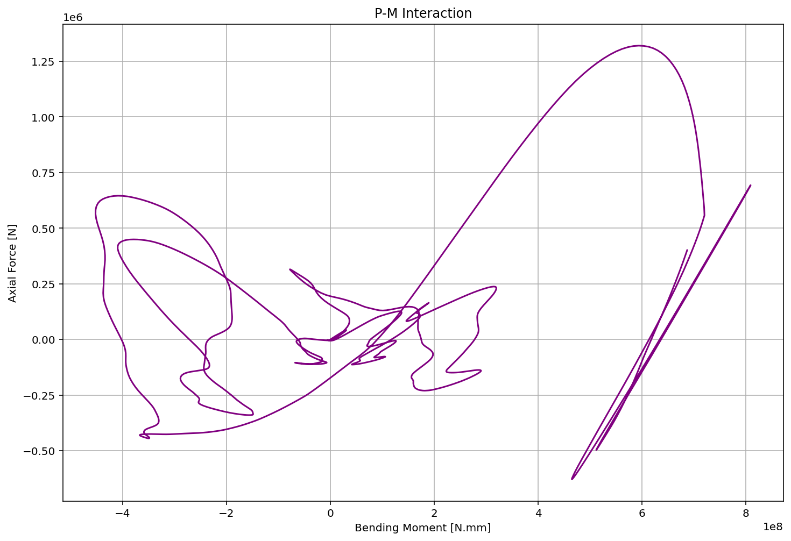

Slide 8
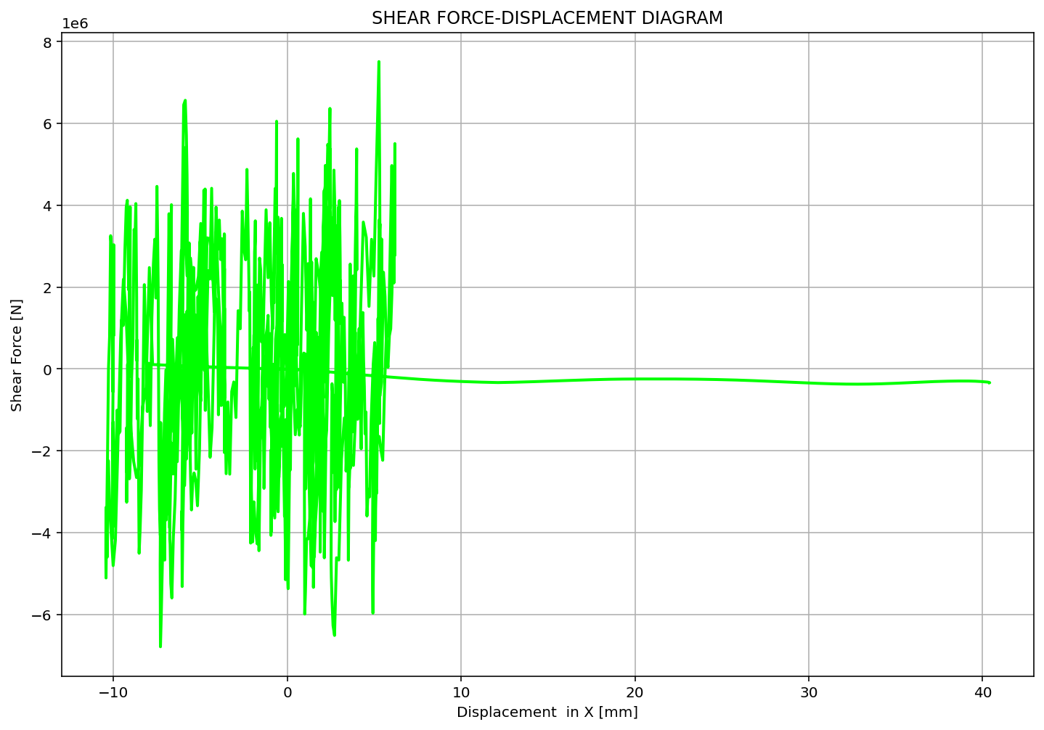

Slide 9
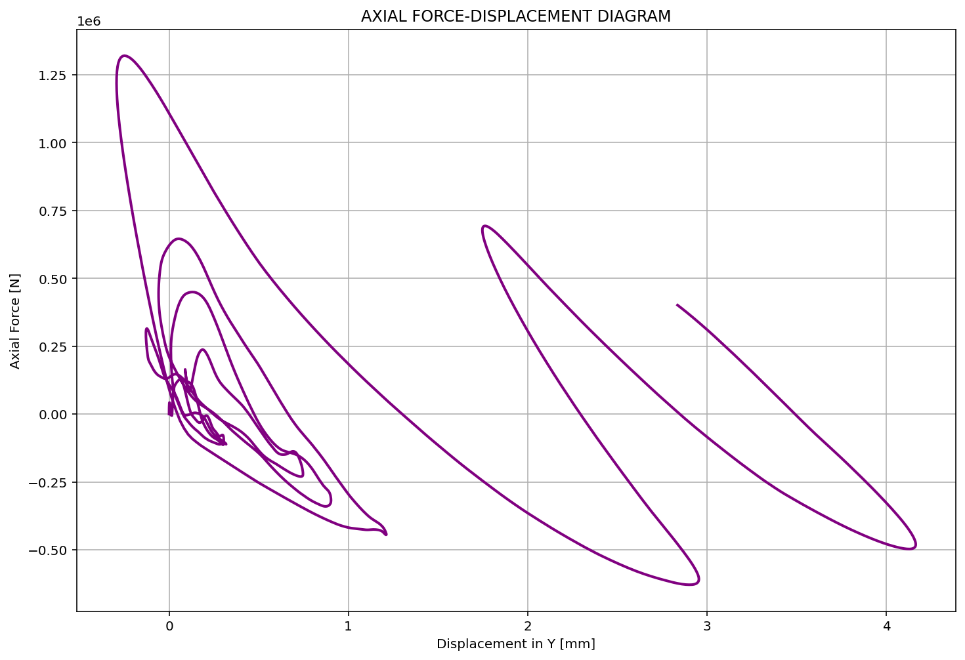

Slide 10
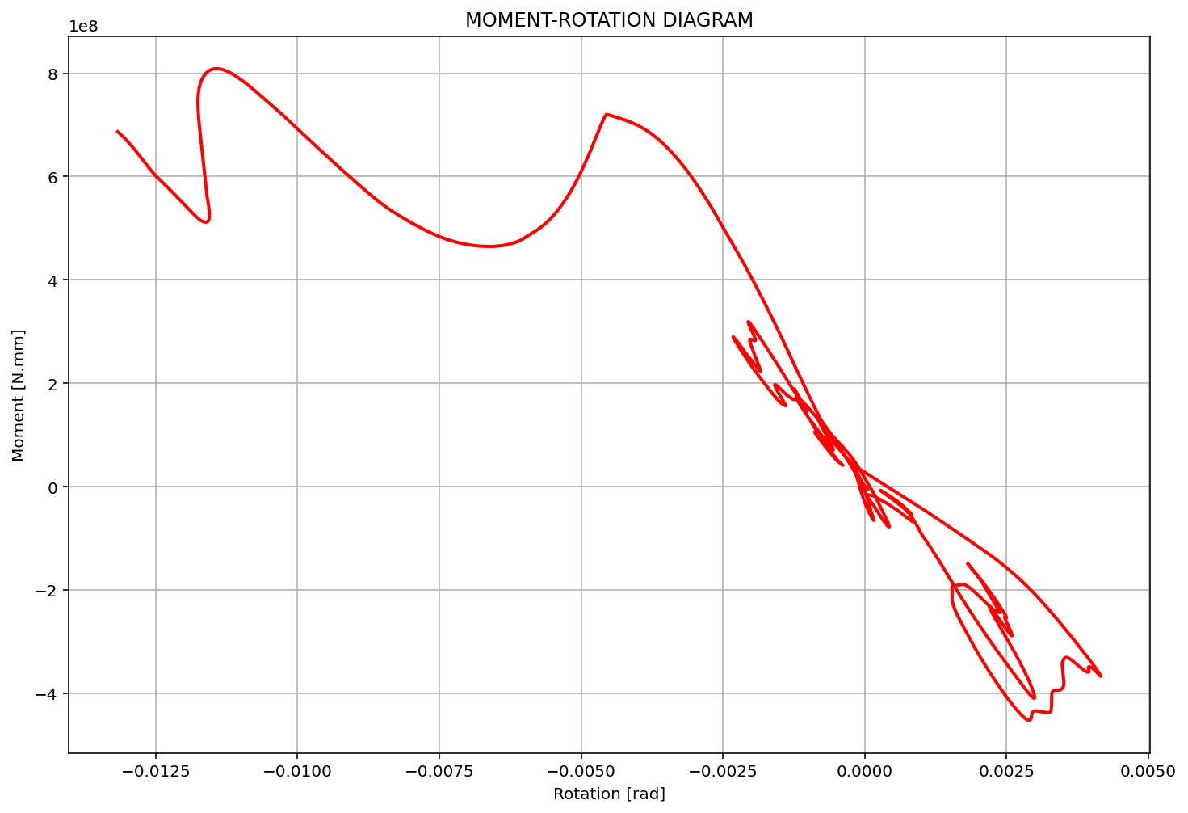

Slide 11
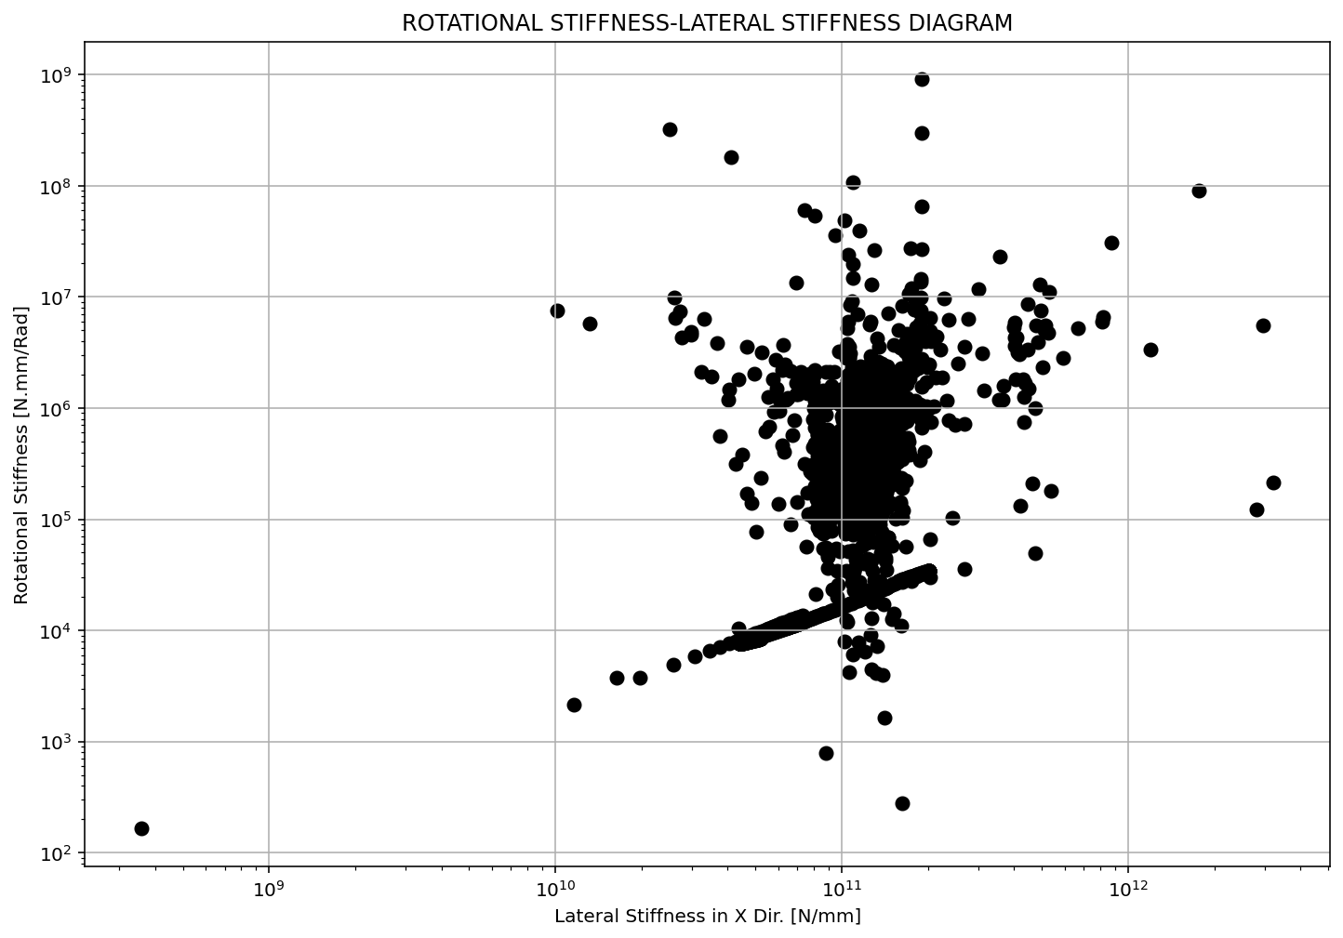

Slide 12
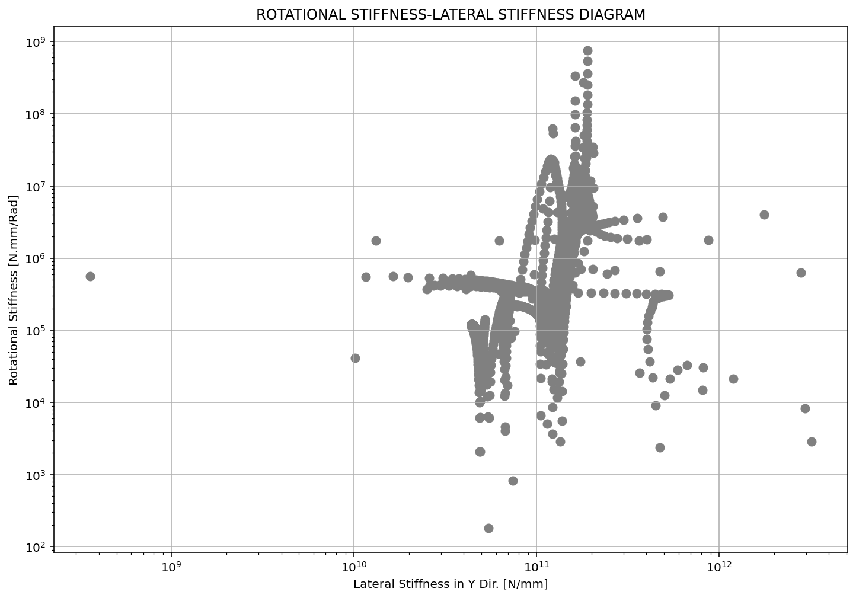

Slide 13
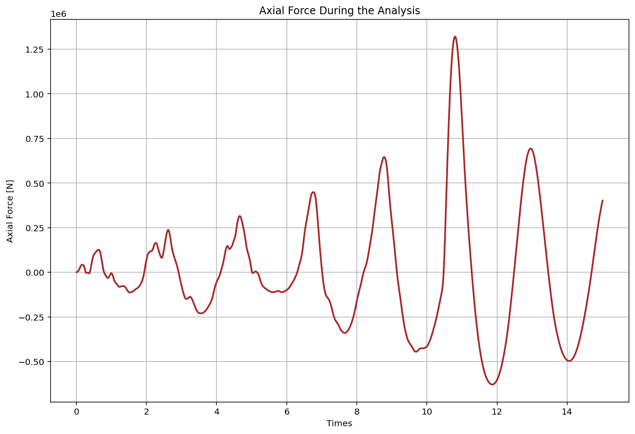

Slide 14
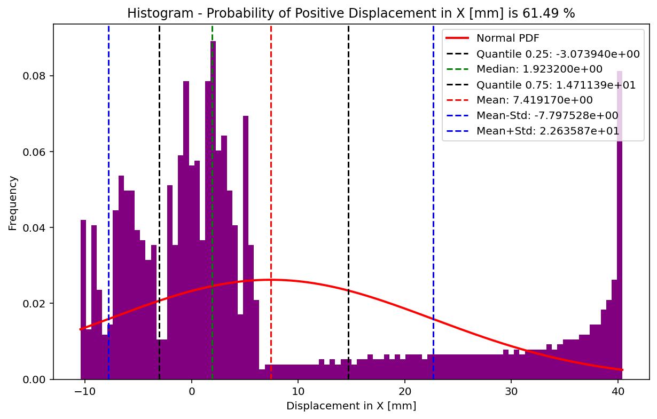

Slide 15
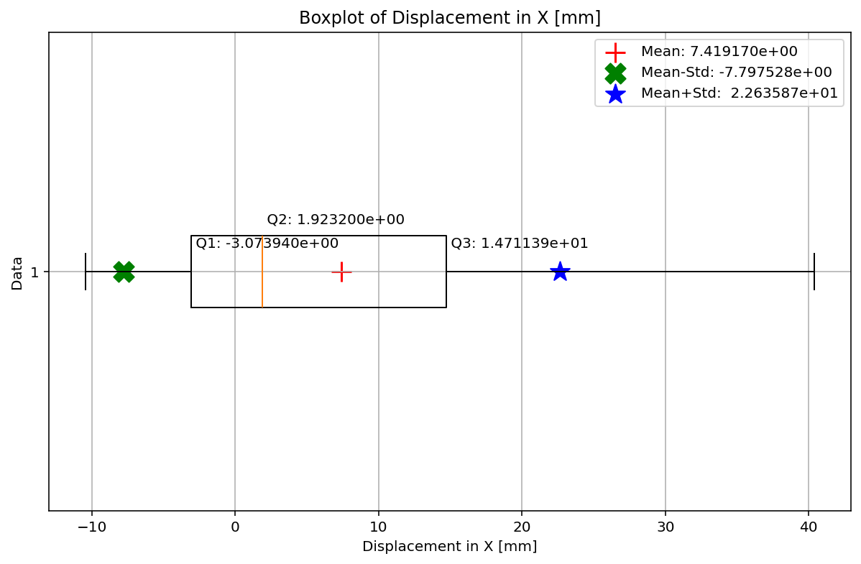

Slide 16
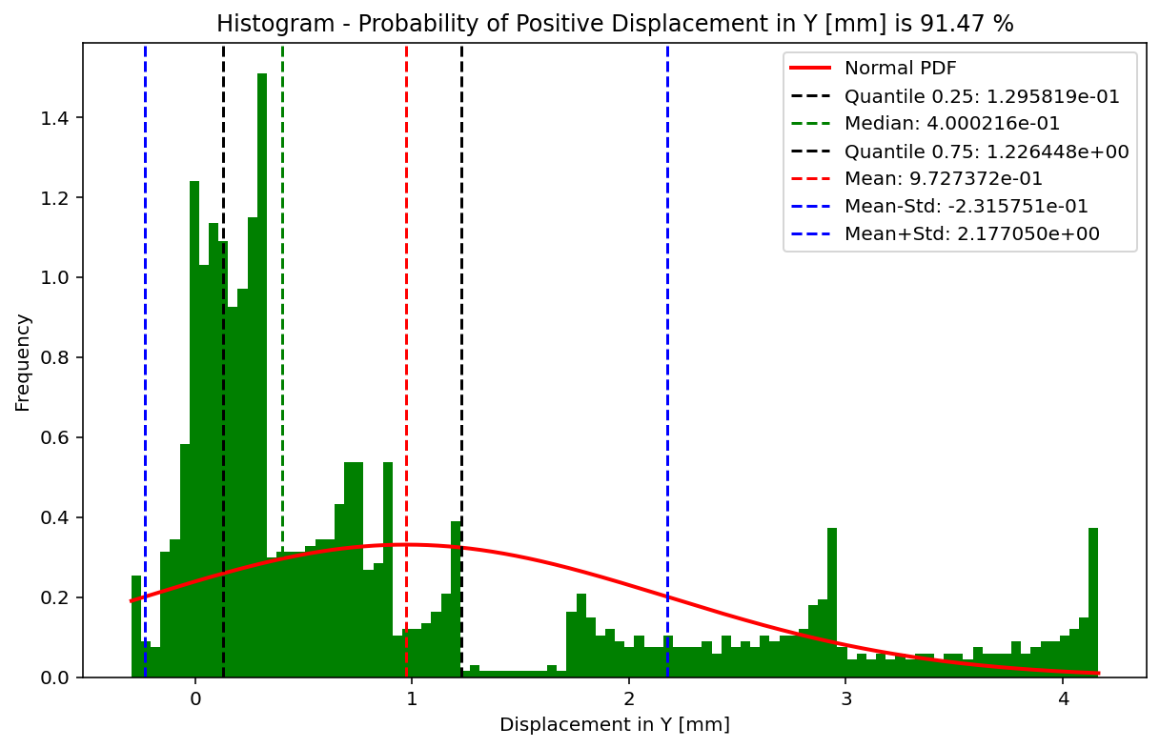

Slide 17
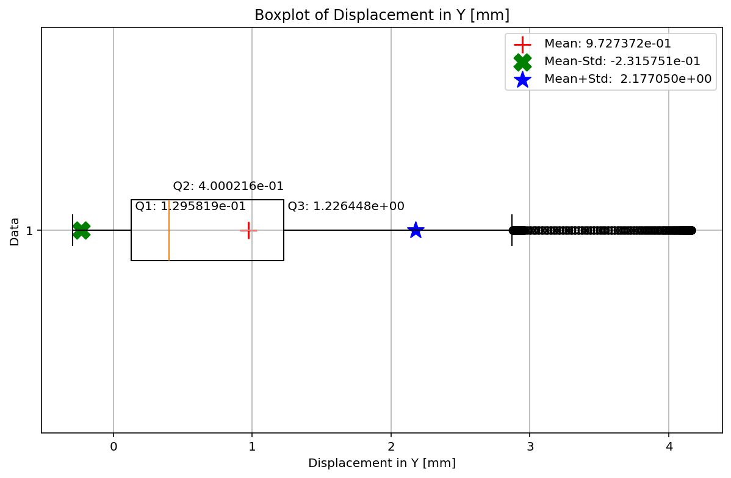

Slide 18
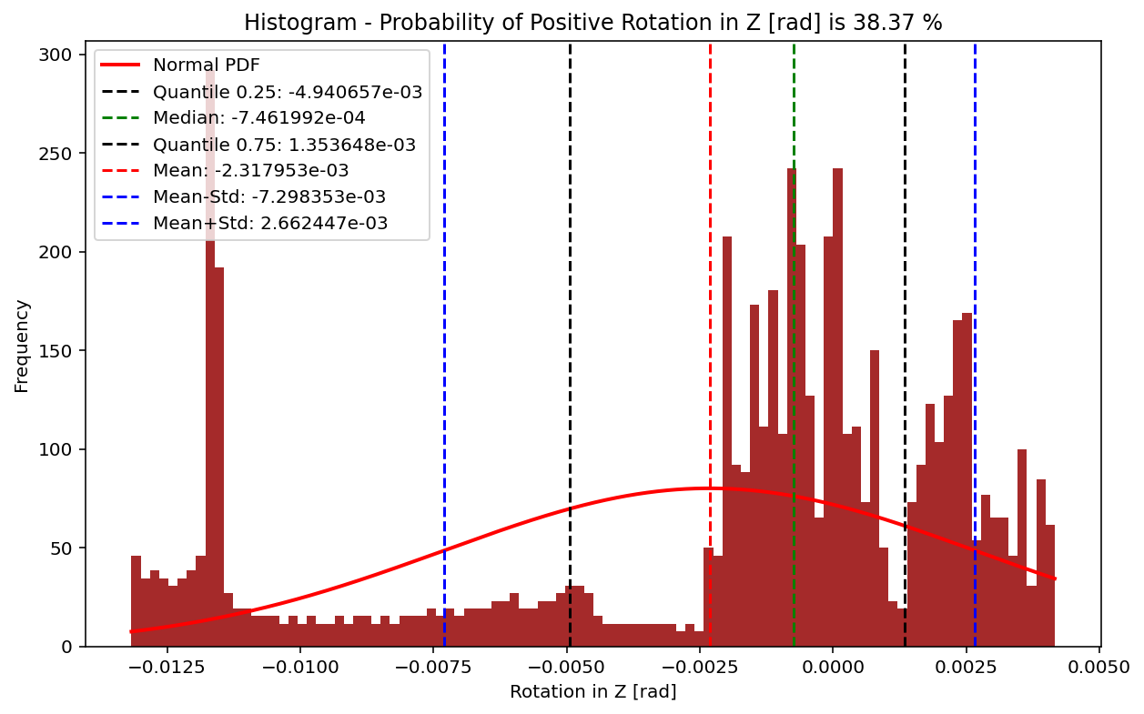

Slide 19
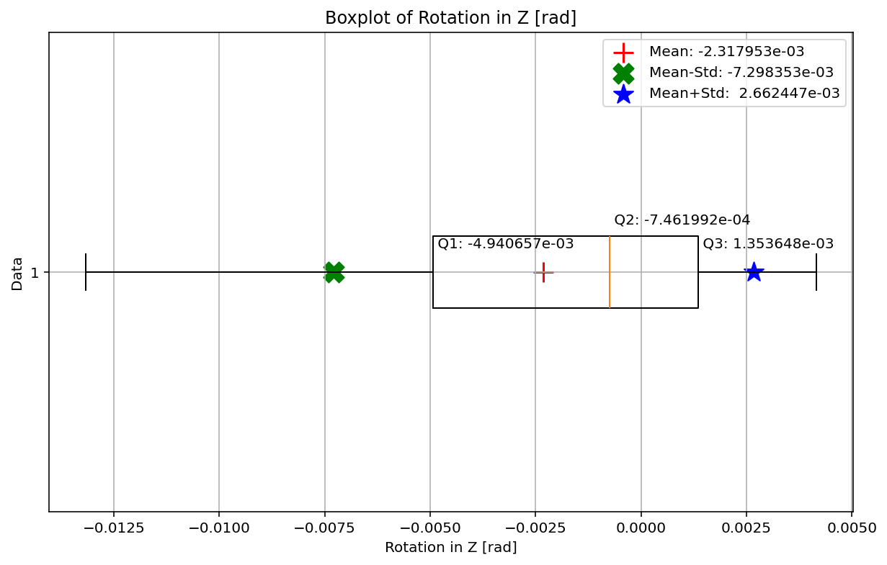

Slide 20
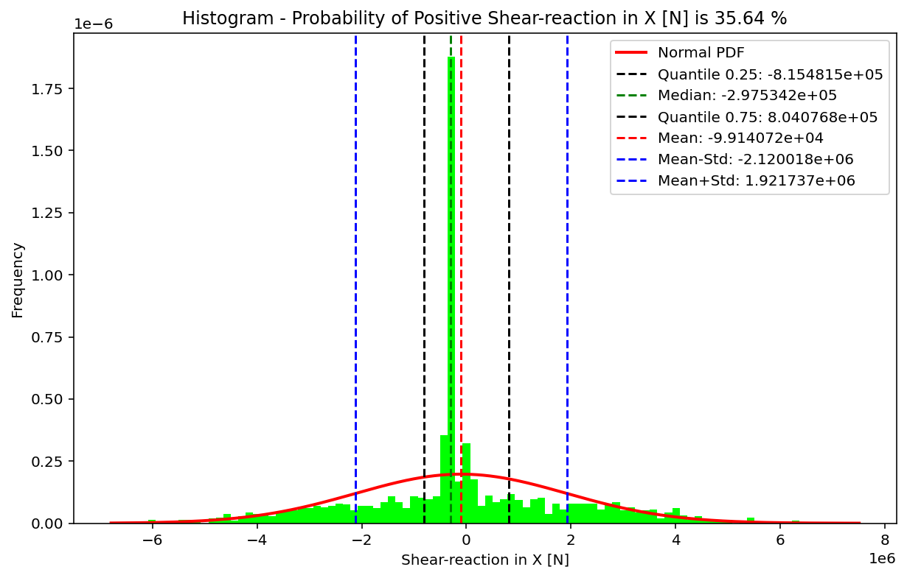

Slide 21
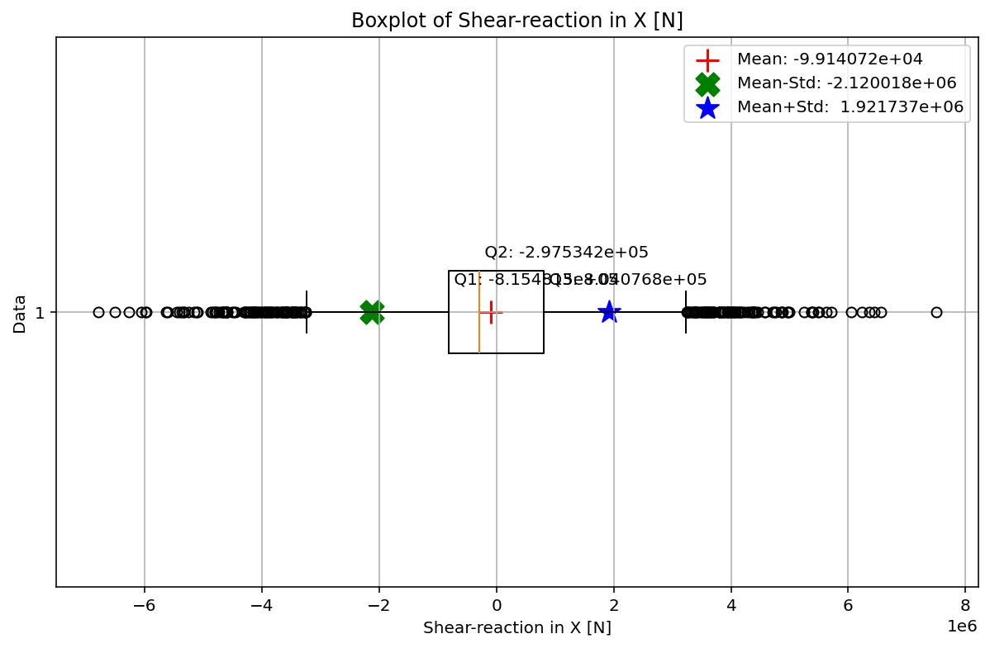

Slide 22
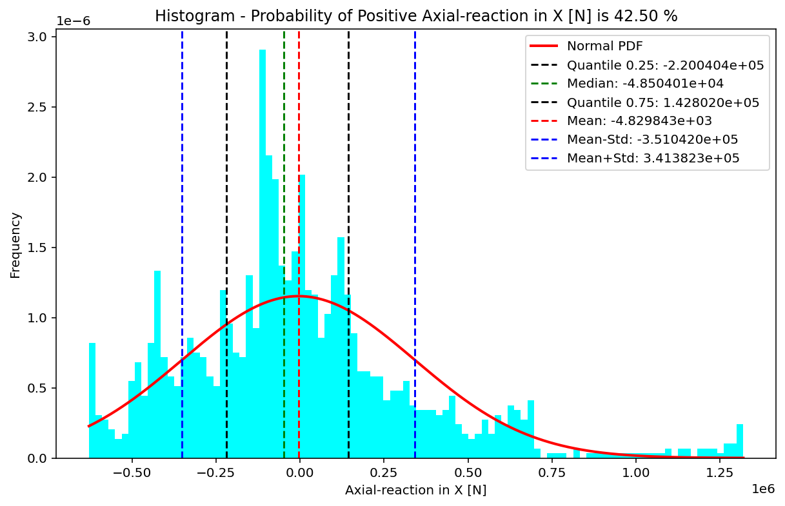

Slide 23
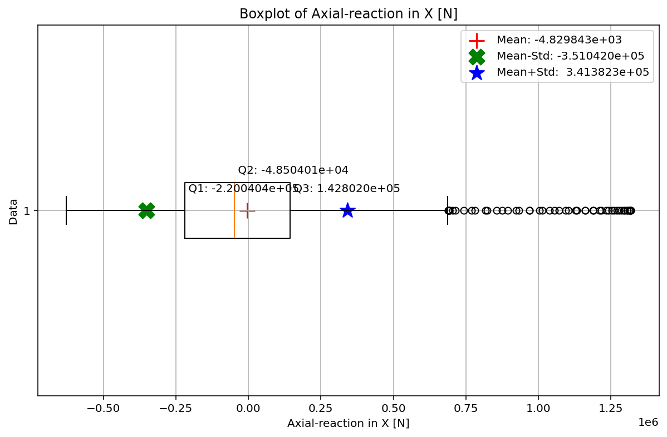

Slide 24
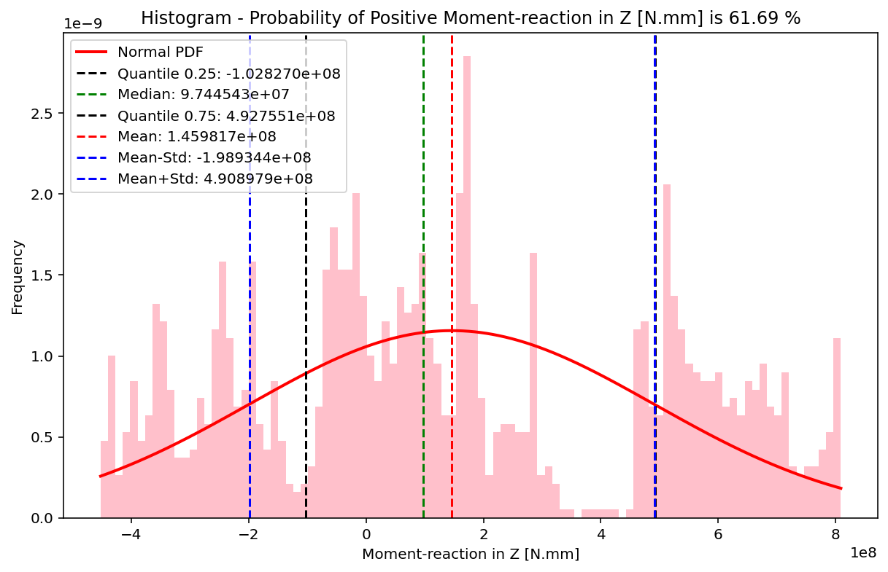

Slide 25
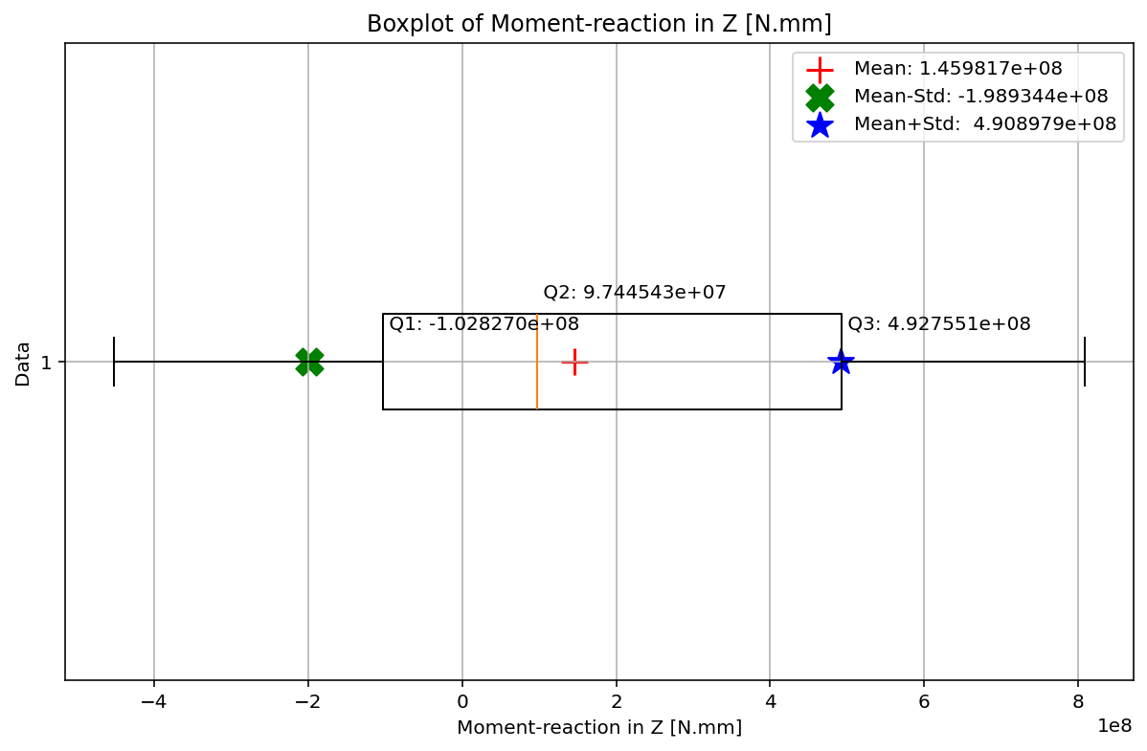

Slide 26
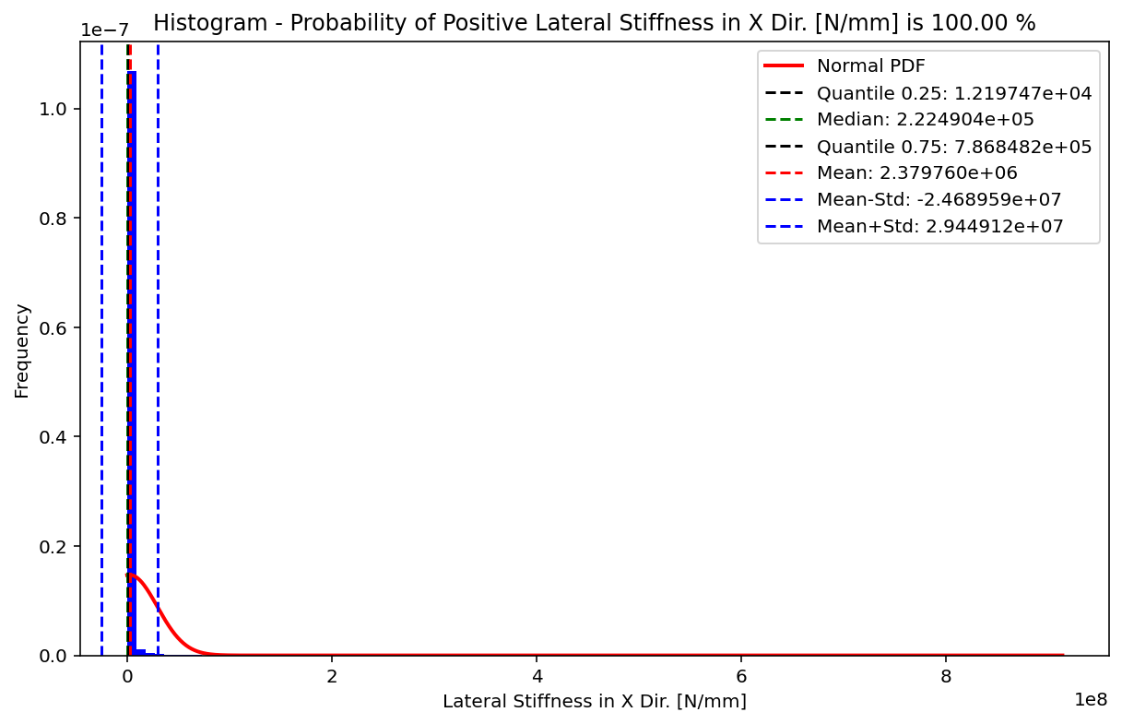

Slide 27
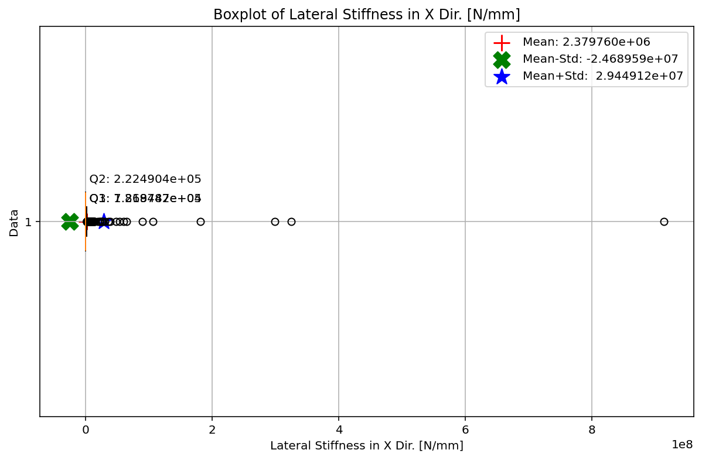

Slide 28
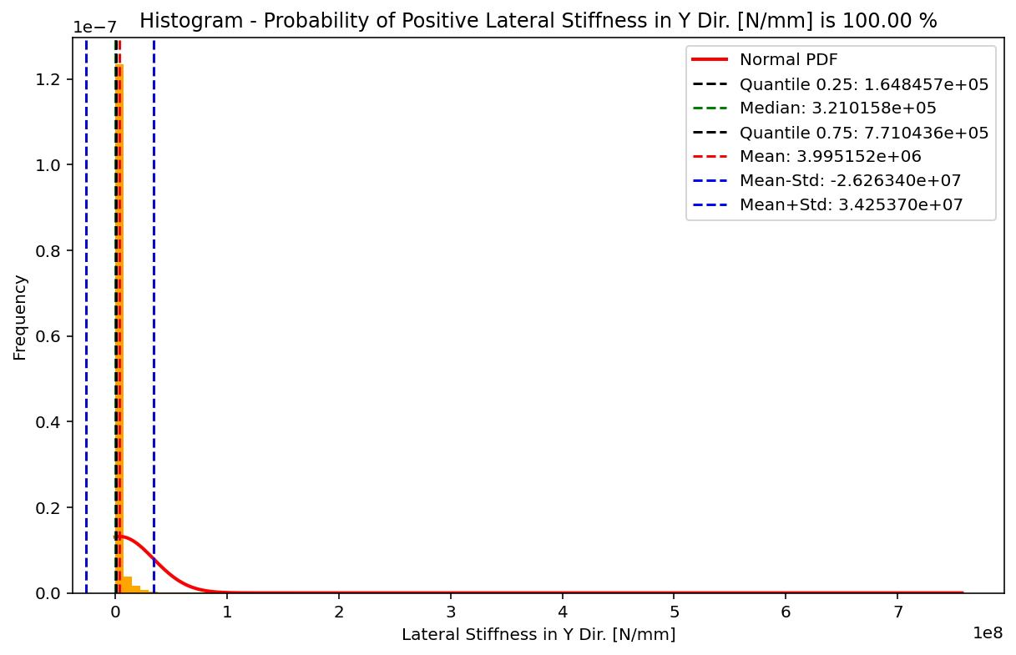

Slide 29
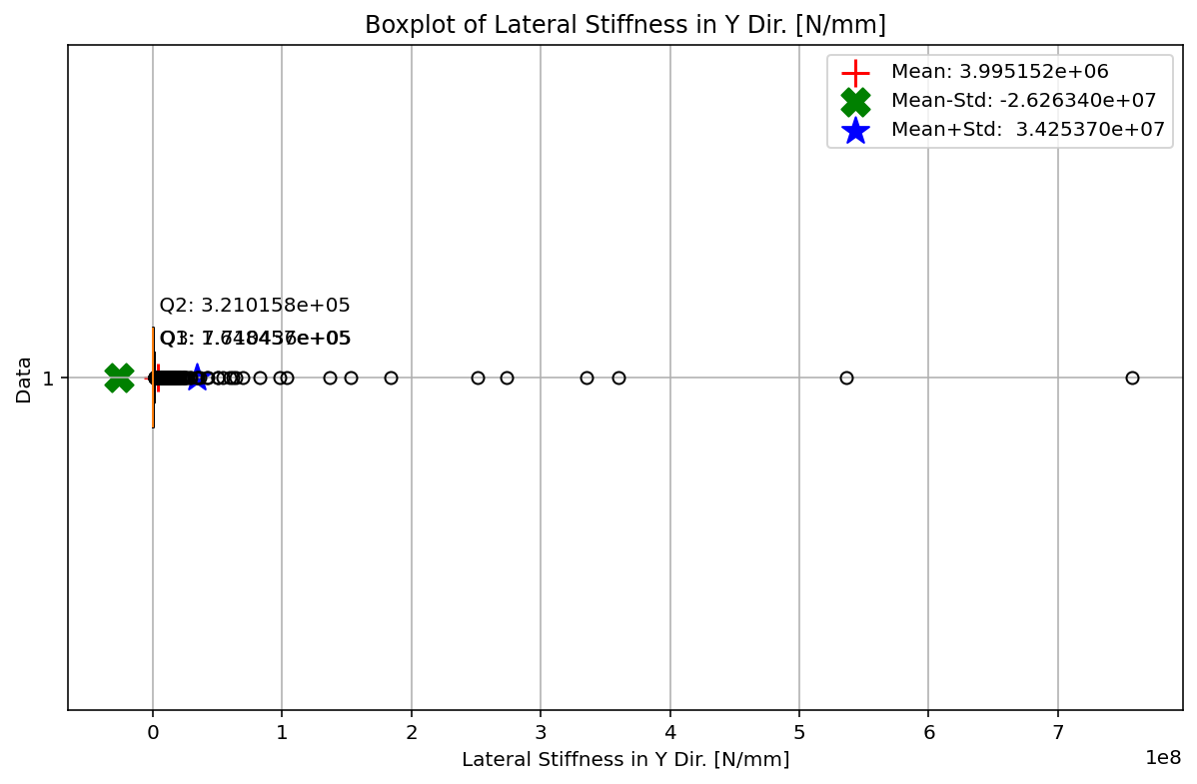

Slide 30
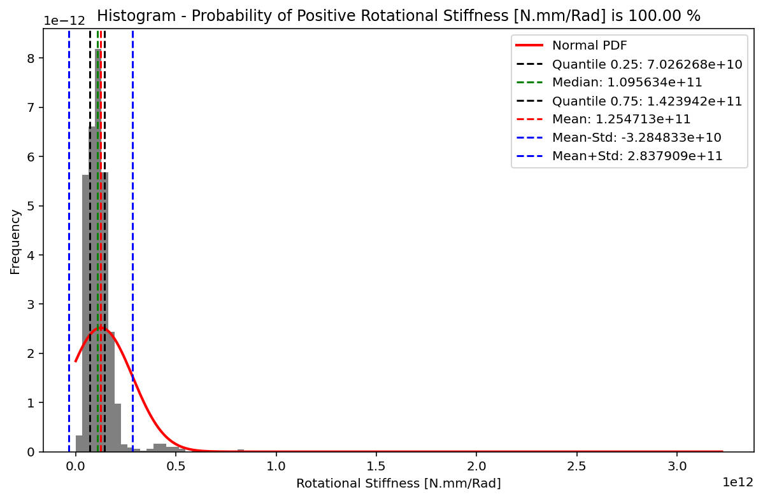

Slide 31
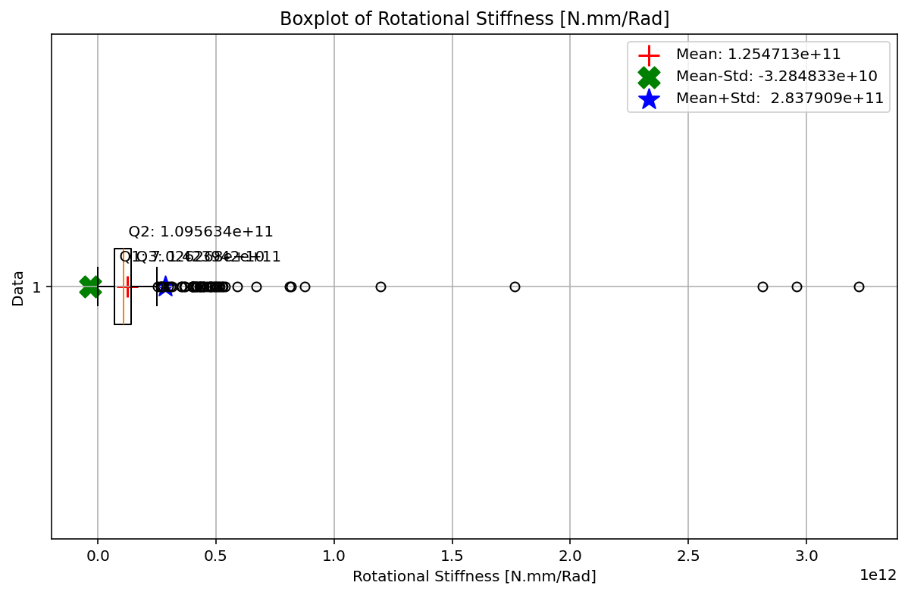

Slide 32
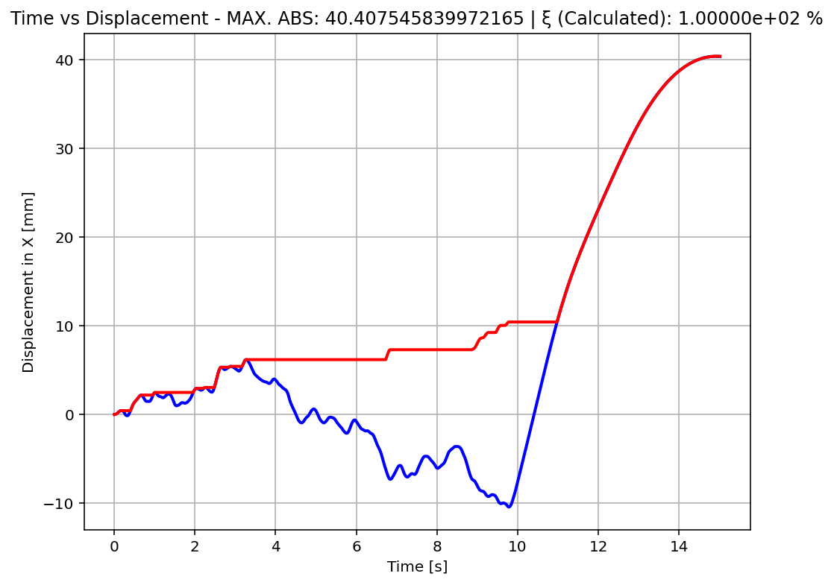

Slide 33
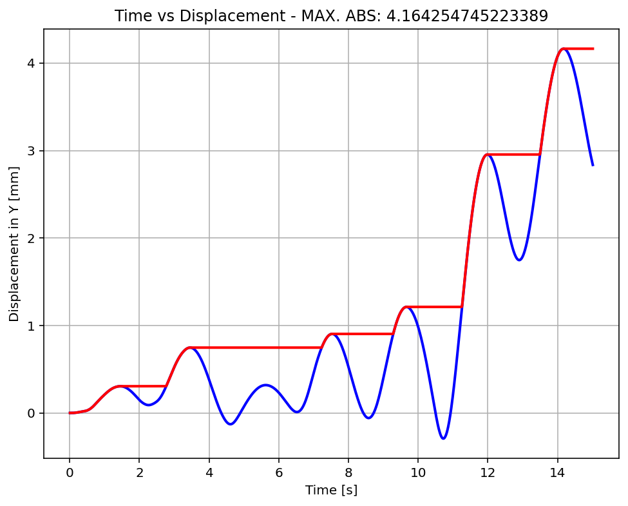

Slide 34
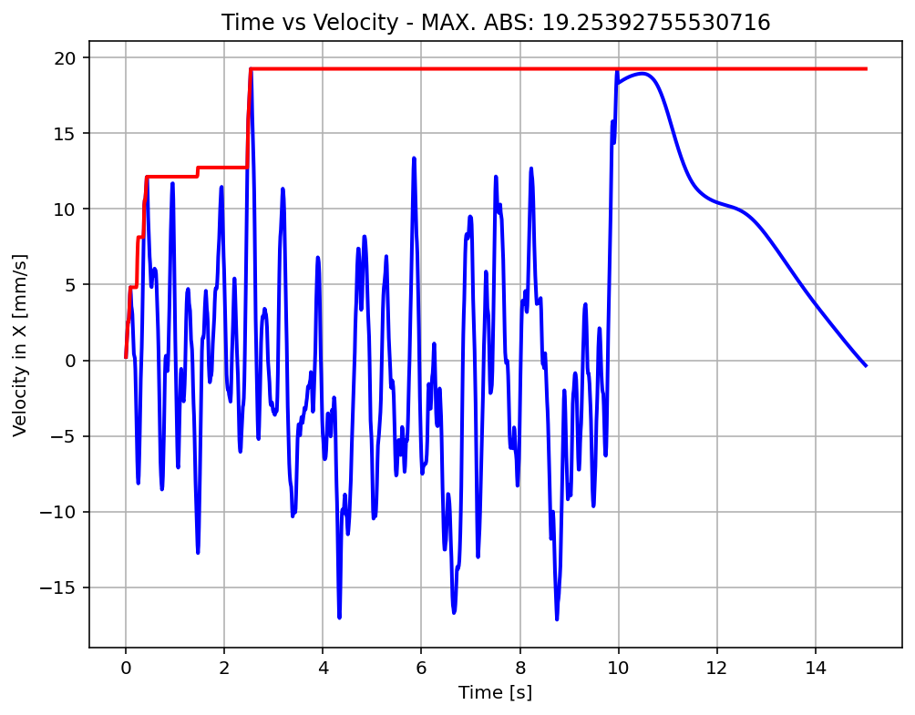

Slide 35
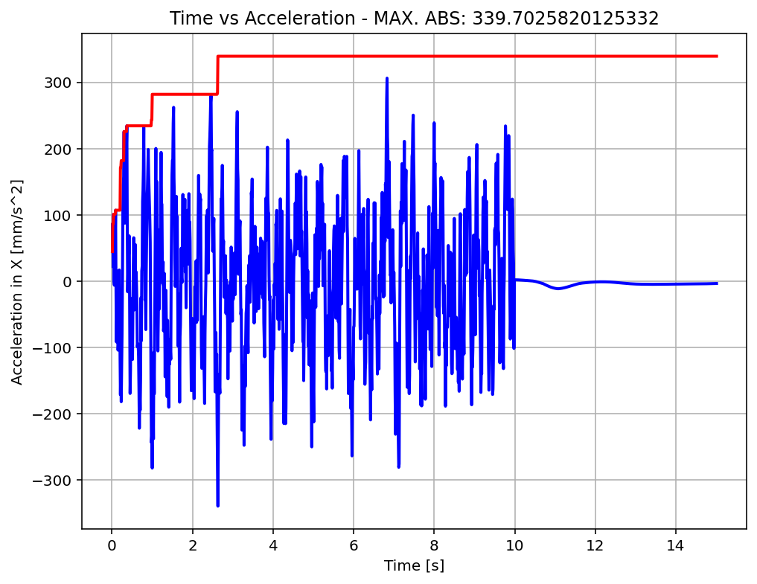

Slide 36
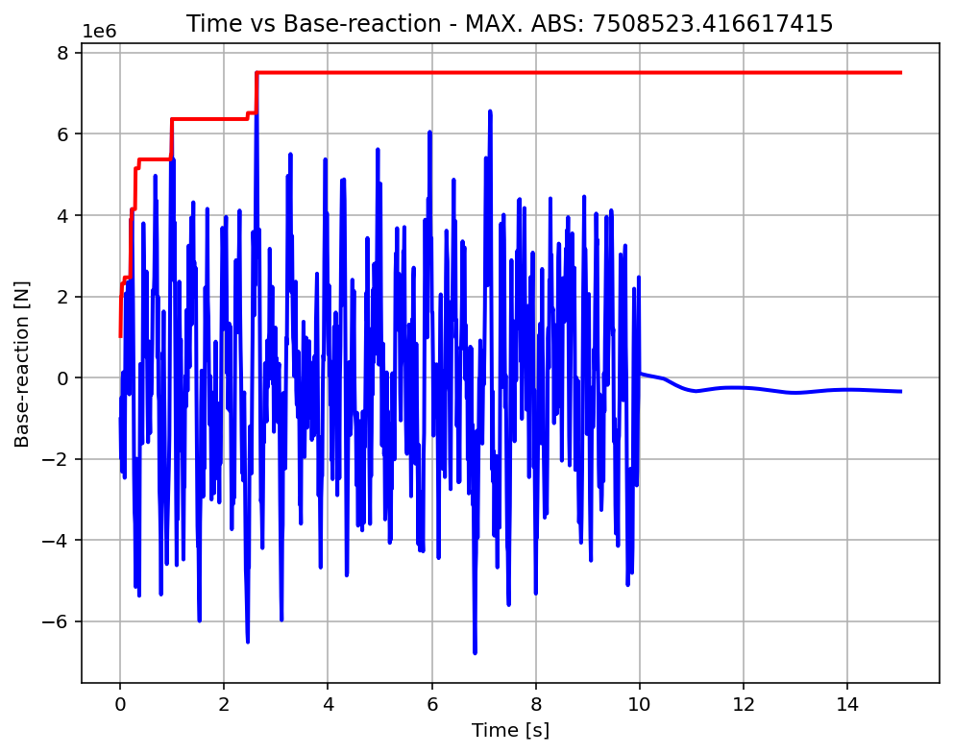

Slide 37
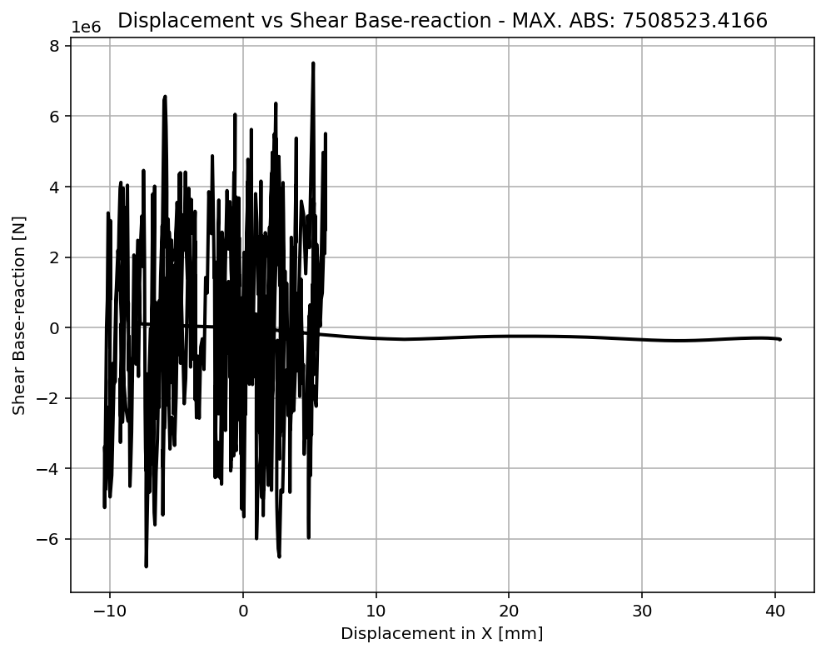

Slide 38
