Slide 1
IN THE NAME OF ALLAH, THE MOST GRACIOUS, THE MOST MERCIFUL
CONCRETE COLUMN SECTION REBAR OPTIMIZATION BASED ON DEMAND BASE-SHEAR REACTION.
UTILIZING PARALLEL PROCESSING PROCEDURES FOR THE SIMULTANEOUS EXECUTION OF NONLINEAR STATIC AND DYNAMIC CONCRETE STRUCTURAL ANALYSIS, USING OPENSEES
WRITTEN BY SALAR DELAVAR GHASHGHAEI (QASHQAI)

Slide 2
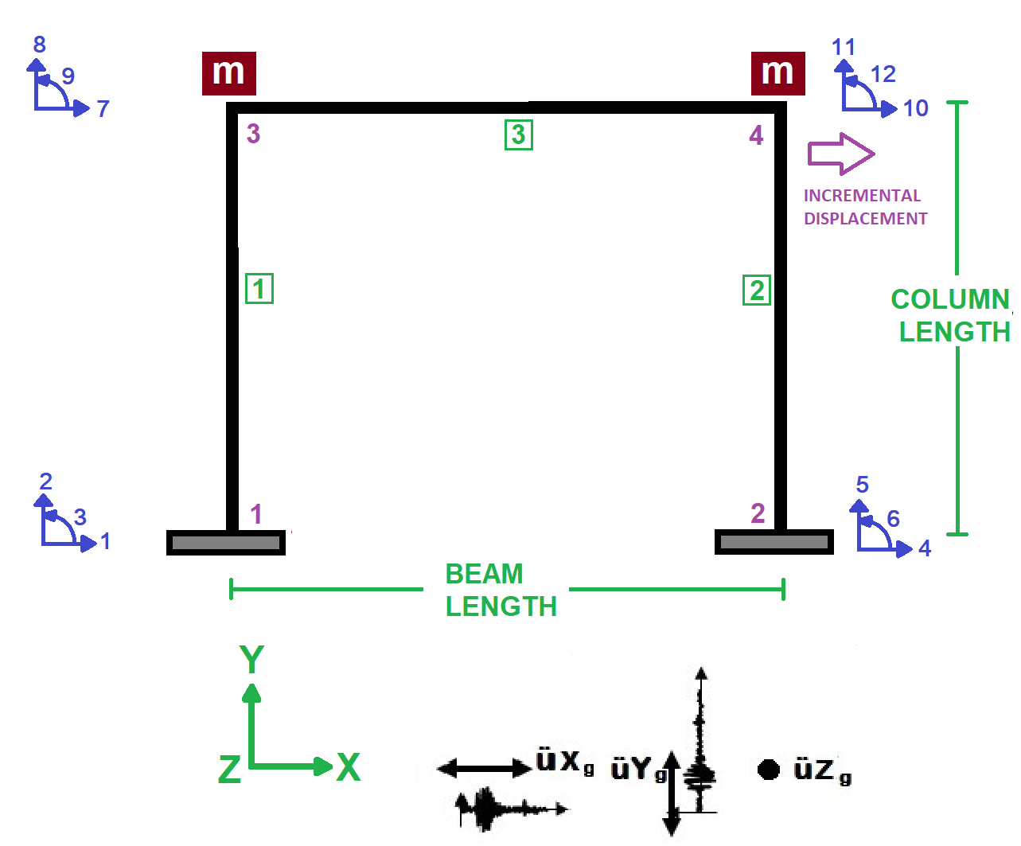

Slide 3
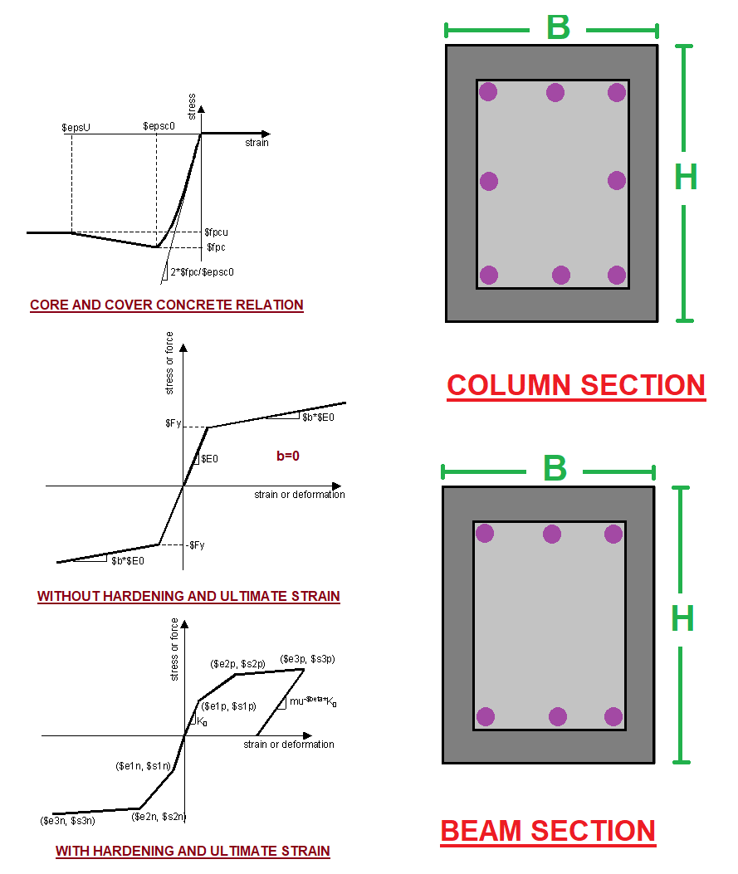

Slide 4
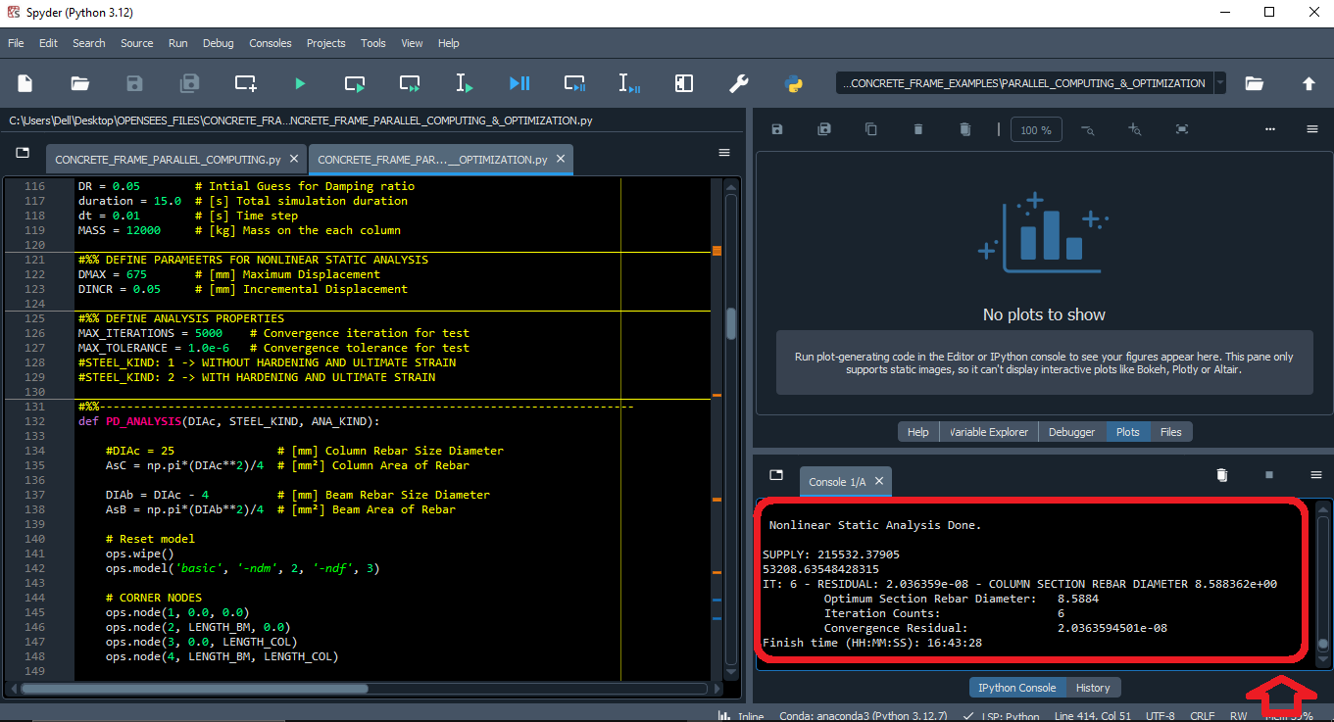

Slide 5
NONLINEAR STATIC ANALYSIS
(PUSHOVER)

Slide 6
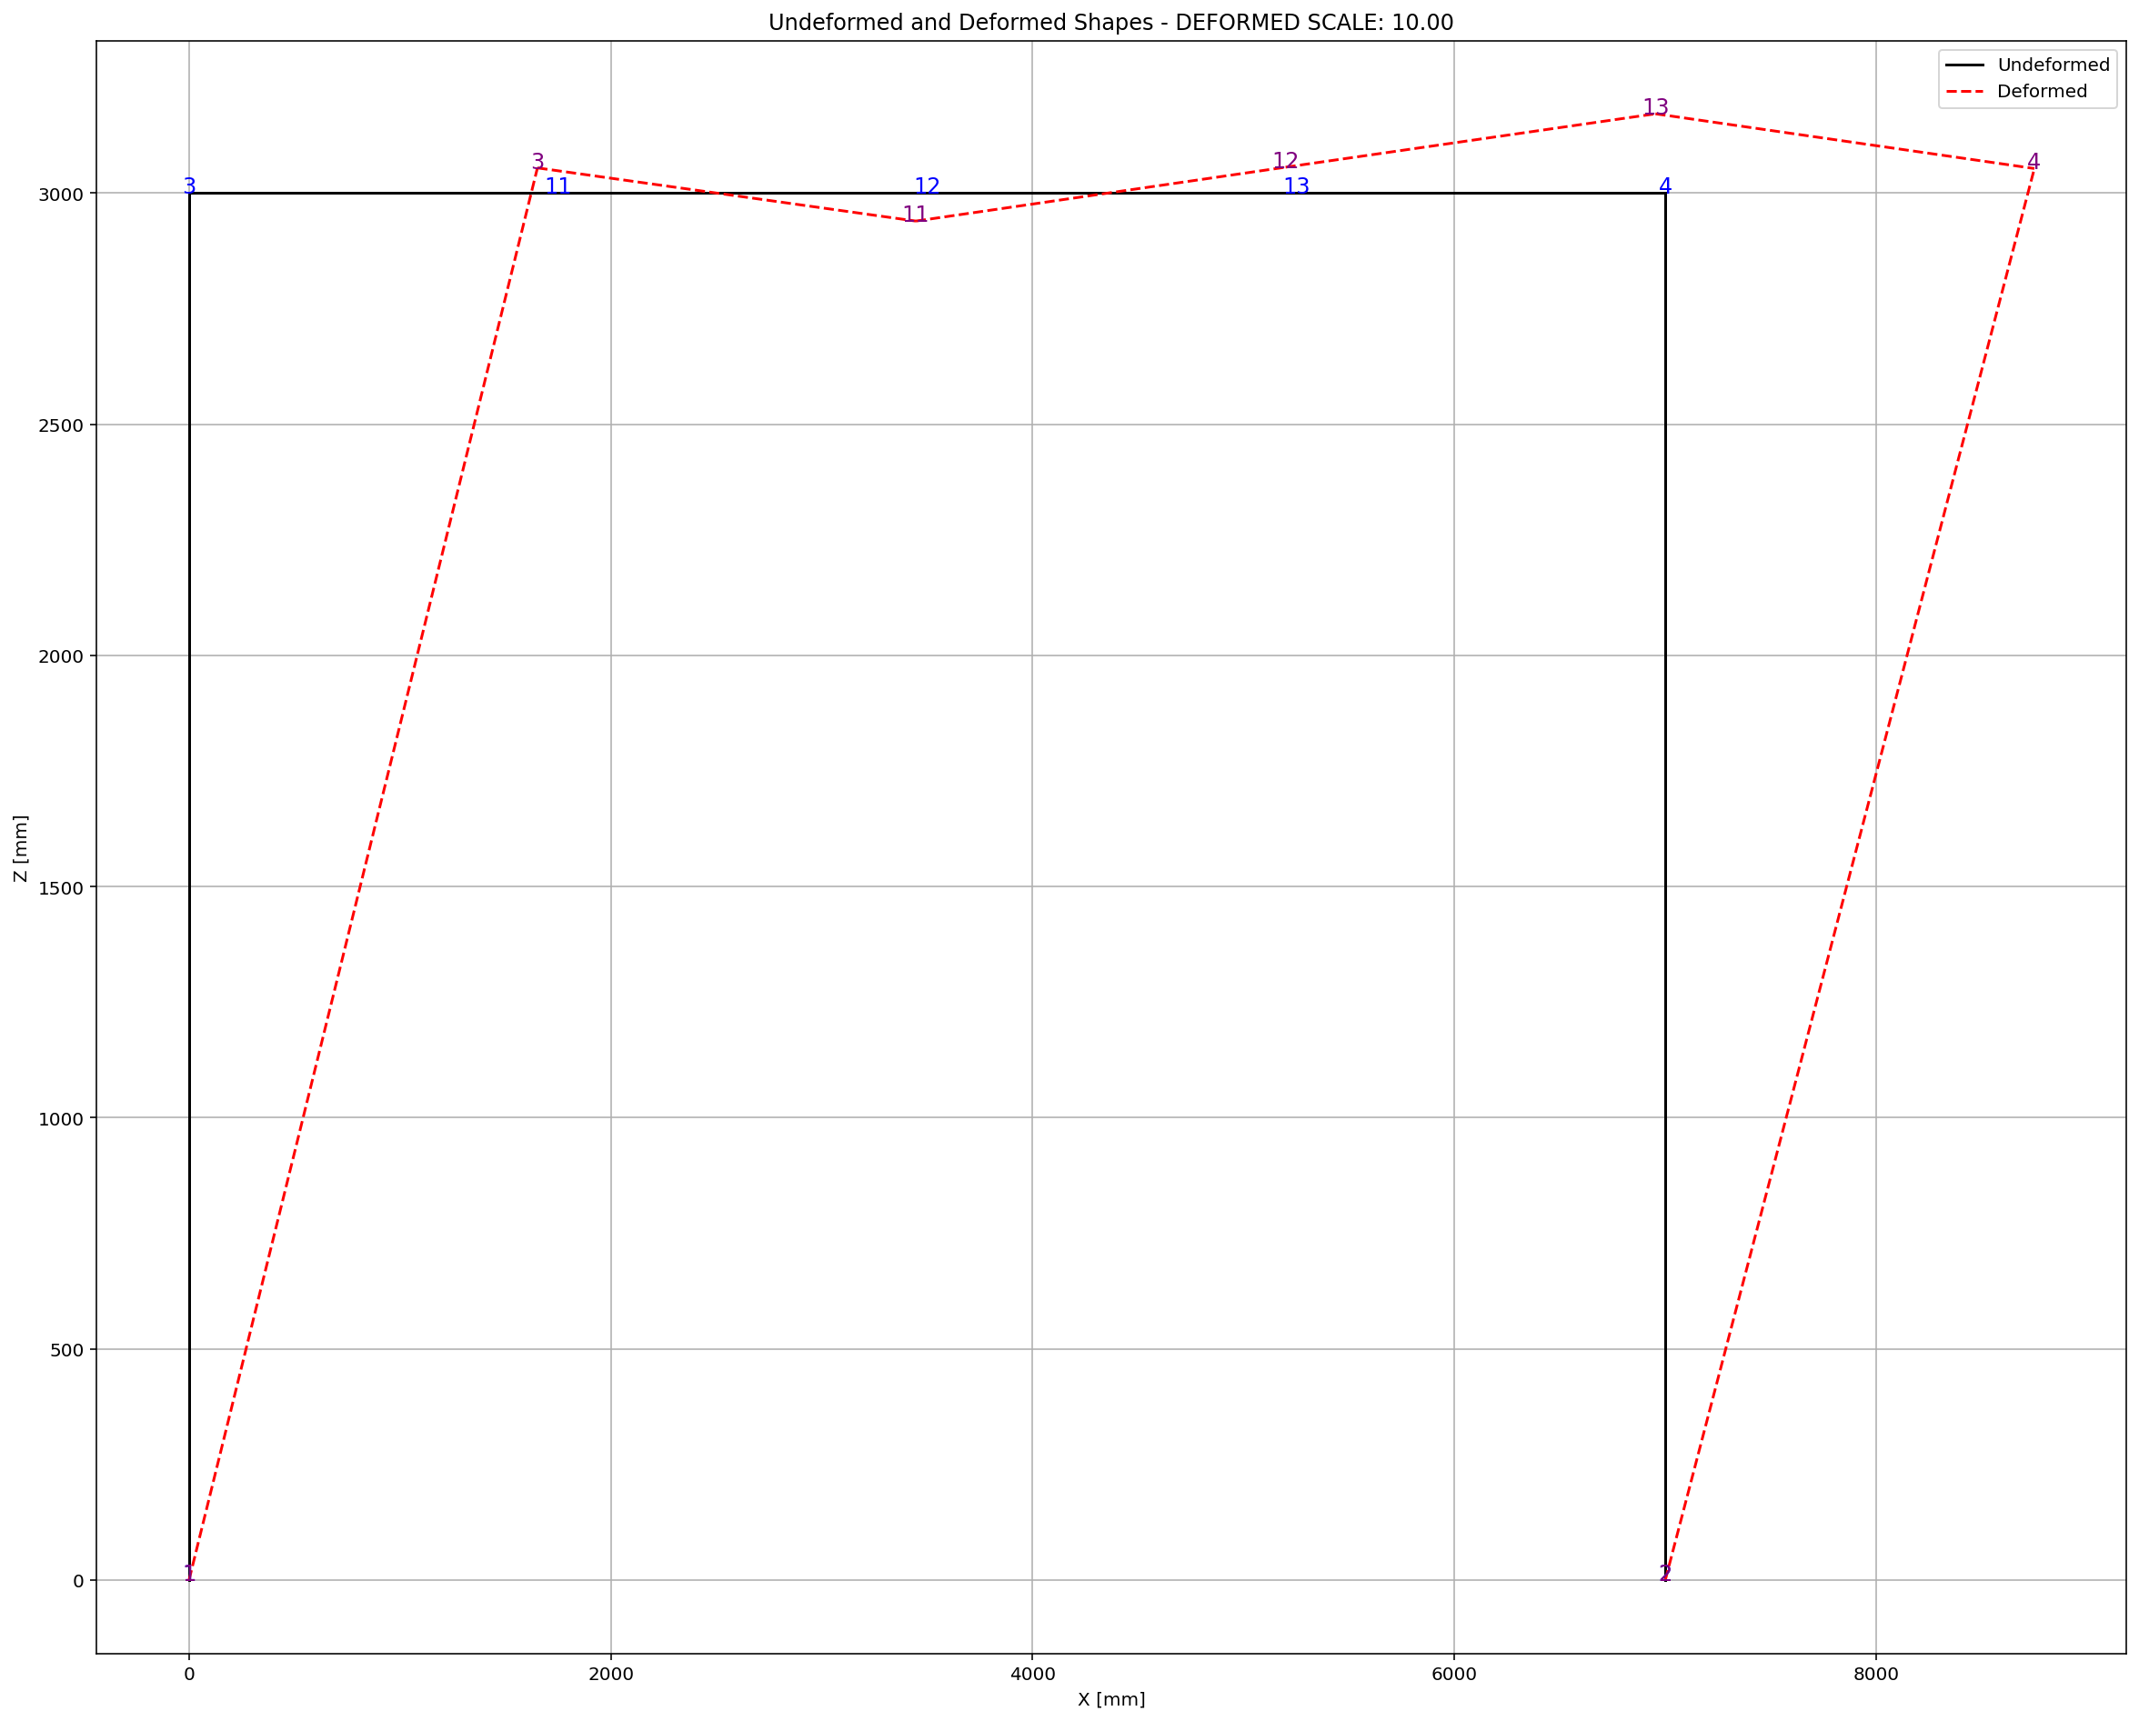

Slide 7
Start time (HH:MM:SS): 16:38:29
SUPPLY: 215532.37905
53208.63548428315
IT: 6 - RESIDUAL: 2.036359e-08 - COLUMN SECTION REBAR DIAMETER 8.588362e+00
Optimum Section Rebar Diameter: 8.5884
Iteration Counts: 6
Convergence Residual: 2.0363594501e-08
Finish time (HH:MM:SS): 16:43:28

Slide 8
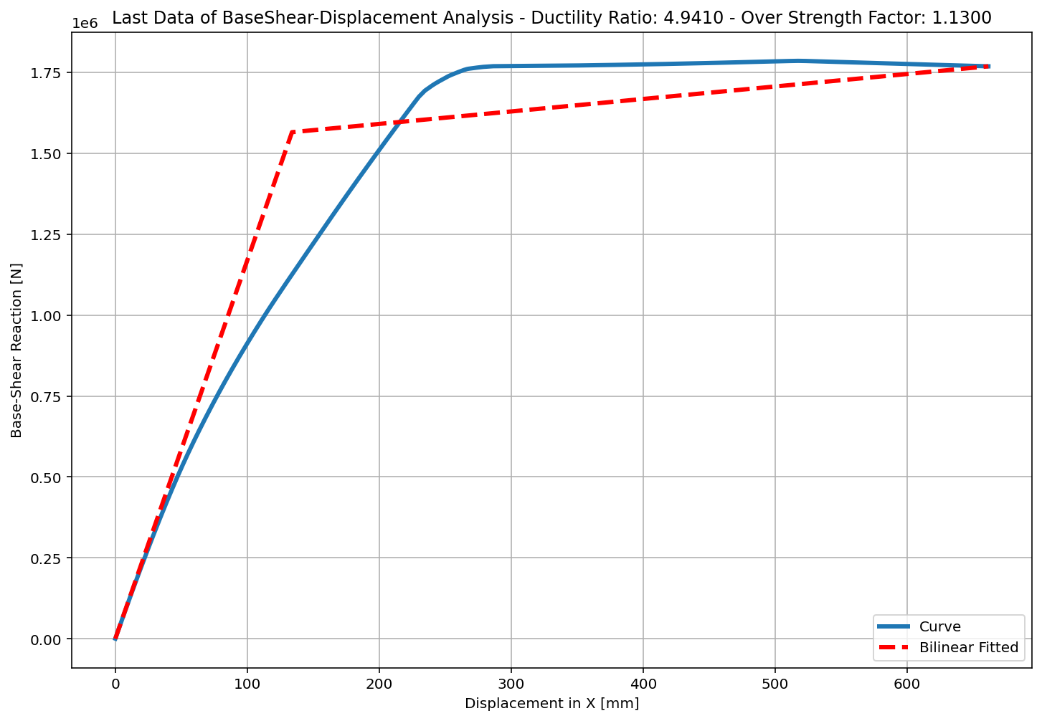

Slide 9
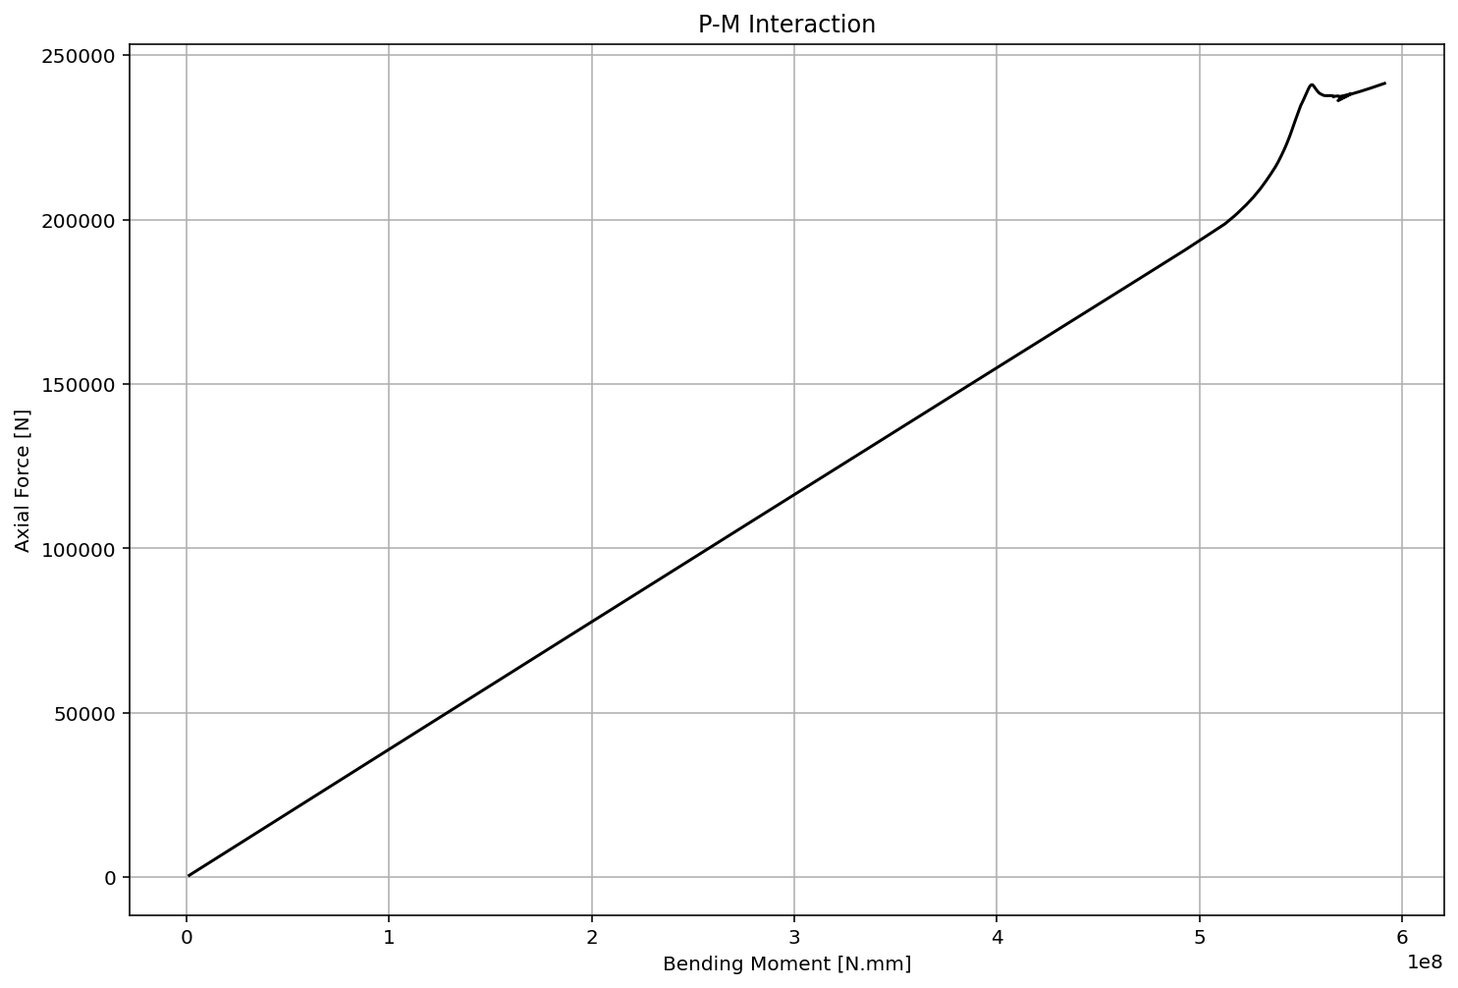

Slide 10
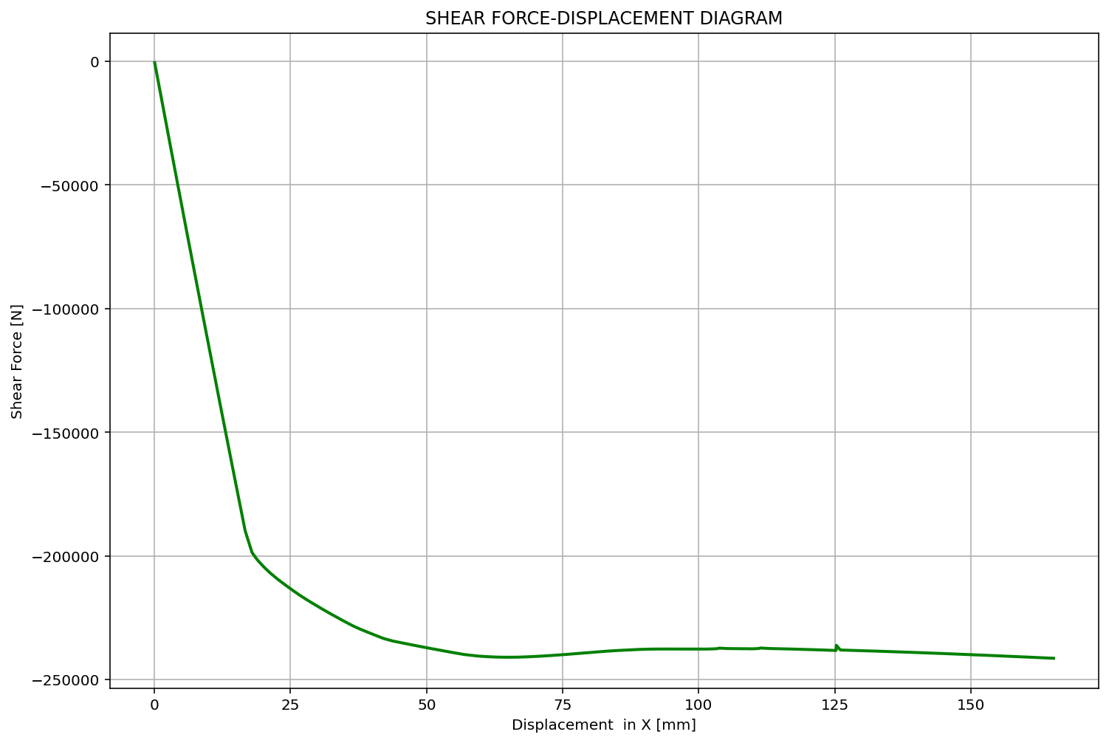

Slide 11
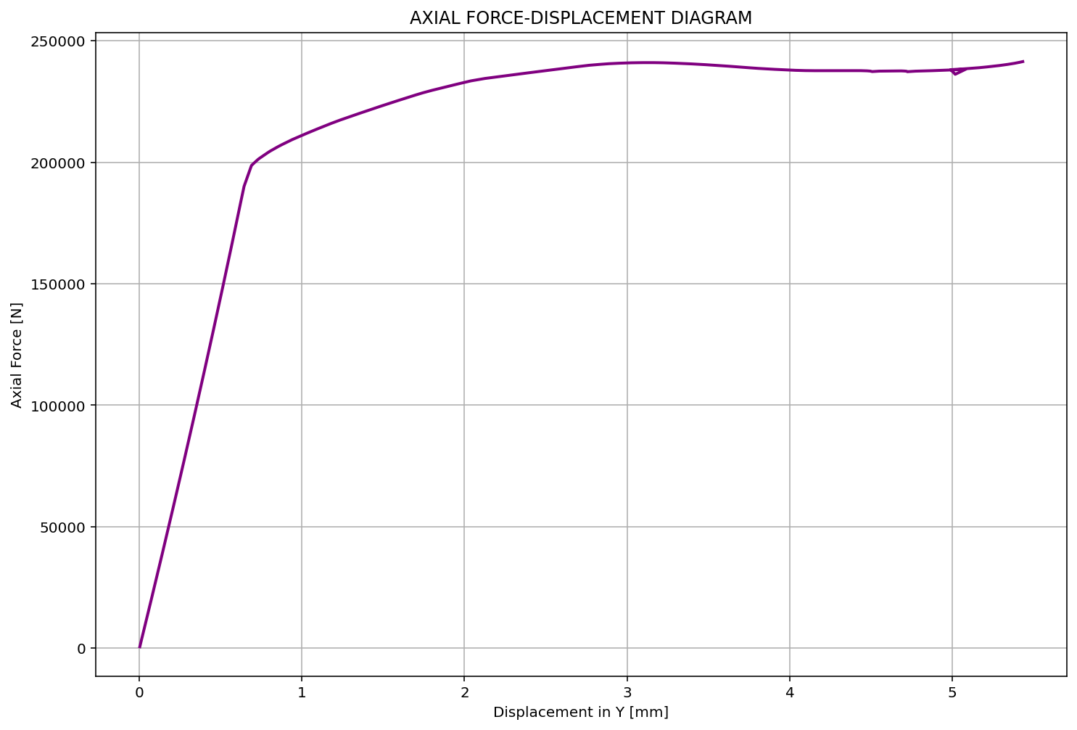

Slide 12
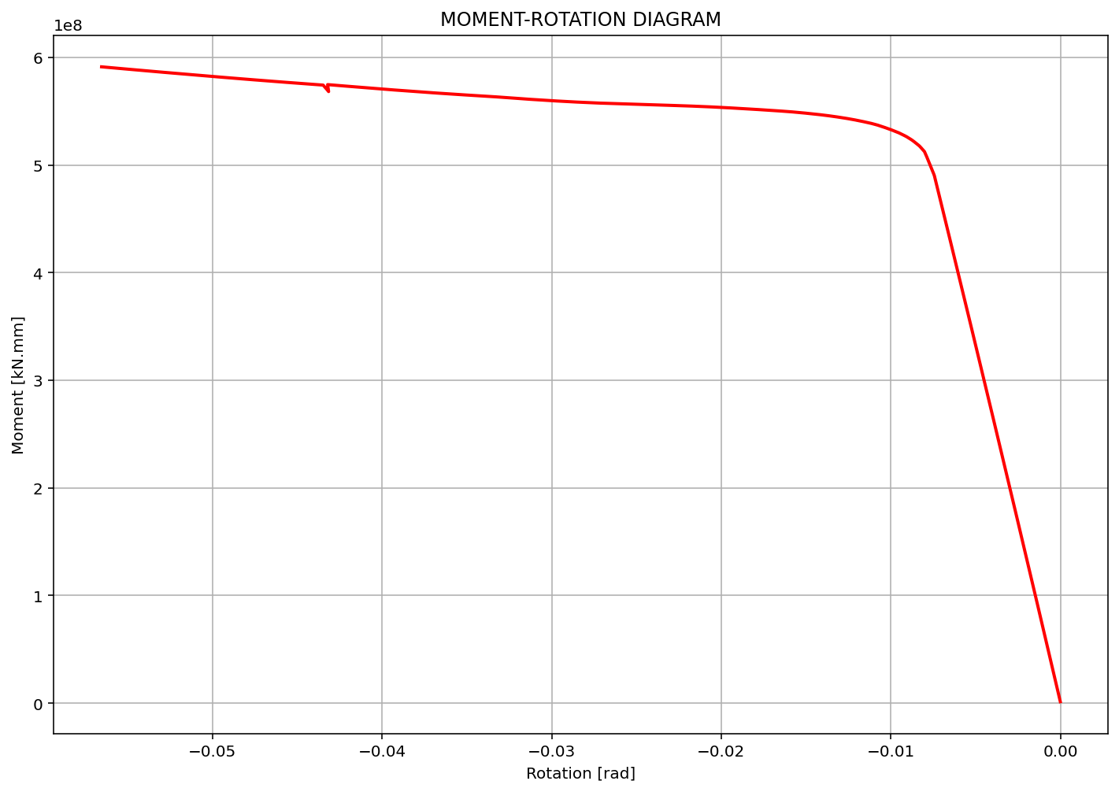

Slide 13
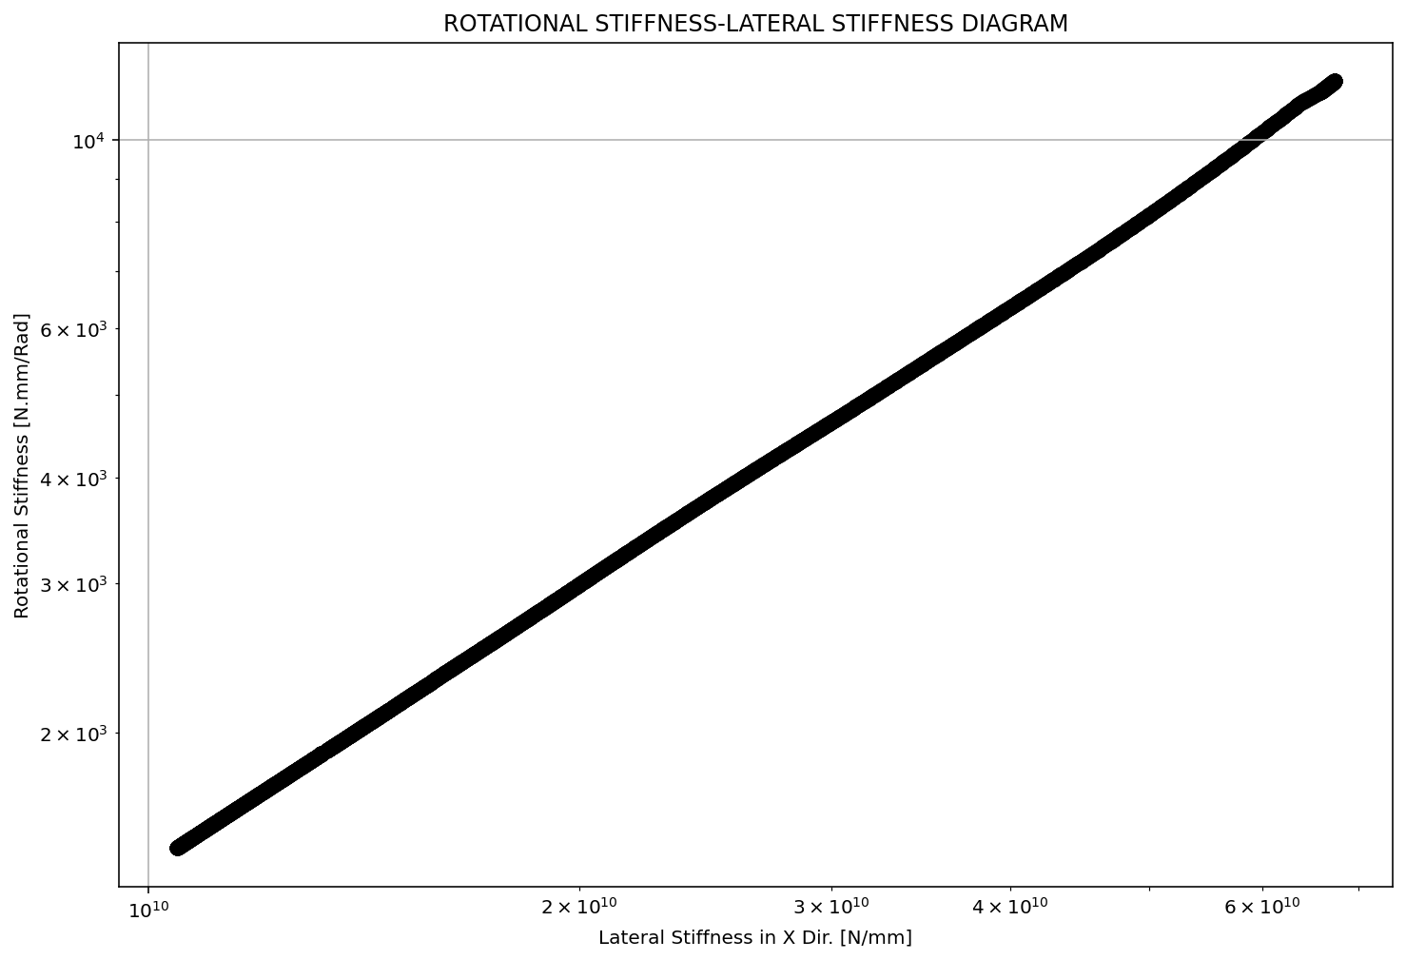

Slide 14
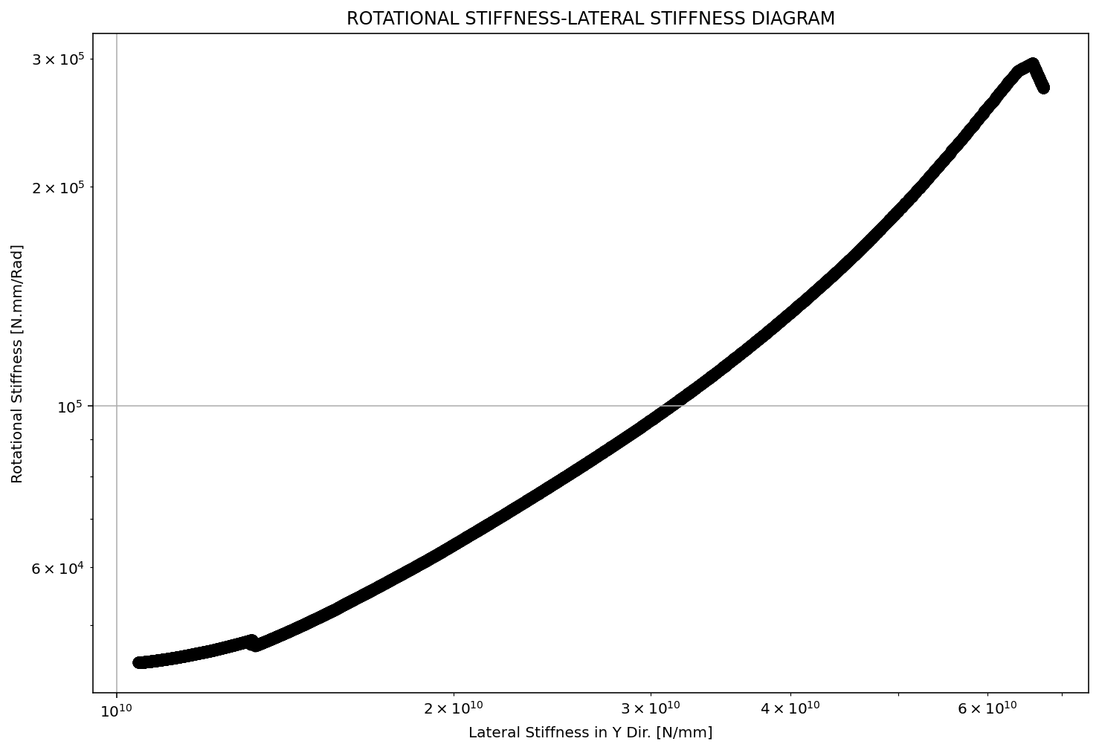

Slide 15
