Slide 1
IN THE NAME OF ALLAH, THE MOST GRACIOUS, THE MOST MERCIFUL
CONCRETE COLUMN SECTION REBAR OPTIMIZATION BASED ON DEMAND BASE-SHEAR REACTION.
UTILIZING PARALLEL PROCESSING PROCEDURES FOR THE SIMULTANEOUS EXECUTION OF NONLINEAR STATIC AND DYNAMIC CONCRETE STRUCTURAL ANALYSIS, USING OPENSEES
WRITTEN BY SALAR DELAVAR GHASHGHAEI (QASHQAI)

Slide 2
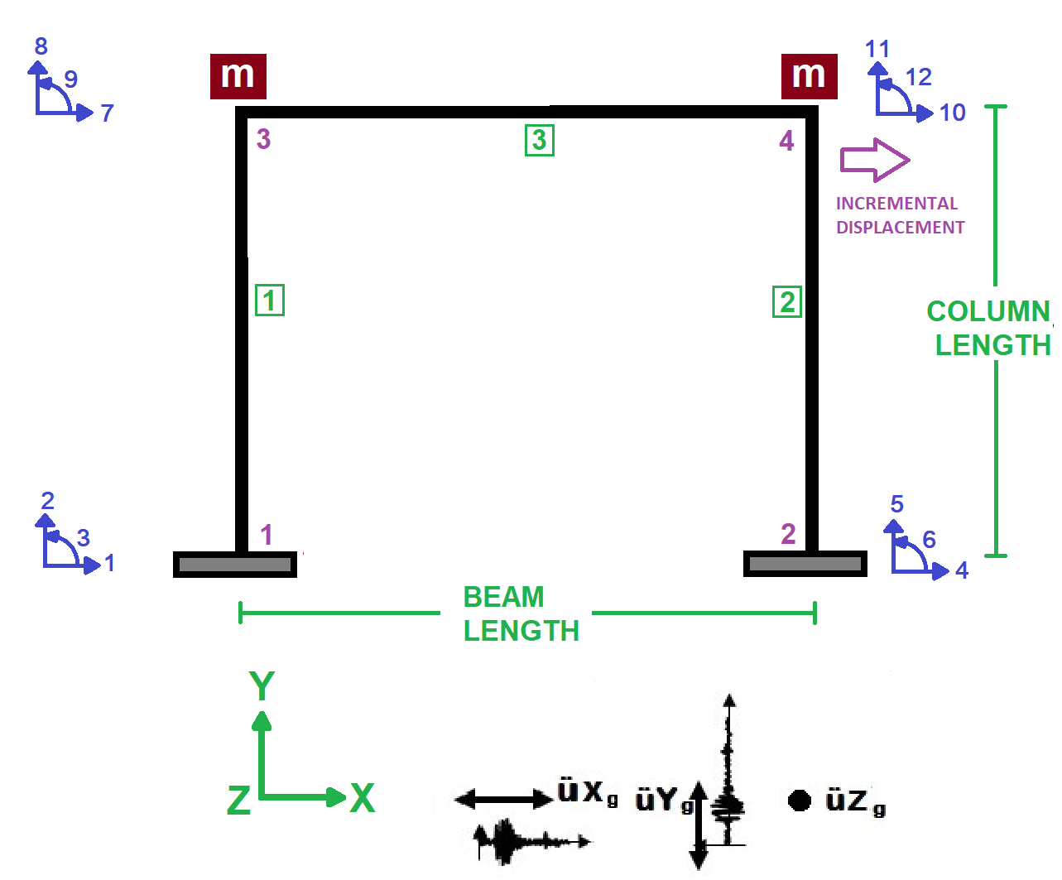

Slide 3
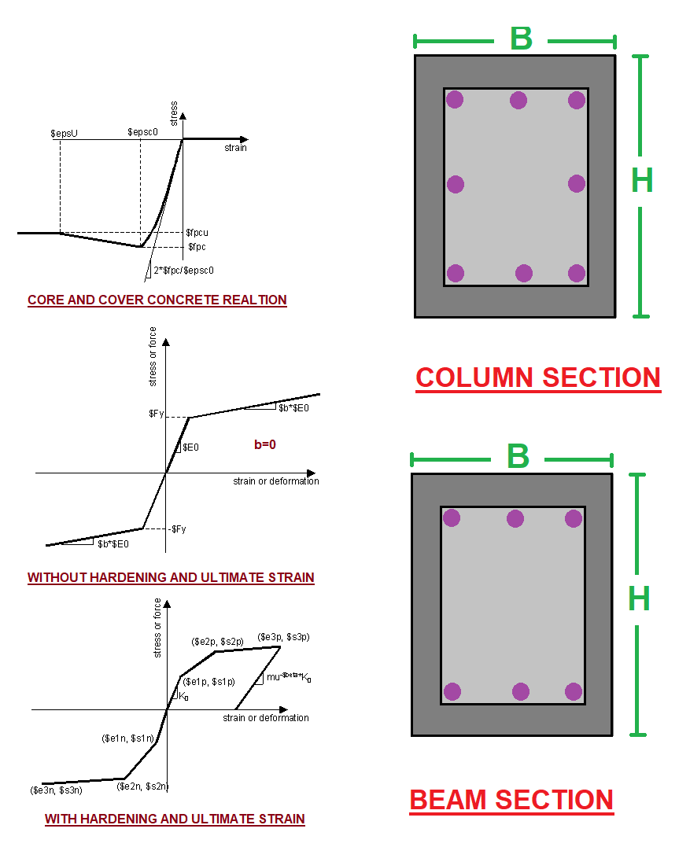

Slide 4
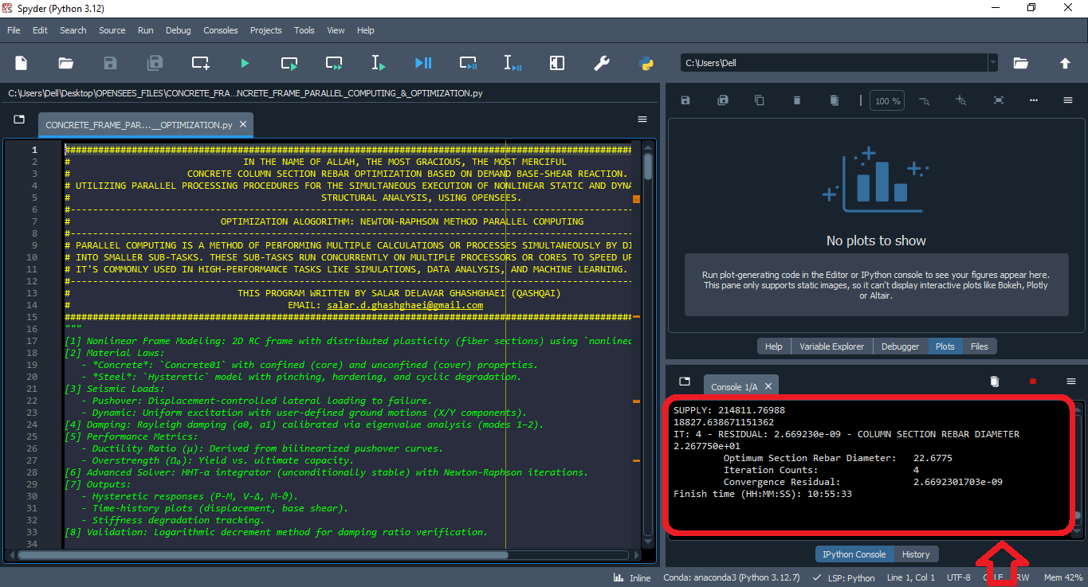

Slide 5
NONLINEAR STATIC ANALYSIS
(PUSHOVER)

Slide 6
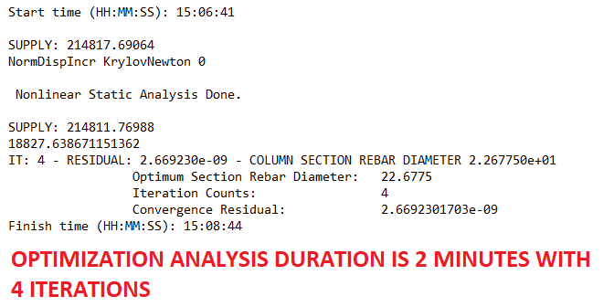

Slide 7
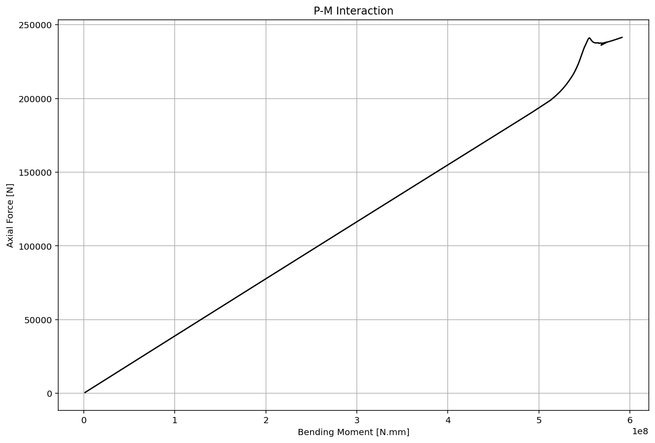

Slide 8
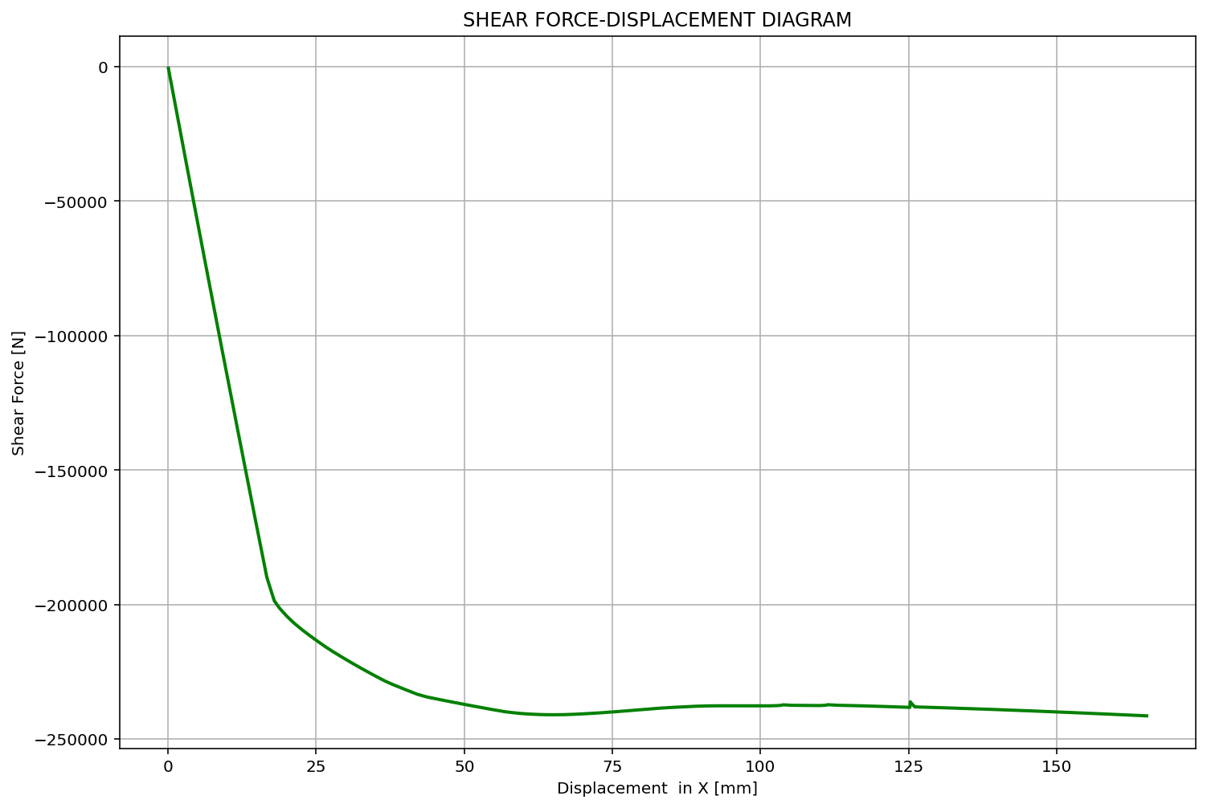

Slide 9
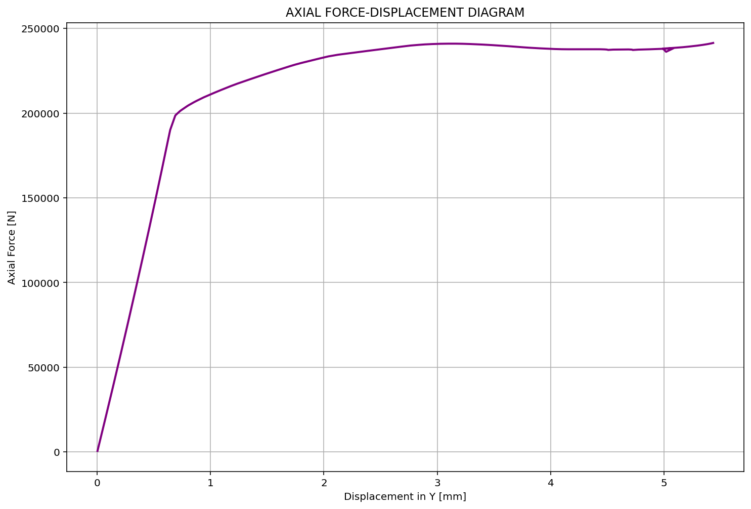

Slide 10
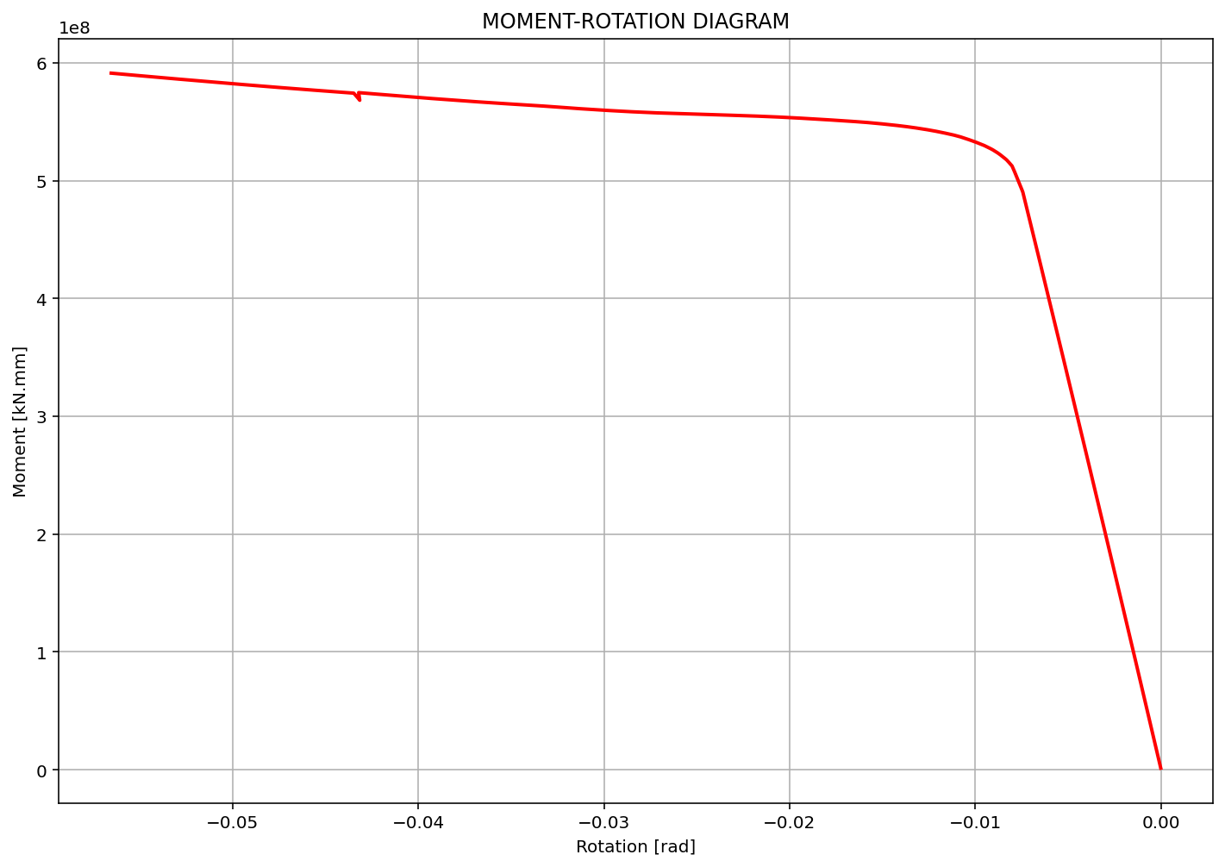

Slide 11
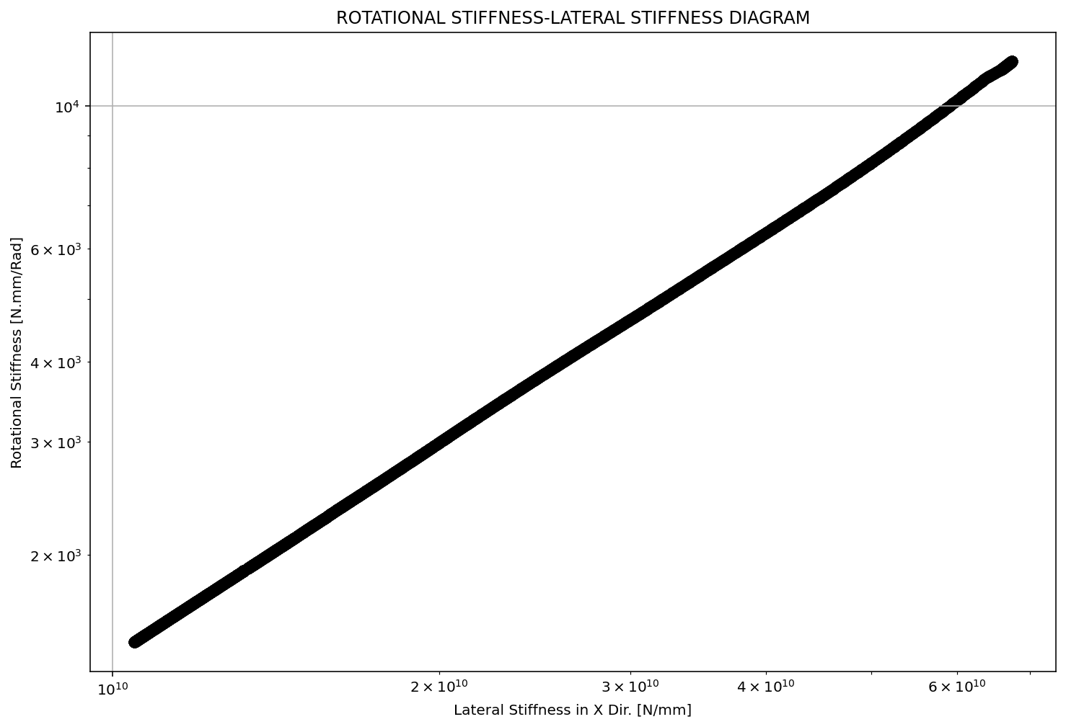

Slide 12
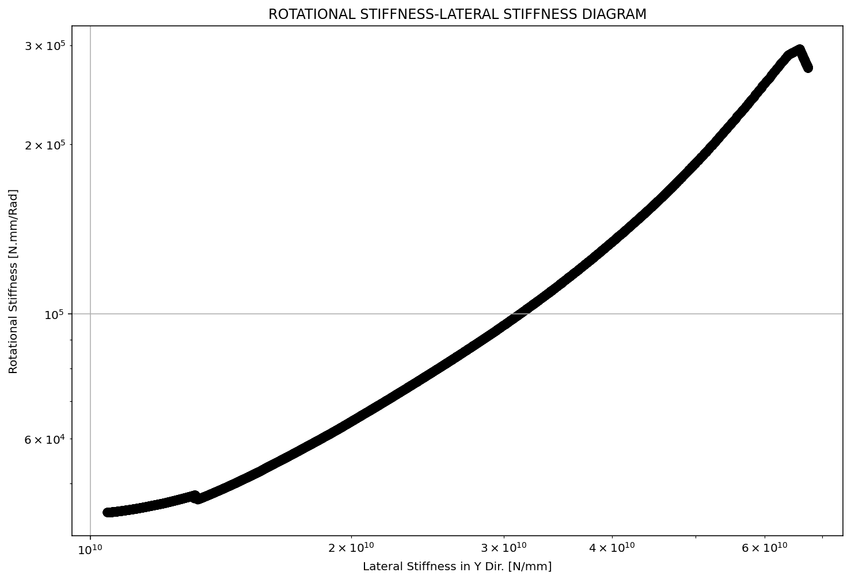

Slide 13
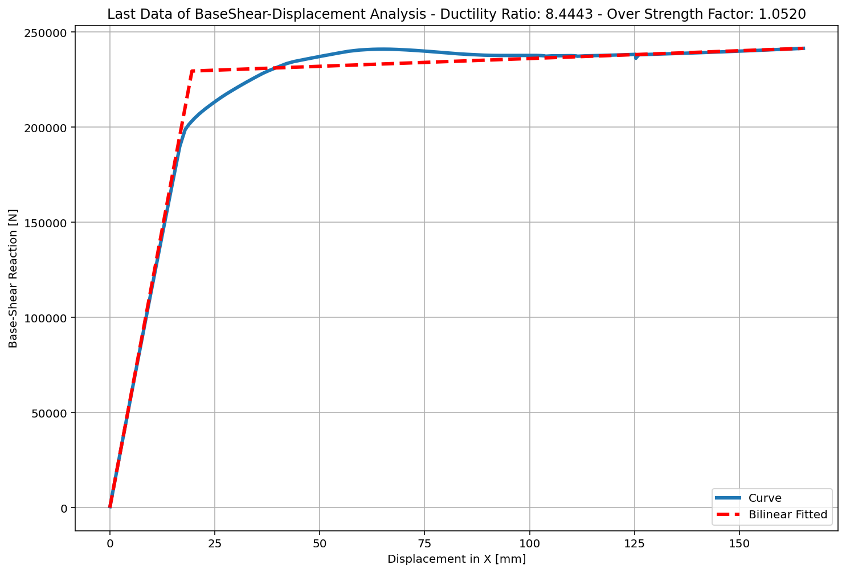

Slide 14
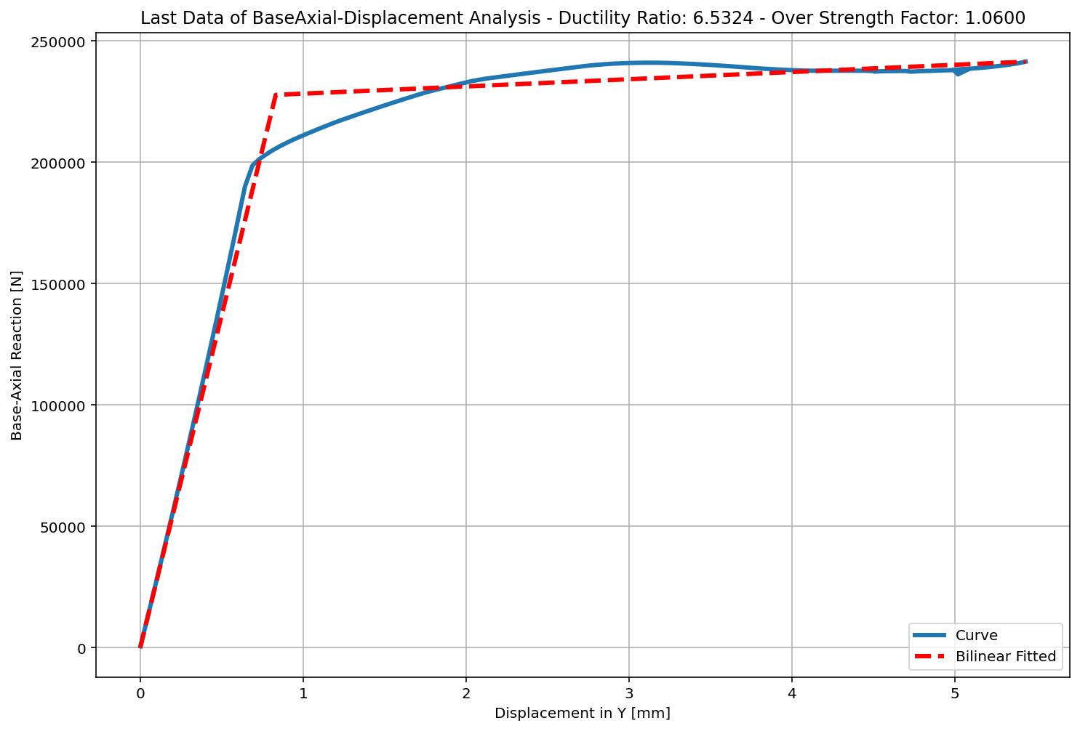

Slide 15
