Slide 1
>> IN THE NAME OF ALLAH, THE MOST GRACIOUS, THE MOST MERCIFUL <<
COMPREHENSIVE NONLINEAR SEISMIC ASSESSMENT OF A CONCRETE FRAME: AN OPENSEES FRAMEWORK FOR STATIC PUSHOVER, CYCLIC DEGRADATION, STATIC TIME-HISTORY AND DYNAMIC TIME-HISTORY ANALYSIS
THIS PROGRAM IS WRITTEN BY SALAR DELAVAR GHASHGHAEI (QASHQAI)

Slide 2
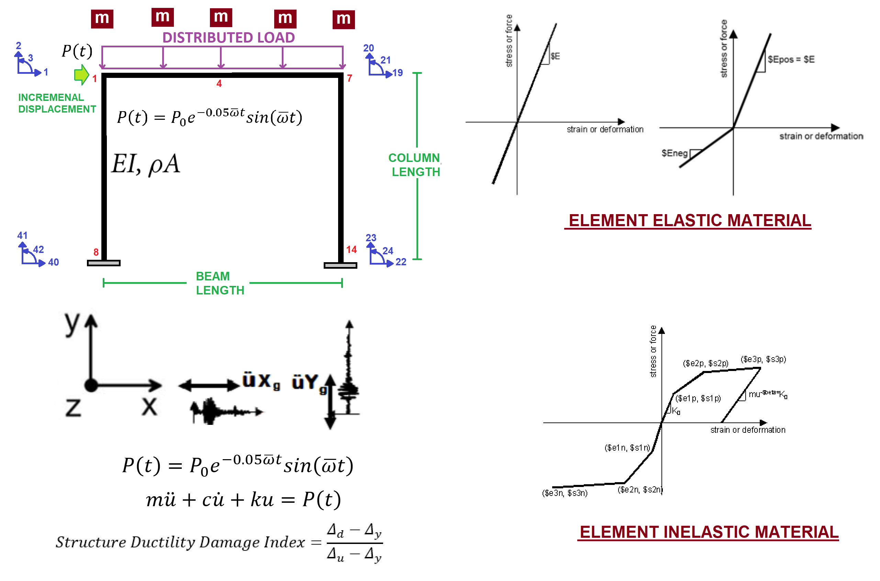

Slide 3
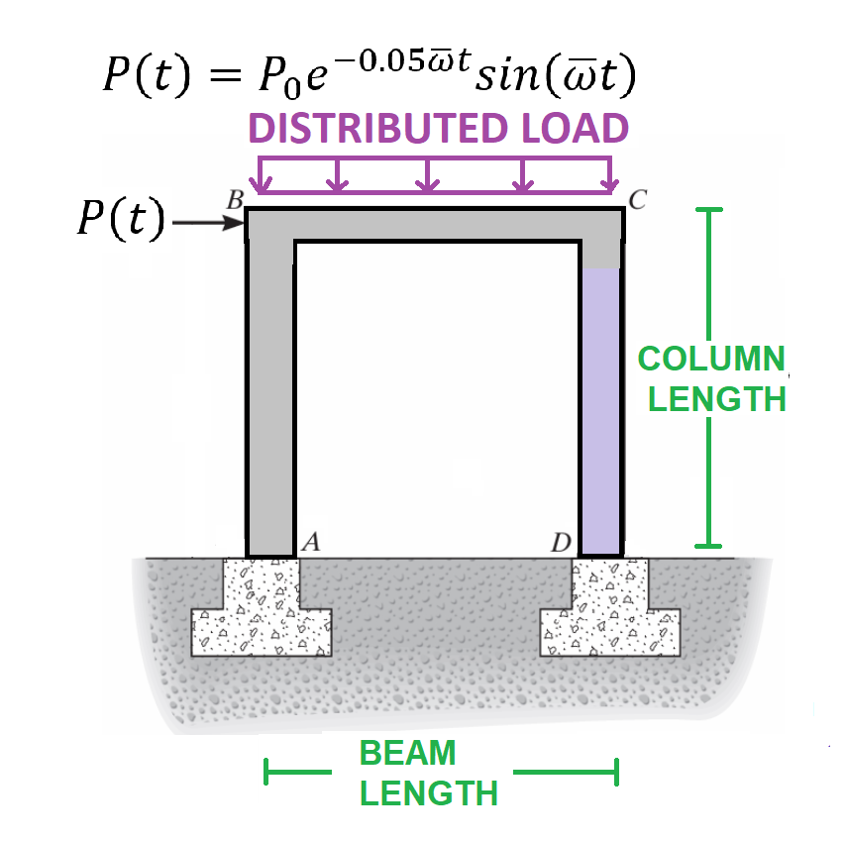

Slide 4
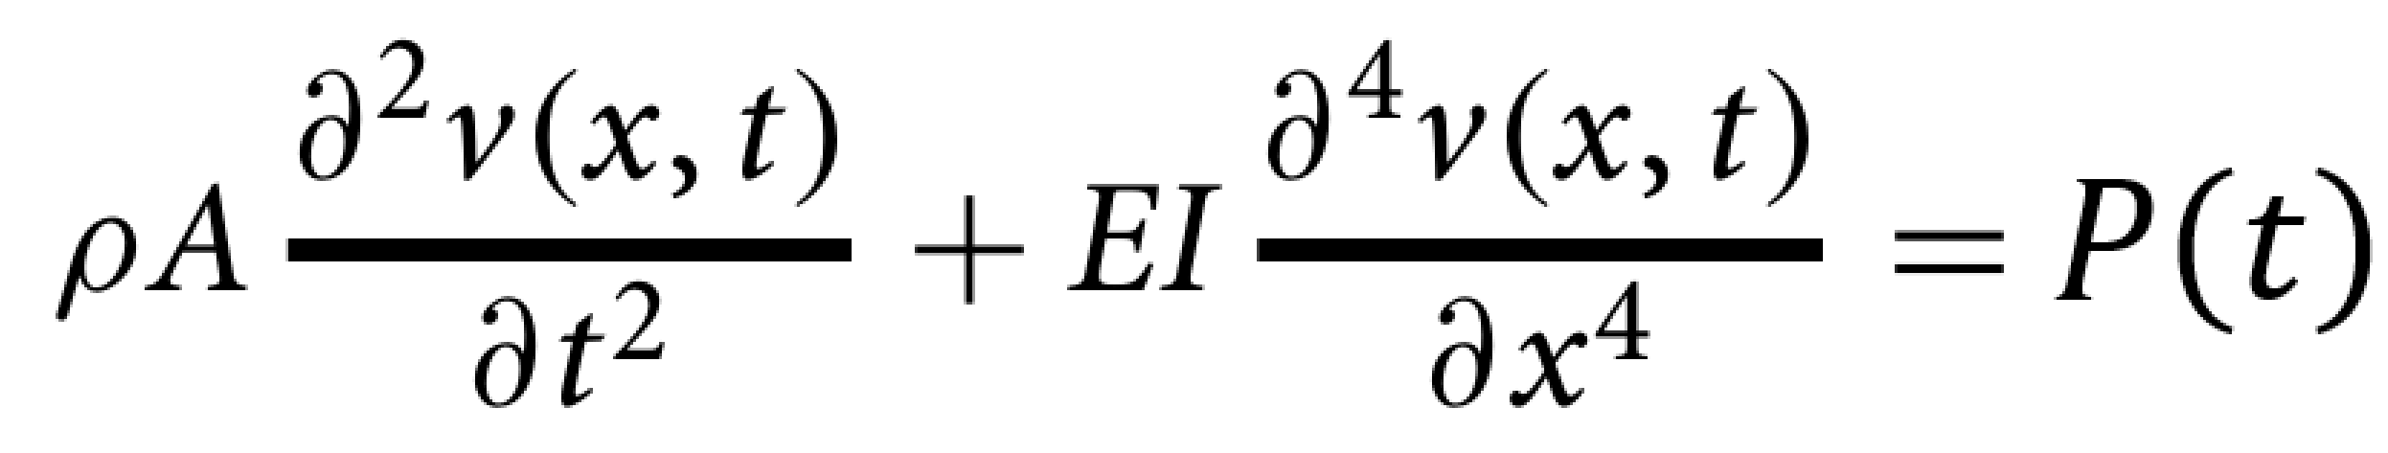

Slide 5
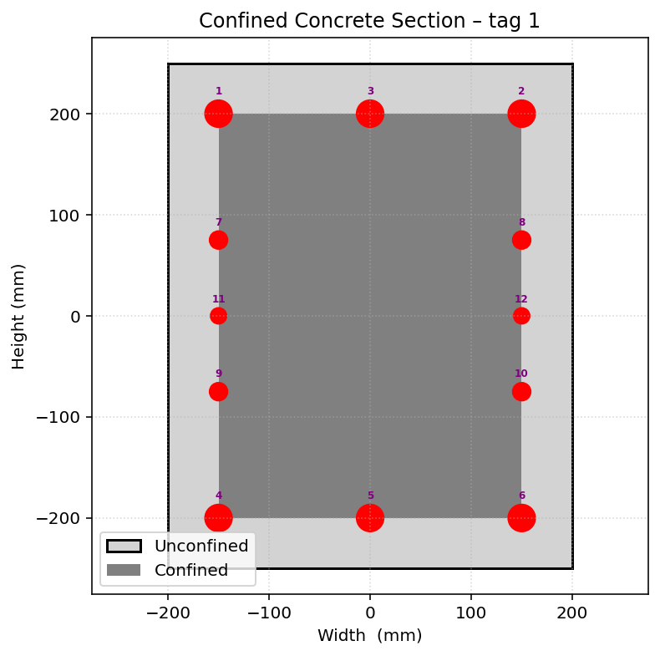
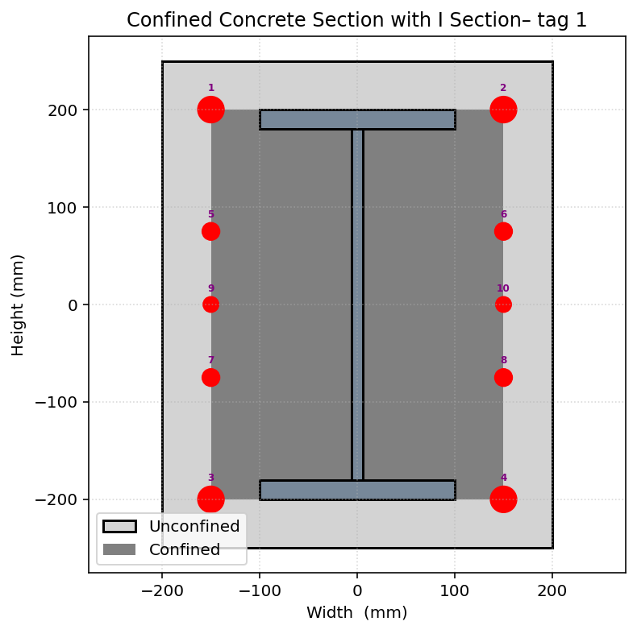

Slide 6
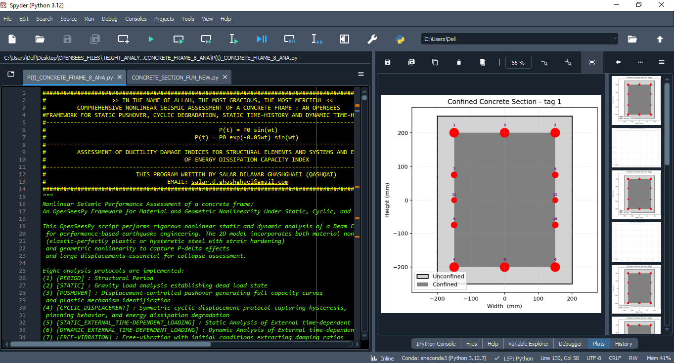

Slide 7
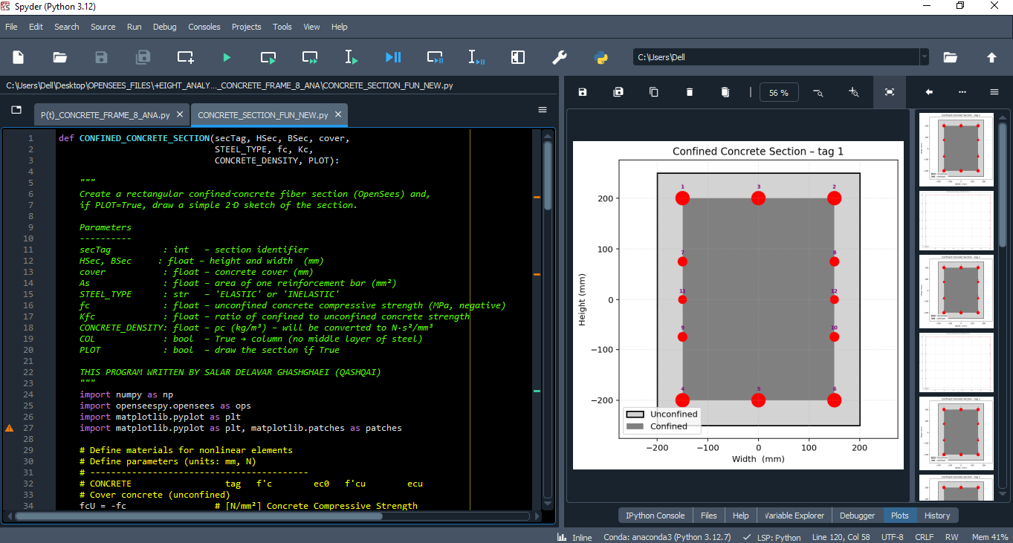

Slide 8
STATIC ANALYSIS

Slide 9
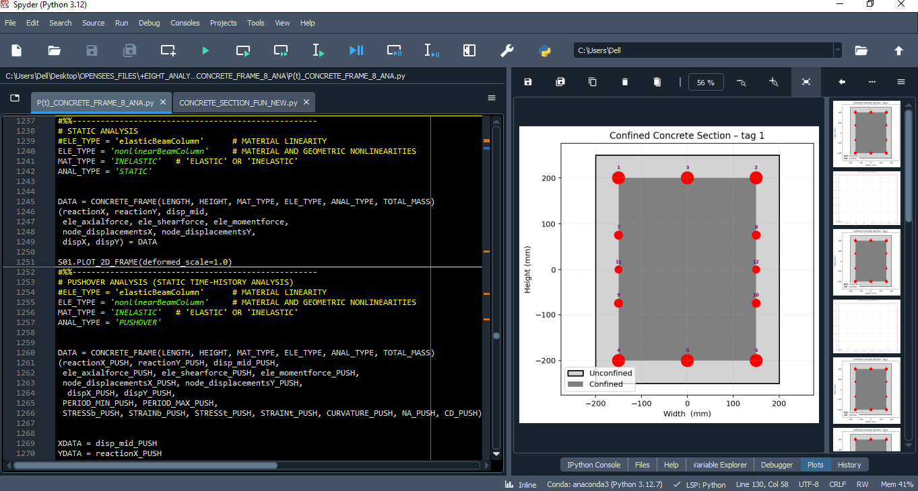

Slide 10
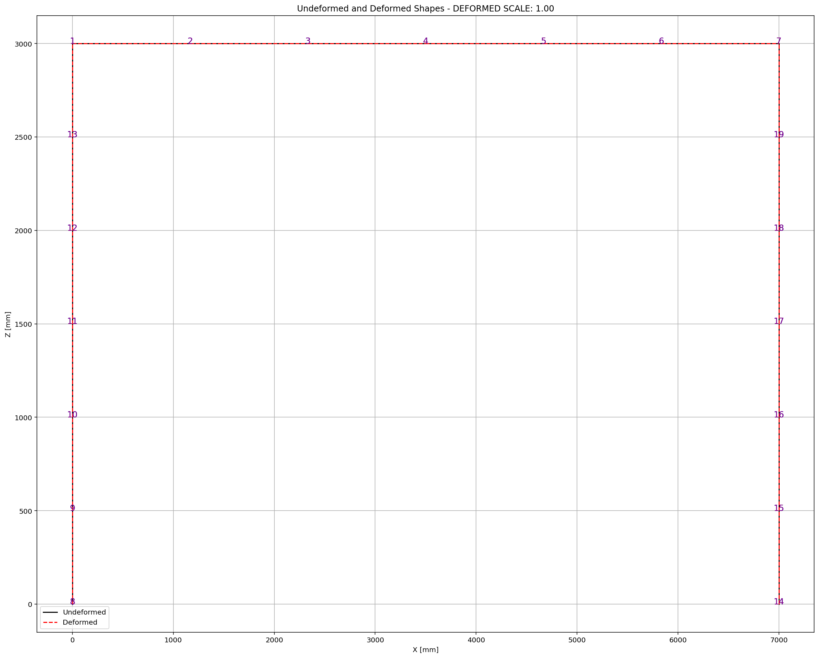

Slide 11
PUSHOVER ANALYSIS

Slide 12
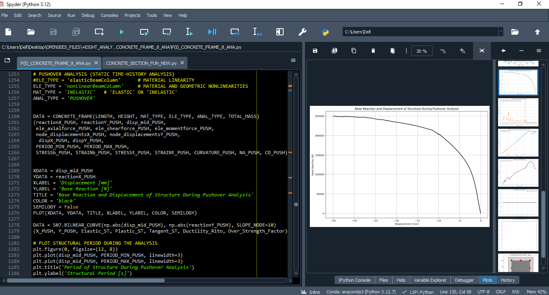

Slide 13
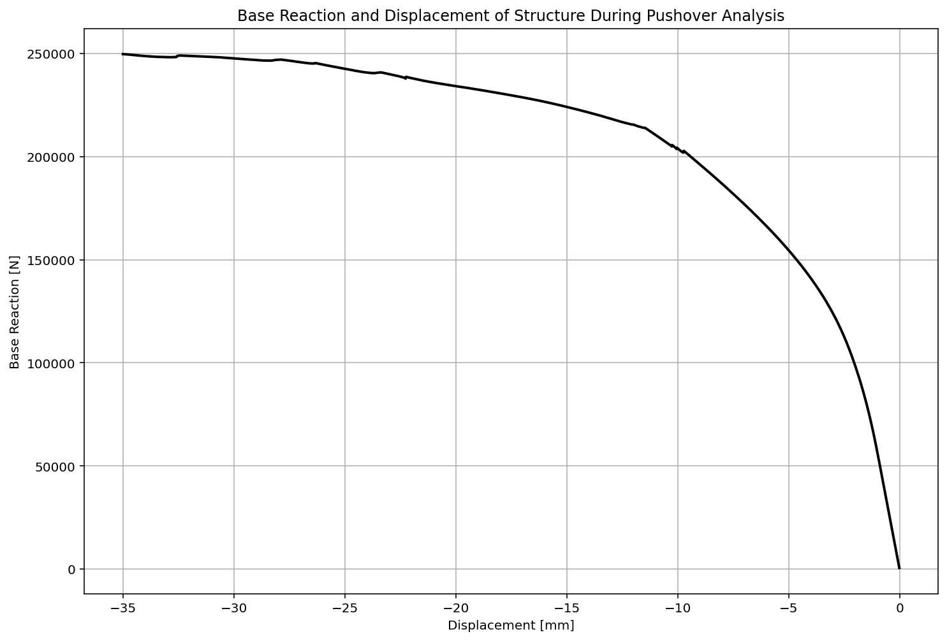

Slide 14
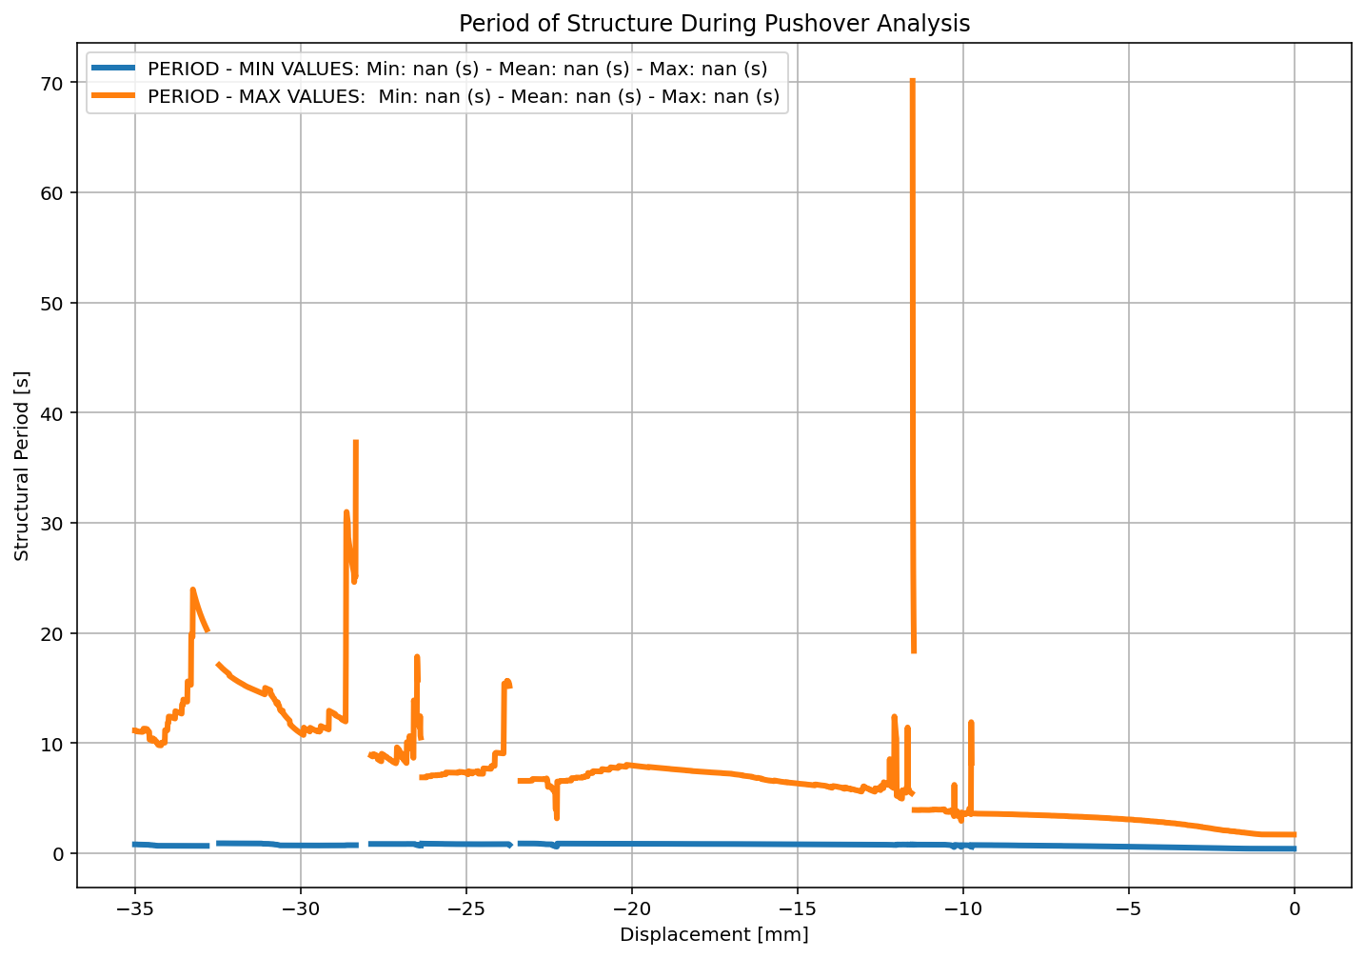

Slide 15
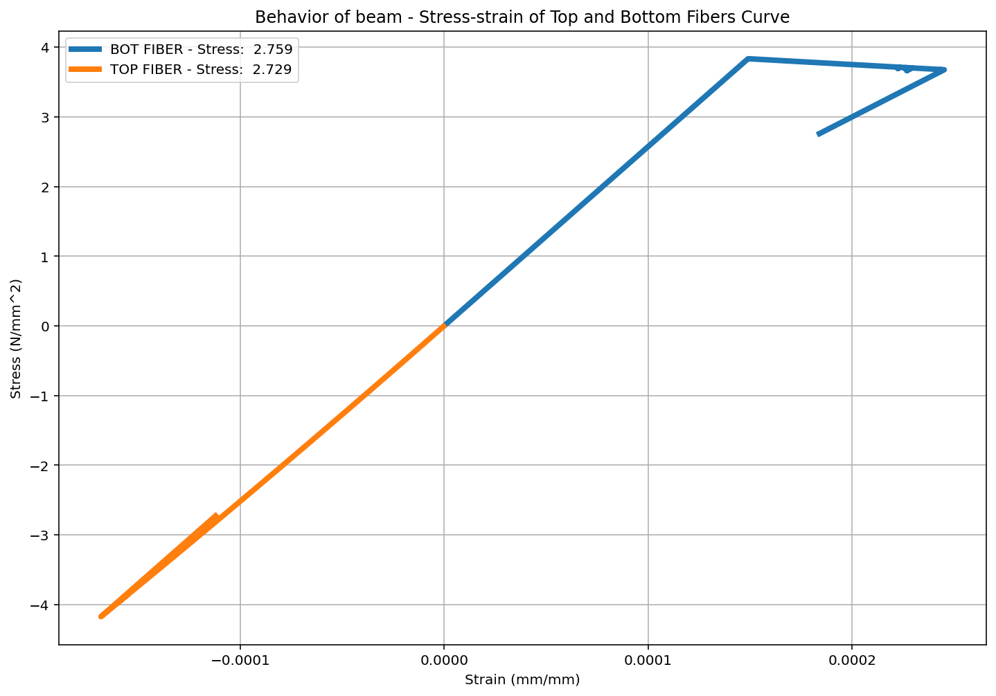

Slide 16
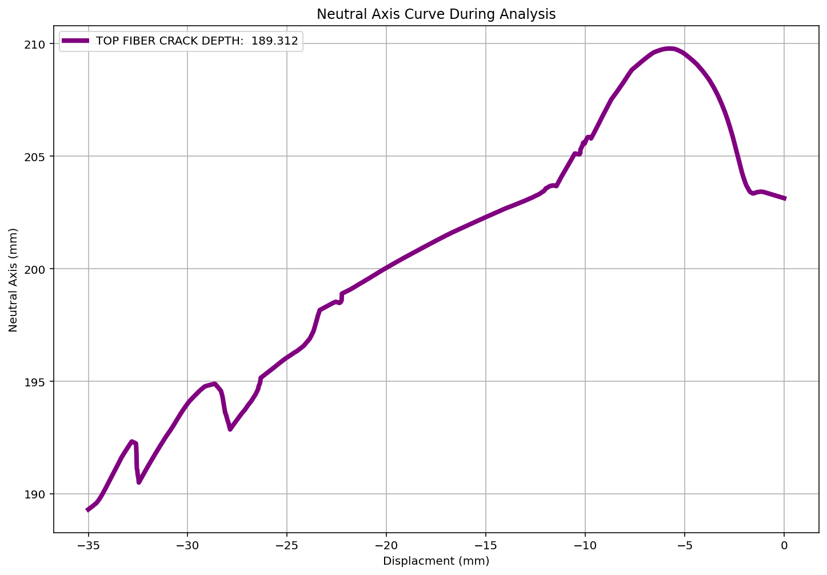

Slide 17
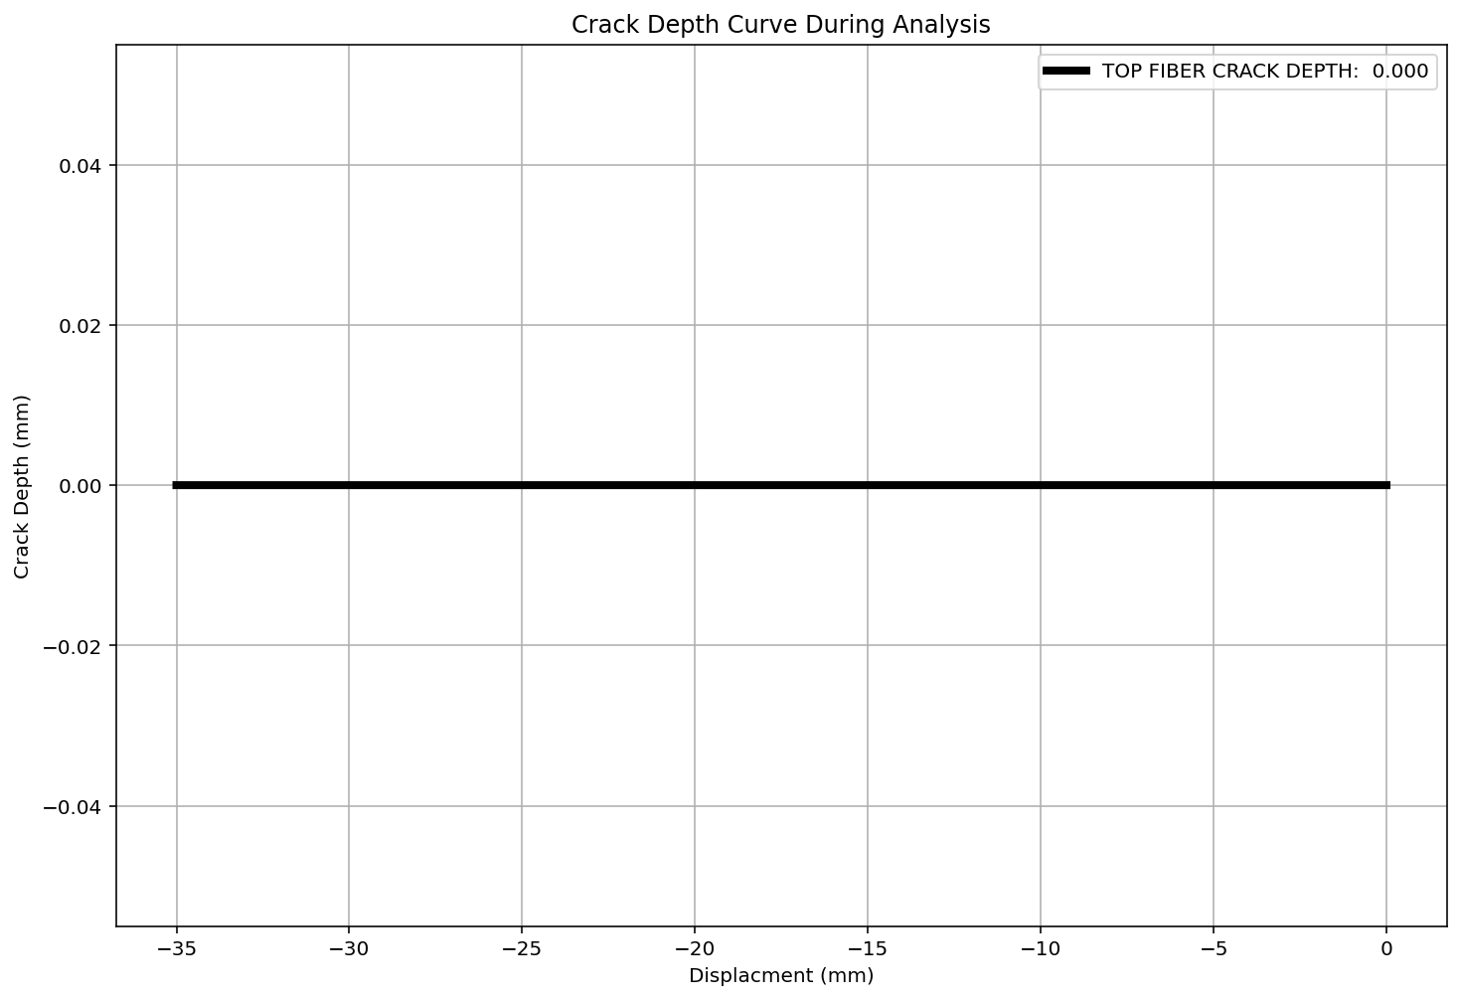

Slide 18
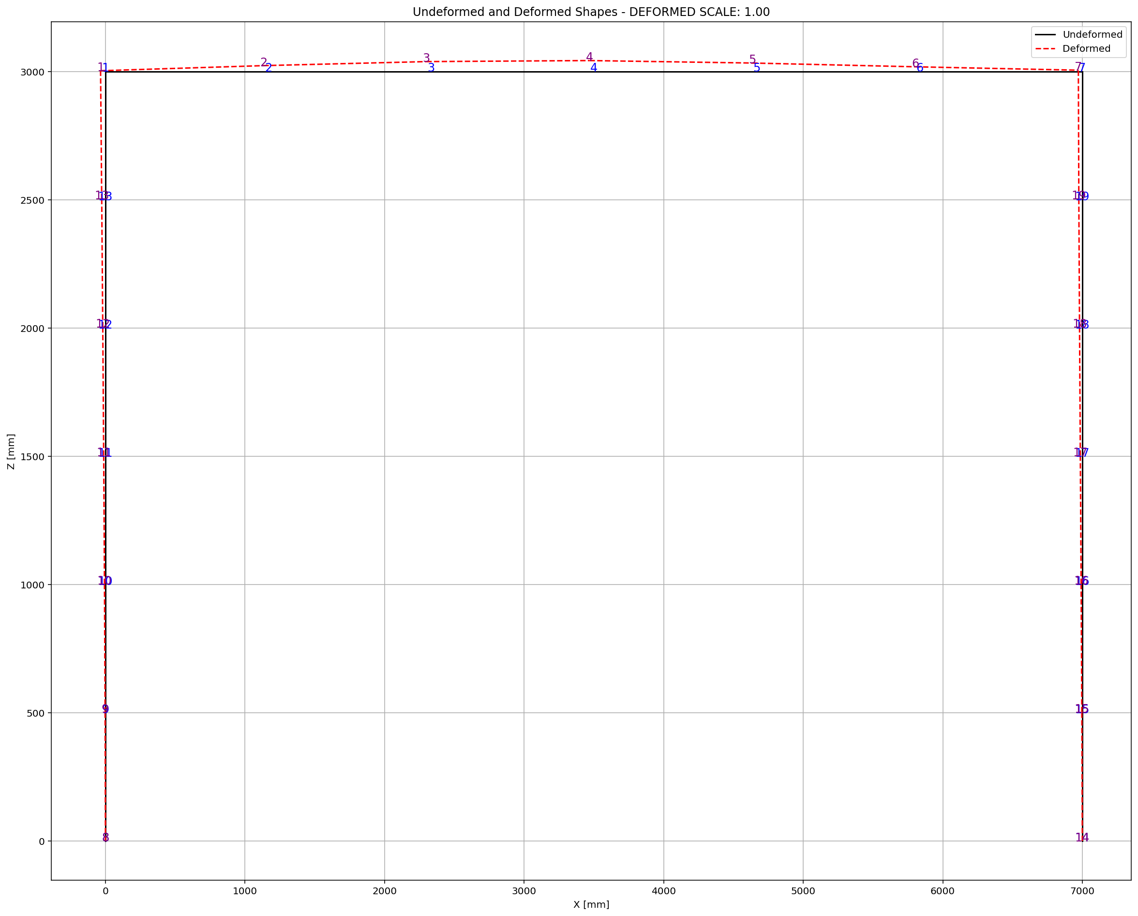

Slide 19
CYCLIC DISPLACEMENT ANALYSIS

Slide 20
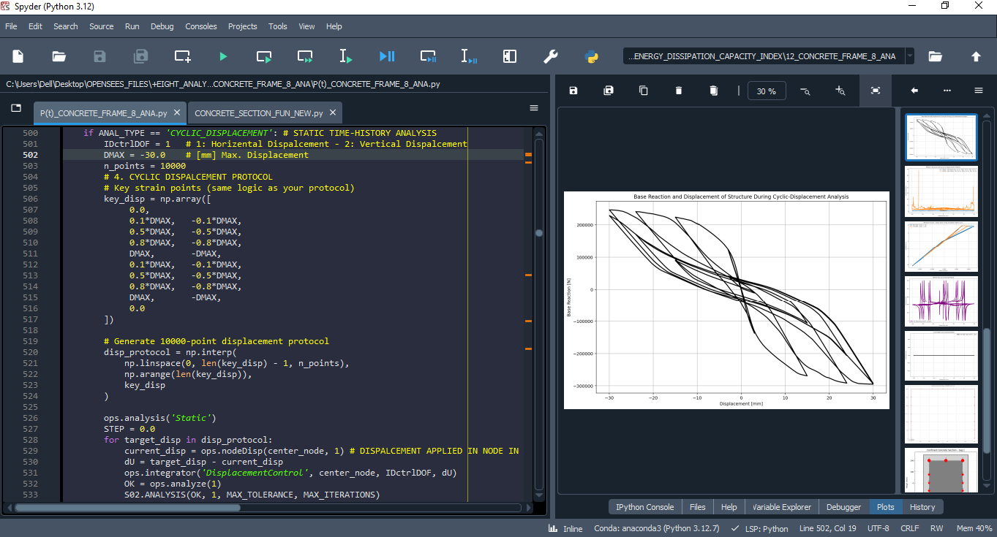

Slide 21
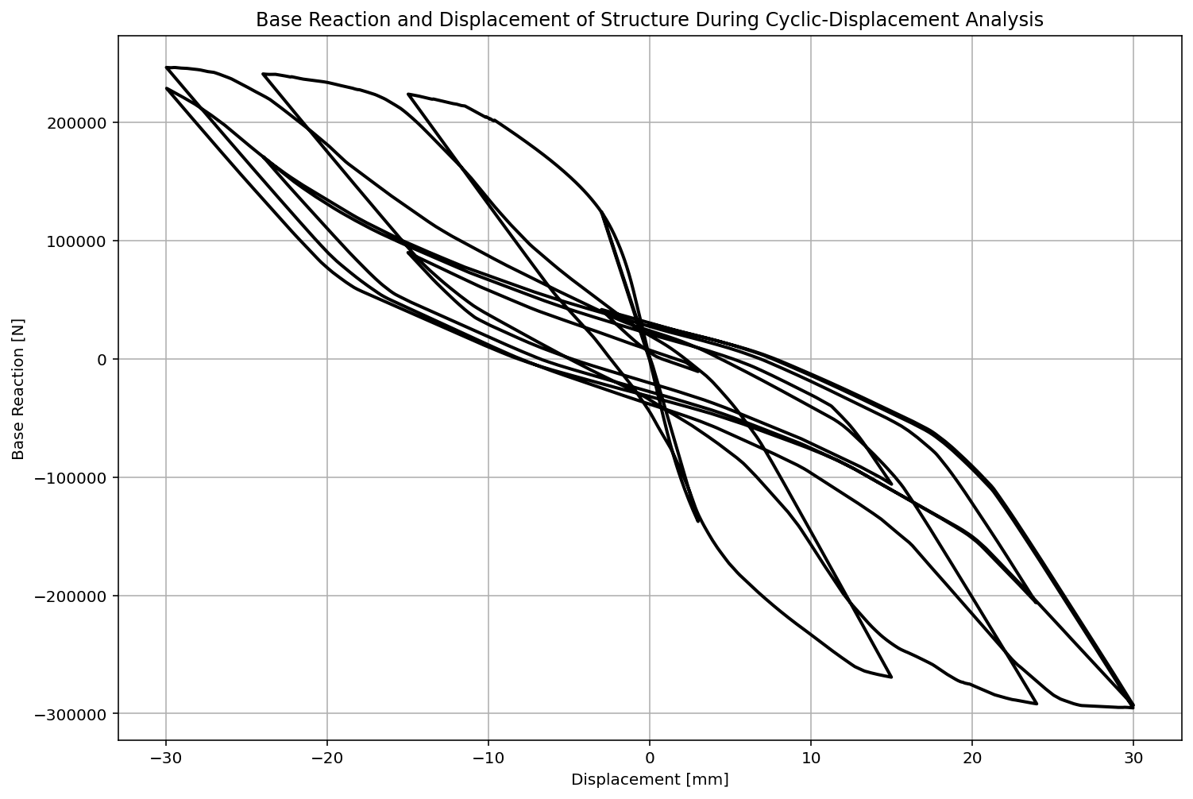

Slide 22
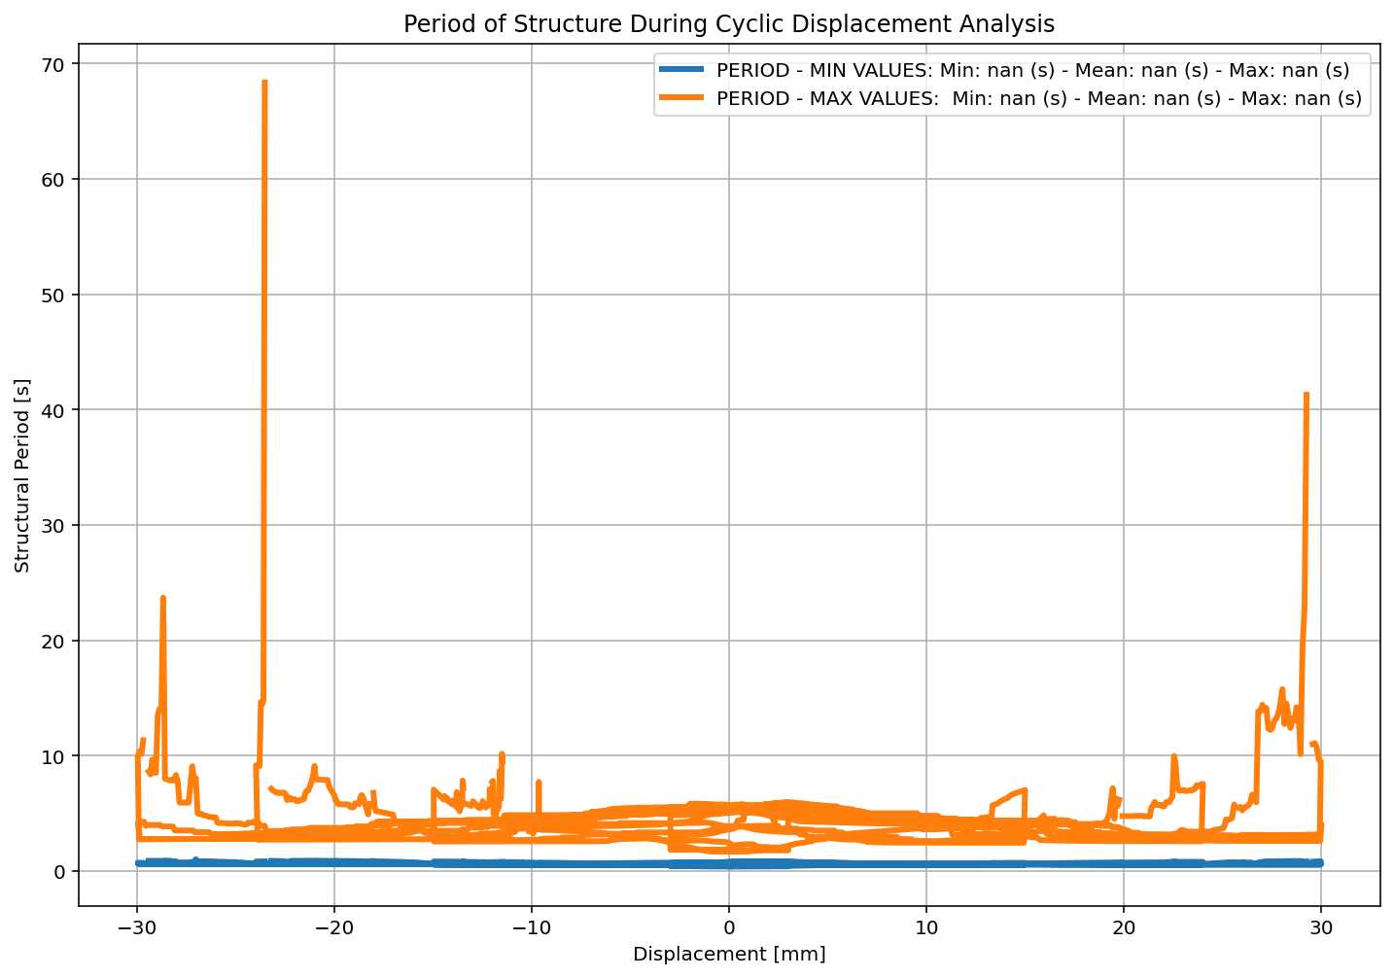

Slide 23
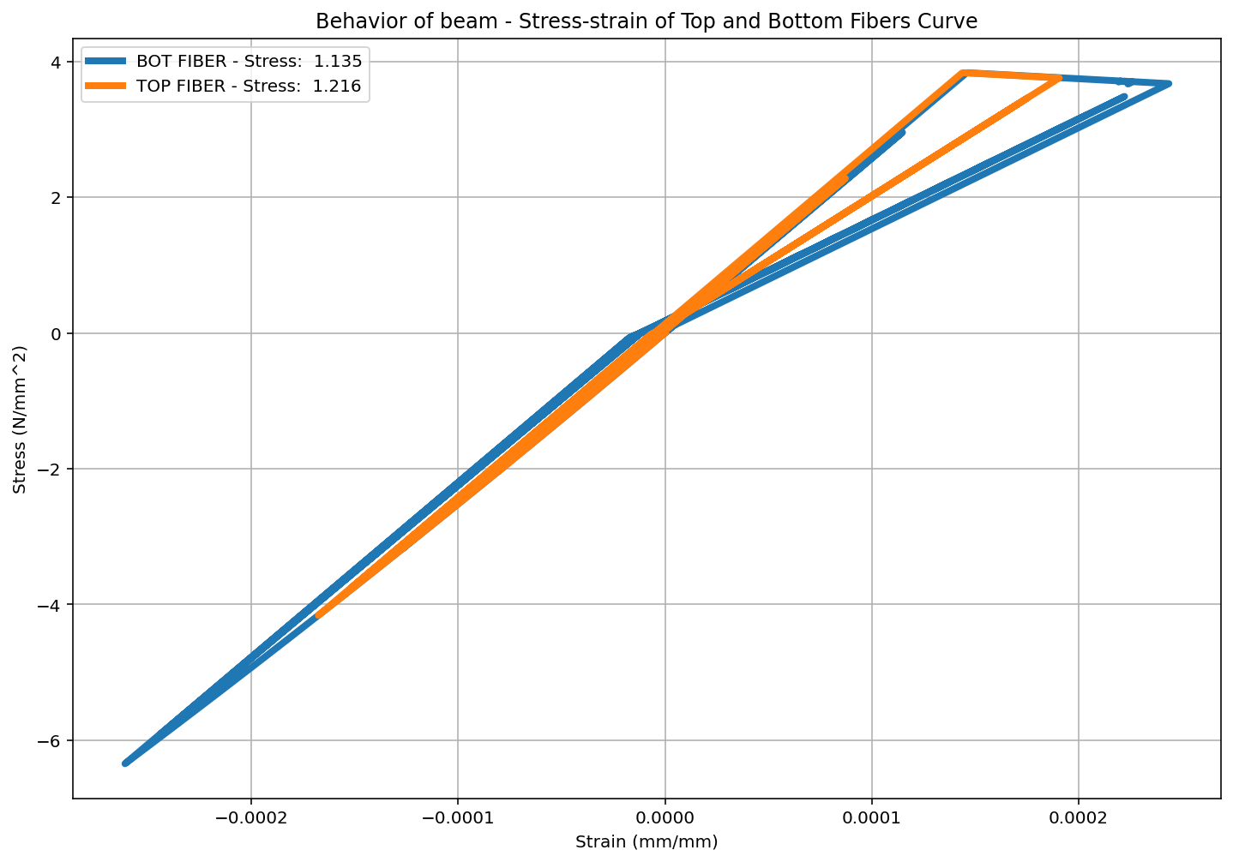

Slide 24
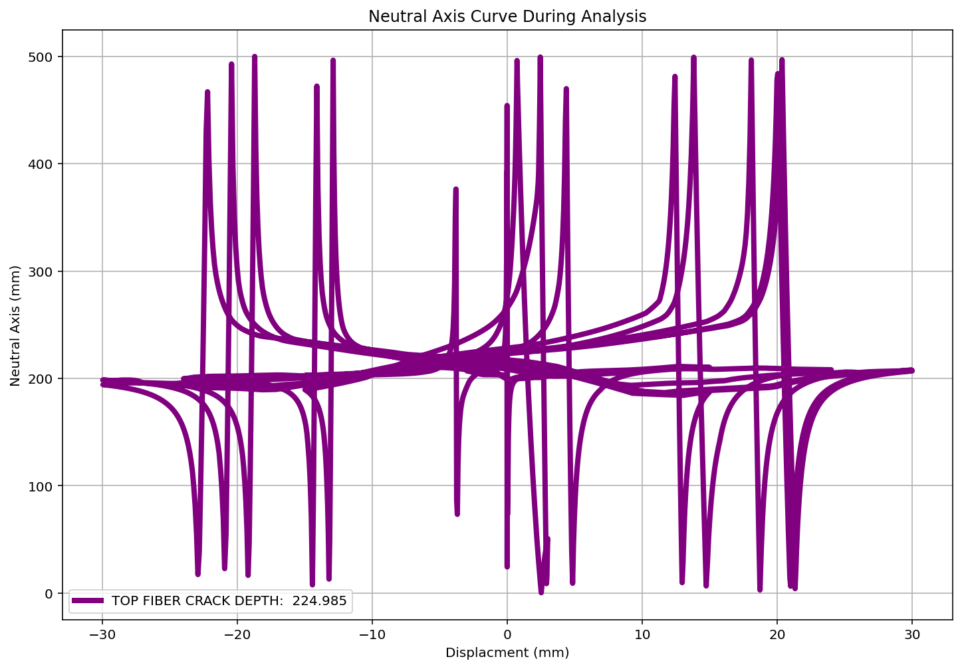

Slide 25
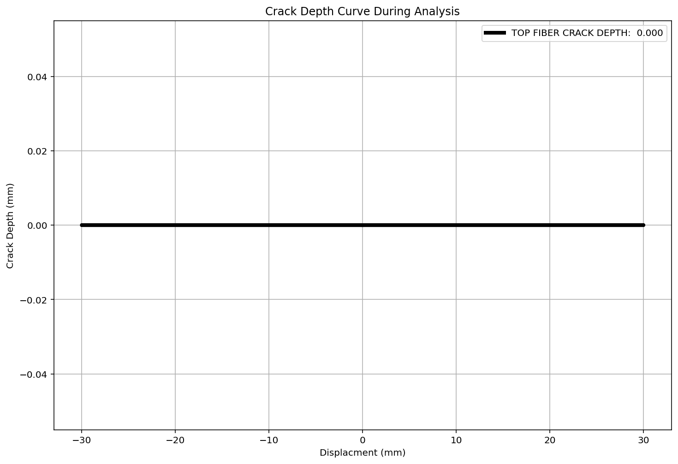

Slide 26
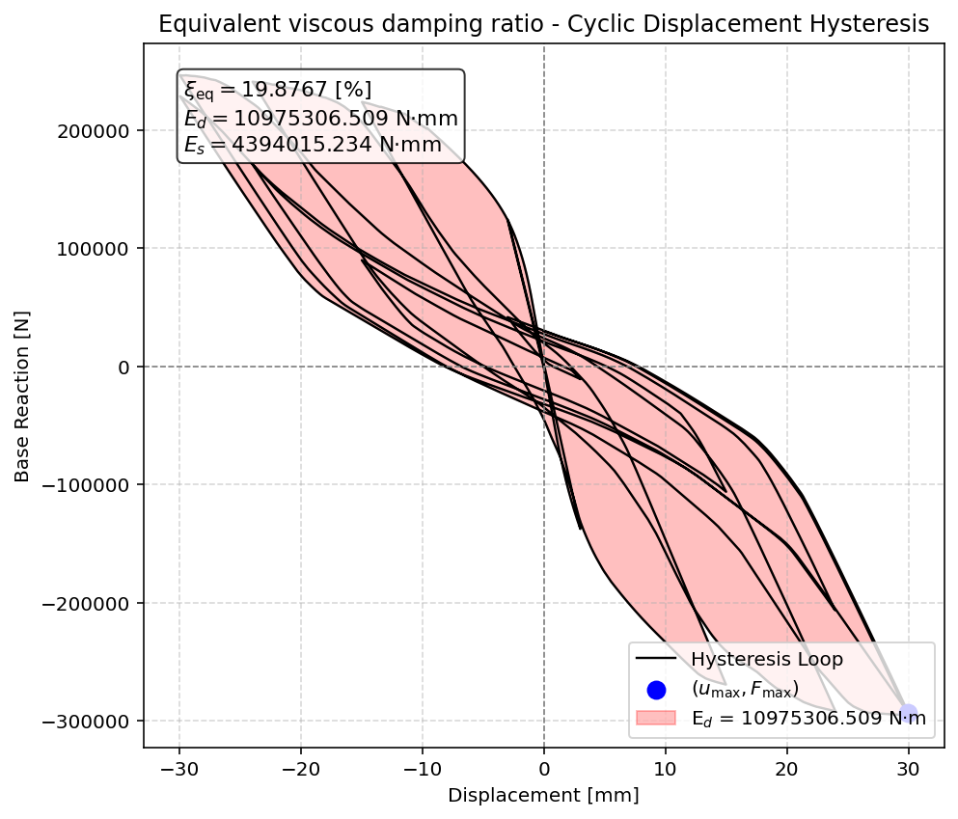

Slide 27
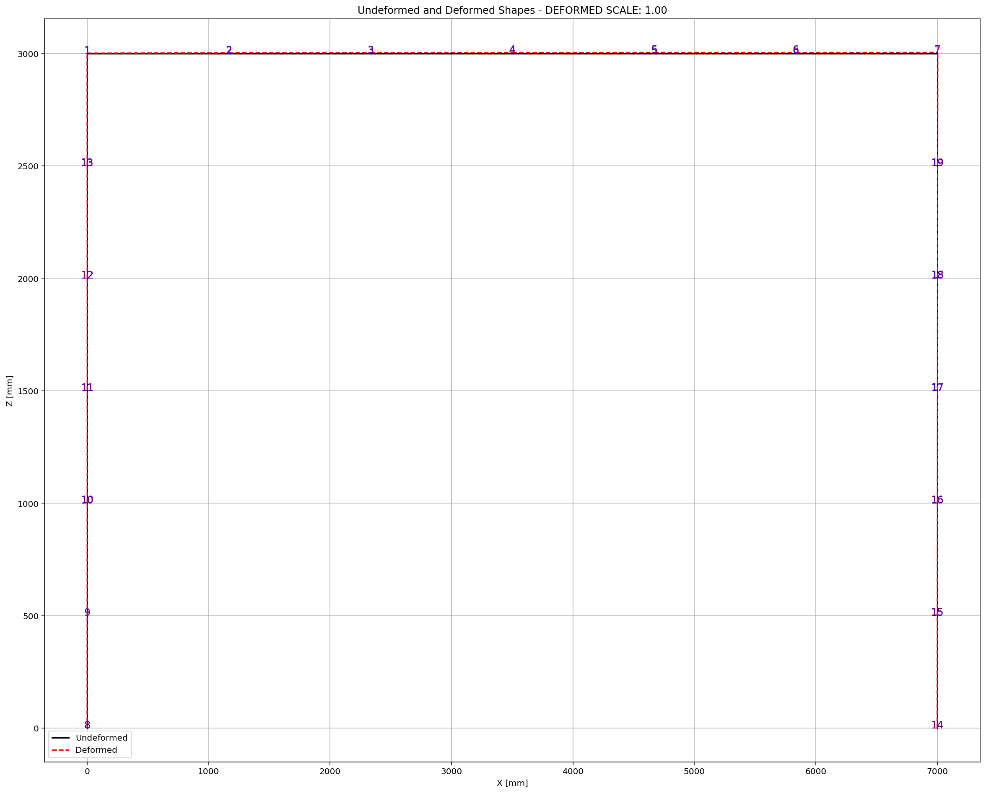

Slide 28
STATIC TIME-HISTORY WITH EXTERNAL TIME-DEPENDENT LOADING ANALYSIS

Slide 29
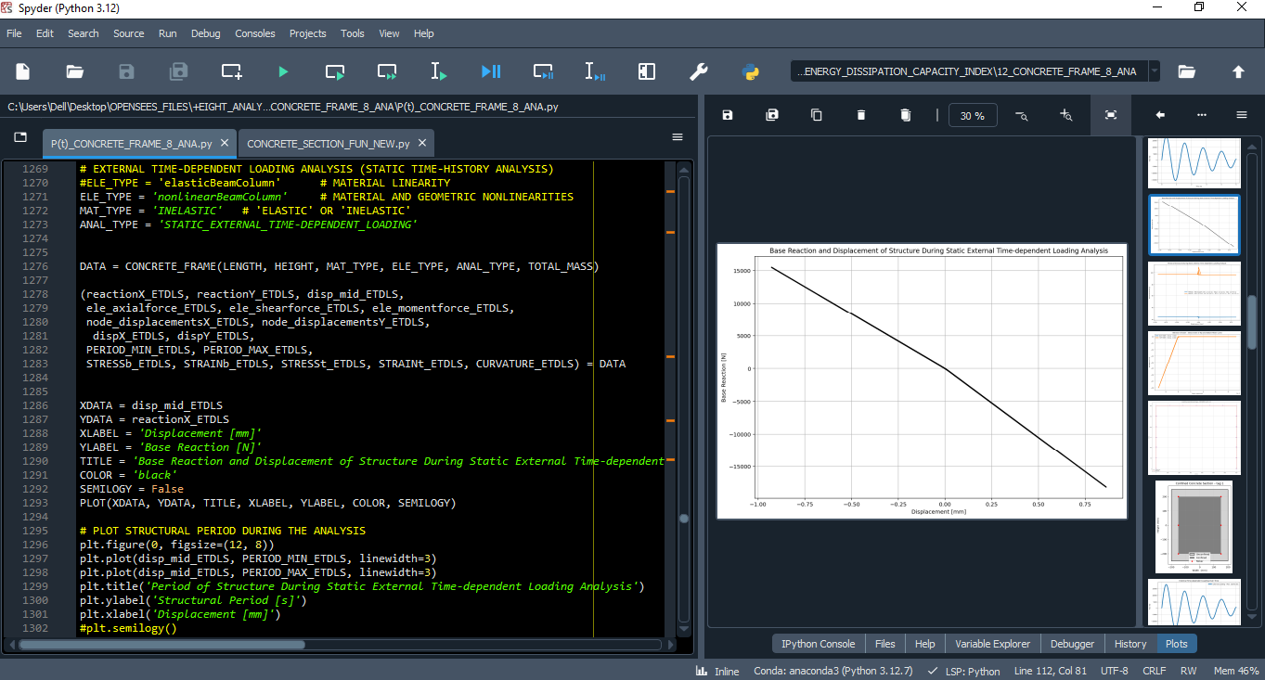

Slide 30
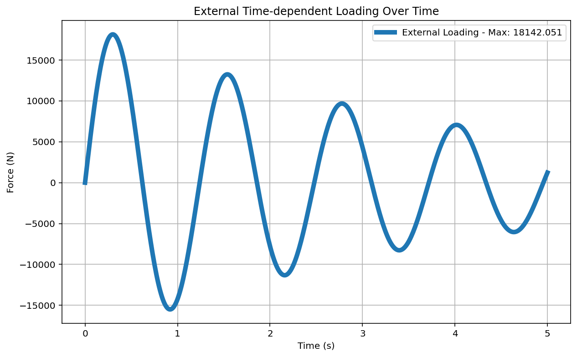

Slide 31
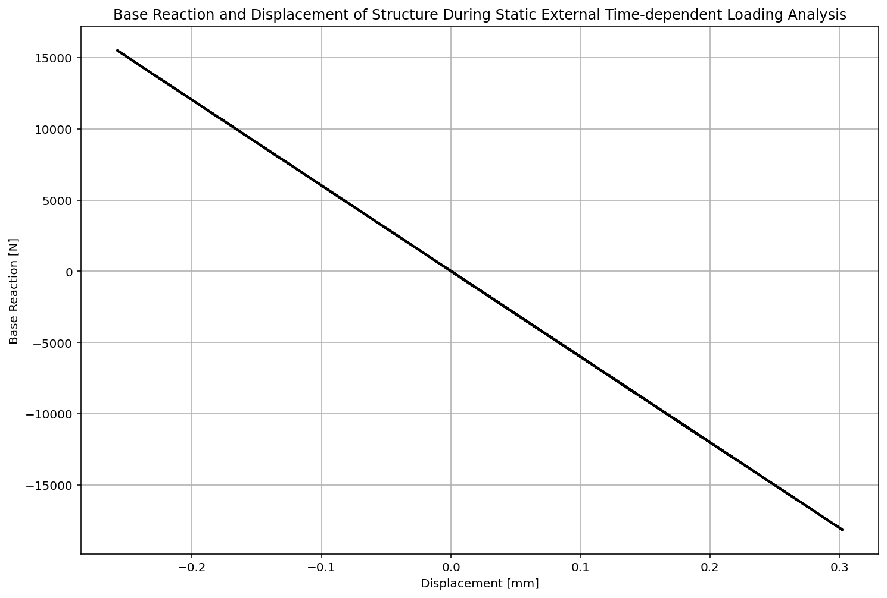

Slide 32
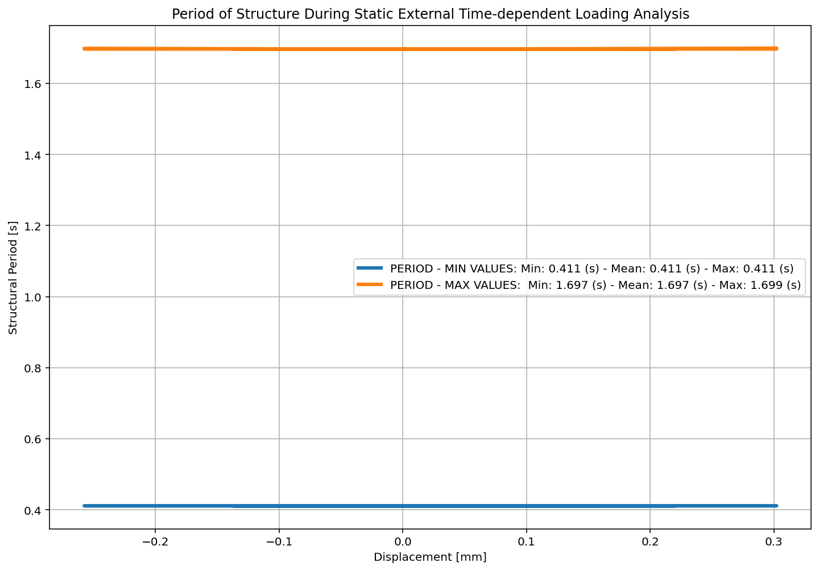

Slide 33
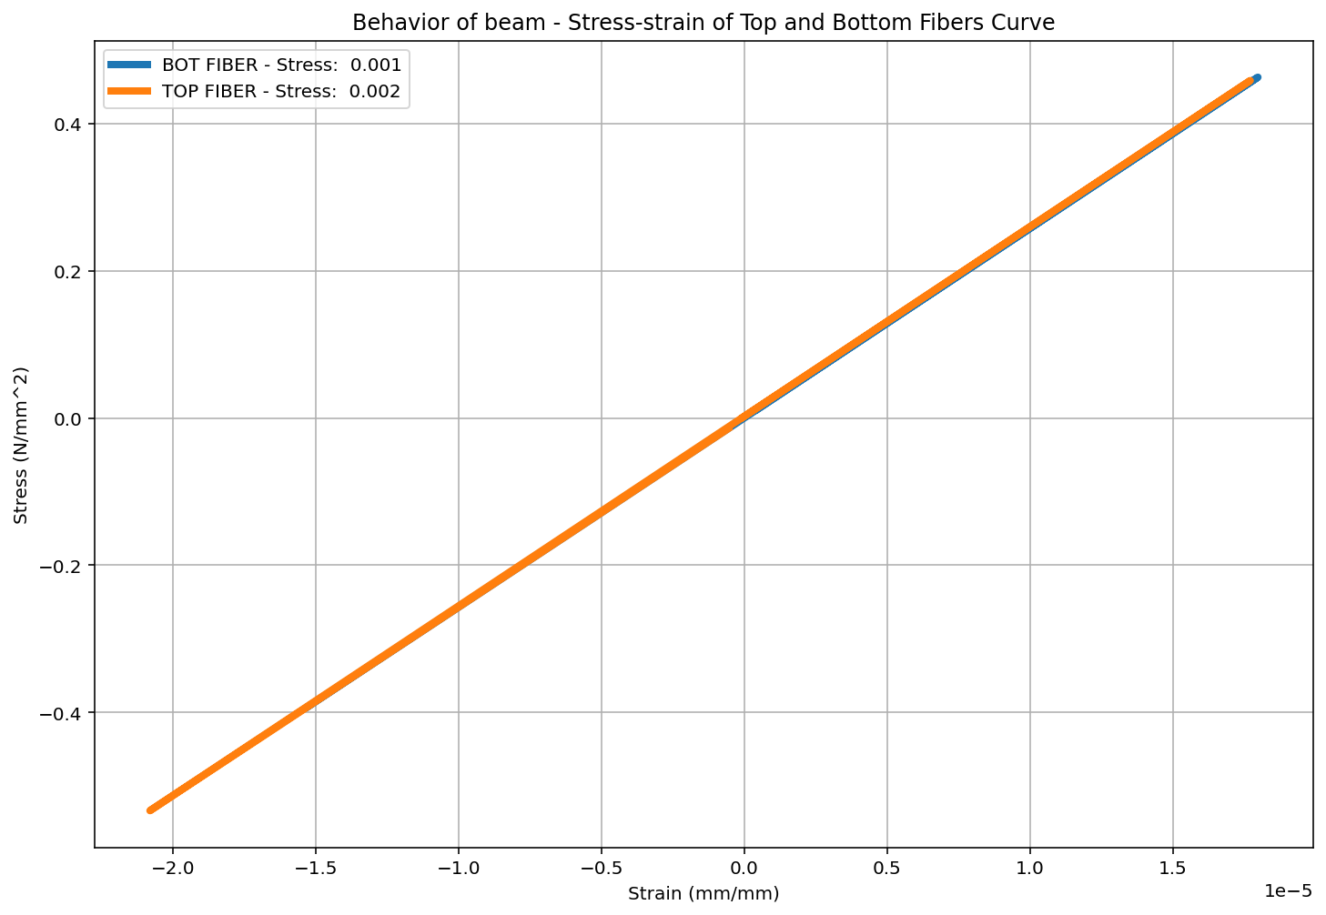

Slide 35
DYNAMIC TIME-HISTORY WITH EXTERNAL TIME-DEPENDENT LOADING ANALYSIS

Slide 36
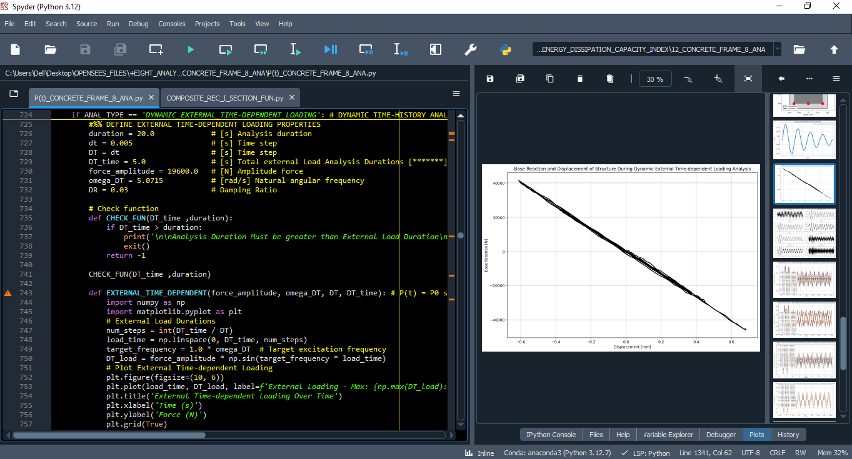

Slide 38
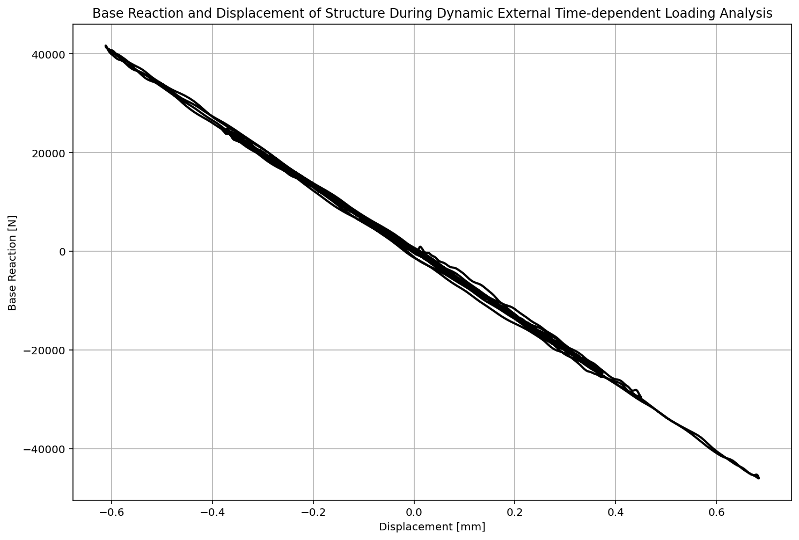

Slide 39
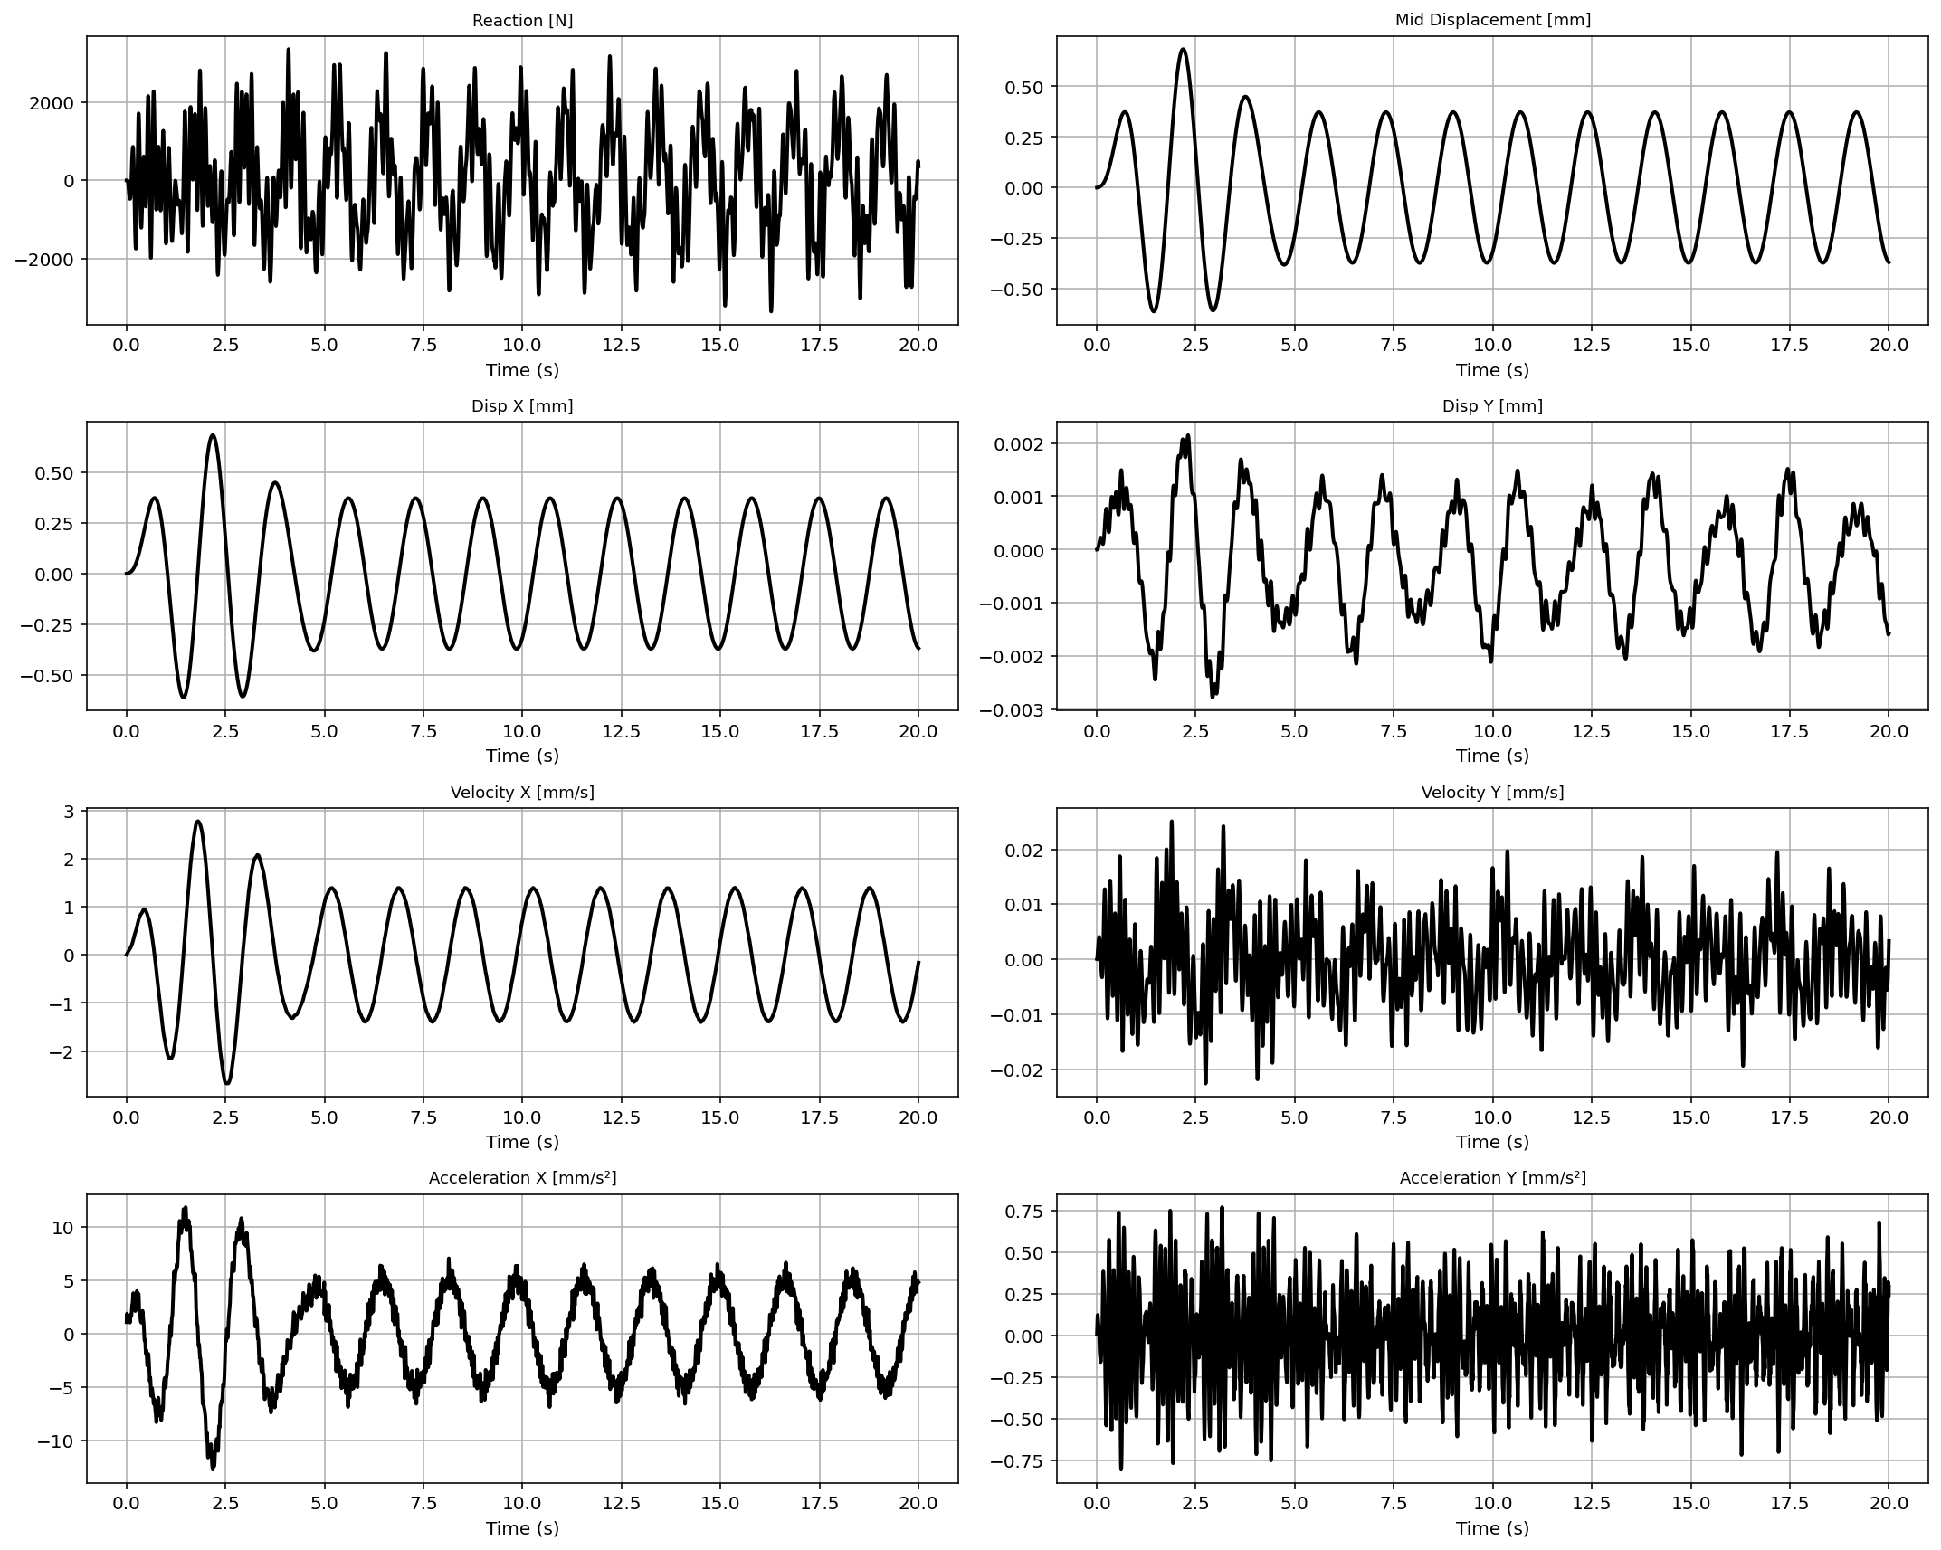

Slide 40
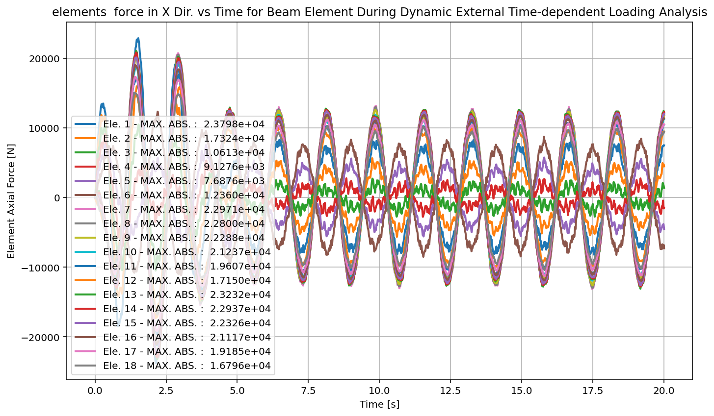

Slide 41
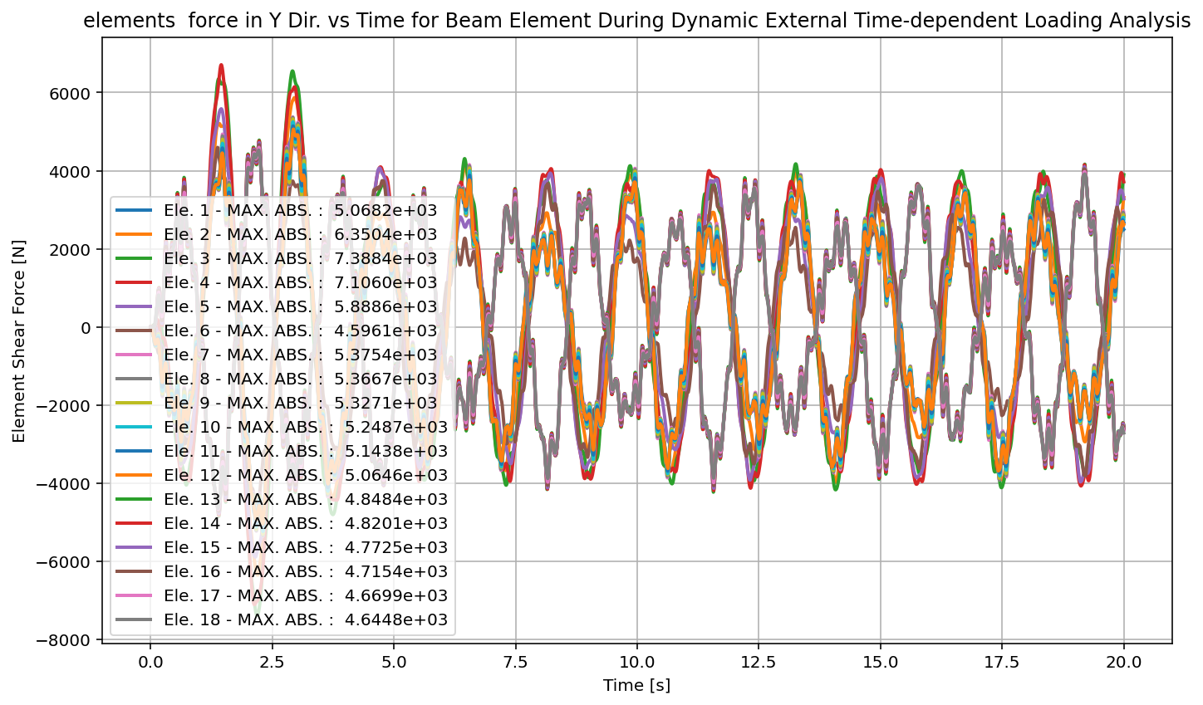

Slide 42
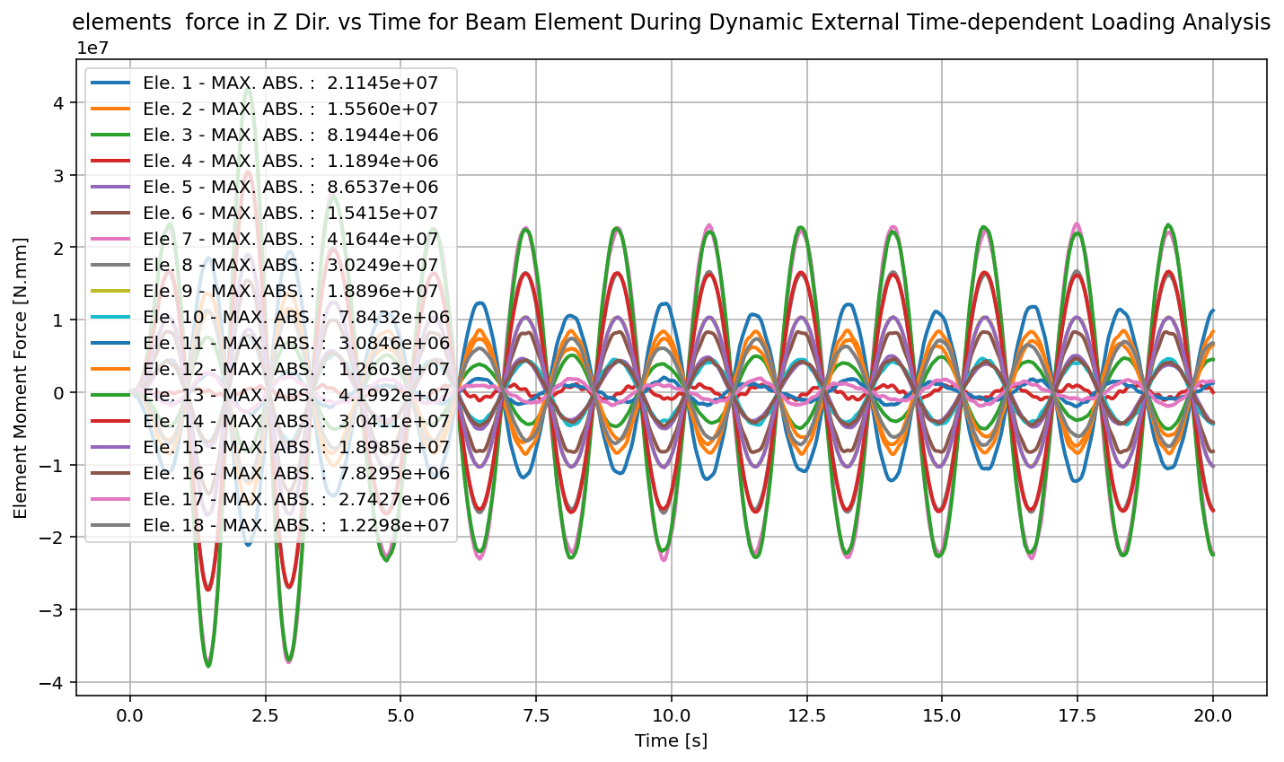

Slide 43
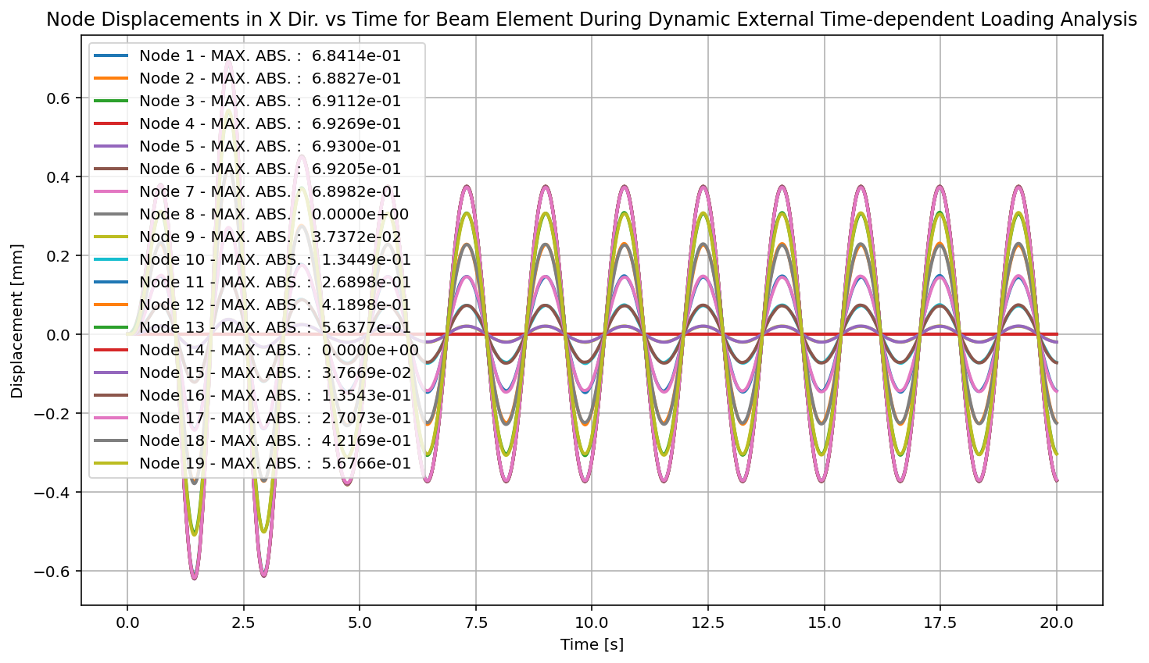

Slide 44
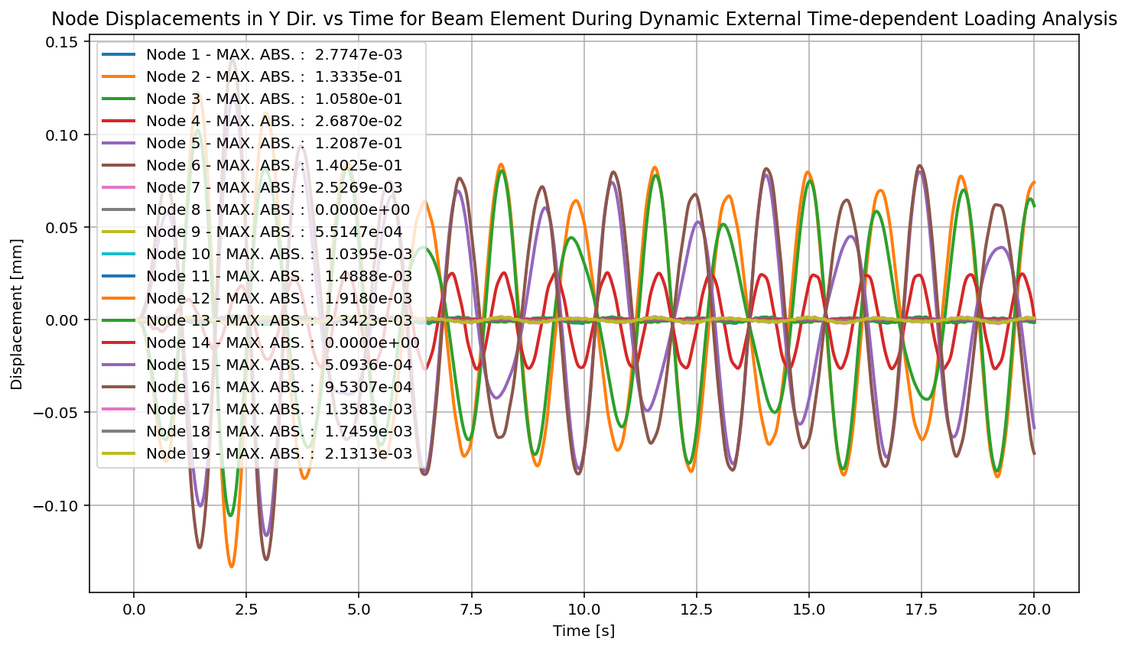

Slide 45
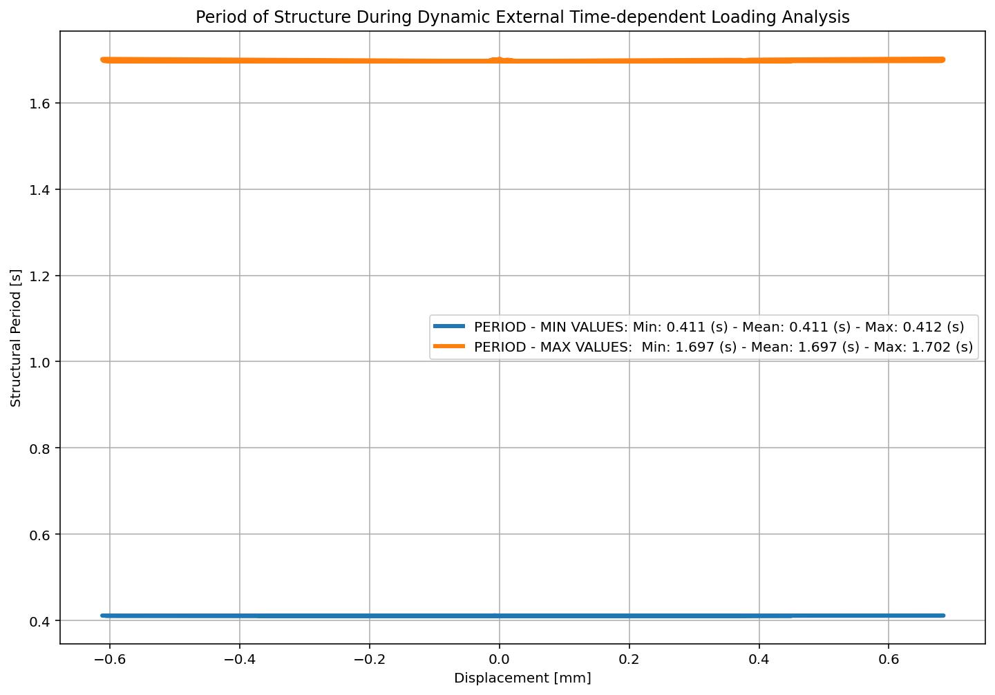

Slide 46
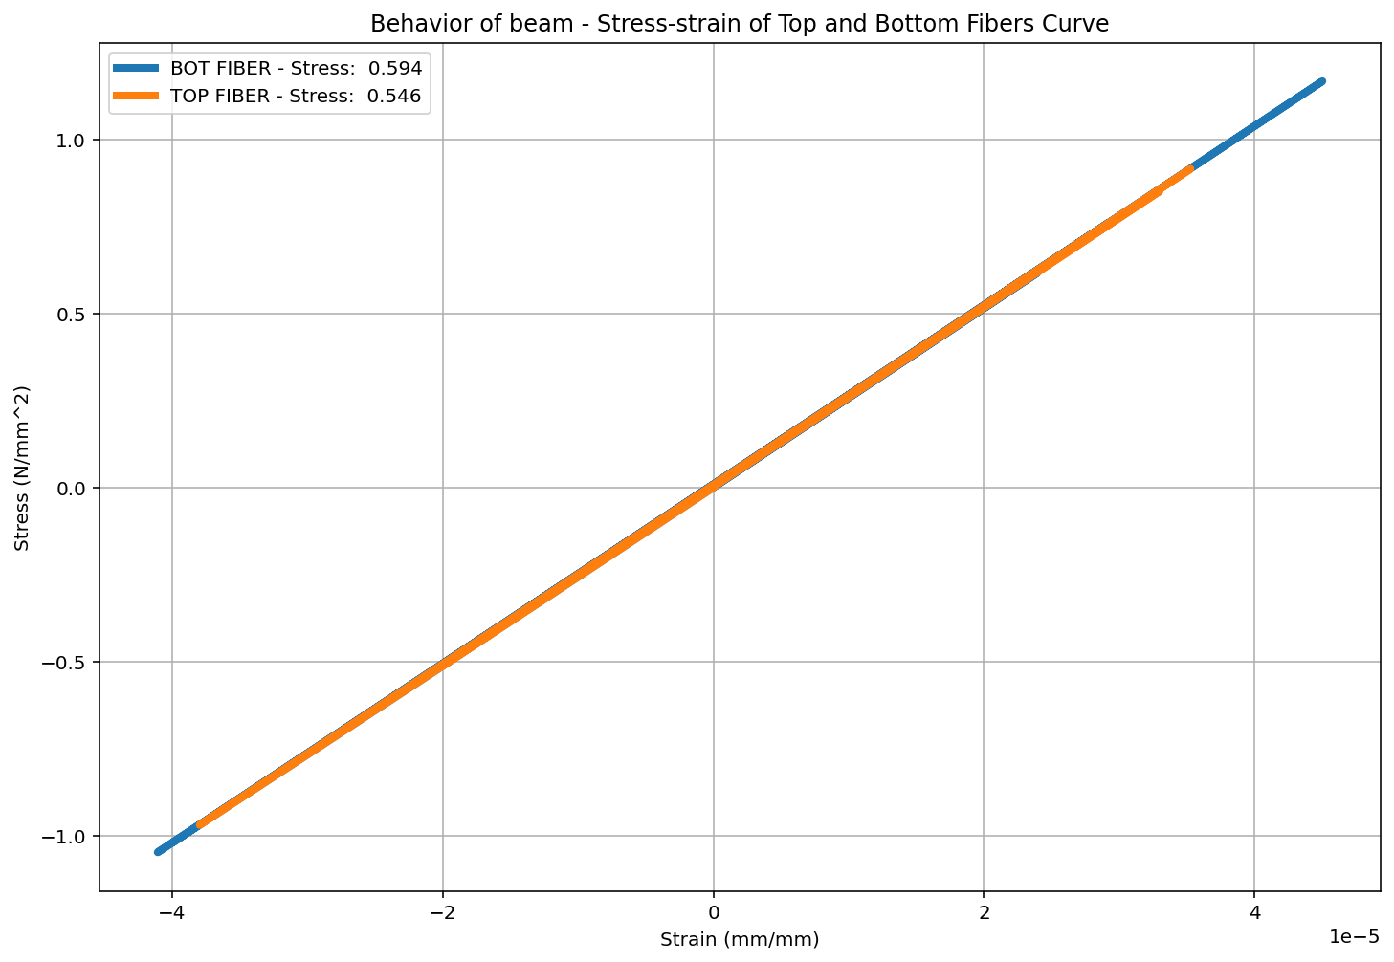

Slide 47
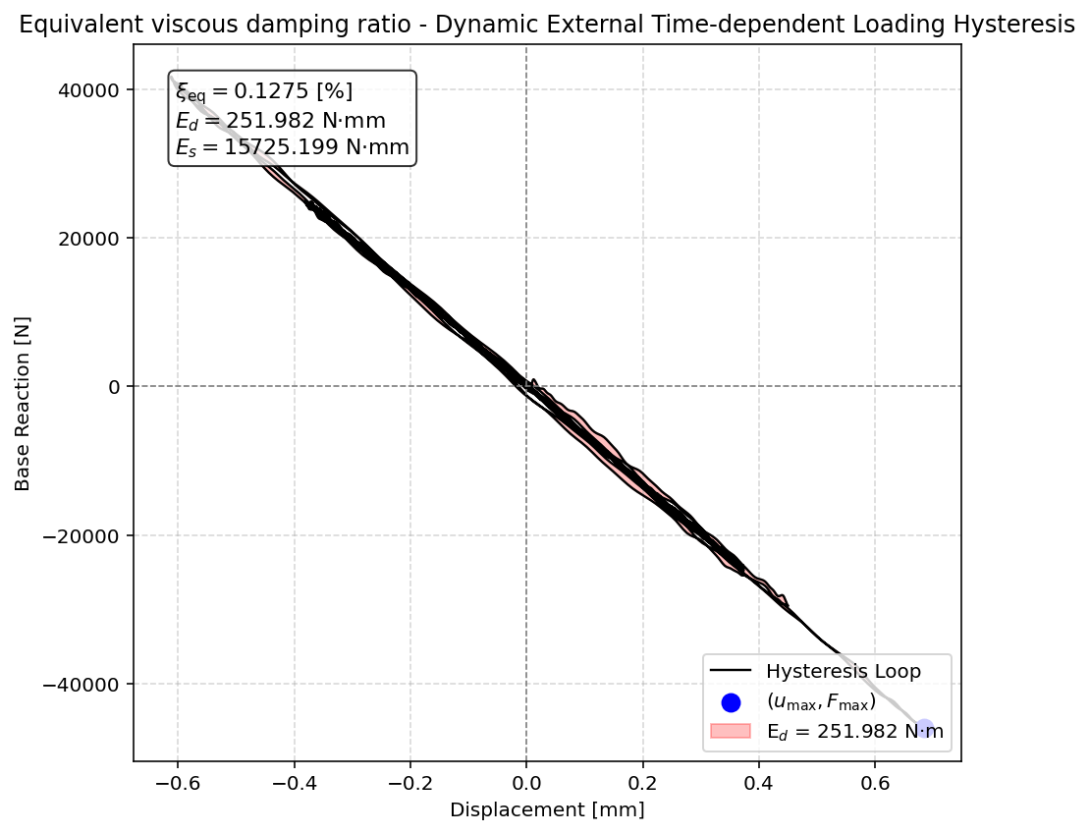

Slide 48
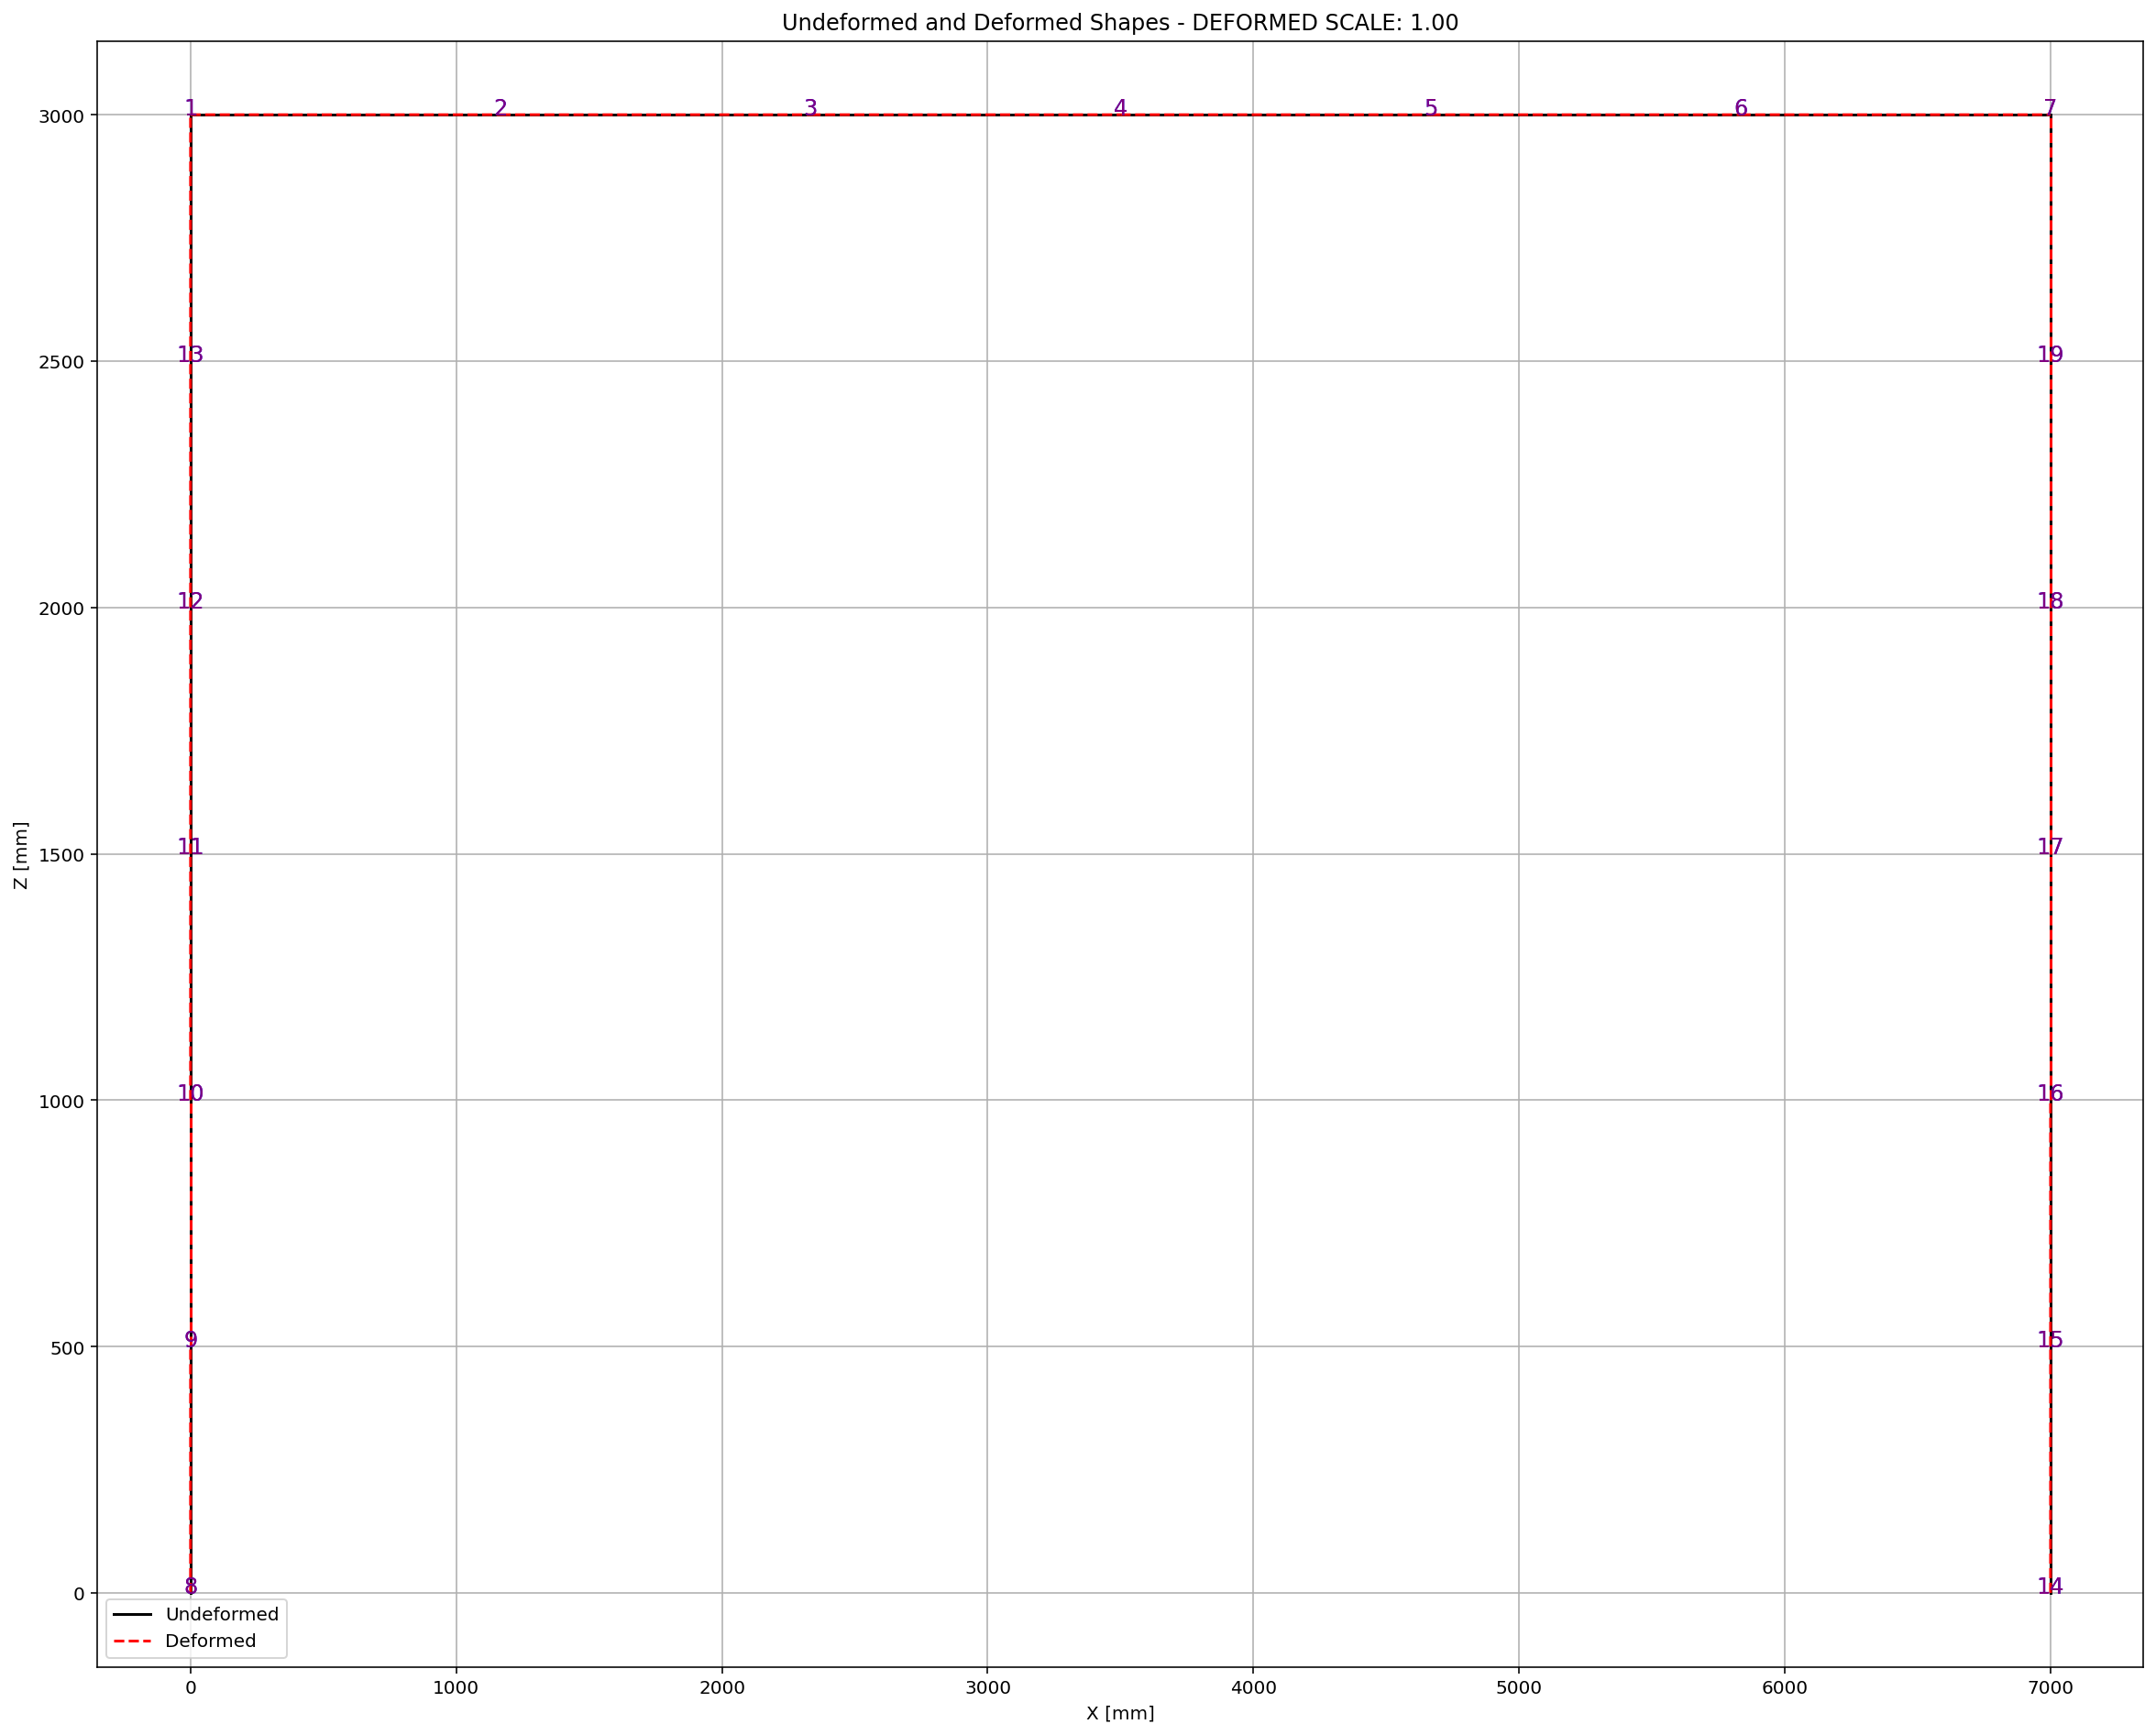

Slide 49
FREE-VIBRATION ANALYSIS

Slide 50
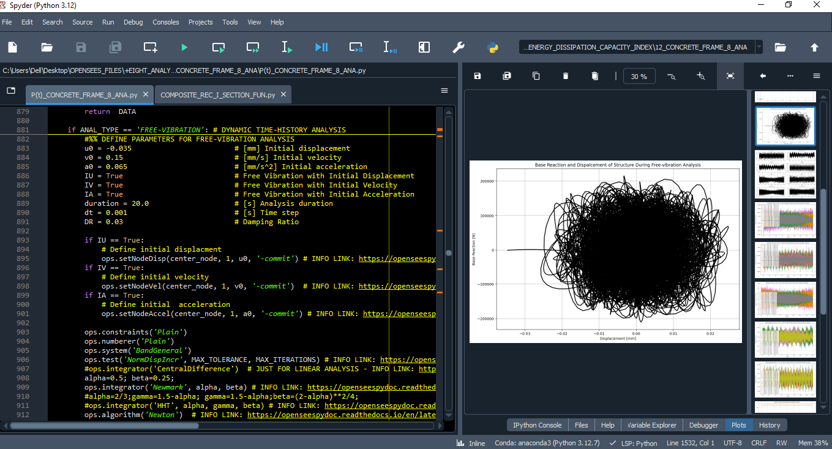

Slide 51
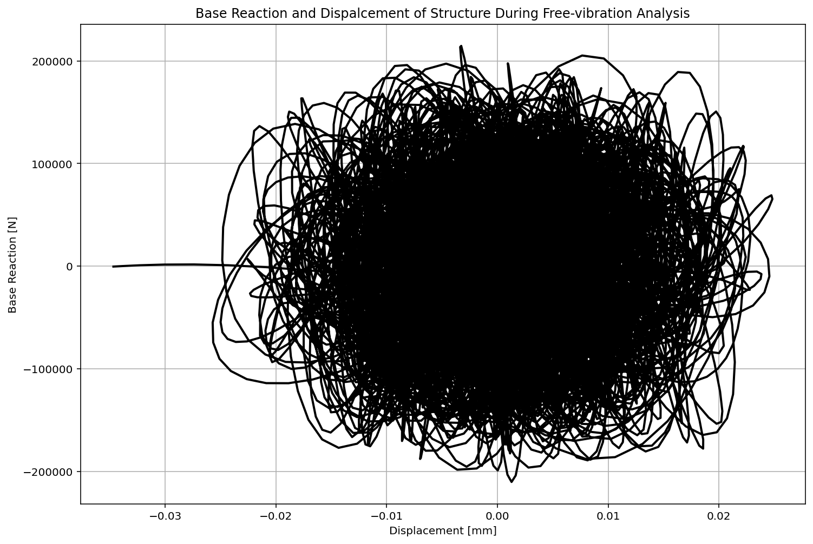

Slide 52
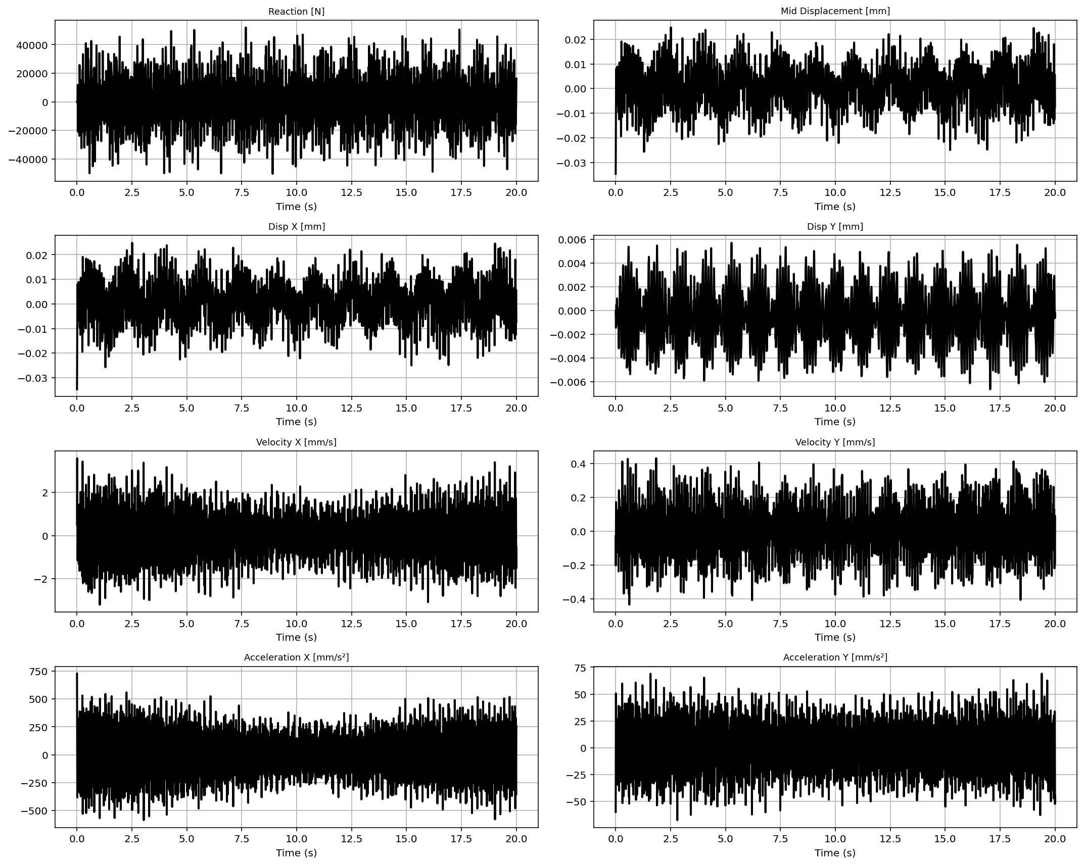

Slide 53
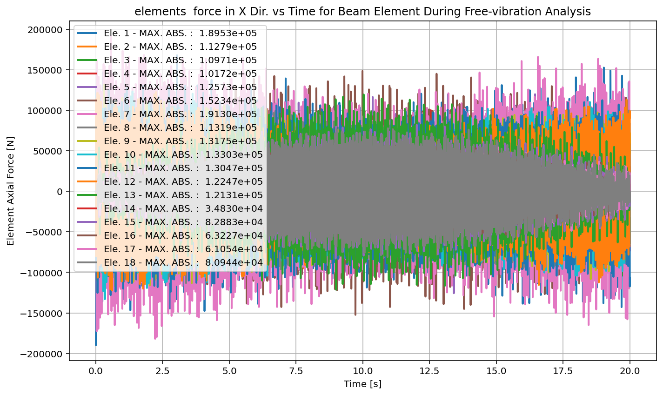

Slide 54
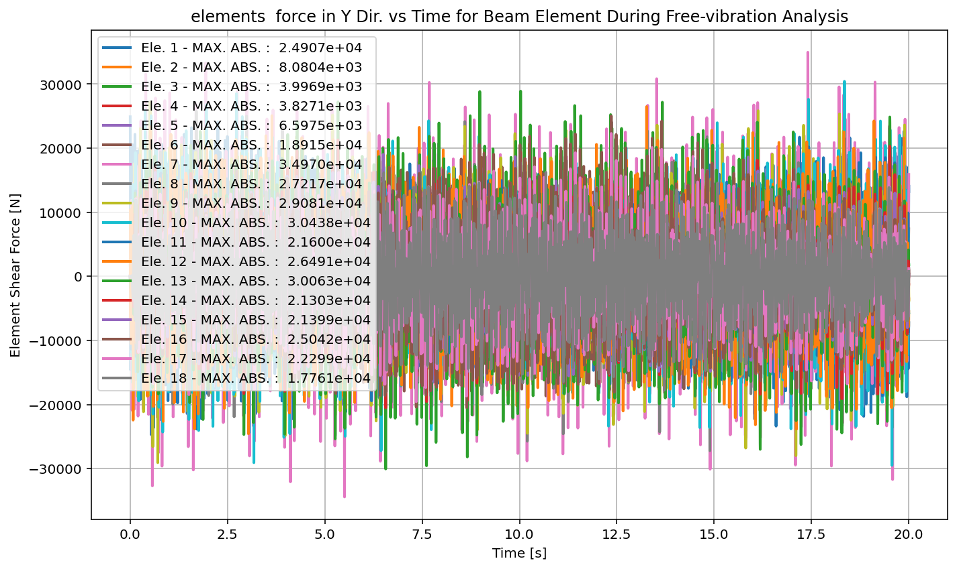

Slide 55
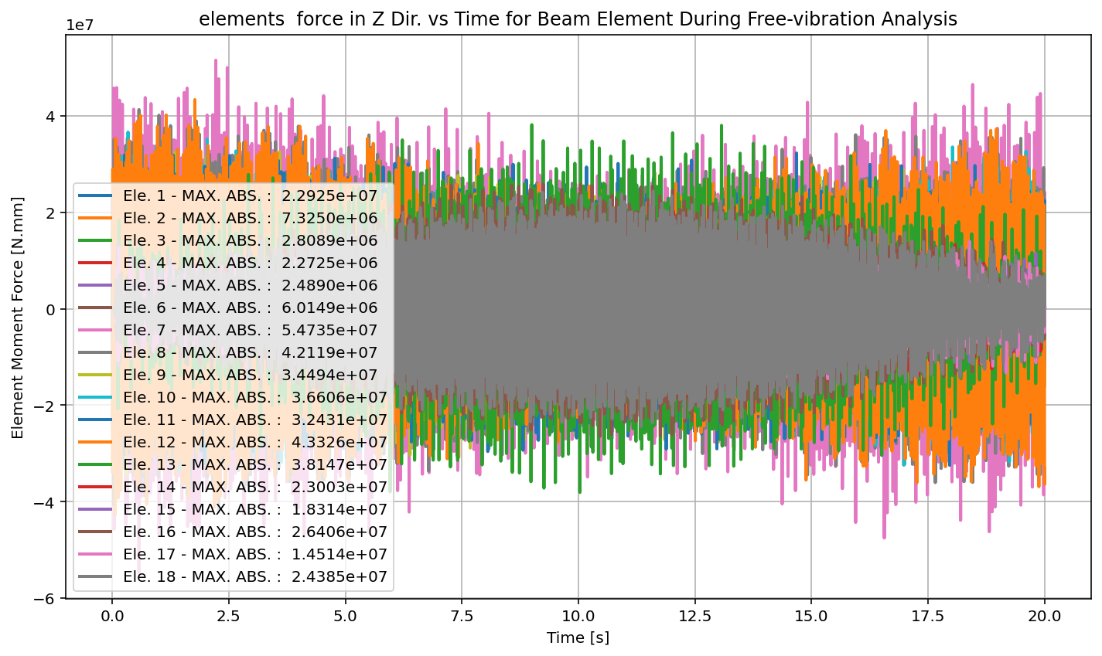

Slide 56
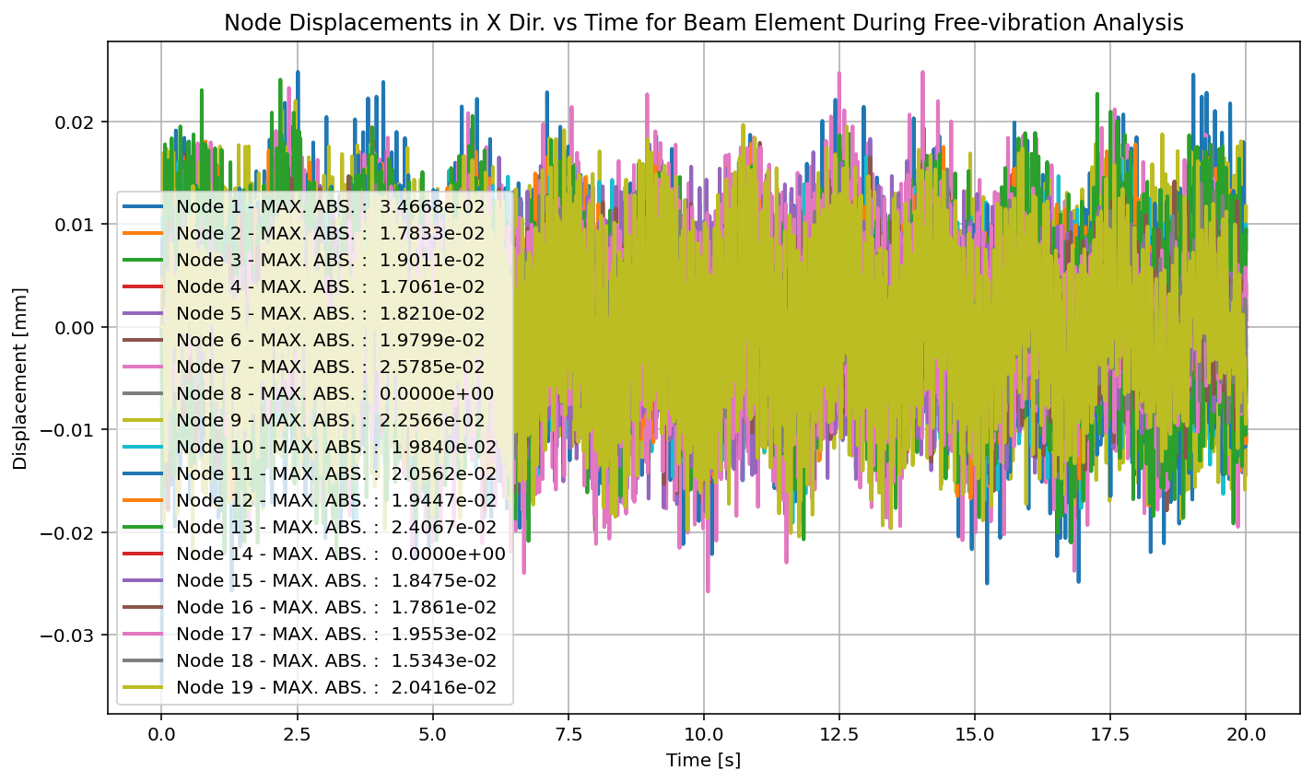

Slide 57
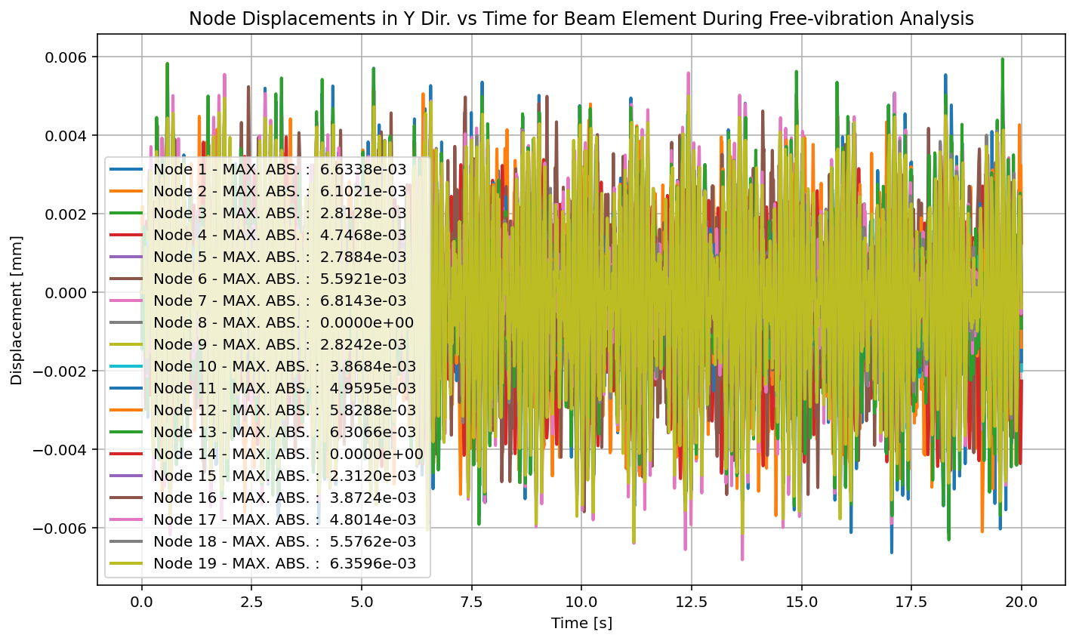

Slide 58
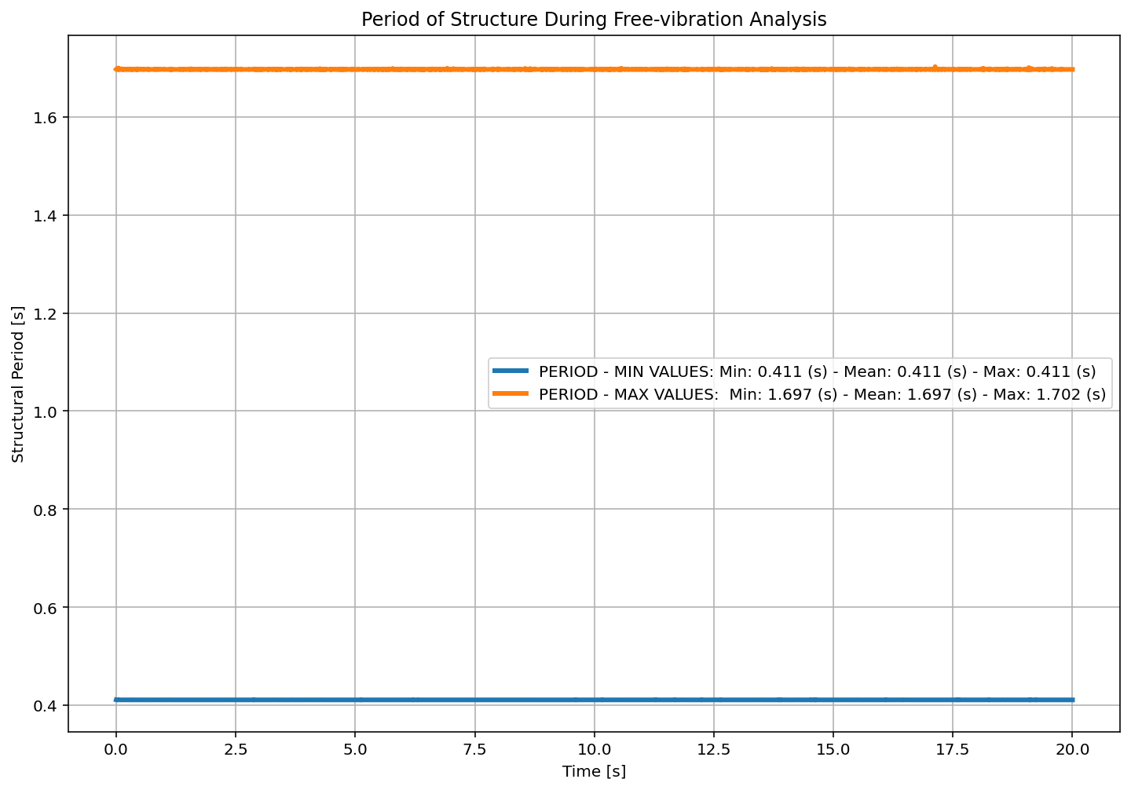

Slide 59


Slide 60


Slide 61


Slide 62


Slide 63


Slide 64
SEISMIC ANALYSIS

Slide 65


Slide 66


Slide 67


Slide 68


Slide 69


Slide 70


Slide 71


Slide 72


Slide 73


Slide 74


Slide 75


Slide 76


Slide 77


Slide 78


Slide 79


Slide 80


Slide 81
Dissipated Energy from Earthquake= 0.03 N·mm
Dissipated Energy from Cyclic Displacement= 17519272.22 N·mm
DISSIPATED ENERGY CAPACITY INDEX: 0.000 [%]
ZONE 1: VERY MINOR DAMAGE

Slide 82


Slide 83
+==========================+
= Analysis curve fitted =
Disp Base Shear
----------------------------
[[0.00000000e+00 0.00000000e+00]
[1.26327517e+01 2.57617793e+05]
[3.50000000e+01 2.49742938e+05]]
+==========================+
+----------------------------------------------------+
Structure Elastic Stiffness : 20392.85
Structure Plastic Stiffness : 7135.51
Structure Tangent Stiffness : -352.07
Structure Ductility Ratio : 2.77
Structure Over Strength Factor: 0.97
+----------------------------------------------------+
Over Strength Coefficient (Ω0): 0.9694
Displacement Ductility Ratio (μ): 2.7706
Ductility Coefficient (Rμ): 2.7706
Structural Behavior Coefficient (R): 2.6859
Structural Ductility Damage Index in X Direction: -56.4751 (%)

