Slide 1
>> IN THE NAME OF ALLAH, THE MOST GRACIOUS, THE MOST MERCIFUL <<
OPTIMIZATION OF A FORCE-PULSE IMPACT LOAD ANALYSIS OF A SINGLE-DEGREE-OF-FREEDOM (SDOF) SYSTEM USING OPENSEES
WRITTEN BY SALAR DELAVAR GHASHGHAEI (QASHQAI)

Slide 2
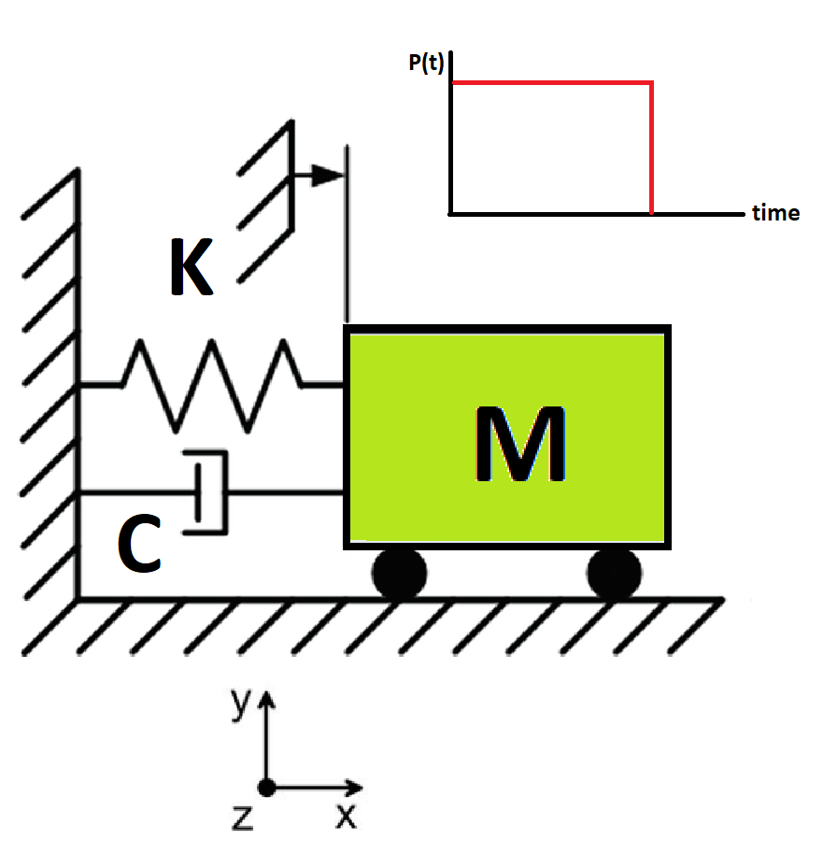

Slide 3
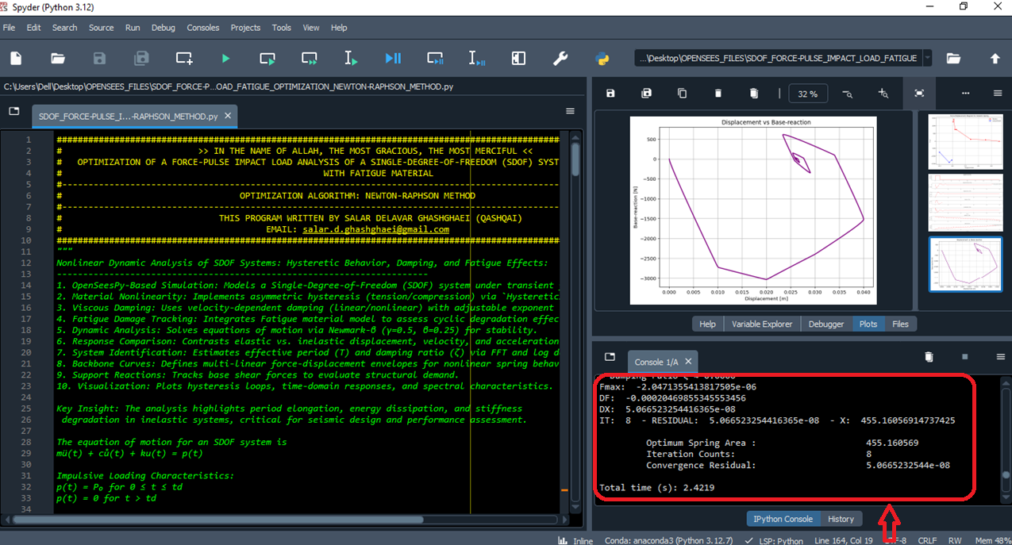

Slide 4
IT: 6 - RESIDUAL: 1.2674278050826335 - X: 455.15496531261266
Period T ≈ 3.847 s
Damping ratio ζ ≈ 0.0000
SUPPLY: 0.04000115
F: 1.147050329011745e-06
Period T ≈ 3.847 s
Damping ratio ζ ≈ 0.0000
Fmin: 3.1938197959102688e-06
Period T ≈ 3.847 s
Damping ratio ζ ≈ 0.0000
Fmax: -8.999481584462399e-07
DF: -0.00020468839771782543
DX: -0.0056038854268282414
IT: 7 - RESIDUAL: 0.0056038854268282414 - X: 455.16056919803947
Period T ≈ 3.847 s
Damping ratio ζ ≈ 0.0000
SUPPLY: 0.04000000
F: -1.0371099812278572e-11
Period T ≈ 3.847 s
Damping ratio ζ ≈ 0.0000
Fmin: 2.0468355277289407e-06
Period T ≈ 3.847 s
Damping ratio ζ ≈ 0.0000
Fmax: -2.0471355413817505e-06
DF: -0.00020469855345553456
DX: 5.066523254416365e-08
IT: 8 - RESIDUAL: 5.066523254416365e-08 - X: 455.16056914737425
Optimum Spring Area : 455.160569
Iteration Counts: 8
Convergence Residual: 5.0665232544e-08
Total time (s): 2.4219

Slide 5
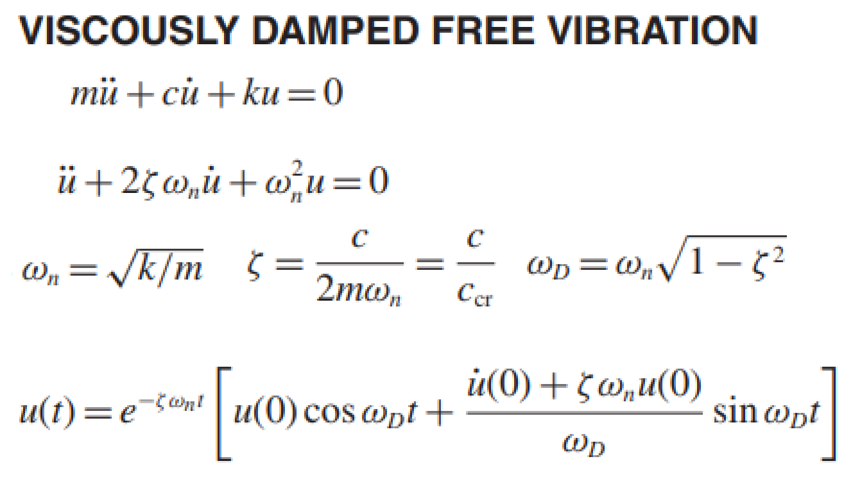
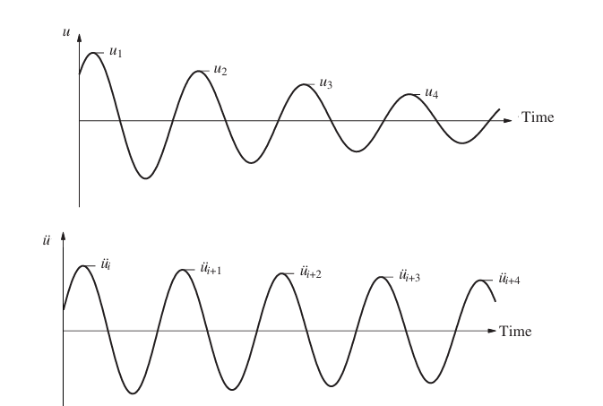
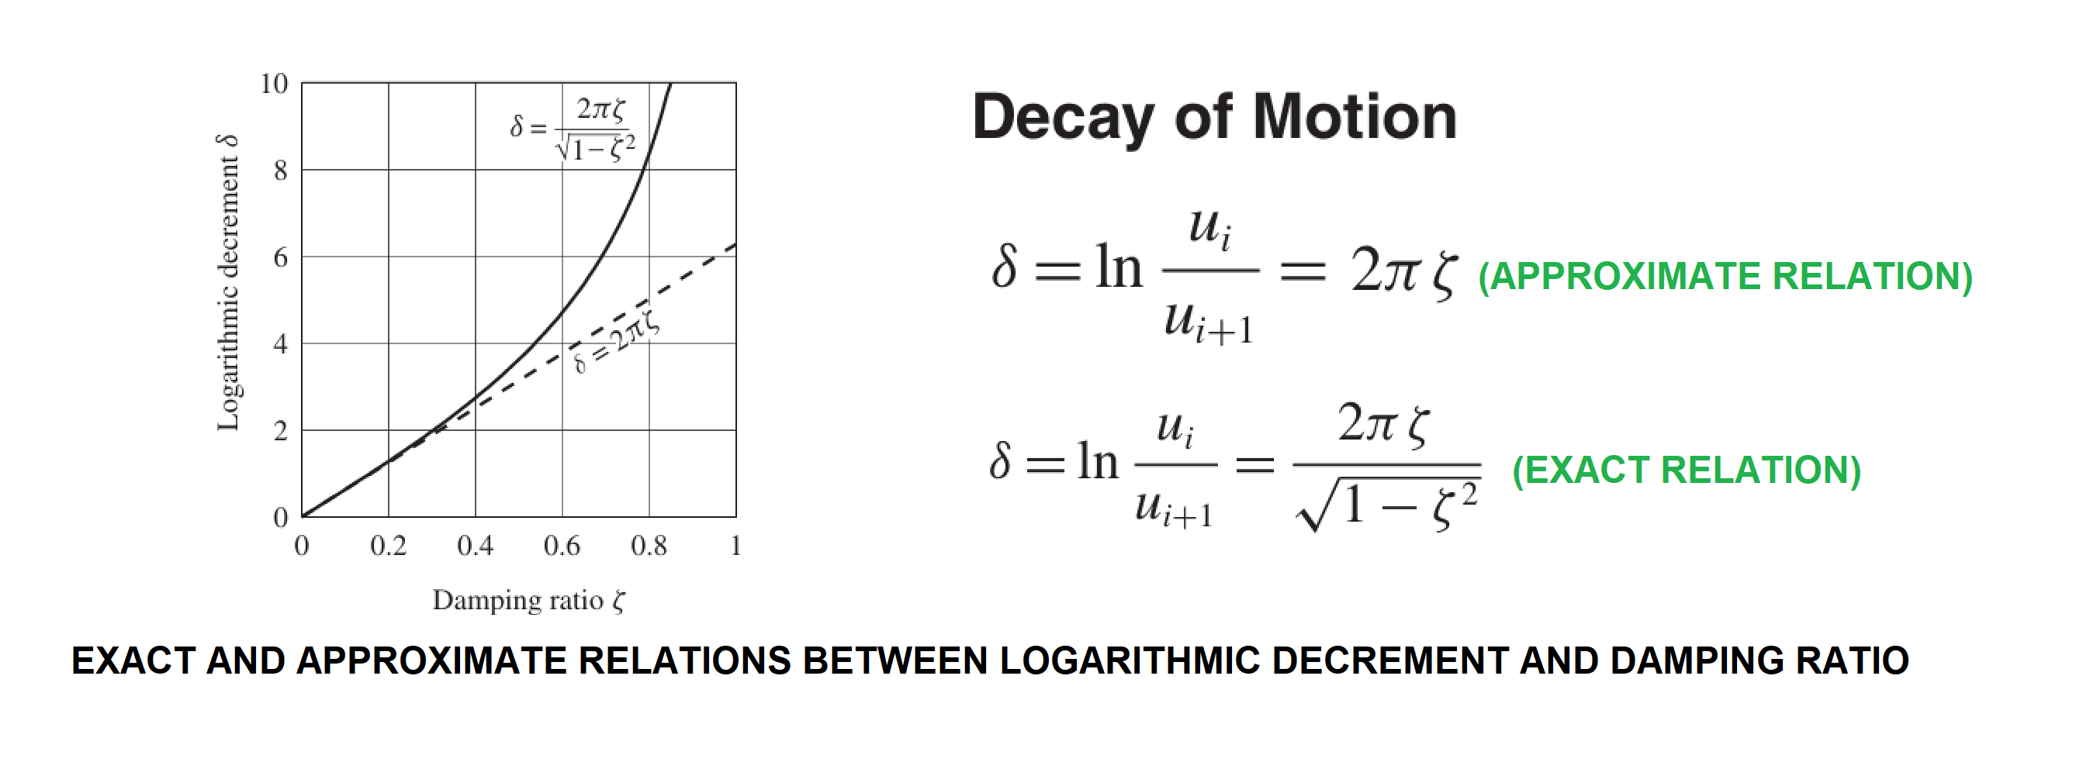

Slide 6
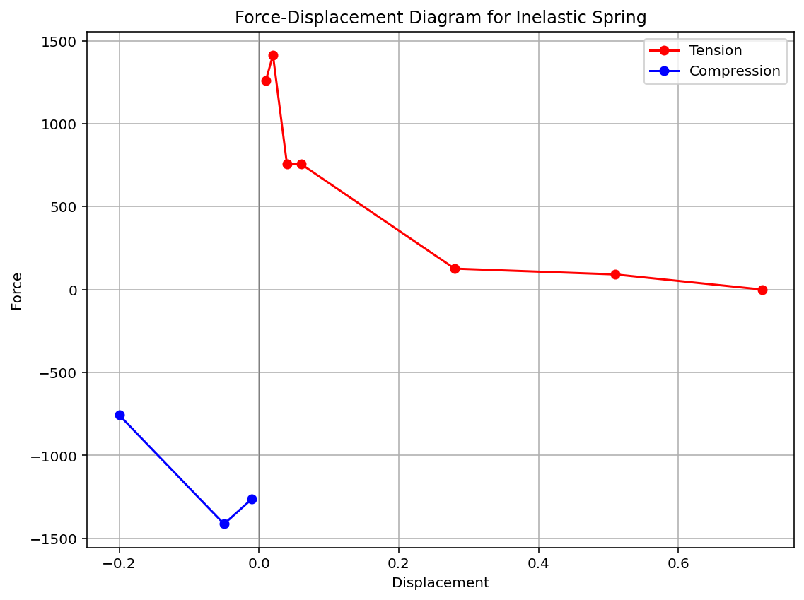

Slide 7
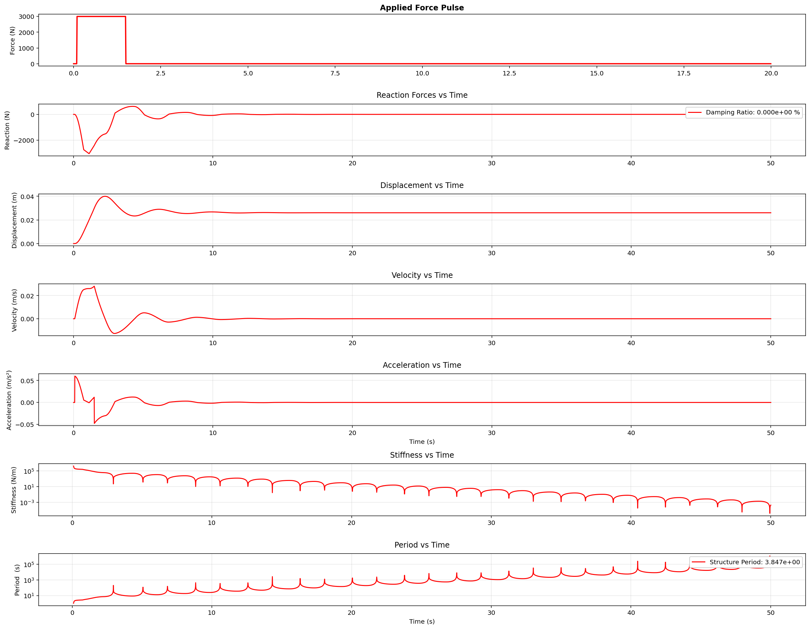

Slide 8
