Slide 1
>> IN THE NAME OF ALLAH, THE MOST GRACIOUS, THE MOST MERCIFUL <<
COMPREHENSIVE NONLINEAR SEISMIC ASSESSMENT OF SINGLE-DEGREE-FREEDOM WITH FOUR ELEMENTS STRUCTURE (SDOF) : AN OPENSEES FRAMEWORK FOR STATIC PUSHOVER, CYCLIC DEGRADATION, STATIC TIME-HISTORY AND DYNAMIC TIME-HISTORY ANALYSIS
THIS PROGRAM WRITTEN BY SALAR DELAVAR GHASHGHAEI (QASHQAI)

Slide 2
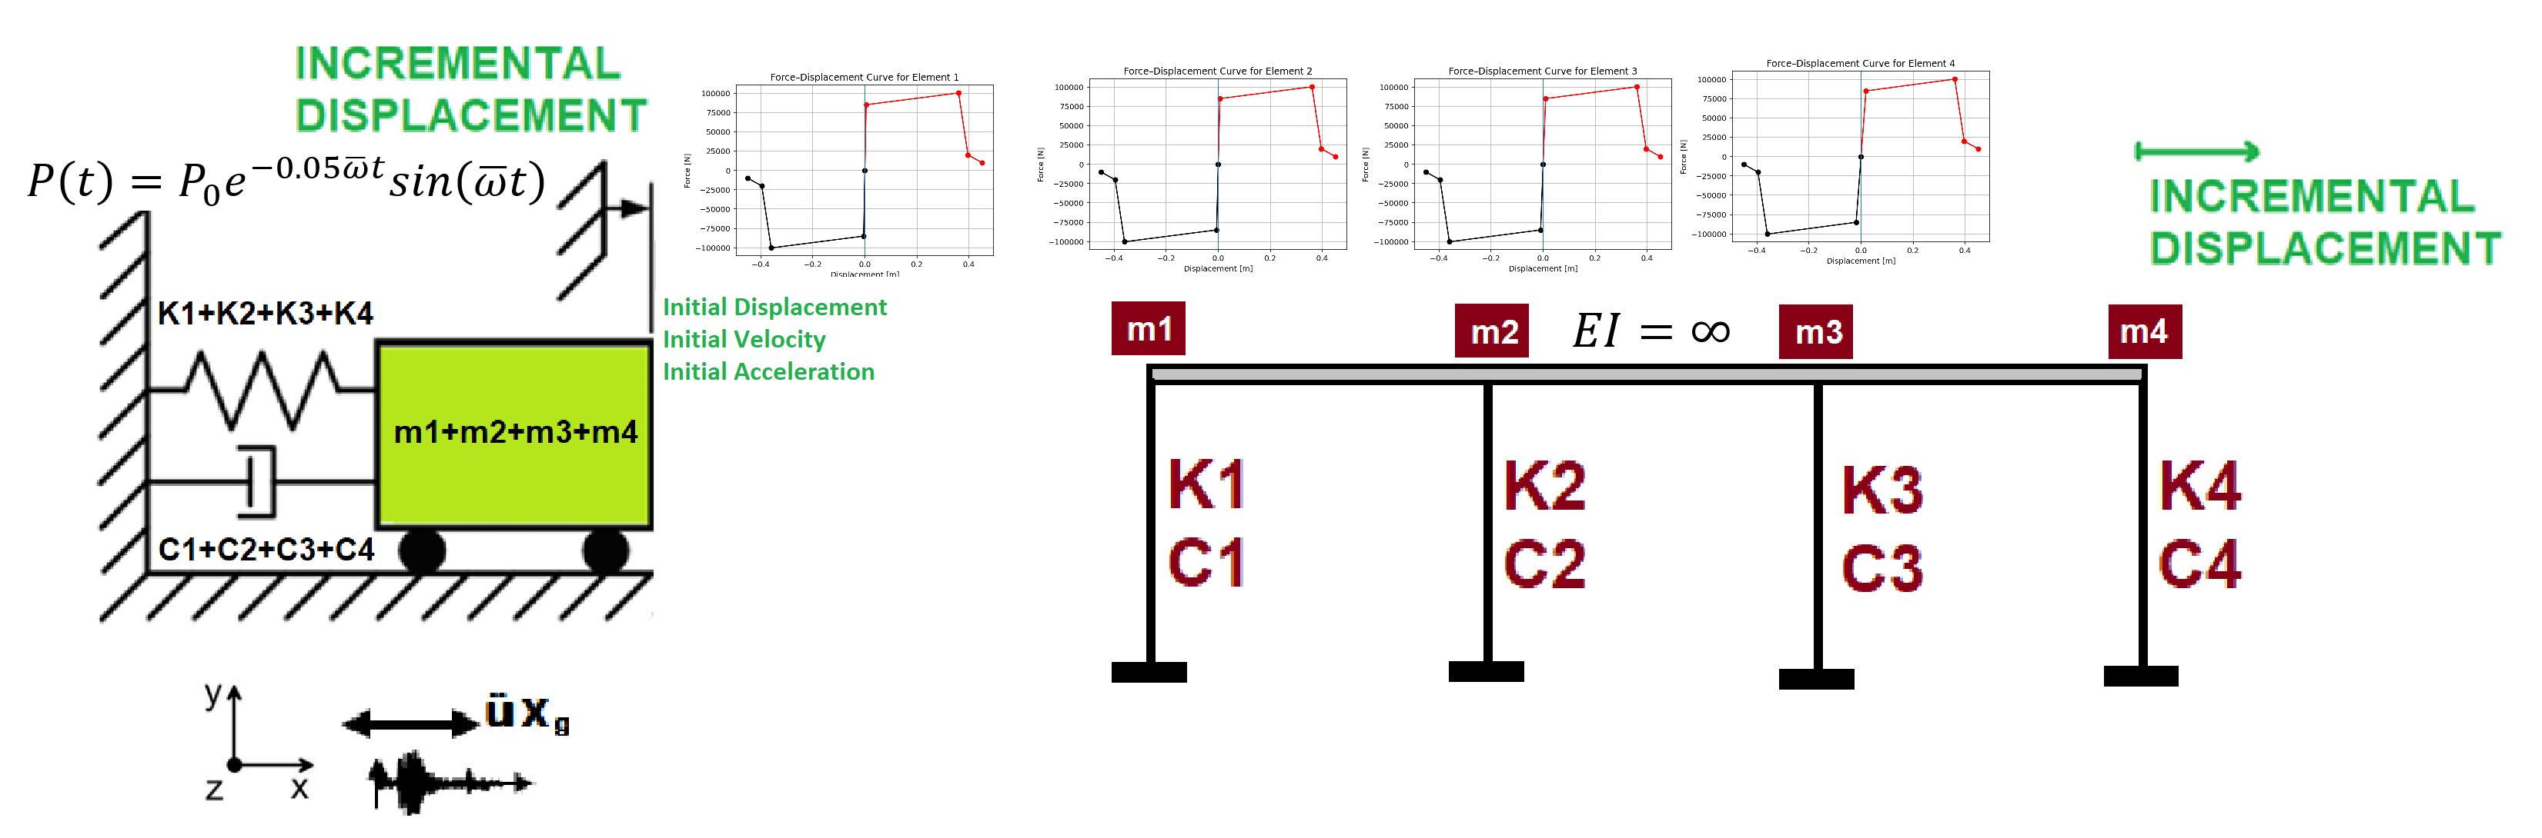

Slide 3
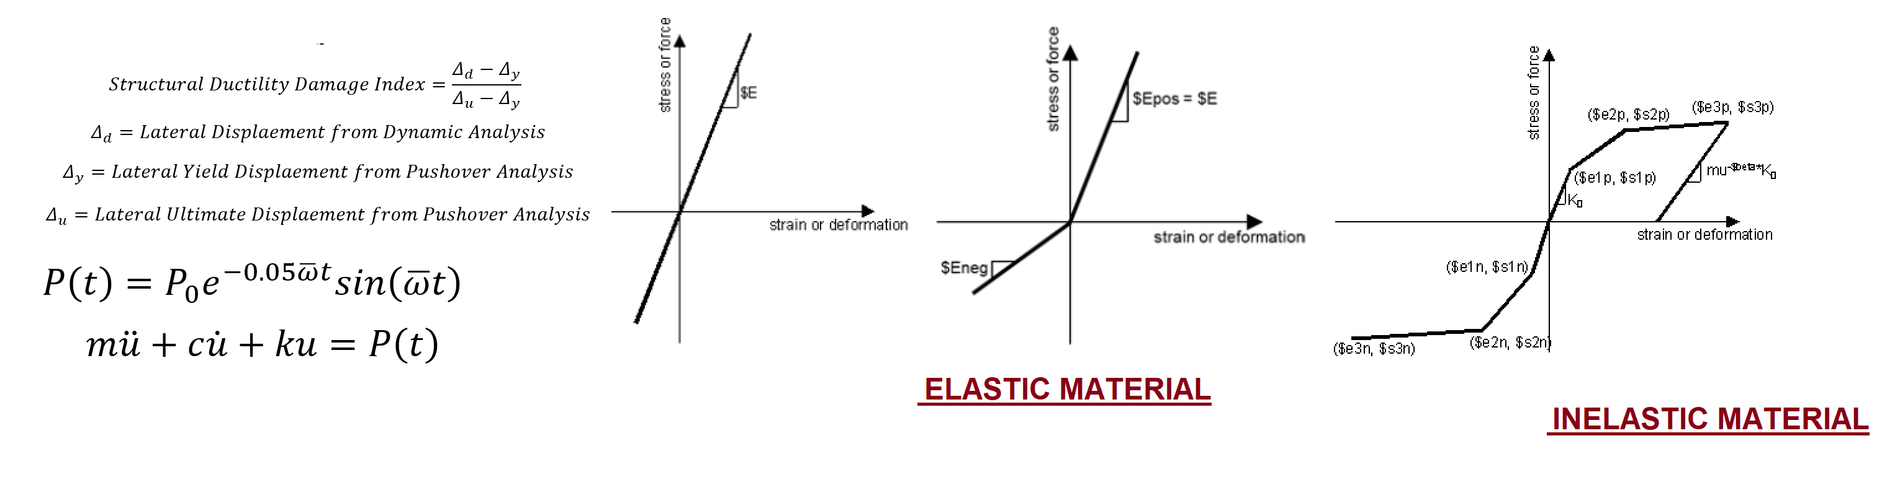

Slide 4
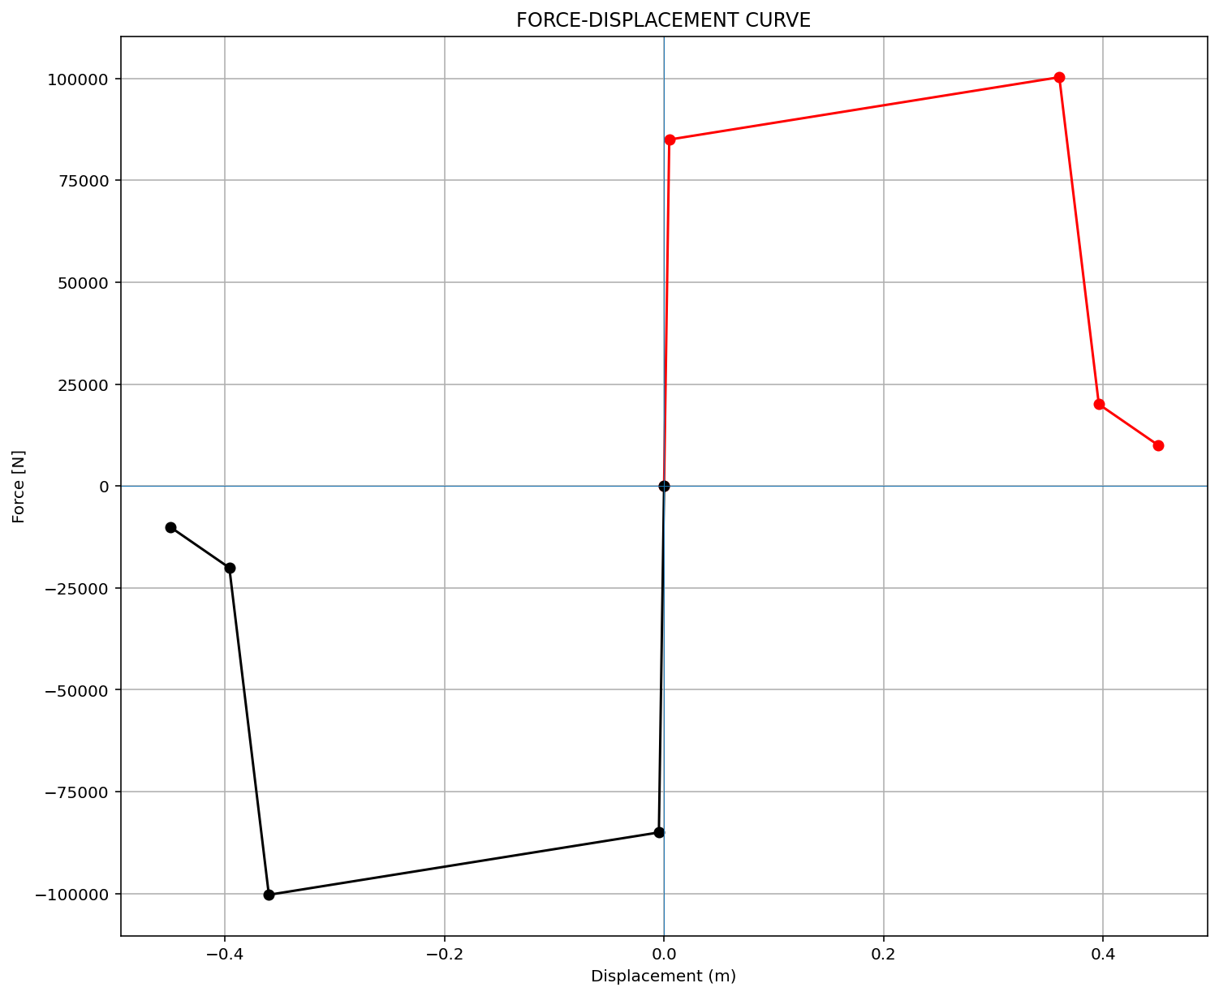
ELEMENT 01

Slide 5

ELEMENT 02

Slide 6
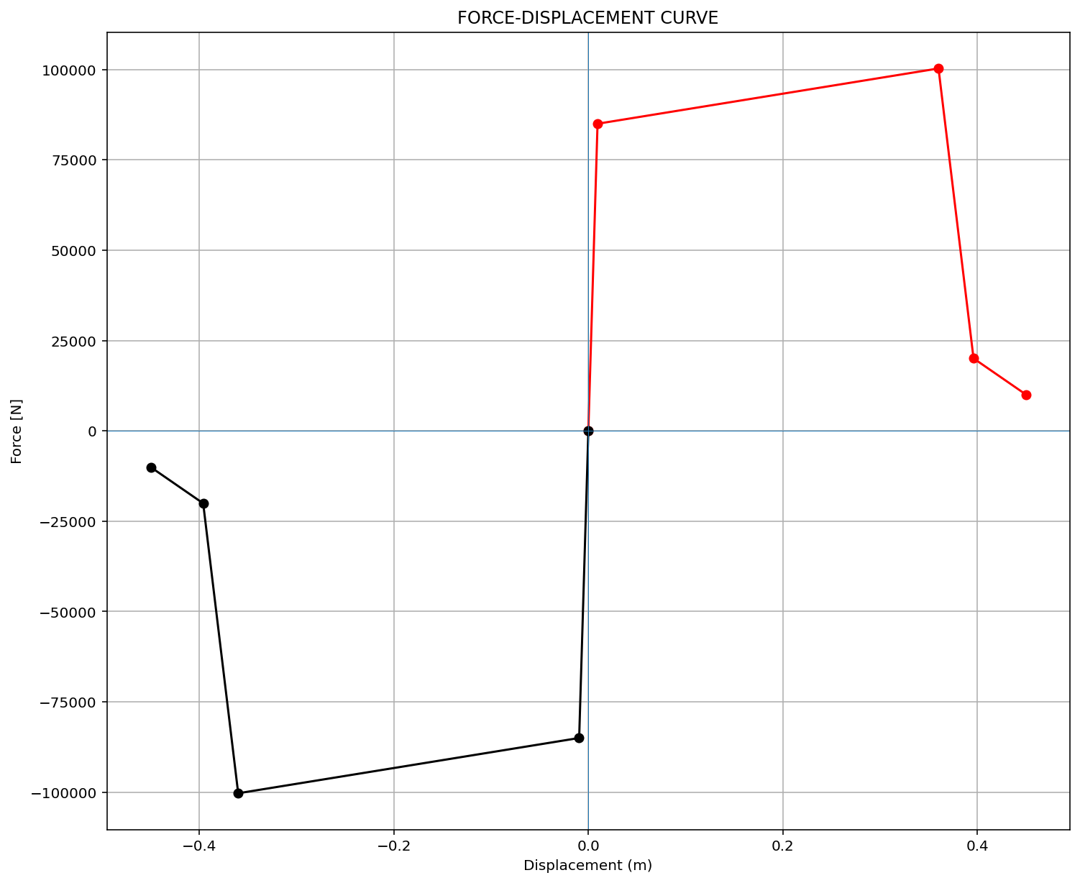
ELEMENT 03

Slide 7
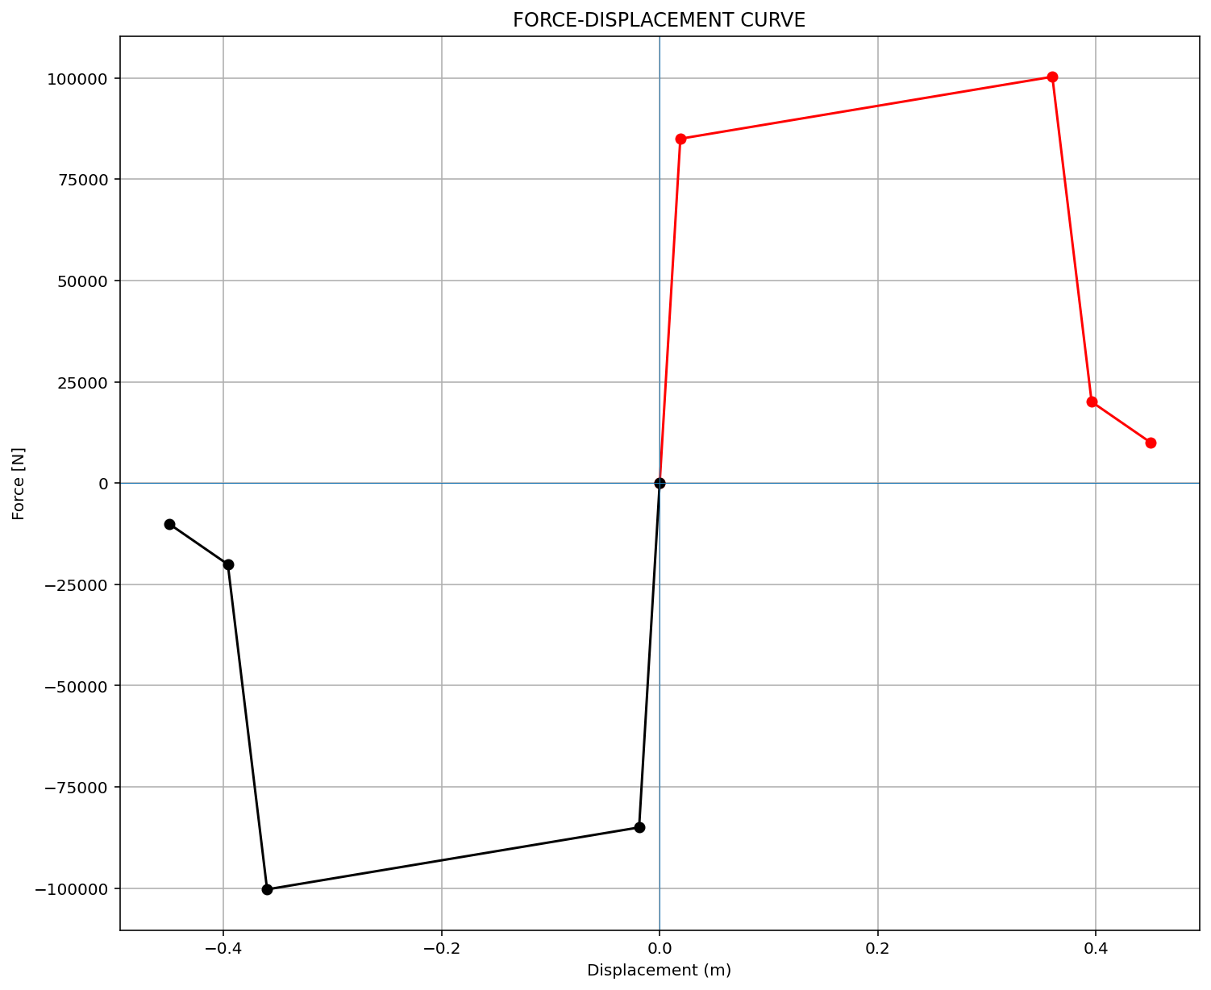
ELEMENT 04

Slide 8
STATIC ANALYSIS

Slide 9
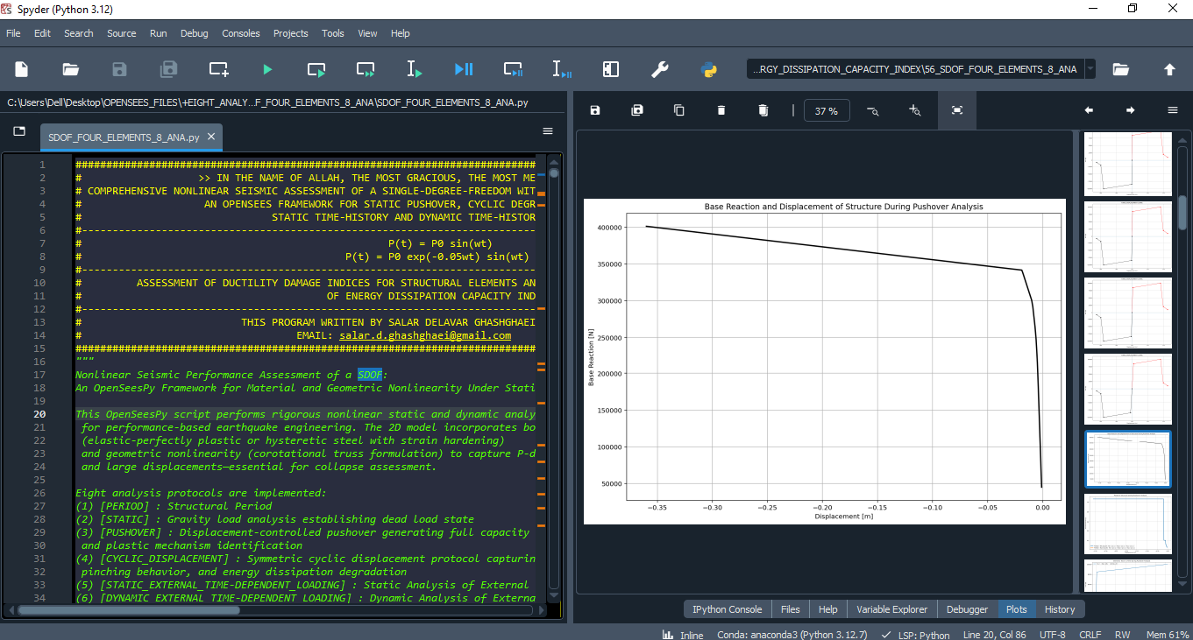

Slide 10
PUSHOVER ANALYSIS

Slide 11
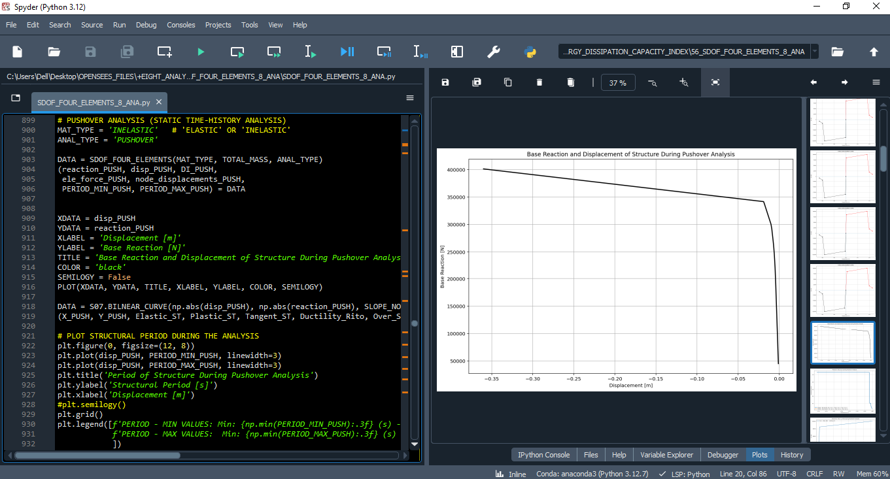

Slide 12
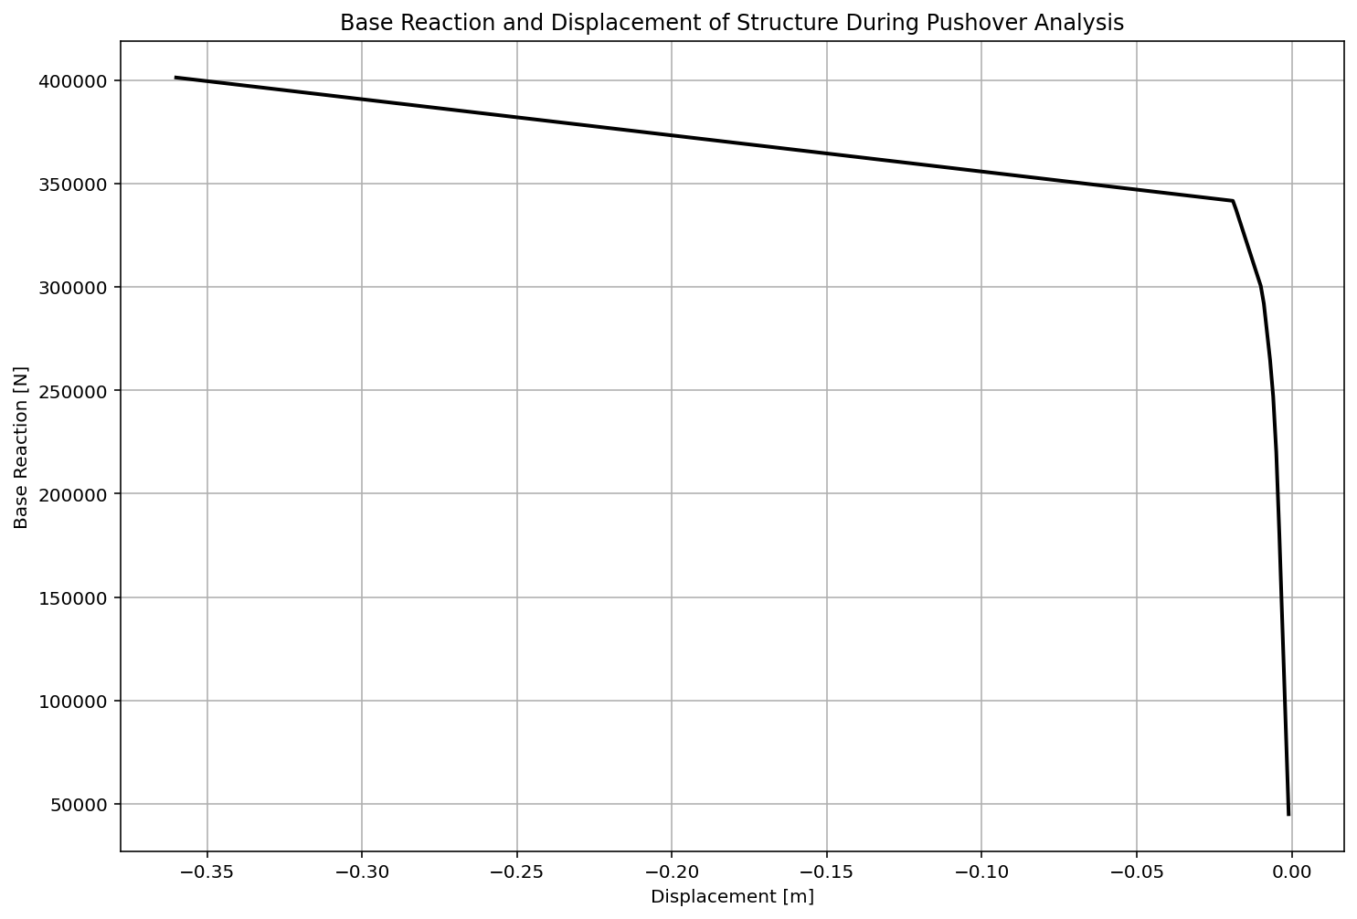

Slide 13
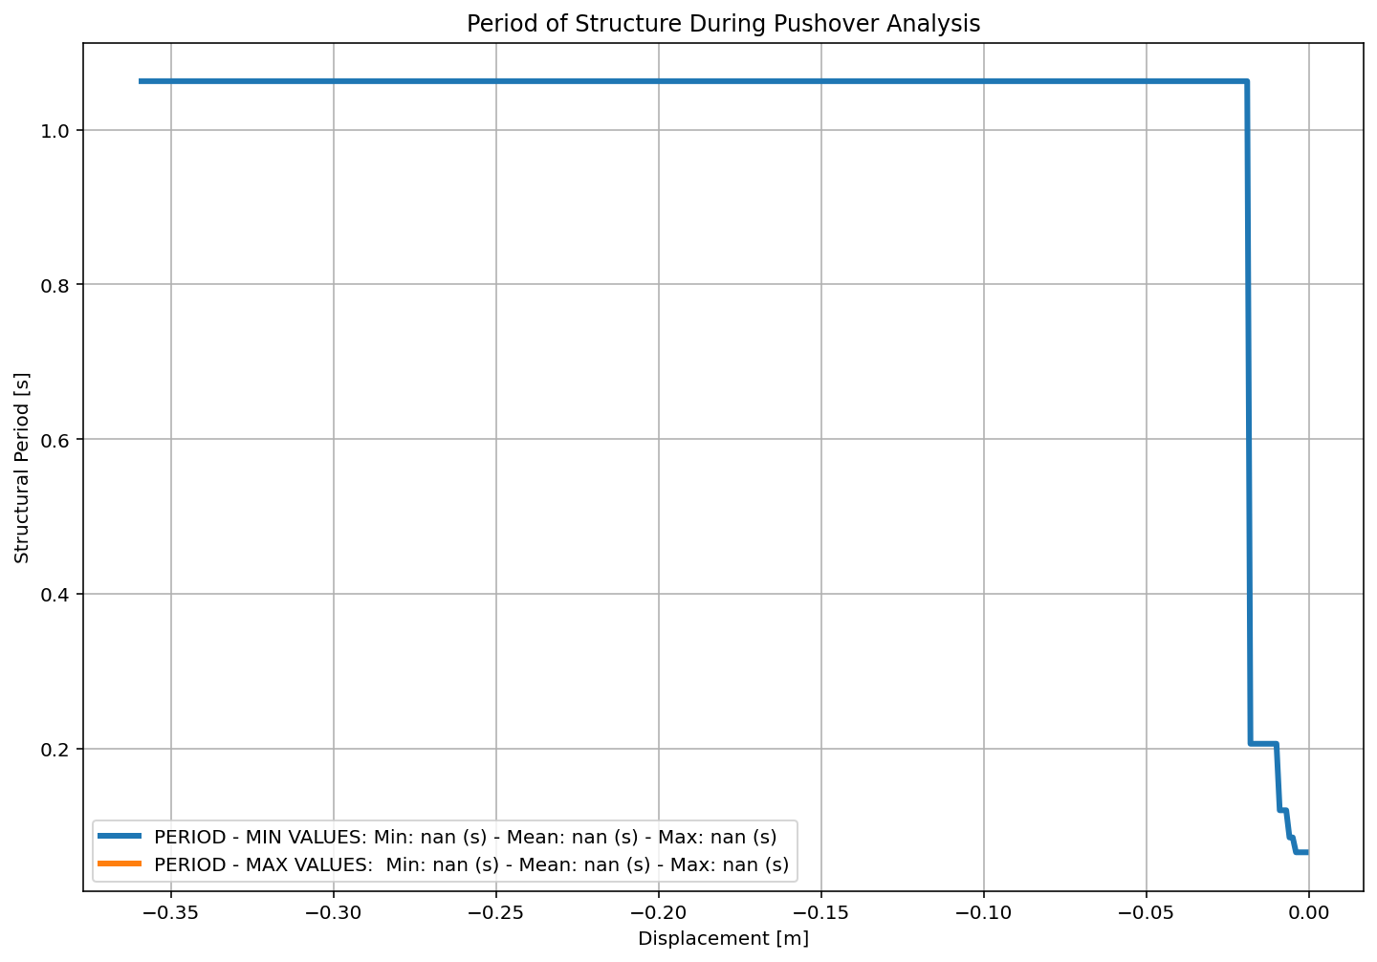

Slide 14
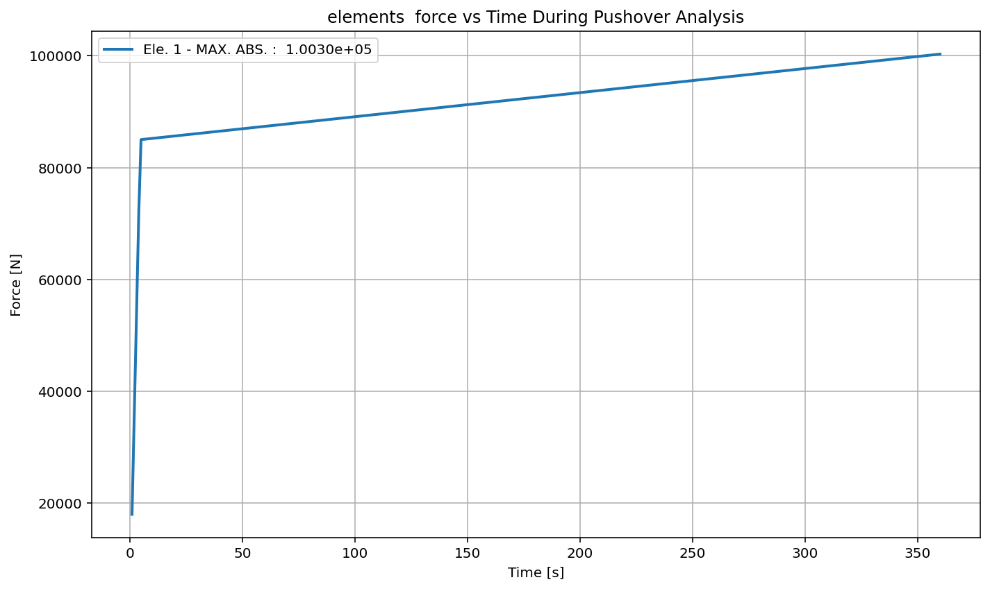

Slide 15
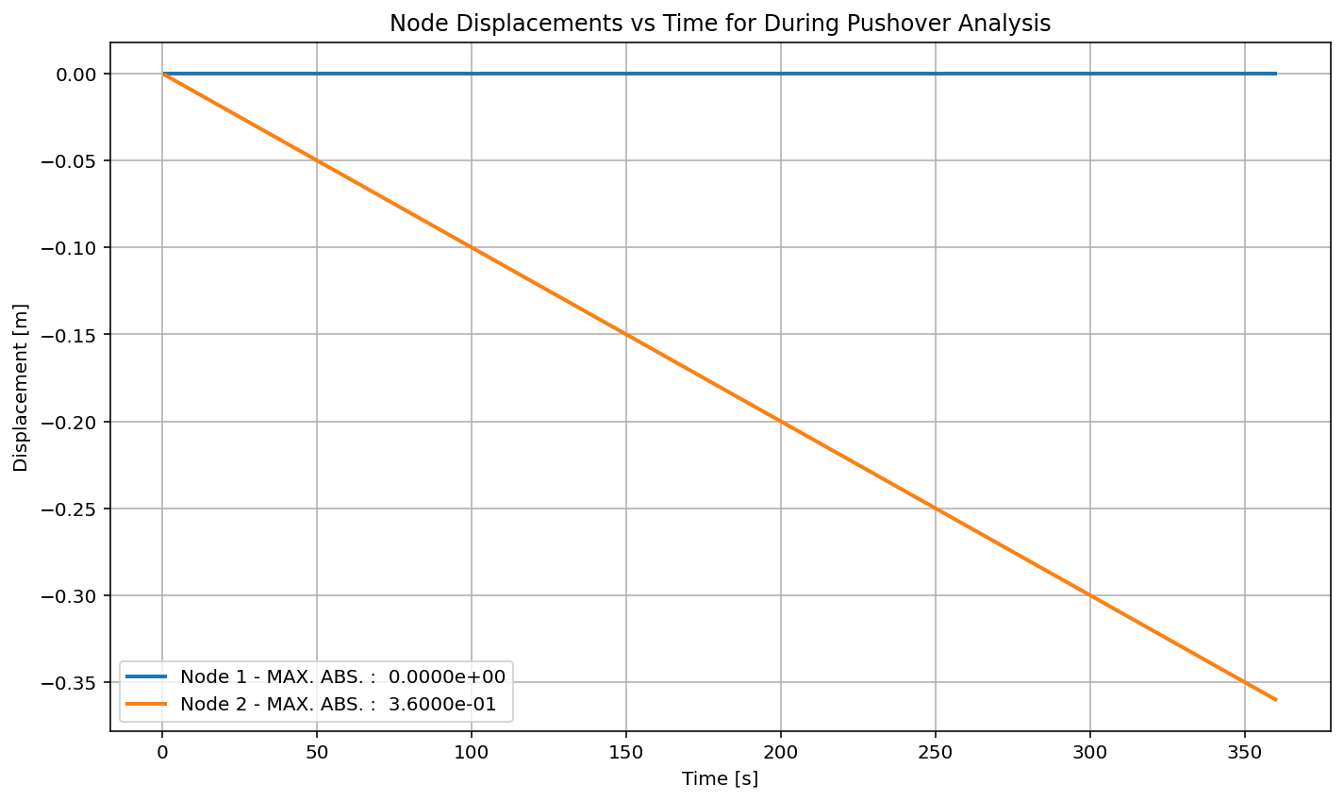

Slide 16
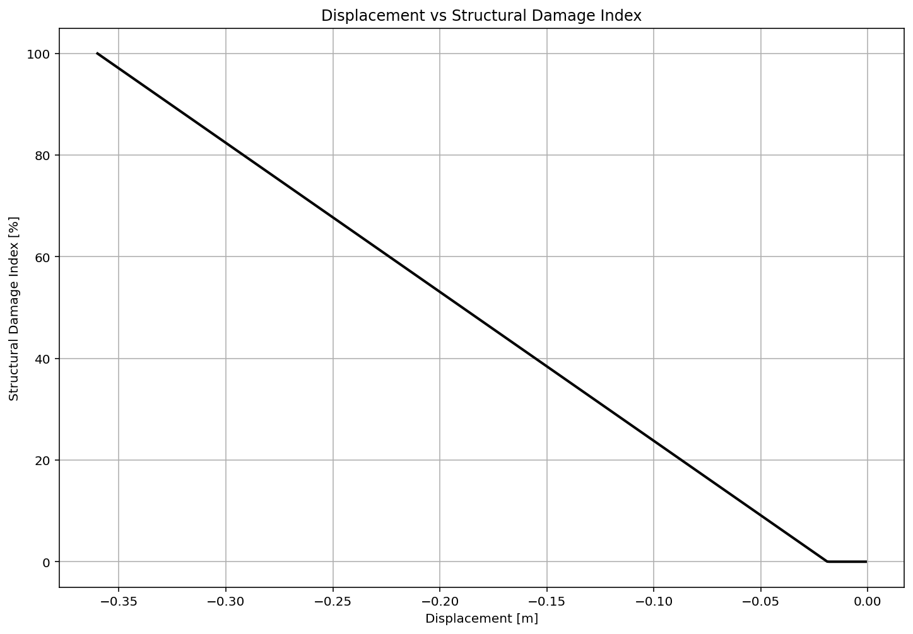

Slide 17
CYCLIC DISPLACEMENT ANALYSIS

Slide 18
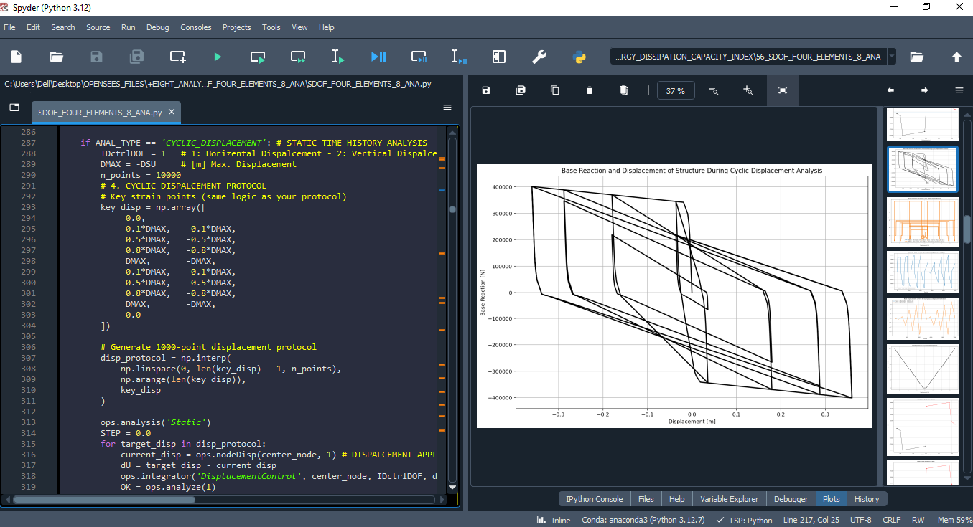

Slide 19
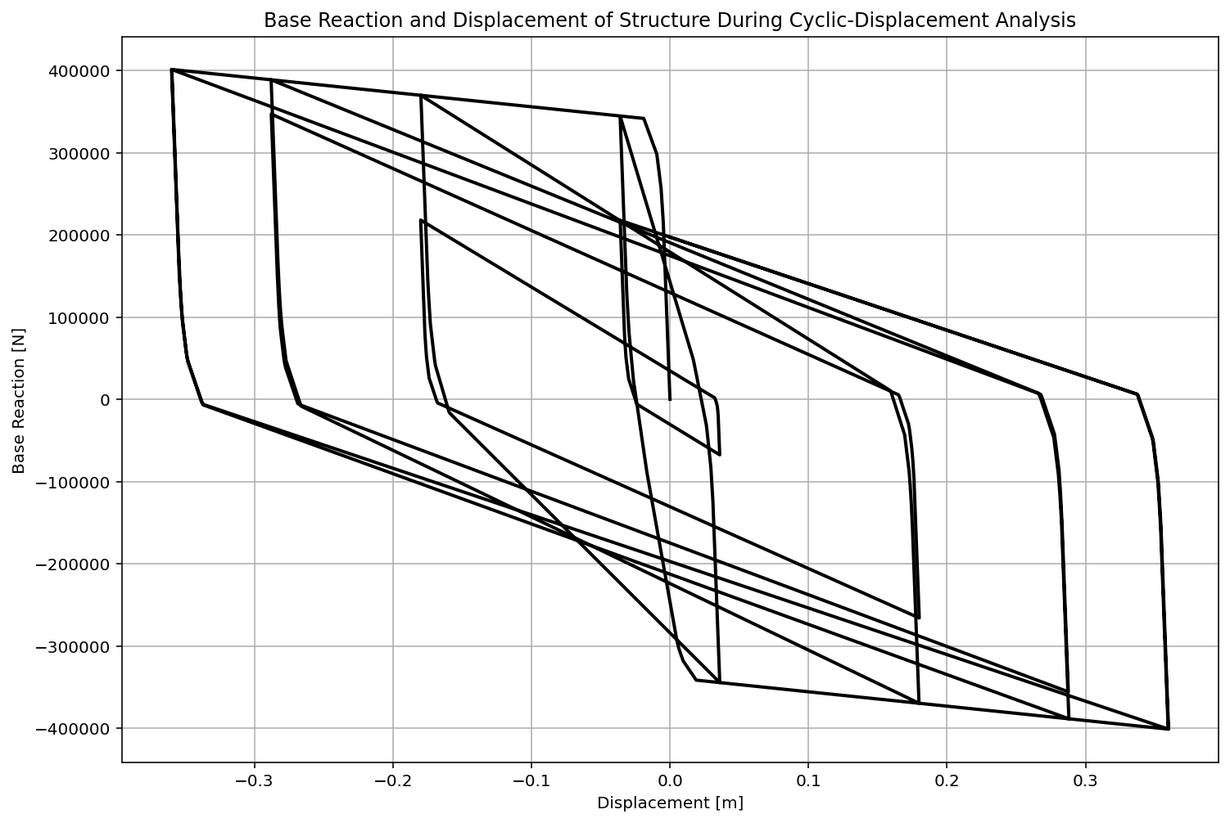

Slide 20
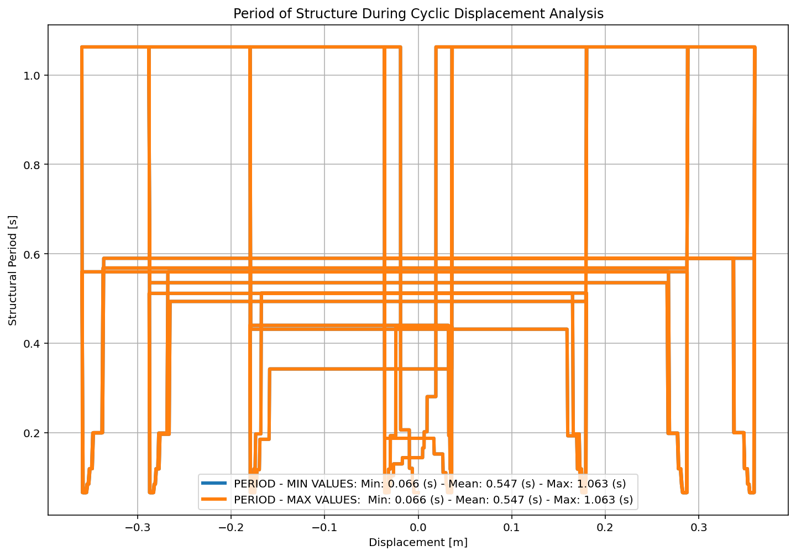

Slide 21
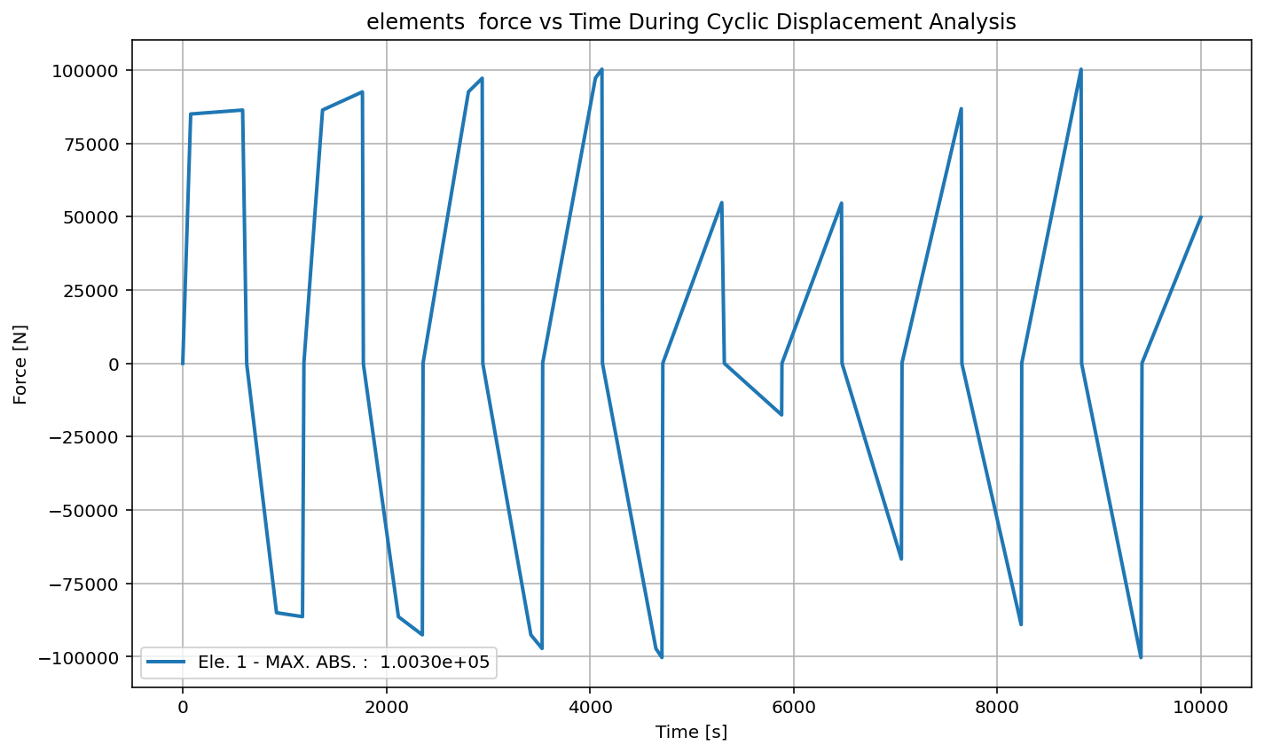

Slide 22
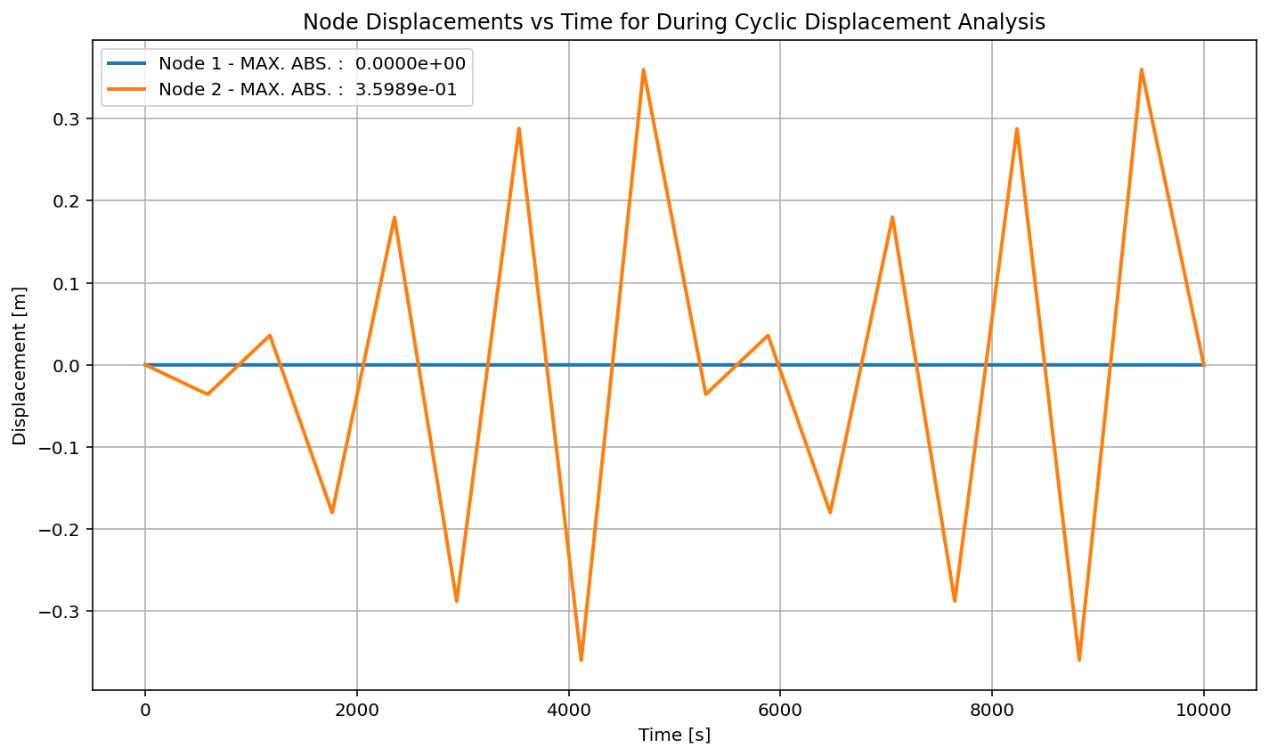

Slide 23
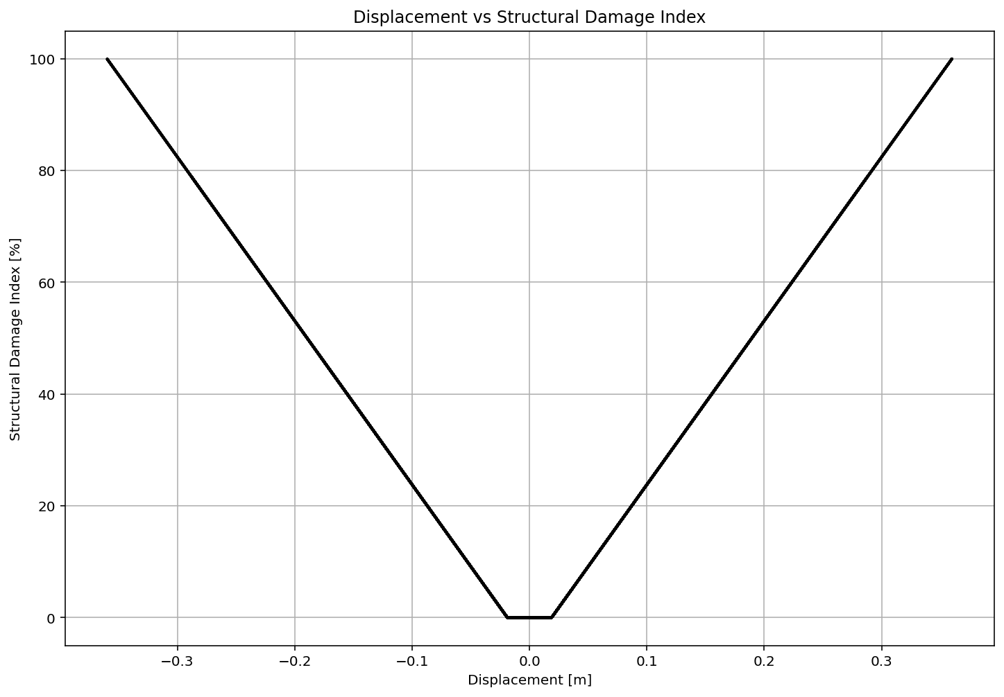

Slide 24
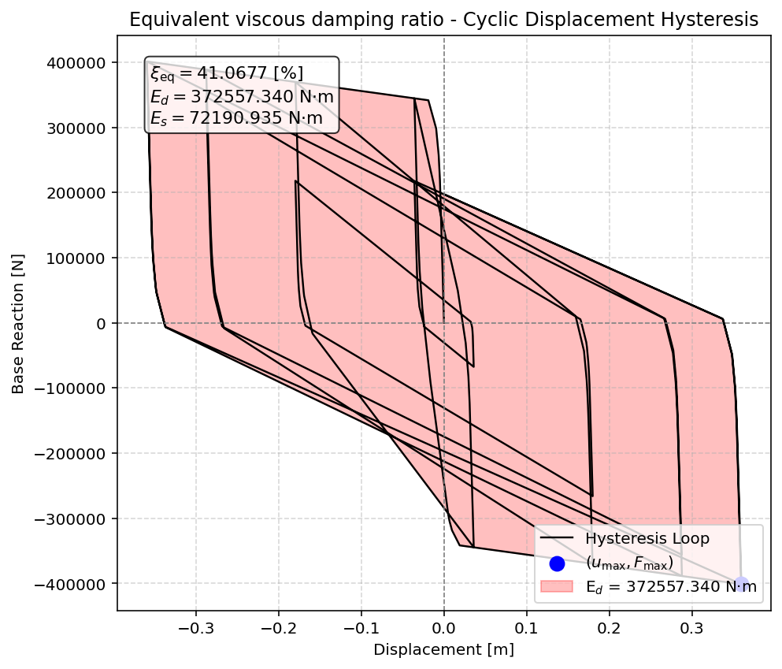

Slide 25
STATIC TIME-HISTORY WITH EXTERNAL TIME-DEPENDENT LOADING ANALYSIS

Slide 26
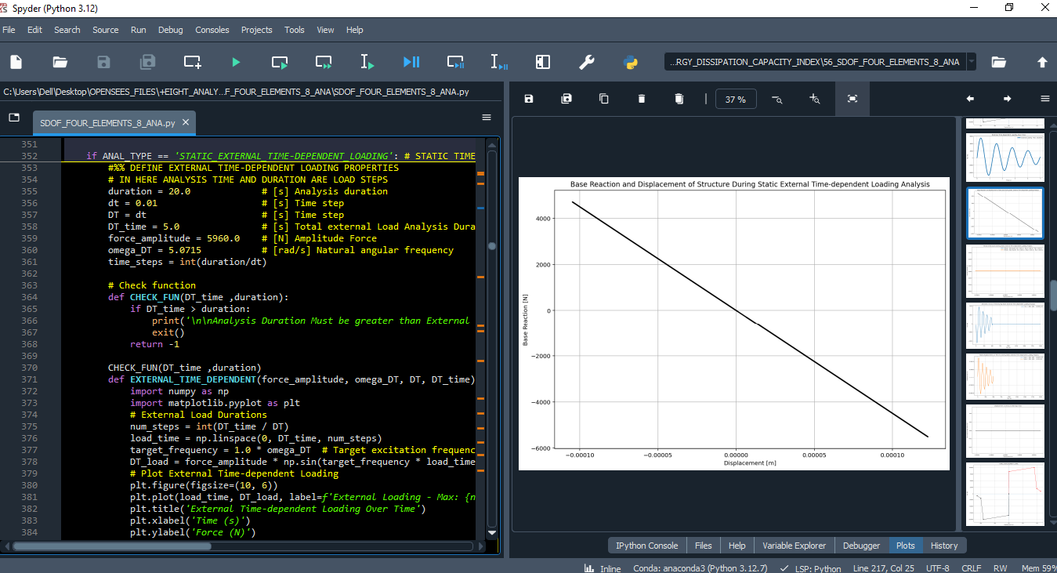

Slide 27
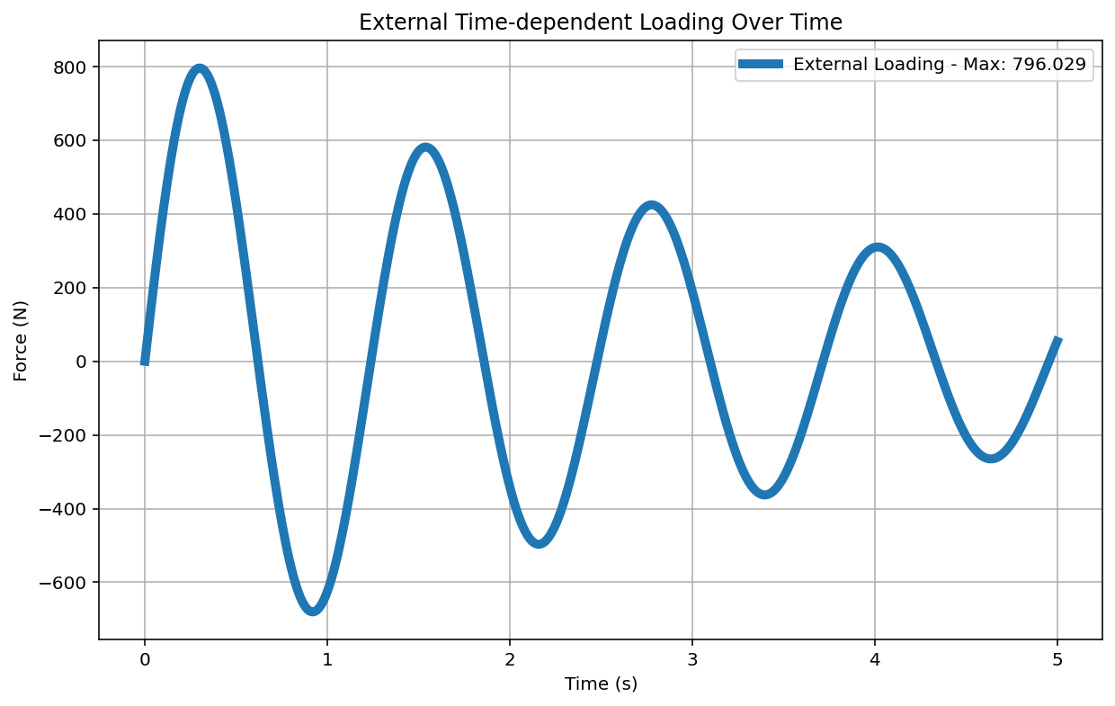

Slide 28
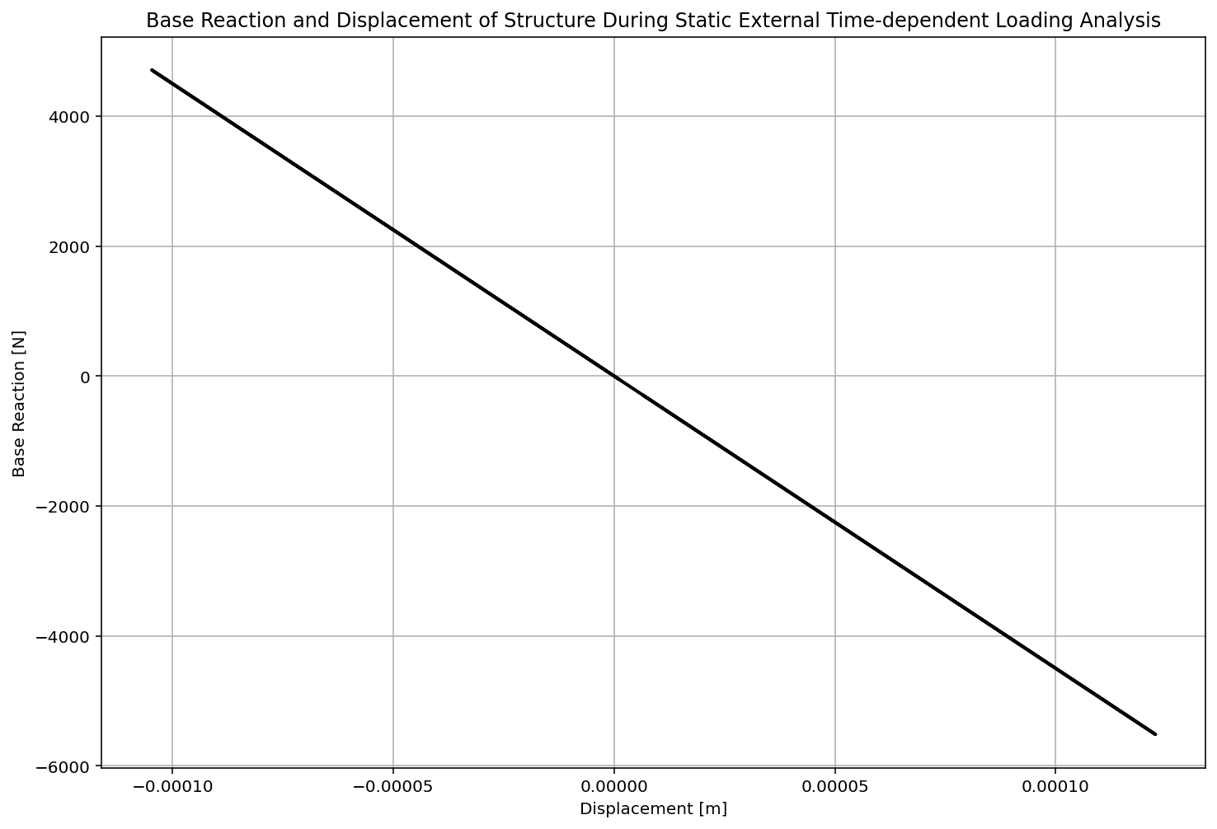

Slide 29
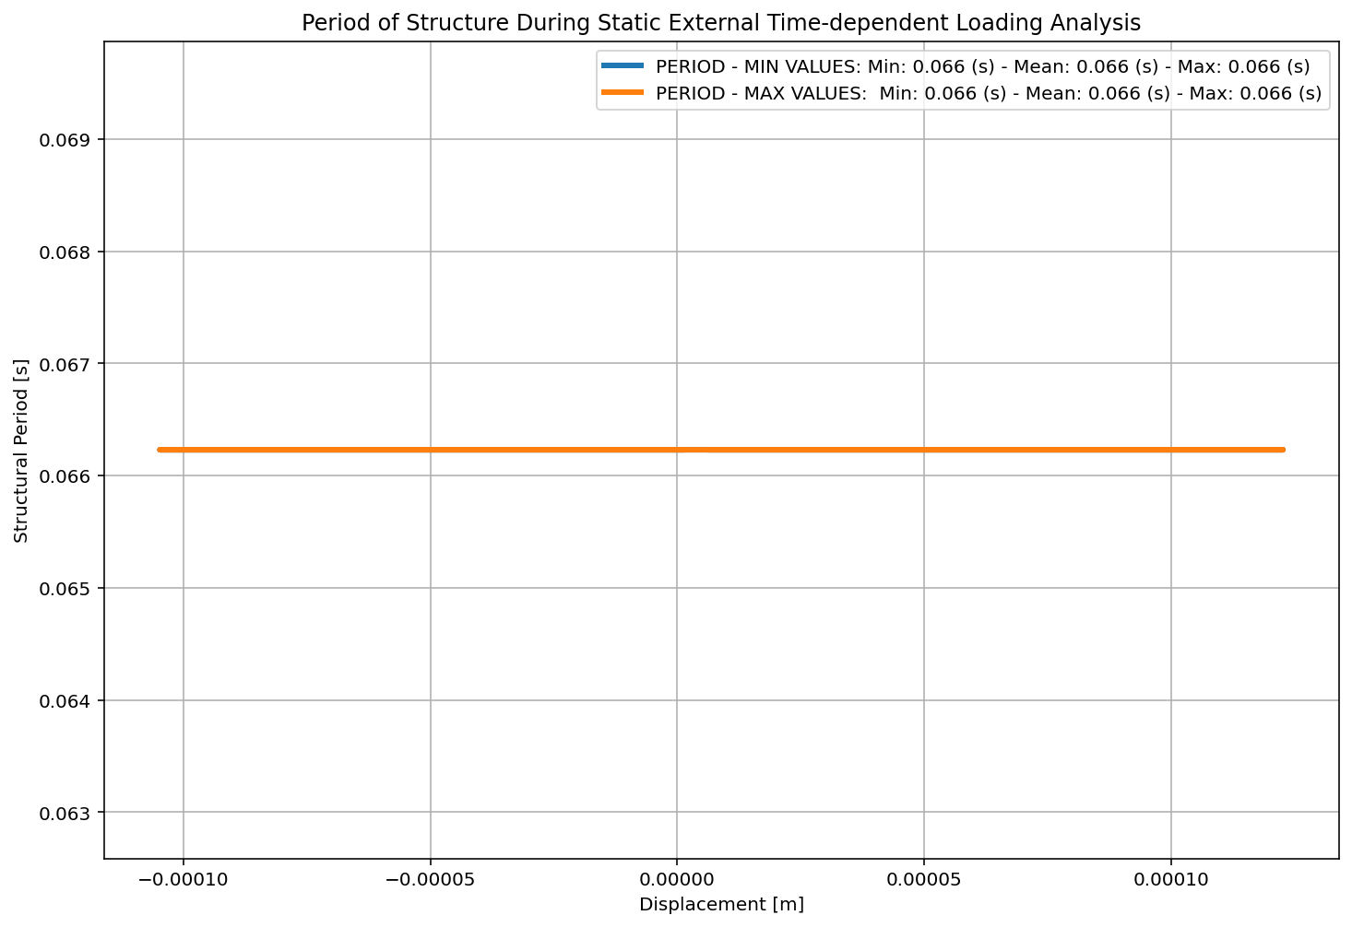

Slide 30
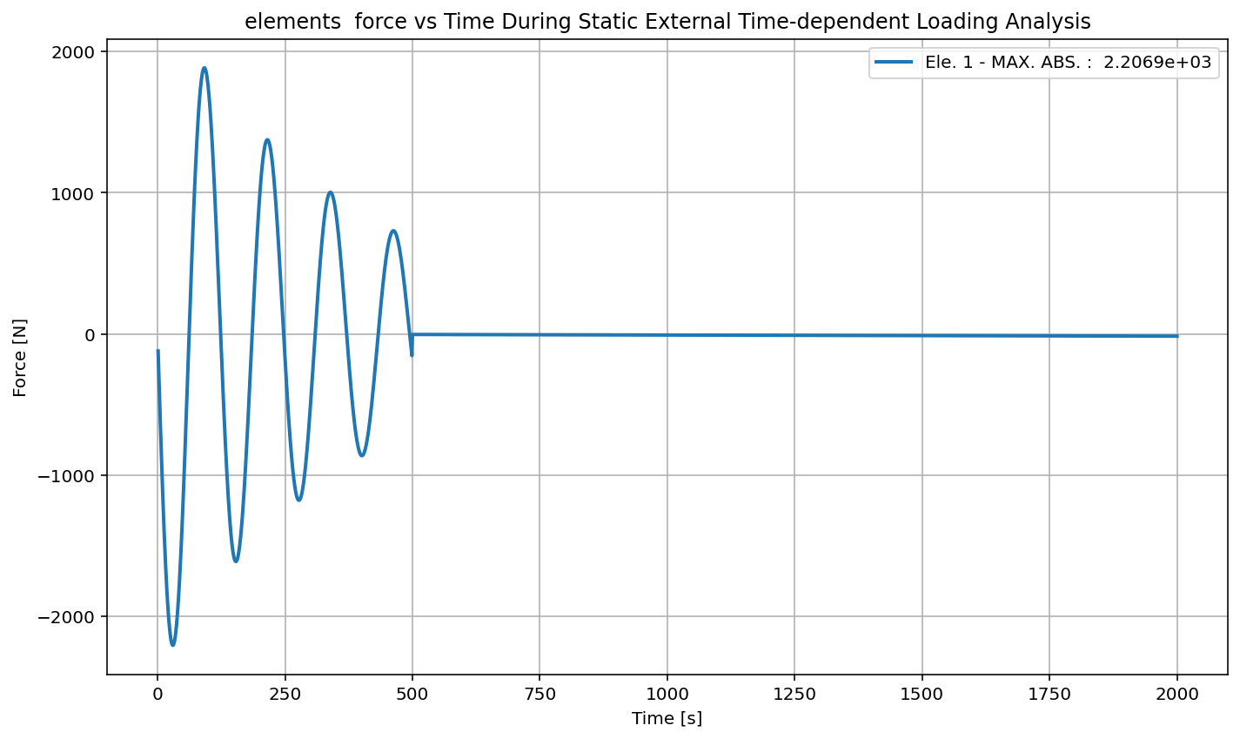

Slide 31
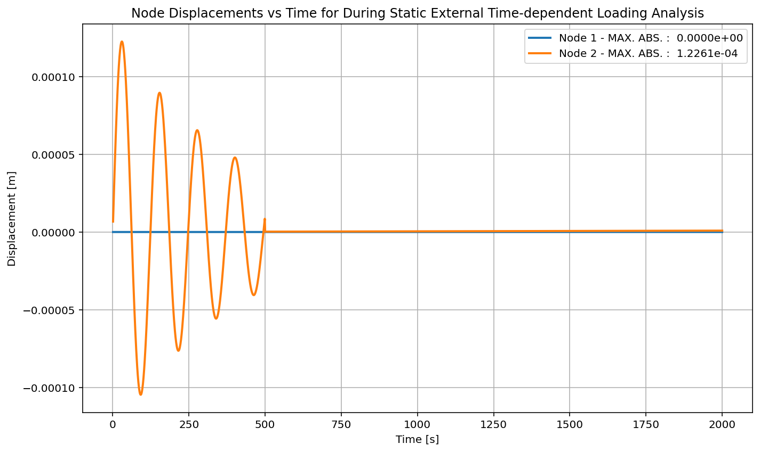

Slide 32
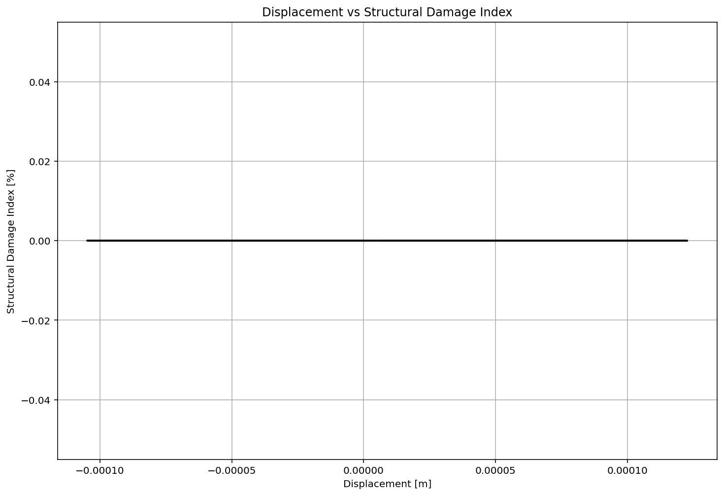

Slide 33
DYNAMIC TIME-HISTORY WITH EXTERNAL TIME-DEPENDENT LOADING ANALYSIS

Slide 34


Slide 36
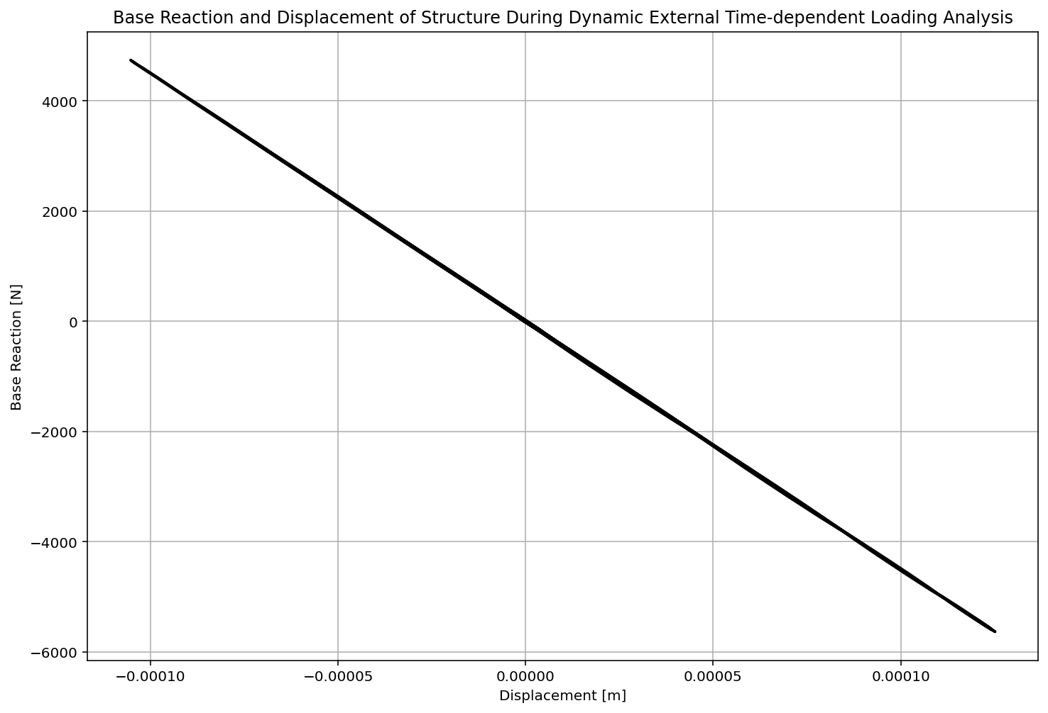

Slide 37
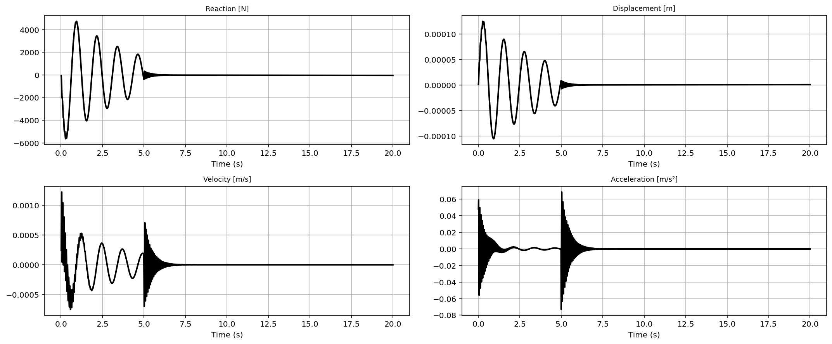

Slide 38
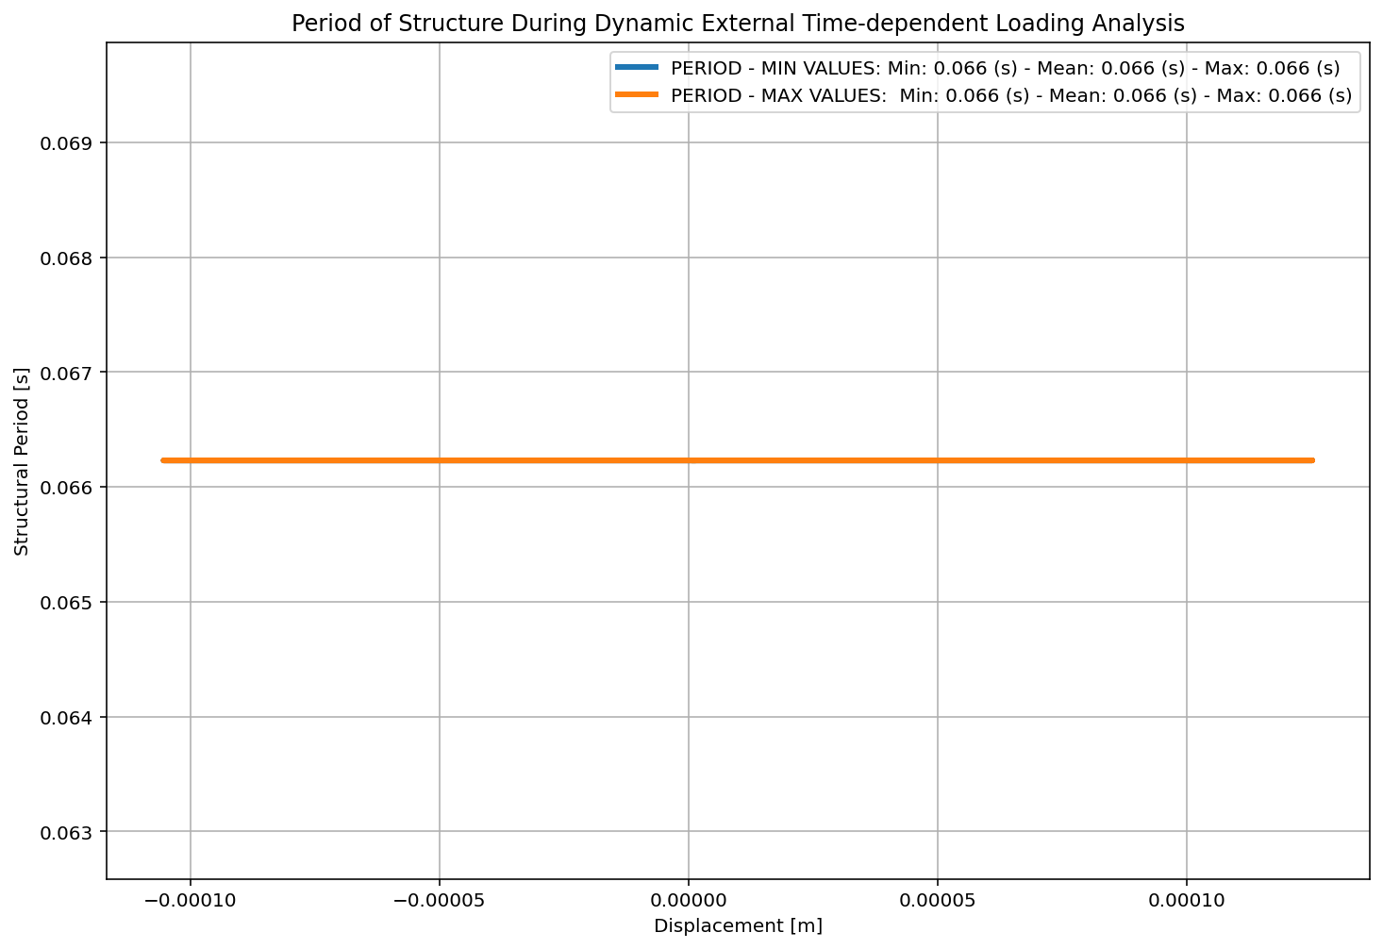

Slide 39
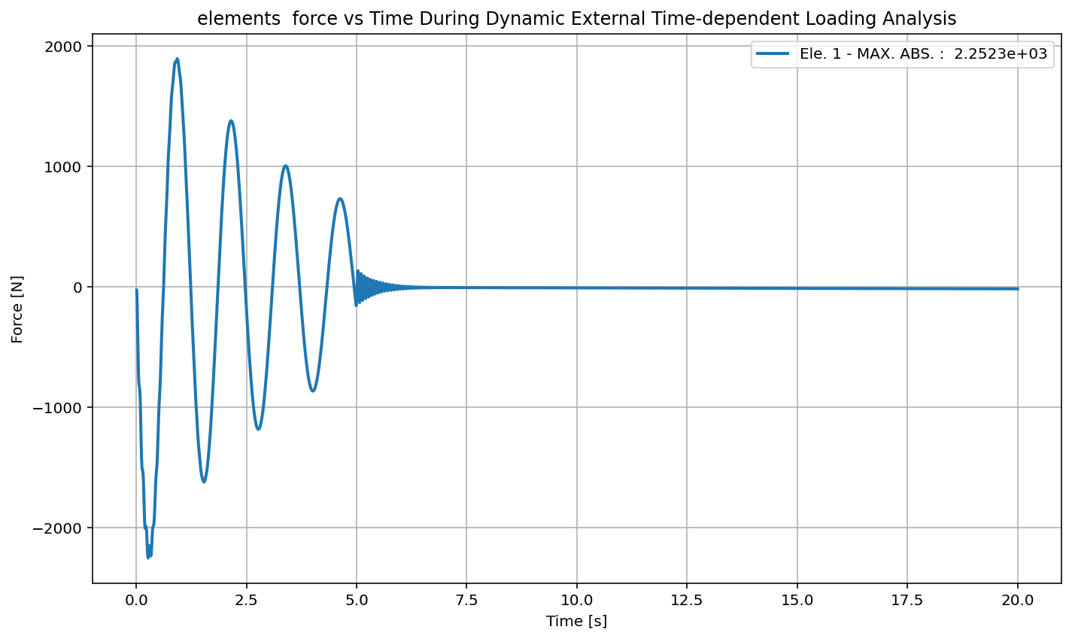

Slide 40
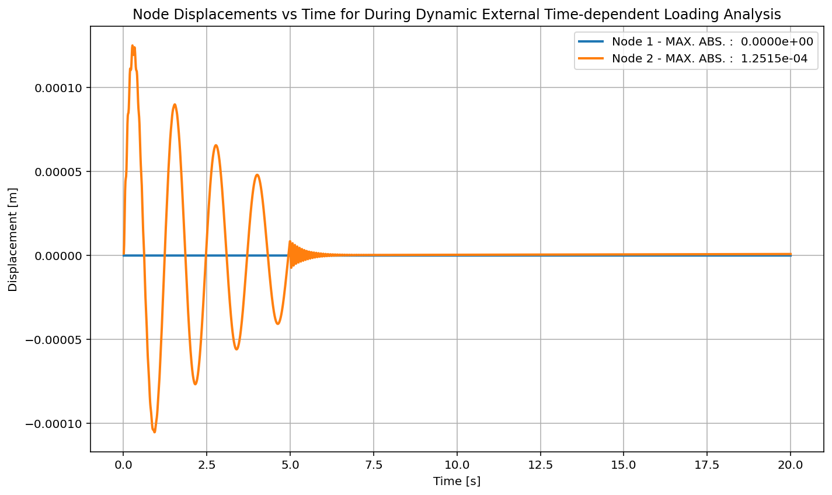

Slide 41


Slide 42
FREE-VIBRATION ANALYSIS

Slide 43
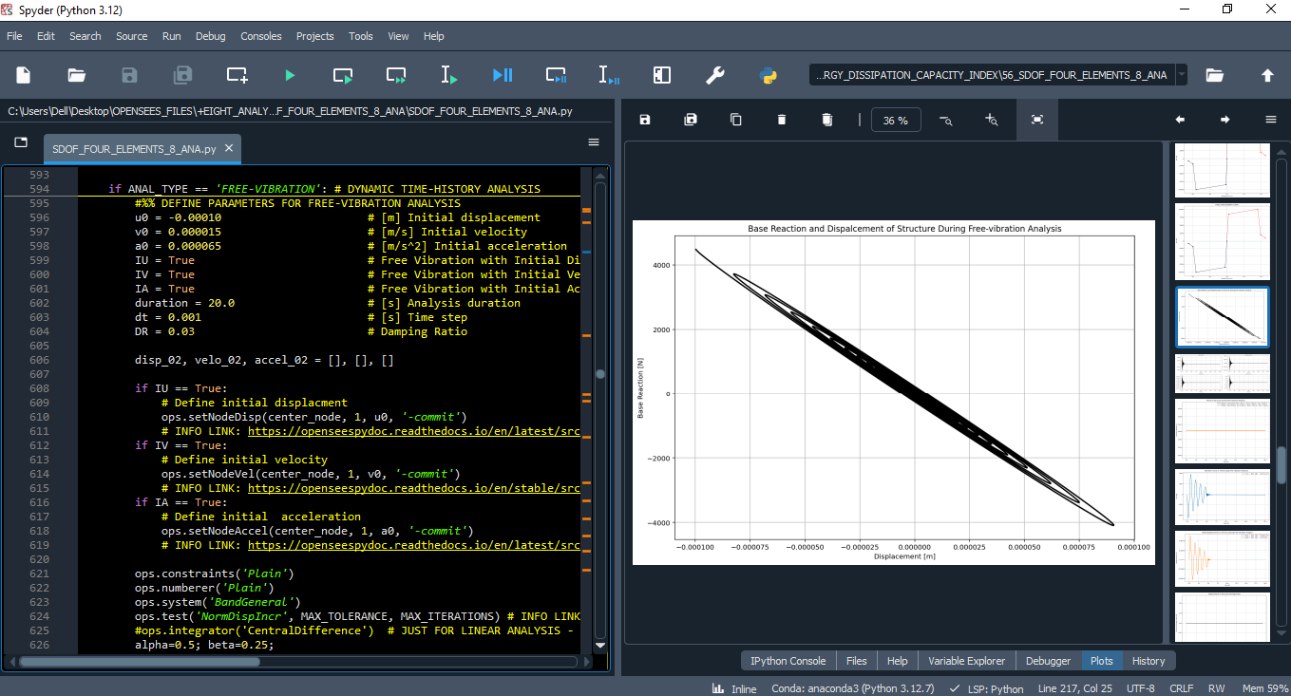

Slide 44
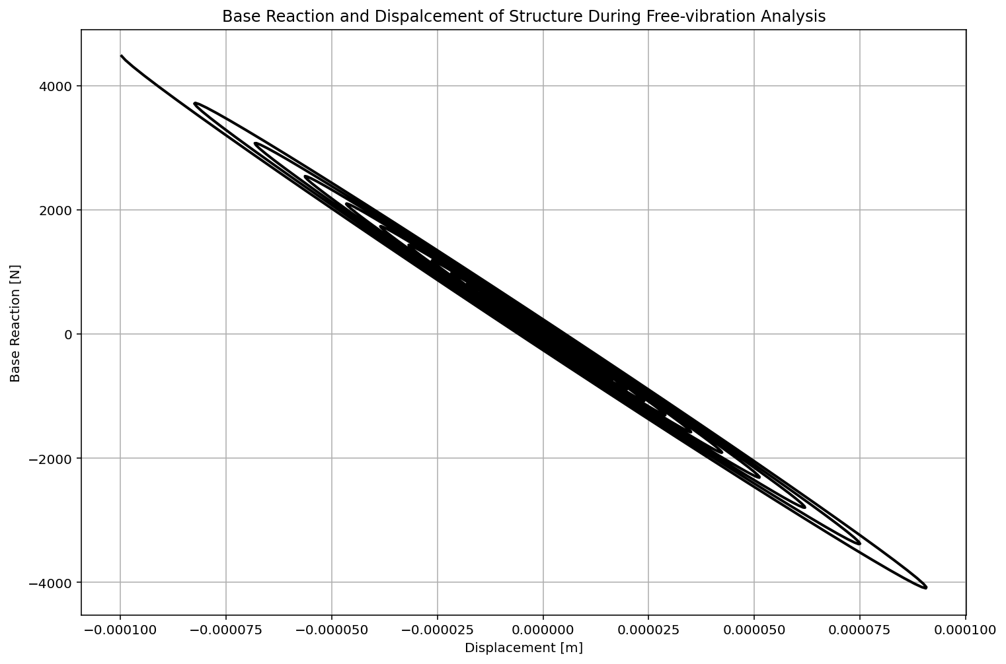

Slide 45
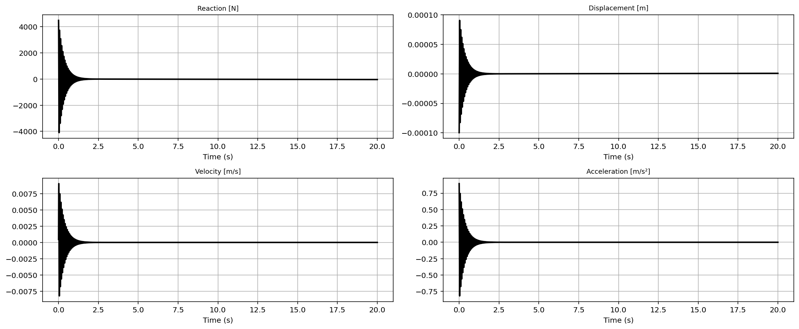

Slide 46
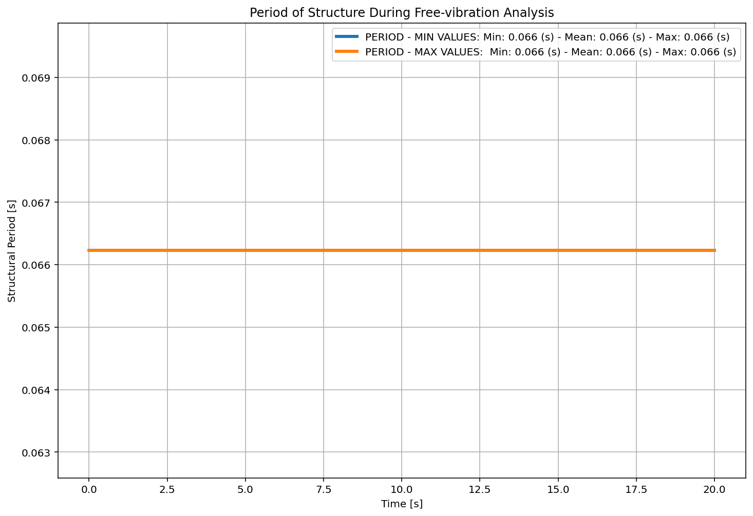

Slide 47
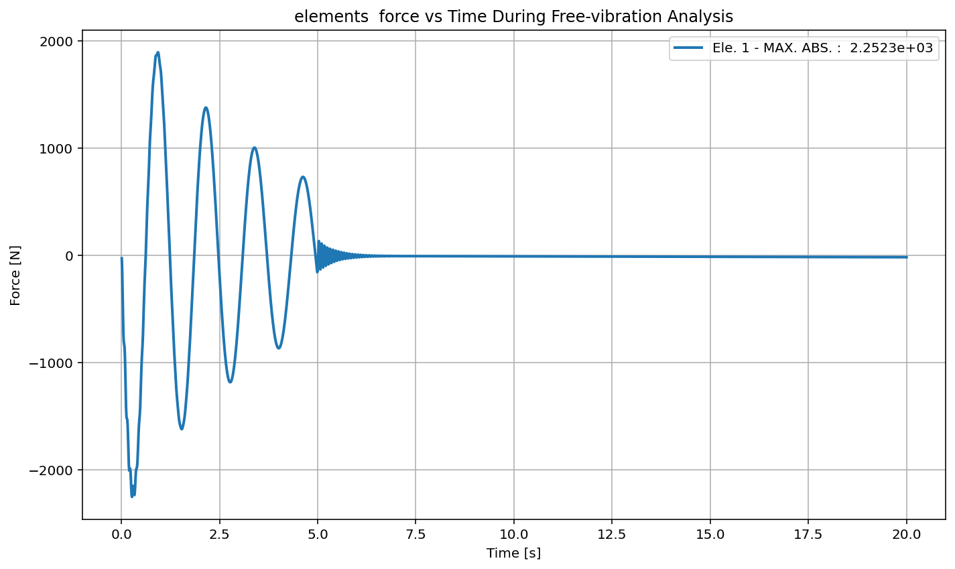

Slide 48
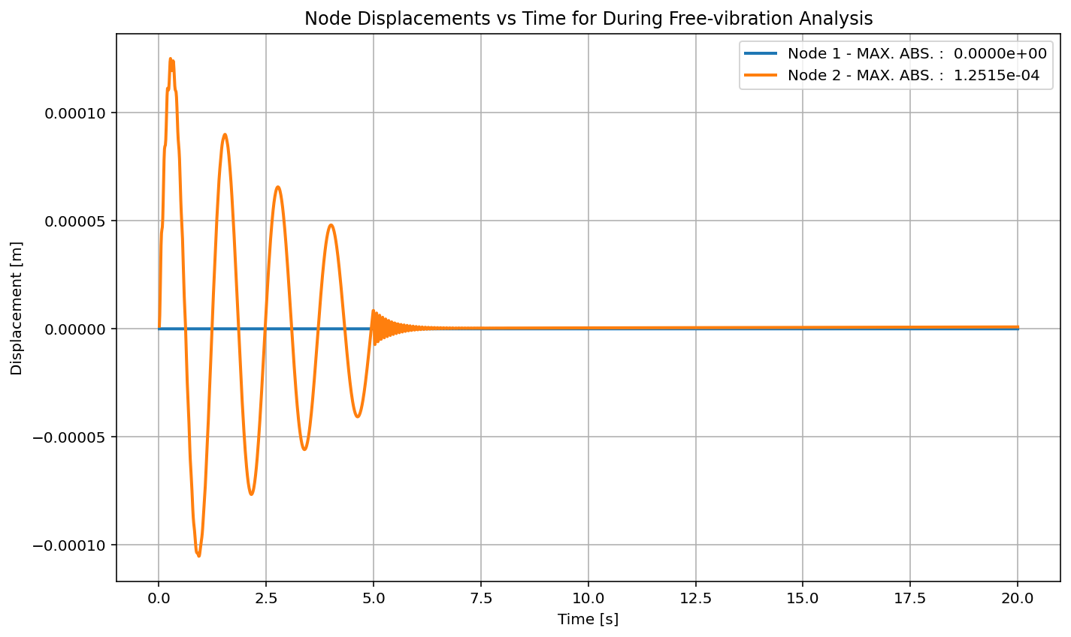

Slide 49
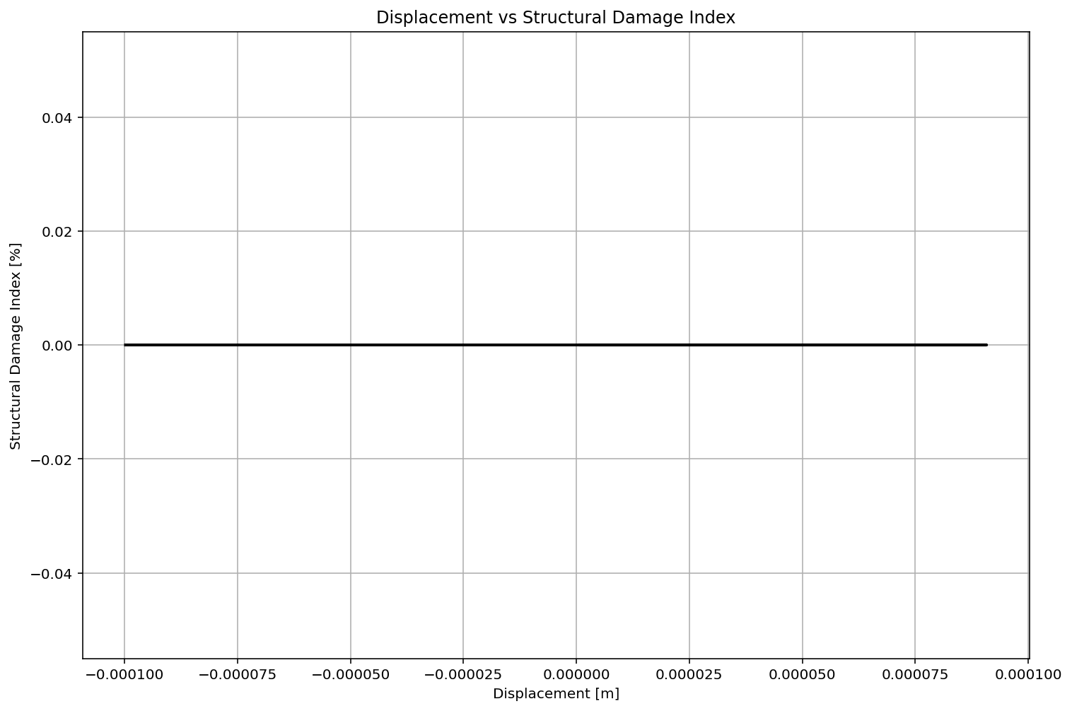

Slide 50
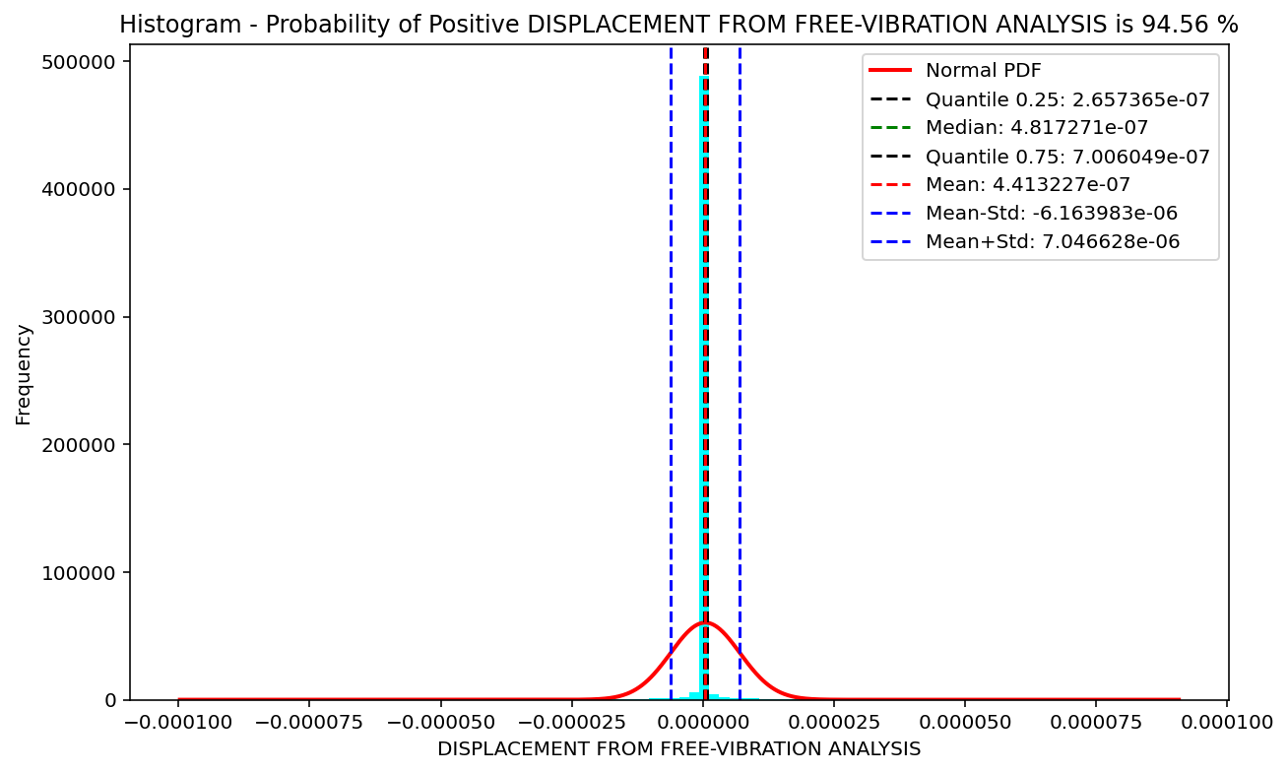

Slide 51
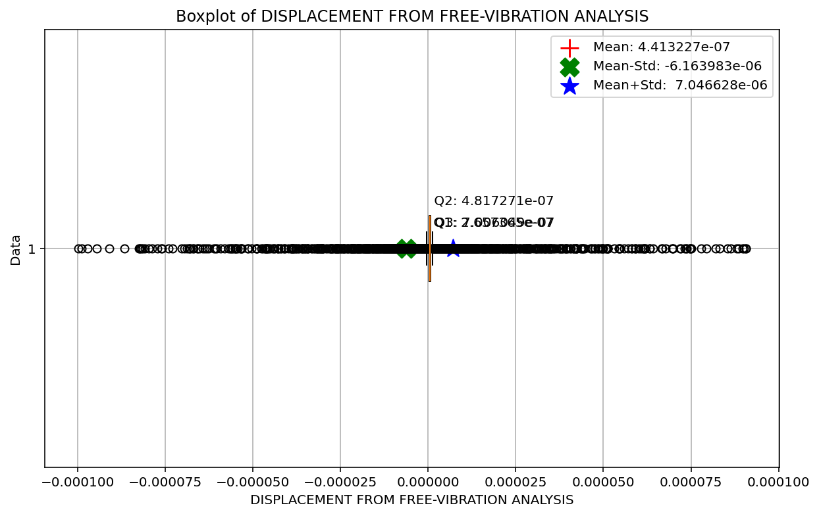

Slide 52
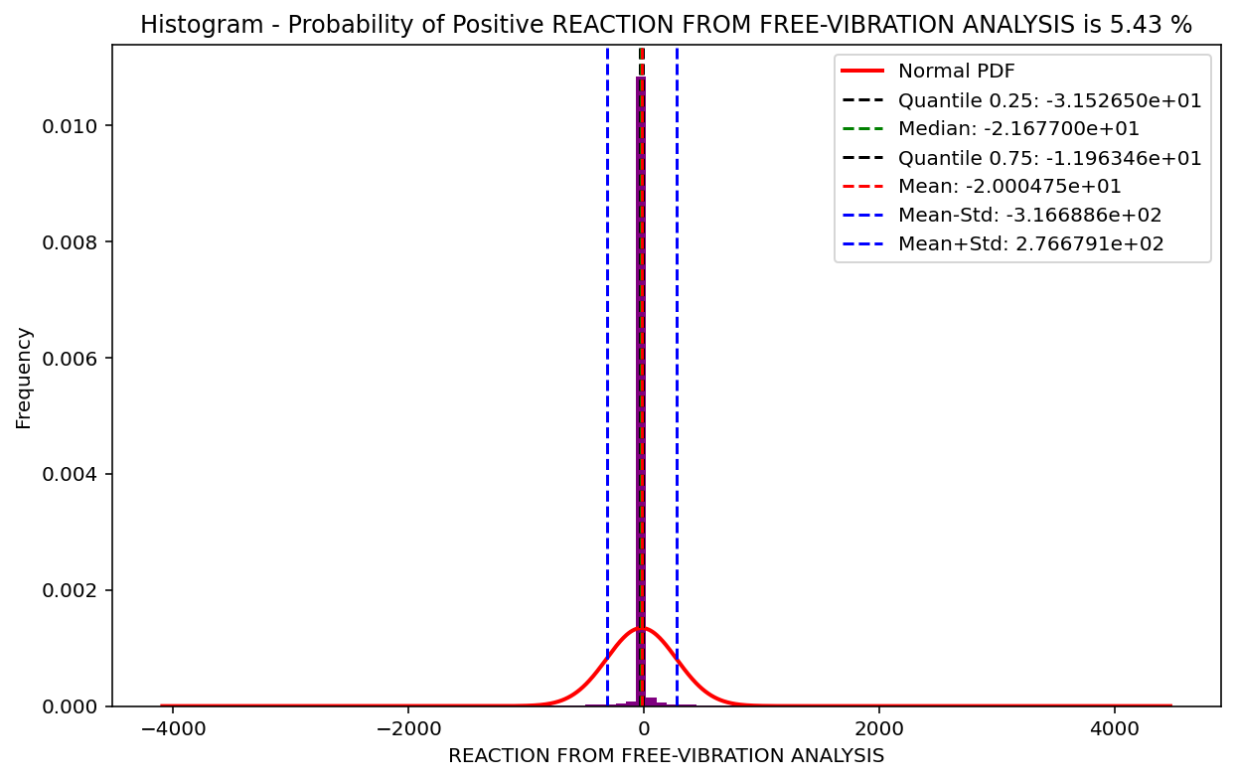

Slide 53
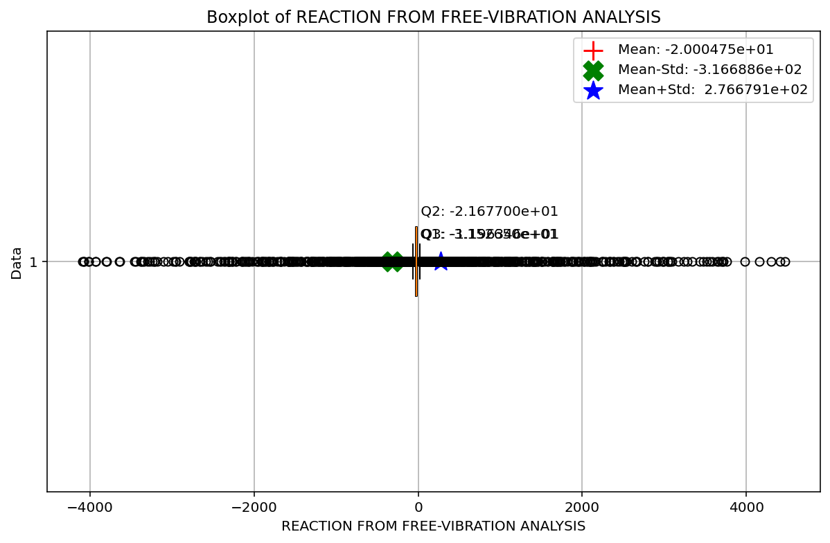

Slide 54
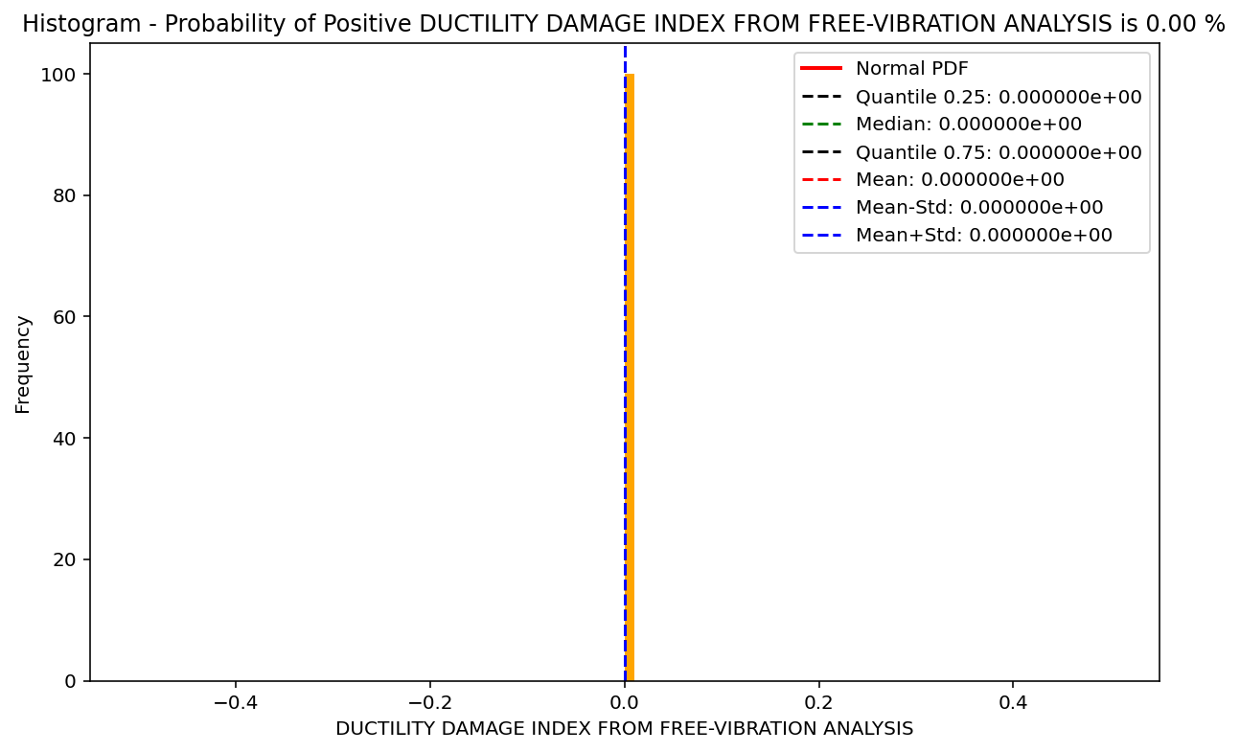

Slide 55
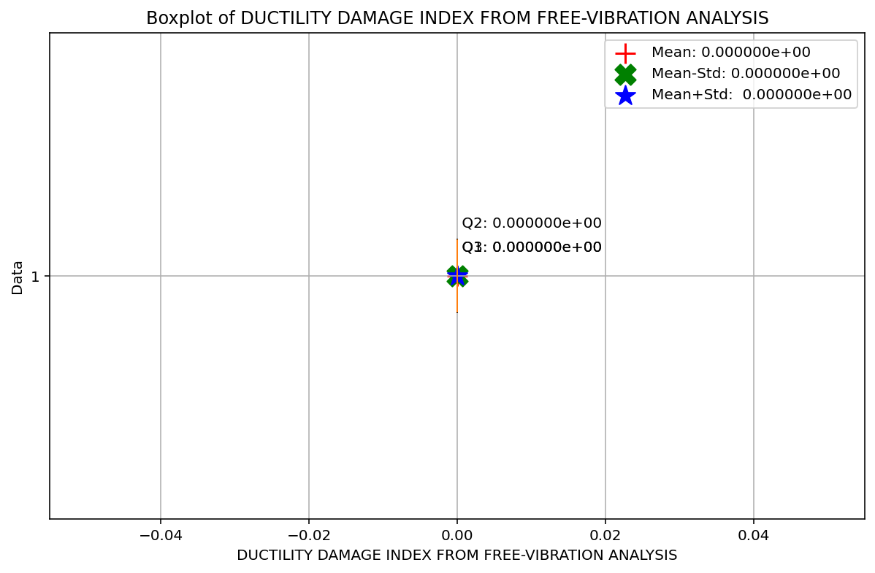

Slide 56
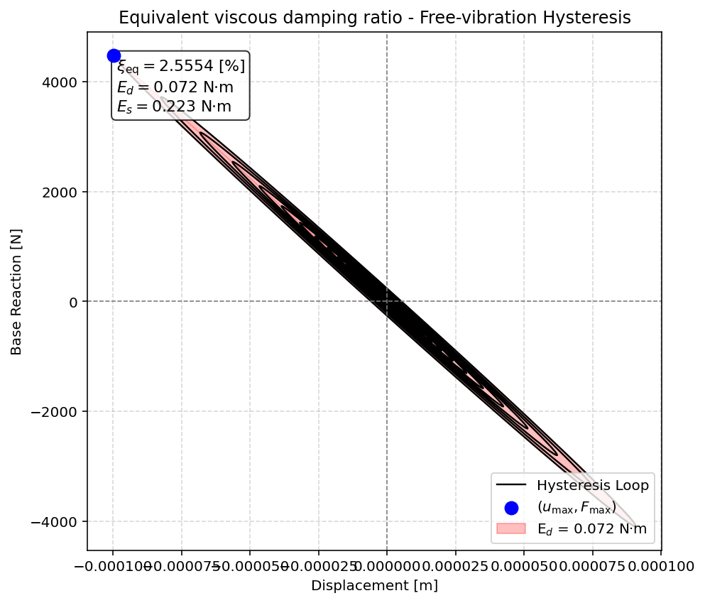

Slide 57
SEISMIC ANALYSIS

Slide 58
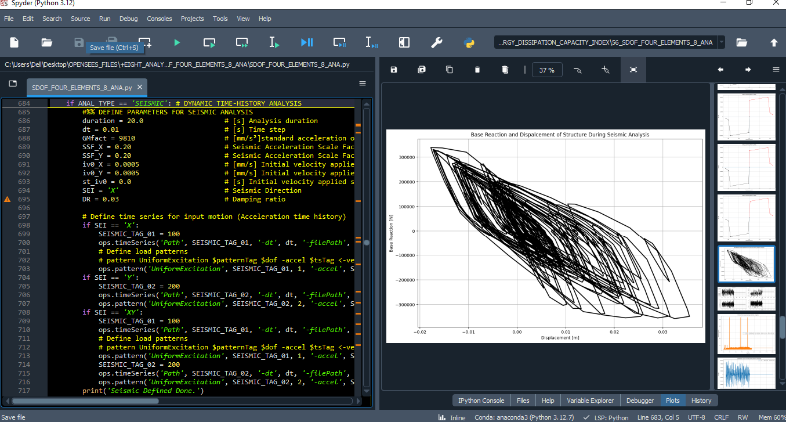

Slide 59
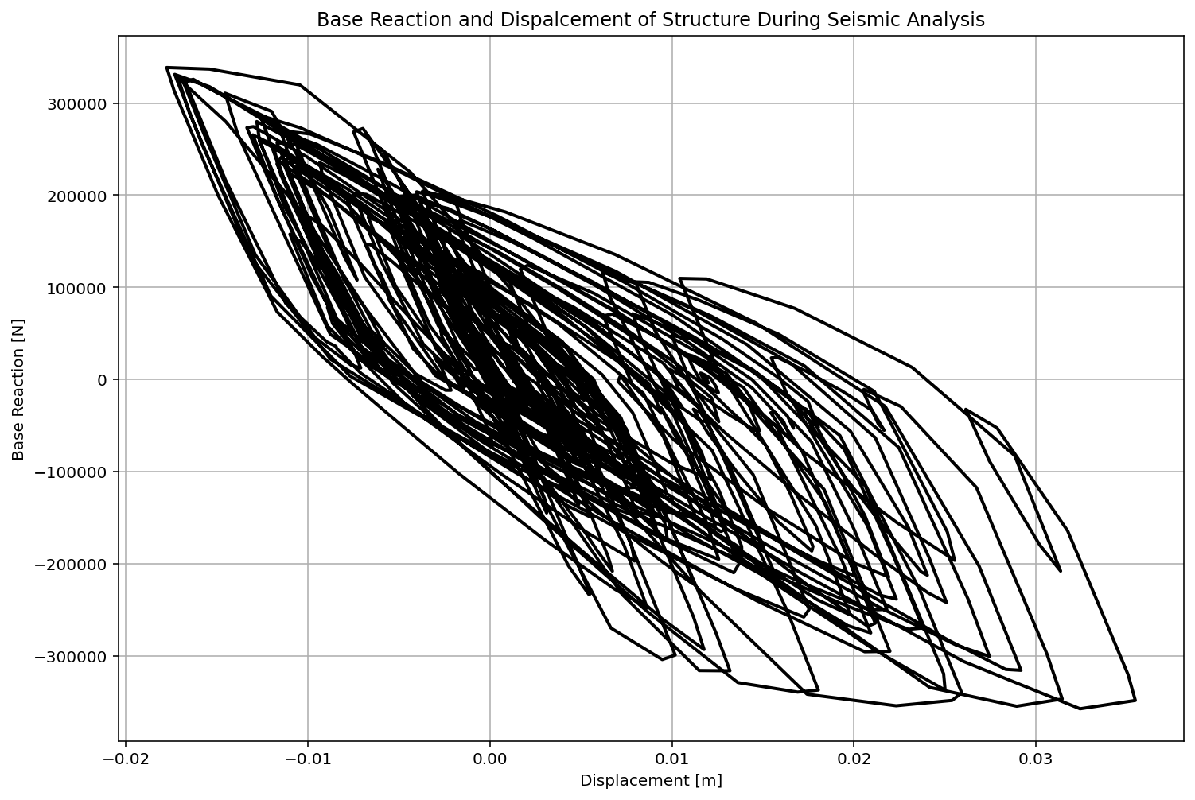

Slide 60
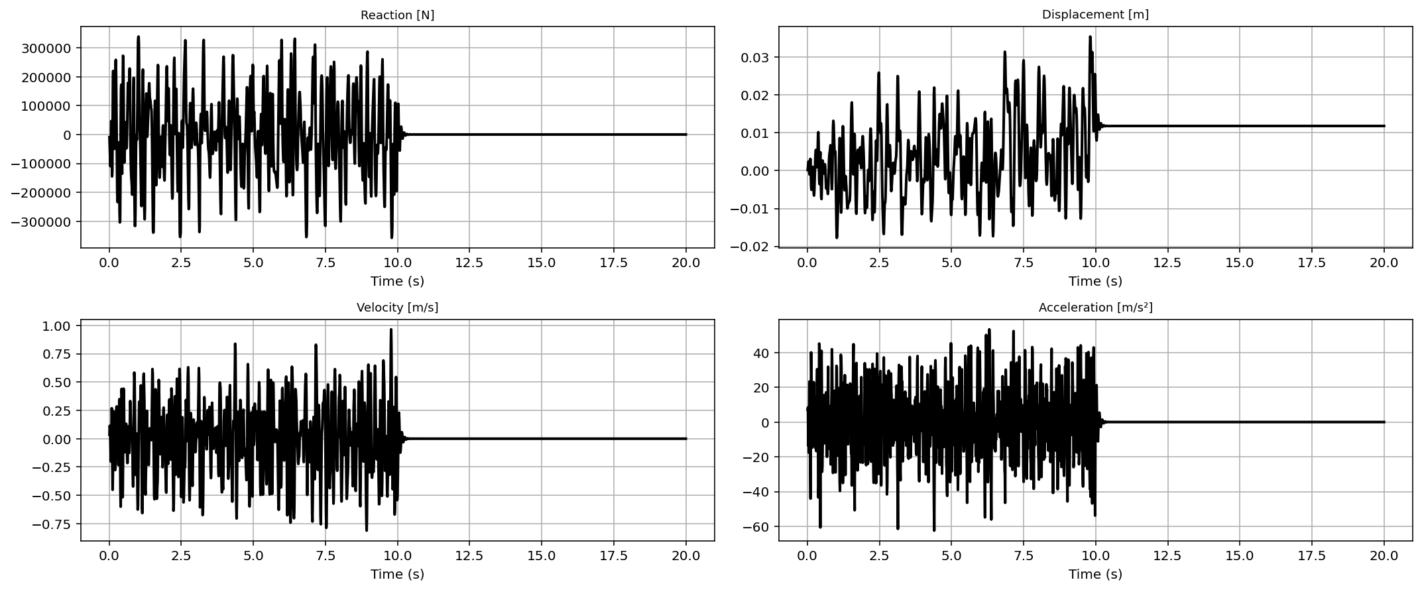

Slide 61
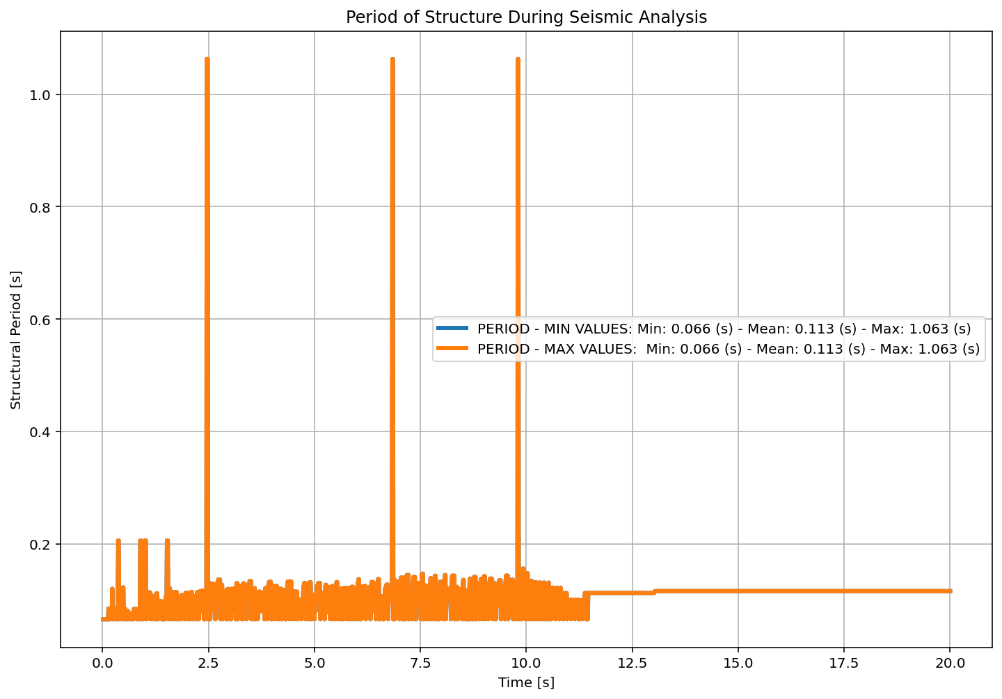

Slide 62
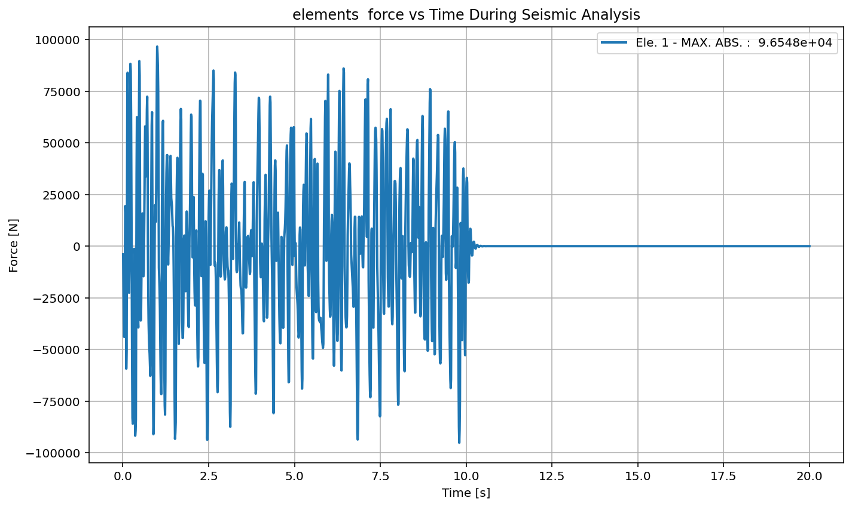

Slide 63


Slide 64


Slide 65


Slide 66


Slide 67


Slide 68


Slide 69


Slide 70


Slide 71


Slide 72


Slide 73


Slide 74
Dissipated Energy from Earthquake= 153679.90 N·m
Dissipated Energy from Cyclic Displacement= 1266886.57 N·m
DISSIPATED ENERGY CAPACITY INDEX: 12.131 [%]
ZONE 2: MINOR DAMAGE

Slide 75


Slide 76
+==========================+
= Analysis curve fitted =
Disp Base Shear
----------------------------
[[0.00000000e+00 0.00000000e+00]
[1.88855314e-02 8.49848911e+04]
[3.49000000e-01 9.91148908e+04]]
+==========================+
+----------------------------------------------------+
Structure Elastic Stiffness : 4500000.00
Structure Plastic Stiffness : 283996.82
Structure Tangent Stiffness : 42803.33
Structure Ductility Ratio : 18.48
Structure Over Strength Factor: 1.17
+----------------------------------------------------+
Over Strength Coefficient (Ω0): 1.1709
Displacement Ductility Ratio (μ): 29.1347
Ductility Coefficient (Rμ): 29.1347
Structural Behavior Coefficient (R): 34.1124
Structural Ductility Damage Index in X Direction: 6.6433 (%)

Slide 77


Slide 78


Slide 79


